Slide 1
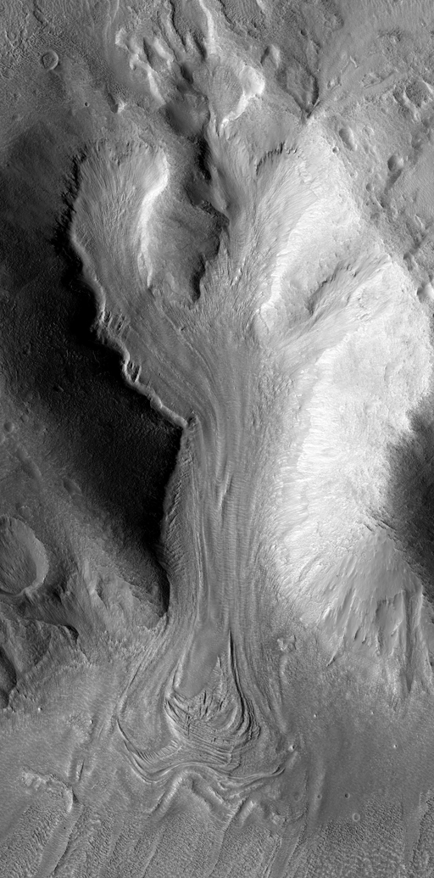
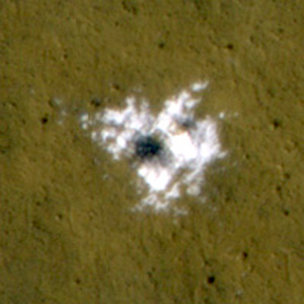
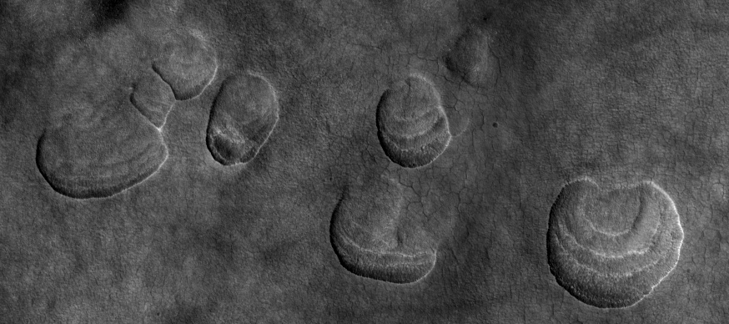
Exploration of Mid-Latitude Ice
S. Byrne, C.M. Dundas, A.S. McEwen, J.W. Holt, N.E. Putzig, M.T. Mellon and I.J. Daubar

Slide 2
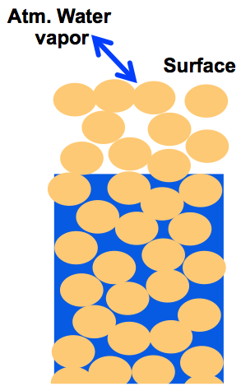
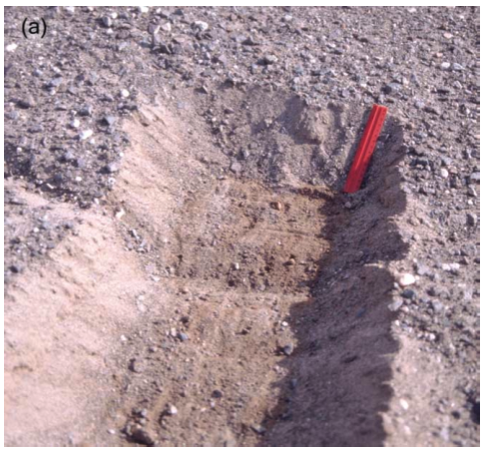
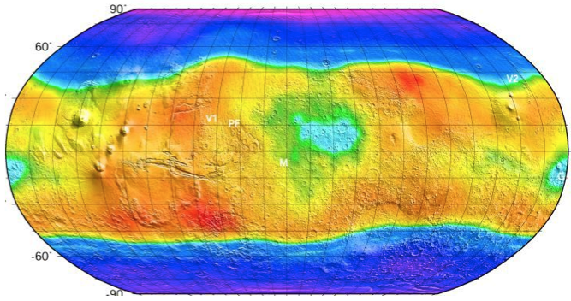
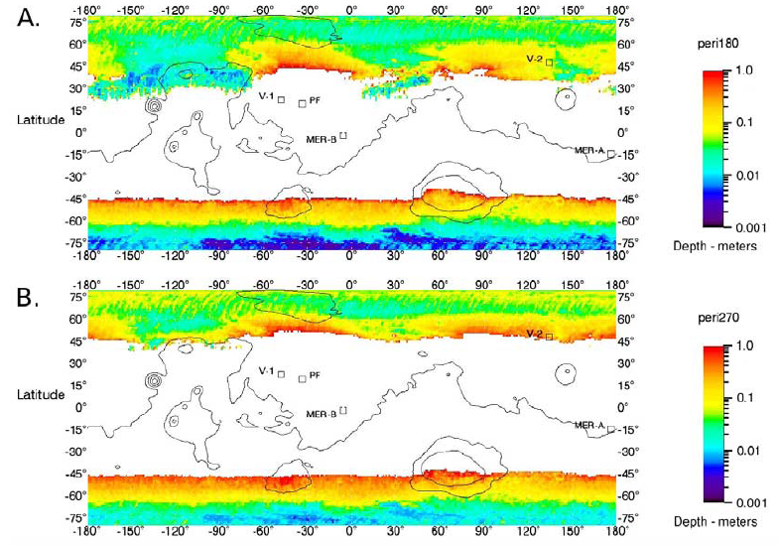
> pore-filling at high-latitudes
The
conventional
picture…
Ground ice extent is very sensitive to climatic conditions
All this ice is young
10 Kyr ago
3 Kyr from now
Chamberlain and Boynton, 2007

Slide 3
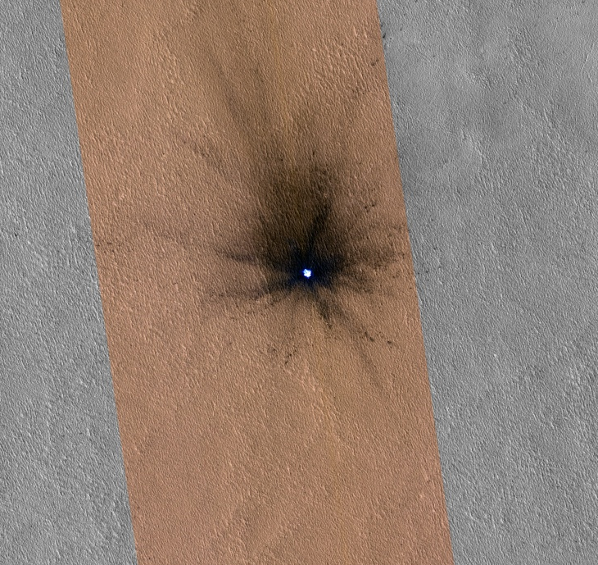
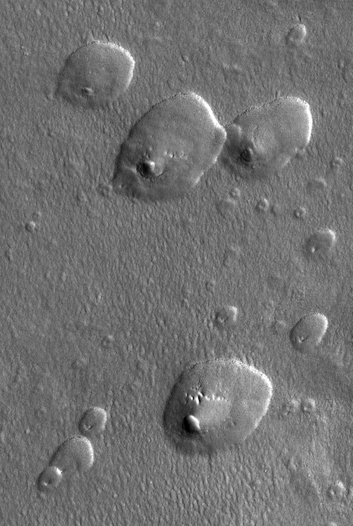
44°N
Evidence now points to widespread mid-latitude excess ice
Excavation at the Phoenix site
Icy impact craters
Pole-orientated Scallops & Expanded craters (thermokarst)
51°N
Possible Sources
Ice lenses from frost heave
Liquid films difficult at these temperatures (salt assisted?)
Snowfall
Avoid desiccating the area recently and explain superposed boulders
Or all of the above…
47°N

Slide 4
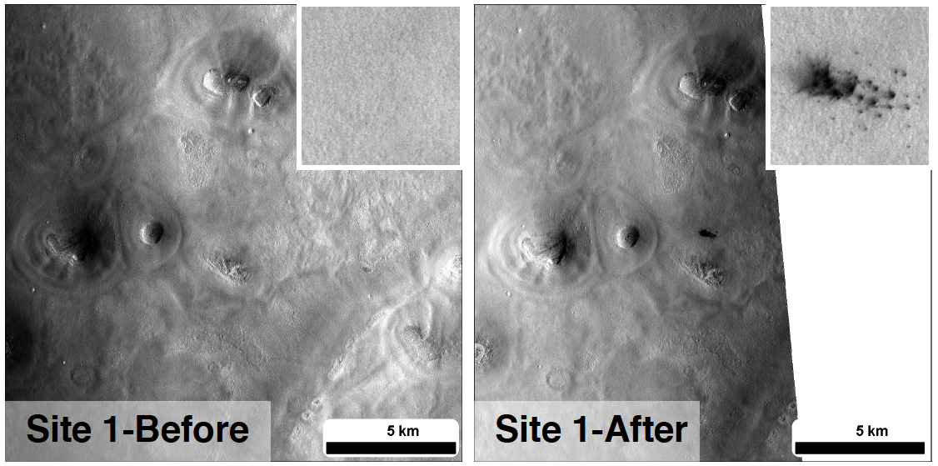
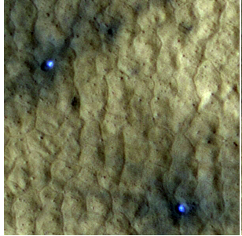
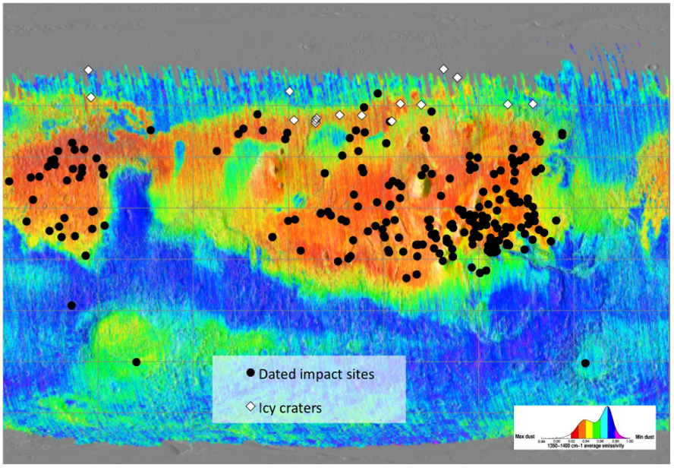
Byrne et al., Science, 2009
75m
June 4th 2008
August 10th 2008
TES dust index (Ruff and Christensen, JGR, 2002)
Known impact events (Daubar et al., This meeting)
Restricted to dusty areas
Good for the northern mid-latitude, but not the south.

Slide 5
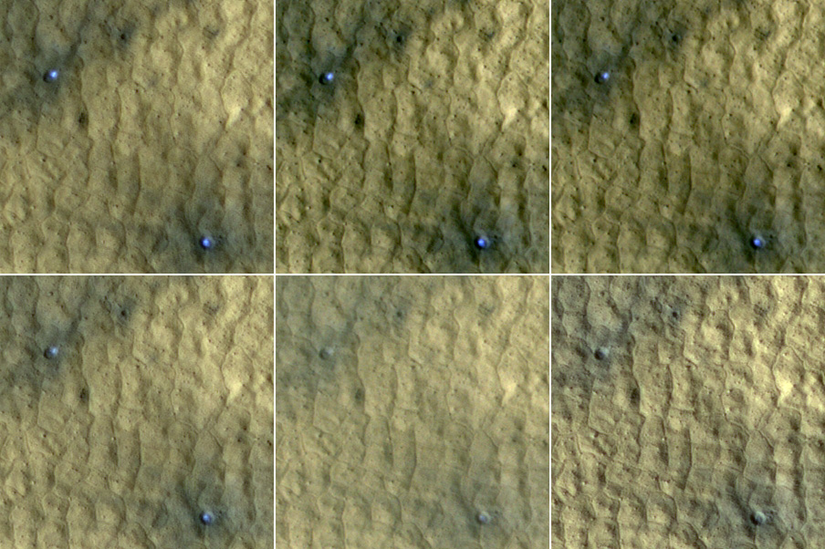
These ice-exposing craters have an ‘expiration date’
Fast high-resolution followup is needed
104 days in this case
46°N

Slide 6
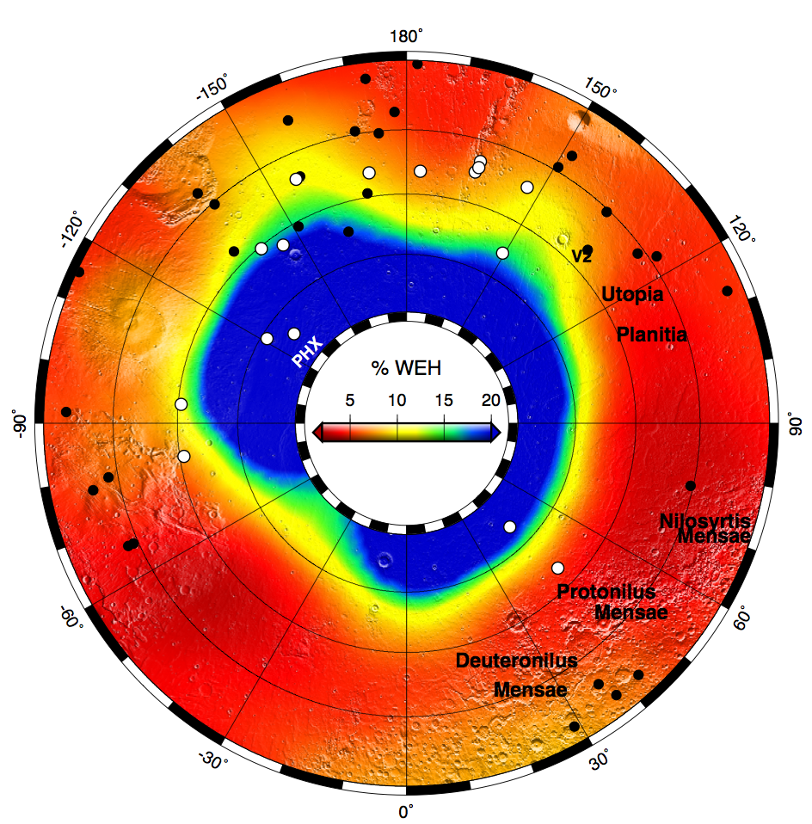
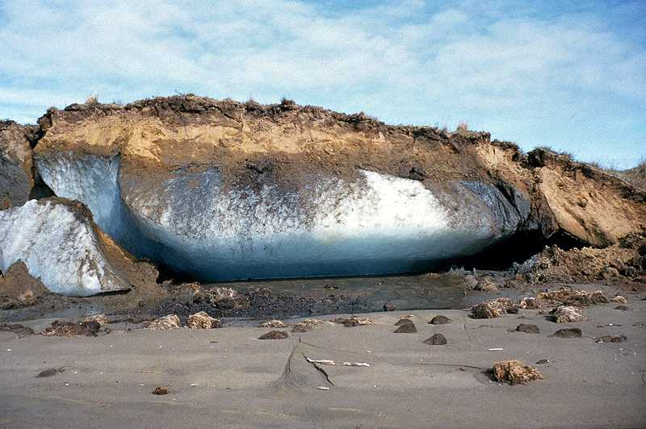
In the mid-latitudes:
Groundice is more widespread than thought
Nature of ground ice is ambiguous to GRS when buried by ~25cm
Footprint of GRS
Byrne et al., Science, 2009
Pore-filling ice
Excess ice

Slide 7
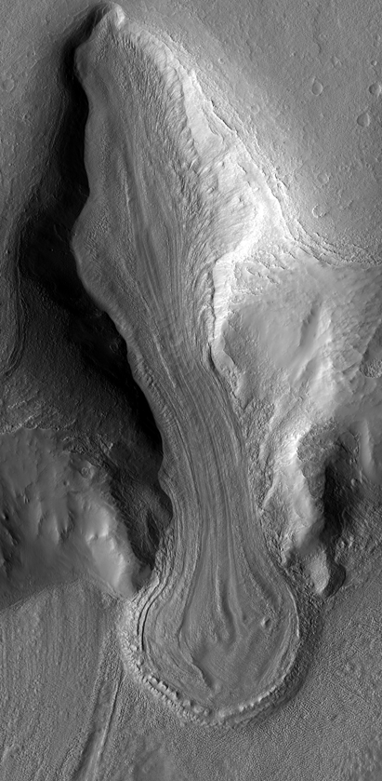
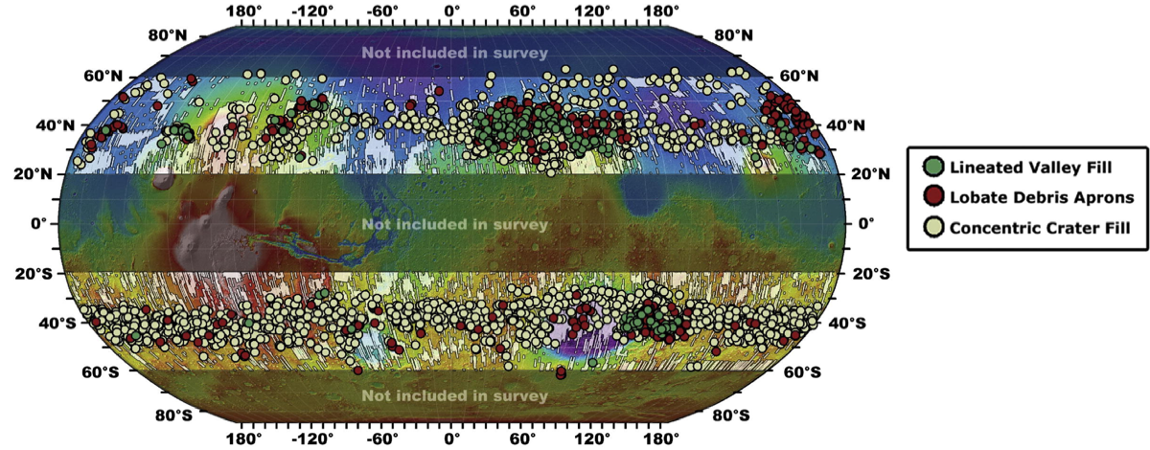
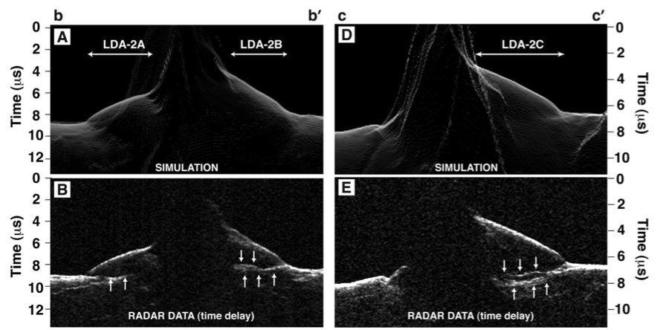
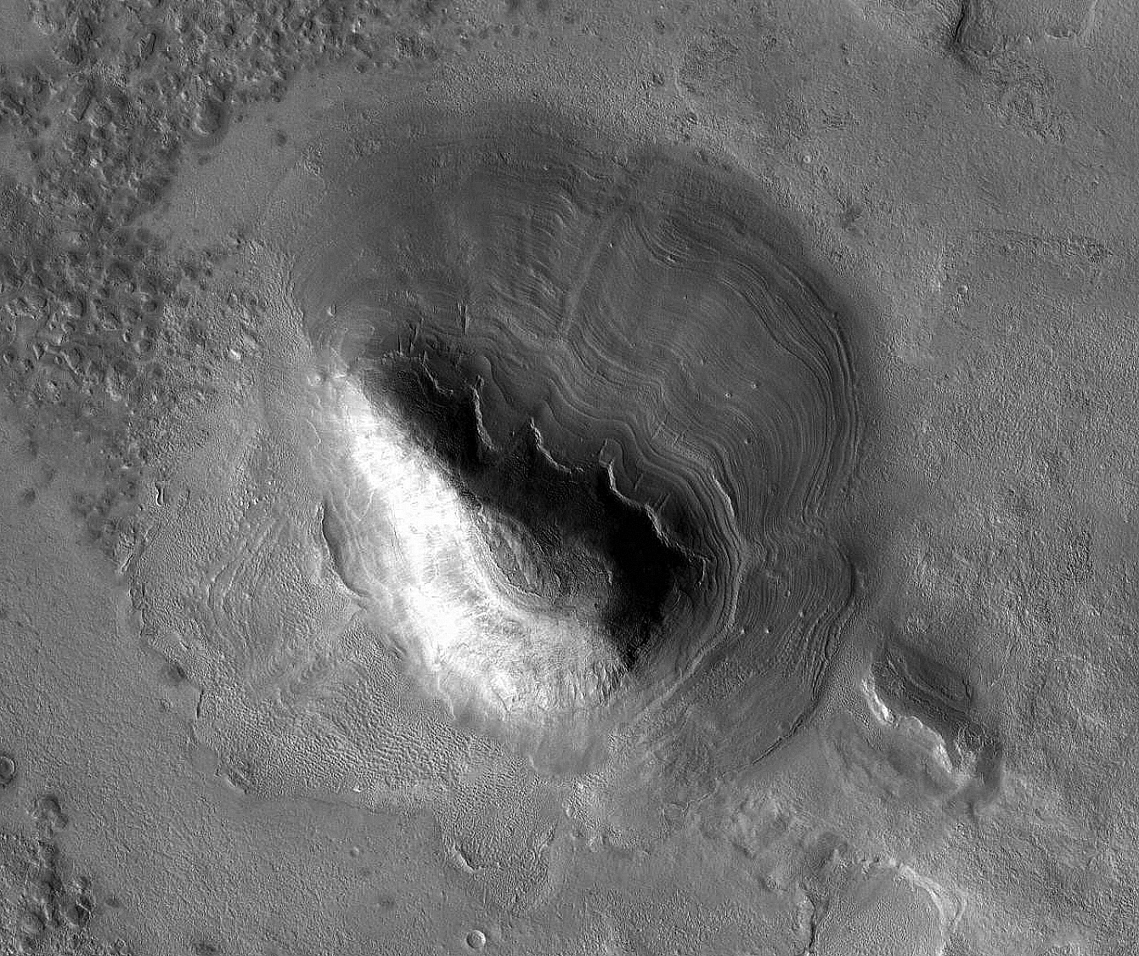
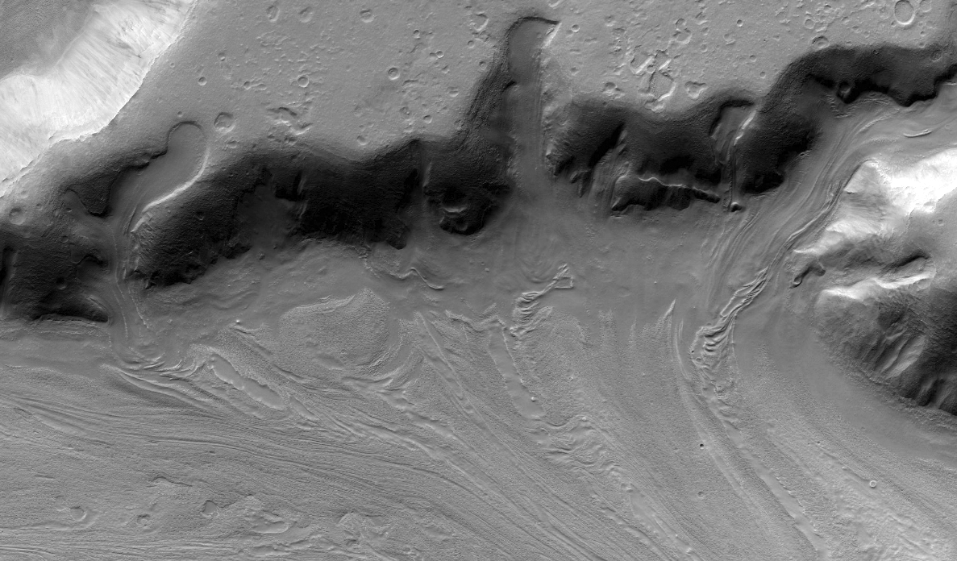
Flowing ice is common in the mid-latitudes
Hundreds of km-scale glaciers and lobate aprons
Lineated-valley and concentric-crater fill
Rheological studies show flowing features must have been nearly pure ice
Thick mid-latitude accumulations of nearly pure ice record climate conditions Myr to perhaps 100s of Myr ago.
Dickson et al., Icarus, 2012
SHARAD shows larger examples are still ~pure ice
Base and some internal layering detected
45°S
46°N
Holt et al., Science, 2008

Slide 8
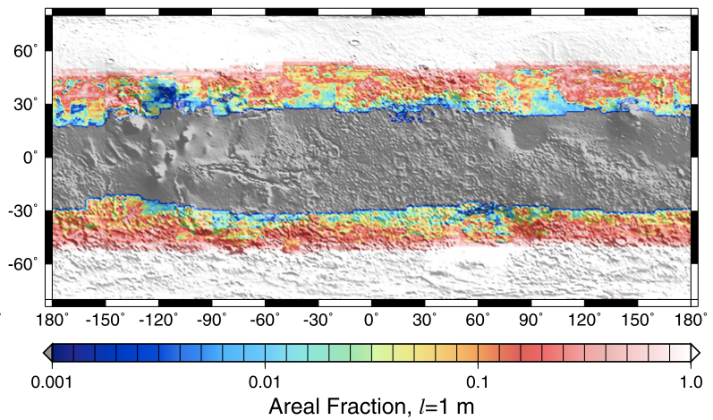
Great! Let’s send a lander!
Investigate isotope record, ice saltiness, liquid films, astrobiological potential etc…
But where? Mid-latitude ice is heterogeneously distributed…
Small slopes and changes in surface properties make huge differences in ice stability
Phoenix went to a high-latitude safe site
A mid-latitude lander could miss ground ice entirely
PHX *
Aharonson and Schorghofer, JGR, 2006.

Slide 9
Motivation for further investigation
Scientific motivation
Understanding the modern climate of Mars and past climates
Understand what role liquid water plays in the subsurface and implications for habitability
We know at least some excess ice has formed within the last few 10s of Kyr
Understanding periglacial processes, a dominant geologic process on Mars today.
Exploration motivation
Mid-latitude ice is very heterogeneous (not like the Phoenix site!).
Where are the most interesting locations?
ISRU implications – An astronaut with a shovel can collect all the water they need.
Is pure ice better for ISRU? How pure? Salts may be common, problem?
44°N
 | Cameras (crater detection) | Thermal | SAR | Radar sounder
Groundice Extent | ✔ | ✔ | ~
Groundice Depth | ~ | ✔ | ~
Excess Ice Extent | ✔ |  | ✔
Mid-latitude Glaciers | ✔ (Stereo for Topography) |  | ✔ | ✔
Two high-SNR cameras 15m/px, 60km Swath <2m/px, color, stereo | Thermal imaging 10m/px 1K accuracy | P-band SAR 4 polarizations | VHF radar sounder 100-200 MHz Phased array

Slide 10
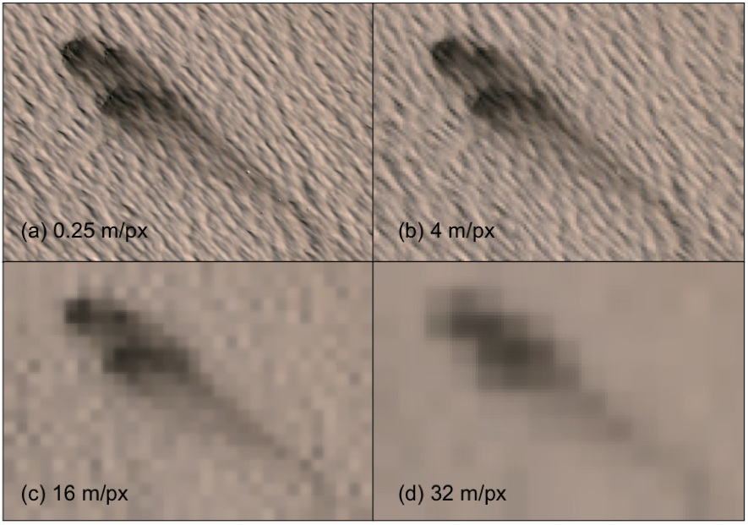
Search for new craters – map out the clean ice distribution
TES dust index (Ruff and Christensen, JGR, 2002)
Context style imaging at 15m/px, high SNR, and a 60km swath width.
Cover latitude 45° with 250 images
Achievable in 6 days with MGS-orbit (9° rolls would avoid recent coverage)
Reduces wintertime SNR limitation
Lower res global images with ability to replay mid-latitude image sections at higher resolution a better option
Color to make finding craters in non-dusty areas easier also a better option
Higher-resolution imaging 1-2m/px in color
Rapid follow required so we need a roll-able spacecraft or instrument pointing mechanism
Limited to dusty areas, but sensitive to ice down to ~1m
Daubar et al. (This meeting)
~1 new impact (D>4m) expected between 30°-70°N every 1-2 days (Hartmann 2005)
[actual rate may be quite different from this!]

Slide 11
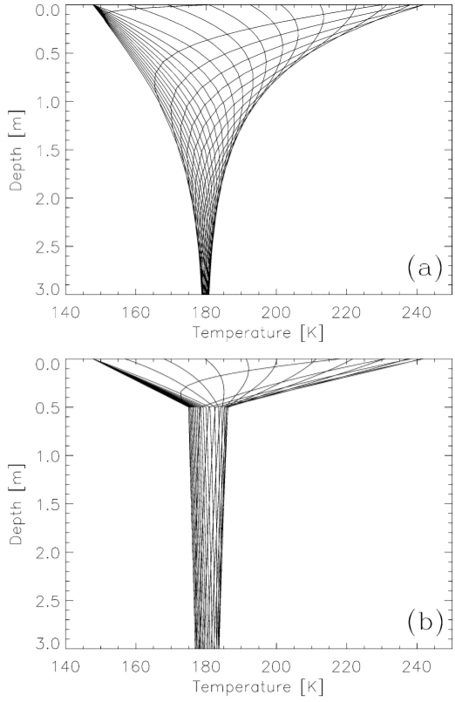
High-Resolution Thermal measurements
If ice-table is within the annual thermal skin depth then it affects surface temperatures in a predictable way
Typical annual skins depths are 0.5-1m
See Mellon et al. (2008) & Putzig & Mellon (2005)
Thermal imaging at 10m/px
Temperature accuracy ~1K for warm periods
Robust CO₂ frost detection in cold periods
High-res topography necessary for interpretation of thermal data
Along track stereo imagery from the High-resolution camera (2m/px imaging yielding slope info at 10/px)
55°S
No groundice
55°S
Groundice @ 50cm
Mellon et al. 2004
From TI (Putzig & Mellon, 2005)

Slide 12
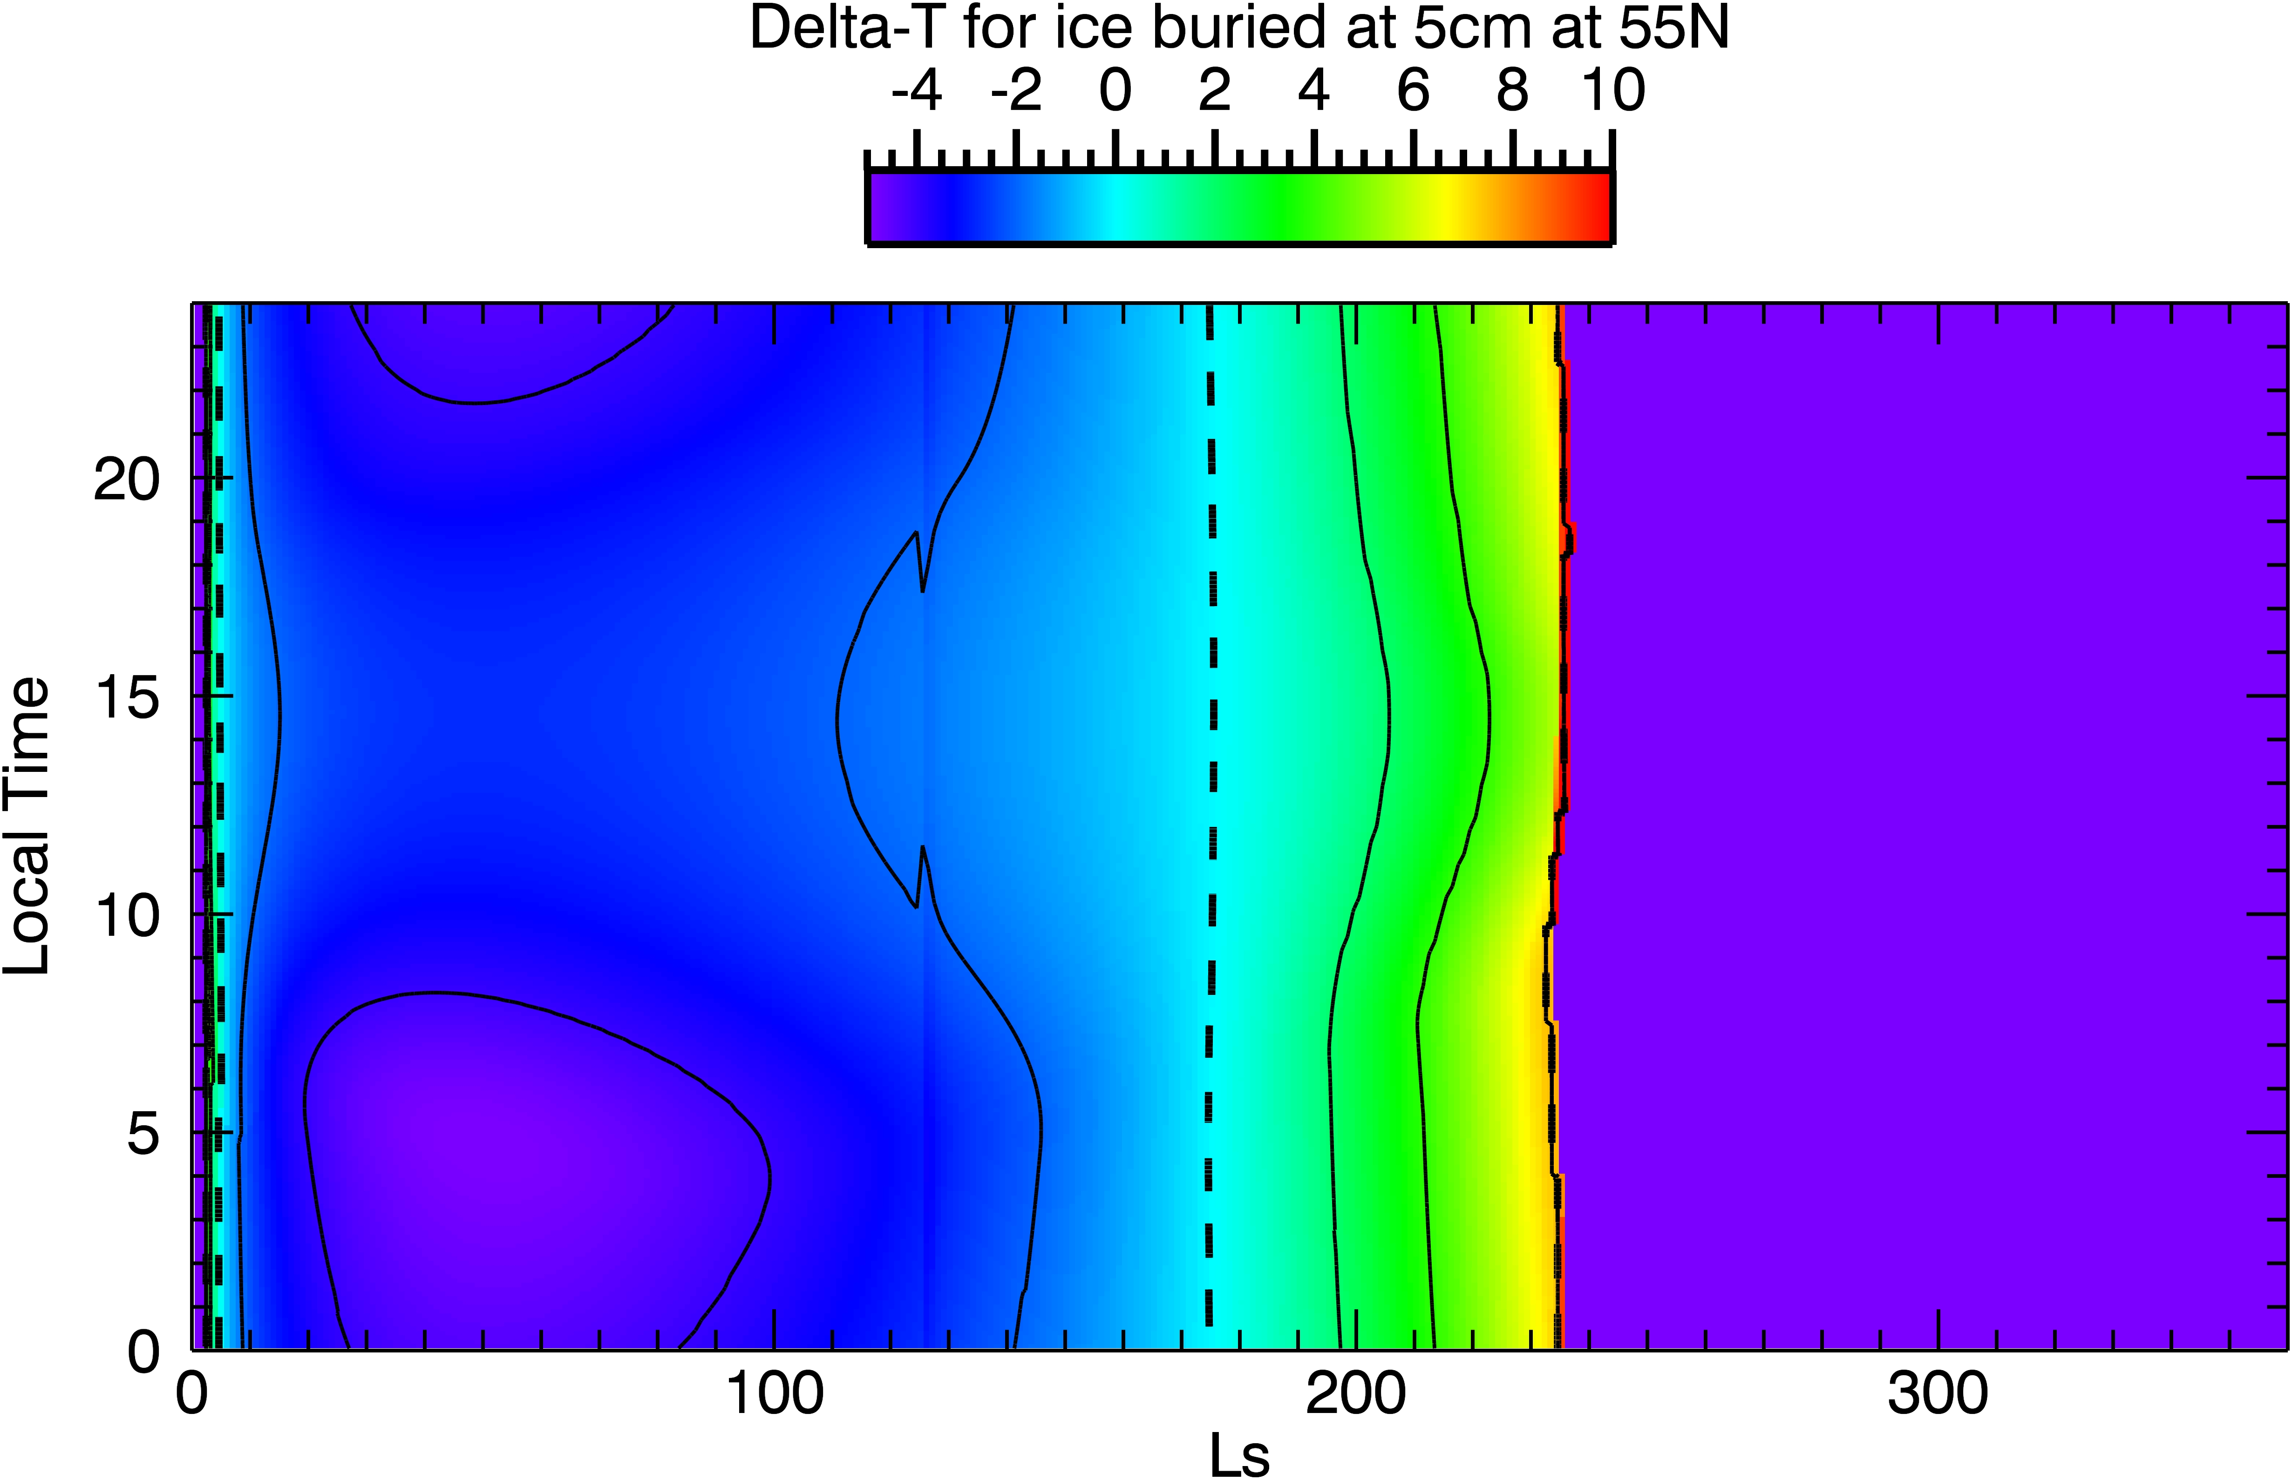
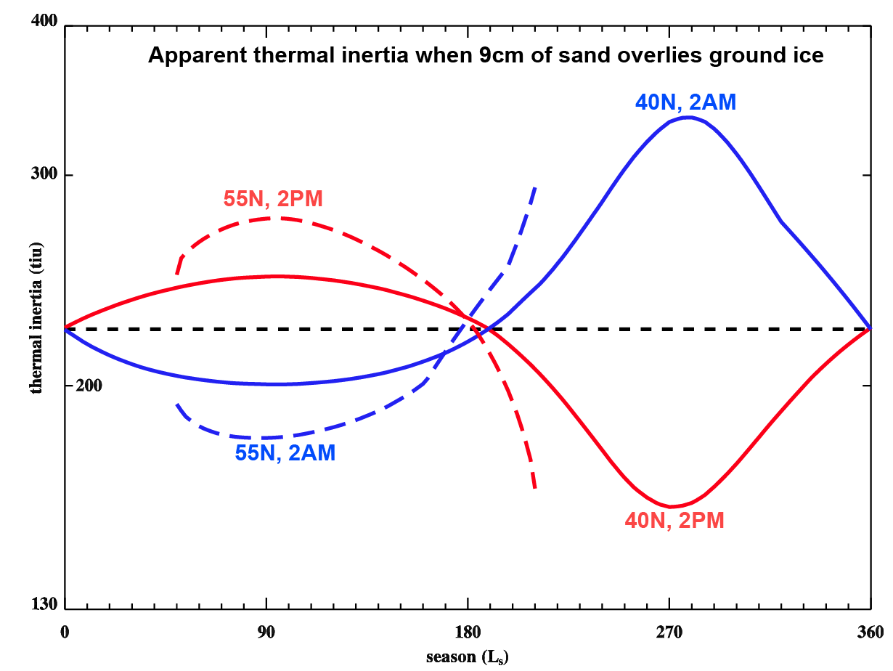
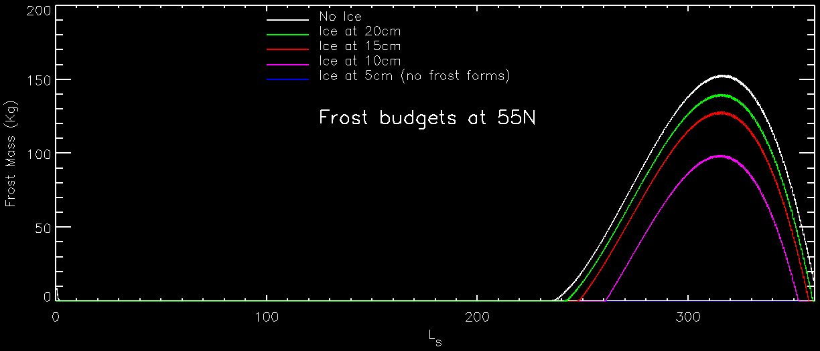
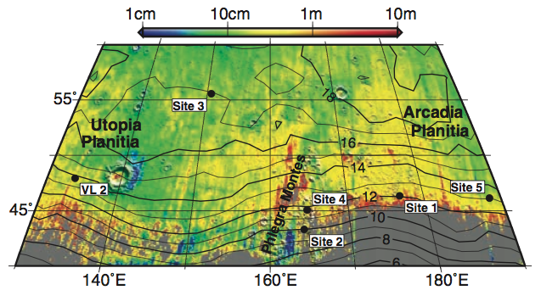
CO₂ frost here
Surface-T change due to ice at 5cm
Single point temperature measurements show only a small thermal effect, but…
(Late Fall and pre-dawn in the summer are the best times/seasons)
Temperatures from multiple times of day over the course of a year can yield both surface thermal inertia and buried ice depth
Date of CO₂ frosting and defrosting is sensitive to the depth to ice depth
Modeled Ice stability Depth

Slide 13
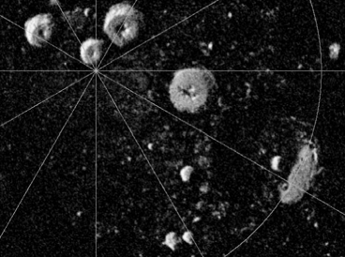
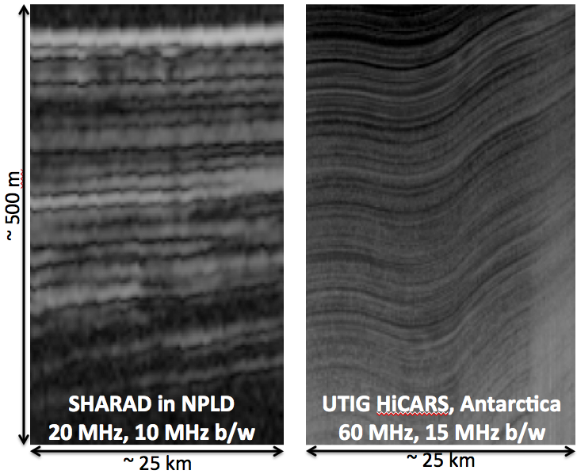
SAR (see Campbell et al. & Clifford et al. on Wednesday PM)
P-band (λ~70cm) SAR has been shown to be feasible for many investigations at Mars (Campbell et al., JGR, 2004; Paillou et al., JGR, 2006).
Quad-pol SAR data can distinguish between pore-filling and excess ice based on phase coherency and polarization (coherent backscatter).
Some information on ice depth also available, but probably less precise than thermal approach.
S-Band (λ~12.6cm)
Harmon et al., Icarus, 2011
VHF RADAR Sounder
SHARAD (~20 MHz, 15m wavelength) detects base of large lobate(10km+) aprons.
200 MHz (1.5m wavelength)
Less penetration than SHARAD
10x better vertical resolution
Resolve apron debris cover and structure within the ice
Phased antenna array can narrow footprint to investigate smaller glacial features
Clutter simulations require hi-res topography (stereo imagery)

Slide 14
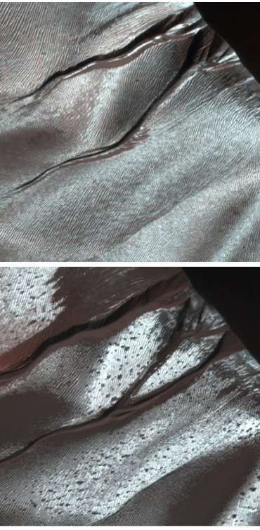
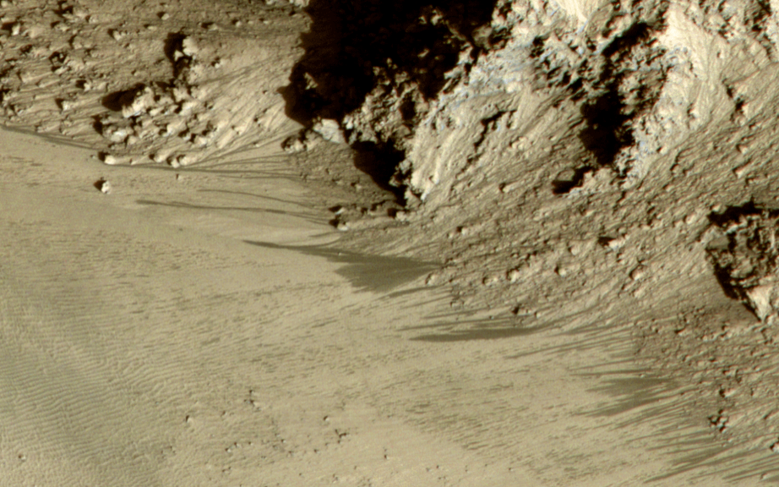
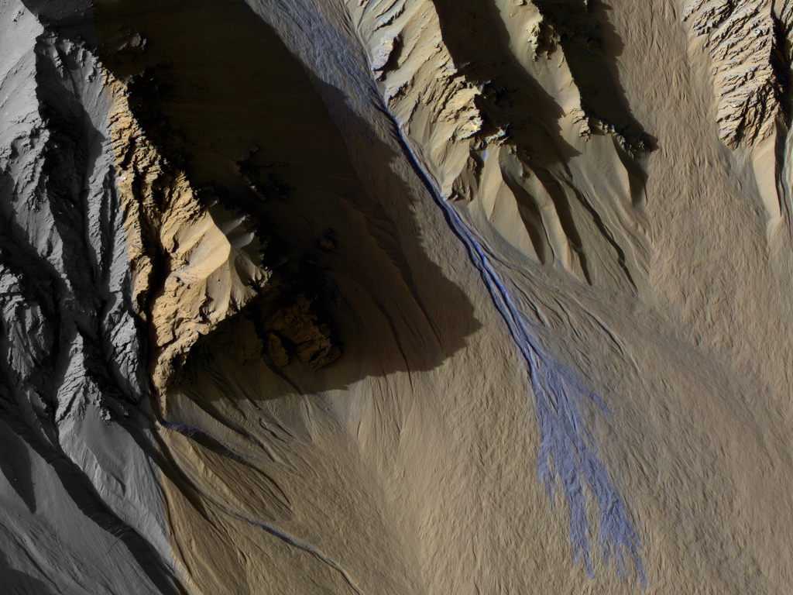
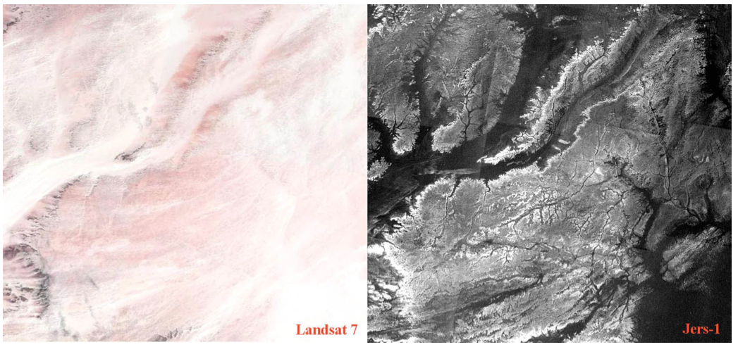
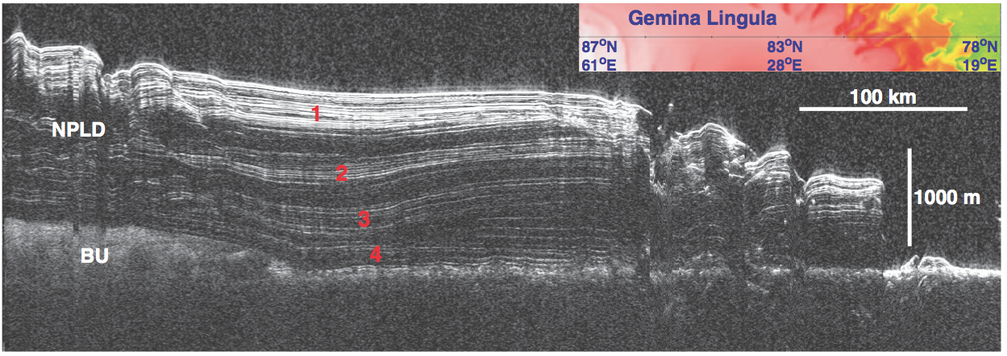
Collateral Benefits
Current Impact Rate (Daubar et al. This meeting)
Other mid-latitude activity e.g.
Gullies (Dundas et al., This meeting)
RSL (McEwen et al. This meeting)
SAR studies over dust mantled regions, moisture detection in the regolith etc…
High Resolution Radar sounding of the Polar Layered Deposits
High-resolution stereo color imagery for many scientific problems

Slide 15
Conclusion: We can (and should) understand a lot more about the heterogeneous mid-latitude ground ice before choosing a site for any landed Investigation (robotic or human)
Feldman et al., 2004
WEH (%)
Questions
Understanding the modern climate of Mars and past climates
Understand what role liquid water plays in the subsurface and implications for habitability
Understanding periglacial processes, a dominant geologic process on Mars today
Understanding the ISRU potential of ground ice
 | Cameras (crater detection) | Thermal | SAR | Radar sounder
Groundice Extent | ✔ | ✔ | ~
Groundice Depth | ~ | ✔ | ~
Excess Ice Extent | ✔ |  | ✔
Mid-latitude Glaciers | ✔ (Stereo for Topography) |  | ✔ | ✔
Two high-SNR cameras 15m/px, 60km Swath <2m/px, color, stereo | Thermal imaging 10m/px 1K accuracy | P-band SAR 4 polarizations | VHF radar sounder 100-200 MHz Phased array

Slide 16
Additional

Slide 17
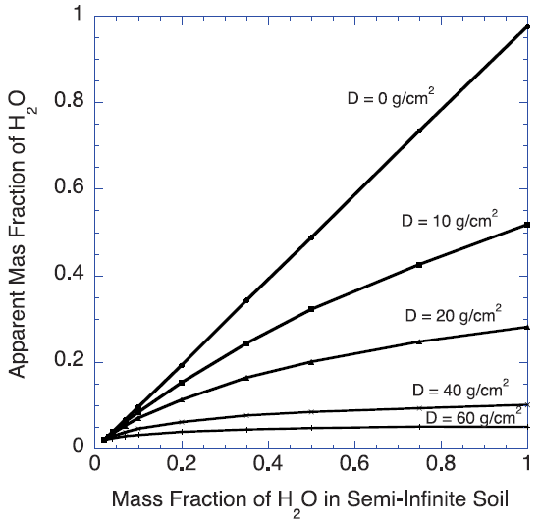
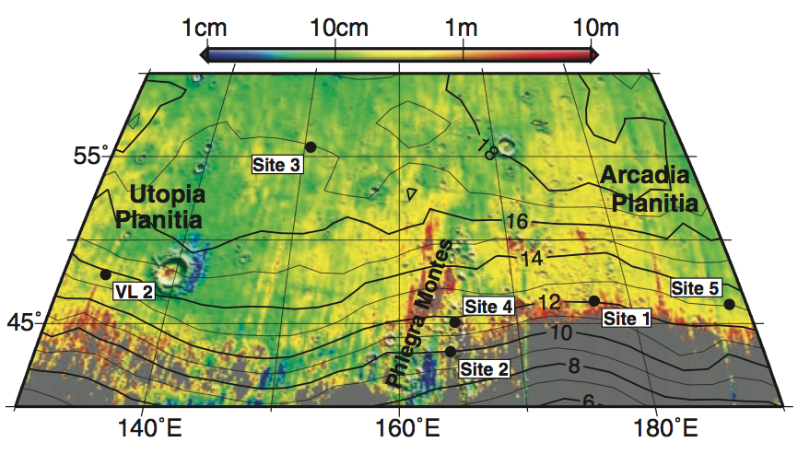
In the mid-latitudes:
Nature of ground ice is ambiguous when buried ~25cm
Groundice is more widespread than thought
Feldman et al., 2008
Footprint of GRS
?
?
Byrne et al., Science, 2009
Pore-filling ice
Excess ice

Slide 18
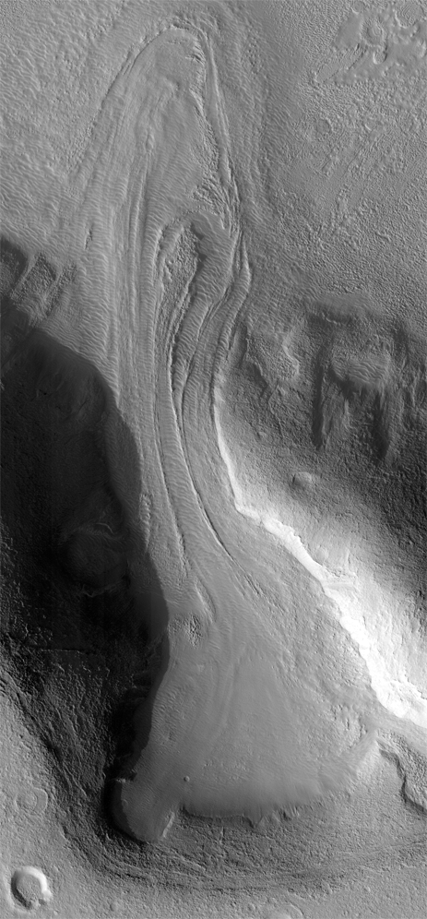
Hundreds of mid-latitude glaciers exist
Obvious flow morphologies in contrast to the much-thicker Polar Layered Deposits
Record of past climates
40 - 45°N

Slide 19
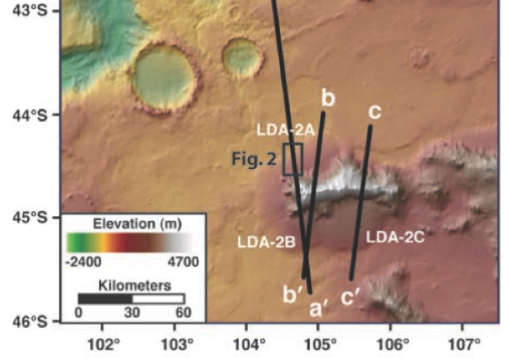
Larger lobate aprons also have morphologies indicating flow
Current radar can detect base and some internal layering
45°S
Holt et al., Science, 2008
Composition is almost pure ice
Age of Lobate Aprons may be Myr to 100s of Myr
i.e. a longer term climatic record
46°N

Slide 20
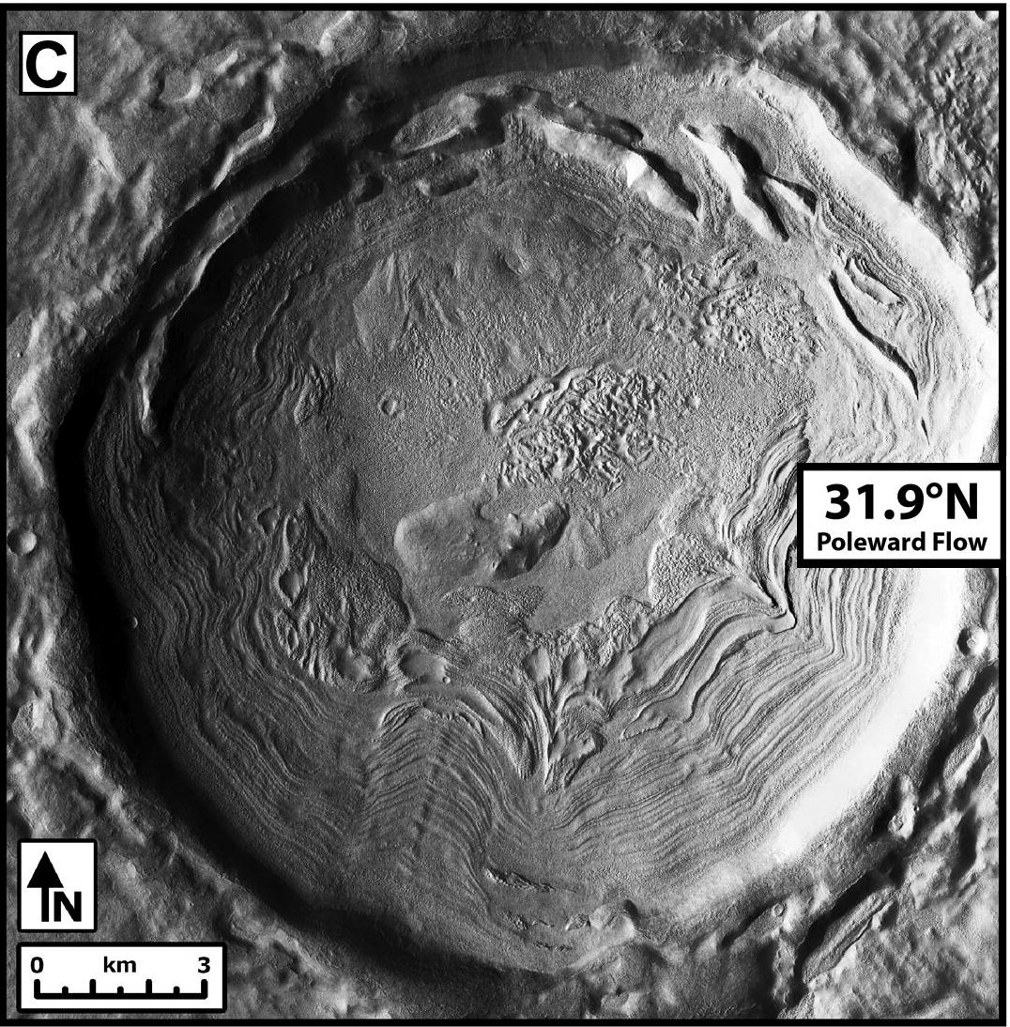
Evidence of ice flow is everywhere in the mid-latitudes
Rheological constraints mean this must all be almost pure ice (e.g. Parsons et al. Icarus 2011)
Dickson et al., Icarus, 2012

Slide 21
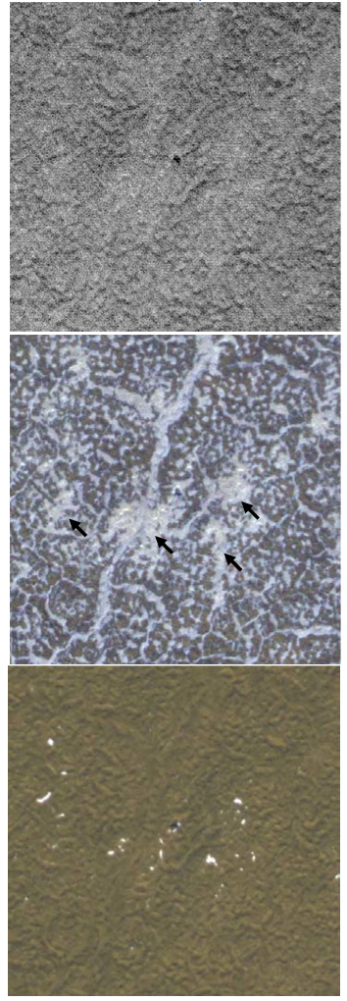
This 2nd approach is being done already for the Phoenix site, but CO₂ and H₂O frost are hard to tell apart in visible images
L_{s} 27
L_{s} 34
L_{s} 56
150m @ 68N
Mellon, LPSC, 2011

Slide 22
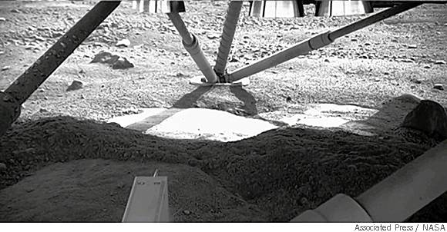
From TI (Putzig & Mellon, 2005)
Annual skin depths >> ice table depth
Allows us to determine the ice depth with temperature measurements
Annual skin depth ≤ ice table depth
i.e. Low thermal Inertia (dusty) areas that are well suited to impact crater searches
~1 crater (>4m across) forms somewhere on this map every 1-2 days (Hartmann 2005)
TES dust index (Ruff and Christensen, JGR, 2002)

