Slide 1
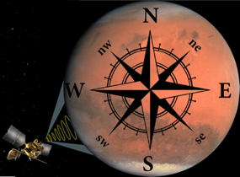
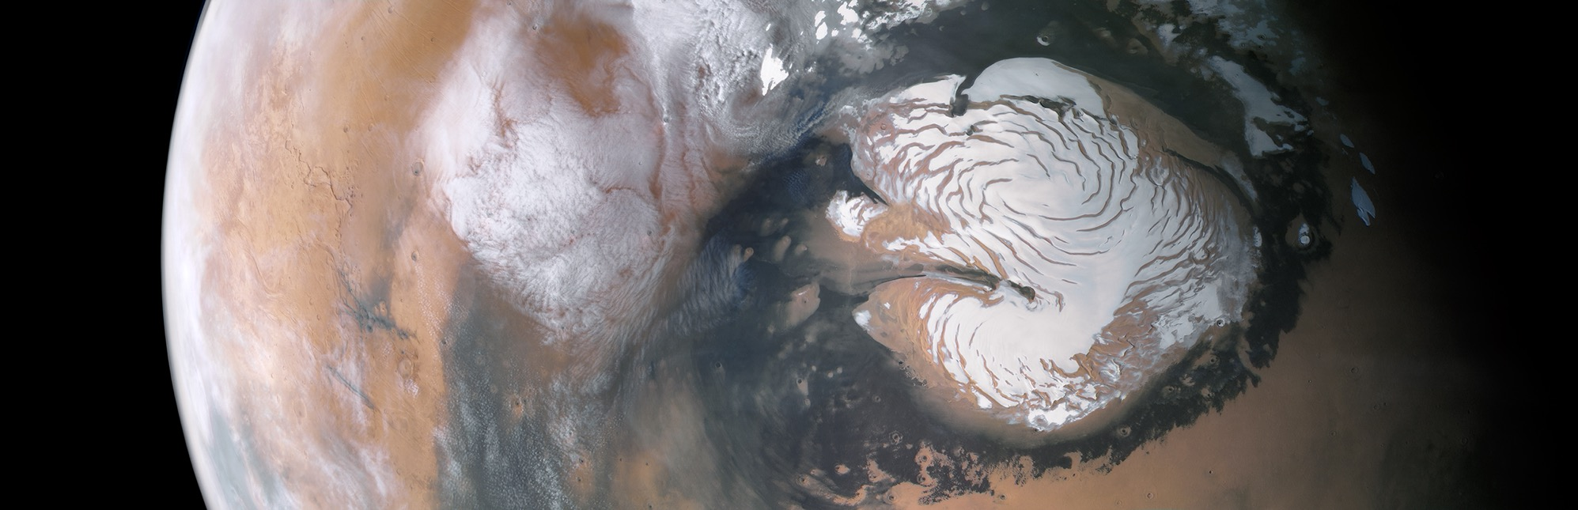
COMPASS: Climate Orbiter For Mars Polar Atmospheric And Subsurface Science
Discovery-class Science
PI: Shane Byrne, LPL, University of Arizona
DPI: Paul O. Hayne, LASP
Co-I: Isaac B. Smith, Planetary Science Institute
Derived from a Keck Institute for Space Studies workshop

Slide 2
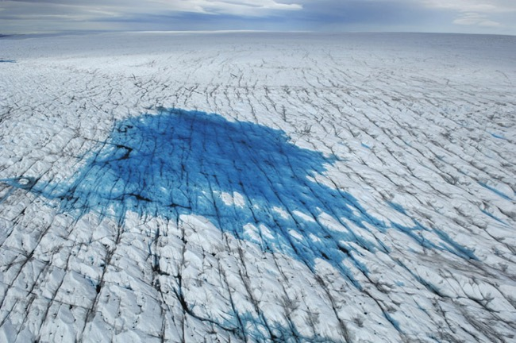
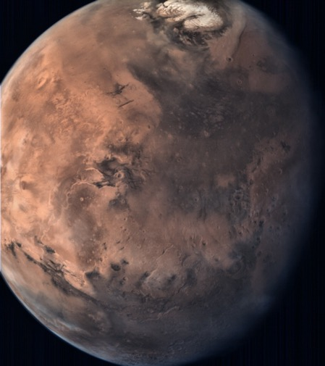
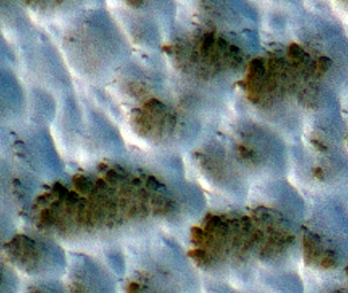
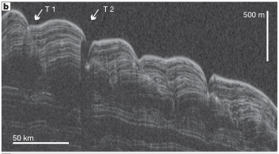
Terrestrial-Planet Climate Change: A Well-Studied and Pressing Scientific Issue
Mars offers a unique setting where similar approaches can study its history

Slide 3
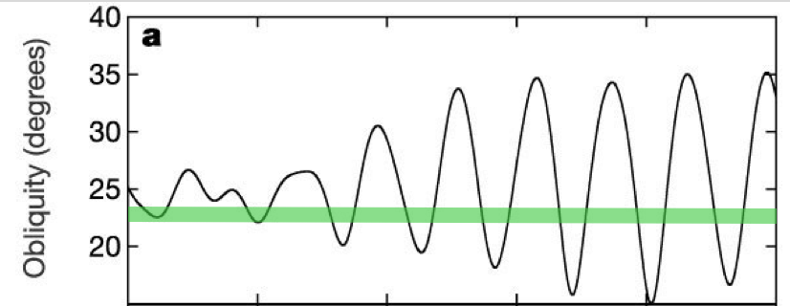
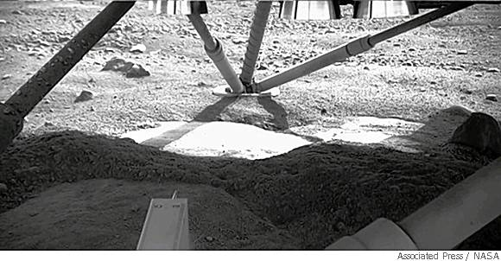
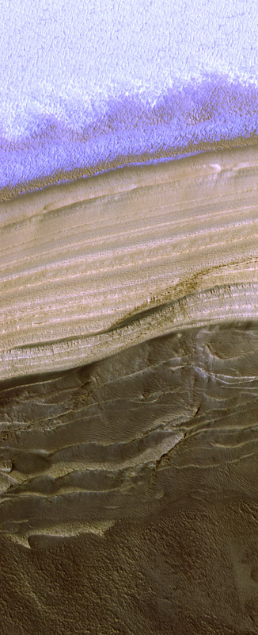
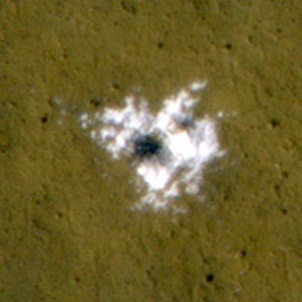
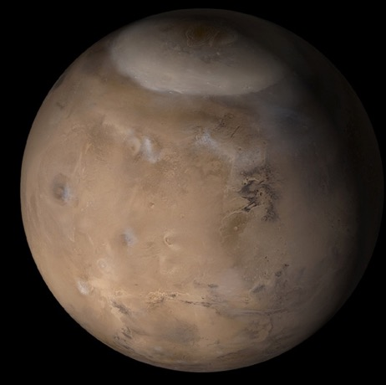
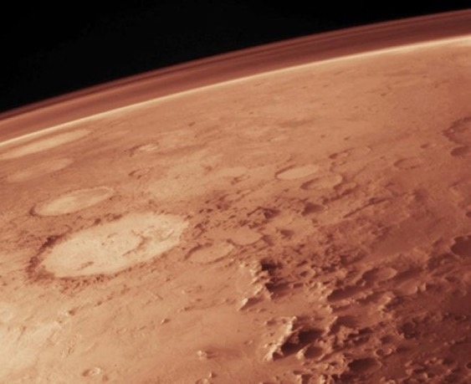
Mars is a (much simpler) terrestrial planet on our doorstep continuously undergoing climate change
Layered icy deposits at the poles and mid-latitudes record these variations
1 Myr

Slide 4
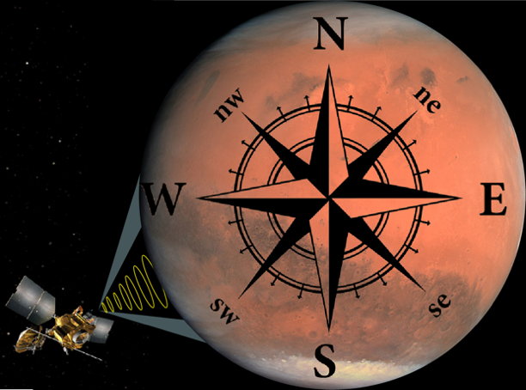
The goal of the COMPASS mission
Link the current climate of Mars to its long-term climate record
A 2017 Keck Institute for Space Studies study on Mars polar exploration brought together >30 experts to determine required measurements and mission concepts to accomplish this goal.
The COMPASS mission concept is a direct product of that meeting and represents the best way to address questions related to Mars’ climate and its history.

Slide 5
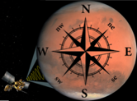
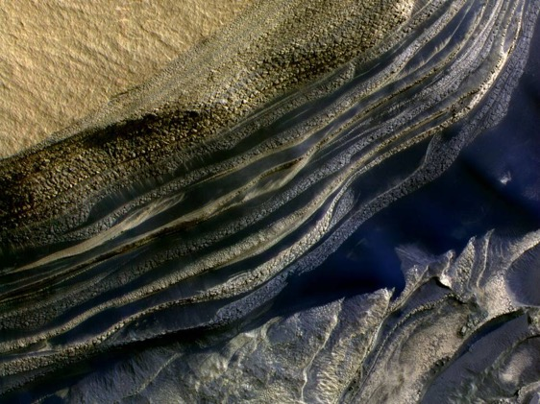
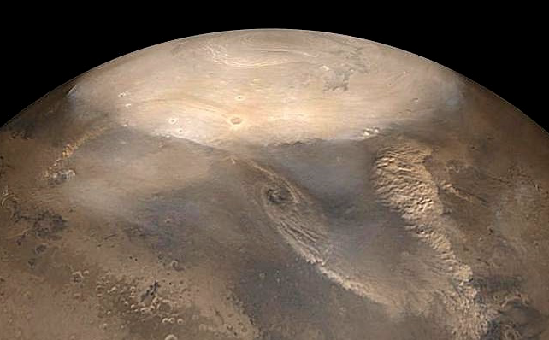
The Goal of COMPASS Has Two Main Objectives
Link the current climate of Mars to its long-term climate record
What is the climatic record within martian icy reservoirs?
How does the current climate affect today’s icy deposits?
Polar Layered Deposits
  Determine properties of this ice and its climatic record
Mid-latitude Ice Sheets
  Determine locations of mid-latitude ice especially those in isolated microclimates close to the equator
  Determine properties of this ice and its climatic record
Dust and ice
  3D distribution vs time
  Fluxes into and out of ice-bearing surfaces
  Transport from one reservoir to another
Energy
  Fluxes into and out of ice-bearing surfaces

Slide 6
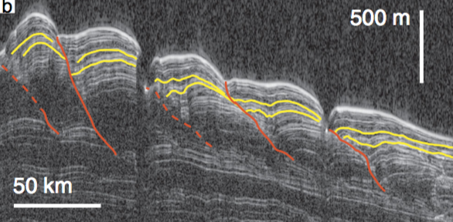
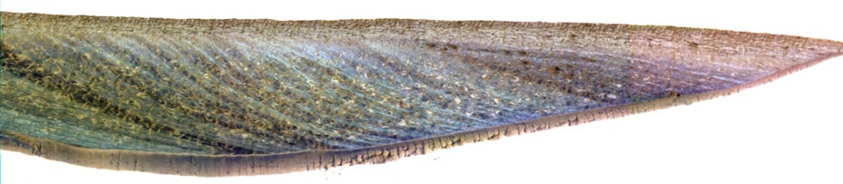

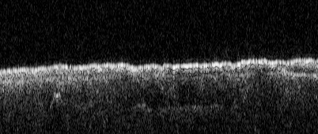
Today’s data are insufficient to resolve these questions
What is the climatic record within martian icy reservoirs?
SHARAD sees polar layering, but at scales much larger than visible exposures
HiRISE views of visible exposures contaminated by dust lags
Orbital periodicities and stratigraphic structures are detected in HiRISE and SHARAD data, but haven’t yielded climatic history
Despite intensive observation, we cannot tell if the polar deposits are gaining or losing mass!
MRO has shown that mid-latitude ice is extensive and forms dust-free sheets that are decameters thick and layered with climatic information
SHARAD can barely detect the thickest of these
HiRISE relies on random impacts and sparse exposures
Ice confirmed as far south as 38N, but likely much more extensive
Ice in the tropics likely and is vital for climate study and human exploration

Slide 7
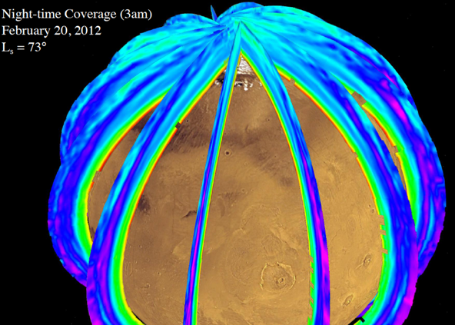
Today’s data are insufficient to resolve these questions
How does the current climate affect today’s icy deposits?
MCS on MRO has delivered information on 3D atmospheric temperatures, clouds and dust
      but
Water vapor was not characterized due to a critical design oversight
Near-surface water vapor concentration controls ice reservoir stabilities, but is unknown
Winds have not been measured and are vital to understand transport of volatiles between reservoirs
MARCI on MRO has delivered 2D information on dust and cloud distribution as well as seasonal caps
      but
Cloud heights are unknown
Cloud composition (H₂O vs CO₂) is unknown
Seasonal H₂O & CO₂ frosts not independently monitored

Slide 8
COMPASS is highly relevant to community science goals
Decadal Survey
Three main goals including: “Understand the Processes and History of Climate”
  “Climate and atmospheric studies remain a major objective of Mars exploration. They are key to understanding how the planet may have been suited for life and how major parts of the surface have been shaped. In addition, studying the atmosphere of Mars and the evolution of its climate at various timescales is directly relevant to our understanding of the past, present, and future climate of Earth. Finally, characterizing the environment of Mars is also necessary for the safe implementation of future robotic and human spacecraft missions.”
Two main objectives including: “Characterize Mars’s atmosphere, present climate, and climate processes under both current and different orbital configurations”
MEPAG
COMPASS satisfies objectives in the Atmospheres Goal
  A. Characterize the state of the present climate of Mars' atmosphere and surrounding plasma environment, and the underlying processes, under the current orbital configuration.
  B. Characterize the history of Mars’ climate in the recent past, and the underlying processes, under different orbital configurations.
COMPASS satisfies objectives in the Geology Goal
  A. Document the geologic record preserved in the crust and interpret the processes that have created that record.
COMPASS satisfies objectives in the Human Exploration Goal related to atmospheric characterization and resource localization
Momentum in the polar science community has led to many new MEPAG investigations that overlap those of COMPASS directly

Slide 9
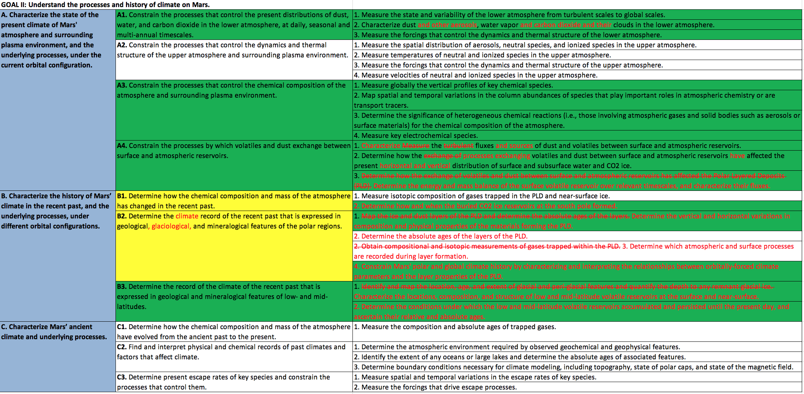
COMPASS is highly relevant as determined by new MEPAG investigations
Satisfies 15 (Green) of 28 investigations in MEPAG’s atmospheric goal
Satisfies 4 sub-objectives completely (Green) and 2 incompletely (Yellow) out of 10 sub-objectives
(remaining 4 sub-objectives relate to upper-atmosphere and ancient climate)
Red text shows new MEPAG changes

Slide 10
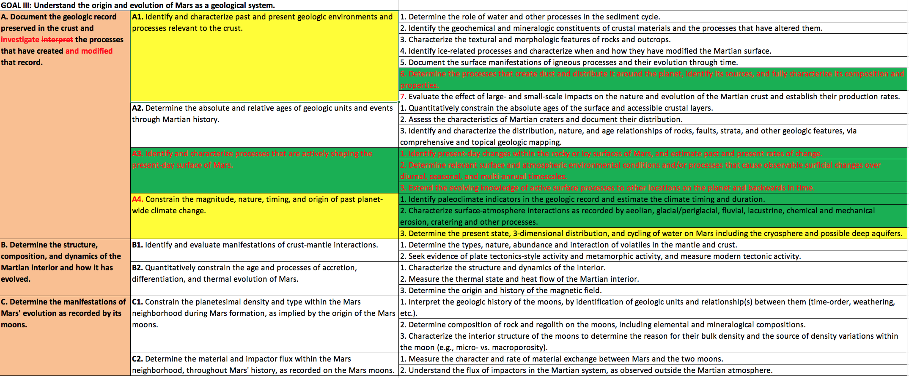
COMPASS is highly relevant as determined by new MEPAG investigations
Satisfies several investigations and sub-objectives in MEPAG’s Geology goal
(Surface ages, the martian interior and Moons are not addressed by COMPASS)
Red text shows new MEPAG changes

Slide 11
COMPASS is highly relevant as determined by other community groups
In a summary of the 6th International Conference on Mars Polar Science and Exploration, a group of attendees listed the high priority science goals for the Mars polar community (Smith et al. 2018). These formed the basis for COMPASS sub-objectives.
Determine the energy and mass balance of the polar ice reservoirs, and characterize volatile fluxes
Inventory and characterize the non-polar ices/volatile reservoirs at the surface and near-surface
Quantify the interplay of local, regional, and global circulations in the polar regions, including polar vortex, katabatic winds, transient eddies, among others
Characterize the transport of volatiles and dust aerosols into and out of the polar regions
International Mars Polar Conferences
The Next Mars Orbiter (NeMO) Science Analysis Group
The NEMO SAG recommended all the instruments being flown on COMPASS
Furthermore: "Observation of wind velocity is the single most valuable new measurement that can be made to advance knowledge of atmospheric dynamic processes. Near-simultaneous observations of atmospheric wind velocities, temperatures, aerosols, and water vapor with global coverage are required to properly understand the complex interactions that define the current climate.”

Slide 12
Perceived Strengths
LASP Science Review (July 2nd) Committee Results
Committee: Dave Brain, Brian Hynek, Bruce Jakosky, Ted Scambos
The COMPASS scientific goals are high priority science for Mars
  Would fill significant knowledge gaps
  Think COMPASS will rise “above the bar” necessary for selection
The COMPASS measurements are novel
  SAR measurements (useful in many other applications as well)
  Wind measurements
  Extending vertical sounding of vapor and aerosols
  Better mapping of mid-latitude ice extent and layers
The COMPASS mission concept has high programmatic value, which was a key Discovery 2014 science evaluation metric
  Extending climate science record with similar measurements, etc.
  Future telecom
  Human exploration and fitting into Mars architecture
High likelihood of scientific success (another Discovery 2014 metric)
  Measurements are the right ones, and instruments well thought out
  Lots of heritage, fits within margin

Slide 13
Suggestions / Concerns
LASP Science Review (July 2nd) Committee Results
Committee: Dave Brain, Brian Hynek, Bruce Jakosky, Ted Scambos
Suggest clearer articulation of how the measurements achieve the science goals
  How to connect 1 Mars year of measurements to layering on millennial timescales?
  Compare to existing spacecraft data (>10 Mars years) to determine if the COMPASS year is anomalous or typical.
  How do these measurements move us forward from existing data?
  Directly measures many parameters currently guessed in models e.g. near-surface water vapor
Suggest converging on a straightforward science goal statement. What’s the mission in one line?
Suggest defining the team now
Suggest confirming that precision and accuracy of wind measurements make them useful
  Resolved with instrument provider – co-adding observations yields the needed accuracy
Concern about horizontal and vertical resolution of atmospheric measurements over summertime cap
  Emphasize that cap is homogeneous over scales of 100s of km
  Many questions are answered just by tracking the flux of volatiles in/out of the polar regions
Concern that claiming that COMPASS will help us to learn about Earth’s climate will create an expectation that detailed comparisons / lessons will be supplied
Suggest minimizing reference to the Keck study as motivation for the mission going forward – the mission must stand on its own

Slide 14
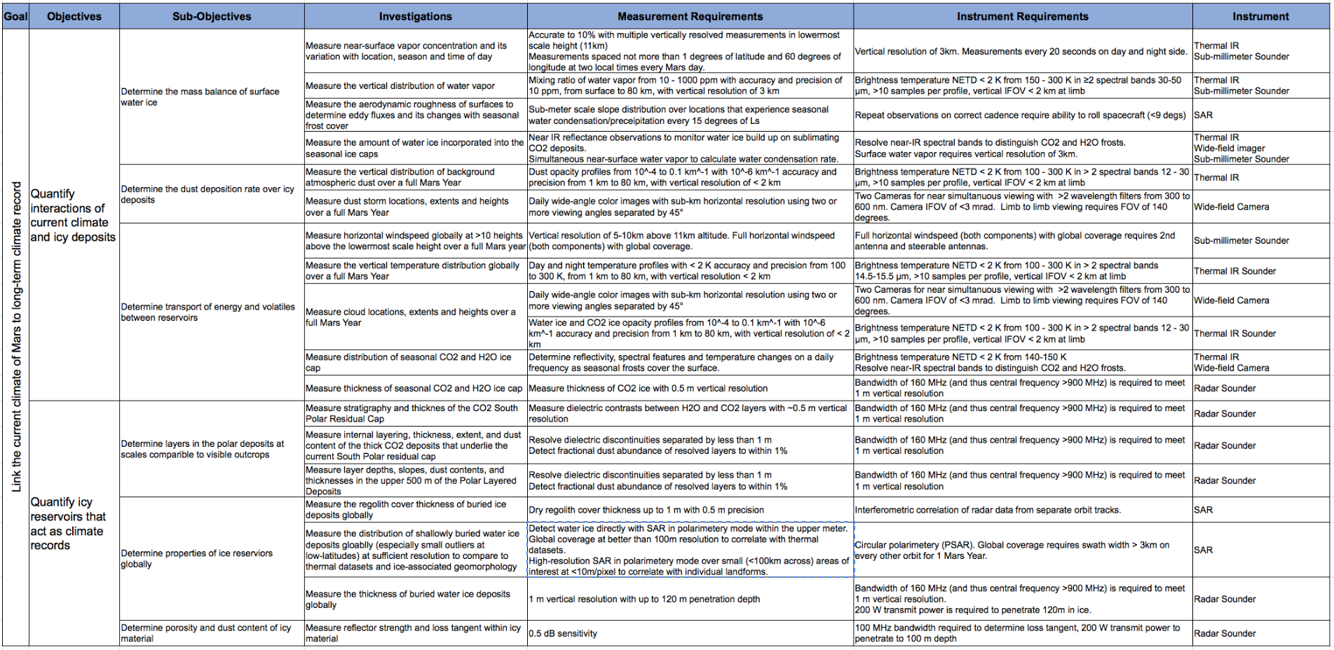
COMPASS measurements require 4 instruments

Slide 15

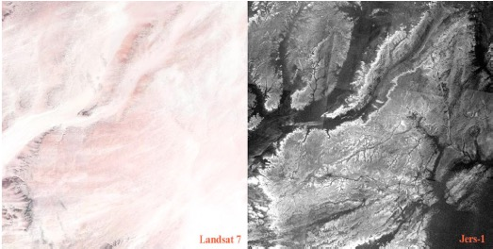
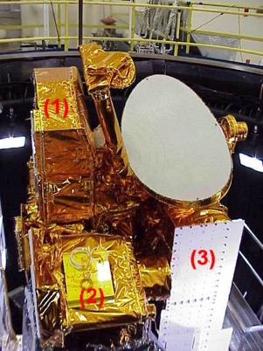
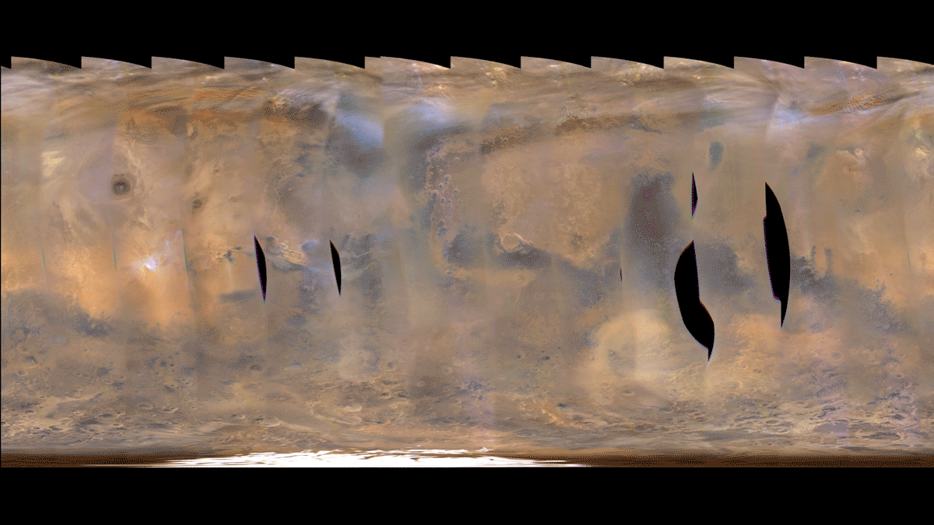
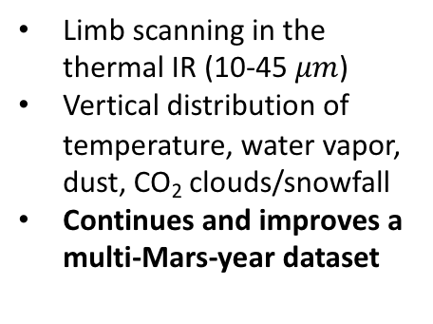
COMPASS measurements require 4 instruments
Thermal-IR Sounder (JPL)
Dual Mode RADAR SAR/Sounder (CSA)
Dual mode at L-band
SAR determines extent and depths of ground ice
Geology beneath dusty regions of Mars
Unprecedented dataset for Mars
Sounder measures ice thicknesses and layers
Limb scanning in the thermal IR (10-45 $μm$)
Vertical distribution of temperature, water vapor, dust, CO₂ clouds/snowfall
Continues and improves a multi-Mars-year dataset
Wide-Angle Camera (APL)
Sub-mm Sounder (JPL)
Visible and Near-IR daily global maps at 460 m/px
Stereo for cloud Heights
Distinguishes dust and clouds
Distinguishes H₂O and CO₂ frosts and clouds
Continues and improves a multi-Mars-year dataset
Limb scanning in the microwave (450 GHz)
Vertical distribution of temperature, water vapor
Vertical profiles of windspeed - Unprecedented dataset for Mars
Vertical profiles of trace compound abundance

Slide 16
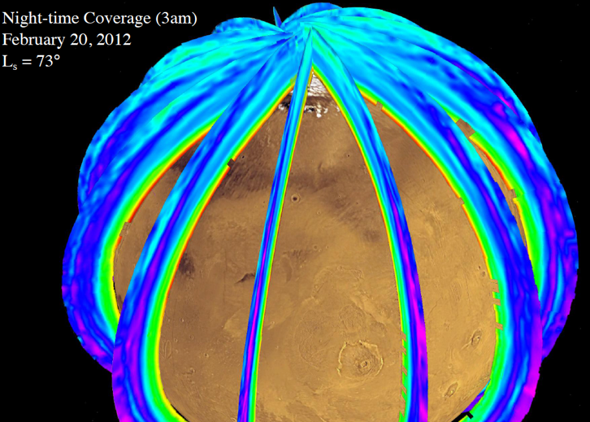
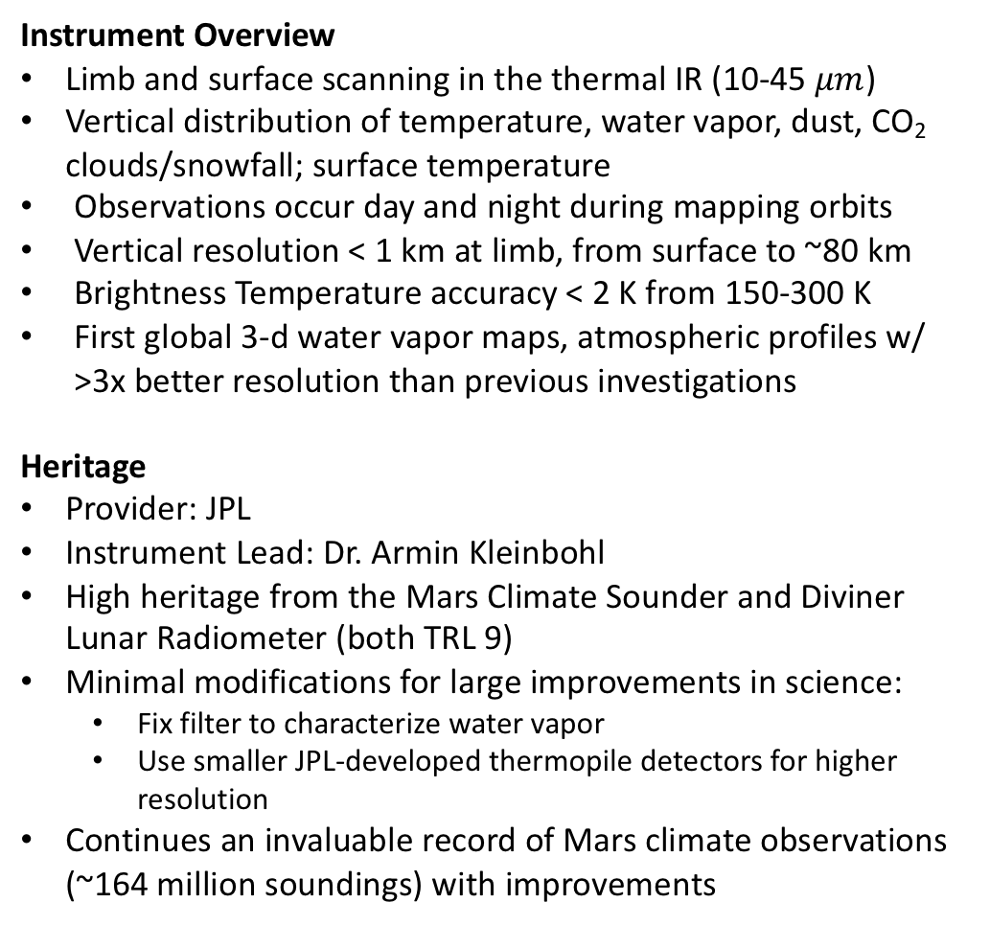
1. Thermal-IR Sounder
Instrument Overview
Limb and surface scanning in the thermal IR (10-45 $μm$)
Vertical distribution of temperature, water vapor, dust, CO₂ clouds/snowfall; surface temperature
Observations occur day and night during mapping orbits
Vertical resolution < 1 km at limb, from surface to ~80 km
Brightness Temperature accuracy < 2 K from 150-300 K
First global 3-d water vapor maps, atmospheric profiles w/ >3x better resolution than previous investigations
Heritage
Provider: JPL
Instrument Lead: Dr. Armin Kleinbohl
High heritage from the Mars Climate Sounder and Diviner Lunar Radiometer (both TRL 9)
Minimal modifications for large improvements in science:
  Fix filter to characterize water vapor
  Use smaller JPL-developed thermopile detectors for higher resolution
Continues an invaluable record of Mars climate observations (~164 million soundings) with improvements

Slide 17
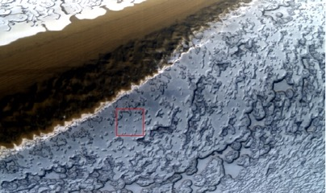
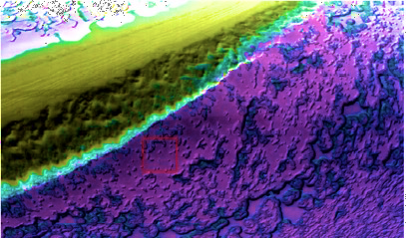
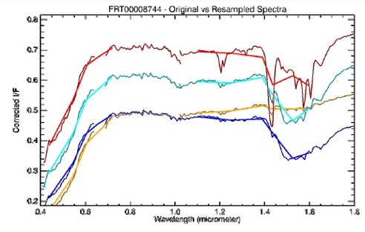
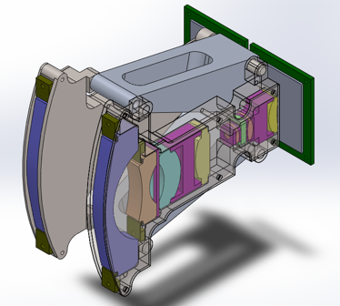
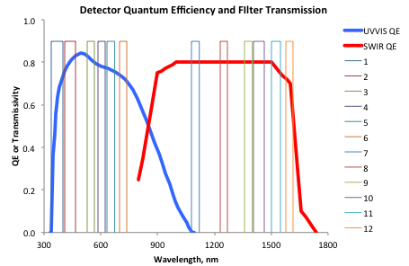
2. Wide-Angle Imager
Instrument Overview
Dual UVVIS and SWIR “push-frame” cameras
150° cross-track FOV
0.46 km/pixel @nadir, 6 km/pixel @limb
  UVVIS binned x2, SWIR unbinned
Baseline includes 2x cameras with stereo separation for cloud heights
Multiple bands in near-IR distinguish different ices
UVVIS: 6 bands 0.34-0.75 µm
  2560*2160 CMOS, 6.5-µm pixels
  SWIR: 6 bands 1.1-1.6 µm
  1280*1080 InGaAs, 13-µm pixels
Heritage
Provider: APL
Instrument Lead: Prof. Wendy Calvin
Optics based on MARCI and MAGIE with UV camera replaced by SWIR
Detector based on National Security Space payload
Matured using internal APL funds
TRL 7, except for InGaAs area array (TRL 5)
UVVIS
SWIR

Slide 18
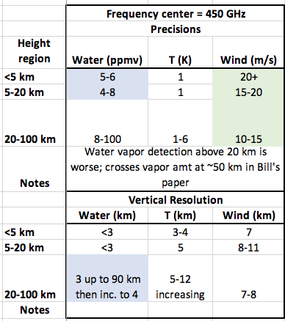
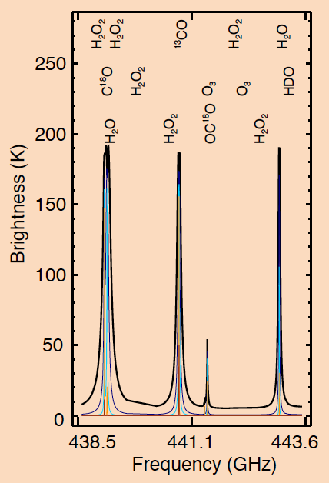
3. Sub-mm Sounder
Instrument Overview
Scans atmospheric limb, 0-150km altitude
Two instruments with separate antennae (23-50cm) for full
horizontal wind reconstruction (descopable to one instrument)
Observation band near 450GHz (optimizes near-surface results), bandwidth 27 GHz
Observations occur day and night during mapping orbits
Windspeed, Temperature and water vapor profiles
Trace species detection
Heritage
Provider: JPL
Instrument Lead: Dr. Leslie Tamppari
450 GHz receiver has strong heritage from MLS/Miro/Herschel etc.
  Most components TRL 6, some TRL 5 with plans to make TRL 6 within months
Antenna, calibration load, and mechanisms have similar heritage (TRL 6)
Lower frequency components all high TRL commercial parts
ASIC digital spectrometers are new and enabling (Currently TRL 5, airborne demonstrators planned for Summer/Fall 2018 will raise to TRL 6)
500 mm

Slide 19
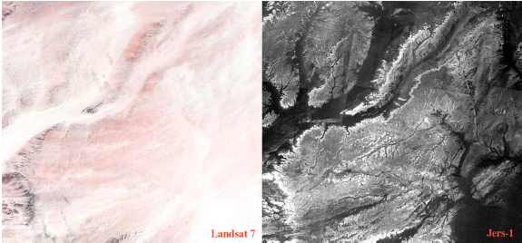
4. Dual-Mode RADAR
1GHz (L-band) SAR/Sounder dual-mode RADAR reveals:
  Fine-scale climatically-driven layering within polar and non-polar ice deposits
  Depth to mid-latitude ice and its thickness
  Geology beneath dusty regions of Mars
A SAR has never flown to Mars and would yield an exciting new dataset of broad significance. Our proposed sounder would be an order of magnitude improvement upon SHARAD.
Pailou et al. 2006 (visible vs L-band SAR)
Sounding mode
Vertical resolution in free space ~1m or ~0.5m in ice
Along-track resolution is flexible – data rate on the order of 1Mb/sec
SAR Mode
Multiple polarizations available – standard mode is to broadcast circular and receive horizontal and vertical
A single polarization at 100m per pixel occupies only a few Mb/s
Smith et al. 2016 (SHARAD layering at 15m wavelength)

Slide 20
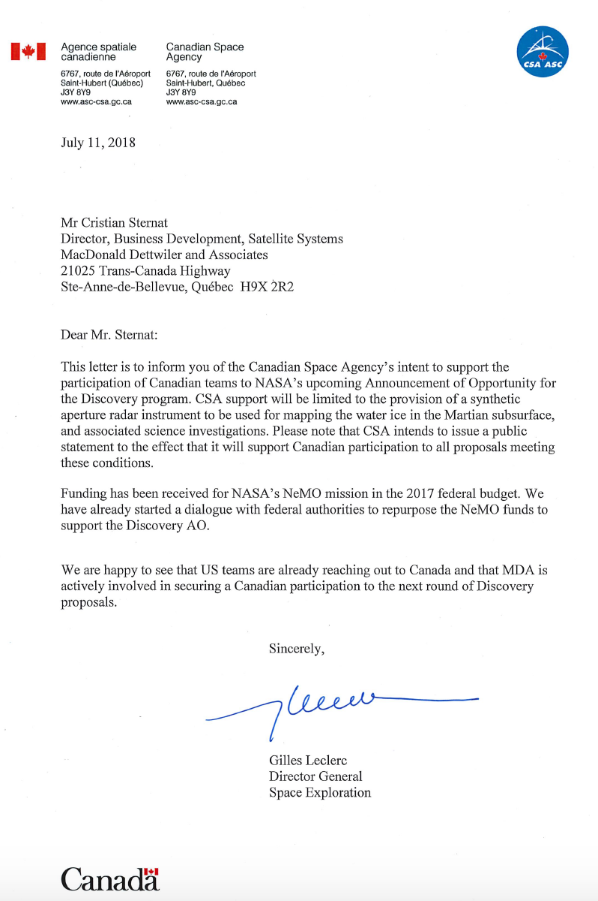
4. Dual-Mode RADAR
The COMPASS radar system will be contributed by the Canadian Space Agency and built by MDA
CSA is reallocating the NeMO funds for that RADAR system to COMPASS – a letter of intent has been provided
940 MHz (L-band), 140-150 MHz bandwidth
High-heritage from terrestrial systems e.g. Radarsat Constellation Mission – but smaller and at longer wavelength
 | Sounder | Low-res SAR | High-res SAR
Power | 365 W | < 544 W | 1061 W
Data Rate | 1.5 Mbps* | 2 Mbps* | 400 Mbps
Swath width | N/A | 24-35 km | 23-30 km
Vertical extent | 100m | N/A | N/A
Resolution Along Track | 30-40m | 60 m | ~3m
Resolution Cross Track | 1.3-1.6km | 60m | 2-3m
Vertical Resolution | 1m free-space 0.5m in ice | N/A | N/A
Based on standard operating modes at 255-320km altitude and SAR incidence angles 30-40 degrees
* Processed on board to reduce the data rate

Slide 21
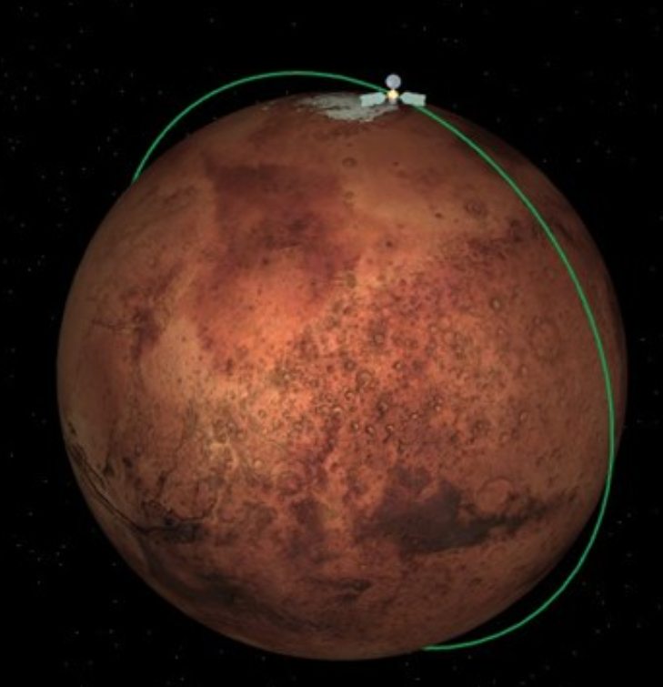
Orbital Implementation
Mapping instruments (Wide-angle imagers & thermal and sub-mm sounders) require a low-altitude circular orbit (~300km)
Polar coverage requires a near-polar orbital inclination (87-93 degrees)
Extension of existing datasets (wide-angle imaging and thermal sounding) require a sun-synchronous orbit, which drives an inclination choice of 93 degrees
  And an ascending node fixed at ~3pm local time
Other benefits of sun synchronous orbit include stable observation and thermal conditions e.g. eclipse-durations are constant throughout the mission etc…

Slide 22
ConOPS
Communications and RADAR instrument share the antenna
6m Astromesh provided by Northrop Grumman Corporation
Deployed after aerobraking – orientation w.r.t. s/c fixed
Alternate orbits for mapping/SAR and sounding/communications
Relative number of each subject to a science trade and may vary with time
Articulated solar arrays provide continuous power
Mapping Orbits - Deck points nadir
SAR in low-res mapping mode (day and night)
  Global coverage at 60m resolution obtainable
Isolated high-res SAR observations (day and night)
IR and sub-mm profilers (day and night)
Imager (dayside only)
  Contiguous maps from latitudes 40-90
  ~75% coverage at the equator
No comm.s and no spacecraft tracking
Targeted Orbits - Dish points nadir (RADAR sounding)
Dish points to Earth (communications)
Sounding on night-side with comm.s on the dayside
  500sec (25 degrees of latitude) each
  >4000 sounding opportunities in primary mission
S/c reorientation required

