Slide 1
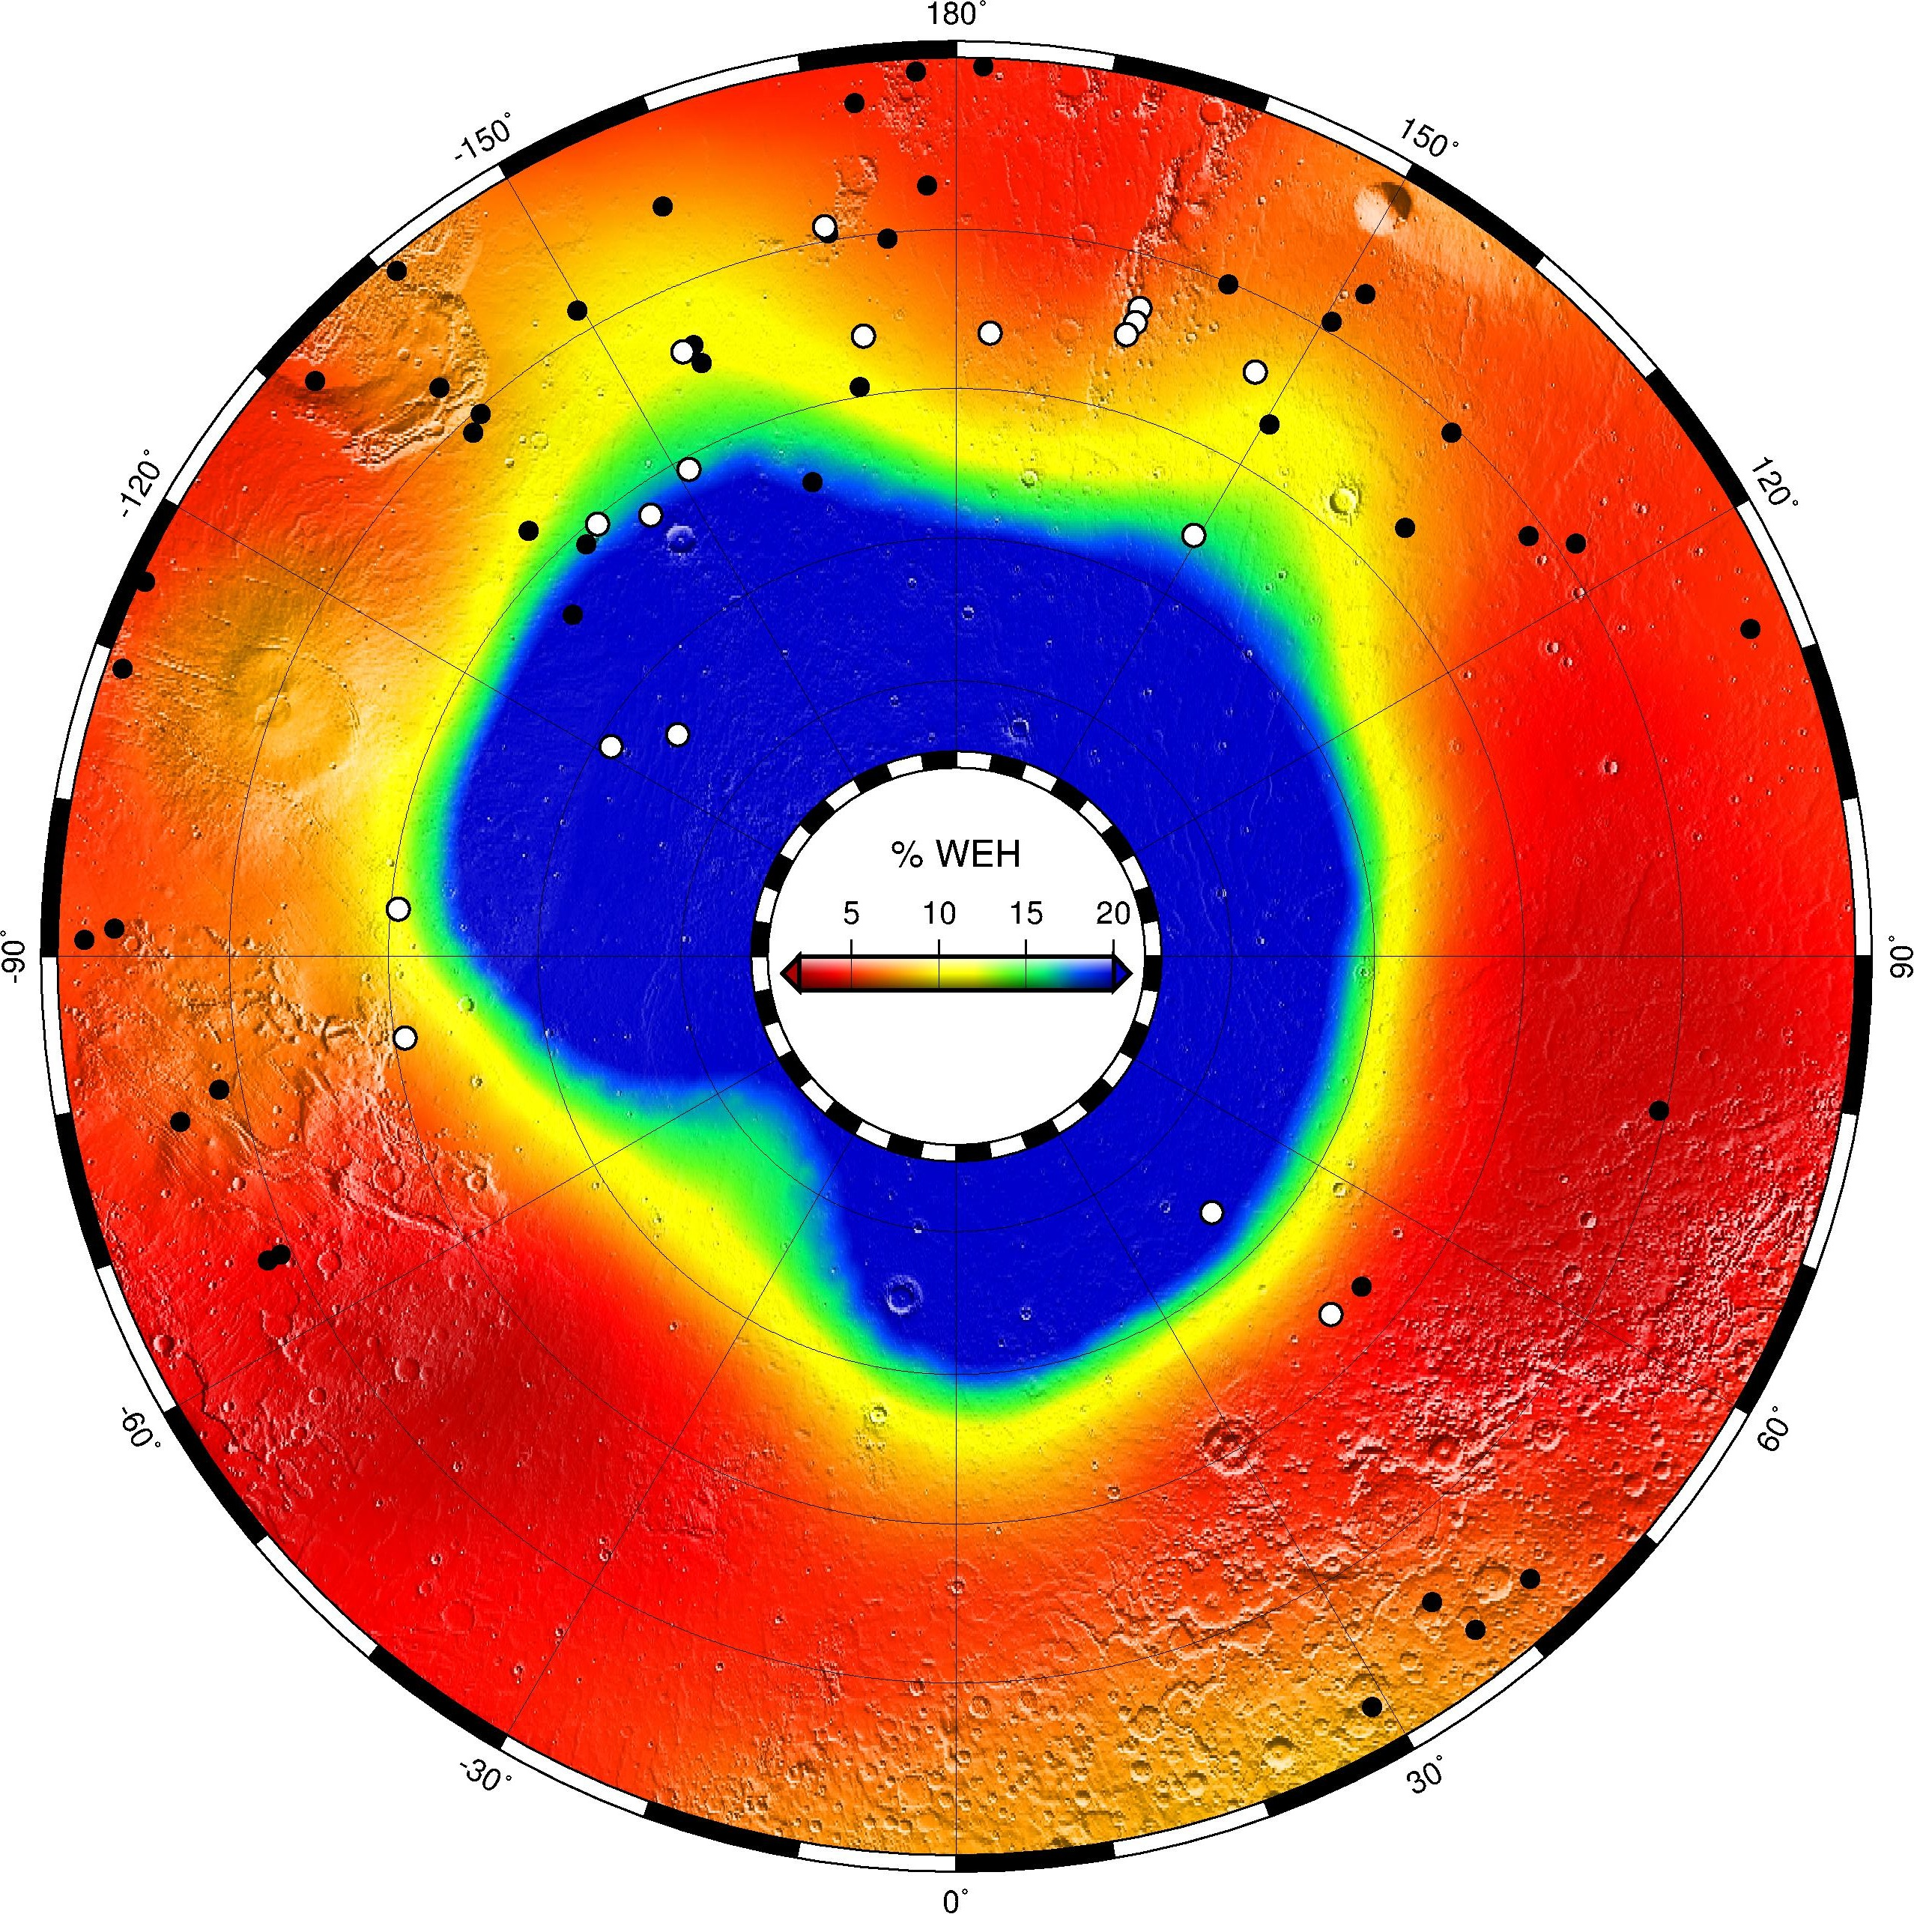
Ice Boundary Campaign
MRO has found 20 new impact sites exposing ice, 18 in the Northern hemisphere and 2 at high Southern latitudes (Dundas et al., in press).
The icy craters located in the Northern hemisphere define the equatorward boundary of the ice table, which is further south than the boundary models predict and that measured by the Mars Odyssey neutron spectrometer (Feldman et al., 2008), which cannot detect ice deeper than ~50 cm.
Two leading (currently indistinguishable) hypotheses are:
Long-term average atmospheric water vapor content is more than double the present value; consistent with the expected effect of recent orbital variations. i.e. ground ice lags climate by about 10 Kyr
(2) Near-surface humidity is higher than expected for current column abundances based on uniform mixing with atmospheric CO₂, as observed at the Phoenix landing site (Tamppari et al., 2010).

Slide 2
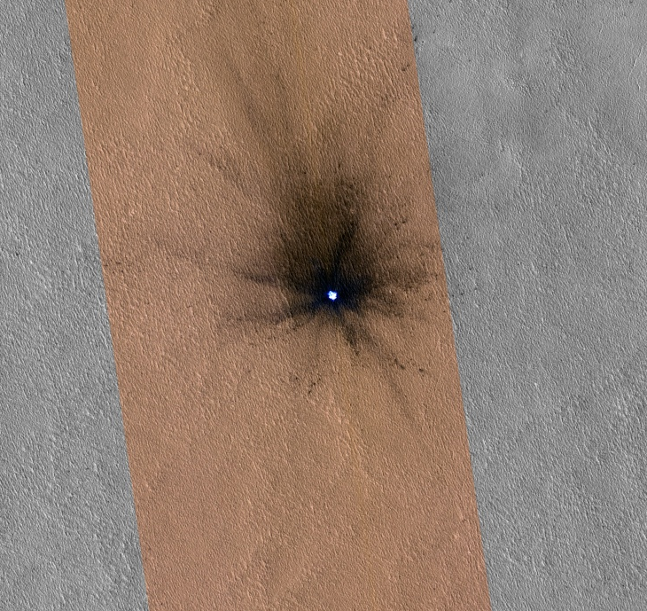
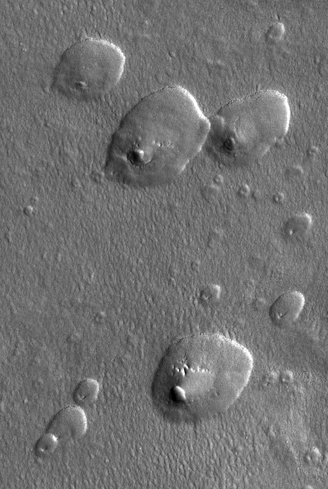
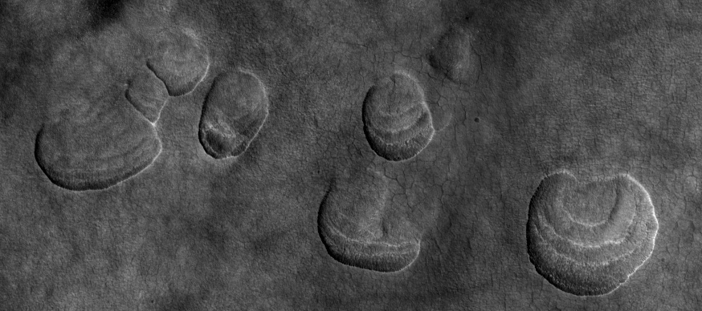
44°N
Evidence now points to widespread northern mid-latitude excess ice
Excavation at the Phoenix site
Icy impact craters
Pole-orientated Scallops & Expanded craters (thermokarst)
51°N
Possible Sources
Ice lenses from frost heave
Sizemore et al. 2014
Snowfall
Avoid desiccating the area recently and explain superposed boulders
Vapor Deposition & Thermal Cycling
Appears to take a very long time
Excess ice should be prevalent in the south too, but the same geomorphic evidence is lacking
47°N

Slide 3
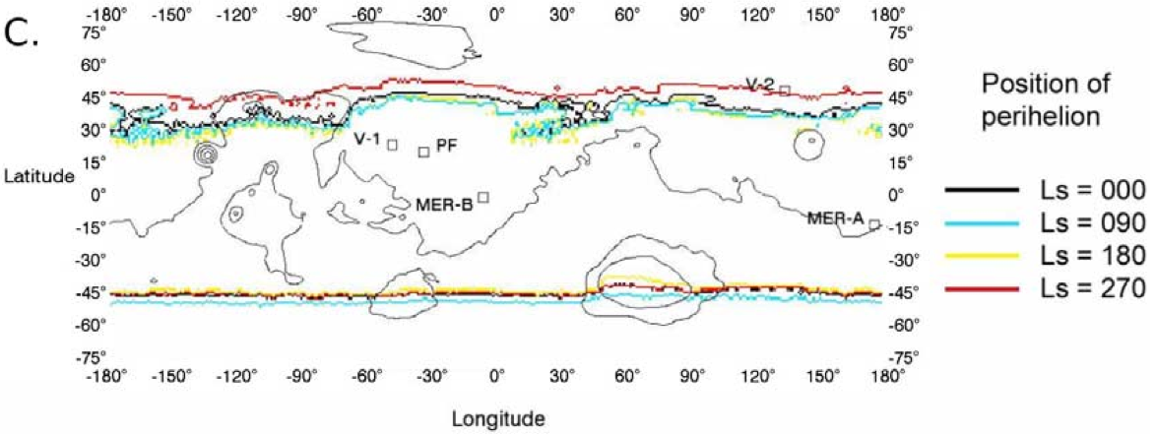
Progress on climatic history
(23 kyr ago)
(10 kyr ago)
(3 kyr from now)
Chamberlain & Boynton (2007)
Northern results current match conditions from 10 Kyr ago
Different than today
Southern stability area unchanged between 10 Kyr and today
Does southern ice-line match today’s conditions?
Yes: Then ice lags climate by ~10Kyr still works
Further equatorward: Then surface concentrated humidity works both here and in the north
Further poleward: Then we have an exciting problem…

Slide 4
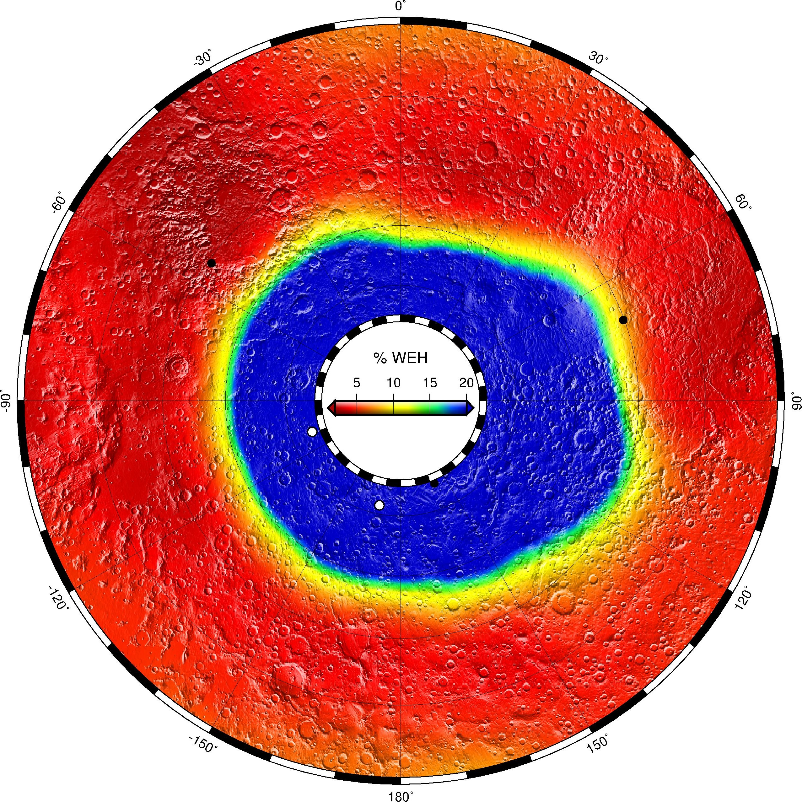
Will we find clean excess ice as pervasively in the south as in the north?
Frost heave and Fisher’s vapor deposition model should work here too.
Thick sheets of precipitated ice may be unique to the northern plains.
N
S
Finding southern hemisphere icy craters will enable fundamental advances, but is difficult…

Slide 5
Ice boundary logistics…
Smaller and more subtle changes at CTX scales and will be best detected by differencing or blinking orthorectified images (or perhaps images with very similar geometry).
In EM3, CTX could systematically image portions of the boundary region, and we will rapidly process the overlapping repeat images to find new impacts for HiRISE and CRISM follow-up to search for ice.
Target selection has begun and is centered on HiRISE monitoring targets of interest (RSL, gullies) i.e. MRO rolls will be multipurpose
Repeat 4 times during the Ls 180-360 period when illumination is favorable
Concentrating on longitudes (e.g. 180-270) that have few other targets
40-50°S is 6.2% of Mars, so ~15 impacts per Earth Year (Daubar et al. 2013)
If we require ~10 impacts then we need:
366 CTX repeat sites with images spanning the full 40-50°S range [acquire in two pieces?]
1 stereo pair and two subsequent images ~90 and ~180 L_{s} later or ~1460 images total
3156 Gb for bin-1 4bpp OR 789 Gb for bin-2 [trade quality and coverage for best detectability]
CTX allocation for EM3 ~10400 Gb (8% or 30% could be used by this campaign)
Benefits
New constraints on recent climate change and water vapor vertical distribution
Identify resources and exploration targets
Help define special regions relevant to planetary protection
Refine the impact rate (and it’s seasonality) and have ride-along science like gullies and RSLs

Slide 6
Switch gears here…

Slide 7
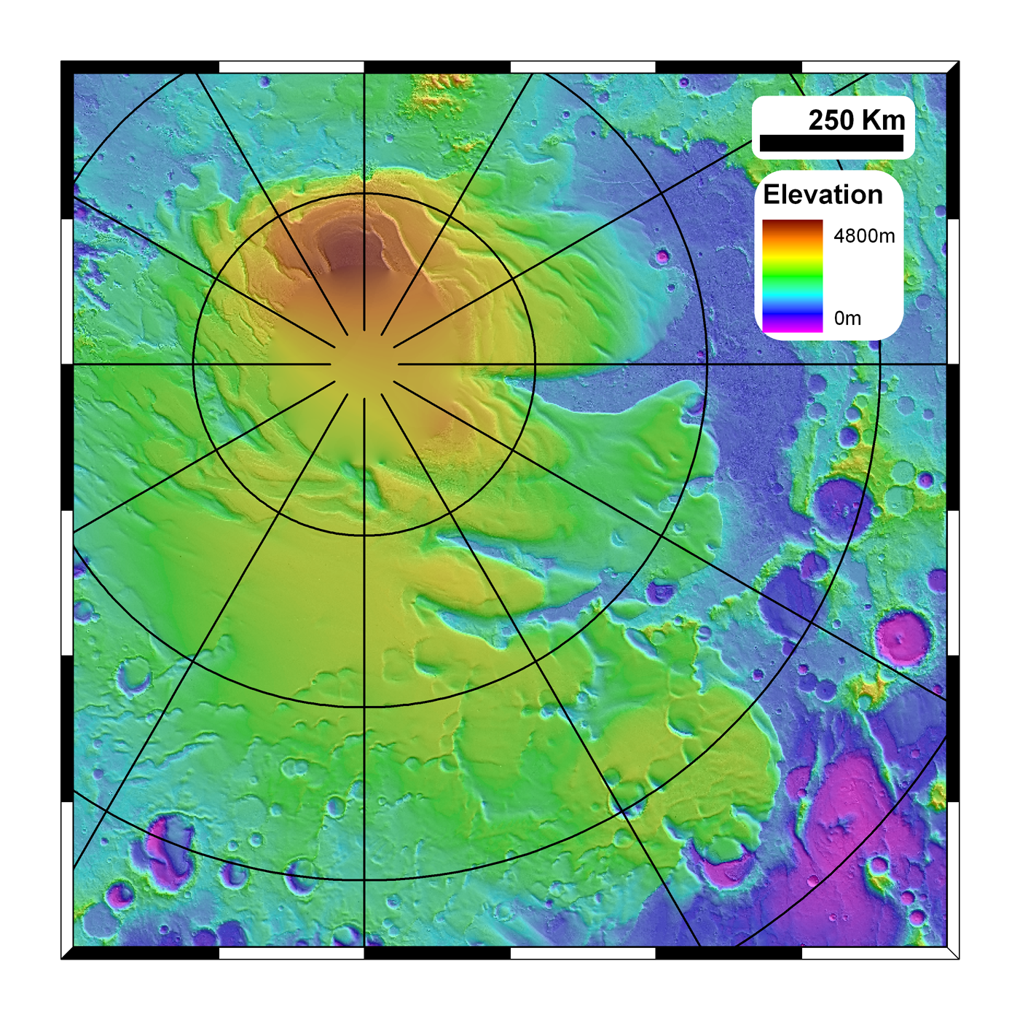
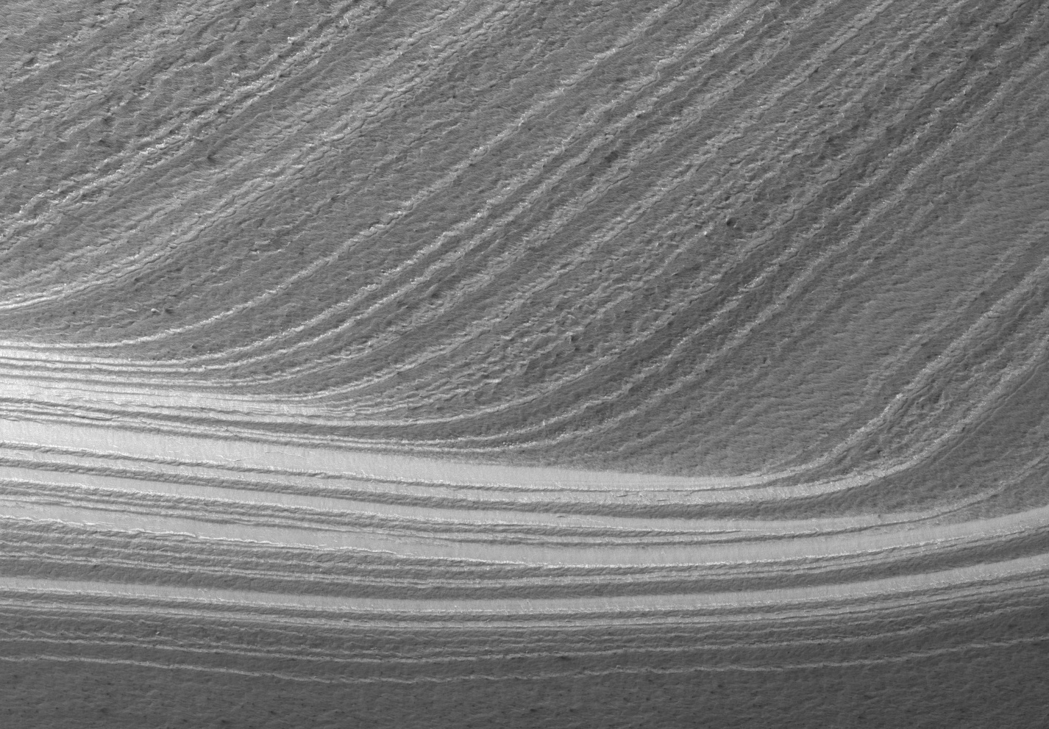
Discontinue Sweeping the SPLD under the Carpet
Exchange of polar reservoirs with the mid-latitudes and tropical high elevations in response to obliquity variations is the paradigm for Amazonian climate.
Models suggest that the NPLD has accumulated over the last 4 Myr or so
Every MRO observation (e.g. surface craters, SHARAD, ice grain sizes etc…) is consistent with this
Problem: We know the SPLD surface is 10s of Myr old and that the these deposits have survived multiple high-obliquity excursions.
The SPLD are typically ignored because they can’t be explained
We really don’t understand Amazonian climate to even first order until the discrepancy between the two polar deposits is understood.
Campaign to examine the SPLD crater population and stratigraphy to place it within Amazonian history – complements SHARAD studies of the Promethei Lingula and RFZs

Slide 8
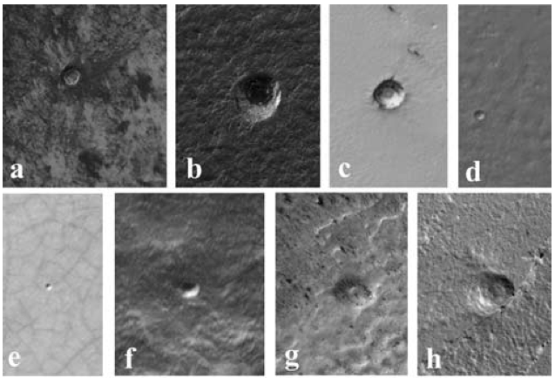
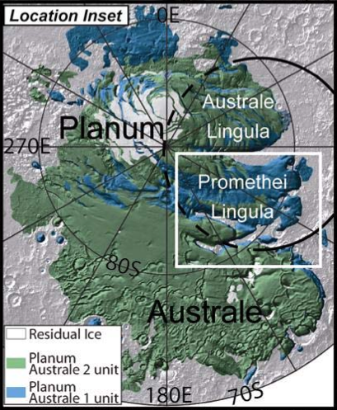
Really figure out this age discrepancy…
Systematic crater search (CTX) with HiRISE stereo follow-up
Previous age estimates contain craters found/measured with:
Viking (Herkenhoff & Plaut 2000)
MOLA (and some MOC) data (Koutnik et al. 2002)
Themis VIS (Plaut et al. – 2004, 2005 conference abstracts)
Revisit this with MRO data
Crater production function has also been updated (several times)
Geologic mapping now shows SPLD surface has two distinct units (Kolb & Tanaka 2006)

Slide 9
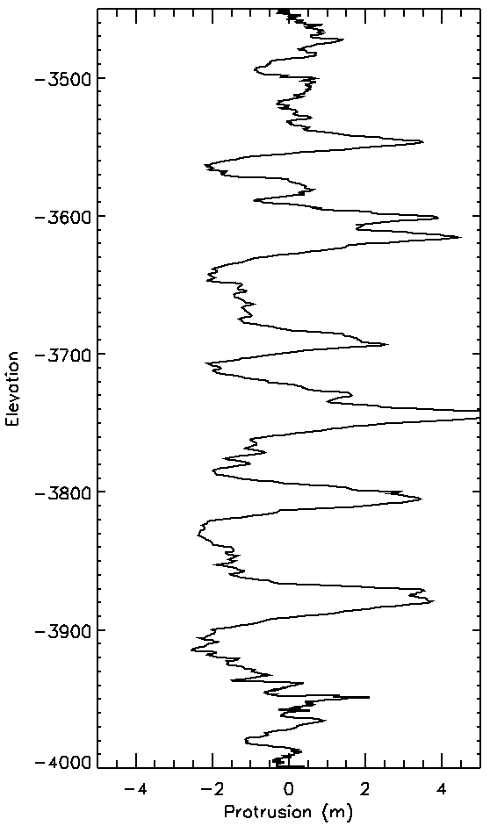
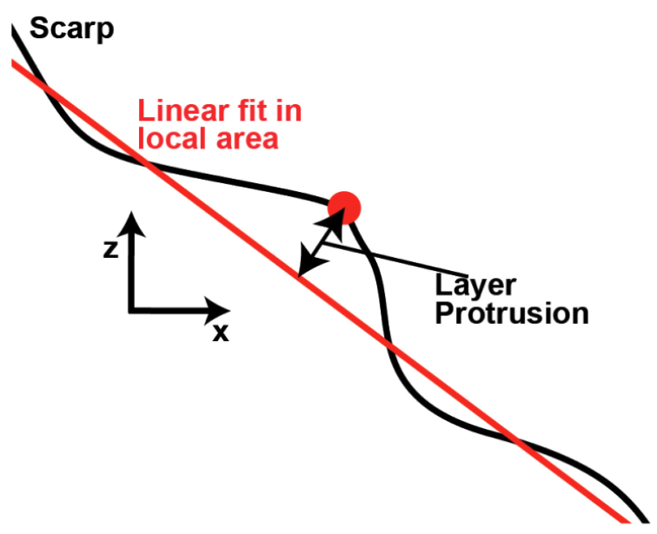
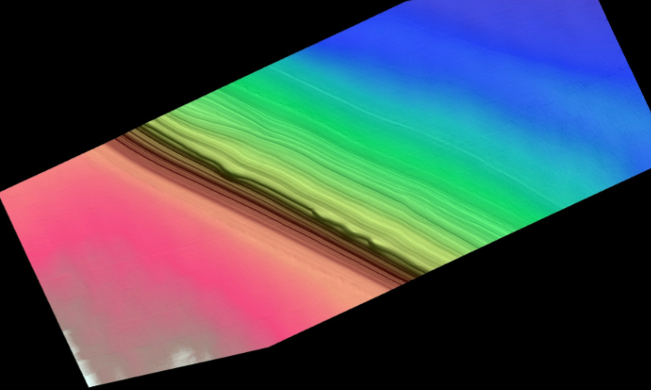
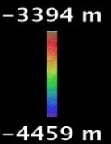
Window 100m

Slide 10
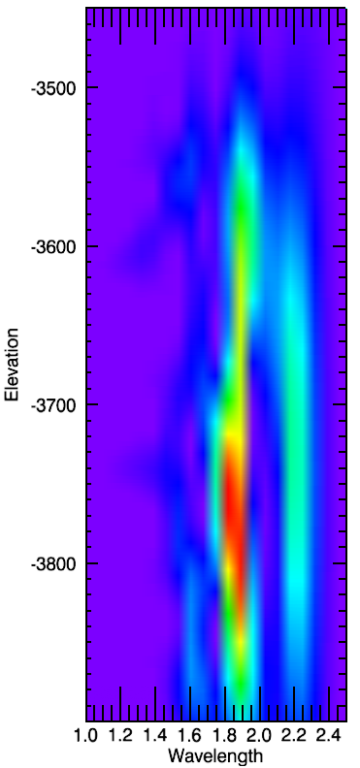
Window 100m
80m
60m
20m
40m

Slide 11
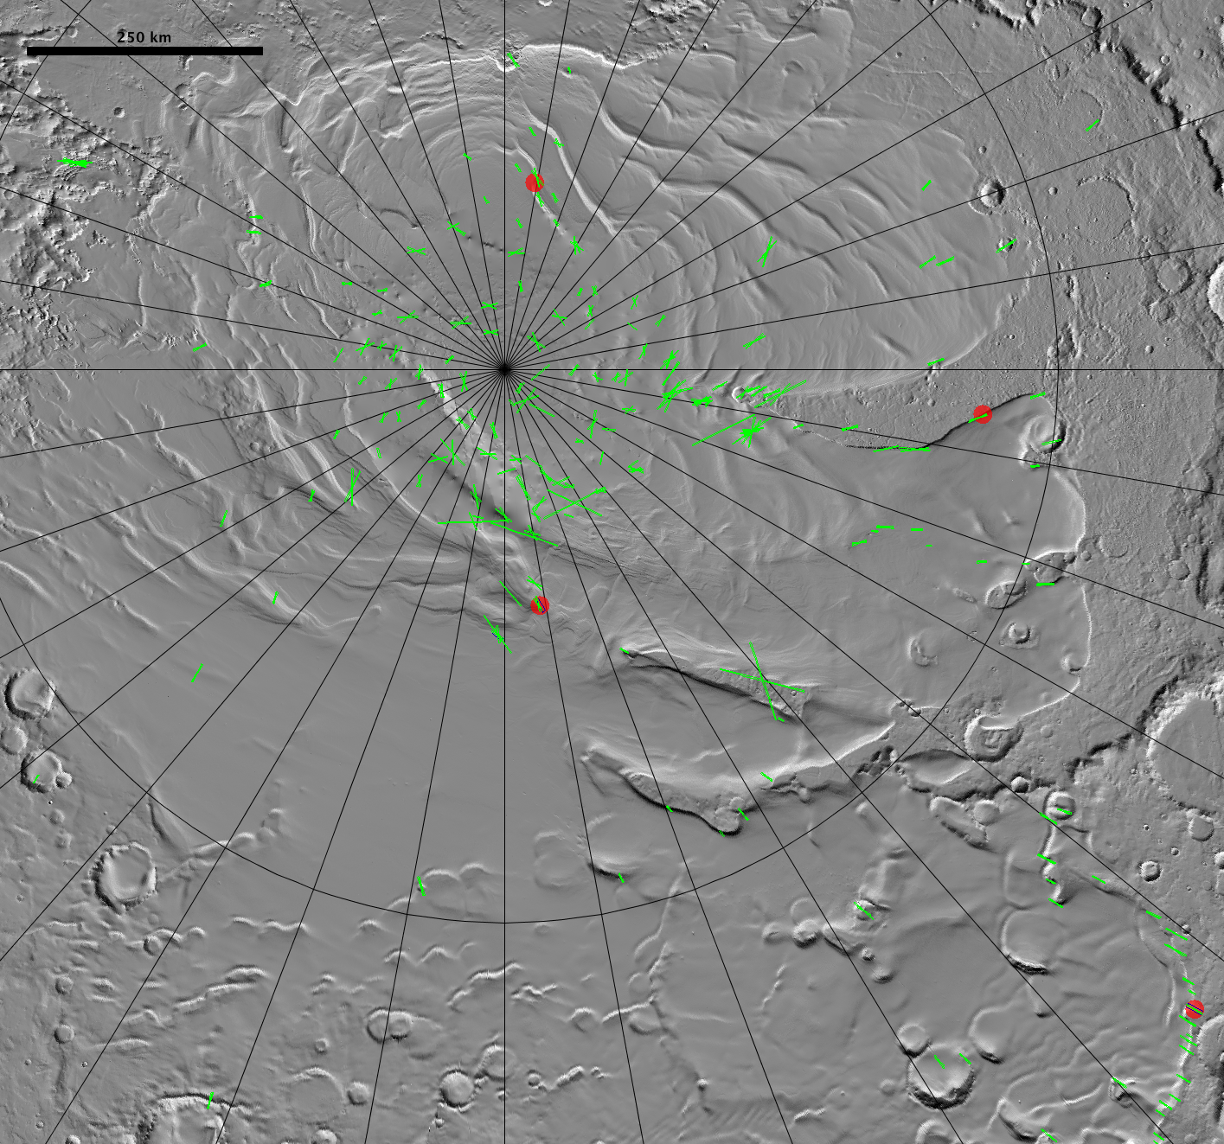
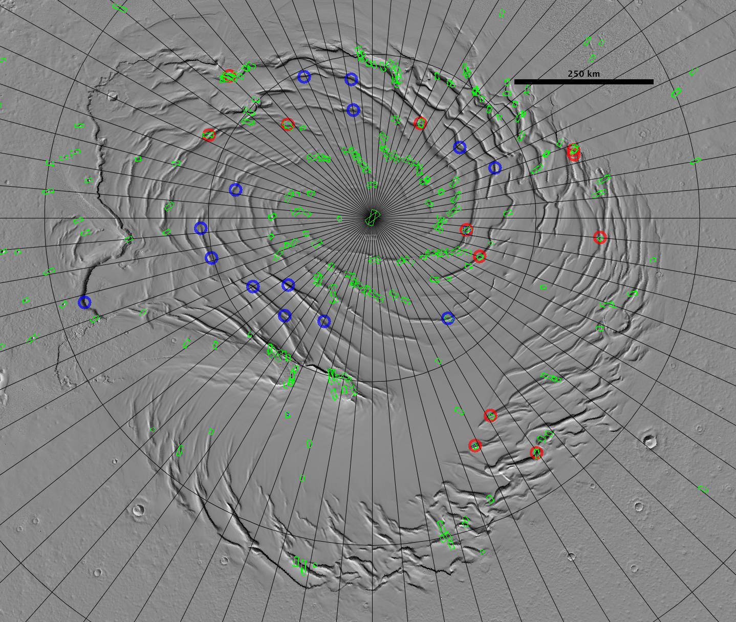
Blue=planned
North
South
In EM3 we will select southern study site for the stratigraphic analysis

