Slide 1
Some more on the Aa3 deposit
HiRISE will acquire DTMs of these collapse features to constrain the thickness of the water ice that separates Aa3 and the current residual cap
Example of one profile shown

Slide 2
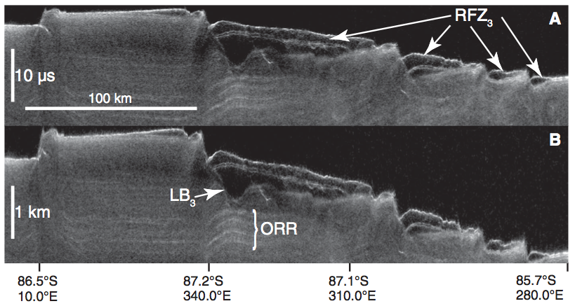
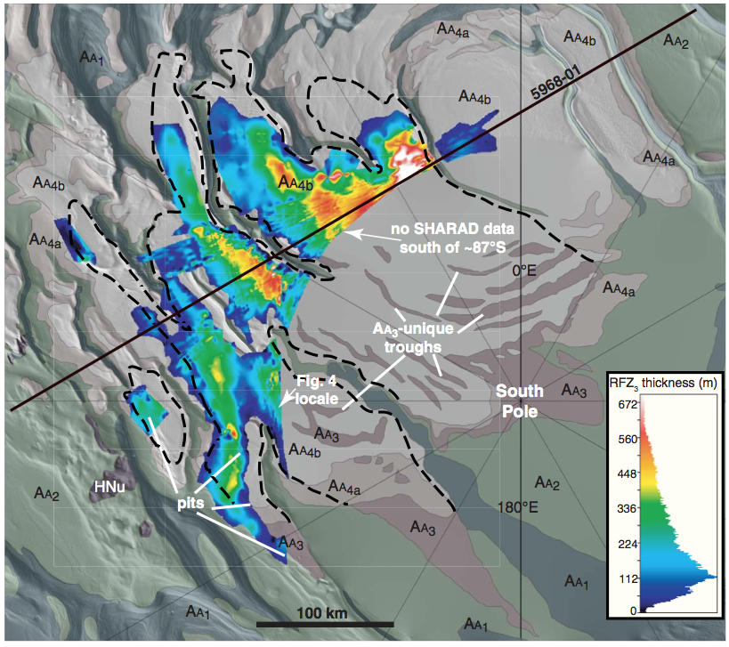
Reflection free zones thought to be buried CO₂ ice
Phillips et al. 2012

Slide 3
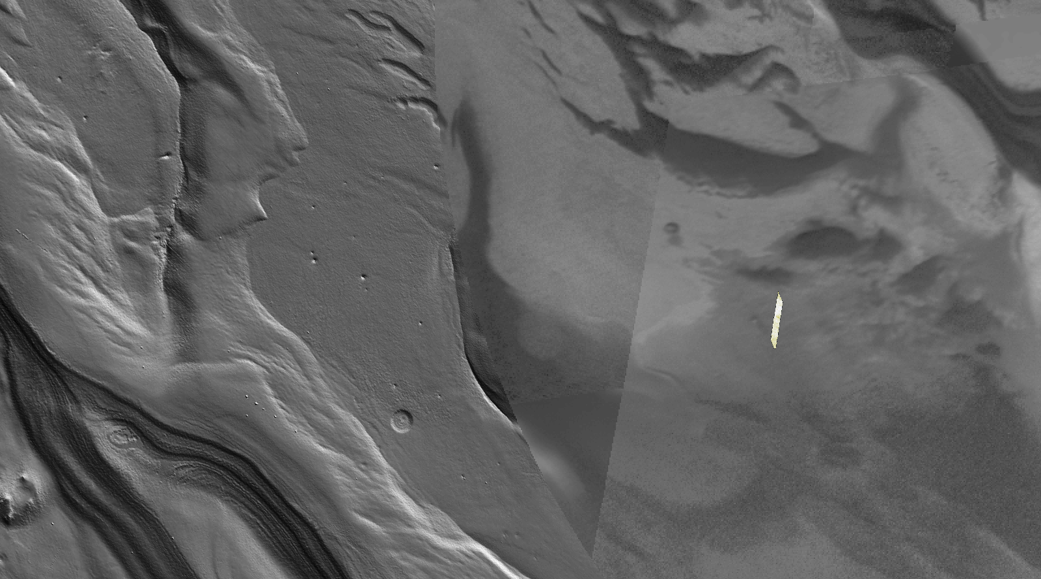

Slide 4
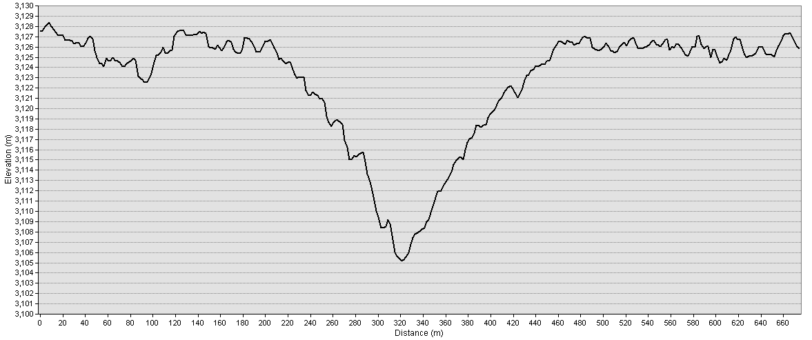
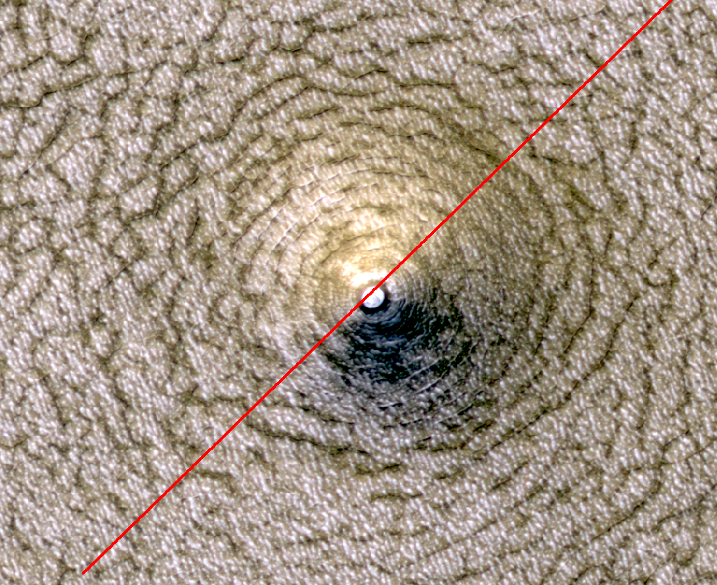
260m
20m

Slide 5
Residual CO2 cap
Models suggest cyclic cap
Extensive defrosting in MY28 (dust storm year) - Cap seems to be refrosting in subsequent years
Defrosted areas growing new slabs of CO2 ice that themselves are beginning to get these Swiss-cheese pits

Slide 6
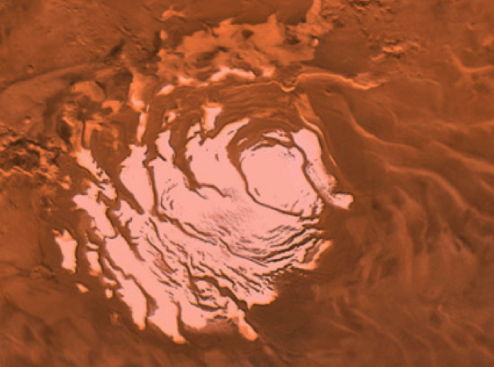
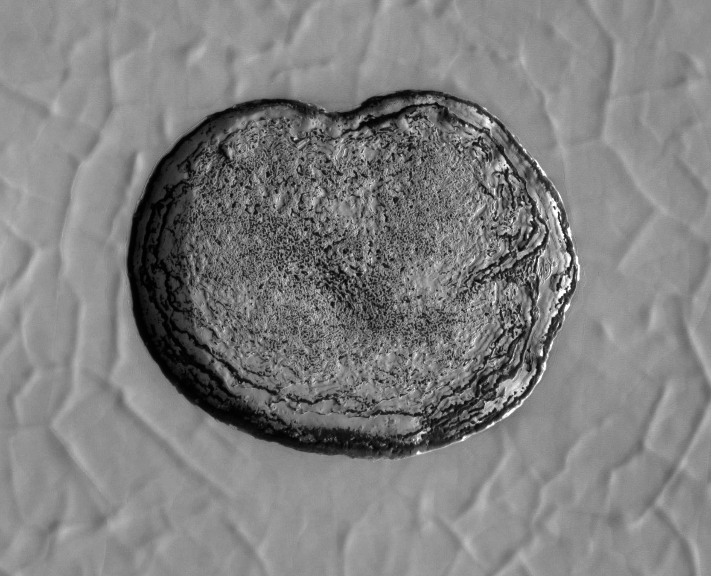
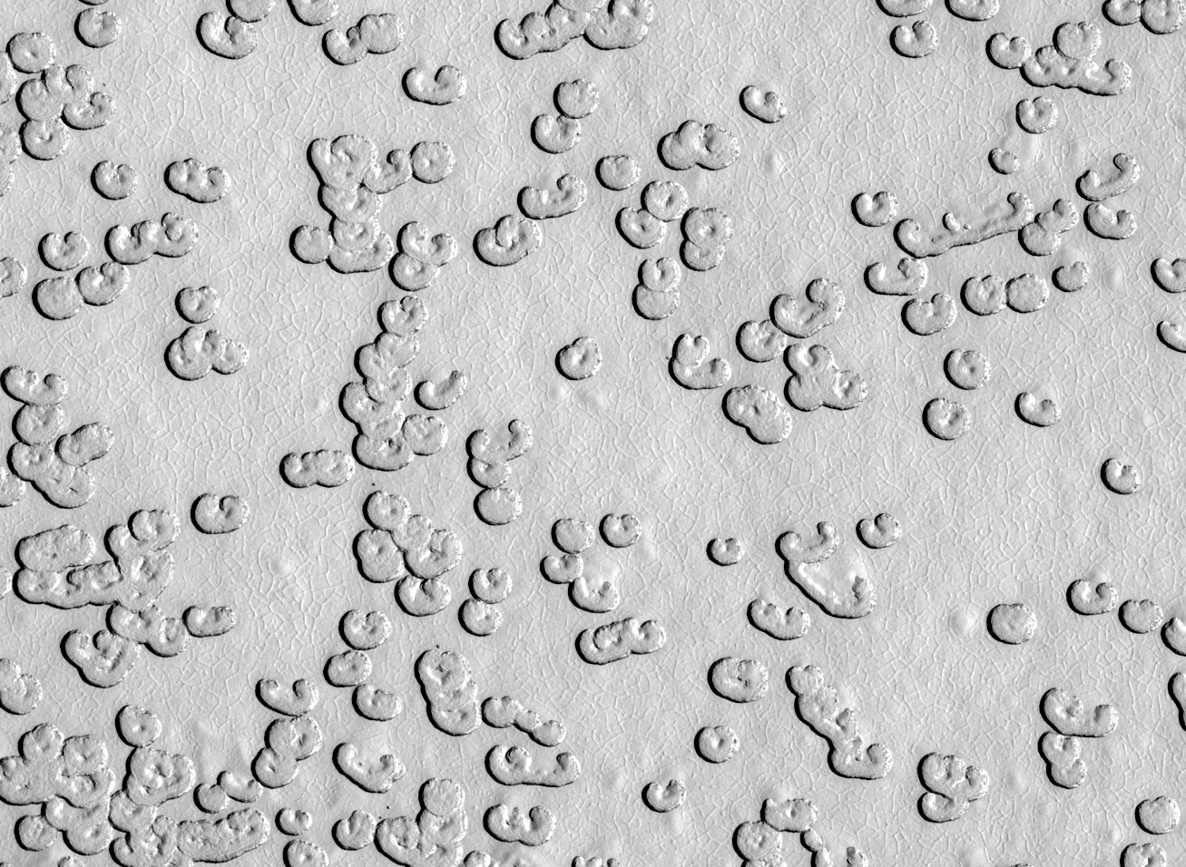
Change in the CO₂ Residual Cap
South polar residual cap is a few-meter-thick slab of CO₂ ice
Pits expand at m/yr (Malin et al. 2001, Thomas et al. 2005; 2009) indicate CO₂ being returned to the atmosphere
Climate change?
G11_022329_0931_XN_86S006W

Slide 7
Preserving a residual cap
Cyclical cap requires reducing surface roughness
E.g. drifting snowfall
Remnants of old cap determine where new pits will form.
Different generations of ice cap overlap
Minimum thickness is always zero
Swiss-cheese depressions are always present
Byrne et al. 2008; 2011

Slide 8
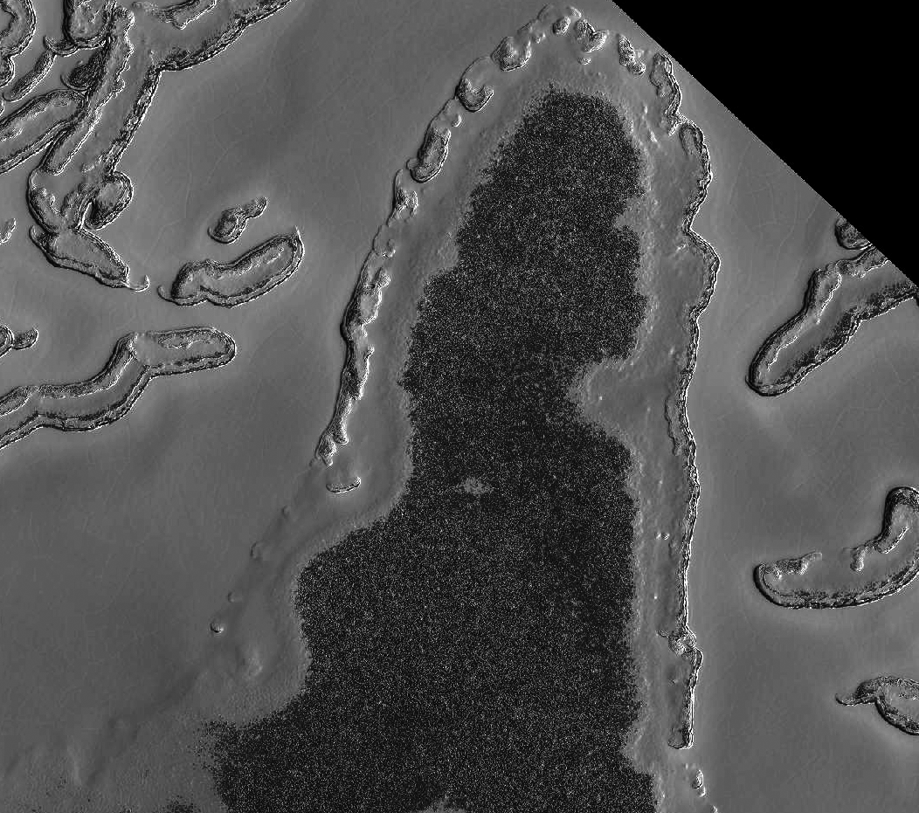
MY 28-31

Slide 9
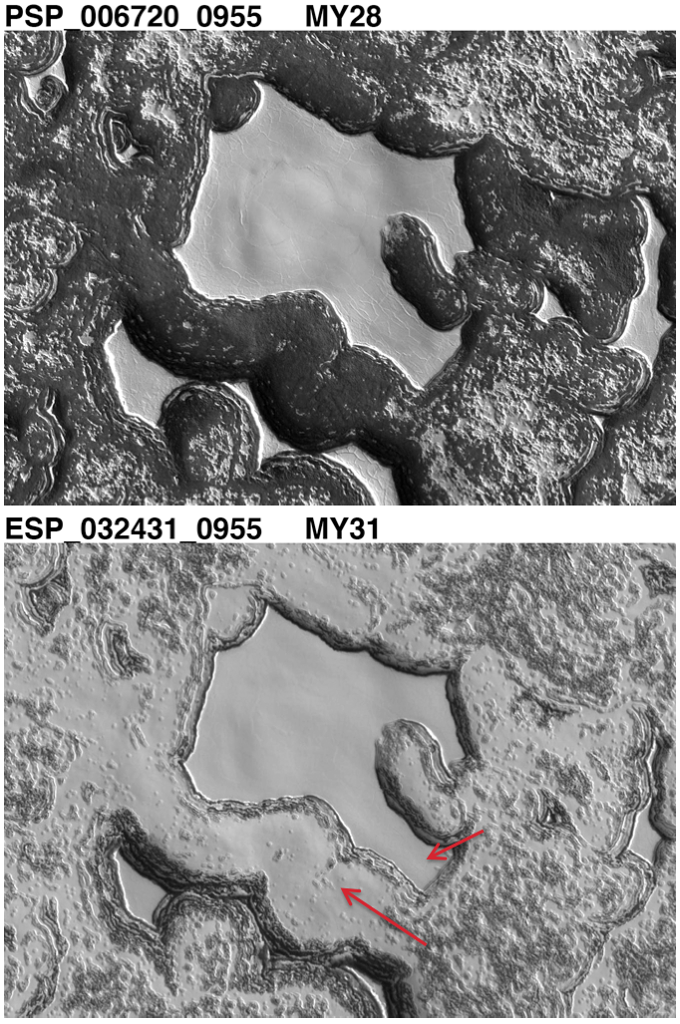
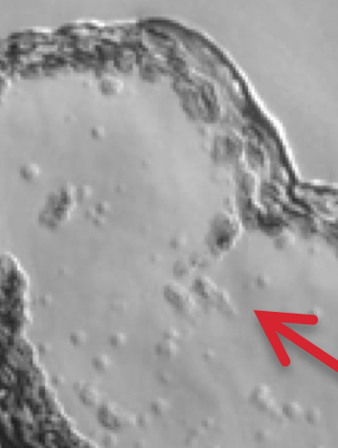
Refrosting ice cap
New slabs of CO₂ ice growing on defrosted areas that are themselves developing Swiss-cheese pits
Many dusty layers probably exist within the thicker CO₂ ice slabs
Multi-year observations allow these geological processes to be tracked and investigated

Slide 10
HiRISE DTM studies on NPLD and SPLD stratigraphy
We extract layer protrusion from the scarp face from the DTM
Wavelet analysis show spectral power at different wavelengths changing with depth
Last slide shows study sites

Slide 11
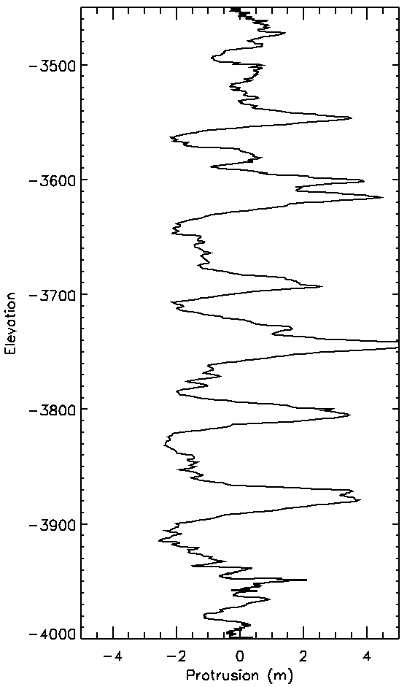
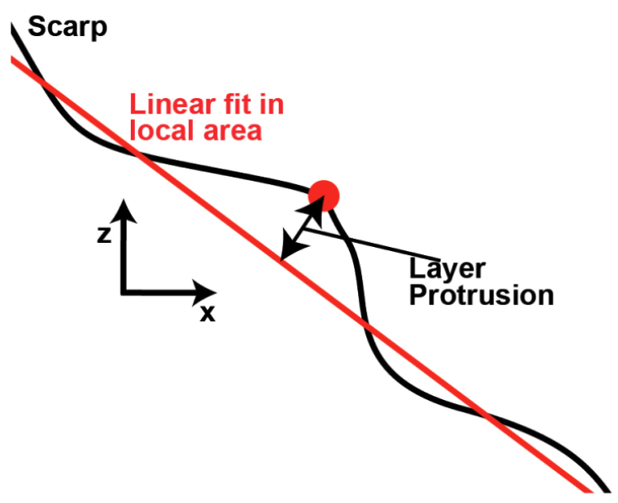
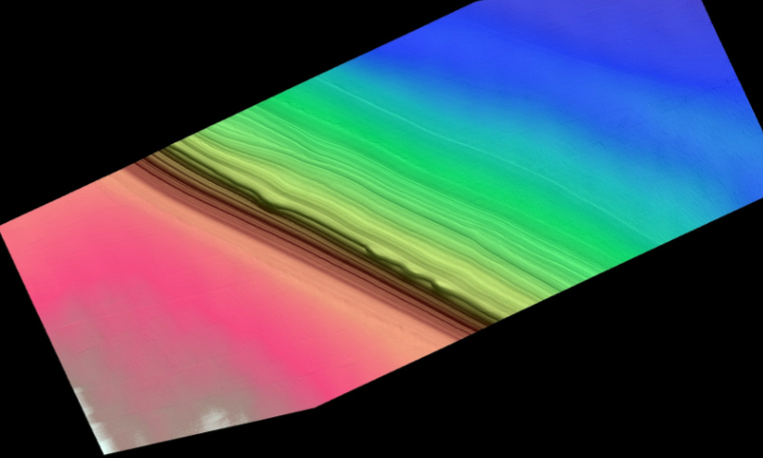
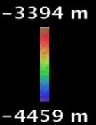
Window 100m

Slide 12
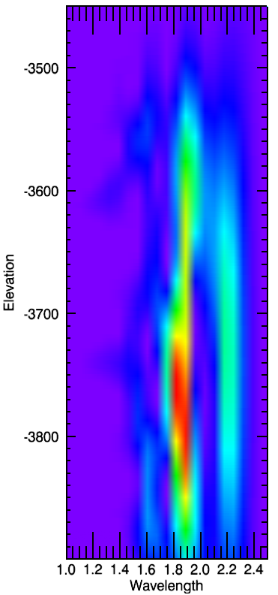
Window 100m
80m
60m
20m
40m

Slide 13
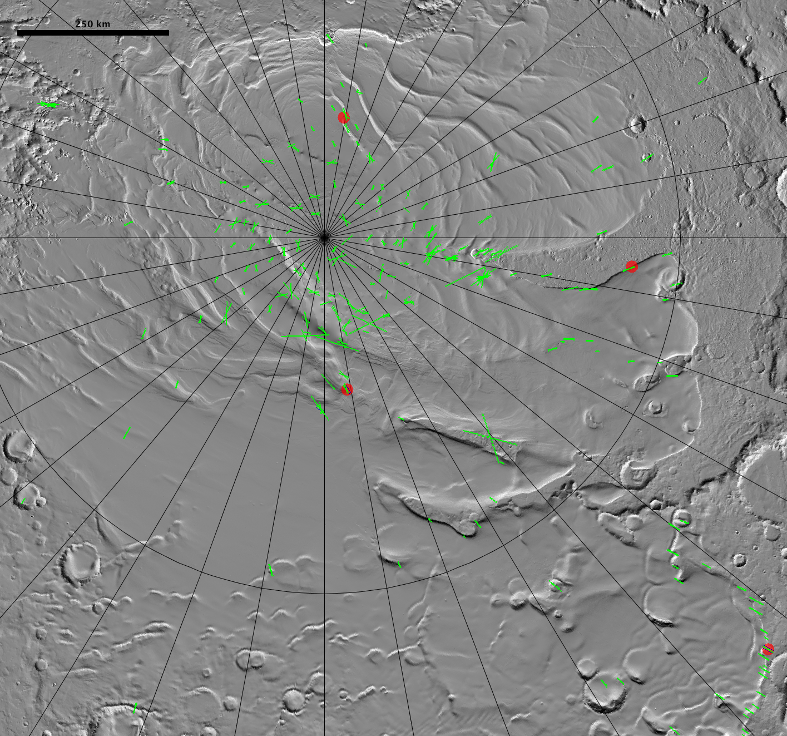
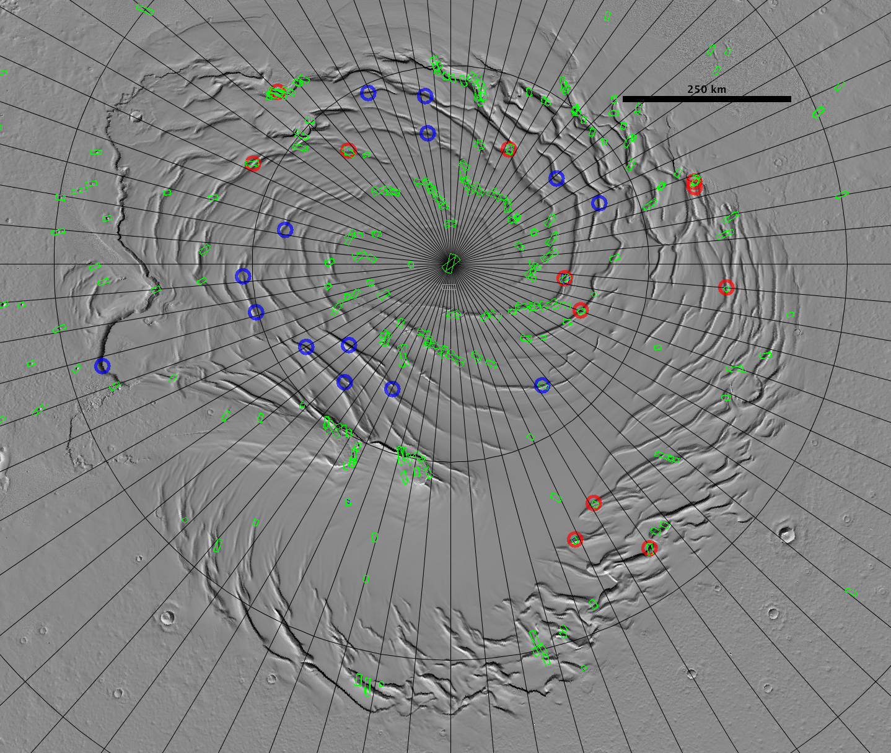
Stereo study sites
Blue=planned
North
South

