Slide 1
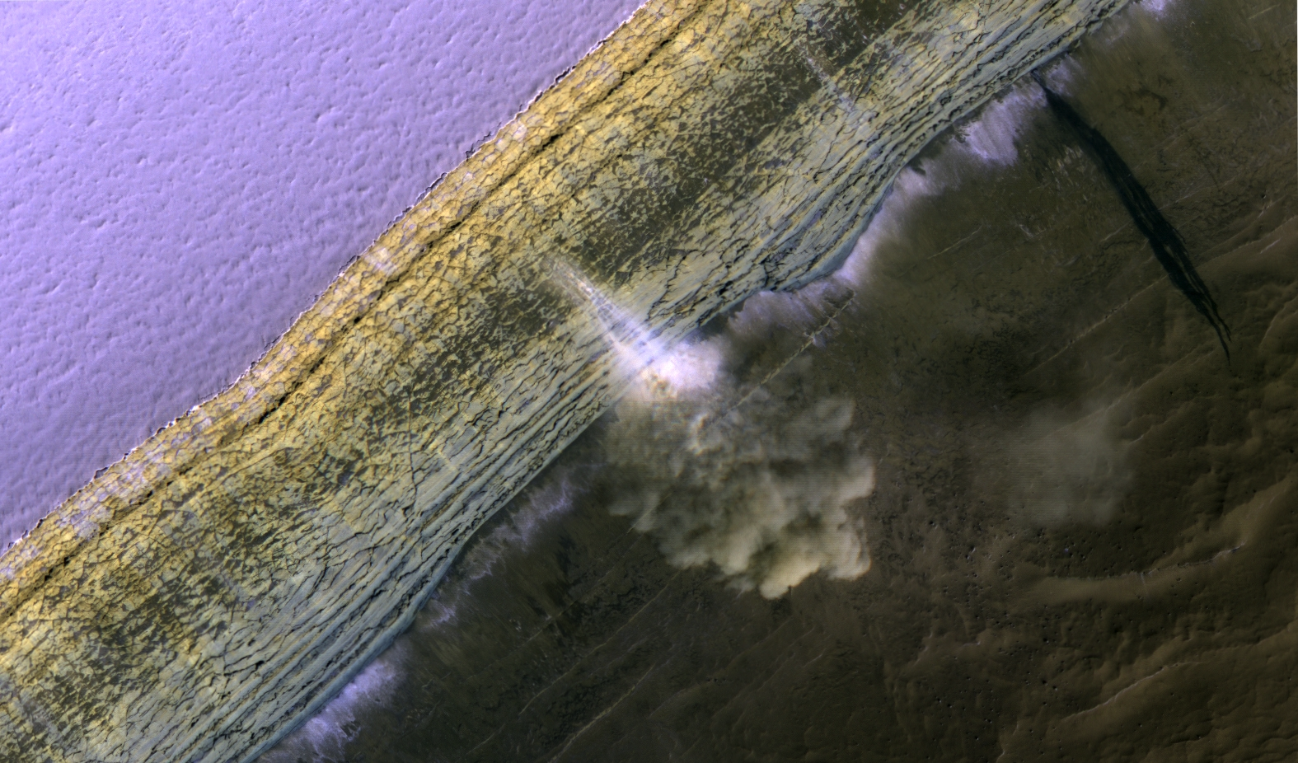
Icy Cliffs: Stressed Out and Falling to Pieces
S. Byrne, M. Sori, P. Russell, A. Pathare, P. Becerra, J. Molaro, S. Sutton & M.T. Mellon

Slide 2
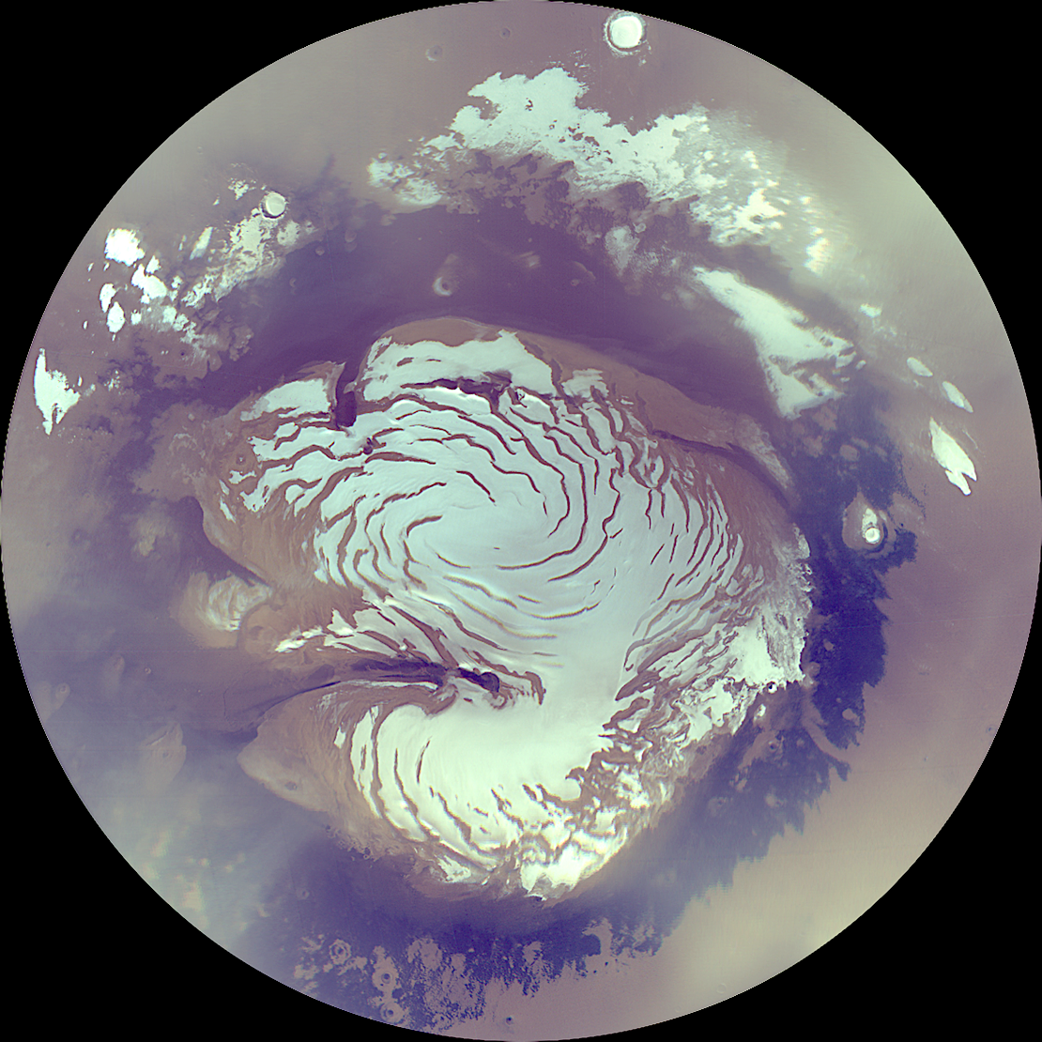
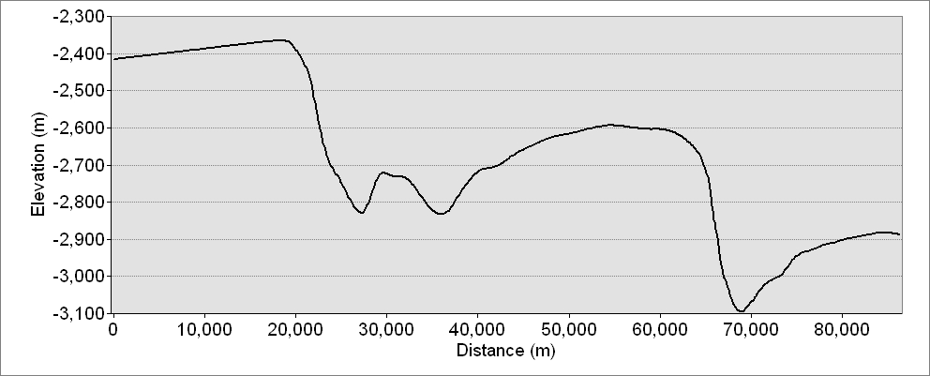
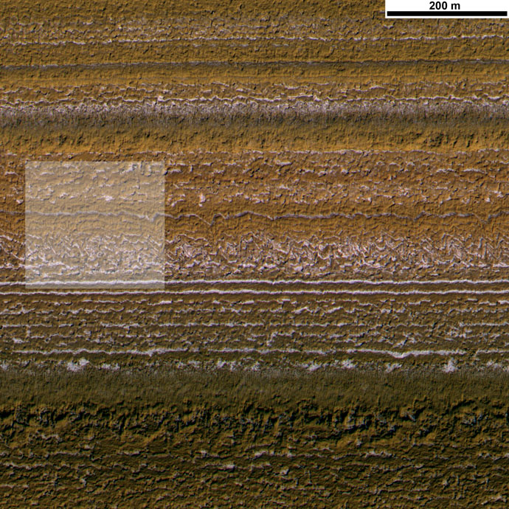
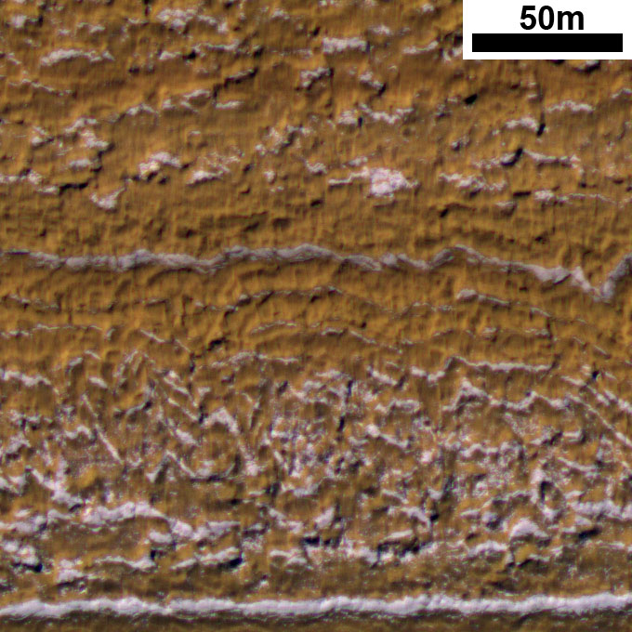
Layers exposed by gently sloping troughs
Thick lag deposits that slump downslope
PSP_001738_2640

Slide 3
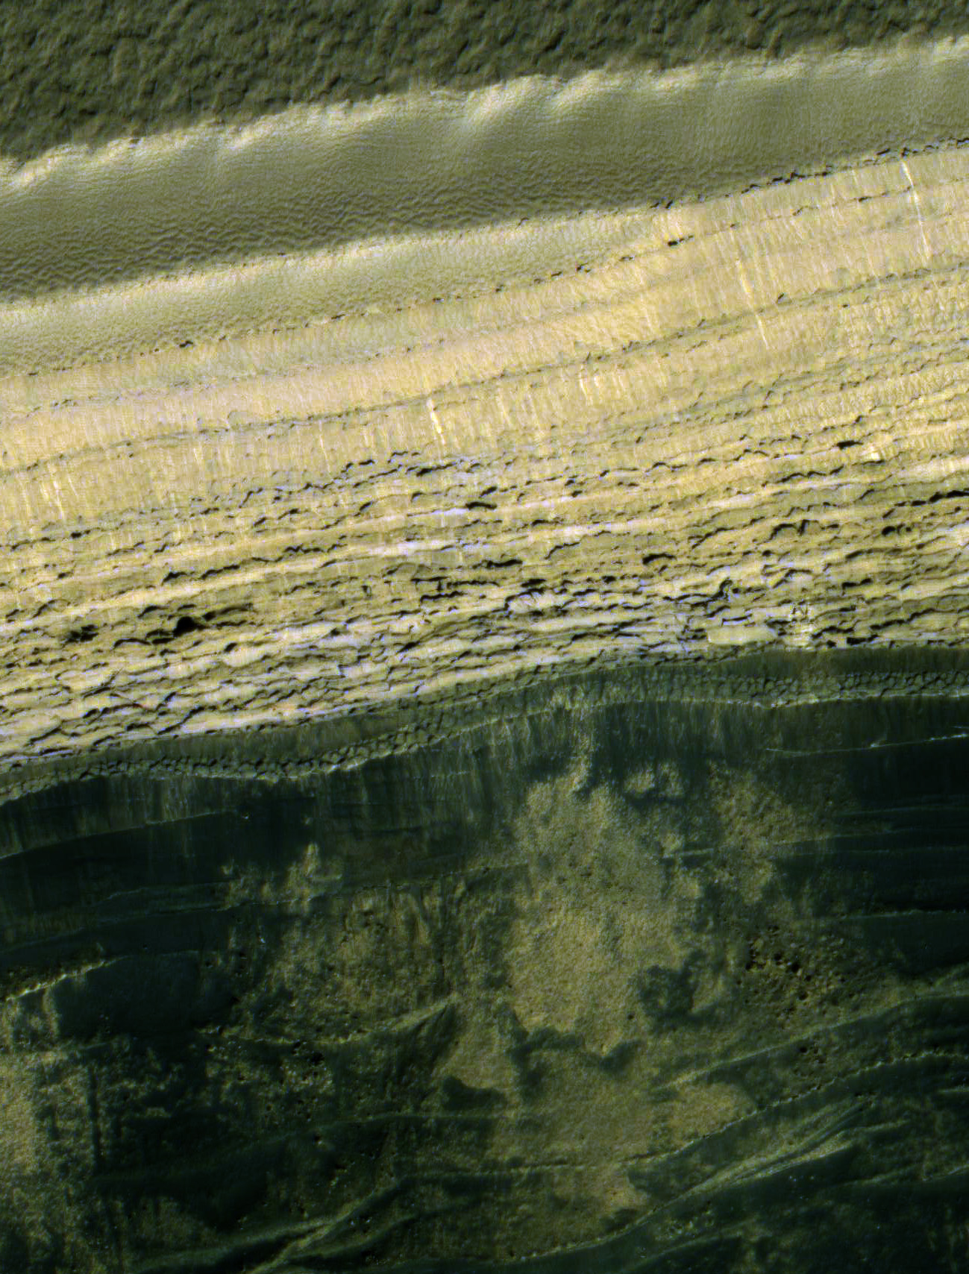
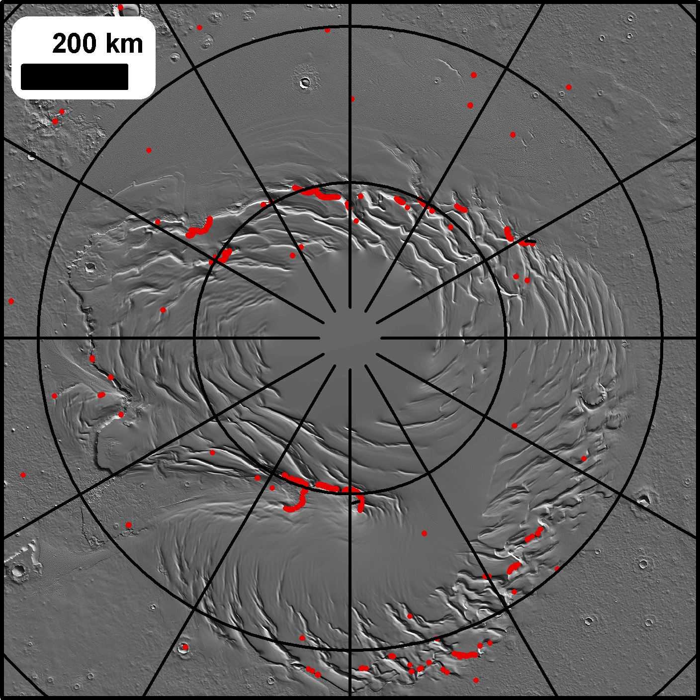
Steep cliffs at the PLD boundaries
Locations of slopes above 35°

Slide 4
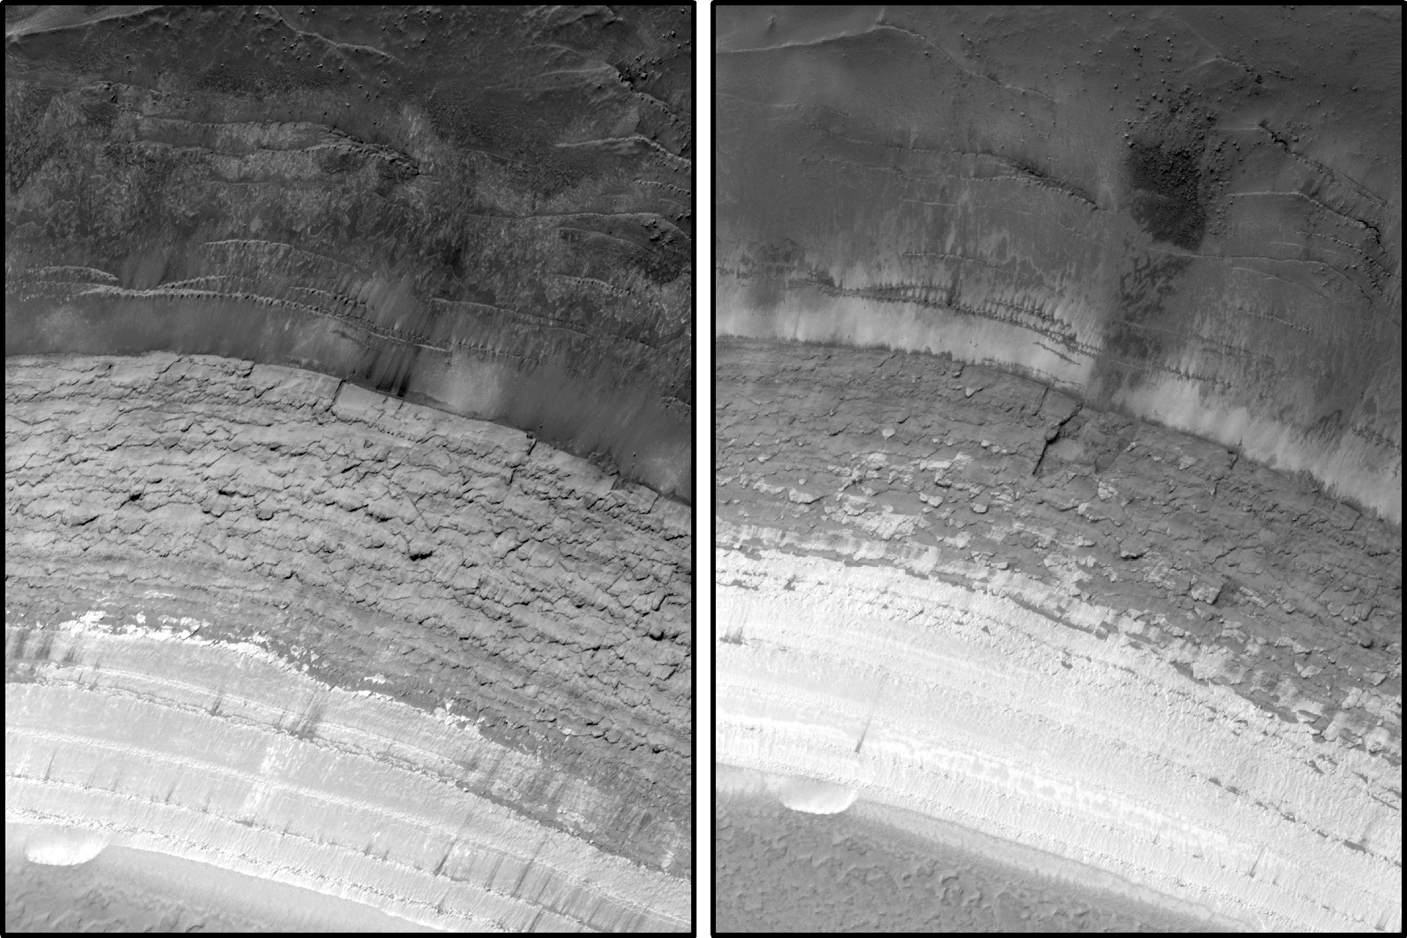
Rolling MRO provides the best way to look for changes
ESP_016292_2640
ESP_024639_2640

Slide 5
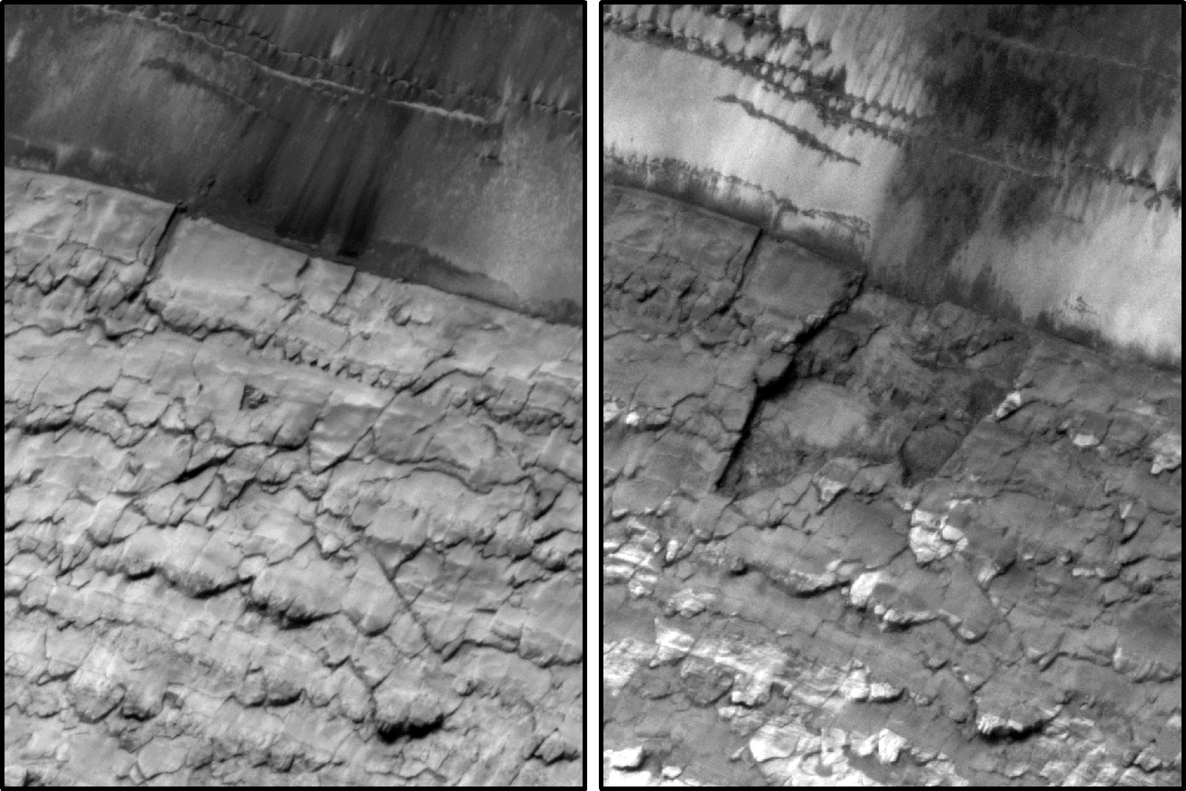
Failure of a 70m wide section in late-summer or winter of MY 30…
ESP_016292_2640
ESP_024639_2640

Slide 6
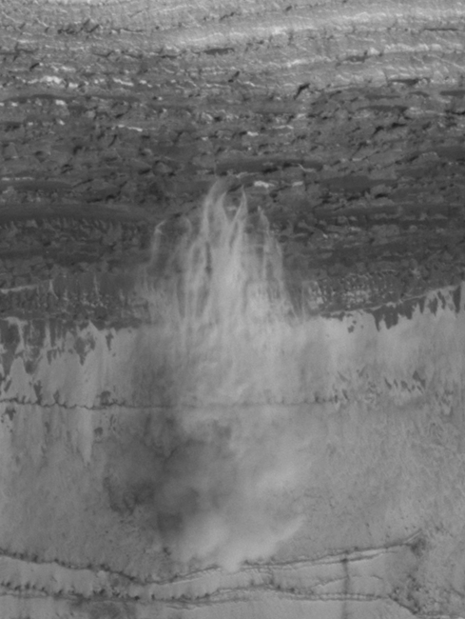
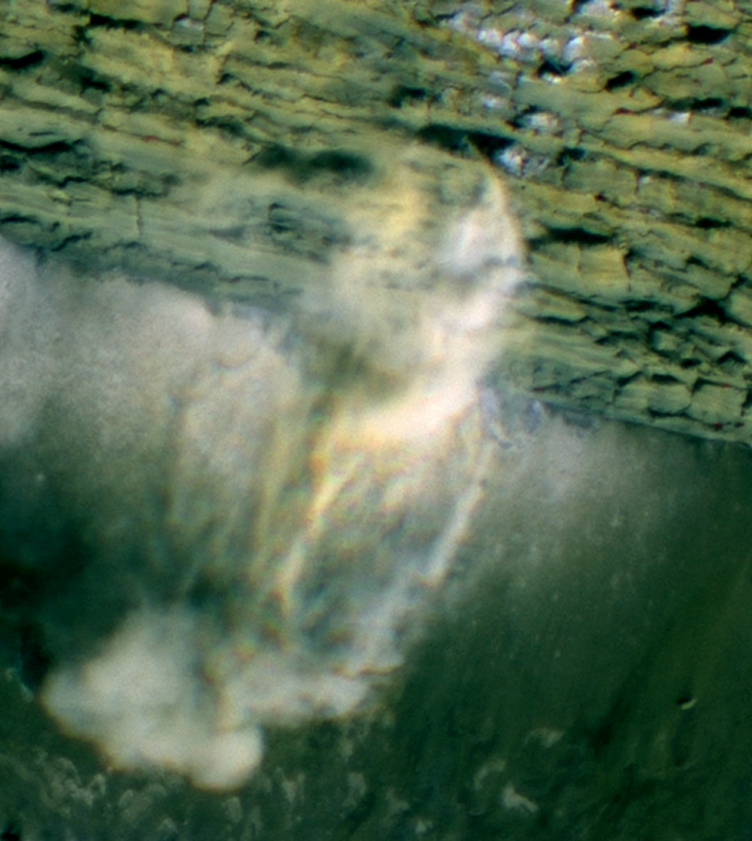
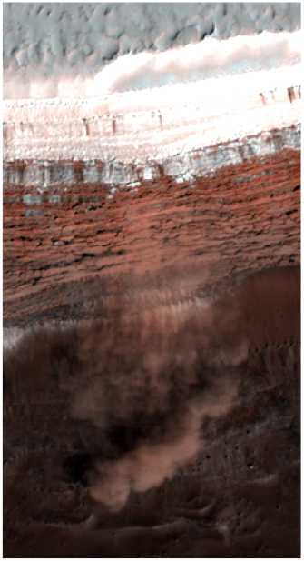
Russell et al., 2008

Slide 7
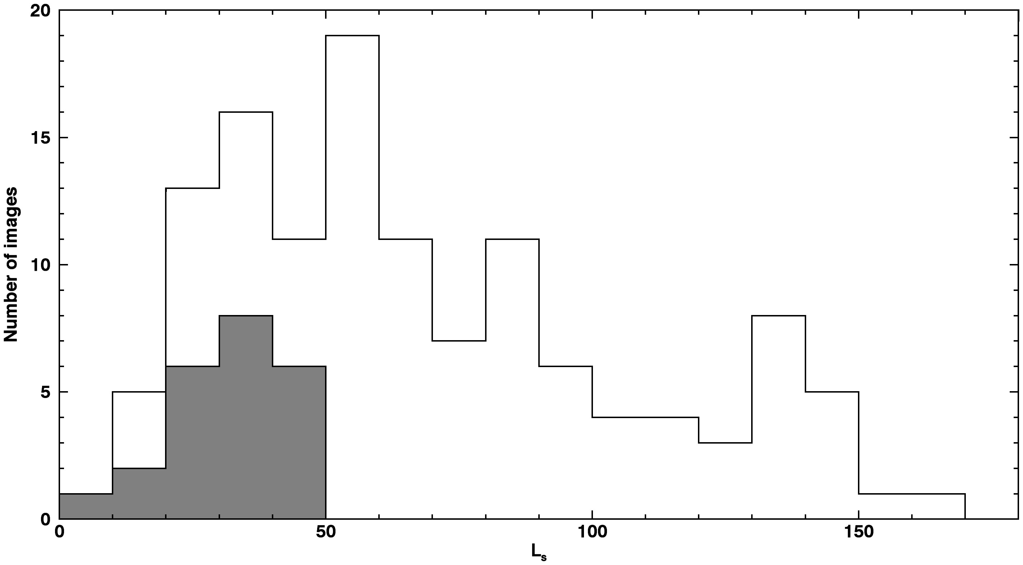
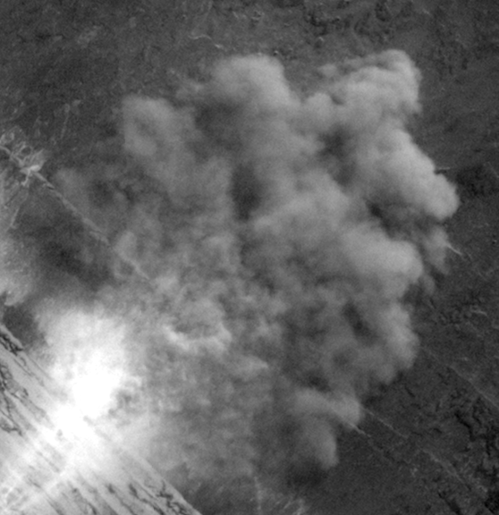
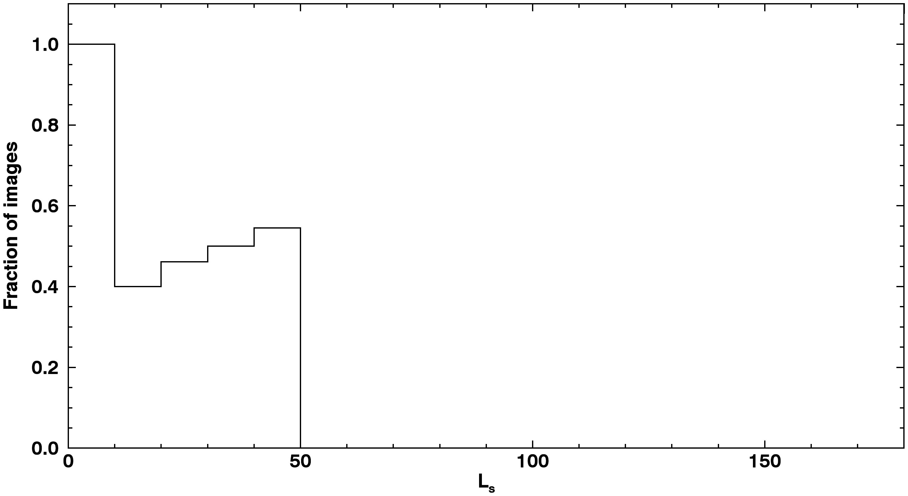
10s of avalanches imaged in progress
Speeds measured to be several m/s
Avalanche Images
Total Scarp Images

Slide 8
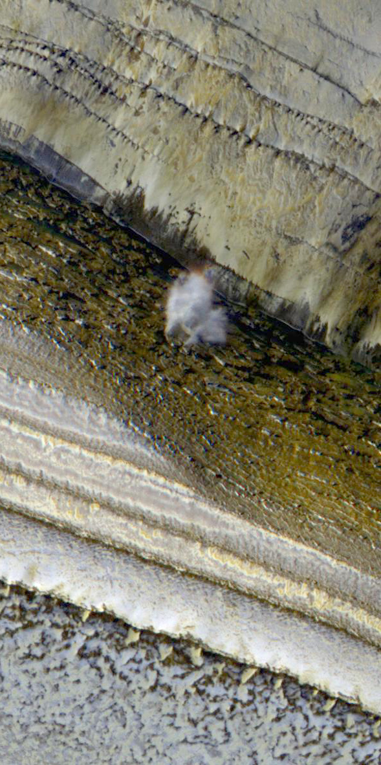
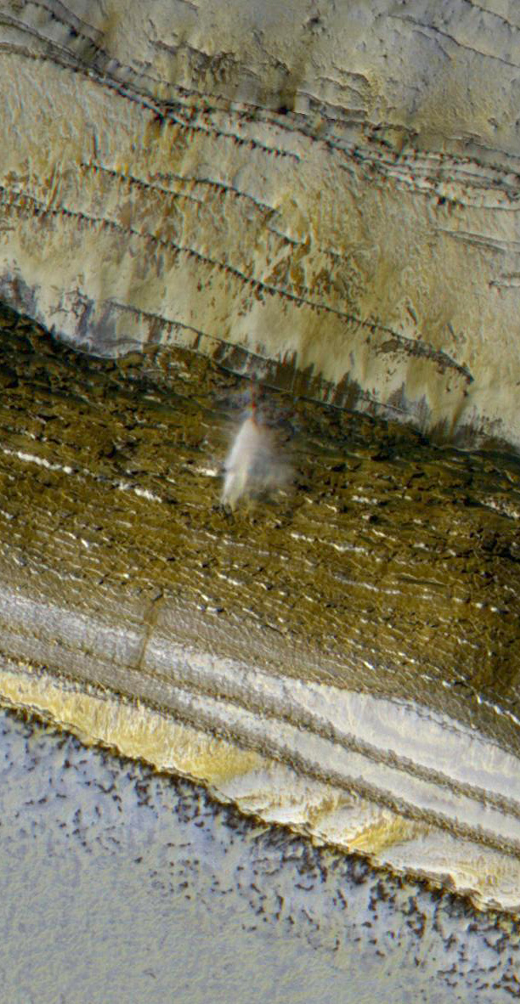
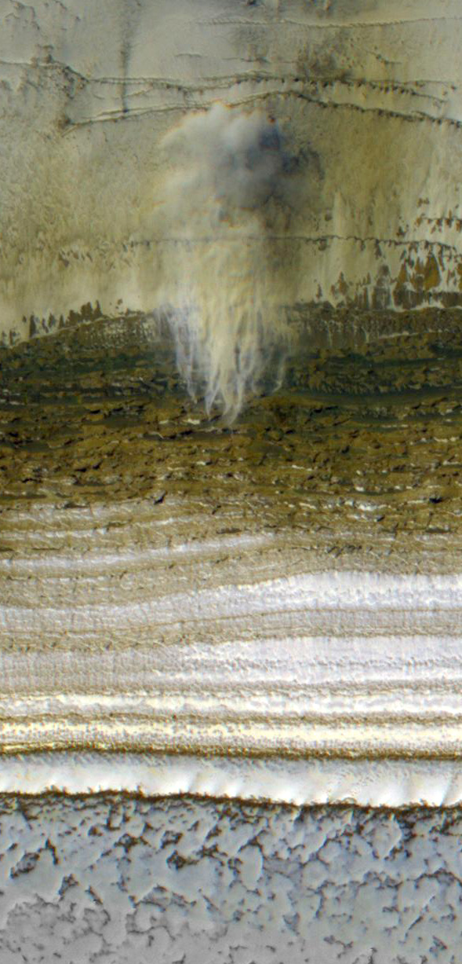
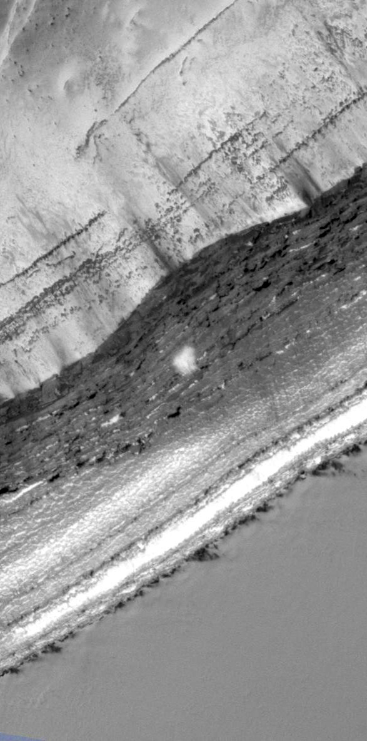
Aspect: W WSW SW S
South
Four simultaneous avalanches with a range of Slope azimuths
ESP_024282_2640, L_{s} 9 MY 30

Slide 9
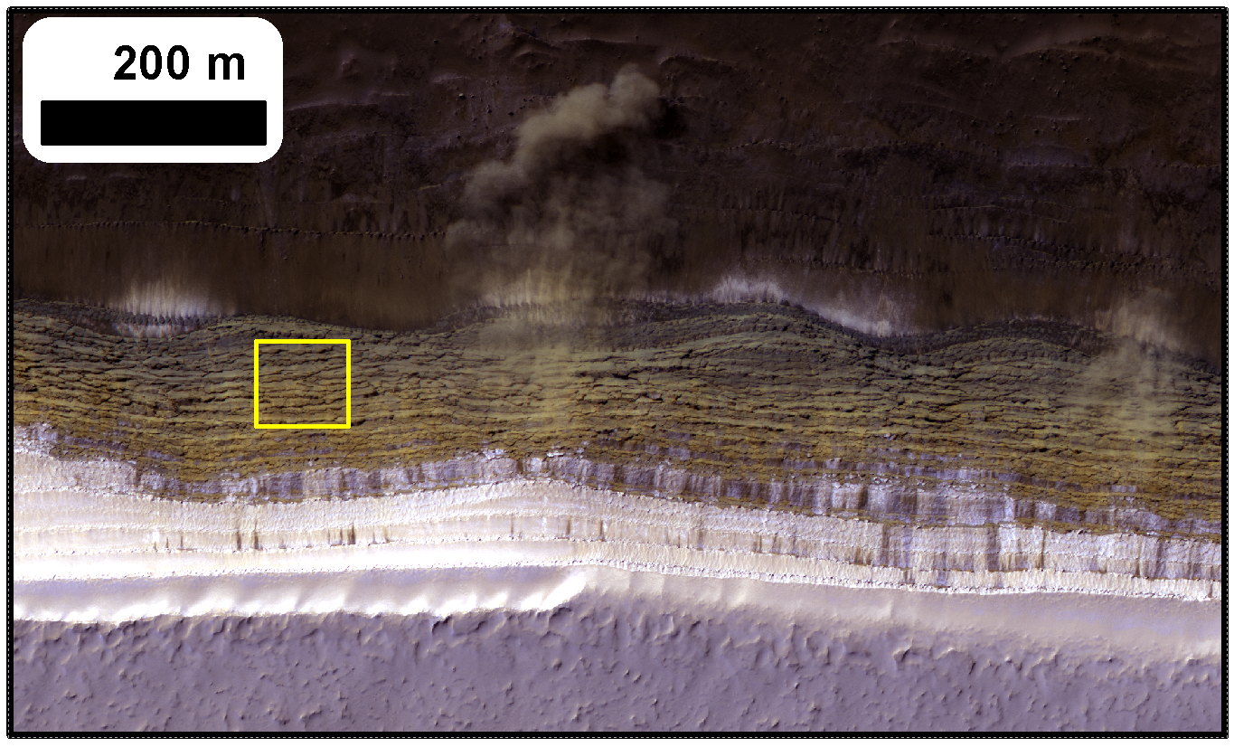
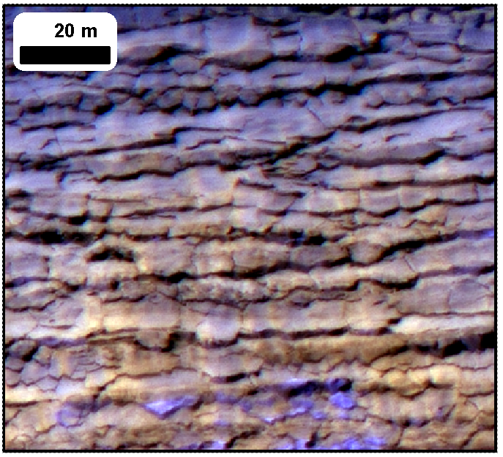
Can we explain:
Pervasive cracking ?
Avalanche timing ?
Slab-like texture on scarps ?
Frequent blockfalls ?

Slide 10
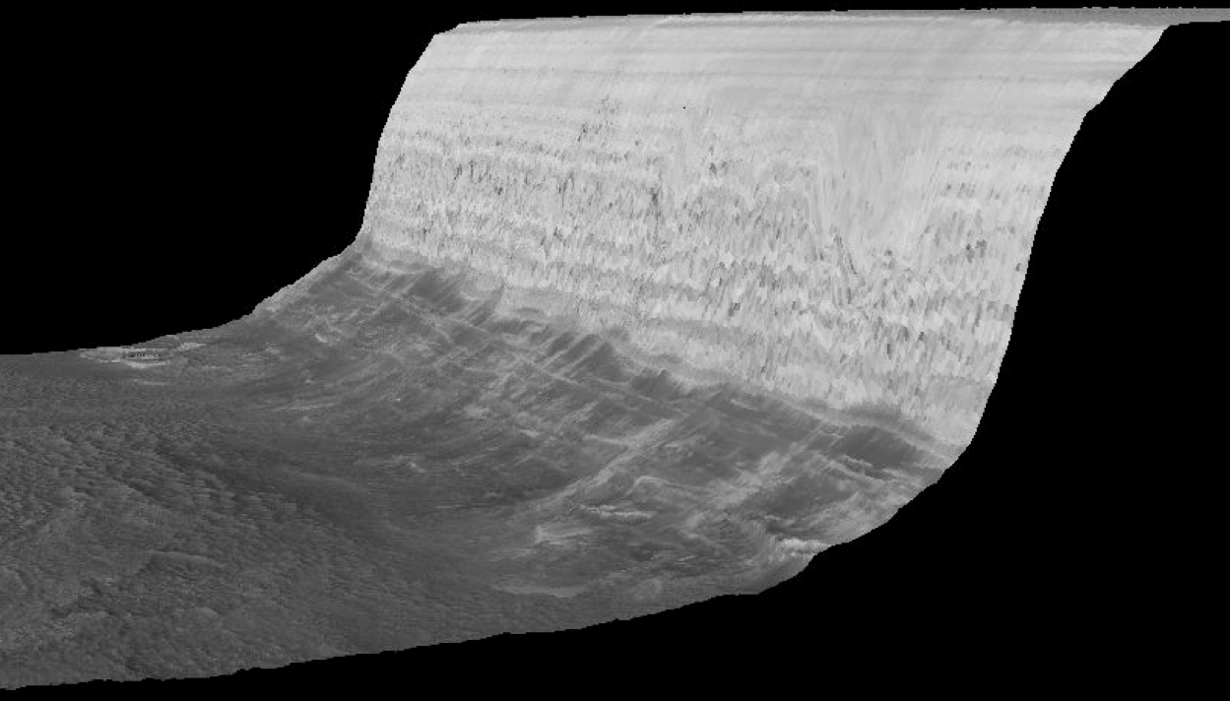
Atm.
emission
Thermal emission
Solar radiation
Emitted & reflected radiation exchanged with surrounding flat terrain
Conduction
We use a standard 1D semi-implicit thermal model to simulate temperatures

Slide 11
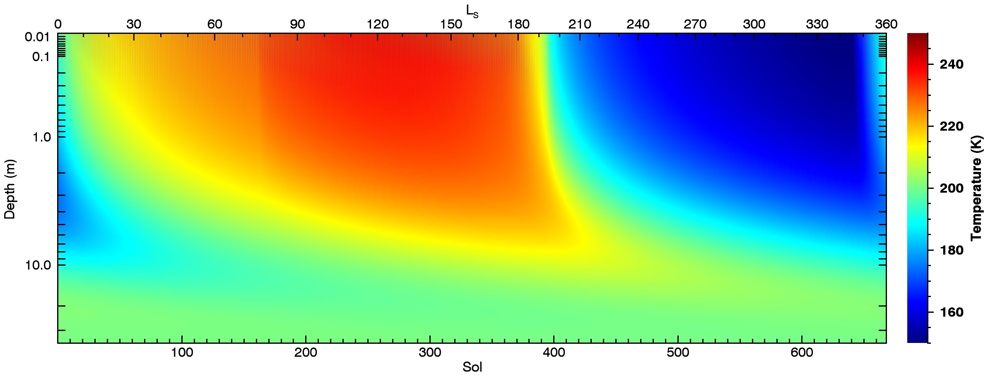
Surface and Sub-surface temperatures on a 70° SW-facing slope

Slide 12
We treat this as a homogeneous viscoelastic solid and solve for stresses induced by thermal expansion and contraction using the approach of Mellon (JGR, 1997)
Thermal expansion and contraction creates a short-term elastic and a longer term viscous response
At the Surface:
Horizontal strains are zero
Horizontal stresses are created
Vertical strains are non-zero
Vertical stresses at surface are zero
A
B
A
B
-σ
A
B
+σ
Cold ice
(contracted)
Average state
Warm ice
(expanded)
Total horizontal strain is zero and so:
Ice-grain-size dependent

Slide 13
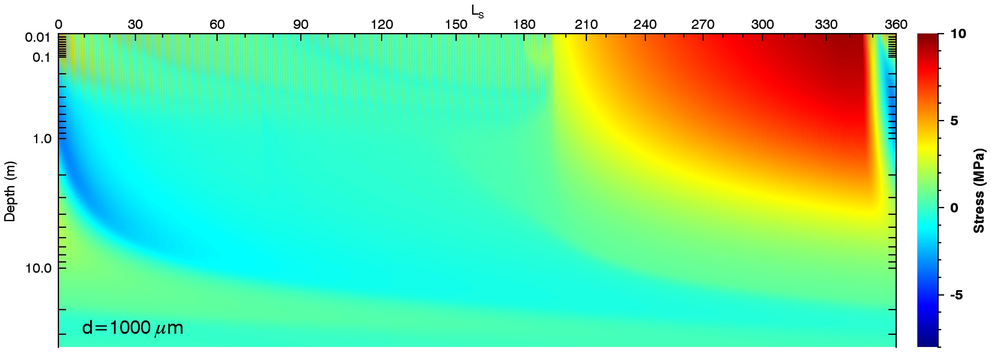
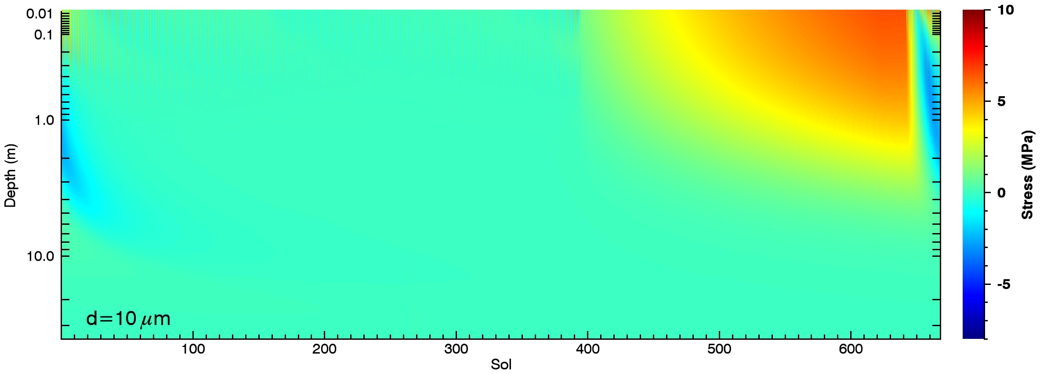
1mm
+ is
tension
- is compre-ssion
0.1 mm
0.01 mm

Slide 14
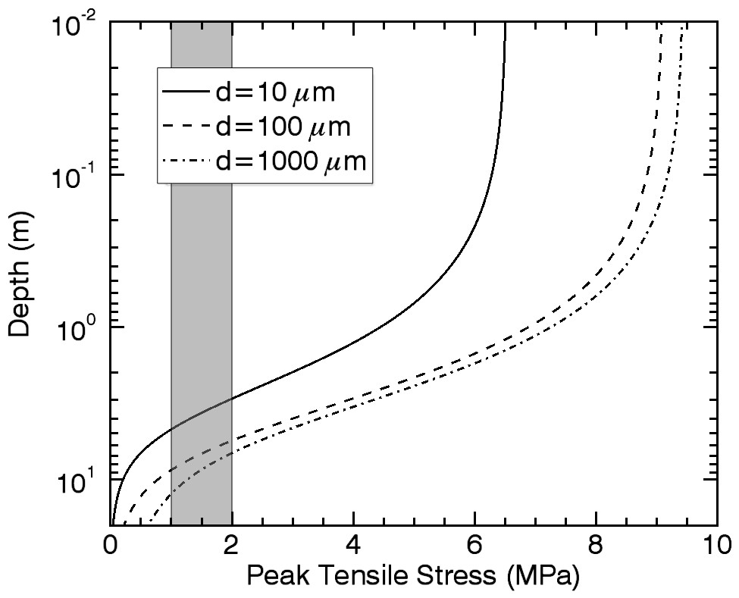
How deep can cracks propagate?
Amplitude of stress variation decreases with depth.
Exceeds water ice strength down to several meters, but some model assumptions start to break down…
Shallow cracks can open and close – adds shear stresses to deeper ice. Promotes crack deepening.
Stresses are concentrated at crack tips. Promotes crack deepening.
Overburden pressure is neglected. Suppresses crack deepening.

Slide 15
Avalanche season coincides with existence of subsurface compressional stress
Avalanche Images
Total Scarp Images

Slide 16
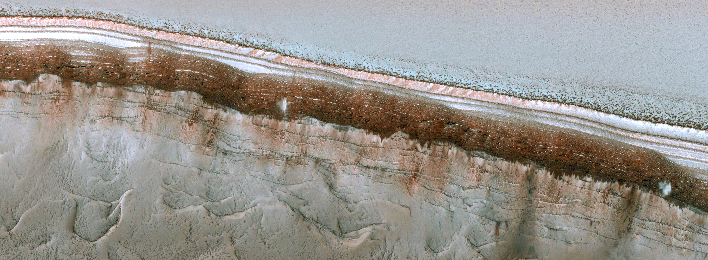
ESP_024282_2640 – Ls 9 – 12:44 PM
Cracks Opening
Cracks Closing
Cracks Open
Cracks Closed
70° SW-facing
@ L_{s} 9
Avalanches

Slide 17
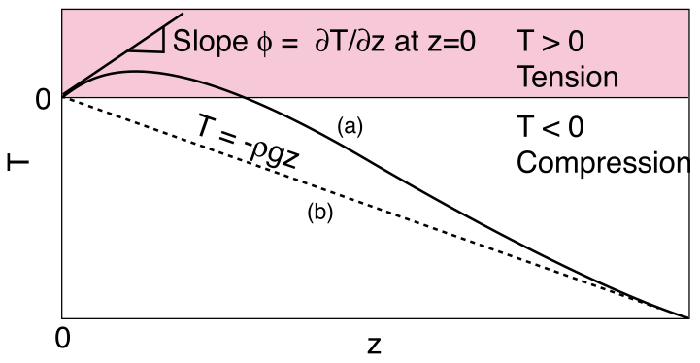
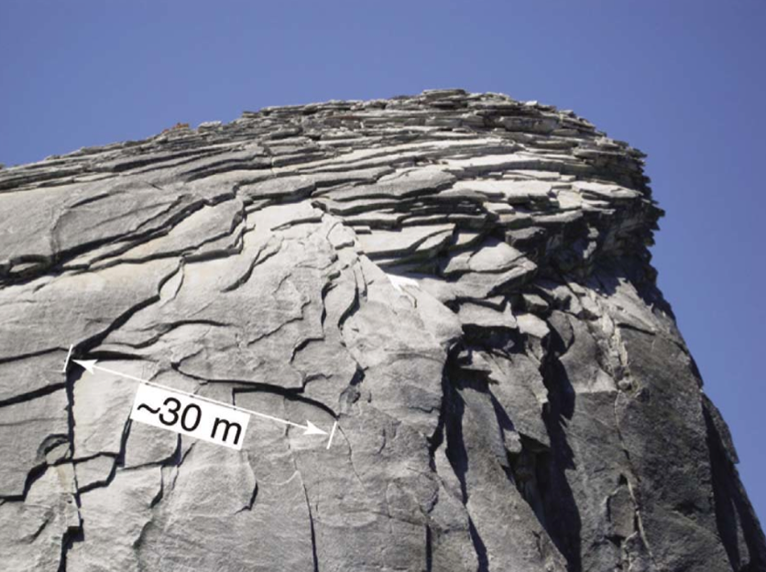
Why does compression work?
Martel (GRL, 2011) explains sheeting joints and exfoliation of slabs with compressive stress and surface curvature
Surface-normal tensional stress generated in the near-sub-surface – slabs exfoliated
Good agreement for terrestrial granitic domes

Slide 18
Wintertime tensile stresses
Exceed ice-strength in this highly-unusual geometry up to meters in depth
Springtime compressional stresses
Causes surface parallel sheeting joints
Can explain blockfalls and scarp appearance
Can explain seasonality of avalanches
A runaway effect that steepens the cliff in spite of fast and continuous viscous relaxation (see Sori et al. – this session).
Large thermal stresses are possible because the steep scarps lack an insulating dust layer
Thermal stresses trigger blockfalls and avalanches
Scarp ablation generates dust, but avalanches scour off the dust each Spring.

Slide 19
Random Extras

Slide 20
Why does compression work?
Martel (GRL, 2011) explains sheeting joints and exfoliation of slabs with compressive stress and surface curvature
Surface-normal tensional stress generated in the near-sub-surface – slabs exfoliated
Good agreement for terrestrial granitic domes

Slide 21
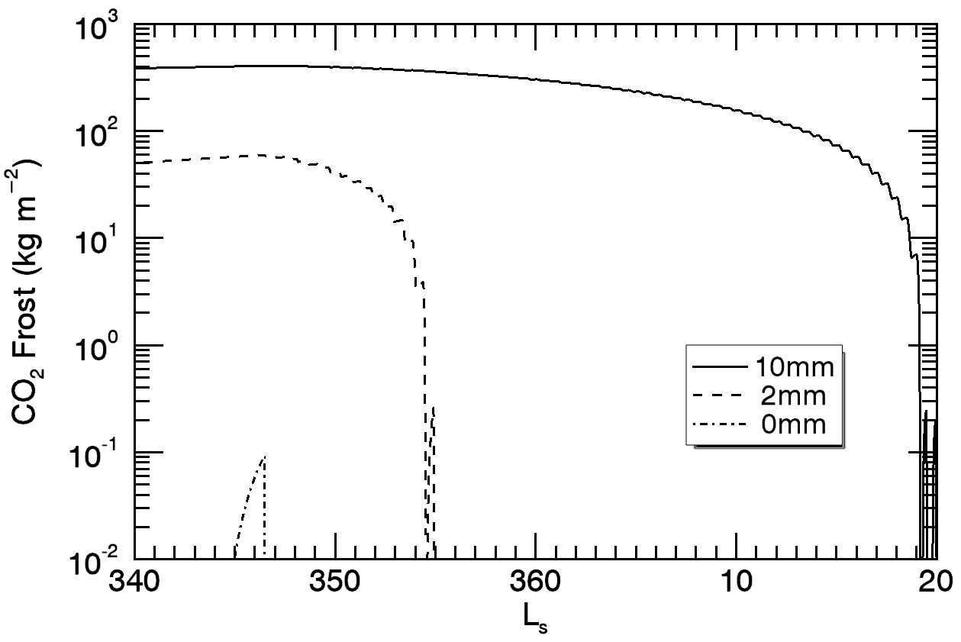
Effects of dust cover
ESP_032616_2640 – L_{s} 350
~70° slopes are already defrosted
~45° slopes still frosted
Defrosting date of slopes very sensitive to thickness of dust cover
5mm is about right for 45° slopes
70° slope behavior consistent with no dust cover

Slide 22
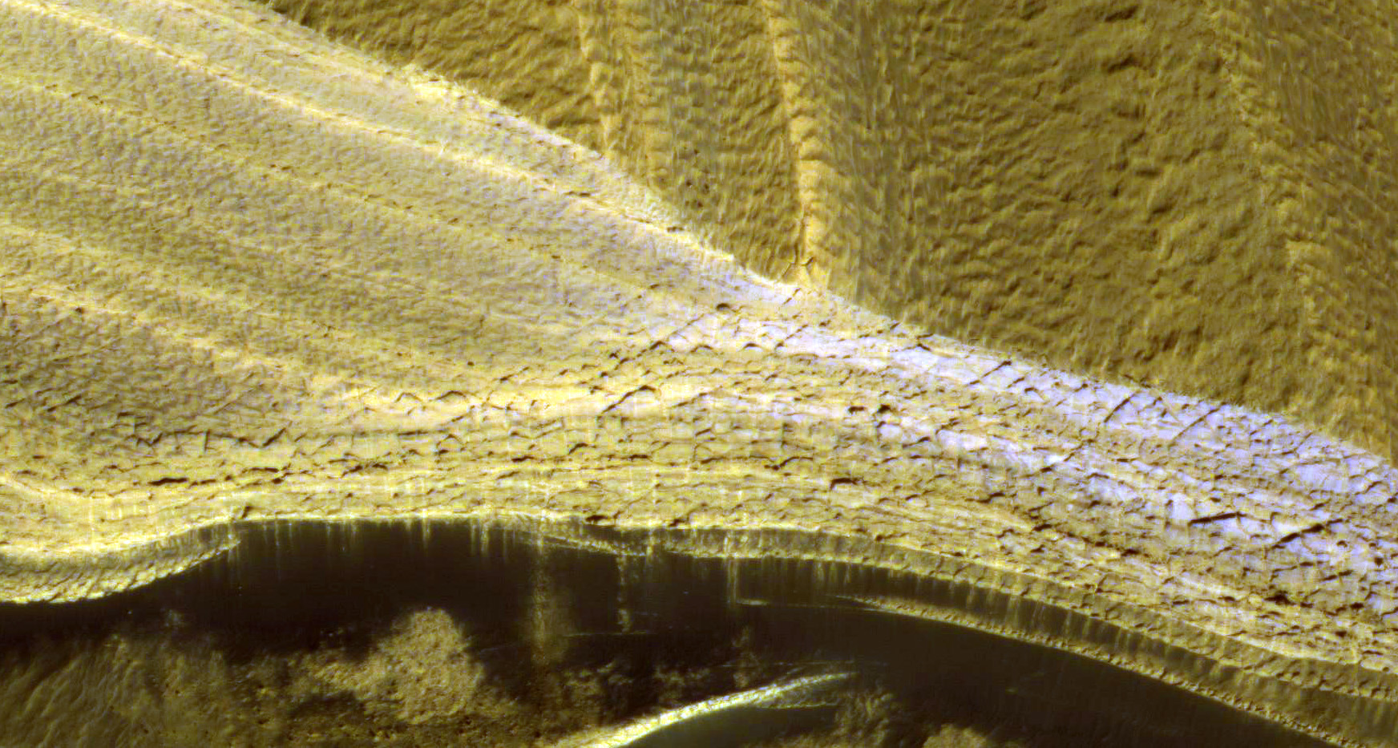
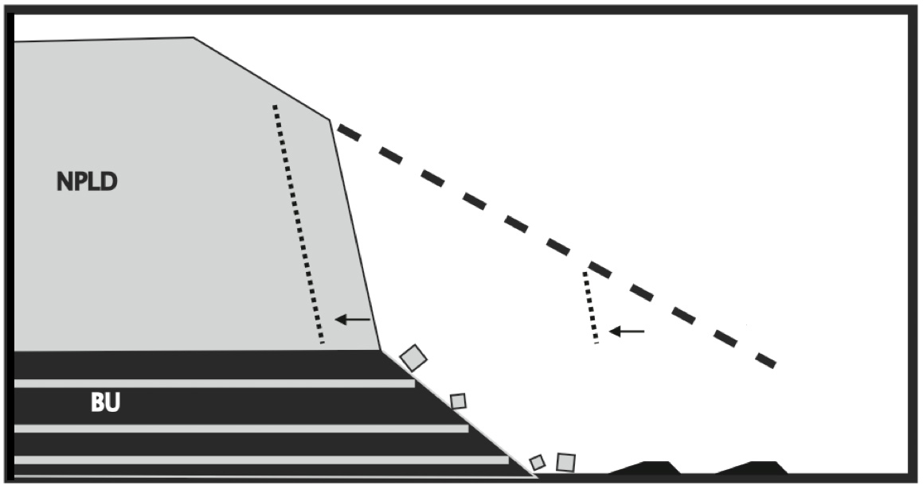
Layers transition from fractured to unfractured with slope
Steep slope may be due to undermining by erosion of the exposed sandy basal unit
Russell et al. 2011

Slide 23
Ice strength (1-2 MPa) exceeded at surface during most of the winter
Tension
Compression
Tension
Compression
Tension
Compression

Slide 24
Expressions for E and α also revised (see me afterwards if interested)
where
In the end we have a differential equation:

Slide 25
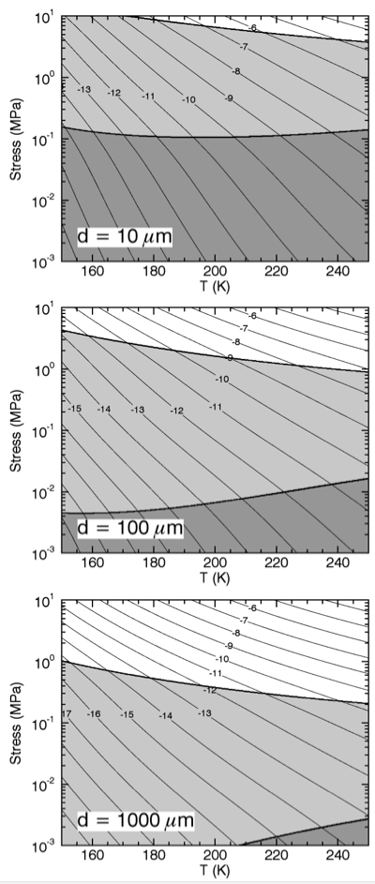
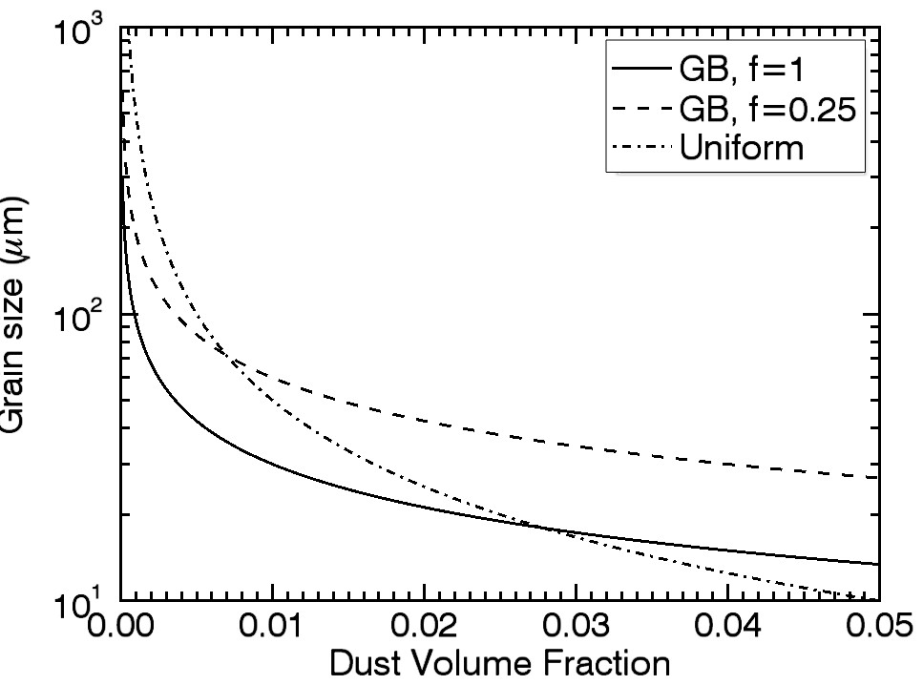
Rheology is now grain size dependent
Dislocation creep dominates at high T and σ
Diffusion dominates at low σ
Grain-size sensitive creep effects dominates for small grains
SHARAD results and Zenner pinning allows estimates of NPLD ice grain size

Slide 26
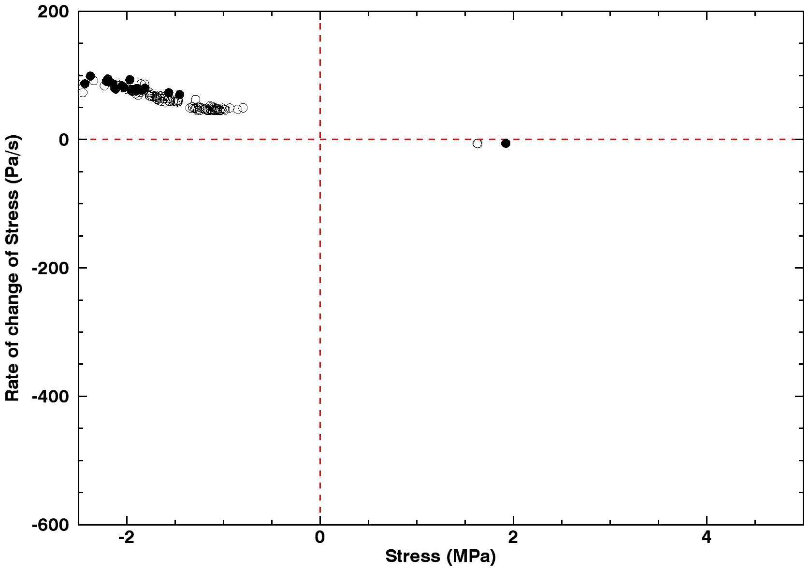
Observational selection effect means we see the scarp in the same stress state all the time on South and south-west facing scarps
Avalanche
No Avalanche
Cracks opening or pressure decreasing
Cracks closing or pressure increasing
Closed Cracks
Open Cracks
70° SW-facing
D=100μm

Slide 27
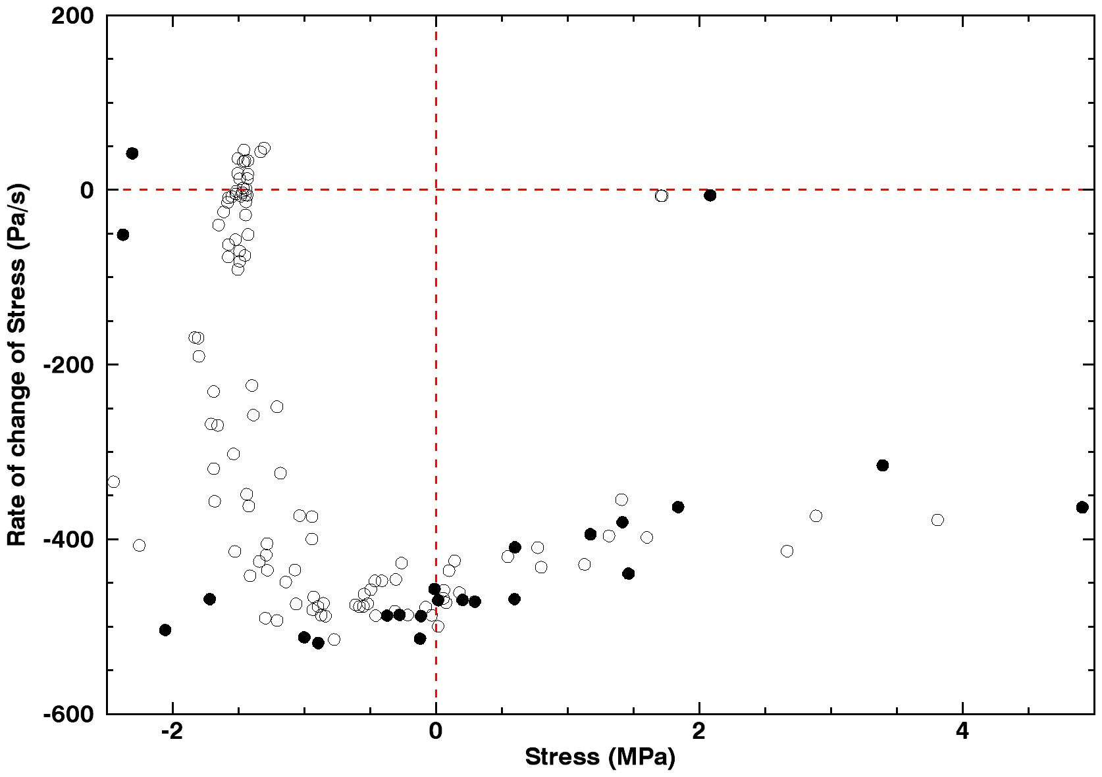
We observe west facing scarps right at local sunrise so small local time variations lead to be stress-state variations
Avalanche
No Avalanche
Cracks opening or pressure decreasing
Cracks closing or pressure increasing
Closed Cracks
Open Cracks
70° W-facing
D=100μm

Slide 28
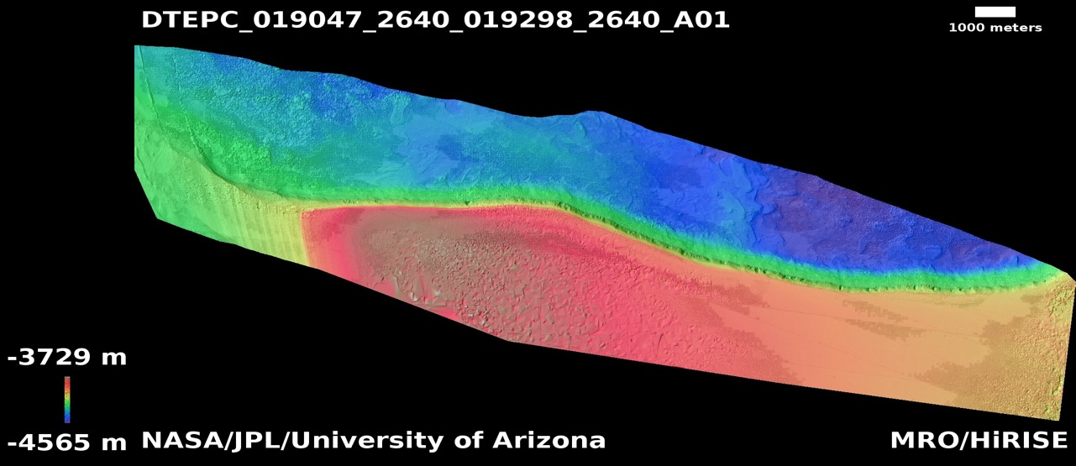
No Vertical Exaggeration (!)

