Slide 1
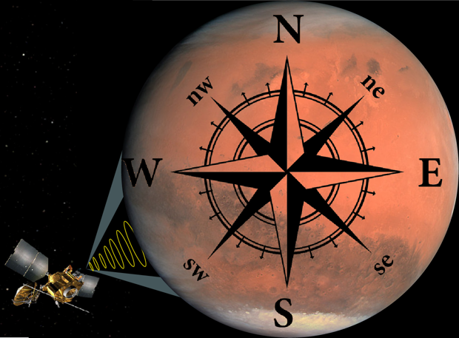
COMPASS: Climate Orbiter For Mars Polar Atmospheric And Subsurface Science
Discovery-class Science
PI: Shane Byrne, LPL, University of Arizona
Co-I: Isaac B. Smith, Planetary Science Institute
Co-I: Paul O. Hayne, LASP
Derived from a Keck Institute for Space Studies workshop

Slide 2
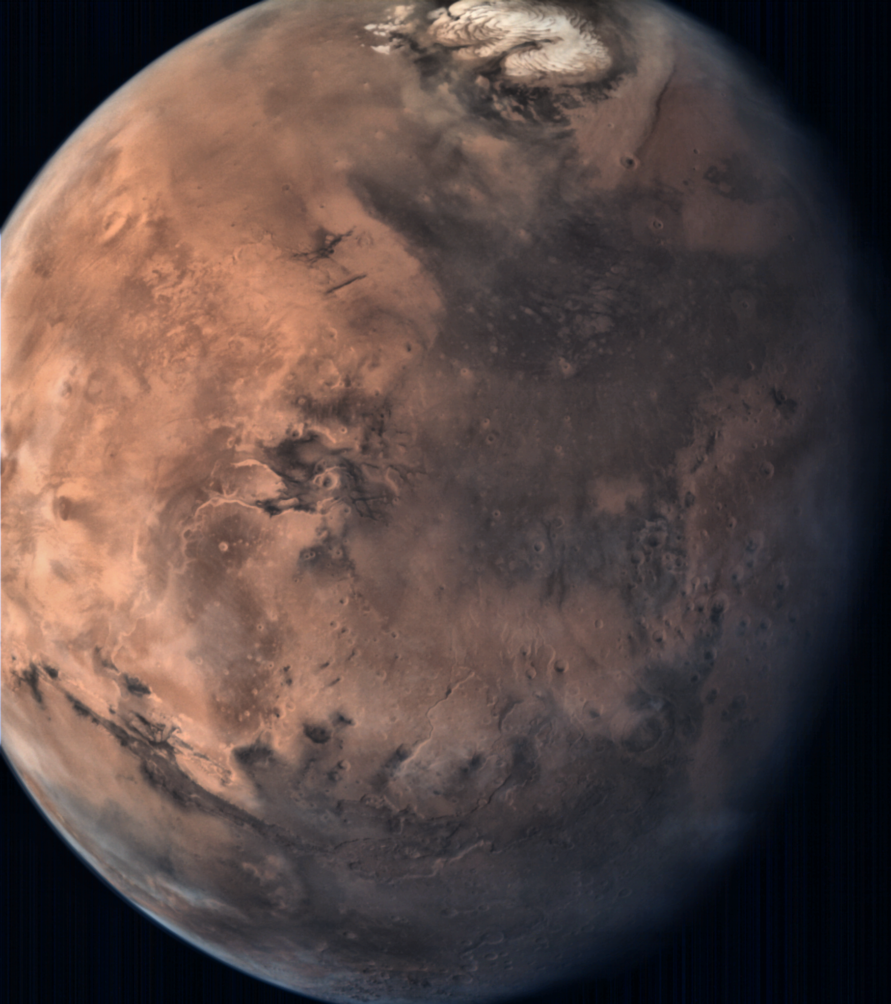
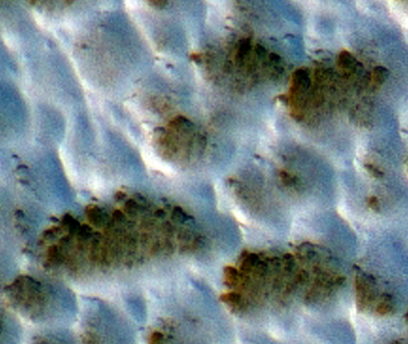
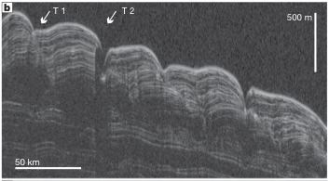
Terrestrial-Planet Climate Change is a Pressing Scientific Issue

Slide 3
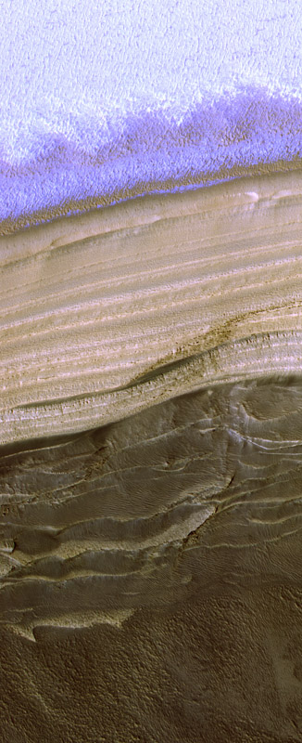
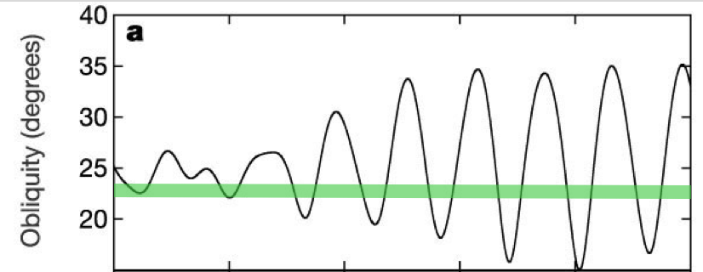
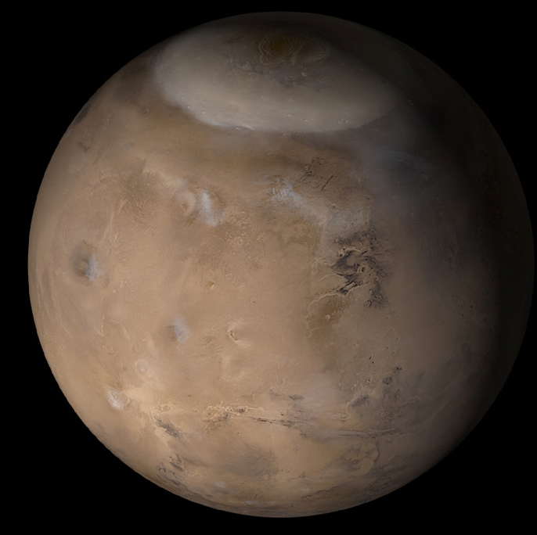
We have a (much simpler) terrestrial planet on our doorstep continuously undergoing climate change
Mars has a climate record millions of years long in its polar regions
A stack of layers built from atmospheric water vapor and dust
Reading this record is possible if we understand how climate and layers are connected

Slide 4
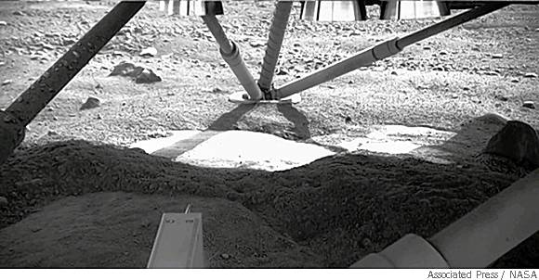
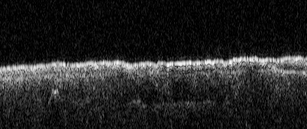
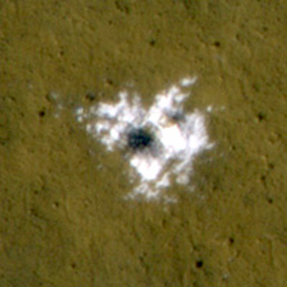
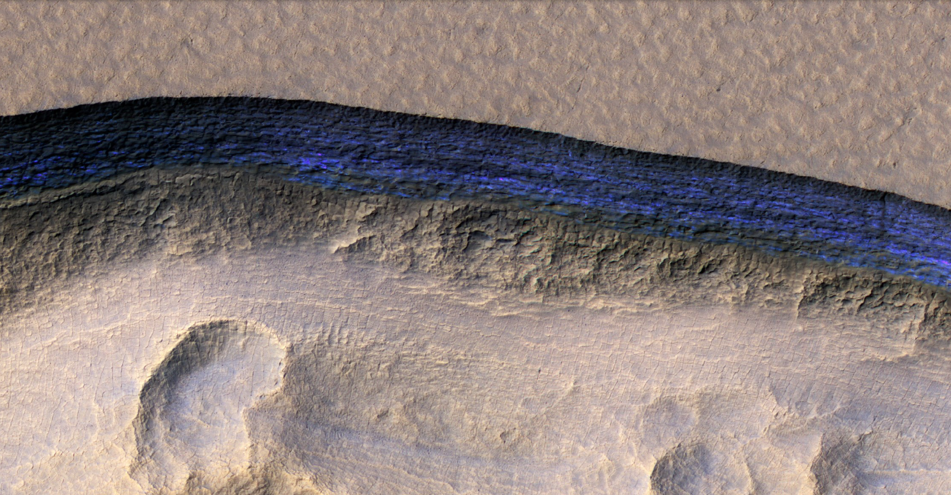
The Phoenix lander, SHARAD, and HiRISE discovered pure buried water ice

Slide 5
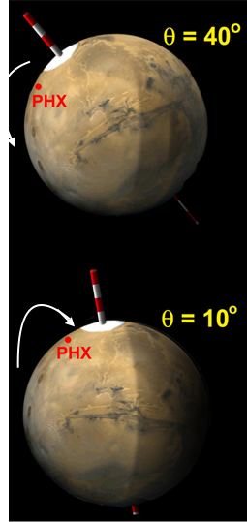
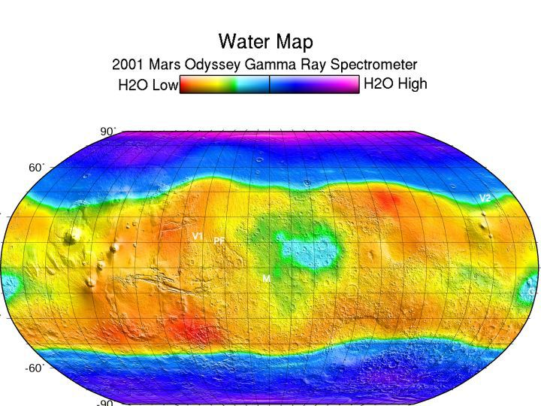
Martian Mid-Latitude Ice
Buried mid-latitude ice reservoirs may be 10s of millions of years old
Information on depths and locations is limited to low resolution (600km) neutron data and models
A vital source of climatic knowledge and future human resources
High Obliquity
Ice transfers to lower latitudes
Low Obliquity
Ice transfers to poles

Slide 6
The goal of the COMPASS mission
Link the current climate of Mars to its long-term climate record
A 2017 Keck Institute for Space Studies study on Mars polar exploration brought together >30 experts to determine required measurements and mission concepts to accomplish these goals.
The COMPASS mission concept is a direct product of that meeting and represents the best way to address the atmospheric component of questions related to Mars’ climate.

Slide 7
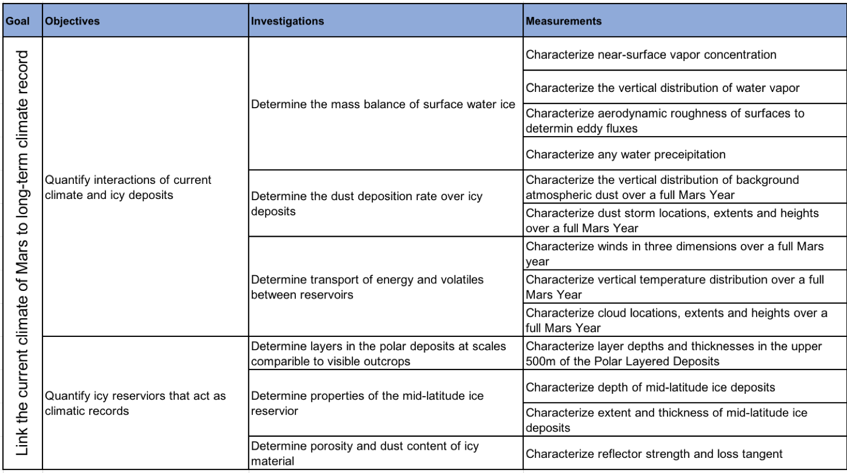

Slide 8
COMPASS is highly relevant to Mars science as determined by several groups
GOAL II: Understand the processes and history of climate on Mars.
A. Characterize the state of the present climate of Mars' atmosphere and surrounding plasma environment, and the underlying processes, under the current orbital configuration.
A1. Constrain the processes that control the present distributions of dust, water, and carbon dioxide in the lower atmosphere, at daily, seasonal and multi-annual timescales.
A4. Constrain the processes by which volatiles and dust exchange between surface and atmospheric reservoirs.
B. Characterize the history of Mars’ climate in the recent past, and the underlying processes, under different orbital configurations.
B2. Determine the record of the recent past that is expressed in geological and mineralogical features of the polar regions.
B3. Determine the record of the climate of the recent past that is expressed in geological and mineralogical features of low- and mid- latitudes.
GOAL III: Understand the origin and evolution of Mars as a geological system.
A. Document the geologic record preserved in the crust and interpret the processes that have created that record.
A3. Constrain the magnitude, nature, timing, and origin of past planetwide climate change.
MEPAG
In addition, MEPAG has agreed to update the goals with a focus on Mars Climate Science, to be completed in June 2018, in time for Discovery Proposals

Slide 9
COMPASS is highly relevant to Mars science as determined by several groups
In a summary of the 6th International Conference on Mars Polar Science and Exploration, a group of attendees listed the high priority science goals for the Mars polar community (Smith et al. 2018).
Determine the energy and mass balance of the polar ice reservoirs, and characterize volatile fluxes
Inventory and characterize the non-polar ices/volatile reservoirs at the surface and near-surface
Quantify the interplay of local, regional, and global circulations in the polar regions, including polar vortex, katabatic winds, transient eddies, among others
Characterize the transport of volatiles and dust aerosols into and out of the polar regions
International Mars Polar Conferences
The Next Mars Orbiter (NeMO) Science Analysis Group
"Observation of wind velocity is the single most valuable new measurement that can be made to advance knowledge of atmospheric dynamic processes. Near-simultaneous observations of atmospheric wind velocities, temperatures, aerosols, and water vapor with global coverage are required to properly understand the complex interactions that define the current climate."

Slide 10
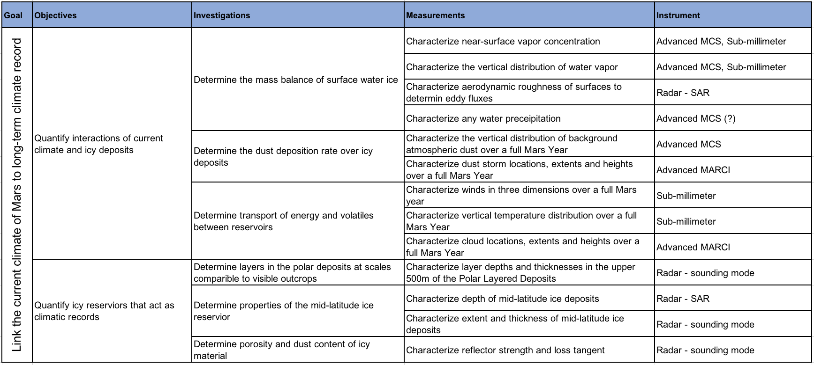
COMPASS measurements can be accomplished by 4 instruments

Slide 11
COMPASS measurements can be accomplished by 4 instruments
Instrument | Possible Source | Mass | Power | Volume | TRL
Dual Mode Radar | CSA/MDA | 77 kg | 174 W | 20x30x40 cm | Terrestrial space systems (TRL 9) and planetary design studies
Sub-mm Sounder | JPL | 25 kg | 50-80 W | 23cm antenna
Thermal Sounder | JPL (MCS rebuild) | 8.9 kg | 18 W |  | 9
Wide-angle Global Imager | MSSS (MARCI rebuild) | 0.14 kg | <5 W | 10x10x14 cm | 9
All high TRL
All with potential partners identified
All scalable to a Discovery Budget

Slide 12
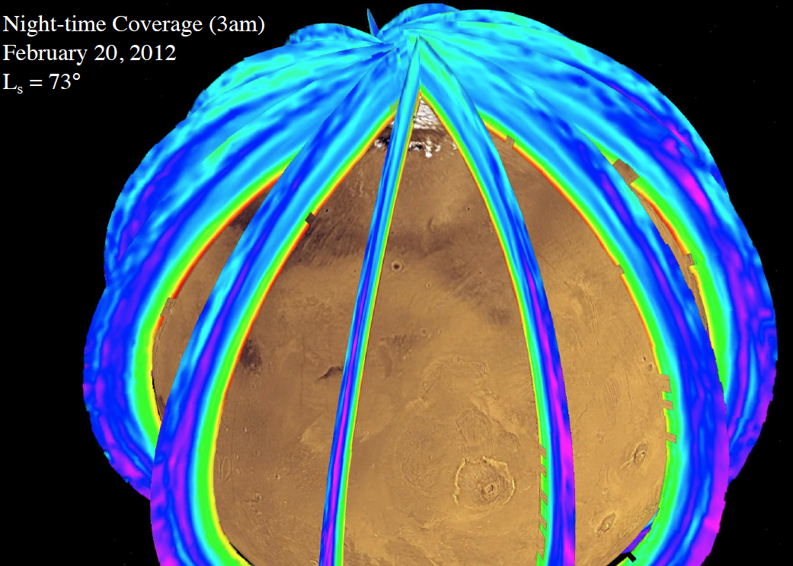
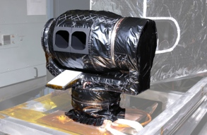
1. Advanced Thermal IR profiler
Limb scanning in the thermal IR (10-45 $μm$) reveals vertical distribution of temperature, water vapor, dust, CO₂ clouds/snowfall
Continues an invaluable record of Mars climate observations (~164 million soundings) with improvements
Operates day and night at all seasons without special spacecraft maneuvers (articulated IR telescopes)
High-heritage from the Mars Climate Sounder (MCS is TRL 9).
Add filter to characterize water vapor
Instrument resources (based on MRO’s MCS)
Mass 8.9kg
Power 18W
Possible Provider: JPL (MCS)

Slide 13
2. Advanced Wide-Angle Imager
Pushbroom nadir-pointed wide-angle VIS/near-IR imager that covers the whole globe each day.
Continues an invaluable record of Mars climate observations (>3600 daily global maps) with improvements
Operates on the dayside at all seasons without special spacecraft maneuvers
High-heritage from the Mars Color Imager (MARCI is TRL 9).
Forward and backward looking pair could retrieve cloud heights, constrain cloud particle sizes and provide redundancy
Higher resolution (currently 1km/pix)
Instrument resources (based on MRO’s MARCI)
Mass 0.15 kg
Power < 5W
Possible Providers: MSSS (MARCI)

Slide 14
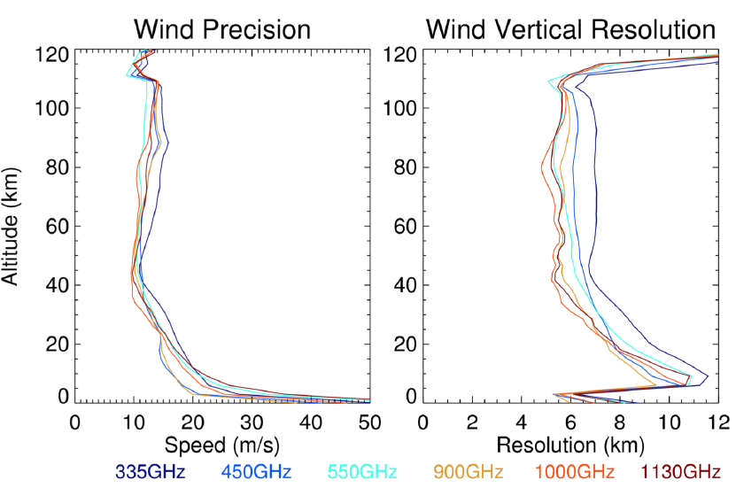
3. Sub-mm Limb Profiler
Limb scanning in the sub-mm (300-1100 GHz) reveals vertical distribution of wind-speed, temperature, water vapor, and minor species like HDO H₂O₂ CO etc…
Windspeeds have never been globally measured before and are “… the single most valuable new measurement that can be made to advance knowledge of atmospheric dynamic processes” – NeMO SDT
Operates day and night at all seasons without special spacecraft maneuvers (articulated 23 cm antenna)
High-heritage from terrestrial systems – planetary concept from Tamppari et al. based on terrestrial systems in flight
Improvements include 2 perpendicular systems to better characterize windspeeds
Instrument resources (Tamppari et al. 2018)
Mass 25kg
Power 50-80 W (band dependent)
Possible Provider: JPL
Results from Tamppari et al. (MEPAG 2018)

Slide 15
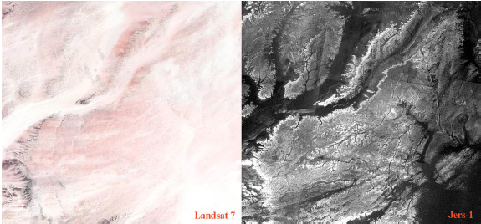
4. Dual-Mode RADAR
P-BAND SAR/Sounder dual-mode RADAR reveals:
Fine-scale climatically-driven layering within the polar ice deposits
Depth to mid-latitude ice and its thickness
Geology beneath dusty regions of Mars
A SAR has never flown to Mars and would yield an exciting new dataset of broad significance. Our proposed sounder would be an order of magnitude improvement upon SHARAD.
Operates day and night at all seasons, with special spacecraft maneuvers required (shared antenna)
High-heritage from terrestrial systems
Instrument resources (Campbell et al. 2004)
Mass 77 kg
Power 174 W
Possible Provider: CSA/MDA (e.g. Radarsat constellation Mission – but smaller and at longer wavelength)
Pailou et al. 2006 (visible vs L-band SAR)
Smith et al. 2016 (SHARAD layering at 15m wavelength)

Slide 16
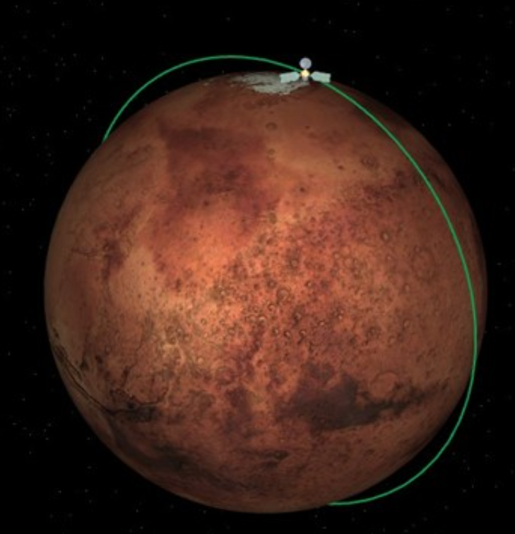
Orbital Implementation
Mapping instruments (Wide-angle imagers & thermal and sub-mm sounders) require a low-altitude circular orbit (~300km)
Polar coverage requires a near-polar orbital inclination (87-93 degrees)
Extension of existing datasets (wide-angle imaging and thermal sounding) require a sun-synchronous orbit, which drives an inclination choice of 93 degrees
And an ascending node fixed at ~3pm local time
Other benefits of sun synchronous orbit include stable observation and thermal conditions e.g. eclipse-durations are constant throughout the mission etc…

Slide 17
COMPASS Summary
Science Advantages
Community consensus on the importance to these science goals - Recognized by MEPAG and the NeMO SDT
A Keck study with >30 experts in the field developed COMPASS to address those goals
Orbital SAR and windspeed measurements have never been performed at Mars and are widely accepted to have great cross-disciplinary value
Discovery Advantages
Maximizes the expertise of GSFC and collaborators in the field
Payload elements have high TRL or are based on high-heritage instruments
NASA needs a new orbiter at Mars for relay purposes

Slide 18
Extras

Slide 19
Orbital elements change
A solved problem (dynamical models) for the timescales we care about
Progress over the last decade with GCMs and mesoscale models
Predictions (testable hypotheses)
Models
Some progress has been made in the MRO era
Fundamental questions remain
Climate changes
The connection between layer properties and climate is unknown
?
The polar record
Low-resolution radar or obscured visible exposures limit our knowledge of the climate record

Slide 20
Objectives | Sub-objectives | Investigations
A. Characterize the state of the present climate of Mars’ atmosphere and surrounding plasma environment, and the underlying processes, under the current orbital configuration | A1. Constrain the processes that control the present distributions of dust, water, and carbon dioxide in the lower atmosphere, at daily, seasonal and multi-annual timescales. | 1. Measure the state and variability of the lower atmosphere from turbulent scales to global scales.
 |  | 2. Characterize dust AND OTHER AEROSOLS, water vapor AND CARBON DIOXIDE and THEIR clouds in the lower atmosphere.
 |  | 3. Measure the forcings that control the dynamics and thermal structure of the lower atmosphere.
 | A3. Constrain the processes that control the chemical composition of the atmosphere and surrounding plasma environment | 1. Measure globally the vertical profiles of key chemical species.
 |  | 2. Map spatial and temporal variations in the column abundances of species that play important roles in atmospheric chemistry or are transport tracers.
 |  | 3. Determine the significance of heterogeneous chemical reactions (i.e., those involving atmospheric gases and solid bodies such as aerosols or surface materials) for the chemical composition of the atmosphere.
 | A4. Constrain the processes by which volatiles and dust exchange between the surface and atmospheric reservoirs. | 1. Measure CHARACTERIZE the turbulent fluxes AND SOURCES of dust and volatiles between surface and atmospheric reservoirs.
 |  | 2. Determine how the exchange of PROCESSES EXCHANGING volatiles and dust between surface and atmospheric reservoirs has HAVE affected the present HORIZONTAL AND VERTICAL distribution of surface and subsurface water and CO₂ ice.
 |  | 3. Determine how the exchange of volatiles and dust between surface and atmospheric reservoirs has affected the Polar Layered Deposits (PLD).DETERMINE THE ENERGYAND MASS BALANCE OF THE SURFACE VOLATILE RESERVOIR OVER RELEVANT TIMESCALES, AND CHARACTERIZE THEIR FLUXES
Before our edits, present climate is the highest level possible in MEPAG goals

Slide 21
Objectives | Sub-objectives | Investigations
B. Characterize the history of Mars’ climate in the recent past, and the underlying processes, under different orbital configurations | B1. Determine how the chemical composition and mass of the atmosphere has changed in the recent past | 1. Measure isotopic composition of gases trapped in the PLD and near-surface ice.
 |  | 2. DETERMINE HOW AND WHEN THE BURIED CO2 ICE RESERVOIRS AT THE SOUTH POLE FORMED
 | B2. Determine the CLIMATE record of the recent past that is expressed in geological, GLACIOLOGICAL, and mineralogical features of the polar regions. | 1. Map the ice and dust layers of the PLD and determine the absolute ages of the layers. DETERMINE THE VERTICAL AND HORIZONTAL VARIATIONS OF COMPOSITION AND PHYSICAL PROPERTIES OF THE MATERIALS FORMING THE POLAR LAYERED DEPOSITS
 |  | 2. DETERMINE THE ABSOLUTE AGES OF THE LAYERS OF THE POLAR LAYERED DEPOSITS
 |  | 2. Obtain compositional and isotopic measurement of gases trapped within the PLD. 3. DETERMINE WHICH ATMOSPHERIC AND SURFACE PROCESSES ARE RECORDED DURING LAYER FORMATION
 |  | 4. CONSTRAIN MARS’ POLAR AND GLOBAL CLIMATE HISTORY BY CHARACTERIZING AND INTERPRETING THE RELATIONSHIPS BETWEEN ORBITALLY-FORCED CLIMATE PARAMETERS AND THE LAYER PROPERTIES OF THE POLAR LAYERED DEPOSITS.
 | B3. Determine the record of the climate of the recent past that is expressed in geological and mineralogical features of low- and mid-latitudes. | 1. Identify and map the location, age, and extent of glacial and peri-glacial features and quantify the depth to any remnant glacial ice. 1. CHARACTERIZE THE LOCATIONS, COMPOSITION, AND STRUCTURE OF LOW AND MID-LATITUDE VOLATILE RESERVOIRS AT THE SURFACE AND NEAR-SURFACE
 |  | 2. DETERMINE THE CONDITIONS UNDER WHICH THE LOW AND MID-LATITUDE VOLATILE RESERVOIRS ACCUMULATED AND PERSISTED UNTIL THE PRESENT DAY, AND ASCERTAIN THEIR RELATIVE AND ABSOLUTE AGES

Slide 22
P-BAND SAR Properties (Campbell et al. 2004)

Slide 23
MARCI |  |  | A-MCS
wavelength (nm) |  |  | Band Center μm
260 | UV |  | 16.5 | Temperature 0-30 km
320 | UV |  | 15.9 | Temperature 30-50 km, Pressure
425 | visible |  | 15.4 | Temperature 50-80 km, Pressure
550 | visible |  | 11.8 | Water ice extinction 0-90 km
600 | visible |  | 22.2 | Dust extinction 0-90 km
650 | visible |  | 1.65 | High altitude haazes and particle size discriminatio
725 | visible |  | 31.7 | Dust and CO2 ice etinction 0-90 km
 |  |  | 41.7 | Water vapor 0-40 km
 |  |  | 42.2 | Dust and Water ice extinction 0-30 km

Slide 24
Humans to Mars
A. Obtain knowledge of Mars sufficient to design and implement a human mission to Mars orbit with acceptable cost, risk, and performance. | A1. Determine the aspects of the atmospheric state that affect aerocapture and aerobreaking for human-scale missions at Mars. | 1. At all local times, make long-term (> 5 Mars years) observations of the global atmospheric temperature field from the surface to ~80 km.
 |  | 2. At all local times, make long-term global measurements of the vertical profile of aerosols between the surface and >60 km.
 |  | 3. Make long-term observations of global winds and wind direction at all local times over altitudes 15 to >60 km, and including a planetary scale dust event.
B. Obtain knowledge of Mars sufficient to design and implement a human mission to the Martian surface with acceptable cost, risk, and performance. | B1. Determine the aspects of the atmospheric state that affect Entry, Descent, and Landing (EDL) design, or atmospheric electricity that may pose a risk to ascent vehicles, ground systems, and human explorers. | 1. Globally monitor the dust and aerosol activity, especially large dust events, to create a long-term dust activity climatology (> 10 Mars years) capturing the frequence of all events and defining the duration, horizontal extent, and evolution of extreme events.
 |  | 2. Monitor surface pressure and near surface meterology over various temporal scales (diurnal, seasonal, annual), and if possible in more than one locale.
 |  | 3. Make temperature and aerosol profile observations under dusty conditions (including within the core of a global dust storm) from the surface to 20 km (40 km in a great dust storm) with a vertical resolution of <5 km.
 |  | 4. Profile the near-surface winds (<15 km) in representative regions (e.g., plains, up/down wind of topography, canyons), simultaneous with the global wind observations.
 |  | 5. Obtain temperature or profiles from all landed missions between the surface and 20 km.
 | B3. Determine the Martian environmental niches that meet the definition of “Special Region.” | 1. Map the distribution of both naturally occurring Special Regions, and regions with the potential for spacecraft-induced Special Regions, as defined by COSPAR5.
Life
Objectives | Sub-objectives | Investigations
GOAL I: Determine if Mars ever supported life.
B. Determine if environments with high potential for current habitability and expression of biosignatures contain evidence of extant life. | B1. Identify environments that are presently habitable, and characterize conditions and processes that may influence the nature or degree of habitability therein. | 3. Establish general geological context (such as rock-hosted aquifer or sub-ice reservoir; host rock type).

