Slide 1
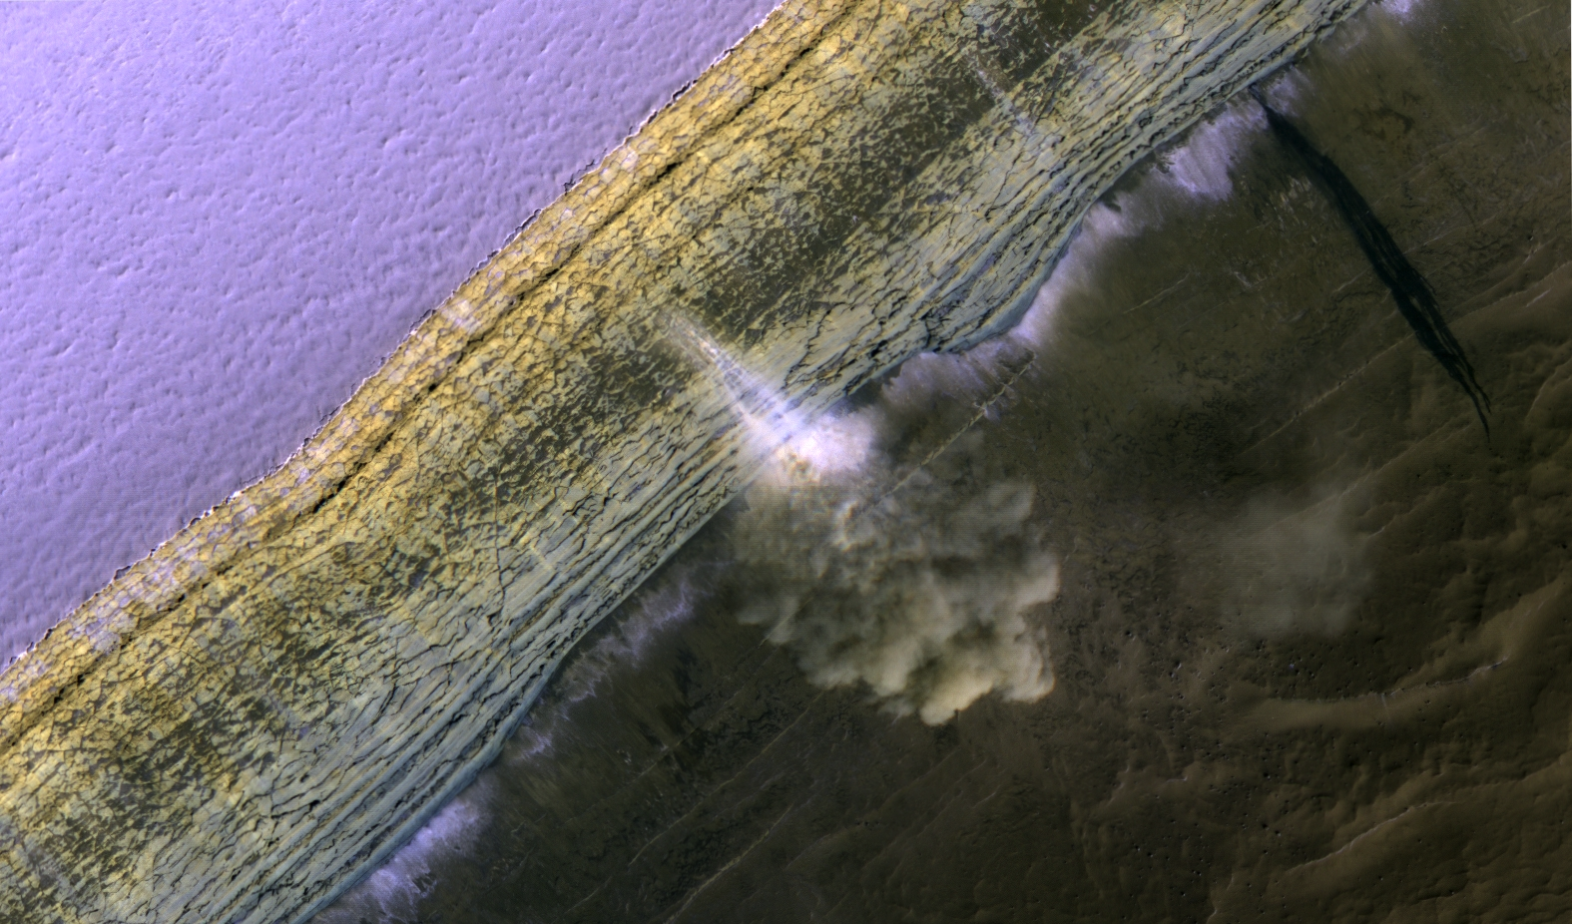
Falling to Pieces: Fractures, Blockfalls and
Avalanches at the North Pole of Mars
S. Byrne, P. Russell, A. Pathare, P. Becerra, J. Molaro, S. Mattson and M.T. Mellon

Slide 2
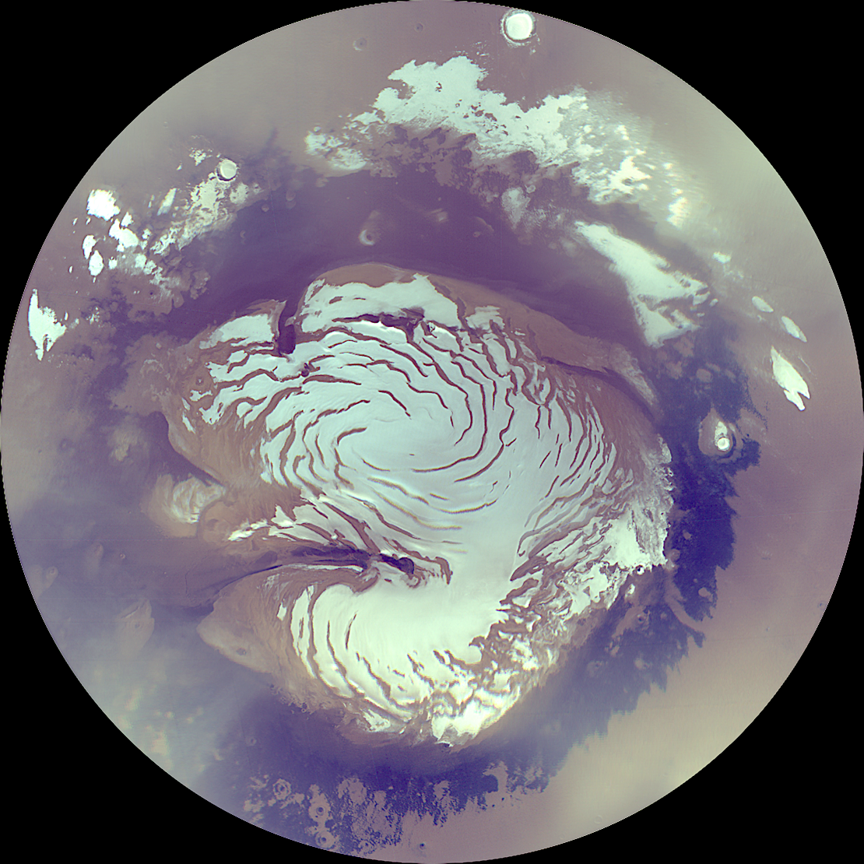
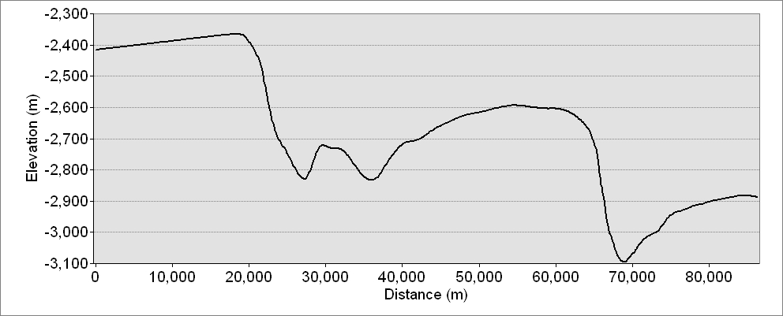
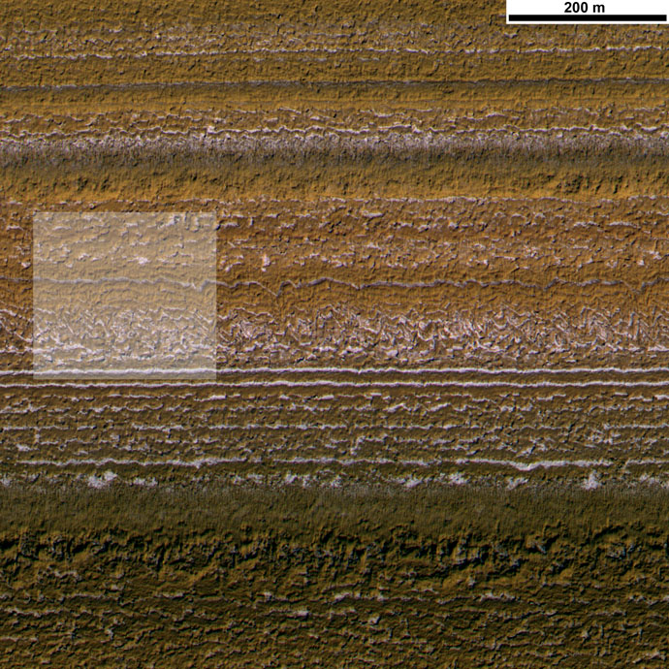
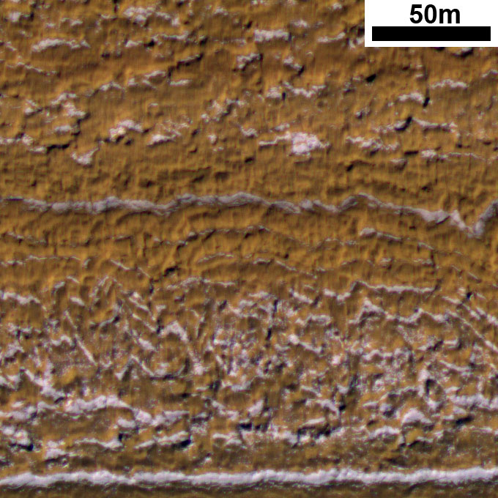
Layers exposed by gently sloping troughs
Thick lag deposits that slump downslope
PSP_001738_2640

Slide 3
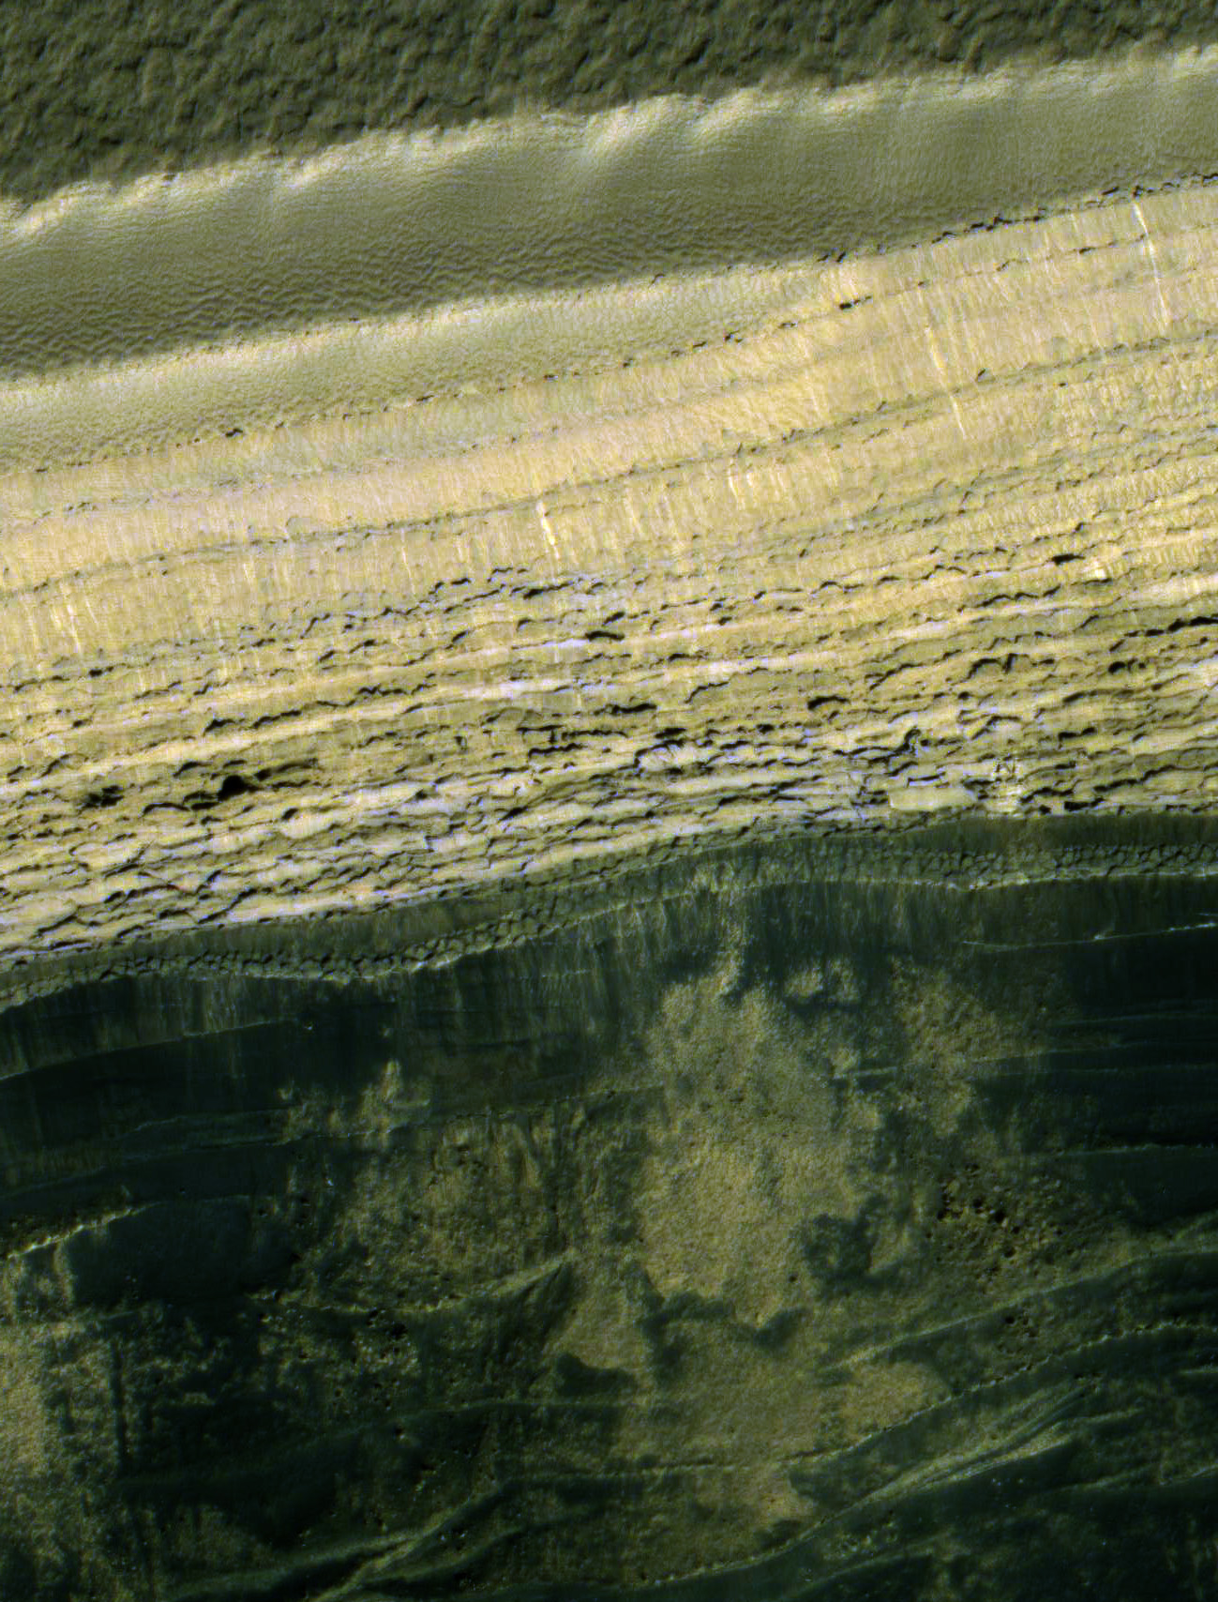
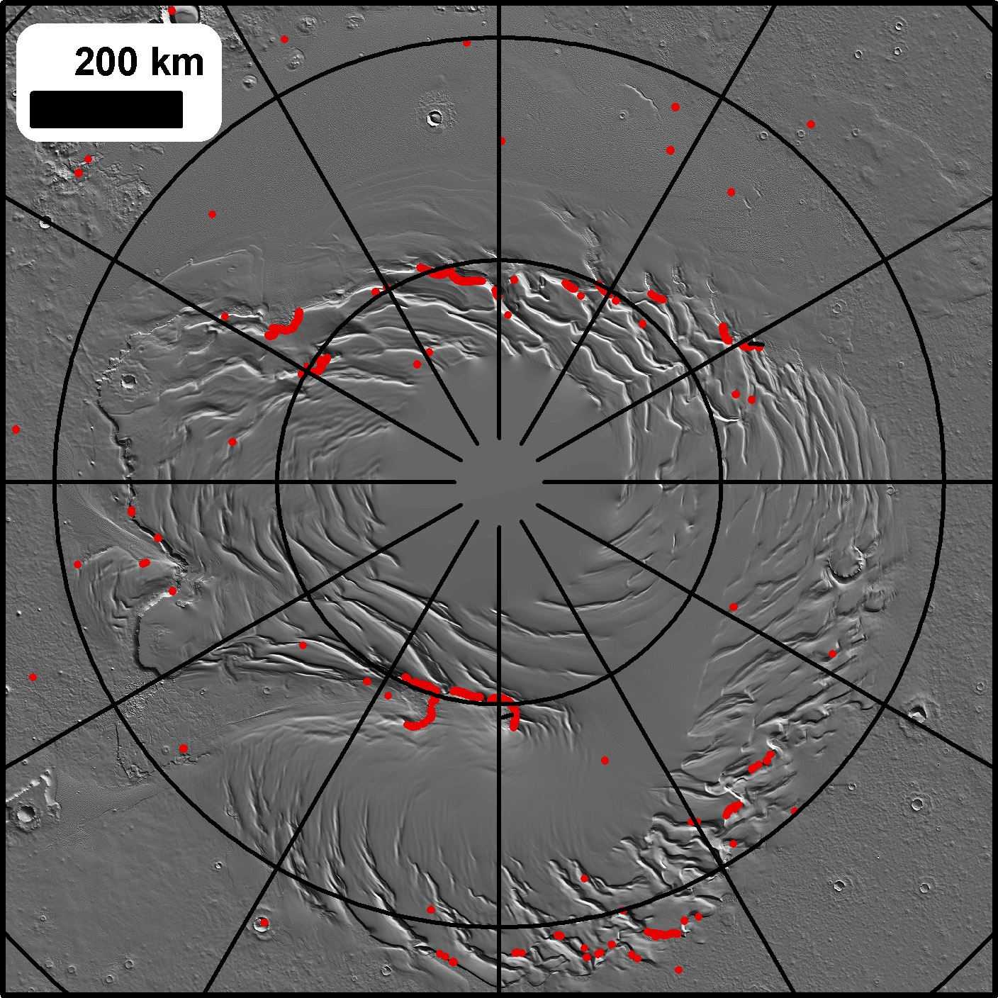
Steep cliffs at the PLD boundaries
Locations of slopes above 35°

Slide 4
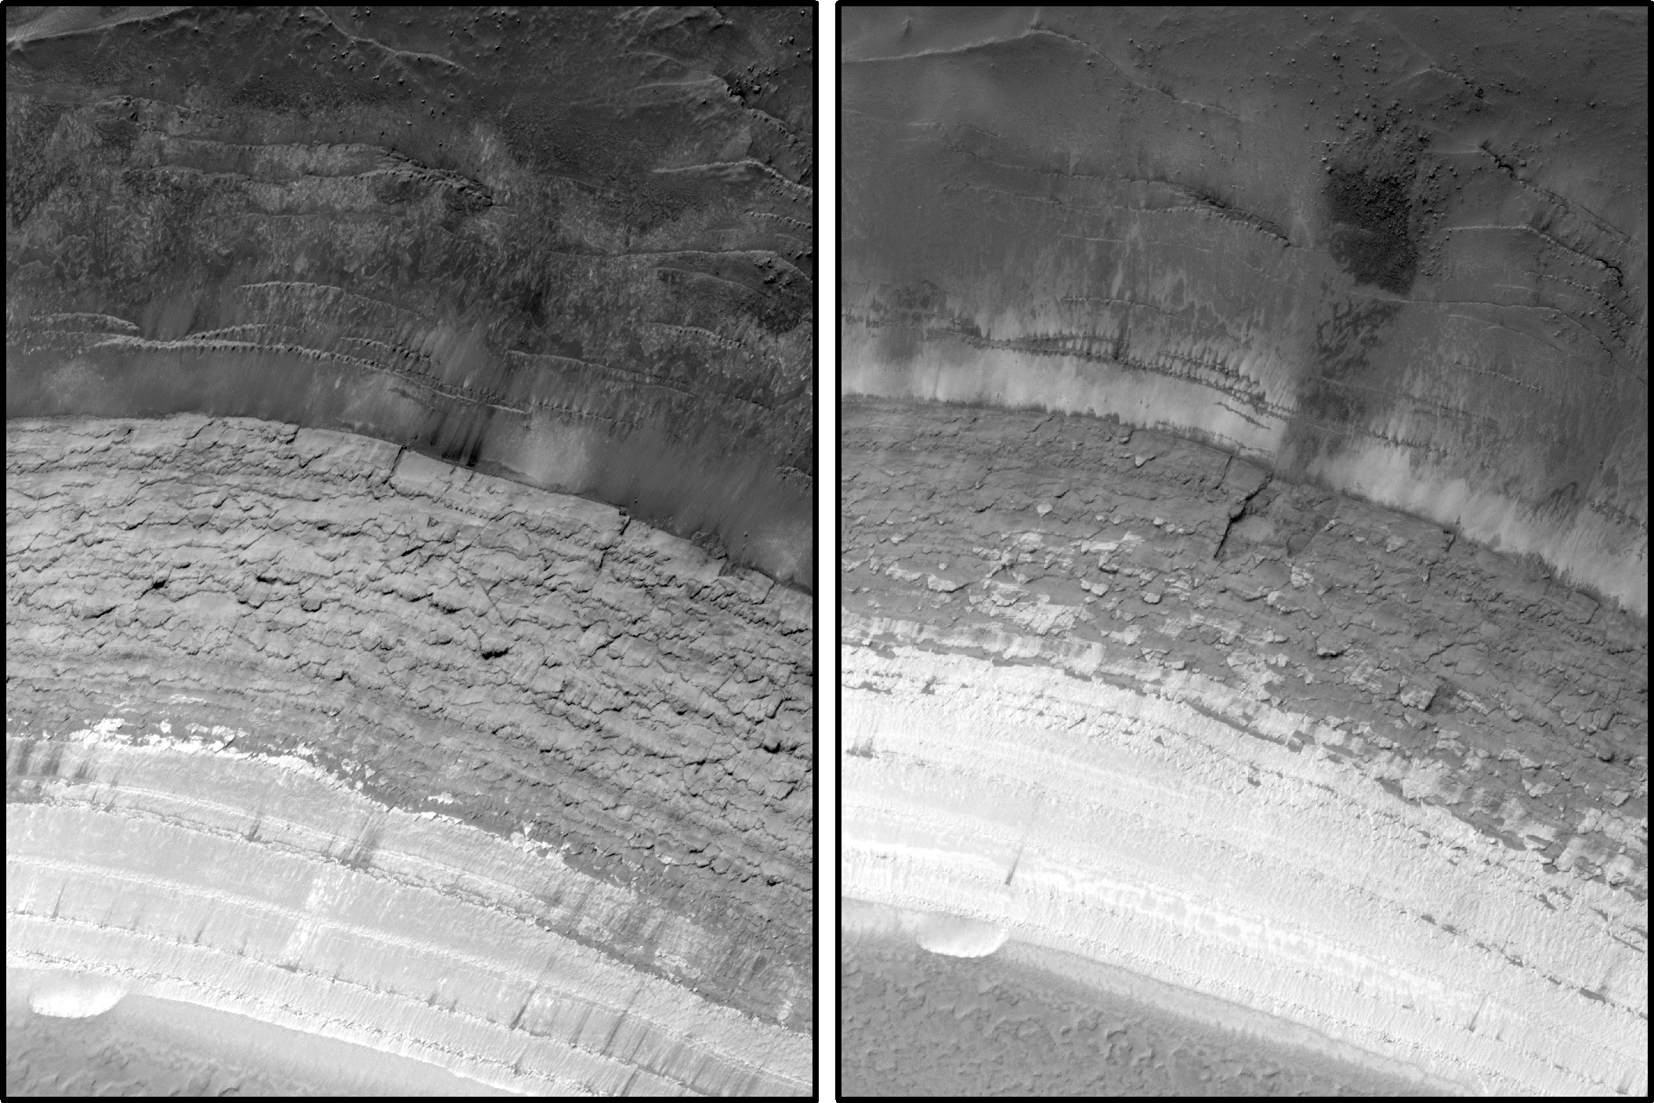
Rolling MRO provides the best way to look for changes
ESP_016292_2640
ESP_024639_2640

Slide 5
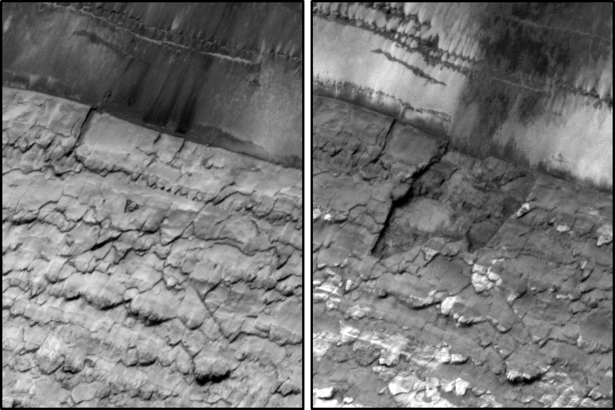
Failure of a 70m wide section in late-summer or winter of MY 30…
ESP_016292_2640
ESP_024639_2640

Slide 6
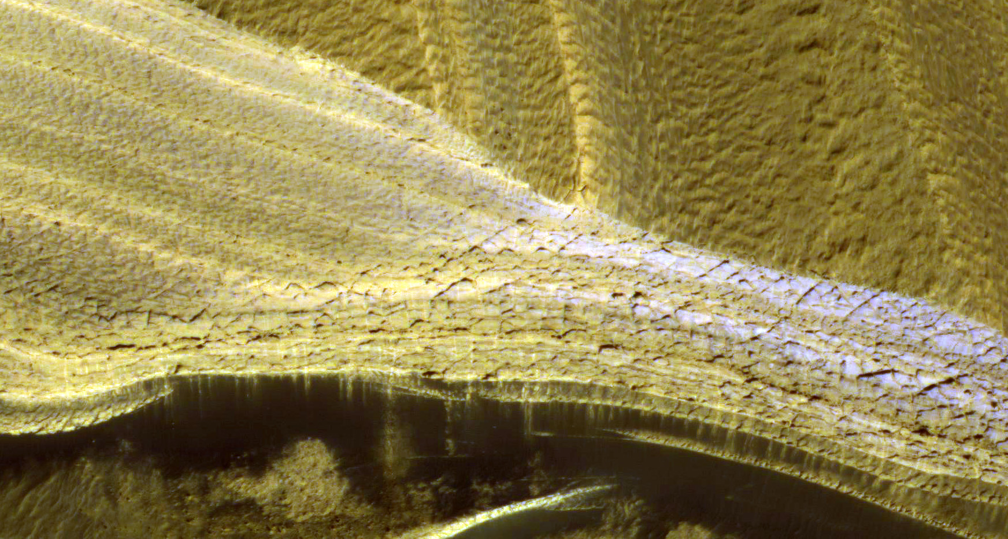
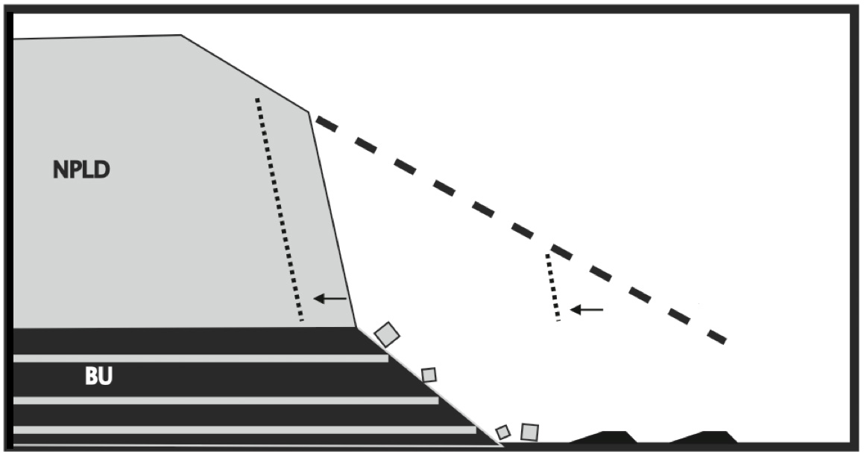
Layers transition from fractured to unfractured with slope
Steep slope may be due to undermining by erosion of the exposed sandy basal unit

Slide 7
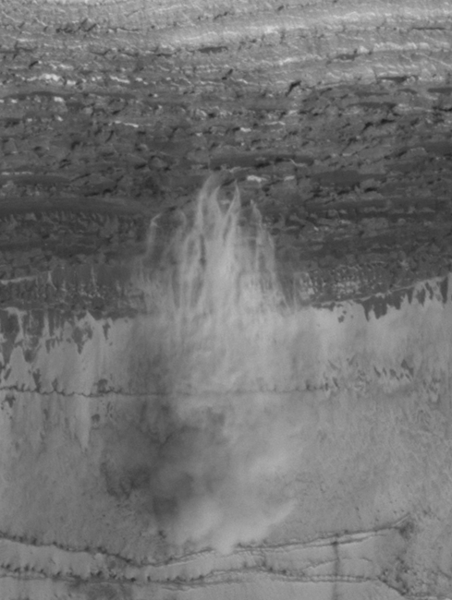
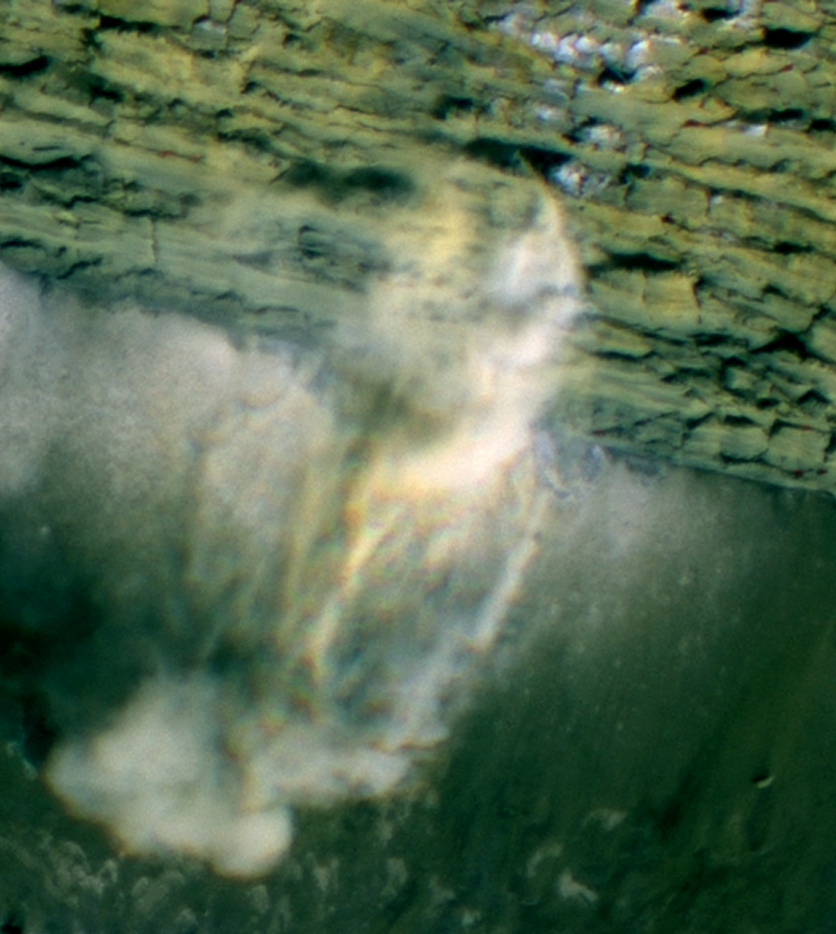
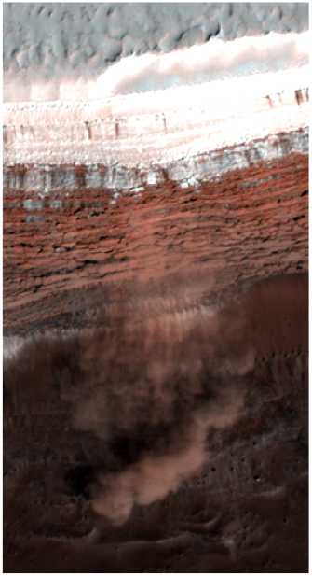
Russell et al., 2008

Slide 8
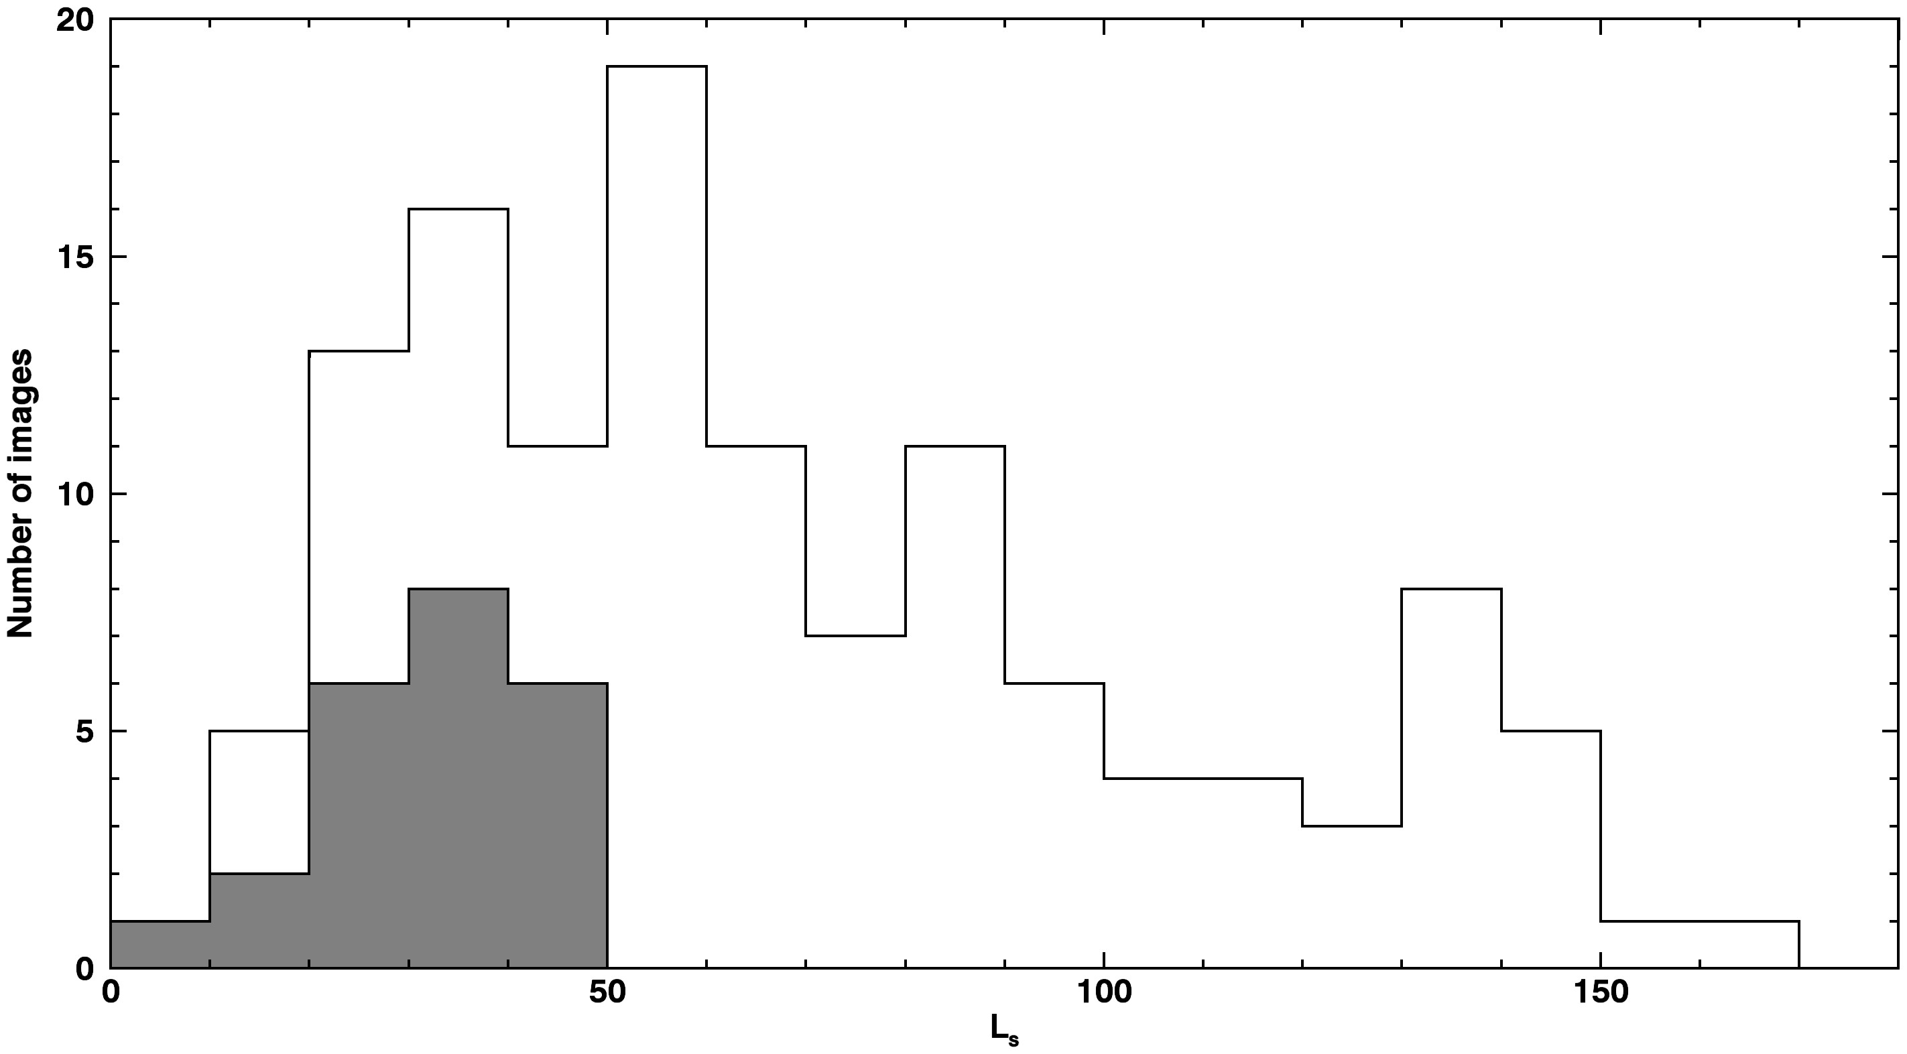
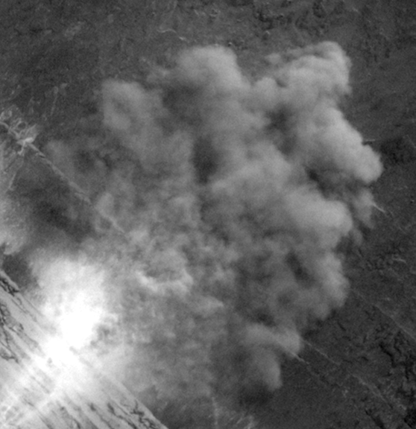
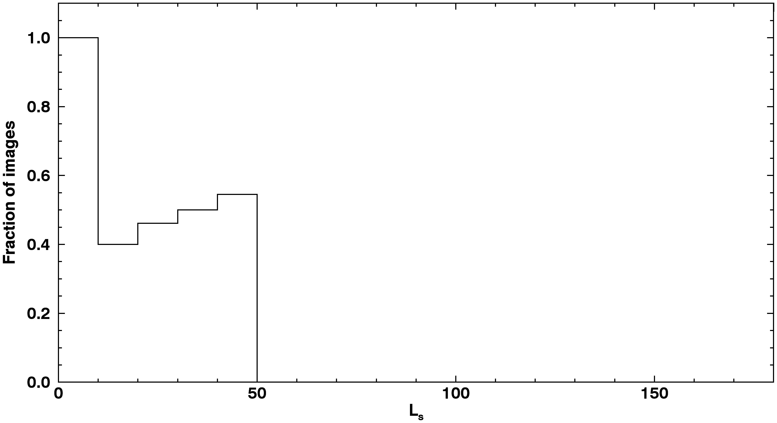
10s of avalanches imaged in progress
Speeds measured to be several m/s
Avalanche Images
Total Scarp Images

Slide 9
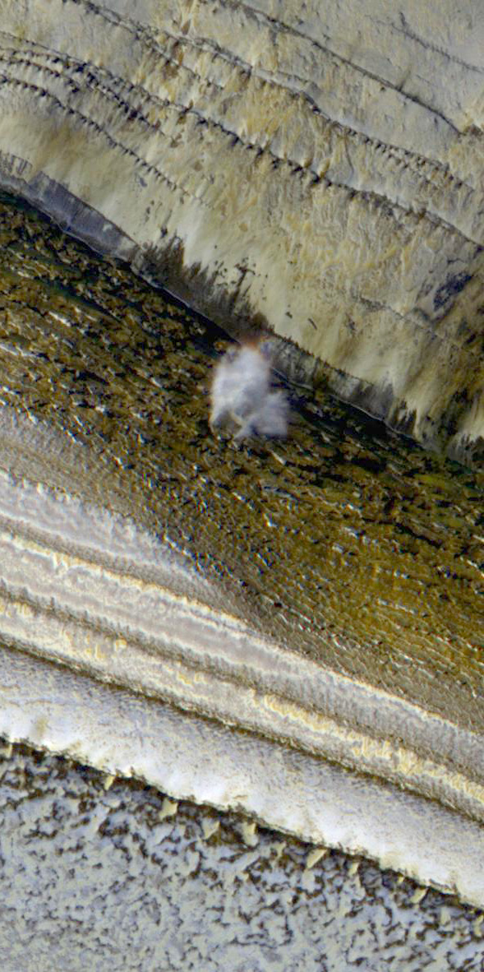
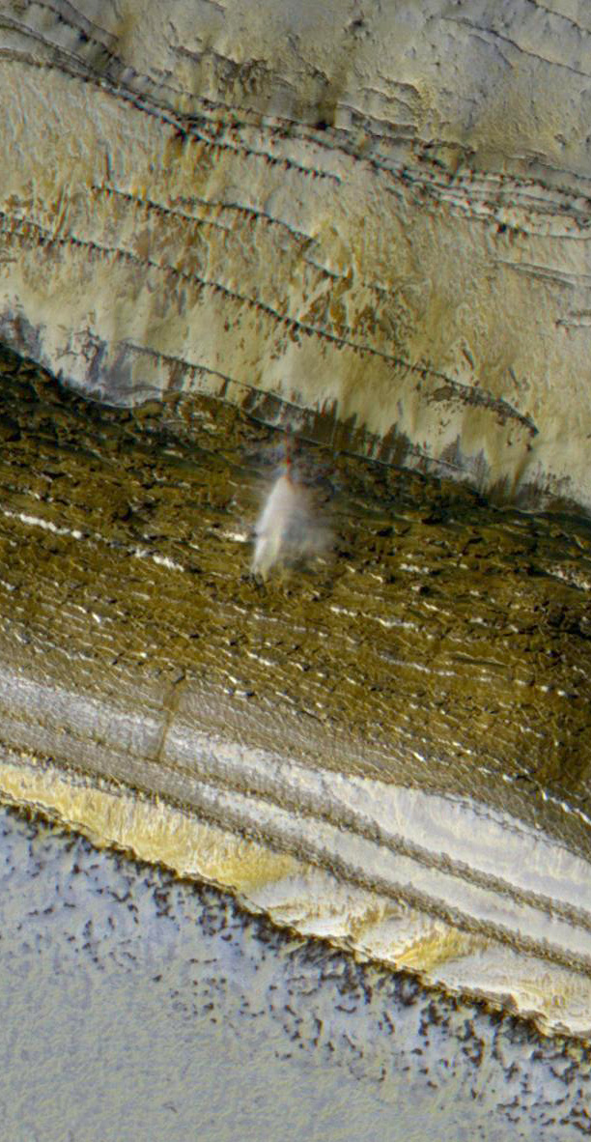
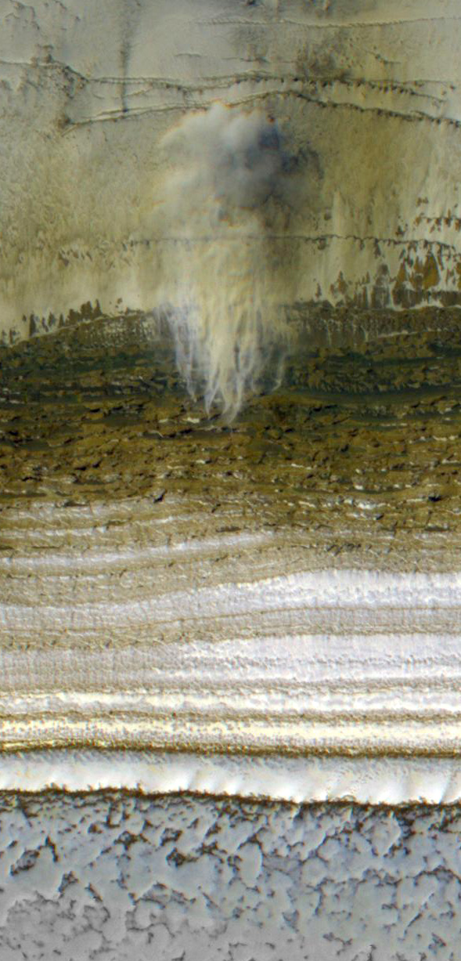
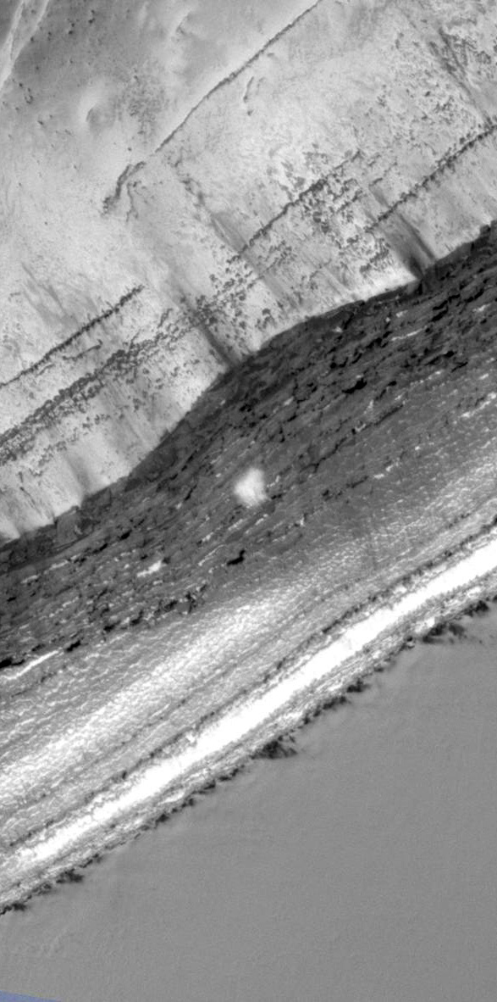
Aspect: W WSW SW S
South
Four simultaneous avalanches with a range of Slope azimuths
ESP_024282_2640, L_{s} 9 MY 30

Slide 10
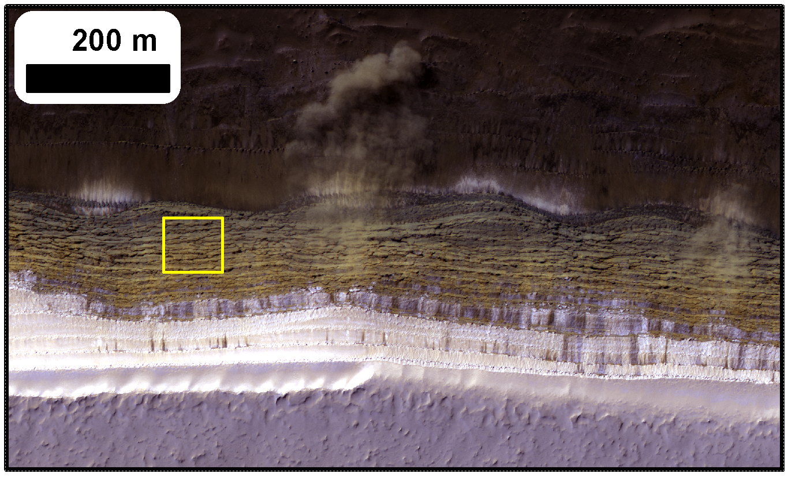
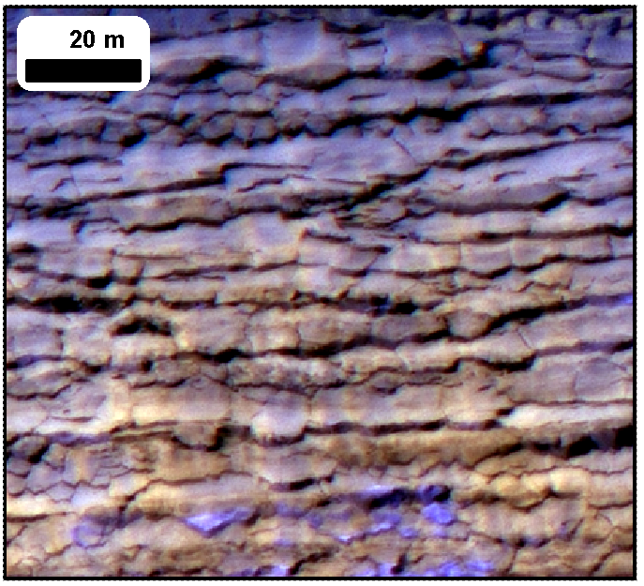
Can we explain:
Pervasive cracking
Avalanche timing
Slab-like texture on scarps
Frequent blockfalls

Slide 11
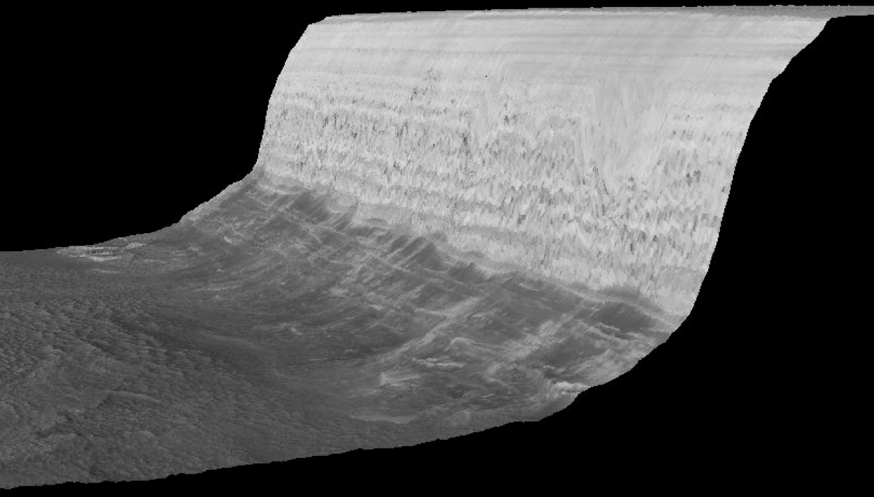
Atm.
emission
Thermal emission
Solar radiation
Emitted & reflected radiation exchanged with surrounding flat terrain
Conduction
We use a standard 1D semi-implicit thermal model to simulate temperatures

Slide 12
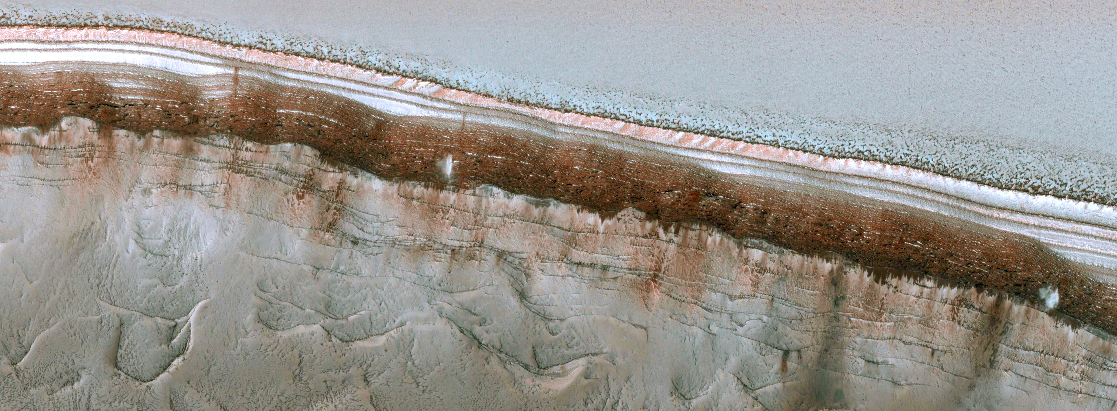
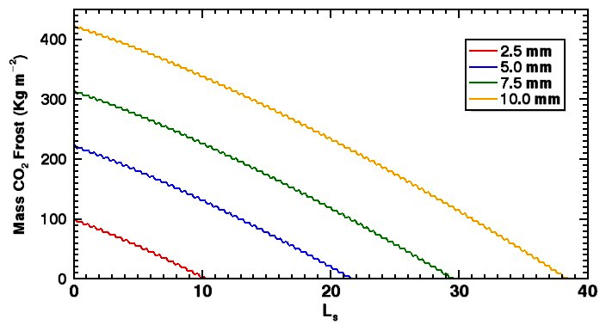
Effects of dust cover
Frost mass on 45° SW-facing slope
ESP_024282_2640 – L_{s} 9
~70° slopes are already defrosted
~45° slopes still frosted
Defrosting date of slopes very sensitive to thickness of dust cover
5mm is about right for 45° slopes
- OK to use for 70° slopes ?

Slide 13
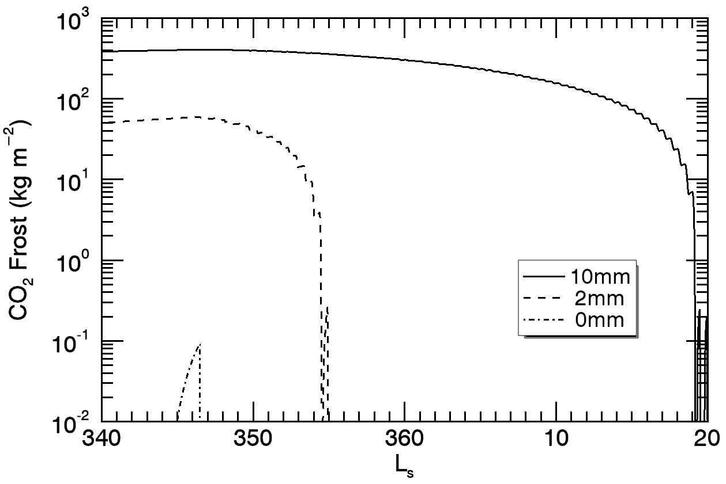
Effects of dust cover
ESP_032616_2640 – L_{s} 350
~70° slopes are already defrosted
~45° slopes still frosted
Defrosting date of slopes very sensitive to thickness of dust cover
5mm is about right for 45° slopes
OK to use for 70° slopes ? NO.
70° slope behavior consistent with no dust cover

Slide 14
Not a surprise given their appearance

Slide 15
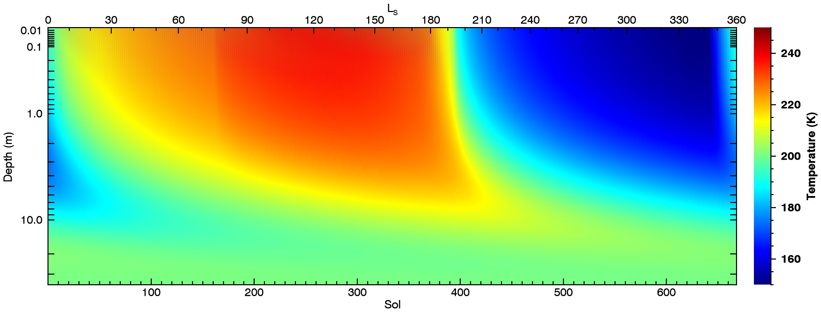
Surface and Sub-surface temperatures on a 70° SW-facing slope

Slide 16
We treat this as a homogeneous viscoelastic solid and solve for stresses induced by thermal expansion and contraction using the approach of Mellon (JGR, 1997)
Thermal expansion and contraction creates a short-term elastic and a longer term viscous response
At the Surface:
Horizontal strains are zero
Horizontal stresses are created
Vertical strains are non-zero
Vertical stresses at surface are zero
A
B
A
B
-σ
A
B
+σ
Cold ice
(contracted)
Average state
Warm ice
(expanded)
Total horizontal strain is zero and so:

Slide 17
Expressions for E and α also revised (see me afterwards if interested)
where
In the end we have a differential equation:

Slide 18
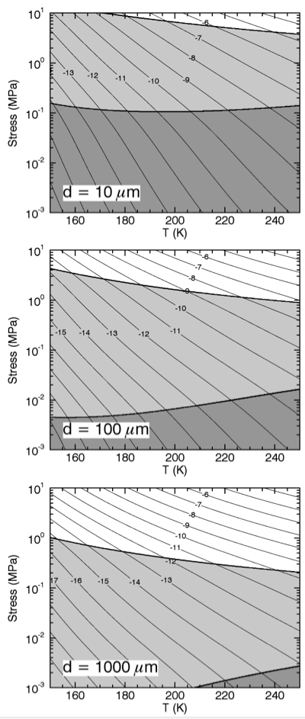
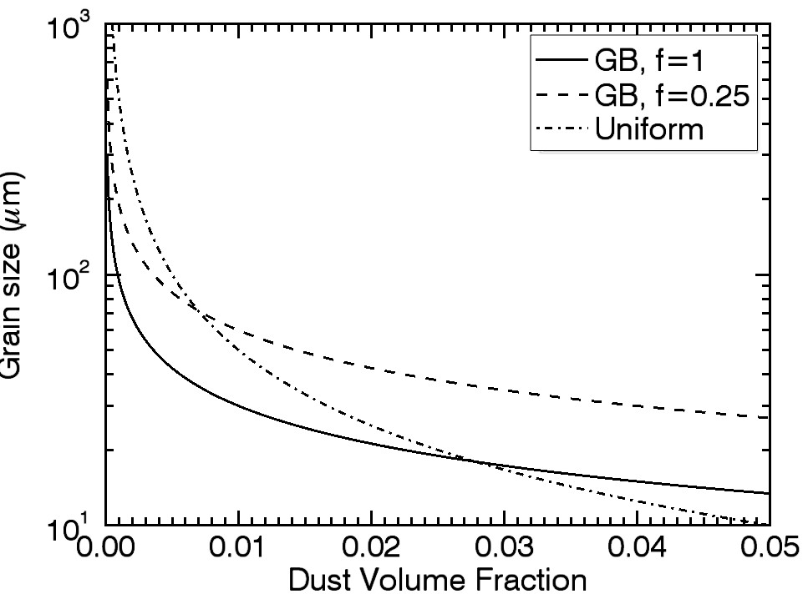
Rheology is now grain size dependent
Dislocation creep dominates at high T and σ
Diffusion dominates at low σ
Grain-size sensitive creep effects dominates for small grains
SHARAD results and Zenner pinning allows estimates of NPLD ice grain size

Slide 19
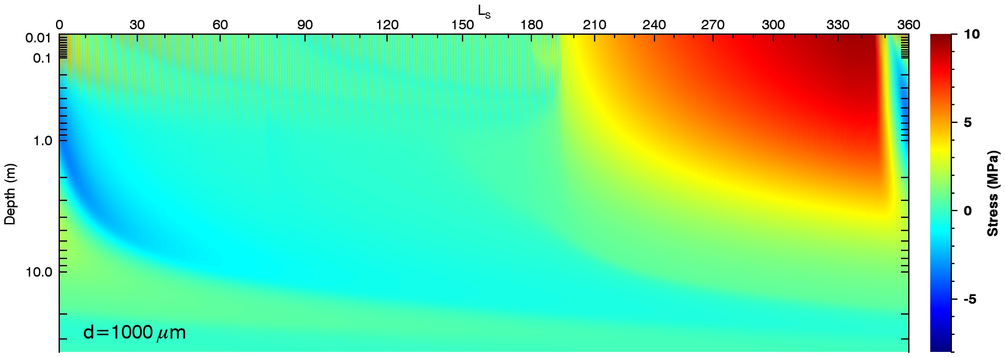
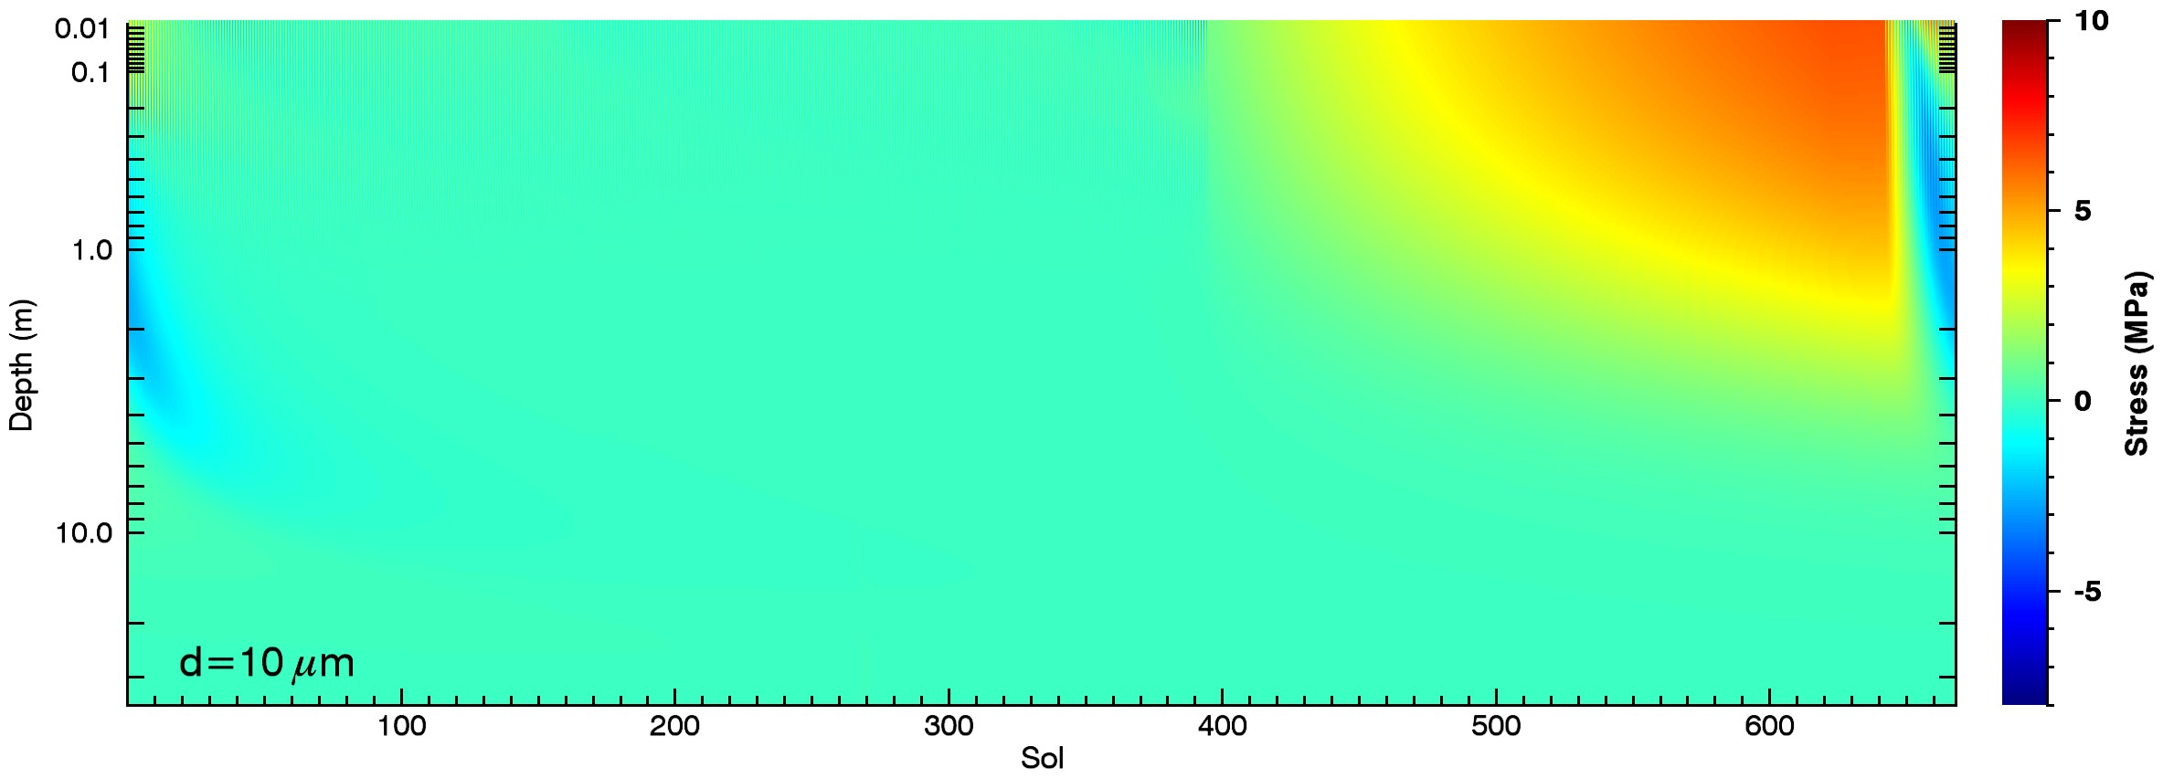
+ve is tension

Slide 20
Ice strength exceeded during most of the winter
Tension
Compression
Tension
Compression
Tension
Compression

Slide 21
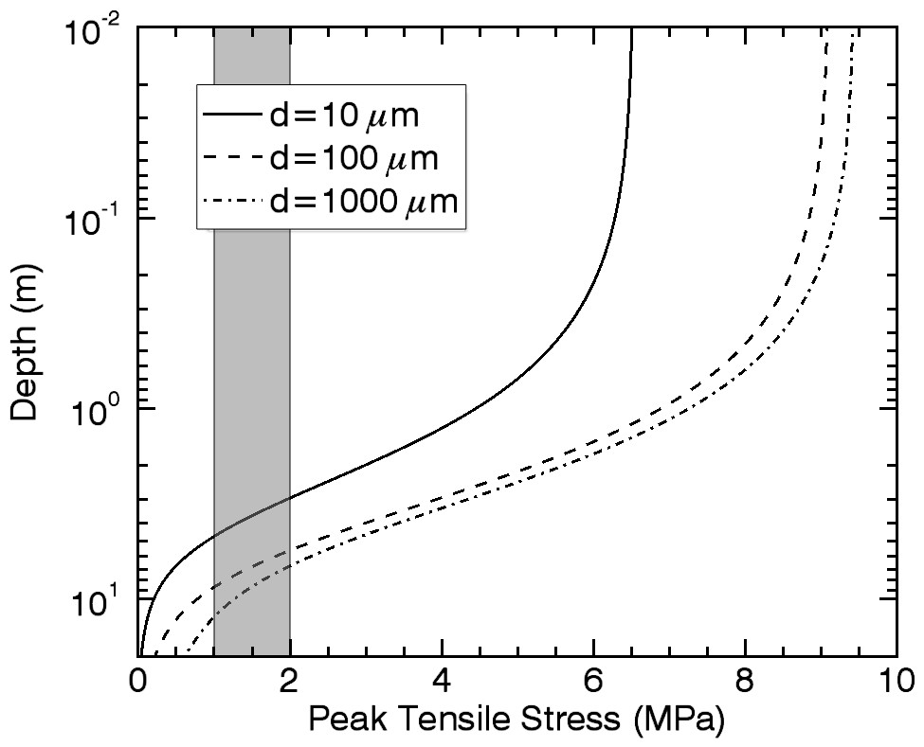
How deep can cracks propagate?
Amplitude of stress variation decreases with depth.
Exceeds water ice strength down to several meters, but some model assumptions start to break down…
Shallow cracks can open and close – adds shear stresses to deeper ice. Promotes crack deepening.
Stresses are concentrated at crack tips. Promotes crack deepening.
Overburden pressure is neglected. Suppresses crack deepening.

Slide 22
Tension
Compression
End of avalanche season coincides with tensional stresses falling below the strength of water ice
Avalanche Images
Total Scarp Images

Slide 23
Avalanche season coincides with existence of subsurface compressional stress

Slide 24
Blockfall seasonality is a work in progress
Tension
Compression

Slide 25
ESP_024282_2640 – Ls 9
Cracks Opening
Cracks Closing
Cracks Open
Cracks Closed
70° SW-facing
@ L_{s} 9

Slide 26
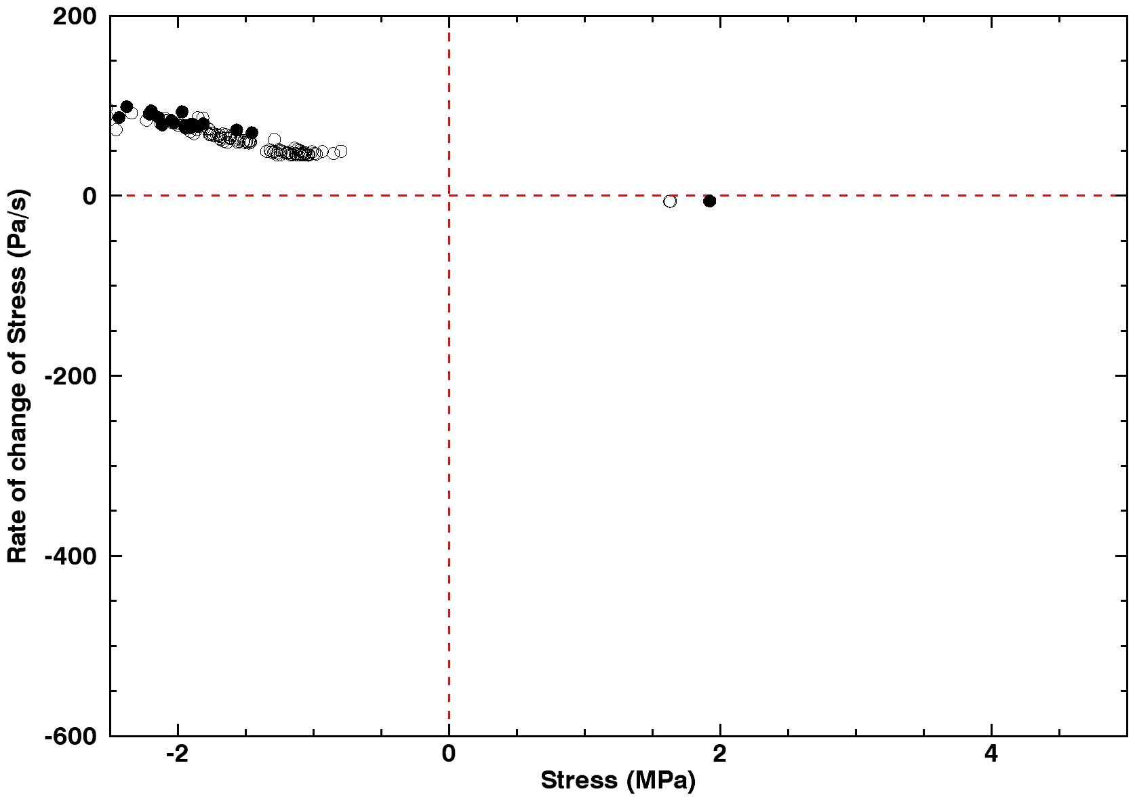
Observational selection effect means we see the scarp in the same stress state all the time on South and south-west facing scarps
Avalanche
No Avalanche
Cracks opening or pressure decreasing
Cracks closing or pressure increasing
Closed Cracks
Open Cracks
70° SW-facing
D=100μm

Slide 27
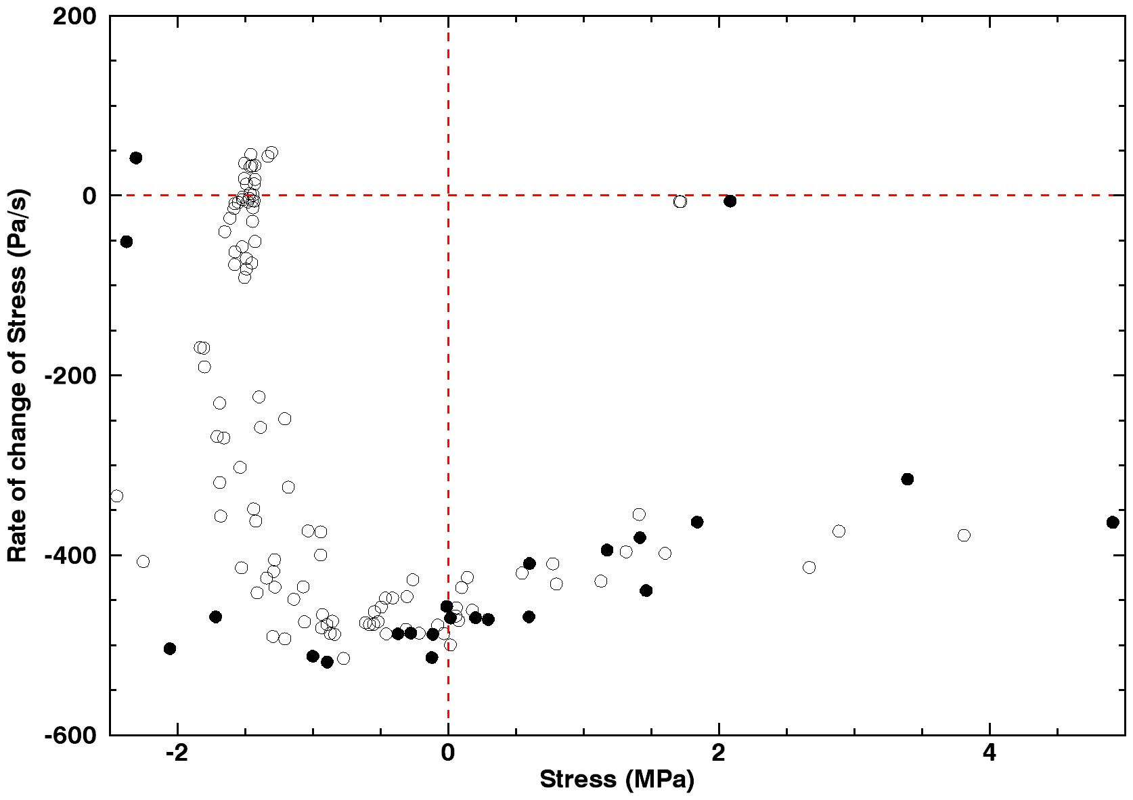
We observe west facing scarps right at local sunrise so small local time variations lead to be stress-state variations
Avalanche
No Avalanche
Cracks opening or pressure decreasing
Cracks closing or pressure increasing
Closed Cracks
Open Cracks
70° W-facing
D=100μm

Slide 28
Tensional stresses create fractures only quasi-perpendicular to the surface
Compressional stresses can expel fragments if they can overcome friction
Tension
Compression

Slide 29
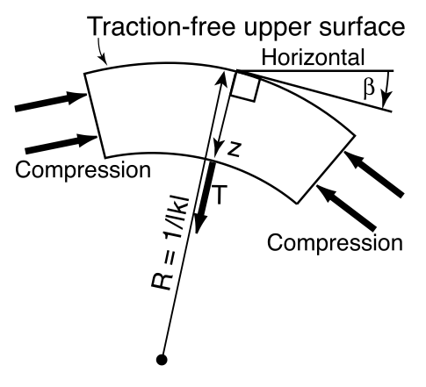
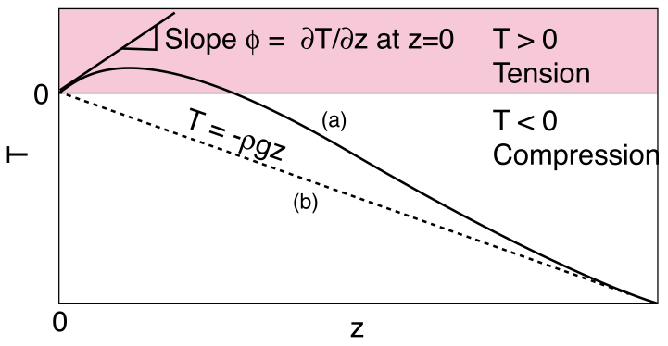
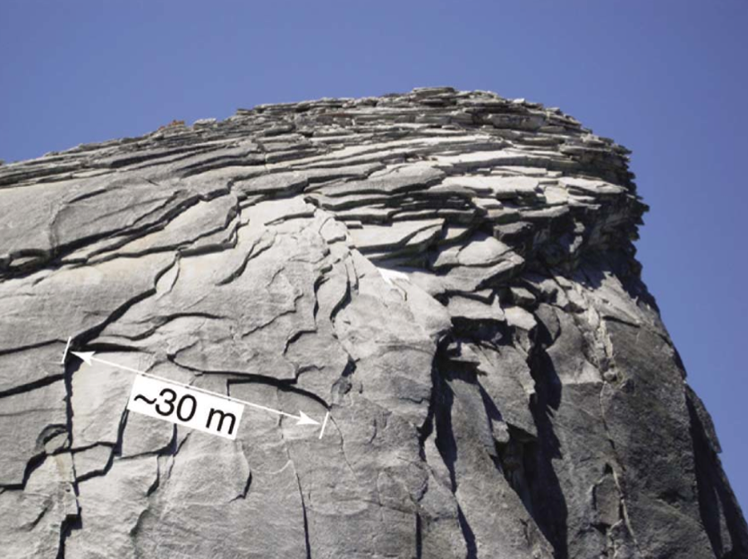
Model for blockfalls?
Martel (GRL, 2011) explains sheeting joints and exfoliation of slabs with compressive stress and surface curvature
Surface-normal tensional stress generated in the near-sub-surface – slabs exfoliated
Good agreement for terrestrial granitic domes

Slide 30
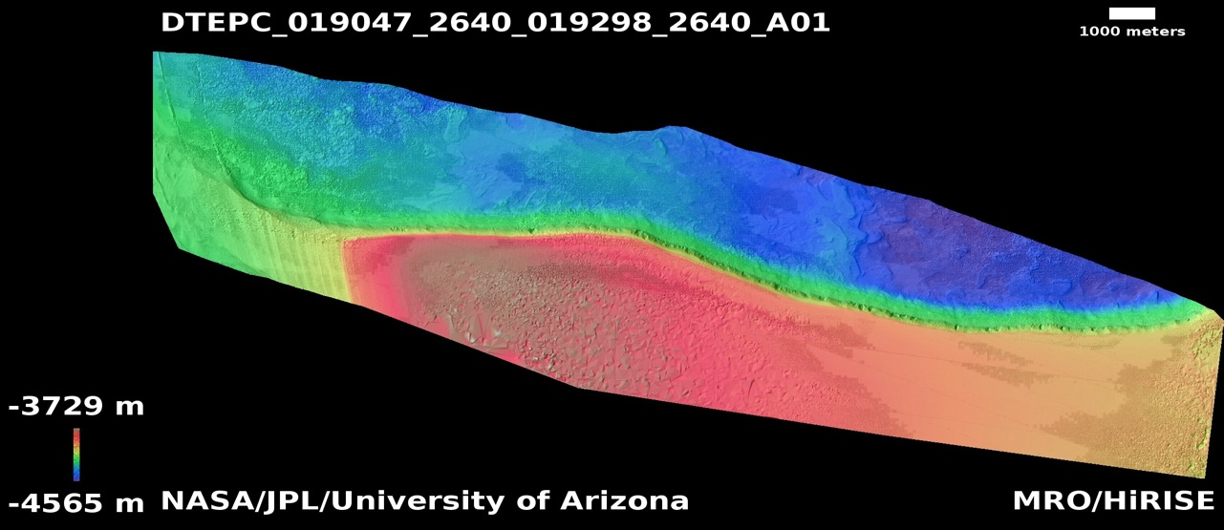
No Vertical Exaggeration (!)

Slide 31
Stuff to do…
A new DTM with better stereo data
Better measurements of local slope and orientation at avalanche points

