Slide 1
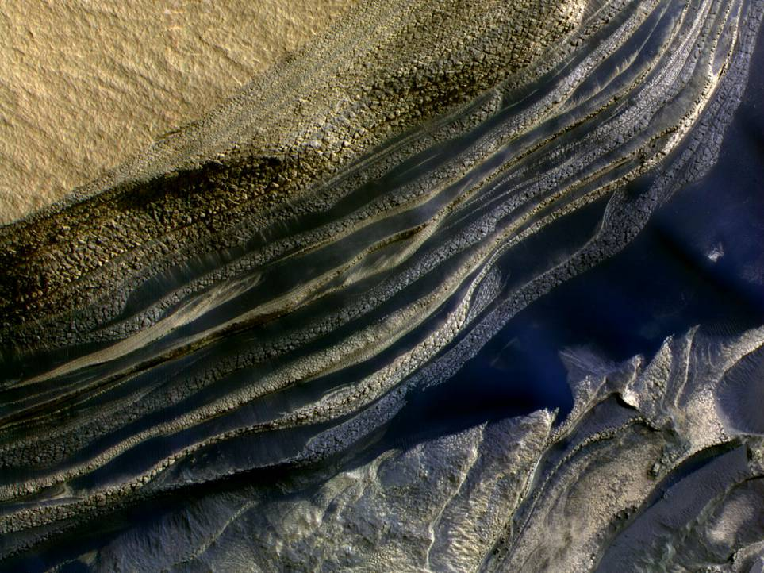
HiRISE Polar Geology
Status and Plans February 2016
Ken Herkenhoff, Shane Byrne, Jon Bapst, Pat Becerra, Margaret Landis, Mike Sori

Slide 2
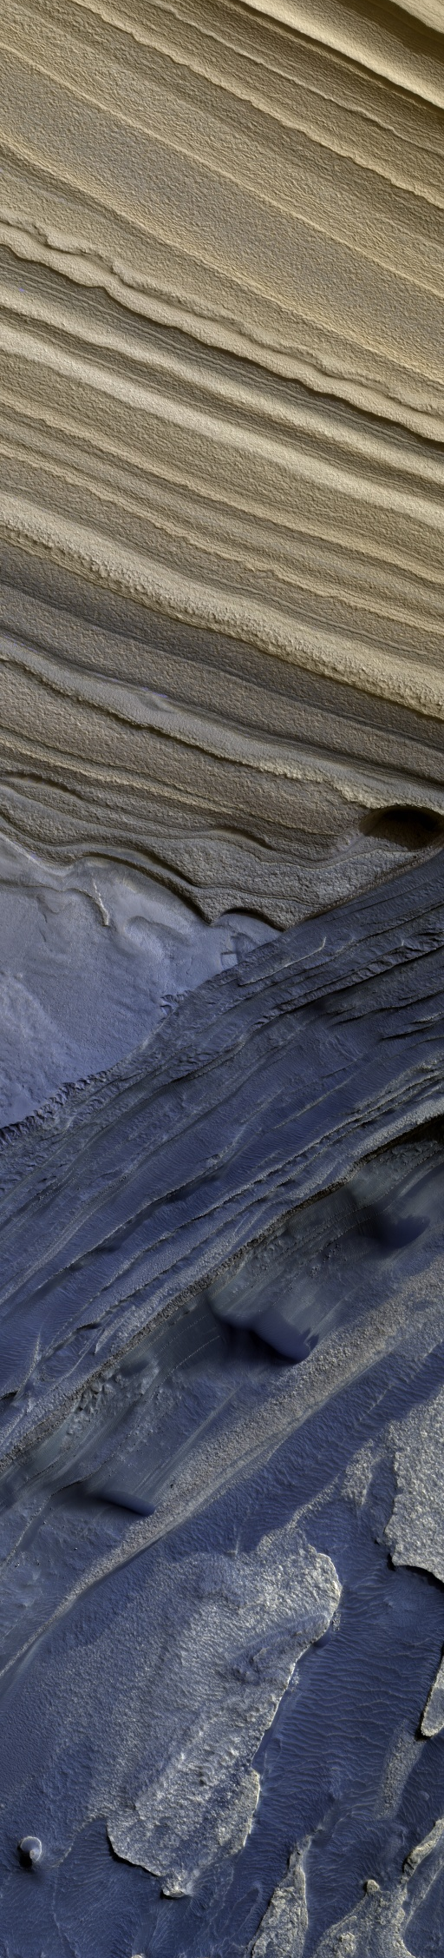
Current status of the Polar Geology Theme
Ongoing Projects
Plans for the upcoming Northern Summer

Slide 3
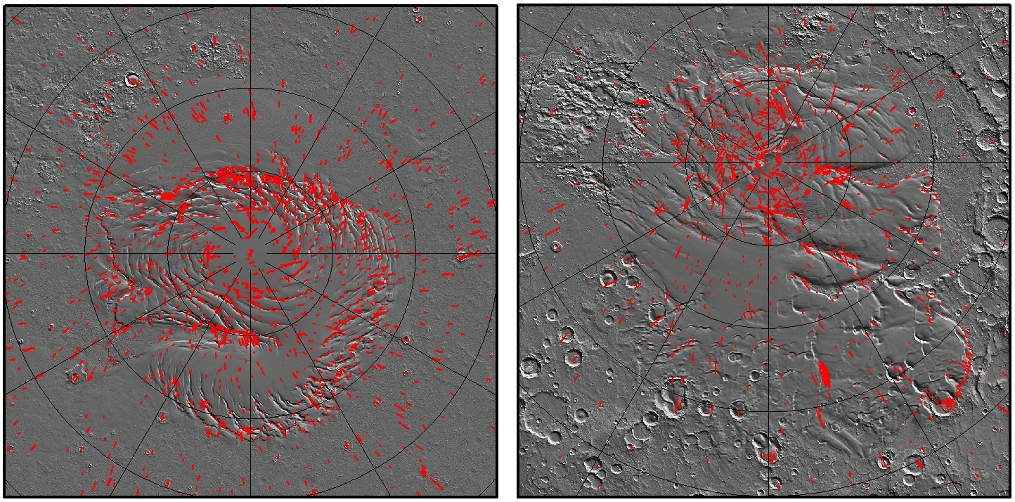
North
South
Imaging Coverage (all seasons)
Up to 2/11/2016

Slide 4
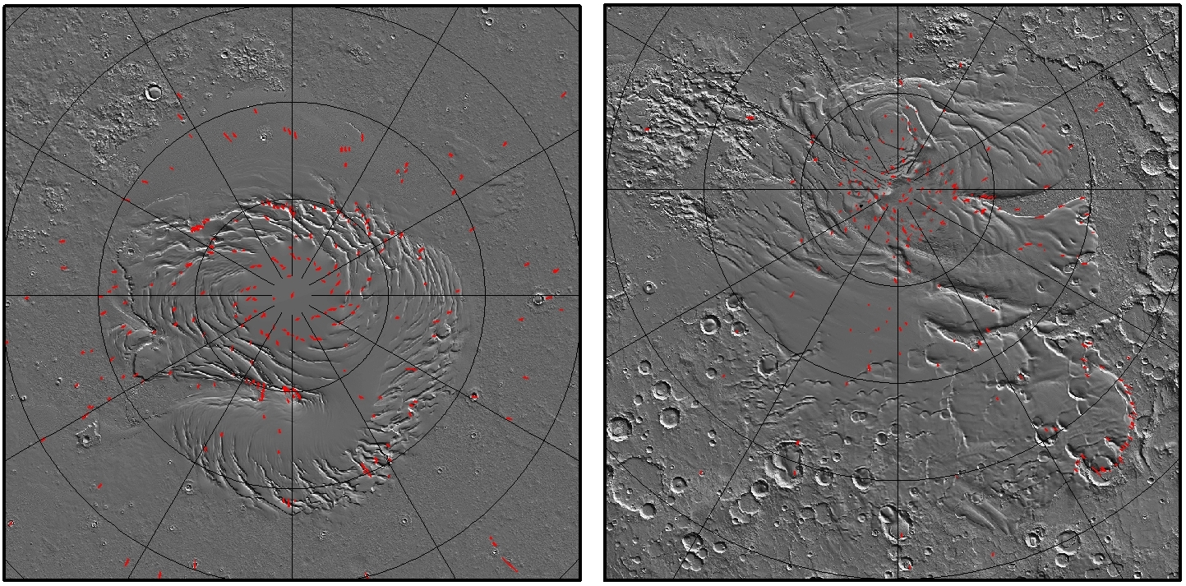
North
South
Stereo Coverage (all seasons)
Up to 2/11/2016

Slide 5
Polar Geology by the numbers
 | Total
Acquired | 2584
Suggested-10 | 7%
Suggested-09 | 27%
Suggested-08 | 35%
Suggested-07 | 26%
Suggested-06 | 5%
Stereo | 752 images
81
But 338 when stereo/seasonal expanded

Slide 6
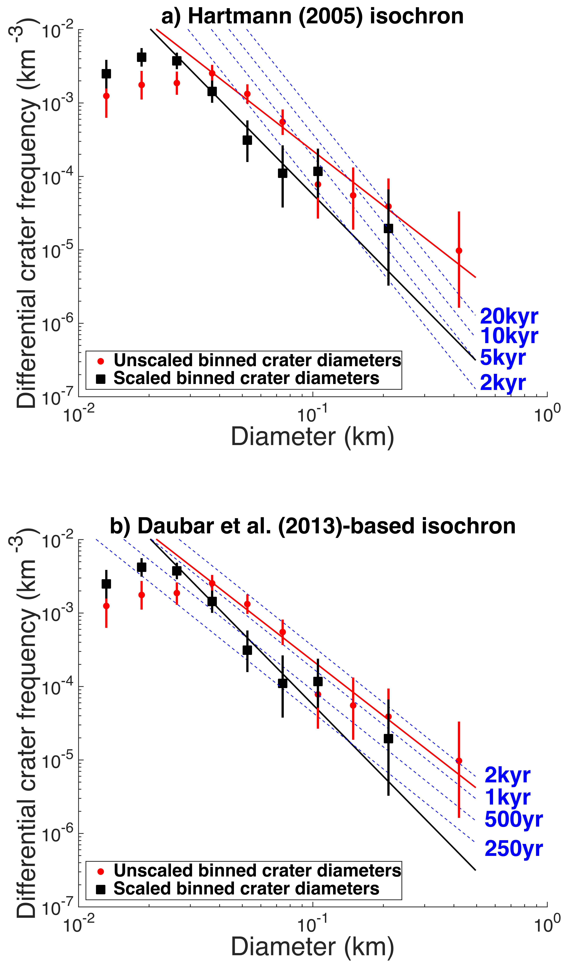
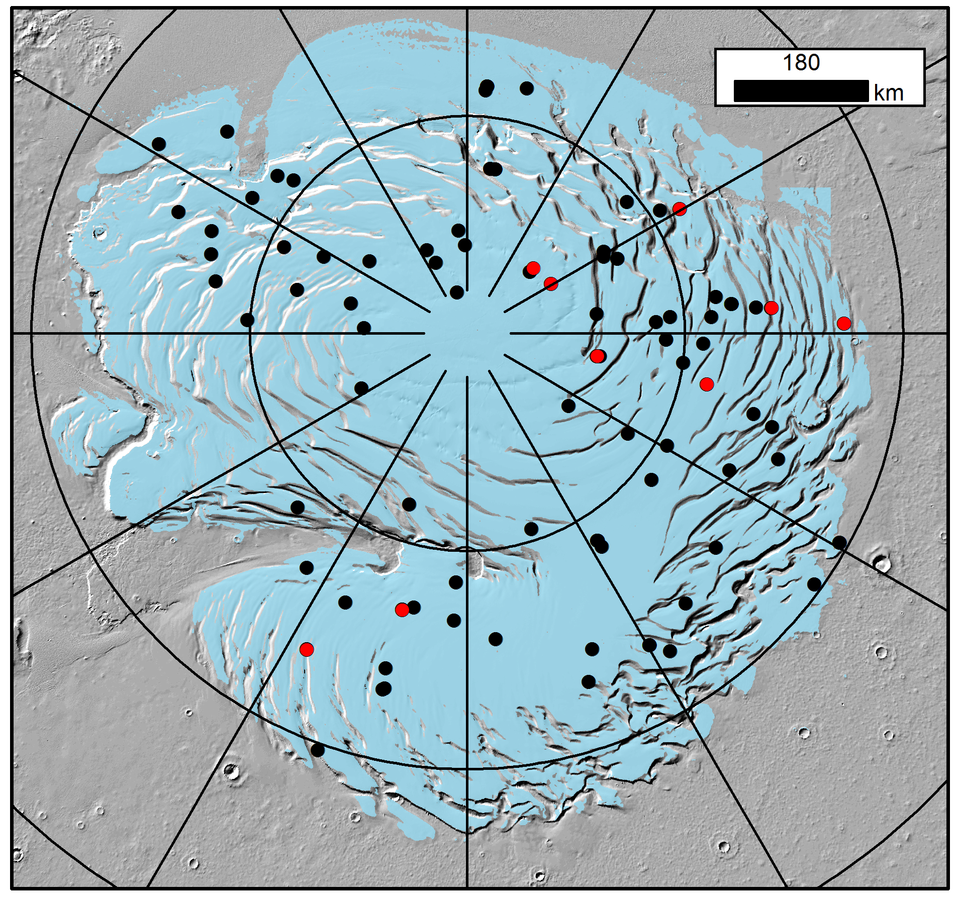
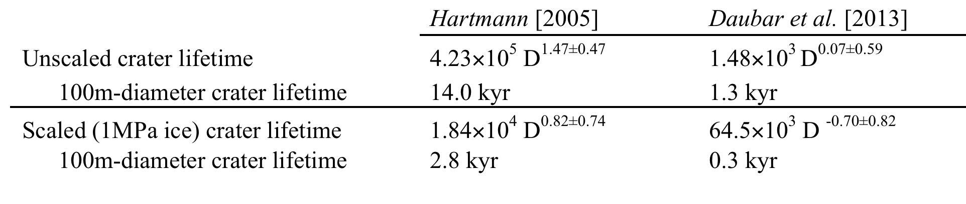
A revised surface age for the North Polar Layered Deposits of Mars
Landis et al. (Submitted)
Effects from isochron system (top vs. bottom panels)
Effects from strength-scaling crater diameters for icy targets (black vs. red data)
Modeling of crater infill is in progress & will settle this
180 E
270 E
90 E
85 E
80 E
0 E

Slide 7
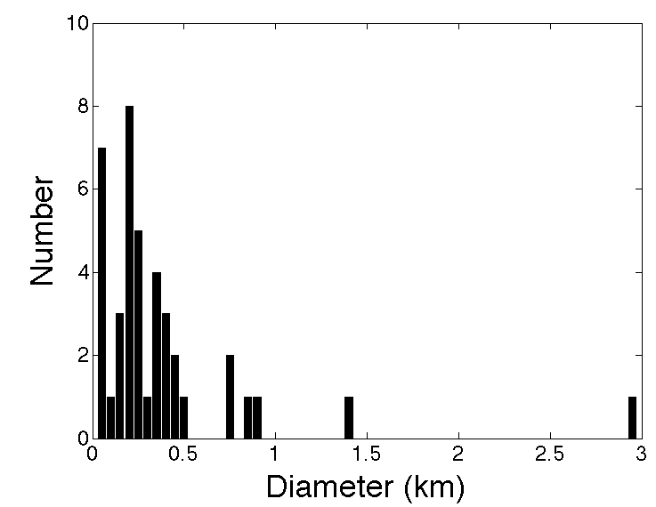
SPLD cratering history
Work in Progress by Margaret Landis
Working from previous partial catalog from Jeff Plaut
Requesting HiRISE follow up for craters that appear as possible sites in THEMIS/CTX
68 images of SPLD craters acquired
(11 stereo pairs)
153 more in Jeff Plaut’s unpublished catalog – many of these are not real craters
PlanetFour citizen scientists also tagging craters in CTX

Slide 8
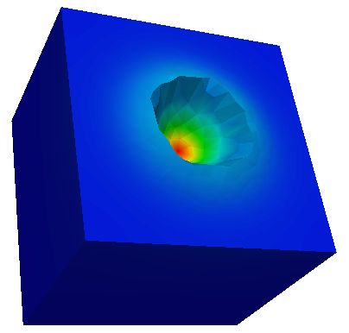


NPLD crater viscous relaxation
Sori et al. (GRL, 2016)
In this work [Sori et al., 2016, GRL 43], we use finite element modeling coupled with HiRISE imagery to quantify the importance of viscous flow for polar topography on Mars.
0.40
200 m
-0.12
0
0.12
Flow Velocity (microns/year)
Horizontal Velocity (microns/year)
0.20
0
-0.04
0.18
-0.40
Vertical Velocity (microns/year)
Presently-observed NPLD craters experience insufficient stresses and temperatures for viscous flow to have been an important modification mechanism in their lifetime.

Slide 9
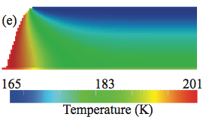
NPLD Steep Scarp Flow
Sori et al. (GRL, 2016)
400 m
PSP_007140_2640
800 m
30 mW/m²
Steep scarps are warm enough to have their shapes altered by viscous flow over ~kyr timescales.

Slide 10
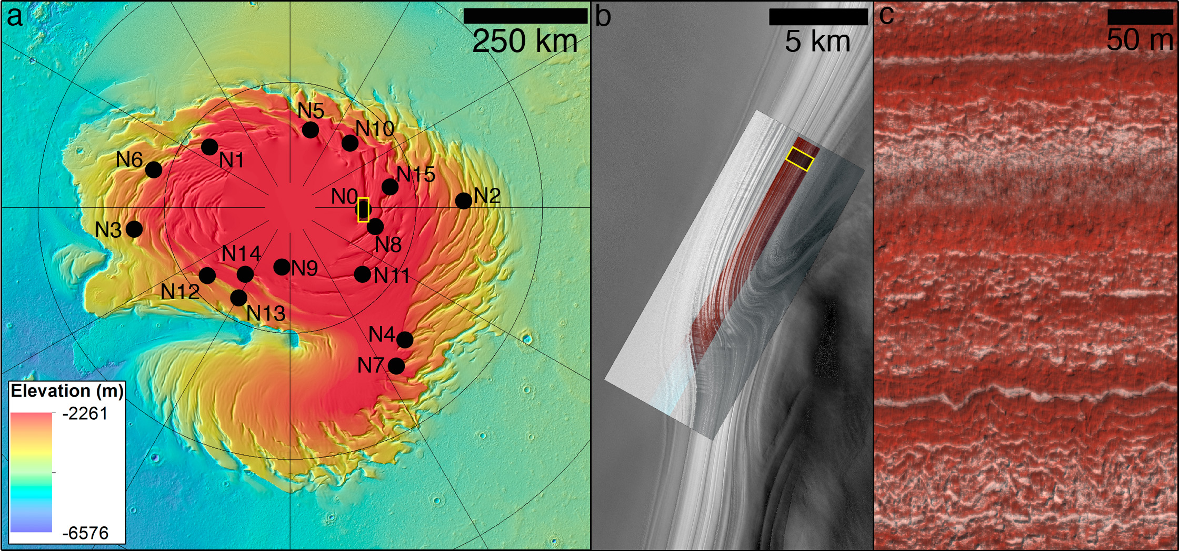
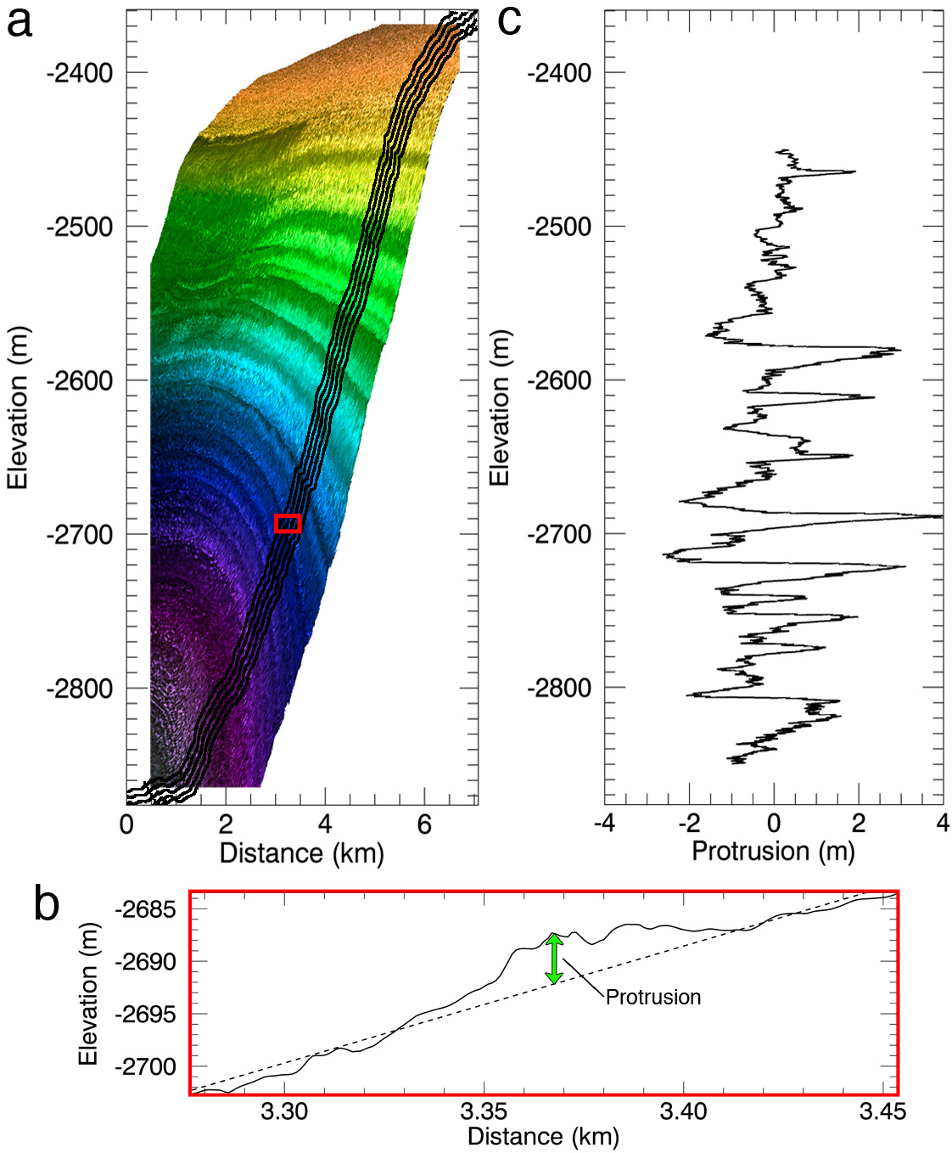
NPLD Stratigraphy with HiRISE Topography
Objective:
Describe the NPLD stratigraphy using the layers’ protrusion, and correlate stratigraphy from different sites through the NPLD
Method for extracting protrusion profiles from a HiRISE DTM.
Vertically exaggerated DTM of site N0 showing the elevation profiles used to calculate protrusion.
A local fit window is moved down the profile so that protrusion is evaluated as the vertical difference between each point in the profile (solid line) and the linear fit (dashed line) at the window center.
Final mean protrusion profile for site N0, which results from averaging the protrusion of the five profiles in (a). This is done to average out roughness differences along-strike.

Slide 11
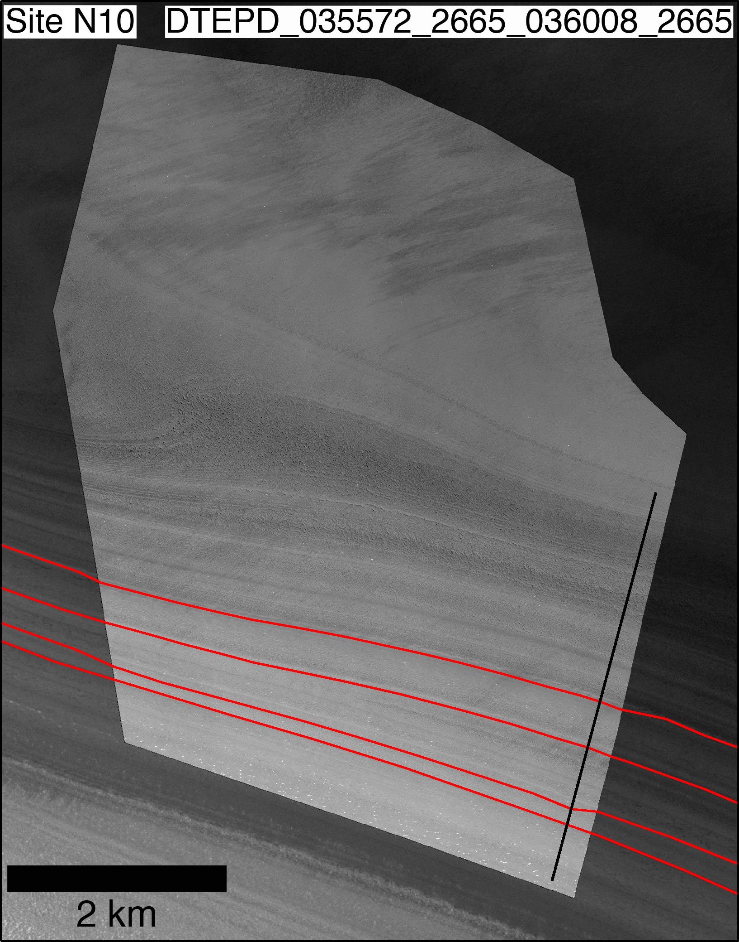
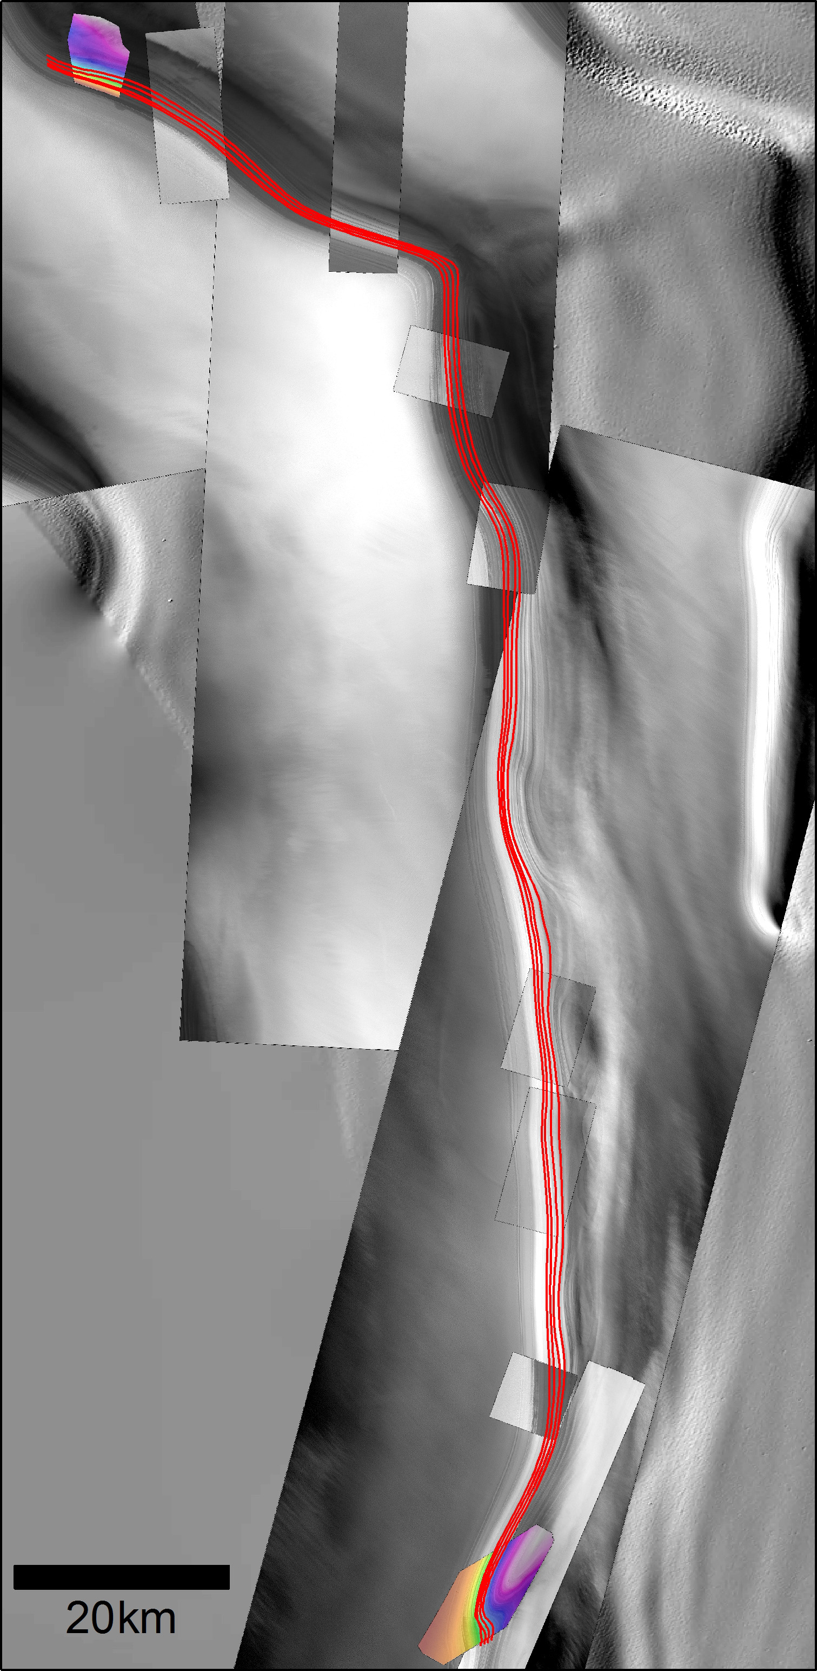
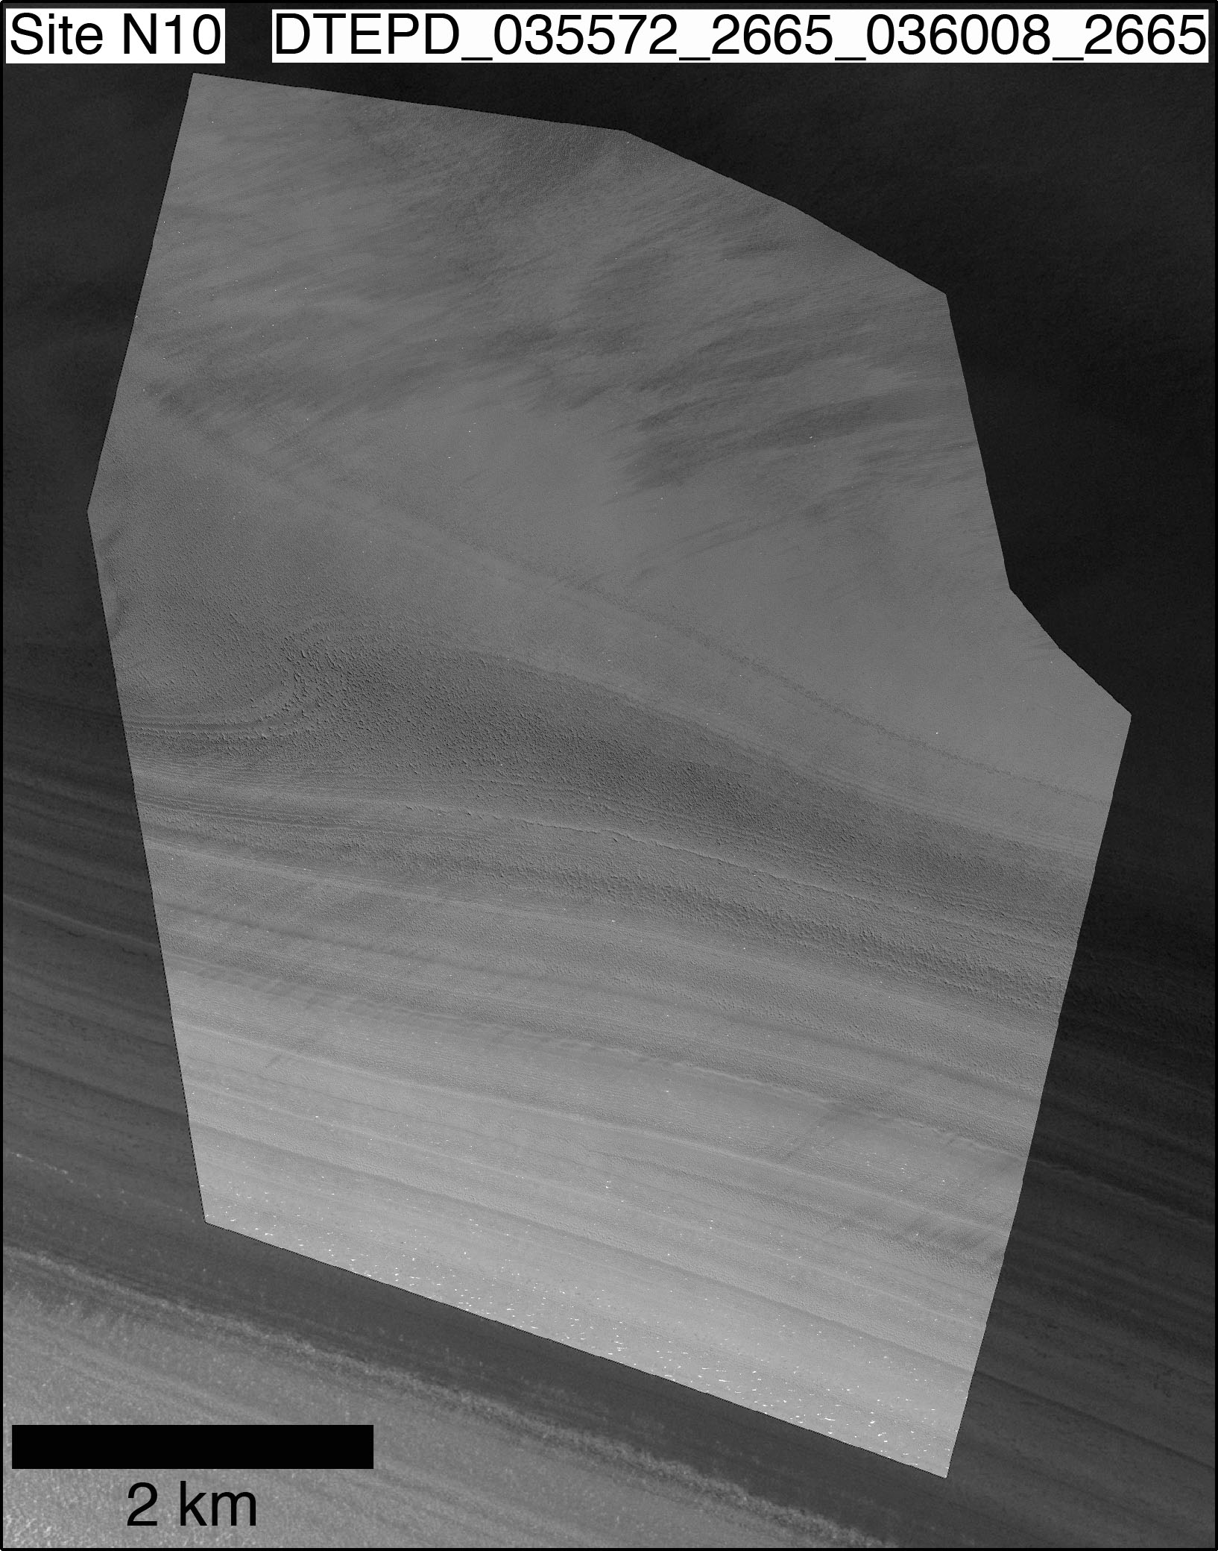
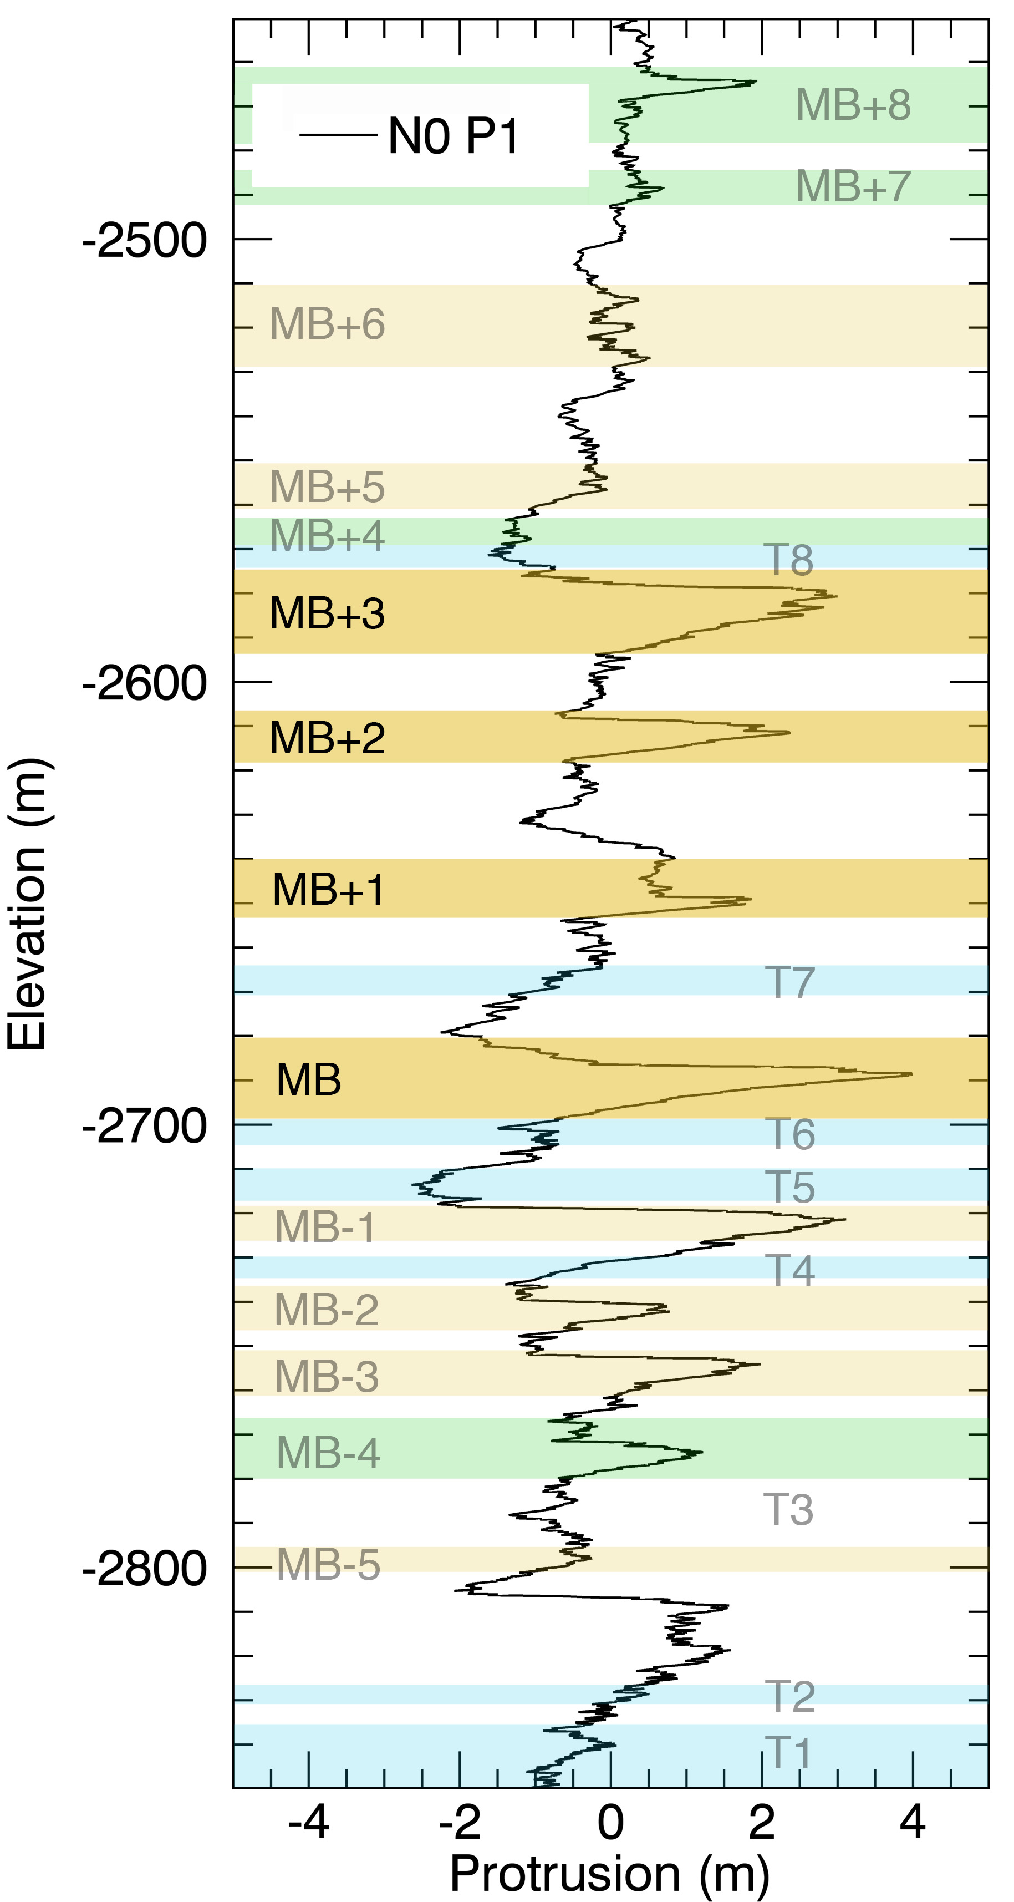
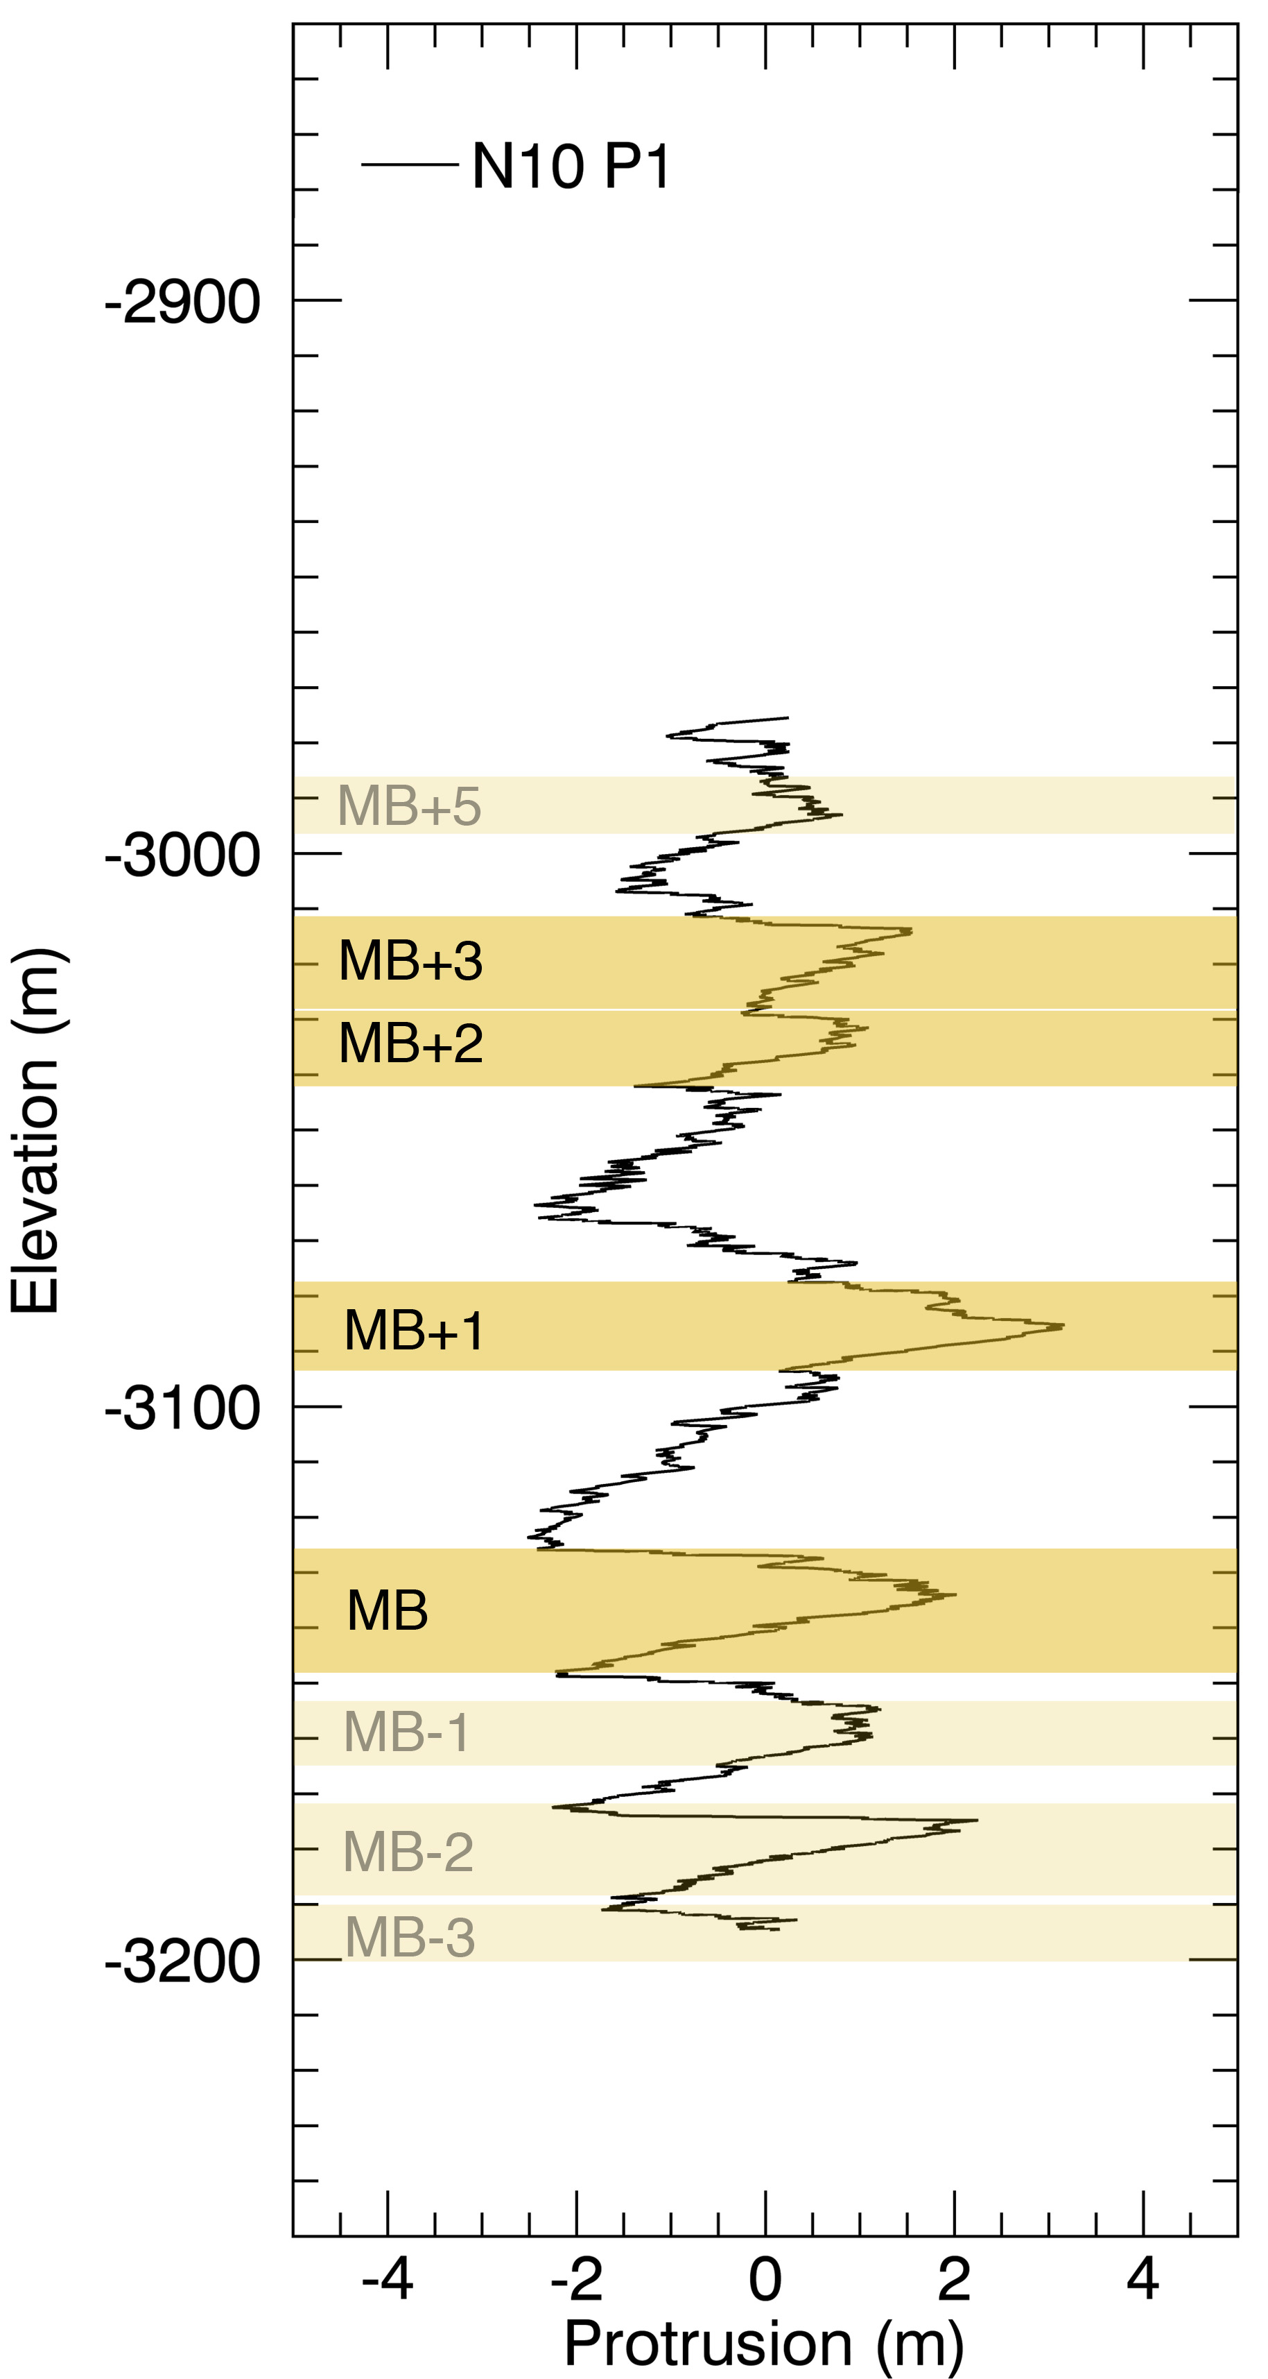
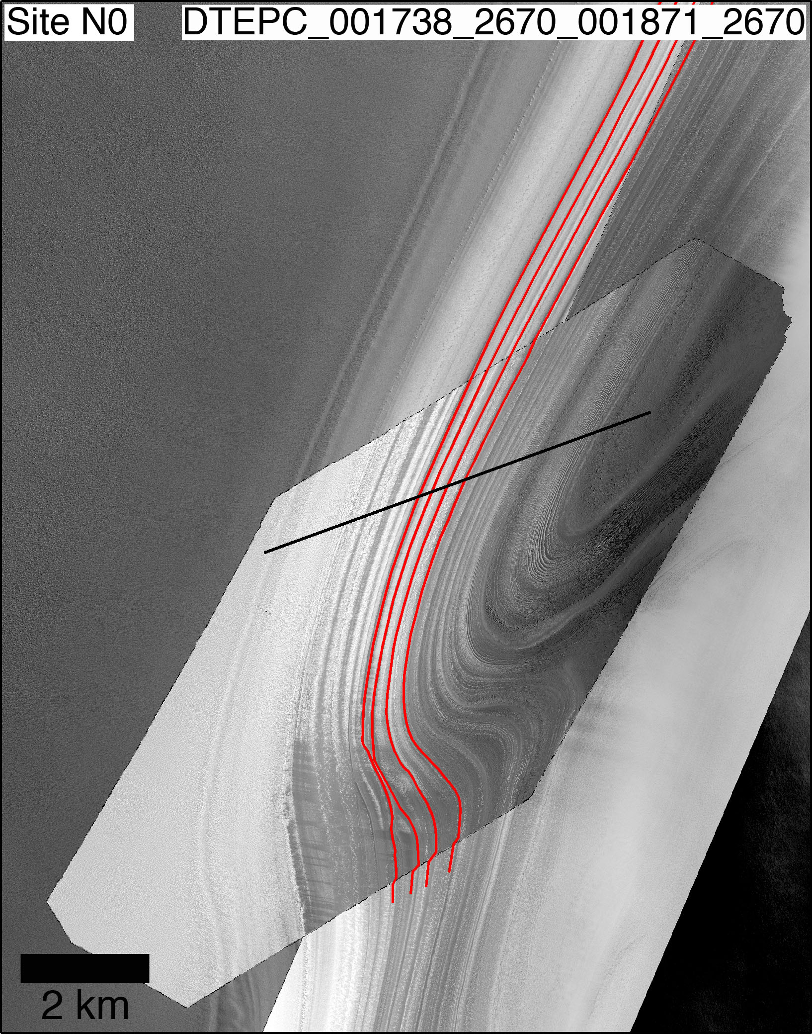
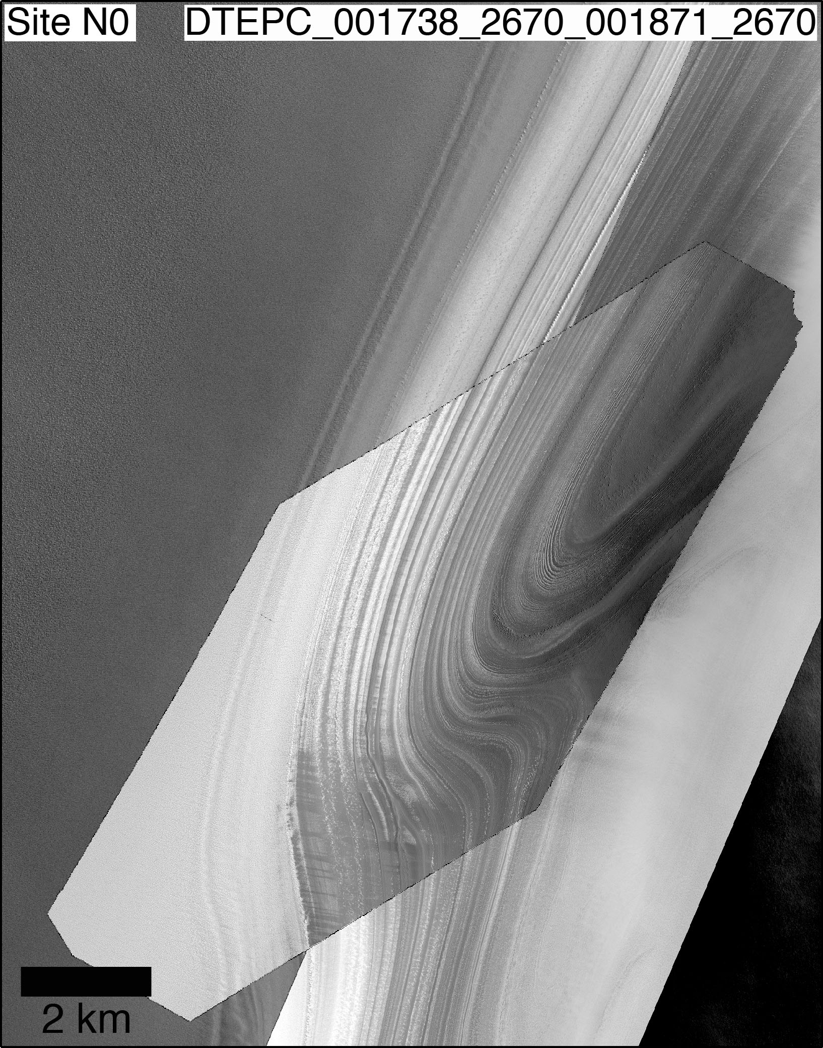
NPLD Stratigraphy with HiRISE Topography:
Image Correlation
We correlate the stratigraphy throughout different sites using a combination of layer tracing in CTX/HiRISE images and signal-matching algorithms (Dynamic Time-Warping or DTW)
From layer tracing we find that sequences of protruding layers correlate across hundreds of kilometers:

Slide 12
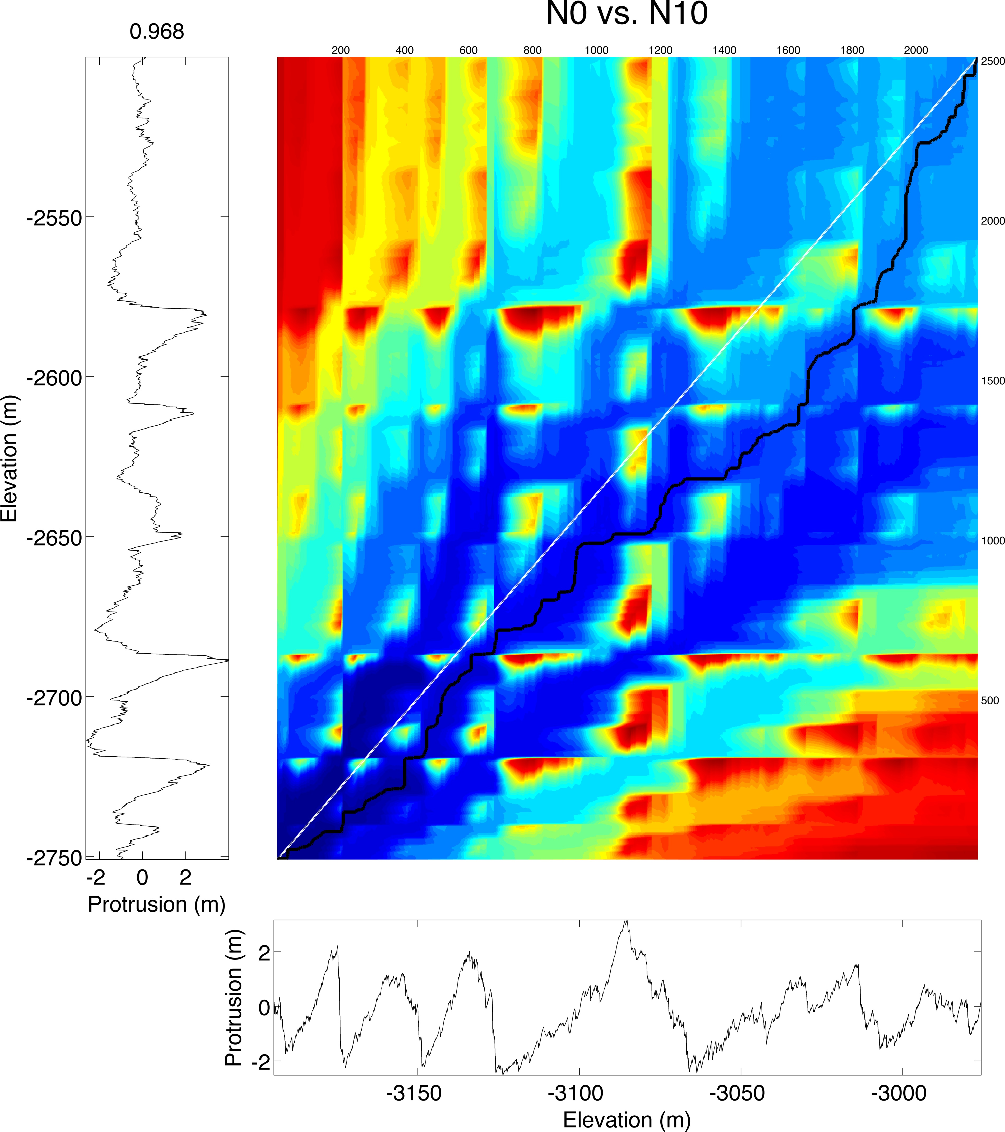
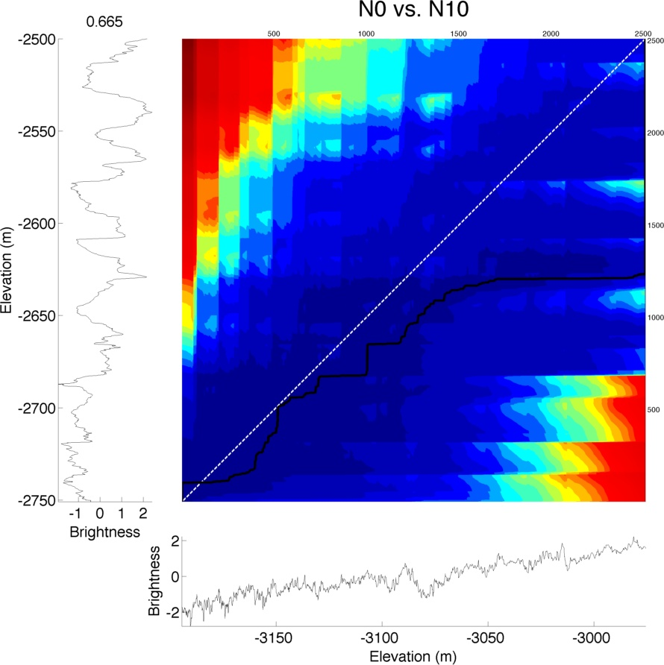
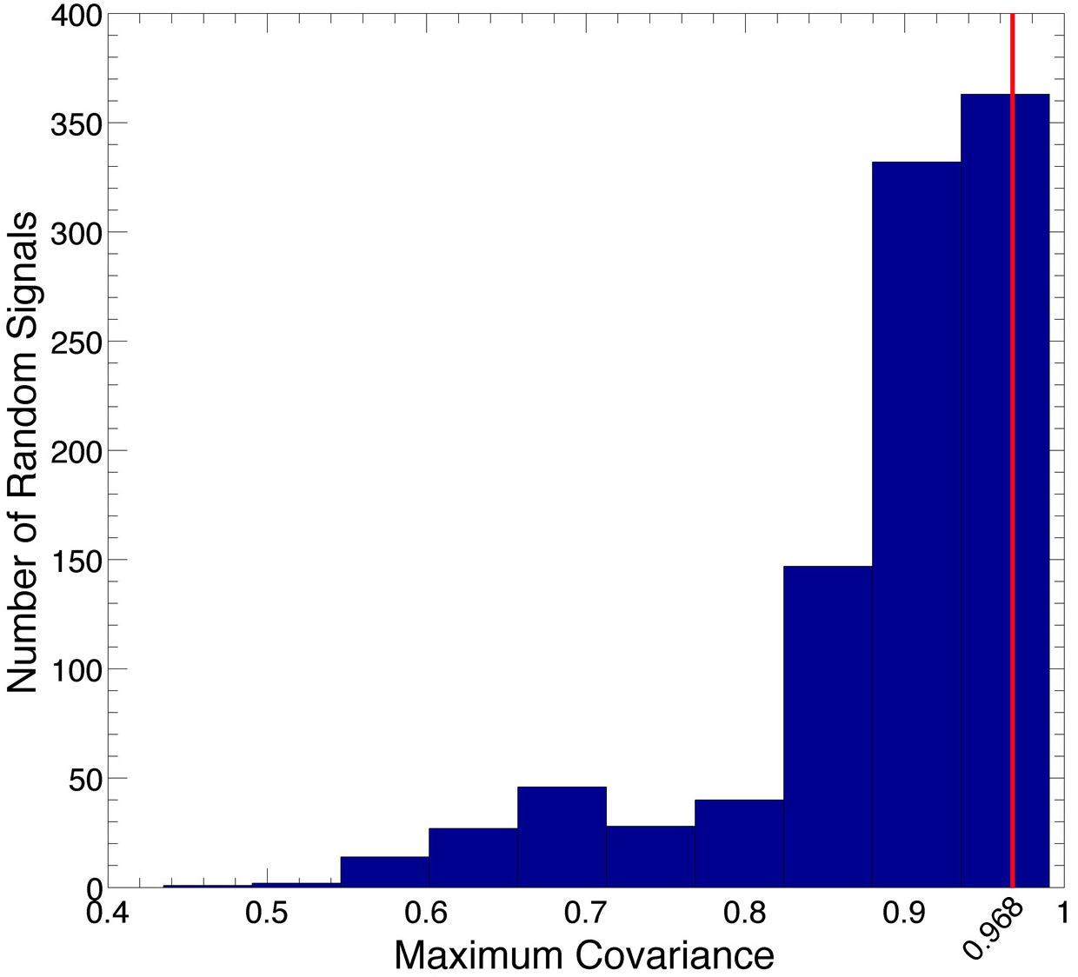
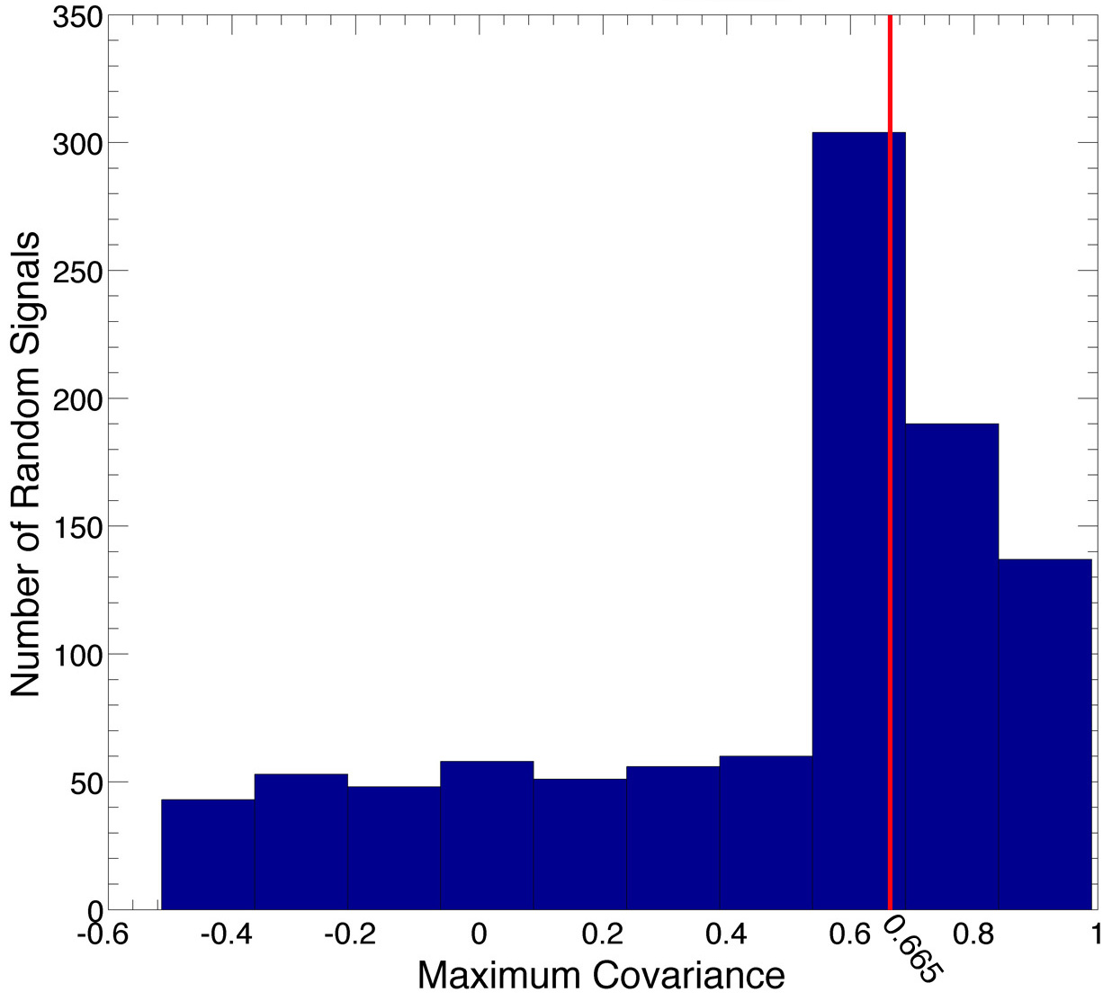
NPLD Stratigraphy with HiRISE Topography:
DTW Correlation
The Dynamic Time-Warping algorithm tunes a depth-protrusion signal in order to find the optimal match with another signal from a different site. The best match is then evaluated for statistical significance with a Monte Carlo procedure
Top panels show tuning of two signals. Left=layer-protrusion and Right = layer-brightness
Bottom panels show the percentage of random signal covariances that are smaller than the real covariance, i.e. the chances that the match is unique and cannot be obtained randomly.
Protrusion provides more unique matches.
In 8 out of 9 cases protrusion is better
Protrusion
Brightness
CL = 93.3%
CL = 60.9%

Slide 13
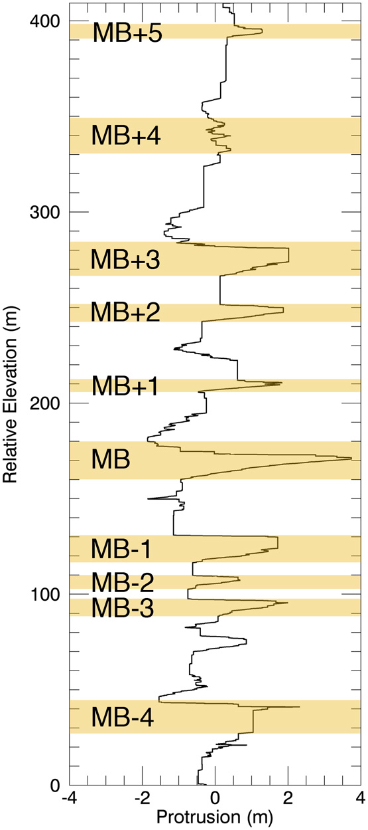
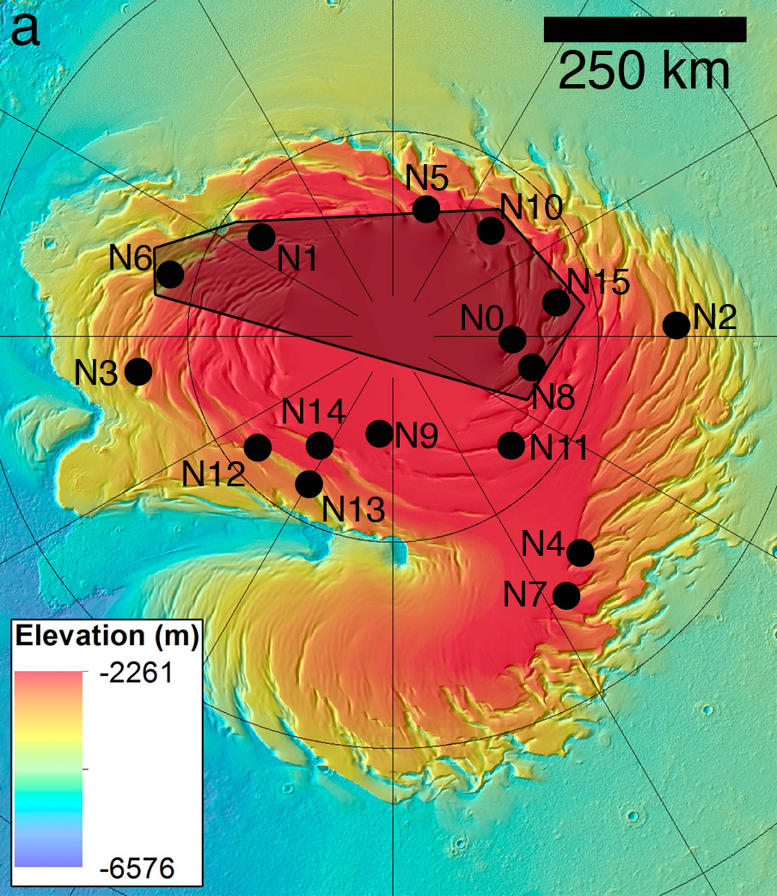
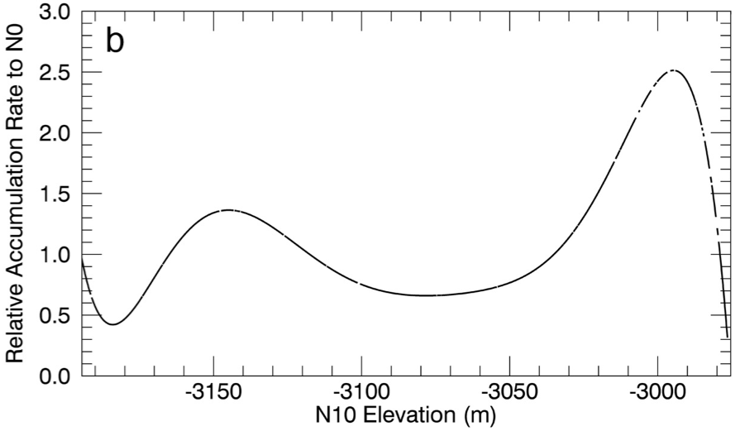
NPLD Stratigraphy with HiRISE Topography: Final results
Through our correlation of signals between sites, we produced a stratigraphic column valid for at least 9% of the surface area of the NPLD.
We derived relative accumulation rates between correlated sites, and found variations of up to a factor of four.
e.g. relative accumulation of N10 compared to N0
The “Main Sequence”, portions of which can be seen at many sites

Slide 14
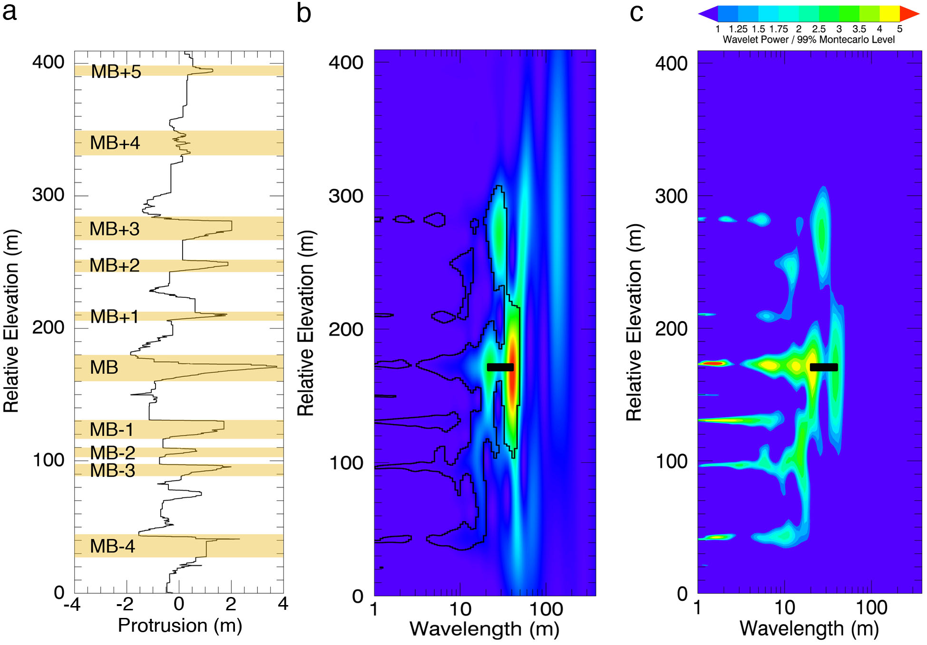
Searching for a Climate Signal in the NPLD
We use Wavelet Analysis to explore the periodicities of the protrusion-based stratigraphic signals
Wavelet power spectra (WPS) expose the dominant periodicities, and show how they vary with depth
Monte Carlo procedures assess the statistical significance of the result
Layer protrusion signal
Wavelet Power Spectrum
Factor by which power exceeds the 99% significance level

Slide 15
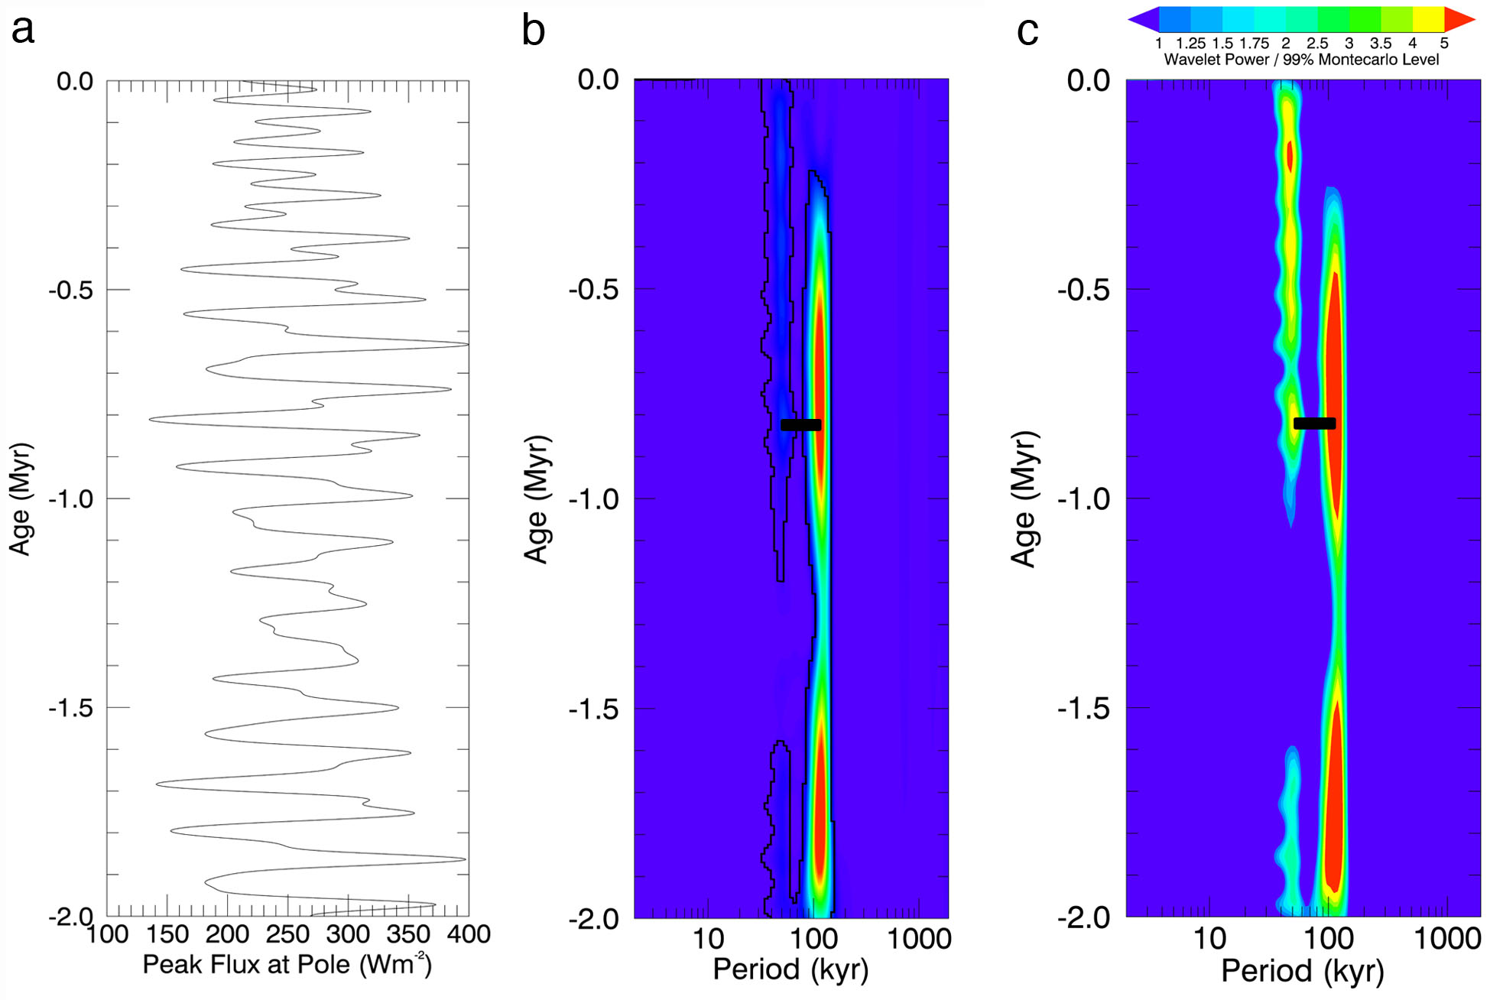
Searching for a Climate Signal in the NPLD
We compare the wavelet power spectrum of the protrusion signal, to that of polar insolation
Plot panels here are the same as in the previous slide
The ratio between the most dominant wavelengths in the middle of the stratigraphic profile (~20 m and ~50 m) is ~2.5, and the ratio of dominant signals in the insolation history (50 kyr and 120 kyr) is ~2.35.
This suggests that the ~20 m and ~50 m signals present in the stratigraphy can be interpreted as climate signals due to the precession of the argument of perihelion and the variation of the obliquity, respectively.
Assuming that each of these sequences is deposited in a single cycle of 51 kyr and 120 kyr, this would imply an average accumulation rate for the NPLD of 0.4 mm/yr, roughly consistent with prior estimates

Slide 16
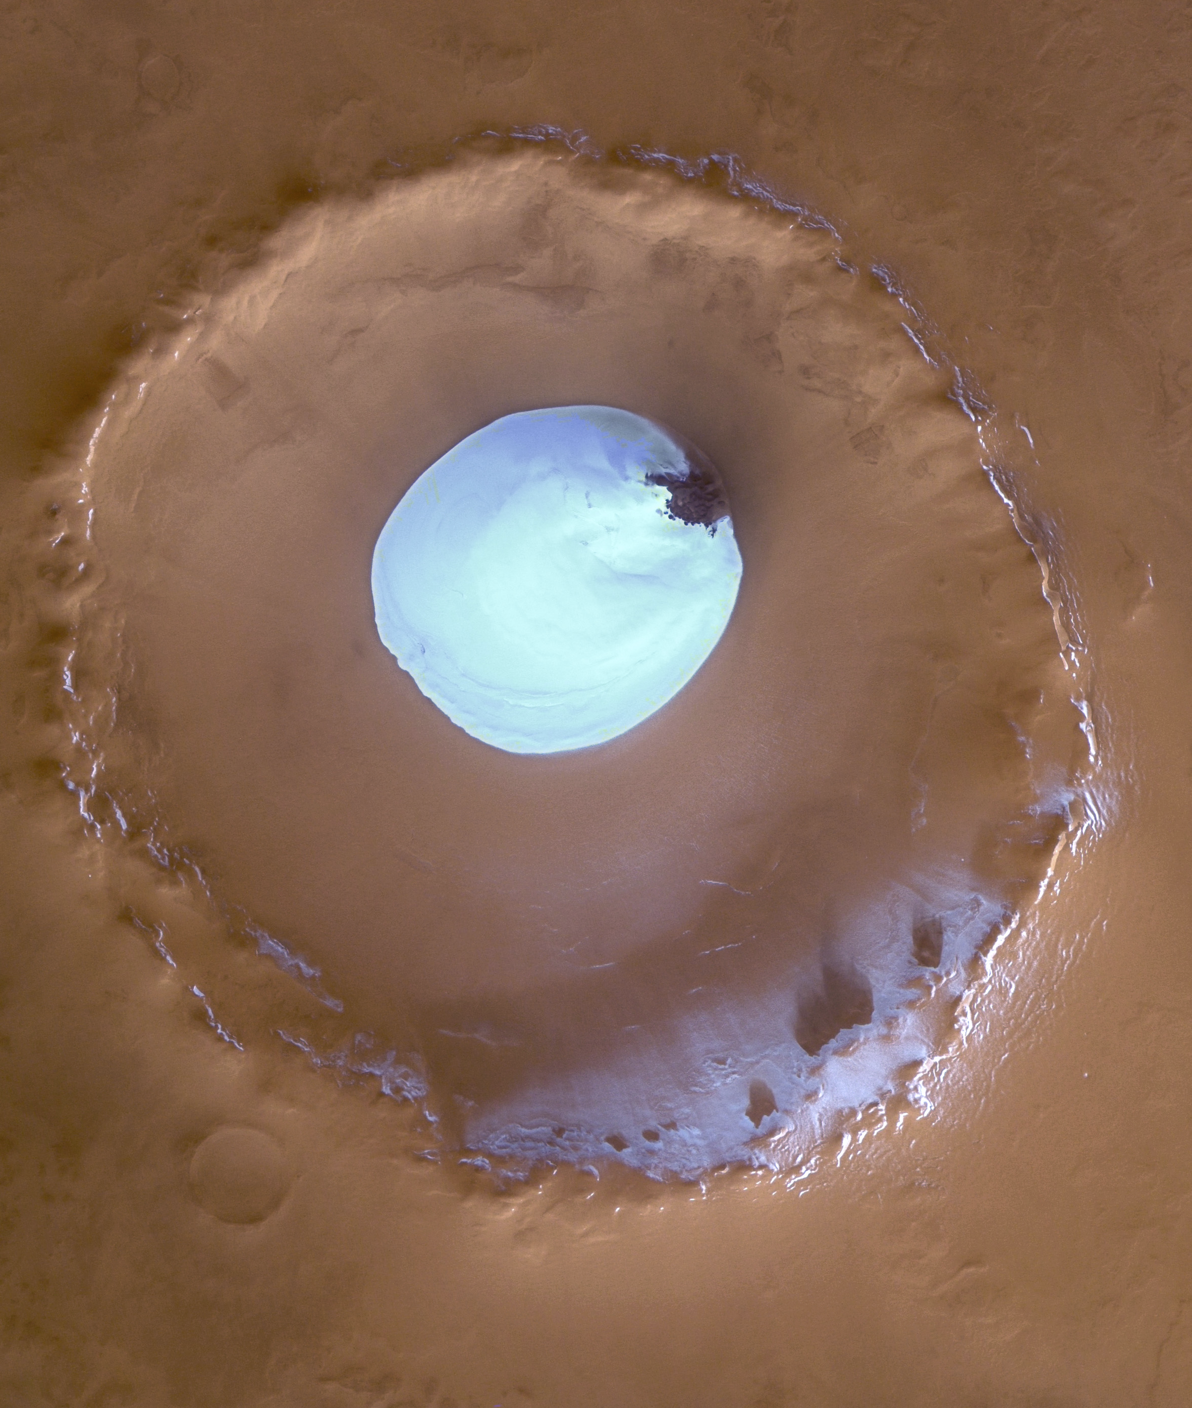
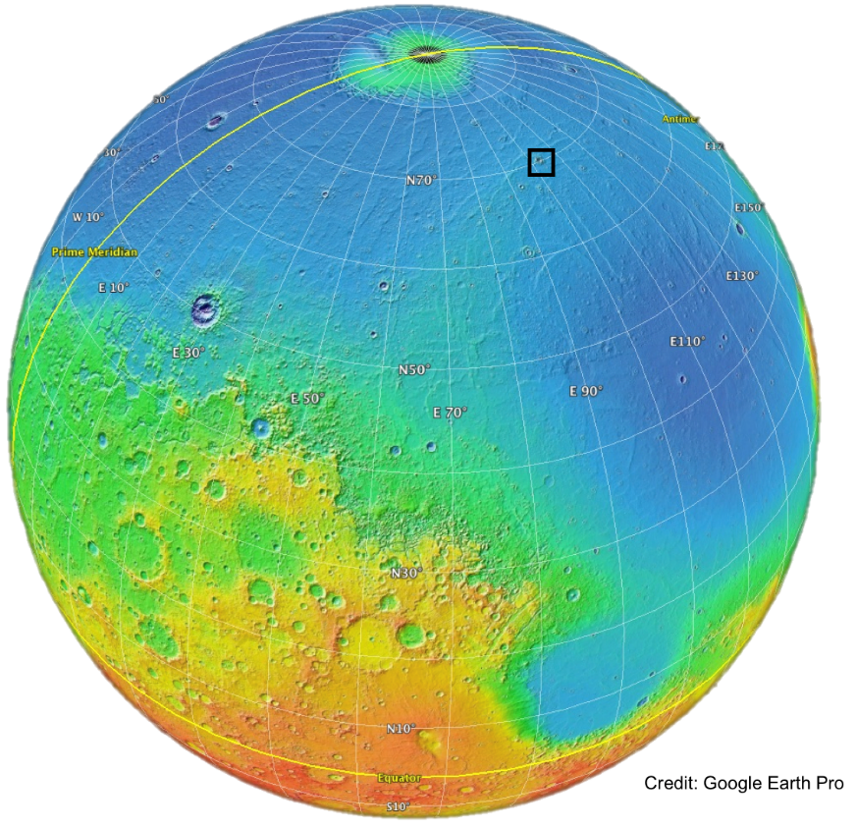
Louth crater water ice mound as a climate proxy
Represents the most-equatorward example of exposed surface ice (70.5°N)
  On average, this is the warmest ice on the surface of Mars
Potentially sensitive to ongoing climate change
  Investigated with repeat, high-resolution images (HiRISE)
HRSC 234192
10 km

Slide 17
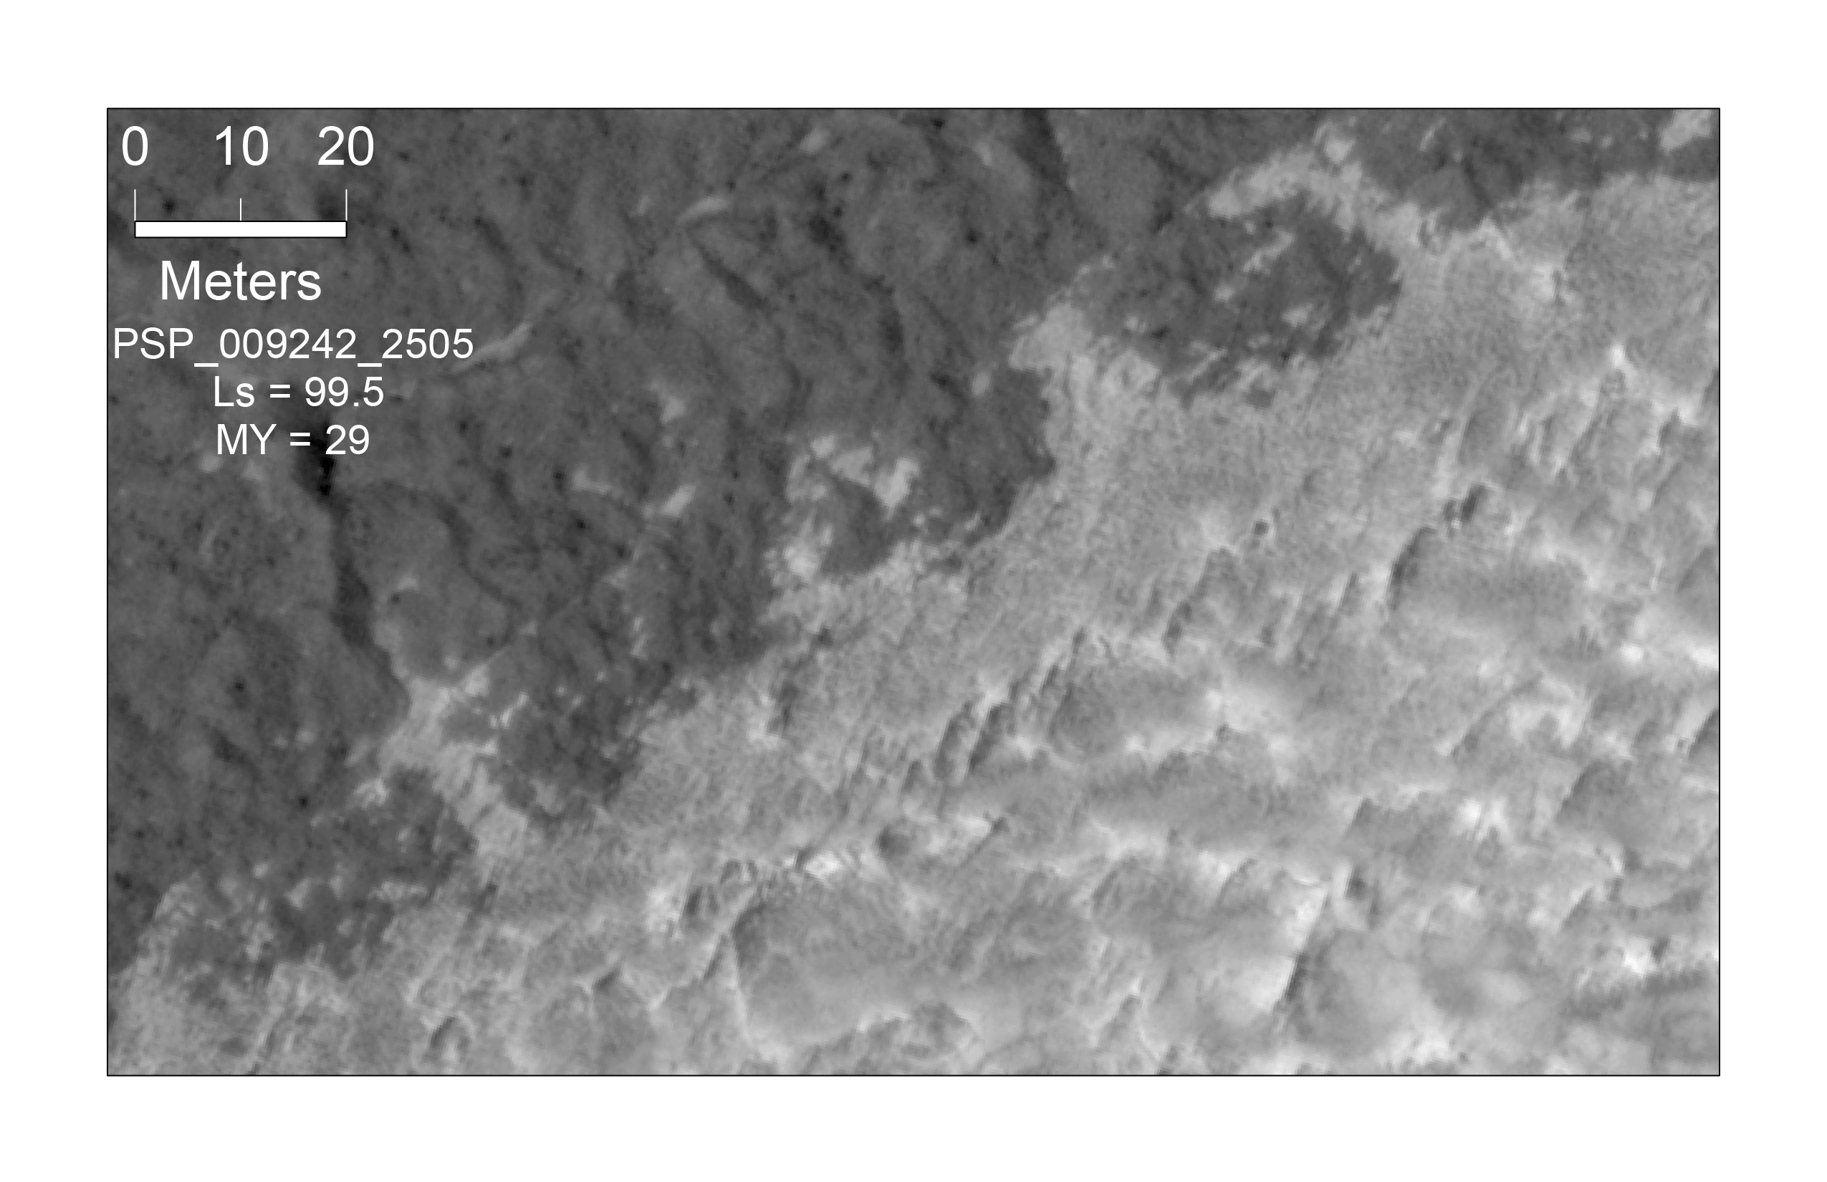
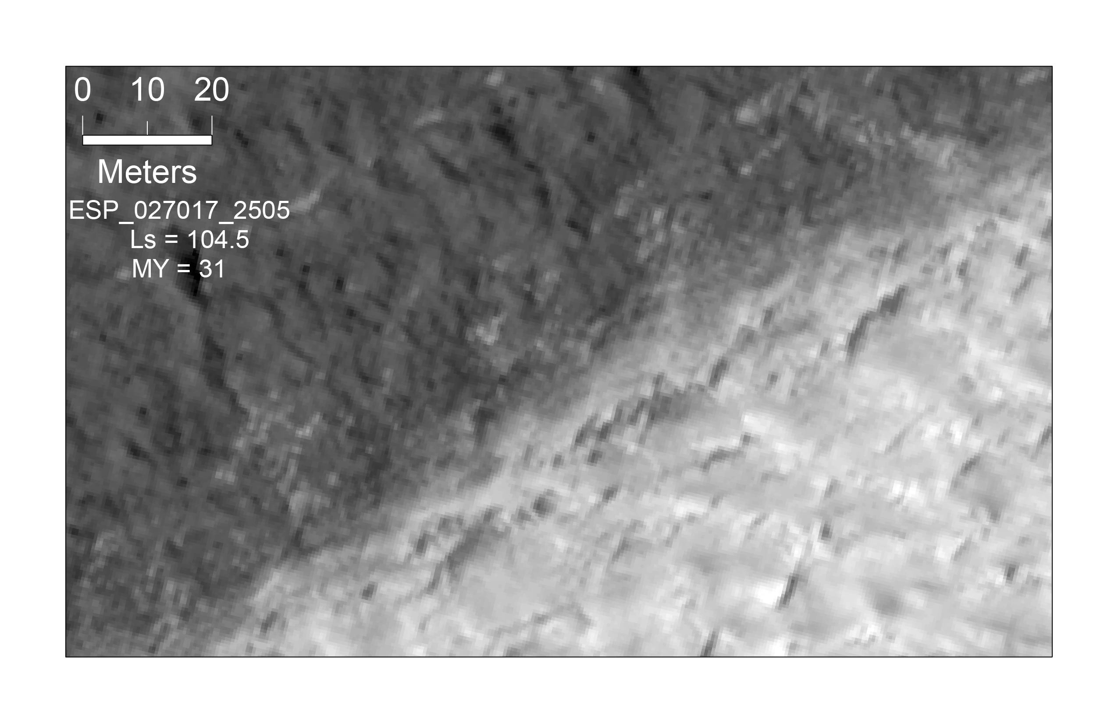
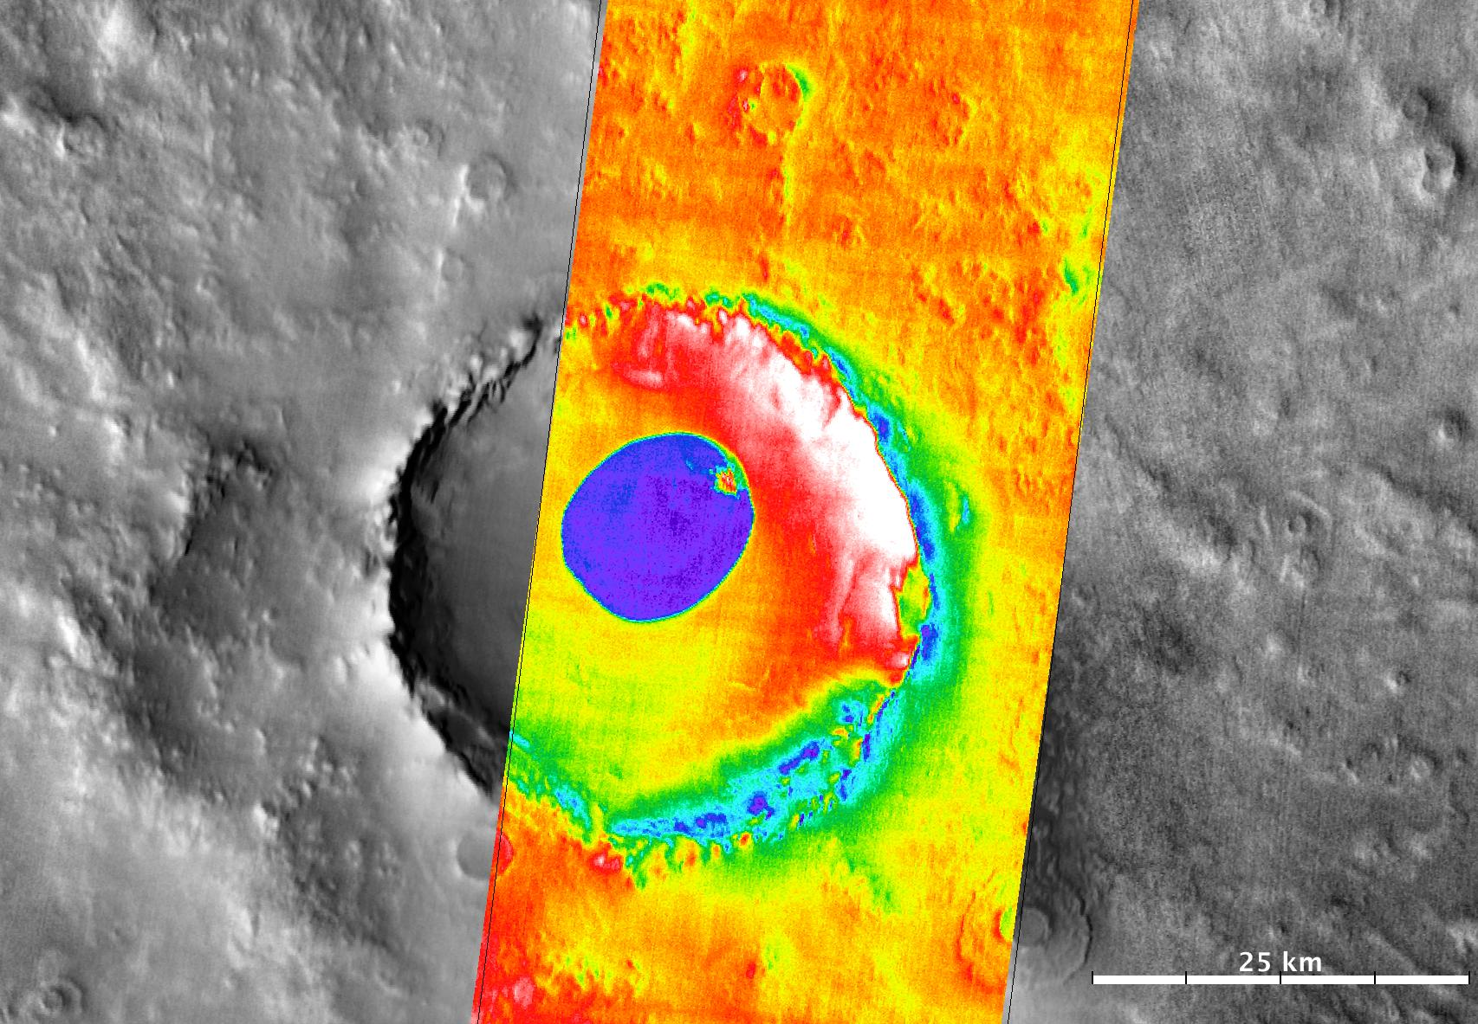
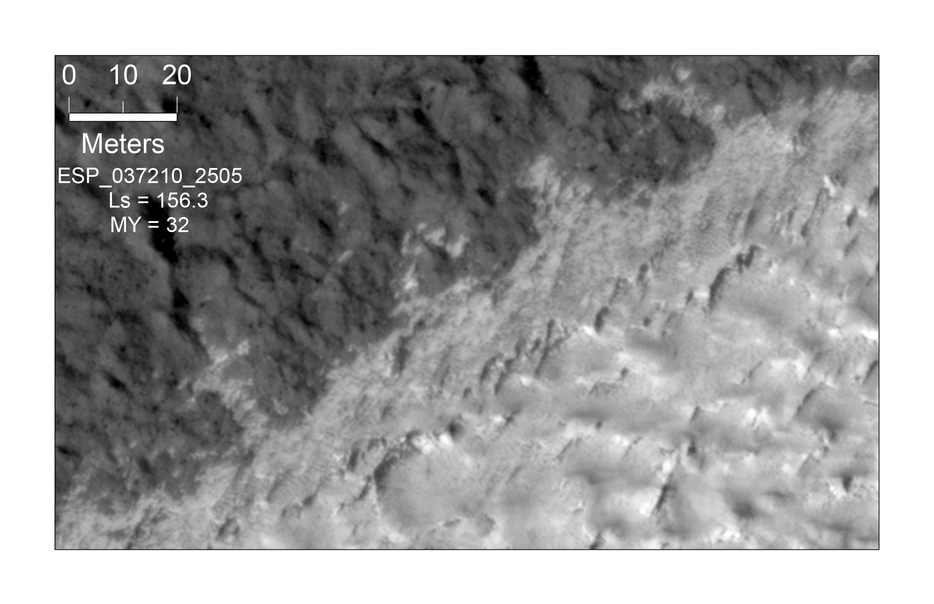
Louth crater water ice mound as a climate proxy
Time
Observations
  Apparent ice loss and replacement during MY29-32
  Observed on north edge of mound
  Spans ~1 km (of ~30 km circumference)
Modeling
  Thermal model constrained with TES/THEMIS
  Estimate mass balance/long-term stability
THEMIS Day IR Global Mosaic with THEMIS I54988020; colorized by temperature

Slide 18
Polar stereo planning
Two large rolls required north of latitude 88.2, so more difficult to get
SPORCs preferred on/near north polar residual cap due to rapid changes
Continuing analysis of stereo pairs acquired at high latitudes suggests no changes to HiSEAS parameters

Slide 19

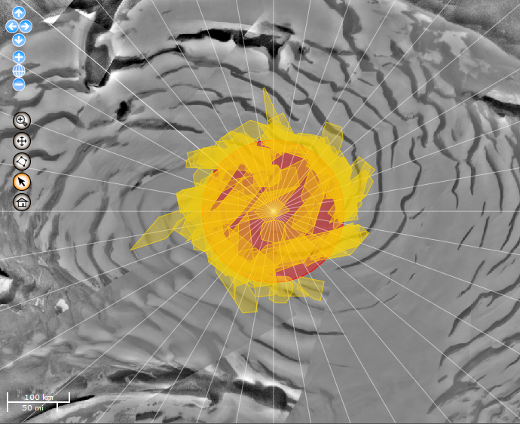
North Polar CTX Coverage
Red circle is >88°N, where MOLA data are sparse
Convergence angle range 7-40 degrees
Maximum solar separation angle = 50°
Minimum intersect area = 800 km²
Pixel scale < 8 meters
Overall, CTX stereo coverage is good, only a few gaps to be filled
More testing needed to determine whether image quality good enough for stereogrammetry
http://pilot.wr.usgs.gov/
Notes:
Filling gaps with new stereo suggestions—is a new CTX mosaic available?

Slide 20
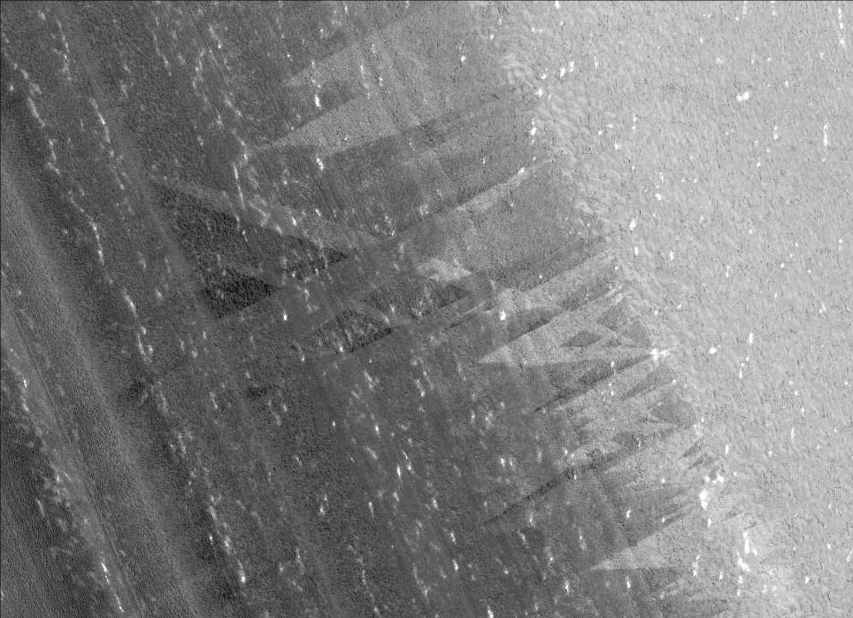

North Polar Summer Streaks
PSP_009273_2610
80.8°N, 330.6°E
L_{s} = 100.6
2008
N
Sun
Downslope
200 m
Notes:
Streaks oriented down and across slope, so not just gravity-driven. No streaks evident in spring images. Monitoring indicates frost mobilized in early summer.

Slide 21
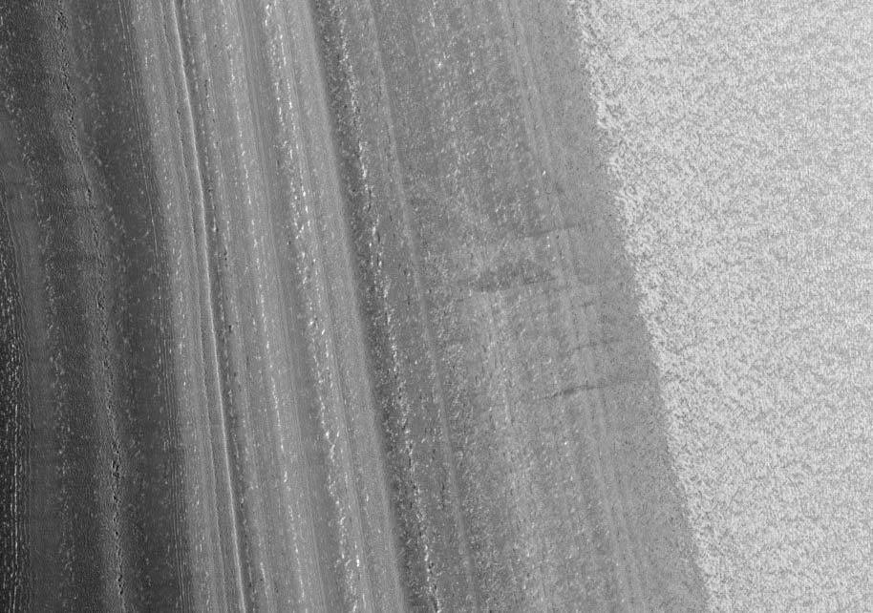
North Polar Summer Streaks
ESP_018068_2610
L_{s} = 99.9°
2010
Only subtle streaks visible
Insufficient time resolution to infer origin, could be remnants from previous summer
Downslope

Slide 22
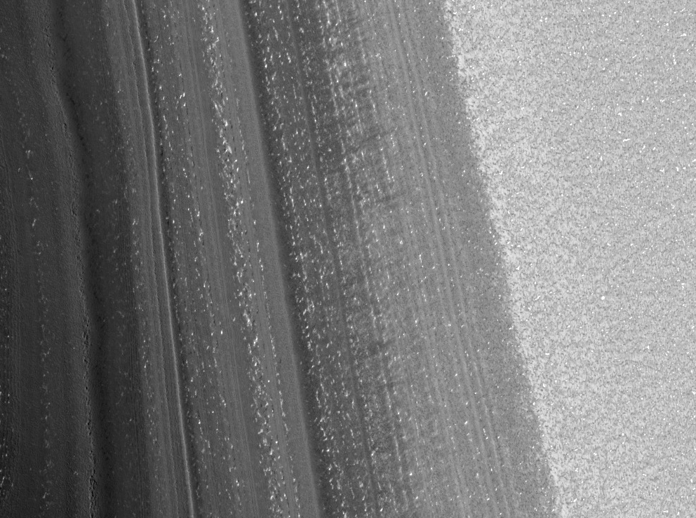
North Polar Summer Streaks
ESP_026916_2610
L_{s} = 101°
2012
Images acquired more frequently this year, but no crossing streaks observed
Downslope
Notes:
More images on planned

Slide 23
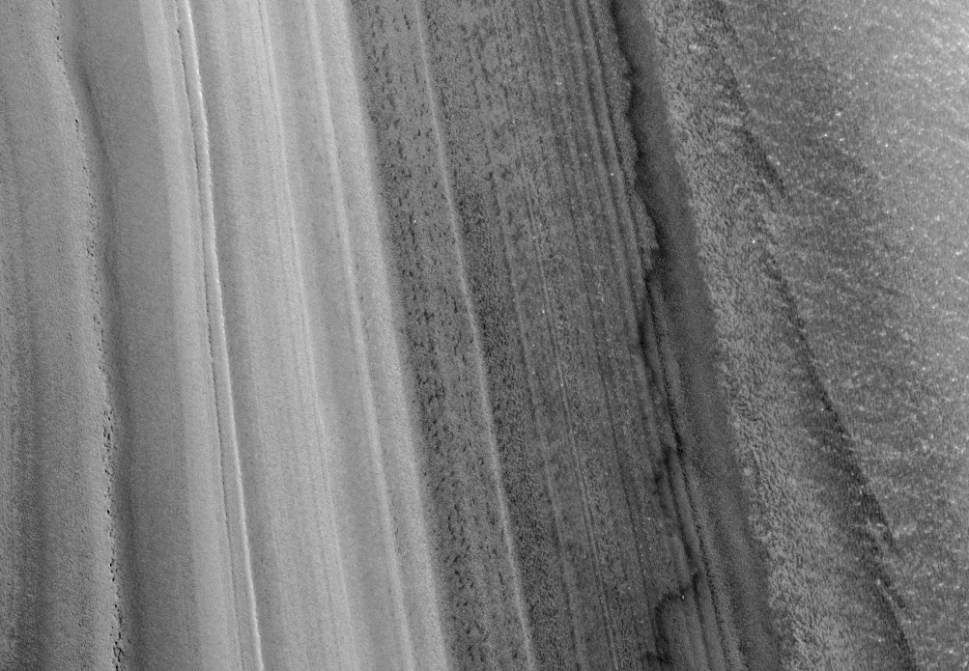
North Polar Summer Streaks
ESP_035698_2610
L_{s} = 99.8°
2014
Changes in distribution of darker material observed this summer -- implies mobility of sand (?)
No 2016 images acquired yet (DSN problems)
Downslope
Notes:
No 2016 images acquired yet, some lost to DSN issues

Slide 24
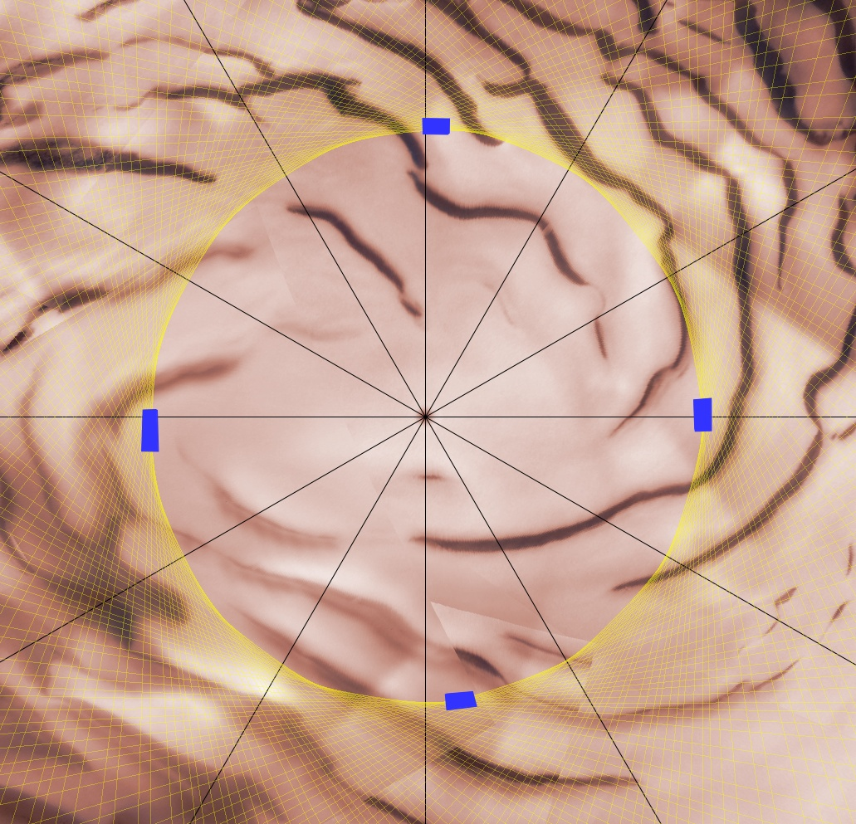
North Polar Residual Cap Monitoring
Comparison of residual cap images complicated by differences in illumination
Four nadir-only targets at 87°N
  Consistent solar azimuth ensured by nadir viewing (don’t plan as IOs!)
  Most images acquired during summer
180°E
90°E
270°E
0°E
Notes:
Yellow lines are example MRO ground tracks

Slide 25
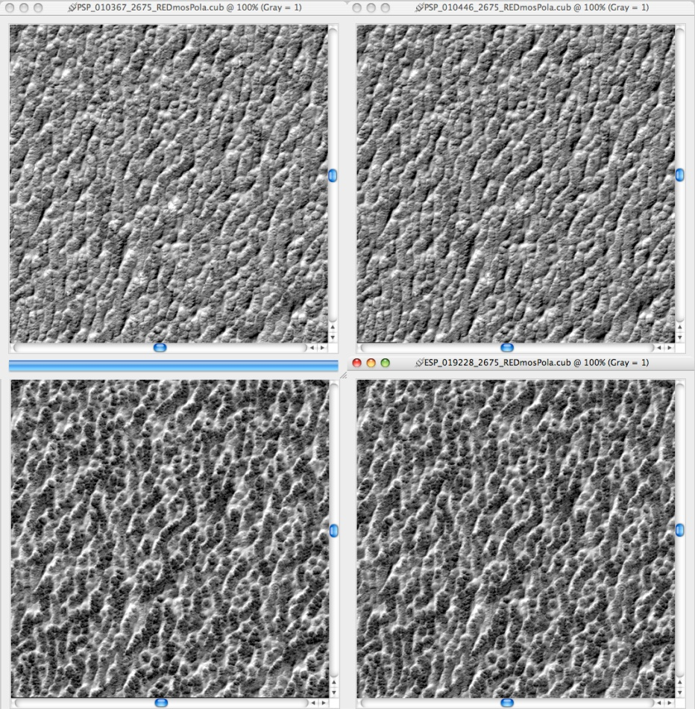
Interannual Changes
PSP_010367_2675
L_{s} = 140.6°
Mars Year 29 (2008)
Albedo = 0.45
Longitude ~ 270°E
PSP_010446_2675
L_{s} = 143.7°
Mars Year 29 (2008)
Albedo = 0.46
300 m
ESP_019070_2675
L_{s} = 136.3°
Mars Year 30 (2010)
Albedo = 0.42
ESP_019228_2675
L_{s} = 142.4°
Mars Year 30 (2010)
Albedo = 0.40
Notes:
Almost no changes during late summer; images stretched independently, polar stereographic projection, illumination from lower right

Slide 26
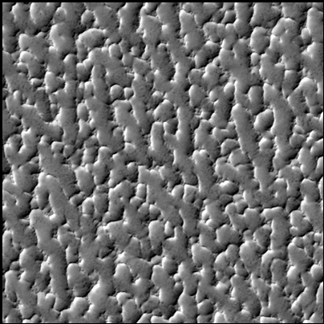
Subtle Interannual Changes
Nearly identical illumination, from lower right:
PSP_010505_2725
MY 29 (2008)
L_{s} = 146.0°
Albedo = 0.45
Solar azimuth = 136°
~300 m
ESP_019327_2675
MY 30 (2010)
L_{s} = 146.2°
Albedo = 0.44
Solar azimuth = 146°
Notes:
Apparent shifting between images may be due to 10 degree difference in solar azimuth; target near 90E long.

Slide 27
Polar Geology Papers within the last 12 months
Submitted
Landis et al., A revised surface age for the North Polar Layered Deposits of Mars, GRL.
Becerra et al., Stratigraphy of the North Polar Layered Deposits of Mars from High-Resolution Topography, JGR-Planets.
Published in the last 12 months
Sori, M.M., S. Byrne, C.W. Hamilton, and M.E. Landis, Viscous flow rates of icy topography on the North Polar Layered Deposits of Mars, Geophys. Res. Lett., 42, 2016.
Becerra, P., S. Byrne, and A.J. Brown, Transient bright "halos" on the South Polar Residual Cap of Mars: Implications for mass-balance, Icarus, 251, 211-225, 2015.
Hansen, C.J., S. Diniega, N. Bridges, S. Byrne, C. Dundas, A. McEwen, and G. Portyankina, Agents of change on Mars' northern dunes: CO2 ice and wind, Icarus, 251, 264-274, 2015.
Piqueux, S., S. Byrne, H.H. Kieffer, T.N. Titus, and C.J. Hansen, Enumeration of Mars years and seasons since the beginning of telescopic exploration, Icarus, 251, 332-338, 2015.
…lots of others in the polar science special issue of Icarus

Slide 28
North Polar Geology Plans
5th late northern summer
Residual cap monitoring
  4 targets along “magic circle” at about 87°N: Nadir only to provide similar illumination/viewing
  Include icy outliers like Korolev and Louth
  Change detection within NPLD craters
Acquire NPLD stereo data of:
  Craters
  Fill gaps in CTX coverage within “magic circle”
  Good quality pairs for steep scarps
High-roll images of steep scarps to look for more missing blocks
  Also test for possible viscous flow

