Slide 1
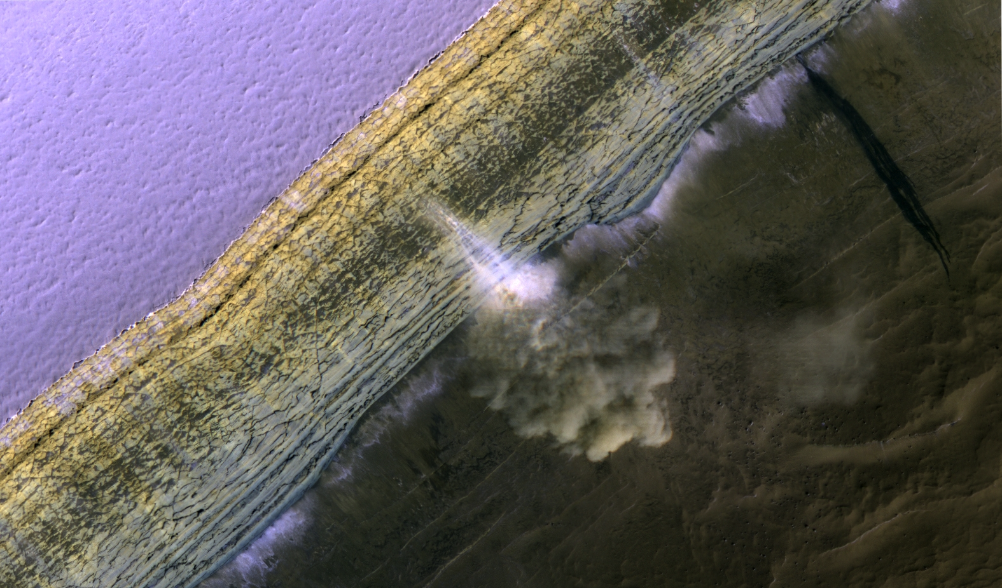
Falling to Pieces: Fractures, Blockfalls and
Avalanches at the North Pole of Mars
S. Byrne, P. Russell, A. Pathare, P. Becerra, J. Molaro, S. Mattson and M.T. Mellon

Slide 2
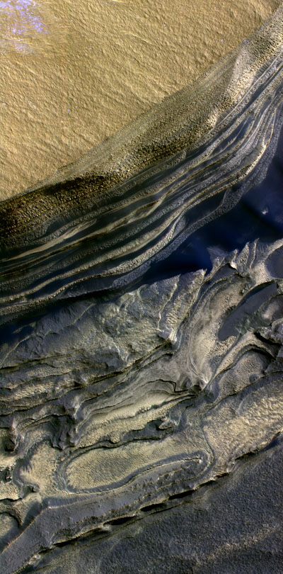
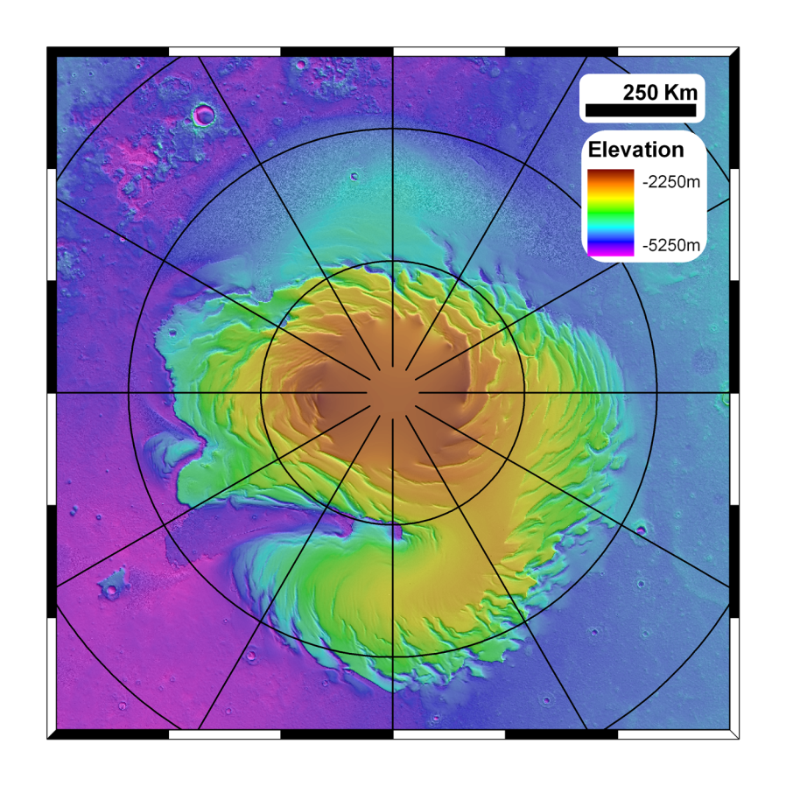
Phillips et al., 2008
1.1 million km³
2km of layered water ice (<5% dust)
Basal unit rich in sand
~20% of the size of the Greenland ice-sheet

Slide 3
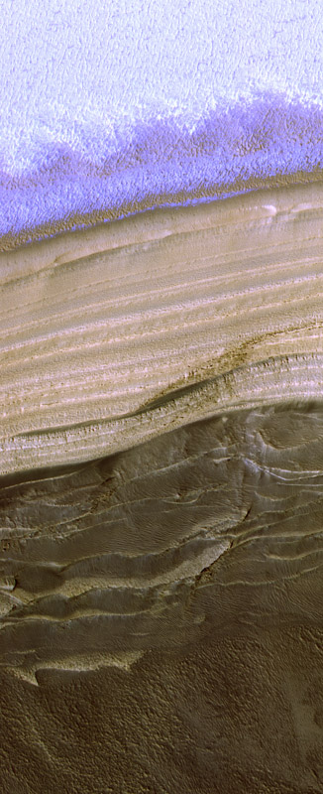
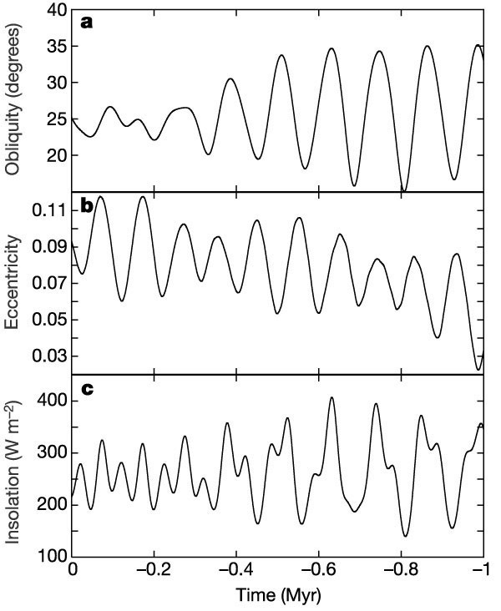
Laskar et al., 2002

Slide 4
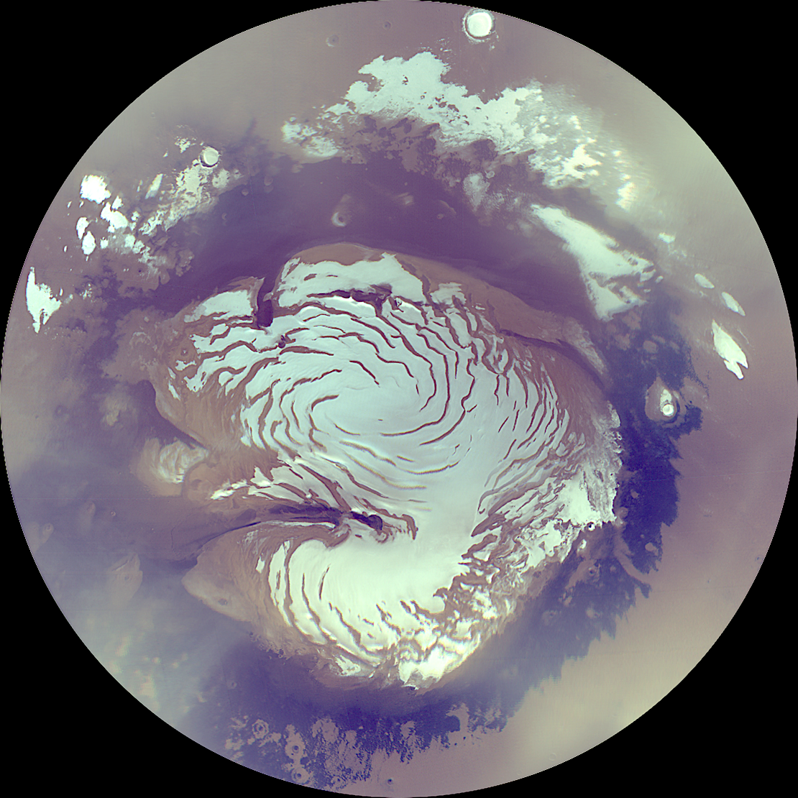
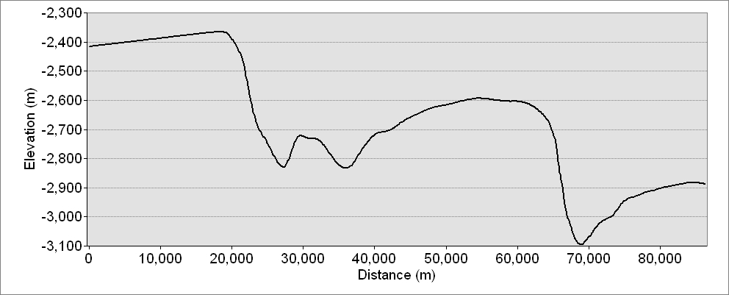
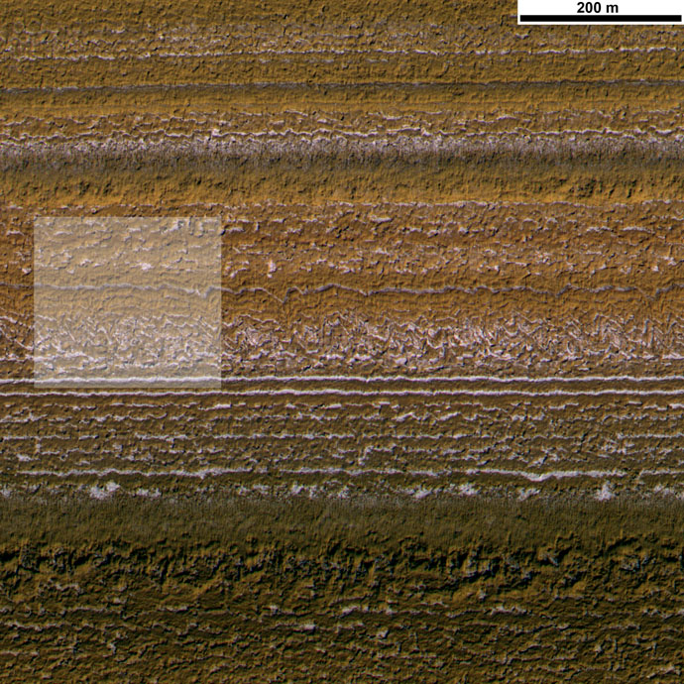
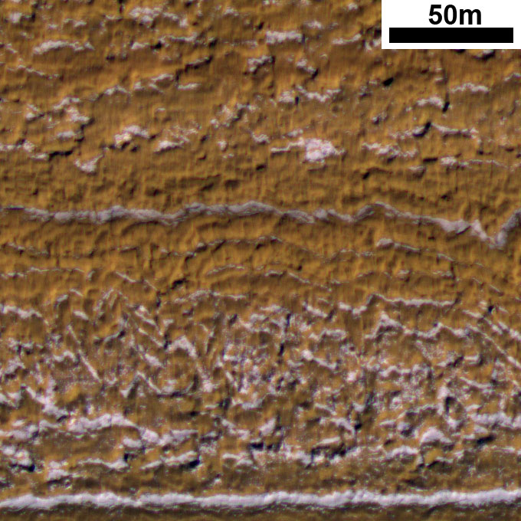
Layers exposed by gently sloping troughs
Thick lag deposits that slump downslope
PSP_001738_2640

Slide 5
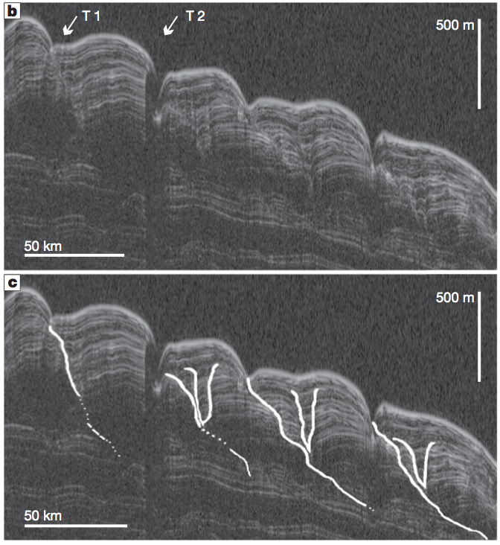
Troughs migrate and are a dynamic part of the stratigraphic record.
Initiated 0.5-2.5 Myr ago
Migrating at 2-16cm yr⁻¹
Knowledge of where troughs are and used to be is necessary to fully understand the record they contain
Smith and Holt, 2010

Slide 6
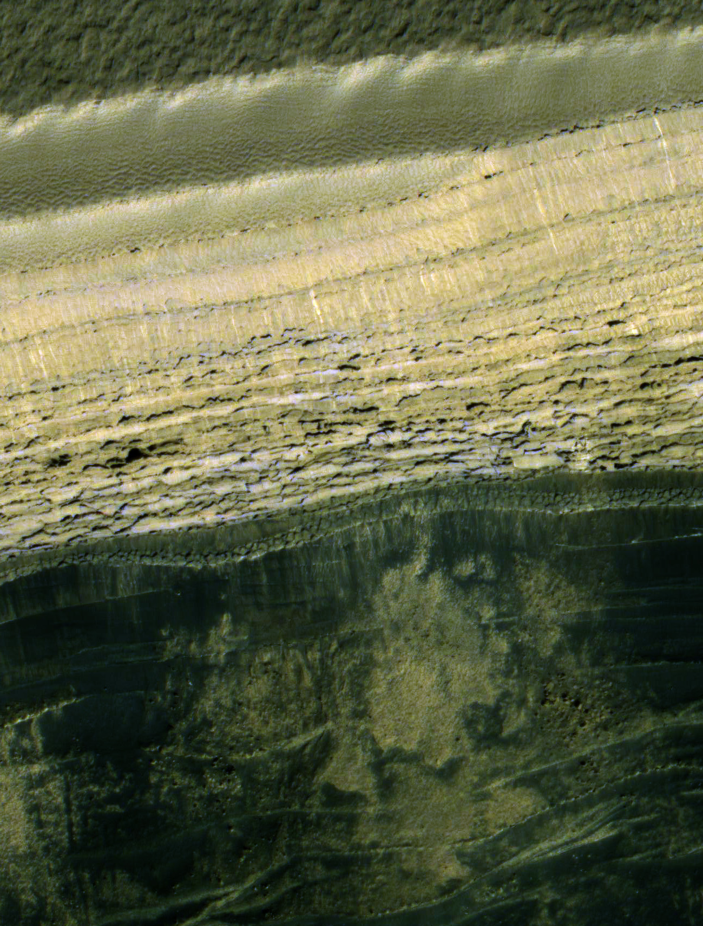
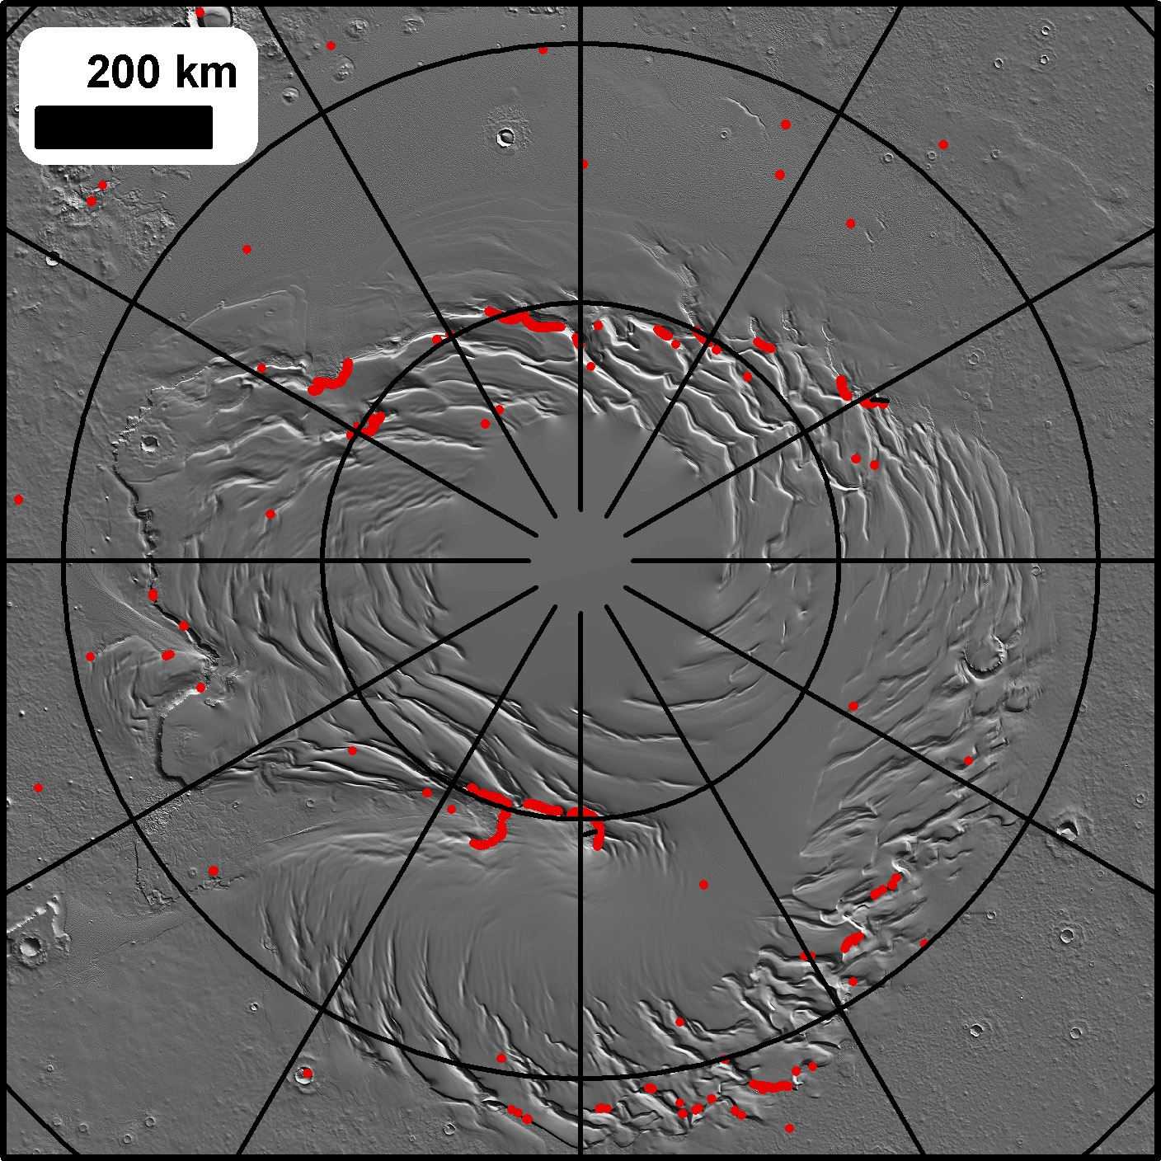
Steep cliffs at the PLD boundaries
Locations of slopes above 35°

Slide 7
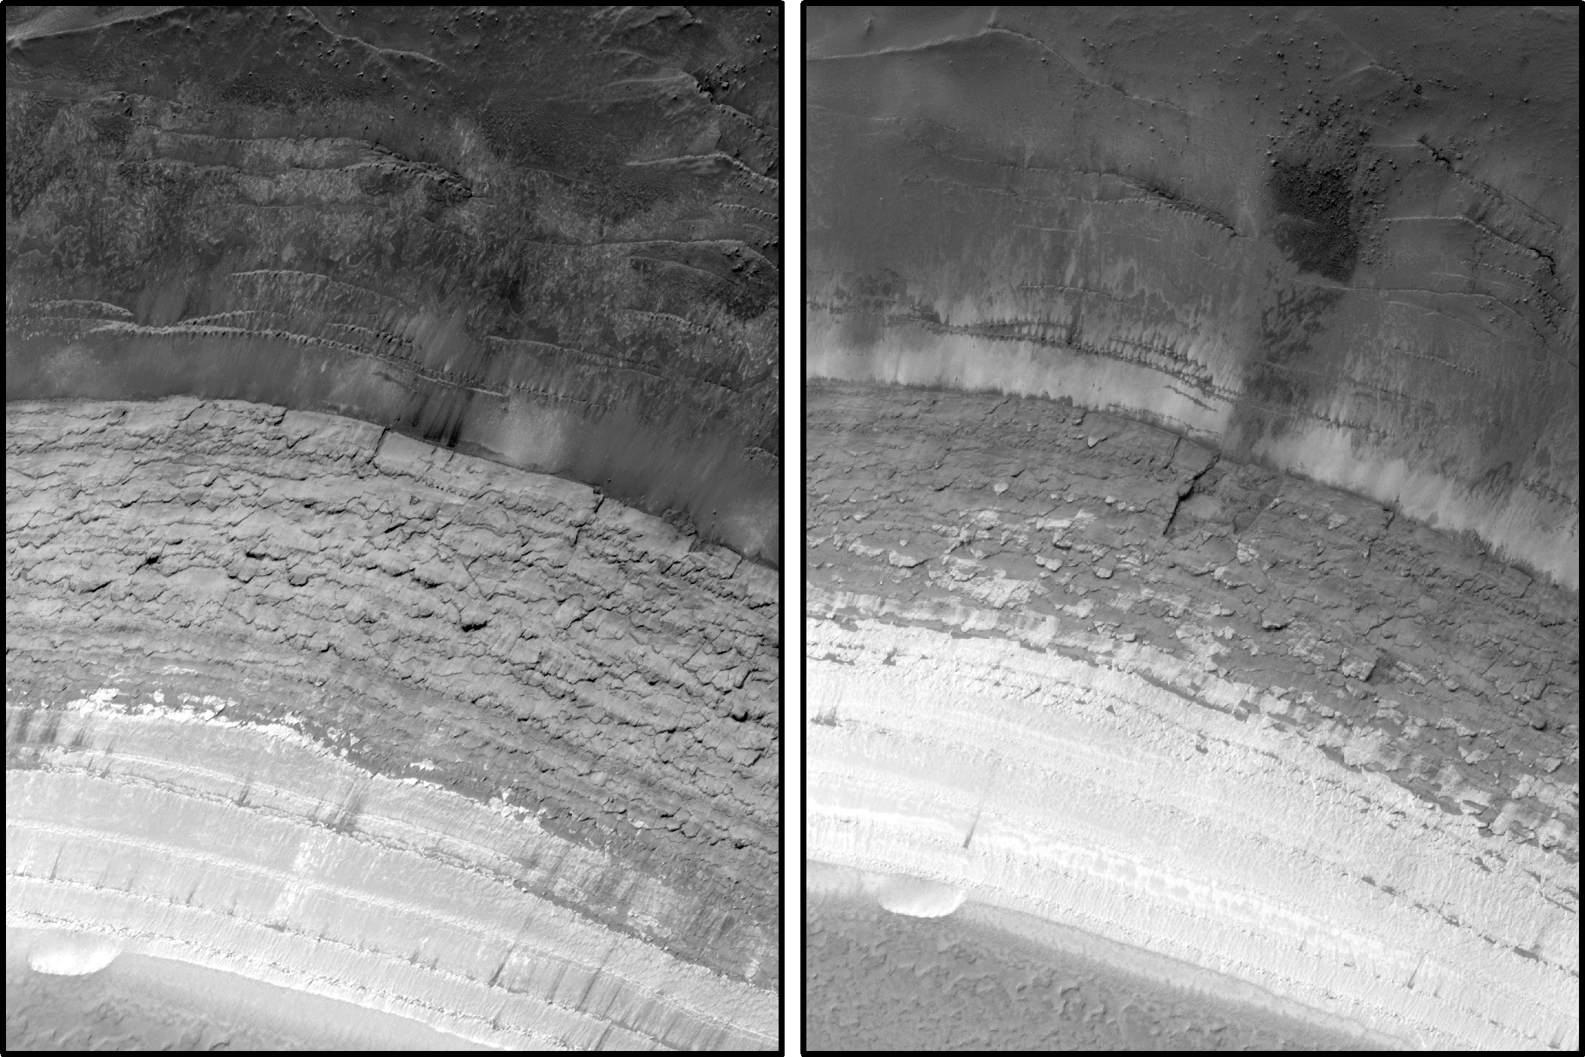
Rolling MRO provides the best way to look for changes
ESP_016292_2640
ESP_024639_2640

Slide 8
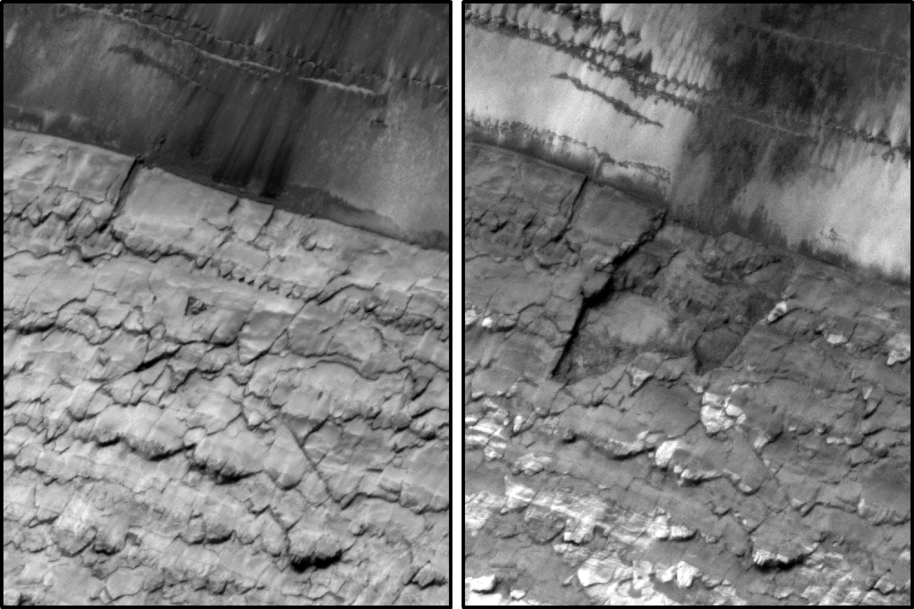
Failure of a 70m wide section in late-summer or winter of MY 30…
ESP_016292_2640
ESP_024639_2640

Slide 9
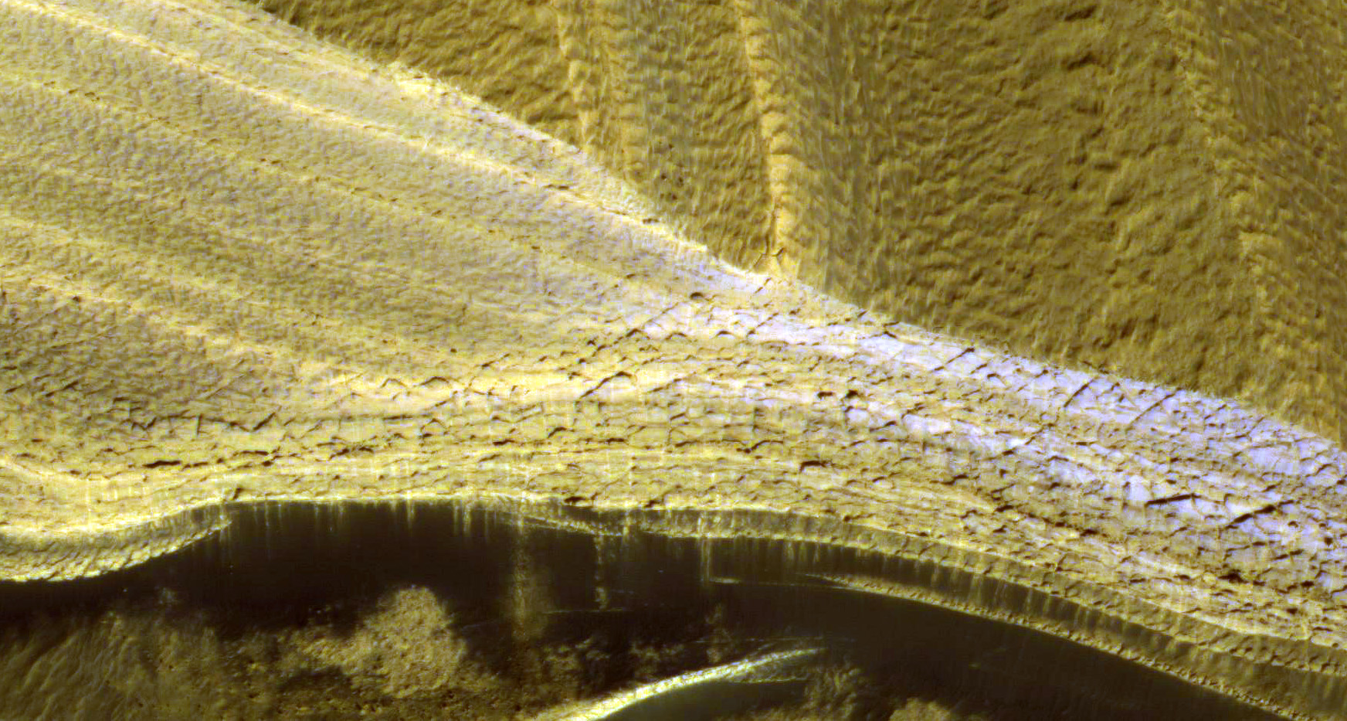
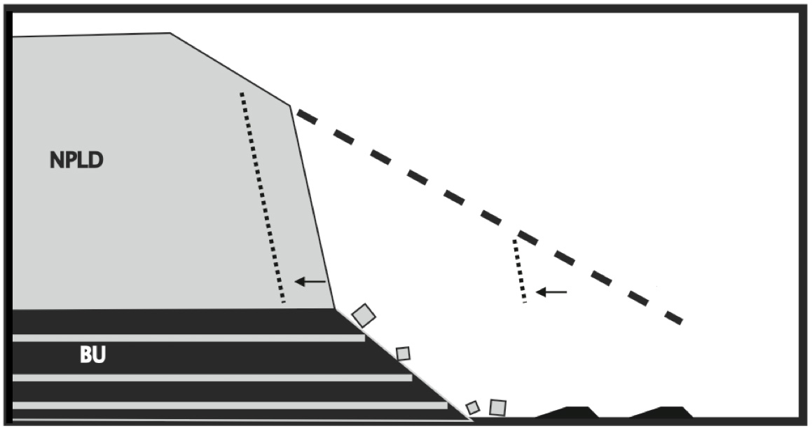
Layers transition from fractured to unfractured with slope
Steep slope may be due to undermining by erosion of the exposed sandy basal unit
Russell et al. 2011

Slide 10
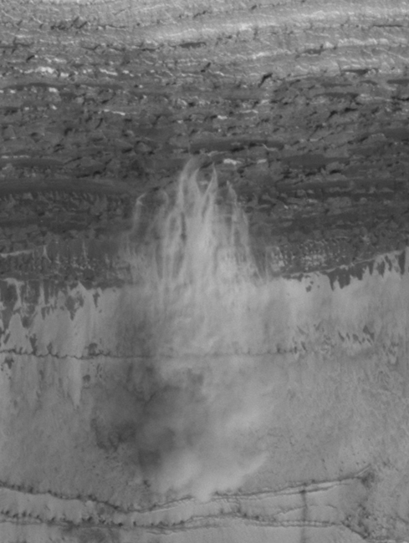
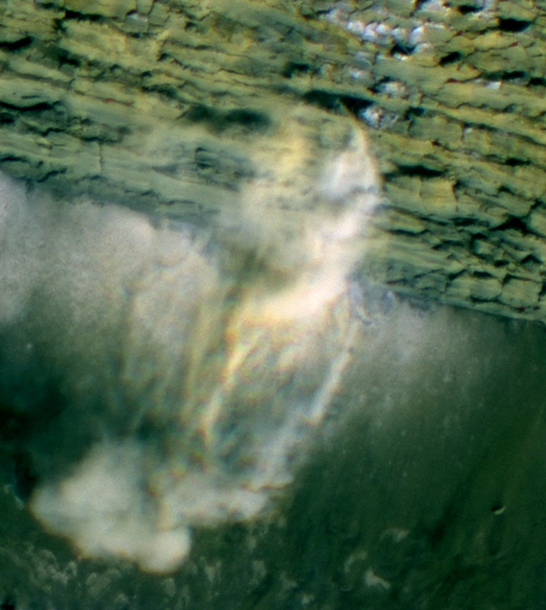
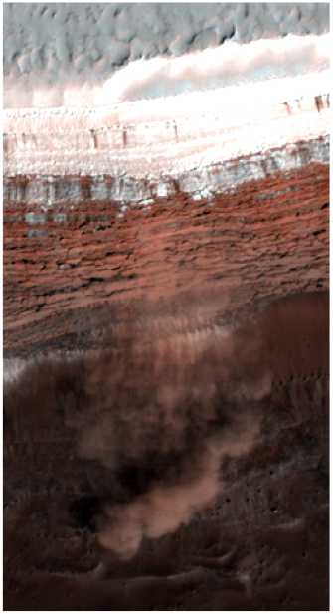
Russell et al., 2008

Slide 11
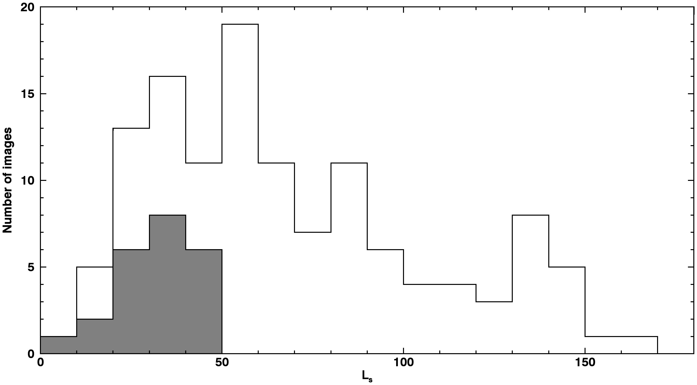
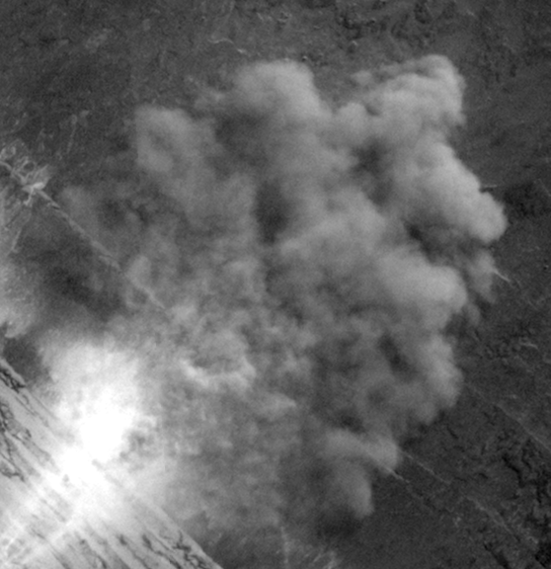
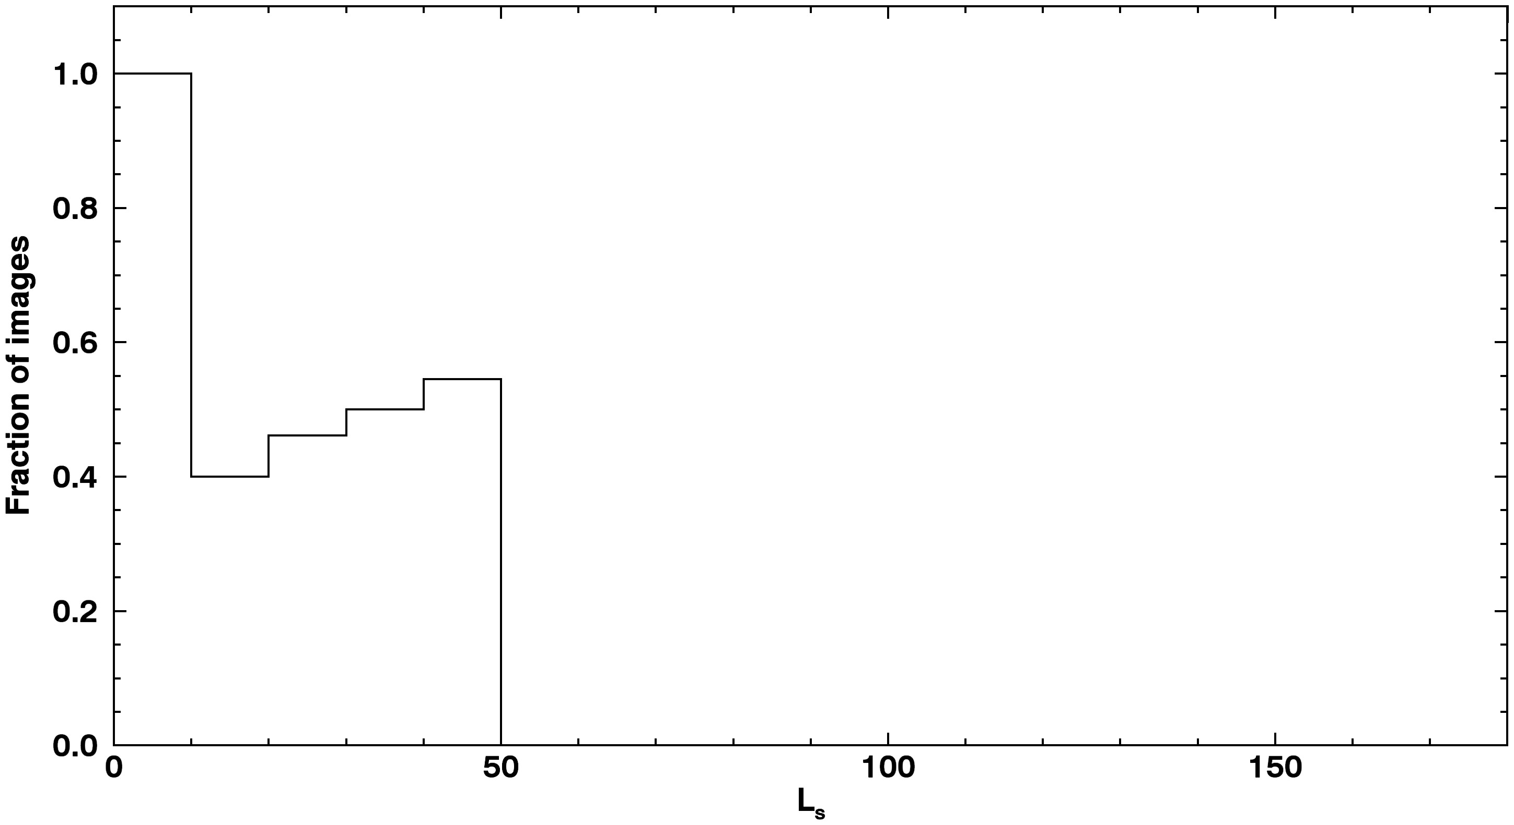
10s of avalanches imaged in progress
Speeds measured to be several m/s
Avalanche Images
Total Scarp Images

Slide 12
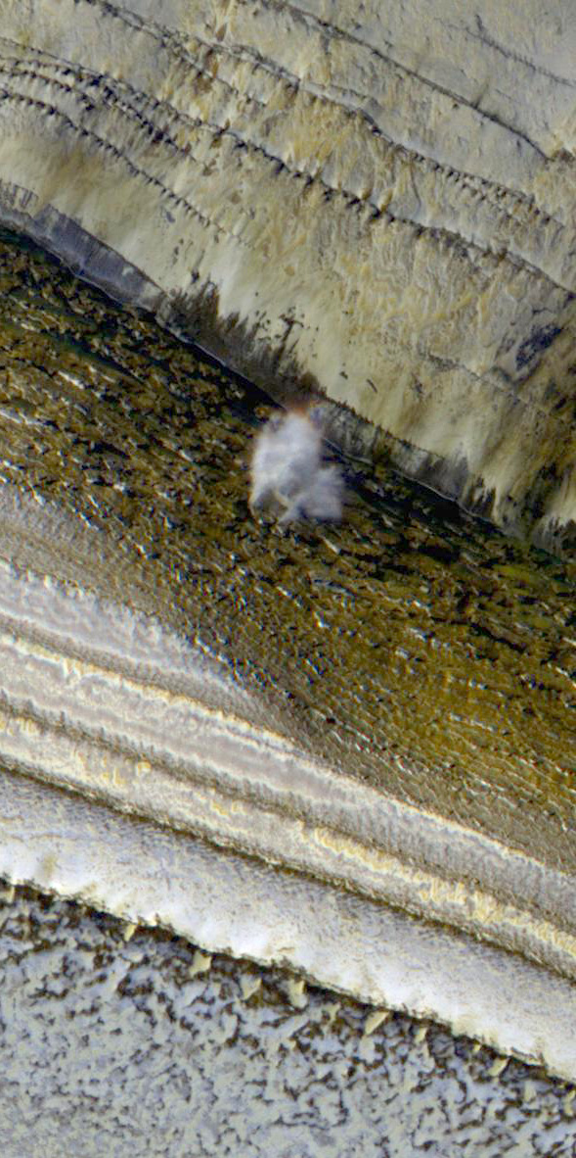
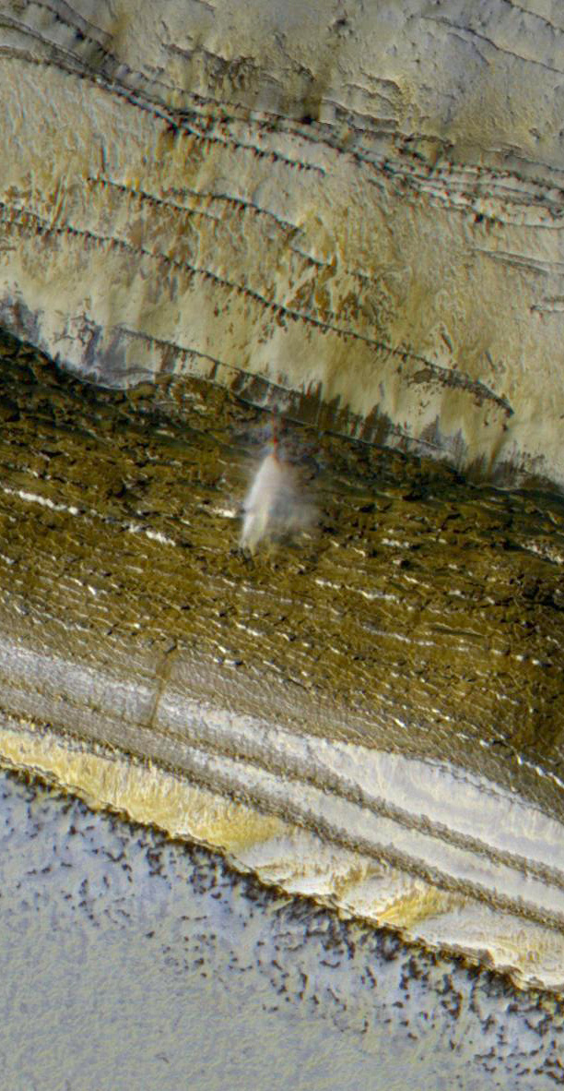
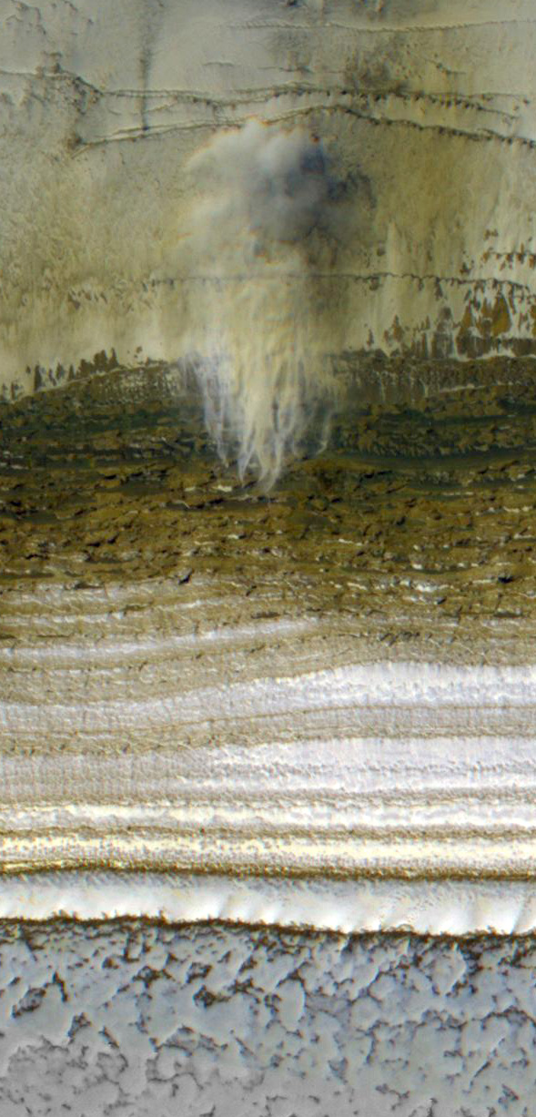
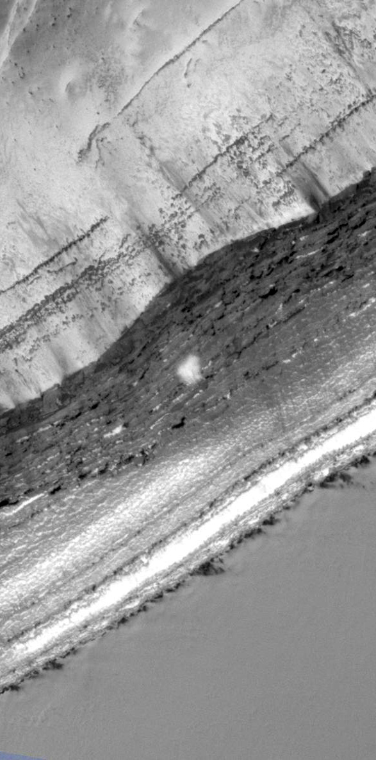
Aspect: W WSW SW S
South
Four simultaneous avalanches with a range of Slope azimuths
ESP_024282_2640, L_{s} 9 MY 30

Slide 13
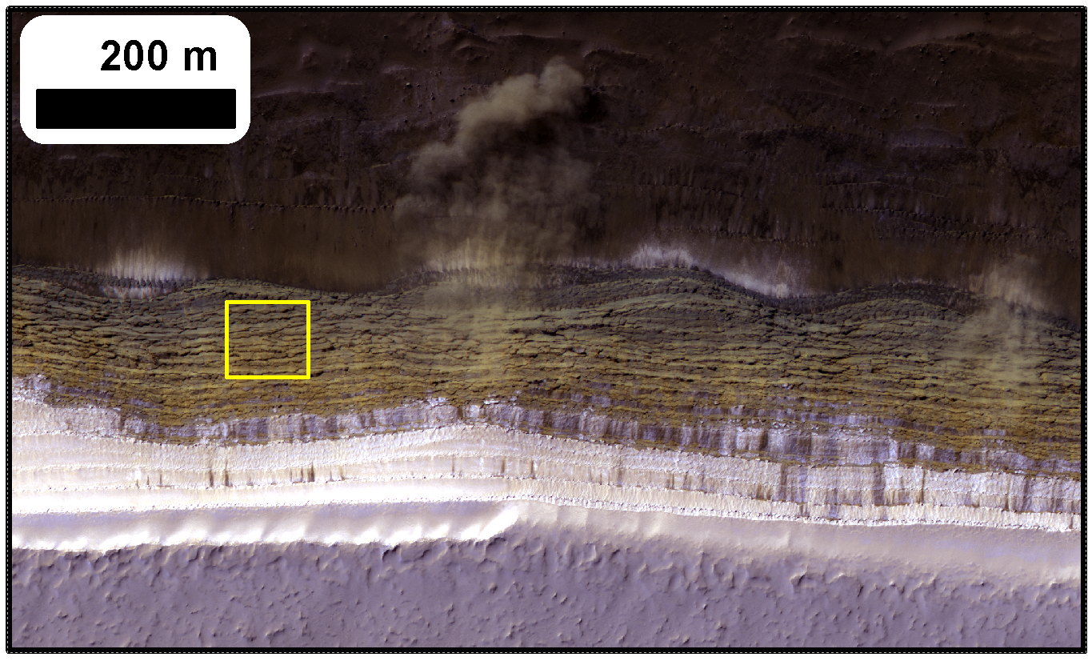
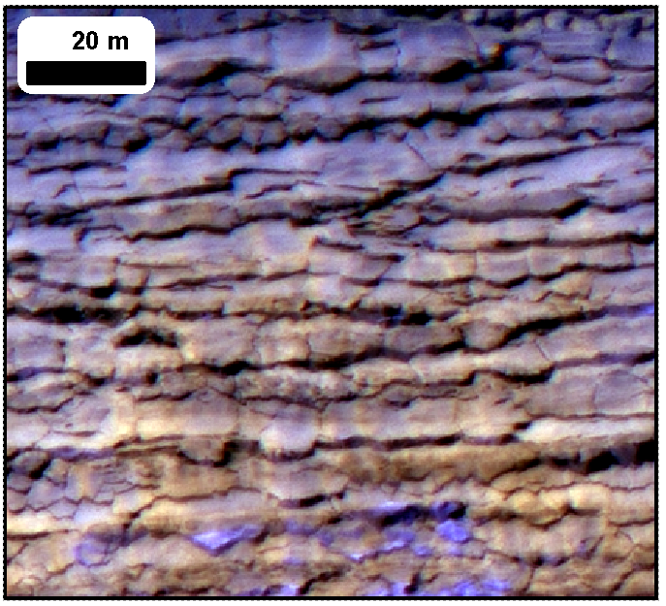
Can we explain:
Pervasive cracking?
Avalanche timing?
Slab-like texture on scarps?
Frequent blockfalls?

Slide 14
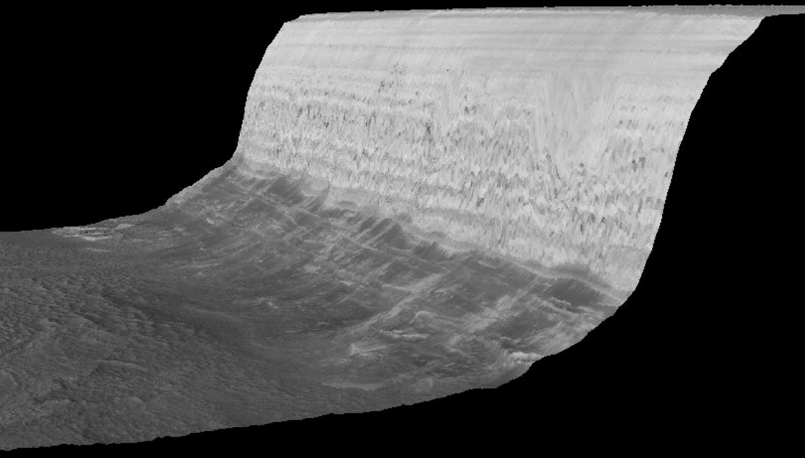
Atm.
emission
Thermal emission
Solar radiation
Emitted & reflected radiation exchanged with surrounding flat terrain
Conduction
We use a standard 1D semi-implicit thermal model to simulate temperatures

Slide 15
Bare ice rather than dust covered ice - not a surprise given their appearance

Slide 16
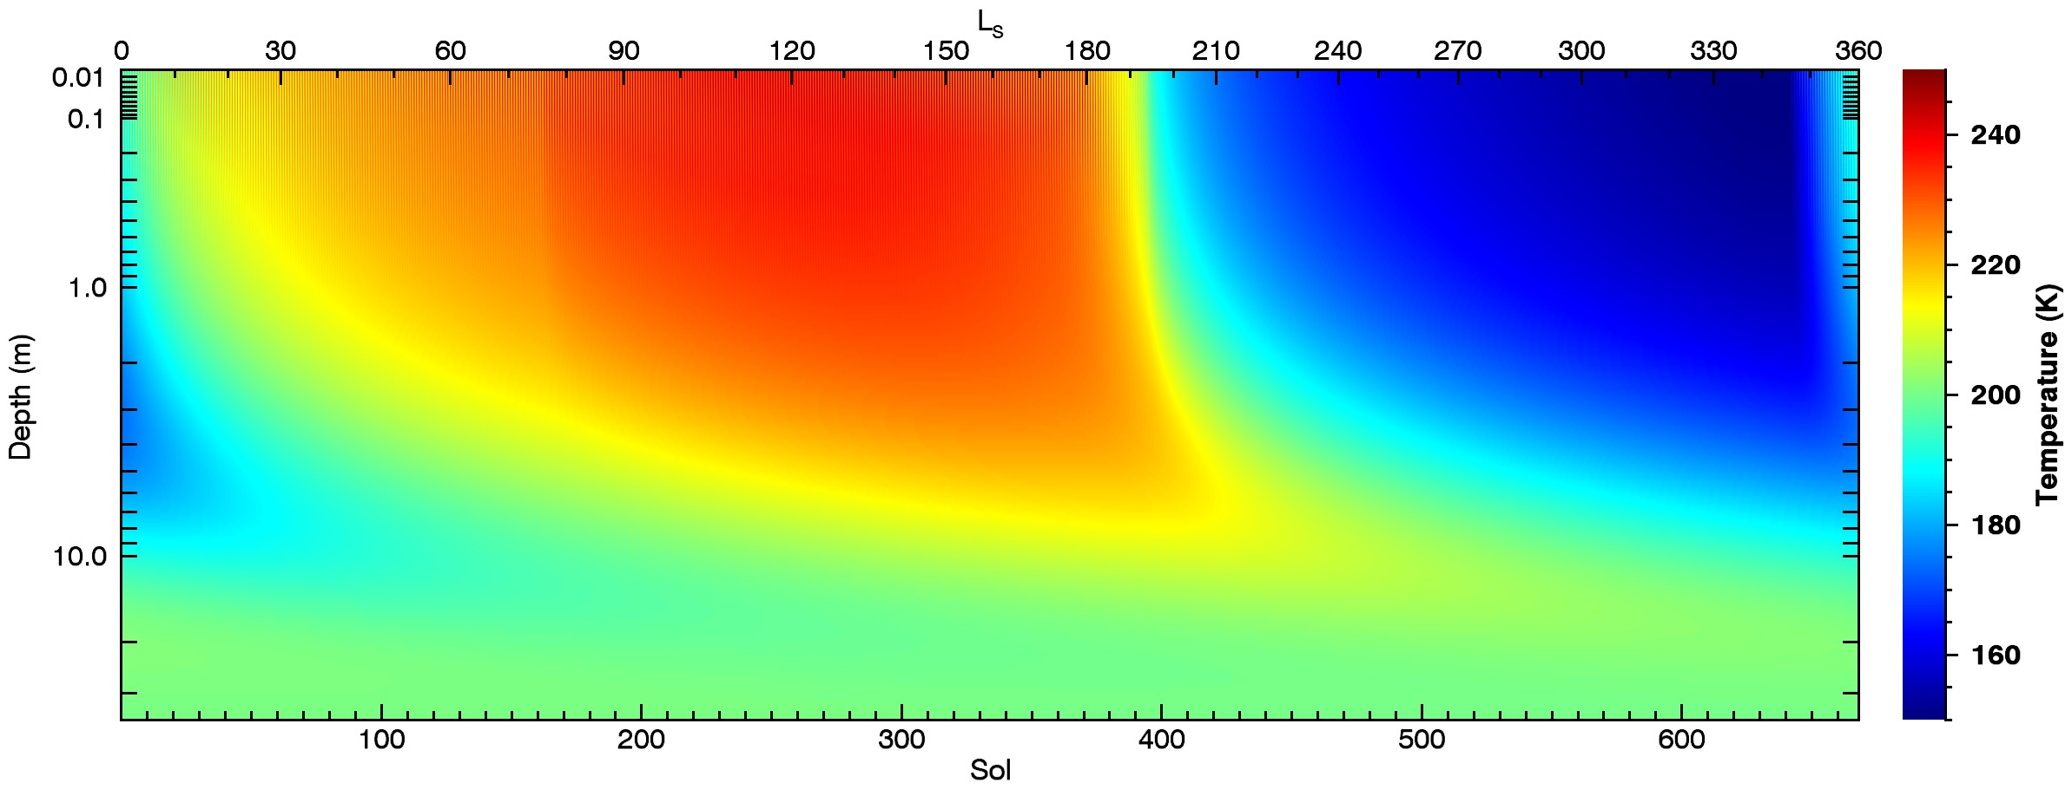
Surface and Sub-surface temperatures on a 70° SW-facing slope

Slide 17
We treat this as a homogeneous viscoelastic solid and solve for stresses induced by thermal expansion and contraction using the approach of Mellon (JGR, 1997)
Thermal expansion and contraction creates a short-term elastic and a longer term viscous response
At the Surface:
Horizontal strains are zero
Horizontal stresses are created
Vertical strains are non-zero
Vertical stresses at surface are zero
A
B
A
B
-σ
A
B
+σ
Cold ice
(contracted)
Average state
Warm ice
(expanded)
Total horizontal strain is zero and so:

Slide 18
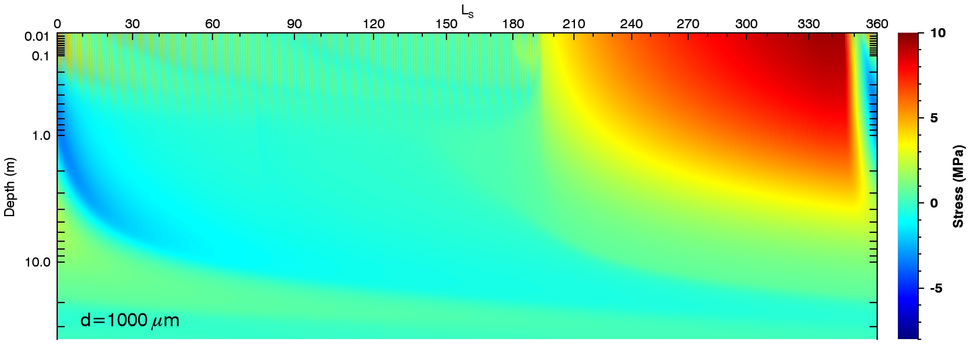
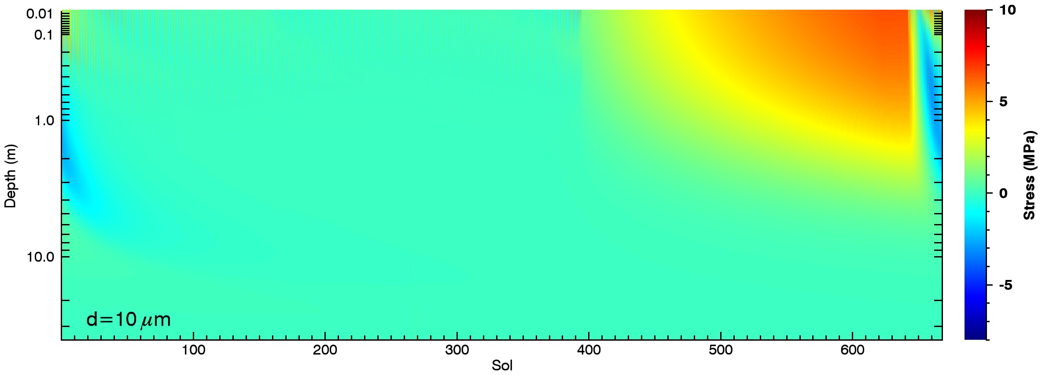
+ve is tension

Slide 19
Ice strength exceeded during most of the winter
Tension
Compression
Tension
Compression
Tension
Compression

Slide 20
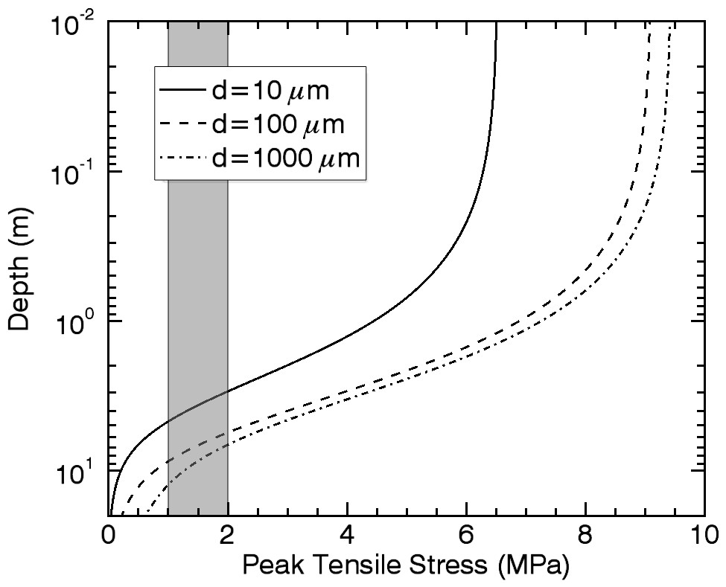
How deep can cracks propagate?
Amplitude of stress variation decreases with depth.
Exceeds water ice strength down to several meters, but some model assumptions start to break down…
Shallow cracks can open and close – adds shear stresses to deeper ice. Promotes crack deepening.
Stresses are concentrated at crack tips. Promotes crack deepening.
Overburden pressure is neglected. Suppresses crack deepening.

Slide 21
Tension
Compression
End of avalanche season coincides with tensional stresses falling below the strength of water ice (~2 MPa)
Avalanche Images
Total Scarp Images

Slide 22
Avalanche season coincides with existence of subsurface compressional stress

Slide 23
Blockfall seasonality is a work in progress
Tension
Compression

Slide 24
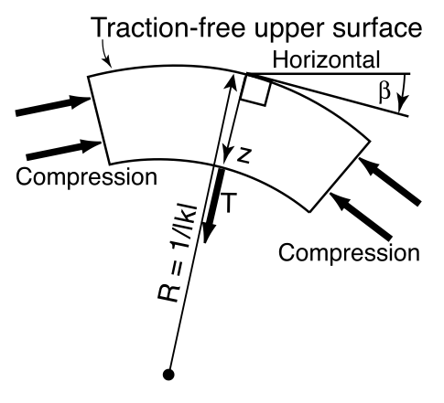
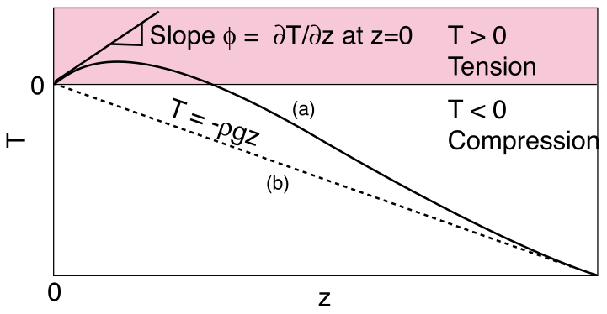
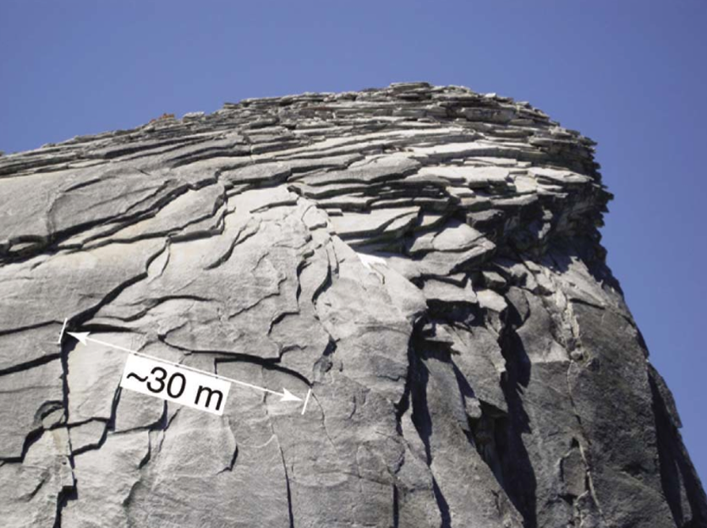
Model for blockfalls?
Martel (GRL, 2011) explains sheeting joints and exfoliation of slabs with compressive stress and surface curvature
Surface-normal tensional stress generated in the near-sub-surface – slabs exfoliated
Good agreement for terrestrial granitic domes

Slide 25
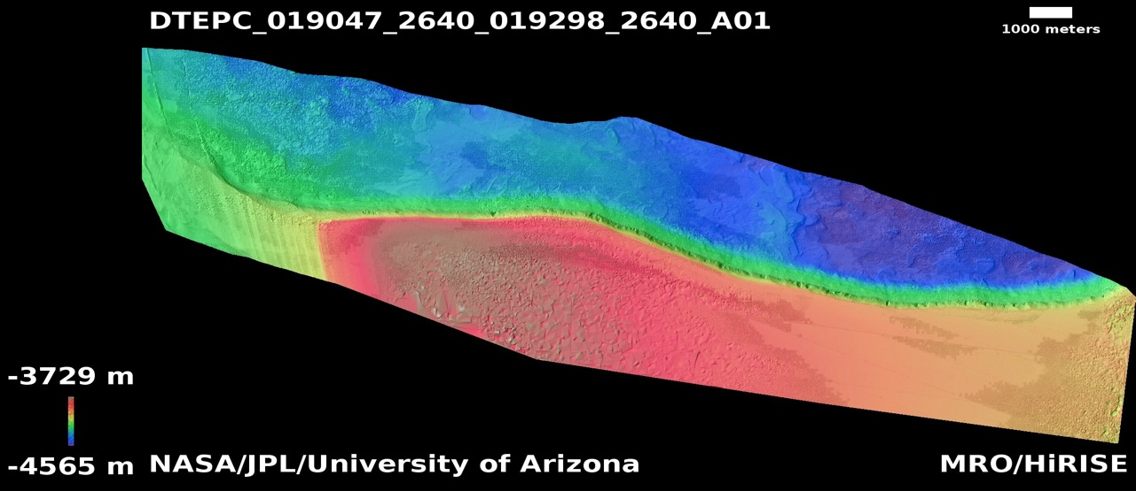
No Vertical Exaggeration (!)

Slide 26
Conclusions
Thermal expansion/contraction is a viable mechanism for:
1. Generating surface normal cracks that penetrate 5-10m
2. Probably generating blockfalls through exfoliation of slabs
3. Correlated with avalanche season – link uncertain

Slide 27
Extras

Slide 28
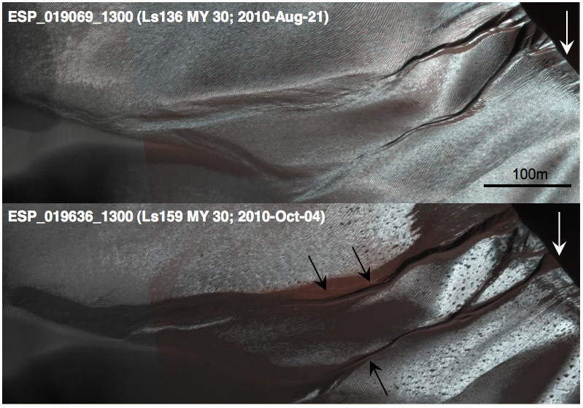
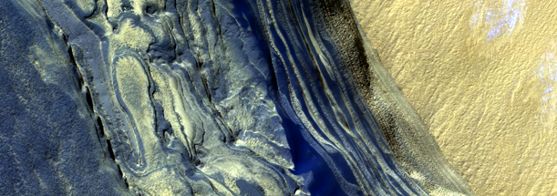
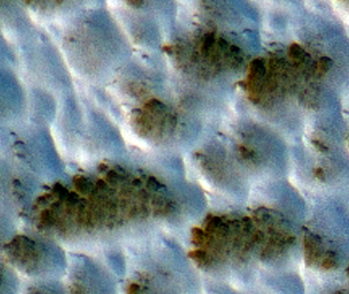
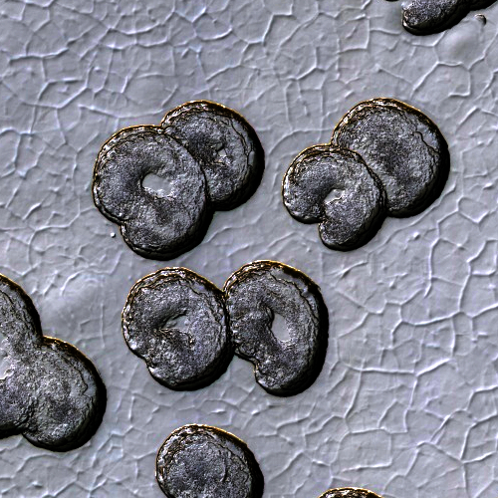
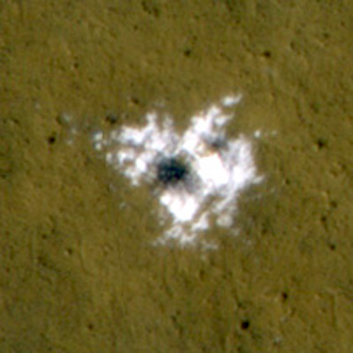
10⁸
10⁷
10⁶
10⁵
10⁴
10³
10²
10¹
10⁰
Recent climatic variations
Interannual variability of the current climate

Slide 29
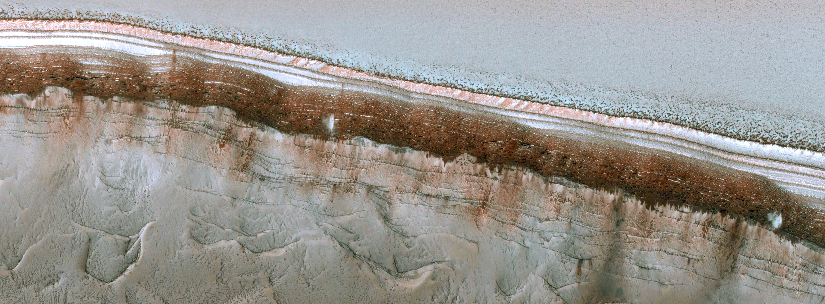
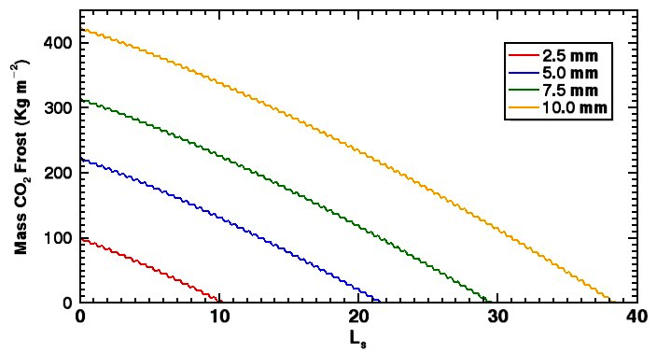
Effects of dust cover
Frost mass on 45° SW-facing slope
ESP_024282_2640 – L_{s} 9
~70° slopes are already defrosted
~45° slopes still frosted
Defrosting date of slopes very sensitive to thickness of dust cover
5mm is about right for 45° slopes
- OK to use for 70° slopes ?

Slide 30
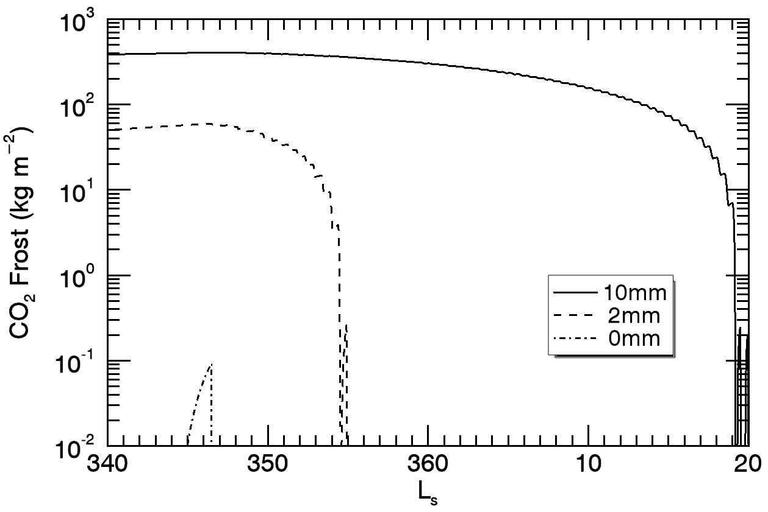
Effects of dust cover
ESP_032616_2640 – L_{s} 350
~70° slopes are already defrosted
~45° slopes still frosted
Defrosting date of slopes very sensitive to thickness of dust cover
5mm is about right for 45° slopes
OK to use for 70° slopes ? NO.
70° slope behavior consistent with no dust cover

Slide 31
Expressions for E and α also revised (see me afterwards if interested)
where
In the end we have a differential equation:

Slide 32
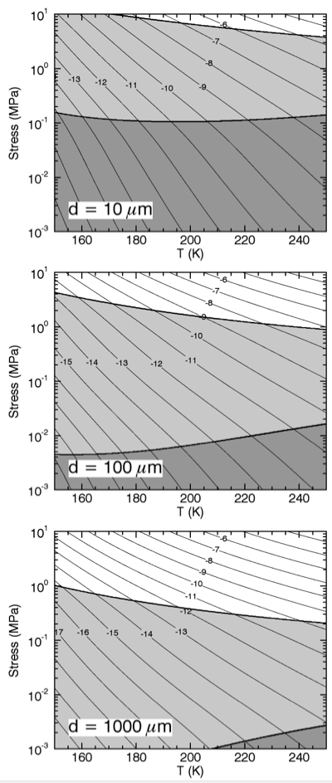
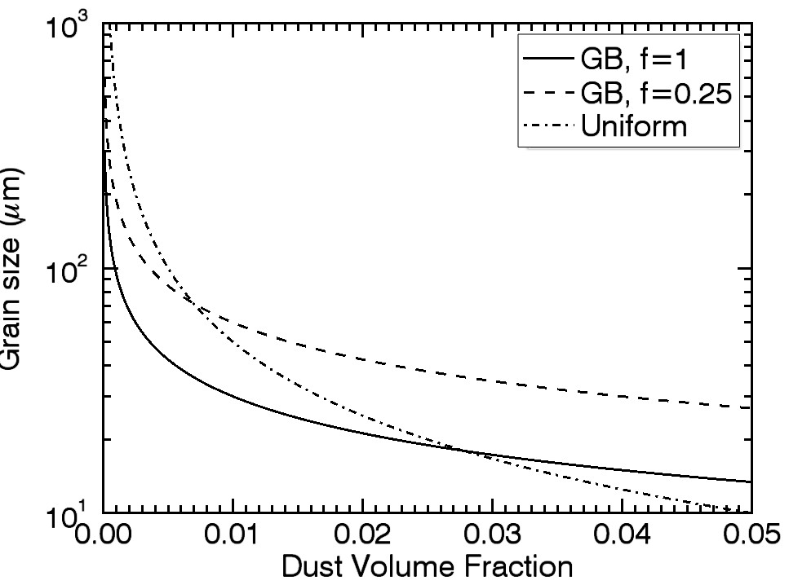
Rheology is now grain size dependent
Dislocation creep dominates at high T and σ
Diffusion dominates at low σ
Grain-size sensitive creep effects dominates for small grains
SHARAD results and Zenner pinning allows estimates of NPLD ice grain size

Slide 33
ESP_024282_2640 – Ls 9
Cracks Opening
Cracks Closing
Cracks Open
Cracks Closed
70° SW-facing
@ L_{s} 9

Slide 34
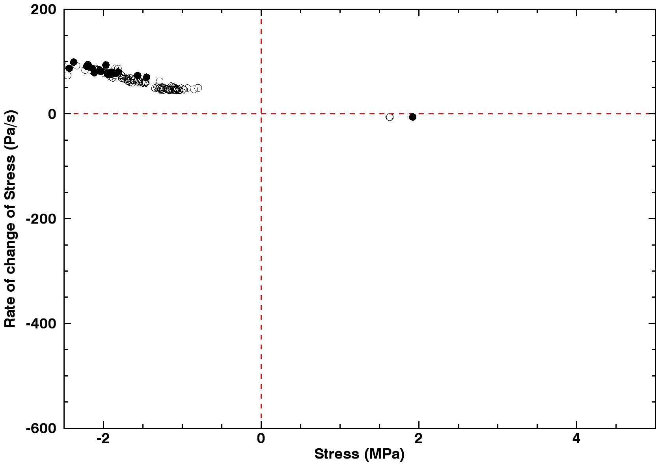
Observational selection effect means we see the scarp in the same stress state all the time on South and south-west facing scarps
Avalanche
No Avalanche
Cracks opening or pressure decreasing
Cracks closing or pressure increasing
Closed Cracks
Open Cracks
70° SW-facing
D=100μm

Slide 35
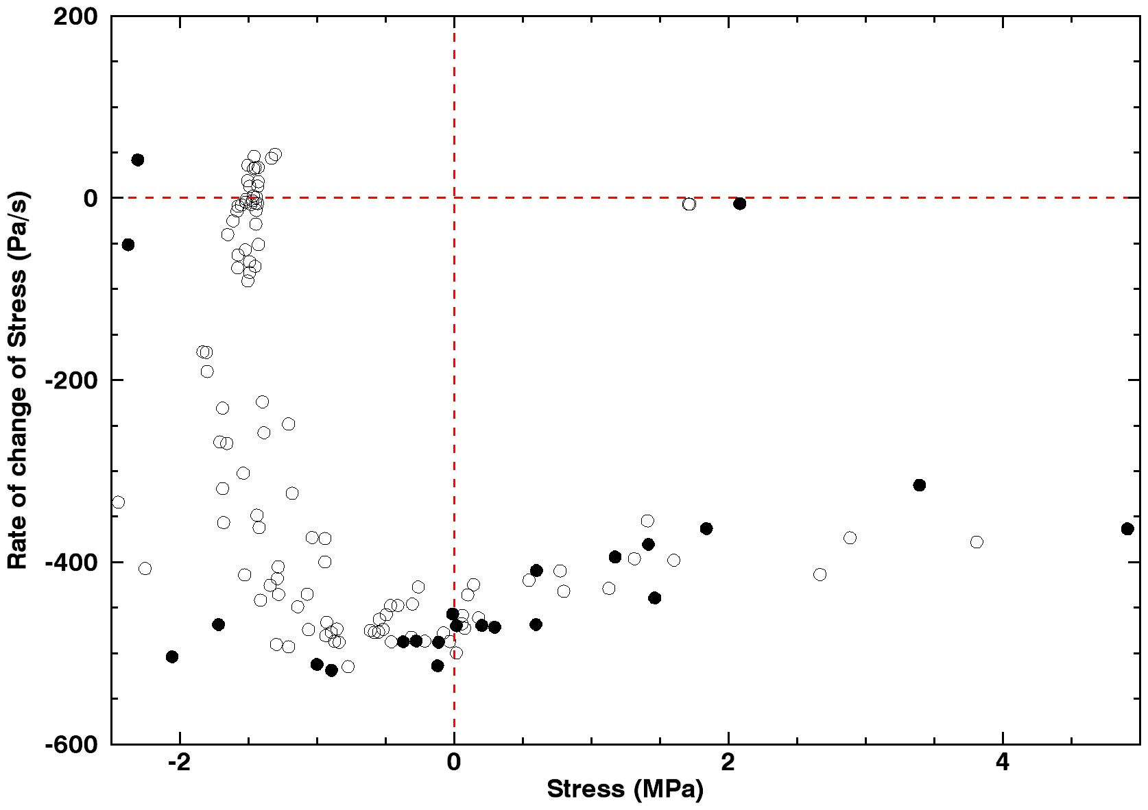
We observe west facing scarps right at local sunrise so small local time variations lead to be stress-state variations
Avalanche
No Avalanche
Cracks opening or pressure decreasing
Cracks closing or pressure increasing
Closed Cracks
Open Cracks
70° W-facing
D=100μm

Slide 36
Tensional stresses create fractures only quasi-perpendicular to the surface
Compressional stresses can expel fragments if they can overcome friction
Tension
Compression

