Slide 1
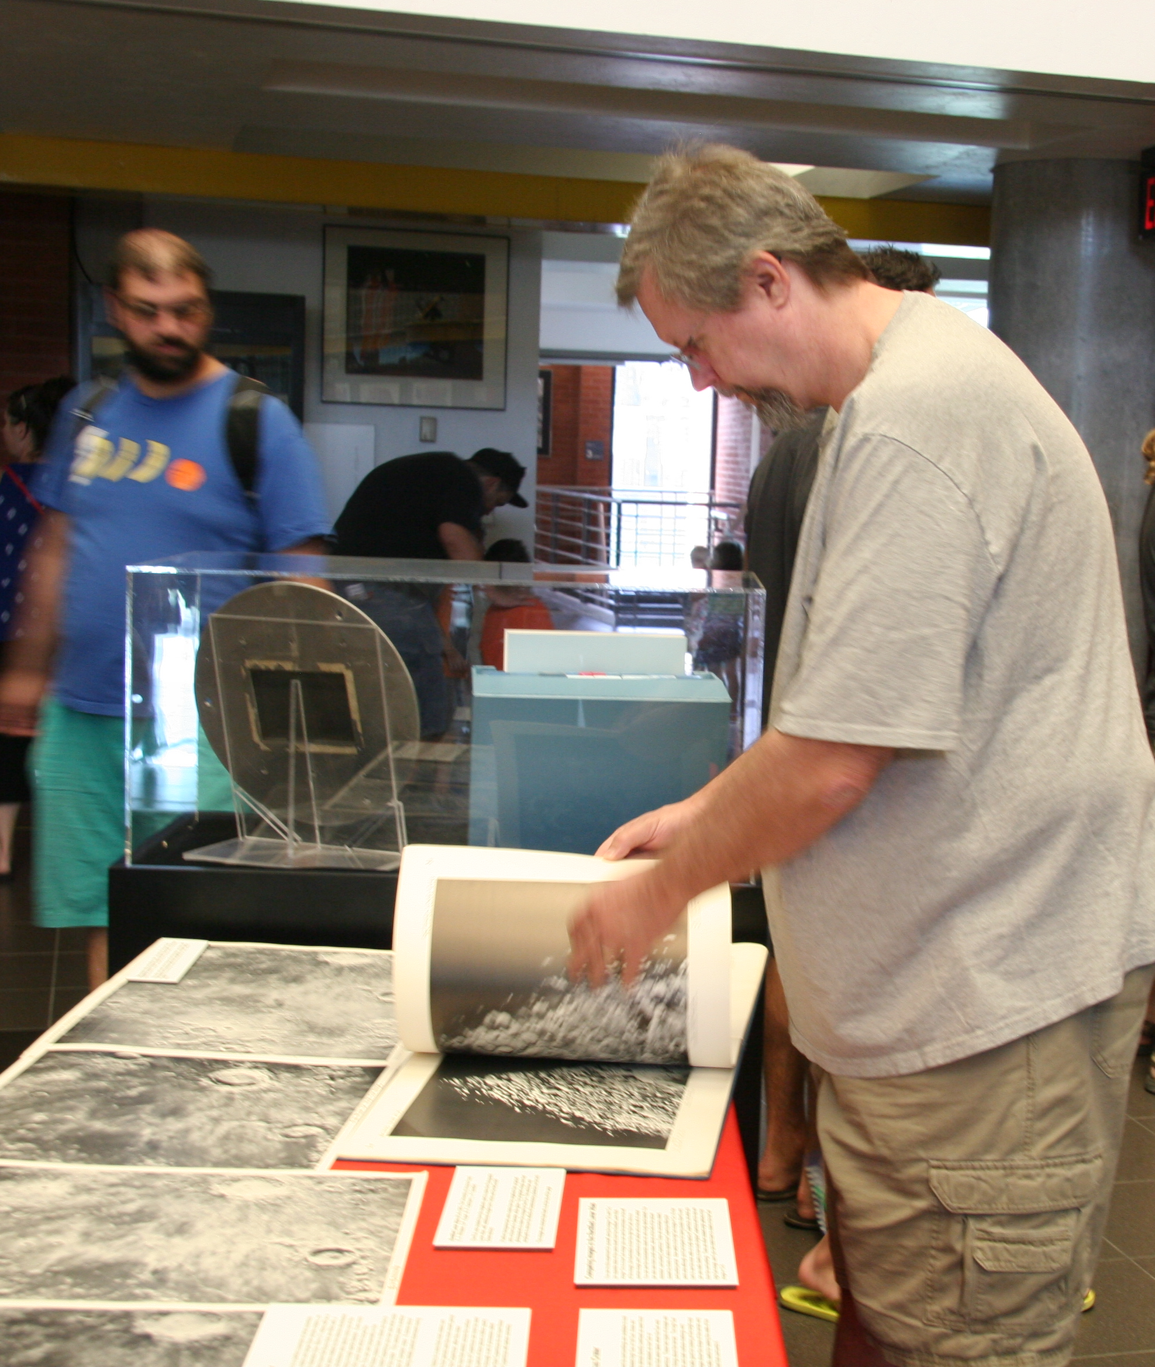
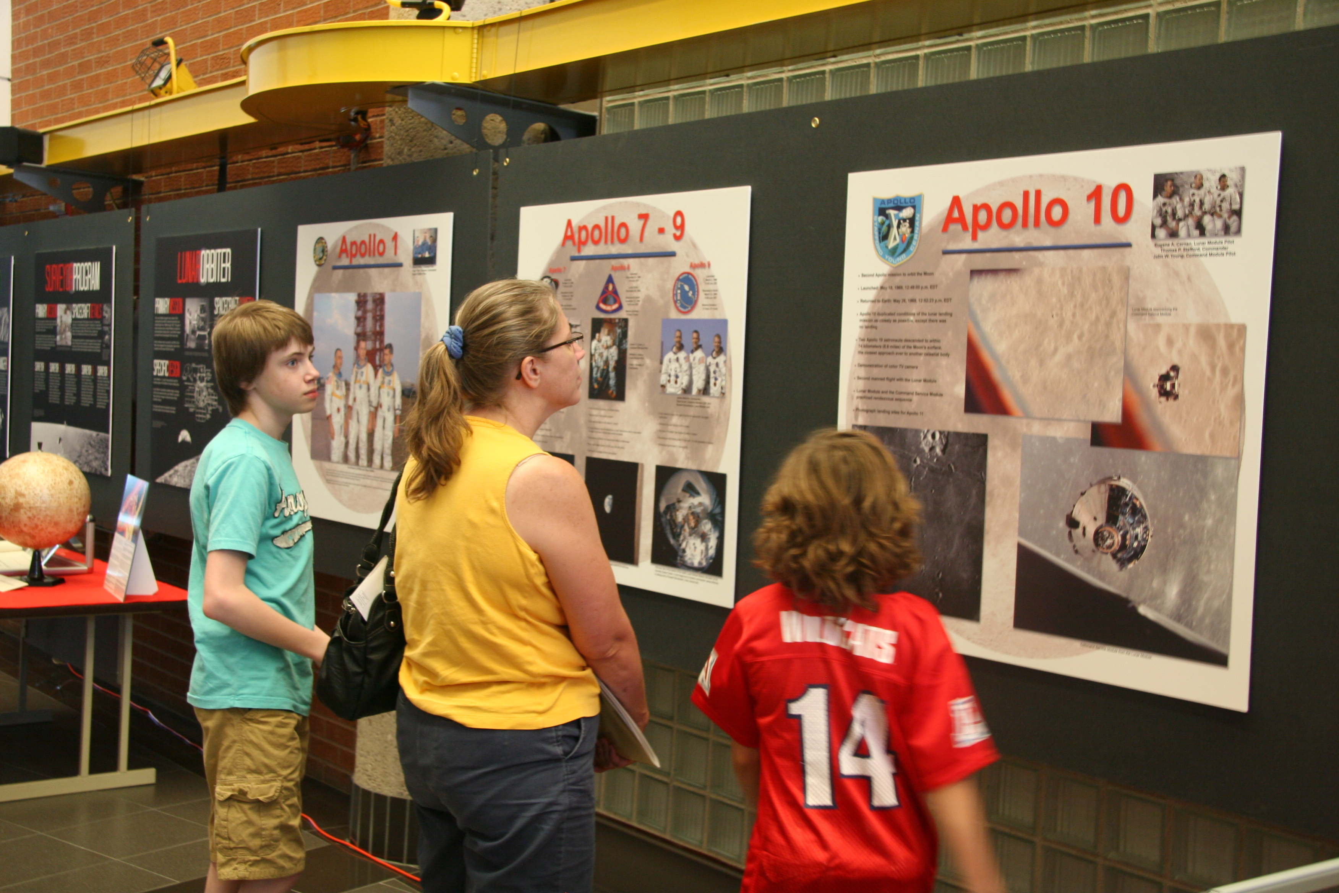
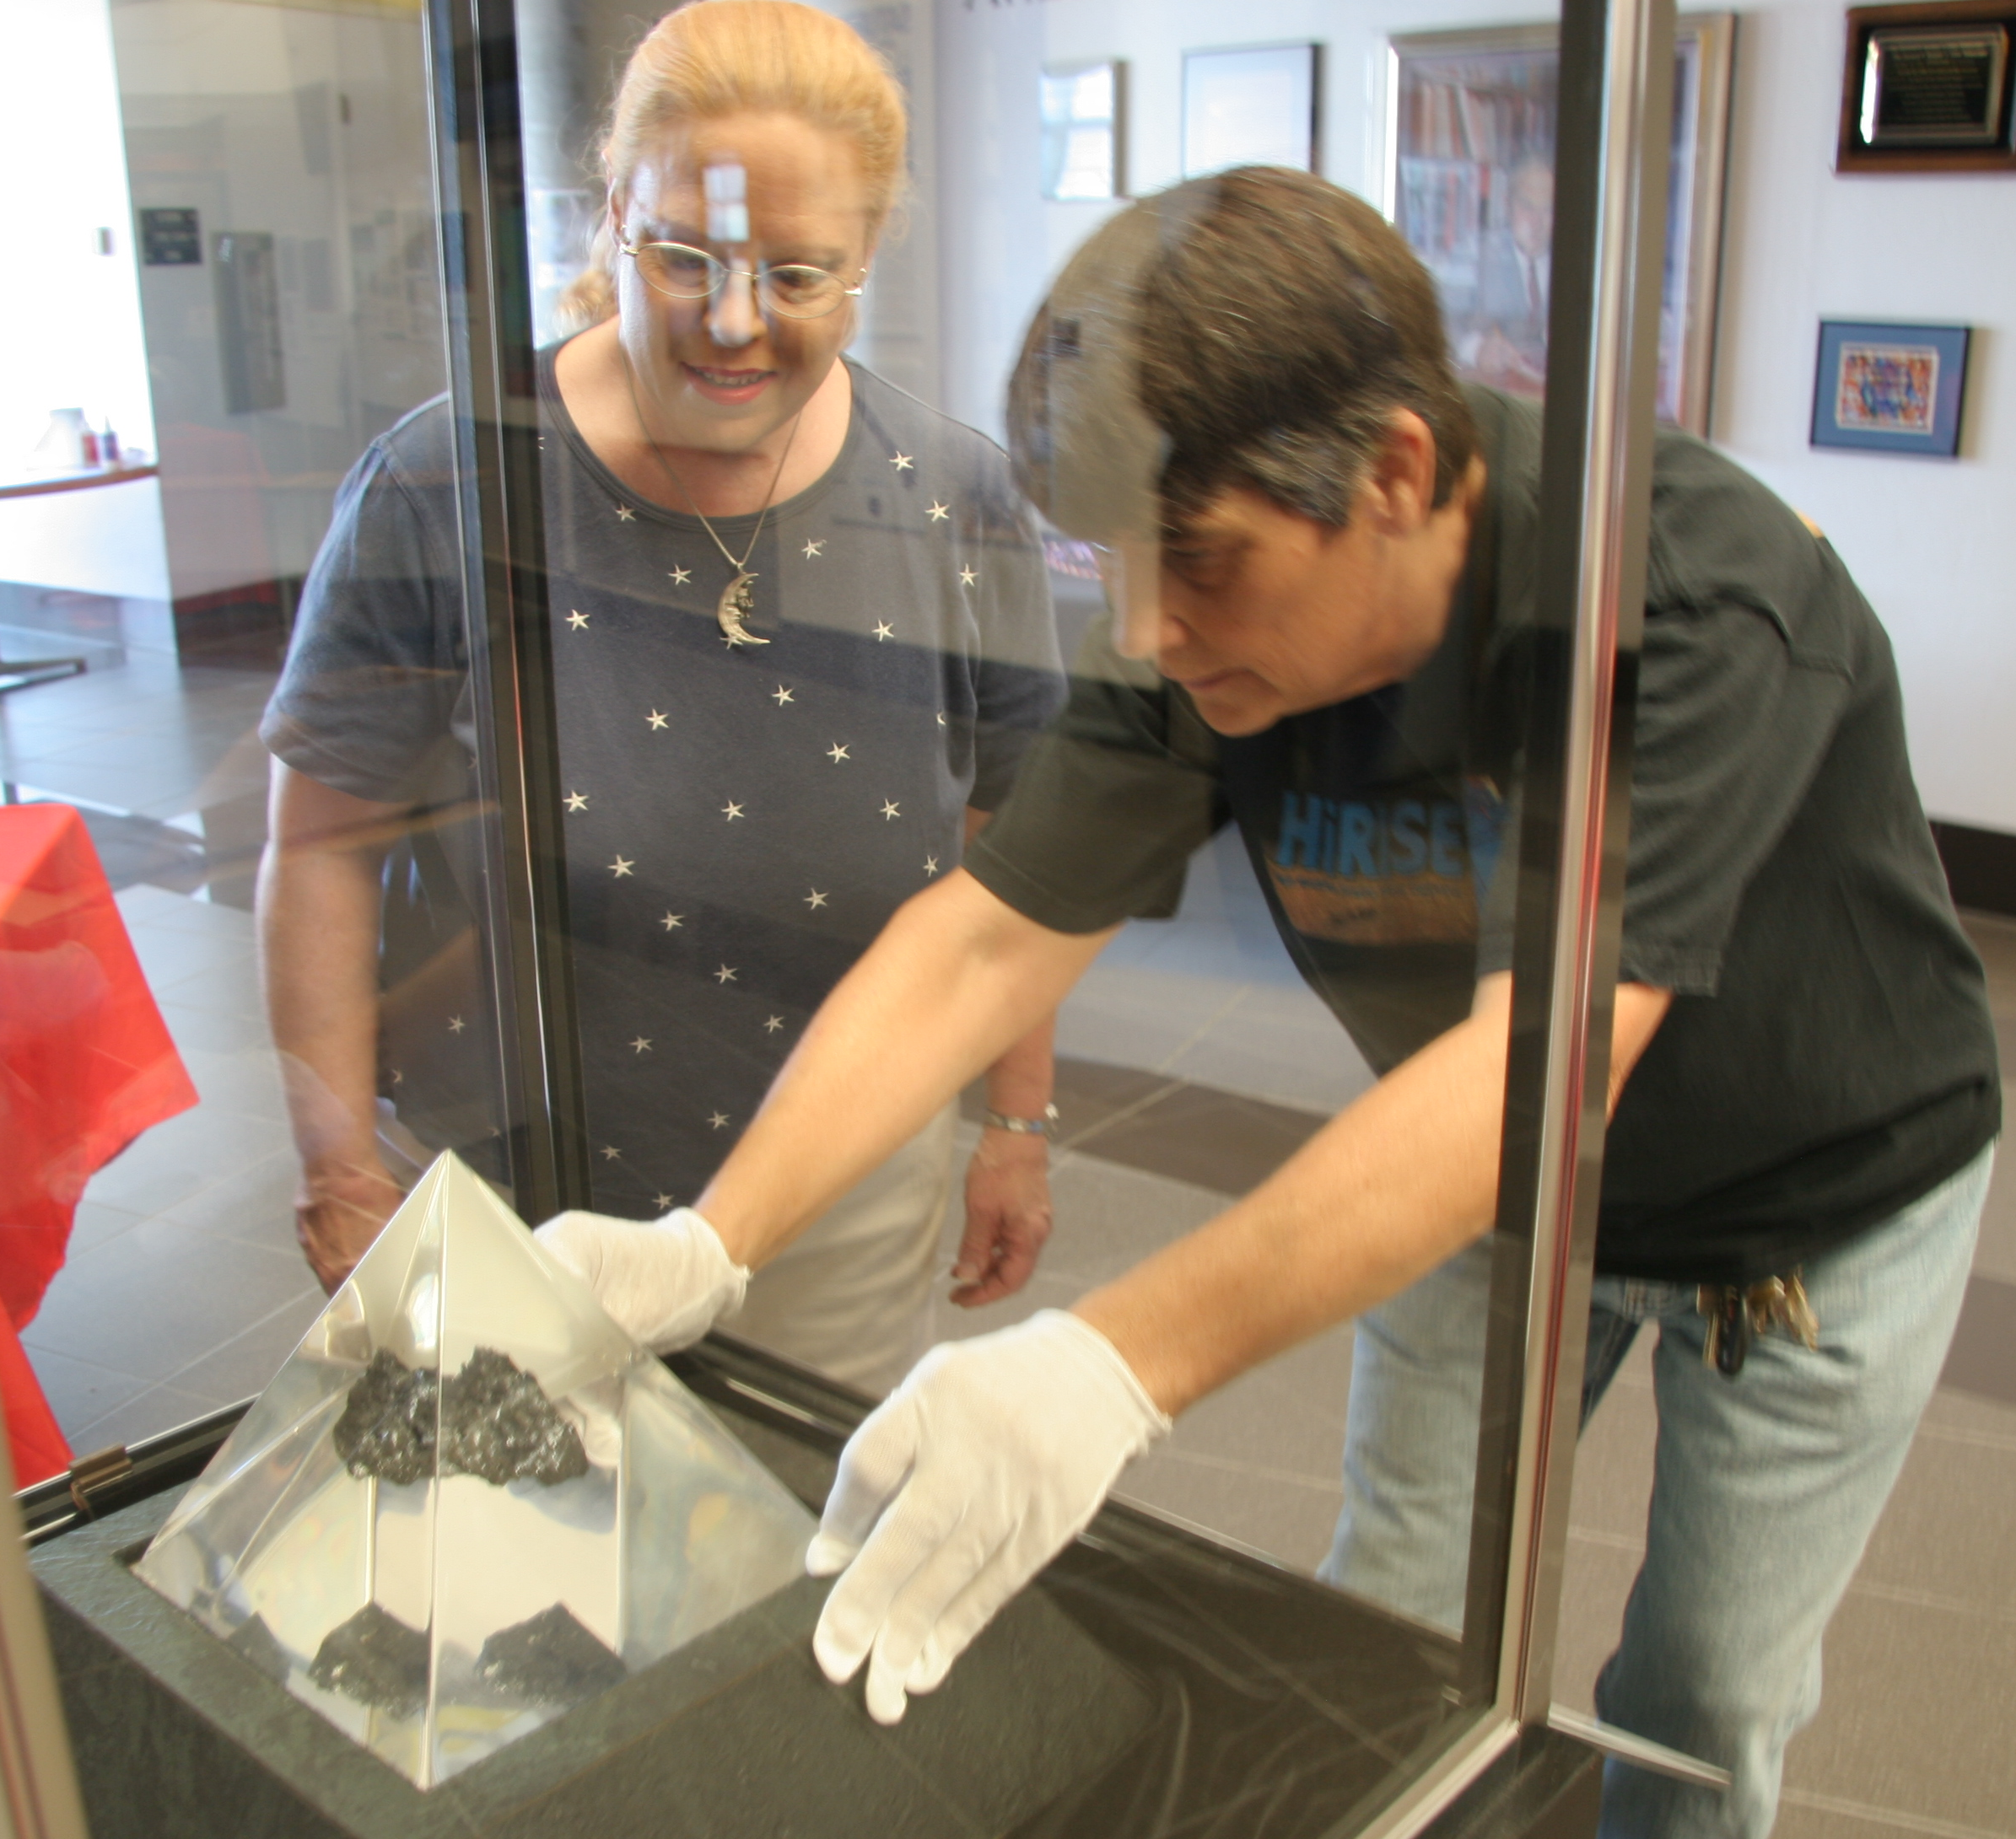
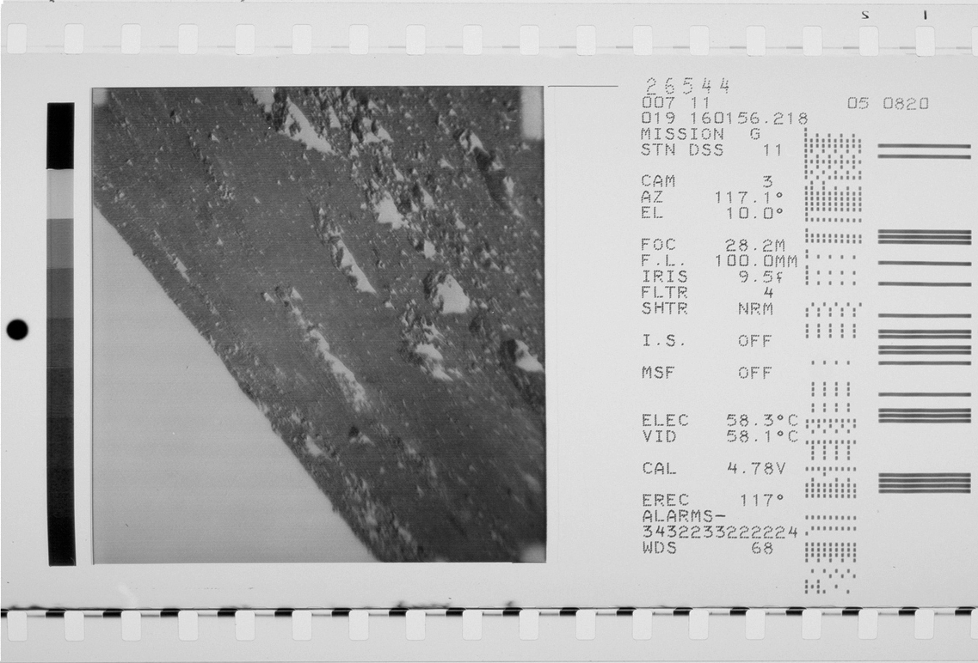
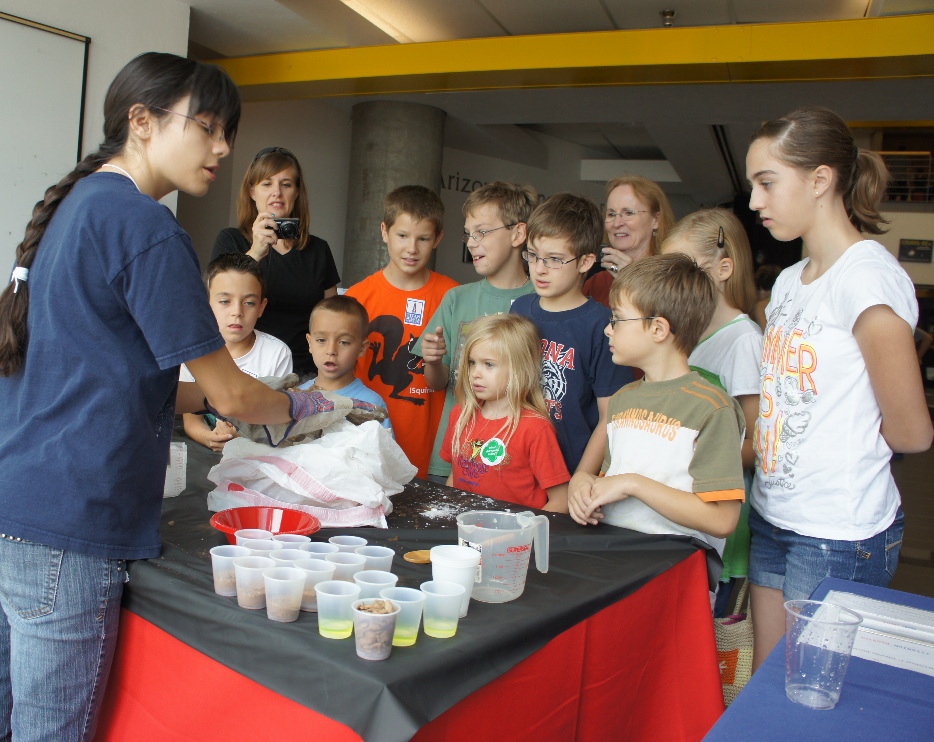
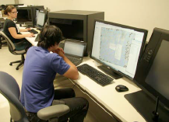
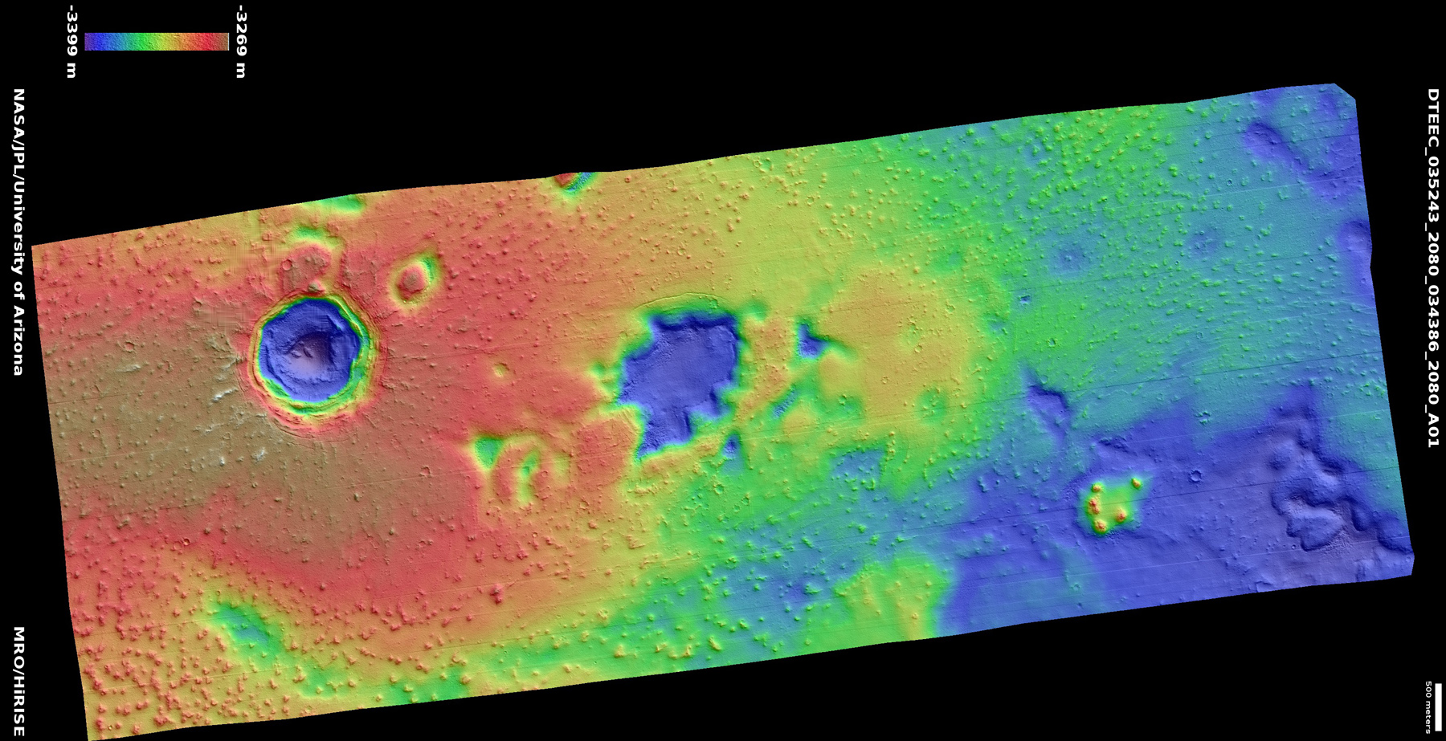
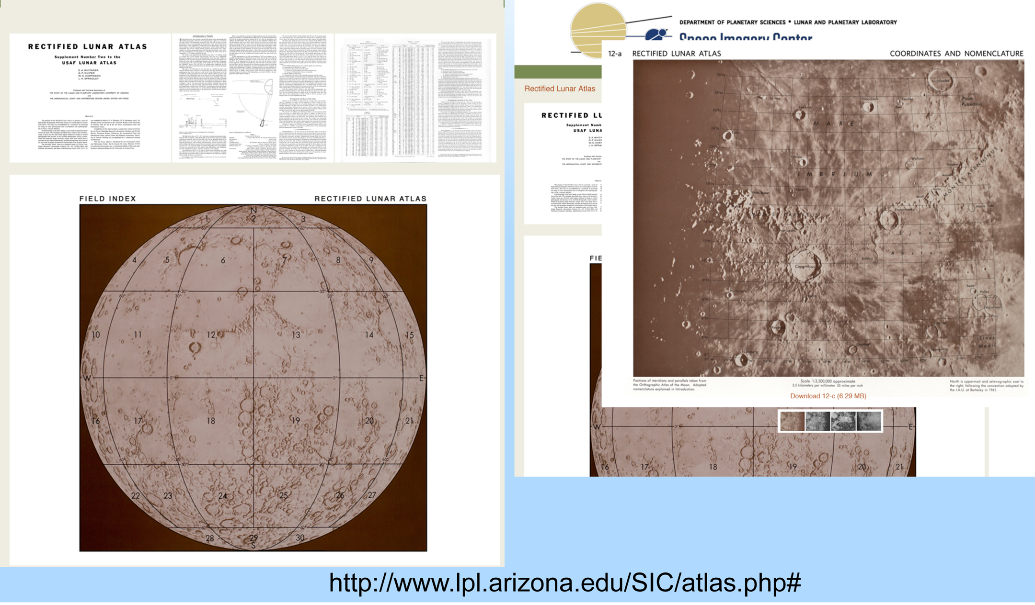
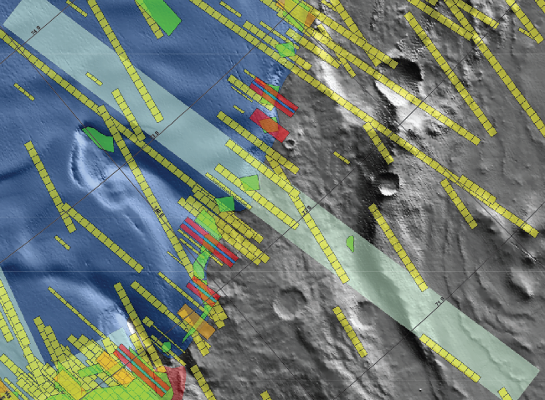
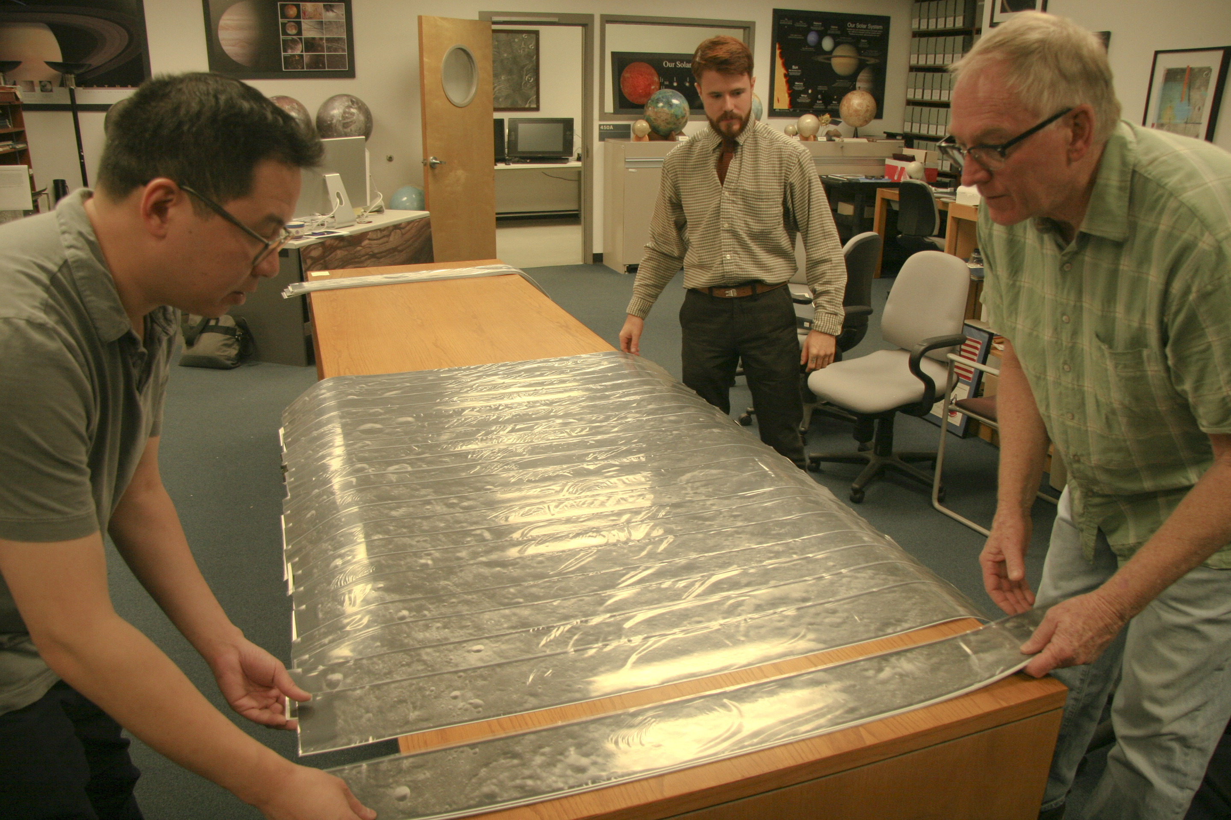
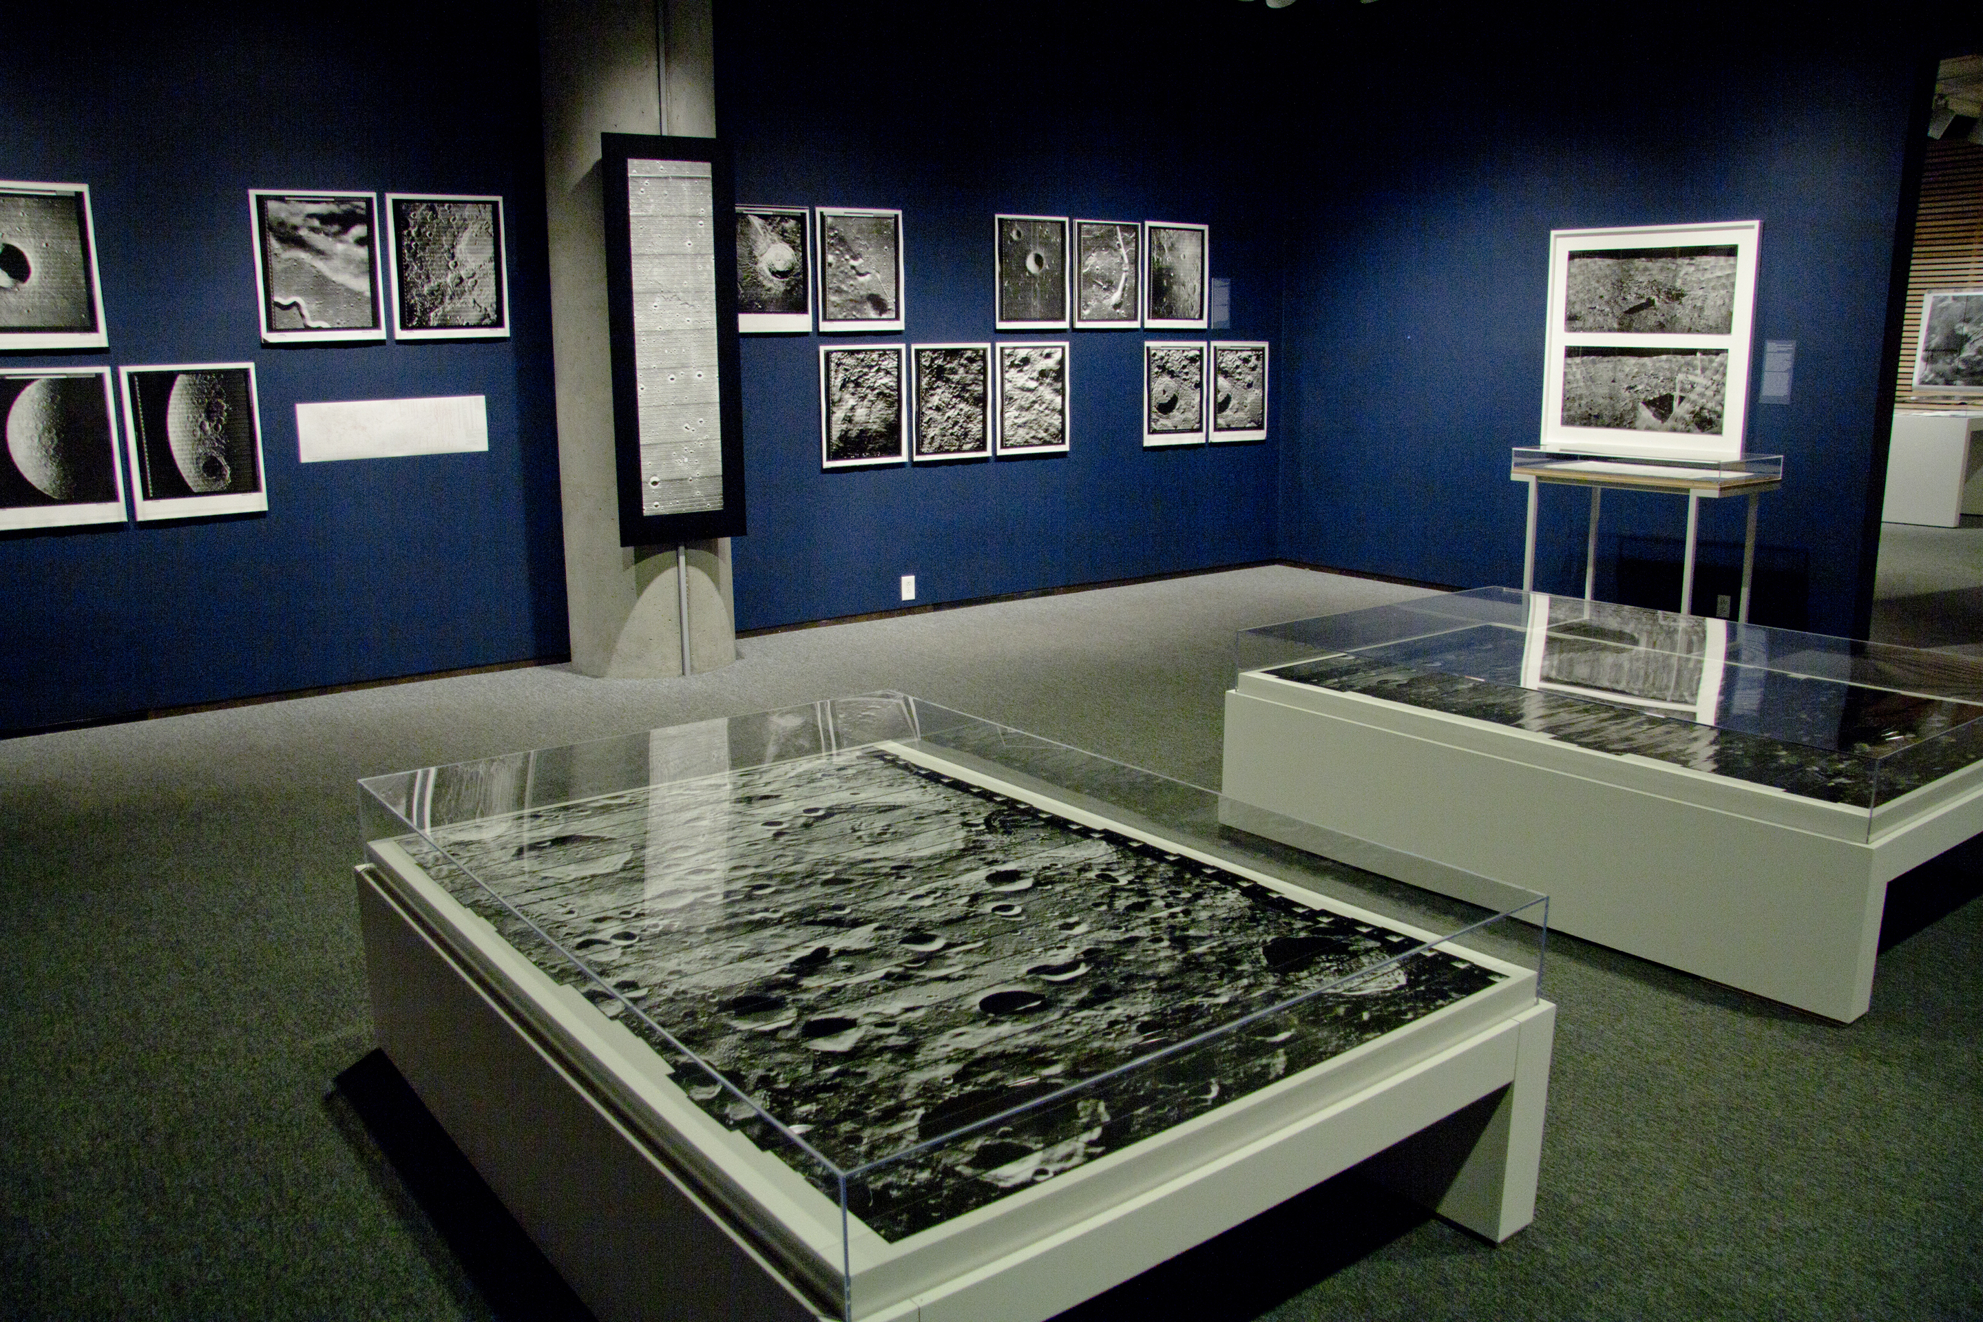
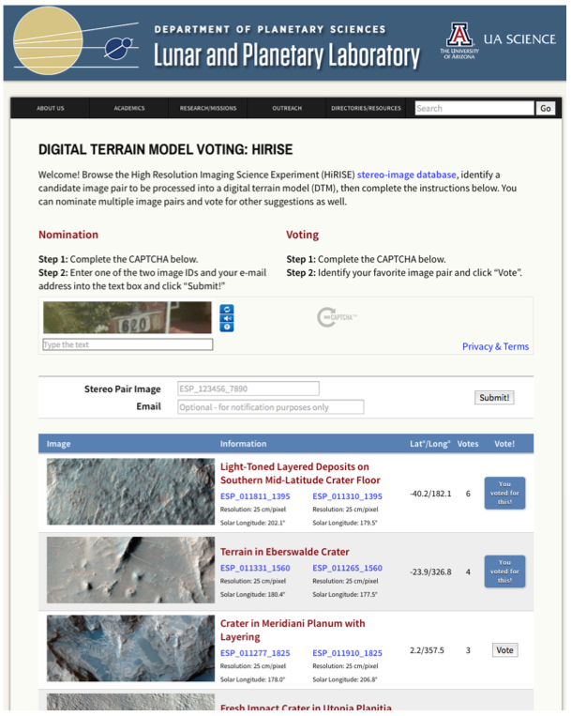


THE SPACE IMAGERY CENTER:
A NASA REGIONAL PLANETARY IMAGE FACILITY
S. Byrne and M. Schuchardt, Lunar and Planetary Laboratory, University of Arizona, Tucson, AZ, USA (shane@lpl.arizona.edu)
The Space Imagery Center is one of 9 domestic and 7 foreign NASA Regional Planetary Image Facilities (RPIFs). The center, established in 1977, at the University of Arizona’s Lunar and Planetary Laboratory serves three basic functions:
Provide services and materials that aid research in planetary science
Preserve, expand and make accessible its collection of material
Public engagement activities
Selected examples in each category are shown below.
More Information on the Space Imagery Center is available online at
https://www.lpl.arizona.edu/sic
We continue our historical role of providing access to hard-copy data and grey literature not easily accessible elsewhere. Today most data are available online (although not all – see next section for examples of how we are digitizing remaining analog datasets).
The focus of our RPIF has shifted to provide technical expertise, access to specialized computer hardware and data processing assistance.
The Space Imagery Center houses and provides free access to three Socet Set (software by BAE Systems) workstations with specialized 3D hardware. Socet Set represents the cutting edge of planetary stereogrammetry. Licenses and specialized hardware are unfeasibly expensive for individual researchers)
The Space Imagery Center provides technical expertise in GIS and pre-compiled geospatially registered data collections.
Future Plans – The Space Imagery Center plans to add the capacity to produce DTMs in response to community requests. Undergraduates already produce almost all the HiRISE Team DTMs that come from UA, we will clone the HiRISE Team procedures.
3. Public Engagement Activities
Introduction
2. Preserving and Archiving Data
The Space Imagery Center continues to preserve its archive of prints, film, slides and maps that span fifty years of spacecraft and telescopic observations. We are steadily digitizing and making available those datasets in our possession that are currently in print form only. Some prominent examples are listed here:
The Surveyor Lander Imaging Dataset. Within a remarkable 1.5-year period (May 1966 to January 1968) NASA’s Surveyor Program successfully landed no less than five spacecraft (Surveyor 1,3,5,6,7) on the surface of the Moon. Their vidicon imaging systems with color filters (polarizing filters replaced the color filters on Surveyor VI and VII) returned over 87,000 surface images at resolutions of up to 1mm.
Despite their significance (e.g. they contain the only surface images of the lunar highlands) these images are not digitally available. We have one of the few remaining complete collections of imaging data from the Surveyor Landers – stored on 70mm film. In conjunction with NASA’s LASER program and the NSSDC we have been digitizing this collection for PDS release.
The Space Imagery Center conducts dozens of public engagement events per year. Some of these recur annually, while others are once off opportunities. A selection of both are described below:
Annual Open House
The Space Imagery Center conducts an open house with a different theme each year (usually tied to current space exploration events). They typically have several hundred attendees and three components:
Exhibits highlighting missions
Lectures provided by Lunar and Planetary Laboratory faculty and researchers
Interactive activities for children
1. Aiding Planetary Science Research
Figure 4. Typical scanned Surveyor image. Image metadata can be seen right of the frame
Figure 7. (above) Some of the displays produced by the Space Imagery Center. (left) children are learning about comets.
Figure 5. Mosaic of extracted frames showing regolith near Surveyor V roll 23, frames 472-512
Figure 1. Three Socet Set workstations are now hosted by the Space Imagery Center and in use for producing digital stereo topography.
Evening Lecture Series
Currently all image data have been digitized and extracted from the frame images shown in figure 4. We are currently working on finishing the meta-data catalogs and PDS formatting.
In 2006 the Space Imagery Center initiated an evening lecture series (typically ~100 attendees per event). Available on iTunesU, see:
https://itunes.apple.com/us/itunes-u/lunar-planetary-laboratory/id1056791227
Rectified Lunar Atlas and Photographic Lunar Atlas. These atlases were digitized and made available online. The Photographic Lunar Atlas was the first in a series of Lunar Atlases edited by Gerard Kuiper. The plates were made from the best moon images taken by five observatories. Later these images were rectified by projecting them onto a sphere and rephotographing them from above.
Figure 8. Professor Robert Brown, PI of the Visual and Infrared Mapping Spectrometer (VIMS) onboard Cassini, talking about his research.
Figure 2. Example Digital Terrain Model (DTM) from a HiRISE stereo image Pair.
Tours, visits to schools and community events
We interact with 1000s of K-12 student per year by offering tours of our facility and visiting local schools to give presentations.
Data Manager Maria Schuchardt is on the organizing committee for Science City, hands-on science activities, that is a part of Tucson Festival of Books. She manages the space science and astronomy tent, which has 18 different organizations. Typically each of these organizations interact with 600 – 800 visitors per day. The telescope operators show the sun to 1,500 people per day.
Figure 3. GIS projects for requested areas can be created and contain image data and their footprints, topography and shaded relief, vector geologic maps among other data types.
Special Projects
We participate in many public engagement activities that do not repeat annually. For example:
We supplied the material for a Space Photography exhibit at the University of Arizona’s Center for creative photography.
Figure 6. Page from the website for the Rectified Lunar Atlas, hosted by the Space Imagery Center.
Planetary Geology Field Guides. Over twenty years of LPL fieldtrips have been run by Professors Jay Melosh and Shane Byrne. These trips visit planetary analog sites throughout the southwestern United States. Each trip has a fieldguide that we digitized, which captures this valuable information.
Communications of the Lunar and Planetary Laboratory. This journal series ran from 1962 to 1973 and contains 195 peer reviewed planetary science papers. We digitized these papers and made them available online as PDFs. Furthermore, we archived the reference information with NASA’s ADS search engine so that these articles can be located through regular online literature searches.
Figure 3. The DTM queue will be populated using online nominations and voting. Check out the prototype page at:
https://www.lpl.arizona.edu/dtm
Initially this service will be for HiRISE images only and will later be extended to CTX and LROC.
We assisted in the production of the documentary “Desert Moon”, which documented the contributions of the Lunar and Planetary Laboratory to the 1960s space race.

