Slide 1
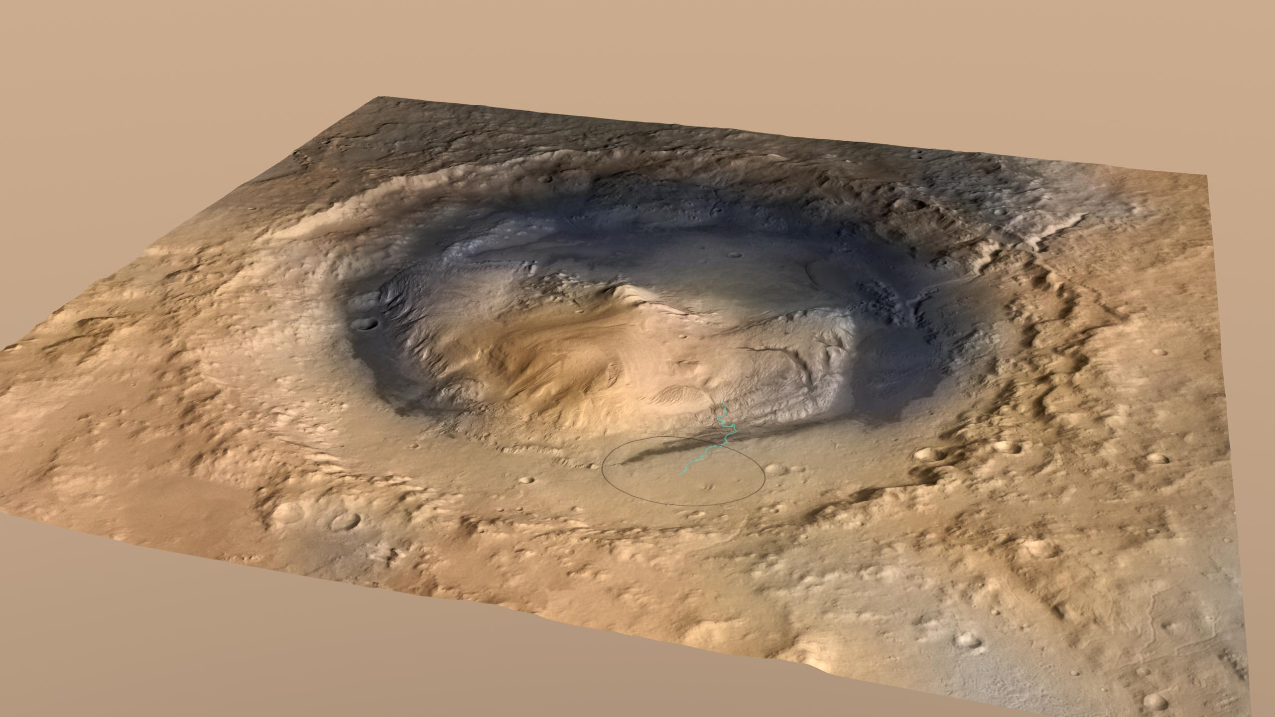
Curiosity and Ancient Mars
Shane Byrne
Lunar and Planetary Lab

Slide 2
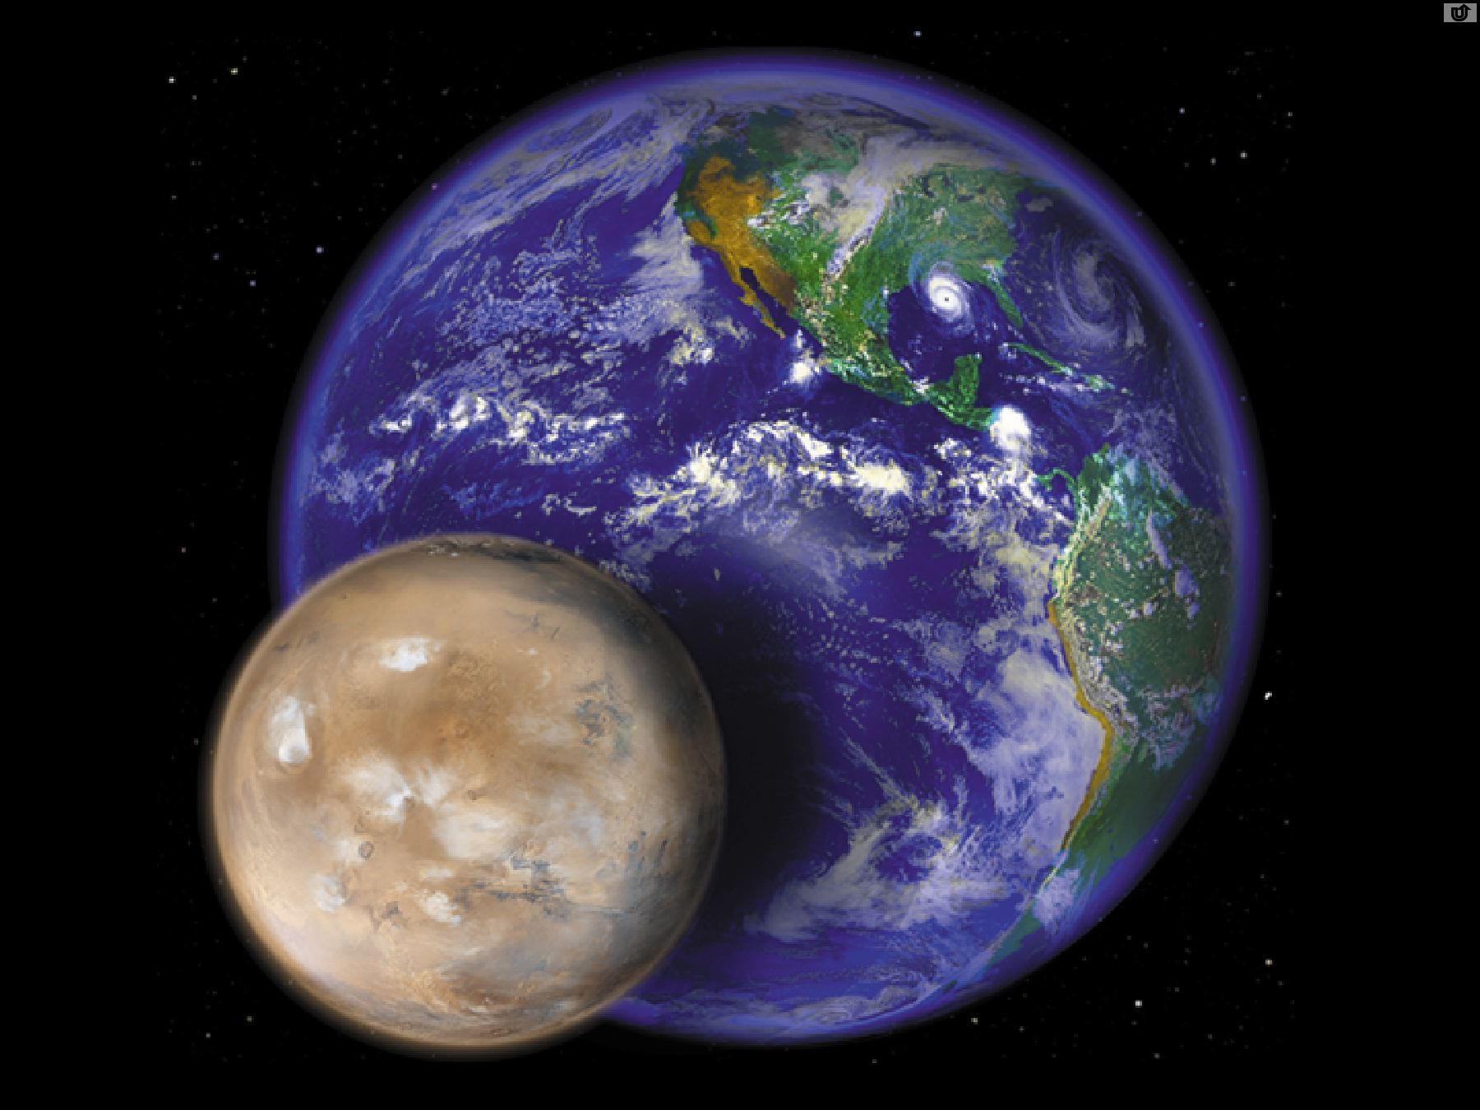
Martian Similarities
Size | 53% of the Earth
Mass | 11% of the Earth
Solar Distance | 1.52 AU (Earth is 1AU)
Year | 687 days, almost 2 Earth years
Obliquity | 25° (Earth = 23½°)
Rotation period | 24hrs 37 minutes (Earth = 1 day)
Surface | Earth-like rocks and landforms
Notes:
Size comparison
142 million miles from sun (earth is 93)
4220 miles in diameter (earth is 7926)
Length of day is 24 hr 37 min
Average temperature is -81 F

Slide 3
Martian Differences
Atmosphere | Mostly CO₂ (Earth = Mostly nitrogen)
Pressure | 0.006 bars (Earth = 1 bar)
Surface Temp. | 200K, -100° F (Earth = 300 K)
Clouds | Water ice and dust (Earth = water vapor)
Seasonal ice | Carbon dioxide (Earth has water frost)
Notes:
Size comparison
142 million miles from sun (earth is 93)
4220 miles in diameter (earth is 7926)
Length of day is 24 hr 37 min
Average temperature is -81 F

Slide 4
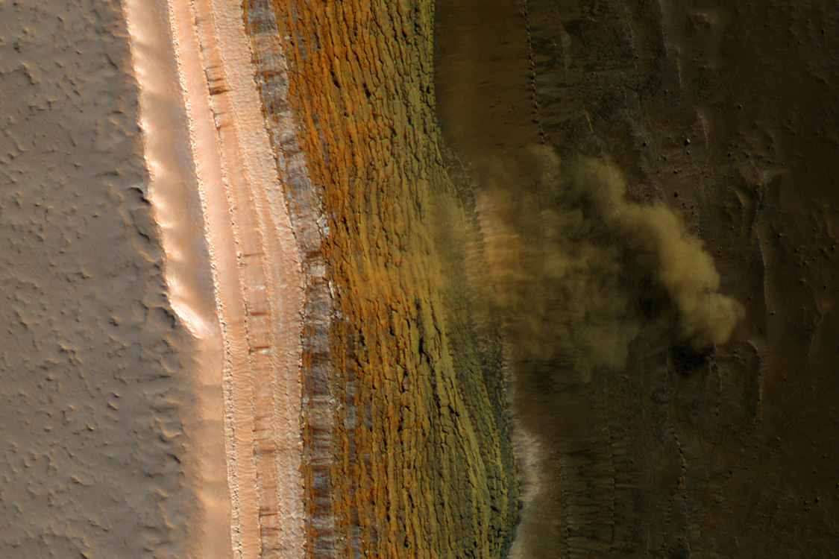
Mars activity today…
  Ice and frost
  Wind
  Mostly dry... But a bit damp in rare places in some seasons

Slide 5
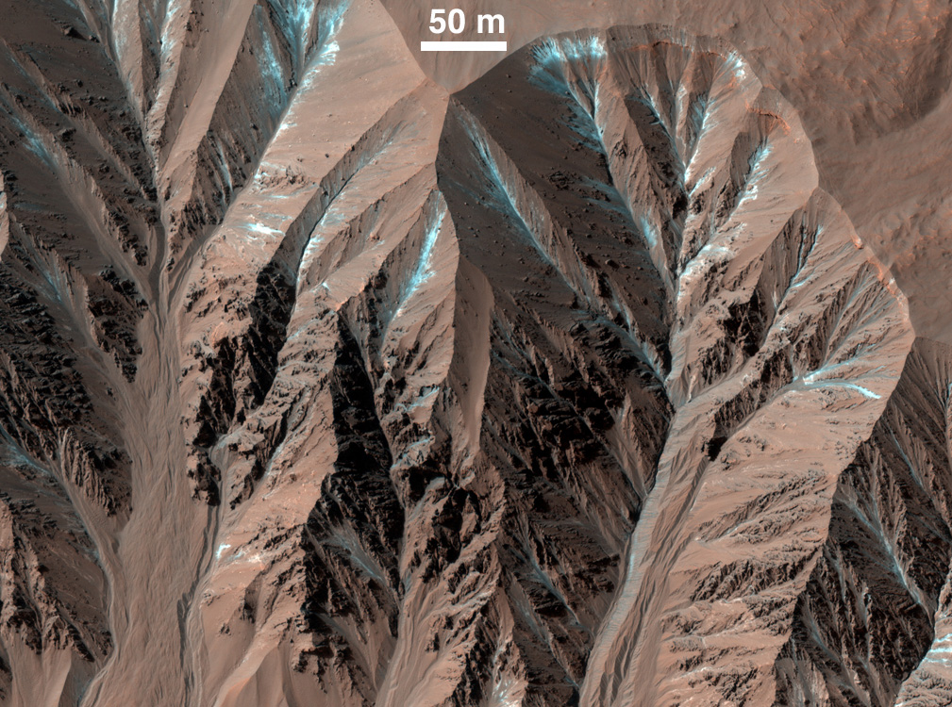

Slide 6
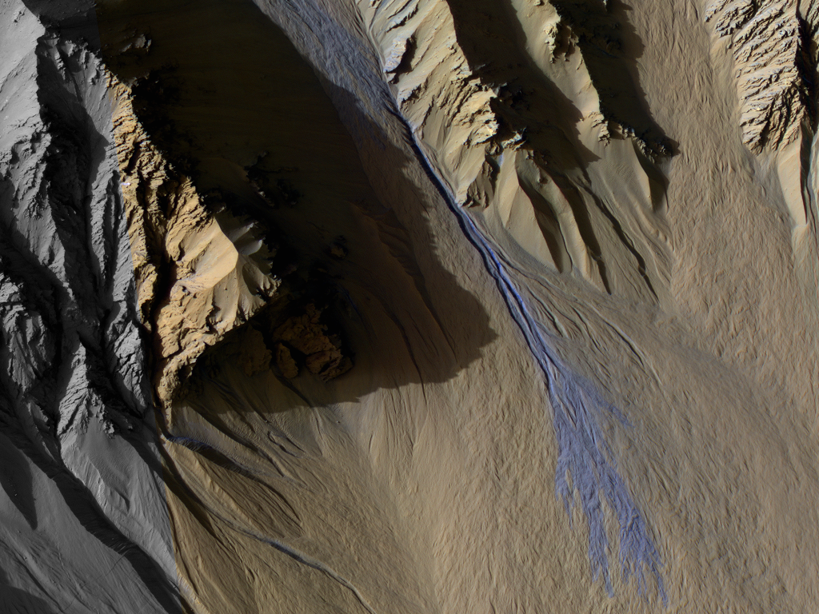

Slide 7
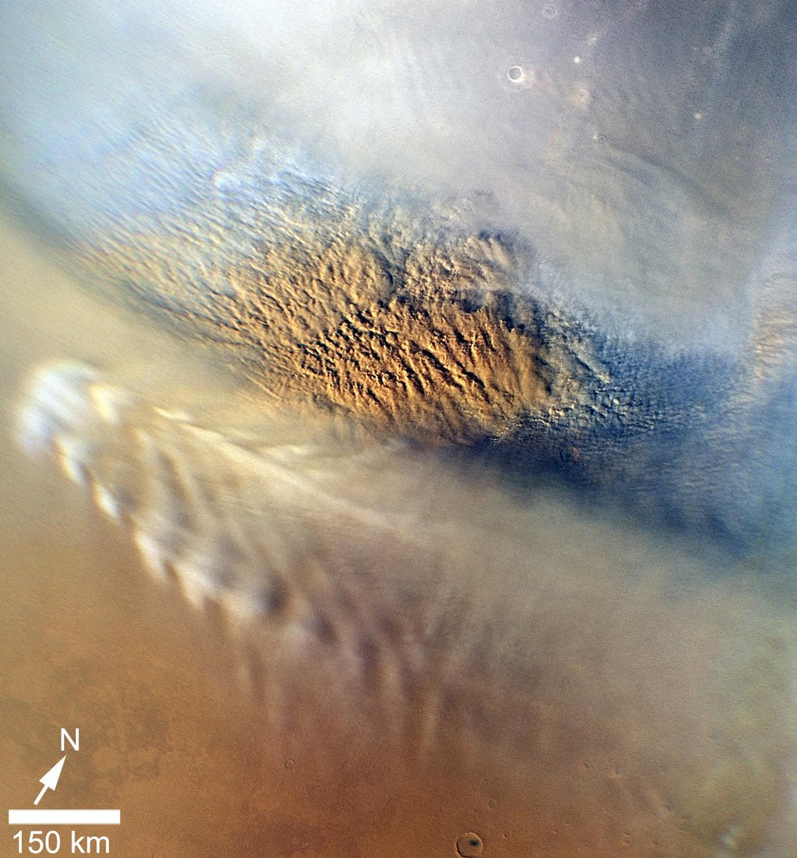
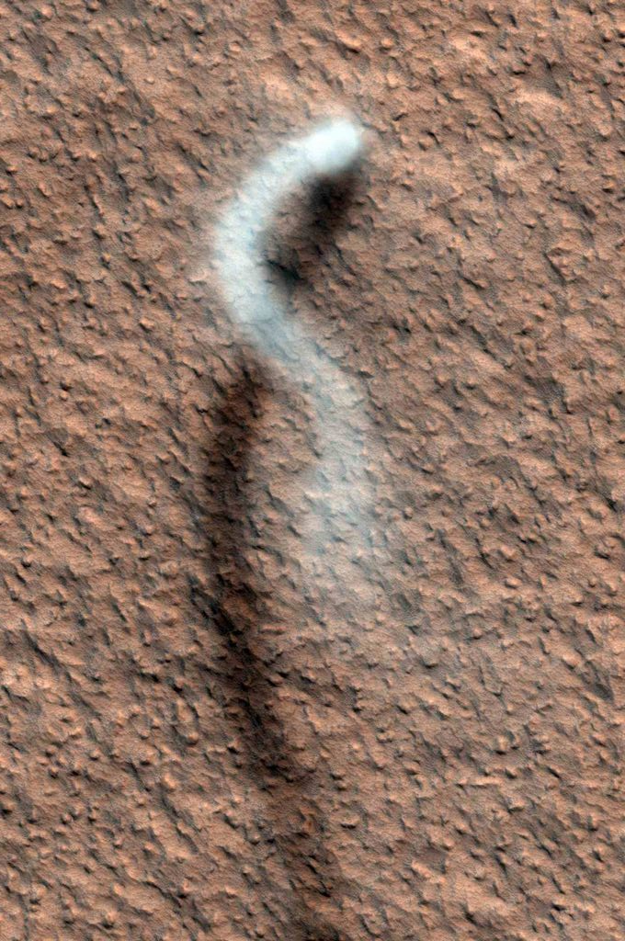
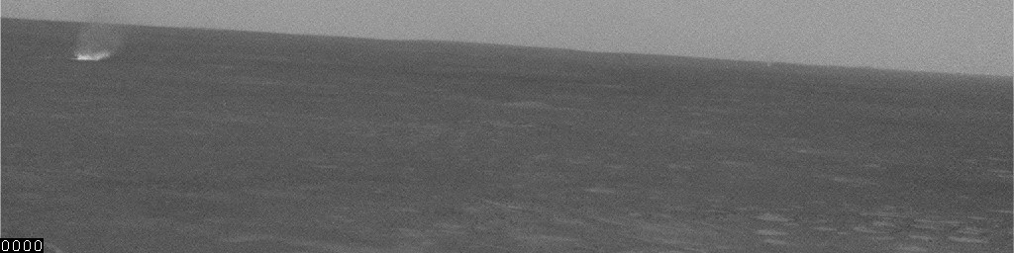
Present-day Mars is Windy…
Large Dust Devil
HiRISE Science Team
Regional dust-storm
MARCI Science Team
Small Dust Devil - MER Science Team

Slide 8
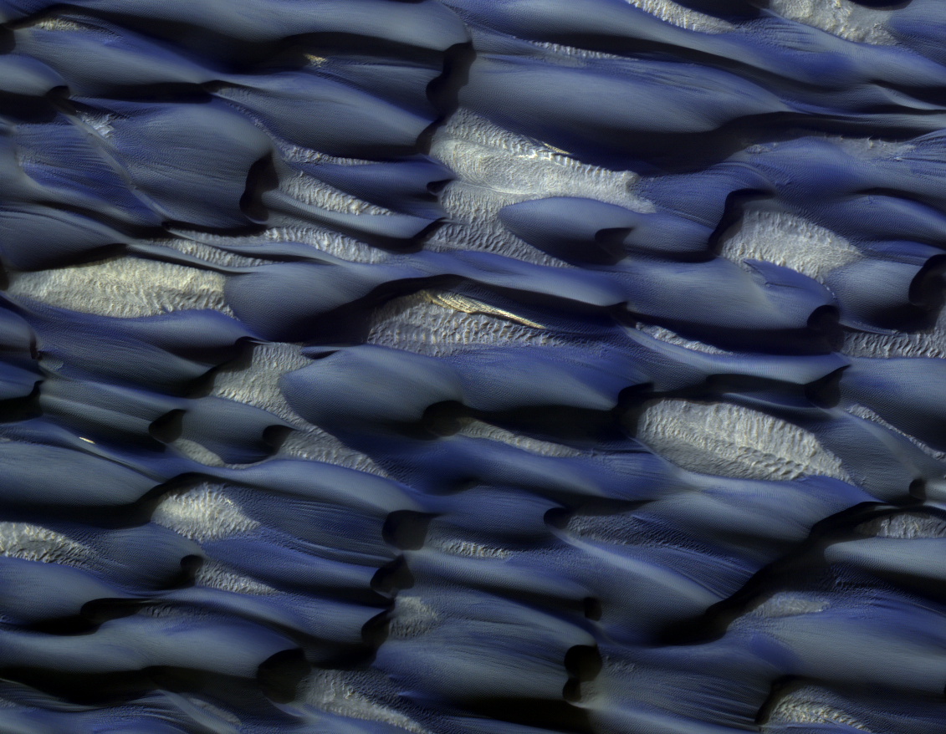

Slide 9
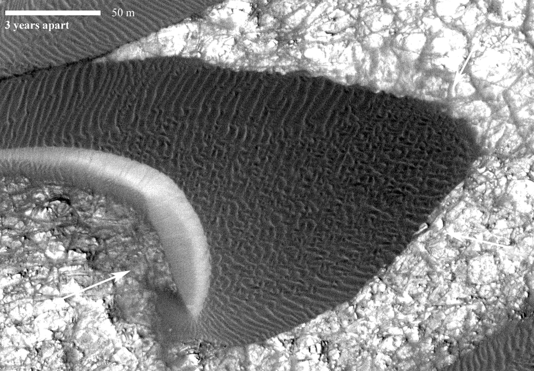
Courtesy of Nathan Bridges

Slide 10
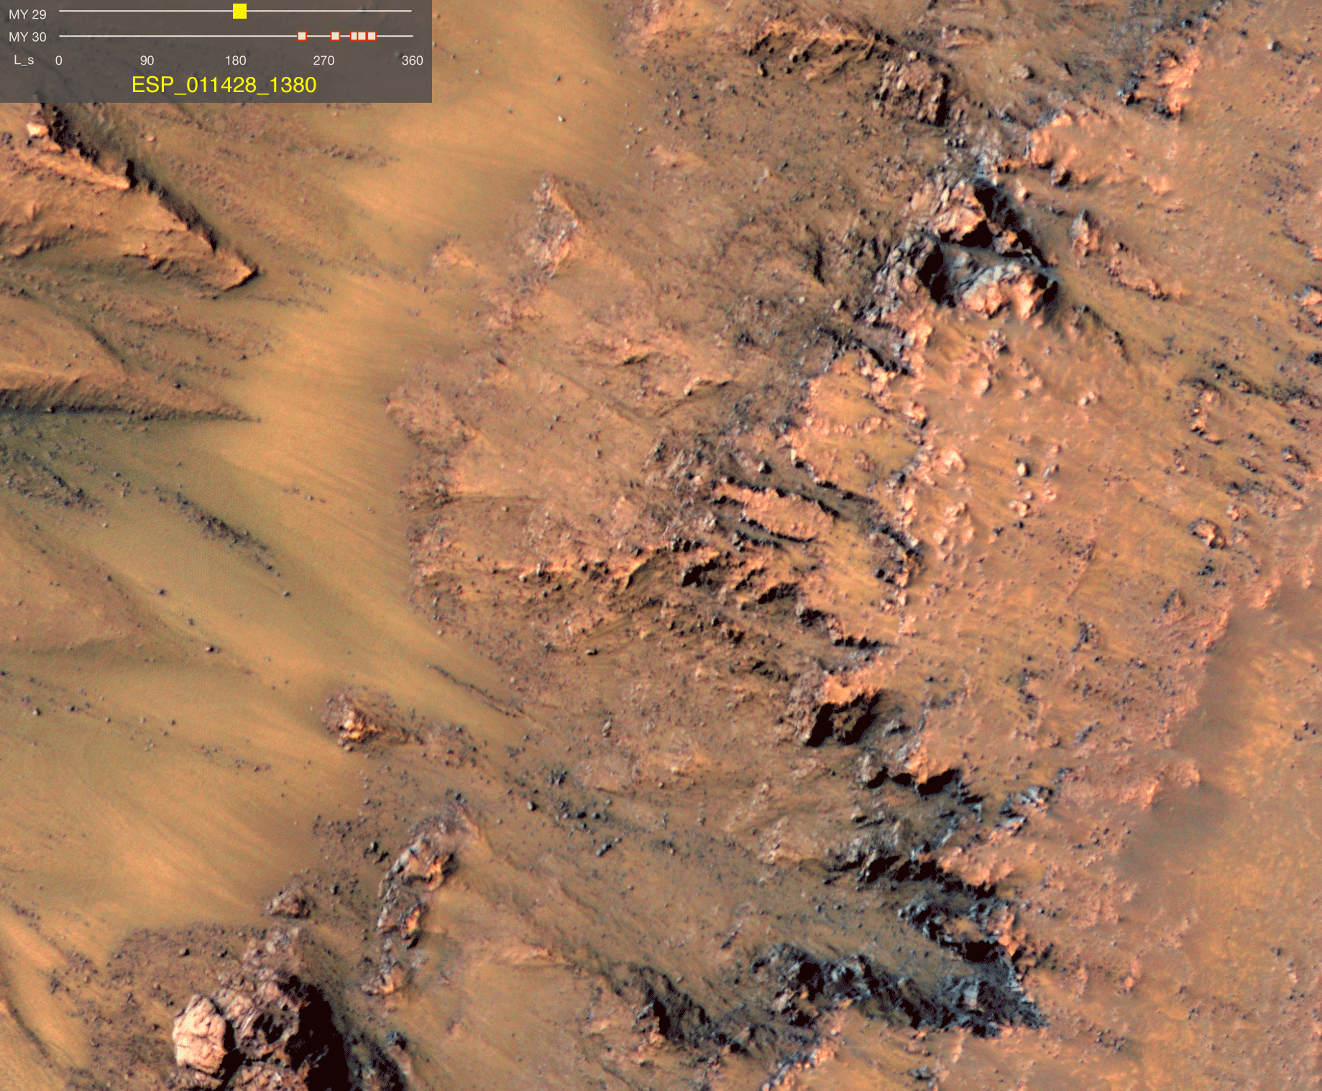
Brine Seeps?
  Liquid water is possible with various salt combinations
  McEwen et al. 2011

Slide 11
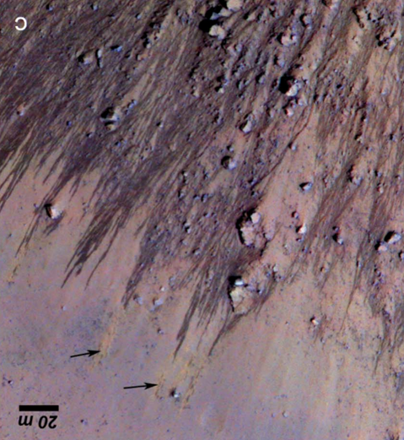
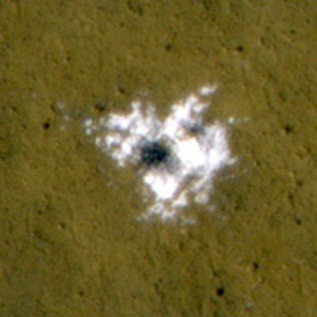
Mars is active today…
Wind
…but only a little Water
Frost
Ice and New impact craters

Slide 12
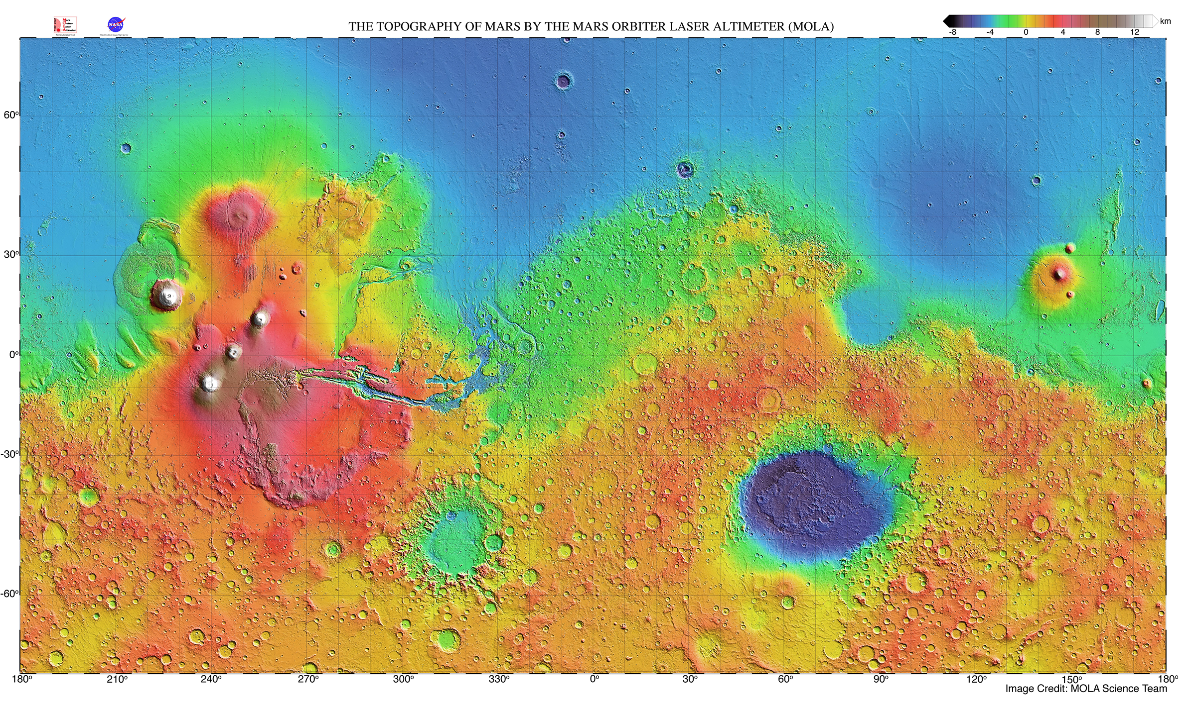
Ancient Mars was REALLY active though

Slide 13
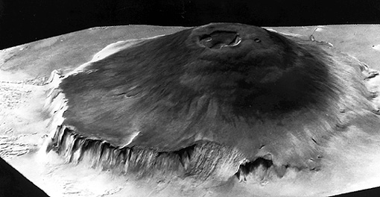
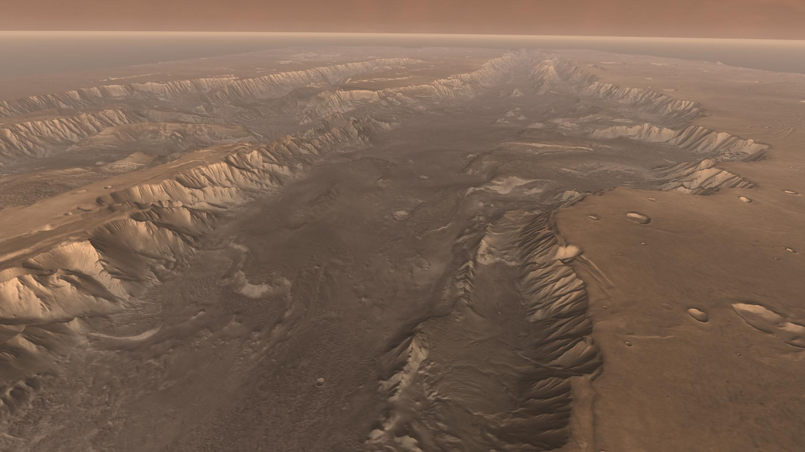
Giant Volcanoes and faults

Slide 14
Many large impact craters formed

Slide 15
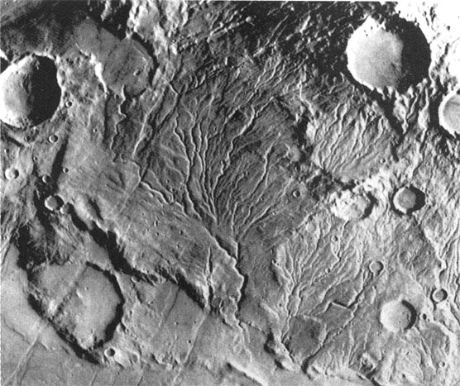
Widespread action of flowing water

Slide 16
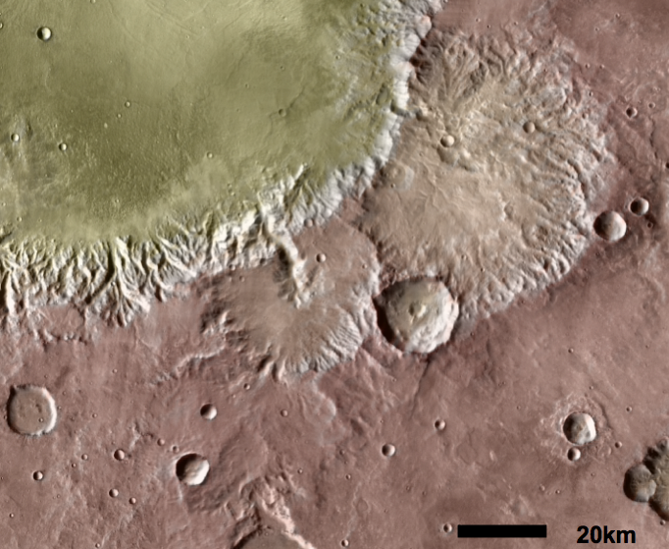
Water drains into many of these craters carving channels

Slide 17
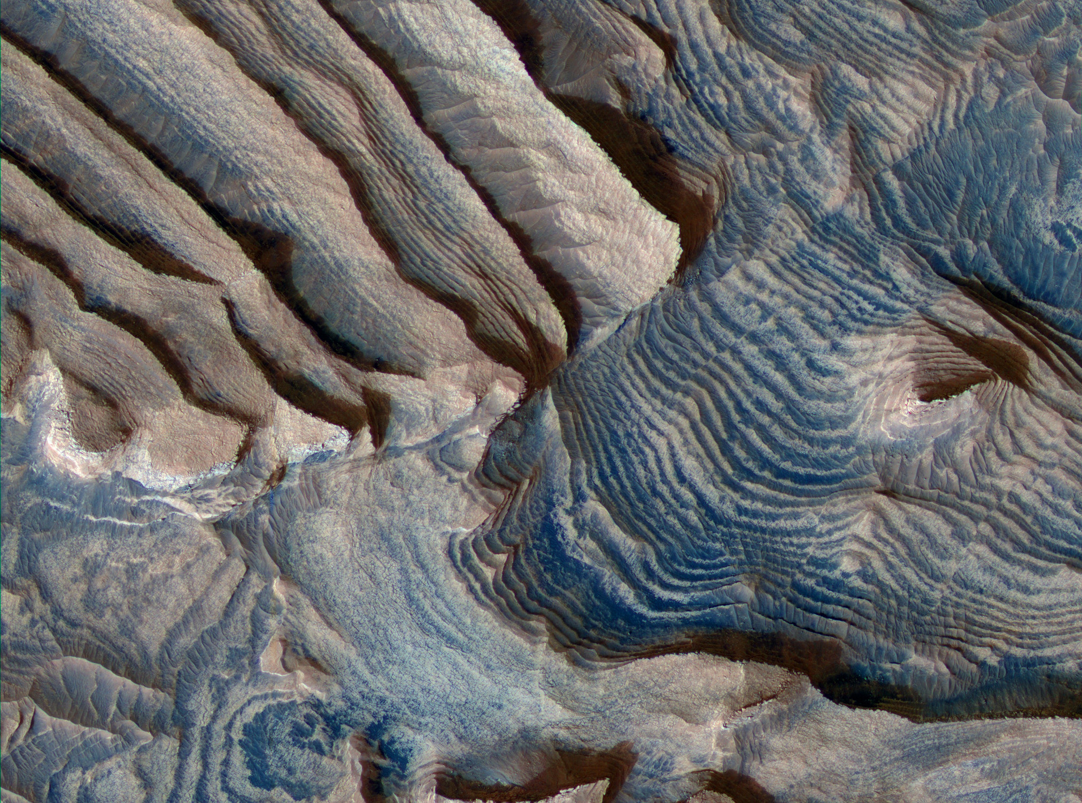
Lakes in craters leaving sediments

Slide 18
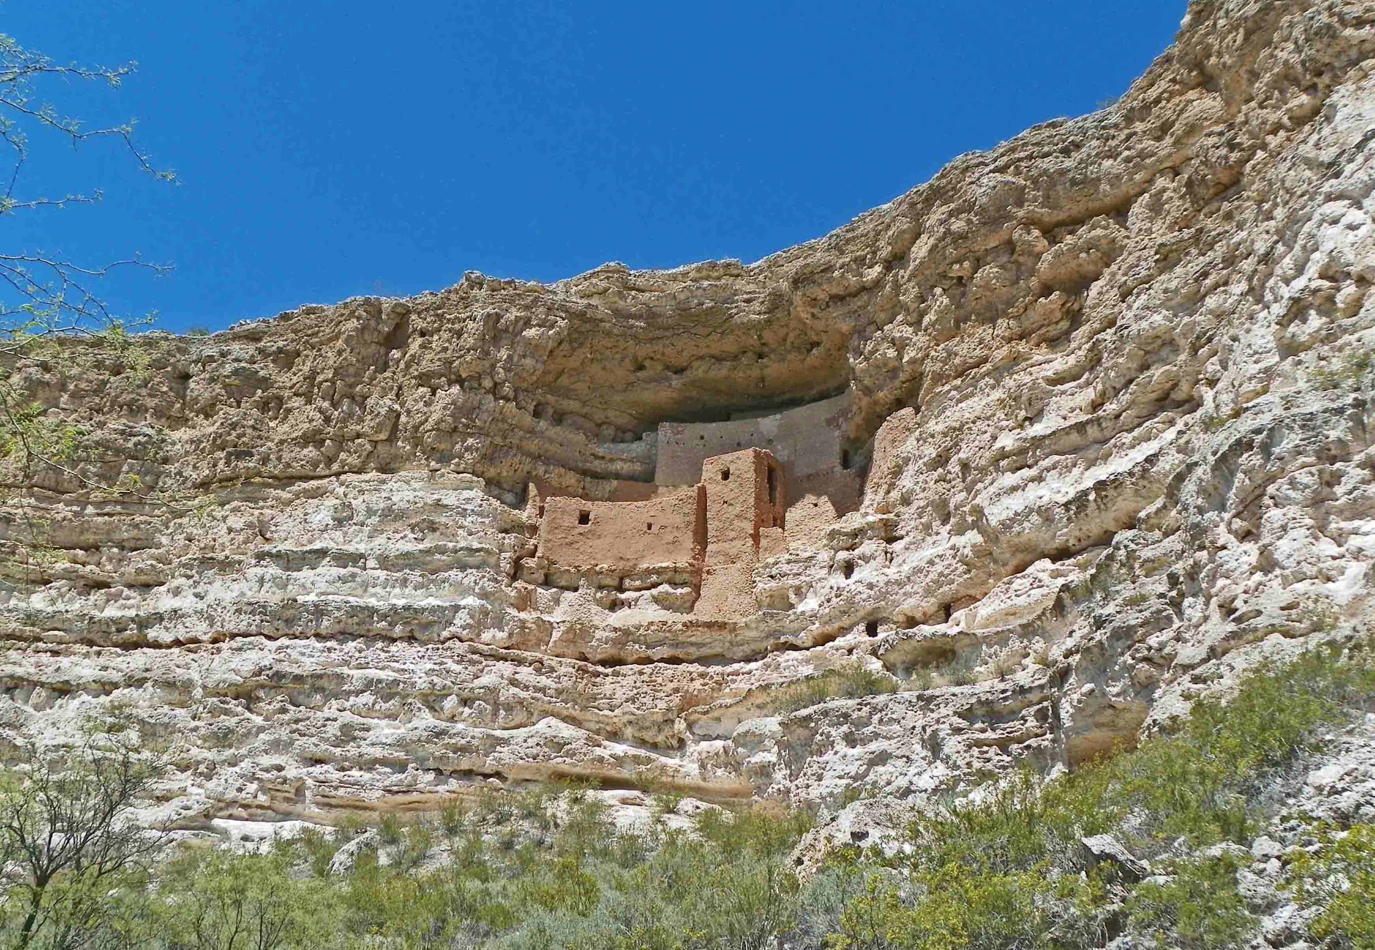
Lakes in craters leaving sediments

Slide 19
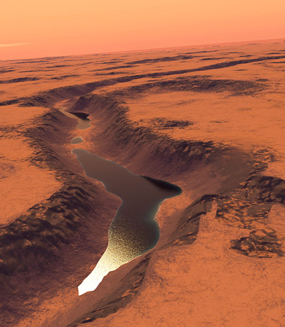
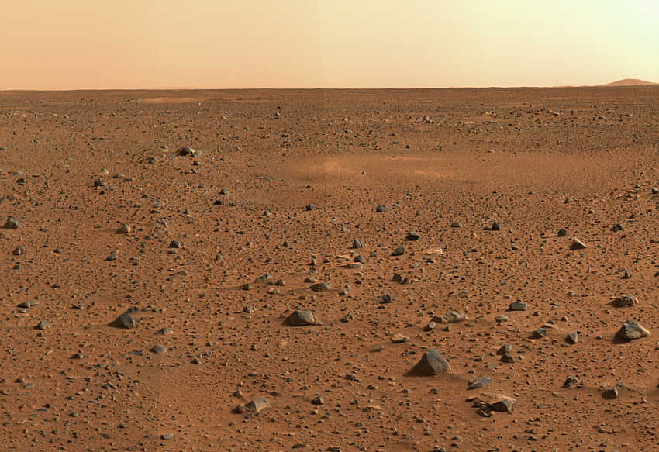
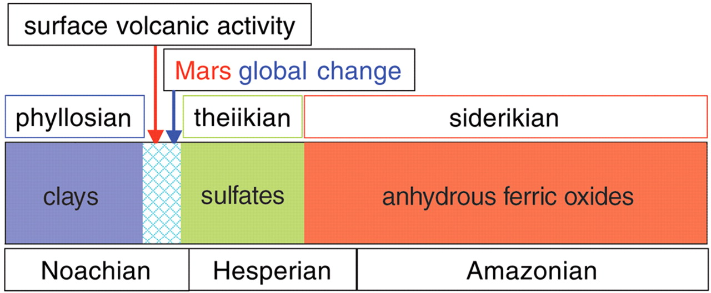
A big change for Mars
(Bibring et al., 2006)
4.5 billon yrs ago
present
MARS
EARTH
Hadean
Archaean
Proterozoic
Phan.
4.6 Gyr
3.85 Gyr
2.5
Gyr
543 Myr
present day
oldest rocks
oldest fossil life

Slide 20
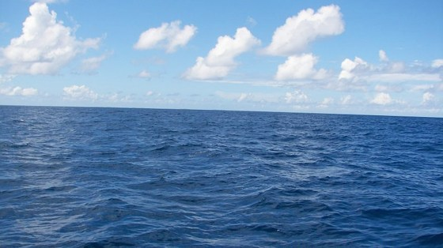
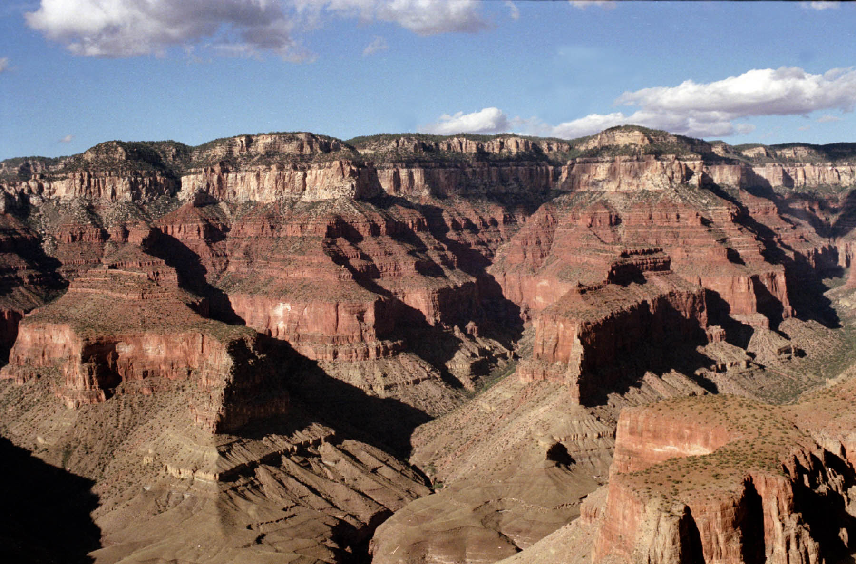
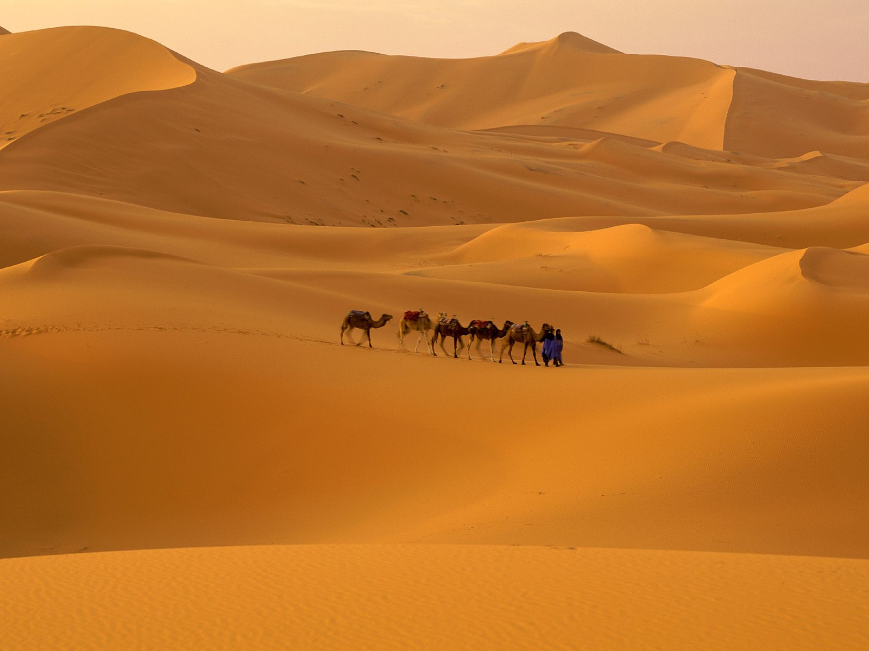
How do we figure out more about what happened on Early Mars?
  We do this on Earth with the rock record…
Arizona 270 million years ago
Grand Canyon - Arizona
Arizona 275 million years ago
(minus the camels…)

Slide 21
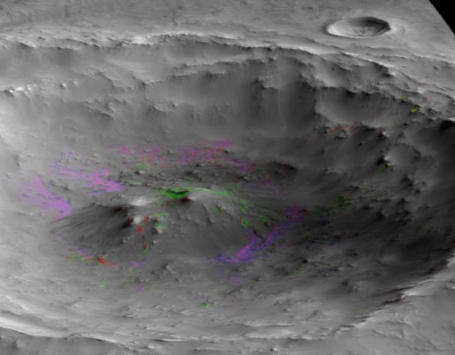
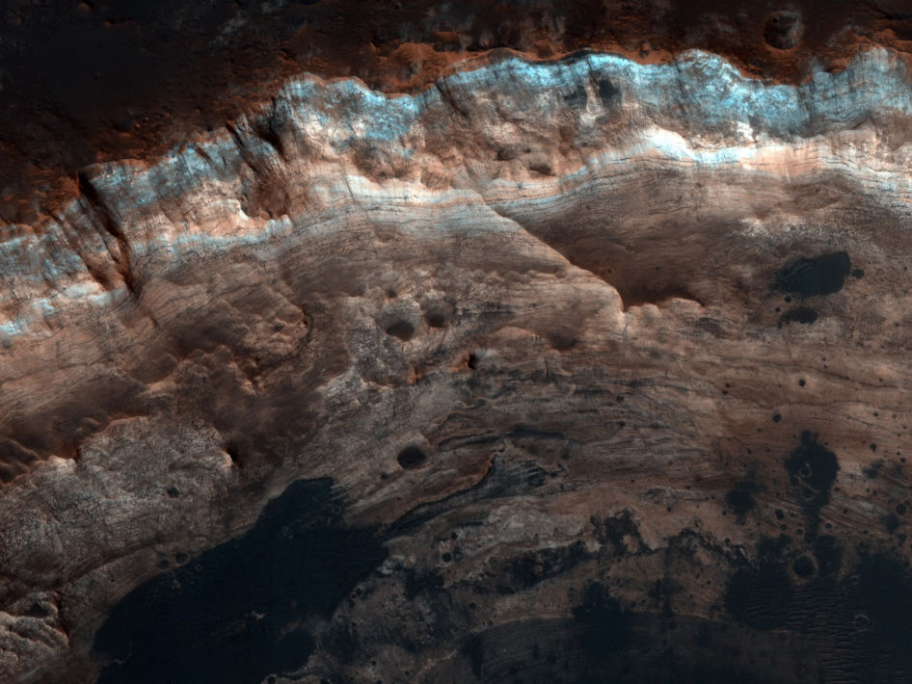
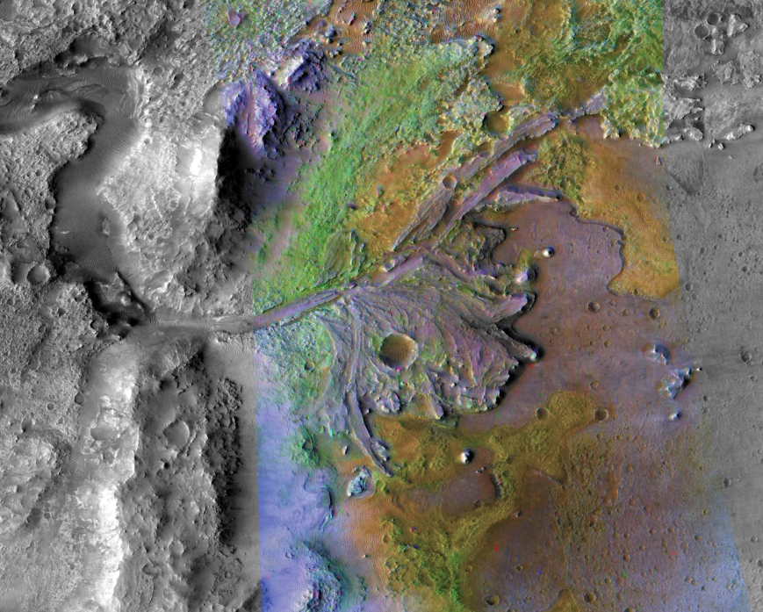
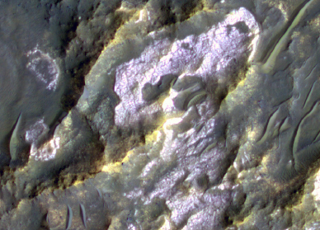
What do ancient martian rocks tell us?
  Clay minerals formed in wet conditions and they’re found in ancient rocks
Wray et al., 2008
Ehlmann et al., 2009
Noachian crustal hydrothermal clays
Noachian layered clays
Ehlmann et al., 2008
Osterloo et al., 2008
Noachian delta/fan clay-bearing sediments
Noachian "glowing terrain" rich in chloride salts

Slide 22
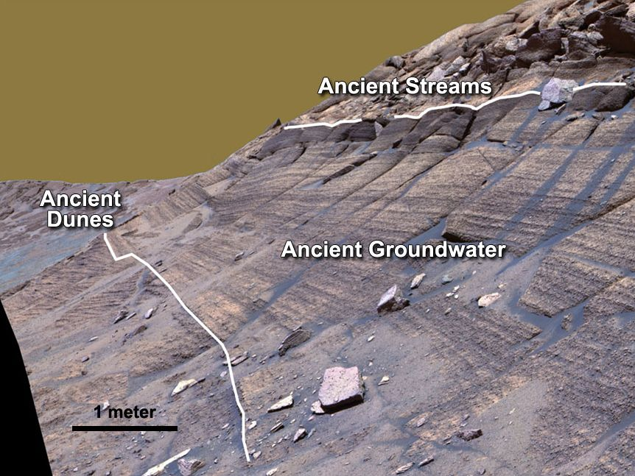
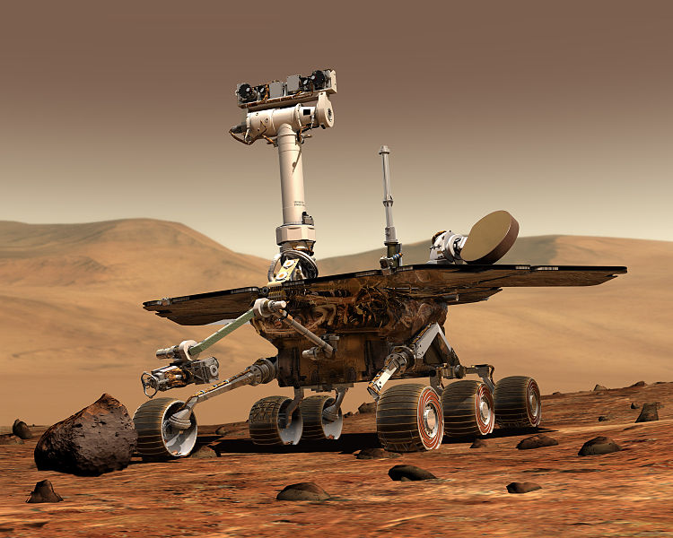
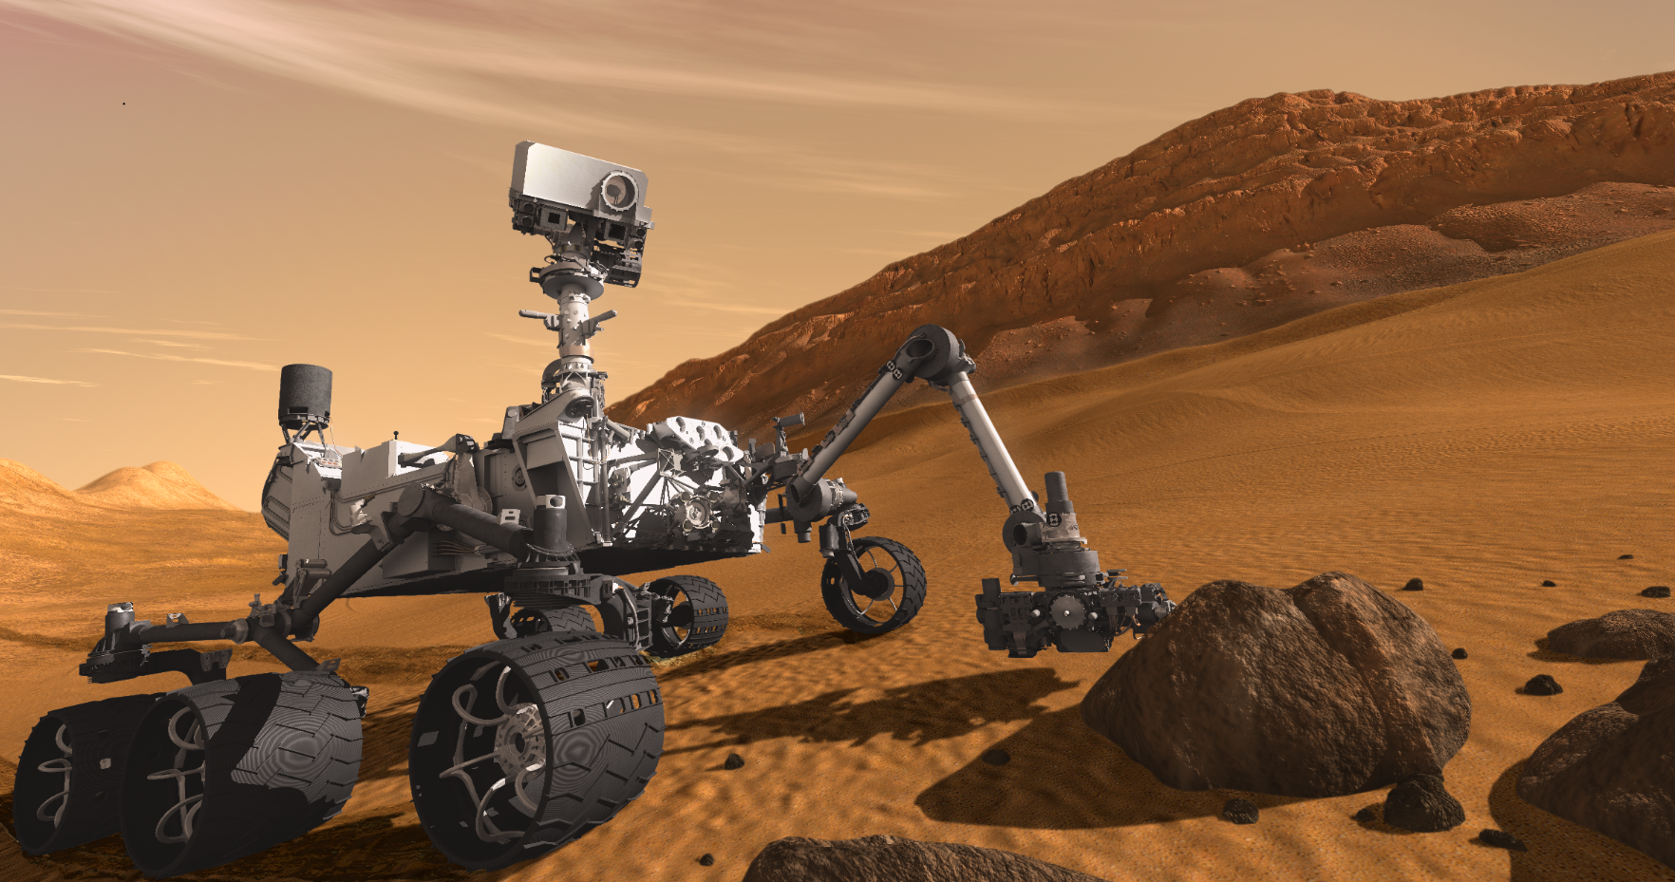
Reading rocks is best done on the ground
Opportunity – still rovin’
MSL
Starting tomorrow

Slide 23
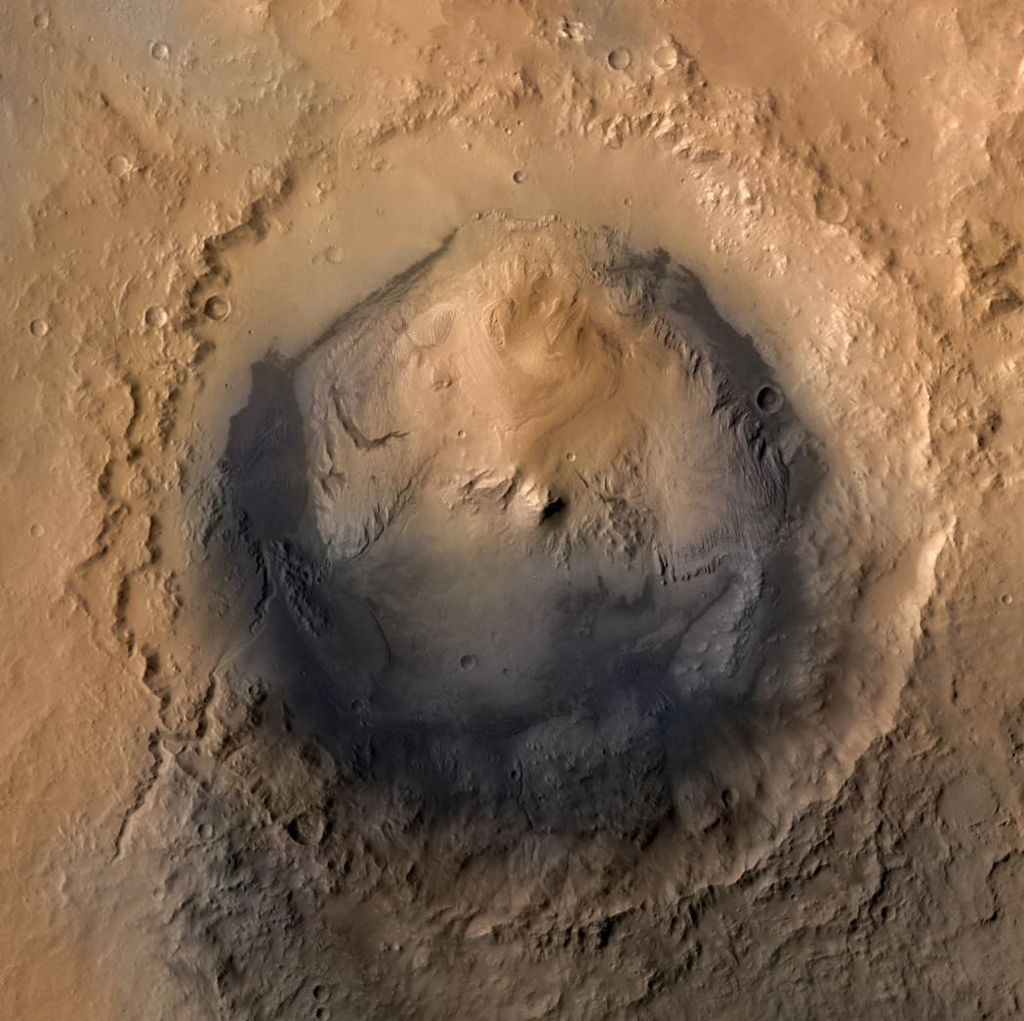
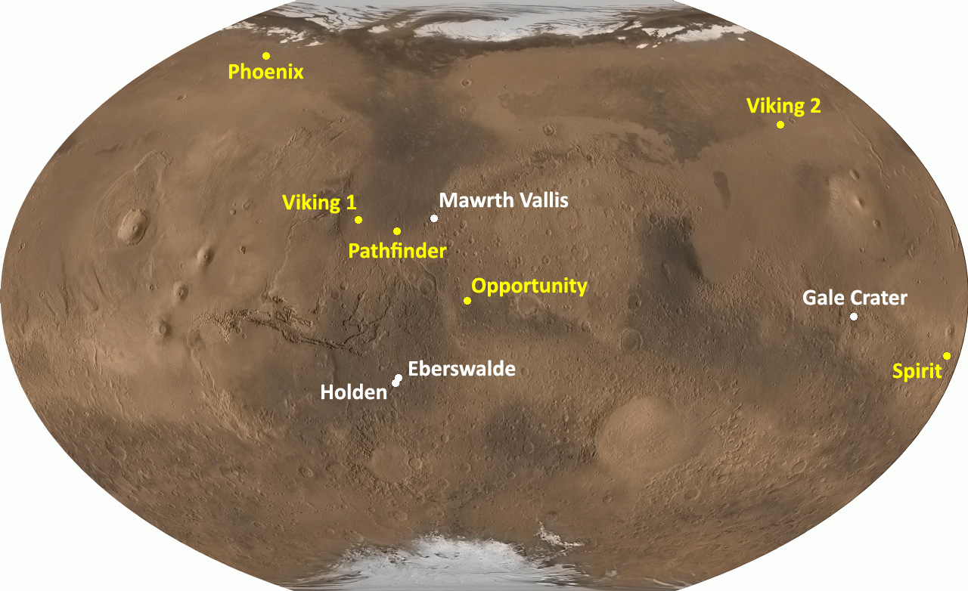
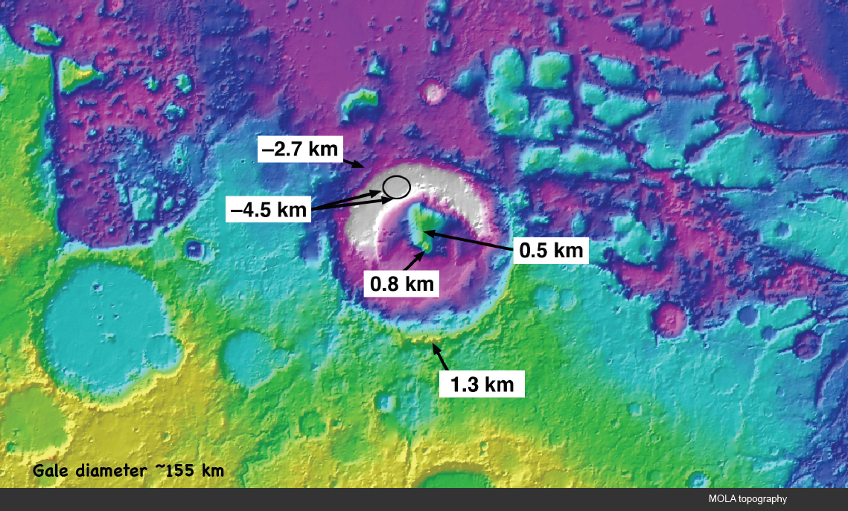
Gale crater & Mt. Sharp

Slide 24
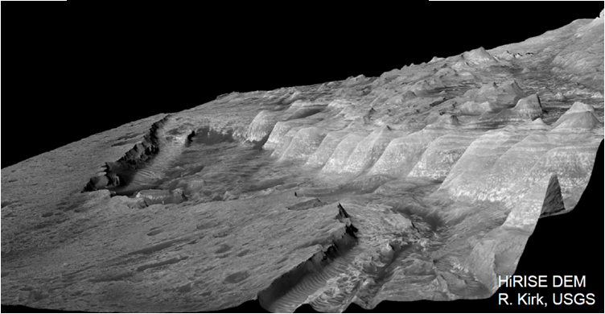

Slide 26
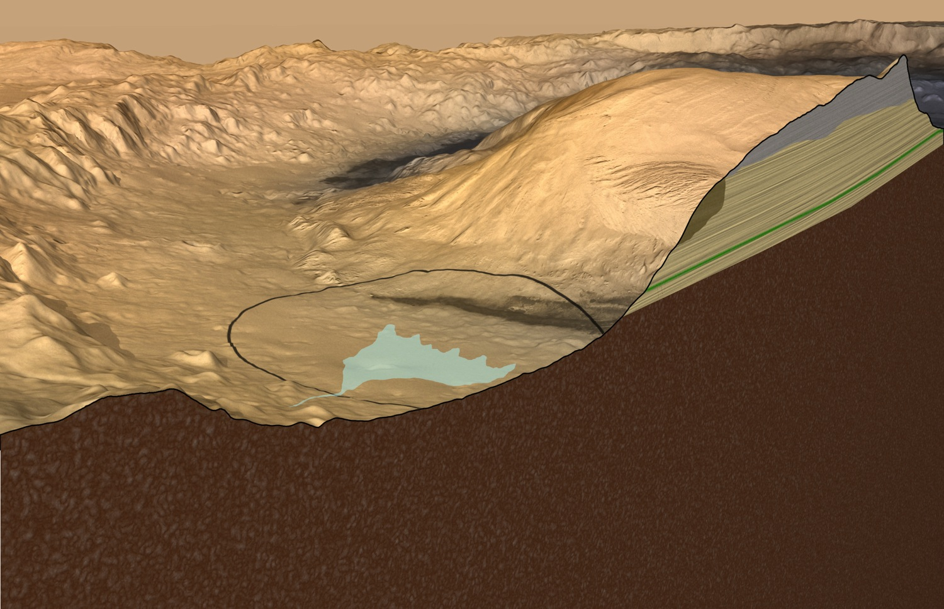
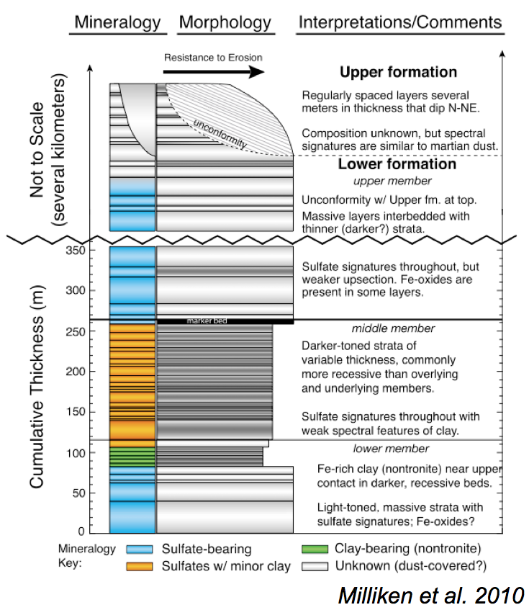
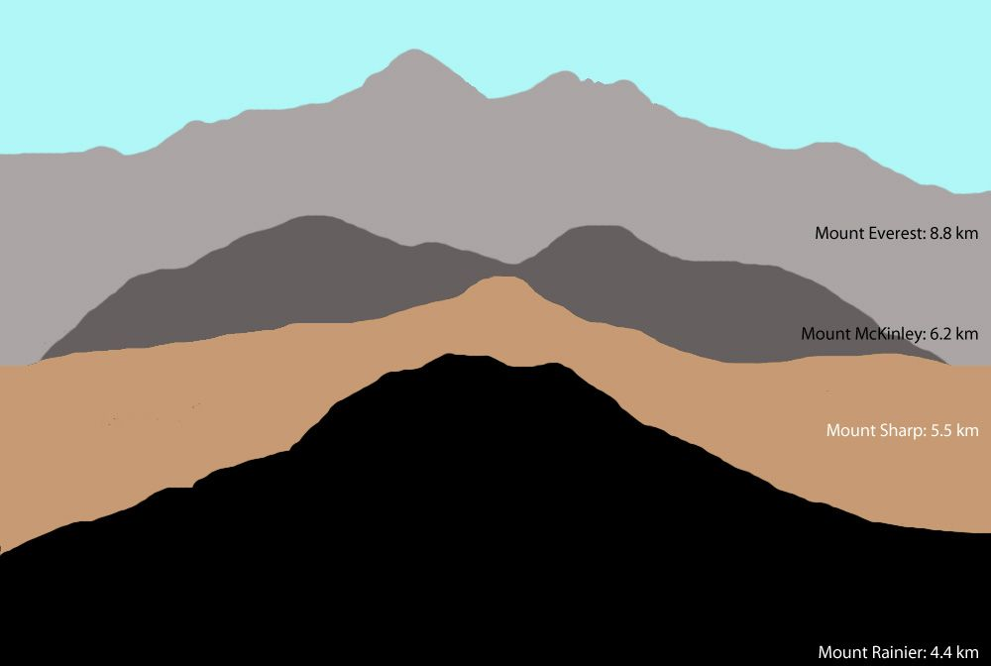

Slide 27
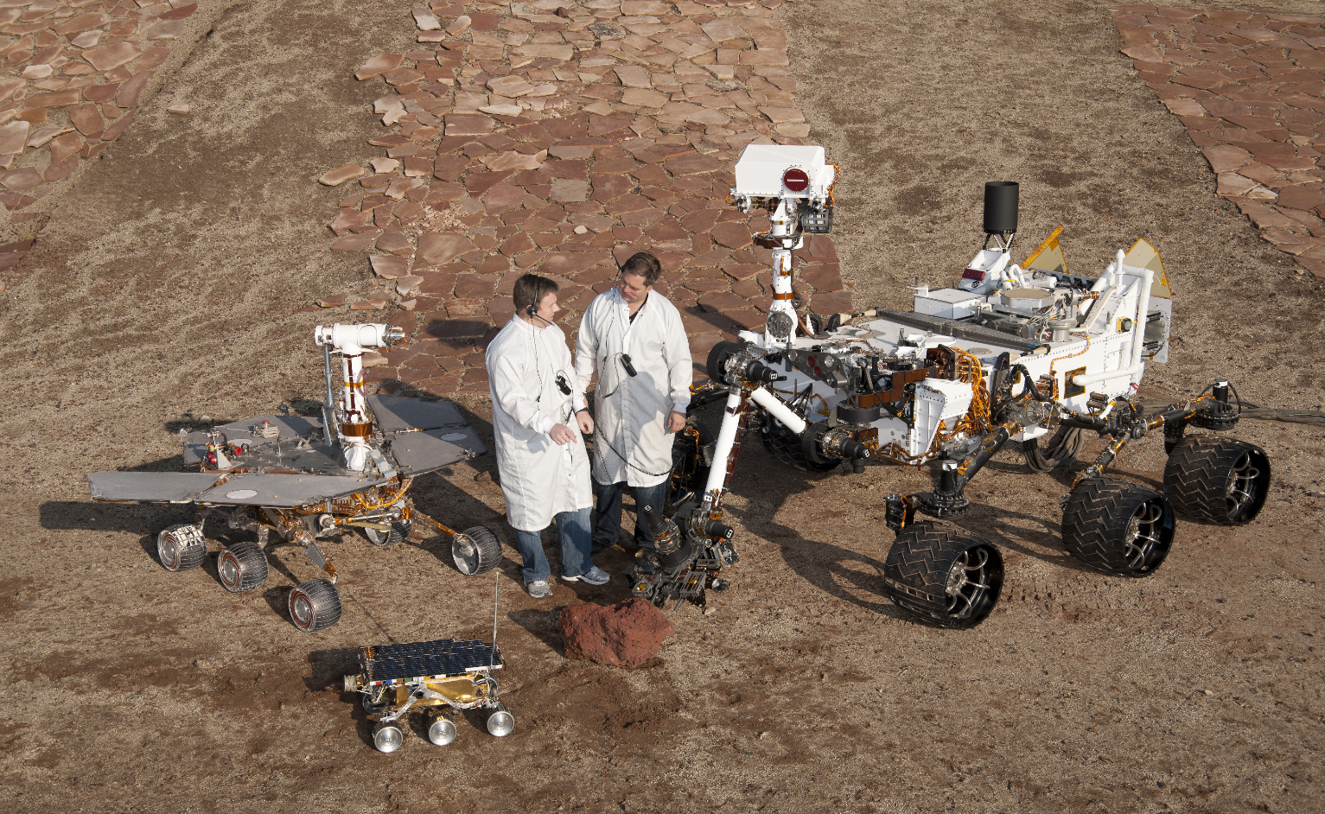
MSL is our largest Mars Rover
  Expected to drive 10s of miles
  Expected to last for 1 Mars Year

Slide 28


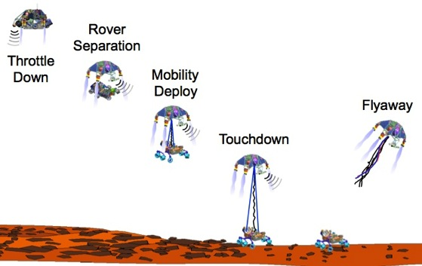



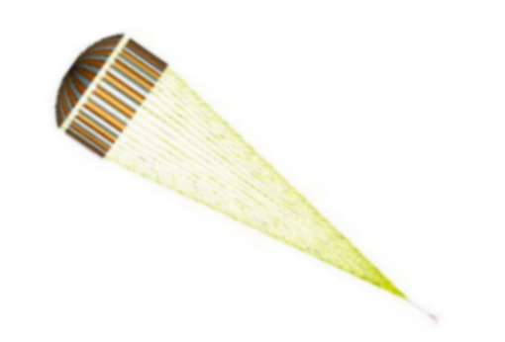
MSL Entry, Descent, and Landing (courtesy of MSL team)
Cruise Stage
Separation
Guided entry corrects for atmospheric variability and improves landing accuracy
“Sky Crane” design places the rover directly on Martian soil while keeping the rockets away from the ground
Max Heating and Deceleration
Parachute Descent
Heatshield Separation
Backshell Separation
Guided Entry (horizontal flight)
Sky Crane
Powered Descent
Touchdown

Slide 29


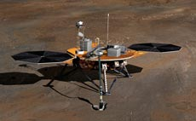

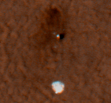
Phoenix on the surface L+22 hours

Slide 30
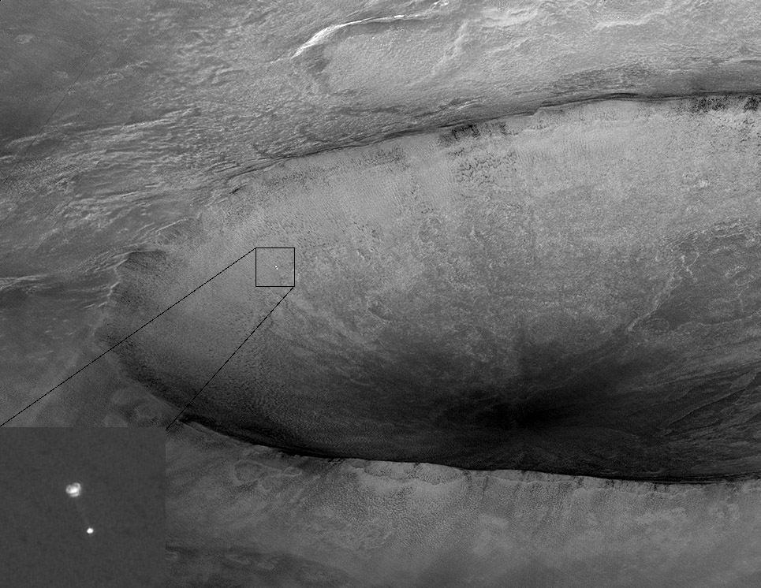
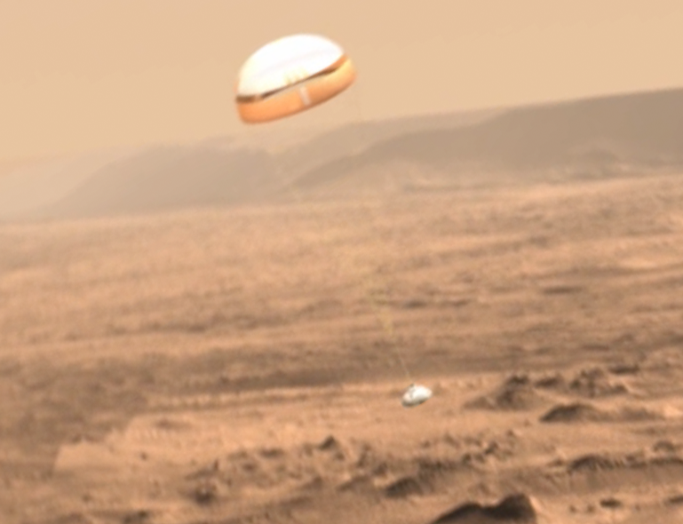
The right place at the right time…

Slide 31
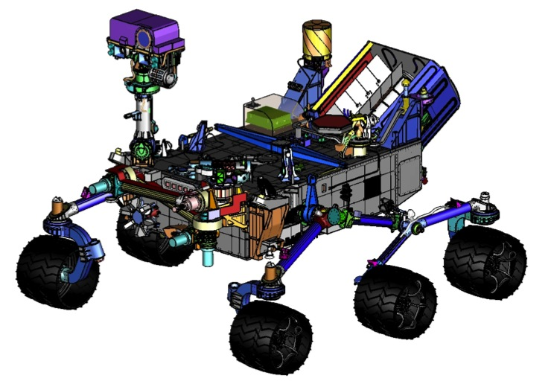
MSL Science Payload (courtesy of MSL team)
ChemCam
REMOTE SENSING
Mastcam (M. Malin, MSSS) - Color and telephoto imaging, video, atmospheric opacity
ChemCam (R. Wiens, LANL/CNES) – Chemical composition; remote micro-imaging
CONTACT INSTRUMENTS (ARM)
MAHLI (K. Edgett, MSSS) – Hand-lens color imaging
APXS (R. Gellert, U. Guelph, Canada) - Chemical composition
ANALYTICAL LABORATORY (ROVER BODY)
SAM (P. Mahaffy, GSFC/CNES) - Chemical and isotopic composition, including organics
CheMin (D. Blake, ARC) - Mineralogy
ENVIRONMENTAL CHARACTERIZATION
MARDI (M. Malin, MSSS) - Descent imaging
REMS (J. Gómez-Elvira, CAB, Spain) - Meteorology / UV
RAD (D. Hassler, SwRI) - High-energy radiation
DAN (I. Mitrofanov, IKI, Russia) - Subsurface hydrogen
Mastcam
RAD
REMS
DAN
MAHLI
APXS
Brush
Drill / Sieves
Scoop
MARDI
Wheel Base: 2.8 m
Height of Deck: 1.1 m
Ground Clearance: 0.66 m
Height of Mast: 2.2 m

Slide 32
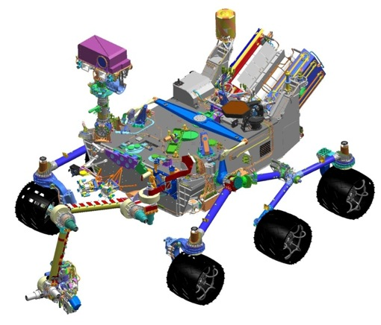
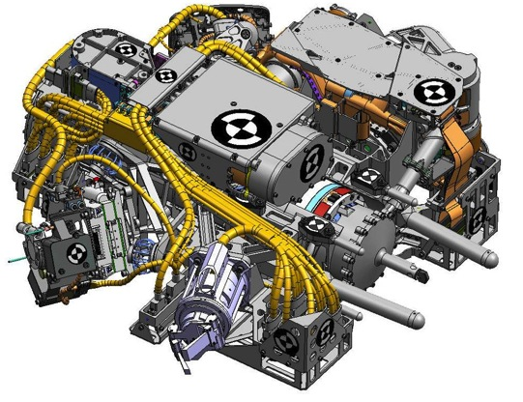
Sampling System (courtesy of MSL team)
Organic Check Material
Cleans rock surfaces with a brush
Places and holds the APXS and MAHLI instruments
Acquires samples of rock or soil with a powdering drill or scoop
Sieves the samples (to 150 μm or 1 mm) and delivers them to instruments or an observation tray
Exchanges spare drill bits
Sample Observation Tray
Extra Drill Bits
Turret
2.25-m Robot Arm
APXS
CHIMRA
MAHLI
Drill
Brush

Slide 33

Learn More about Curiosity (courtesy of MSL team)
Mars Science Laboratory
http://mars.jpl.nasa.gov/msl
MSL for Scientists
http://msl-scicorner.jpl.nasa.gov
Mars Exploration Program
http://mars.jpl.nasa.gov

Slide 34
Extra

Slide 35

Reading martian rocks from orbit…

Slide 36

Nili Fossae region from HiRISE
Ancient terrains on Mars contain mineral (color) diversity.
Blue color marks unaltered mafic minerals; other colors indicate alteration.
Image width ~1.1 km
Enhanced colors

Slide 37

HiRISE “Movie”

Slide 38

BG

Slide 39

RED

Slide 40

IR

