Slide 1
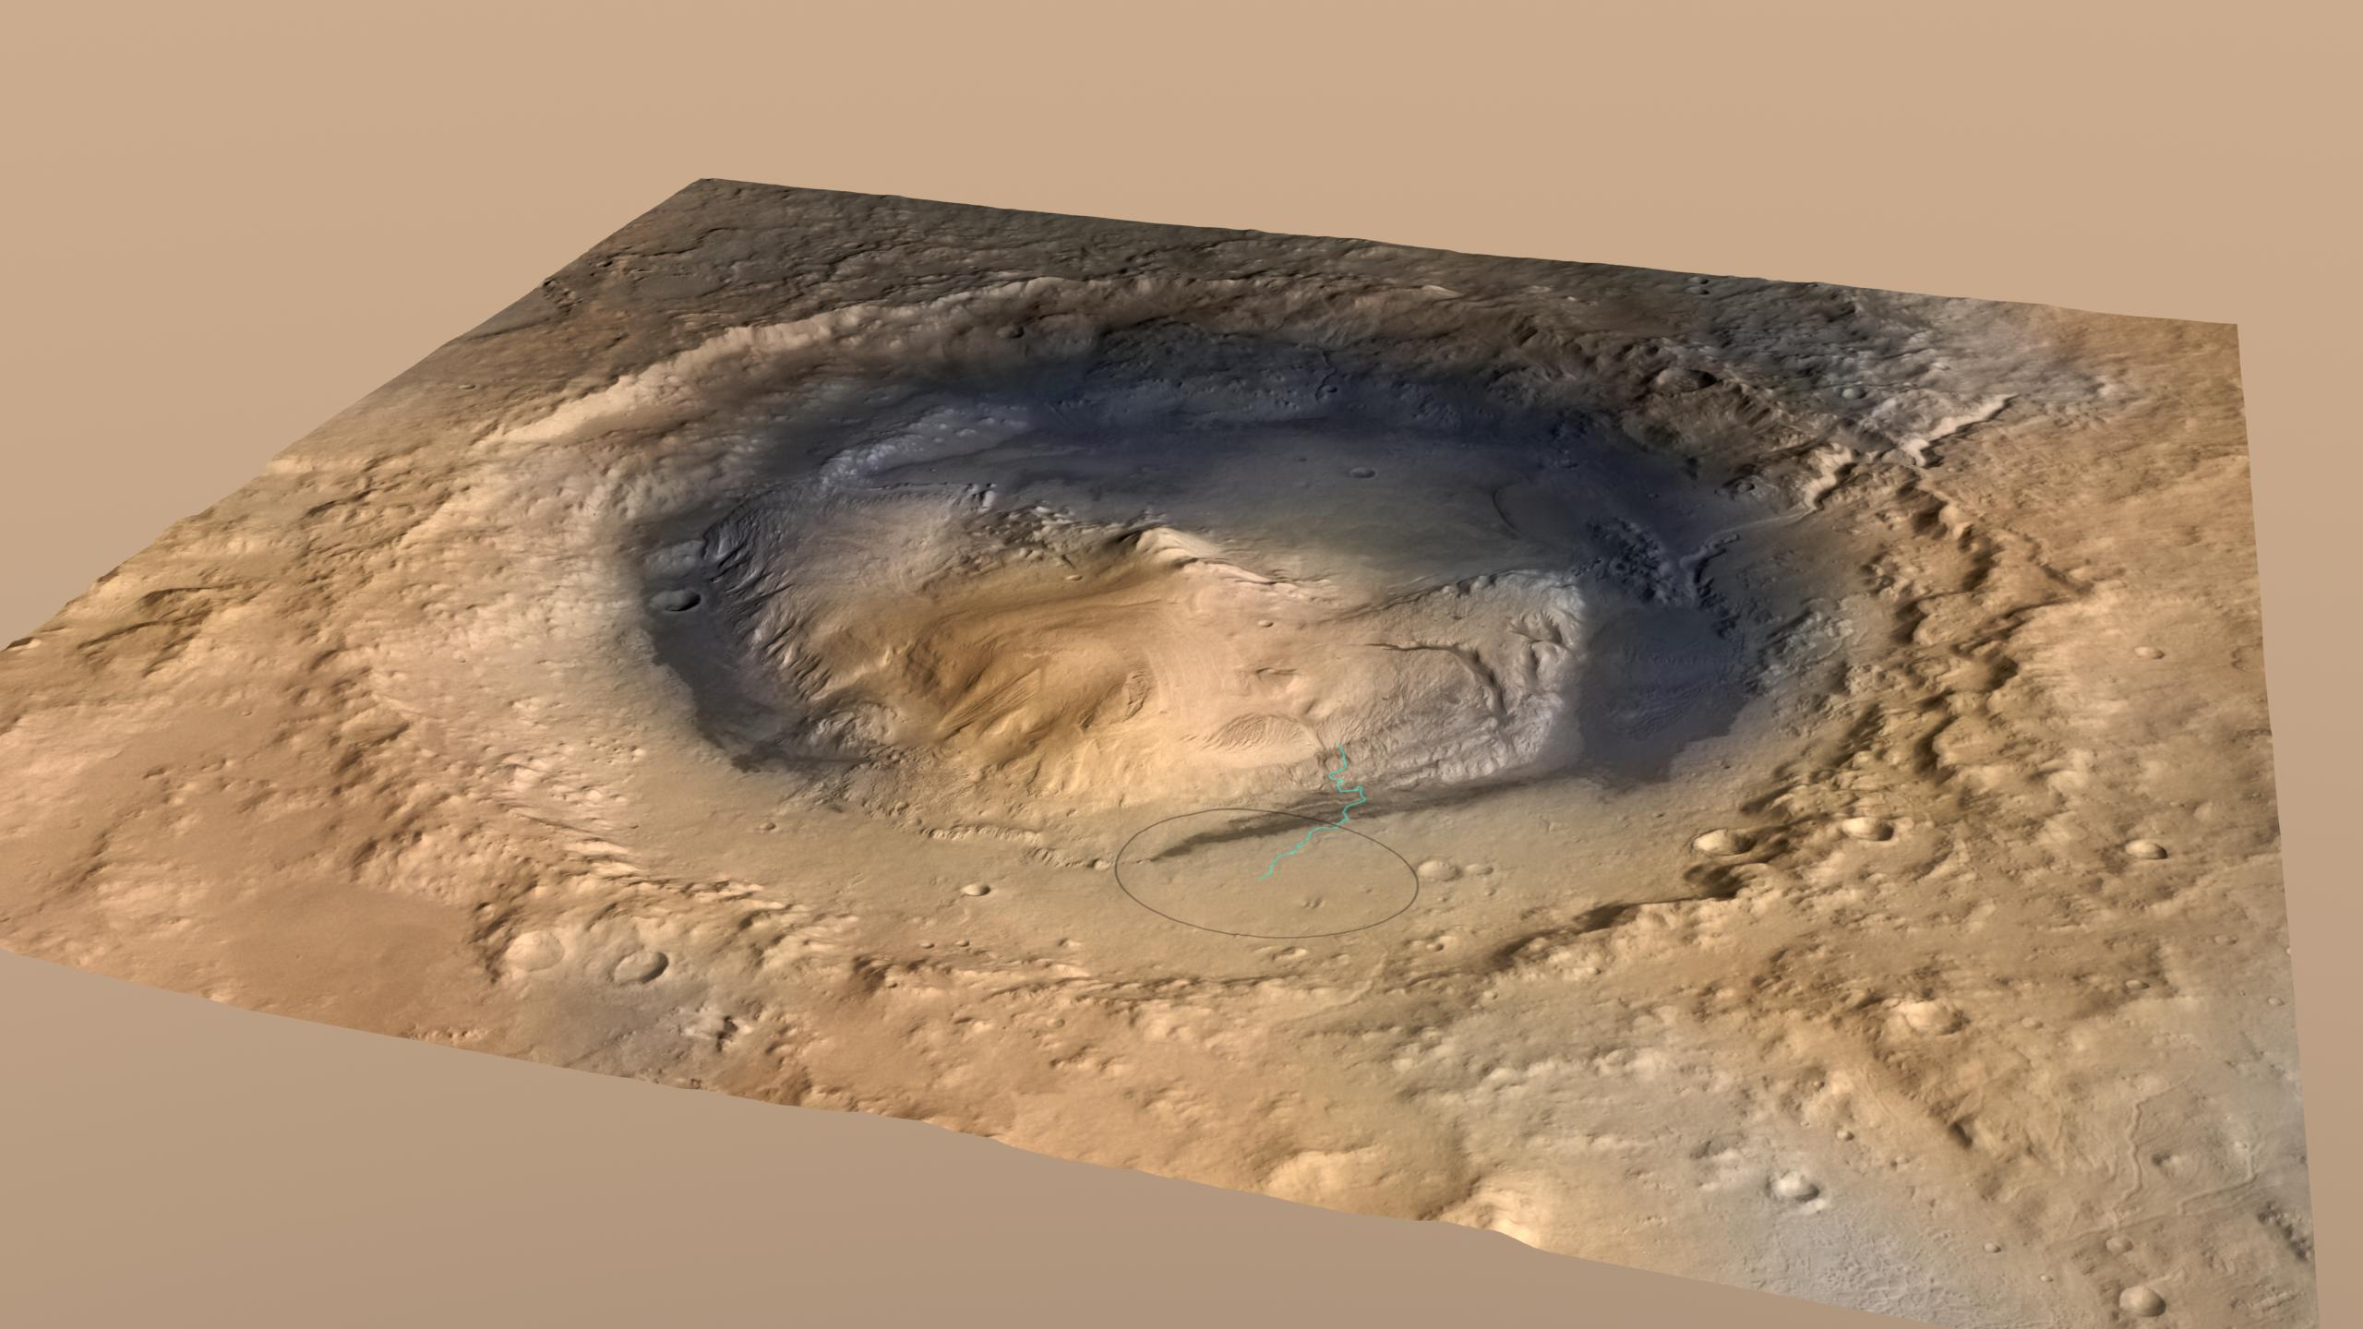
Curiosity and Water on Mars
Shane Byrne
Lunar and Planetary Lab

Slide 2
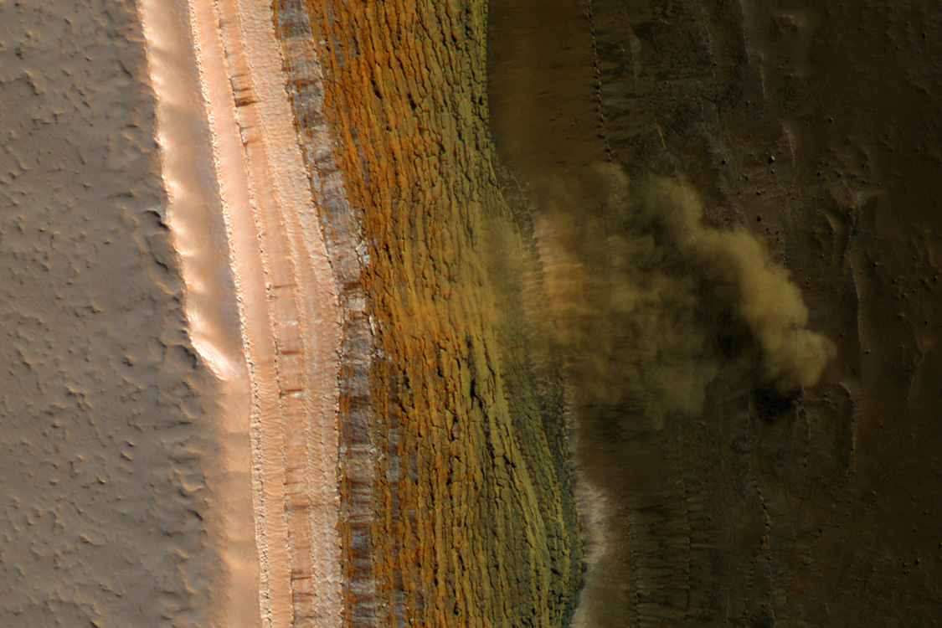
Mars activity today…
  Ice and frost
  Wind
  Mostly dry... But a bit damp in rare places in some seasons

Slide 3
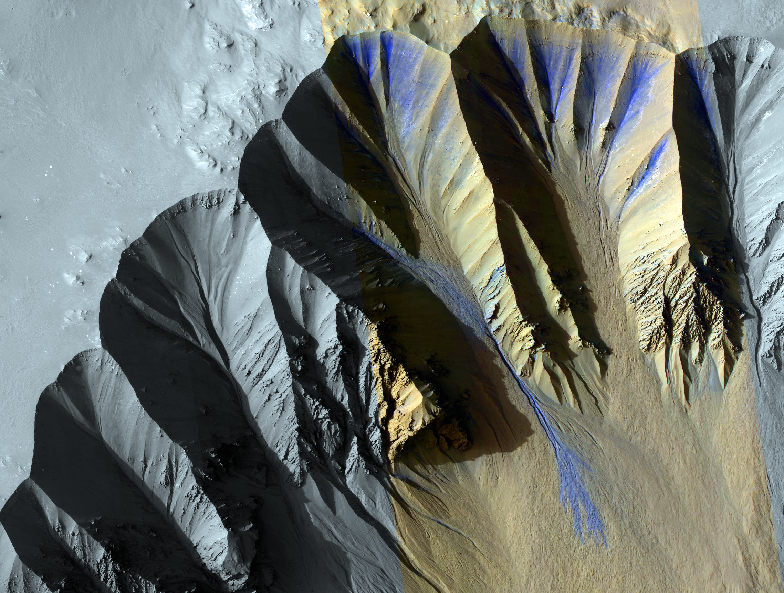

Slide 4
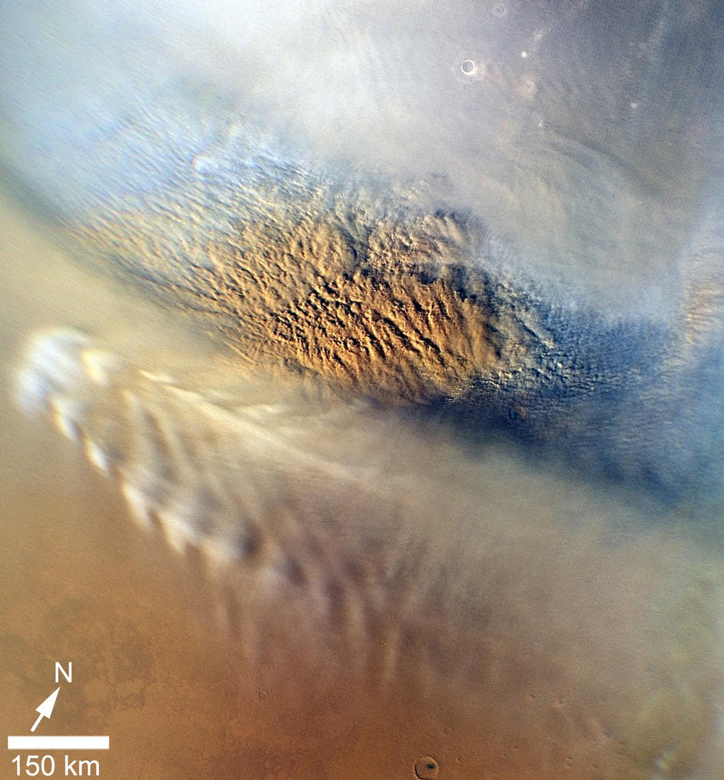
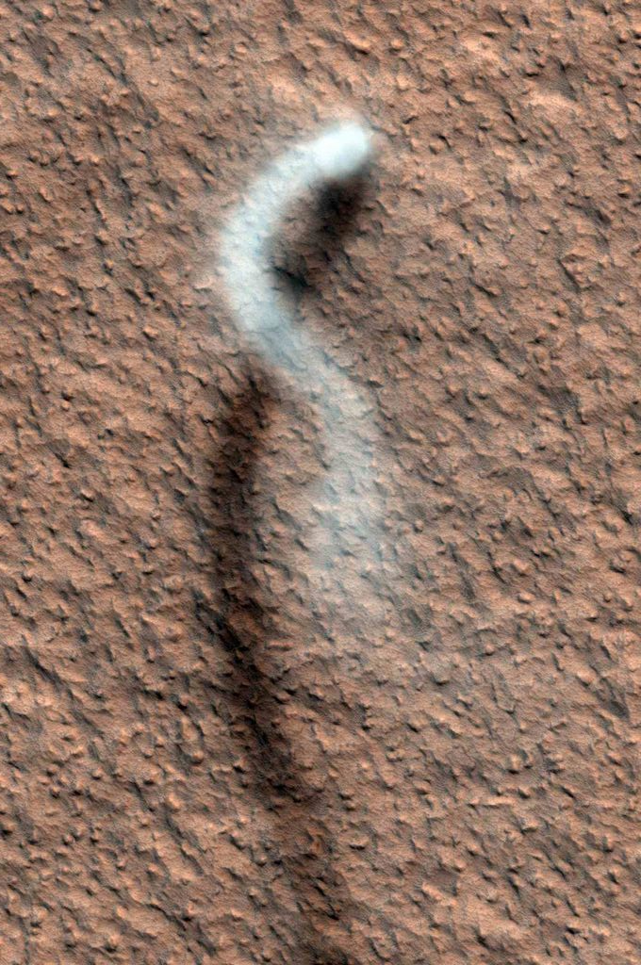
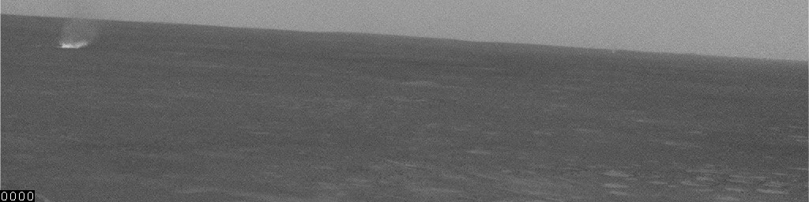
Present-day Mars is Windy…
Large Dust Devil
HiRISE Science Team
Regional dust-storm
MARCI Science Team
Small Dust Devil - MER Science Team

Slide 5
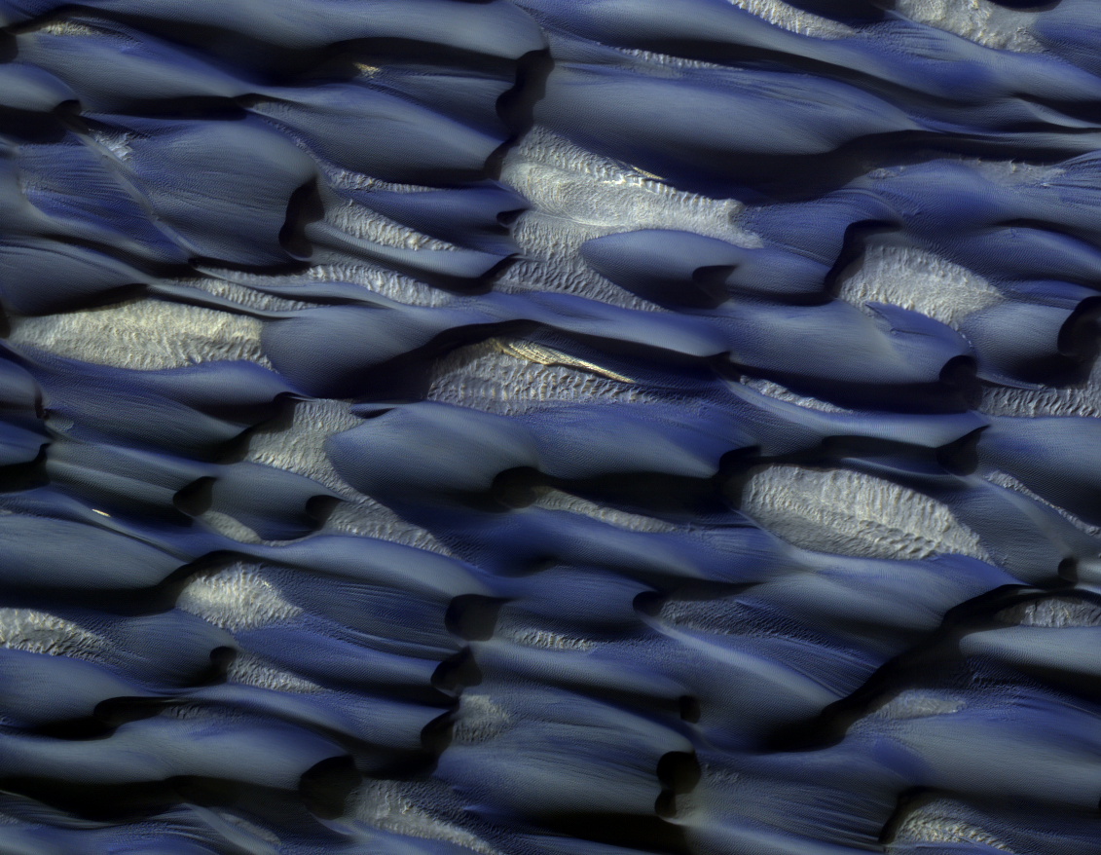

Slide 6
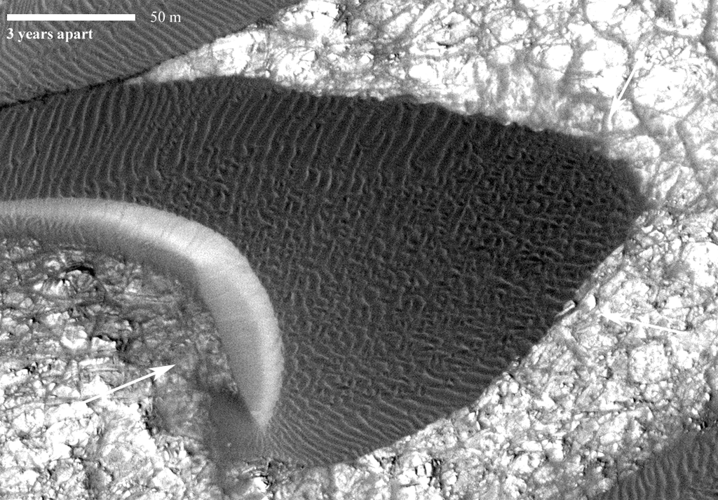
Courtesy of Nathan Bridges

Slide 7
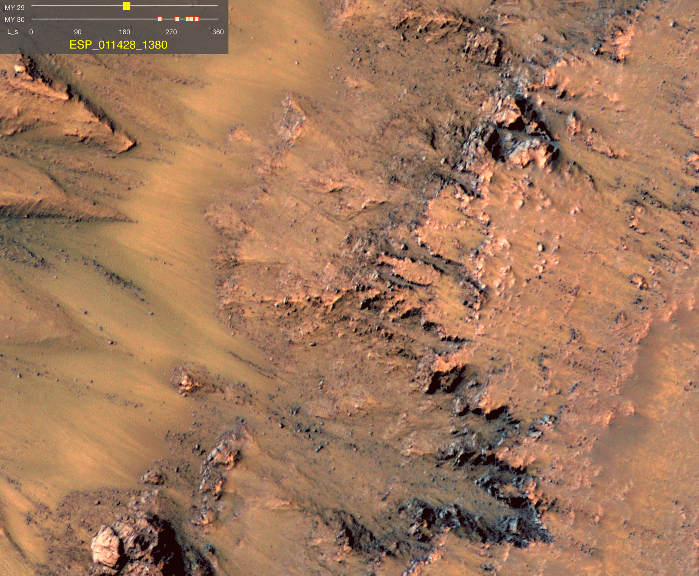
Brine Seeps?
  Liquid water is possible with various salt combinations
  McEwen et al. 2011

Slide 8
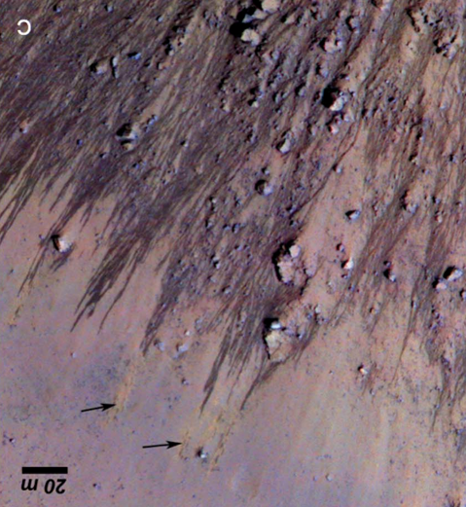
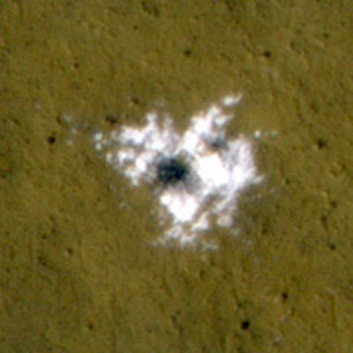
Mars is active today…
Wind
…but only a little Water
Frost
Ice and New impact craters

Slide 9
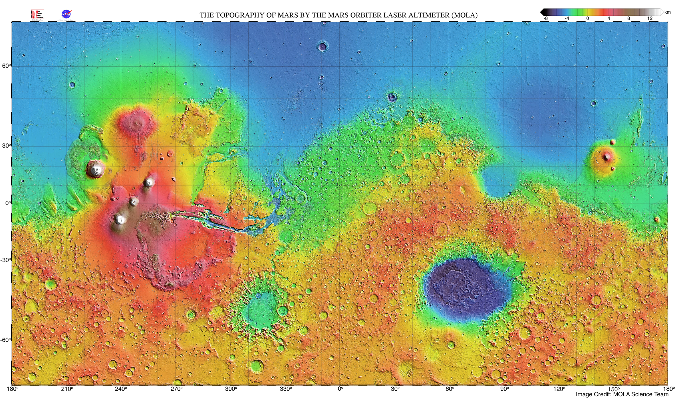
Ancient Mars was REALLY active though

Slide 10
Many large impact craters formed

Slide 11
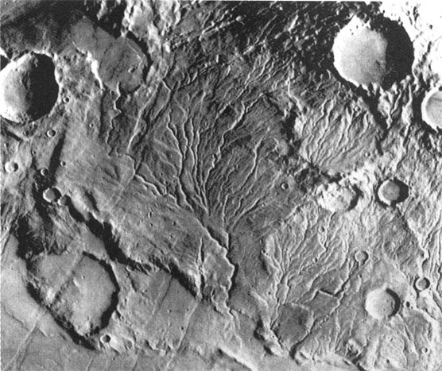
Widespread action of flowing water

Slide 12
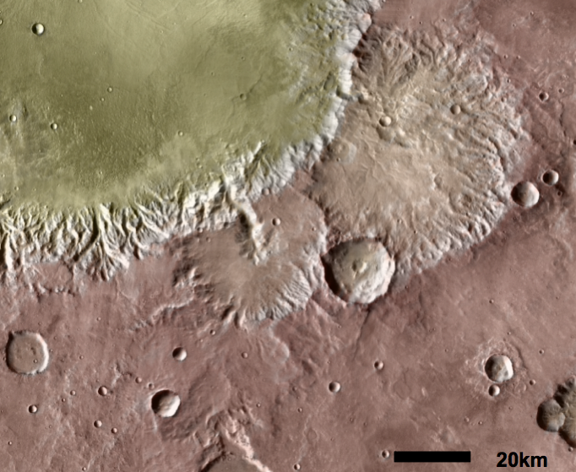
Water drains into many of these craters carving channels

Slide 13
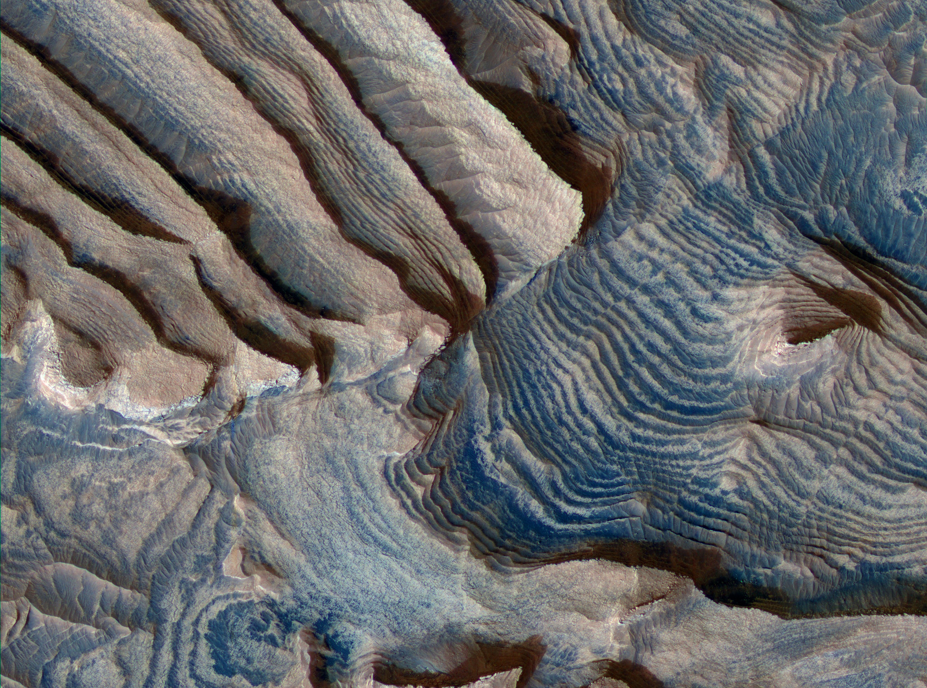
Lakes in craters leaving sediments

Slide 14
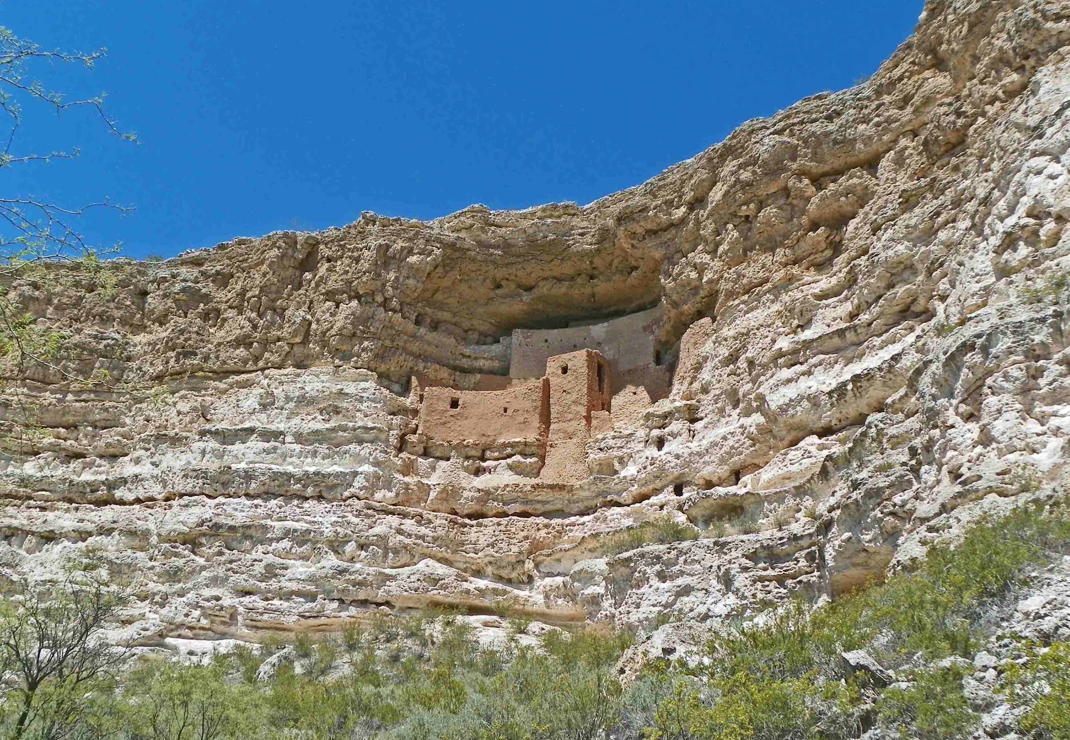
Lakes in craters leaving sediments

Slide 15
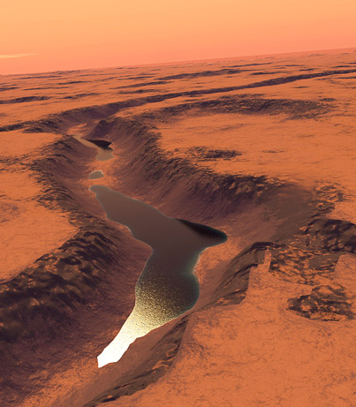
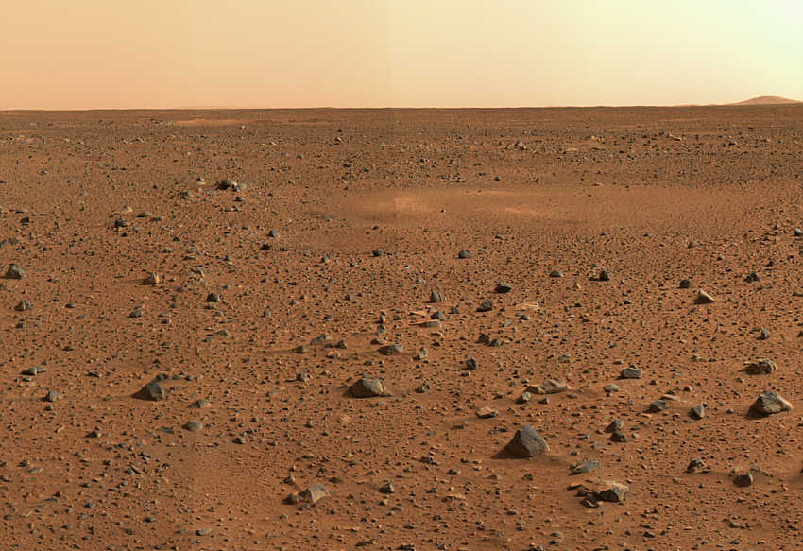
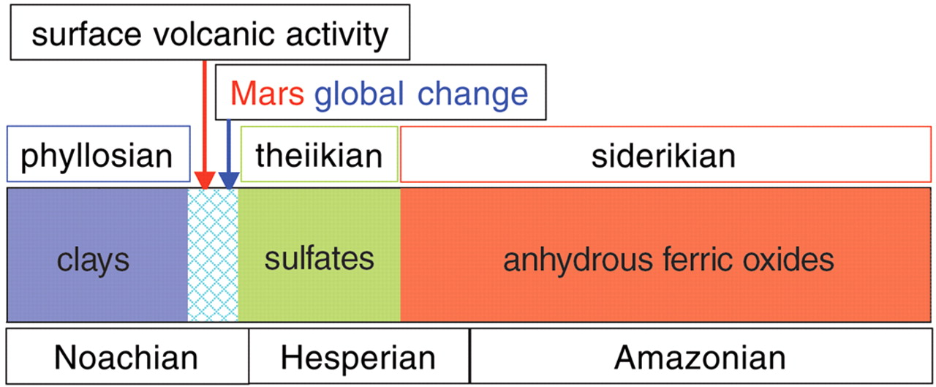
A big change for Mars
(Bibring et al., 2006)
4.5 billon yrs ago
present
MARS
EARTH
Hadean
Archaean
Proterozoic
Phan.
4.6 Gyr
3.85 Gyr
2.5
Gyr
543 Myr
present day
oldest rocks
oldest fossil life

Slide 16
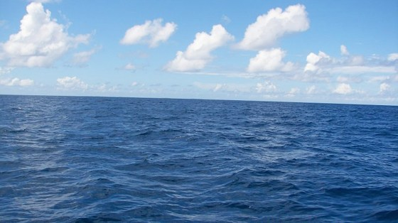
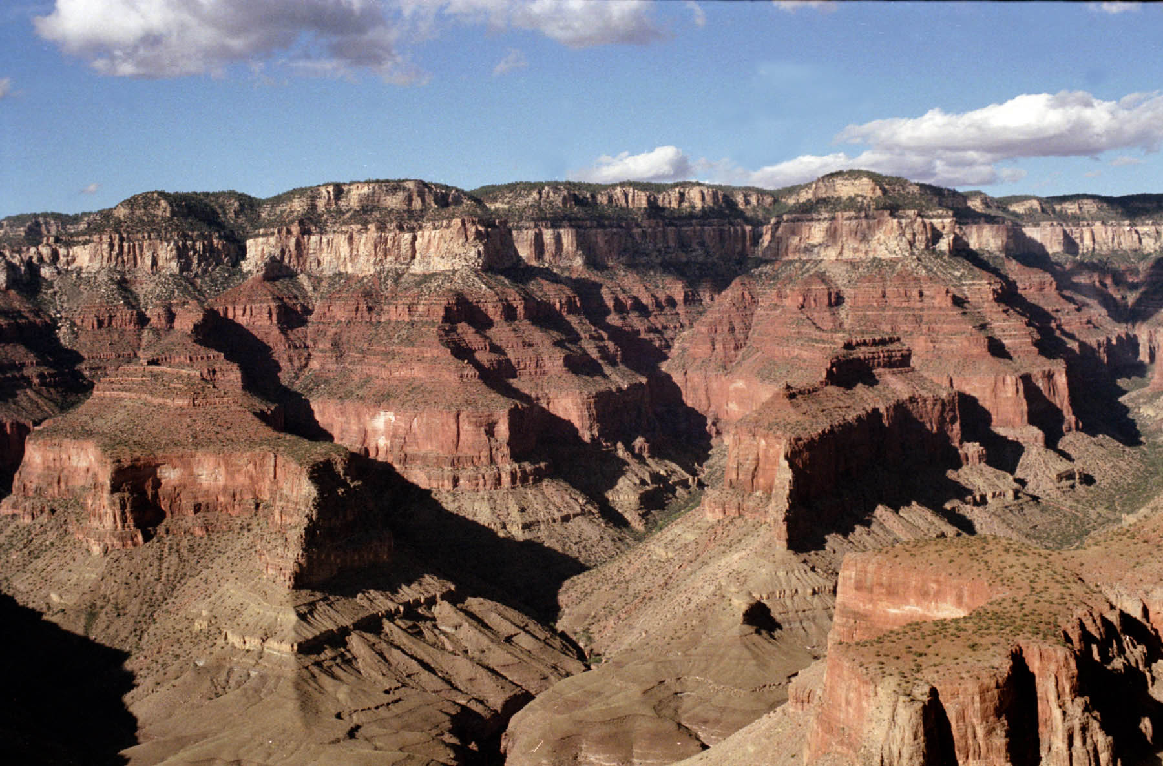
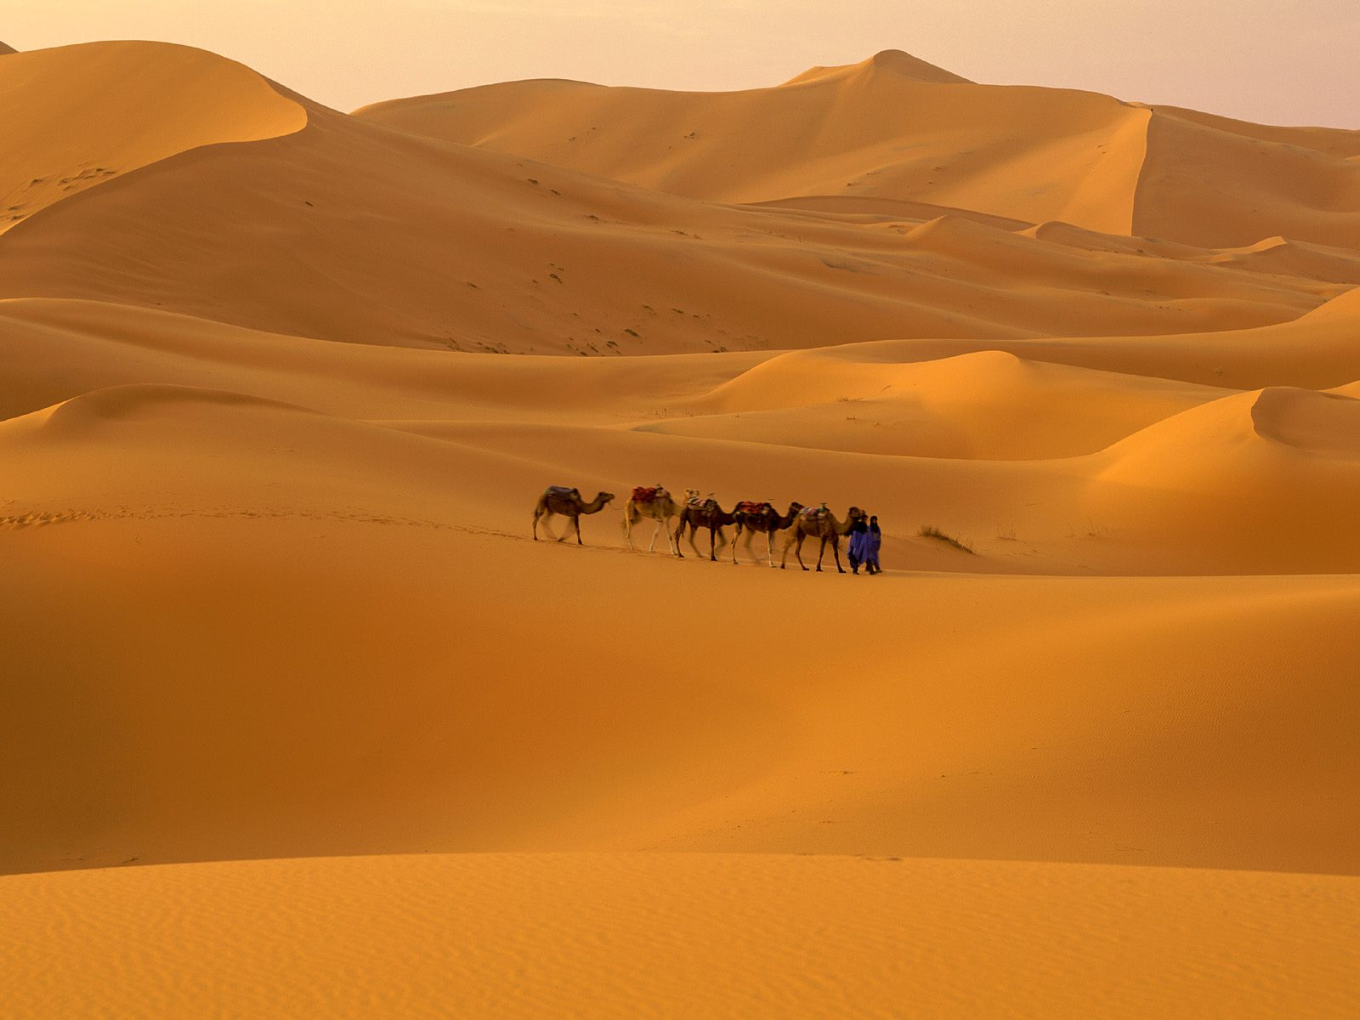
How do we figure out more about what happened on Early Mars?
  We do this on Earth with the rock record…
Arizona 270 million years ago
Grand Canyon - Arizona
Arizona 275 million years ago
(minus the camels…)

Slide 17
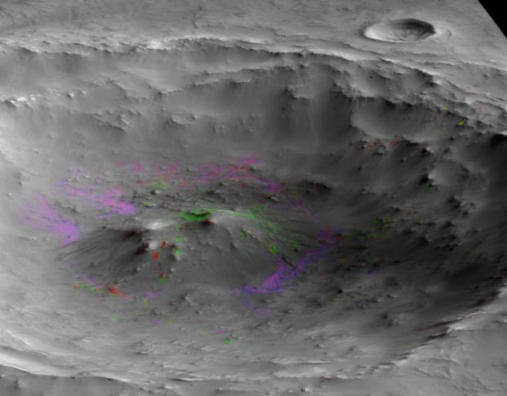
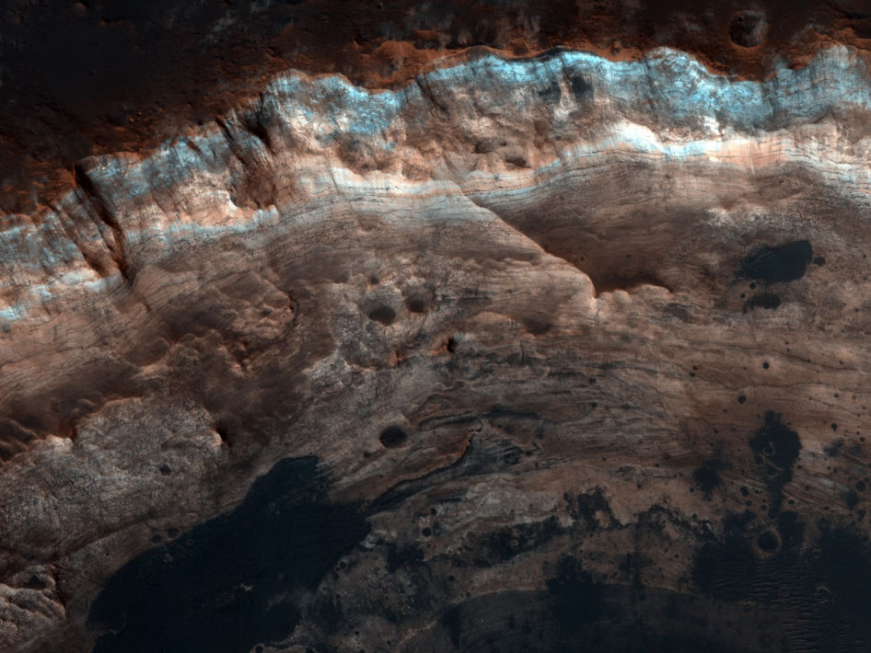
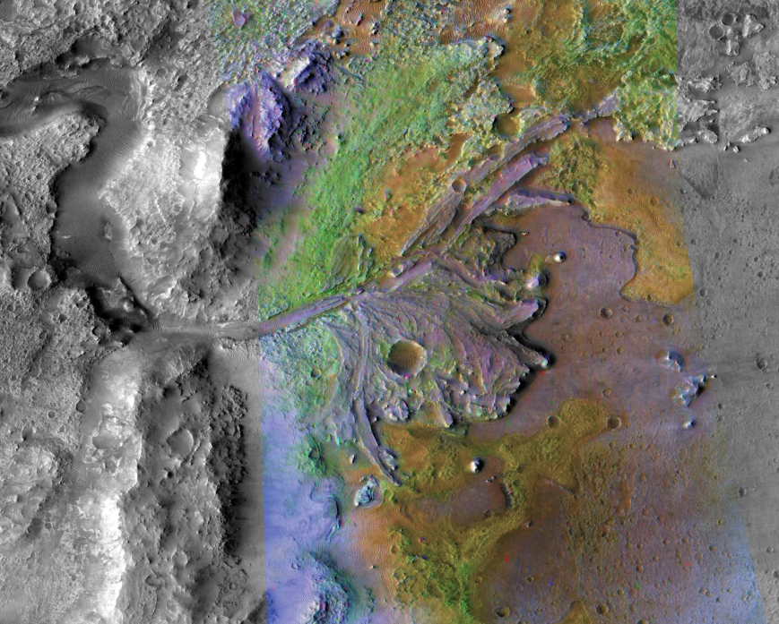
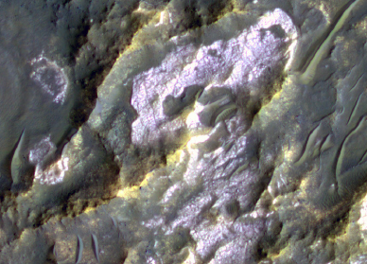
What do ancient martian rocks tell us?
  Clay minerals formed in wet conditions and they’re found in ancient rocks
Wray et al., 2008
Ehlmann et al., 2009
Noachian crustal hydrothermal clays
Noachian layered clays
Ehlmann et al., 2008
Osterloo et al., 2008
Noachian delta/fan clay-bearing sediments
Noachian "glowing terrain" rich in chloride salts

Slide 18
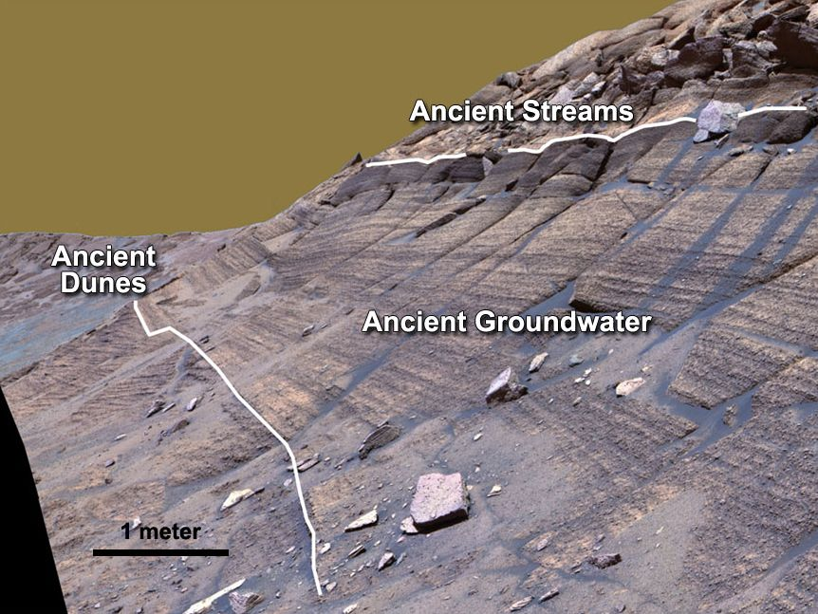
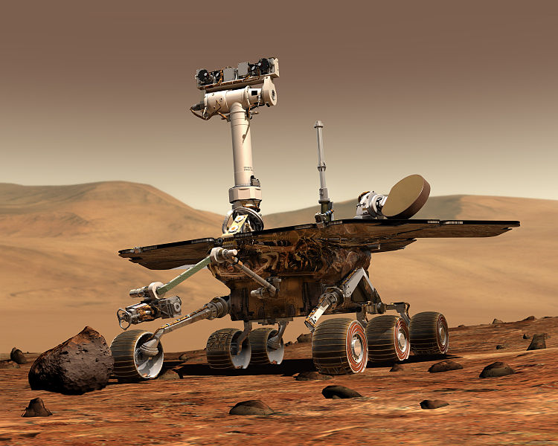
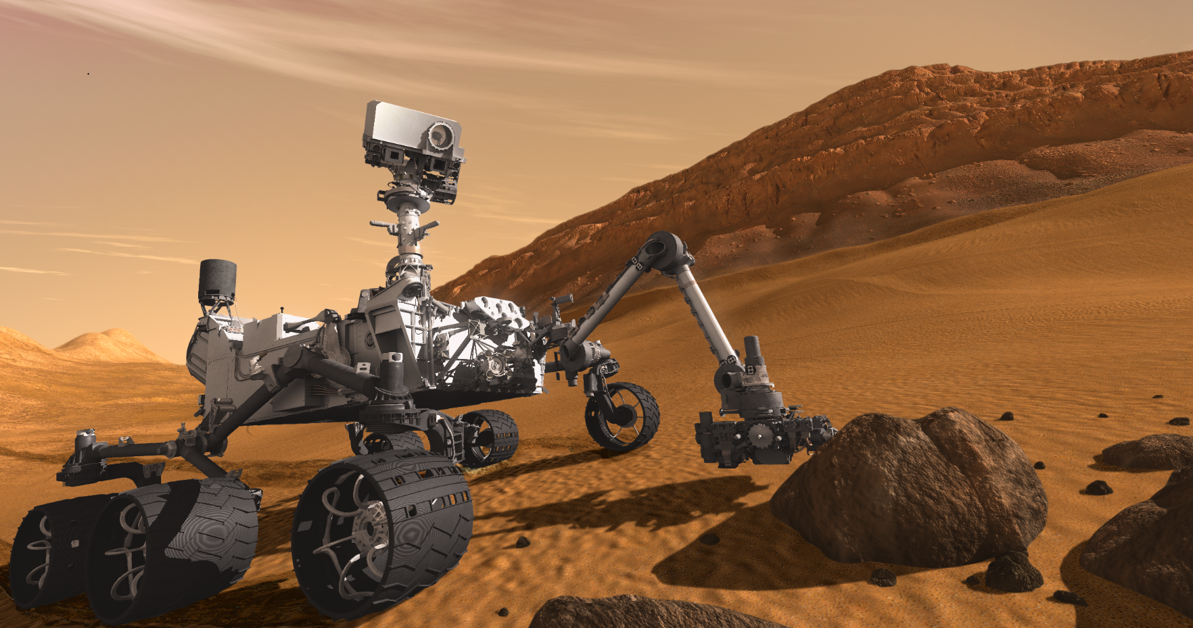
Reading rocks is best done on the ground
Opportunity – still rovin’
MSL
Starting tomorrow

Slide 19
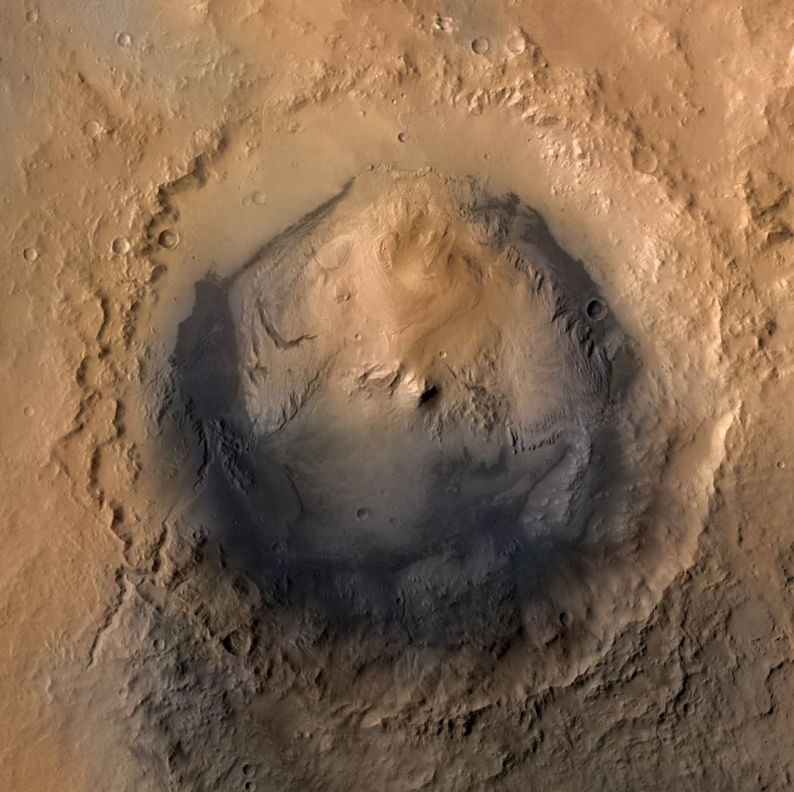
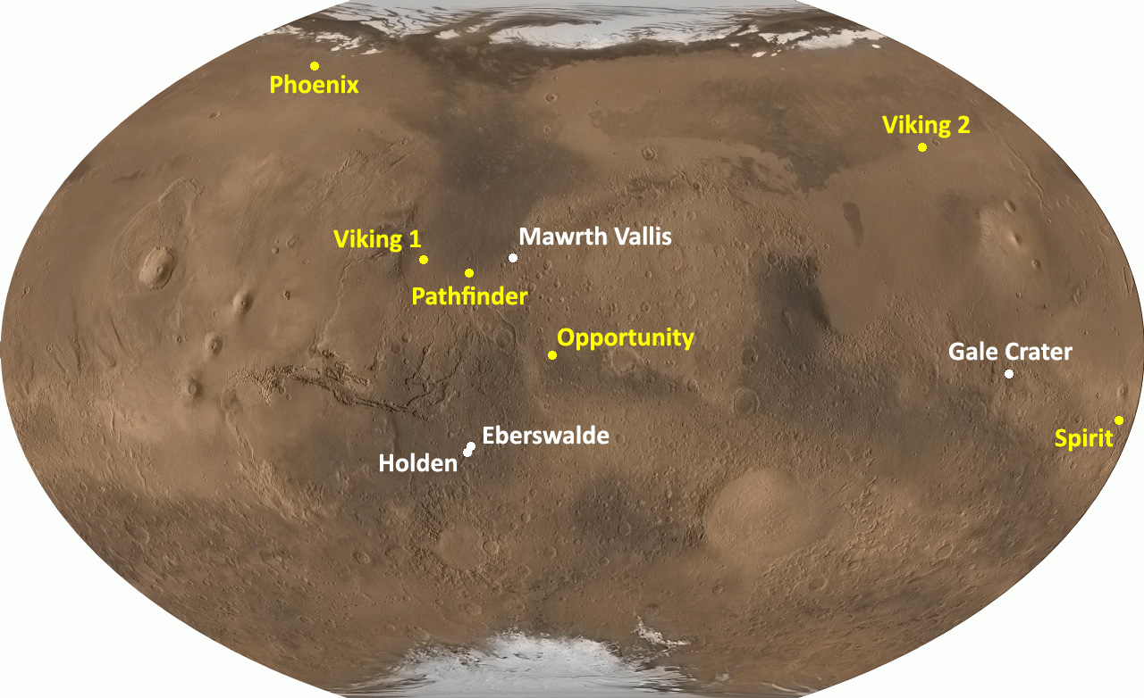
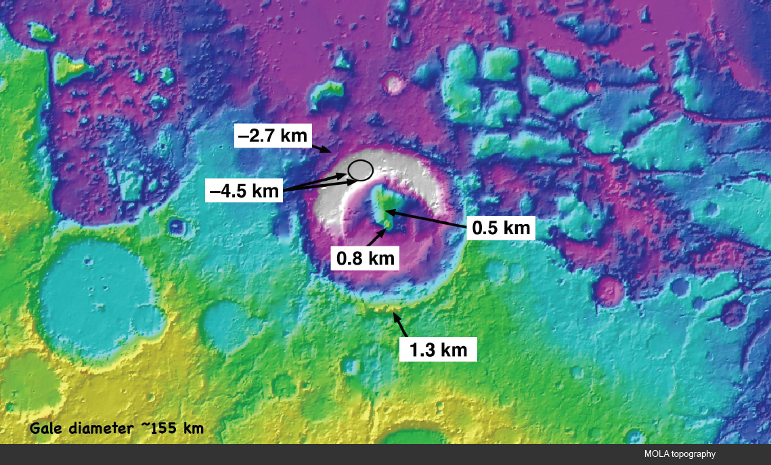
Gale crater & Mt. Sharp

Slide 20
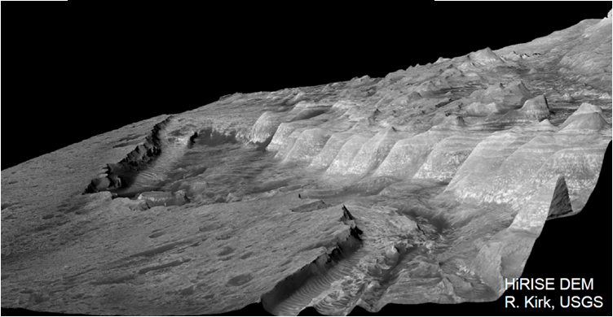

Slide 22
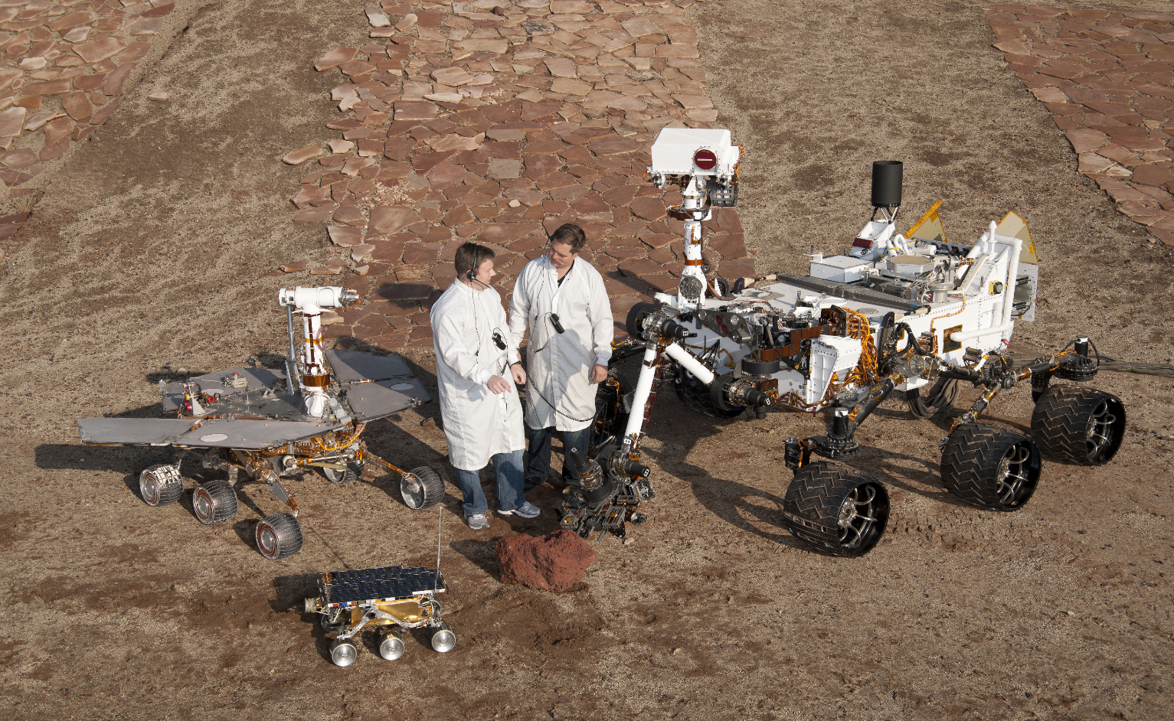
MSL is our largest Mars Rover
  Expected to drive 10s of miles
  Expected to last for 1 Mars Year

Slide 23
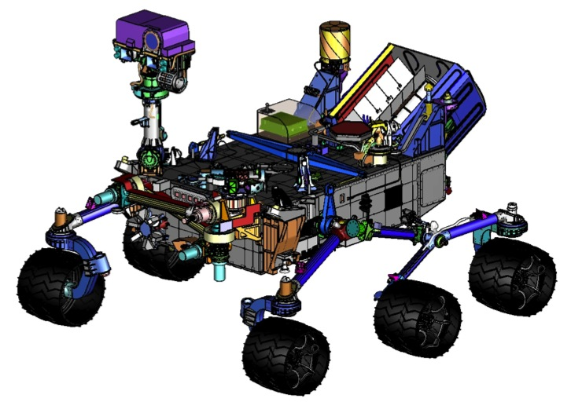
MSL Science Payload (courtesy of MSL team)
ChemCam
REMOTE SENSING
Mastcam (M. Malin, MSSS) - Color and telephoto imaging, video, atmospheric opacity
ChemCam (R. Wiens, LANL/CNES) – Chemical composition; remote micro-imaging
CONTACT INSTRUMENTS (ARM)
MAHLI (K. Edgett, MSSS) – Hand-lens color imaging
APXS (R. Gellert, U. Guelph, Canada) - Chemical composition
ANALYTICAL LABORATORY (ROVER BODY)
SAM (P. Mahaffy, GSFC/CNES) - Chemical and isotopic composition, including organics
CheMin (D. Blake, ARC) - Mineralogy
ENVIRONMENTAL CHARACTERIZATION
MARDI (M. Malin, MSSS) - Descent imaging
REMS (J. Gómez-Elvira, CAB, Spain) - Meteorology / UV
RAD (D. Hassler, SwRI) - High-energy radiation
DAN (I. Mitrofanov, IKI, Russia) - Subsurface hydrogen
Mastcam
RAD
REMS
DAN
MAHLI
APXS
Brush
Drill / Sieves
Scoop
MARDI
Wheel Base: 2.8 m
Height of Deck: 1.1 m
Ground Clearance: 0.66 m
Height of Mast: 2.2 m

Slide 24
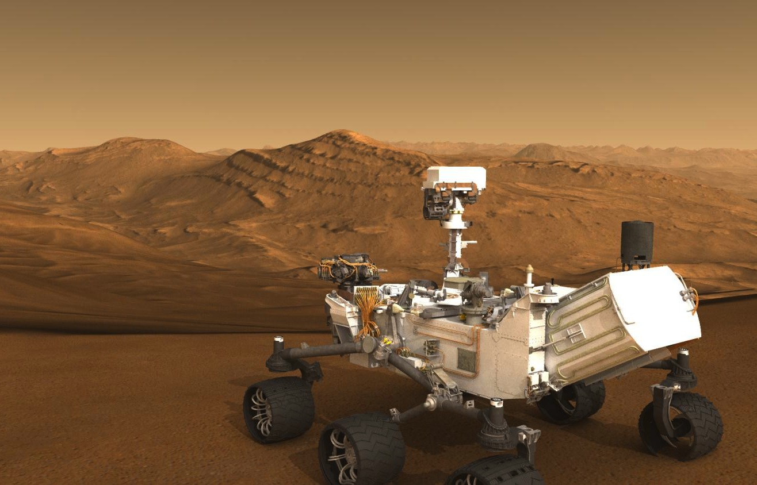
Learn More about Curiosity (courtesy of MSL team)
Mars Science Laboratory
http://mars.jpl.nasa.gov/msl
MSL for Scientists
http://msl-scicorner.jpl.nasa.gov
Mars Exploration Program
http://mars.jpl.nasa.gov

