Slide 1
Summary of Key Science Objectives
Obtain a global inventory of water in ground ice and glacial remnants, whether ice is pore filling or solid “pure” ice.
Obtain an inventory of water in the polar caps and determine how polar layered deposits record past climate.
Obtain an inventory of trapped SPLD CO₂ and determine implications of these deposits for past climate.
Understand volatile cycling between poles and equatorial regions and infer obliquity effects (seasonal changes in the polar caps).
Obtain boundary value conditions needed to model the evolution of the surface in polar regions and in areas with ground ice.

Slide 2
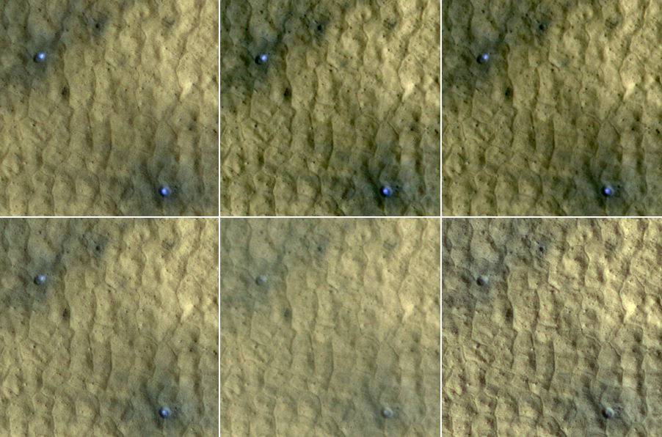
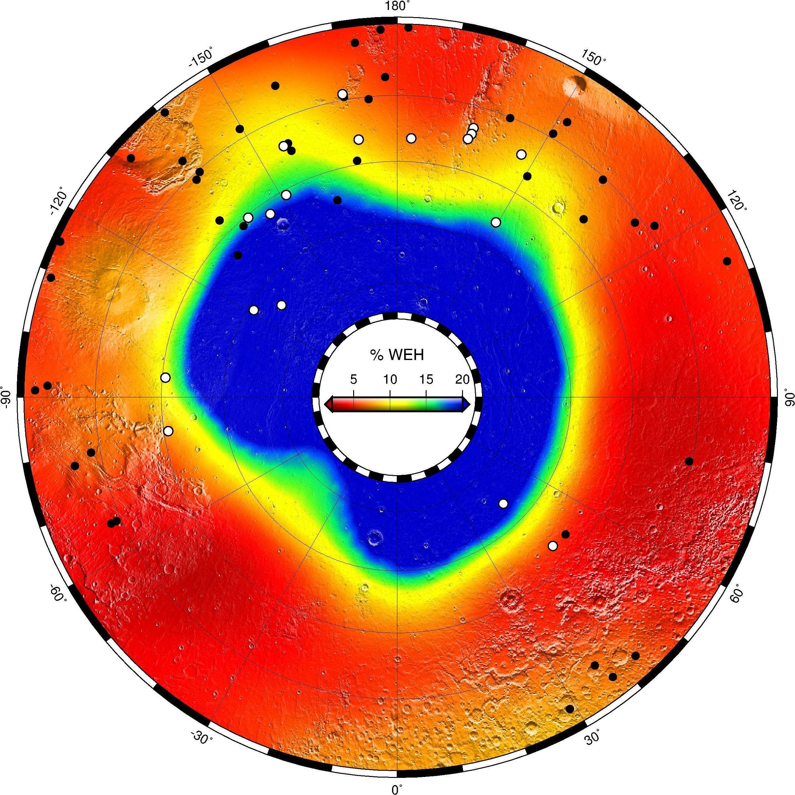
Obj1 Measurement: High resolution imaging
High-resolution (cm-scale) imaging can identify ice in fresh crater deposits.
Can track ice deposits at higher resolution than GRS/neutrons. 1new impact expected between 30-70 every 1-2 days (Hartmann 2005). (?)
(Find the overall impact rate – quantify seasonal variation helps small body population modeling.)
Ice-exposing craters have a fast “expiration date” (104 days in this case).
High SNR cameras needed, 15 m/pix, 60 km swath for context and detection, plus <2 m/pix stereo camera.
Rapid follow-up required roll-able spacecraft or instrument pointing.
GRS footprint

Slide 3
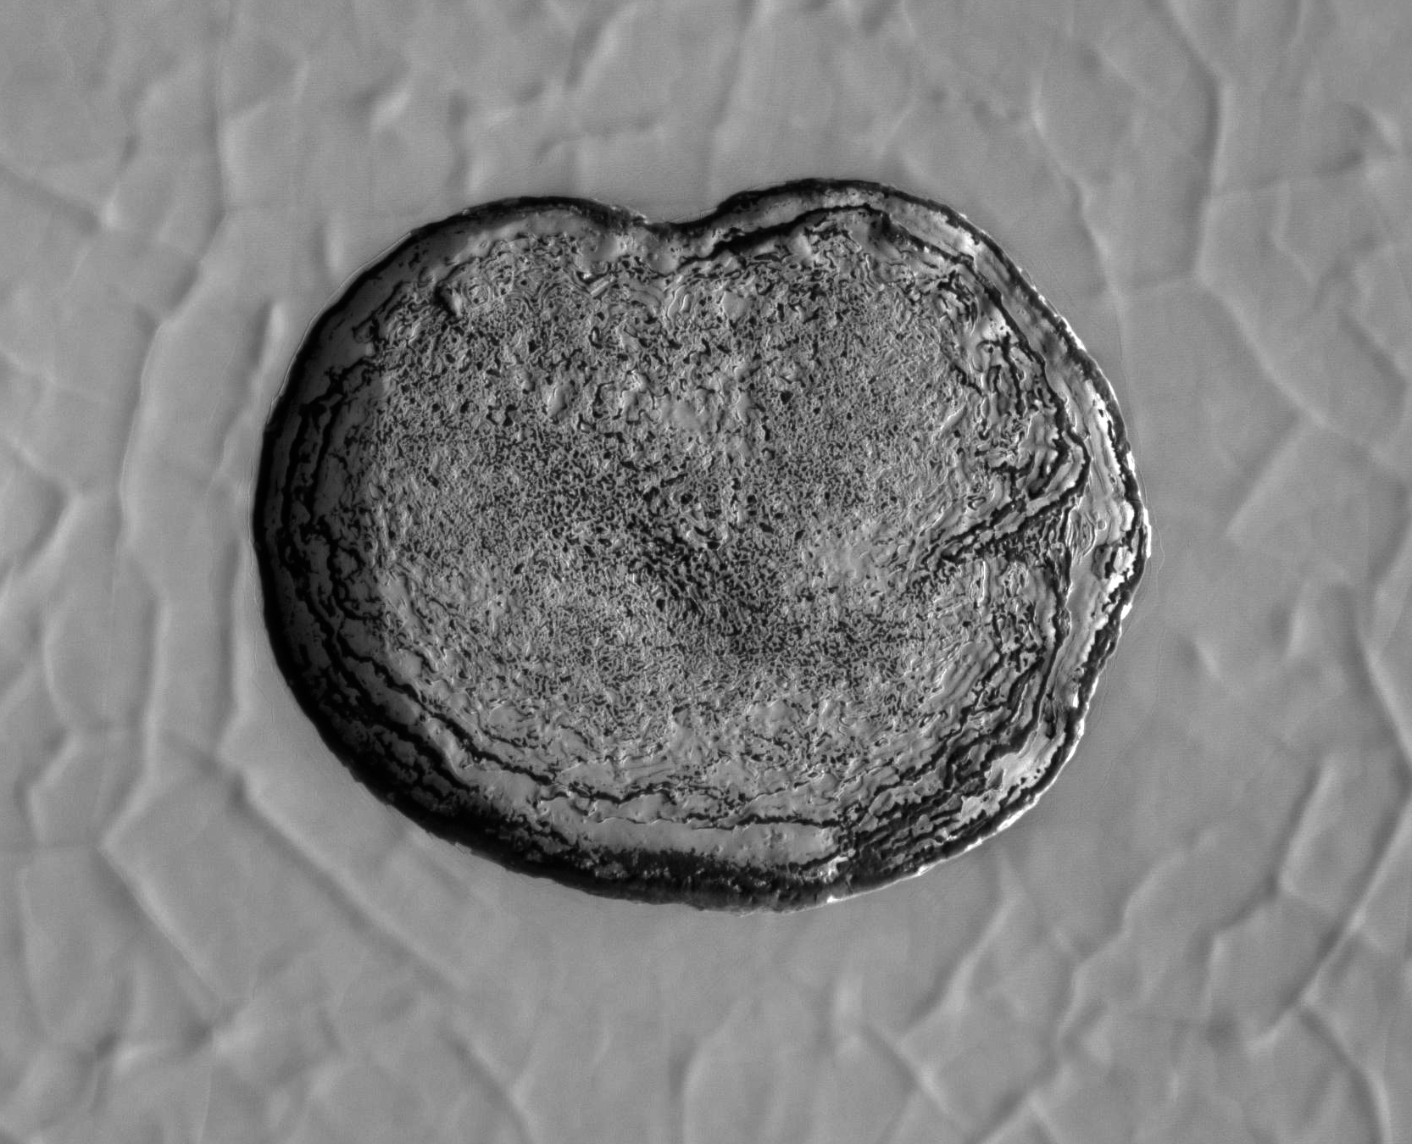
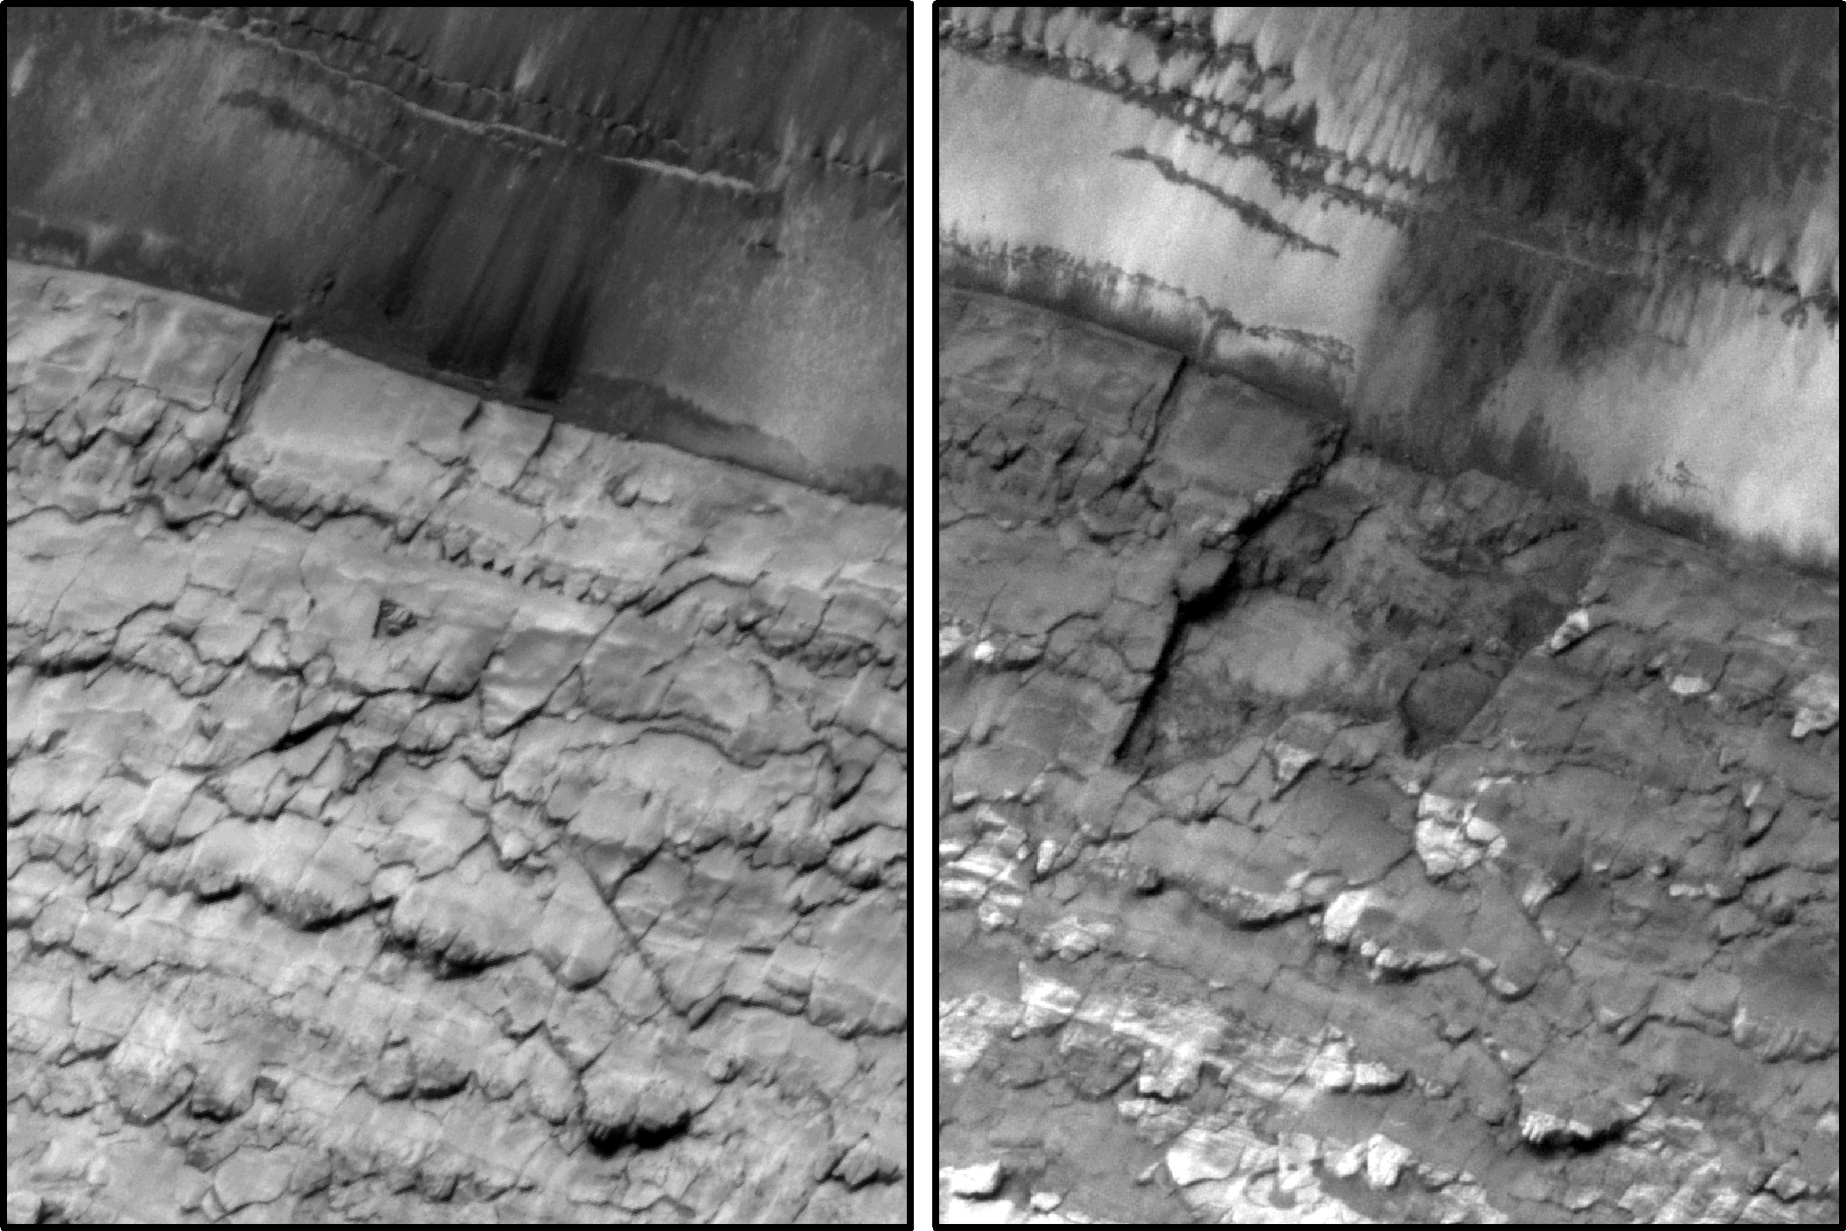
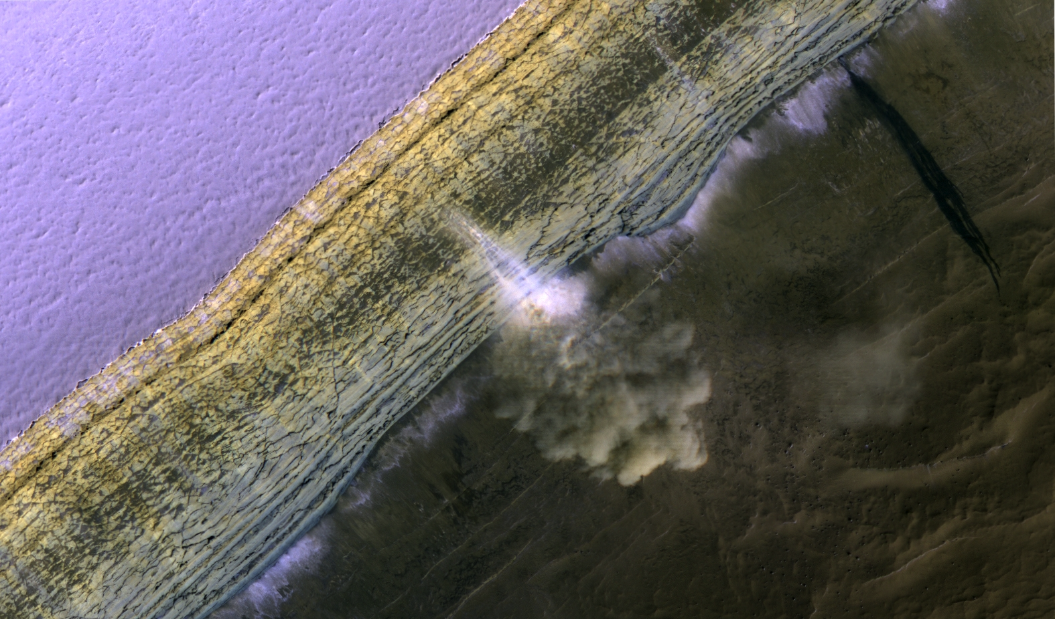
Obj2/3 Measurement: High-res Imaging
High-resolution (cm-scale) imaging can track surface changes linked to climate
Extend current record
Seasonally resolve changes where HiRISE can only record total annual change
Examples include
Evolution of “Swiss-cheese” pits at the South Pole
Mass wasting and avalanches driving scarp retreat at the north pole
70m

Slide 4
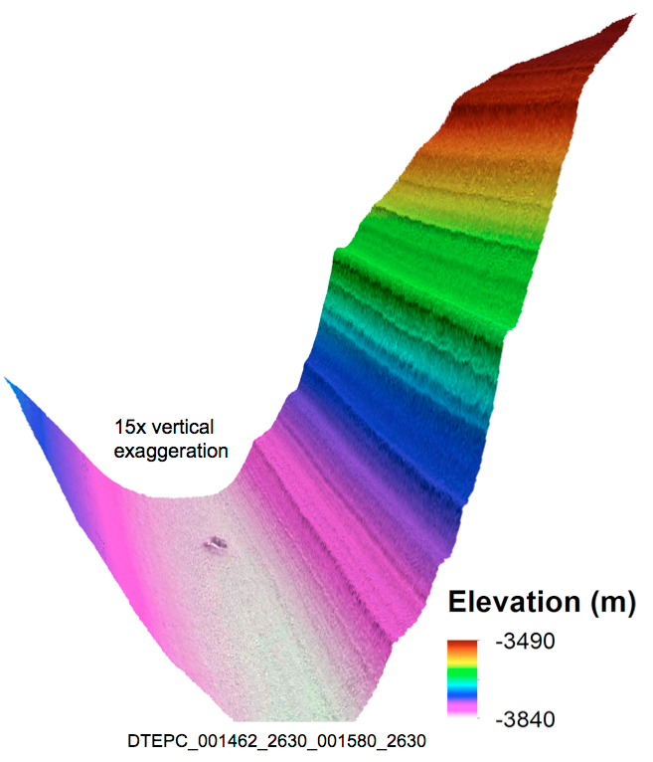
Obj2/3 Measurement: High-res Imaging
Widespread Stereo imagery of the poles can be used to assemble the full stratigraphic (climatic) record available in polar exposures.
HiRISE stereo coverage currently sparse

Slide 5
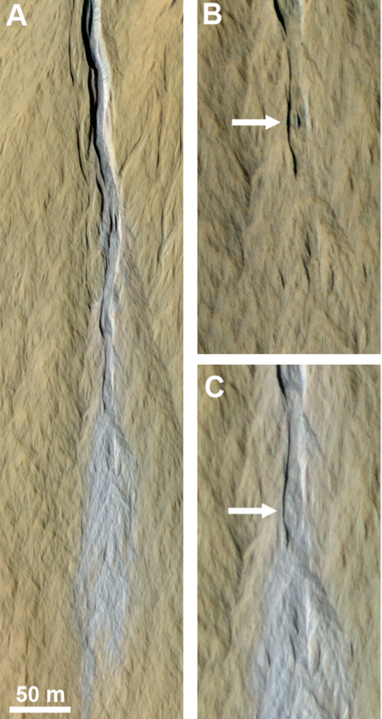
Obj4 Measurement: High-Res Imaging
Seasonal frost effects extend well beyond the poles
CO₂ frost cause flows in gullies in craters and dunes (mechanism unknown)
One of the fastest geomorphic agents operating on Mars today
High-resolution spectral data can separate water and CO₂ frosts in gully alcoves

Slide 6
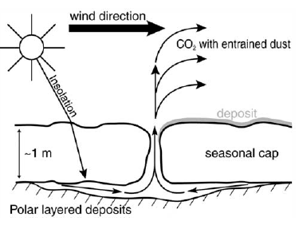
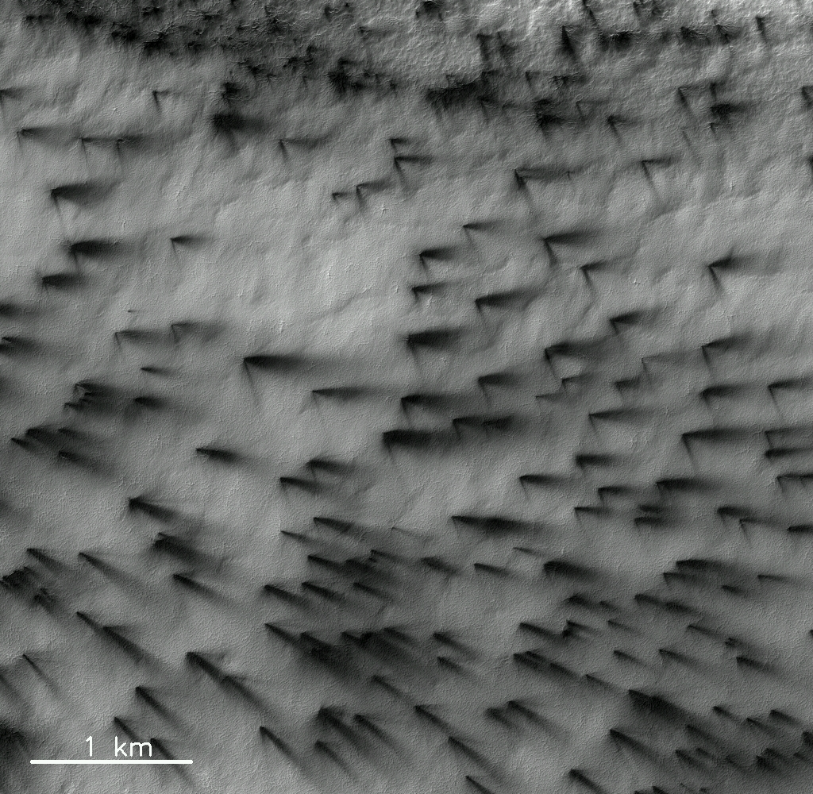
Obj4 Measurement: High-Res Imaging
CO₂ slab ice leads to a solid state greenhouse and explosive venting
We’ve never imaged this in progress due to MRO’s local time

