Slide 1
#9 a

Slide 2
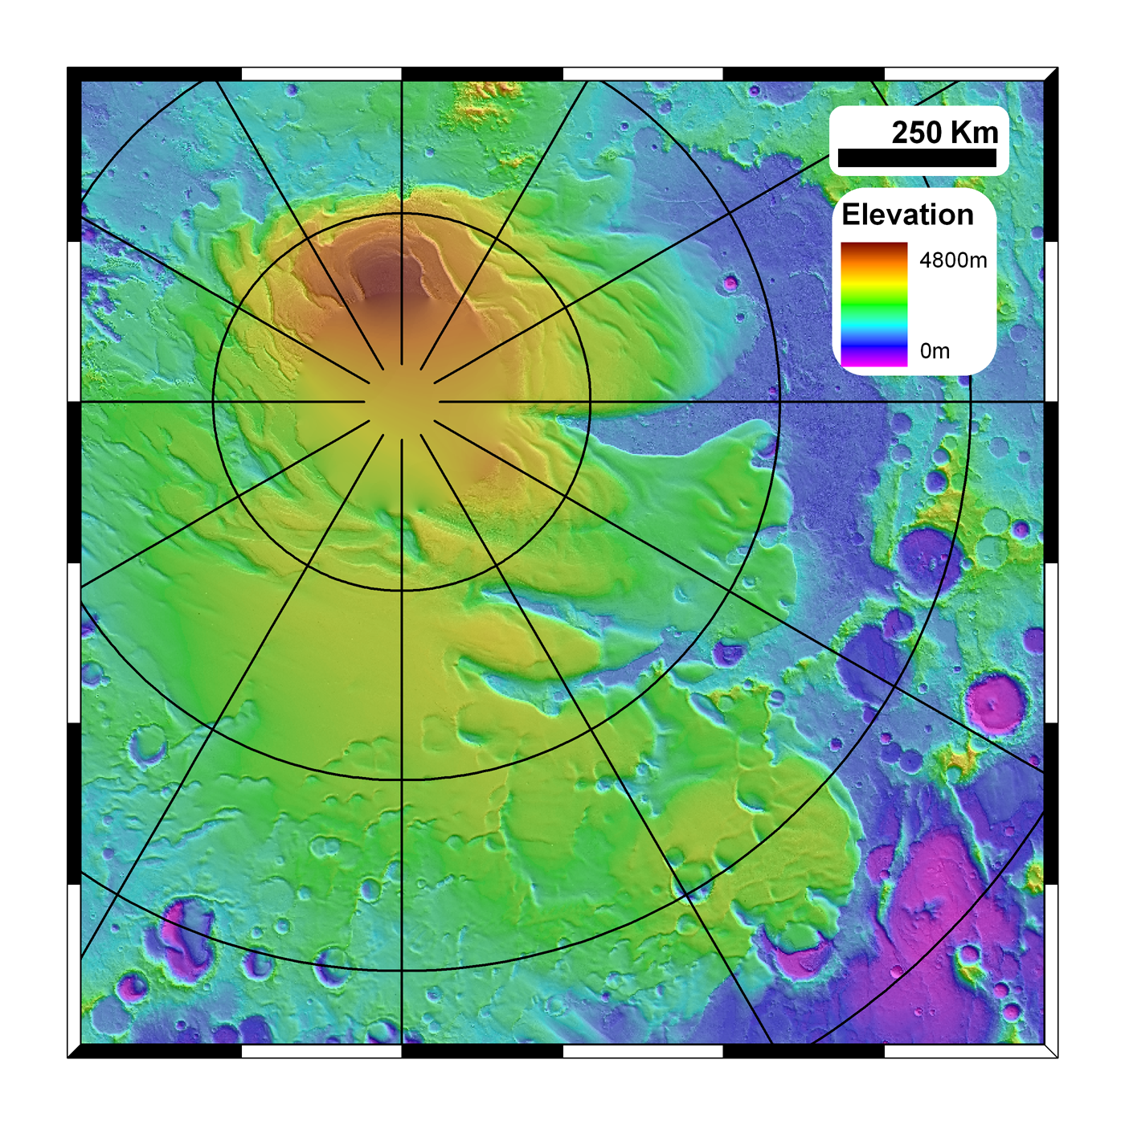
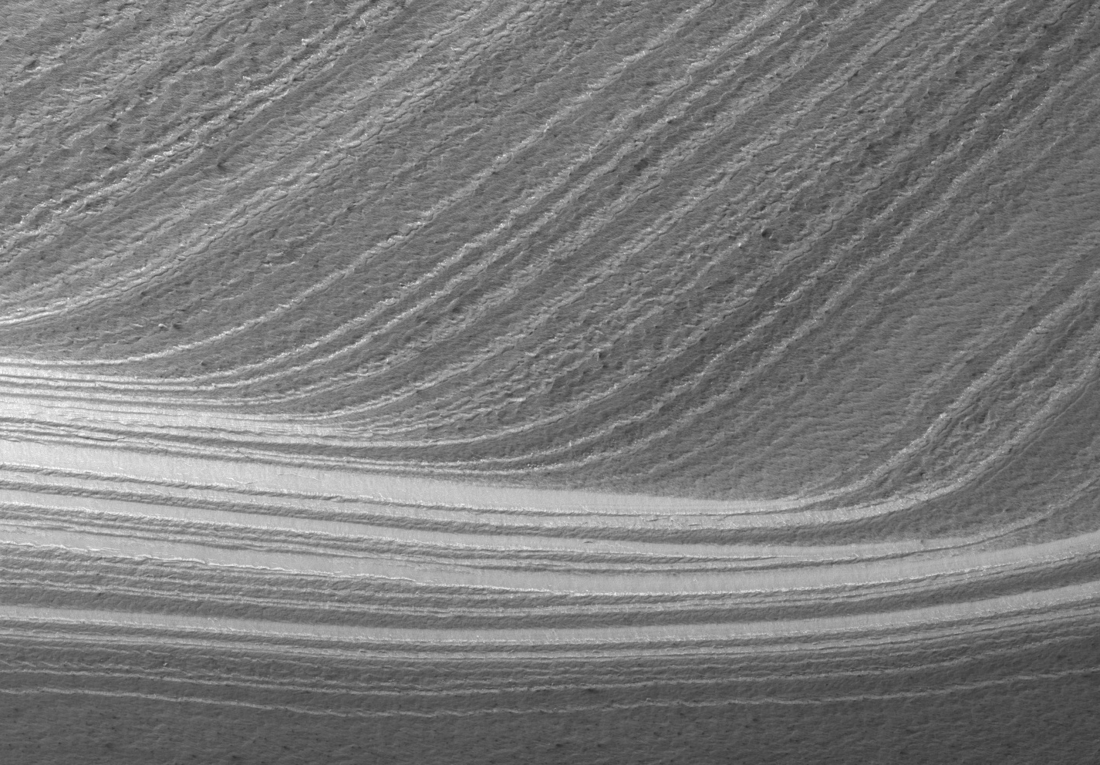
Discontinue Sweeping the SPLD under the Carpet
Exchange of polar reservoirs with the mid-latitudes and tropical high elevations in response to obliquity variations is the paradigm for Amazonian climate.
Models suggest that the NPLD has accumulated over the last 4 Myr or so
Every north-polar MRO observation (e.g. surface craters, SHARAD, ice grain sizes etc…) is consistent with this
Problem: We know the SPLD surface is 10s of Myr old and that the these deposits have survived multiple high-obliquity excursions.
The SPLD are typically ignored because they can’t be explained
We really don’t understand Amazonian climate to even first order until the discrepancy between the two polar deposits is understood.

Slide 3
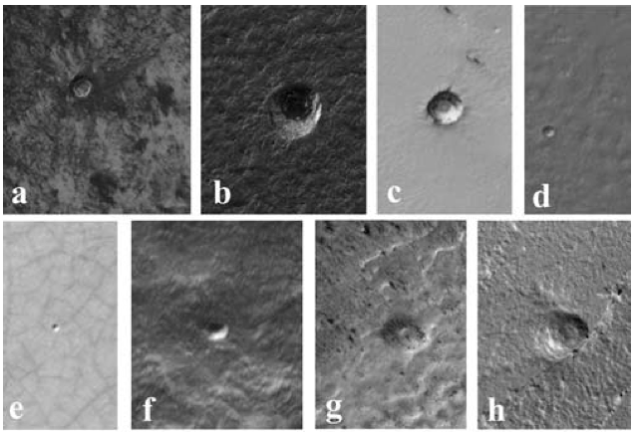
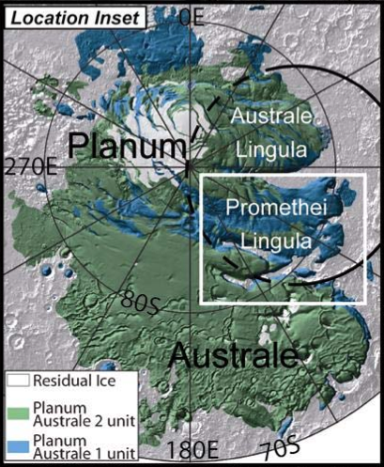
Really figure out the polar age discrepancy…
Systematic crater search (CTX) with HiRISE stereo follow-up
Previous age estimates contain craters found/measured with:
Viking (Herkenhoff & Plaut 2000)
MOLA (and some MOC) data (Koutnik et al. 2002)
Themis VIS (Plaut et al. – 2004, 2005 conference abstracts)
Revisit this with MRO data
Crater production function has also been updated (several times)
Geologic mapping now shows SPLD surface has two distinct units (Kolb & Tanaka 2006)

Slide 4
Observational Plan
SPLD imaging doesn’t really become useful until all the crazy south polar frost phenomena has passed (Late-Spring/ Early-Summer).
Between now (Ls ~200) and Ls 250, we’ll identify craters in CTX coverage and compile a catalog of targets
Between Ls 250 and Ls ~345 we’ll image all these craters (likely a few 10s of targets) with as many as possible in stereo

Slide 5
#9 b

Slide 6
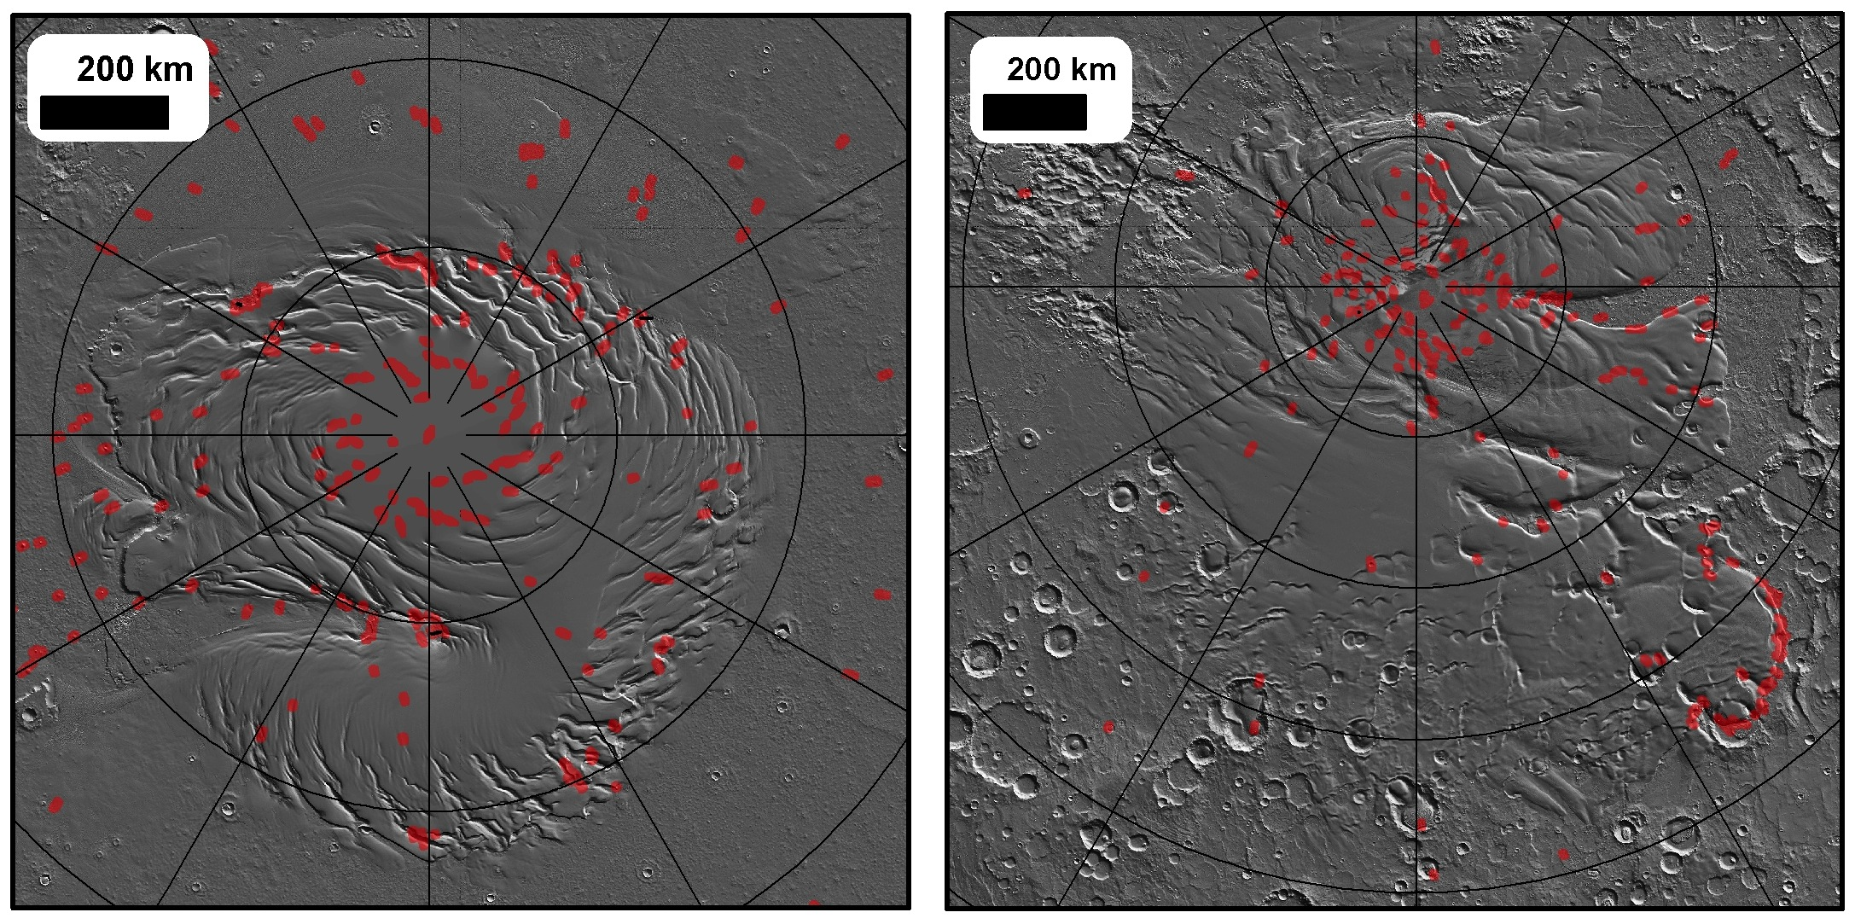
South polar stereo coverage is extremely good in some places and extremely bad in others
We’ll fix these areas of poor coverage so that a full stratigraphic study is possible
HiRISE Stereo Coverage
North
South

Slide 7
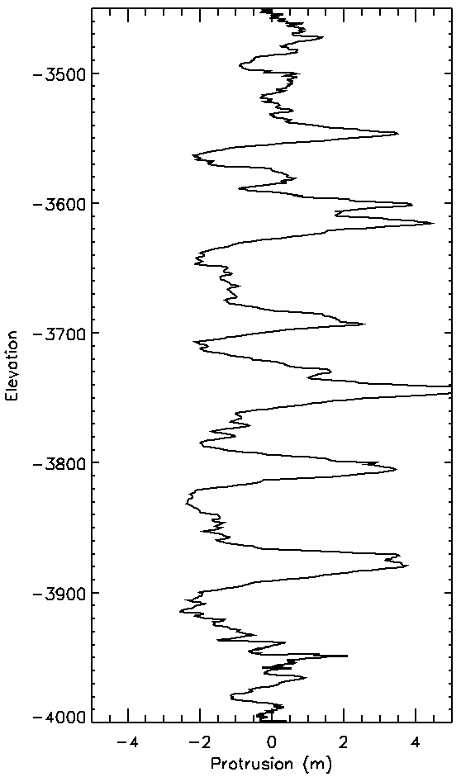
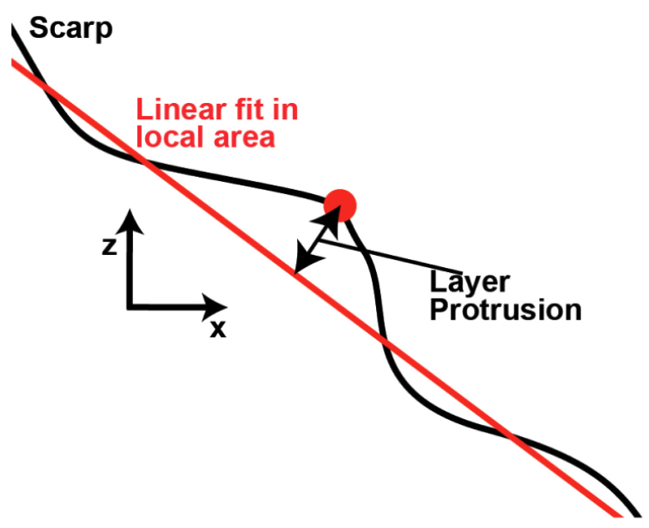
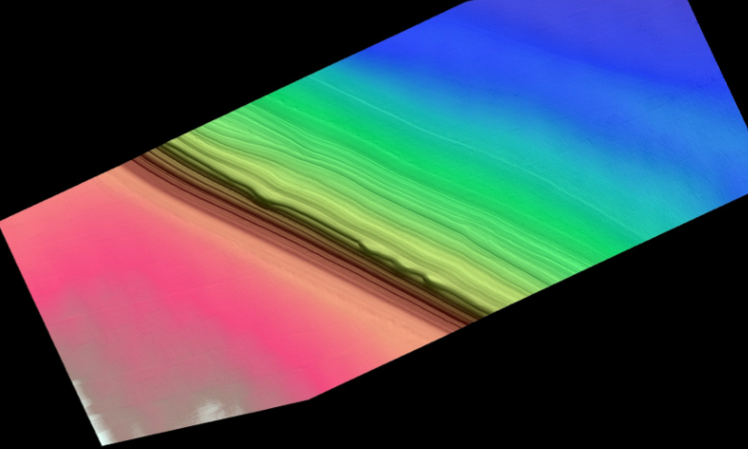
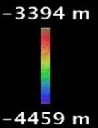
DTMs will be analyzed using our north polar methods

Slide 8
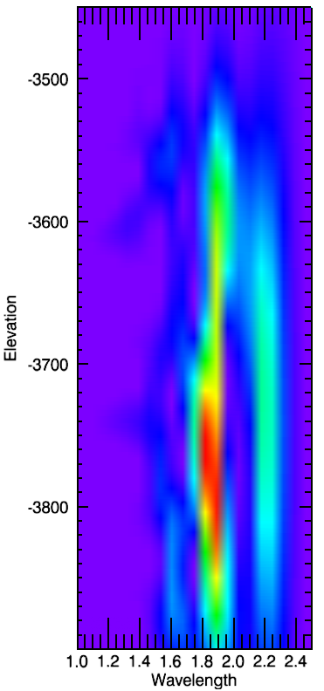
Wavelet transforms search for periodicities that change with depth
80m
60m
20m
40m

Slide 9
#16 a

Slide 10
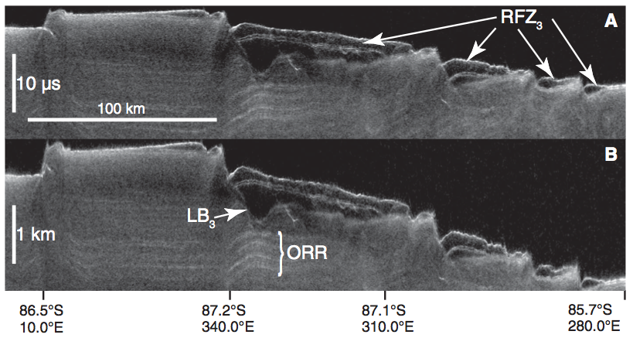
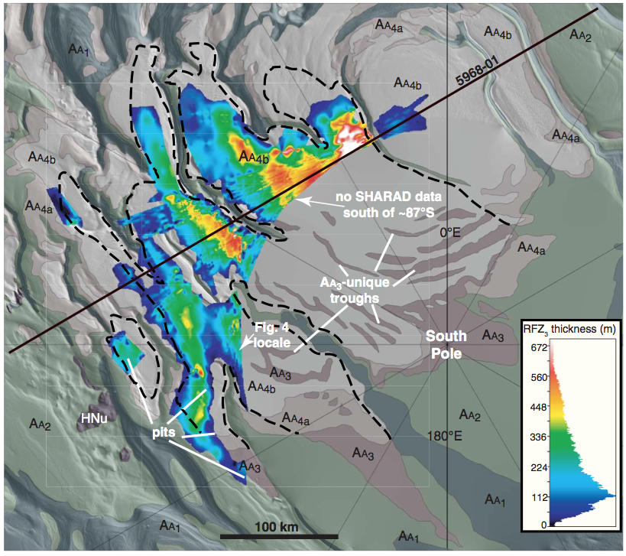
Reflection free zones thought to be buried CO₂ ice
Phillips et al. 2012
Thickness inferred to be 100s of meters, which dwarfs the surface residual cap

Slide 11
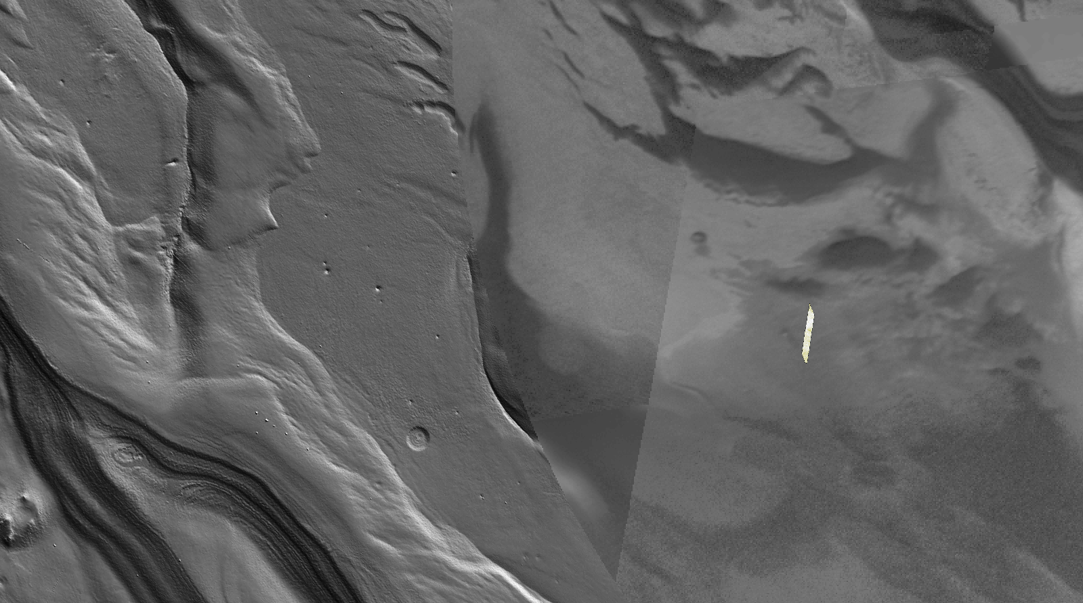
Collapse pits are abundant above this buried CO₂ in areas that the current residual CO₂ cap doesn’t cover

Slide 12
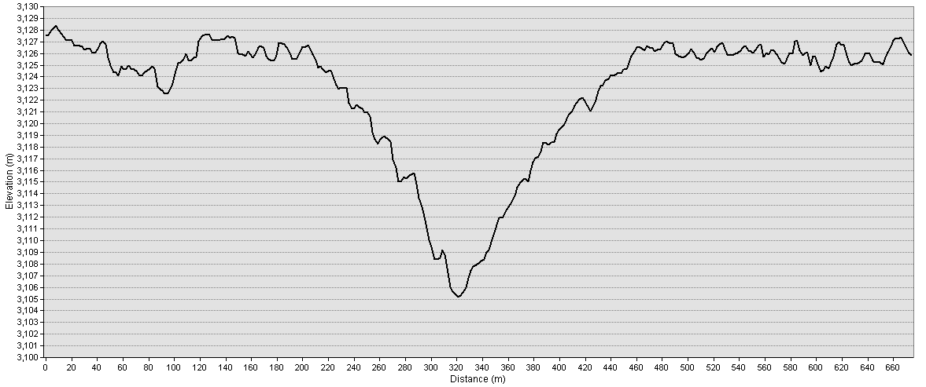
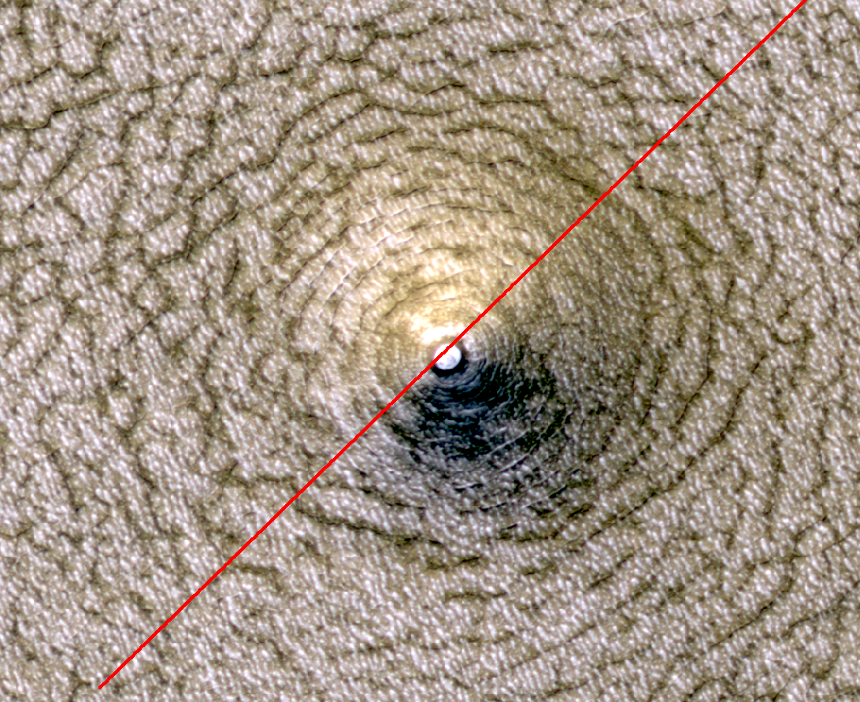
260m
20m

Slide 13
Observational Plan
The residual cap evolves by m/year and is easy to track in HiRISE observations
The buried CO₂ deposit may also be losing mass quickly through these collapse pit windows
We’ll image many of these collapse pit features in stereo to quantify the amount of material lost
We’ll repeat previous year’s imagery and stereo coverage to see if these pits are actively enlarging at a measurable rate.

Slide 14
#16 b

Slide 15
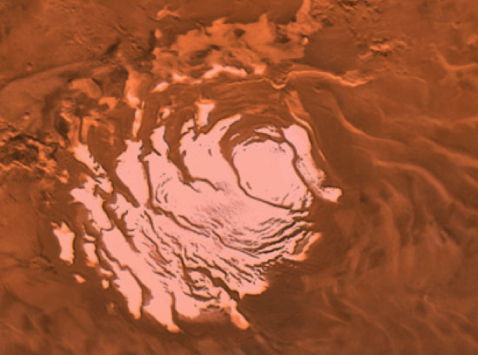
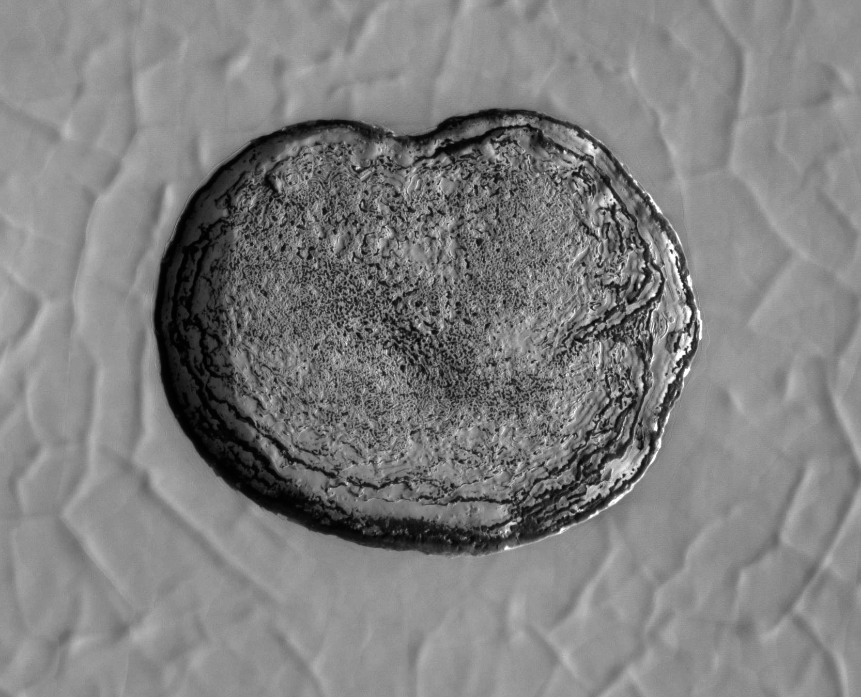
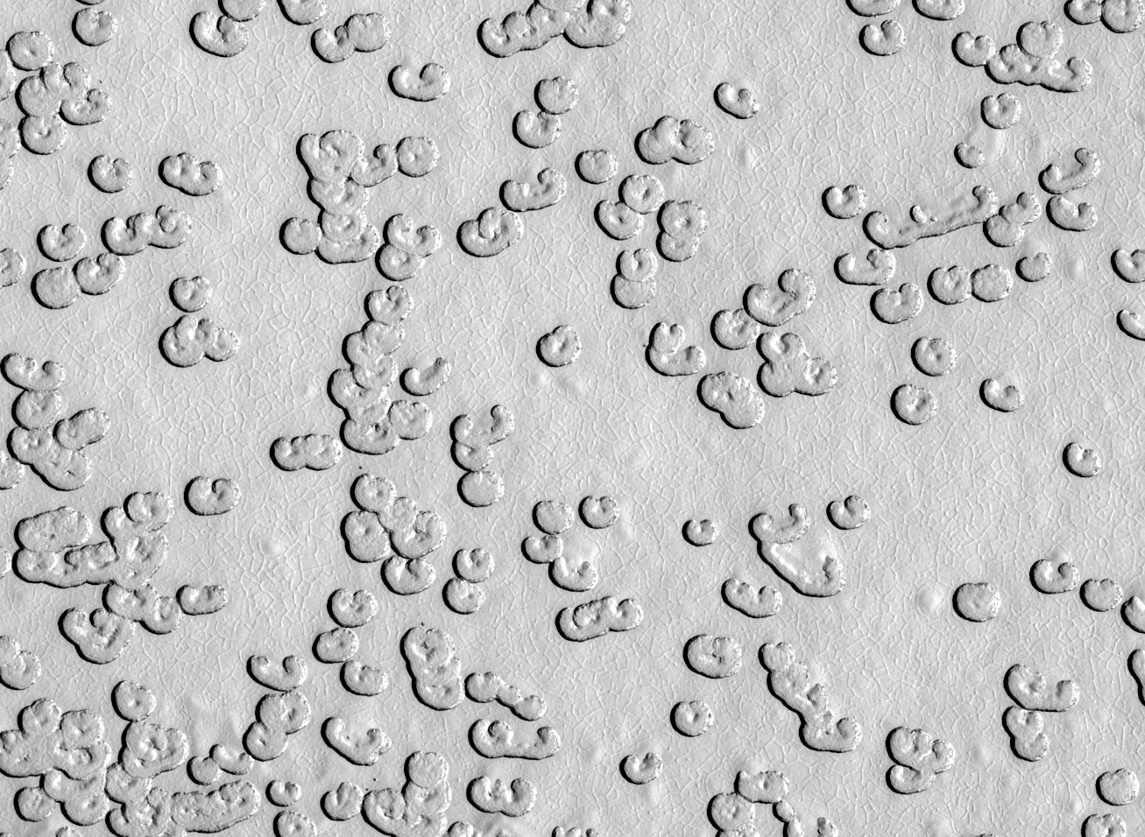
Change in the CO₂ Residual Cap
South polar residual cap is a few-meter-thick slab of CO₂ ice
Pits expand at m/yr (Malin et al. 2001, Thomas et al. 2005; 2009) indicate CO₂ being returned to the atmosphere
G11_022329_0931_XN_86S006W

Slide 16
Models suggest cyclic cap
Requires loose surficial material like snowfall
Byrne et al. 2008; 2011

Slide 17
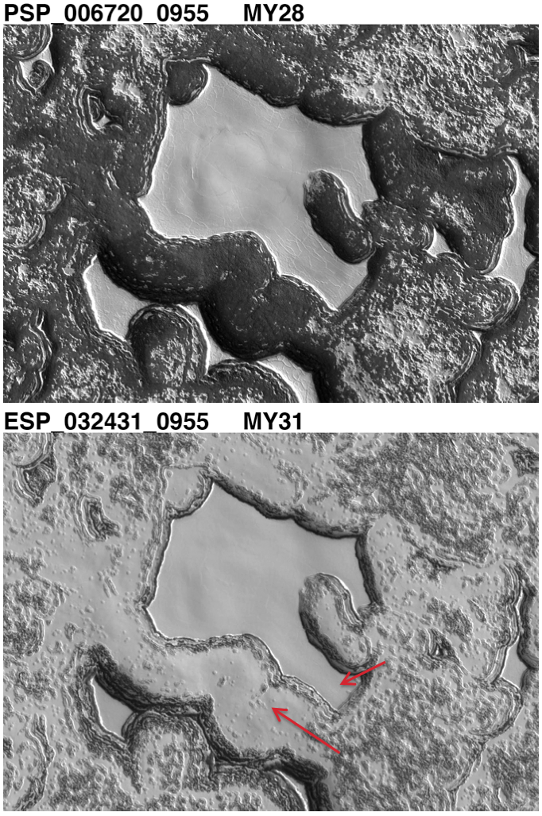
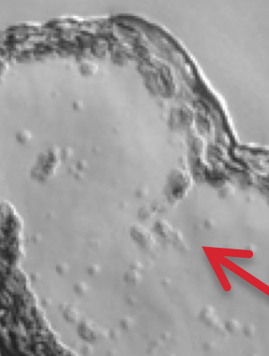
Refrosting ice cap
New slabs of CO₂ ice growing on defrosted areas that are themselves developing Swiss-cheese pits
Many dusty layers probably exist within the thicker CO₂ ice slabs
Multi-year observations allow these geological processes to be tracked and investigated

Slide 18
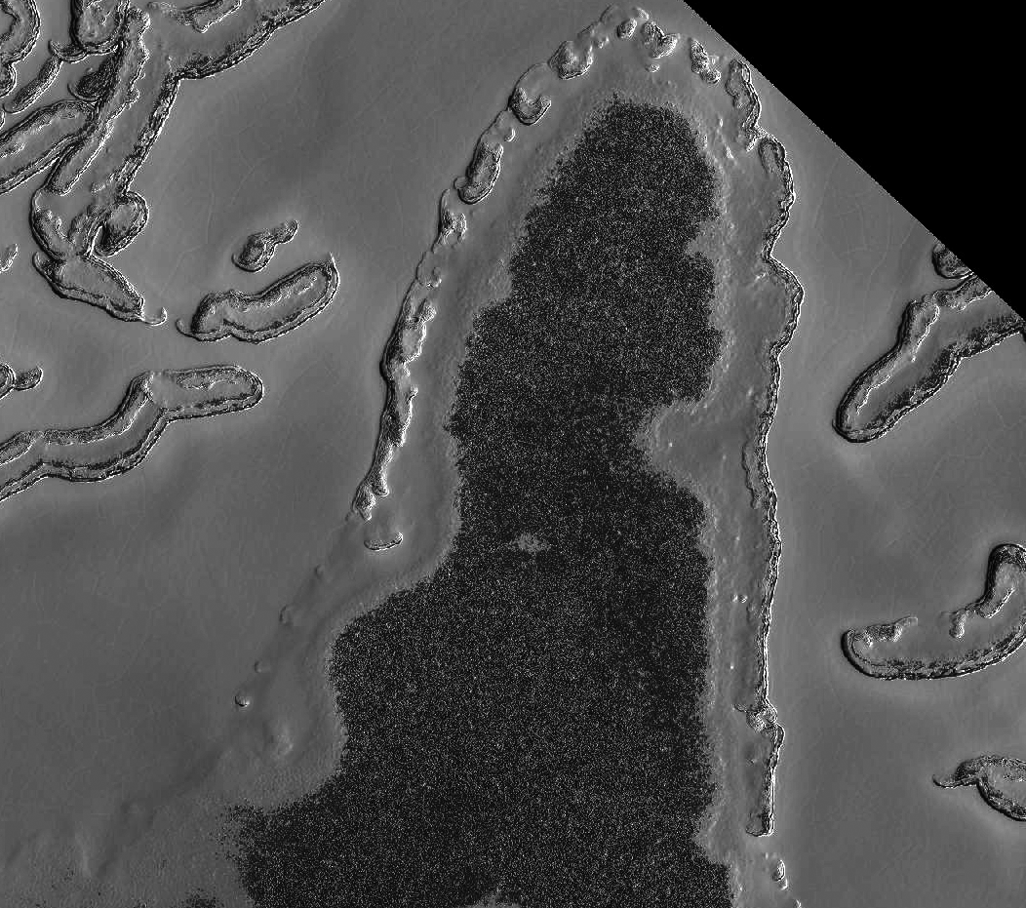
MY 28-31
Another
refrosting
Example

Slide 19
Observational Plan
High-resolution repeat coverage of the residual cap to extend our record
Collaboration with MCS in tying interannual variability in snowfall rates to changes observed with HiRISE (Shane Byrne+Paul Hayne)
Fingers crossed for a MY28-style global dust storm

