Slide 1
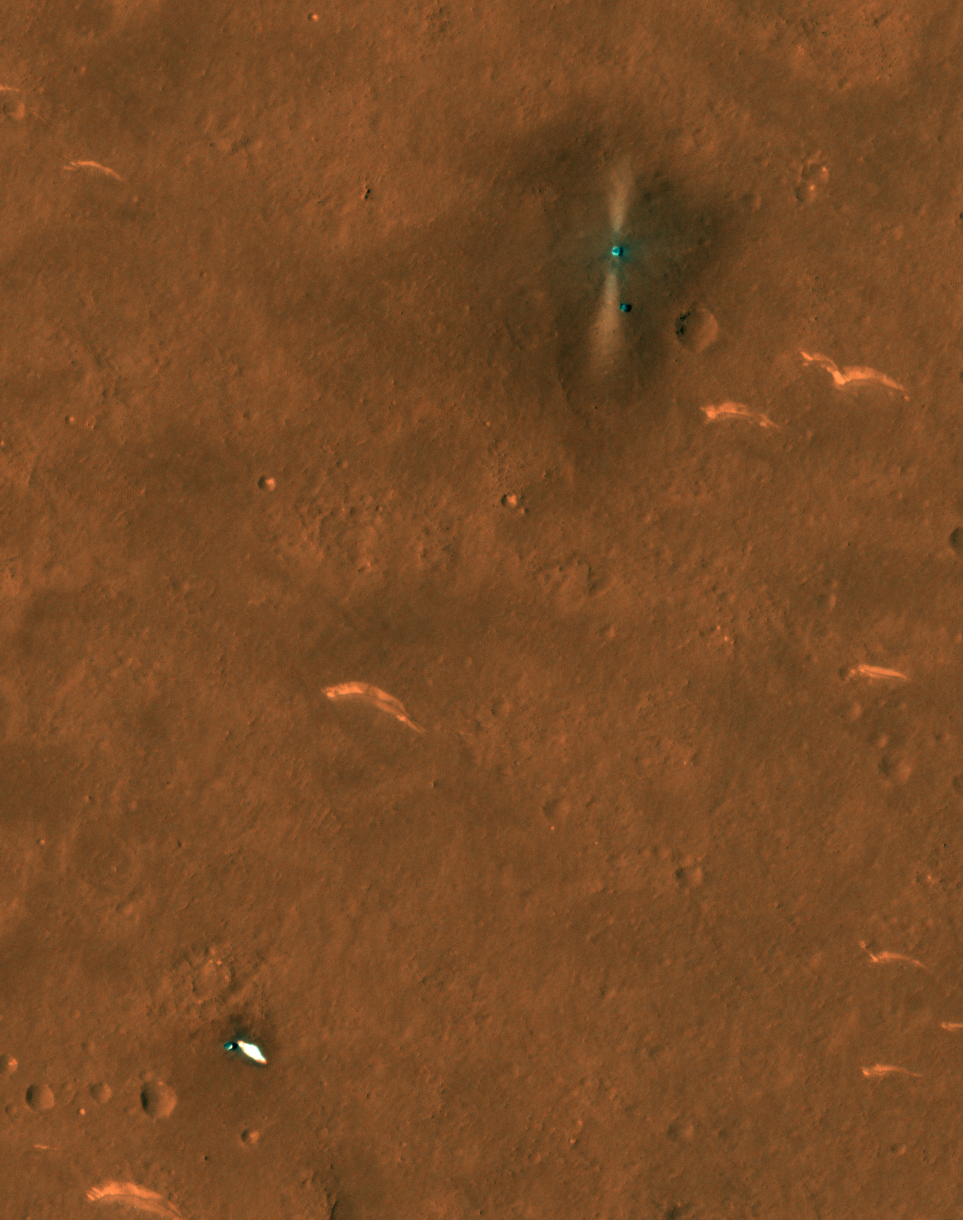
HiRISE Update
1. EM5 accomplishments (Shane)
2. Bit flip and ADC test update (Alfred)
3. Revisit EM6 ideas (all)
ESP_069665_2055 Tianwen-1 landing site with Zhurong rover

Slide 2
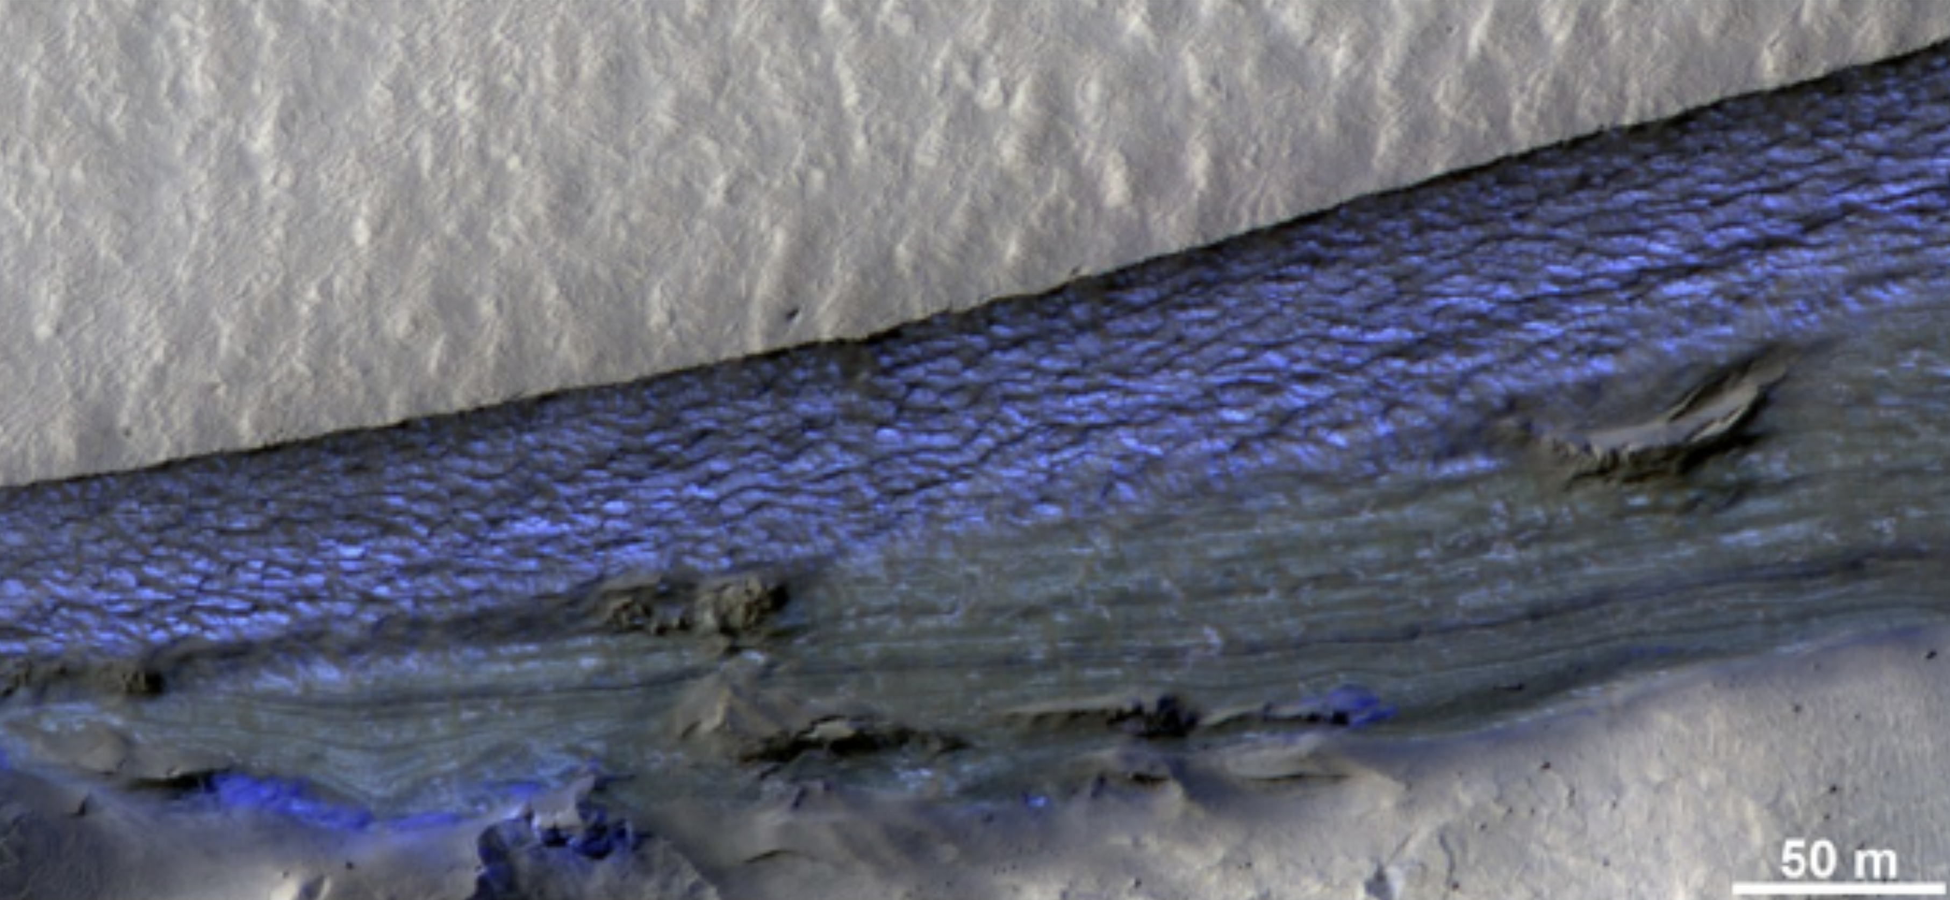
HiRISE – EM5 Results
With Hasty Input From:
Matt Chojnacki
Ingrid Daubar
Colin Dundas
John Grant
Candy Hansen
Laz Keszthelyi
Mike Mellon
Ganna Portyankina
Cathy Weitz
James Wray

Slide 3
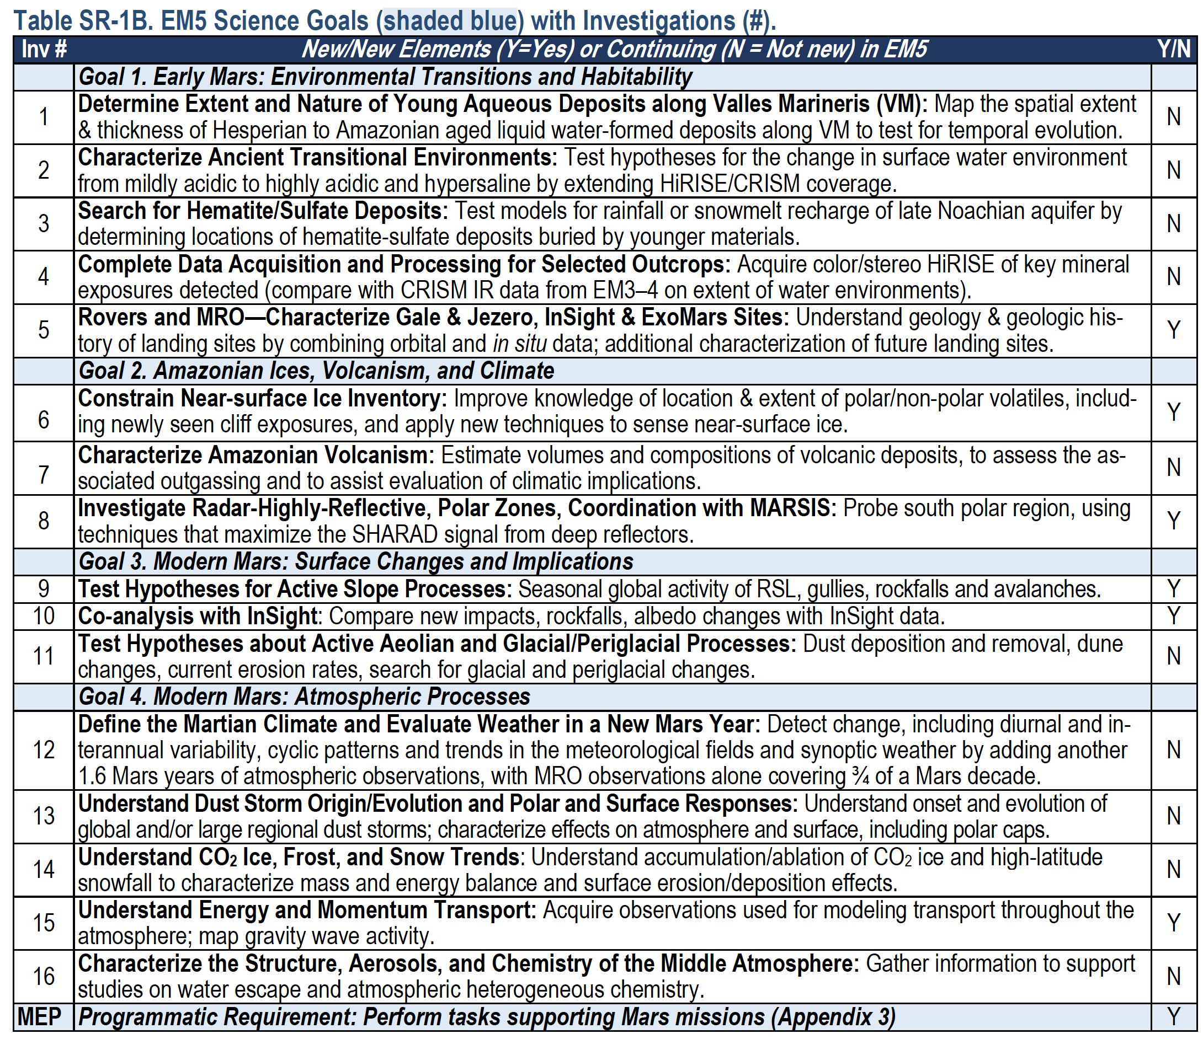
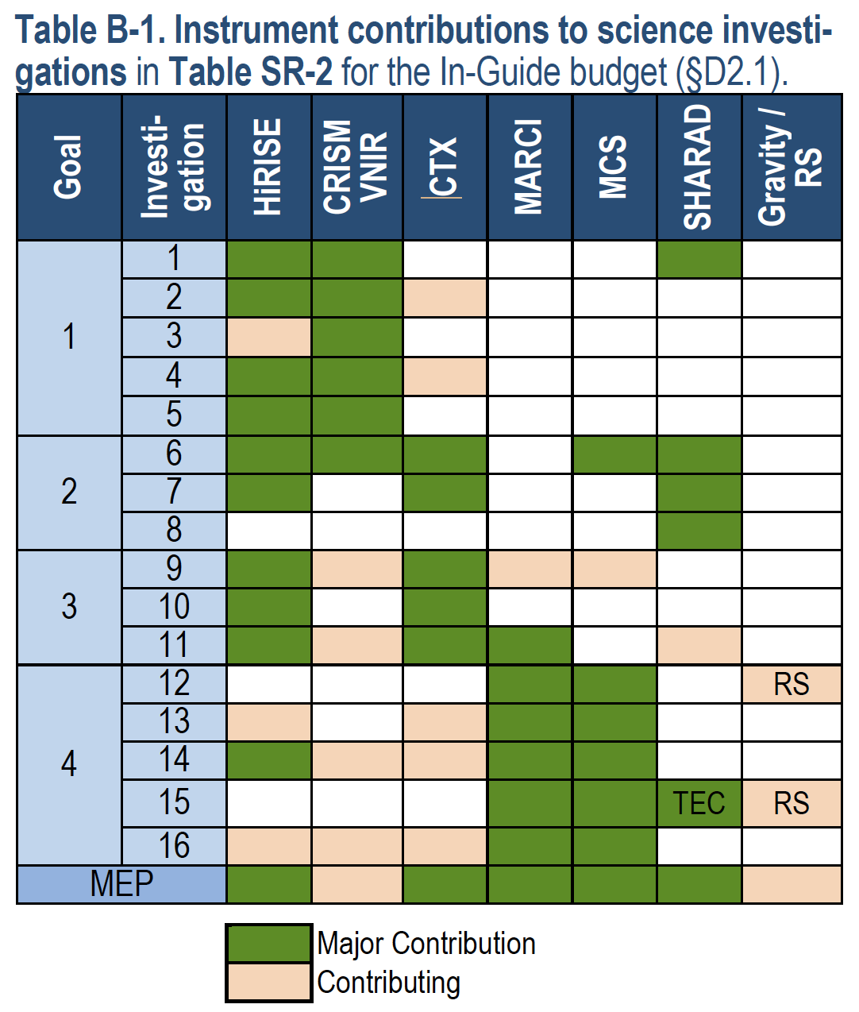

Slide 4
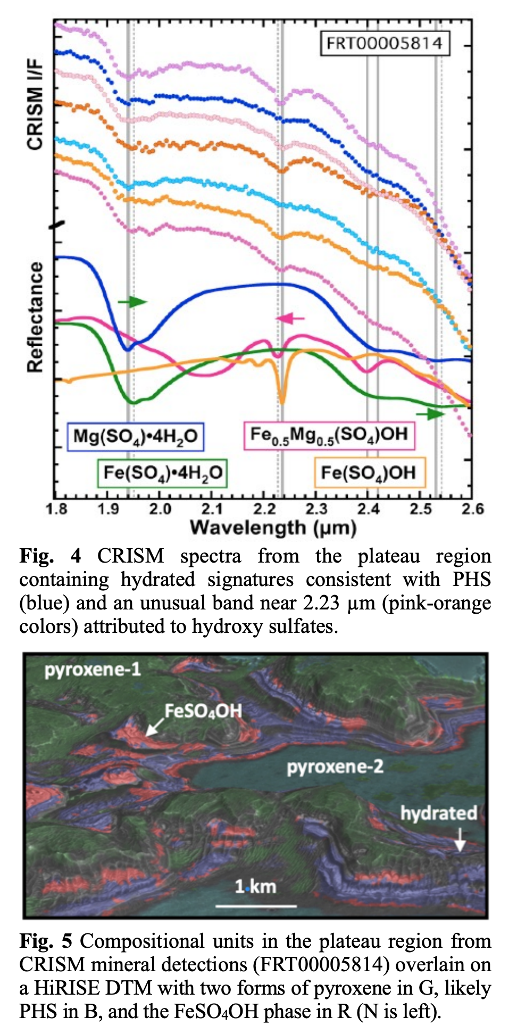
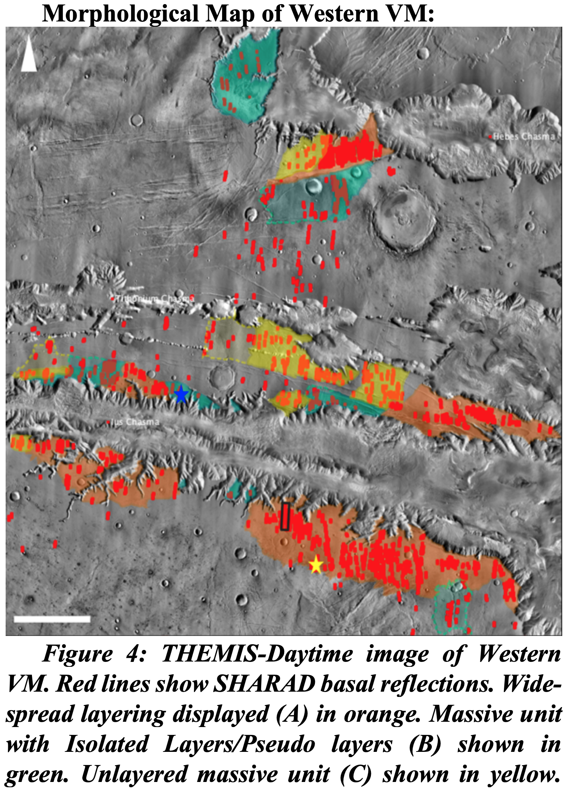
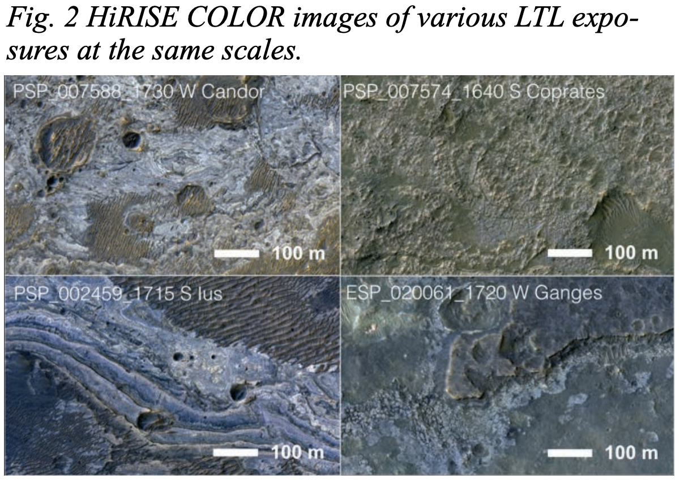
Investigation 1: Determine Extent and Nature of Young Aqueous Deposits along Valles Marineris (VM): Map the spatial extent & thickness of Hesperian to Amazonian aged liquid water-formed deposits along VM to test for temporal evolution.
Outcrops along VM have been identified using HiRISE, SHARAD, CRISM, and CTX data
Deposits display variations in brightness, color, morphology, and composition [Smith et al., LPSC 50, Abstract 2713, 2019]
CRISM data suggest they contain hydrated silica, Fe-hydroxy sulfate, jarosite, and Al- and Fe/Mg-bearing phyllosilicates [Smith et al., 2019; Bishop et al., LPSC 52, Abstract 1082, 2021]
Formation mechanisms include fluvial deposits and volcanic ash deposits [Mishev et al., LPSC 52, Abstract 1694, 2021]
[Bishop et al., LPSC 52, Abstract 1082, 2021]
[Mishev et al., LPSC 52, Abstract 1694, 2021]
[Smith et al., LPSC 50, Abstract 2713, 2019]

Slide 5
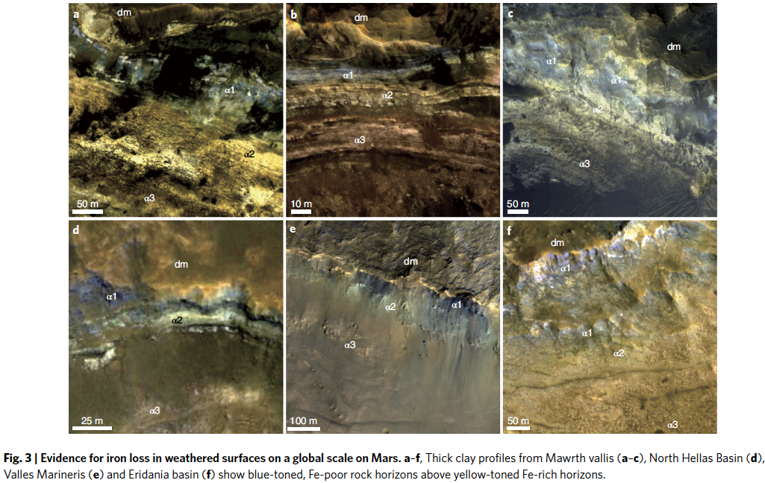
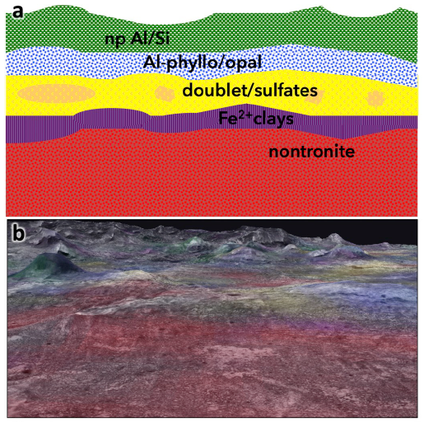
Investigation 2: Characterize Ancient Transitional Environments: Test hypotheses for the change in surface water environment from mildly acidic to highly acidic and hypersaline by extending HiRISE/CRISM coverage.
Late Noachian NE Syrtis Major sulfate-bearing sediments up to ~600 m thick have HiRISE-measured orientations consistent with deposition from suspension, followed by localized jarosite mineralization forming resistant ridges (Quinn & Ehlmann, JGR, 2019)
CRISM data overlain on HiRISE digital terrain models reveal the stratification of salty/transitional and clay layers in Mawrth Vallis (Bishop et al., Icarus, 2020)
HiRISE color gradients used to infer that the weathering that formed alunite and Al-phyllosilicates occurred under a reduced atmosphere (Liu et al., Nature Astron., 2021)
HiRISE color used to tie salt and clay weathering distribution in Gale crater to globally widespread processes (Liu et al., Sci. Adv., 2021)
HiRISE images used to used to understand contacts between clay- and salt-rich Noachian/Hesperian layers in Gale crater (Sheppard et al., JGR-Planets, 2021)
[Liu et al., Nature Astron., 2021]
[Bishop et al., 2020]

Slide 6
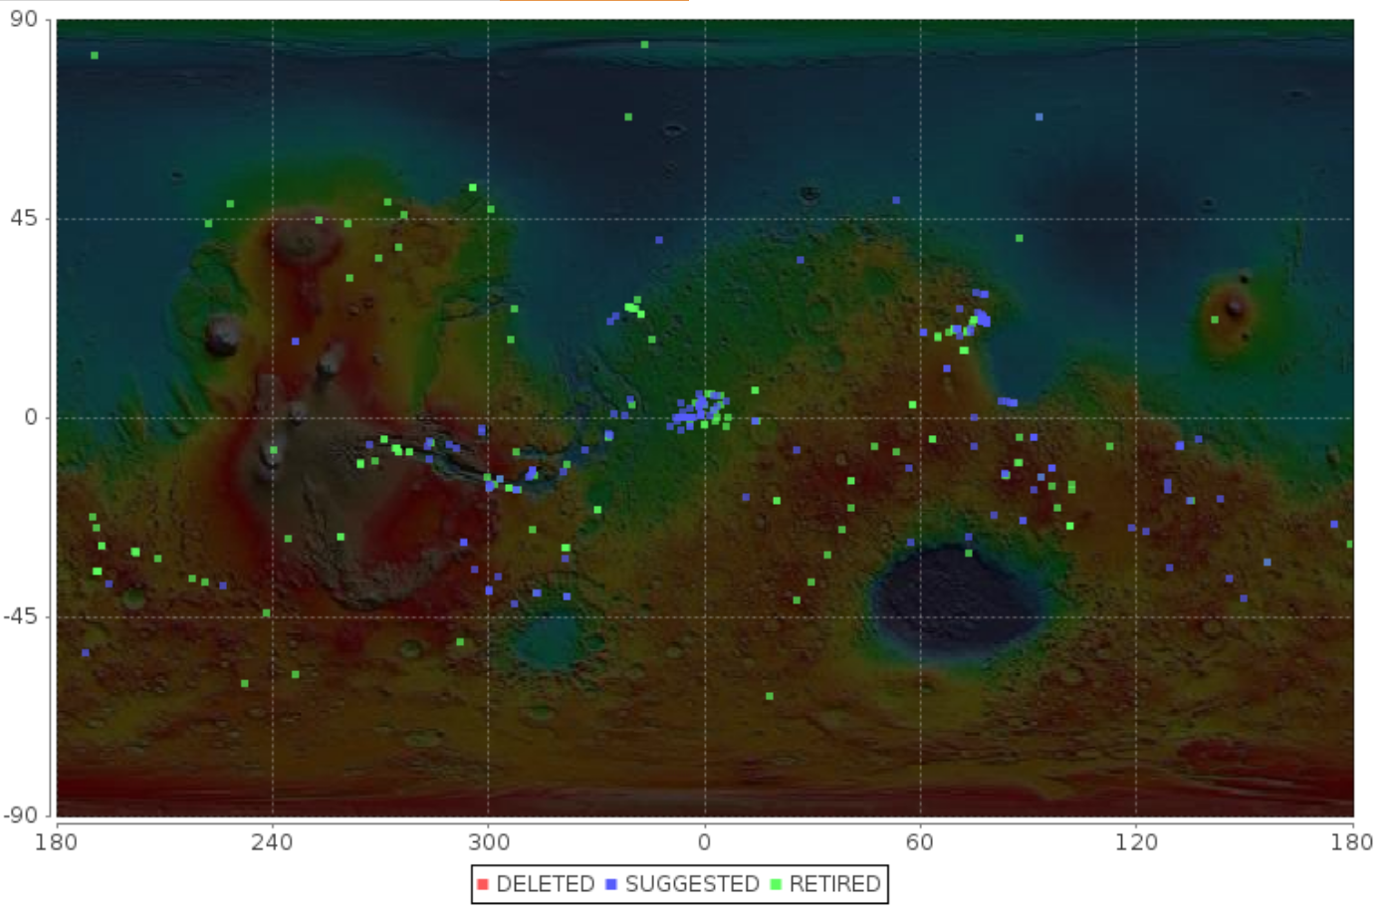
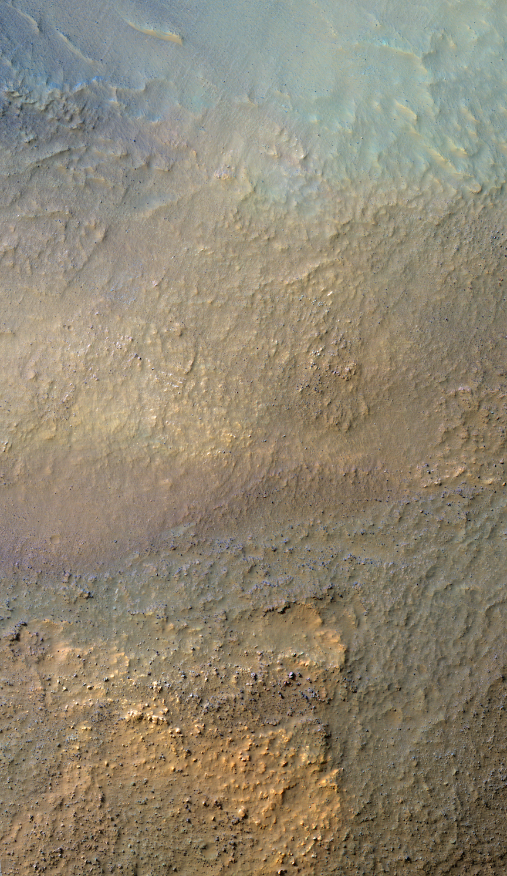
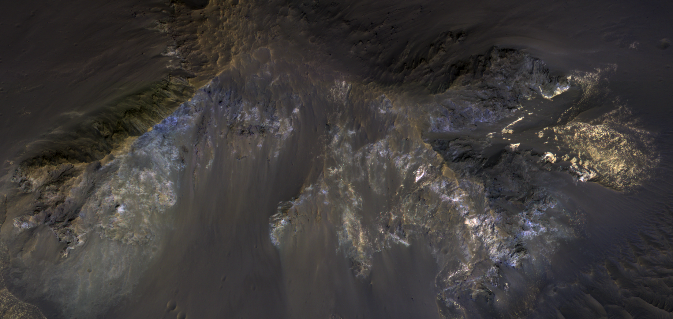
Investigation 4: Complete Data Acquisition and Processing for Selected Outcrops: Acquire color/stereo HiRISE of key mineral exposures detected (compare with CRISM IR data from EM3–4 on extent of water environments).
“Olivine-rich ejecta of crater near Argyre Planitia”
EM5 promised that HiRISE would follow up on >100 targets
356 HiRISE targets submitted by CRISM during EM5 to improve coverage over existing high-resolution CRISM observations
182 of these imaged by HiRISE to date
“Aureum Chaos hydrated sulfates”
ESP_069064_1390
ESP_066134_1755

Slide 7
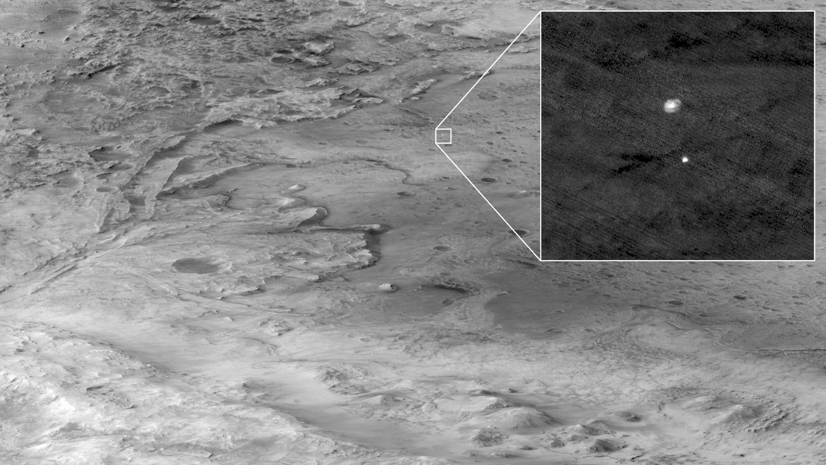
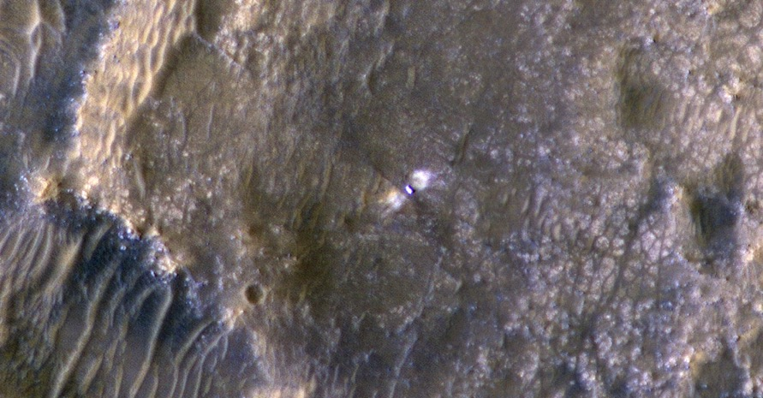
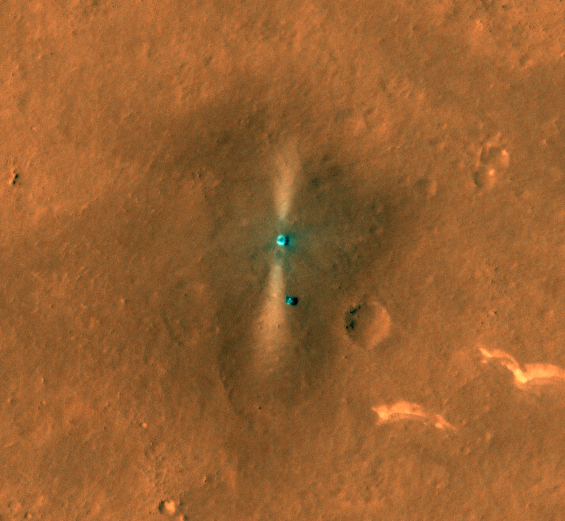
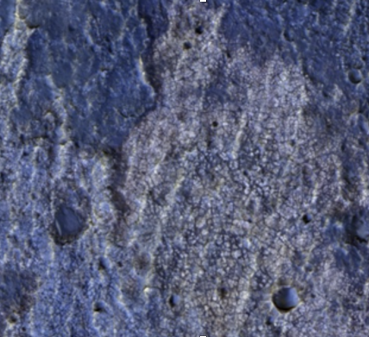
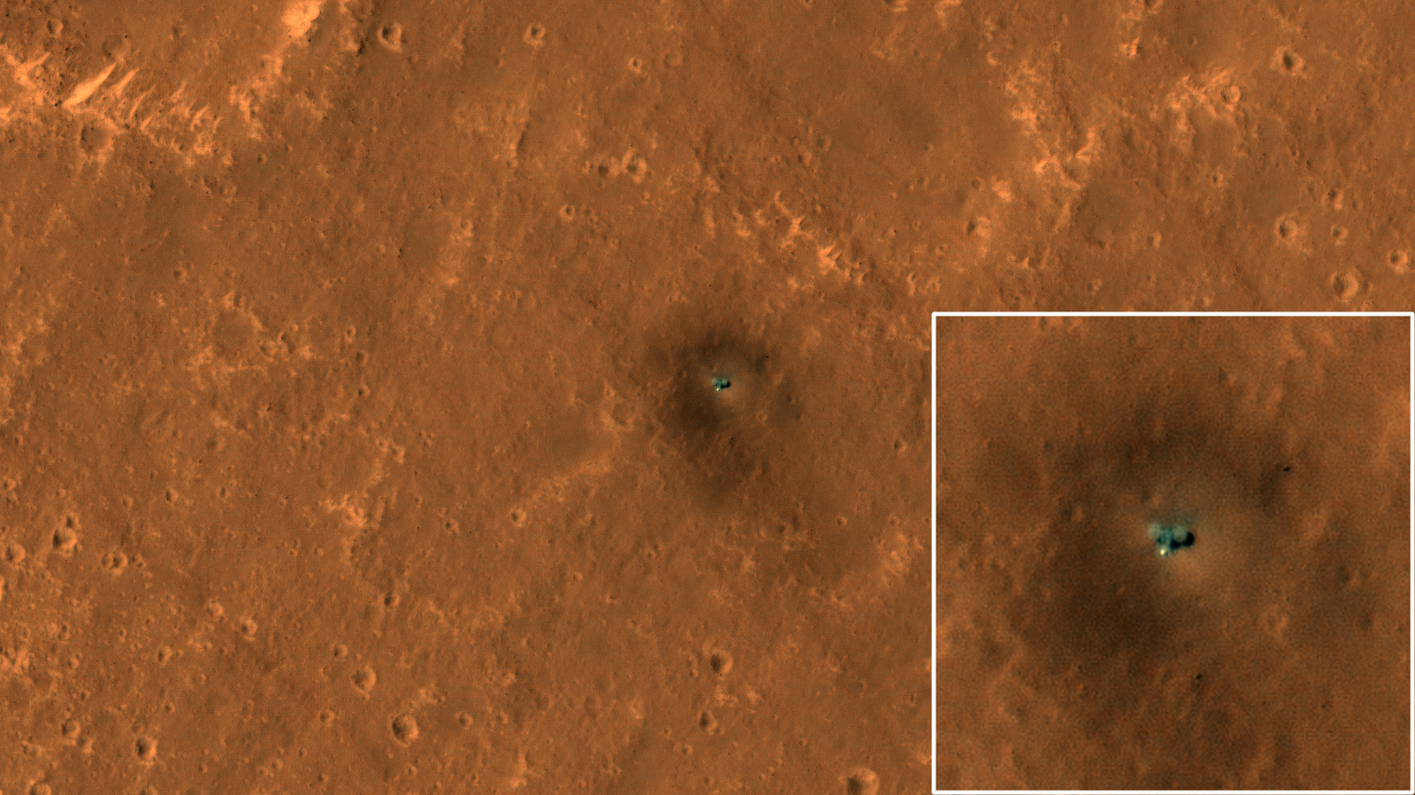
Investigation 5: Rovers and MRO—Characterize Gale & Jezero, InSight & ExoMars Sites: Understand geology & geologic history of landing sites by combining orbital and in situ data; additional characterization of future landing sites.
Zhurong
Perseverance
Oxia Planum
Curiosity
Insight

Slide 8
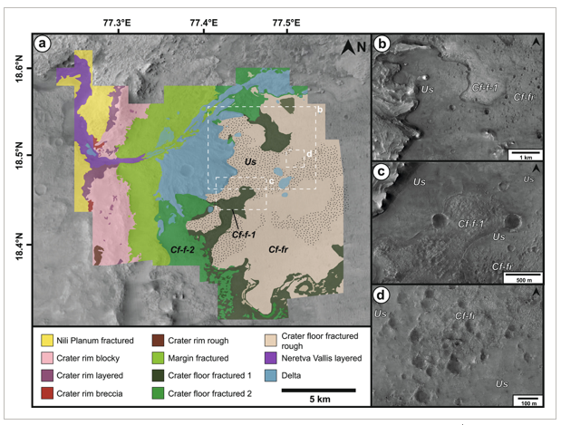
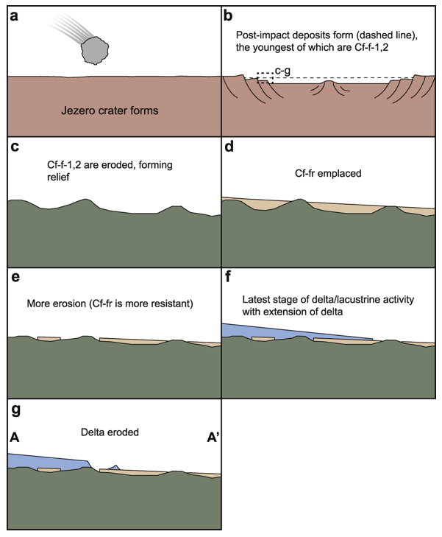
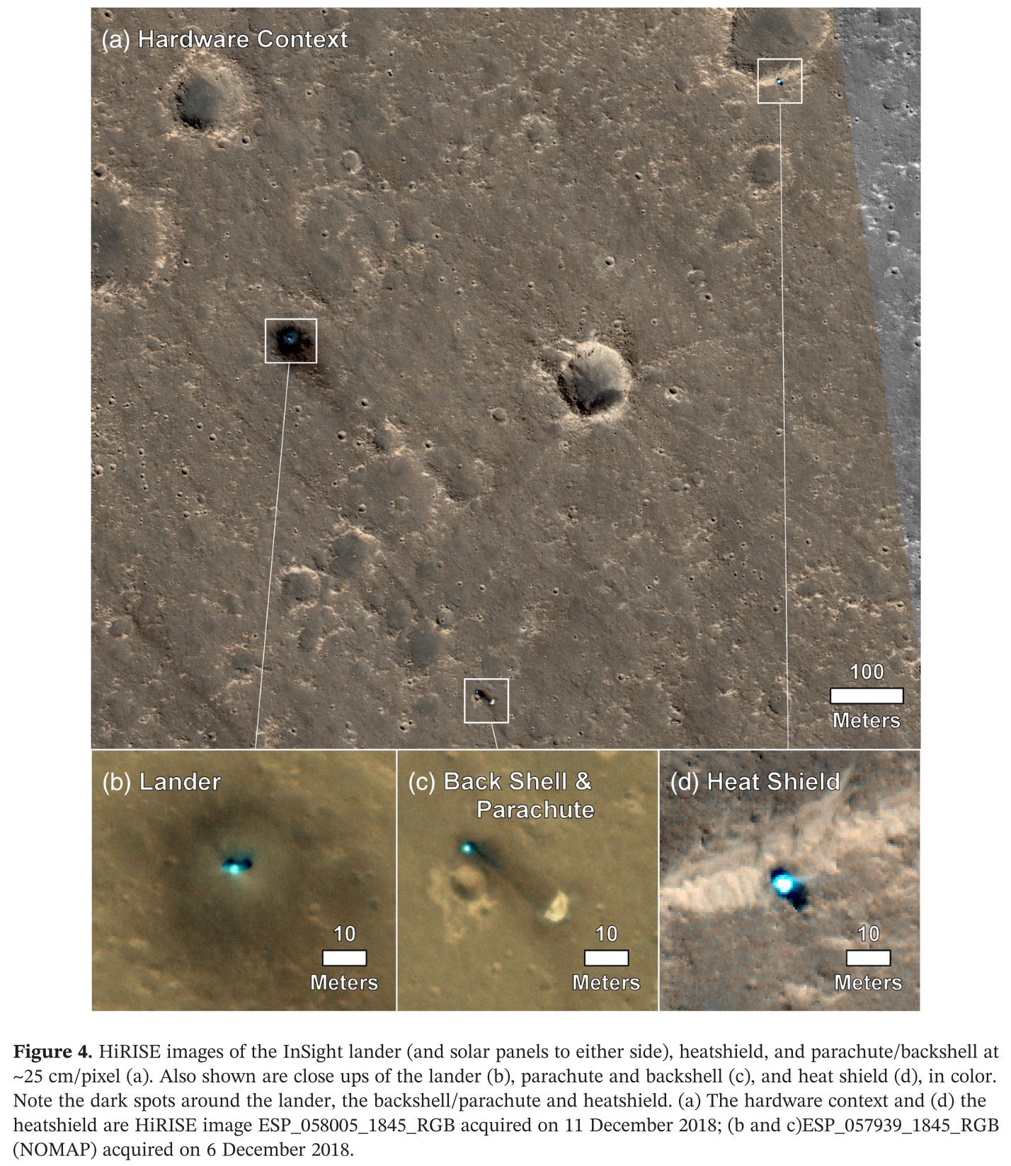
Investigation 5: Rovers and MRO—Characterize Gale & Jezero, InSight & ExoMars Sites: Understand geology & geologic history of landing sites by combining orbital and in situ data; additional characterization of future landing sites.
M2020 and Jezero
Holm-Alwmark et al. 2021 Stratigraphic Relationships in Jezero Crater, Mars: Constraints on the Timing of Fluvial-Lacustrine Activity From Orbital Observations, J. Geophys. Res.
Grant, J. A., et al. 2018. The science process for selecting the landing site for the 2020 Mars rover. Planet Space Sci. 164, 106-126.
Insight
Golombek, M., et al. 2020. Assessment of InSight Landing Site Predictions. Journal of Geophysical Research (Planets) 125,.
Weitz, C. M., et al. 2020. Comparison of InSight Homestead Hollow to Hollows at the Spirit Landing Site. Journal of Geophysical Research (Planets) 125,.
Grant, J. A., et al. 2020. Degradation of Homestead Hollow at the InSight Landing Site Based on the Distribution and Properties of Local Deposits. Journal of Geophysical Research (Planets) 125,.
Warner et al. 2020. An Impact Crater Origin for the InSight Landing Site at Homestead Hollow, Mars: Implications for Near Surface Stratigraphy, Surface Processes, and Erosion Rates. Journal of Geophysical Research (Planets) 125,.
Golombek, et al. 2020. Geology of the InSight landing site on Mars. Nature Communications 11,.
Golombek, et al. (2020) Location and Setting of the Mars InSight Lander, Instruments, and Landing Site. Earth and Space Science 7, e01248. DOI:10.1029/2020EA001248
Krasner et al. (2021), Reconstruction of Entry, Descent, and Landing Communications for the InSight Mars Lander, J. Spacecraft and Rockets, https://doi.org/10.2514/1.A34892, 2021.
And many others

Slide 9
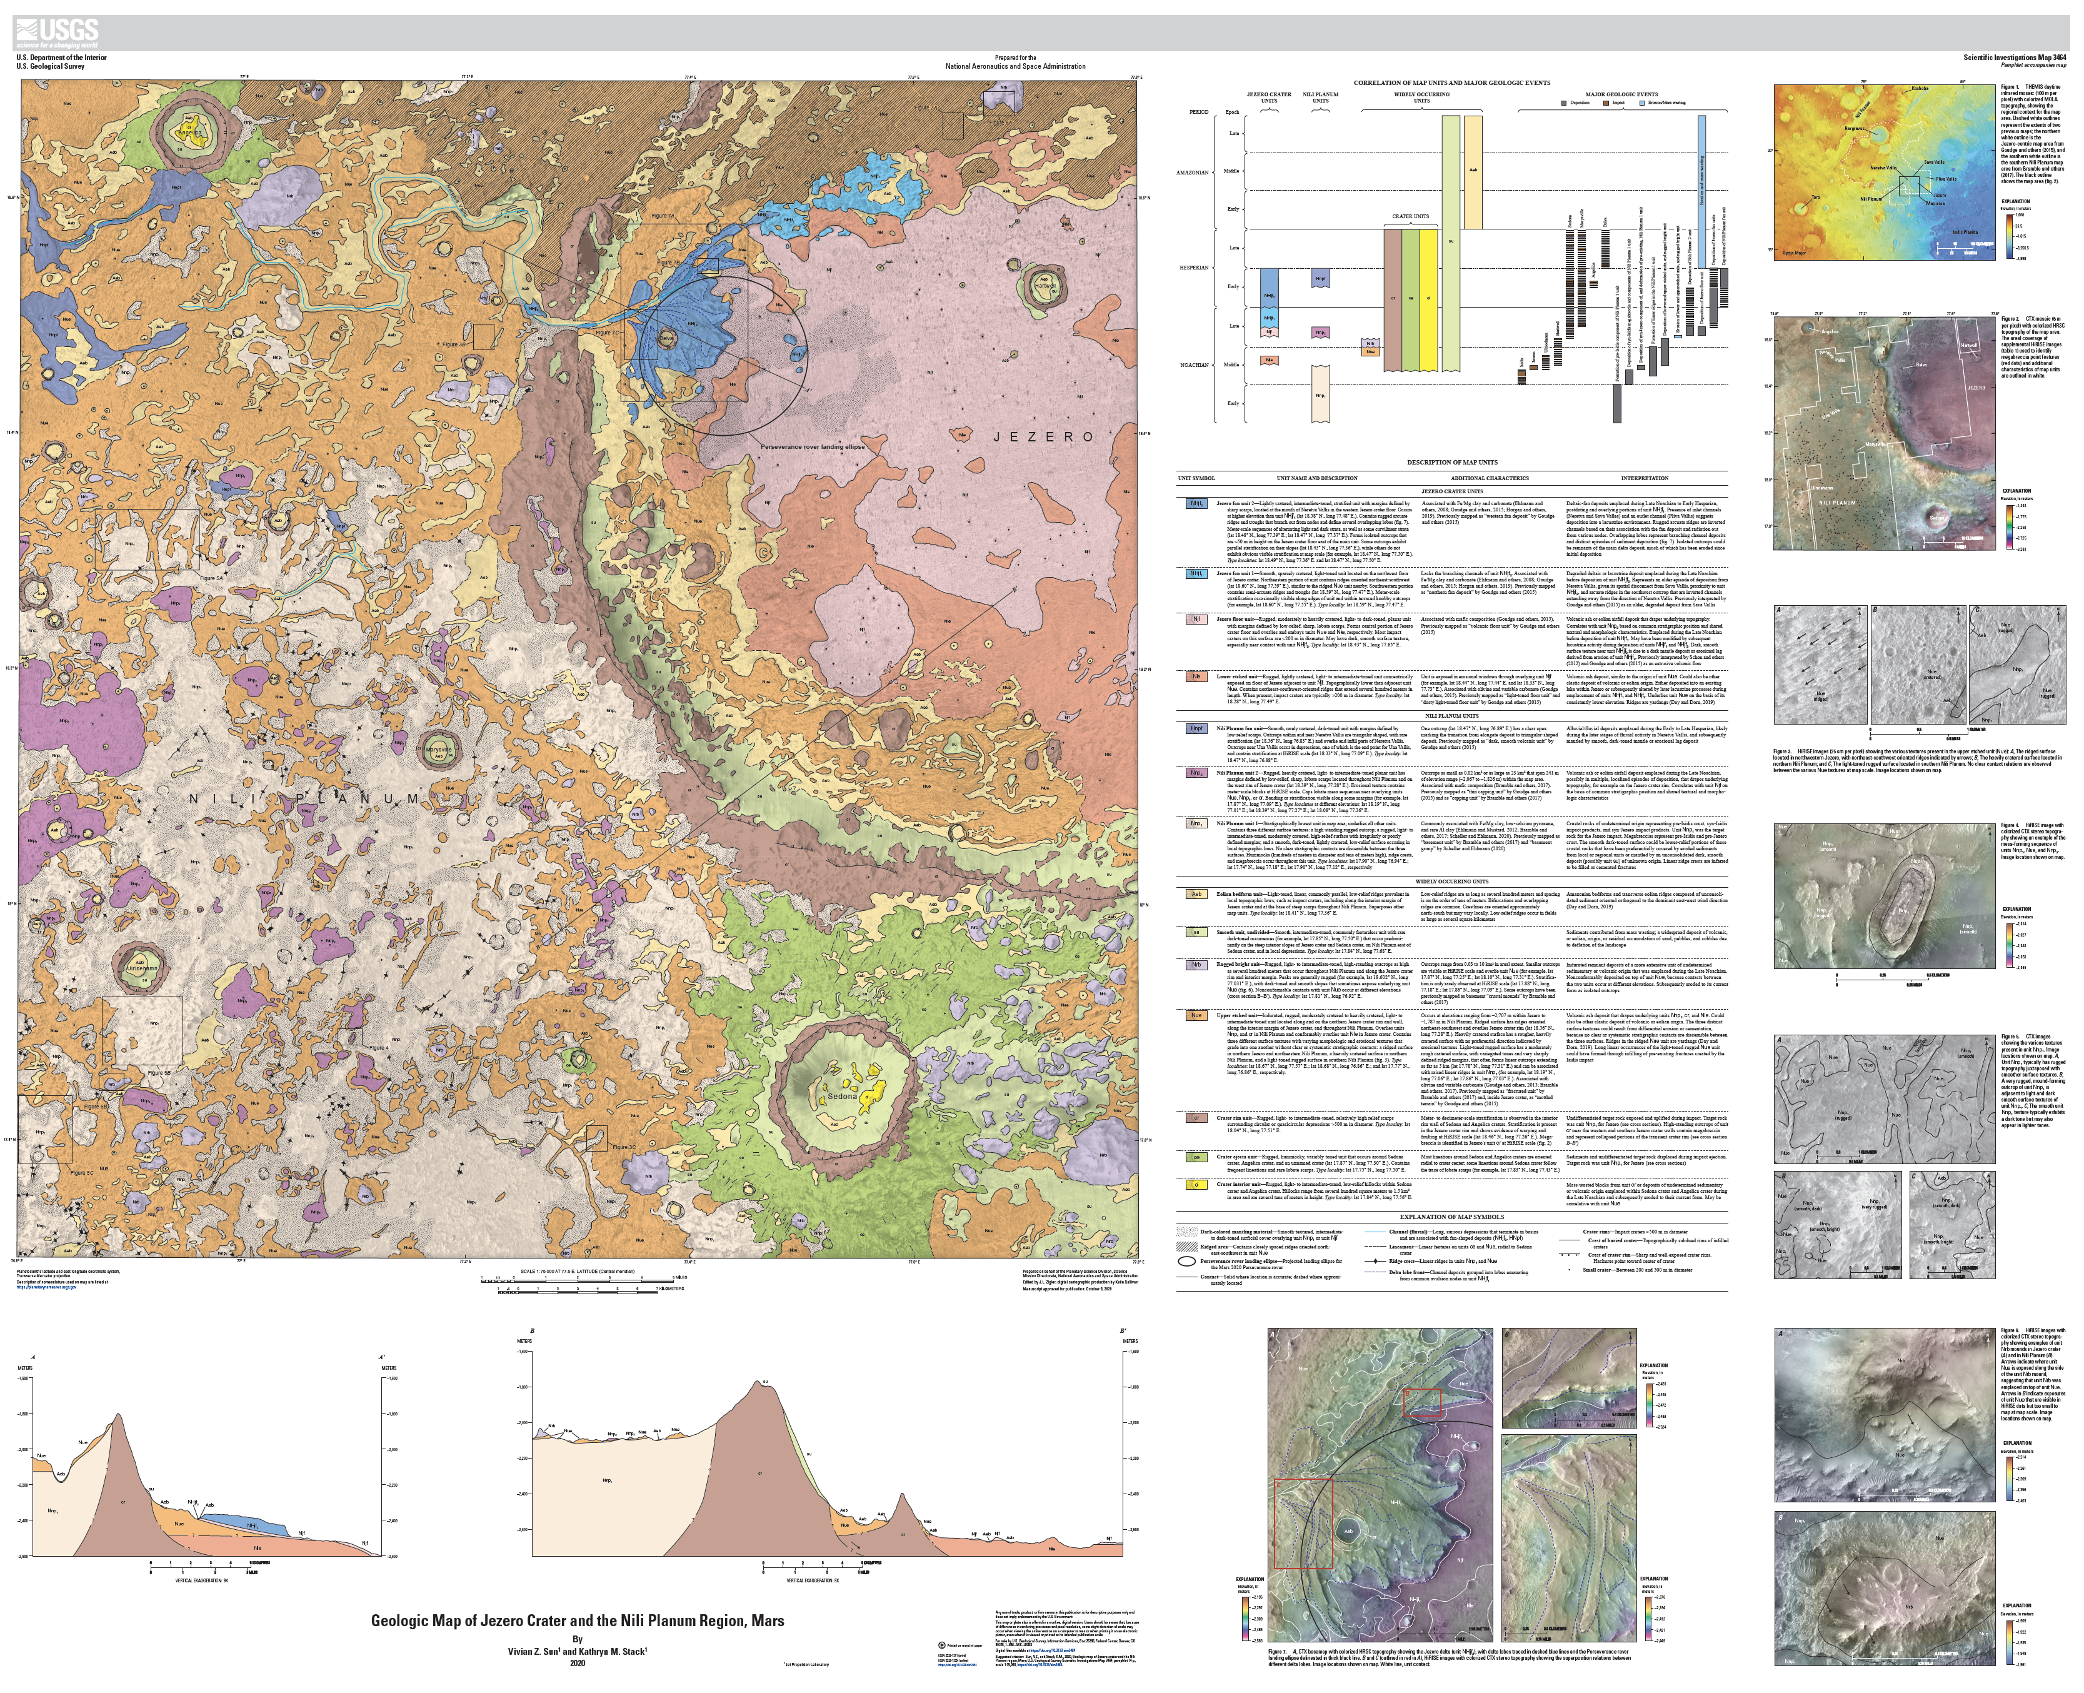
Investigation 5: Rovers and MRO—Characterize Gale & Jezero, InSight & ExoMars Sites: Understand geology & geologic history of landing sites by combining orbital and in situ data; additional characterization of future landing sites.
Geologic Map of Jezero Crater and the Nili Planum Region, Mars
Sun, V.Z., and Stack, K.M., 2020, Geologic map of Jezero crater and the Nili Planum region, Mars: U.S. Geological Survey Scientific Investigations Map 3464, pamphlet 14 p., 1 sheet, scale 1:75,000, https://doi.org/10.3133/sim3464.
Geologic Map Southern Utopia including the Zhurong landing site
Mills, M.M., A.S. McEwen, and C.H. Okubo, A Preliminary Regional Geomorphologic Map in Utopia Planitia of the Tianwen-1 Zhurong Landing Region, J. Geophys. Res., In Press, 2021.

Slide 10
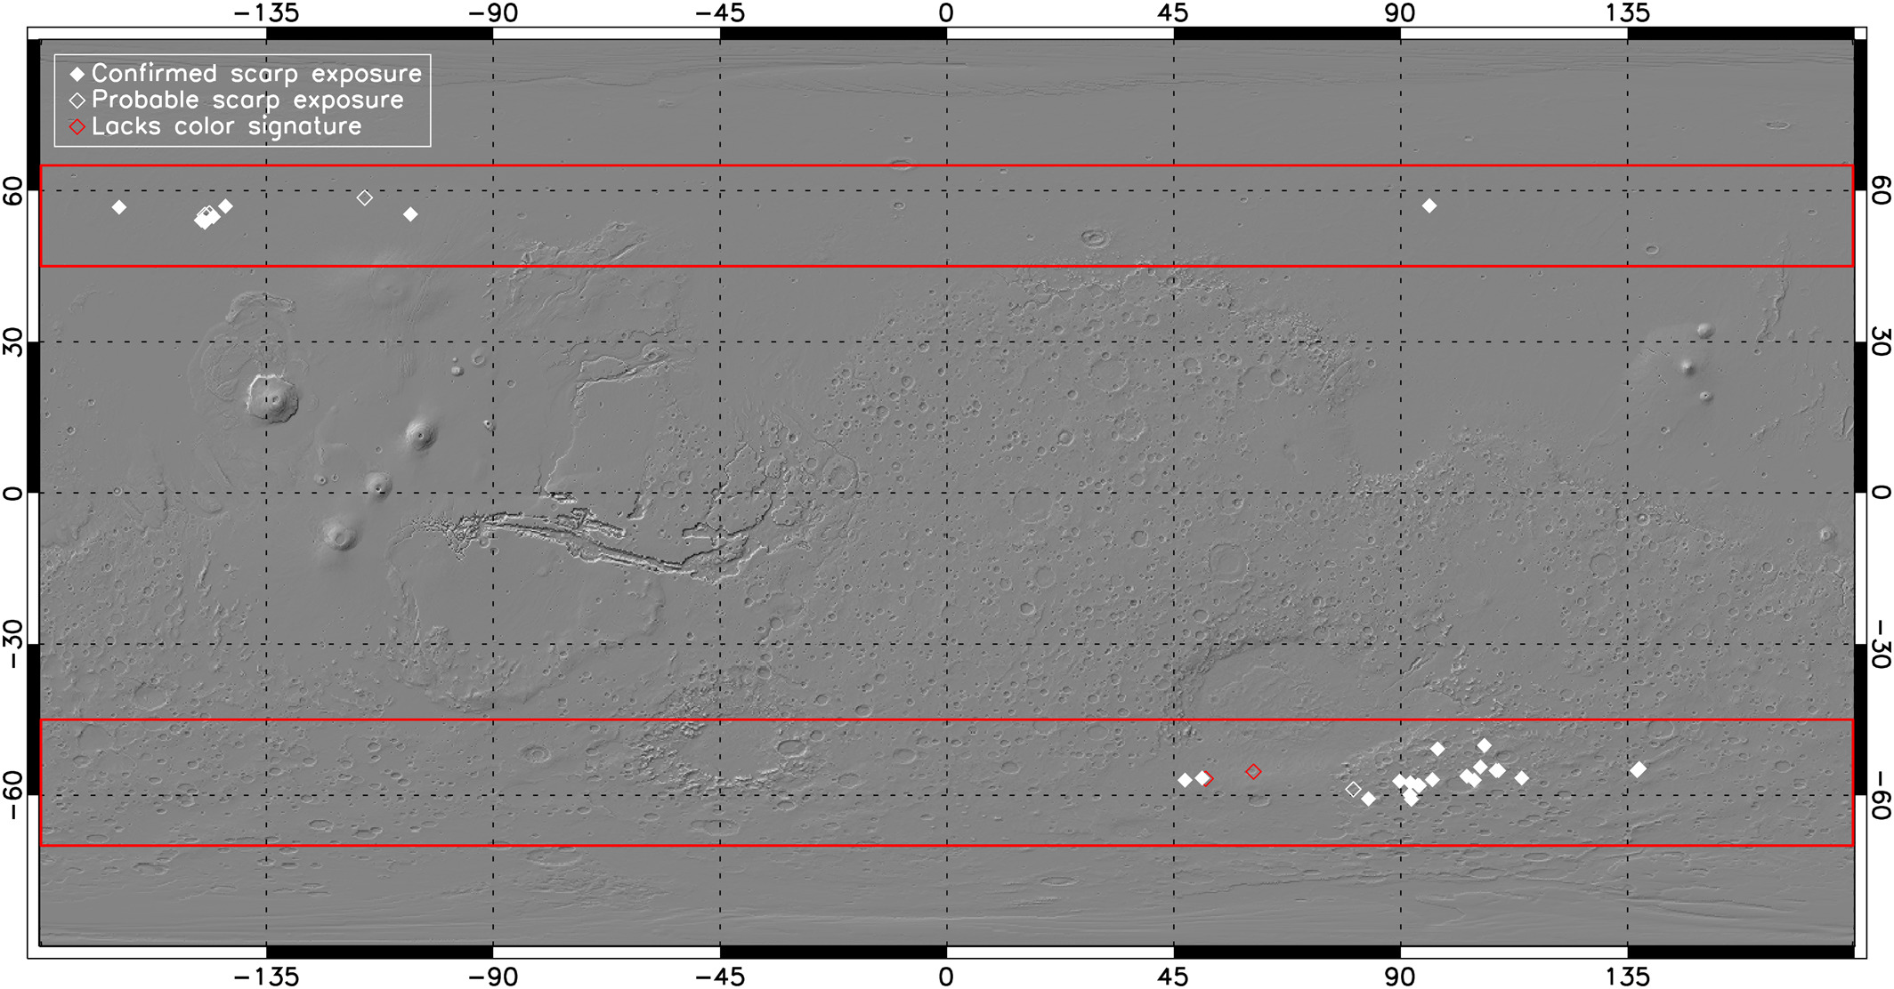
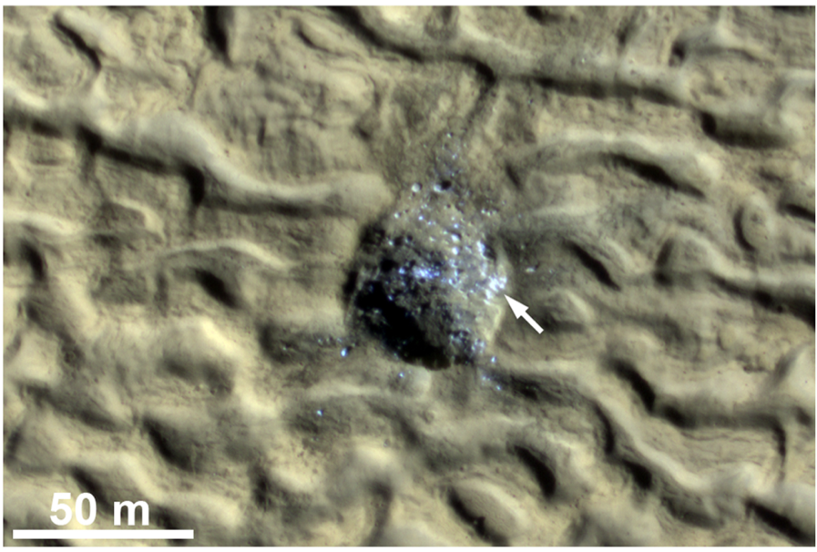
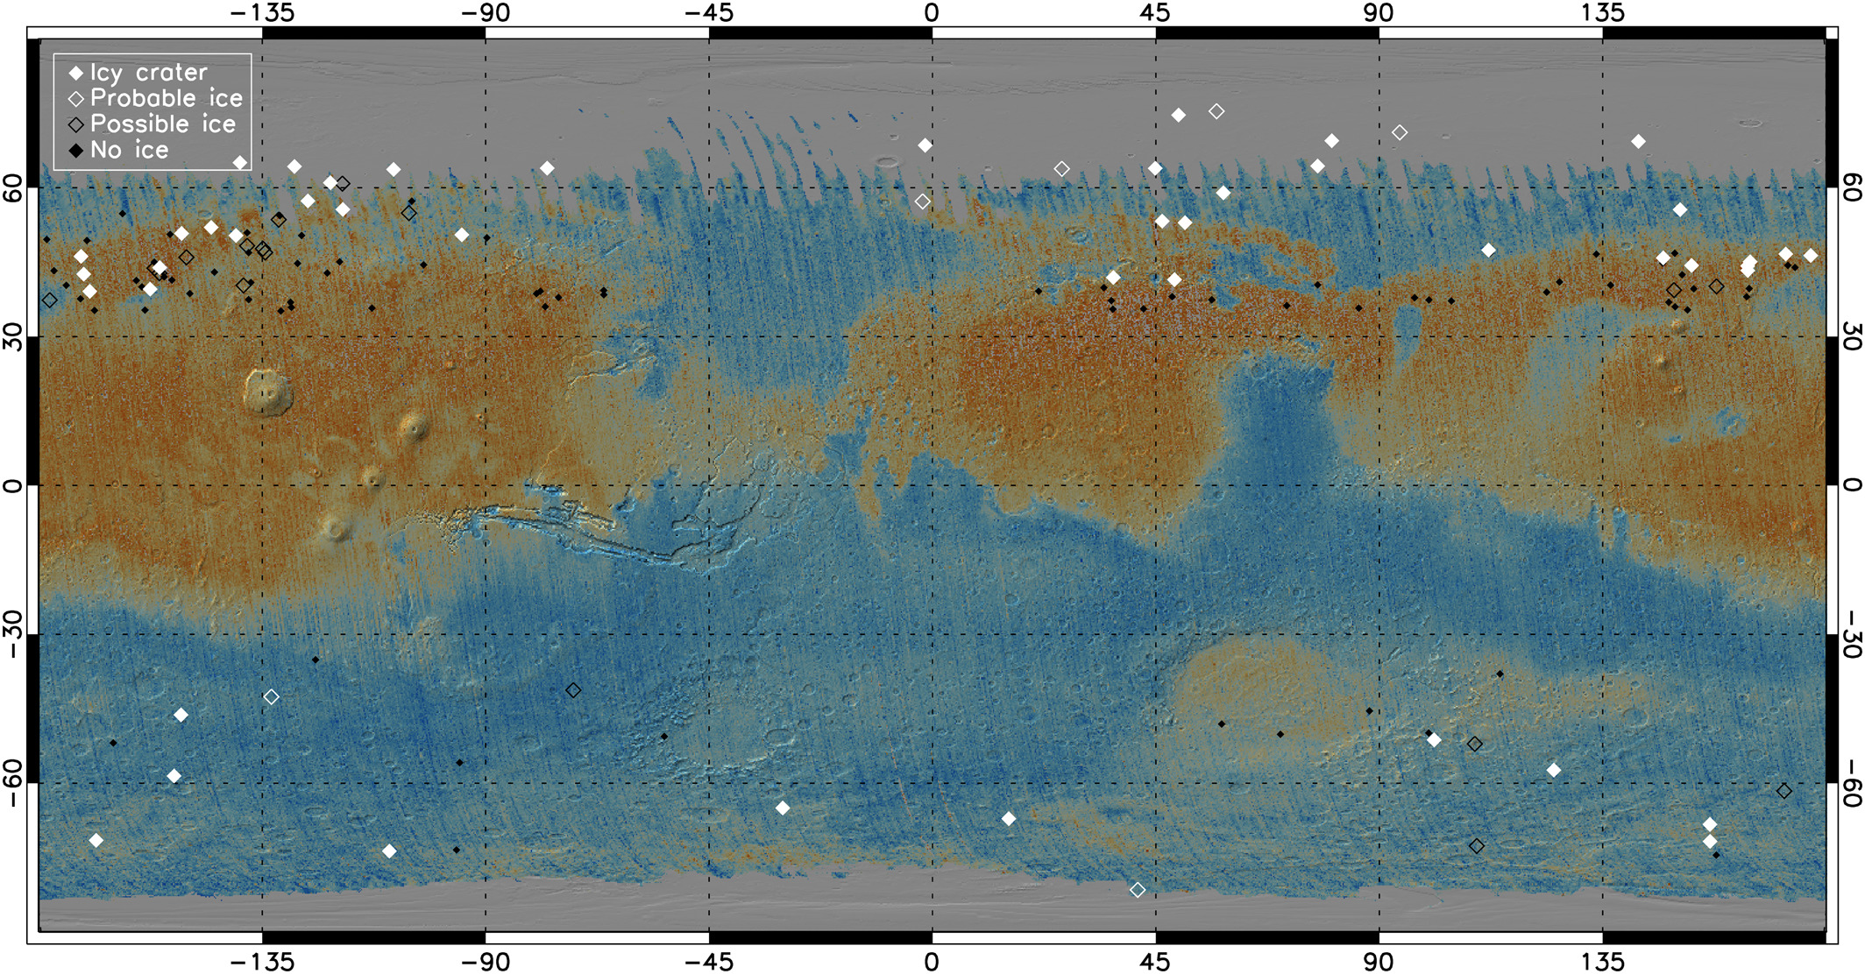
Investigation 6: Constrain Near-surface Ice Inventory: Improve knowledge of location & extent of polar/non-polar volatiles, including newly seen cliff exposures, and apply new techniques to sense near-surface ice.
Completed broad mid-latitude survey of icy scarps, more than doubling the inventory; acquired stereo coverage of many, though not all (completing stereo coverage is a good EM6 goal)
Icy crater finds have more than doubled since 2014, becoming dense enough that we can start to see longitudinal variations in ice
Icy craters also potentially exposing the icy core of LDAs (getting a few more to see if we can puzzle this out for sure is another good EM6 goal)
Dundas et al. 2021

Slide 11
Dundas, C. M., Bramson, A. M., Ojha, L., Wray, J. J., Mellon, M. T., Byrne, S., etal. (2018). Exposed subsurface ice sheets in the Martian mid-latitudes. Science, 359, 199–201. https://doi.org/10.1126/science.aao1619
Dundas, C. M., Mellon, M. T., Conway, S. J., Daubar, I. J., Williams, K. E., Ojha, L., et al. (2021). Widespread exposures of extensive clean shallow ice in the midlatitudes of Mars. Journal of Geophysical Research: Planets, 126, e2020JE006617. https://doi.org/10.1029/2020JE006617
Harish Vijayan, S., Mangold, N., & Bhardwaj, A. (2020). Water-ice exposing scarps within the northern mid-latitude craters on Mars. Geo-physical Research Letters, 47, e2020GL089057. https://doi.org/10.1029/2020GL089057
Morgan, G.A., Putzig, N.E., Perry, M.R. et al. Availability of subsurface water-ice resources in the northern mid-latitudes of Mars. Nat Astron 5, 230–236 (2021). https://doi.org/10.1038/s41550-020-01290-z
Martellato, E., A. M. Bramson, G. Cremonese, A. Lucchetti, F. Marzari, M. Massironi, C. Re, and S. Byrne 2020. Martian Ice Revealed by Modeling of Simple Terraced Crater Formation. Journal of Geophysical Research (Planets) 125,.
Mellon, M. T. and H. G. Sizemore 2022. The history of ground ice at Jezero Crater Mars and other past, present, and future landing sites. Icarus 371,.
Douglas, T. A. and M. T. Mellon 2019. Sublimation of terrestrial permafrost and the implications for ice-loss processes on Mars. Nature Communications 10,.
…and probably a few dozen non-MRO-team papers on glacial/periglacial features using HiRISE images and DTMs
SWIM

Slide 12
Investigation 7: Characterize Amazonian Volcanism: Estimate volumes and compositions of volcanic deposits, to assess the associated outgassing and to assist evaluation of climatic implications.
Amazonian volcanism extends into Utopia Planitia from the Elysium rise, with implications for the Tianwen-1 landing site regional geology. The potential for ground truth of these observations is especially interesting for the future.
Current magmatic activity may be associated with some of the more prominent seismic events detected by InSIGHT, in line with continued investigations of the very recent volcanism around the Cerberus Fossae
Continued analysis of new observations is allowing new synoptic studies of young volcanic terrains on Mars (geologic maps, review papers, etc.).
Distinguishing recent lava flows from mudflows has become an area of active research.
Wu, B., et al. (2021). Characterization of the candidate landing region for Tianwen-1—China's first mission to Mars. Earth and Space Science, 8, e2021EA001670. https://doi.org/10.1029/2021EA001670
Wu, X. et al. (2021) Geological characteristics of China's Tianwen-1 landing site at Utopia Planitia, Mars, Icarus,
370, 114657, https://doi.org/10.1016/j.icarus.2021.114657.
Horvath, D.G., et al., (2021) Evidence for geologically recent explosive volcanism in Elysium Planitia, Mars,
Icarus, 365, 114499, https://doi.org/10.1016/j.icarus.2021.114499.
Brož, P., et al., 2021, An overview of explosive volcanism on Mars, Journal of Volcanology and Geothermal Research, 409, 107125, https://doi.org/10.1016/j.jvolgeores.2020.107125.
Eggers, G. L., Wray, J. J., & Dufek, J. (2021). Compositional mapping of the Nili Patera feldspathic unit: Extent and implications for formation. Journal of Geophysical Research: Planets, 126, e2020JE006383. https://doi.org/10.1029/2020JE006383
Dapremont, A. M., & Wray, J. J. (2021). Igneous or mud volcanism on Mars? The case study of Hephaestus Fossae. Journal of Geophysical Research: Planets, 126, e2020JE006390. https://doi.org/10.1029/2020JE006390
Pan, L., et al., 2020 Crust stratigraphy and heterogeneities of the first kilometers at the dichotomy boundary in western Elysium Planitia and implications for InSight lander, Icarus, 338, 113511, https://doi.org/10.1016/j.icarus.2019.113511.
Hamilton, J., 2021, Constraining the Source Craters of the Martian Meteorites: Shock Analysis and Geologic Mapping of Candidate Craters, MS Thesis, https://doi.org/10.7939/r3-7hzx-sn70
Dapremont, A. M., & Wray, J. J. (2021). Insights into Mars mud volcanism using visible and near-infrared spectroscopy, Icarus, 359, 114299, https://doi.org/10.1016/j.icarus.2020.114299.
Zimbleman, J.R., et al., (2021) The Volcanoes of Mars, Elsevier, ISBN: 978-0-12-822876-0.
Di Pietro, I.D., et al., (2021) Evidence of mud volcanism due to the rapid compaction of martian tsunami deposits in southeastern Acidalia Planitia, Mars, Icarus, 354, 114096, https://doi.org/10.1016/j.icarus.2020.114096.
Peters, S. I., Christensen, P. R., & Clarke, A. B. (2021). Lava flow eruption conditions in the Tharsis volcanic province on Mars. Journal of Geophysical Research: Planets, 126, e2020JE006791. https://doi.org/10.1029/2020JE006791
Xiong, S., Tao, Y., Persaud, D. M., Campbell, J. D., Putri, A. R. D., & Muller, J. P. (2021). Subsurface reflectors detected by SHARAD reveal stratigraphy and buried channels over central Elysium Planitia, Mars. Earth and Space Science, 8, e2019EA000968. https://doi.org/10.1029/2019EA000968
Moitra, P., et al., (2021) Investigating the roles of magmatic volatiles, ground ice and impact-triggering on a very recent and highly explosive volcanic eruption on Mars, Earth and Planetary Science Letters, 567, 116986, https://doi.org/10.1016/j.epsl.2021.116986.

Slide 13

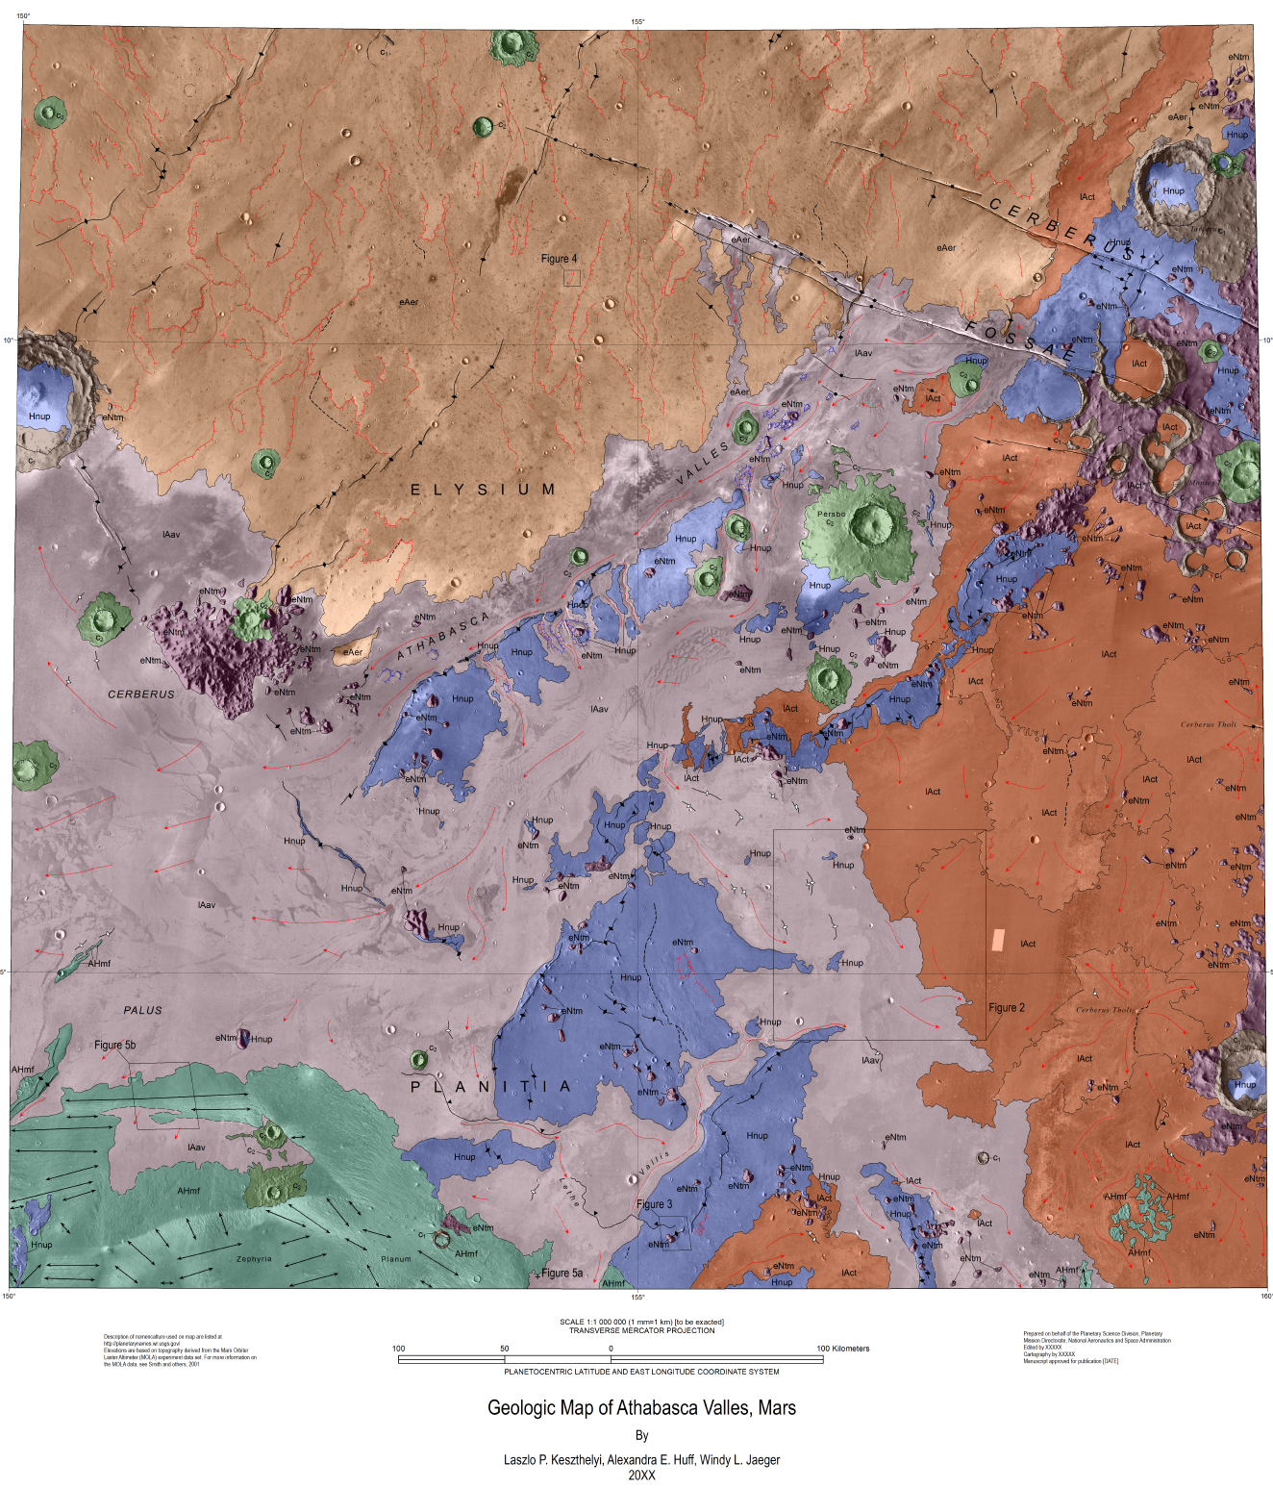
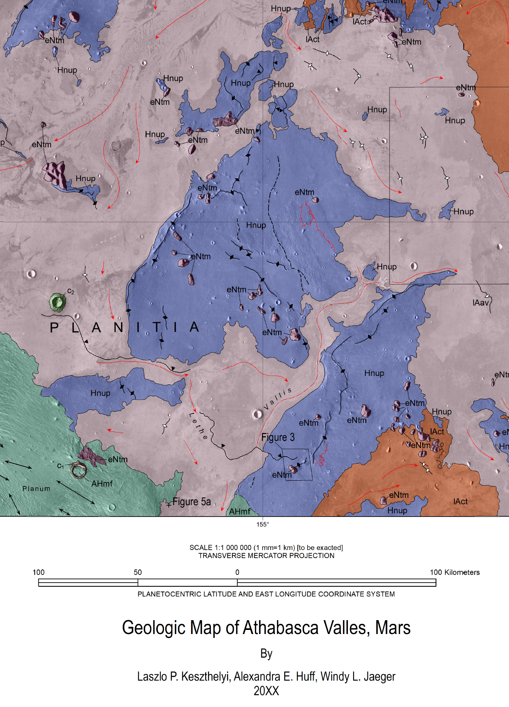
Investigation 7: Characterize Amazonian Volcanism: Estimate volumes and compositions of volcanic deposits, to assess the associated outgassing and to assist evaluation of climatic implications.

Slide 14
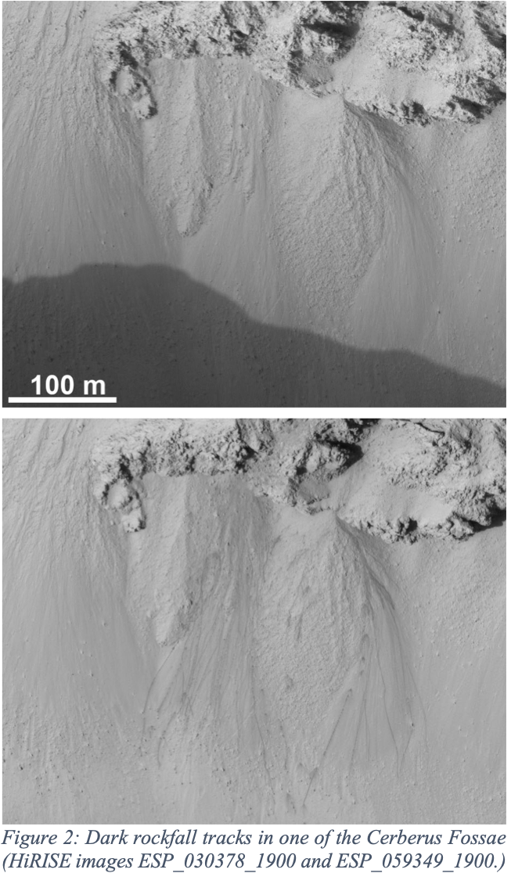
Investigation 9: Test Hypotheses for Active Slope Processes: Seasonal global activity of RSL, gullies, rockfalls and avalanches.
RSL
Massive RSL activity following the 2018 dust storm demonstrating association of activity with surface dust (McEwen et al. 2018)
Since early 2019, multiple papers arguing for dry RSL with various models based on sand and/or dust; maybe not consensus but there's been a significant shift in community thinking in EM4/EM5
Slope Streaks
Evidence for dry slope streak processes from HiRISE change detection (Dundas 2020)
Gullies
Inventory of gully activity has ~doubled since the last major summary paper, which used data through 2017
  New Dundas et al. paper in should be submitted by the time the EM6 proposal goes in
  Starting to detect examples of repeat activity in individual gullies
Other
Evidence for significant slope activity in the Cerberus Fossae: https://www.hou.usra.edu/meetings/lpsc2020/pdf/2404.pdf

Slide 15
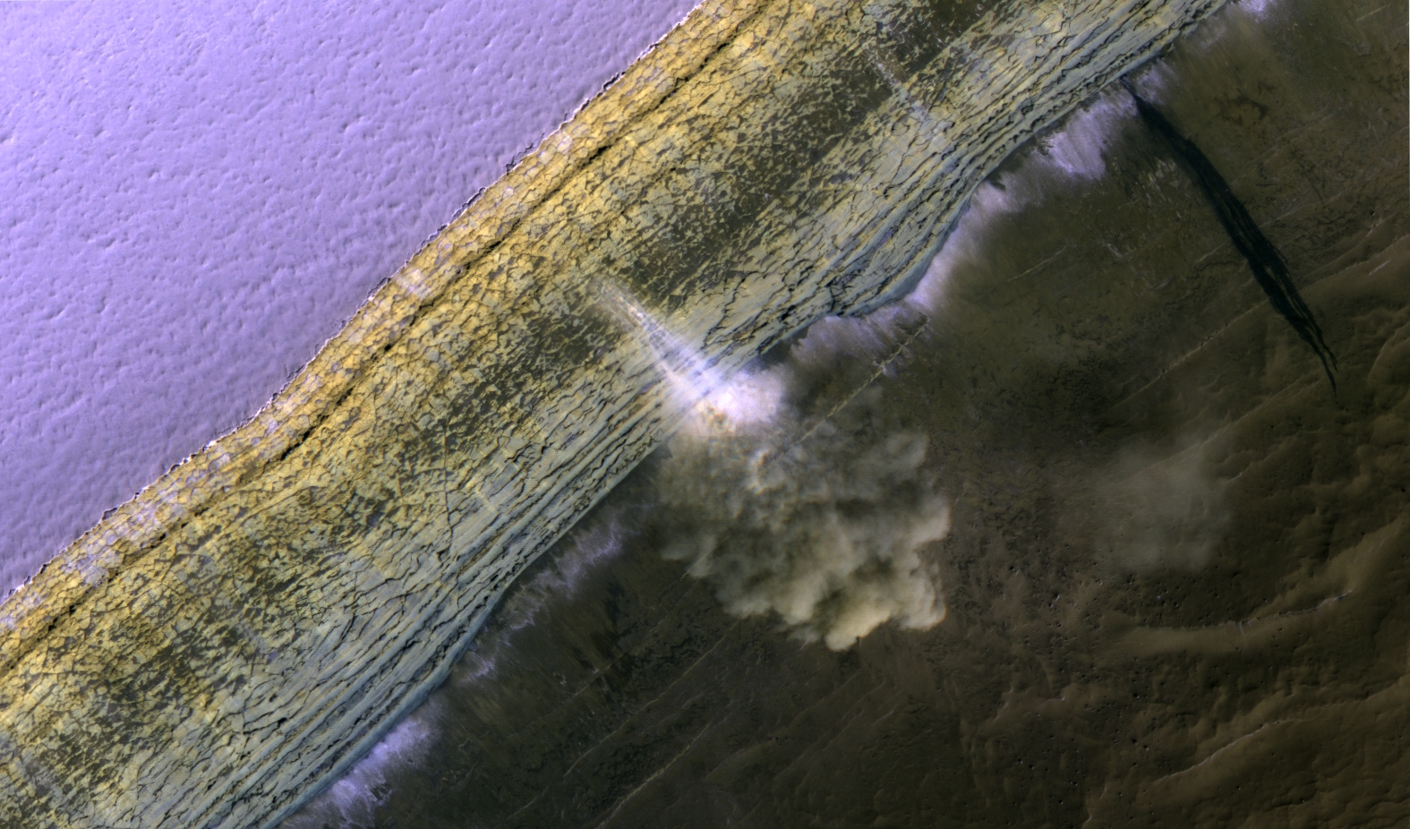
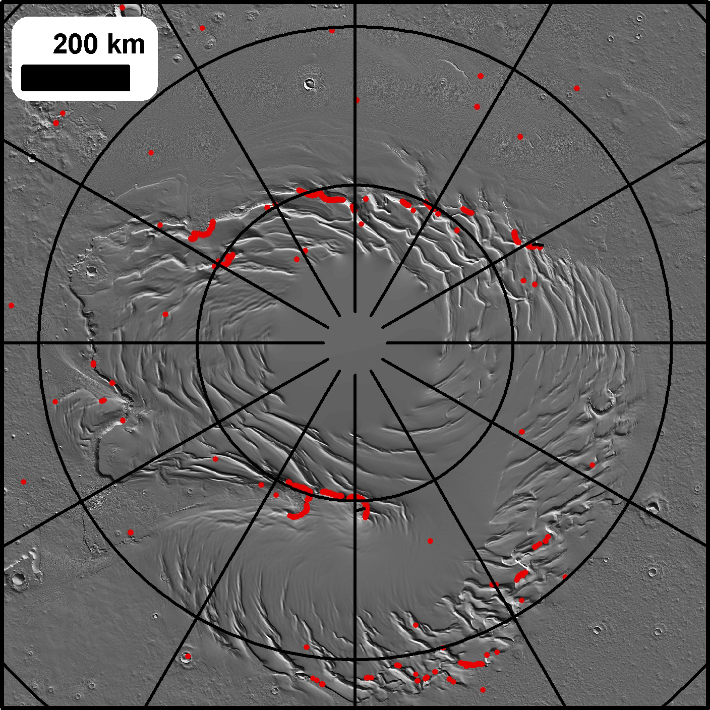
Steep Scarps at the NPLD routinely have an avalanche season from Ls ~0 to ~50.
This year, avalanche activity is much* reduced. EM6 followup next northern spring to figure this out.
*A formal search needs to be done and numbers normalized for image coverage, but “much reduced” will be ~100%
Locations of slopes above 35°
(at 115m/px scales)

Slide 16
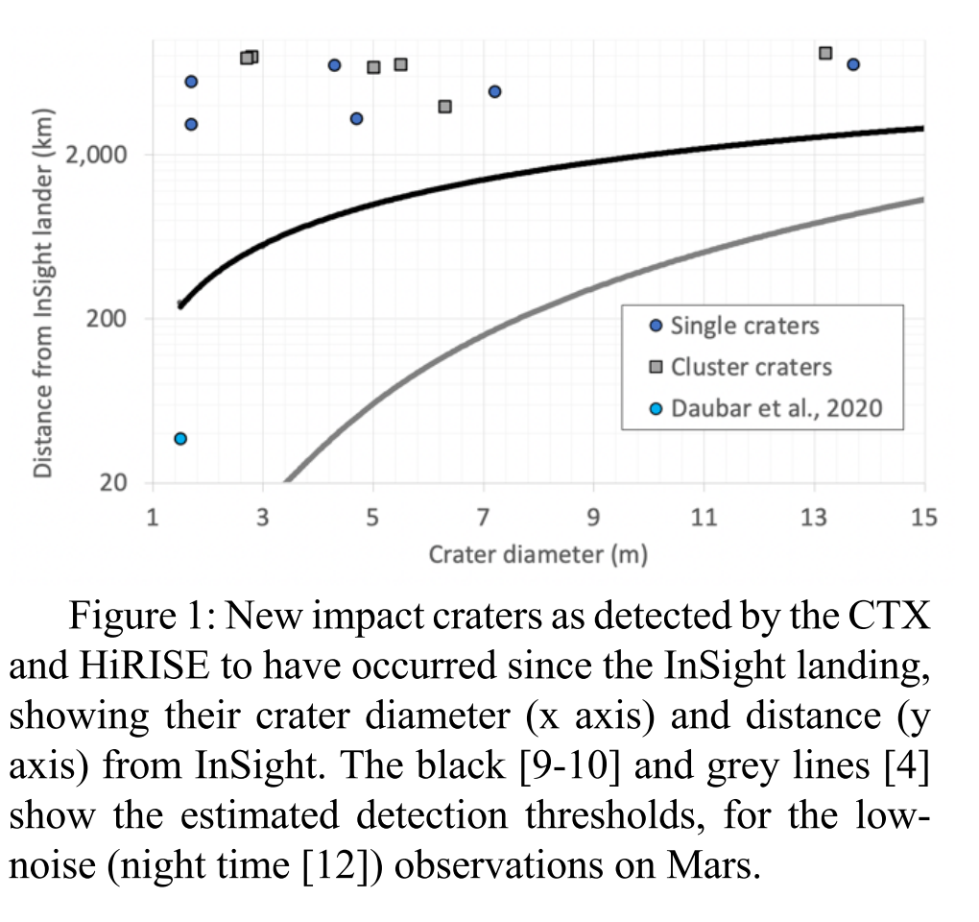
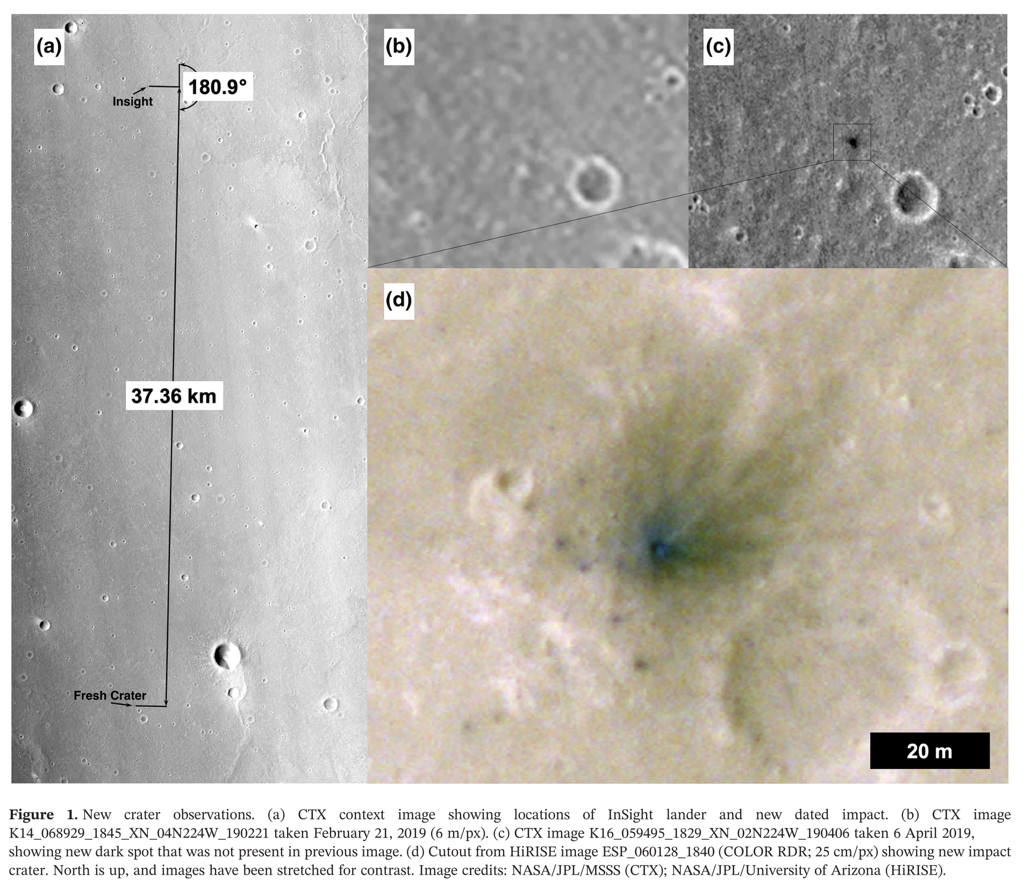
Investigation 10: Co-analysis with InSight: Compare new impacts, rockfalls, albedo changes with InSight data.
New impacts - CTX has detected ~20 impacts constrained to have occurred within the timeframe of the InSight mission and at various distances, but none have been definitively linked to a specific seismic event. Papers (bold) and abstracts:
Miljkovic, K., et. al (2021) New Impact Craters on Mars Since the Landing of the InSight Mission. LPSC 1758.
Daubar, I. J., P. et al (2020) A New Crater Near InSight: Implications for Seismic Impact Detectability on Mars. Journal of Geophysical Research (Planets) 125, e06382.
Insight

Slide 17
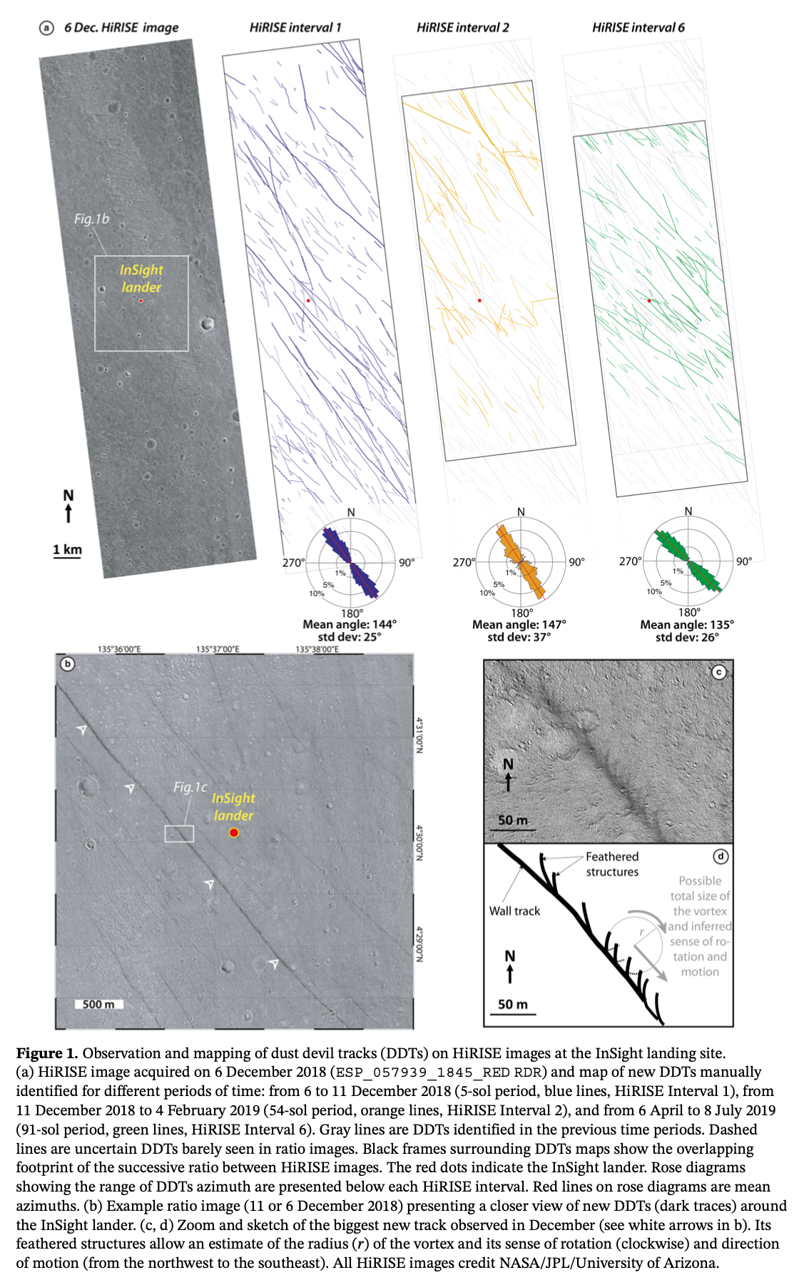
Investigation 10: Co-analysis with InSight: Compare new impacts, rockfalls, albedo changes with InSight data.
Albedo changes – Work ongoing on blast zone albedo changes. Work performed on dust devils, using HiRISE to map and monitor dust devil tracks. There has also been work on the soil properties of the landing site using HiRISE, with overlap with the below. Papers and abstracts:
Charalambous et al. (2021) Vortex-Dominated Aeolian Activity at InSight's Landing Site, Part 1: Multi-Instrument Observations, Analysis, and Implications. Journal of Geophysical Research (Planets) 126, e06757. DOI:10.1029/2020JE006757
Losen, et al. (2020) One Martian Year of Dust Devil Tracks Around the InSight Landing Site, Mars: analysis of HiRISE images and Comparison with in-situ Atmospheric Data.. AGU Fall Meeting Abstracts 2020, EP023-08.
Perrin, et al. (2020) Monitoring of Dust Devil Tracks Around the InSight Landing Site, Mars, and Comparison With In Situ Atmospheric Data. Geophysical Research Letters 47, e87234. DOI:10.1029/2020GL087234
Charalambous, et al. (2020) Aeolian Changes at the Insight Landing Site on Mars: Multi-instrument Observations. EGU General Assembly Conference Abstracts 12178.
Charalambous, et al. (2020) Aeolian Changes at the InSight Landing Site: Multi Instrument Observations. Lunar and Planetary Science Conference 2194.
Piqueux, et al. (2020) Regolith Properties Near the InSight Lander Derived from 100 Sols of Radiometer Measurements. Lunar and Planetary Science Conference 1309. (paper almost accepted)
Rodriguez, et al. (2019) Dust devils' signature around the InSight landing site (Mars): analysis of HiRISE satellite images and SEIS seismic data. AGU Fall Meeting Abstracts 2019, DI51A-0008.
Rodriguez, et al. (2019) Searching for geological surface changes around the InSight landing site (Mars) from HiRISE satellite images.. EGU General Assembly Conference Abstracts 10206.
Perrin, et al. (2019) Searching for Geological Surface Changes Around the InSight Landing Site (Mars) from HiRISE Satellite Images. Lunar and Planetary Science Conference 2390.
Insight

Slide 18
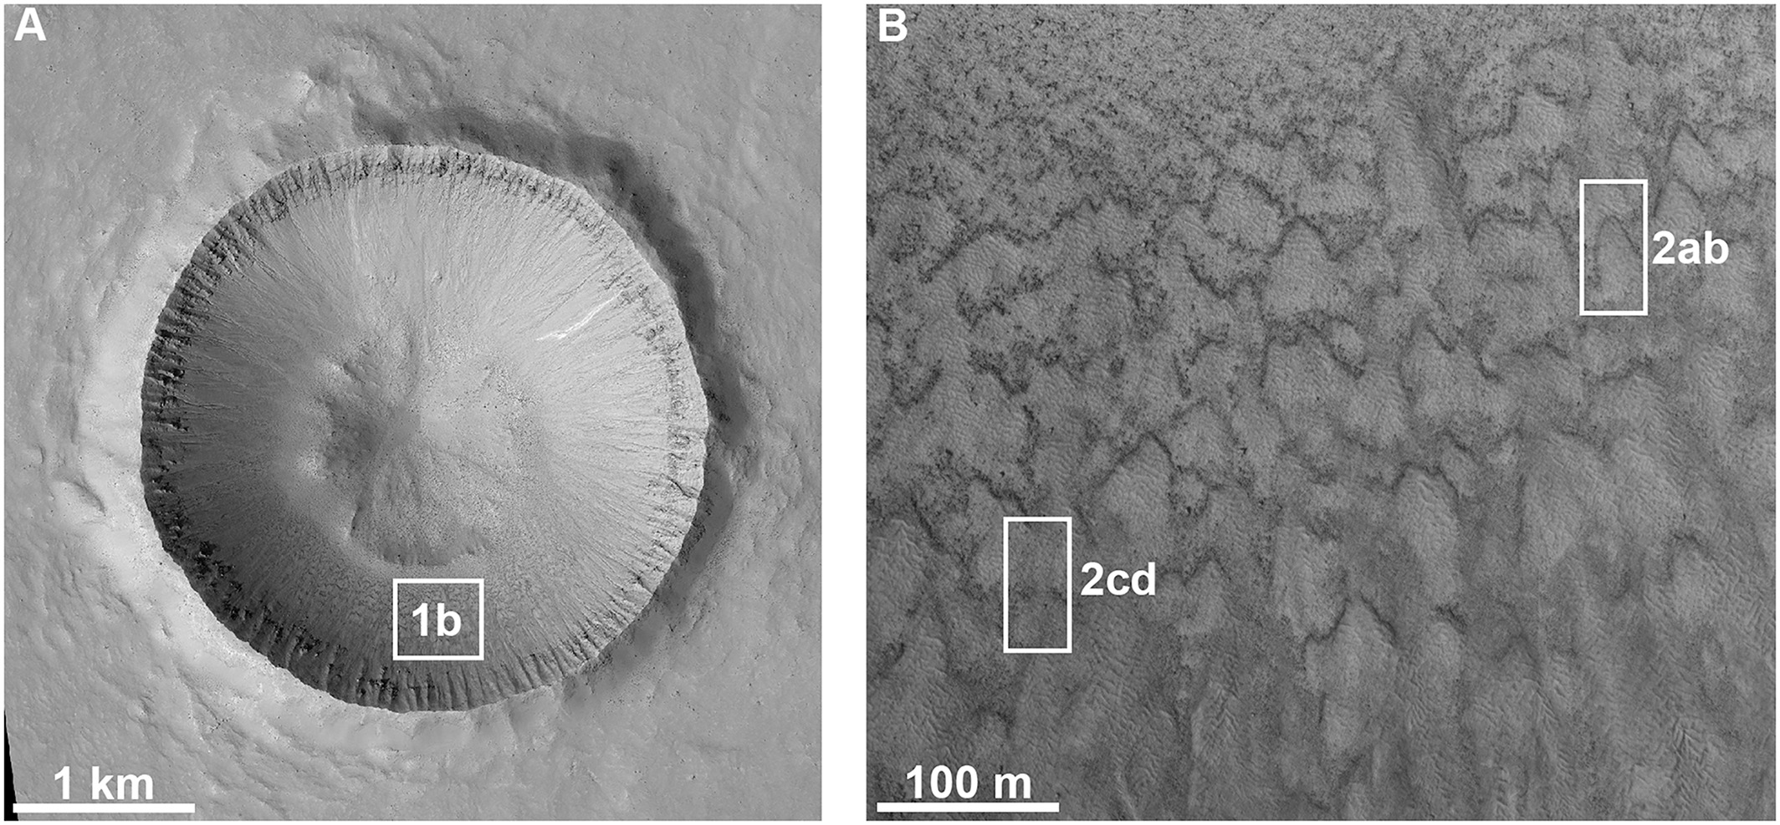
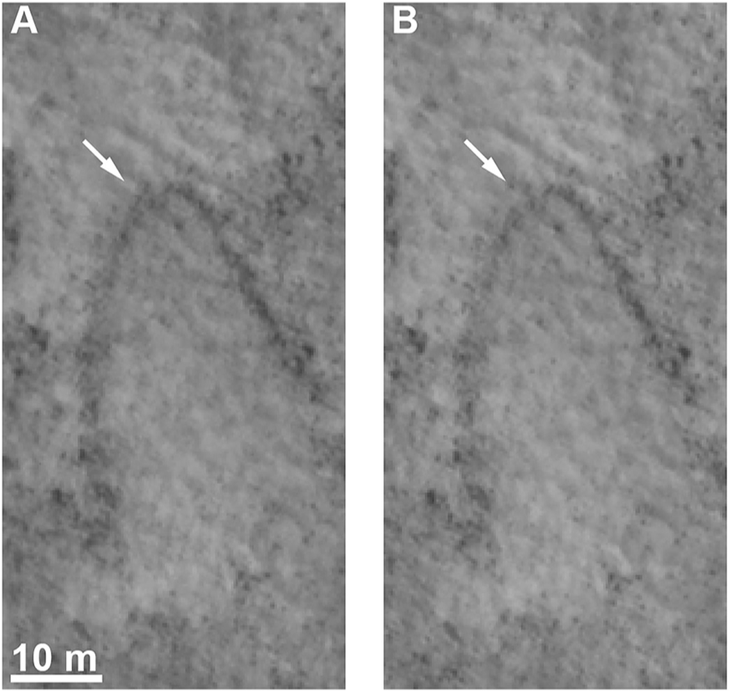
Investigation 11: Test Hypotheses about Active Aeolian and Glacial/Periglacial Processes: Dust deposition and removal, dune changes, current erosion rates, search for glacial and periglacial changes.
Glacial/Periglacial Processes
Predicted deformation rates could be detectable under favorable conditions
e.g. 1-10 cm/yr , so beginning to become detectable in a ~10 yr baseline
No claims of flow detection to date
Many (>200) EM5 papers/abstracts looking at glacial features with HiRISE
Some very minor changes reported by Dundas et al. 2019 in features thought to be solifluction lobes. See also Gastineau et al. 2020 for terrestrial comparison.
A lot of EM5 data are still being acquired and still need careful analysis
Chances of success increase with time and tie into the MIM mission.
Gastineau et al. 2020. Small-scale lobate hillslope features on Mars: A comparative 3D morphological study with terrestrial solifluction lobes and zebra stripe lobes. Icarus 342.
Dundas et al. 2019. Active Boulder Movement at High Martian Latitudes. Geophys. Res. Lett., 46, 5075-5082.

Slide 19
Investigation 11: Test Hypotheses about Active Aeolian and Glacial/Periglacial Processes: Dust deposition and removal, dune changes, current erosion rates, search for glacial and periglacial changes.
Aeolian Processes
“The longer baseline of observations from EM5 will enable measurement of slower or less frequent changes over extended regions.”
Global analysis showed average dune migration rates converge around 0.5 m/yr (σ ±0.4 m/yr), dune crest fluxes average to 7.8 ± 6.4 (1σ) m3 m-1 yr-1, and the highest flux for an individual dune is 35 m3 m-1 yr-1 (Chojnacki et al., 2019). The highest sand fluxes are concentrated in three regions: Syrtis Major, Hellespontus Montes, and the North polar erg (Chojnacki et al., 2019). These regions are located near prominent transition zones of topography (e.g., basins, polar caps) and thermophysical properties (e.g., albedo variations).
Once thought to be static and relics of past climates, Silvestro et al. (2020) used long-baseline (4–5 Mars years) HiRISE orthoimage pairs to show bright-toned bedforms termed megaripples or small Transverse Aeolian Ridges are still active today. Using longer baseline HiRISE pairs (up to 7 Mars years) it was found megaripples located within the north polar erg are migrating at even higher rates despite the limited seasonality for aeolian transport due to the restrictive seasonal polar ice (Chojnacki et al., 2021).
Davis et al. (2020b) utilized repeat MRO Context Camera images to estimate sand dune migration and flux rates in new areas not covered by HiRISE. The use of CTX in monitoring dune migration has advantages (wider spatial coverage, faster processing time) and disadvantages (ripples not resolved, digital elevation model dune heights may be underestimates); the future combined use of HiRISE and CTX is likely to be beneﬁcial.
“Testing hypotheses for current erosion rates … by additional HiRISE monitoring … and through coordinated studies with Curiosity, InSight...”
EM5 investigations exploiting HiRISE to estimate erosion rates by sand abrasion have been limited. One exception was Williams et al. (2020) that tested the hypothesis that retreating scarps on Mars may prefer orientations that reflect the direction of erosive winds. That study found no statistically significant correlation between estimated wind direction and scarp orientation.
An analysis of Elysium Planitia wind streak orientations and wind speeds during the early portions of the InSight mission found limited correlation (Day and Rebolledo, 2019). The authors suggested limited and intermit sediment transport capacity during that season was the cause for the lack of correlation.
Other relevant studies published in during EM5 (FY20-21) include: (Roback et al., 2019; Siminovich et al., 2019; Foroutan et al., 2019; Day and Dorn, 2019; Duran Vinent et al., 2019; Safi et al., 2019; Fenton et al., 2019; Zimbelman, 2019; Day and Rebolledo, 2019; Williams et al., 2020; Cardinale et al., 2020; Davis et al., 2020b, 2020a; Foroutan and Zimbelman, 2020; Boazman et al., 2021; Lapôtre et al., 2021)

Slide 20
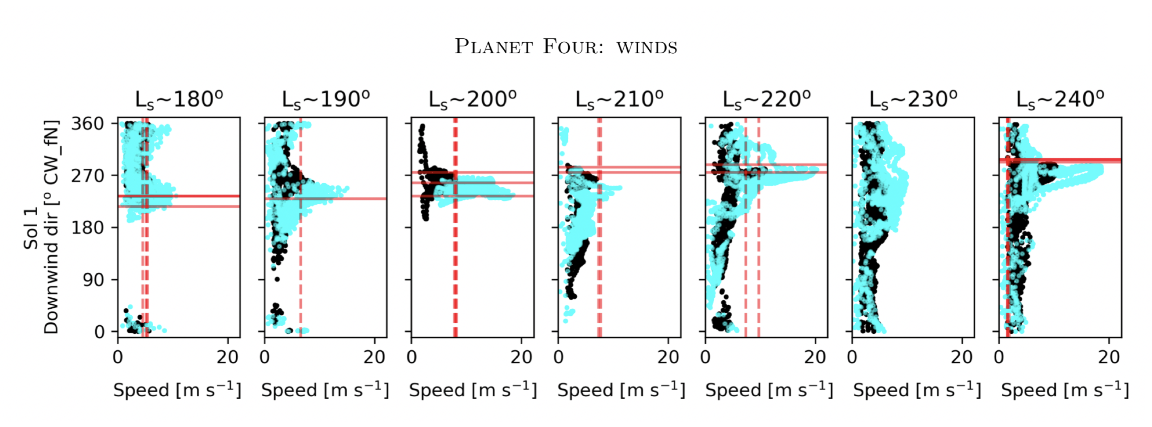
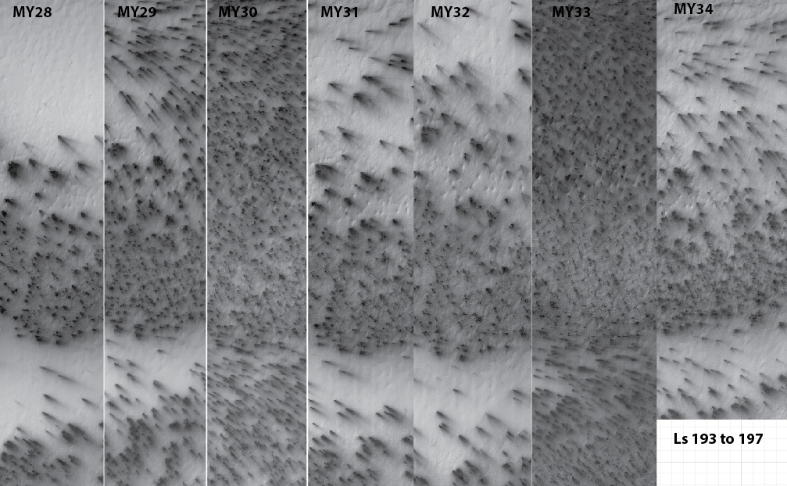
Investigation 12: Define the Martian Climate and Evaluate Weather in a New Mars Year
Compare seasonal fan data to MRAMS regional circulation model to assess model predictions (the Planet Four (P4) citizen science task that has given us a catalog of seasonal fans at each Mars Year for 27 Regions of Interest)
  Paper accepted for publication: Ganna Portyankina, Timothy I. Michaels, Klaus-Michael Aye, Megan E. Schwamb, Candice J. Hansen, and Chris J. Lintott, "Planet Four: Derived South Polar Martian Winds Interpreted Using Mesoscale Modeling"
Evaluate interannual variability of seasonal activity compared to regional and global dust storms
  LPSC abstract, Hansen et al., 2019
  Also uses P4 fan catalog to quantify differences
  Paper in progress
  Derived spatially and temporarily resolved near-surface wind characteristics from HiRISE images
  Multiyear spring wind direction and speed in the polar regions
  Comparison to mesoscale atmospheric model MRAMS shows the fits are - surprisingly - good, considering that polar regions are the toughest for atmospheric models
Seasonal fans show differences in activity in “Manhattan” for 7 Mars years

Slide 21
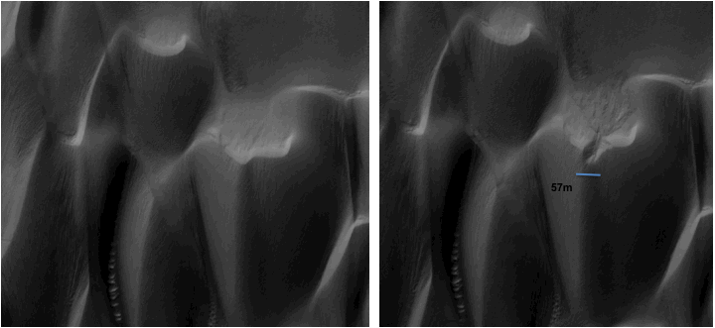
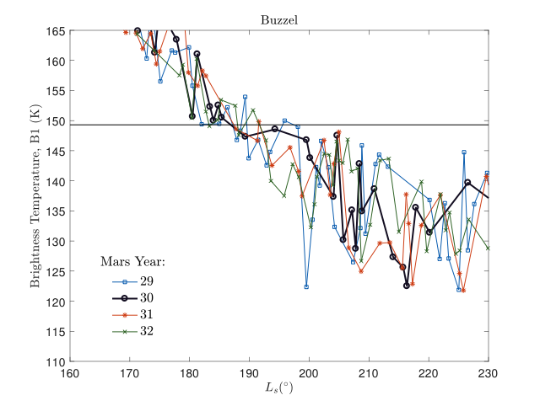
Investigation 14: Understand CO₂ Ice, Frost, and Snow Trends
HiRISE images of dunes in the north polar erg are compared to MCS data to look for the connection between frost onset, regional snowstorms, and new alcove formation
  6 additional imaging sites added to original four
  Images have been taken
  Data needs to be analyzed
MCS Brightness Temps.

Slide 22
Unused

Slide 23
Matt’s Eolian references
Boazman, S., Davis, J., and Grindrod, P., 2021, CTX DEM and Shapefiles - Coprates Chasma Dunes:, doi:10.6084/M9.FIGSHARE.C.5198183.V3.
Cardinale, M., Pozzobon, R., Tangari, A.C., Runyon, K., Di Primio, M., and Marinangeli, L., 2020, Reconstruction of the sand transport pathways and provenance in Moreux crater, Mars: Planetary and Space Science, v. 181, p. 104788, doi:10.1016/j.pss.2019.104788.
Chojnacki, M., Banks, M.E., Fenton, L.K., and Urso, A.C., 2019, Boundary condition controls on the high-sand-flux regions of Mars: Geology, doi:10.1130/G45793.1.
Chojnacki, M., Vaz, D.A., Silvestro, S., and Silva, D.C.A., 2021, Global Heterogeneity of Martian Megaripples and Transverse Aeolian Ridges: Distribution and Activity, in 52nd Lunar and Planetary Science Conference, Houston, Lunar and Planetary Institute, p. Abstract #2524, http://www.lpi.usra.edu/meetings/lpsc2021/pdf/2524.pdf.
Davis, J.M., Banham, S.G., Grindrod, P.M., Boazman, S.J., Balme, M.R., and Bristow, C.S., 2020a, Morphology, Development, and Sediment Dynamics of Elongating Linear Dunes on Mars: Geophysical Research Letters, doi:10.1029/2020GL088456.
Davis, J.M., Grindrod, P.M., Boazman, S.J., Vermeesch, P., and Baird, T., 2020b, Quantified Aeolian Dune Changes on Mars Derived From Repeat Context Camera Images: Earth and Space Science, v. 7, doi:10.1029/2019EA000874.
Day, M., and Dorn, T., 2019, Wind in Jezero Crater, Mars: Geophysical Research Letters, v. 46, p. 3099–3107, doi:10.1029/2019GL082218.
Day, M., and Rebolledo, L., 2019, Intermittency in Wind‐Driven Surface Alteration on Mars Interpreted From Wind Streaks and Measurements by InSight: Geophysical Research Letters, v. 46, p. 12747–12755, doi:10.1029/2019GL085178.
Duran Vinent, O., Andreotti, B., Claudin, P., and Winter, C., 2019, A unified model of ripples and dunes in water and planetary environments: Nature Geoscience, v. 12, p. 345–350, doi:10.1038/s41561-019-0336-4.
Fenton, L.K., Gullikson, A.L., Hayward, R.K., Charles, H., and Titus, T.N., 2019, The Mars Global Digital Dune Database (MGD3): Global patterns of mineral composition and bedform stability: Icarus, v. 330, p. 189–203, doi:10.1016/j.icarus.2019.04.025.
Foroutan, M., Steinmetz, G., Zimbelman, J.R., and Duguay, C.R., 2019, Megaripples at Wau-an-Namus, Libya: A new analog for similar features on Mars: Icarus, v. 319, p. 840–851, doi:10.1016/j.icarus.2018.10.021.
Foroutan, M., and Zimbelman, J.R., 2020, Evaluation of large data sets for Transverse Aeolian Ridges (TARs) on Earth and Mars: Planetary and Space Science, v. 189, p. 104966, doi:10.1016/j.pss.2020.104966.
Lapôtre, M.G.A., Ewing, R.C., and Lamb, M.P., 2021, An Evolving Understanding of Enigmatic Large Ripples on Mars: Journal of Geophysical Research: Planets, v. 126, doi:10.1029/2020JE006729.
Roback, K.P., Runyon, K.D., Avouac, J.P., Newman, C.E., and Ayoub, F., 2019, Understanding Ripple and Whole-Dune Motion at Active Martian Dune Fields, in 50th Lunar and Planetary Science Conference, Houston, Lunar and Planetary Institute, p. Abstract #3169, http://www.lpi.usra.edu/meetings/lpsc2019/pdf/3169.pdf.
Safi, E. et al., 2019, Aeolian abrasion of rocks as a mechanism to produce methane in the Martian atmosphere: Scientific Reports, v. 9, p. 8229, doi:10.1038/s41598-019-44616-2.
Silvestro, S., Chojnacki, M., Vaz, D.A., Cardinale, M., Yizhaq, H., and Esposito, F., 2020, Megaripple Migration on Mars: Journal of Geophysical Research: Planets, doi:10.1029/2020JE006446.
Siminovich, A., Elperin, T., Katra, I., Kok, J.F., Sullivan, R., Silvestro, S., and Yizhaq, H., 2019, Numerical Study of Shear Stress Distribution Over Sand Ripples Under Terrestrial and Martian Conditions: Journal of Geophysical Research: Planets, v. 124, p. 175–185, doi:10.1029/2018JE005701.
Williams, J., Day, M., Chojnacki, M., and Rice, M., 2020, Scarp orientation in regions of active aeolian erosion on Mars: Icarus, v. 335, p. 113384, doi:10.1016/j.icarus.2019.07.018.
Zimbelman, J.R., 2019, The transition between sand ripples and megaripples on Mars: Icarus, v. 333, p. 127–129, doi:10.1016/j.icarus.2019.05.017.

Slide 24
Ingrid’s ref list of InSight site analysis with MRO
Golombek, M., N. Williams, N. H. Warner, T. Parker, M. G. Williams, I. Daubar, F. Calef, J. Grant, P. Bailey, H. Abarca, R. Deen, N. Ruoff, J. Maki, A. McEwen, N. Baugh, K. Block, L. Tamppari, J. Call, J. Ladewig, A. Stoltz, W. A. Weems, L. Mora-Sotomayor, J. Torres, M. Johnson, T. Kennedy, and E. Sklyanskiy (2020) Location and Setting of the Mars InSight Lander, Instruments, and Landing Site. Earth and Space Science 7, e01248. DOI:10.1029/2020EA001248
Golombek, M., D. Kass, N. Williams, N. Warner, I. Daubar, S. Piqueux, C. Charalambous, and W. T. Pike (2020) Assessment of InSight Landing Site Predictions. Journal of Geophysical Research (Planets) 125, e06502. DOI:10.1029/2020JE006502
Golombek, M., N. Warner, J. Grant, C. Weitz, and N. Williams (2021) Comparison of Degradation Rates at the InSight and Spirit Landing Sites on Mars. Lunar and Planetary Science Conference 1563.
Weitz, C. M., J. A. Grant, M. P. Golombek, N. H. Warner, E. Hauber, V. Ansan, S. A. Wilson, C. Charalambous, N. Williams, F. Calef, W. T. Pike, H. Lethcoe-Wilson, J. Maki, A. DeMott, and M. Kopp (2020) Comparison of InSight Homestead Hollow to Hollows at the Spirit Landing Site. Journal of Geophysical Research (Planets) 125, e06435. DOI:10.1029/2020JE006435
Grant, J. A., N. H. Warner, C. M. Weitz, M. P. Golombek, S. A. Wilson, M. Baker, E. Hauber, V. Ansan, C. Charalambous, N. Williams, F. Calef, W. T. Pike, A. DeMott, M. Kopp, H. Lethcoe, and M. E. Banks (2020) Degradation of Homestead Hollow at the InSight Landing Site Based on the Distribution and Properties of Local Deposits. Journal of Geophysical Research (Planets) 125, e06350. DOI:10.1029/2019JE006350
Warner, N. Â. H., J. Â. A. Grant, S. Â. A. Wilson, M. Â. P. Golombek, A. DeMott, C. Charalambous, E. Hauber, V. Ansan, C. Weitz, T. Pike, N. Williams, M. Â. E. Banks, F. Calef, M. Baker, M. Kopp, M. Deahn, H. Lethcoe, and L. Berger (2020) An Impact Crater Origin for the InSight Landing Site at Homestead Hollow, Mars: Implications for Near Surface Stratigraphy, Surface Processes, and Erosion Rates. Journal of Geophysical Research (Planets) 125, e06333. DOI:10.1029/2019JE006333
Wilson, S. A., N. H. Warner, J. A. Grant, M. P. Golombek, and C. M. Weitz (2020) Comparison of the Crater Retention Ages at the InSight and Spirit Landing Sites. Lunar and Planetary Science Conference 2247.
Grant, J. A., N. H. Warner, C. M. Weitz, M. P. Golombek, S. A. Wilson, M. Baker, E. Hauber, V. Ansan, C. Charalambous, N. Williams, F. Calef, M. E. Banks, T. Pike, A. DeMott, M. Kopp, and H. Lethcoe-Wilson (2020) The Origin of Rocky Field at the InSight Landing Site in Homestead Hollow and Implications for the Timing of Degradation. Lunar and Planetary Science Conference 2166.
Warner, N. H., J. A. Grant, S. A. Wilson, M. P. Golombek, A. DeMott, E. Hauber, V. Ansan, C. Weitz, N. Williams, C. Charalambous, T. Pike, M. Banks, M. Baker, H. Lethcoe, L. Berger, M. Kopp, and M. Deahn (2020) An Impact Crater Origin for Homestead Hollow, the InSight Landing Site on Mars. Lunar and Planetary Science Conference 1536.
Golombek, M., N. H. Warner, J. A. Grant, E. Hauber, V. Ansan, C. M. Weitz, N. Williams, C. Charalambous, S. A. Wilson, A. DeMott, M. Kopp, H. Lethcoe-Wilson, L. Berger, R. Hausmann, E. Marteau, C. Vrettos, A. Trussell, W. Folkner, S. Le Maistre, N. Mueller, M. Grott, T. Spohn, S. Piqueux, E. Millour, F. Forget, I. Daubar, N. Murdoch, P. Lognonné, C. Perrin, S. Rodriguez, W. T. Pike, T. Parker, J. Maki, H. Abarca, R. Deen, J. Hall, P. Andres, N. Ruoff, F. Calef, S. Smrekar, M. M. Baker, M. Banks, A. Spiga, D. Banfield, J. Garvin, C. E. Newman, and W. B. Banerdt (2020) Geology of the InSight landing site on Mars. Nature Communications 11, 1014. DOI:10.1038/s41467-020-14679-1
Wilson, S. A., N. H. Warner, J. A. Grant, M. Golombek, C. M. Weitz, A. DeMott, M. Kopp, E. Hauber, V. Ansan, C. Charalambous, W. T. Pike, H. Lethcoe-Wilson, and R. Hausmann (2019) Crater Retention Ages at the InSight and Spirit Landing Sites. AGU Fall Meeting Abstracts 2019, DI51B-0030.
Weitz, C. M., J. A. Grant, N. H. Warner, M. P. Golombek, E. Hauber, V. Ansan, S. A. Wilson, C. Charalambous, N. R. Williams, F. J. Calef, W. T. Pike, H. Lethcoe-Wilson, J. Maki, A. DeMott, and M. Kopp (2019) Comparison of InSight Homestead hollow to Spirit Laguna hollow. AGU Fall Meeting Abstracts 2019, DI51B-0022.
Golombek, M. P., N. H. Warner, J. A. Grant, E. Hauber, V. Ansan, C. M. Weitz, N. R. Williams, C. Charalambous, S. A. Wilson, T. J. Parker, I. Daubar, E. Marteau, N. T. Mueller, S. Piqueux, W. T. Pike, A. DeMott, M. Kopp, H. Lethcoe-Wilson, L. Berger, R. Hausmann, M. Banks, M. M. Baker, and J. B. Garvin (2019) Geology of the InSight Landing Site, Mars. AGU Fall Meeting Abstracts 2019, DI42A-01.
Grant, J. A., N. H. Warner, C. M. Weitz, M. P. Golombek, S. A. Wilson, E. Hauber, V. Ansan, C. Charalambous, N. Williams, F. Calef, T. Pike, A. DeMott, M. Kopp, H. Lethcoe-Wilson, and M. Banks (2019) Modification of Homestead Hollow at the InSight Landing Site Based on the Distribution and Properties of Local Deposits. LPI Contributions 2089, 6207.
Golombek, M., N. H. Warner, J. Grant, E. Hauber, V. Ansan, C. Weitz, N. Williams, C. Charalambous, S. Wilson, T. Parker, I. Daubar, E. Marteau, N. Mueller, W. T. Pike, A. DeMott, M. Kopp, H. Lethcoe-Wilson, L. Berger, R. Hausmann, M. Banks, M. Baker, and J. Garvin (2019) Geology of the InSight Landing Site, Mars. LPI Contributions 2089, 6106.
Ansan, V., E. Hauber, M. Golombek, N. Warner, J. Grant, J. Maki, R. Deen, F. Calef, C. Weitz, J. Garvin, S. Wilson, N. Williams, C. Charalambous, T. Pike, H. Lethcoe, M. Kopp, A. De Moot, S. Smrekar, B. Banerdt, and R. Lorenz (2019) InSight Landing Site: Subsurface Stratigraphy and Implications for Formation Processes. LPI Contributions 2089, 6050.
Hauber, E., V. Ansan, M. Golombek, N. Warner, J. Grant, C. Weitz, F. Calef, N. Williams, S. Wilson, C. Charalambous, T. Pike, A. DeMott, M. Kopp, H. Lethcoe-Wilson, M. Banks, and J. Garvin (2019) Geology of the InSight Landing Site, Mars: Initial Observations. EGU General Assembly Conference Abstracts 7953.
Ansan, V., E. Hauber, M. Golombek, N. Warner, J. Grant, J. Maki, R. Deen, F. Calef, C. Weitz, J. Garvin, S. Wilson, N. Williams, C. Charalambous, T. Pike, H. Lethcoe, M. Kopp, A. De Mott, S. Smrekar, B. Banerdt, and R. Lorenz (2019) Insight landing site: stratigraphy of the regolith beneath the lander and in its surroundings, and implications for formation processes.. EGU General Assembly Conference Abstracts 4273.
Wilson, S. A., N. H. Warner, J. A. Grant, M. P. Golombek, A. DeMott, M. Kopp, L. Berger, C. M. Weitz, E. Hauber, V. Ansan, C. Charalambous, N. Williams, F. Calef, T. Pike, H. Lethcoe, and R. Hausmann (2019) Crater Retention Ages at the InSight Landing Site: Implications for the Degradation History of the Homestead Hollow. Lunar and Planetary Science Conference 2161.
Golombek, M., N. Williams, N. Warner, I. Daubar, and S. Piqueux (2019) Initial Assessment of InSight Landing Site Predictions. Lunar and Planetary Science Conference 1696.
Golombek, M., N. H. Warner, J. Grant, E. Hauber, V. Ansan, C. Weitz, N. Williams, C. Charalambous, S. Wilson, T. Parker, W. T. Pike, A. DeMott, M. Kopp, H. Lethcoe-Wilson, L. Berger, M. Banks, and J. Garvin (2019) Geology of the InSight Landing Site, Mars: Initial Observations. Lunar and Planetary Science Conference 1694.
Grant, J. A., N. H. Warner, C. M. Weitz, M. P. Golombek, S. A. Wilson, E. Hauber, V. Ansan, C. Charalambous, N. Williams, F. Calef, T. Pike, A. DeMott, M. Kopp, and H. Lethcoe (2019) Modification of Homestead Hollow at the InSight Landing Site Based on the Distribution and Properties of Local Deposits. Lunar and Planetary Science Conference 1199.
Warner, N. H., M. P. Golombek, N. Williams, R. Hausmann, A. DeMott, and M. Kopp (2019) Probing the Regolith at the InSight Landing Site Using Rocky Ejecta Craters. Lunar and Planetary Science Conference 1185.
Sweeney, J., N. H. Warner, V. Ganti, M. P. Golombek, M. P. Lamb, R. Fergason, and R. Kirk (2018) Degradation of 100-m-Scale Rocky Ejecta Craters at the InSight Landing Site on Mars and Implications for Surface Processes and Erosion Rates in the Hesperian and Amazonian. Journal of Geophysical Research (Planets) 123, 2732-2759. DOI:10.1029/2018JE005618
Williams, N. R., M. P. Golombek, I. J. Daubar, A. Huertas, M. R. Trautman, and R. B. Hausmann (2018) Rock Distributions Around Fresh Impact Craters at the InSight Landing Site in Elysium Planitia, Mars. Lunar and Planetary Science Conference 2819.
Pan, L. and C. Quantin (2018) Regional Geological Context of the InSight Landing Site from Mineralogy and Stratigraphy. Lunar and Planetary Science Conference 1918.
Warner, N. H., M. P. Golombek, J. Sweeney, R. Fergason, R. Kirk, and C. Schwartz (2017) Near Surface Stratigraphy and Regolith Production in Southwestern Elysium Planitia, Mars: Implications for Hesperian-Amazonian Terrains and the InSight Lander Mission. Space Science Reviews 211, 147-190. DOI:10.1007/s11214-017-0352-x

Slide 25

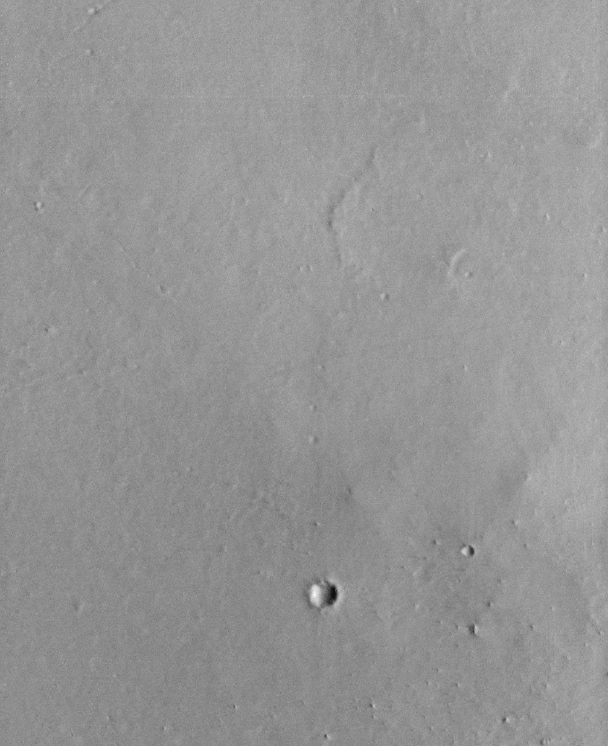
Improvement of Red1_1 (worst channel) at FPE 37 C (in 2019) is dramatic: 54_54 (left) vs. 74_74 (right).
However, the problem continues to worsen over time, and is an existential threat to HiRISE.
HiRISE ADC bit-flip and Cal Updates

Slide 26
RED1_1 History was alarming (2019)
Plotted are RED1_1 images with >0% but <5% LIS (significant bit flip) pixels, full 321 s warmup time, Bin1A mode.
Note increase in slope after orbit 57,000.
Ls=0.
Ls=0.

Slide 27
Increase in number of warmup and Mars images since about orbit 55,000
Hypothesis: degradation proportional to number of images acquired rather than to time.

Slide 28
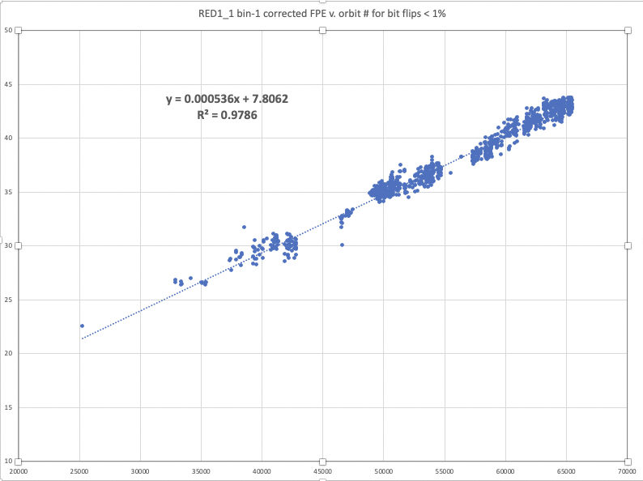
July 2021 analysis (ADC 54_54)
More data and correction for range to sun helps to remove wiggles in the slope, now very linear with orbit number.
Same plot vs. image number is slightly worse, so no evidence that degradation is a function of how many images we take (including warmup images)
For orbit 100,000 (in 2028), need to increase FPE T by 19 deg., to 61 deg.
Compare to IR10_1 with slope of 0.0002 deg. C/orbit

Slide 29
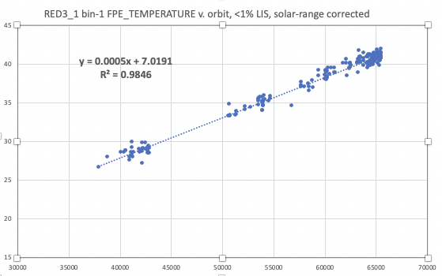
RED3_1 is very similar to RED1_1

Slide 30
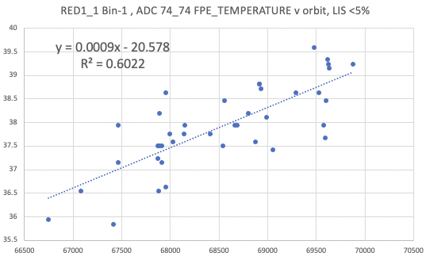
Degradation rate with ADC 74_74 is similar to that in 54_54 (but reset to ~4 C cooler)
New ADC settings probably do not change degradation rate, but can reset to lower FPE-T, to buy more time

Slide 31
Why would degradation be linearly proportional to time in orbit?
Total radiation dose increase?
  But IR10_1 showed problems right after launch when total dose was near zero
Ionic contamination effects somehow linear with time rather than FPS-on time?
Correlation ≠ Causation
No evidence from bit-flip trends that stand-down cycles would help prolong the lifetime of HiRISE
  But temperature cycles are still bad for electronics, especially higher temperatures
  Stand-down cycles is still a way to manage the shrinking funding, and might prolong lifetime of HiRISE

Slide 32
Major Result from June 2020 Tests
ADC setting of ch0 has major impact on bit flips of ch1, and vice-versus
Need to always think in terms of settings for both channels:
  54_54 rather than just “54”
  We now have a large 2D matric of possible ADC settings to consider: 44² = 1936 combinations!

Slide 33
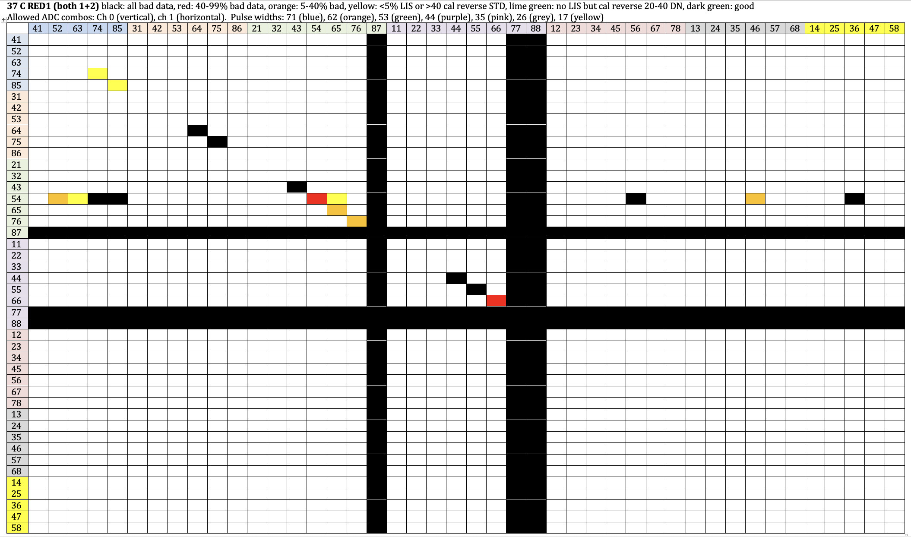
Pre-2021 matrix for RED1
Black rows and columns: ADC settings in which the offset saturates the calibration data. Really only 41² = 1681 combinations to test

Slide 34
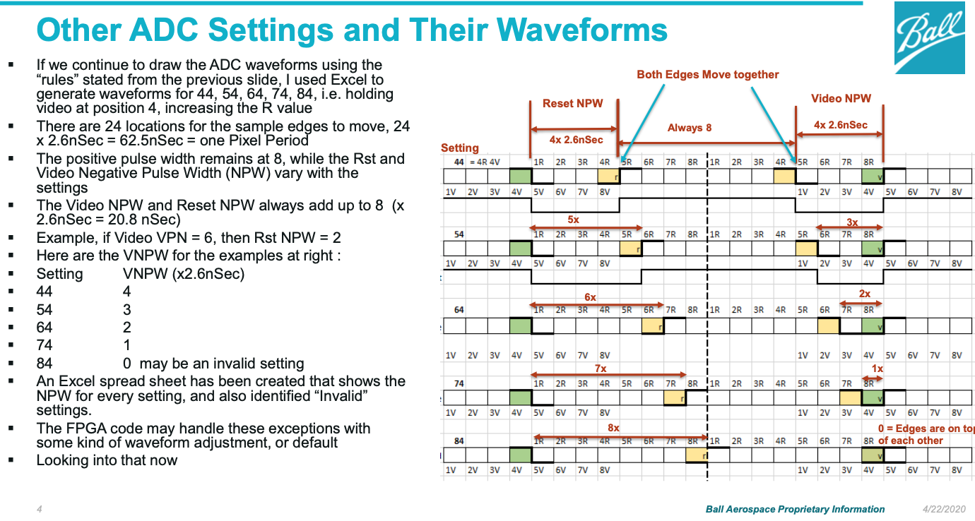
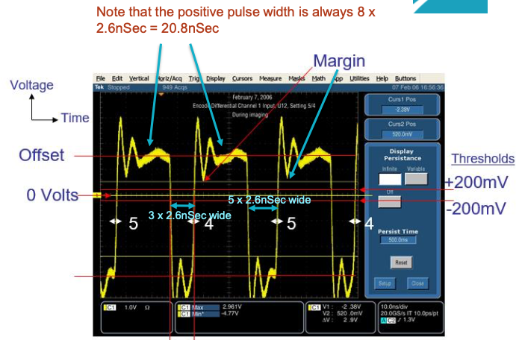
Use of VPW = 1 (and RPW = 7) somehow samples the ringing waveform is a way to avoids bit flips in ch 1

Slide 35
New ADC test images 7/28-8/8/21
43 images planned, 2 lost, 82 ADC settings tested
  CCDs split to test 2 ADC settings per image:
    setting1: CCDs 0, 1, 4, 6, 8, 10, 12
    setting2: CCDs 2, 3, 5, 7, 11, 13
2 lost images testing 44_44, 55_55, 66_66, 12_12
  All had been tested previously except 12_12
FPE temperature ranges from 35-41 C, not carefully controlled
Goal is just to eliminate obviously bad settings and find a small set of settings worth more detailed study
  Also, hope to see patterns that help guide future tests
Results are grouped by sets of CCDs that behave similarly to each other:
  RED0-1-2-3
  RED 4-5-6 and IR11
  RED7-8
  BG12-13
  IR10 (undersampled in split-CCD test)

Slide 36
Results:
Elimination of whole rows and columns
Offsets produce negative cal pixel values:
  Add 67, 68, and 78 to 87, 77, and 88
  No further testing needed on these rows and columns
Pulse width 17 produces badly bit-flipped images in all channels:
  14, 25, 36, 47, 58
  No further testing needed on these rows and columns
  Tom Ebben theory: reset pulse width narrower than expected, so “1” is really less than 1 and “7” is wider. This is why 71 is good (which was surprising) but 17 is bad.

Slide 37

Pre-2021 matrix for RED1 (x = candidate planned test)

Slide 38
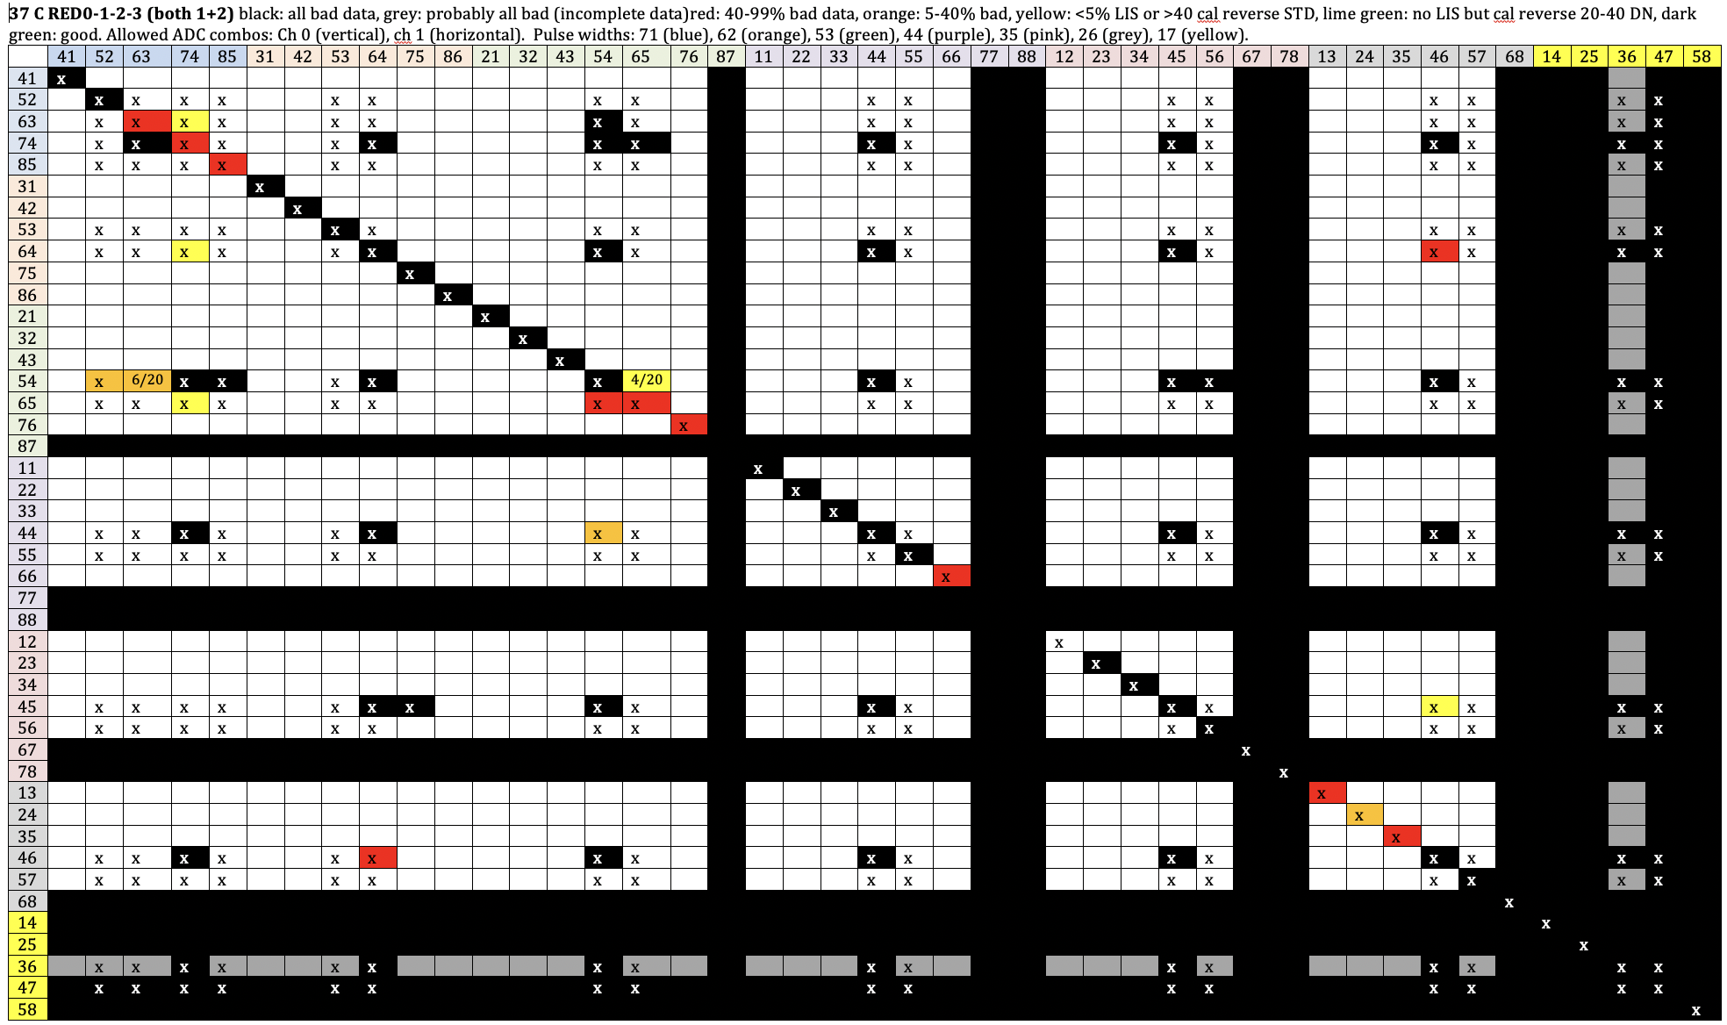
2021 matrix for RED0-1-2-3 (very close to that for just RED1). There are 5 known yellow settings that appear better than 74_74, and 4 orange settings that may be slightly better. No green settings. Note that 74_74 and 85_85 are now red at ~37 C.

Slide 39
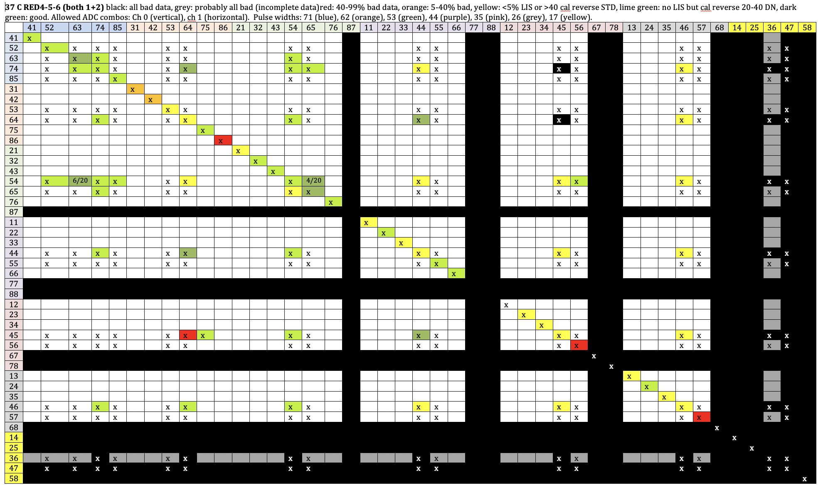
RED 4-5-6 and IR11 (8 dark green settings known)

Slide 40
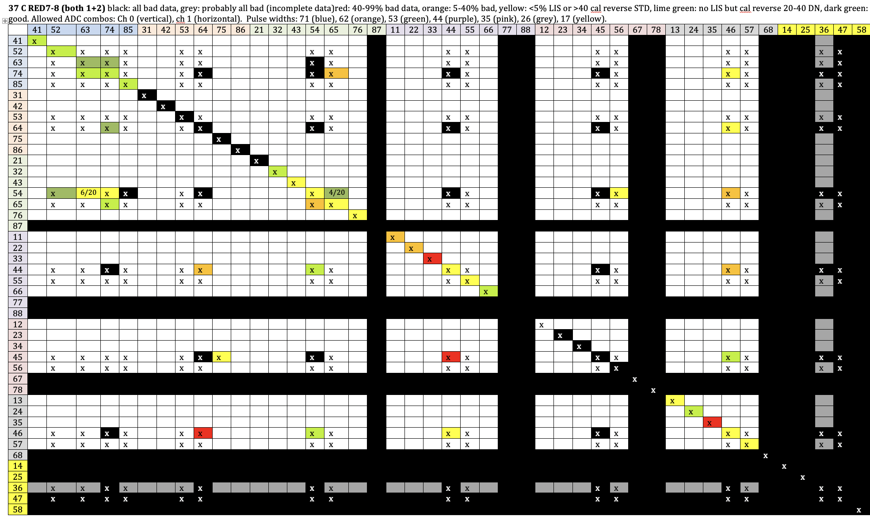
RED 7-8 (5 dark green settings known)

Slide 41
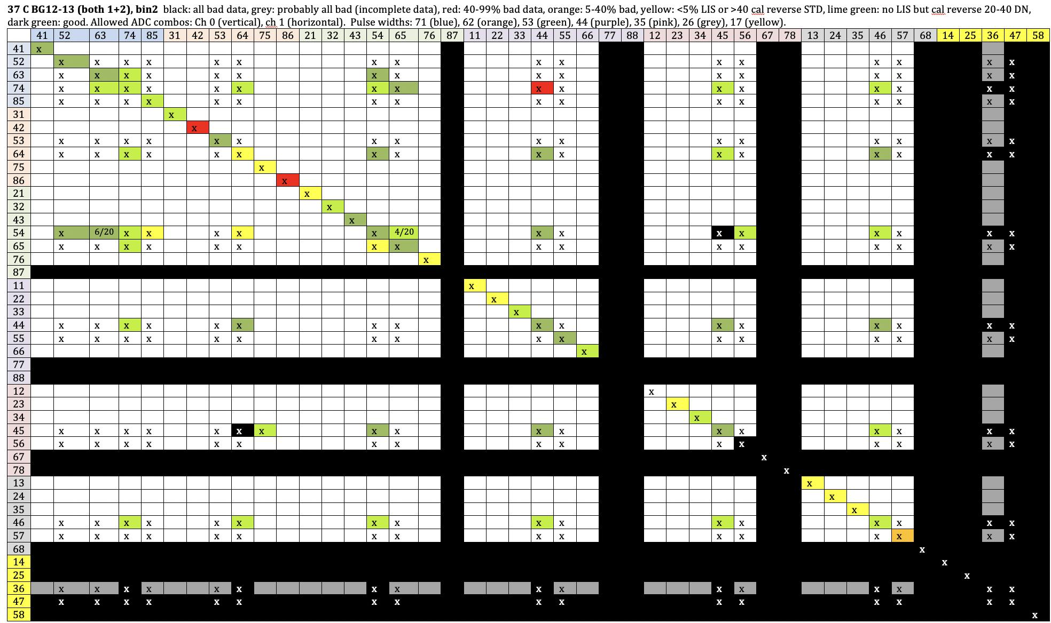
BG12-13 (23 dark green settings, including 54_54)

Slide 42
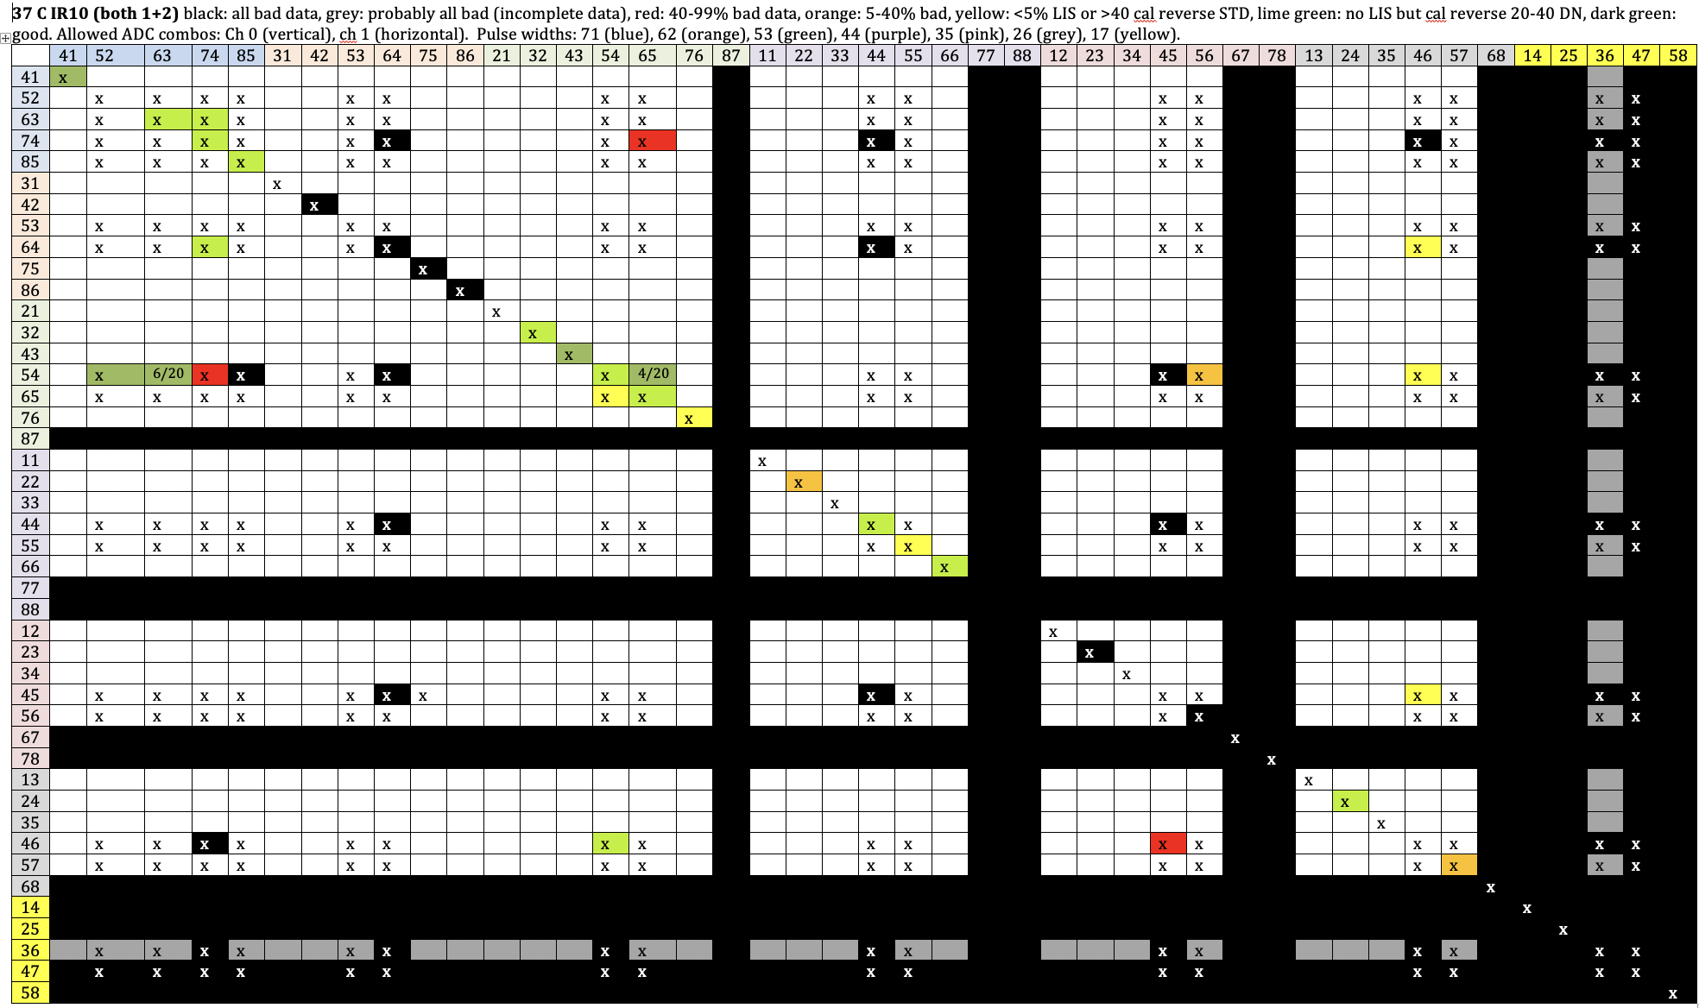
IR10 (Sparse coverage as there is no good “analog” CCD to use, but 5 dark green settings known)

Slide 43

Summary of settings that are relatively good in one of the CCD sets (in yellow), and preliminary prioritized settings for future testing
Favor columns (ch 1) 74, 65, 46, 2nd priority 52, 63, 54, 24
Favor rows (ch 0) with lowest electronic noise (not 74)
Favor settings near relatively good prior results

Slide 44
Summary of 2021 ADC tests
Results are encouraging: better ADC settings exist for all problematic CCDs
  No dramatic improvements, but the matrix is still very sparsely sampled
Eliminated some settings entirely
  Only 33 x 33 = 1089 viable settings left
    Tested 73 of these, 1016 more to go
We need a lot more ADC testing
  MCR for new commanding procedure

Slide 45
Future Plans
Now: developing HiRISE commanding software and procedures to change ADC settings without MCR process
  MCR approval needed before use in flight? In early 2022?
Plan new tests
  About 3 months needed for 1st-order tests of 1000 settings
  Another ~3 months for temperature-controlled tests on most promising candidates
    Need nadir-only orbits, so MCR needed
It will be at least 1 year before we have new ADC settings for routine Mars imaging
  Too much worsening expected over next year at current FPE temperatures
  We prefer not to raise the temperature
  Interim solution: In ~6 months we will ban Bin1 mode until new ADC settings are in place
    Only RED4-5-6 can be used in bin-1 (Bin1-2 mode). Bad for stereo and landing sites
New ADC settings should allow full-res imaging for at least another 2 years. Banning Bin-1 except for RED4-5-6 could keep us going another 2 years.
After ~2025 the choices may get more difficult, unless we can better understand and mitigate this problem

Slide 46
Discussion
We are doing empirical ADC tests to find what works best
Ideally, actual engineers would help us to really understand what is happening and find the best mitigation.
  New idea from last week’s telecon with Ball: supply line power from aging of decoupling caps
    Need advice from an expert
  Need lab experiments
Ball engineers like Tom Ebben are helping a little on their own time.
  No funding available for greater Ball support, because HiRISE is a low priority to the MEP. Or is it?

Slide 47
HiRISE Calibration Update
HiCal group
9/20/2021

Slide 48
Calibration Issues
Low-temperature and some “nominal temperature” data acquisition can be impacted by bit-flip noise and excessive low-instrument saturation (LIS) pixels in calibration areas.
Lookup table changes required after change in ADC settings
Operation of FPA at 37°C increases dark current
Dark current tables based on 21°C
  Need 37°C correction that includes variations across image
Gains different at 37°C than 21°C
  Need updated gains
Coherent noise higher with some ADC settings
  FFT filtering helps some channels

Slide 49

Bit-flip remediation
Prior calibration
New bit-flip fix
Difference
New algorithm examines each image histogram and attempts to discern the DN range that contains “real” DN values, and then excludes the outliers. Improves many images, and makes some that were previously unusable, suitable for analysis.

Slide 50
LIS pixels in calibration areas
HiRISE depends on pixel values in non-image “calibration” areas of each returned data product.
When the instrument is too cold, or the LUT table is not right, these pixels can be returned to the ground as low-instrument saturation (LIS) values.
The existing calibration routines are robust to some number of LIS pixels, but not excessive amounts (which we’ve seen recently), with the result typically being large vertical brightness variations in observation mosaics
We’ve developed a new algorithm to derive the missing values from existing “good” pixels in the calibration areas and if there aren’t enough of those, will fall back to a more generic model.

Slide 51
HiCal Actions
Bit-flip and LIS-fix corrections are about to be deployed
LUT tables updated to minimize the return of LIS pixels
HiCal modifications for high temperature in progress
  Dark current modeled for higher temperatures
  Correction implemented in ISIS, not tested yet

Slide 52
Reprocessing
Ideally, we should reprocess entire HiRISE dataset with new calibration (and other fixes)
  Recover many IR10_1 channels that were not processed
  New ADC settings in future will need new cal updates, but that will not affect older images
Most efficient to do this while creating PDS-4 products
No funding to actually do either reprocessing or PDS-4 conversion for full dataset, but we should plan to do these together, eventually

Slide 53
Destination Mars: Understanding the Red Planet for Future Exploration
1. Ancient Mars surface and atmosphere
fluvial morphologies and layered sedimentary deposits, implications for ancient atmosphere
SHARAD subsurface layering; quantify volumes
context for continuing analysis of CRISM
mud volcanism (Zhurong rover)
co-analysis with results from 4 active rover missions
SHARAD TEC correlation with magnetic anamalies
2. Modern Mars surface
slope, aeolian, impact processes
greater time range to detect changes
MCS optical depth to correct images for change detection
including machine learning and citizen science
3. Modern Mars atmosphere
see MCS and MARCI presentations
3.5 Polar/seasonal processes cut across 2 and 3, so maybe a separate section is best
new ideas for seasonal process studies (multi-instrument)
South Polar Layered Deposits
machine learning and citizen science
3D maps
4. Resources
shallow non-polar ice; context for Ice Mapper
pit craters with potential lava tubes
characterize potential future landing sites (i.e., SpaceX)

Slide 54
Backup: slides presented at PSG telecon

Slide 55
EM6 Science Focus ideas from the HiRISE team
8/23/21

Slide 56
Fine-layered sedimentary deposits, some quasi-periodic
There are many outstanding questions relevant to climate change, and high-res imaging is important. These tend to be highly contested areas to image, but we can still tell a good proposal story.
Great locations for stereo and DTMs
Many publications by scientists outside MRO
  Alfred
Many of the fine-layered sedimentary deposits contain hydrated minerals like sulfates, e.g. Valles Marineris, Gale, Meridiani. HiRISE can provide images of locations where CRISM has detected these hydrated minerals in the deposits and HiIRSE DTMs can be used to show any mineralogical and morphologic changes through time that reflect climate change.
  Cathy Weitz
  (Already imaging CRISM detections for EM5, but not stereo)

Slide 57
Fluvial Processes:
HiRISE can characterize alluvial fan surfaces to gain a better understanding the late water sources on Mars.
A number of fans and deltas have been imaged on Mars (e.g., deltas in images on next slide), but new global inventories enable the number and coverage of features to be expanded for a more comprehensive assessment of the form
Some of the fans and deltas were likely last active in the late Hesperian and perhaps into the Amazonian and their surface properties reflect the amount and style of discharge associated with water occurring at the surface late in the planet's history.
The task would focus on bin 1 stereo imaging (for DTMs) of fans and deltas using recently published global inventories for targeting and focus on characterize gradients and the presence or absence of meter scale blocks to help constrain conditions during late deposition.
For example, fans with low gradients and lacking apparent coarse components likely reflect an inventory of finer sediments being produced in alcoves and requires lesser discharge for transport out onto fan surfaces (perhaps associated with melting snow?). Fans characterized by steeper gradients and/or that include a resolvable coarser component could reflect “flashier” discharge conditions associated with direct precipitation into alcoves causing flushing of less sorted sediments onto fans as higher rock-to-water ratio deposits.
DTMS would also enable constraint of bedding geometry that can reflect depositional processes (e.g., fan versus delta, deposits with differing rock-to-sediment ratios) and can be used for mass-balance estimates between the volume of fans and and their source alcoves
  John Grant, Ernst Hauber

Slide 58




Percent HiRISE coverage of each delta. Lots of red (0%), especially for stereo coverage

Slide 59
“Mud Volcanism”
Mud volcanism may be the dominant process in the region being explored by the Zhurong rover in southern Utopia Planitia. HiRISE observations are critical to link the rover-scale observations to the global geologic history (i.e., the timing, lateral extent, and third dimension of the mud volcanism).
A key unresolved question in recent literature is how to distinguish between mud flows and lava flows – HiRISE resolution and stereo may be essential to address this question.
Large scale mud volcanism in Utopia Planitia has profound implications for a global ocean and the evolution of the global dichotomy.
Coordination with international partners (especially ESA’s TGO CaSSIS) on this topic is ongoing and growing.
  Laz, Alfred, others

Slide 60
Photometry
MCS has a major new product release of dust optical depths—use that to correct HiRISE, etc. data for photometry?
  Alfred
The new MCS optical depth results could be compared with the brightness of shadows in HiRISE images to help verify that the opacity data can be used to model atmospheric scattering and better estimate surface photometric/spectral properties. If such a comparison is successful, then the MCS opacity data could be used to correct HiRISE images that do not include deep shadows.
  Ken Herkenhoff
Would more coordinated CaSSIS observations be at all helpful here as well? Perhaps CRISM could include something along these lines in their proposal as well since the s-detector overlaps nicely with both HiRISE and CaSSIS?
  Livio Tornabene

Slide 61
Shallow ice in mid-latitudes, support for Ice Mapper and future human exploration
I'm happy to help with the shallow mid-latitude ice section, including inter-instrument collaborations with SHARAD as relevant. Channels in Arcadia Planitia have been proposed to be volcanic (Tanaka et al., 2014), a distributary fluvial system (Ramsdale et al. 2018), or relict ice streams with residual debris-covered glaciers expressed as linear and arcuate banding (Hibbard et al., 2021 ). SHARAD dielectric constants and loss tangent estimates have also led to a variety of interpretations of the region, ranging from ice to volcanic. There are expanded craters and surface textures suggestive of glacial/periglacial processes. Additional high-resolution images and DTMs of these channel features, their surroundings, surface features and topography would be useful for piecing together the geology of the region. Additional data in Erebus and Phlegra would also be useful for understanding ice content in the subsurface and relationship to the LDM and LDAs. These areas are all important given SpaceX Starship interest, etc.
  Ali Bramson
Frank Seelos said they’re interested in proposing using the remaining S-detector capability to observe the caps but to also do this as well (differentiate between CO2 and water-ice, etc.). Perhaps this is useful for some sort of coordination on proposals?
  Livio Tornabene
Another potentially interesting idea to include in the EM proposal that relates to ice in the mid-latitudes would be imaging the numerous (>400 in the southern hemisphere alone) small craters with exit breaches (“pollywog craters”). We have targeted and imaged some, and also have a handful of DTMs. We have completed a survey of pollywog craters and nearly completed a survey of fresh, shallow valleys in the southern mid-latitudes (currently working on the northern hemisphere).
  Sharon Wilson Purdy

Slide 62
Icy Impact Craters
Beyond more detections in general, one possible specific campaign could be a focused effort to find more in the mid-latitude radar reflector areas. In particular, we have no craters in the Utopia zone--it's low albedo, but any bright ice patches should stick out. This would be useful to Ice Mapper, and there's uncertainty about the iciness of the material above the reflectors.
  There are several previous icy crater detections in areas with TES albedo <0.2, like these:
    https://hireport.lpl.arizona.edu/hireport/ctx/B03_010625_2358_XI_55N209W
    https://hireport.lpl.arizona.edu/hireport/ctx/J02_045519_2439_XI_63N282W
  The surfaces aren't dust-free, but they're not the classic dusty regions.
  From Colin Dundas
  CTX-SHARAD-HiRISE

Slide 63
South Polar Layered Deposits
One thing HiRISE could do is help with revising our understanding of the geologic context and surface history of the SPLD. A lot of SPLD work has focused on radar so far, and looking at a complementary data set and examining contacts between the two geologic units that Kolb and Tanaka (2006) identified could be helpful in understanding the deposition history of the deposit (and therefore the mid-latitude deposits by extension). Some of that’s happening now with the new small SPLD impacts and some work I got funded with Jenny Whitten through PDART to generate a THEMIS-scale geologic map, but I could see how HiRISE data could strengthen/complement a broader-scale re-study of the surface including over regions where there are other unusually bright radar reflectors that Jeff Plaut’s been identifying. Plus, this could complement work Dan Lalich has been doing trying to determine specific dust contents within the SPLD using SHARAD.
  Margaret Landis
There was an EM5 task to investigate radar-highly-reflective polar zones but was SHARAD-only, so expanding to other datasets would be good in EM6
  Alfred

Slide 64
Volcano-Tectonic Caves (lava tubes and pit craters)
Of enduring interest to future human exploration despite the fact that most of these are at high altitude and thus inaccessible with current technology.
HiRISE will continue to determine which candidate features identified in lower resolution images are actually deep pits, collecting key data for future studies.
  will prioritize search to the 149 known potential caves that are below -0.5 km elevation (i.e., accessible)
HiRISE will continue to obtain data necessary to quantify the conditions under which lava tubes formed (e.g., analysis of recently completed DTM of the only clear lava tube cave on Mars).
  Nicole Bardabelias, Laz Kestay

Slide 65
Machine Learning v. Citizen Science for active processes
If you want to mention Planet Four (we briefly did in EM5), then this looks like a good opportunity to advertise creation of labeled catalog data for machine learning applications. So far not really successful for us - we have a paper in works that shows why citizen science is so far better than machine learning - machine learning requires labeled data to train neural network and Planet Four is the best tool to creat those. More different frosty images would be a valuable dataset for this task.
  Ganna Portyankina
If we want to expand on the machine learning aspect, I've been working with a group at JPL (Kiri Wagstaff, Gary Doran, et al.) using machine learning to find new impacts in CTX images. It's been successful so far (see our LPSC abstract), but is fairly preliminary.
  Ingrid Daubar

Slide 66
Seasonal Processes (1)
Serina, Jake and Candy came up with the following suggestions:
We began collecting seasonal data at mid-latitudes primarily to study processes throughout the Mars year at locations not masked by the seasonal hood and polar night. The images show that seasonal processes at the mid-latitudes are different than in the polar regions. We would like to follow up on this discovery by carrying out a deliberate campaign of imaging seasonal activity at the full range of latitudes covered by seasonal frost. Because of Mars' elliptical orbit that also results in data collection as a function of Mars' distance from the sun, which can then be connected to longer climate change models.
There are also longitudinal differences in seasonal activity that deserve study - for this we'd like to combine HiRISE data with MCS data to study the affects of the polar vortex on frost distribution, and seasonal activity, over multiple years, with optimized coordinated observations.
Crater rims and ejecta blankets show different seasonal processes than their surroundings. We suspect differences in near-surface thermal properties. Systematic coverage of craters of different sizes and ages will help to illuminate trends.
Most of the focus to-date on seasonal processes has been in the polar regions. A coordinated campaign with CTX that catalogs seasonal sublimation spots at low to mid-latitudes as a function of when and where they occur will extend our understanding of volatile flux and can be used to inform climate models.

Slide 67
Seasonal Processes (2)
Anya, Michael and Candy (and Meg and Tim) came up with the following suggestions:
We have been analyzing the Planet Four (P4) fans catalog and comparing the data to model predictions from MRAMS (paper accepted for publication)
This analysis has led to two specific campaigns we’d like to carry out in the next EM:
  Multiple images acquired at short time scales at specific locations. This is because the model runs show considerable variability at short timescales (sols) and our data is generally collected at Ls spacing of 10 – 20 deg
  At a few sites collect images with frost over-exposed in order to detect layering in the dark fans that will inform the eruption process (i.e. multiple eruptions from the same source)
We also understand that MCS will be releasing a new data product that is focused closer to the surface. This combined with HiRISE images of fans, the P4 measurements, and the MRAMS model predictions will help us with processes in the boundary layer
Beyond that, the usual data collection adds another year of Mars meteorology for studying interannual variability in the polar region

Slide 68
Mass Wasting and Icy Scarps
Mass wasting is mostly same old change detection, particularly emphasizing HiKERs. Extended monitoring has some definite benefits, though--the first ~half of the gully monitoring sites have almost 3x the active fraction as the second half, even though the average time baseline between first and last images is only 15-20% more. Some (most?) of this is because we got the biggest and freshest (probably most active) sites first, but it's also because we have more images and thus can more often find/confirm subtle changes.
Possible new ideas for EM6: focused searches for 1) gully initiation and 2) for flows over frost (these give us the most detailed information about initiation points and shapes of the flows).
We should get stereo of all the icy scarps that we don't get this summer (very limited shadow-free window, partially clobbered by cycle 386 safe mode) and there are several regions where a focused search for icy craters might add something new.
Colin

Slide 69
Extended-time change detection
Along the theme of dynamic Mars, it might also be worthwhile to have a dedicated campaign where we specifically target sites that were only observed during the PSP or early ESP era.
There are many single PSP observations of steep slopes that were acquired before 2010. One example here (https://hireport.lpl.arizona.edu/hireport/observation/PSP_005063_1660) where the observation was acquired in 2007 to look for gullies. ~14 years is a pretty long time and it would be very interesting to see if this crater and others like it have experienced any surface modification in that time. Maybe new gullies? new slumps? landslides? We need high resolution to answer that.
We already do something like this with specific geological themes but it might be worthwhile to consider a dedicated campaign that is focused on detecting all the changes that may (or not) have occurred in the last ~10 years. This may help us better understand how dynamic Mars is after all.
  Lujendra Ojha
It’s worth noting that we are still finding new types of change, like short-distance high-latitude boulder movement. More likely remain that are slow/rare/located in places no one has bothered to look yet.
We had essentially this same proposal in EM5, so maybe just briefly note which EM5 investigations will continue in EM6?
  Alfred

Slide 70
Aeolian Processes
For aeolian, we have some new campaigns/projects looking at spatial and temporal trends for active sand dunes and ripples. 2-3 will have some crossover with MARCI and CTX.
1) Examine the sand flux and directional variability of multi-directional aeolian systems influenced by multiple wind regimes.
2) Quantify sand dune annual volumetric sediment fluxes between Mars years 28-35 in comparison to planetary forcing factors (e.g., regional dust storms, global temperature trends etc.).
3) For a dozen sites, explore the surface response of aeolian bedform systems to the Mars year 28 and 34 planet-encircling dust storms.
  Matt Chojnacki

