Slide 1
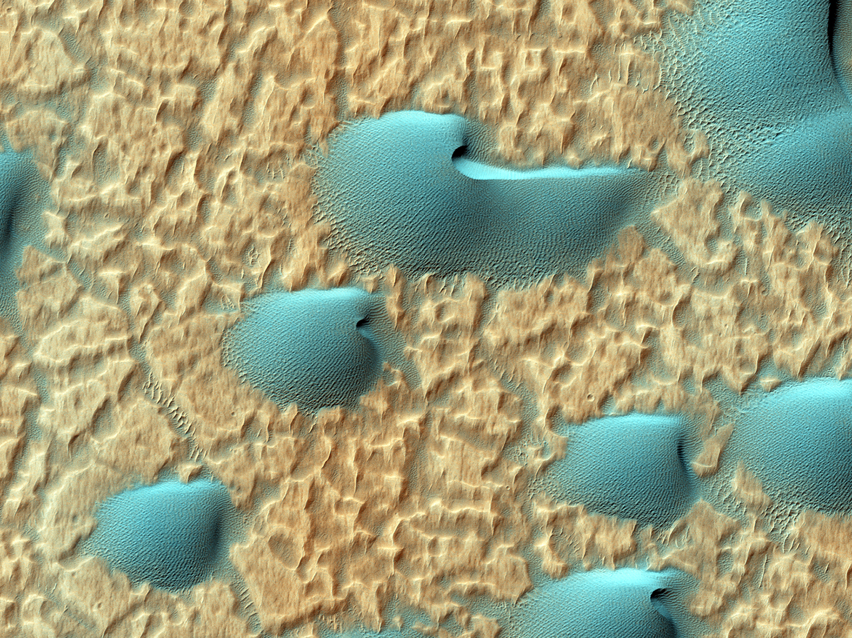
HiRISE Update
MRO PSG, 16-17 October 2013

Slide 2
Instrument Hardware Issues
Same 3 instrument issues:
  BG13 smear in TDI 64 and 128
    Pre-launch issue, rarely seen in flight
    More common recently, but just affects first lines of image due to 2x brightness of bottom of ramp (reverse and forward-clocked data)
  Bit-flip noise (since launch)
    Likely Cl contamination of ADCs, worsens over time, but only to a certain level
    Mitigated by warming electronics prior to imaging
  CPMM13 (RED9) stopped responding to commands Aug 2011
    Narrows RED swath width by 10%
    Can’t predict future with 1 data point
    No further failures for >2 years is reassuring

Slide 3
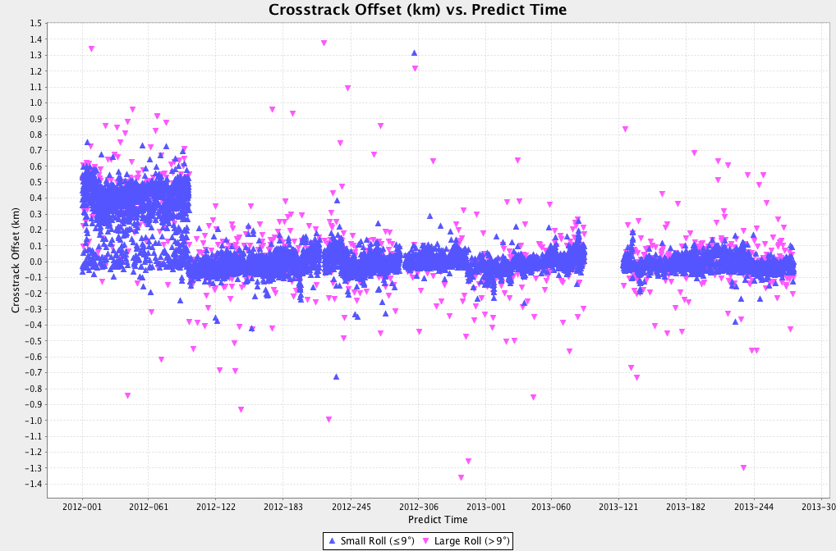
Systematic pointing offsets

Slide 4
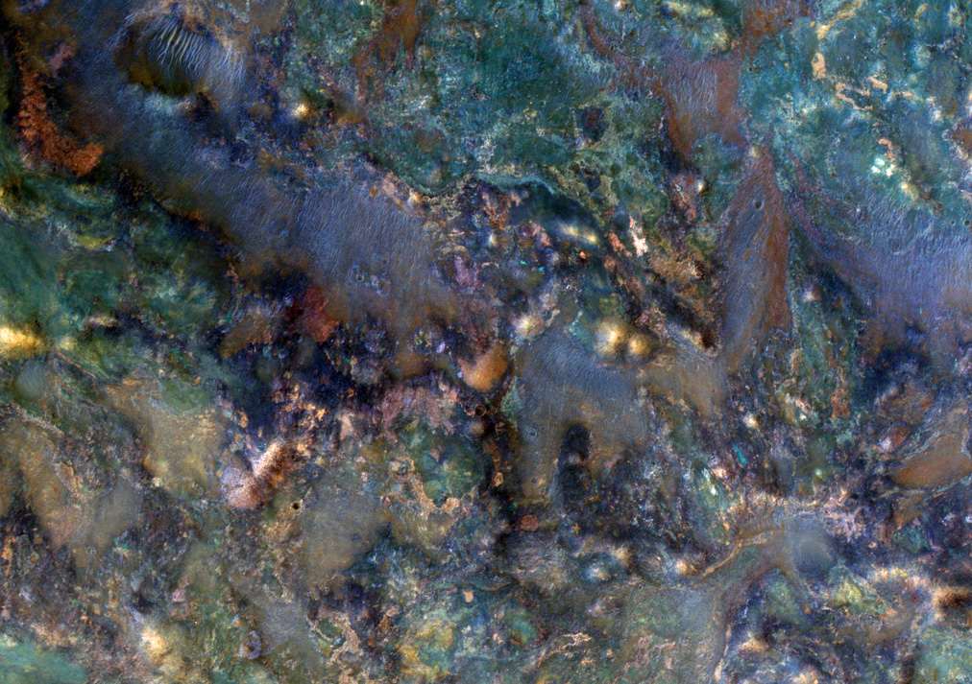
HiRISE at Mars: 10 Oct, 2013
31,117 Mars images returned
22,636 Giga-pixels
  Covers 1.92% of Martian surface
  Covers >0.38% in color
>3,509 stereo pairs completed
  ~0.22% of Mars covered in stereo
  161/199 DTMs released to PDS
ESP_026412_2035
Impact ejecta in Nili Fossae region

Slide 5
Total HiRISE PDS Volume
Data acquired up to 9/3/2013
Products | Data Volume
59,587 RDRs | 27.5 TB
723,285 RDR Extras | 52.1TB
813,245 EDRs | 23.6 TB
1,577,977 EDR Extras | 0.3 TB
161 DTM projects (1,145 products) | 251 GB
3,089 DTM Extras | 1.9 GB
3,149 Anaglyphs (9,447 Products) | 1.3 TB
Total: 3,204,705 products | 102.6 TB

Slide 6
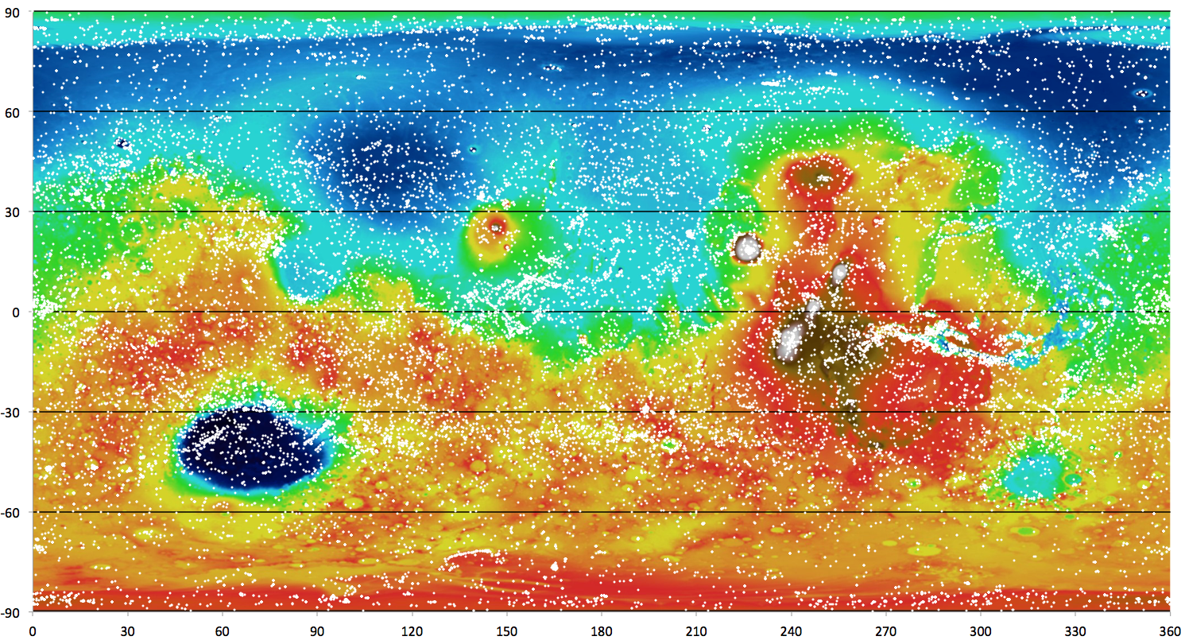
HiRISE Coverage as of 10/7/2013

Slide 7
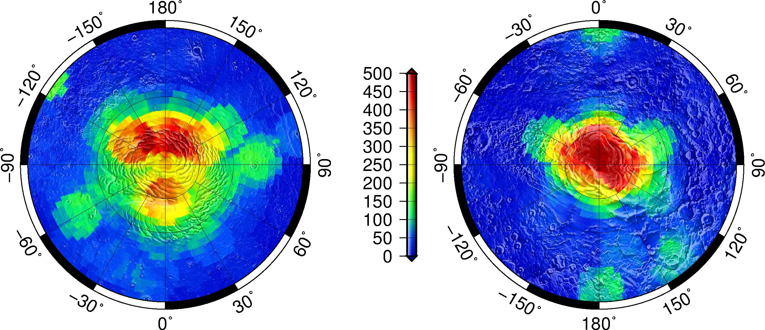
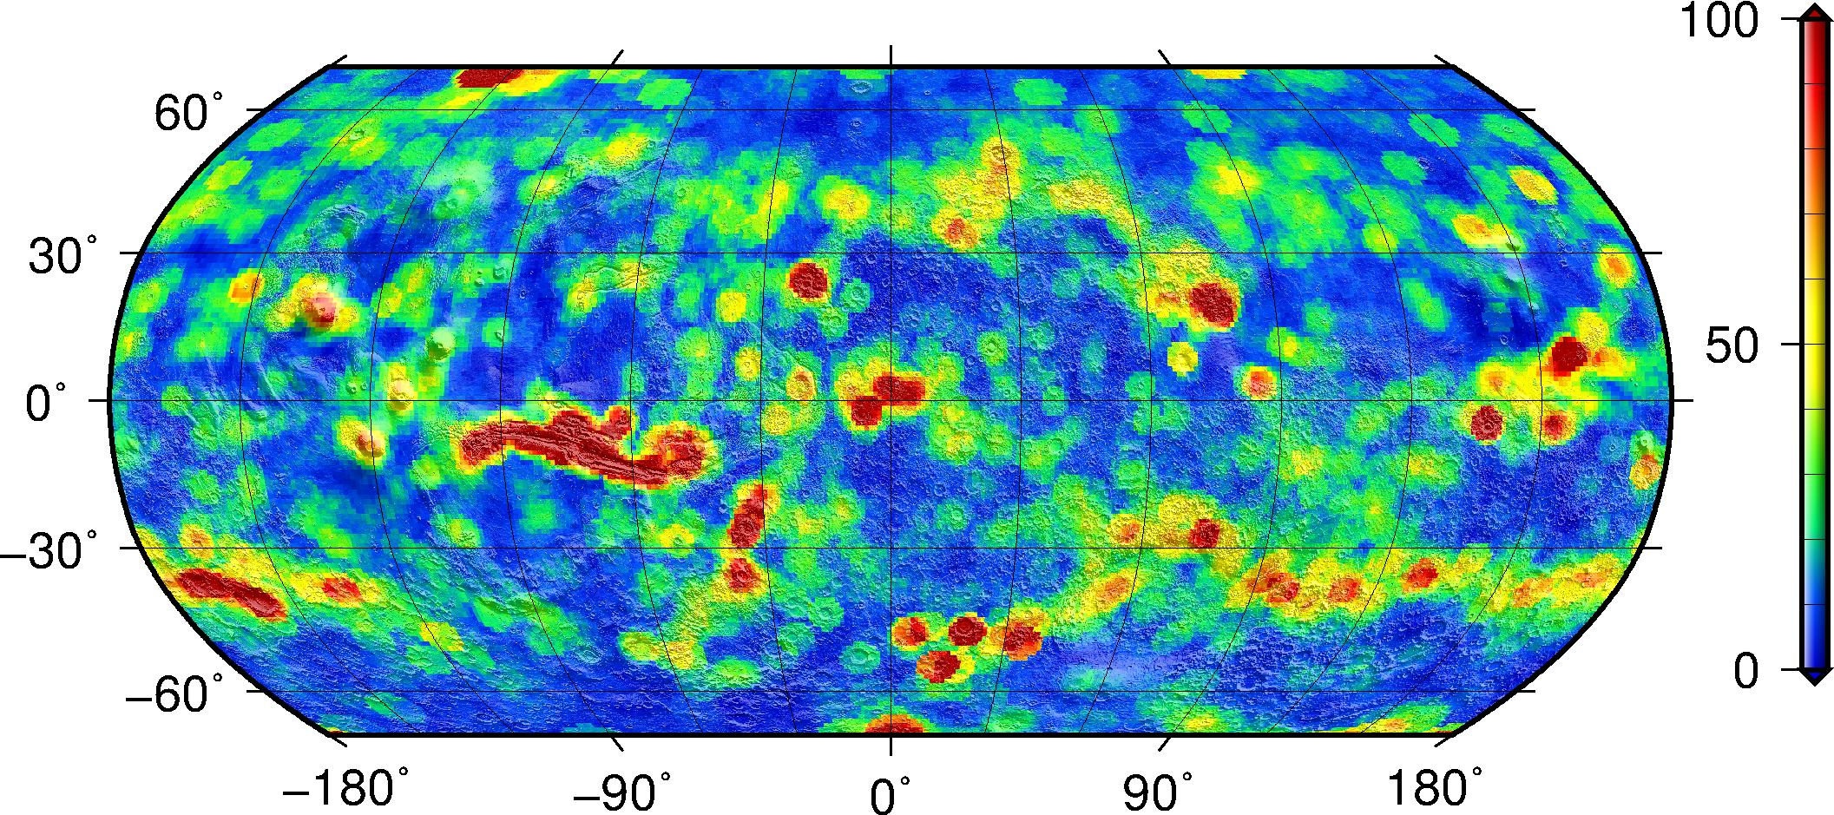
HiRISE images within 250km

Slide 8
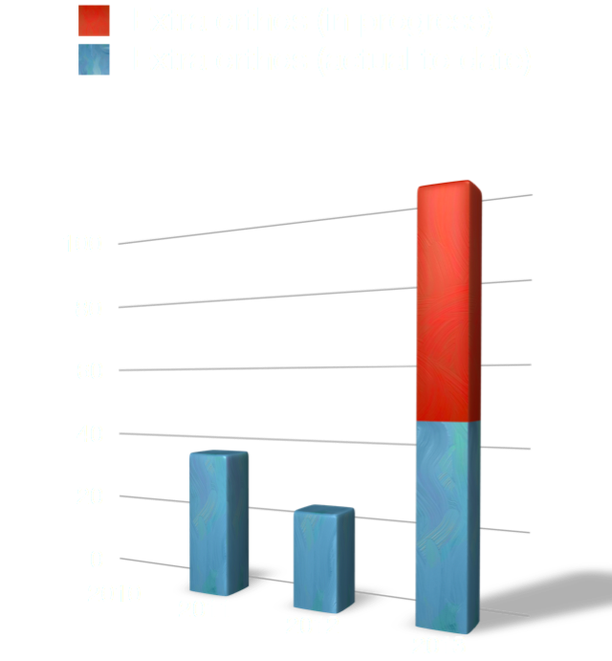

Annual Rate of Production (UA only)

Slide 9
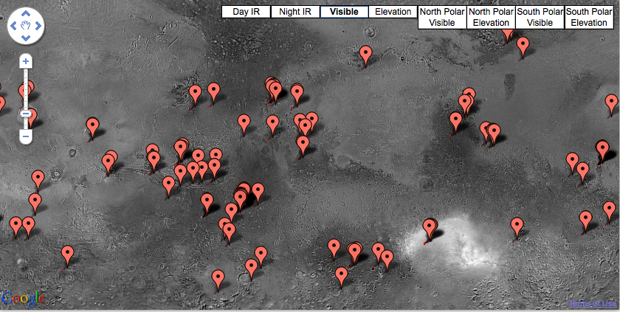
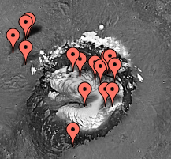
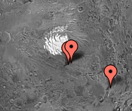
DTM PDS Release Update
161 released as of October 1, 2013
http://hirise.lpl.arizona.edu/dtm/

Slide 10
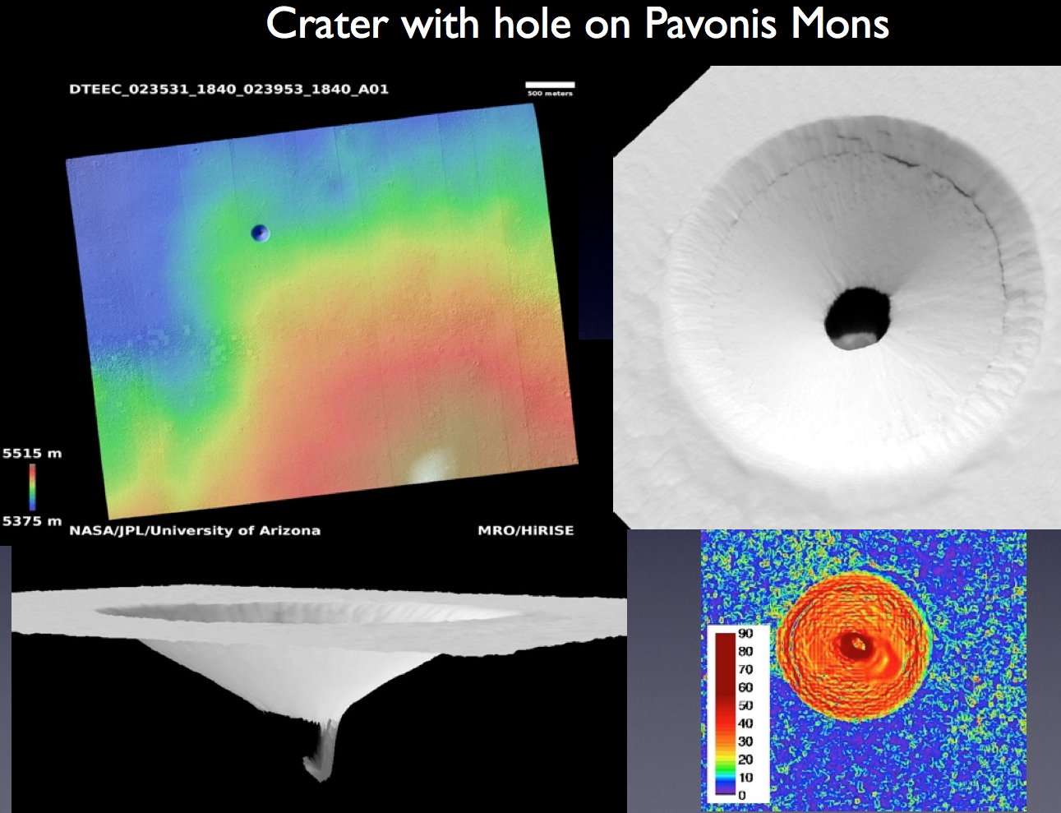

Slide 11
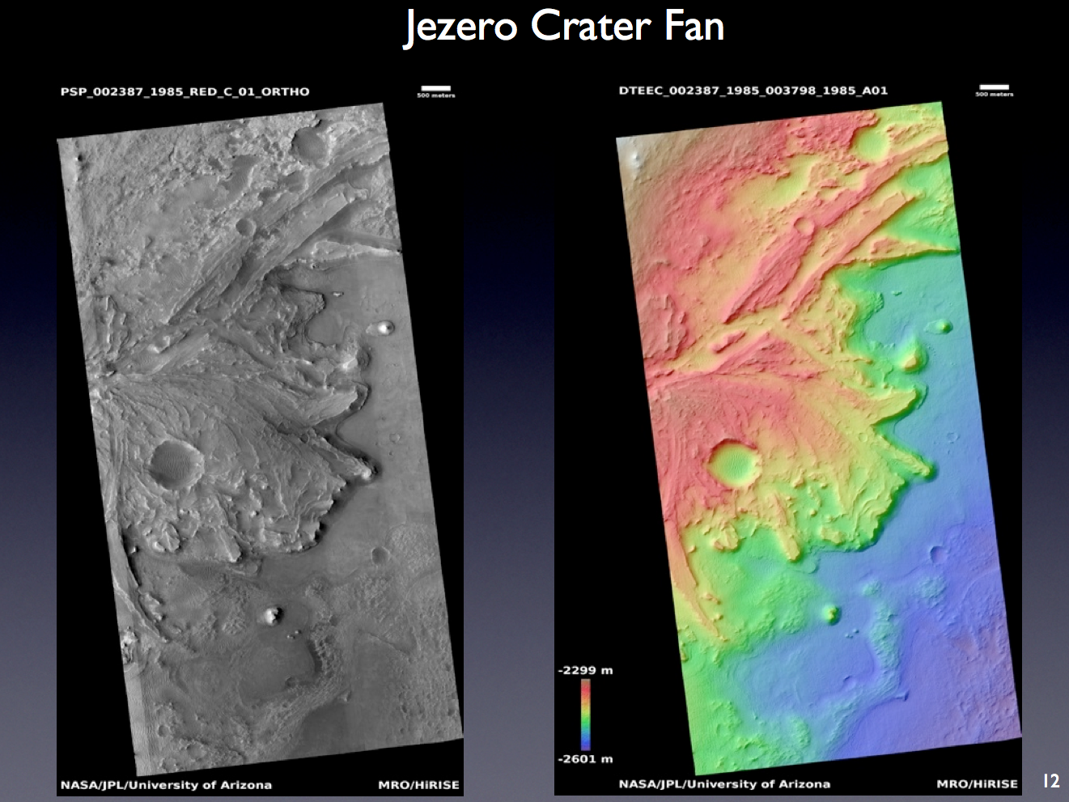

Slide 12
HiRISE team 2013 publications (1/2) (22, red=press-release)
Atwood-Stone, C. and A. S. McEwen (2013), Avalanche slope angles in low-gravity environments from active Martian sand dunes, Geophys. Res. lett., 40, 2929-2934.
Balme, M, Gallagher, C., Hauber, E. (2013) Morphological evidence for geologically young thaw of ice on Mars: A review of recent studies using high-resolution imaging data, Progress in Physical Geography, 37, 289–324, doi: 10.1177/0309133313477123.
Bridges, N., P. Geissler, S. Silvestro, M. Banks (2013), Bedform migration on Mars: Current results and future plans, Aeolian Research, 9, 133-151.
Brož, P., Hauber, E. (2013) Hydrovolcanic tuff rings and cones as indicators for phreatomagmatic explosive eruptions on Mars, J. Geophys. Res., 118, 1656–1675, doi:10.1002/jgre.20120.
Chojnacki, M., Devon M. Burr, Jeffrey E. Moersch, Valles Marineris dune fields as compared with other martian populations: Diversity of dune compositions, morphologies, and thermophysical properties, I carus, In Press, 2013.
Christian, S., J.W. Holt, S. Byrne and K.E. Fishbaugh, Integrating Radar Stratigraphy with High Resolution Visible Stratigraphy of the North Polar Layered Deposits, Mars, Icarus, 226, 1241-1251, 2013.
Clifford, S. M., K. Yoshikawa, S. Byrne, W. Durham, D. Fisher, F. Forget, M. Hecht, P. Smith, L. Tamppari, T. Titus, and R. Zurek, Introduction to the fifth Mars Polar Science special issue: Key questions, needed observations, and recommended investigations, Icarus, 225, 864-868, 2013.
Daubar, I. J., A. S. McEwen, S. Byrne, M. R. Kennedy, and B. Ivanov, The current martian cratering rate. Icarus 225, 506-516, 2013.
Diniega, S., C. J. Hansen, J. N. McElwaine, C. H. Hugenholtz, C. M. Dundas, A. S. McEwen, and M. C. Bourke (2013), A new dry hypothesis for the formation of martian linear gullies, Icarus, 225, 526-537.
Dundas, C. M. and L. P. Keszthelyi (2013), Modeling steam pressure under martian lava flows, Icarus, 226, 1058-1067.
El-Maarry, M. R., J. M. Dohm, G. Michael, N. Thomas, and S. Maruyama (2013), Morphology and evolution of the ejecta of Hale crater in Argyre basin, Mars: Results from high resolution mapping, Icarus, 226, 905-922.
Grott, M., Baratoux, D., Hauber, E., et al. (2013), Long-term evolution of the Martian crust-mantle system, Space Sci. Rev., 174, 49–111, doi:10.1007/s11214-012-9948-3.

Slide 13
HiRISE team 2013 publications (2/2) (22, red=press-release)
Haas, T., Hauber, E., Kleinhans, M.G. (2013) Local late Amazonian boulder breakdown and denudation rate on Mars, Geophys. Res. Lett., 40, 3527-3531, doi: 10.1002/grl.50726.
Hansen, C.J., S. Byrne, G. Portyankina, M. Bourke, C. Dundas, A. McEwen, M. Mellon, A. Pommerol and N. Thomas, Observations of the northern seasonal polar cap on Mars: I. Spring sublimation activity and processes, Icarus, 225, 881-897, 2013.
Hauber, E., et al. (2013), Asynchronous formation of Hesperian and Amazonian-aged deltas on Mars and implications for climate, J. Geophys. Res., 118, 1529–1544, doi:10.1002/jgre.20107.
McEwen et al., Recurring Slope Lineae in Equatorial Regions of Mars, Nature Geoscience, In Press, 2013.
Pommerol, A., T. Appere;, G. Portyankina, K.-M. Aye, N. Thomas, and C. J. Hansen (2013), Observations of the northern seasonal polar cap on Mars III: CRISM/HiRISE observations of spring sublimation, Icarus, 225, 911-922.
Portyankina, G., A. Pommerol, K.-M. Aye, C. J. Hansen, and N. Thomas (2013), Observations of the northern seasonal polar cap on Mars II: HiRISE photometric analysis of evolution of northern polar dunes in spring, Icarus, 225, 898-910.
Thomson, B. J., N. T. Bridges, J. Cohen, J. A. Hurowitz, A. Lennon, G. Paulsen, K. Zacny, Estimating rock compressive strength from Rock Abrasion Tool (RAT) grinds, Journal of Geophysical Research, 18, 1233–1244, doi:10.1002/jgre.20061, 2013.
Tornabene, L. L., G. R. Osinski, A. S. McEwen, J. J. Wray, M. A. Craig, H. M. Sapers, and P. R. Christensen (2013), An impact origin for hydrated silicates on Mars: A synthesis, Journal of Geophysical Research (Planets), 118, 994-1012.
Weitz, C.M., J.L. Bishop, and J.A. Grant. (2013), Gypsum, opal and fluvial channels within a trough of Noctis Labyrinthus, Mars: Implications for aqueous activity during the Late Hesperian to Amazonian. Planetary and Space Science, in press, 2013.
Wray, J.J., S. T. Hansen, J. Dufek, G. A. Swayze, S. L. Murchie, F. P. Seelos, J. R. Skok, R. P. Irwin III, and M. S. Ghiorso. "Prolonged magmatic activity on Mars inferred from the detection of felsic rocks." Nature Geosci., in press.
Wray, J.J., (2013). "Gale crater: the Mars Science Laboratory/Curiosity Rover Landing Site." Int. J. Astrobiol. 12, 25–38.
>100 non-team 2013 papers that use HiRISE data

Slide 14
More on publications
Team Papers
22 papers extrapolated to ~29 for the whole year
Up somewhat from the 22 team papers from 2012
Team papers Submitted or In Prep.
Dundas et al., HiRISE Observations of New Impact Craters Exposing Martian Ground Ice, Submitted, Icarus.
Ojha et al., Spectral Constraints on the Formation Mechanism of Recurring Slope Linea, Submitted, Icarus.
Ojha et al., HiRISE Observations of Recurring Slope Lineae during Southern Summer on Mars, Submitted, Icarus.
Byrne + others, contributions to chapters Haberle’s “Mars Climate and Atmosphere” book.
Becerra & Byrne, Bright “Halos” after a near-perihelion Global Dust Storm on the South Polar Residual Cap of Mars, In Prep.
Dundas et al., Modeling formation of martian thermokarst features, In Prep.
Byrne et al., Fracturing Icy Polar Cliffs on Mars, In Prep.
Viola et al., Expanded secondary craters in Arcadia Planitia, Mars: Implications for the distribution (and amount) of subsurface ice, In Prep.
Daubar et al., The morphology of fresh craters on Mars: Implications for secondary contamination at small crater sizes, In Prep.
Keske. A. et al., Distinguishing Volcanic and Fluvial Activity in Mangala Valles, Mars, via Geomorphic Mapping. In Prep., Paper & MS Thesis
12 other team papers In Prep., promised to Special Issue on Martian Change (Nov. Deadline)
Non-Team papers
Only 14 2013 papers mention HiRISE in the abstract
Searching for HiRISE+Mars in the full text turns up 120 papers
(ref.s on the following 4 slides)

Slide 15
All HiRISE publications 1/4
Ganna Portyankina, Antoine Pommerol, Klaus-Michael Aye, Candice J. Hansen, Nicolas Thomas, Observations of the northern seasonal polar cap on Mars II: HiRISE photometric analysis of evolution of northern polar dunes in spring, Icarus, Volume 225, Issue 2, August 2013, Pages 898-910, ISSN 0019-1035, http://dx.doi.org/10.1016/j.icarus.2012.10.017.
Nathan Bridges, Paul Geissler, Simone Silvestro, Maria Banks, Bedform migration on Mars: Current results and future plans, Aeolian Research, Volume 9, June 2013, Pages 133-151, ISSN 1875-9637, http://dx.doi.org/10.1016/j.aeolia.2013.02.004.
C.J. Hansen, S. Byrne, G. Portyankina, M. Bourke, C. Dundas, A. McEwen, M. Mellon, A. Pommerol, N. Thomas, Observations of the northern seasonal polar cap on Mars: I. Spring sublimation activity and processes, Icarus, Volume 225, Issue 2, August 2013, Pages 881-897, ISSN 0019-1035, http://dx.doi.org/10.1016/j.icarus.2012.09.024.
Jung-Rack Kim, Shih-Yuan Lin, Jan-Peter Muller, Nicholas H. Warner, Sanjeev Gupta, Multi-resolution digital terrain models and their potential for Mars landing site assessments, Planetary and Space Science, Volume 85, 1 September 2013, Pages 89-105, ISSN 0032-0633, http://dx.doi.org/10.1016/j.pss.2013.06.001.
M.R. El-Maarry, J.M. Dohm, G. Michael, N. Thomas, S. Maruyama, Morphology and evolution of the ejecta of Hale crater in Argyre basin, Mars: Results from high resolution mapping, Icarus, Volume 226, Issue 1, September–October 2013, Pages 905-922, ISSN 0019-1035, http://dx.doi.org/10.1016/j.icarus.2013.07.014.
Rishitosh K. Sinha, S.V.S. Murty, Evidence of extensive glaciation in Deuteronilus Mensae, Mars: Inferences towards multiple glacial events in the past epochs, Planetary and Space Science, Available online 11 September 2013, ISSN 0032-0633, http://dx.doi.org/10.1016/j.pss.2013.09.002.
R.J. Soare, S.J. Conway, G.D. Pearce, J.M. Dohm, P.M. Grindrod, Possible crater-based pingos, paleolakes and periglacial landscapes at the high latitudes of Utopia Planitia, Mars, Icarus, Volume 225, Issue 2, August 2013, Pages 971-981, ISSN 0019-1035, http://dx.doi.org/10.1016/j.icarus.2012.08.041.
Lorenz Wendt, Janice L. Bishop, Gerhard Neukum, Knob fields in the Terra Cimmeria/Terra Sirenum region of Mars: Stratigraphy, mineralogy and morphology, Icarus, Volume 225, Issue 1, July 2013, Pages 200-215, ISSN 0019-1035, http://dx.doi.org/10.1016/j.icarus.2013.03.020.
P.C. Thomas, W.M. Calvin, P. Gierasch, R. Haberle, P.B. James, S. Sholes, Time scales of erosion and deposition recorded in the residual south polar cap of Mars, Icarus, Volume 225, Issue 2, August 2013, Pages 923-932, ISSN 0019-1035, http://dx.doi.org/10.1016/j.icarus.2012.08.038.
Thiago Statella, Pedro Pina, Erivaldo Antônio da Silva, Automated determination of the orientation of dust devil tracks in mars orbiter images, Advances in Space Research, Available online 16 May 2013, ISSN 0273-1177, http://dx.doi.org/10.1016/j.asr.2013.05.012.
T.C. Orloff, M.A. Kreslavsky, E.I. Asphaug, Possible mechanism of boulder clustering on Mars, Icarus, Volume 225, Issue 2, August 2013, Pages 992-999, ISSN 0019-1035, http://dx.doi.org/10.1016/j.icarus.2013.01.002.
Catherine M. Weitz, Janice L. Bishop, John A. Grant, Gypsum, opal, and fluvial channels within a trough of Noctis Labyrinthus, Mars: Implications for aqueous activity during the Late Hesperian to Amazonian, Planetary and Space Science, Available online 21 August 2013, ISSN 0032-0633, http://dx.doi.org/10.1016/j.pss.2013.08.007.
Akos Kereszturi, An unnamed fluvial valley system formed under different climates at Xanthe Terra, Mars, Planetary and Space Science, Volume 85, 1 September 2013, Pages 220-231, ISSN 0032-0633, http://dx.doi.org/10.1016/j.pss.2013.06.007.
James R. Zimbelman, Stephen P. Scheidt, Precision topography of a reversing sand dune at Bruneau Dunes, Idaho, as an analog for Transverse Aeolian Ridges on Mars, Icarus, Available online 13 August 2013, ISSN 0019-1035, http://dx.doi.org/10.1016/j.icarus.2013.08.004.
C.R. Cousins, I.A. Crawford, J.L. Carrivick, M. Gunn, J. Harris, T.P. Kee, M. Karlsson, L. Carmody, C. Cockell, B. Herschy, K.H. Joy, Glaciovolcanic hydrothermal environments in Iceland and implications for their detection on Mars, Journal of Volcanology and Geothermal Research, Volume 256, 15 April 2013, Pages 61-77, ISSN 0377-0273, http://dx.doi.org/10.1016/j.jvolgeores.2013.02.009.
H. Bernhardt, H. Hiesinger, D. Reiss, M. Ivanov, G. Erkeling, Putative eskers and new insights into glacio-fluvial depositional settings in southern Argyre Planitia, Mars, Planetary and Space Science, Volume 85, 1 September 2013, Pages 261-278, ISSN 0032-0633, http://dx.doi.org/10.1016/j.pss.2013.06.022.
Rebecca M.E. Williams, Rossman P. Irwin III, Devon M. Burr, Tanya Harrison, Phillip McClelland, Variability in martian sinuous ridge form: Case study of Aeolis Serpens in the Aeolis Dorsa, Mars, and insight from the Mirackina paleoriver, South Australia, Icarus, Volume 225, Issue 1, July 2013, Pages 308-324, ISSN 0019-1035, http://dx.doi.org/10.1016/j.icarus.2013.03.016.
David A. Vaz, Simone Silvestro, Mapping and characterization of small-scale aeolian structures on Mars: An example from the MSL landing site in Gale Crater, Icarus, Available online 14 August 2013, ISSN 0019-1035, http://dx.doi.org/10.1016/j.icarus.2013.08.007.
S.K. Harrison, M.R. Balme, A. Hagermann, J.B. Murray, J.-P. Muller, A. Wilson, A branching, positive relief network in the middle member of the Medusae Fossae Formation, equatorial Mars—Evidence for sapping?, Planetary and Space Science, Volume 85, 1 September 2013, Pages 142-163, ISSN 0032-0633, http://dx.doi.org/10.1016/j.pss.2013.06.004.
J.L. Heldmann, W. Pollard, C.P. McKay, M.M. Marinova, A. Davila, K.E. Williams, D. Lacelle, D.T. Andersen, The high elevation Dry Valleys in Antarctica as analog sites for subsurface ice on Mars, Planetary and Space Science, Volume 85, 1 September 2013, Pages 53-58, ISSN 0032-0633, http://dx.doi.org/10.1016/j.pss.2013.05.019.
Nathaniel E. Putzig, Michael T. Mellon, Kenneth E. Herkenhoff, Roger J. Phillips, Brian J. Davis, Kenneth J. Ewer, Lauren M. Bowers, Thermal behavior and ice-table depth within the north polar erg of Mars, Icarus, Available online 16 July 2013, ISSN 0019-1035, http://dx.doi.org/10.1016/j.icarus.2013.07.010.
Richard J. Soare, Susan J. Conway, Geoffrey D. Pearce, François Costard, Antoine Séjourné, Sub-kilometre (intra-crater) mounds in Utopia Planitia, Mars: character, occurrence and possible formation hypotheses, Icarus, Volume 225, Issue 2, August 2013, Pages 982-991, ISSN 0019-1035, http://dx.doi.org/10.1016/j.icarus.2012.06.003.
R.K. Hayward, L.K. Fenton, T.N. Titus, Mars Global Digital Dune Database (MGD3): Global dune distribution and wind pattern observations, Icarus, Available online 24 April 2013, ISSN 0019-1035, http://dx.doi.org/10.1016/j.icarus.2013.04.011.
S. Christian, J.W. Holt, S. Byrne, K.E. Fishbaugh, Integrating radar stratigraphy with high resolution visible stratigraphy of the north polar layered deposits, Mars, Icarus, Volume 226, Issue 2, November–December 2013, Pages 1241-1251, ISSN 0019-1035, http://dx.doi.org/10.1016/j.icarus.2013.07.003.
Gordon R. Osinski, Livio L. Tornabene, Neil R. Banerjee, Charles S. Cockell, Roberta Flemming, Matthew R.M. Izawa, Jenine McCutcheon, John Parnell, Louisa J. Preston, Annemarie E. Pickersgill, Alexandra Pontefract, Haley M. Sapers, Gordon Southam, Impact-generated hydrothermal systems on Earth and Mars, Icarus, Volume 224, Issue 2, June 2013, Pages 347-363, ISSN 0019-1035, http://dx.doi.org/10.1016/j.icarus.2012.08.030.
Liang Cheng, Lei Ma, Kang Yang, Yongxue Liu, Manchun Li, Registration of Mars remote sensing images under the crater constraint, Planetary and Space Science, Volume 85, 1 September 2013, Pages 13-23, ISSN 0032-0633, http://dx.doi.org/10.1016/j.pss.2013.05.002.
S.W. Hobbs, D.J. Paull, J.D.A. Clarke, The influence of slope morphology on gullies: Terrestrial gullies in Lake George as analogues for Mars, Planetary and Space Science, Volume 81, June 2013, Pages 1-17, ISSN 0032-0633, http://dx.doi.org/10.1016/j.pss.2012.10.009.

Slide 16
All HiRISE publications 2/4
S.W. Hobbs, D.J. Paull, J.D.A. Clarke, A comparison of semiarid and subhumid terrestrial gullies with gullies on Mars: Implications for Martian gully erosion, Geomorphology, Available online 30 August 2013, ISSN 0169-555X, http://dx.doi.org/10.1016/j.geomorph.2013.08.018.
Joseph R. Michalski, P.B. Niles, J. Cuadros, A.M. Baldridge, Multiple working hypotheses for the formation of compositional stratigraphy on Mars: Insights from the Mawrth Vallis region, Icarus, Volume 226, Issue 1, September–October 2013, Pages 816-840, ISSN 0019-1035, http://dx.doi.org/10.1016/j.icarus.2013.05.024.
Janice L. Bishop, Damien Loizeau, Nancy K. McKeown, Lee Saper, M. Darby Dyar, David J. Des Marais, Mario Parente, Scott L. Murchie, What the ancient phyllosilicates at Mawrth Vallis can tell us about possible habitability on early Mars, Planetary and Space Science, Available online 24 May 2013, ISSN 0032-0633, http://dx.doi.org/10.1016/j.pss.2013.05.006.
Edwin S. Kite, Antoine Lucas, Caleb I. Fassett, Pacing early Mars river activity: Embedded craters in the Aeolis Dorsa region imply river activity spanned ≳(1–20)&#xa0;Myr, Icarus, Volume 225, Issue 1, July 2013, Pages 850-855, ISSN 0019-1035, http://dx.doi.org/10.1016/j.icarus.2013.03.029.
J.H.P. Oosthoek, J. Flahaut, A.P. Rossi, P. Baumann, D. Misev, P. Campalani, V. Unnithan, PlanetServer: Innovative approaches for the online analysis of hyperspectral satellite data from Mars, Advances in Space Research, Available online 11 July 2013, ISSN 0273-1177, http://dx.doi.org/10.1016/j.asr.2013.07.002.
Donald M. Hooper, Cynthia L. Dinwiddie, Debris flows on the Great Kobuk Sand Dunes, Alaska: Implications for analogous processes on Mars, Icarus, Available online 16 July 2013, ISSN 0019-1035, http://dx.doi.org/10.1016/j.icarus.2013.07.006.
Jacek Wierzchos, Alfonso F. Davila, Octavio Artieda, Beatriz Cámara-Gallego, Asunción de los Ríos, Kenneth H. Nealson, Sergio Valea, M. Teresa García-González, Carmen Ascaso, Ignimbrite as a substrate for endolithic life in the hyper-arid Atacama Desert: Implications for the search for life on Mars, Icarus, Volume 224, Issue 2, June 2013, Pages 334-346, ISSN 0019-1035, http://dx.doi.org/10.1016/j.icarus.2012.06.009.
Joshua L. Bandfield, Elena S. Amador, Nancy H. Thomas, Extensive hydrated silica materials in western Hellas Basin, Mars, Icarus, Volume 226, Issue 2, November–December 2013, Pages 1489-1498, ISSN 0019-1035, http://dx.doi.org/10.1016/j.icarus.2013.08.005.
Ralph D. Lorenz, Irregular dust devil pressure drops on Earth and Mars: Effect of cycloidal tracks, Planetary and Space Science, Volume 76, February 2013, Pages 96-103, ISSN 0032-0633, http://dx.doi.org/10.1016/j.pss.2013.01.001.
Justin R. Bergonio, Kimberly M. Rottas, Norbert Schorghofer, Properties of martian slope streak populations, Icarus, Volume 225, Issue 1, July 2013, Pages 194-199, ISSN 0019-1035, http://dx.doi.org/10.1016/j.icarus.2013.03.023.
Natalia Zalewska (Andrzejewska), Hellas Planitia as a potential site of sedimentary minerals, Planetary and Space Science, Volume 78, April 2013, Pages 25-32, ISSN 0032-0633, http://dx.doi.org/10.1016/j.pss.2012.12.006.
Yasutaka Iijima, Kazuhisa Goto, Koji Minoura, Goro Komatsu, Fumihiko Imamura, Hydrodynamics of impact-induced tsunami over the Martian ocean, Planetary and Space Science, Available online 27 September 2013, ISSN 0032-0633, http://dx.doi.org/10.1016/j.pss.2013.09.014.
I.J. Daubar, A.S. McEwen, S. Byrne, M.R. Kennedy, B. Ivanov, The current martian cratering rate, Icarus, Volume 225, Issue 1, July 2013, Pages 506-516, ISSN 0019-1035, http://dx.doi.org/10.1016/j.icarus.2013.04.009.
Davide Baioni, Maria Sgavetti, Karst terrains as possible lithologic and stratigraphic markers in northern Sinus Meridiani, Mars, Planetary and Space Science, Volume 75, January 2013, Pages 173-181, ISSN 0032-0633, http://dx.doi.org/10.1016/j.pss.2012.08.011.
Colin J. Souness, Bryn Hubbard, An alternative interpretation of late Amazonian ice flow: Protonilus Mensae, Mars, Icarus, Volume 225, Issue 1, July 2013, Pages 495-505, ISSN 0019-1035, http://dx.doi.org/10.1016/j.icarus.2013.03.030.
Melissa M. Battler, Gordon R. Osinski, Neil R. Banerjee, Mineralogy of saline perennial cold springs on Axel Heiberg Island, Nunavut, Canada and implications for spring deposits on Mars, Icarus, Volume 224, Issue 2, June 2013, Pages 364-381, ISSN 0019-1035, http://dx.doi.org/10.1016/j.icarus.2012.08.031.
Csilla Orgel, Ákos Kereszturi, Tamás Váczi, Gernot Groemer, Birgit Sattler, Scientific Results and Lessons Learned from an Integrated Crewed Mars Exploration Simulation at the Rio Tinto Mars Analogue Site, Acta Astronautica, Available online 8 October 2013, ISSN 0094-5765, http://dx.doi.org/10.1016/j.actaastro.2013.09.014.
Genevieve Berard, Daniel Applin, Edward Cloutis, Jessica Stromberg, Raven Sharma, Paul Mann, Stephen Grasby, Ruth Bezys, Briony Horgan, Kathleen Londry, Melissa Rice, Bill Last, Fawn Last, Pascal Badiou, Gordon Goldsborough, James Bell III, A hypersaline spring analogue in Manitoba, Canada for potential ancient spring deposits on Mars, Icarus, Volume 224, Issue 2, June 2013, Pages 399-412, ISSN 0019-1035, http://dx.doi.org/10.1016/j.icarus.2012.12.024.
M.A. de Pablo, G.G. Michael, J.D. Centeno, Age and evolution of the lower NW flank of the Hecates Tholus volcano, Mars, based on crater size–frequency distribution on CTX images, Icarus, Volume 226, Issue 1, September–October 2013, Pages 455-469, ISSN 0019-1035, http://dx.doi.org/10.1016/j.icarus.2013.05.012.
Nicolas Mangold, Alan D. Howard, Outflow channels with deltaic deposits in Ismenius Lacus, Mars, Icarus, Volume 226, Issue 1, September–October 2013, Pages 385-401, ISSN 0019-1035, http://dx.doi.org/10.1016/j.icarus.2013.05.040.
Giuseppe Etiope, Bethany L. Ehlmann, Martin Schoell, Low temperature production and exhalation of methane from serpentinized rocks on Earth: A potential analog for methane production on Mars, Icarus, Volume 224, Issue 2, June 2013, Pages 276-285, ISSN 0019-1035, http://dx.doi.org/10.1016/j.icarus.2012.05.009.
Thomas Platz, Gregory Michael, Kenneth L. Tanaka, James A. Skinner Jr., Corey M. Fortezzo, Crater-based dating of geological units on Mars: Methods and application for the new global geological map, Icarus, Volume 225, Issue 1, July 2013, Pages 806-827, ISSN 0019-1035, http://dx.doi.org/10.1016/j.icarus.2013.04.021.
J. Carter, F. Poulet, S. Murchie, J.P. Bibring, Automated processing of planetary hyperspectral datasets for the extraction of weak mineral signatures and applications to CRISM observations of hydrated silicates on Mars, Planetary and Space Science, Volume 76, February 2013, Pages 53-67, ISSN 0032-0633, http://dx.doi.org/10.1016/j.pss.2012.11.007.
J. Korteniemi, M.A. Kreslavsky, Patterned ground in martian high northern latitudes: Morphology and age constraints, Icarus, Volume 225, Issue 2, August 2013, Pages 960-970, ISSN 0019-1035, http://dx.doi.org/10.1016/j.icarus.2012.09.032.
Stephen M. Clifford, Kenji Yoshikawa, Shane Byrne, William Durham, David Fisher, Francois Forget, Michael Hecht, Peter Smith, Leslie Tamppari, Timothy Titus, Richard Zurek, Introduction to the fifth Mars Polar Science special issue: Key questions, needed observations, and recommended investigations, Icarus, Volume 225, Issue 2, August 2013, Pages 864-868, ISSN 0019-1035, http://dx.doi.org/10.1016/j.icarus.2013.04.005.
Colin M. Dundas, Laszlo P. Keszthelyi, Modeling steam pressure under martian lava flows, Icarus, Volume 226, Issue 1, September–October 2013, Pages 1058-1067, ISSN 0019-1035, http://dx.doi.org/10.1016/j.icarus.2013.06.036.
Mikhail A. Ivanov, H. Hiesinger, G. Erkeling, D. Reiss, Mud volcanism and morphology of impact craters in Utopia Planitia on Mars: Evidence for the ancient ocean, Icarus, Available online 8 October 2013, ISSN 0019-1035, http://dx.doi.org/10.1016/j.icarus.2013.09.018.
Anna Szynkiewicz, Magdalena Modelska, Sebastian Buczyński, David M. Borrok, Jonathan P. Merrison, The polar sulfur cycle in the Werenskioldbreen, Spitsbergen: Possible implications for understanding the deposition of sulfate minerals in the North Polar Region of Mars, Geochimica et Cosmochimica Acta, Volume 106, 1 April 2013, Pages 326-343, ISSN 0016-7037, http://dx.doi.org/10.1016/j.gca.2012.12.041.

Slide 17
All HiRISE publications 3/4
Matthew R. Smith, Joshua L. Bandfield, Edward A. Cloutis, Melissa S. Rice, Hydrated silica on Mars: Combined analysis with near-infrared and thermal-infrared spectroscopy, Icarus, Volume 223, Issue 2, April 2013, Pages 633-648, ISSN 0019-1035, http://dx.doi.org/10.1016/j.icarus.2013.01.024.
Pascual Tabares-Rodenas, Jens Ormö, David T. King Jr., Cosmic wabi-sabi: Tell-tale morphological imperfections in impact crater shapes revealed by numerical analysis, Earth and Planetary Science Letters, Volumes 377–378, September 2013, Pages 211-217, ISSN 0012-821X, http://dx.doi.org/10.1016/j.epsl.2013.06.043.
Matthew Chojnacki, Devon M. Burr, Jeffrey E. Moersch, Valles Marineris dune fields as compared with other martian populations: Diversity of dune compositions, morphologies, and thermophysical properties, Icarus, Available online 22 August 2013, ISSN 0019-1035, http://dx.doi.org/10.1016/j.icarus.2013.08.018.
S. Diniega, C.J. Hansen, J.N. McElwaine, C.H. Hugenholtz, C.M. Dundas, A.S. McEwen, M.C. Bourke, A new dry hypothesis for the formation of martian linear gullies, Icarus, Volume 225, Issue 1, July 2013, Pages 526-537, ISSN 0019-1035, http://dx.doi.org/10.1016/j.icarus.2013.04.006.
Luke A. McGuire, Jon D. Pelletier, Relationships between debris fan morphology and flow rheology for wet and dry flows on Earth and Mars: A numerical modeling investigation, Geomorphology, Volume 197, 1 September 2013, Pages 145-155, ISSN 0169-555X, http://dx.doi.org/10.1016/j.geomorph.2013.05.005.
Joshua L. Bandfield, Christopher S. Edwards, David R. Montgomery, Brittany D. Brand, The dual nature of the martian crust: Young lavas and old clastic materials, Icarus, Volume 222, Issue 1, January 2013, Pages 188-199, ISSN 0019-1035, http://dx.doi.org/10.1016/j.icarus.2012.10.023.
Marine Gourronc, Olivier Bourgeois, Daniel Mège, Stéphane Pochat, Benjamin Bultel, Marion Massé, Laetitia Le Deit, Stéphane Le Mouélic, Denis Mercier, One million cubic kilometers of fossil ice in Valles Marineris: Relicts of a 3.5&#xa0;Gy old glacial landsystem along the Martian equator, Geomorphology, Available online 20 August 2013, ISSN 0169-555X, http://dx.doi.org/10.1016/j.geomorph.2013.08.009.
William K. Hartmann, Veronique Ansan, Daniel C. Berman, Nicolas Mangold, Francois Forget, Comprehensive Analysis of Glaciated Martian Crater Greg, Icarus, Available online 2 October 2013, ISSN 0019-1035, http://dx.doi.org/10.1016/j.icarus.2013.09.016.
J.R. Zimbelman, M.C. Bourke, R.D. Lorenz, Recent developments in planetary Aeolian studies and their terrestrial analogs, Aeolian Research, Available online 10 July 2013, ISSN 1875-9637, http://dx.doi.org/10.1016/j.aeolia.2013.04.004.
Lori K. Fenton, Rosalyn K. Hayward, Briony H.N. Horgan, David M. Rubin, Timothy N. Titus, Mark A. Bishop, Devon M. Burr, Matthew Chojnacki, Cynthia L. Dinwiddie, Laura Kerber, Alice Le Gall, Timothy I. Michaels, Lynn D.V. Neakrase, Claire E. Newman, Daniela Tirsch, Hezi Yizhaq, James R. Zimbelman, Summary of the Third International Planetary Dunes Workshop: Remote Sensing and Image Analysis of Planetary Dunes, Flagstaff, Arizona, USA, June 12–15, 2012, Aeolian Research, Volume 8, March 2013, Pages 29-38.
Carlton C. Allen, Dorothy Z. Oehler, Giuseppe Etiope, Pieter Van Rensbergen, Calin Baciu, Akper Feyzullayev, Giovanni Martinelli, Kazuhiro Tanaka, David Van Rooij, Fluid expulsion in terrestrial sedimentary basins: A process providing potential analogs for giant polygons and mounds in the martian lowlands, Icarus, Volume 224, Issue 2, June 2013, Pages 424-432, ISSN 0019-1035, http://dx.doi.org/10.1016/j.icarus.2012.09.018.
G.B.M. Pedersen, Frozen Martian lahars? Evaluation of morphology, degradation and geologic development in the Utopia–Elysium transition zone, Planetary and Space Science, Volume 85, 1 September 2013, Pages 59-77, ISSN 0032-0633, http://dx.doi.org/10.1016/j.pss.2013.05.020.
P. Gläser, I. Haase, J. Oberst, G.A. Neumann, Co-registration of laser altimeter tracks with digital terrain models and applications in planetary science, Planetary and Space Science, Available online 25 September 2013, ISSN 0032-0633, http://dx.doi.org/10.1016/j.pss.2013.09.012.
Daniel R. Muhs, The geologic records of dust in the Quaternary, Aeolian Research, Volume 9, June 2013, Pages 3-48, ISSN 1875-9637, http://dx.doi.org/10.1016/j.aeolia.2012.08.001.
Apostolos A. Christou, Jürgen Oberst, Valery Lupovka, Vasily Dmitriev, Maria Gritsevich, The meteoroid environment and impacts on Phobos, Planetary and Space Science, Available online 21 August 2013, ISSN 0032-0633, http://dx.doi.org/10.1016/j.pss.2013.07.012.
Richard A. Schultz, Christian Klimczak, Haakon Fossen, Jon E. Olson, Ulrike Exner, Donald M. Reeves, Roger Soliva, Statistical tests of scaling relationships for geologic structures, Journal of Structural Geology, Volume 48, March 2013, Pages 85-94, ISSN 0191-8141, http://dx.doi.org/10.1016/j.jsg.2012.12.005.
Joseph Paul Cohen, Wei Ding, Crater detection via genetic search methods to reduce image features, Advances in Space Research, Available online 16 May 2013, ISSN 0273-1177
Bo Wu, Jian Guo, Han Hu, Zhilin Li, Yongqi Chen, Co-registration of lunar topographic models derived from Chang’E-1, SELENE, and LRO laser altimeter data based on a novel surface matching method, Earth and Planetary Science Letters, Volume 364, 15 February 2013, Pages 68-84, ISSN 0012-821X, http://dx.doi.org/10.1016/j.epsl.2012.12.024.
F.C. Wasiak, A. Luspay-Kuti, W.D.D.P. Welivitiya, L.A. Roe, V.F. Chevrier, D.G. Blackburn, T. Cornet, A facility for simulating Titan’s environment, Advances in Space Research, Volume 51, Issue 7, 1 April 2013, Pages 1213-1220, ISSN 0273-1177, http://dx.doi.org/10.1016/j.asr.2012.10.020.
Chris R. Stokes, Andrew C. Fowler, Chris D. Clark, Richard C.A. Hindmarsh, Matteo Spagnolo, The instability theory of drumlin formation and its explanation of their varied composition and internal structure, Quaternary Science Reviews, Volume 62, 15 February 2013, Pages 77-96, ISSN 0277-3791, http://dx.doi.org/10.1016/j.quascirev.2012.11.011.
Curiosity at Gale Crater, Mars: Characterization and Analysis of the Rocknest Sand Shadow, D. F. Blake, R. V. Morris, G. Kocurek, S. M. Morrison, R. T. Downs, D. Bish, D. W. Ming, K. S. Edgett, D. Rubin, W. Goetz, M. B. Madsen, R. Sullivan, R. Gellert, I. Campbell, A. H. Treiman, S. M. McLennan, A. S. Yen, J. Grotzinger, D. T. Vaniman, S. J. Chipera, C. N. Achilles, E. B. Rampe, D. Sumner, P.-Y. Meslin, S. Maurice, O. Forni, O. Gasnault, M. Fisk, M. Schmidt, P. Mahaffy, L. A. Leshin, D. Glavin, A. Steele, C. Freissinet, R. Navarro-González, R. A. Yingst, L. C. Kah, N. Bridges, K. W. Lewis, T. F. Bristow, J. D. Farmer, J. A. Crisp, E. M. Stolper, D. J. Des Marais, P. Sarrazin, and MSL Science Team, Science 27 September 2013: 341 (6153).
Martian Fluvial Conglomerates at Gale Crater, R. M. E. Williams, J. P. Grotzinger, W. E. Dietrich, S. Gupta, D. Y. Sumner, R. C. Wiens, N. Mangold, M. C. Malin, K. S. Edgett, S. Maurice, O. Forni, O. Gasnault, A. Ollila, H. E. Newsom, G. Dromart, M. C. Palucis, R. A. Yingst, R. B. Anderson, K. E. Herkenhoff, S. Le Mouélic, W. Goetz, M. B. Madsen, A. Koefoed, J. K. Jensen, J. C. Bridges, S. P. Schwenzer, K. W. Lewis, K. M. Stack, D. Rubin, L. C. Kah, J. F. Bell III, J. D. Farmer, R. Sullivan, T. Van Beek, D. L. Blaney, O. Pariser, R. G. Deen, and MSL Science Team, Science 31 May 2013: 340 (6136), 1068-1072.
Supervolcanoes within an ancient volcanic province in Arabia Terra, Mars, Joseph R. Michalski & Jacob E. Bleacher, Nature 502, 47-52 doi:10.1038/nature12482
Groundwater activity on Mars and implications for a deep biosphere, Joseph R. Michalski, Javier Cuadros, Paul B. Niles, John Parnell, A. Deanne Rogers et al., Nature Geoscience 6, 133-138 doi:10.1038/ngeo1706
Water and Brines on Mars: Current Evidence and Implications for MSL, G. M. Martínez, N. O. Renno in Space Science Reviews (2013)
Quantitative Assessments of the Martian Hydrosphere, Jeremie Lasue, Nicolas Mangold, Ernst Hauber, Steve Clifford… in Space Science Reviews (2013)
Long-Term Evolution of the Martian Crust-Mantle System, M. Grott, D. Baratoux, E. Hauber, V. Sautter, J. Mustard… in Space Science Reviews (2013)
Geochemical Consequences of Widespread Clay Mineral Formation in Mars’ Ancient Crust, Bethany L. Ehlmann, Gilles Berger, Nicolas Mangold… in Space Science Reviews (2013)
Geochemistry of Carbonates on Mars: Implications for Climate History and Nature of Aqueous Environments, Paul B. Niles, David C. Catling, Gilles Berger, Eric Chassefière… in Space Science Reviews (2013)
Variability of rock texture and morphology correlated with the clay-bearing units at Mawrth Vallis, Mars, J. Geophys. Res., Volume 118, Issue 6, June 2013, Pages: 1245–1256, Nancy K. McKeown, Janice L. Bishop and Eli A. Silver
Bed thickness distributions on Mars: An orbital perspective, J. Geophys. Res., Volume 118, Issue 6, June 2013, Pages: 1323–1349, K. M. Stack, J. P. Grotzinger and R. E. Milliken

Slide 18
All HiRISE publications 4/4
Mineralogy and morphology of geologic units at Libya Montes, Mars: Ancient aqueously derived outcrops, mafic flows, fluvial features, and impacts, J. Geophys. Res., Volume 118, Issue 3, March 2013, Pages: 487–513, Janice L. Bishop, Daniela Tirsch, Livio L. Tornabene, Ralf Jaumann, Alfred S. McEwen, Patrick C. McGuire, Anouck Ody, Francois Poulet, Roger N. Clark, Mario Parente, Nancy K. McKeown, John F. Mustard, Scott L. Murchie, Joana Voigt, Zeynep Aydin, Marlene Bamberg, Andreas Petau, Gregory Michael, Frank P. Seelos, Christopher D. Hash, Gregg A. Swayze and Gerhard Neukum
Deltaic deposits at Aeolis Dorsa: Sedimentary evidence for a standing body of water on the northern plains of Mars, J. Geophys. Res., Volume 118, Issue 6, June 2013, Pages: 1285–1302, Roman A. DiBiase, Ajay B. Limaye, Joel S. Scheingross, Woodward W. Fischer and Michael P. Lamb
Evidence for Noachian flood volcanism in Noachis Terra, Mars, and the possible role of Hellas impact basin tectonics, J. Geophys. Res., Volume 118, Issue 5, May 2013, Pages: 1094–1113, A. D. Rogers and A. H. Nazarian
Geomorphic signatures of glacial activity in the Alba Patera volcanic province: Implications for recent frost accumulation on Mars, J. Geophys. Res., Volume 118, Issue 8, August 2013, Pages: 1609–1631, Rishitosh K. Sinha and Sripada V. S. Murty
Distribution of polygon characteristic scale in Martian patterned ground terrain in the northern hemisphere using the Fourier transform, J. Geophys. Res., Volume 118, Issue 7, July 2013, Pages: 1558–1566, T. Orloff, M. Kreslavsky and E. Asphaug
Surface scattering properties at the Opportunity Mars rover's traverse region measured by CRISM, J. Geophys. Res., Volume 118, Issue 8, August 2013, Pages: 1699–1717, Amy Shaw, M. J. Wolff, F. P. Seelos, S. M. Wiseman and S. Cull
An impact origin for hydrated silicates on Mars: A synthesis, J. Geophys. Res., Volume 118, Issue 5, May 2013, Pages: 994–1012, Livio L. Tornabene, Gordon R. Osinski, Alfred S. McEwen, James J. Wray, Michael A. Craig, Haley M. Sapers and Philip R. Christensen
Identification of possible recent water/lava source vents in the Cerberus plains: Stratigraphic and crater count age constraints, J. Geophys. Res., Volume 118, Issue 4, April 2013, Pages: 789–802, Rebecca J. Thomas
Exposures of olivine-rich rocks in the vicinity of Ares Vallis: Implications for Noachian and Hesperian volcanism, J. Geophys. Res., Volume 118, Issue 5, May 2013, Pages: 916–929, J. H. Wilson and J. F. Mustard
Searching at the right time of day: Evidence for aqueous minerals in Columbus crater with TES and THEMIS data, J. Geophys. Res., Volume 118, Issue 2, February 2013, Pages: 179–189, Alice M. Baldridge, Melissa D. Lane and Christopher S. Edwards
Global investigation of olivine on Mars: Insights into crust and mantle compositions, J. Geophys. Res., Volume 118, Issue 2, February 2013, Pages: 234–262, A. Ody, F. Poulet, J.-P. Bibring, D. Loizeau, J. Carter, B. Gondet and Y. Langevin
Orbital radar, imagery, and atmospheric modeling reveal an aeolian origin for Abalos Mensa, Mars, Geophys. Res. Lett., Volume 40, Issue 7, 16 April 2013, Pages: 1334–1339, T. C. Brothers, J. W. Holt and A. Spiga
Photometric properties of Mars soils analogs, J. Geophys. Res., A. Pommerol, N. Thomas, B. Jost, P. Beck, C. Okubo and A. S. McEwen
Asynchronous formation of Hesperian and Amazonian-aged deltas on Mars and implications for climate, J. Geophys. Res., Volume 118, Issue 7, July 2013, Pages: 1529–1544, E. Hauber, T. Platz, D. Reiss, L. Le Deit, M. G. Kleinhans, W. A. Marra, T. de Haas and P. Carbonneau
Avalanche slope angles in low-gravity environments from active Martian sand dunes, Geophys. Res. Lett., Volume 40, Issue 12, 28 June 2013, Pages: 2929–2934, Corwin Atwood-Stone and Alfred S. McEwen
Roughness and near-surface density of Mars from SHARAD radar echoes, J. Geophys. Res., Volume 118, Issue 3, March 2013, Pages: 436–450, Bruce A. Campbell, Nathaniel E. Putzig, Lynn M. Carter, Gareth A. Morgan, Roger. J. Phillips and Jeffrey J. Plaut
The spiral troughs of Mars as cyclic steps, J. Geophys. Res., Isaac B. Smith, John W. Holt, Aymeric Spiga, Alan D. Howard and Gary Parker
Local late Amazonian boulder breakdown and denudation rate on Mars, Geophys. Res. Lett., Volume 40, Issue 14, 28 July 2013, Pages: 3527–3531, Tjalling de Haas, Ernst Hauber and Maarten G. Kleinhans
Hydrovolcanic tuff rings and cones as indicators for phreatomagmatic explosive eruptions on Mars, J. Geophys. Res., Volume 118, Issue 8, August 2013, Pages: 1656–1675, P. Brož and E. Hauber
Hydrous minerals on Mars as seen by the CRISM and OMEGA imaging spectrometers: Updated global view, J. Geophys. Res., Volume 118, Issue 4, April 2013, Pages: 831–858, J. Carter, F. Poulet, J.-P. Bibring, N. Mangold and S. Murchie
Extensive linear ridge networks in Nili Fossae and Nilosyrtis, Mars: implications for fluid flow in the ancient crust, Geophys. Res. Lett., Volume 40, Issue 2, 28 January 2013, Pages: 245–249, Lee Saper and John F. Mustard
Rocket dust storms and detached dust layers in the Martian atmosphere, J. Geophys. Res., Volume 118, Issue 4, April 2013, Pages: 746–767, Aymeric Spiga, Julien Faure, Jean-Baptiste Madeleine, Anni Määttänen and François Forget
A mechanism for bringing ice and brines to the near surface of Mars, J. Geophys. Res., Volume 118, Issue 5, May 2013, Pages: 877–890, Bryan J. Travis, William C. Feldman and Sylvestre Maurice
Implications for early hydrothermal environments on Mars through the spectral evidence for carbonation and chloritization reactions in the Nili Fossae region, J. Geophys. Res., Christina E. Viviano, Jeffrey E. Moersch and Harry Y. McSween
Experimental delta formation in crater lakes and implications for interpretation of Martian deltas, J. Geophys. Res., Volume 118, Issue 4, April 2013, Pages: 651–670, Germari de Villiers, Maarten G. Kleinhans and George Postma
Hydrology of early Mars: Valley network incision, J. Geophys. Res., Volume 118, Issue 6, June 2013, Pages: 1365–1387, Yo Matsubara, Alan D. Howard and J. Parker Gochenour
Determining olivine composition of basaltic dunes in Gale Crater, Mars, from orbit: Awaiting ground truth from Curiosity, Geophys. Res. Lett., Volume 40, Issue 14, 28 July 2013, Pages: 3517–3521, Melissa D. Lane and Philip R. Christensen
Evidence for a short period of hydrologic activity in Newton crater, Mars, near the Hesperian-Amazonian transition, J. Geophys. Res., Volume 118, Issue 5, May 2013, Pages: 1082–1093, R. A. Parsons, J. M. Moore and A. D
Ground penetrating radar geologic field studies of the ejecta of Barringer Meteorite Crater, Arizona, as a planetary analog, J. Geophys. Res., Patrick S. Russell, John A. Grant, Kevin K. Williams, Lynn M. Carter, W. Brent Garry and Ingrid J. Daubar
Cryovolcanism on Titan: New results from Cassini RADAR and VIMS, J. Geophys. Res., Volume 118, Issue 3, March 2013, Pages: 416–435, R. M. C. Lopes, R. L. Kirk, K. L. Mitchell, A. LeGall, J. W. Barnes, A. Hayes, J. Kargel, L. Wye, J. Radebaugh, E. R. Stofan, M. A. Janssen, C. D. Neish, S. D. Wall, C. A. Wood, J. I. Lunine and M. J. Malaska
D. Reiss, A. Spiga, G. Erkeling, The horizontal motion of dust devils on Mars derived from CRISM and CTX/HiRISE observations, Icarus, Volume 227, 1 January 2014, Pages 8-20, ISSN 0019-1035, http://dx.doi.org/10.1016/j.icarus.2013.08.028.
A. Pommerol, T. Appéré, G. Portyankina, K.-M. Aye, N. Thomas, C.J. Hansen, Observations of the northern seasonal polar cap on Mars III: CRISM/HiRISE observations of spring sublimation, Icarus, Volume 225, Issue 2, August 2013, Pages 911-922, ISSN 0019-1035, http://dx.doi.org/10.1016/j.icarus.2012.08.039.
Lori K. Fenton, Timothy I. Michaels, Matthew Chojnacki, Ross A. Beyer, Inverse maximum gross bedform-normal transport 2: Application to a dune field in Ganges Chasma, Mars and comparison with HiRISE repeat imagery and MRAMS, Icarus, Available online 16 July 2013, ISSN 0019-1035, http://dx.doi.org/10.1016/j.icarus.2013.07.009.

Slide 19
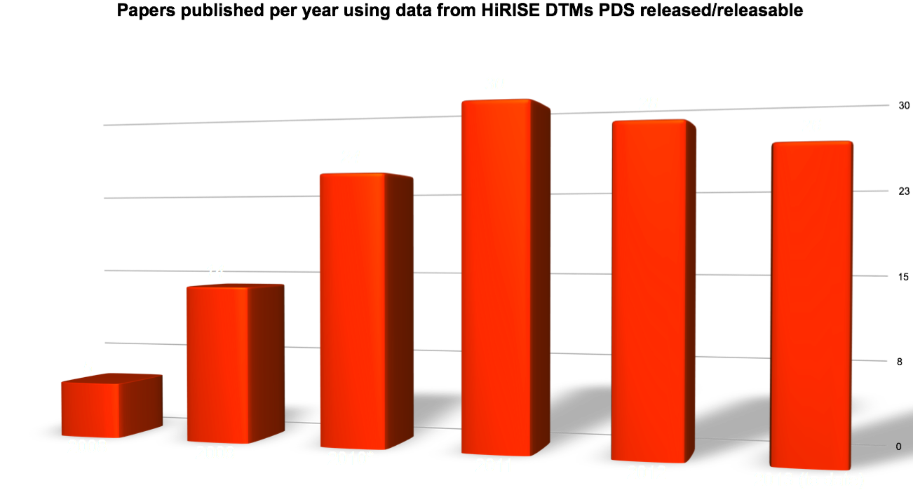
HiRISE DTMs in Publication
* Including 9 from Icarus special issue published Jan., 2010

Slide 20
Science Highlights
HiRISE has transitioned into an experiment that investigates rates of surface change and interannual variability
Repeat coverage of study sites and identification of new study sites is now as important as the ‘static’ surface investigations that dominated the earlier mission (see coverage map below)
    RSL behavior
    Dune motion
    Gully activity in craters and on dunes
    Seasonal CO₂ frost activity
    Changes in the residual caps over decadal timescales
    New impact craters – including those that probe ground ice distribution
HiRISE images within 250km

Slide 21
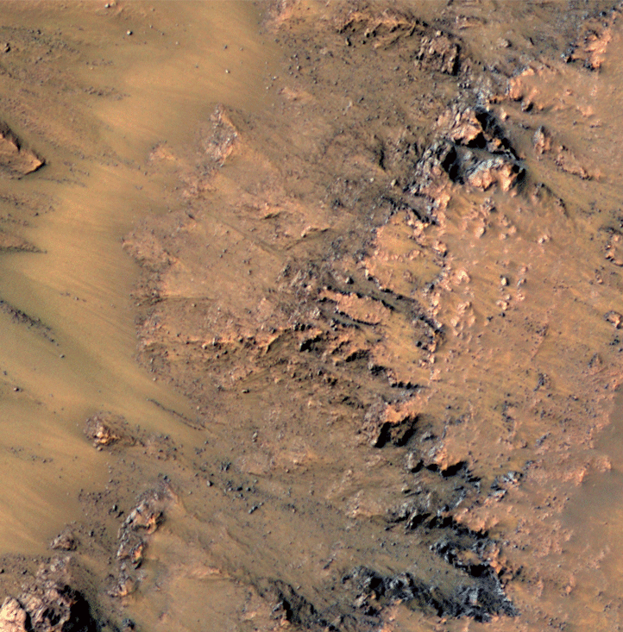
Seasonal Flows on Warm Martian Slopes
(McEwen et al., Science, 5 Aug 2011)
What we knew 2 years ago:
Recurring Slope Lineae (RSL) are narrow (0.5-5 m), dark markings on steep slopes (>25°)
Concentrated in southern hemisphere (32°S to 48°S), favoring equator-facing slopes.
Form and incrementally grow in late spring to summer, then fade or disappear in fall.
Reform at nearly same locations in multiple Mars years.
Extend downslope from bedrock outcrops or rocky areas; often associated with small gullies.
Form and grow at temperatures at which brines would be liquid.
Exact mechanism not understood, but activity of brines is current best model.

Slide 22
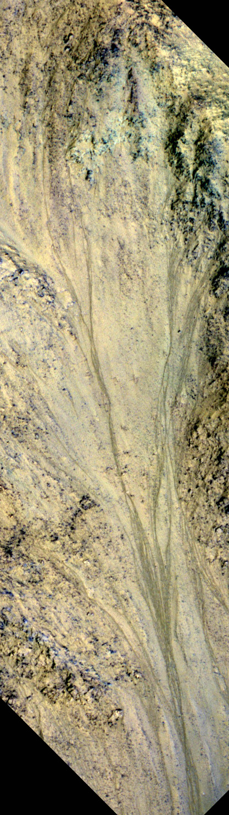
What we know today: (McEwen et al. Nature Geoscience, In Press)
RSL also concentrated in Valles Marineris (VM) on all slope aspects.
There are a few RSL sites in other equatorial regions
In VM they form and grow in N spring/summer on N-facing slopes, S spring/summer on S-facing slopes, then fade or disappear.
Recur at nearly same locations in multiple Mars years.
Extend downslope from bedrock outcrops or rocky areas; often associated with “small” gullies (some are larger in VM).
Associated with fans that have Fe²⁺ and Fe³⁺ absorptions (greenish in HiRISE IRB color)
Longer RSL in VM, >1 km
Shallow ice origin less likely; deeper sources more plausible
RSL is Eos/Capri Chasma. RSL start at top of this image and extend beyond the bottom, ~1.2 km total length

Slide 23
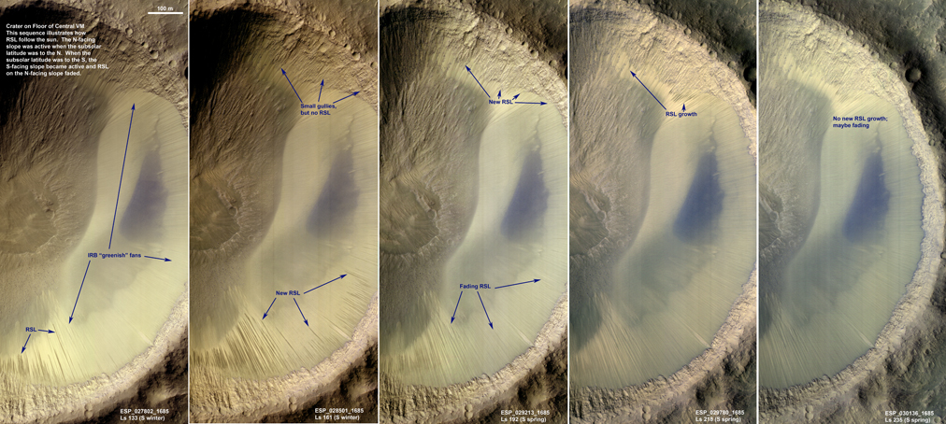
Image Sequence of Melas Chasm & map of confirmed RSL
MOLA elevations

Slide 24
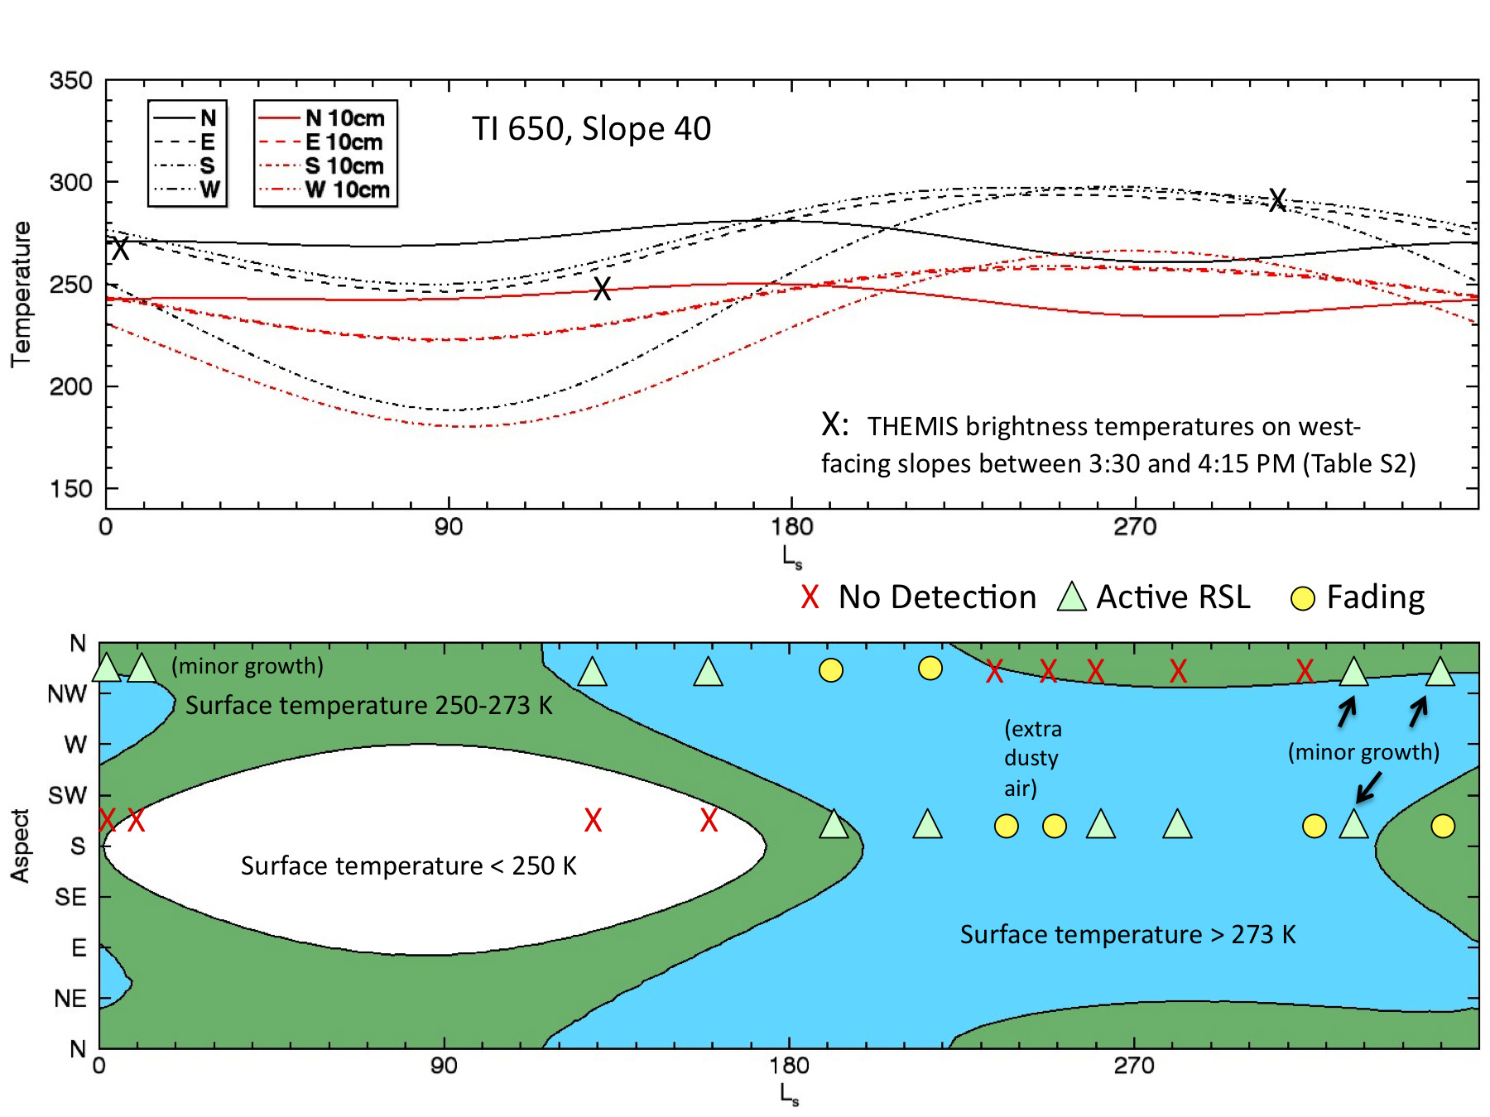
Temperatures of crater in Melas Chasma, thermal inertia 650, Slope 40°

Slide 25
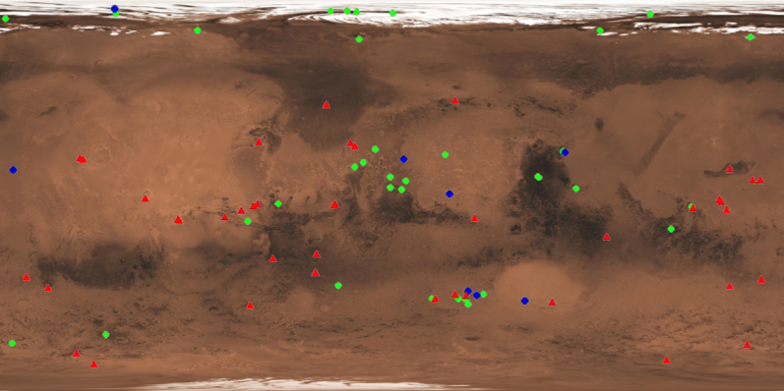
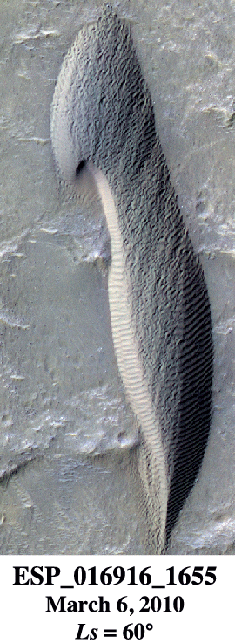
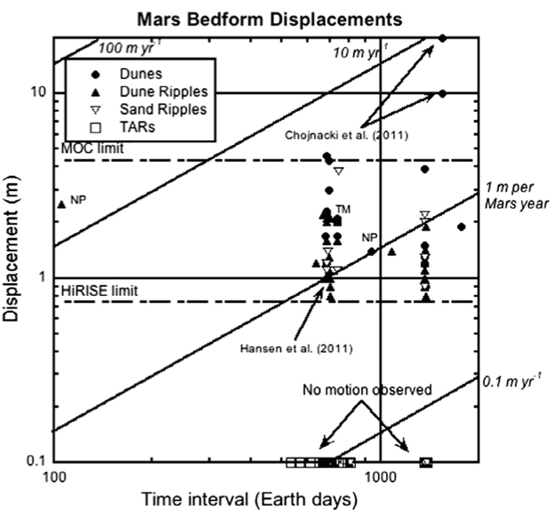
Bridges et al. 2013
We’ve moved beyond change detection to rate measurements.
What’s the real distribution of near-surface wind speeds?
More time allows the slower/less-frequent motion to be quantified.

Slide 26
Cracks on crest become source of sandfalls
Landscape restoration
“Buzzel” Lat / Lon: 84N / 233E

Slide 27
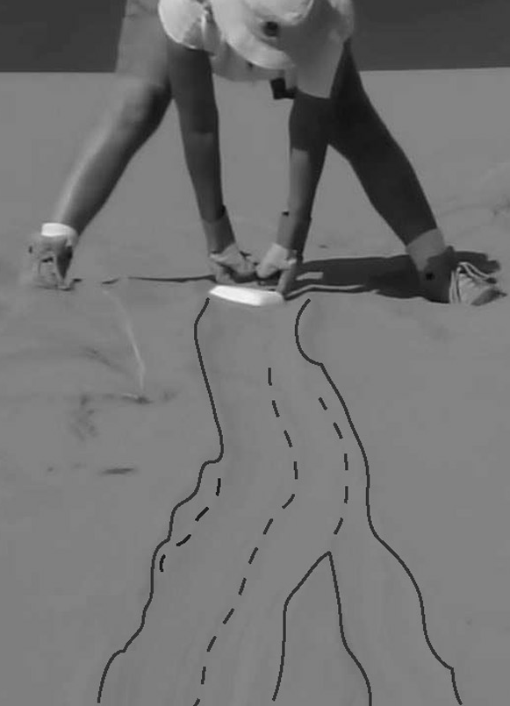
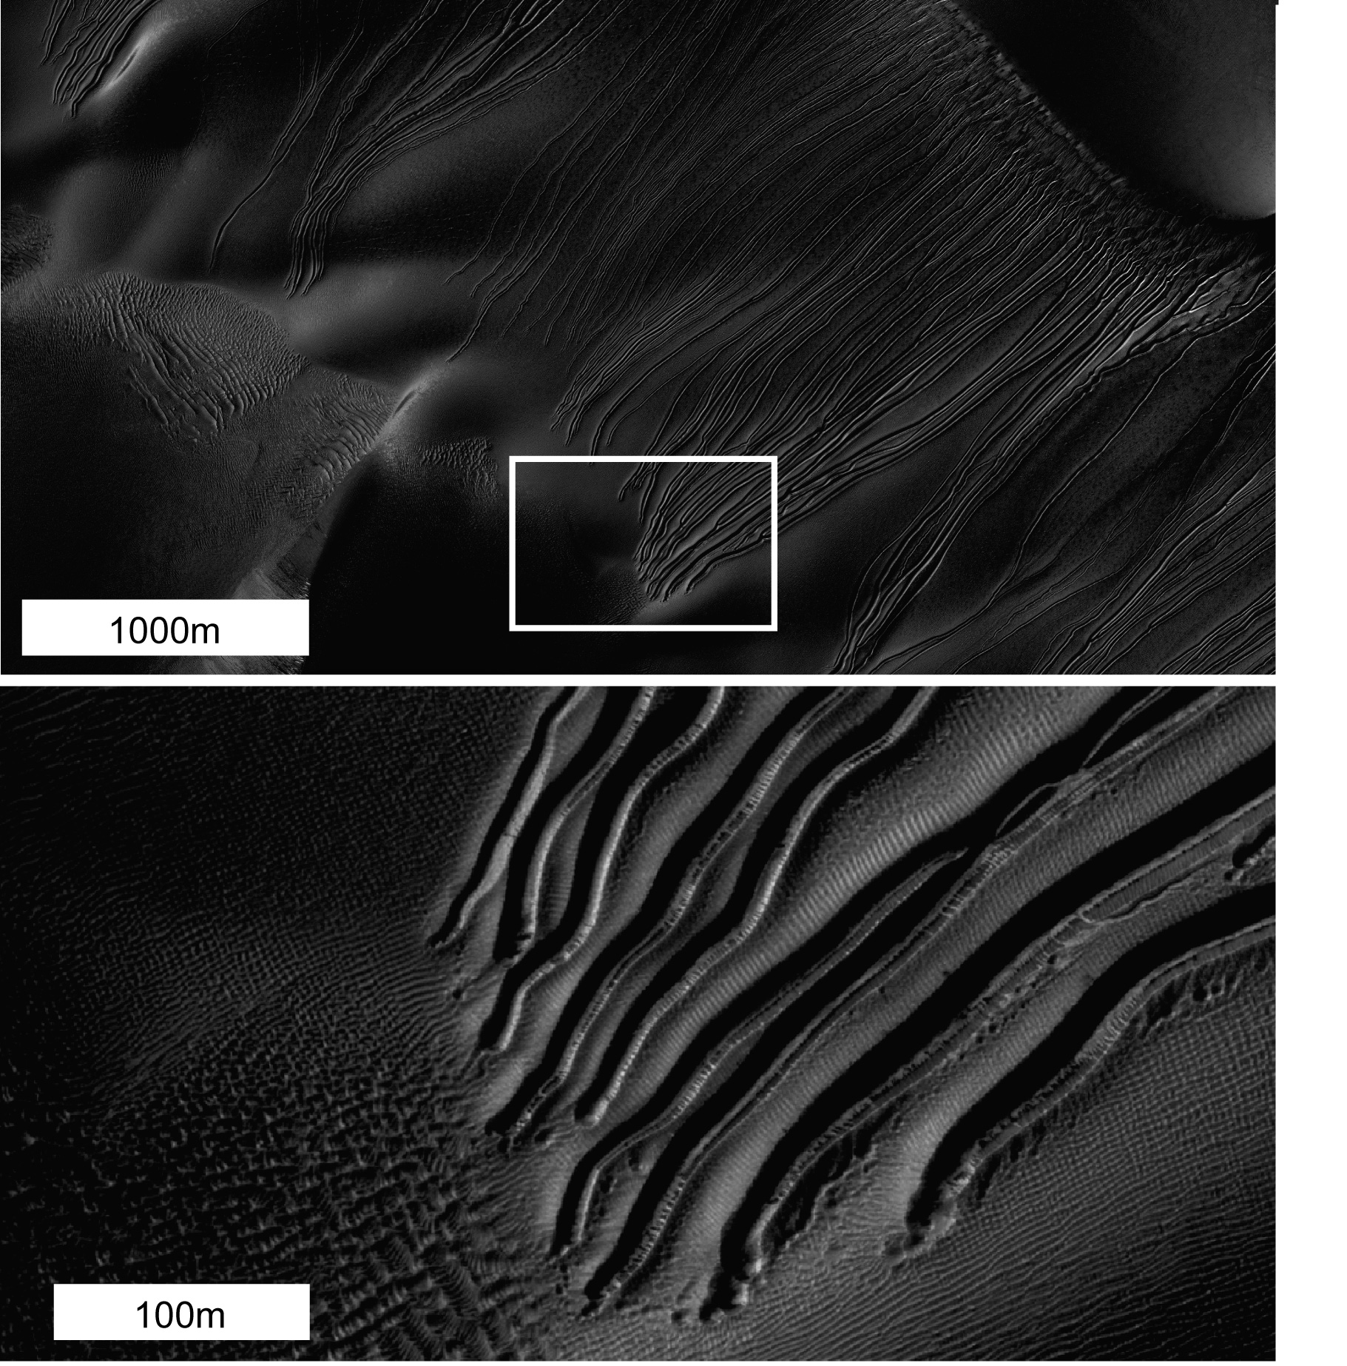
Dry ice blocks ‘hovercraft’ down Martian dunes
Dry ice (frozen carbon dioxide) blocks form naturally every winter in the Martian polar regions.
When warmed, dry ice blocks sublimate (go directly from solid
to gas), rather than melt. This creates a cushion of gas beneath
the block that makes it very easy for the block to slide or roll
down the dune slope, carving out a shallow trough.
Although Mars is
colder and has much lower
atmospheric pressure, calculations
predict the same behavior as seen
with experiments on Earth dunes. Videos can be
found at http://www.jpl.nasa.gov/
news/news.php?release=2013-200.
When the block stops, it continues sublimating and the gas flow can dig out a pit. The block will eventually disappear, leaving just the track and ending-pit.
Over many winters, downhill motion of broken dry ice blocks can perhaps form the large linear gullies (up to 2km long!) seen on Martian dunes.
For more info, see Diniega et al., 2013, Icarus, doi:/10.1016/j.icarus.2013.04.006.

Slide 28
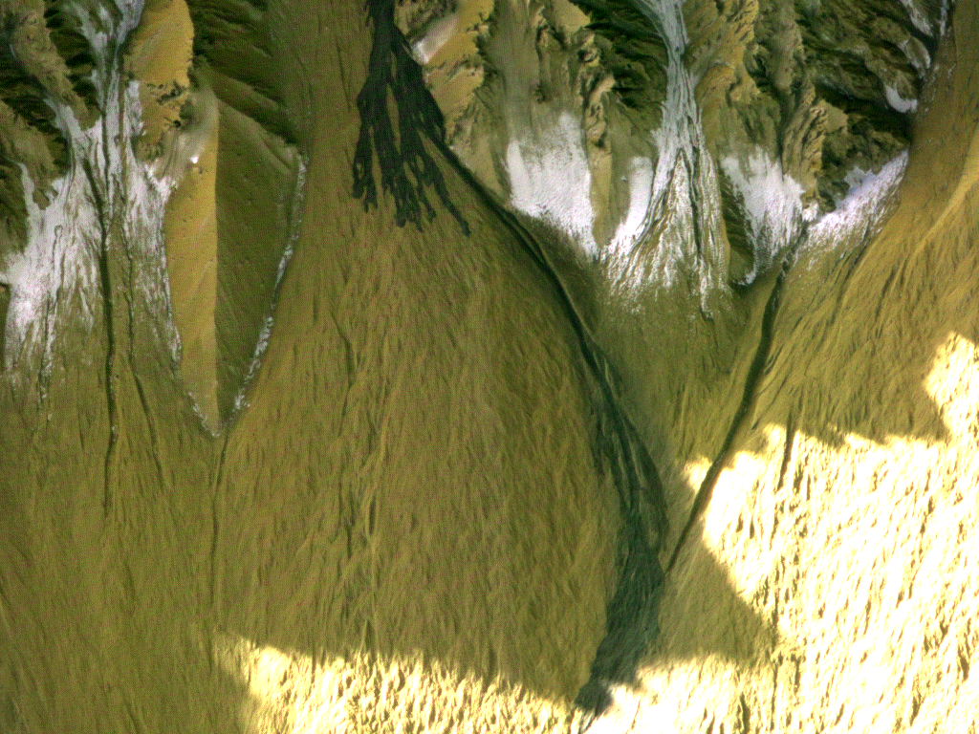
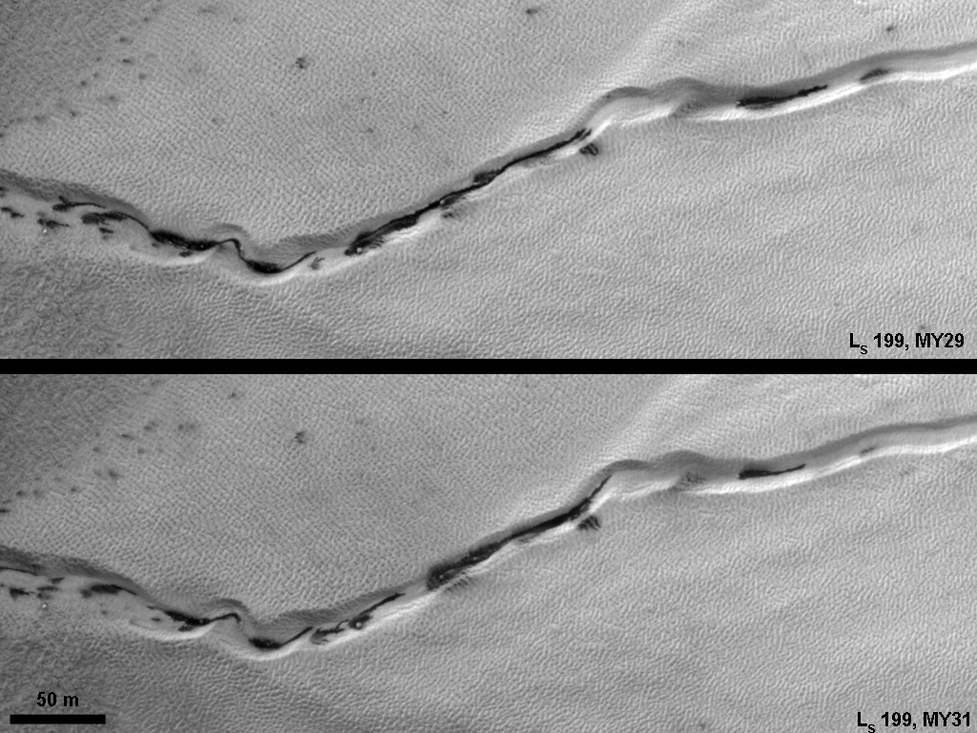
Frost and Gully Activity
Mass movements in gullies occur when CO₂ frost is present, or during defrosting.
Defrosting spots and flows often concentrate in gullies.
Frost activity is largely repeatable from year to year, but major mass movements are stochastic.
Current activity may be a major component of gully formation
Gasa crater: new deposit between L_{S} 128-141.

Slide 29
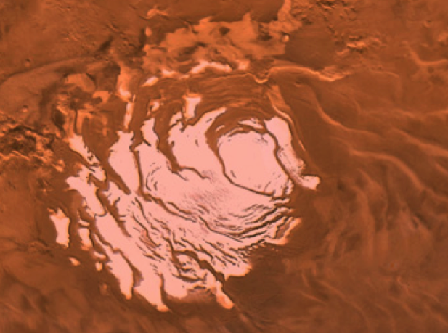
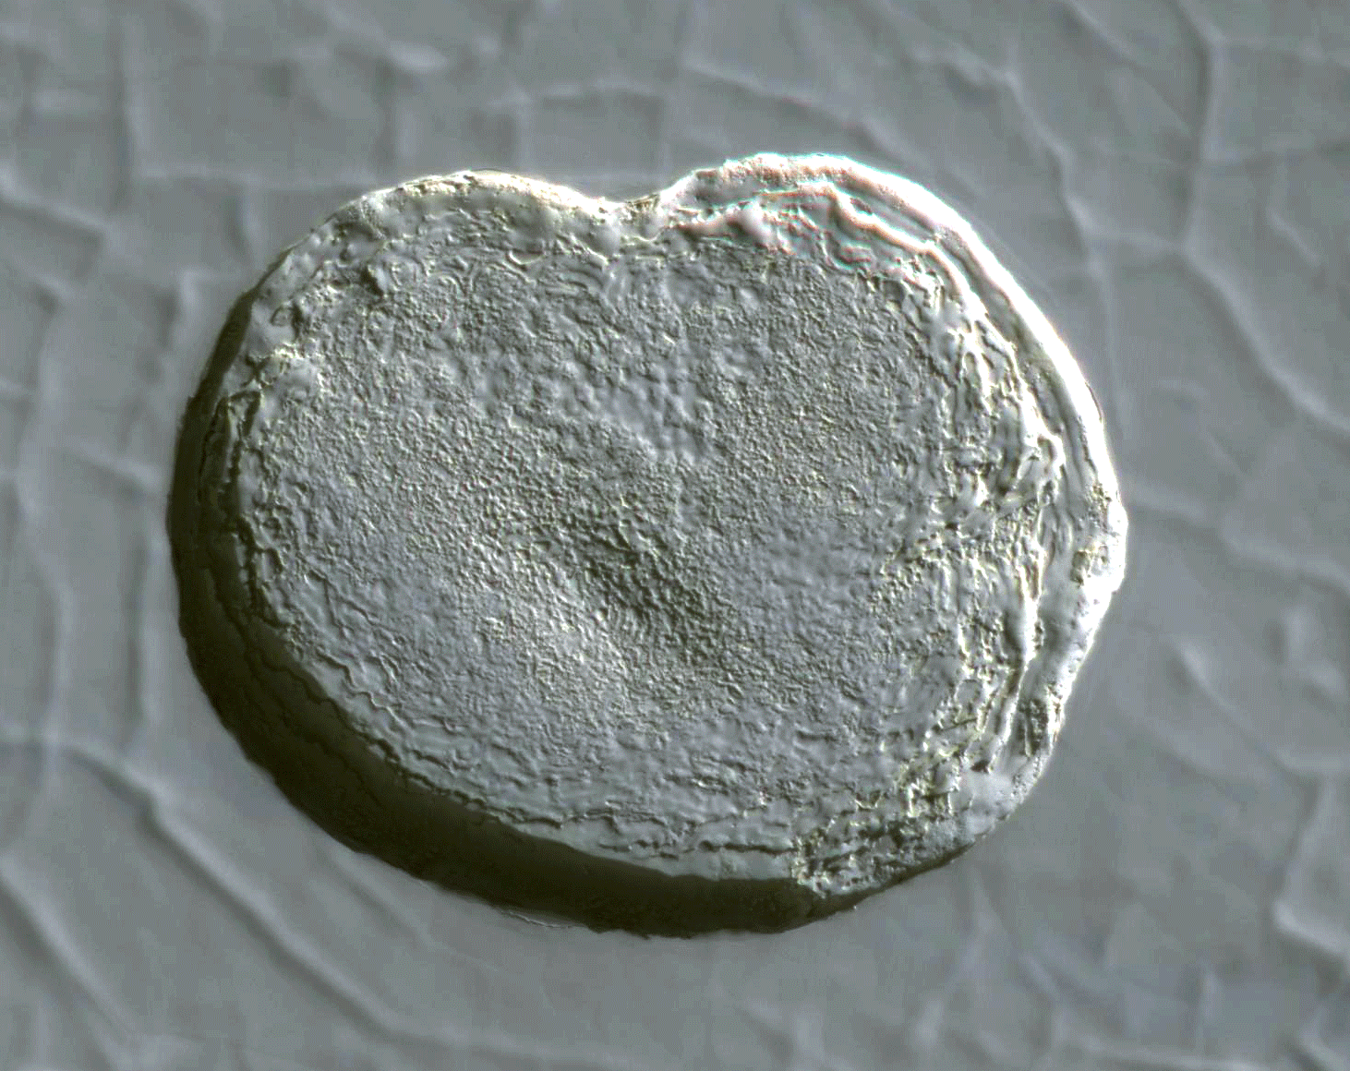
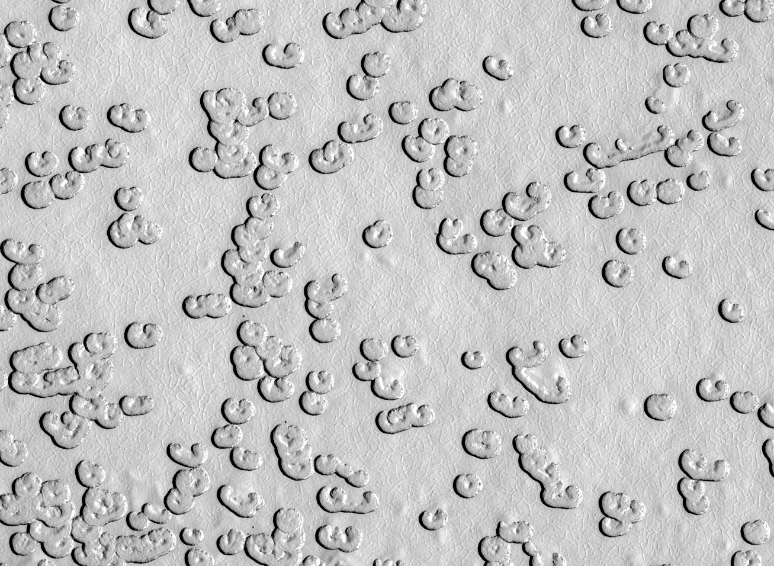
Change in the CO₂ Residual Cap
South polar residual cap is a few-meter-thick slab of CO₂ ice
  Pits below are a distinct population, each ~200m across
  Expanding (m/yr) pits indicate CO₂ being returned to the atmosphere
  Climate change?
G11_022329_0931_XN_86S006W

Slide 30
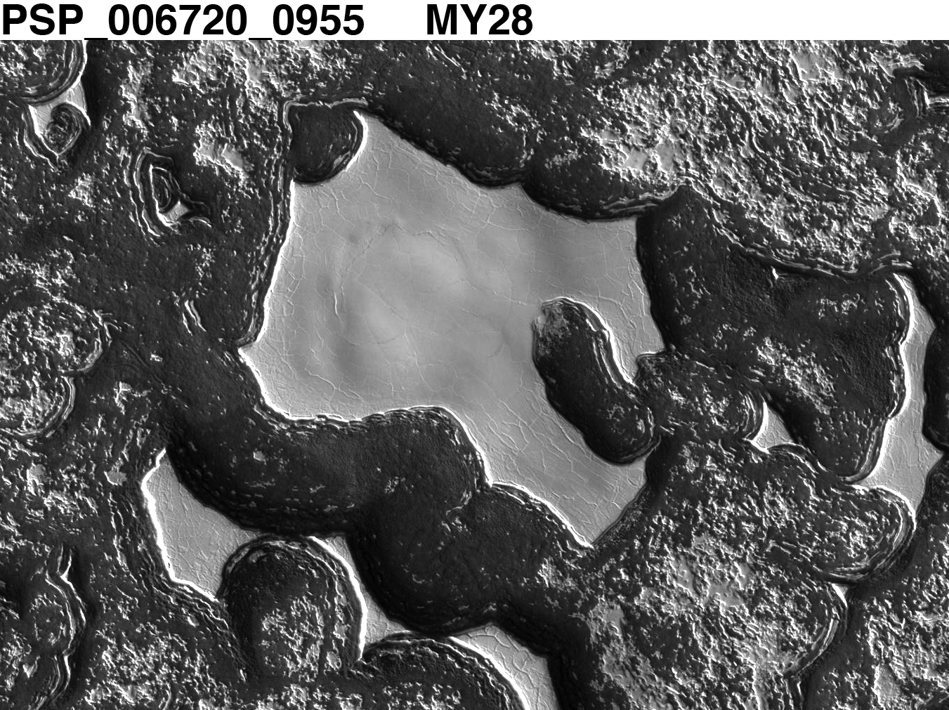
SRC - reaccumulation

Slide 31
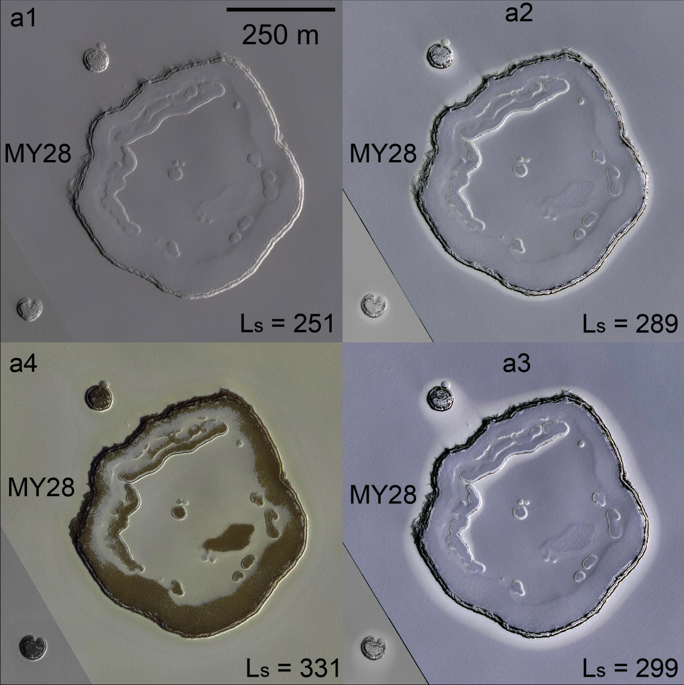
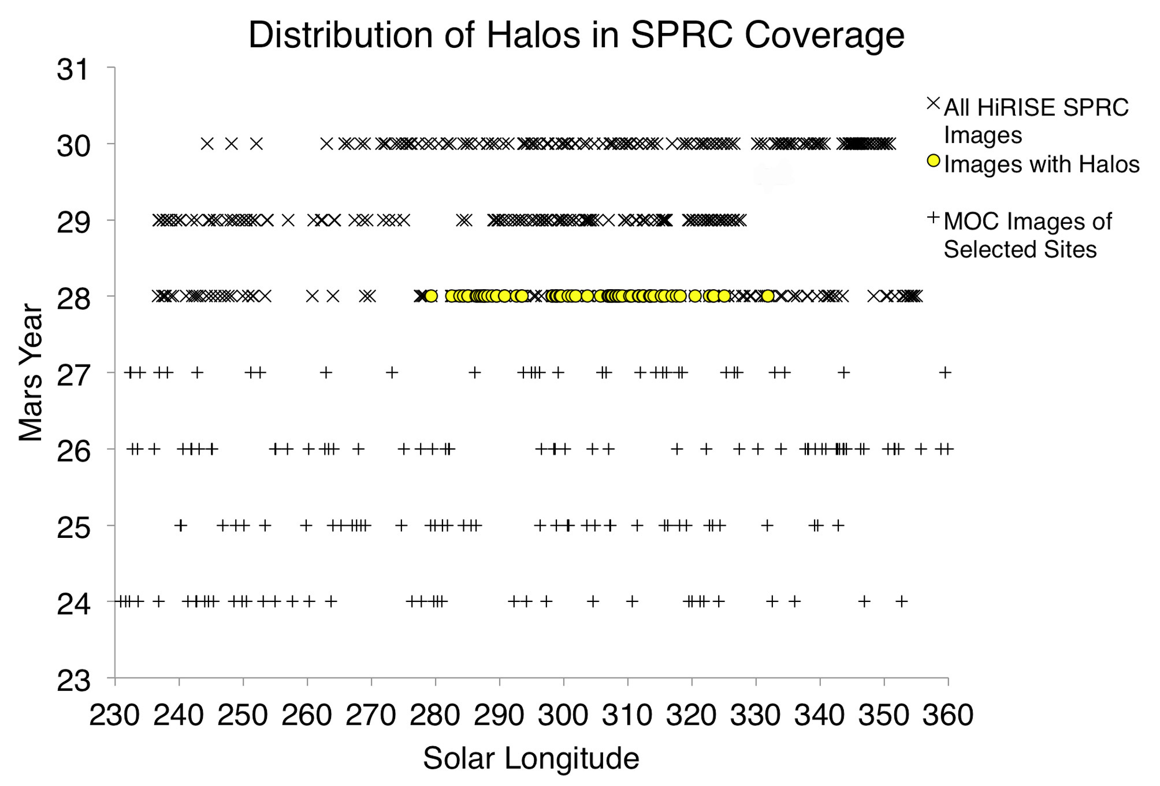
South polar Halos
Observed only during one particular Mars year (MY 28)
Also the year of a perihelion duststorm
MY 25 had equinox duststorm – no halo effect
Notes:
(this and following 2 slides: 1min)

Slide 32
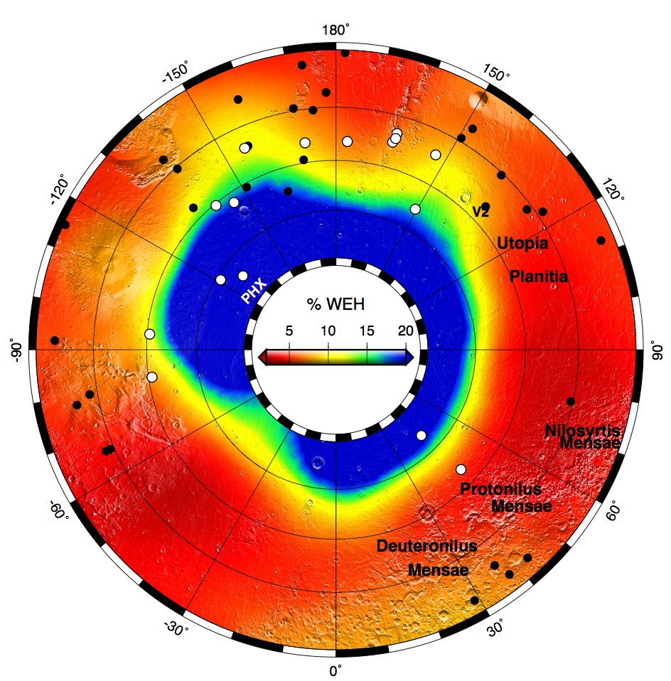
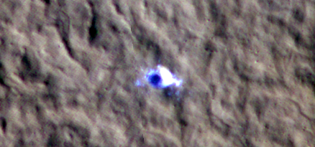
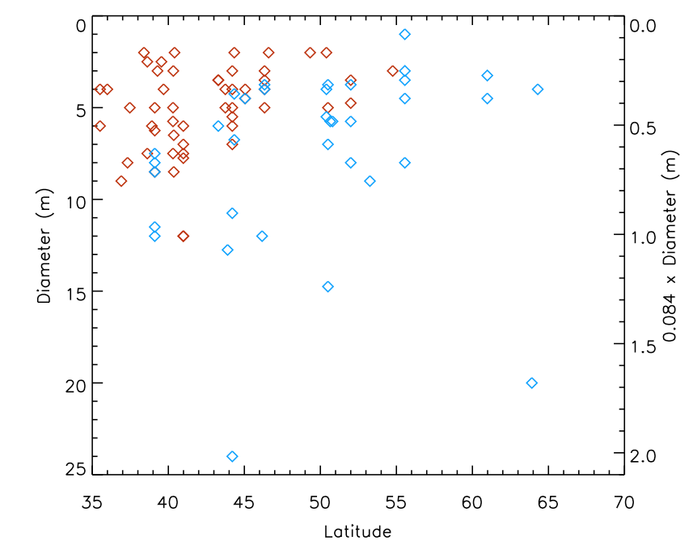
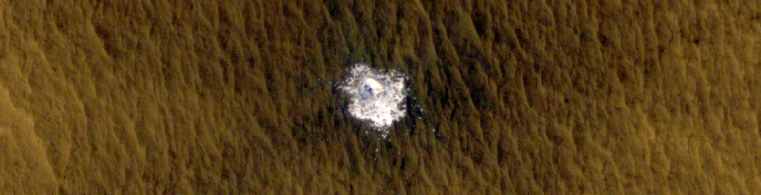
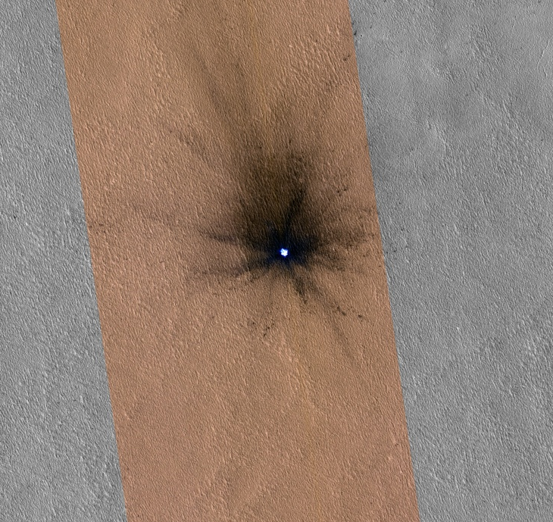
Footprint of GRS
ESP_029467_2195
~20 of these impact sites now known
Expected that the detection rate will accelerate
44°N

Slide 33
Data Products and Tools
New Products:
  Merged color products – now complete
  Processing PDS-released CTX EDRs to HiRISE RDR format
  Improvements to web site and HiWish (maps, search tools, CRISM footprints)
  HiView
  Color orthoimages – now being released on PDS schedule
Candidate new products for EM2/EM3 (progress on each since last PSG, but not yet released)
  DTM confidence and Figure of Merit (FOM) maps
  “Accidental” stereo anaglyphs
  Color ratio products
  PDS archive of HiPrecision products (currently resolving ISIS glitch)
  FFT noise cleanup and image sharpening (development done)
  Reprocessing with improved radiometric cal.
  Photometrically-corrected products?

Slide 34
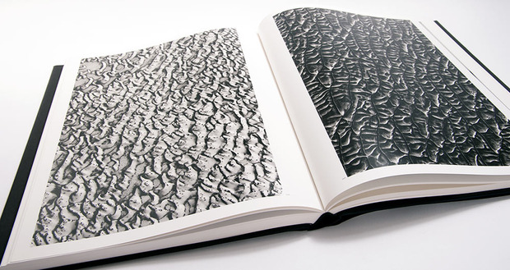
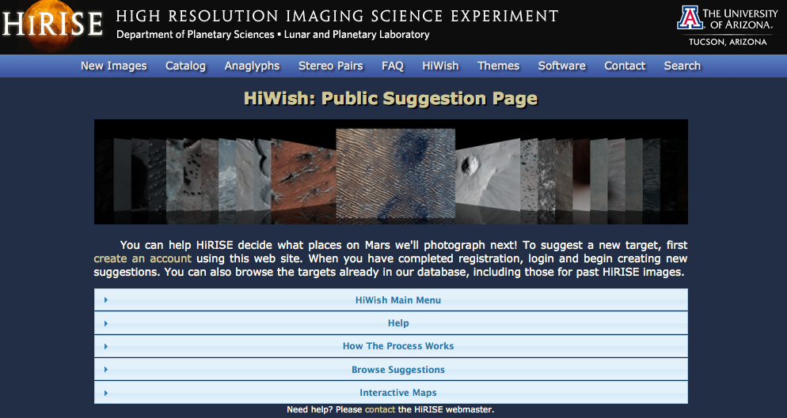
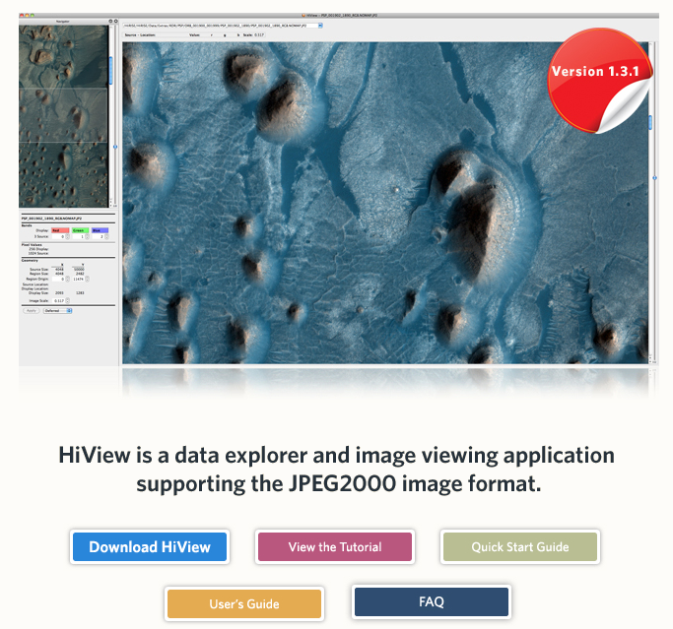
EPO activity
“This is Mars” – coffee table book
New Vimeo channel for archived HiClips
New Russian HiTranslate version now available
Dedicated YouTube channel for Russian HiClips (We have 5 others)
40 new inquiries about joining HiTranslate 5 new Tumblrs launched
Upcoming Tumblrs: Ukrainian, Polish & Latin
HiWish
HiView

Slide 35
EM3 ideas
Themes (2)
  Rates of surface change
    Impact rate (coordination with INSIGHT in EM4) – with CTX
      What is the seasonal variability?
      What is the interannual variability?
      Additional constraints on the distribution of near-surface ice. Can frost-heave operate on Mars?
    Dune migration as proxy for near surface meteorology
      What is the seasonal variation in wind (can be measured at the windiest sites)?
      What is the interannual variability at any given site?
      What is the balance of dune gully formation vs. erasure?
      Calibration of mesoscale models. How common are sites of intermediate or low windiness?
    Gully activity
      Does the rate of gully formation explain their formation all in the current climate?
      Do the spatial trends inform us of local meteorology? i.e. its effect on frost accumulation
  Interannual Variability
    RSL activity – with CRISM
      Is the northern hemisphere really deficient in RSL (or just deficient in steep rocky slopes)?
      What is the interannual variability?
      Can additional observations coordinated with THEMIS constrain necessary temperatures?
      Can we get some composition from CRISM?
    Seasonal and residual ice caps (especially dust storm vs. clear years) – with CRISM
      What kind of interannual variability do dust storms drive?
      Placing limits on the mass balance of the SRC and secular climate change.
    Polar avalanches (not emphasized because of timing of next conjunction)
      There’s already huge interannual variability – what is driving it?

Slide 36
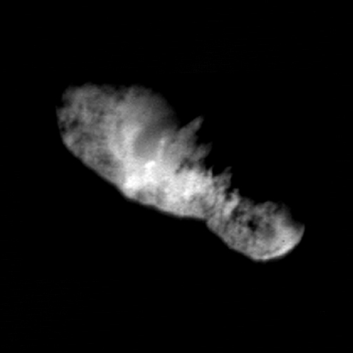
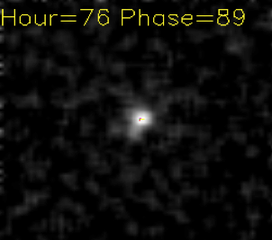
Other Joint Instrument Projects (ongoing/future)
  Residual cap co-analysis of CRISM and HiRISE color-ratio data
  Polar stratigraphy with HiRISE DTMs and SHARAD
  Mid-latitude ice depths from SHARAD and terraced craters
  Multiple studies of stratigraphy of ancient deposits with CRISM
Curiosity, Insight, Mars 2020 etc…
  Landing site hazards
  Rover-Science context
Siding Springs
  100m/px images of nucleus
  Similar to DS1 Borrelly encounter
  Could CTX get coma structure?
  Could CRISM get compositional info?
ISON from HiRISE
Borrelly from DS1
(similar to Siding Springs from HiRISE)

Slide 37
Bottom line? Example of RSL & Gullies…
  Repeat coverage was needed to discover RSL – an important paradigm shift concerning contemporary water on Mars
  Repeat coverage also showed the gully activity to be unrelated to liquid water – despite previous entrenched consensus to the contrary.
  Almost certainly there are other processes that take more than 3 years of data to be observed; probably hiding in plain sight in our current datasets
Monitoring isn’t a word to be avoided – we should point out that these activities yield first-order scientific discoveries that we just can’t get from static datasets i.e. this is NOT just an incremental improvement

Slide 38
Response to cuts (from numbers provided by Rich)
  MRO funds reduced
  No more funds from PDS
  Increased student and other costs from UA
  HiSCI and CaSSIS both gone
Cut all Co-Is and the PI by 20% - less Science and Science-Planning
Cut off 1 of 3 grad students at UA
Reduce operations staff (by natural attrition) – Can probably stretch to cover FY15 low data rate, but not FY16
Cut admin support to 1 FTE – no redundancy so longs waits during vacations/sick-days etc…
Cut computer equipment purchases by 50% - more likely an issue in FY16
Operation budget cut 20% - including maintenance contracts (maybe too risky to do)
Cut travel by ~40% - Only 2 HiRISE people will attend future PSGs, and ops people can't attend team meetings except in Tucson
Cut Ball support 20% - If we have a significant problem, will ask for project reserves.
  No extra capacity to support Siding Springs work, so maybe skip Mars imaging for those cycles.
  We can limp through FY15, but something will have to give in FY16 – perhaps turning off HiRISE for some cycles

