Slide 1
Recent HiRISE science results MRO PSG, October 2015

Slide 2
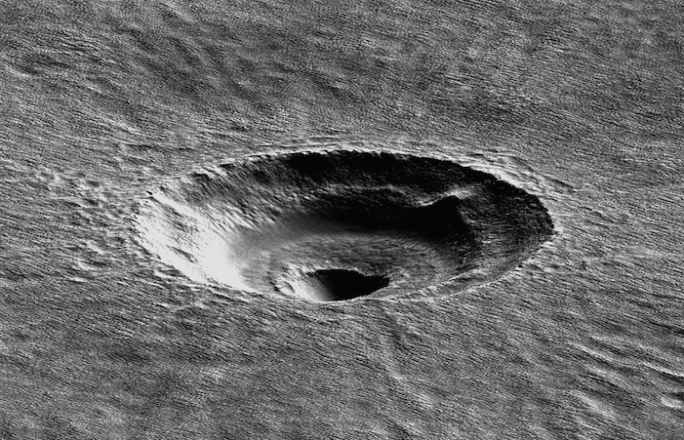
Themes
Mid-latitude and polar ice
New Impacts
Aeolian activity

Slide 3
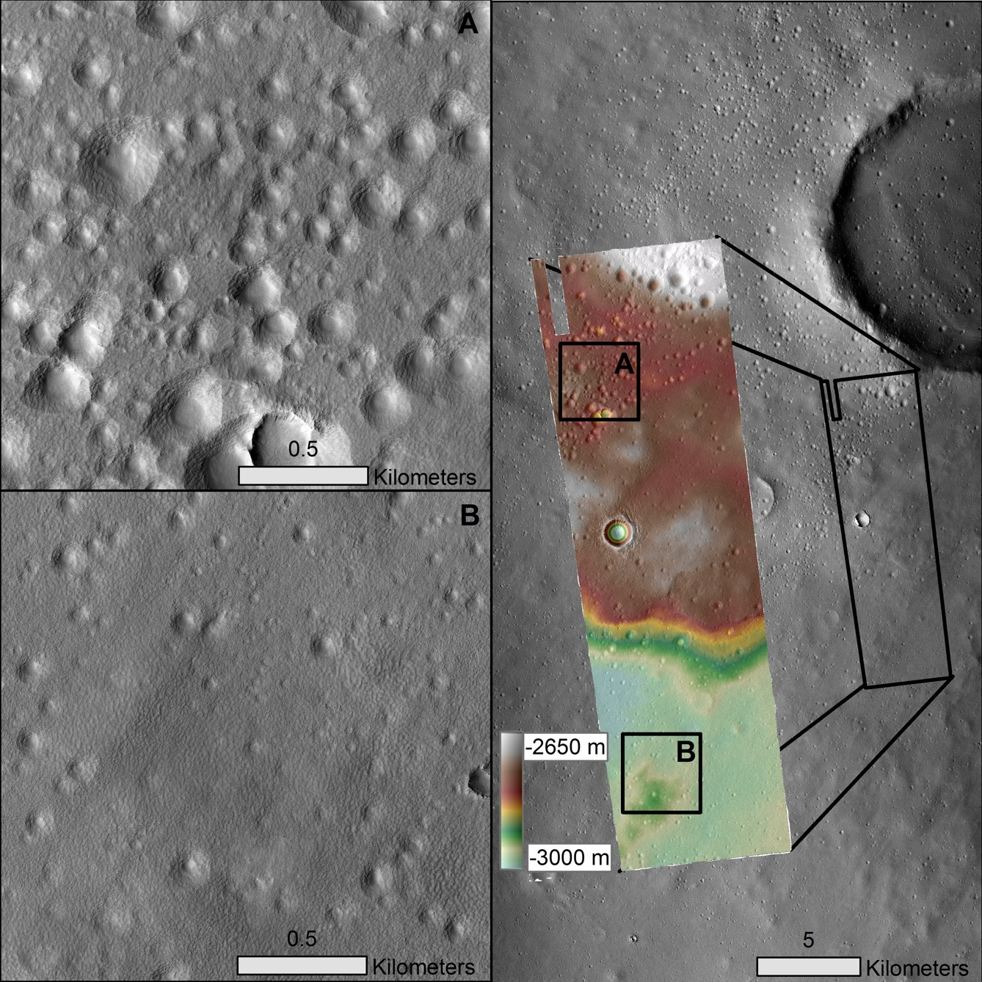
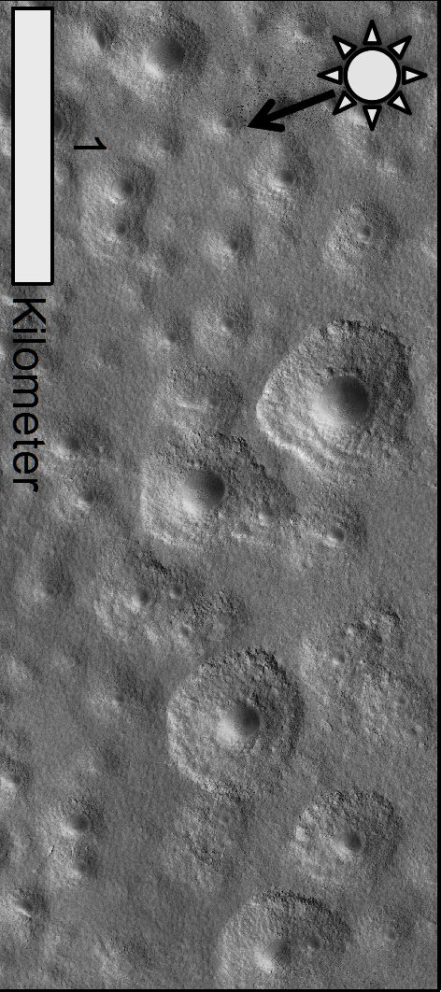
Expanded Secondary Craters as Evidence for Ancient Subsurface Ice
The source of these expanded secondaries appear to be four larger craters that are between 20 and 70 million years old based on crater counts.
Estimated that there is at least 6000 cubic kilometers of ancient ice remains in the near subsurface of Arcadia Planitia
Viola et al. (2015). Icarus 248, pp.190-204.

Slide 4
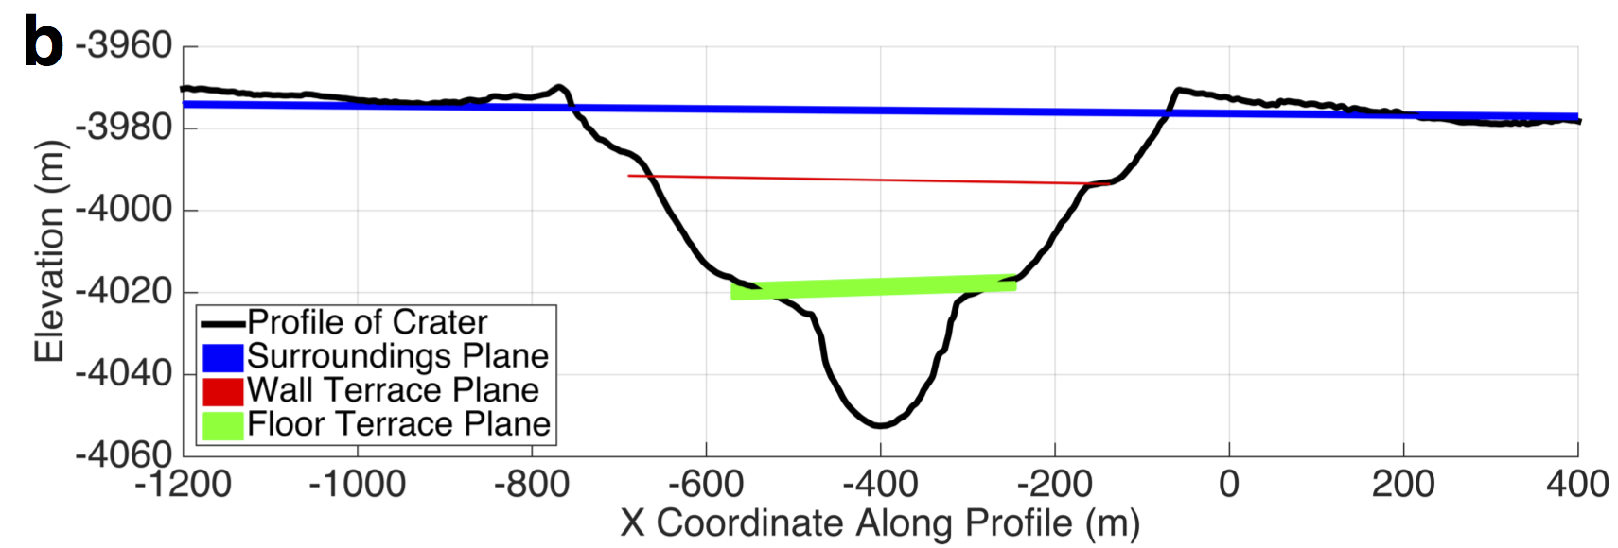
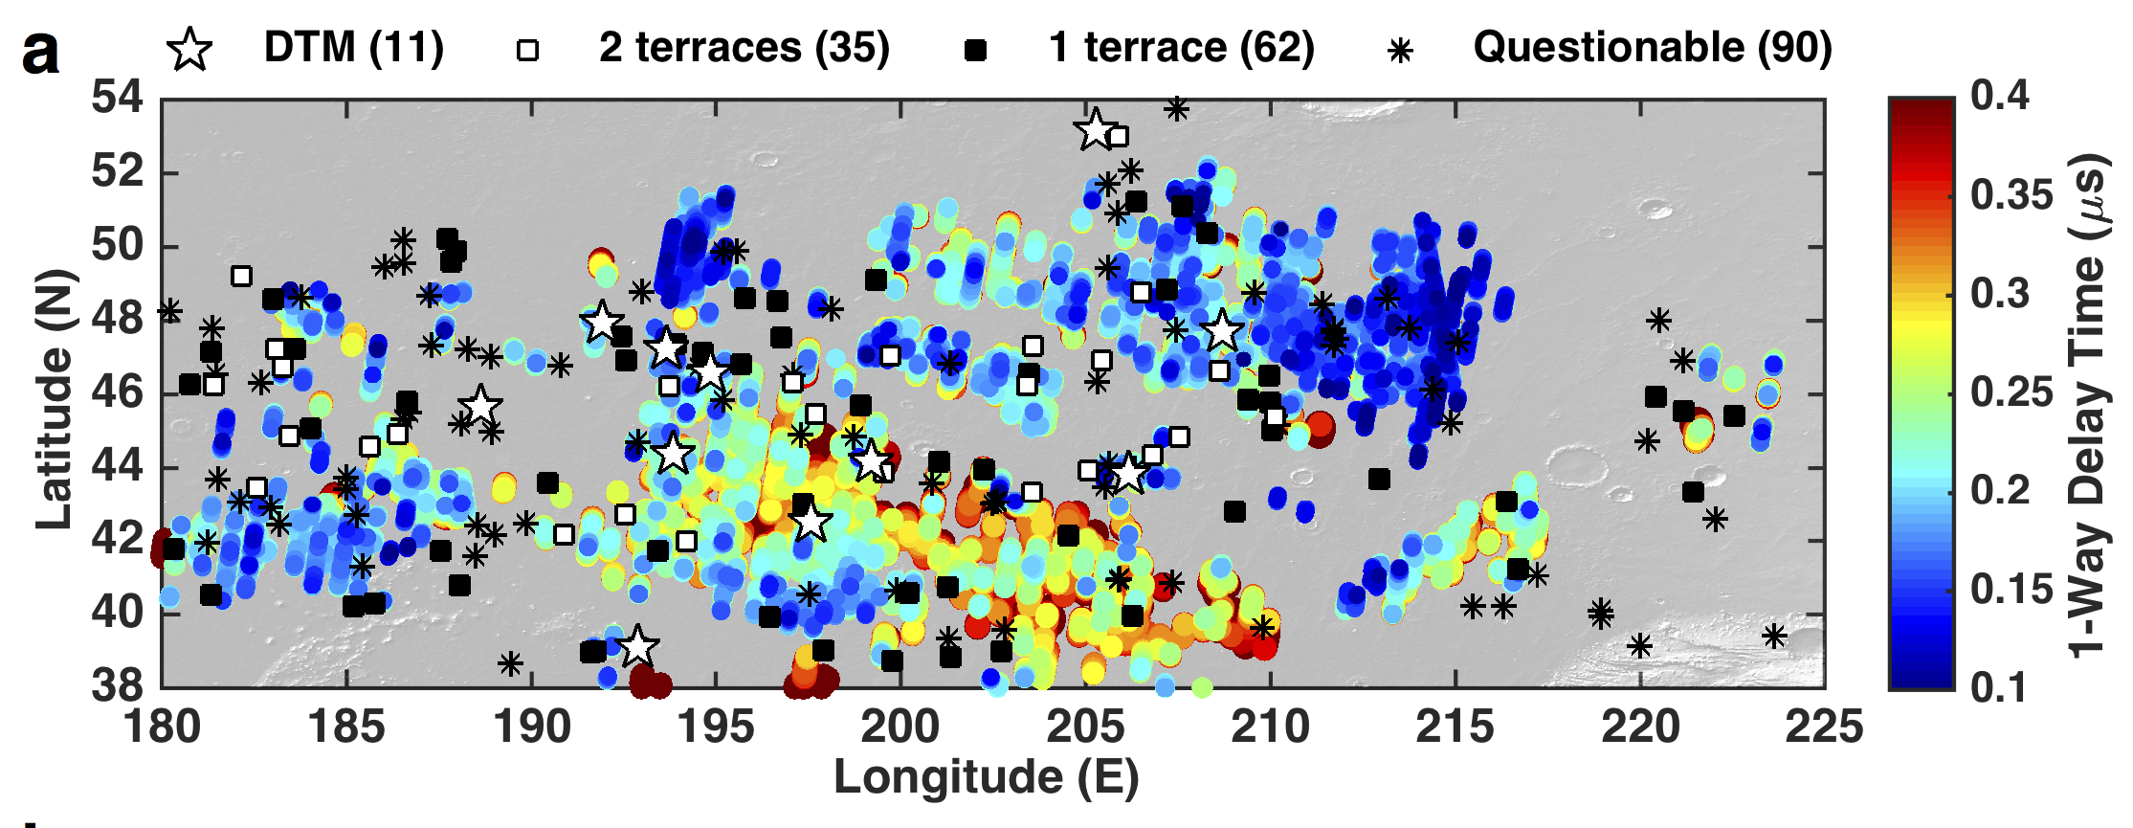
Widespread Ice in Arcadia Planitia on Mars
Combined SHARAD/HiRISE data finds decameters of excess ice over 10⁶ km²
Results published in: Bramson, A. M., S. Byrne, N. E. Putzig, S. Sutton, J. J. Plaut, T. C. Brothers, and J. W. Holt (2015), Widespread excess ice in Arcadia Planitia, Mars, Geophys. Res. Lett., 42, doi:10.1002/2015GL064844.

Slide 5
Analysis of most equatorward perennial surface ice
Louth crater ice mound (~12km across) is stable over many Mars years
Sensitive climatic indicator at 70.5N
Bapst et al., LPSC, 2015.

Slide 6
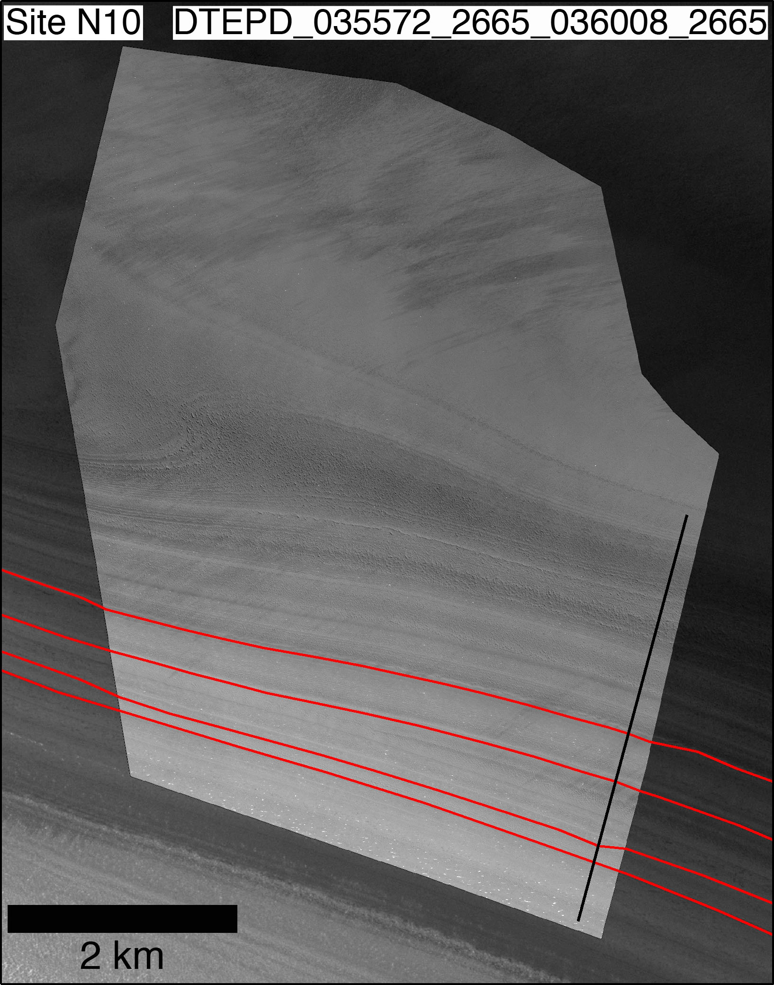
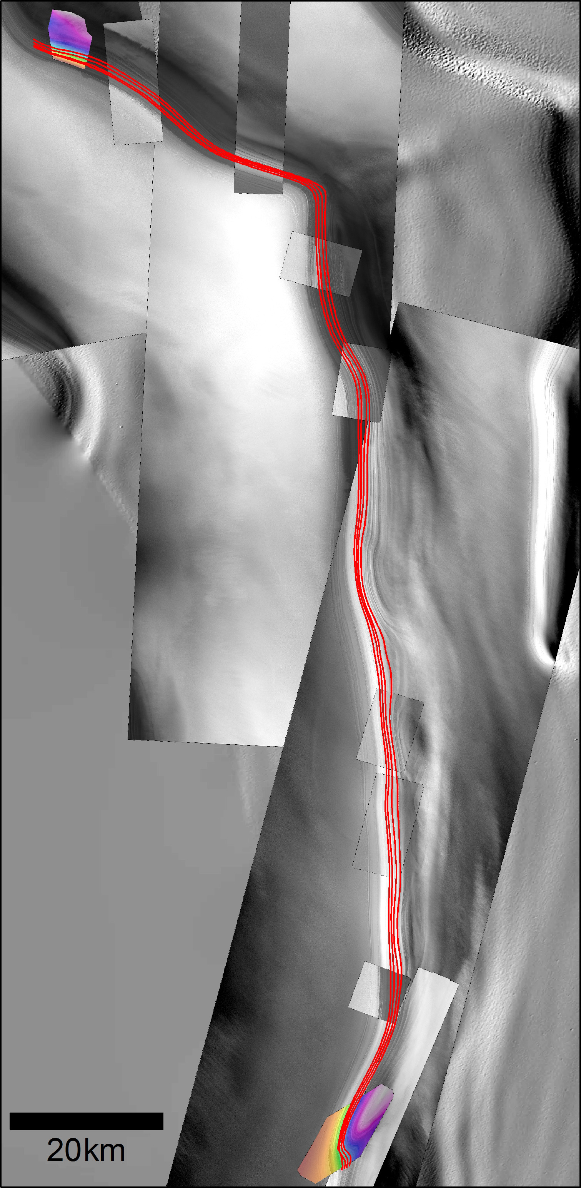
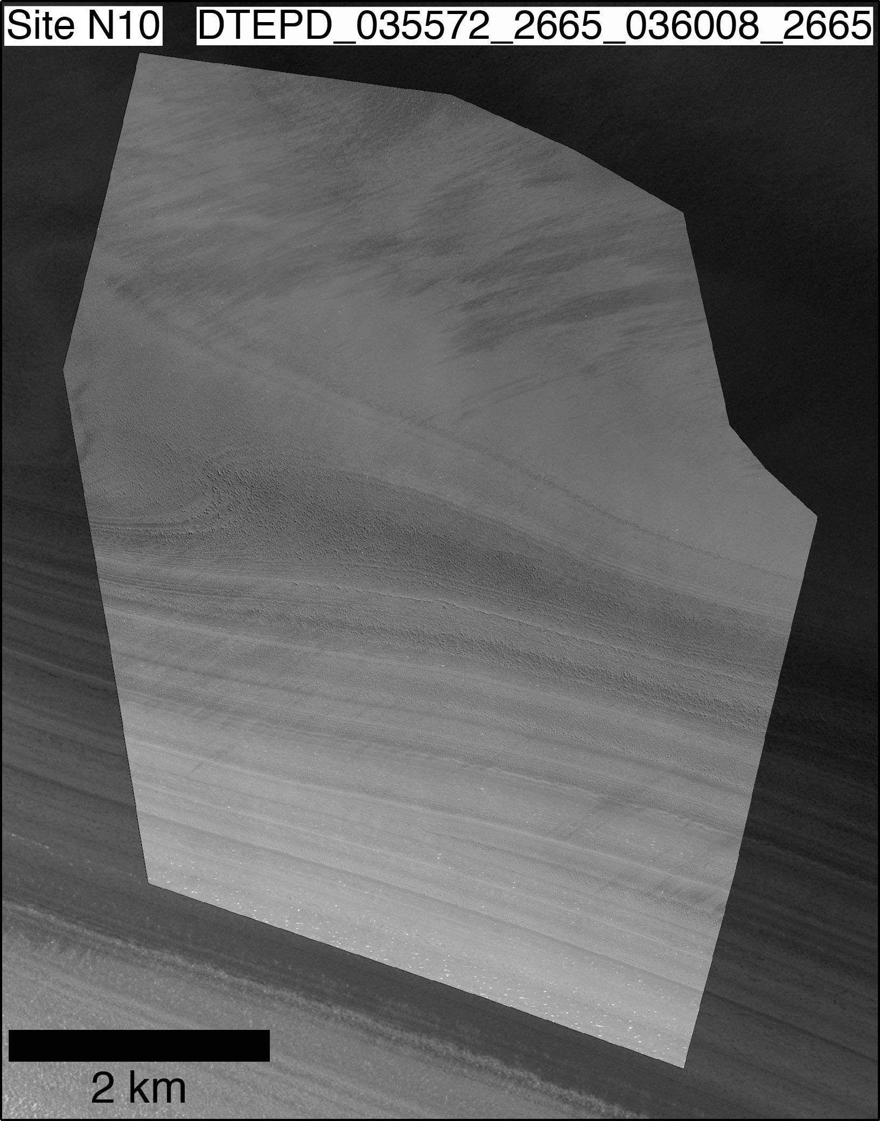
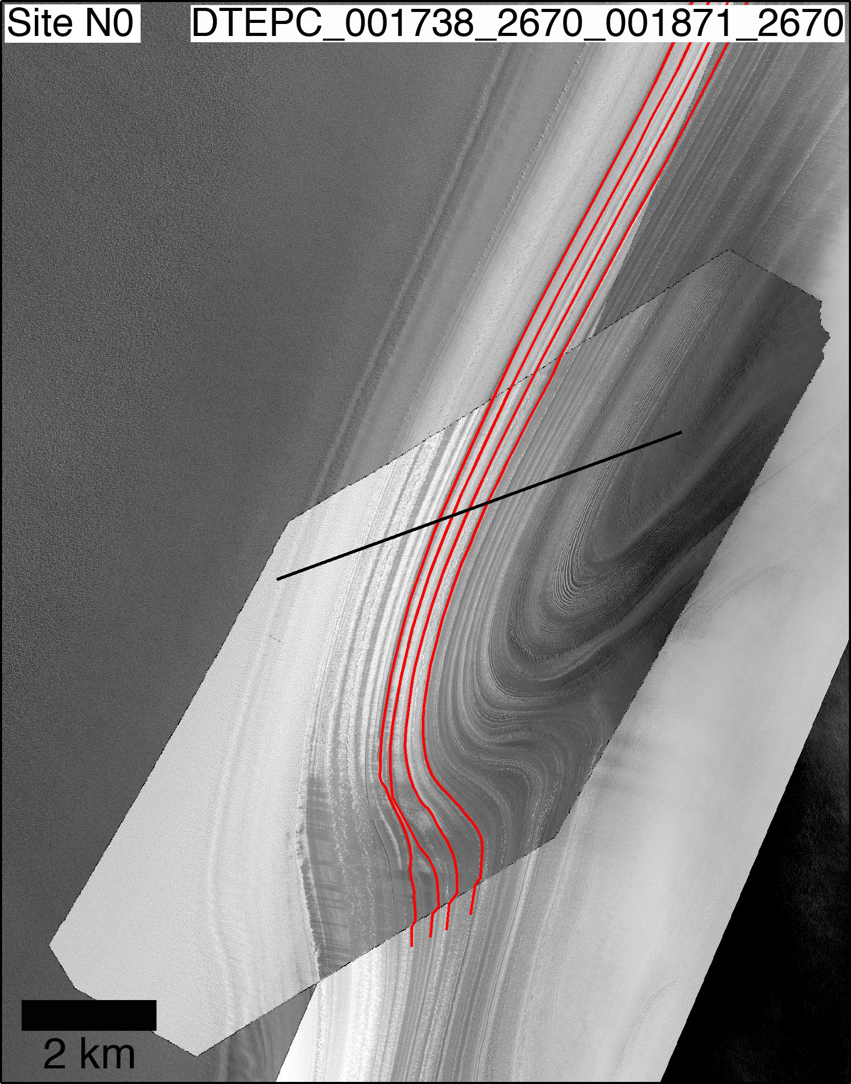
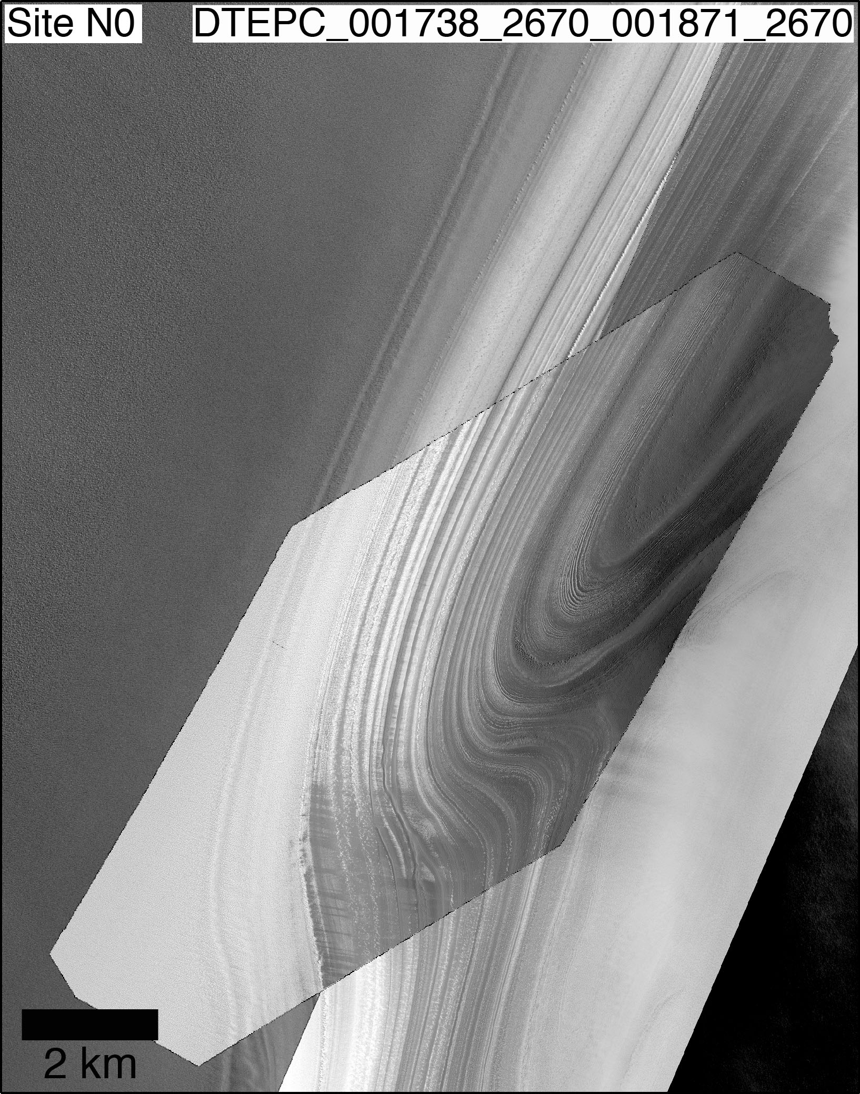
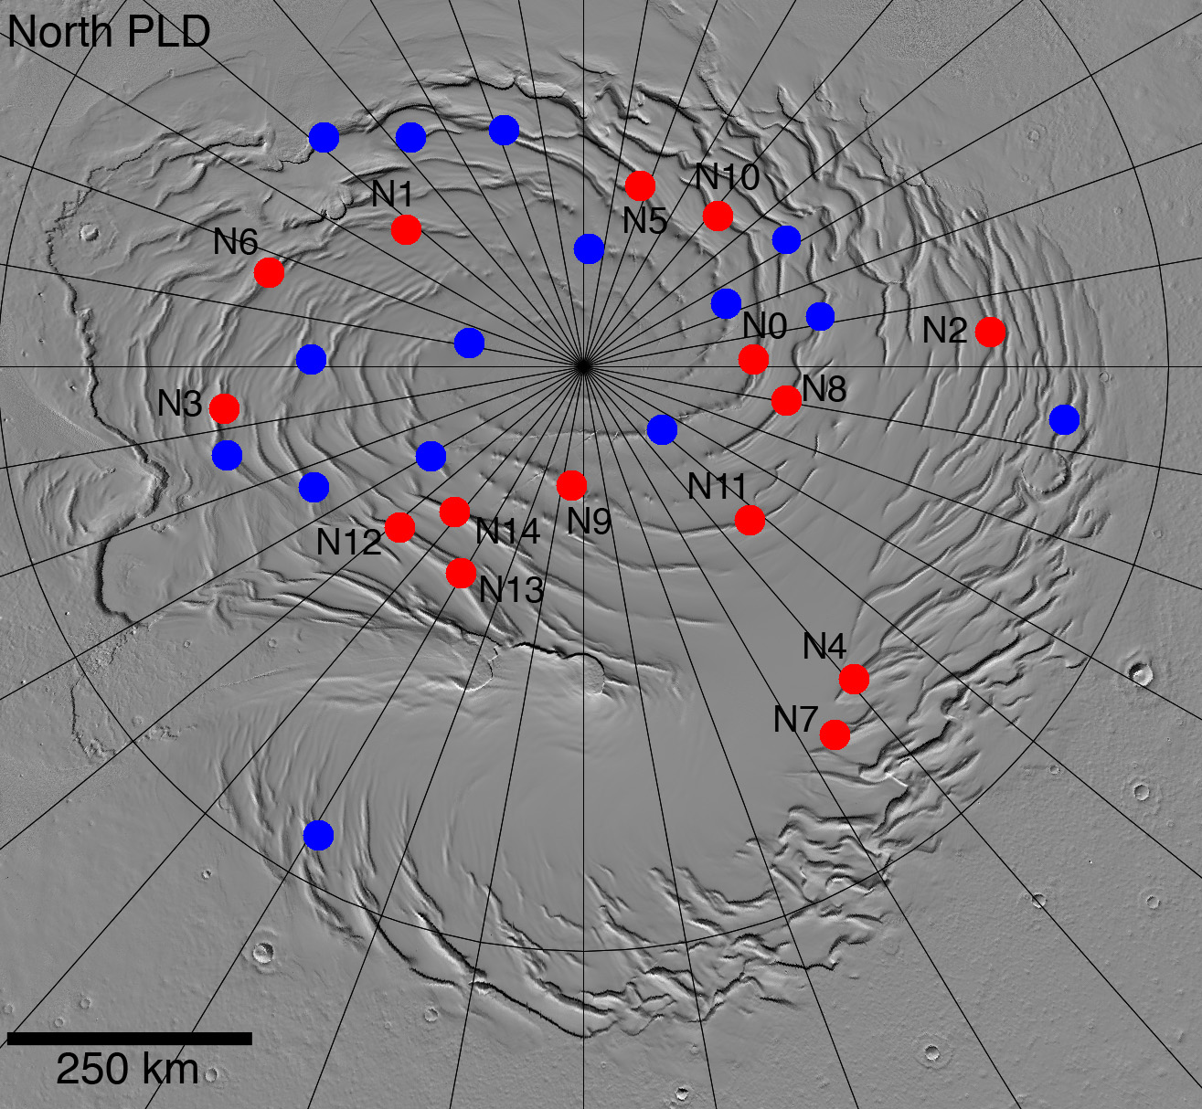
Correlation and analysis of NPLD layers with HiRISE DTMs
Becerra et al., LPSC 2015
CTX coverage allows for tracing individual layers from one site to another along a scarp
Intervening HiRISE coverage helps to check tracing with high-resolution view of layer morphology

Slide 7
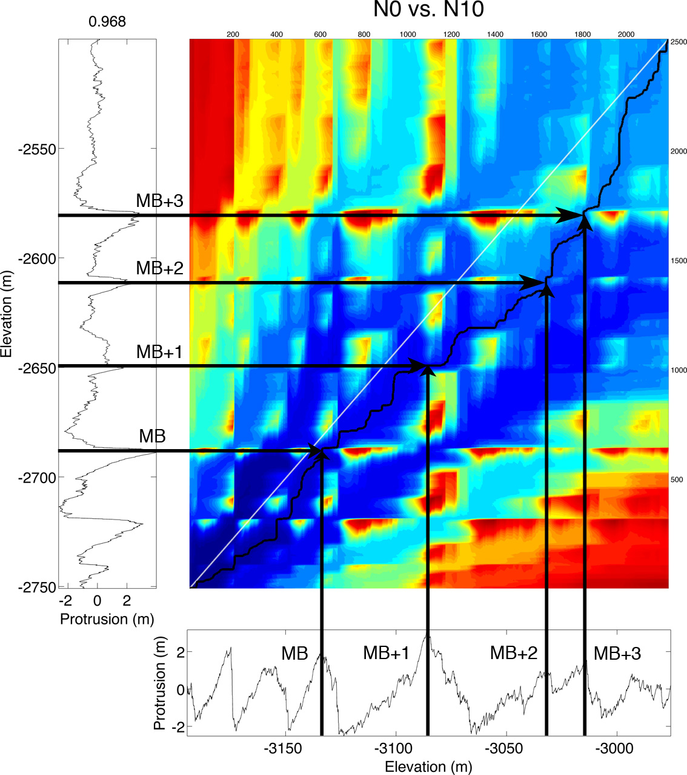
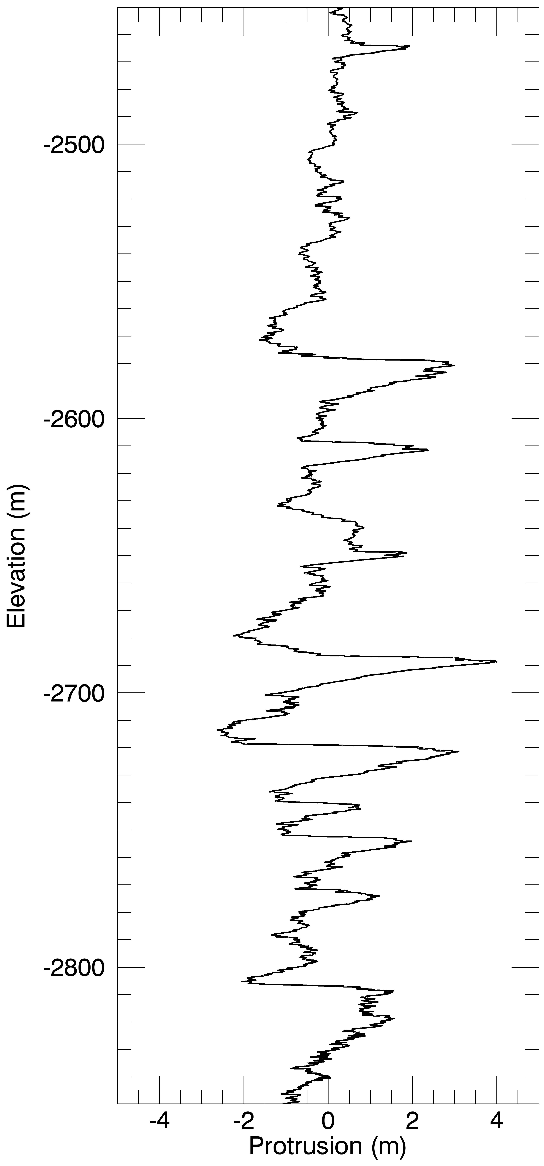
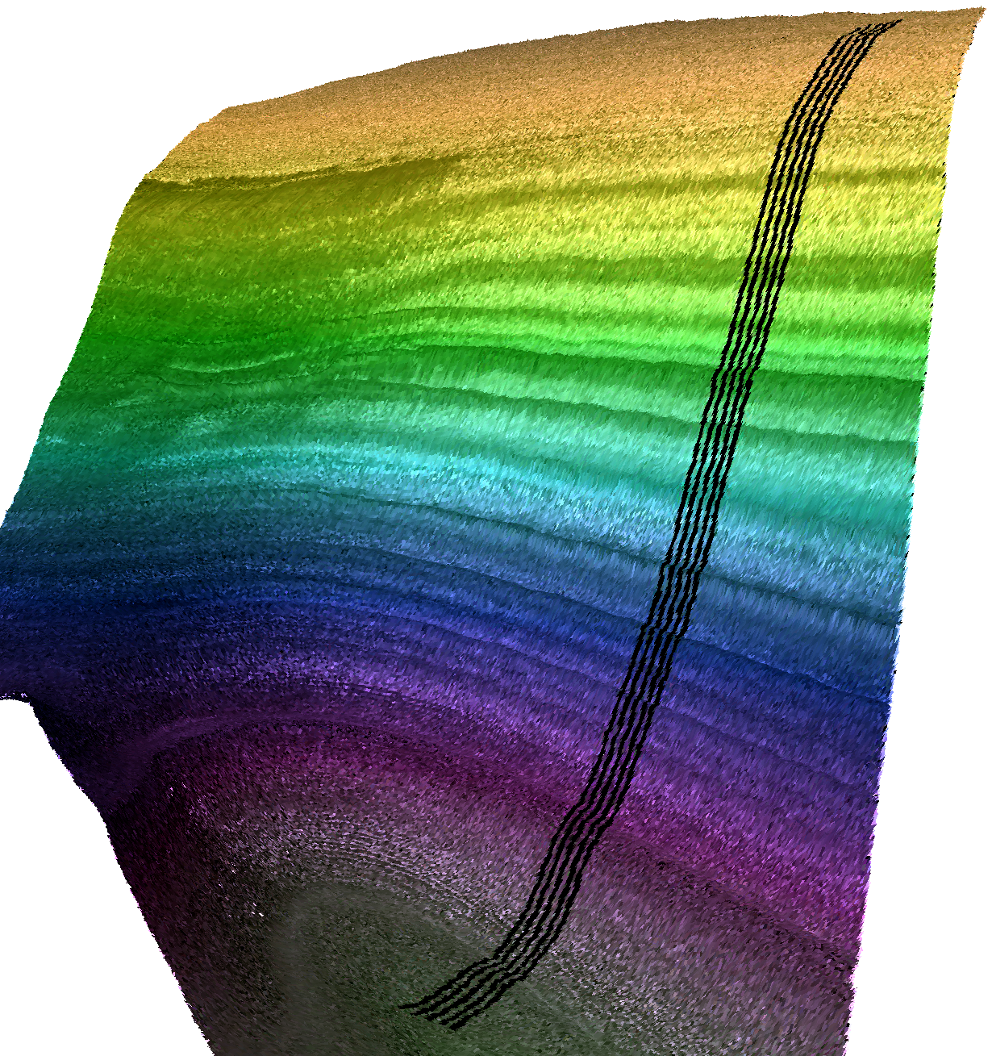
Dynamic time warping can match signals and get relative accumulation rates as a function of depth
Wavelet analysis (not shown) can tease out periodic signals that vary with depth
Layer Protrusion used as stratigraphic signal
Protrusion shown to be better than traditional layer brightness

Slide 8
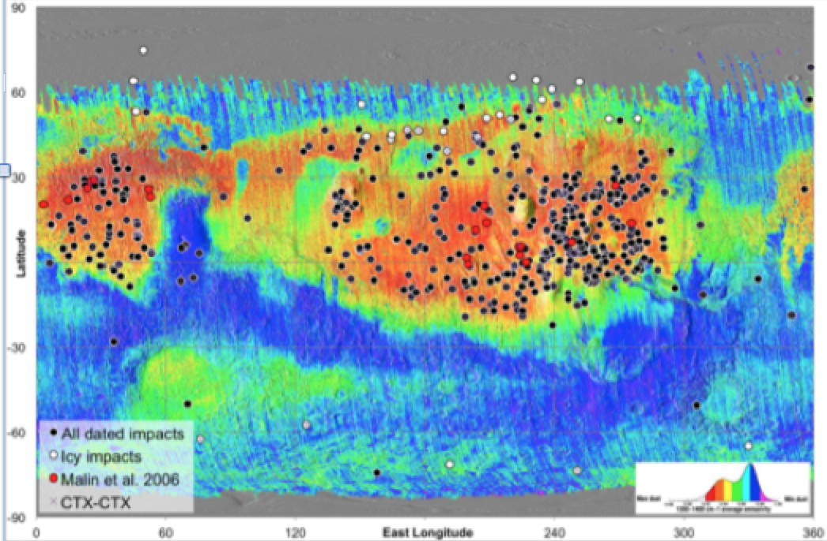
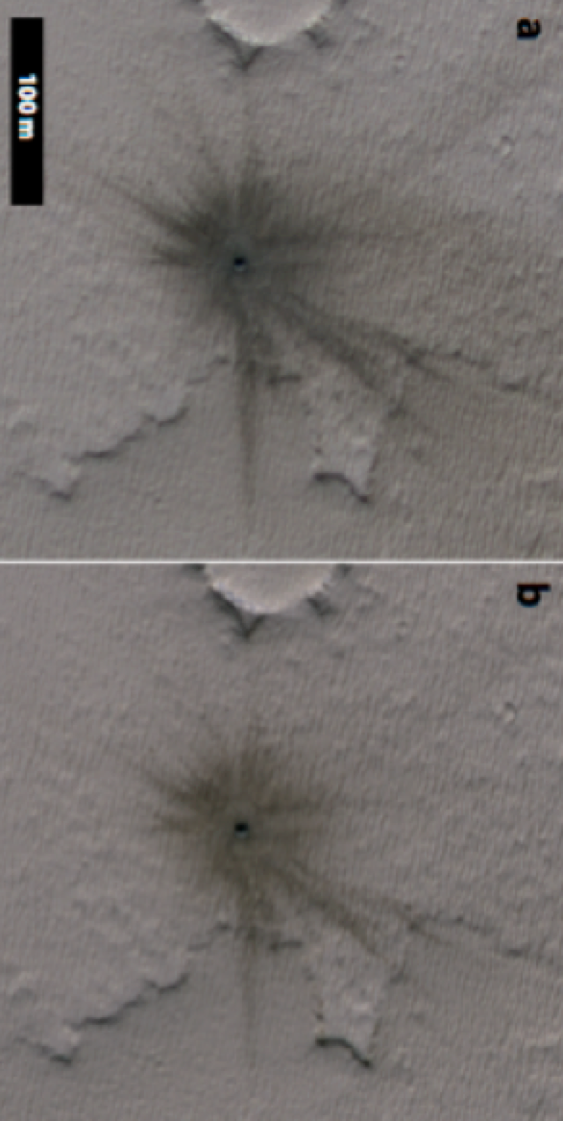
New Impacts and Support for Insight
We now have >489 confirmed newly formed craters
Refinements to impact rates, subsurface ice distribution & surface dust activity
Daubar et al. 2015, Submitted to Icarus
Daubar et al., LPSC, 2015

Slide 11
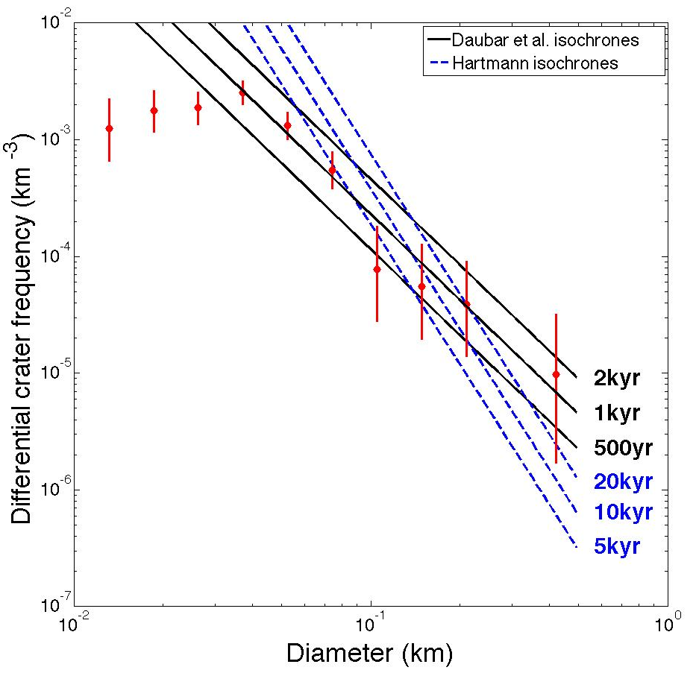
Application of New Cratering Rates
New crater production function is changing our understanding of recent accumulation on the NPLD – rates may be an order of magnitude higher
Daubar et al.
based-isochrons
Hartmann isochrons
Landis et al., LPSC, 2015.

Slide 12
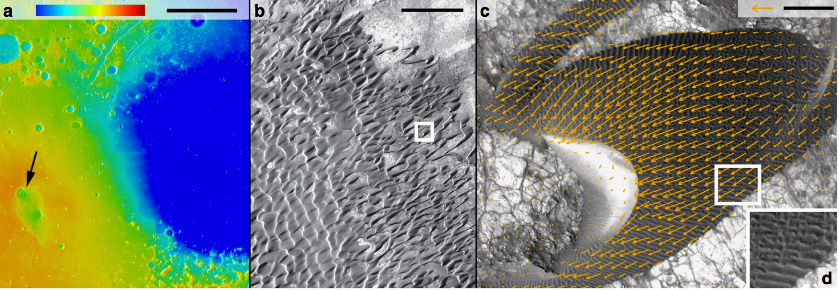
HiRISE Sand Flux Measurements and GCMs
Tracking features like ripple and dune motion yields sand fluxes.
Sand flux, and so wind strength, vary seasonally.
GCM comparison shows wind speeds needed to sustain saltation are only 1/10 of those required to initiate in a wind tunnel.
Nili Patera dune field (8°N, 293°E)
Ayoub et al., Nature Communications, 5, 5096.
MSL dunes campaign underway now and showing ripple migration of ~1m/yr
Collaboration with CRISM to investigate dune material provenance

Slide 13
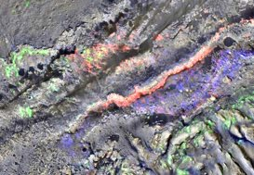
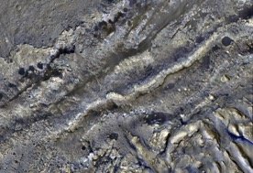
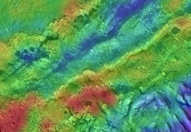
HiRISE/CRISM/Thermal analysis of Curiosity site
Association of Silica deposits with light-toned unit in HiRISE images (Fraeman, Ehlmann & Edwards)
CRISM (18 m/pixel) Mineralogy
Goal: Detailed stratigraphic examination including mineralogy, morphology, thermophysical properties of units, with an emphasis on contact relationships
1 km
CRISM: Normal CRISM observations + along-track oversampled datasets
HiRISE: color mosaic of 8 normalized, orthorectified and georeferenced color images (Edwards et al., JGR 2011; Ashogan et al., LPSC 2014) and gray-scale images where no color coverage
TI: new thermal inertia calculations to account for local slope, albedo, elevation
Hematite
Sulfate
Phyllosilicate
HiRISE
1 km
TI (100 m/pixel) Overlay
1 km
200
450
Notes:
We are examining orbital data over lower Mt. Sharp to look for variations in thermophysical, spectral, and textural characteristics
Mapping distinguishes units with compositional and physical properties differences caused by sediment source region, nature of cementing materials, and post-depositional diagenesis
End goal is to use info to develop hypotheses to test for the origin and evolution of Mt. Sharp and to provide broader stratigraphic context for Curiosity’s exploration
1) each band has systematic across track variations removed independently (this removes any color tilt say from variable path lengths
2) each band is stretched on a 5000 long line segment basis - maximize the local-scale variability.

Slide 14
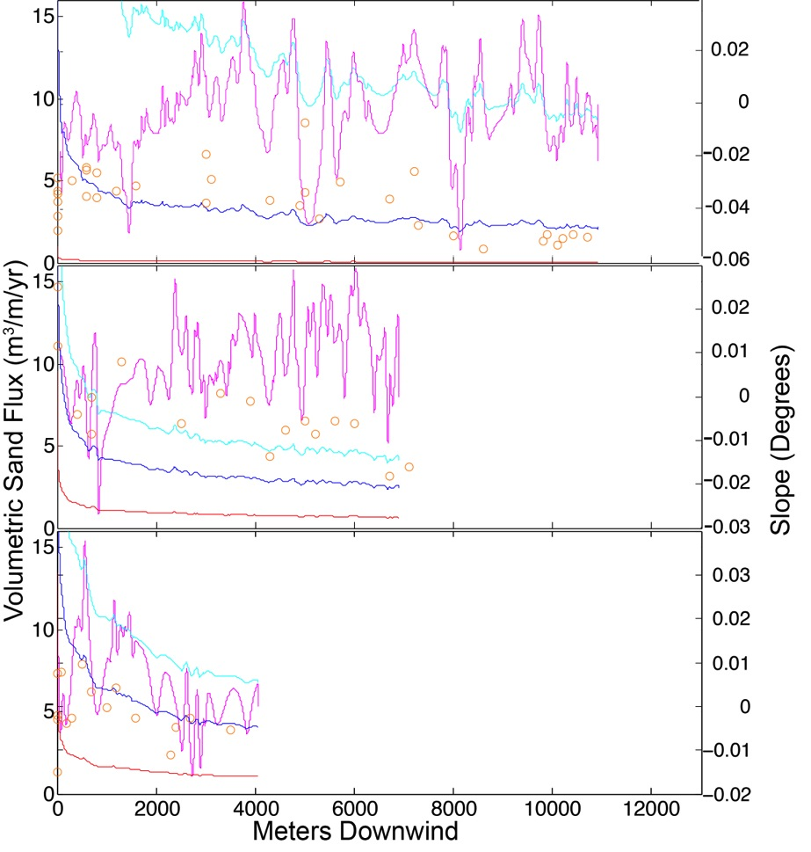
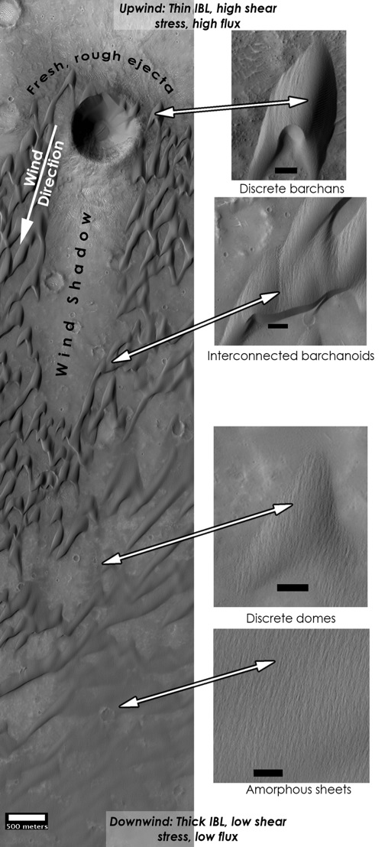
HiRISE Sand Flux Measurements and Dune Types
Volumetric Fluxes can now be broken up by individual dune type (Bridges and Runyon)

Slide 15
Dune motion is global
Concentrated in low albedo regions (Maria Banks)
Sediment flux is constant: migrating dunes are in steady-state (Matt Chojnacki)

Slide 16
Themes
Mid-latitude and polar ice
New Impacts
Aeolian activity

Slide 17
Spares

Slide 18
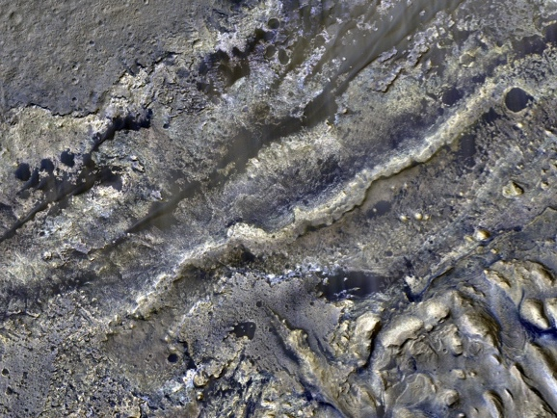
High resolution mapping of lower Mt. Sharp: Finding rover scale targets of interest and providing geologic context for Curiosity
Abigail Fraeman (Caltech), Bethany Ehlmann (Caltech/JPL), Christopher Edwards (USGS Flagstaff)
HiRISE Team Meeting Presentation
1-7 Sept. 2015

Slide 19
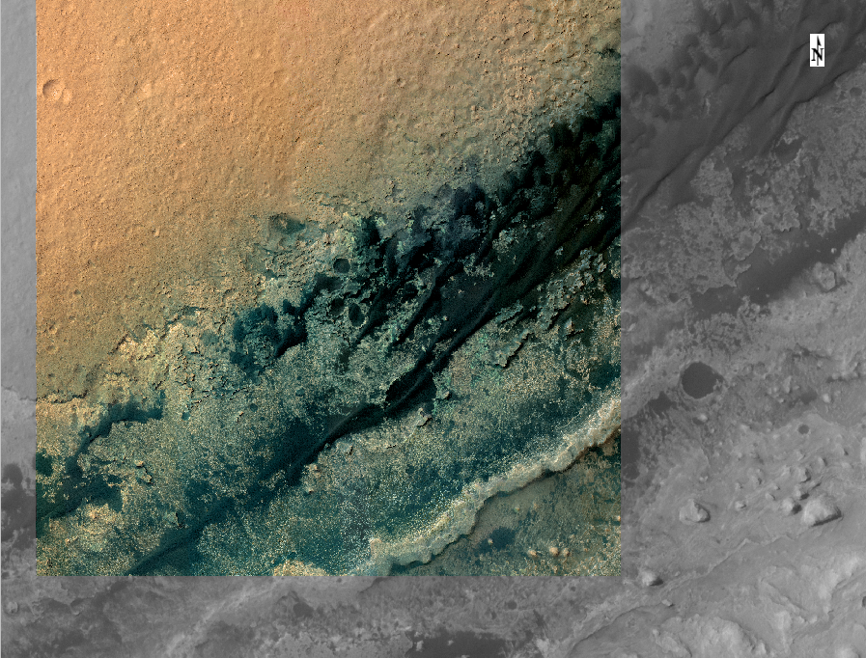
T. Parker HiRISE Color Mosaic
Transition
Future Path

Slide 20
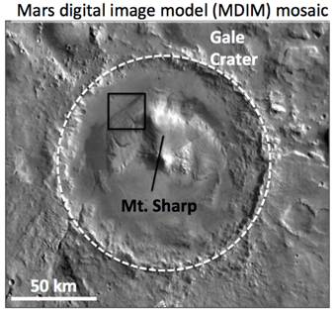
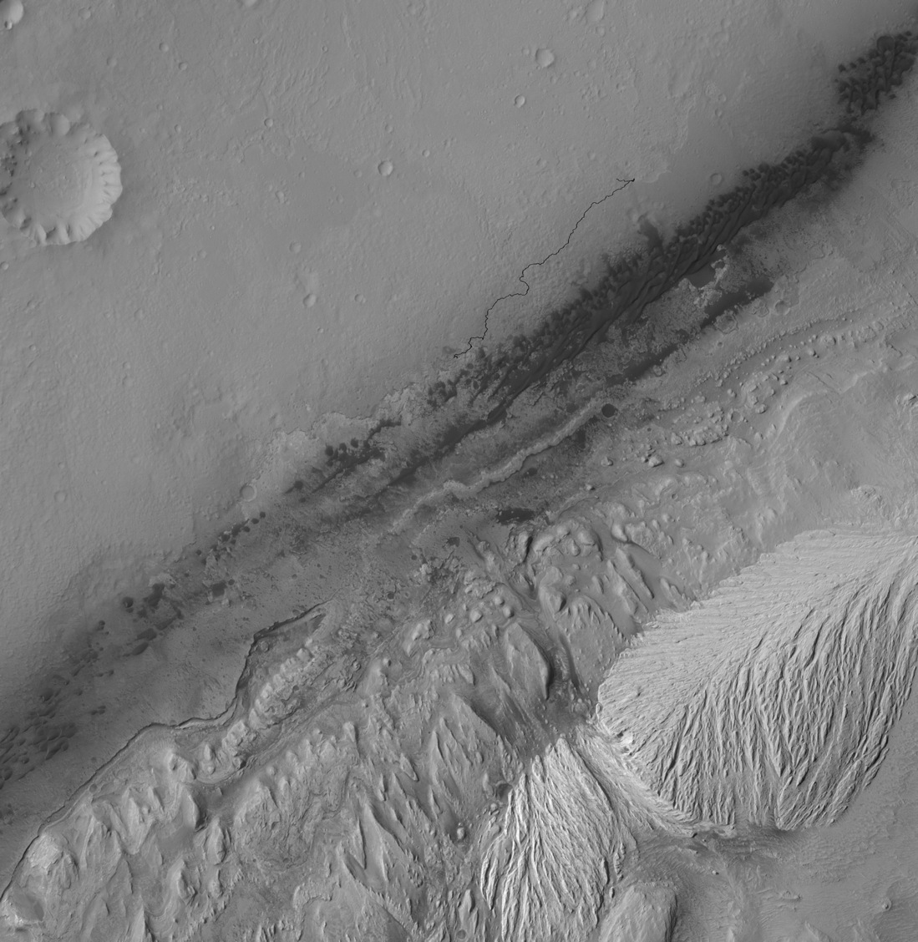
Lower Mt. Sharp Overview
Location #1
Curiosity traverse
Murray Formation
Location #2
Curiosity
future
traverse
CTX Mosaic
Loc 1 & 2: Clear evidence for overprinting by secondary diagenesis

Slide 21
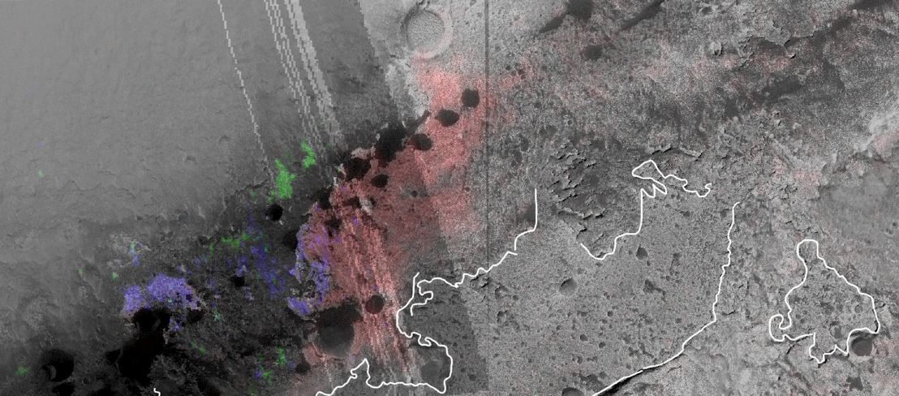
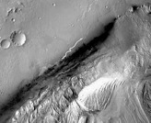
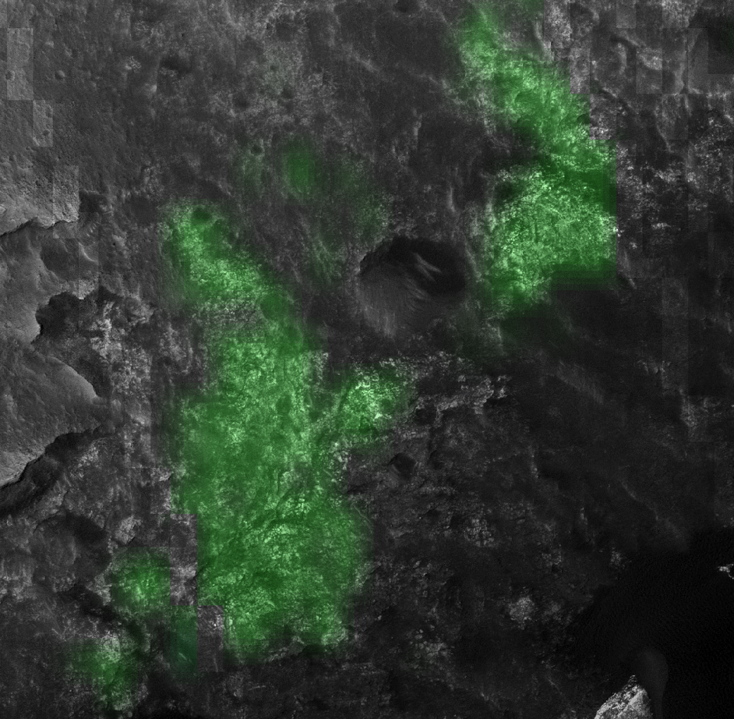
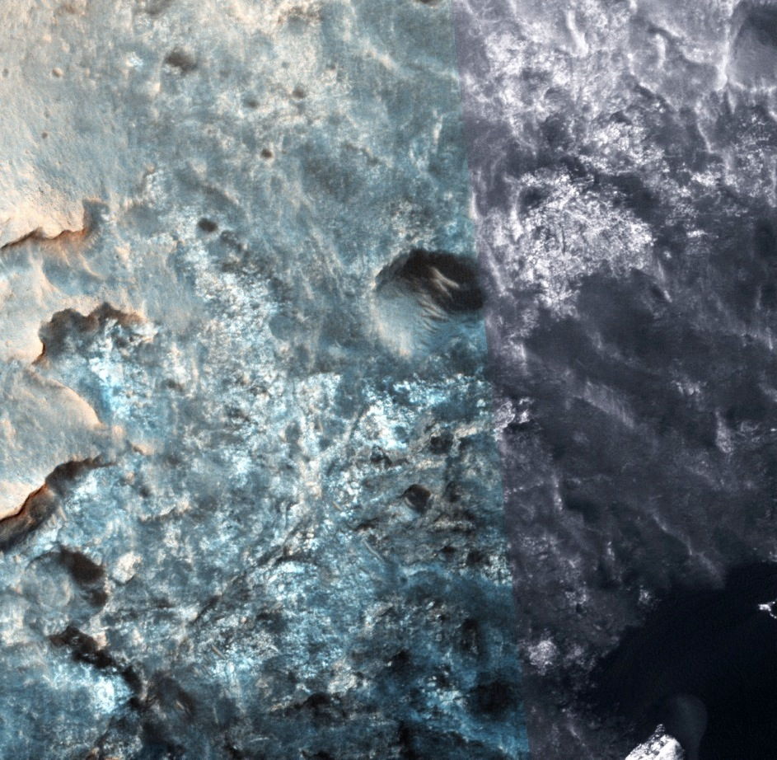
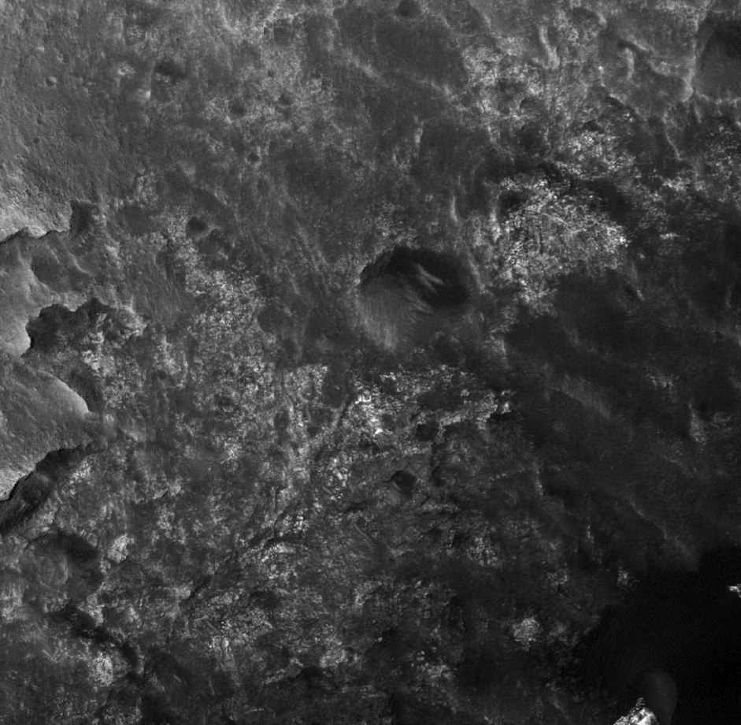
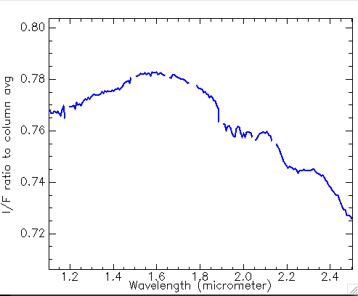
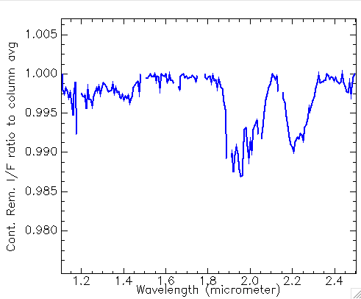
Silica deposit having clear association with light toned material in HiRISE
Murray Formation
~150 m
~150 m
~150 m
High TI Unit
High TI
Unit
Ratio spectrum
Silica detection
1.92 µm
2.2 µm
Continuum Removed
Broad 2.2 µm + 1.9 µm feature consistent with hydrated Si
HiRISE ESP_024300_1755

Slide 22
Silica deposit having clear association with light toned material in HiRISE
Murray Formation
CRISM Si detections
~150 m
High TI Unit
High TI
Unit
Ratio spectrum
Silica detection
1.92 µm
2.2 µm
Continuum Removed
Broad 2.2 µm + 1.9 µm feature consistent with hydrated Si
HiRISE ESP_024300_1755

Slide 23
Notes:
As aforesaid, the second part of the current work it’s focalized on the LLD in Iani Chaos region…

Slide 24
Notes:
As aforesaid, the second part of the current work it’s focalized on the LLD in Iani Chaos region…

Slide 25
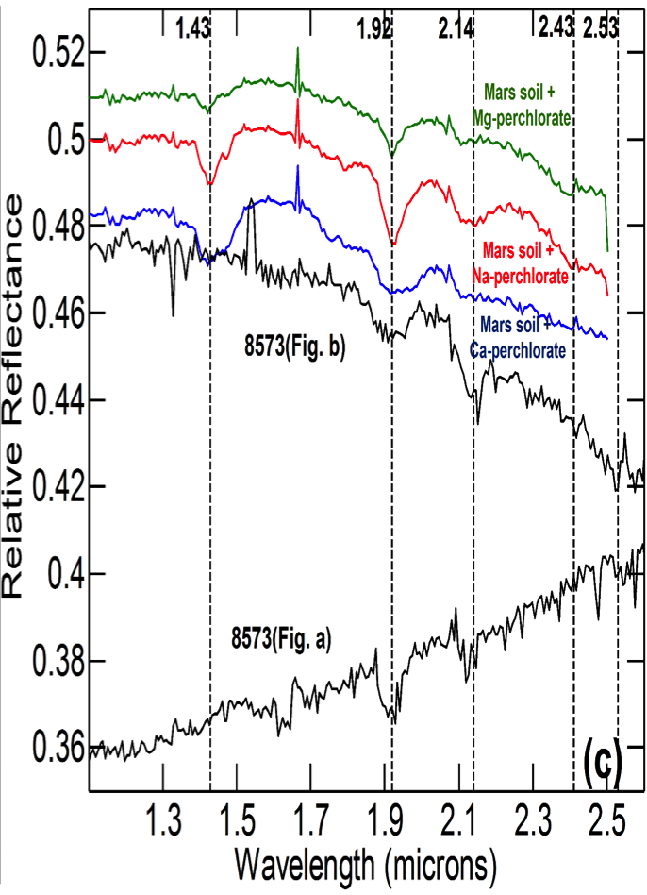
Results from Spectroscopy
Laboratory Observations
Observed on Mars

Slide 29
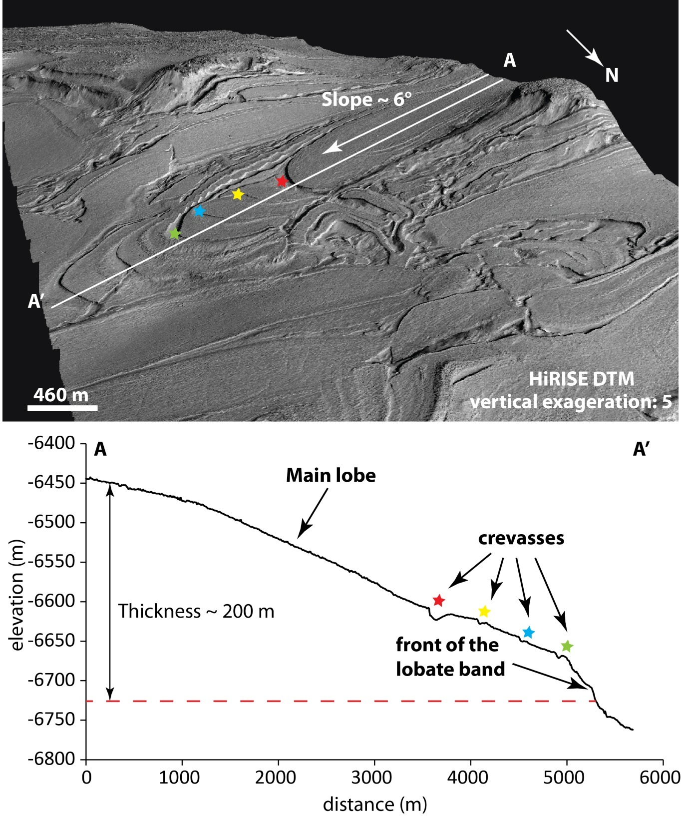
Glacial Flows in the Hellas Basin
Geomorphologic mapping using HiRISE and CTX images and DTMs has revealed an enigmatic unit named banded terrain made up of an alternation of bands and inter-bands
Many of these bands display signs of viscous flow with frozen structures in the slope and multiple smooth changes in direction. In other words, these are glaciers.
The morphology of the bands seems to be controlled by the topography and the competition of the flows of the adjacent bands
Results published in Diot, X., et al., 2014. PSS 101(0), 118–134. http://dx.doi.org/10.1016/j.pss.2014.06.013

Slide 30
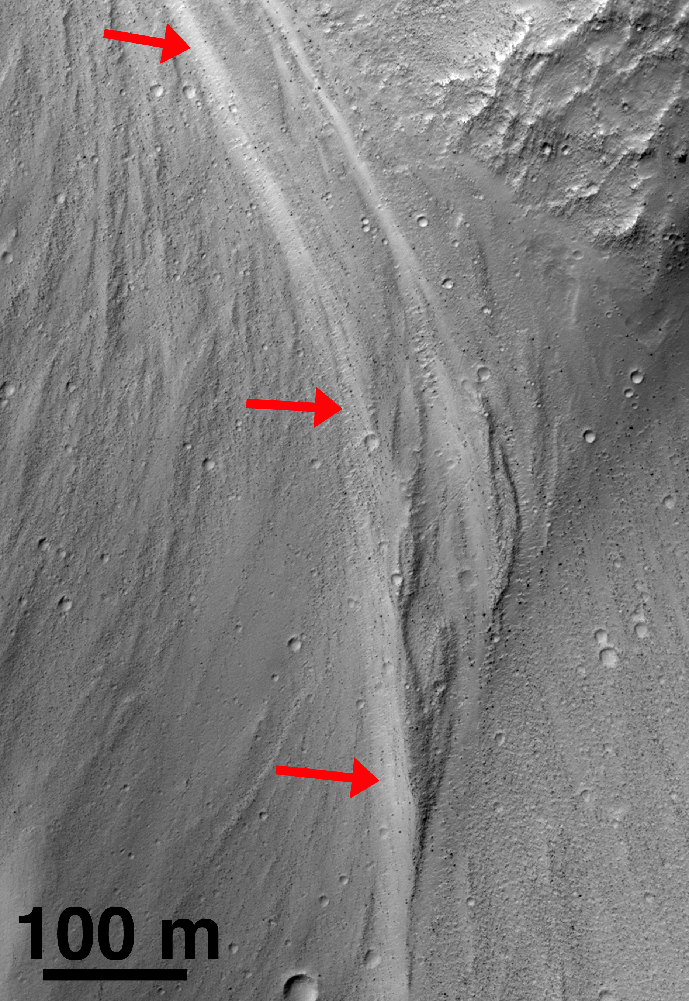
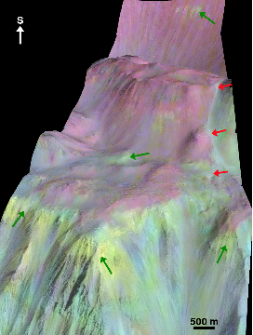
Fresh Exposures of Hydrous Fe-bearing Amorphous Silicates on Mars
Discovered relatively fresh exposures of a hydrated, amorphous material along the wallrock slopes in Coprates Chasma, Mars.
CRISM reflectance spectra extracted from the deposits exhibit broad absorptions at 1.42, 1.94, and ~2.25 µm that are most consistent with laboratory spectra of nanophase hydrated Fe-rich allophane and Fe-rich opal.
Channel containing Fe-allophane/opal (red arrows). Portion of HiRISE image PSP_008141_1645.
At this time, the Fe-rich allophane/opal deposits at Coprates appear to have some of the strongest hydration signatures yet detected on Mars using CRISM data, indicating a young exposure time and minimal time for dehydration.
The discovery of new Fe-bearing hydrated amorphous silicates by orbital spectroscopy provides additional information about the history of water and aqueous alteration on Mars, and is consistent with the detection of hydrated amorphous phases by rovers on the martian surface.
Results published in Weitz C.M. et al. (2014) Geophysical Research Letters 41, 8744-8751.
HiRISE DTM perspective view at 2X vertical exaggeration with CRISM spectral parameters overlain in color. Red arrows identify an Fe-allophane/opal deposit (whitish blue), which extends across 940 m in elevation, whereas green arrows identify exposures of smectites within the wallrock (yellow-light green).

Slide 31
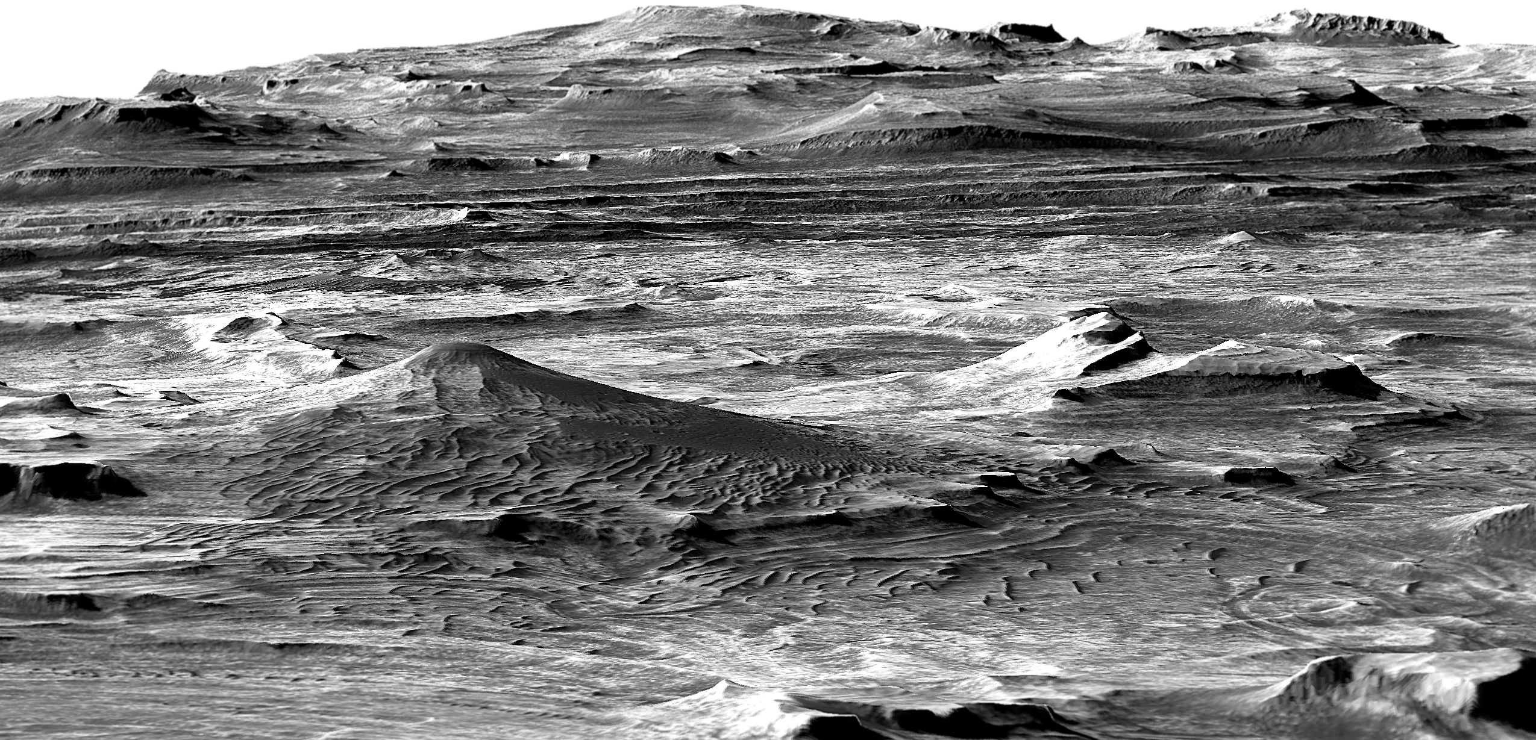
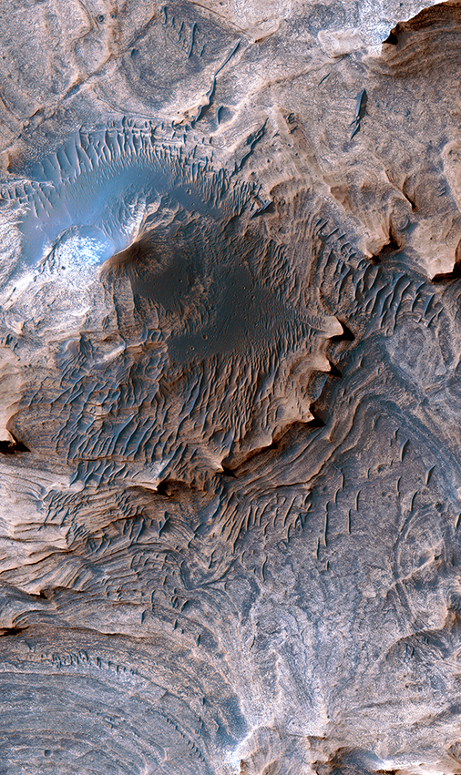
Marsquakes and Water-Lain Sediments in Candor Chasma
Perspective view of the Candor Colles region of west Candor Chasma, Mars. HiRISE image PSP_001641_1735
Unprecedented high-resolution geologic and structural mapping using HiRISE data has revealed evidence of past marsquakes and water-lain sediments in the west Candor Chasma region of Valles Marineris.
Orientations of the sediment layers indicate that these rocks formed as sand and dust was blown in by the wind and became trapped in shallow playa lakes.
Injectite megapipes are also observed. These features formed by underground movement of the water-lain sediments in response to ground shaking (marsquakes) from several large fault zones in the area.
An injectite megapipe (conical hill). Image is ~1 km across. HiRISE image PSP_001641_1735
These injectites served as reservoirs for groundwater and thereby would have hosted potentially habitable environments in the Martian subsurface approximately 3 to 3.5 billion years ago.
Results published in Okubo, C.H., 2014, Bedrock geologic and structural map through the western Candor Colles region of Mars: U.S. Geological Survey SIM 3309, scale 1:18,000, http://dx.doi.org/10.3133/sim3309.

Slide 32
Threshold For Sand Motion on Mars Determined With HiRISE Images
Old View: The wind strength required to move sand on Mars was highly uncertain
New View: HiRISE measurements show that dune sand flux, and therefore wind strength, varies seasonally. Tying these measurements to general circulation models shows that that the wind strengths needed to move the sand are about 10% of previous estimates based on wind tunnel data*.
Why: The average flux of sand is driven by both higher wind speeds from gusts needed to initiate motion, and lower speeds necessary to maintain it. At scales of several kilometers seen from HiRISE, this “effective” threshold for motion is a mixture of these two components.
Implication: This measured value provides a calibrated input into climate models where detailed observational data are lacking, allowing the accurate prediction of sand fluxes across the planet.
Future work: Continued monitoring by MRO/HiRISE will refine these estimates for Nili Patera and other regions on the planet.
Location of the study area in the Nili Patera dune field, Mars (8°N, 293°E)
*http://www.nature.com/ncomms/2014/140930/ncomms6096/pdf/ncomms6096.pdf

Slide 33
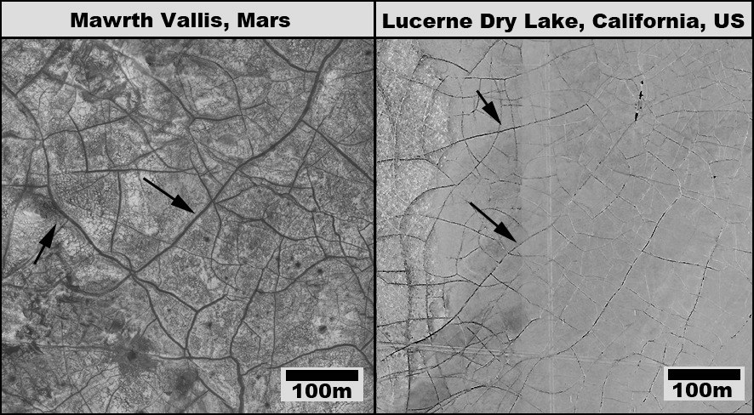
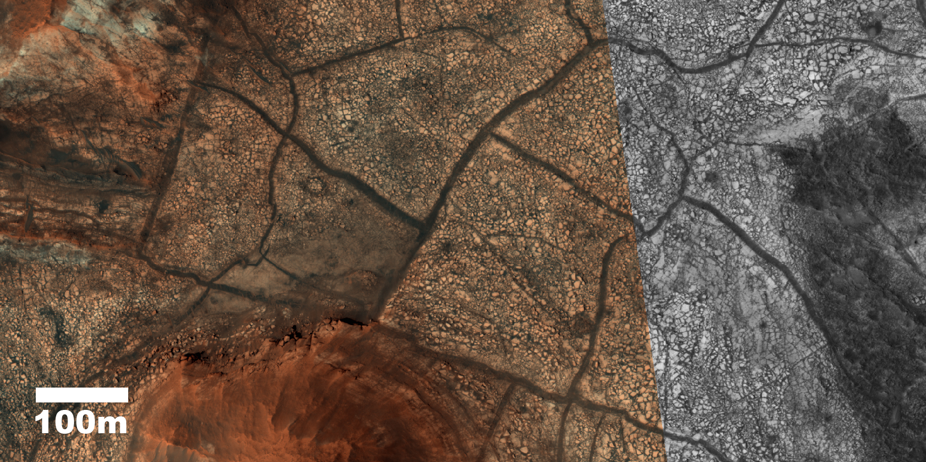
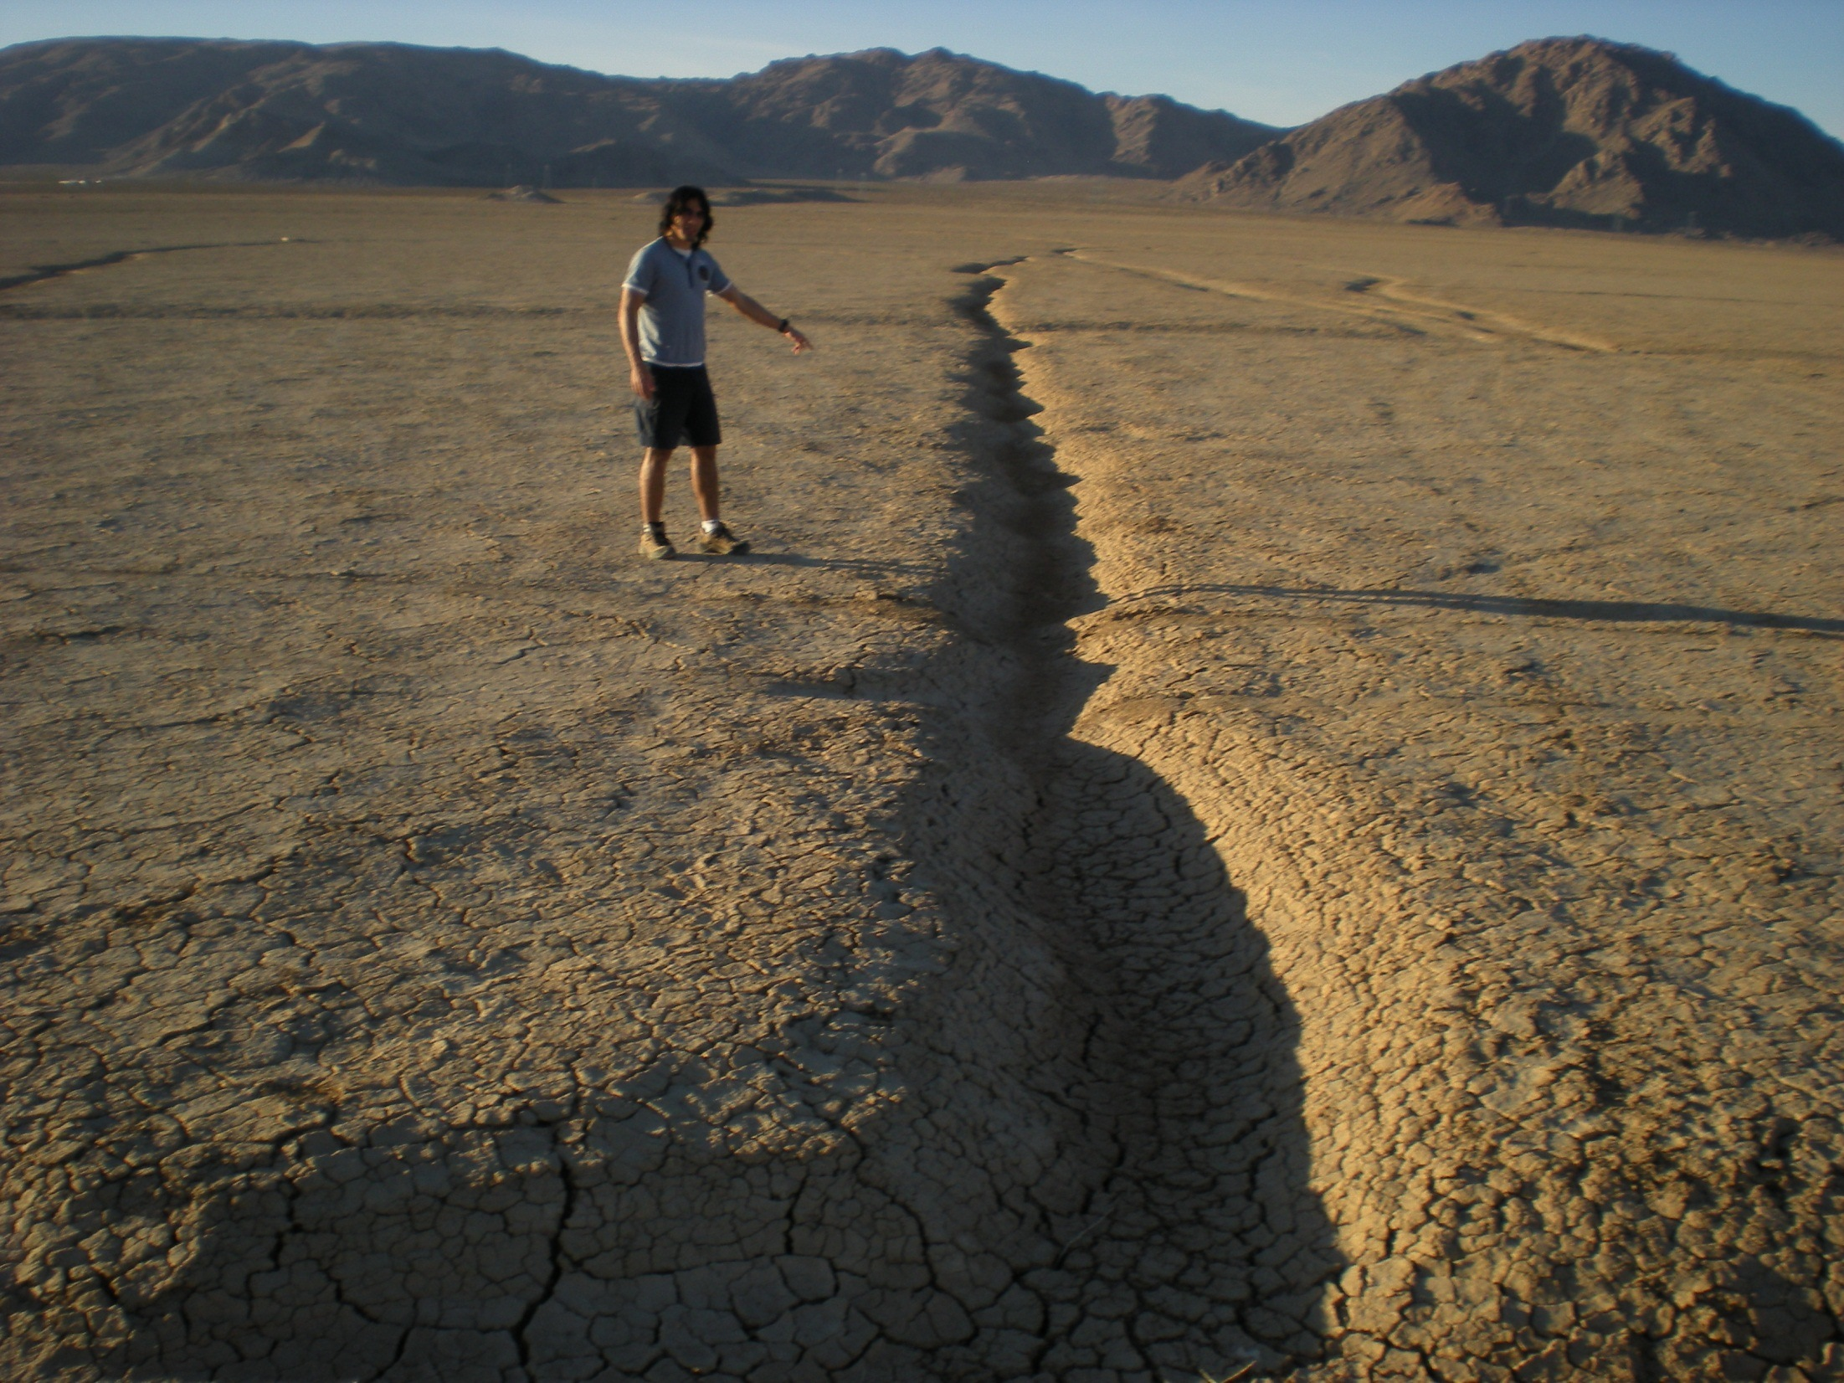
Large “Mud Cracks” on Mars
Mawrth Vallis, Mars (HiRISE image PSP_006755_2030)
Large polygonal surface features resembling giant mud-cracks are observed by HiRISE in many locations on Mars.
They are located in areas that display minerals that may have formed in ancient lakes and rivers.
When these ancient lakes dried out, they may have produced these beautiful features.
Significance
The presence of giant mud cracks can be used as an identifying tool of areas that may have harbored lakes and possibly life on ancient Mars.
El-Maarry et al., 2014, (Icarus)

Slide 34
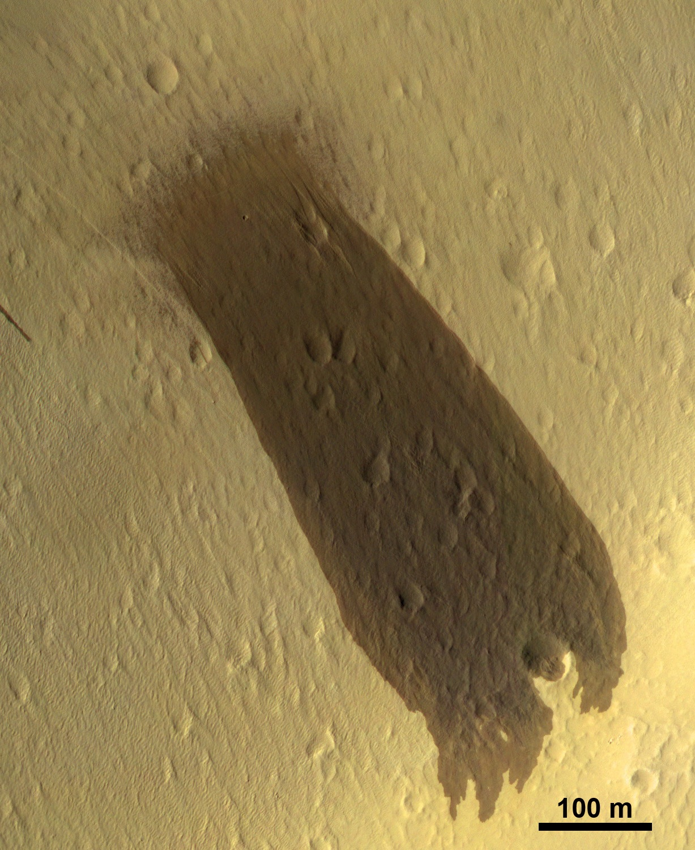
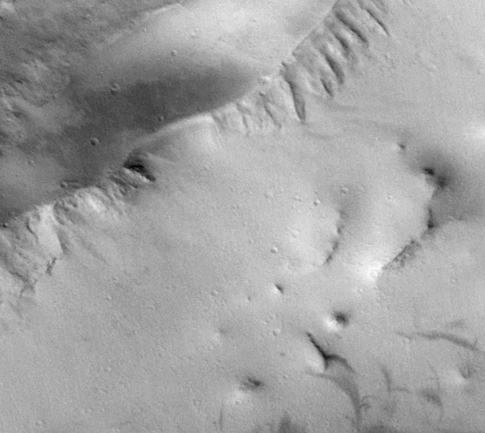
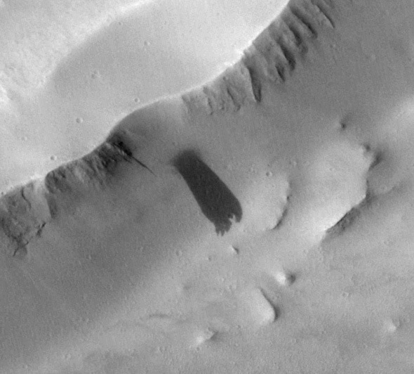
Impact-triggered dust avalanche on Mars
MRO’s Context camera (CTX) acquired the image at lower left on Nov 18, 2007 and the adjacent image on Feb 14, 2010, showing a large new slope streak in the aureole (giant landslide deposits) of Olympus Mons. Slope streaks (dust avalanches) are common on Mars but this one is unusually wide and it began from an unusual extended/fuzzy source area. HiRISE acquired the follow-up image (right) March 31, 2010, revealing a small, pristine impact crater (blue arrow) in the fuzzy source area, which resembles the air-blast patterns seen at many other new (recent year) impact sites. We conclude that an impact event occurred sometime between the dates of the CTX images and triggered a large dust avalanche.
P13_006153_2133_XN_ 33N141W_071118
B18_016662_2087_XN_ 28N140W_100214

Slide 35
Mars Sand Dunes on the Move
Old View: Winds strong enough to blow sand occur in just a few locations
New View: This happens in many places on the planet as shown in HiRISE camera pictures from MRO
Why: Winds on Mars more gusty and carry more sand than previously thought
Implication: Current Mars winds capable of moving many dunes. Immobile dunes, which are probably hardened or covered by large grains, are markers for a different climate in the past.
Future work: Continued monitoring by MRO/HiRISE will advance our understanding of present and past surface and atmospheric processes on Mars.
Moving dune in Herschel Crater
between March 3, 2007 and December 1, 2010.
Moving sand patch in Becquerel Crater
between November 24, 2006 and September 5, 2010.

