Slide 1
Mars Tectonics
Chris Okubo
cokubo@usgs.gov
March 11, 2015

Slide 2
Outline
What is ‘tectonics’?
Stress and strain
Folding vs. Fracturing
Earth vs. Mars
Principle of cross-cutting relationships
Plus Principle of superposition
Folding on Mars
Pure folds
Fault-related folding
Fracturing on Mars
Normal faults, Thrust faults
Joints
Dikes
Volcanic fissures
Pit craters
Deformation bands

Slide 3
What is ‘tectonics’?
General term applied to the deformation of rocks
Scale – mm to thousands of km
Mixture of permanent (plastic) deformation and temporary (elastic) deformation
Time-dependent aspects
Deformation can be localized, distributed or both
‘Tectonics’ is a multi-faceted issue
Approach to studying heavily dependent on scientific question
Seismicity, coseismic displacements
Elastic+plastic, ~localized, near term, 100’s of km
Crustal rifting or uplift
Plastic, localized+distributed, long term, 1000’s of km
Sedimentation and compaction
Plastic, localized+distributed, long term, mm’s to m’s

Slide 4
Tectonics driven by stress
Driving stress
The force that acts on a rock unit to change its shape and/or its volume
Common sources
Mantle convection – Plate tectonics
Gravitational instabilities – Landsliding
Impact cratering – Collapse of crater walls, uplifts of central peaks
Volcanic activity – Dike intrusion, loading
Seismic shaking – Induced by any of the above can cause secondary deformation

Slide 5
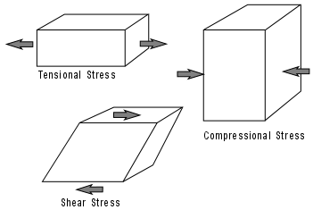
Types of stress
Compression
The stress generated by forces acting toward one another
Tension
The stress generated by forces acting away from one another
Shear
The stress generated by forces acting parallel with one another

Slide 6
Stress causes strain ➔ Tectonic features
Strain
Any change in original shape or size of an object in response to stress acting on the object (compressive, tensile, shear)
Many classifications of ‘strain’
Elastic
Temporary
Plastic
Permanent
Brittle (fractures) or Ductile (folds)
Localized
Occurs in a narrow zone
Distributed
Occurs over a wide area

Slide 7
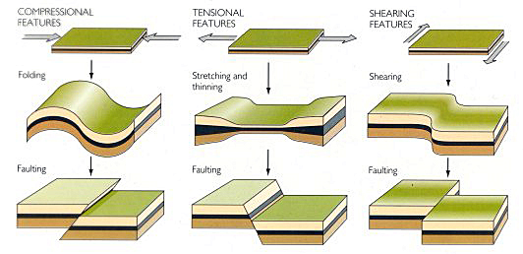
Driving stresses and tectonic features

Slide 8
Folding vs. Fracturing
Folding
The change in shape and volume of rock in response to applied stresses
Fracturing
The displacement of rock along a planar or tabular zone of weakness
Folding can be accomplished with or without fracturing
Fracturing can induce folding

Slide 9
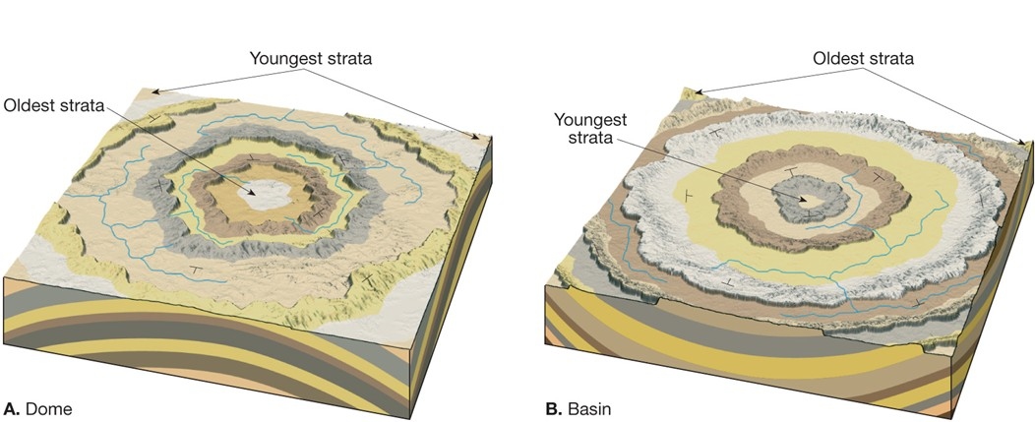
Basic types of folds
Syncline
Anticline
Dome
Basin

Slide 10
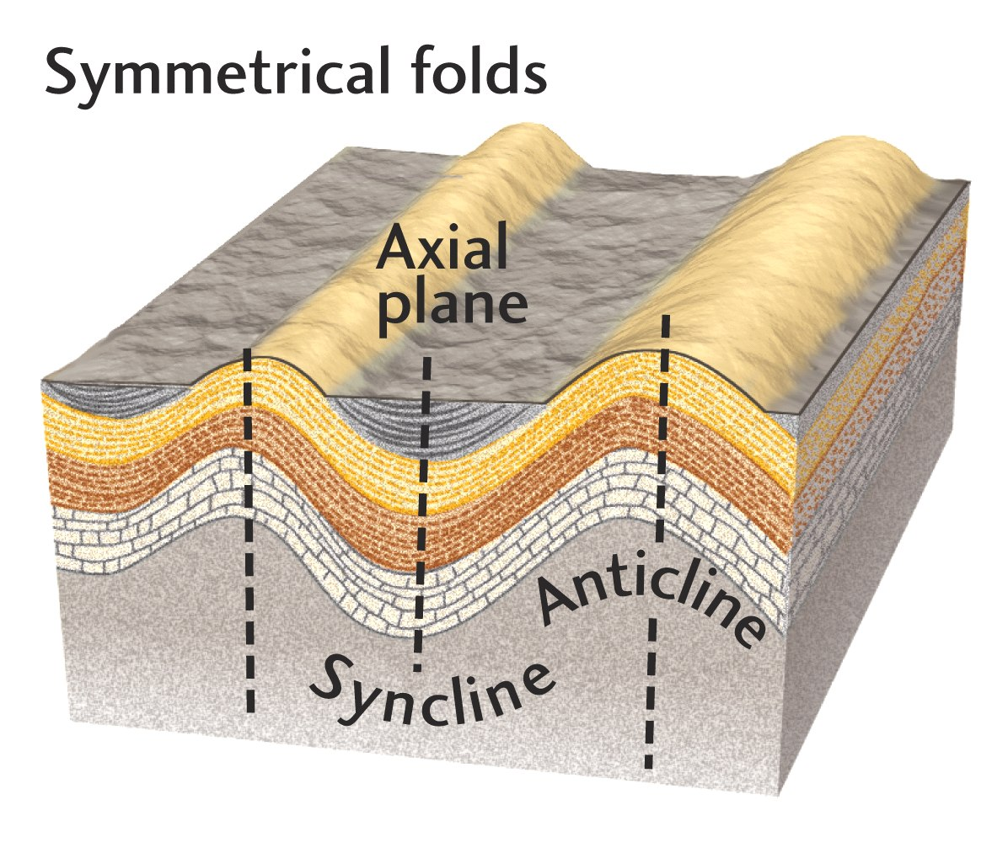
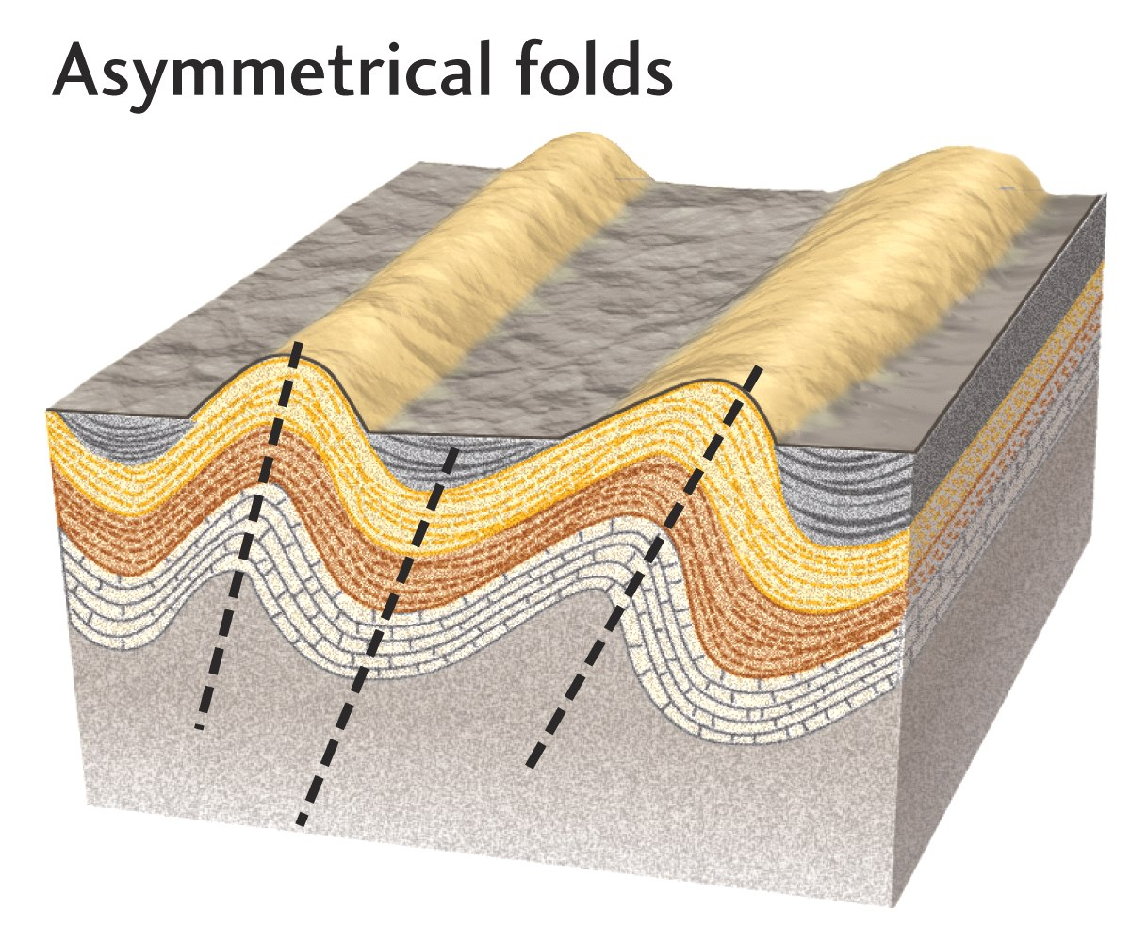
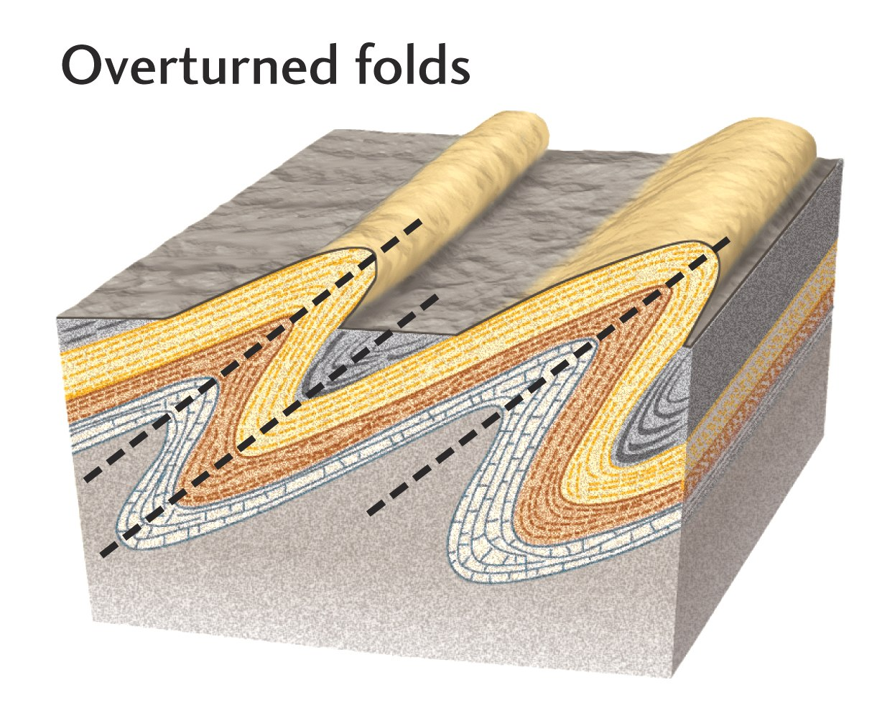
Other fold descriptors
Symmetrical
Hinge planes are vertical
Asymmetrical
Hinge planes dip
Youngest beds overlie older beds everywhere
Overturned
Hinge planes dip
Older beds overlie younger beds along steep limbs

Slide 11
Types of fractures
Faults
Thrust
Normal
Strike-slip
Oblique

Slide 12
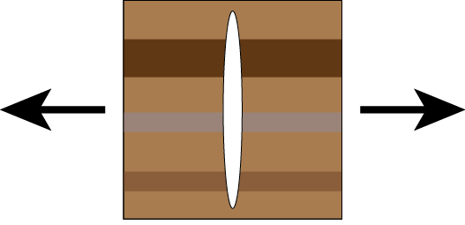
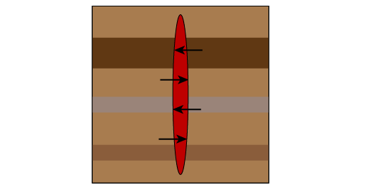
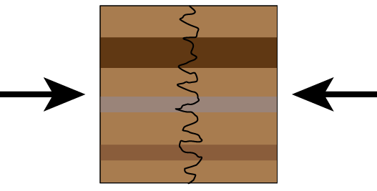
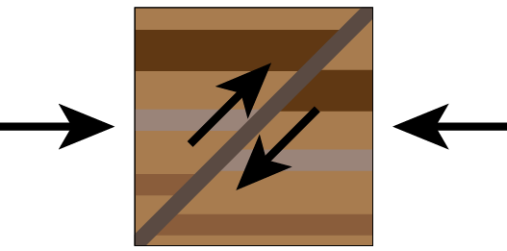
Types of fractures
Joints
Extension (external)
Dikes
Extension (internal)
Stylolites
Compression & chemical
dissolution of grains
Deformation bands
Compression & mechanical
crushing of grains and pore space

Slide 13
Factors that affect folding vs. fracturing
Strain may be manifest as folds, fractures or a combination of both depending on:
Temperature
Pressure
Strain rate
Rock microstructure
Crystalline (volcanic, metamorphic) or clastic (sedimentary)
Water content
Generally rocks are
Brittle near the surface
Ductile at depth
Because of increasing pressure and temperature
But this is not always the case…

Slide 14
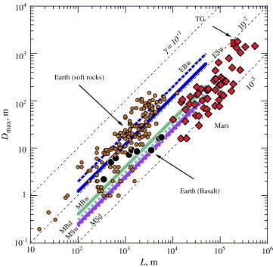
Tectonics on Earth vs. Mars
Processes of deformation are fundamentally the same on Earth and Mars
Martian fractures have less displacement per unit length than Earth
Cumulatively, fractures on Mars have a factor of 5-6 less displacement than terrestrial counterparts
A result of lower gravitational acceleration on Mars
Lower overburden weight
Lower driving stress required
to cause deformation
Smaller displacements
per unit length
Earth
150 m
25 m
Mars
10 km

Slide 15
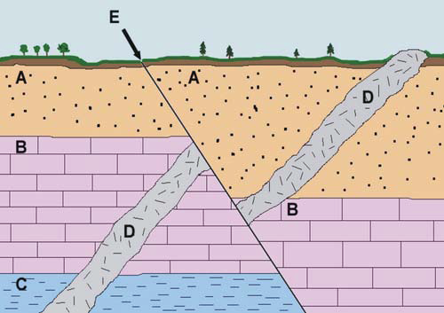
Principle of cross-cutting relationships
Rule that lets you determine relative ages of geologic features
The geologic feature which cuts another is the younger of the two features
Example
Oldest
Unit C
Unit B
Unit A
Intrusion D
Fault E
Youngest

Slide 16
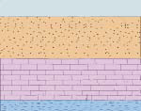
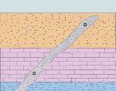
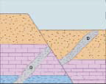
Principle of cross-cutting relationships
Deposition of unit C, then unit B, then unit A (Principle of superposition – Sedimentary units deposited in time order, with oldest units on the bottom, youngest on the top)
Intrusion of dike D through units C, B, A
D cross-cuts units C, B, A and is therefore youngest
Formation of normal Fault E through units C, B, A, D
E cross-cuts units C, B, A, D and is therefore youngest
A
B
C
A
B
D
Recap:
Fault E cross-cuts all units and is therefore the youngest feature here
Dike D cross-cuts units C, B, A and is therefore younger than C, B, A, but is older than E (because E cross-cuts it)
C
A
E
D
B
D
C

Slide 17
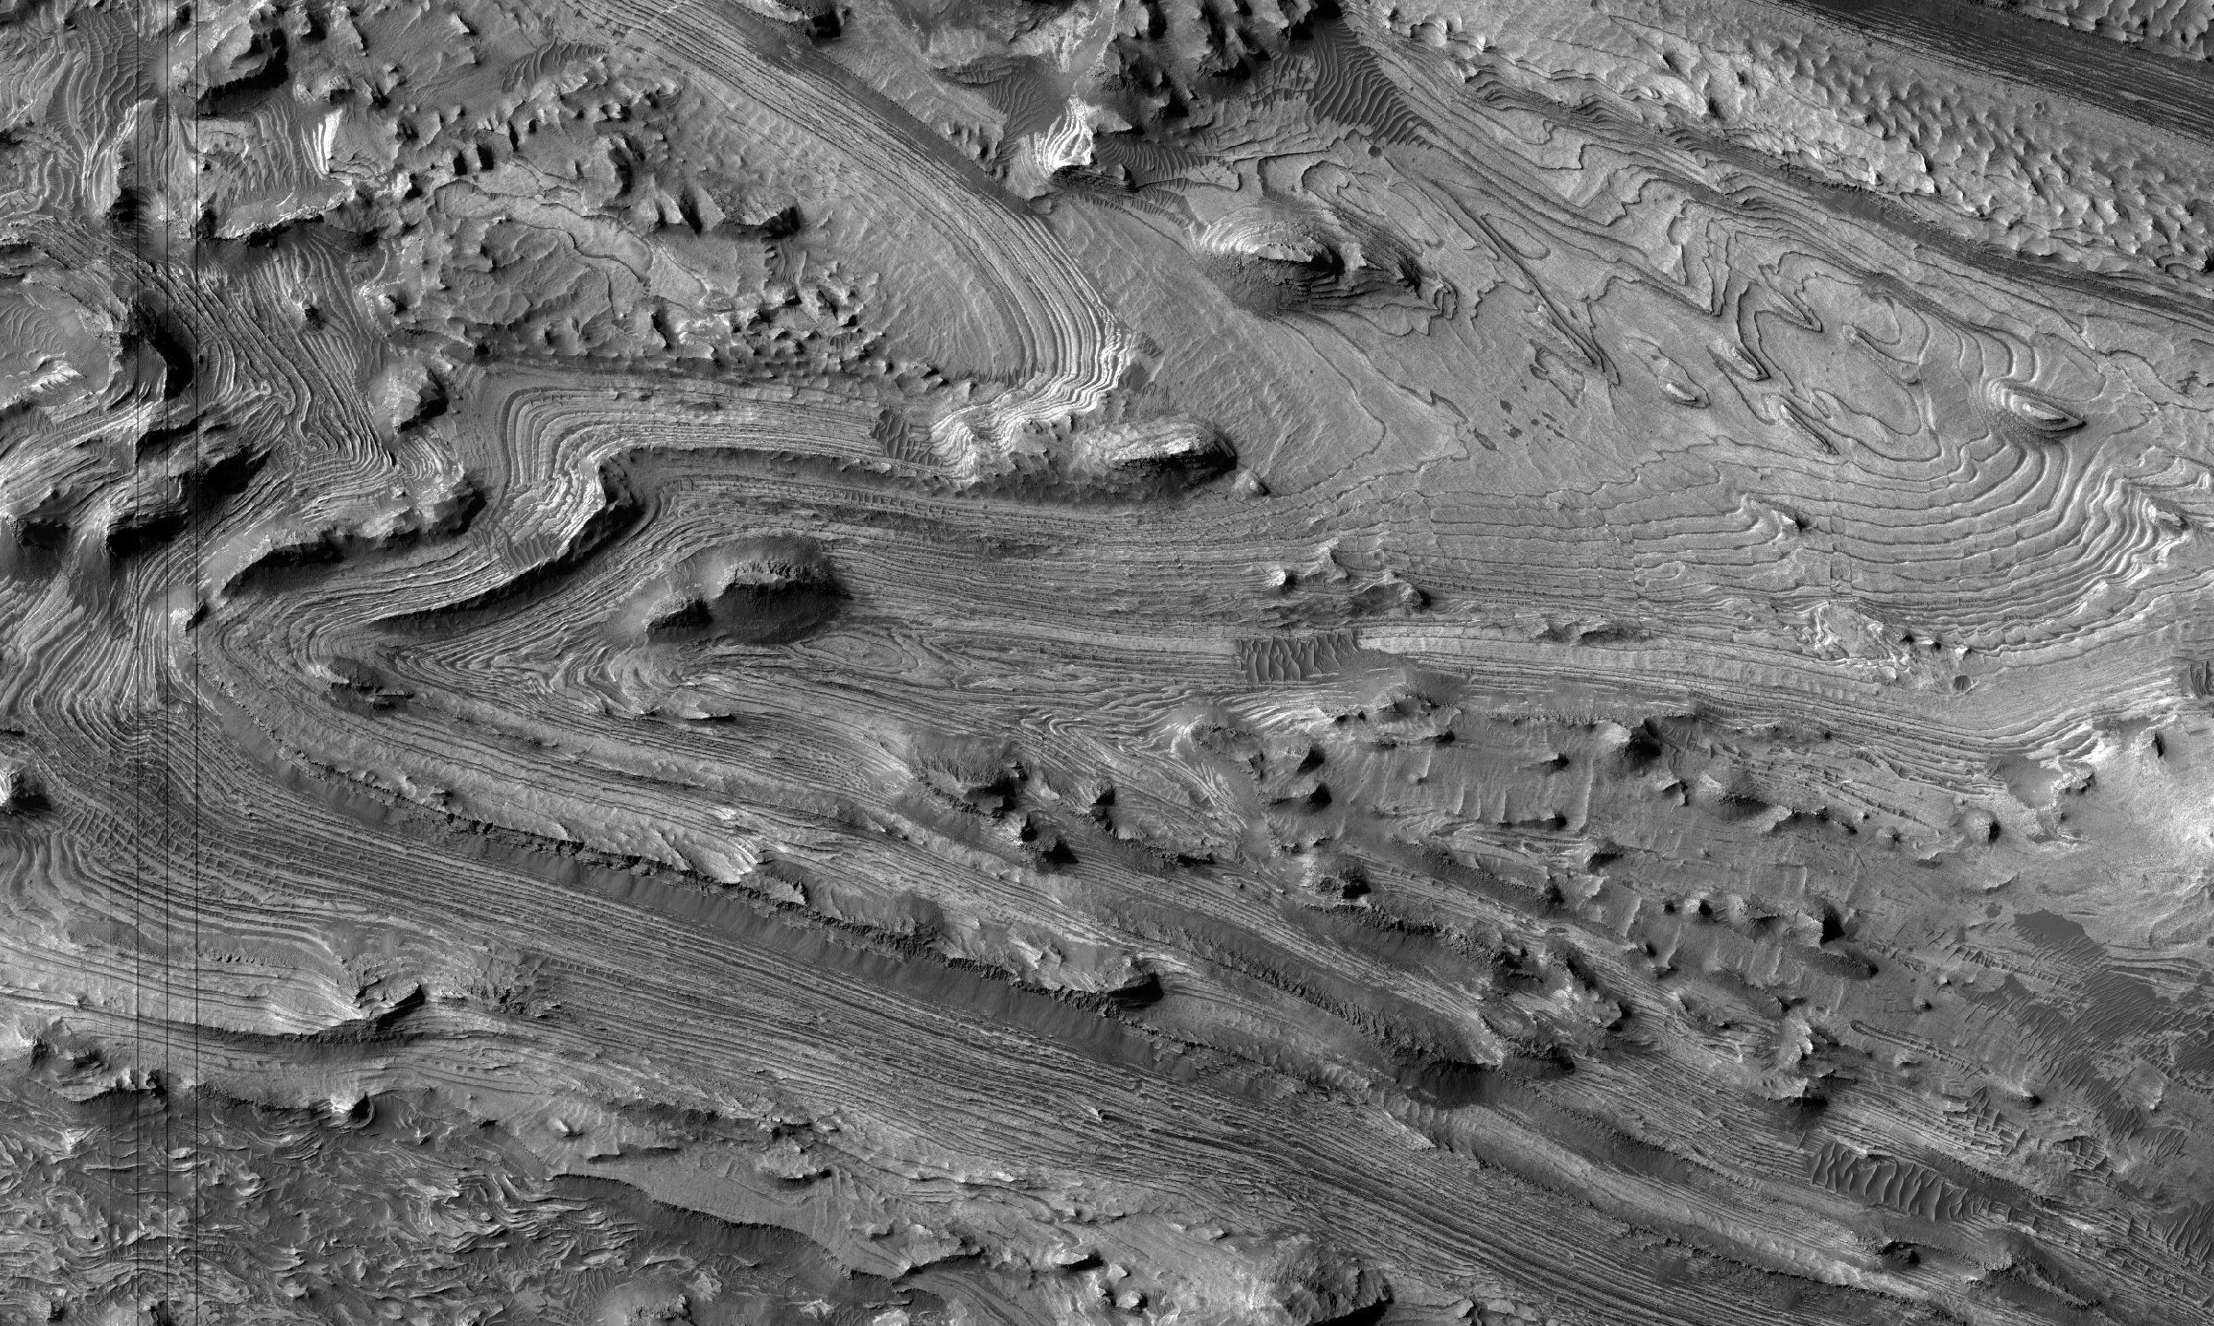
Folding on Mars – Pure folds
Asymmetric and overturned folds in west Candor Chasma
Formed through unidirectional compression (NE-SW) of sedimentary rocks
Image ~5.5 km across (PSP_001984_1735)

Slide 18
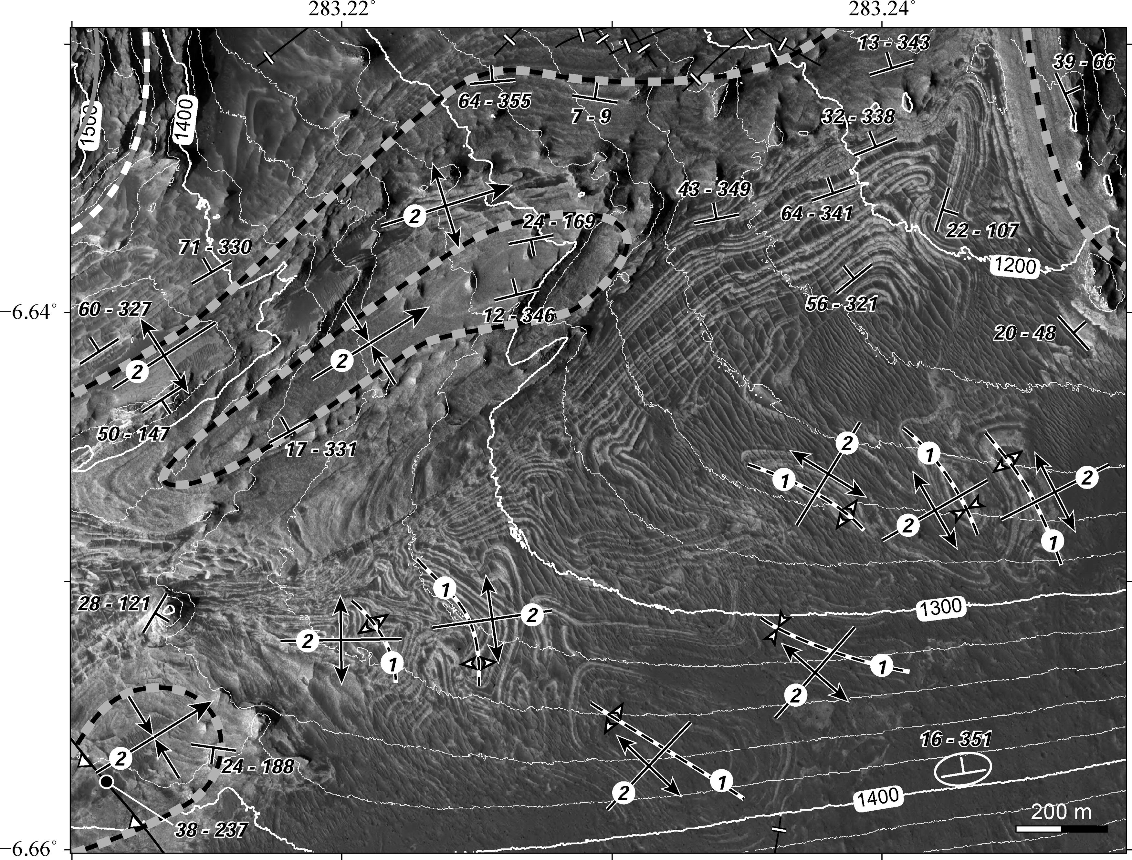
Folding on Mars – Pure folds
Superimposed folds in west Candor Chasma
Folds express interference patterns - “Dome and basin” or “crescent and mushroom”
Formed through multiphase, bidirectional compression (NE-SW, NW-SE) of sedimentary rocks
(PSP_001984_1735)
Oldest
Youngest

Slide 19
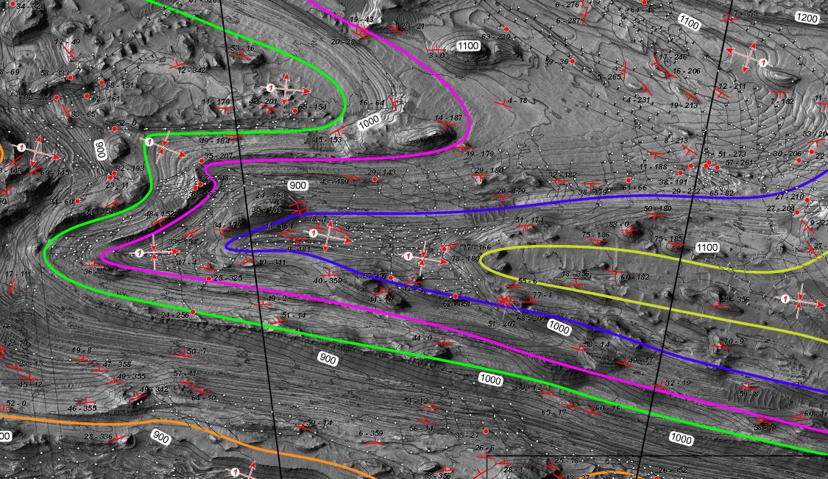
Folding on Mars – Pure folds
Folds in west Candor Chasma
Folds revealed by
structural mapping
Crosscutting
relationships – Folds
preceded faulting
Clues to evolution of
driving stresses
Reconstruct cause of
deformation (regional
landsliding)

Slide 20
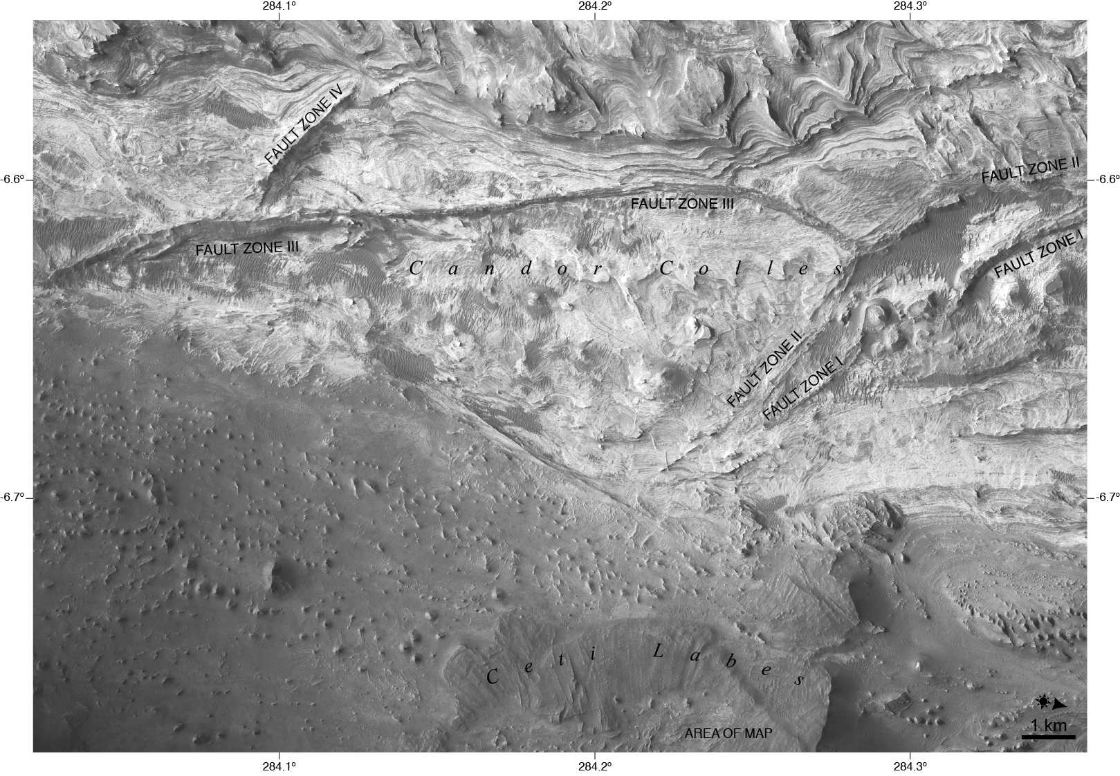
Folding on Mars – Pure folds
Soft sediment deformation in west Candor Chasma
Domes formed through upward migration of water-saturated sand (injectites)
Injectites - Sand mobilized by seismicity
Domes and fault zones mutually crosscutting ➔ Slip and resulting marsquakes along faults caused domes to form
Local process
No regional
compression or uplift

Slide 21
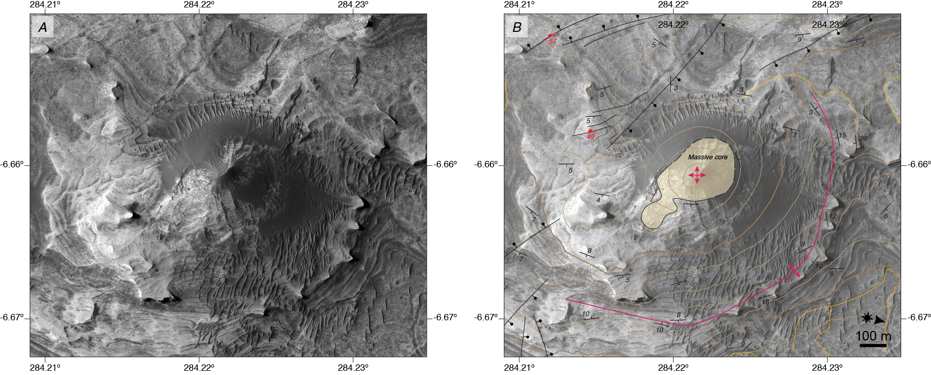
Folding on Mars – Pure folds
Soft sediment deformation in west Candor Chasma
Domes (Injectites)
(PSP_002063_1735)

Slide 22
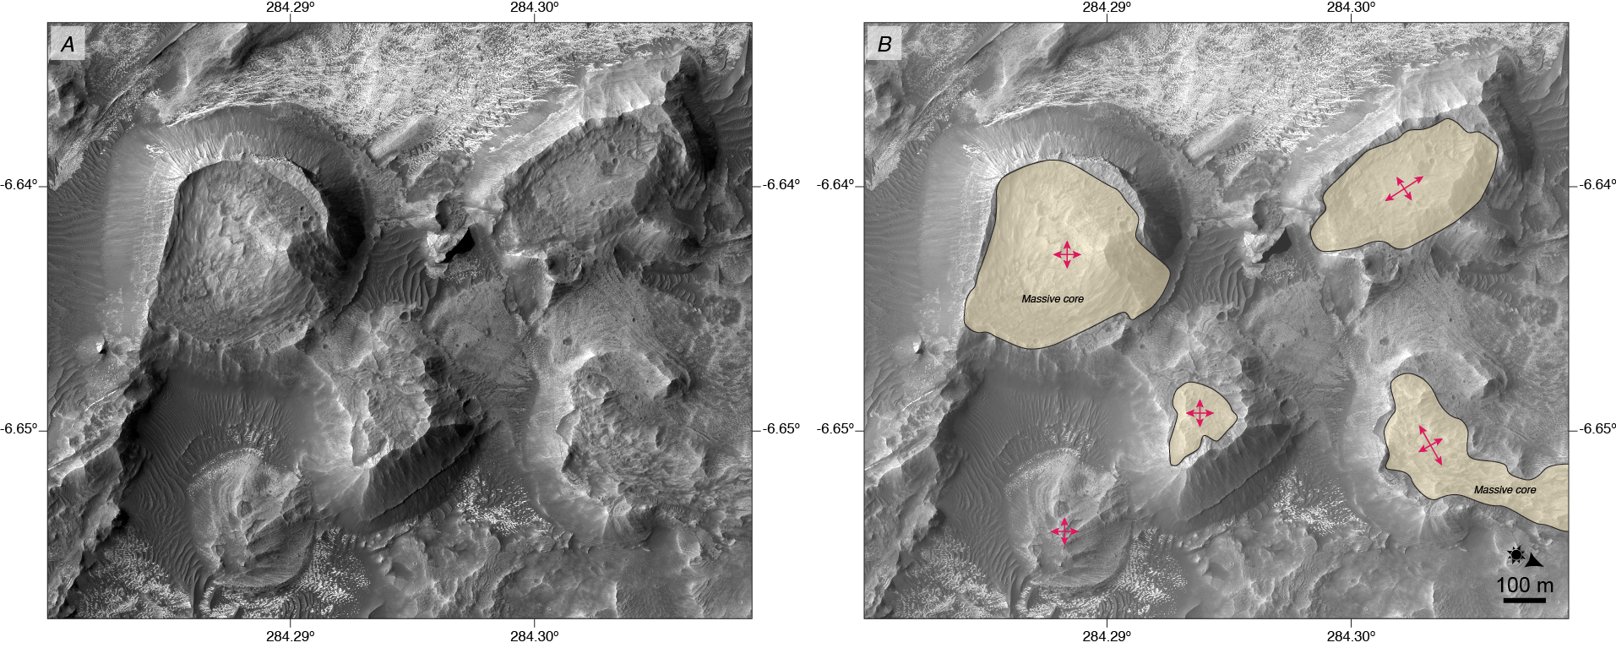
Folding on Mars – Pure folds
Soft sediment deformation in west Candor Chasma
Domes (Injectites)
(ESP_028277_1735)

Slide 23
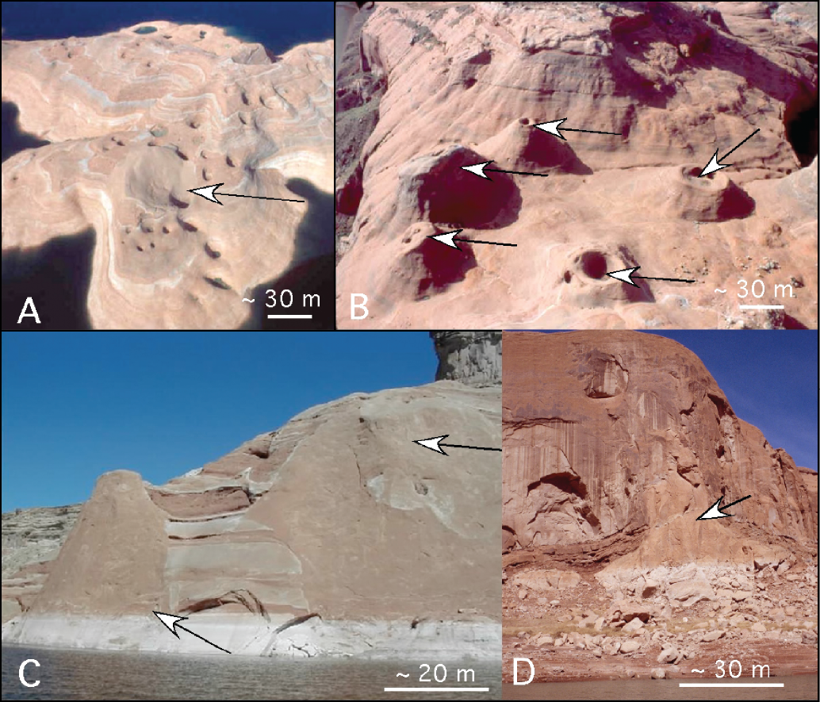
Folding on Mars – Pure folds
Soft sediment deformation in the Entrada Sandstone

Slide 24
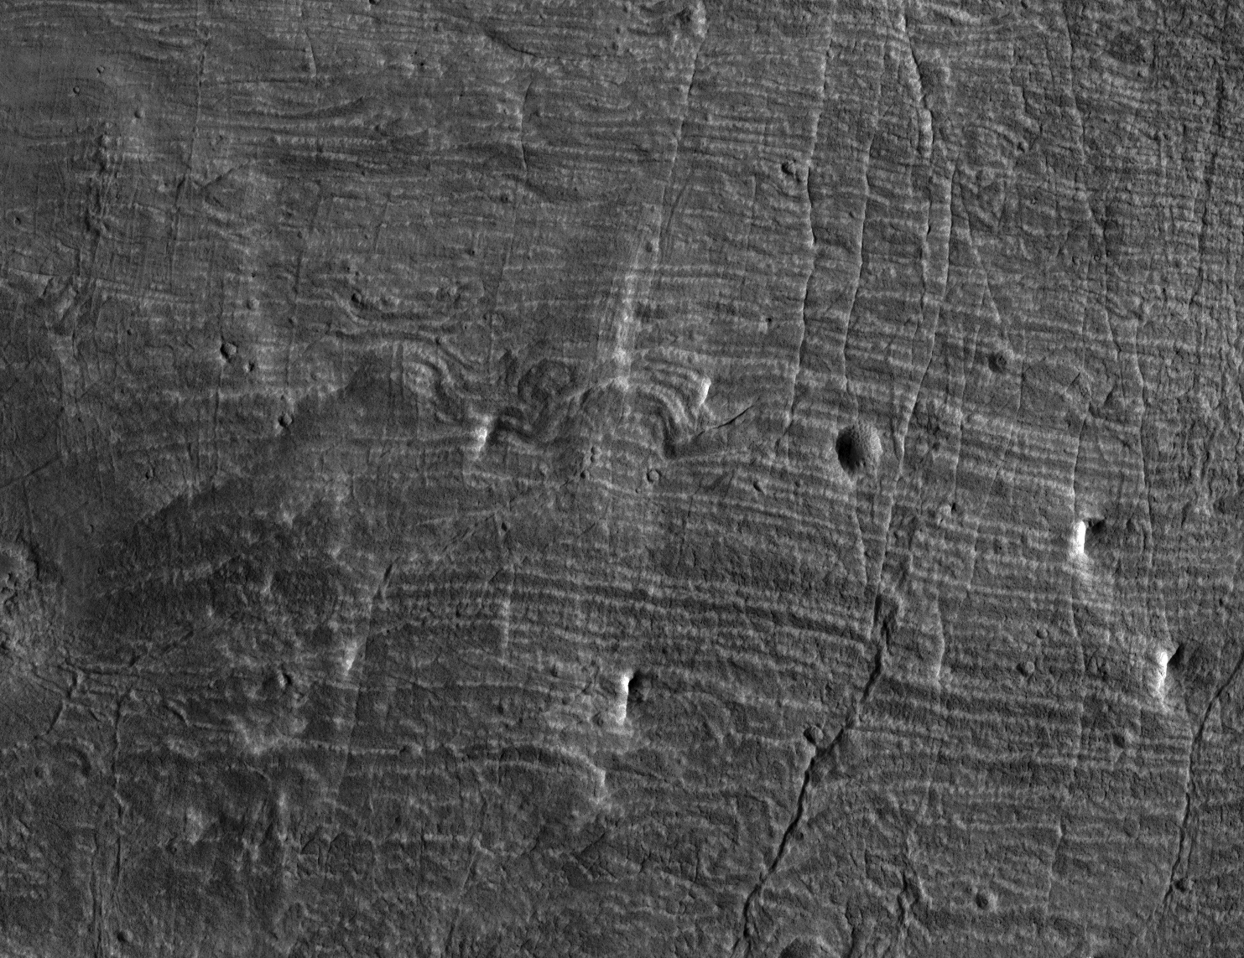
Folding on Mars – Pure folds
Soft sediment deformation in Capen crater
“Contorted bedding”
Syndepositional; Slumping of water-saturated sand
Local process; No regional compression or uplift
Image ~1.5 km across (PSP_002574_1865)

Slide 25
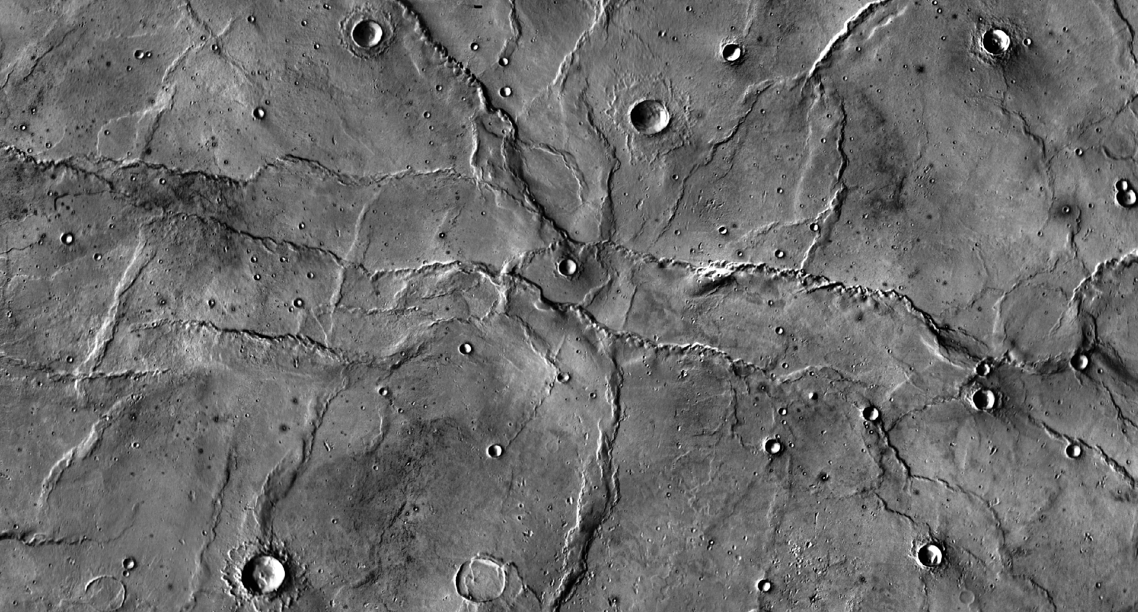
Folding on Mars – Fault-related folds
Wrinkle ridges in Hesperia Planum
Formed through bidirectional compression (NW-SE, NE-SW) of volcanic rocks
Reflects changes in regional compression
Image is ~270 km across (THEMIS day IR mosaic)
Youngest
Oldest

Slide 26
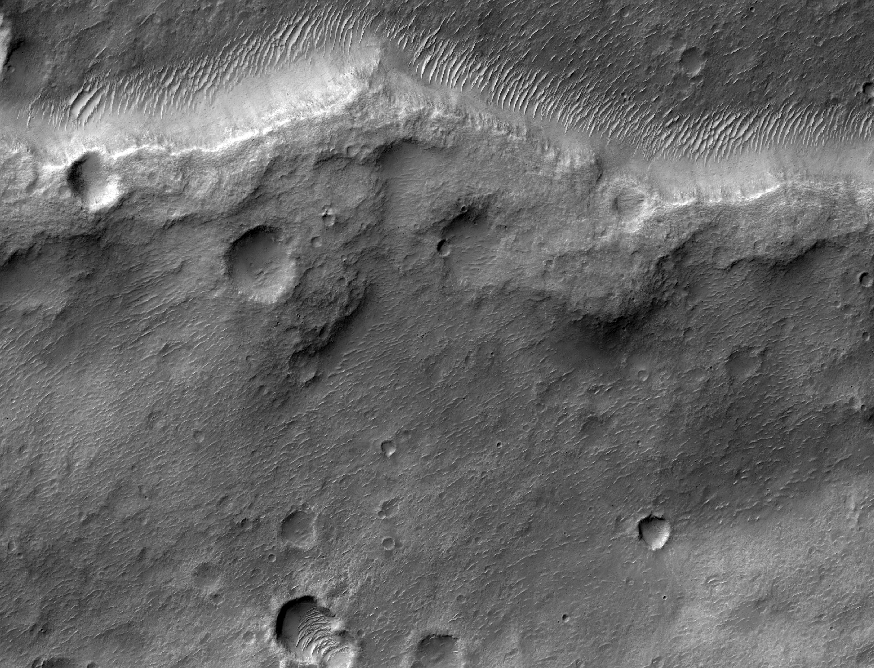
Folding on Mars – Fault-related folds
Wrinkle ridges in Hesperia Planum
Asymmetric folds
Image is ~5.5 km across (ESP_016442_1580)
Steeply-dipping
forelimb
Shallowly-dipping
backlimb

Slide 27
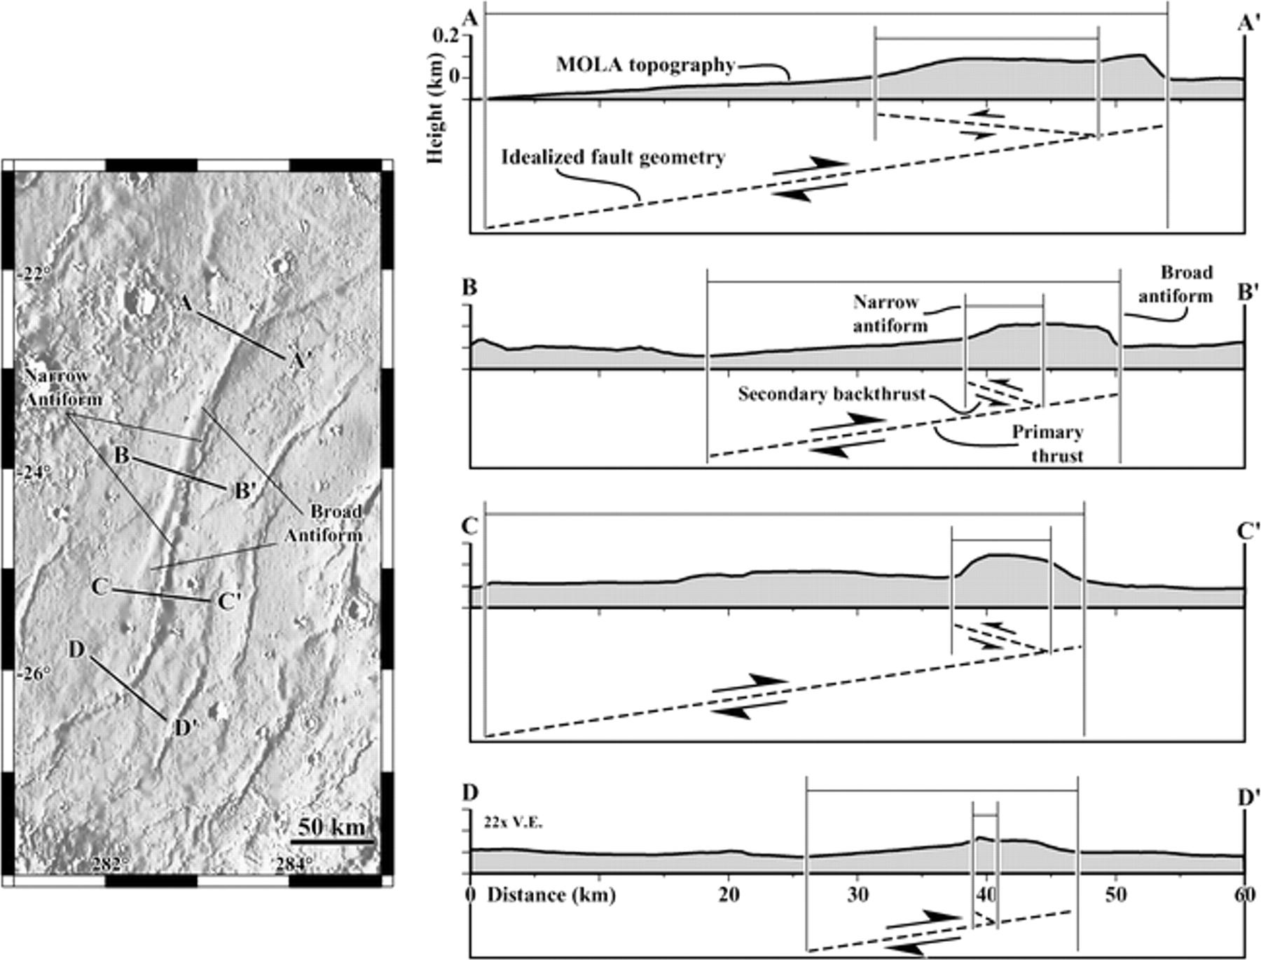
Folding on Mars – Fault-related folds
Wrinkle ridges in Solis Planum
Assumption: Topography reflects plastic deformation above fault (fault-induced folding)
Numerical models used to infer fault geometries necessary to result in this deformation
Fold asymmetry correlates with fault geometry
Fault nearest to surface below steepest limb, dips toward shallower limb
Shallowly-dipping
backlimb
Steeply-dipping
forelimb

Slide 28
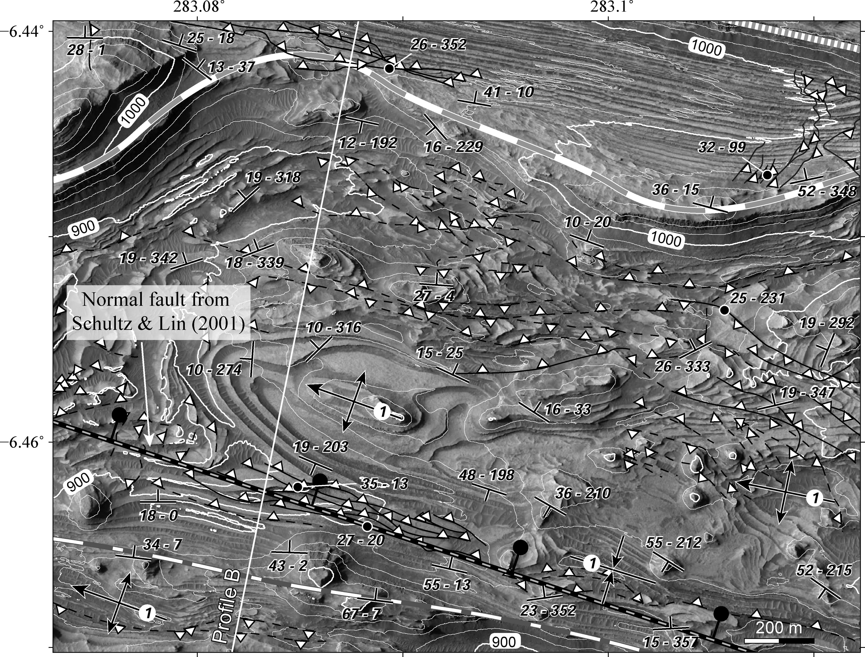
Folding on Mars – Fault-related folds
Thrust faults in west Candor Chasma
Faults crosscut folds
(Folding happened first)
This and other cross-cutting
relationships ➔ Regional
landsliding
(PSP_001984_1735)

Slide 29
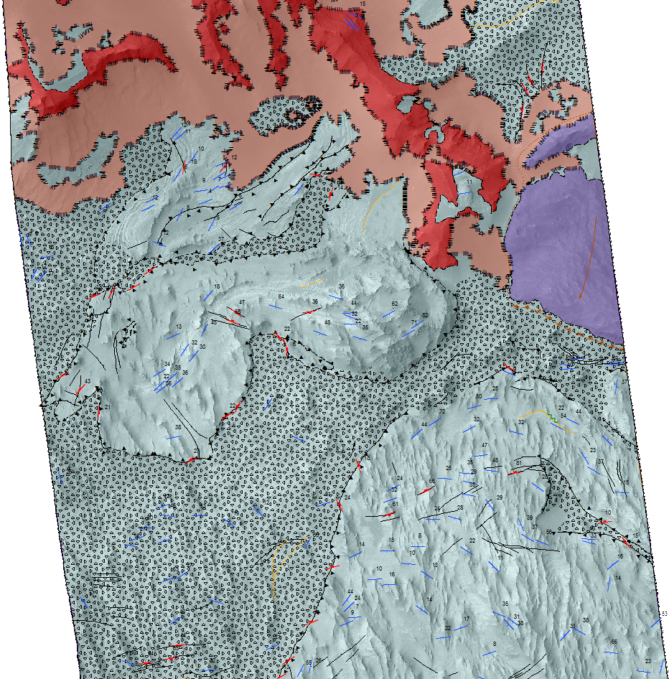
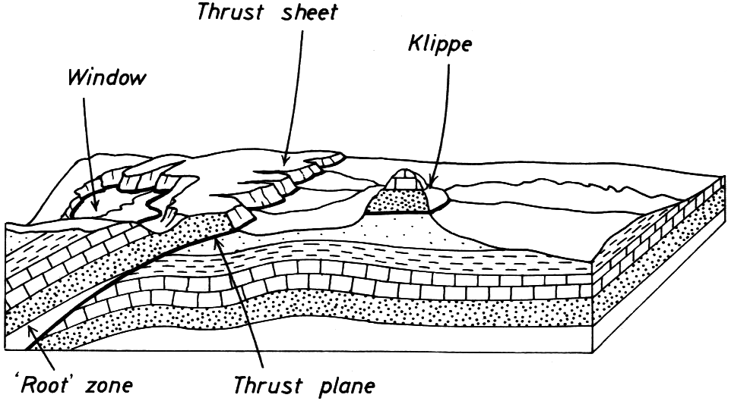
Folding on Mars – Fault-related folds
Landslide toes in west Candor Chasma
Drag
folds
Klippe
Nappe
Detachment zone
Window

Slide 30
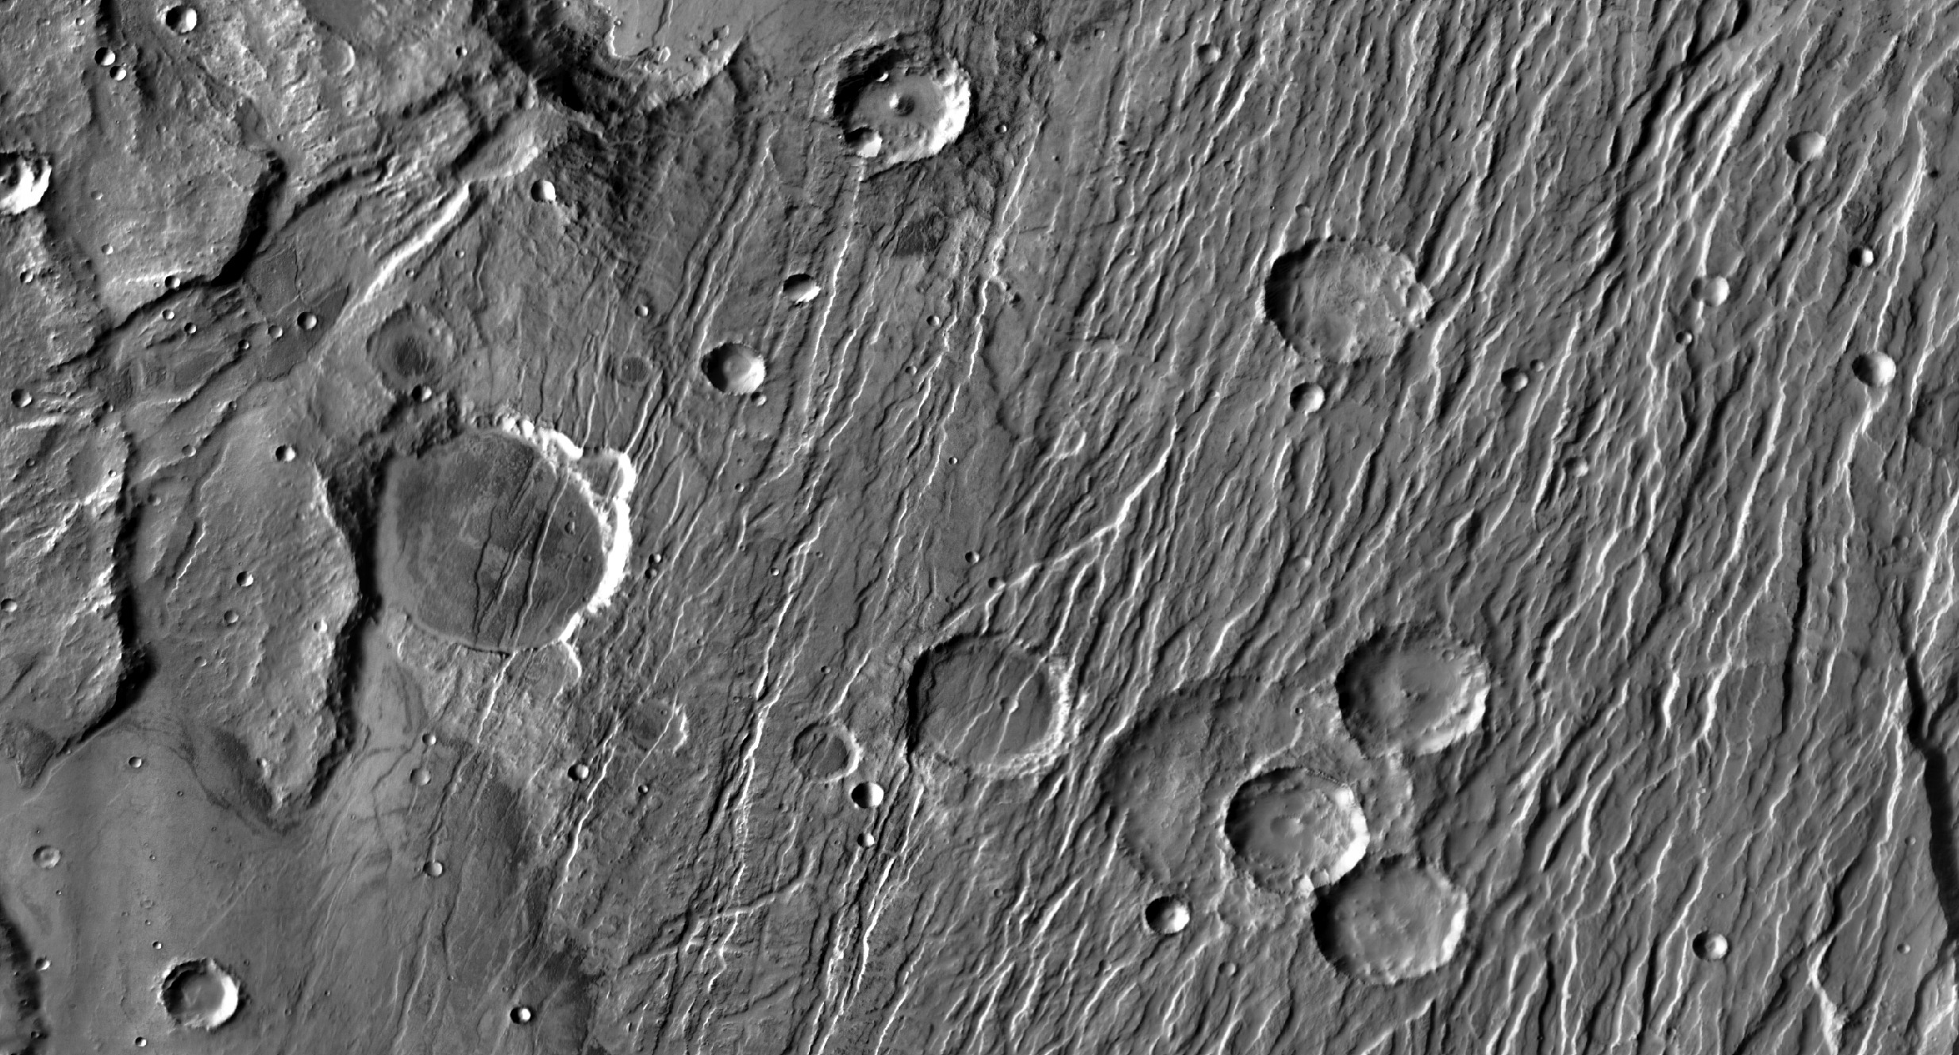
Fracturing on Mars – Normal faults
Normal faults in Claritas Fossae
NW-SE regional extension
Cross-cut (older) craters stretched, superimposed craters (younger) circular
Image is ~250 km across (THEMIS day IR mosaic)

Slide 31
Fracturing on Mars – Thrust faults
Wrinkle ridges in Hesperia Planum
Cross-cutting relationships ➔ 1) NW-SE compression, 2) NE-SW compression
Image is ~270 km across (THEMIS day IR mosaic)
Youngest
Oldest

Slide 32
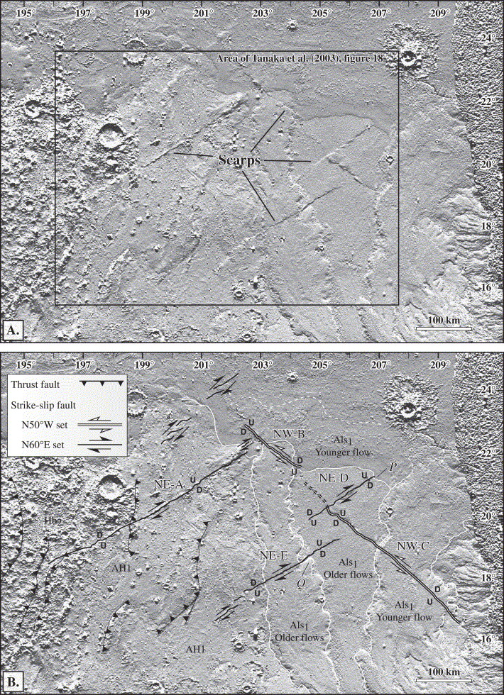
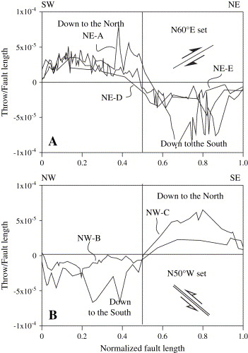
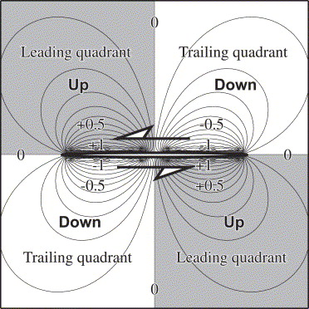
Fracturing on Mars – Strike slip faults
Strike slip faults in Amazonis Planitia
MOLA shaded relief (Lighting from the top)

Slide 33
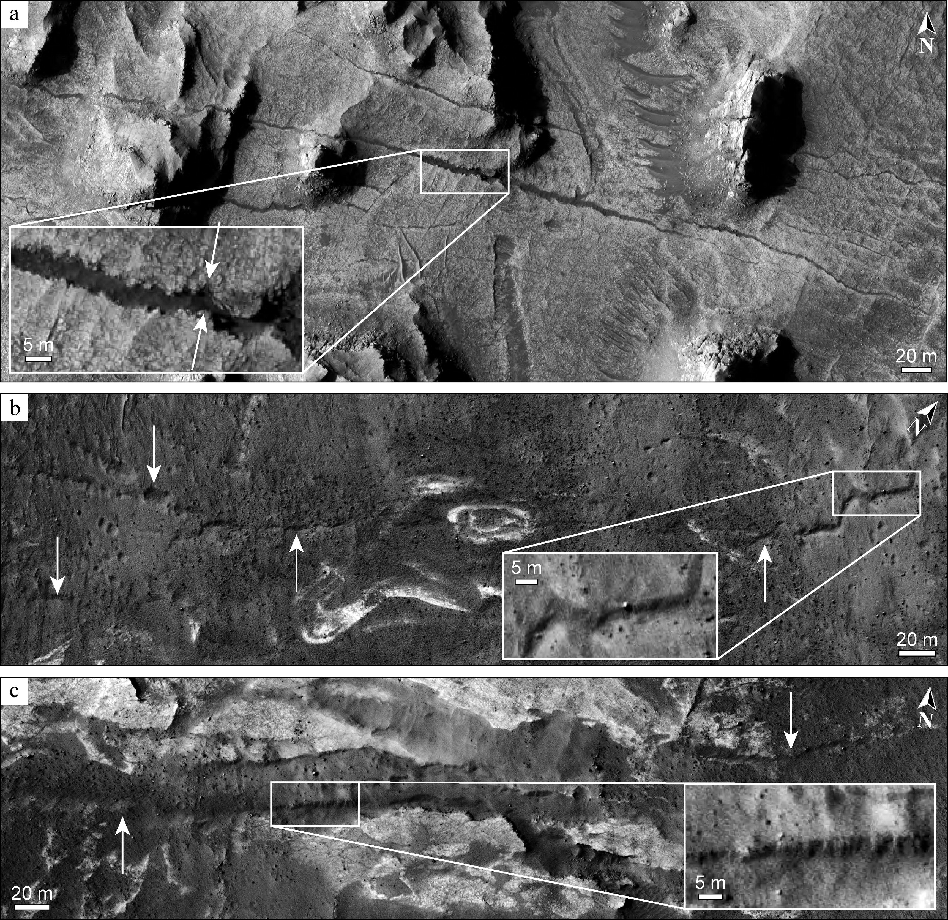
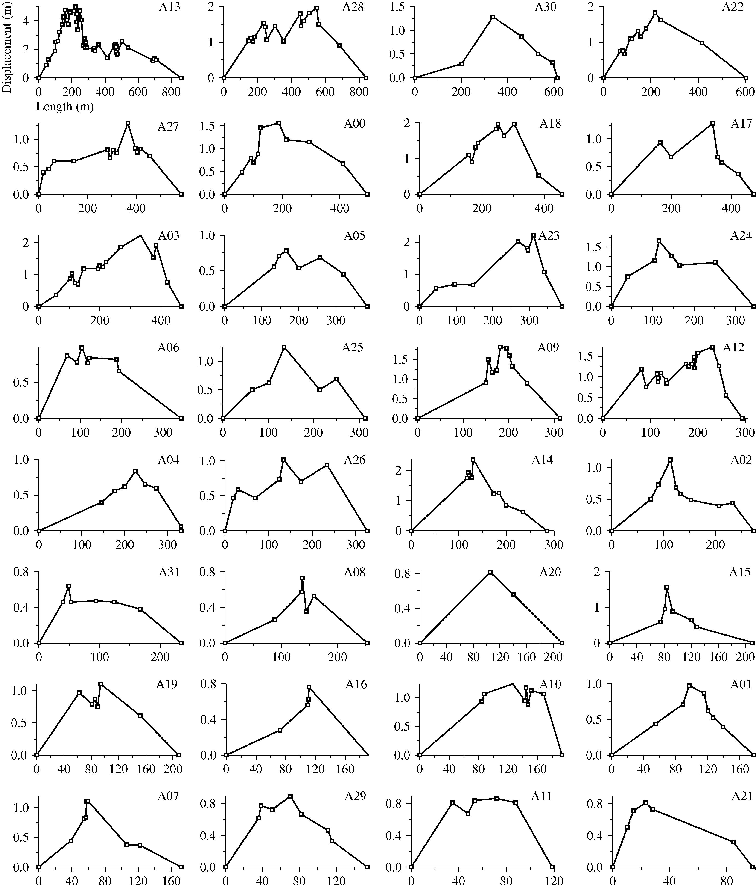
Fracturing on Mars – Joints
Joints in west Candor Chasma

Slide 34
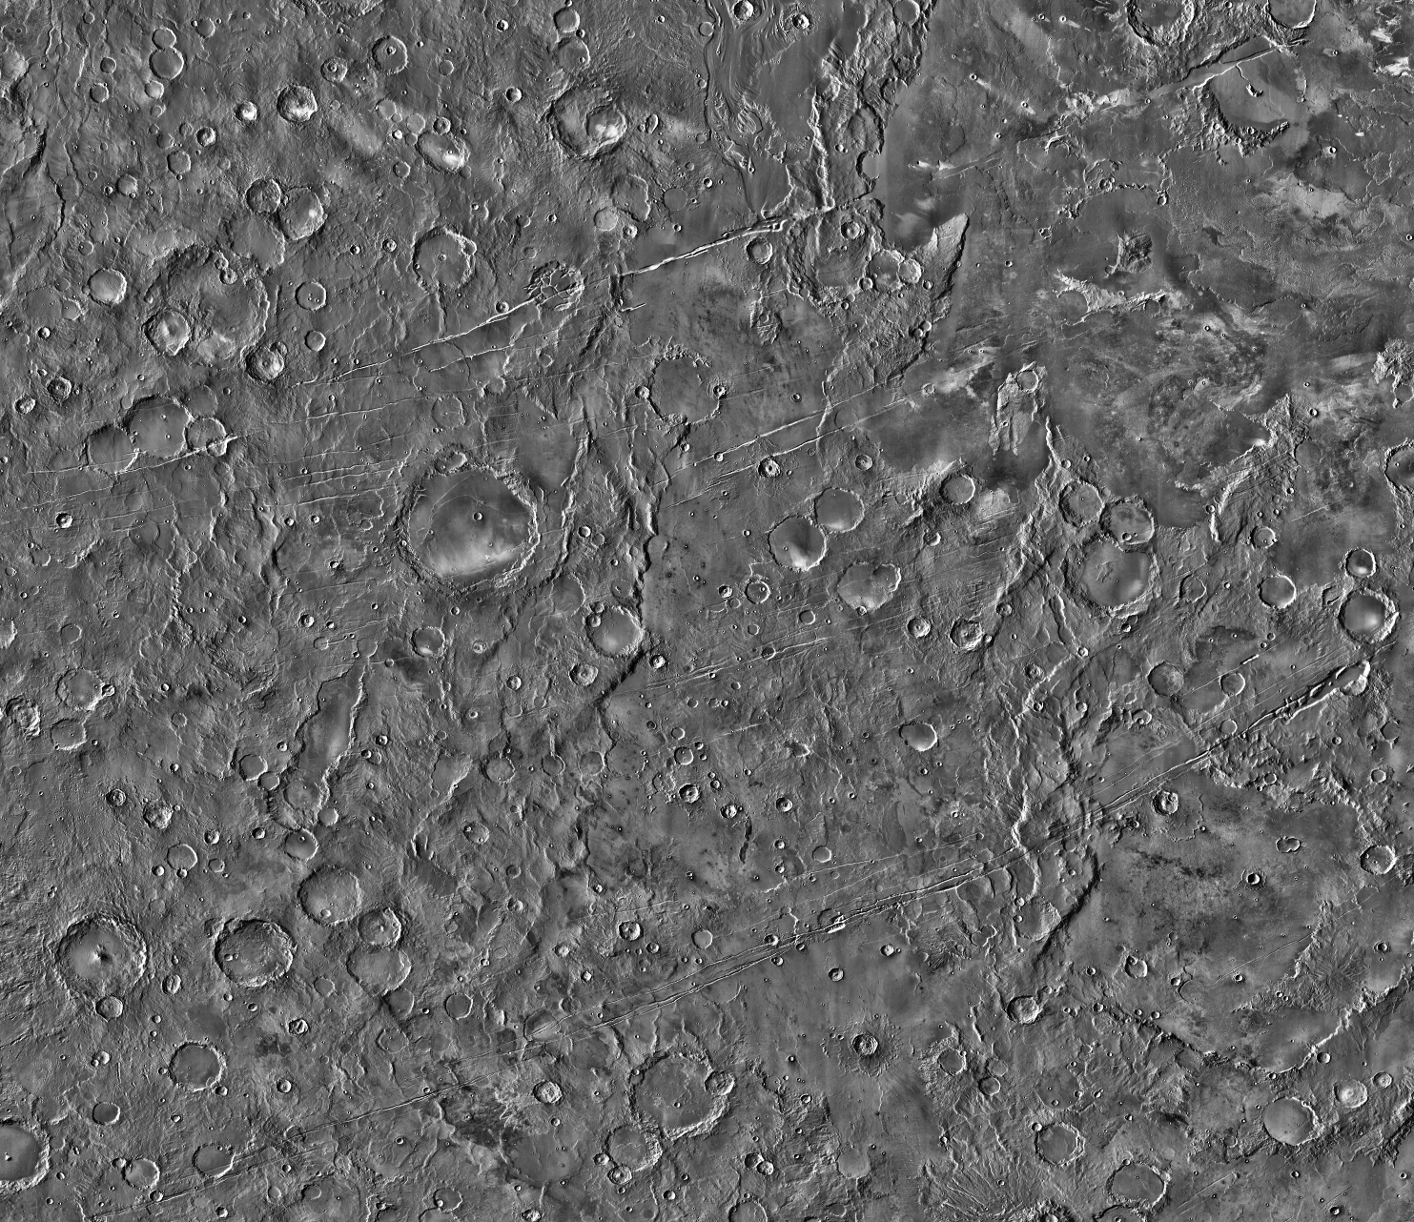
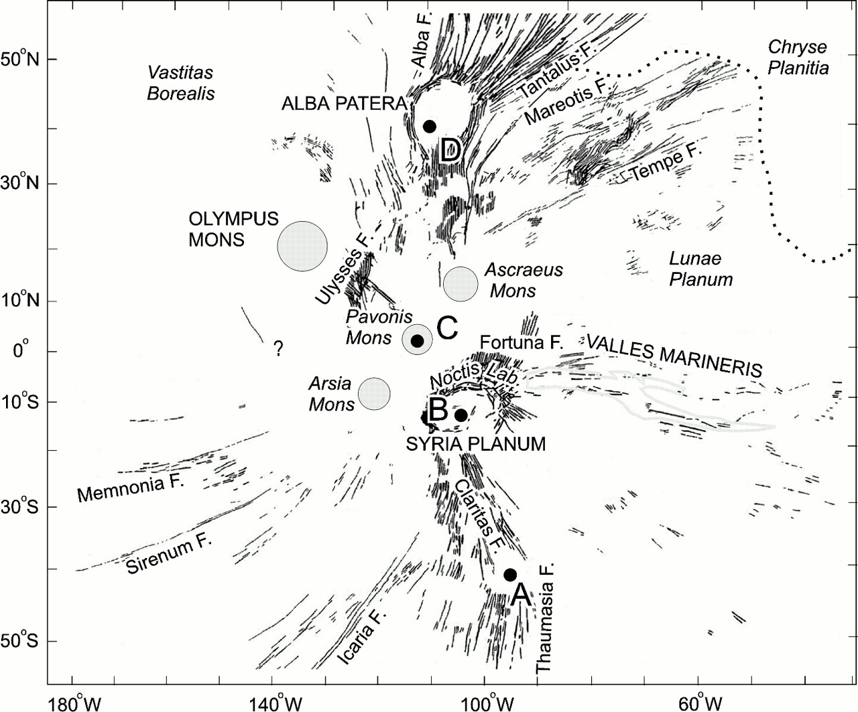
Fracturing on Mars – Dikes
Dike swarm – Tharsis-radial graben
Image is ~1300 km across
(THEMIS day IR mosaic)

Slide 35
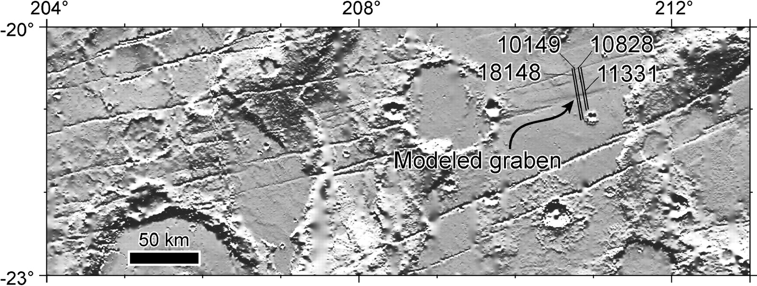
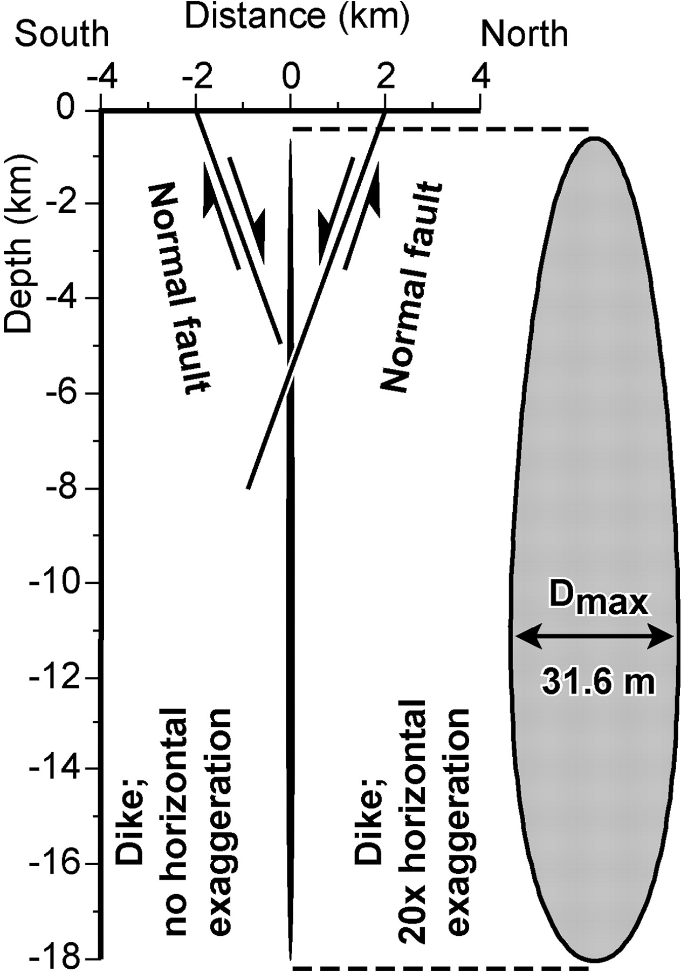
Fracturing on Mars – Dikes
Inversion of topography reveals a dike origin
Assumption: Topography reflects plastic deformation above fault
Numerical models used to infer fracture geometries necessary to result in this deformation

Slide 36
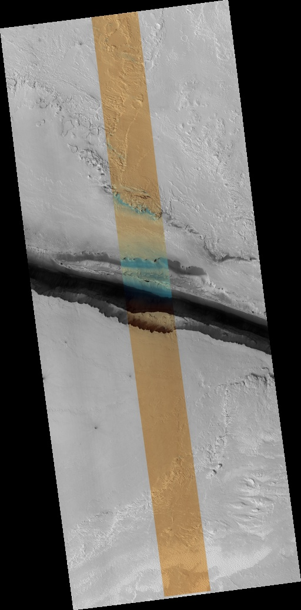
Fracturing on Mars – Dikes
Other Tharsis-radial graben
Athabasca Valles
Top of the dike breaches the surface
Volcanic fissures

Slide 37
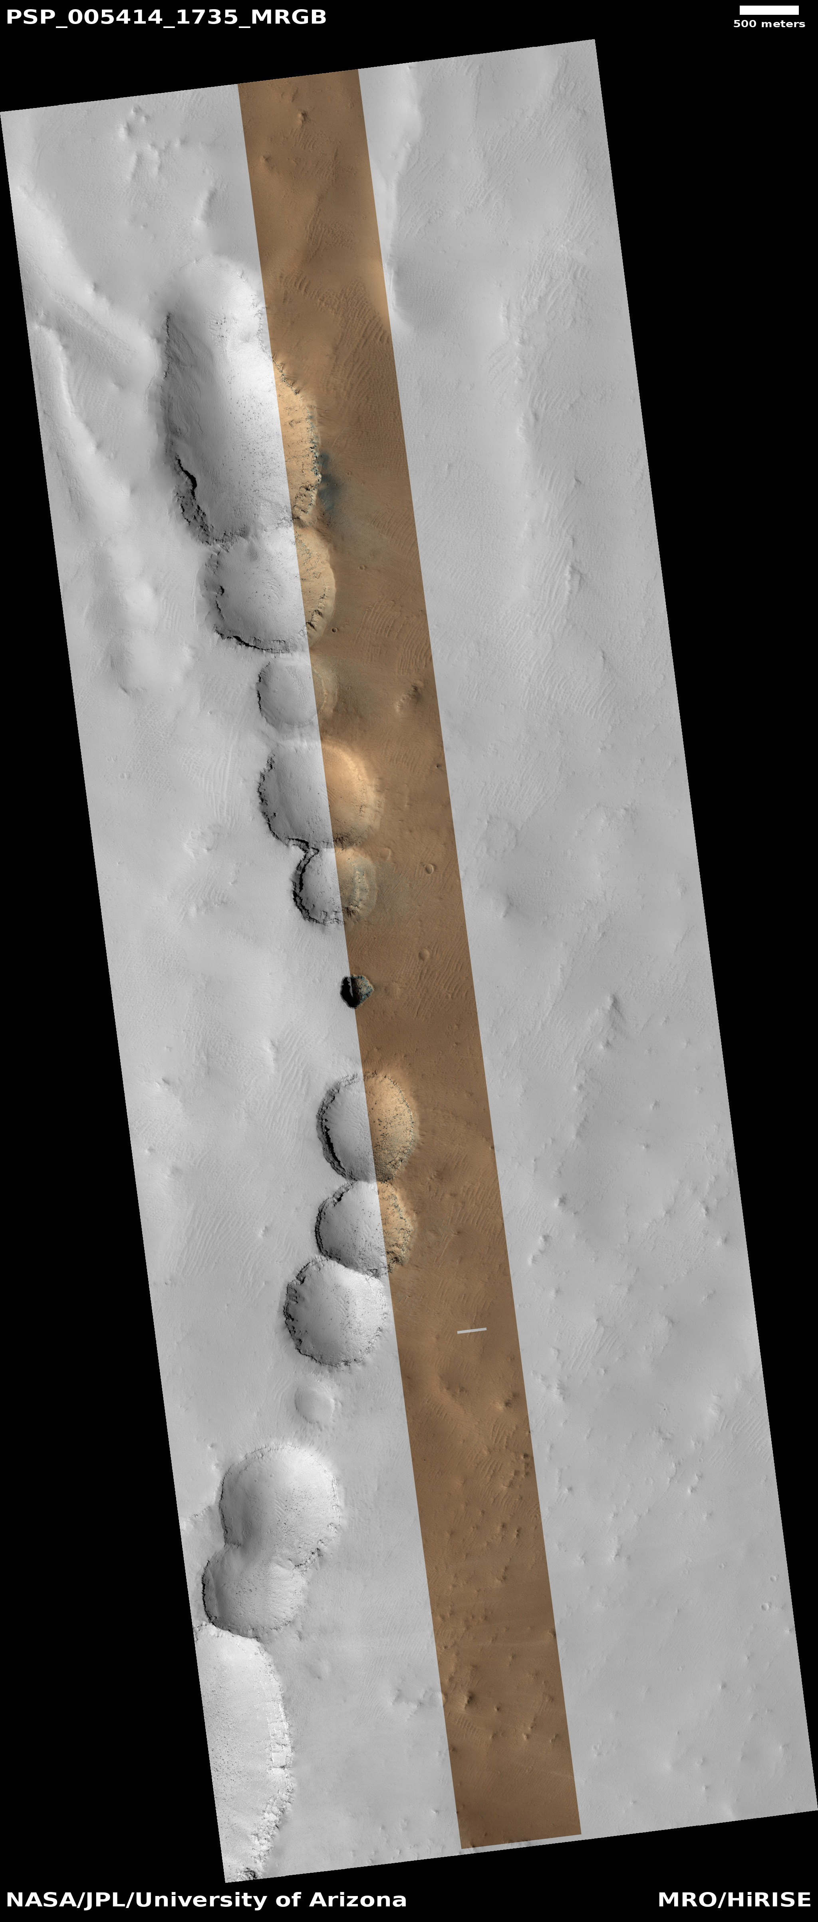
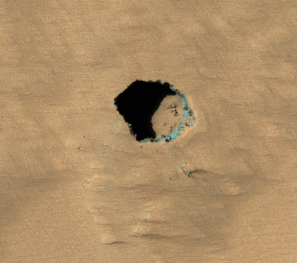
Fracturing on Mars – Dikes
Other evidence of dikes
Pit craters in Tharsis
No topographic evidence of dikes
However, pit craters form above dikes on Earth
Dike top likely deeper than for graben
Inhibit graben formation
Facilitate pit formation
Pit is ~100m across (ESP_033935_1805)

Slide 38
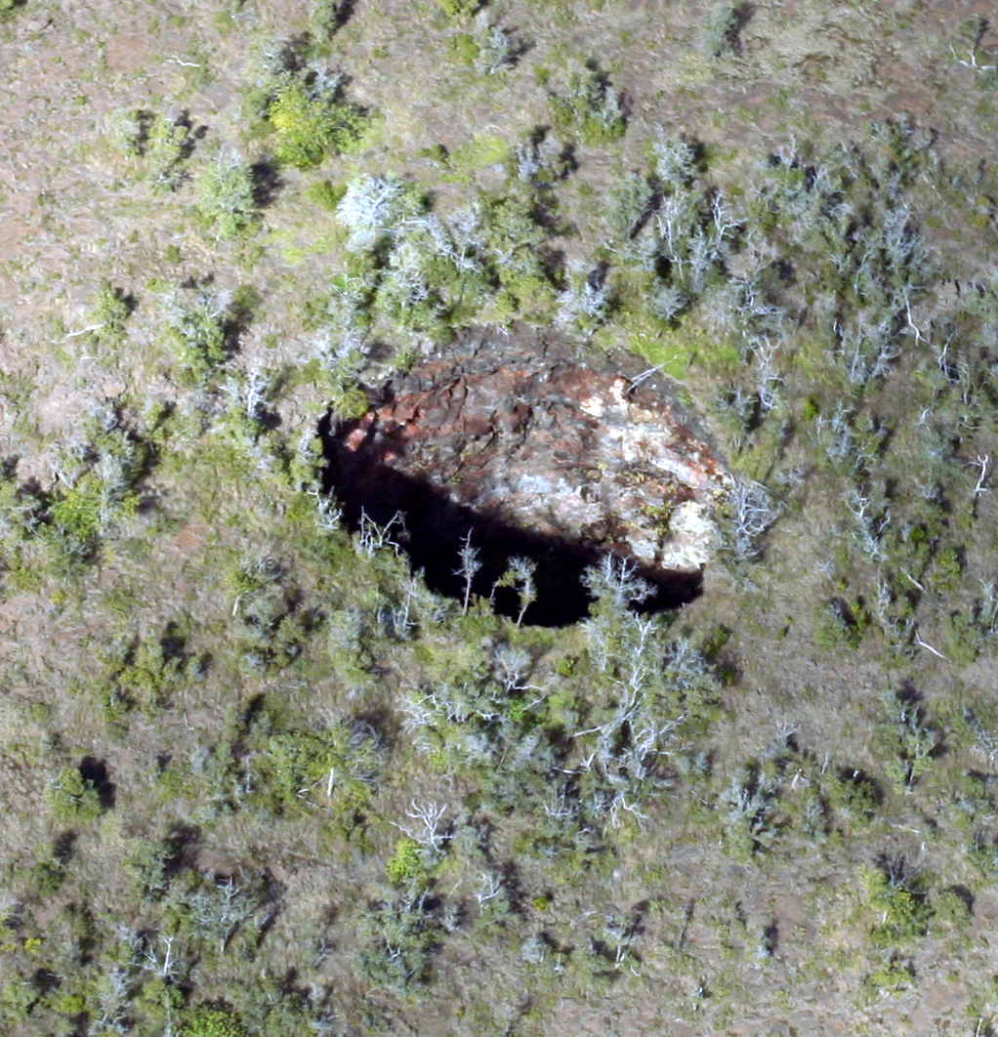
Fracturing on Mars – Dikes
Pit craters on Kilauea volcano, Hawaii
Pit craters form through collapse above partially-drained dikes

Slide 39
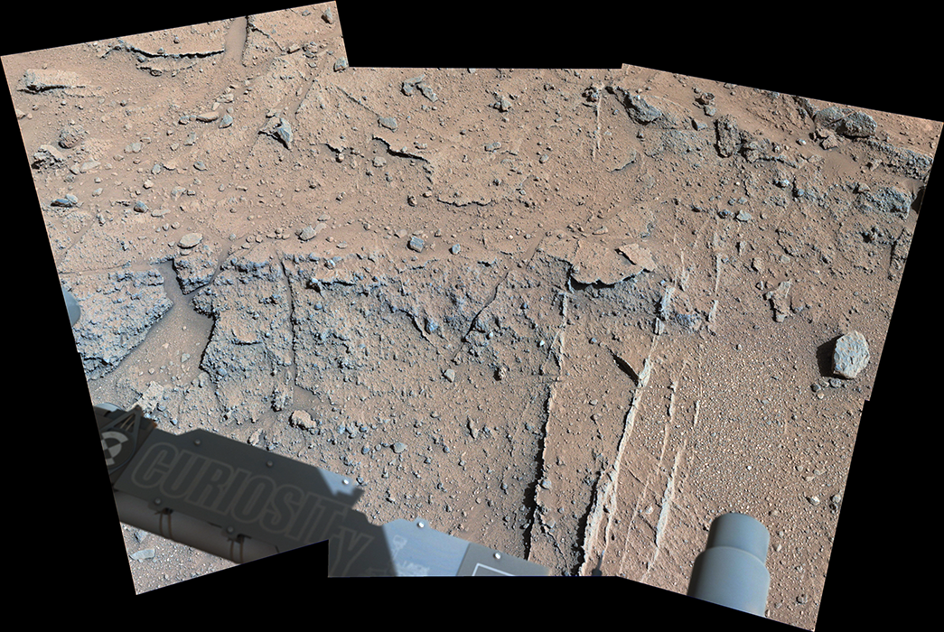
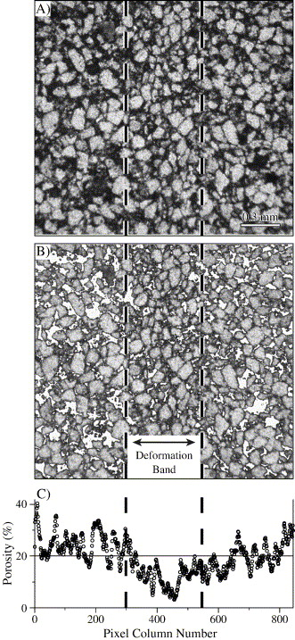
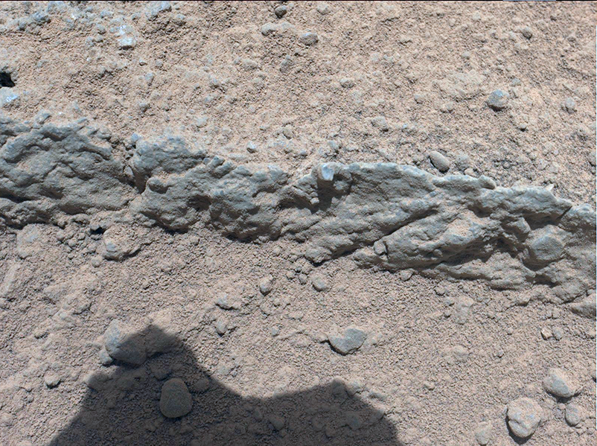
Fracturing on Mars – Deformation bands
Individual deformation bands in Gale crater
Compactional deformation band
in Wingate Sandstone

Slide 40
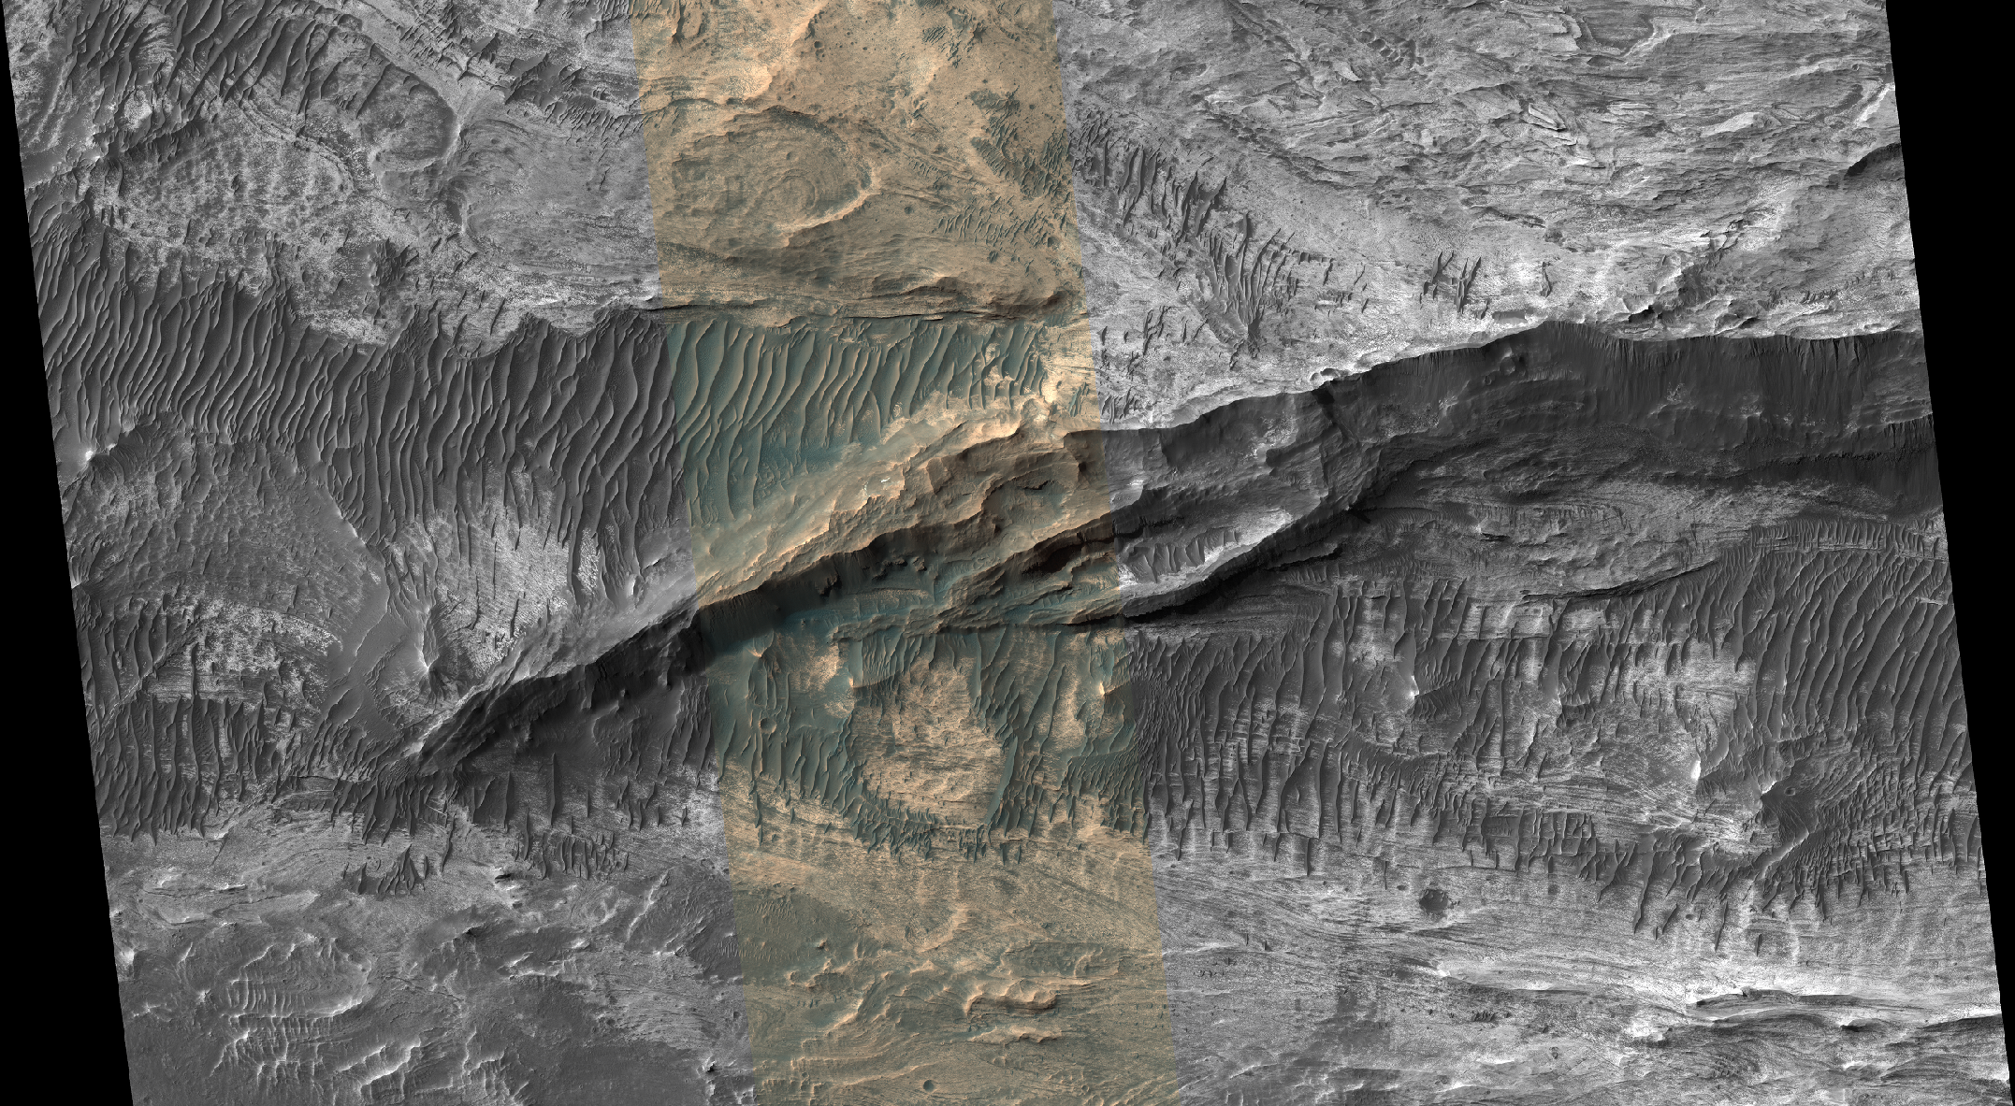
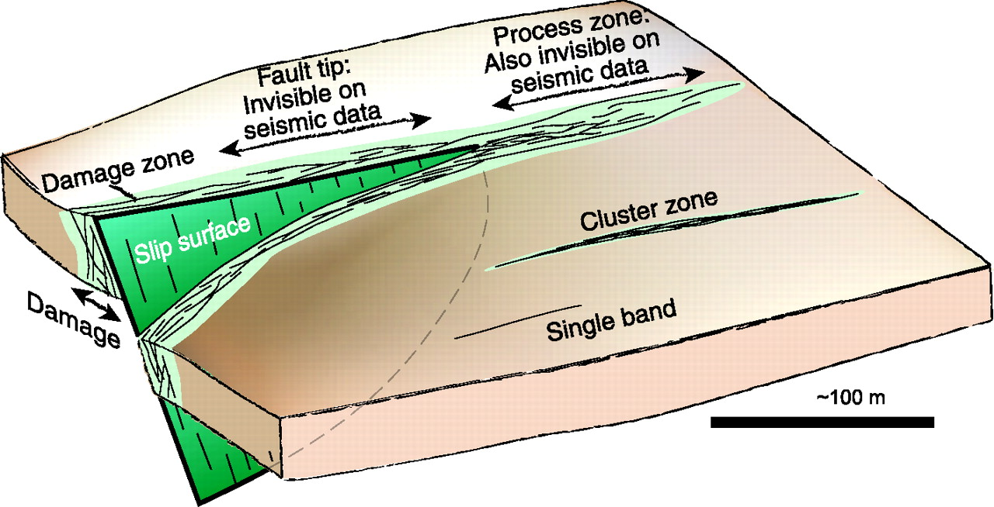
Fracturing on Mars – Deformation bands
Deformation band damage zones in west Candor
Localized and distributed
deformation
Damage zone – Distributed
Fault plane (Slip surface) – Localized

Slide 41
Summary
Studies of tectonics – understanding causes and manifestation of deformation on planetary surfaces
Stress ➔ Strain = Tectonic features
Folding & Fracturing – Primary mechanisms for strain
Mars fractures have less deformation (per unit length) than terrestrial counterparts
Principle of cross-cutting relationships
The geologic feature which cuts another is the younger of the two features
Principle of superposition
Sedimentary units deposited in time order, with oldest units on the bottom, youngest on the top
Folding on Mars
Pure folds & Fault-related folds
Regional compression & local processes
Fracturing on Mars
Any ‘structure’ consists of multiple types of fractures, localized & distributed deformation
Tharsis-radial graben – Normal faults and subjacent dike
Faults in west Candor Chasma – Fault planes and damage zones of individual deformation bands

