Slide 1
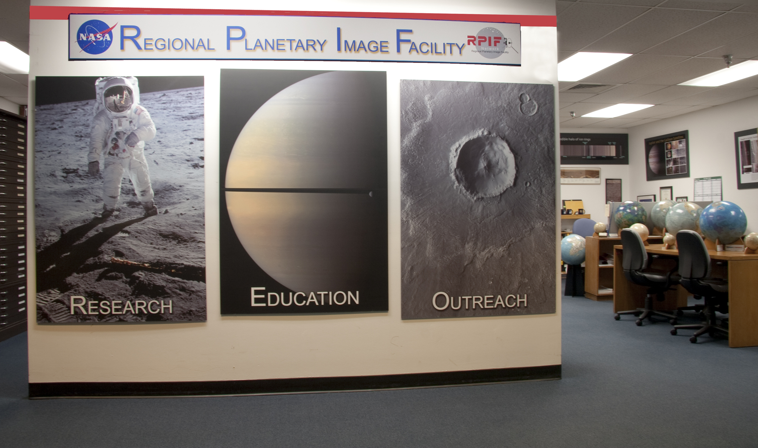
RPIF Senior Review 2015
Space Imagery Center
University of Arizona
Director: Shane Byrne Data Manager: Maria Schuchardt

Slide 2
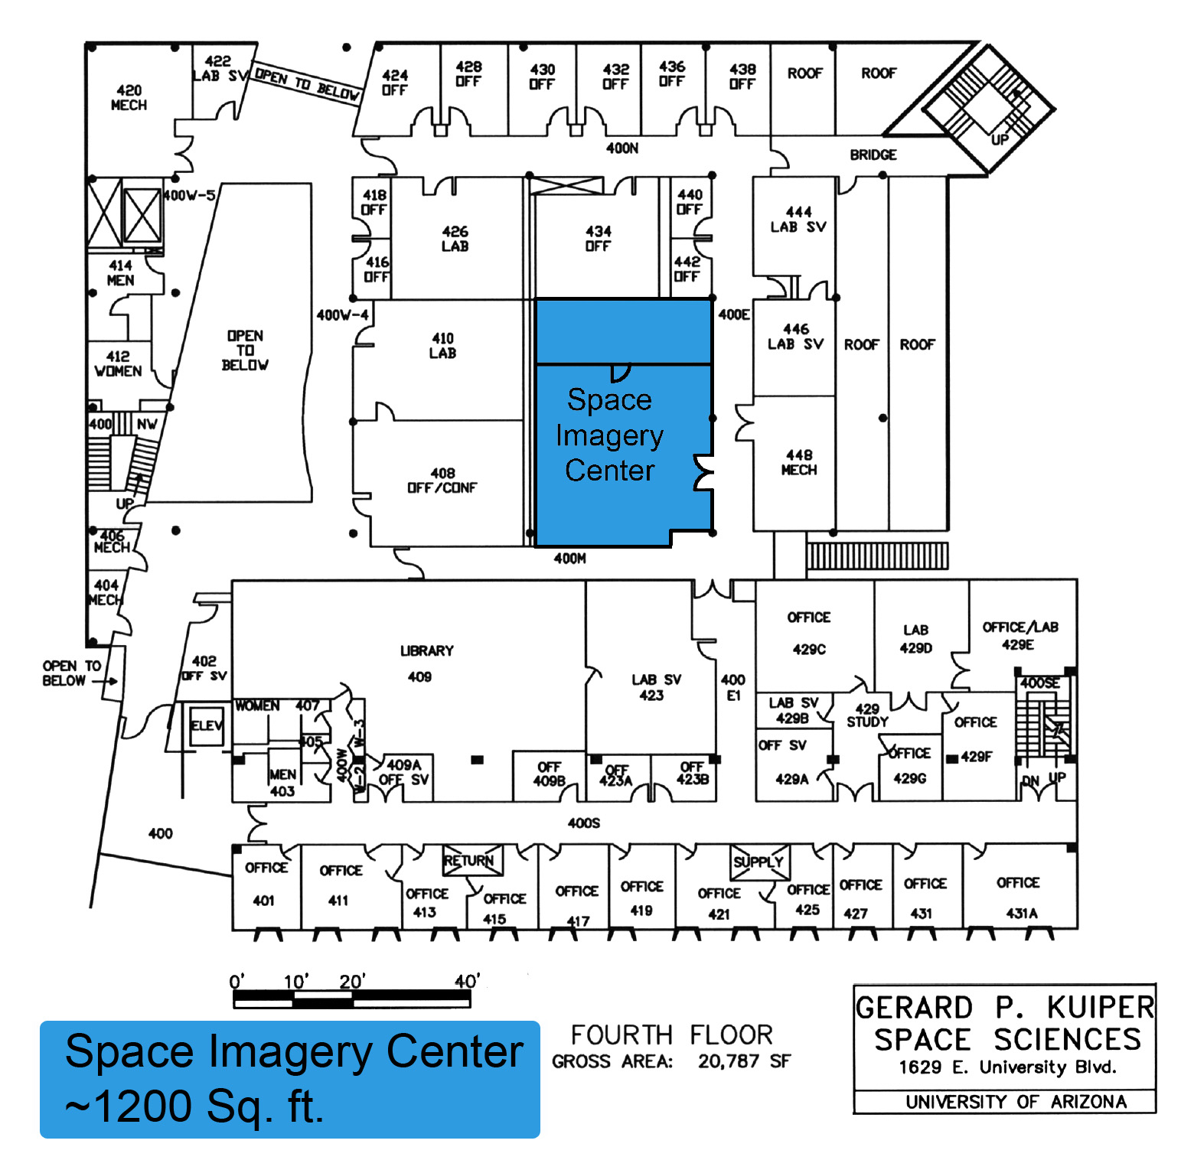
Established in 1977
Library is 1200 sq. ft
with extra storage in basement
MOU with NASA
Data manager and Physical Space provided by LPL
Large Physical Collection
Prints/Negatives/CDS of the following missions (~400,000) Lunar Orbiter, Surveyor, Ranger, Apollo, Gemini, Mariner 6 - 10, Pioneer 10 & 11, Voyager, Viking, Pathfinder, Mars Global Surveyor, Magellan
Maps: 1,900, not including duplicates
Much gray literature and historical books and artifacts

Slide 3
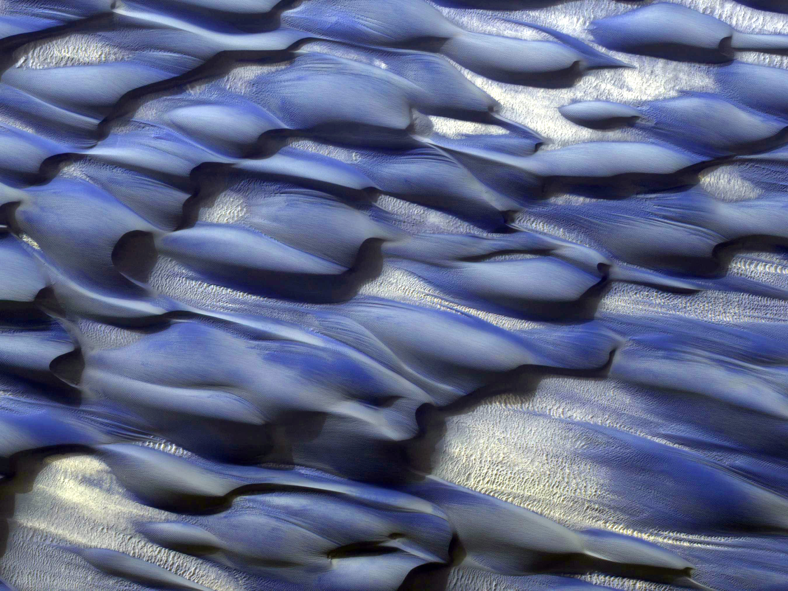
Archiving
Research
Education & Public Outreach

Slide 4
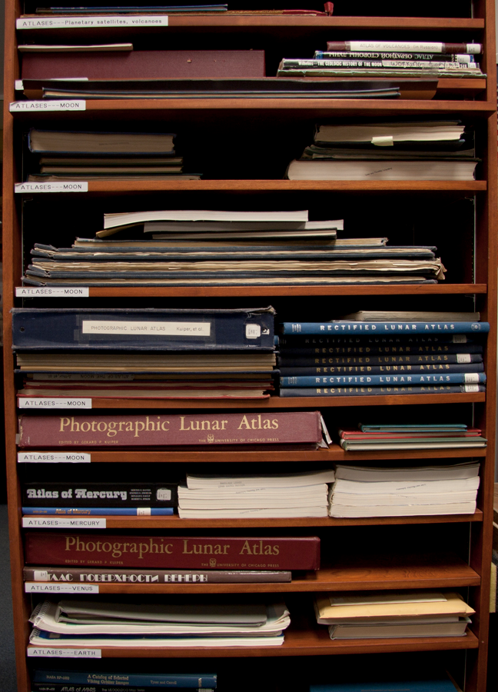
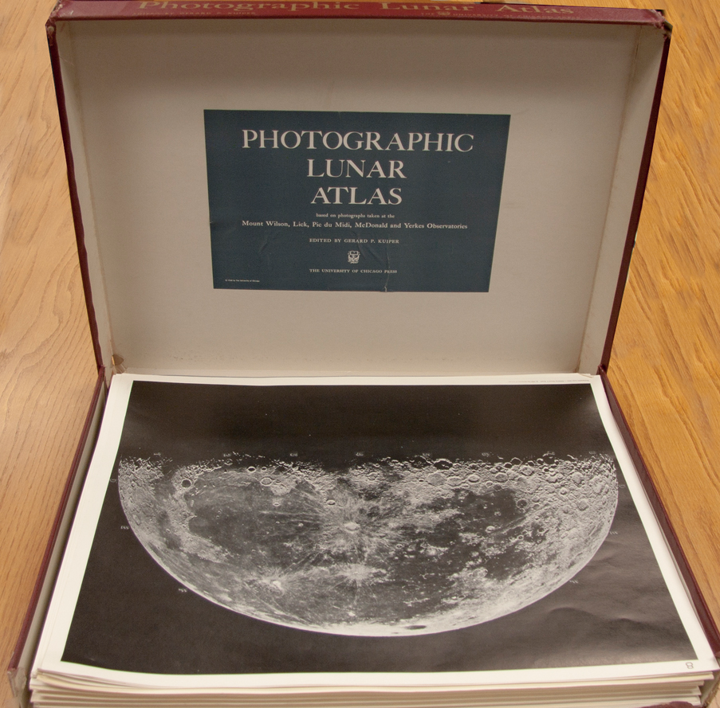
Scanning of maps and atlases

Slide 5
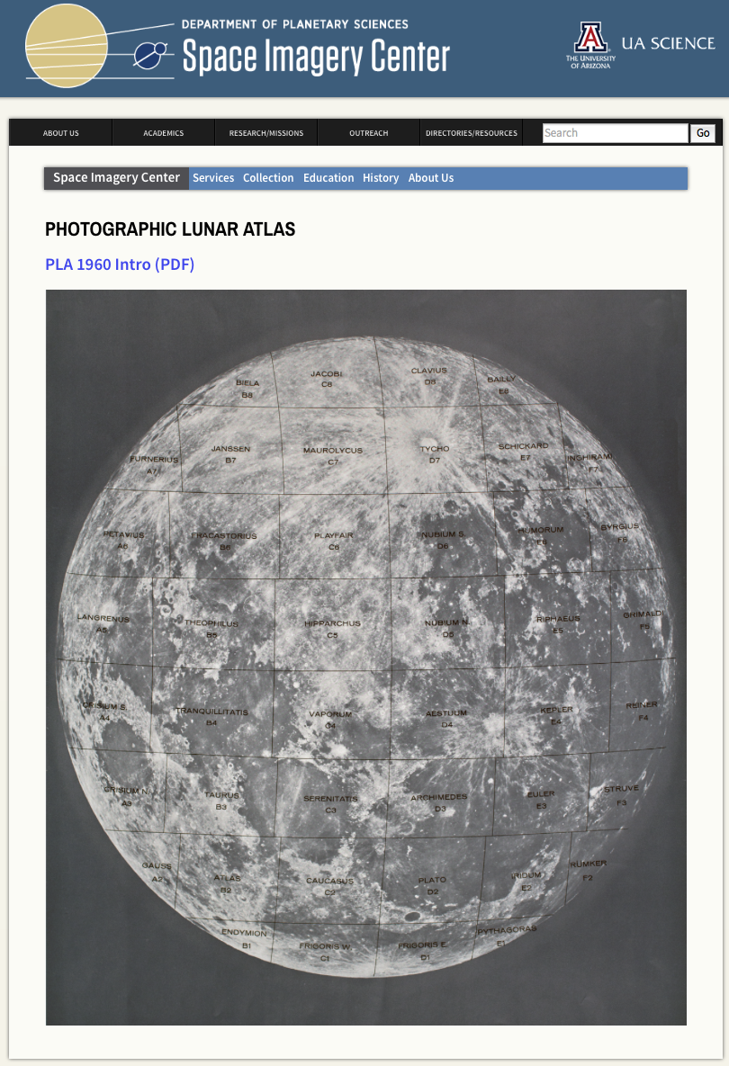
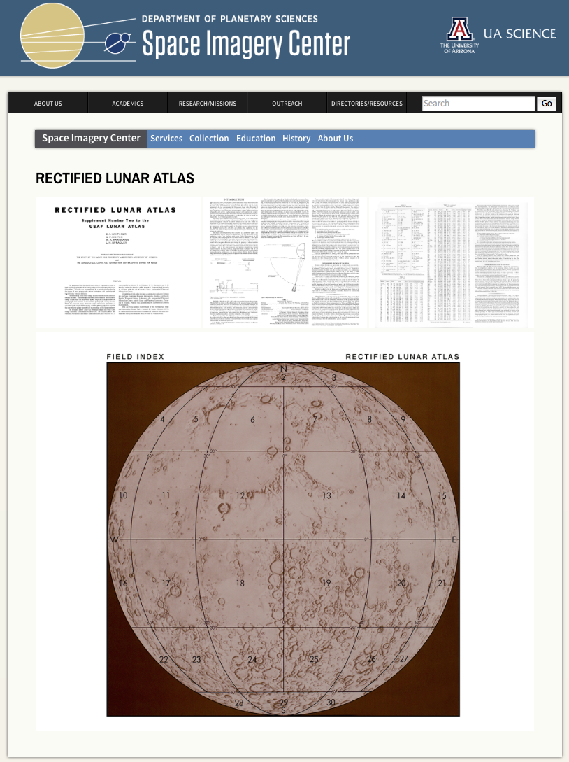

Slide 6
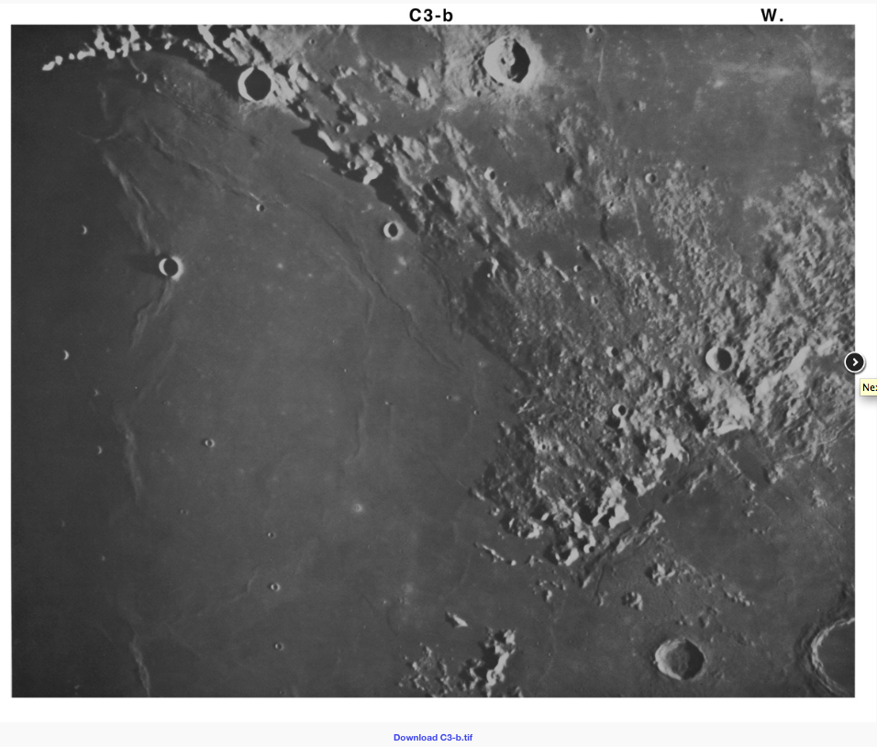
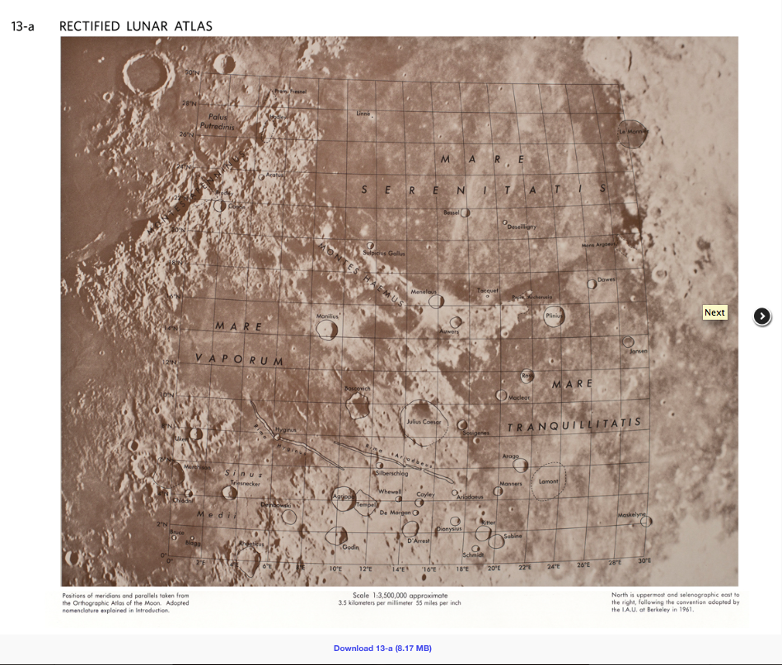

Slide 7
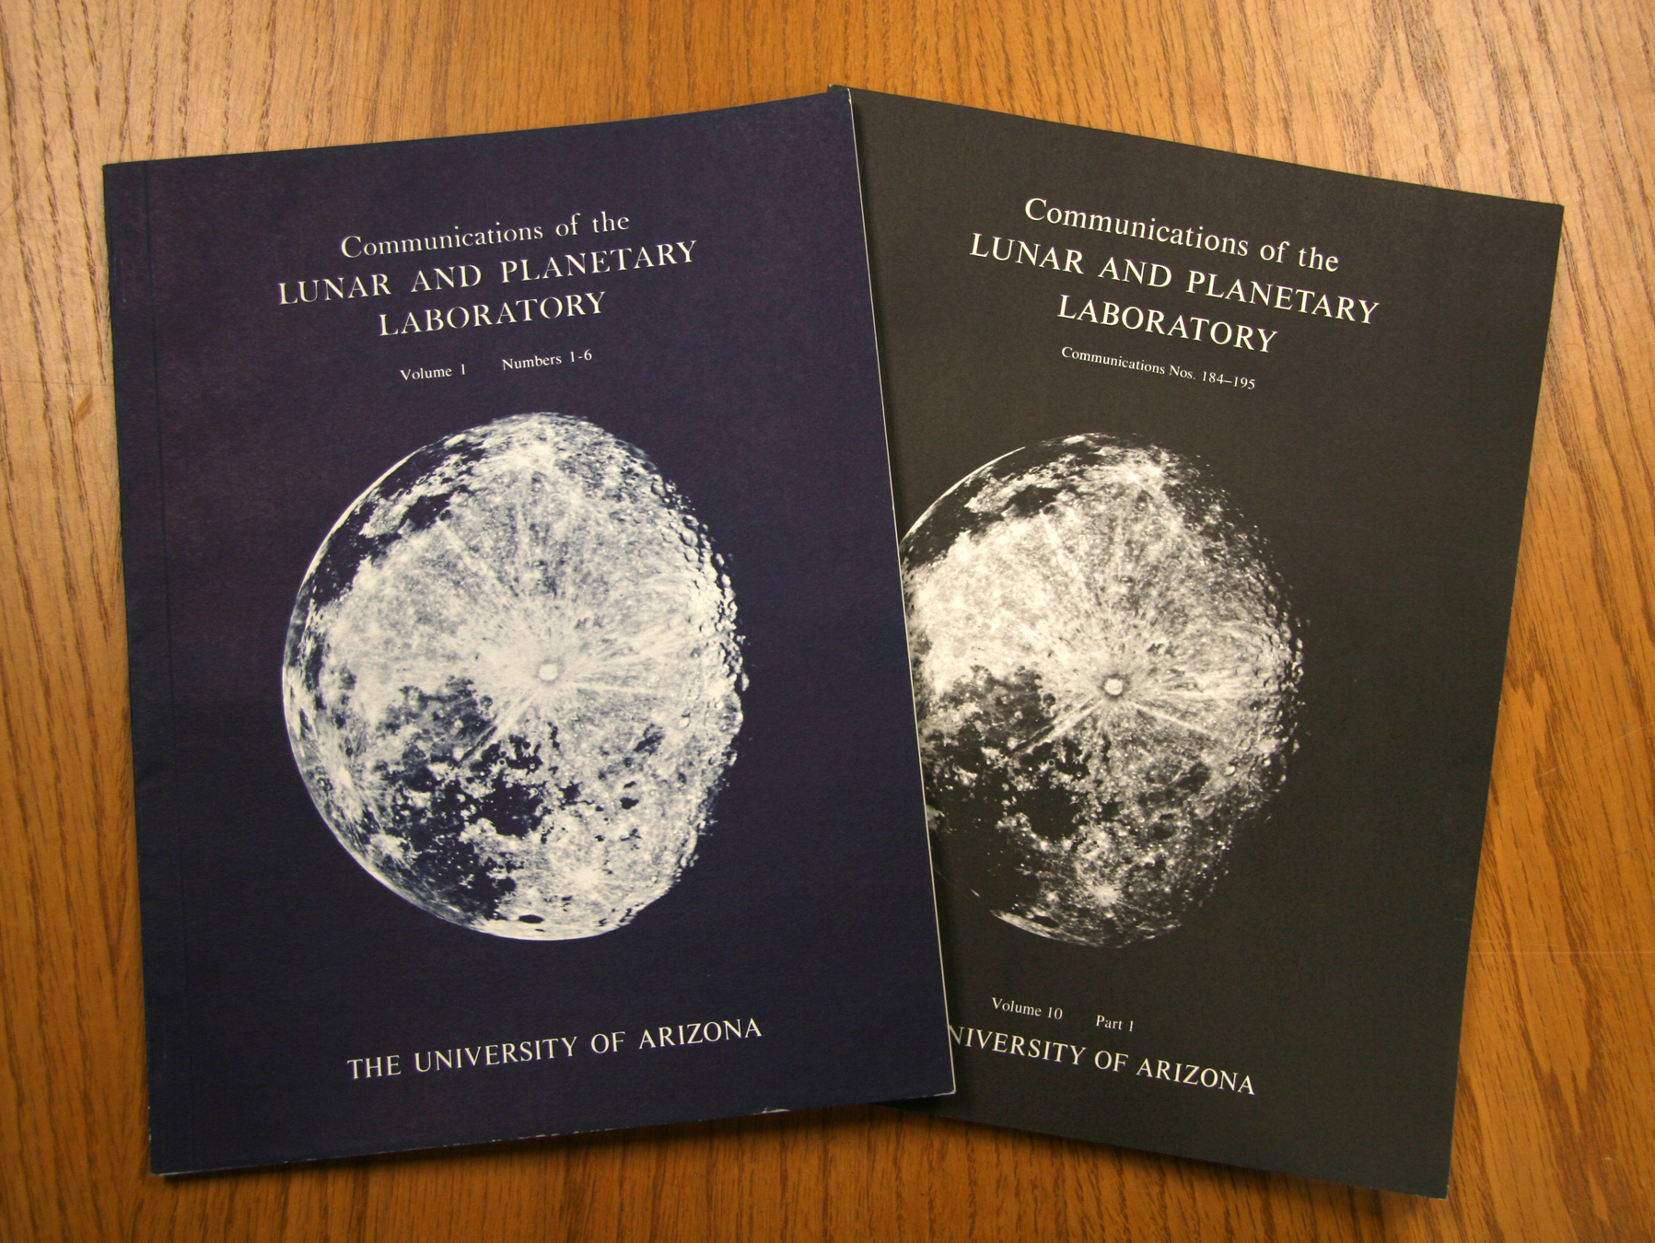
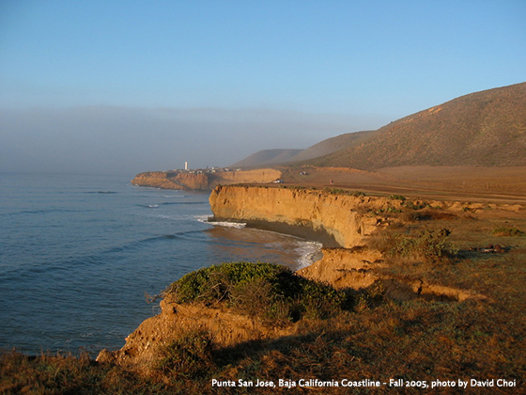
Communications of the Lunar and Planetary Laboratory
Peer-reviewed journal that ran from 1962-1973
PDFs of all papers online
Metadata searchable on NASA ADS, with links to PDFs
20 years of geologic fieldtrip guides scanned and made available online
LPL’s Planetary Analogue Fieldtrip class
Covers a few hundred geologic stops
Widely distributed throughout the south-west

Slide 8
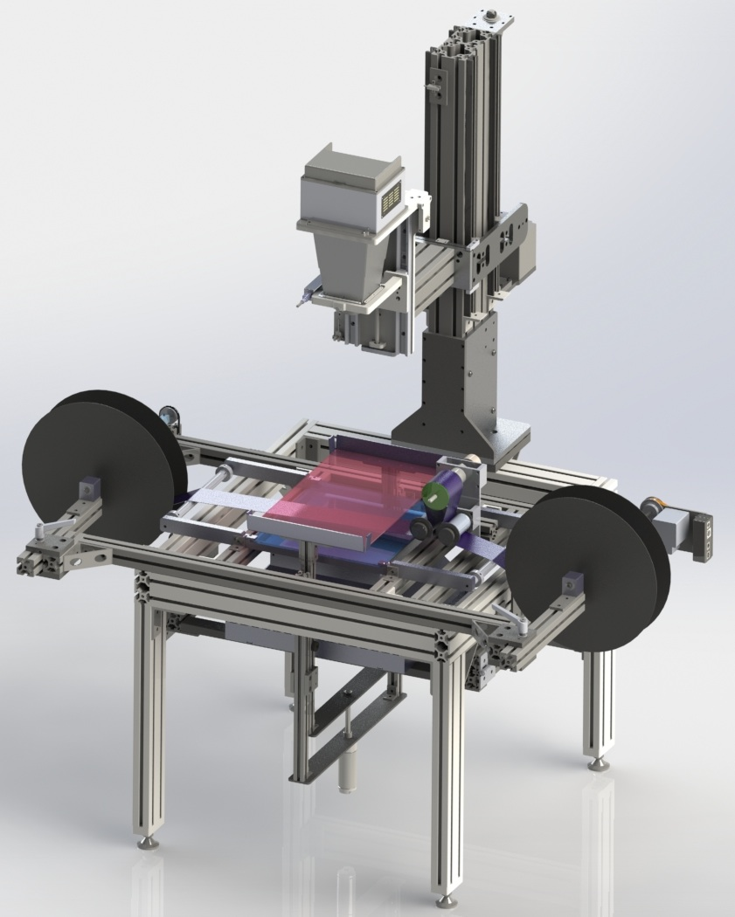
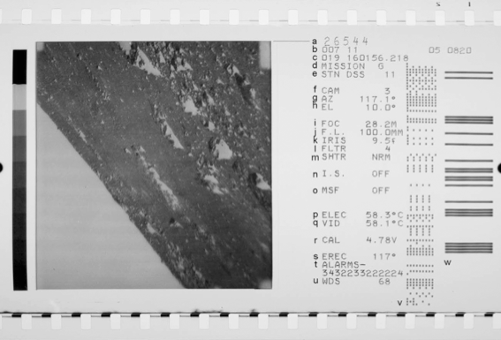
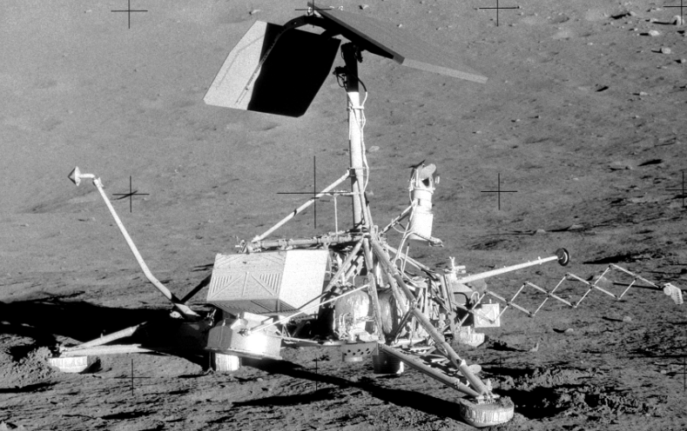
Current work:
Scanning the Lunar Surveyor Imaging Dataset
Possible with additional LASER funds
Will generate a PDS archive of ~88,000 images

Slide 9
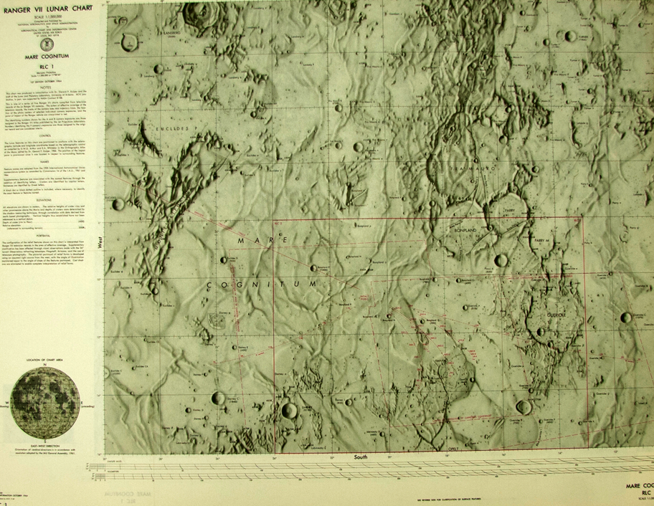
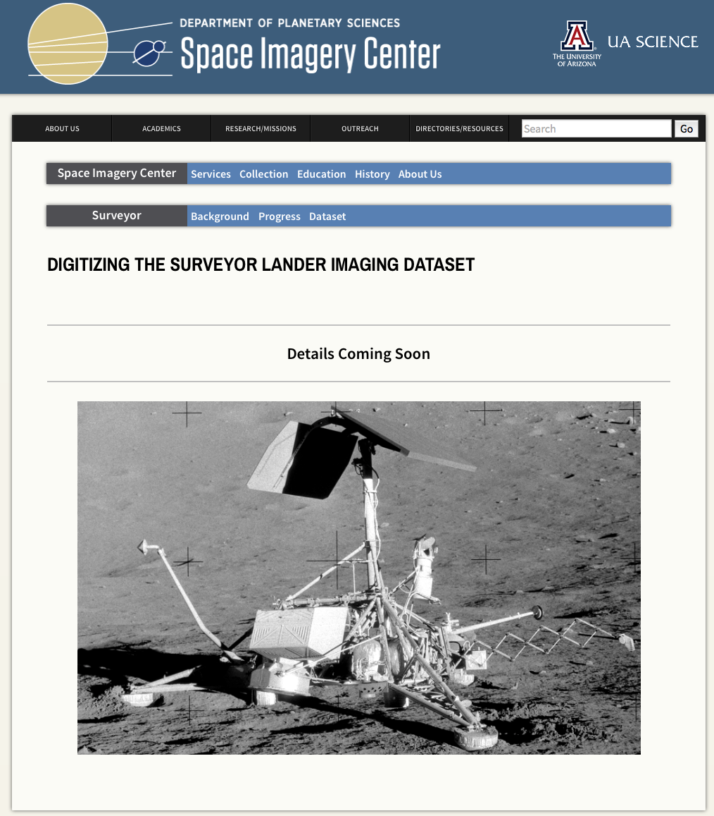
The Future
Scanning Maps and Atlases
Large format scanner (48”)
That do not duplicate existing online content
Surveyor digital archive
Digital data from scanning
Gray literature
Surveyor related publications
Regenerate landing site mosaics
Audio Archive
Initial digitization of early LPL symposia complete
Plans to archive interviews with Planetary Scientists involved with early missions
Continue to conserve and digitize…
Earth telescopic data, gray literature, ~10⁵ hard copy prints from early lunar and planetary missions, ~2000 USGS geologic maps, etc…

Slide 10
Archiving
Research
Education & Public Outreach

Slide 11
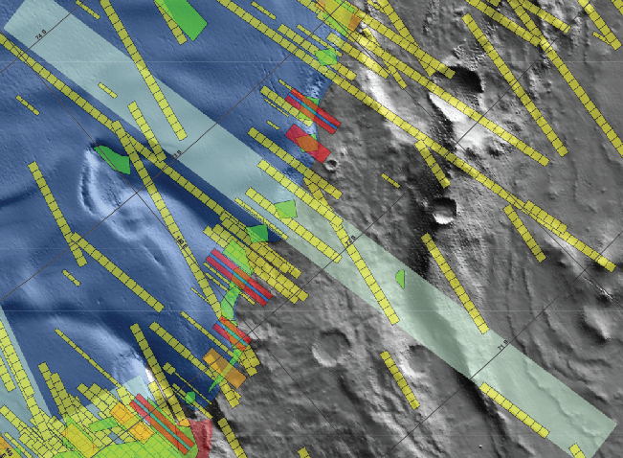
Assistance with data preparation
Especially GIS data
Accessible hardware running GIS software
A useful service while ArcGIS licenses were expensive
Target selection for ongoing instruments/missions
HiRISE
Messenger

Slide 12
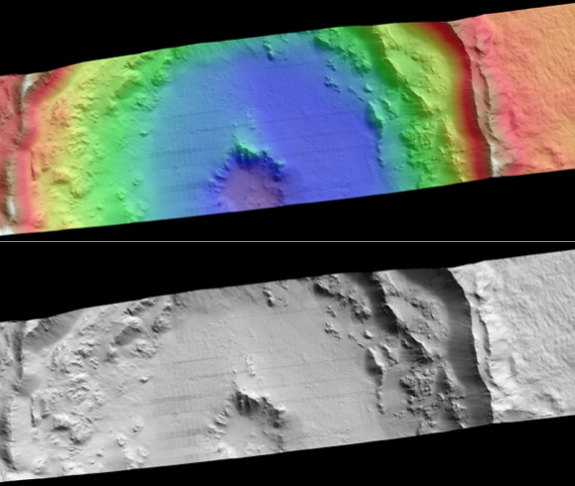
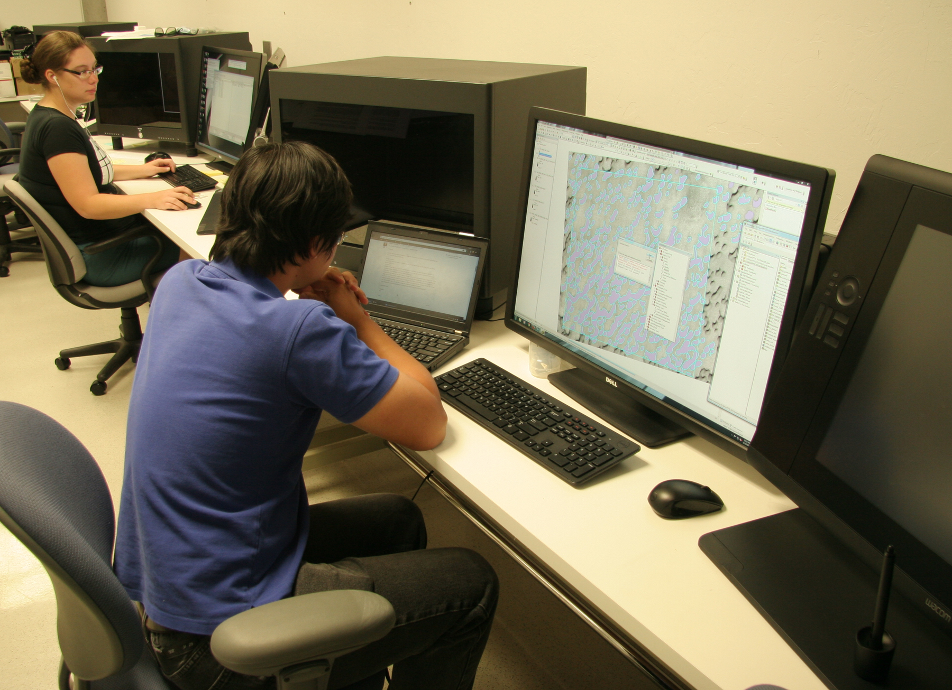
Current work:
Assembly of a three-station stereogrammetry lab
Our industry partner BAE Systems have provided an academic license worth multiple $100K
RPIF money leveraged with the Lunar and Planetary Lab and another faculty member allowed us to acquire three stations with specialized polarizing displays
Currently in high use by faculty, postdocs, graduate students and Spacegrant undergrads

Slide 13
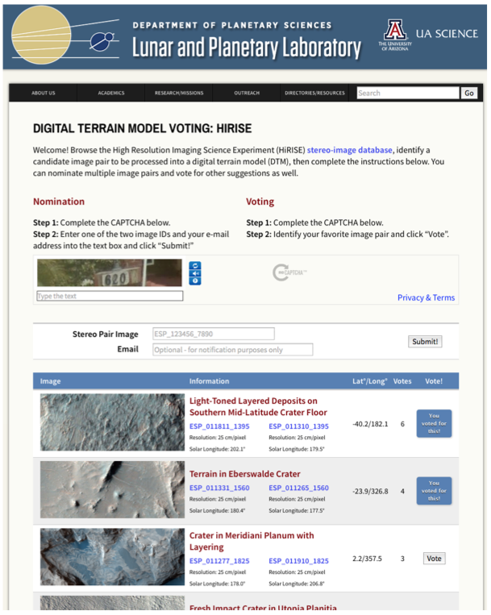
The Future
Community requested DTMs
Currently this capacity rests mostly with spacecraft teams
We plan to solicit DTM requests online from the Planetary Science community
We plan to purchase another two workstations and hire undergraduates to do the processing (we’ve cloned the procedures developed by the HiRISE team)
A PDART proposal to leverage RPIF infrastructure is currently under review

Slide 14
The Future
GIS data bundles
Space Imagery Center has assisted many researchers with digital data analysis through use of GIS.
Such investments of work have typically not been preserved (except as publications)
We will Sample GIS project files can ship with the data
Mars
N. Pole
MOLA
Moon
S. Pole
HiRISE
12 TB disk
Titan
Hellas
GRS
Etc…
Etc…
Etc…

Slide 15
Archiving
Research
Education & Public Outreach

Slide 16
The Present and the Future
Summer Open Houses
Evening Lecture Series
K12 School Visits
University of Arizona Classes
Partnering with Local Collaborators

Slide 17
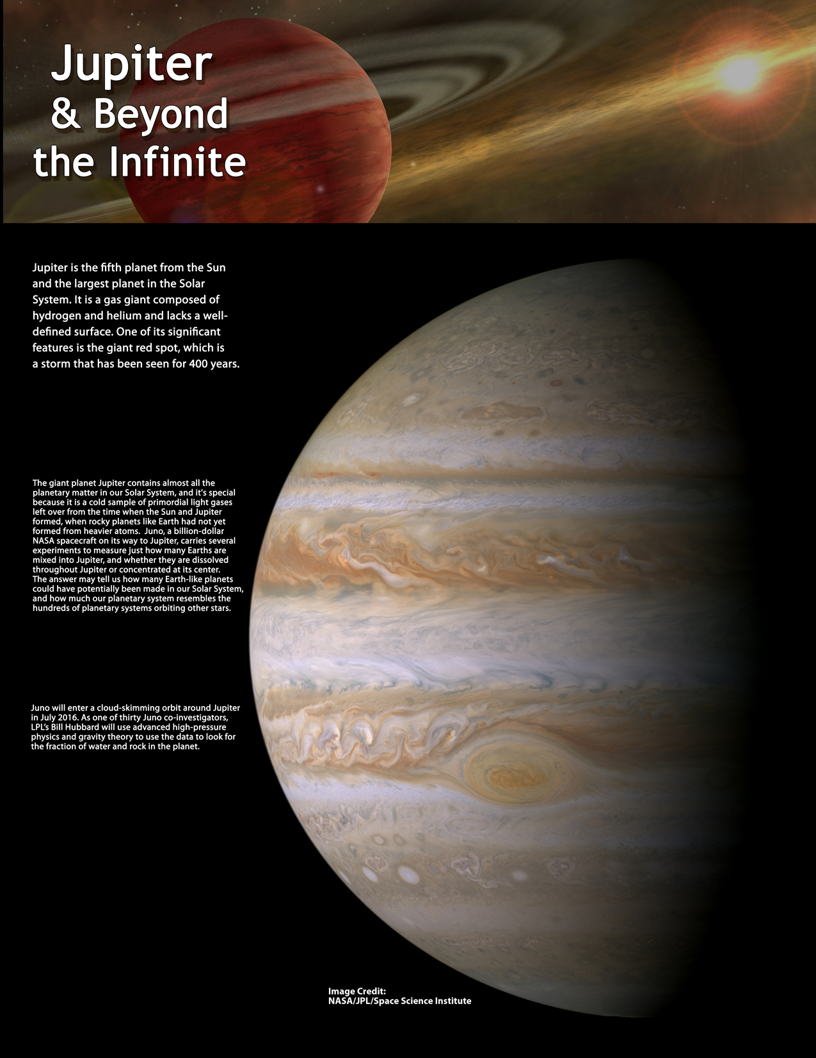
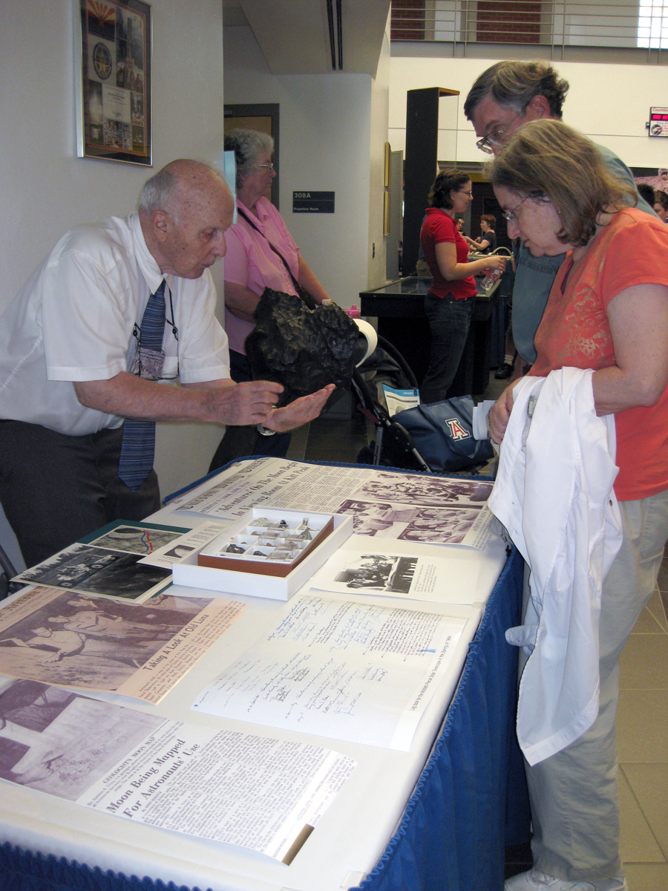
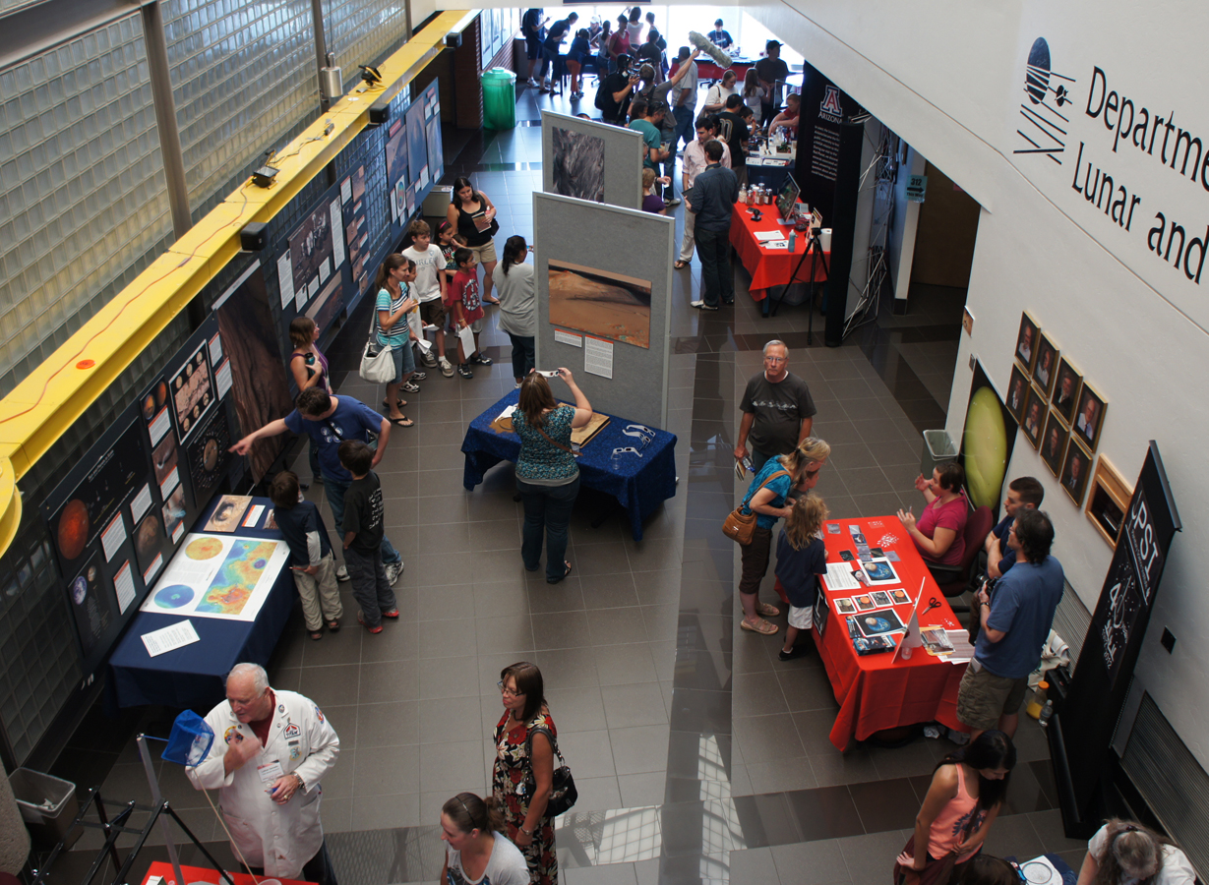
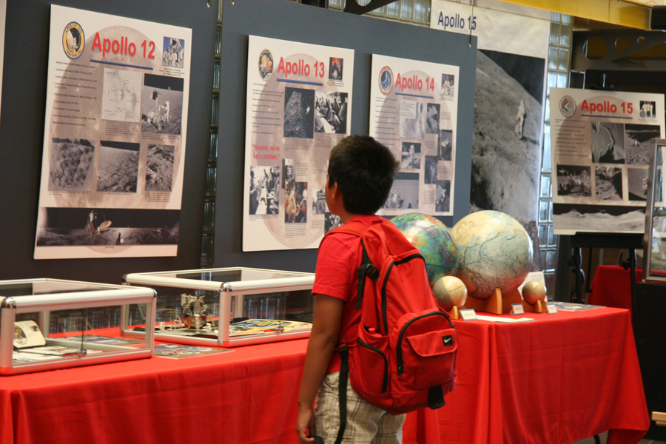
Summer Open Houses
Our main annual event: Attracts 100s of people per year
2007, May 5th: “Cinco de Mars” - Phoenix Mission exhibit. 450 Participants.
2008, May 25th: Phoenix Mission Landing Event. 1500 Participants.
2009, July 18th: 40th Anniversary of Apollo 11’s moon landing. 500 Participants.
2010, Jan. 30th: Arizona Meteorites. 330 Participants.
2011, April 12th: 50th Anniversary of Yuri Gagarin’s flight. 150 Participants.
2012, July, 28th: Curiosity Mission and Landing. 693 Participants.
2013, July 20th: Jupiter and Beyond the Infinite, 773 Participants.
2014, July 20th: Everything Lunar, 531 Participants

Slide 18
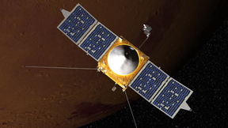
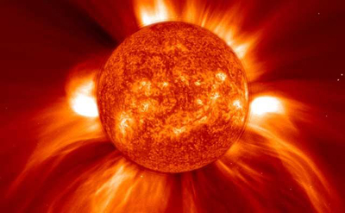
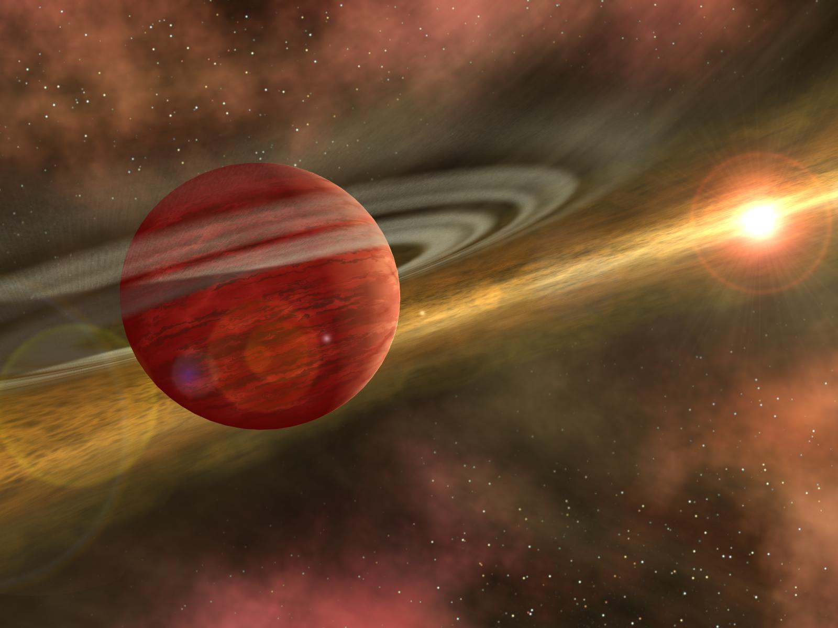
Evening Lecture Series
Series of three Planetary Science Lectures each Fall Semester
Over 100 attendees per lecture on average
All lectures available on iTunes
Public Talks
Tucson Amateur Astronomical Society
College of Science Science Café
Retirement groups
Other public events e.g. MSL landing
Imaging Exoplanets
Dr. Travis Barman
A Comet Approaches Mars
Dr. Roger Yelle
The Big Boundary
Dr. Walter Harris

Slide 19
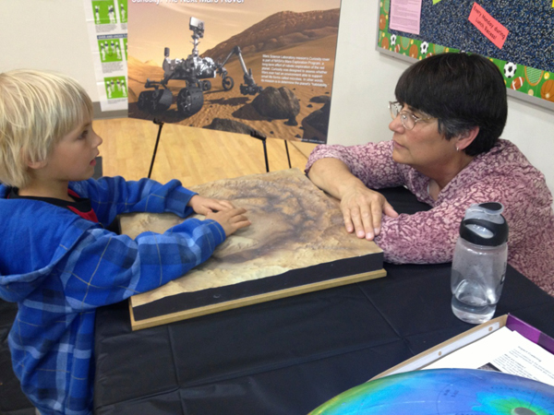
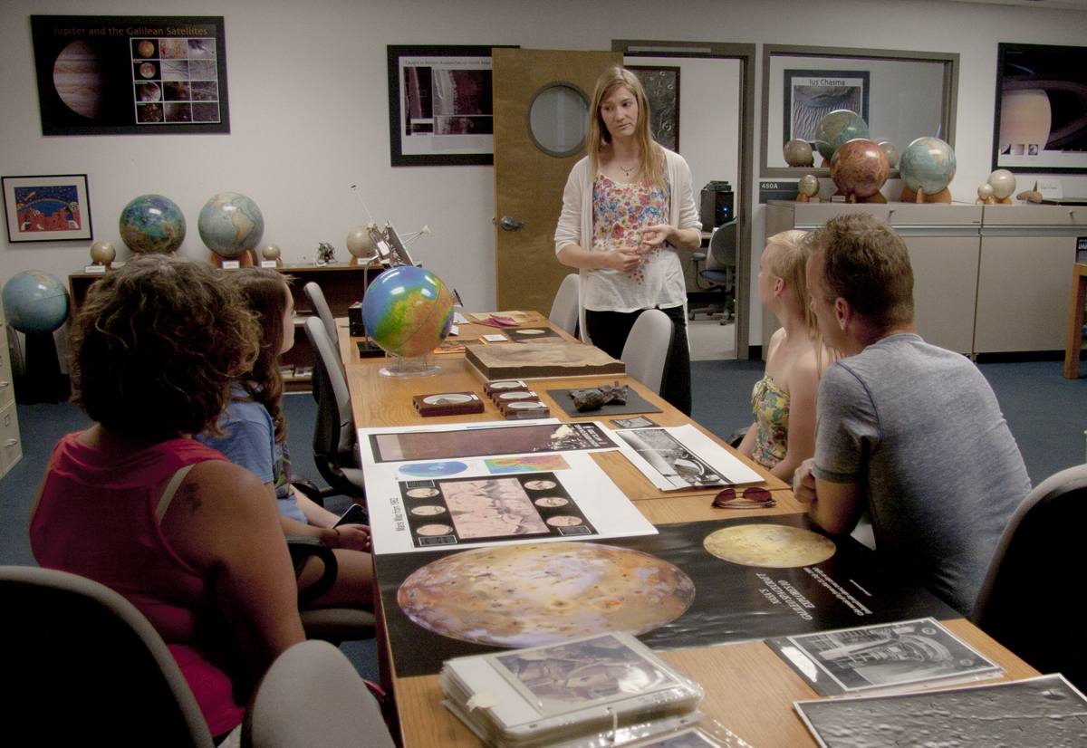
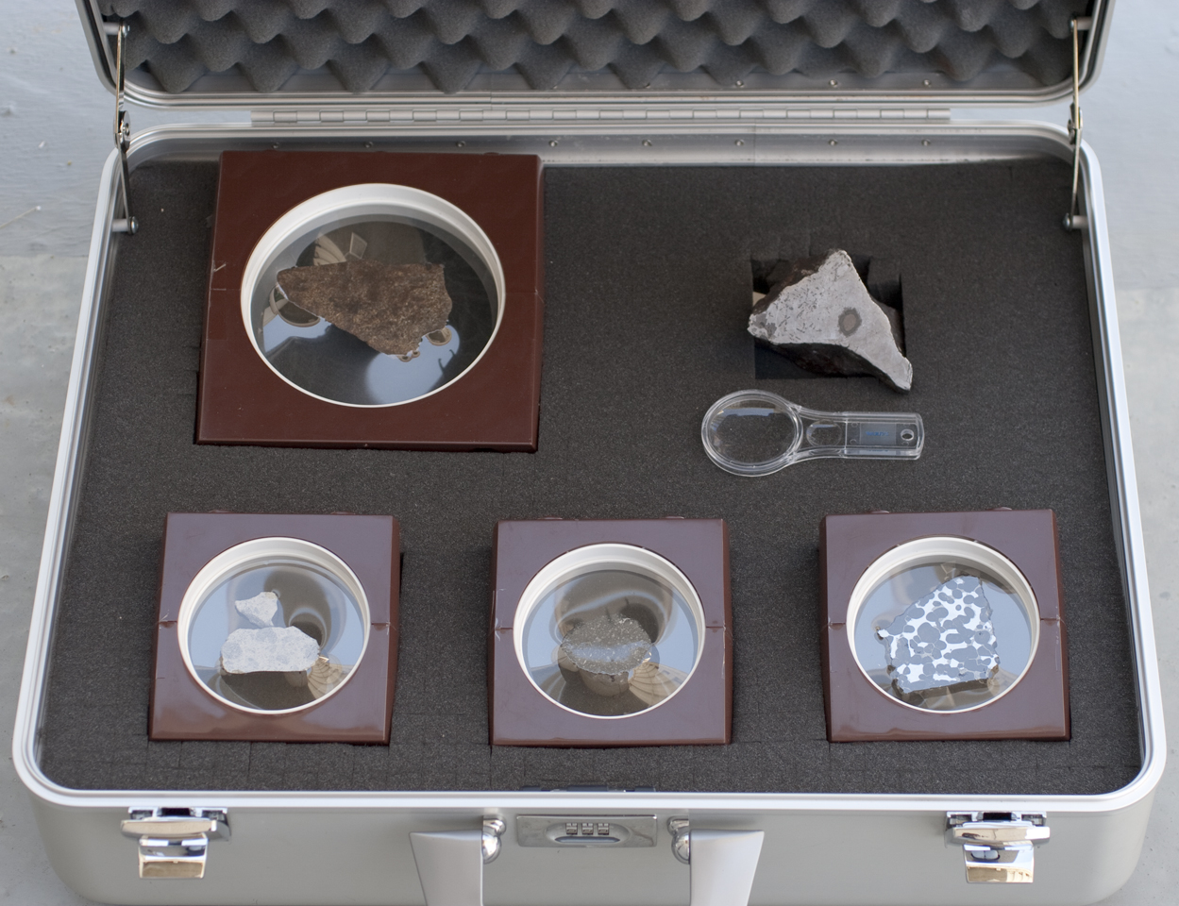
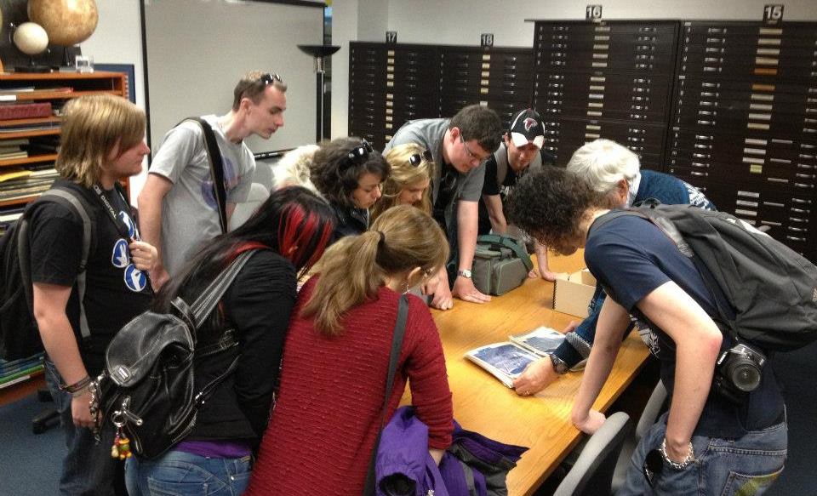
K12 School Visits and Tours
In the past five years we’ve presented to 1000s of K12 students. Both through School visits and in-house tours
Hosted ~100 visiting teachers
Educational meteorite kits and a telescope are also used.

Slide 20
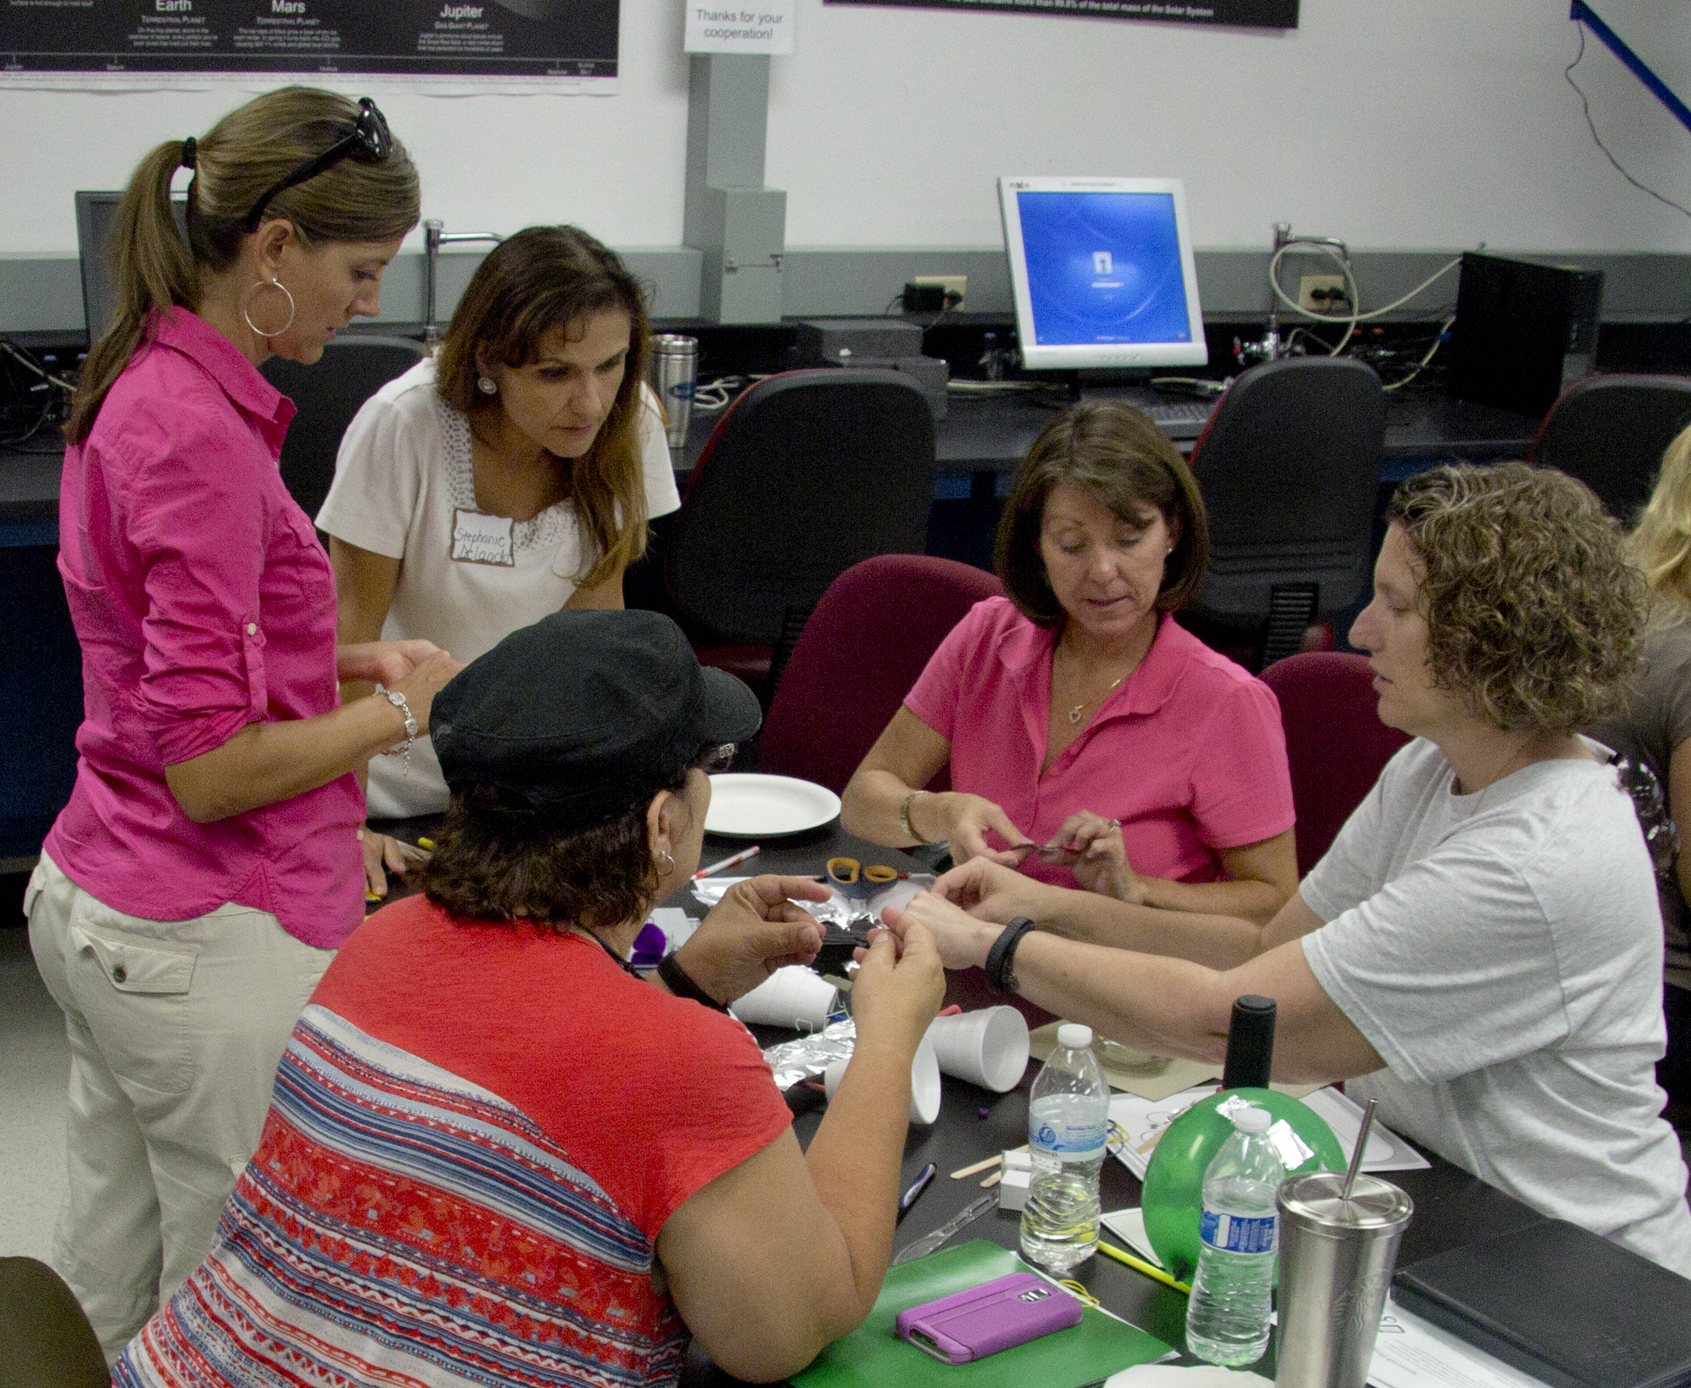
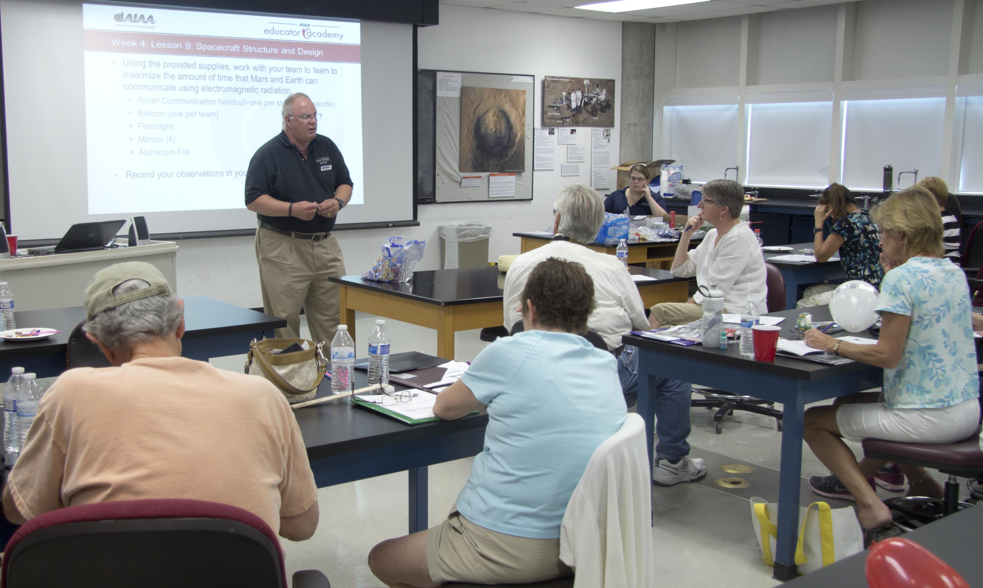
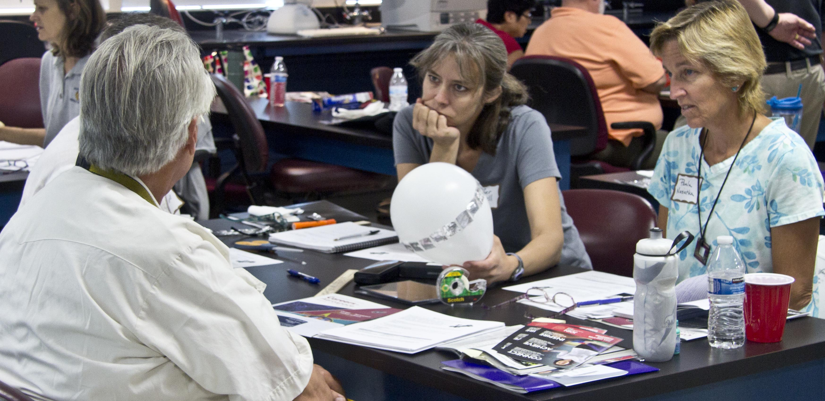
Teacher Workshops
Notes:
Edgar Bering led the Mars Rover workshop. There were 26 teachers.
The workshop was a combination of lectures and hands on activities, which the teachers could do with their students.
PSI, AIAA and Space Imagery Center worked together to put together the workshop.

Slide 21
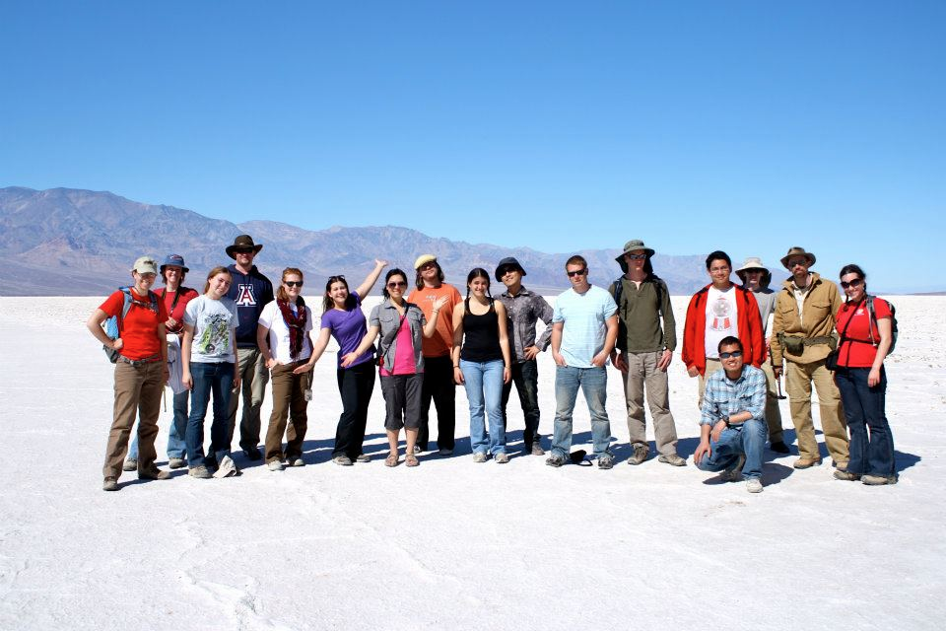
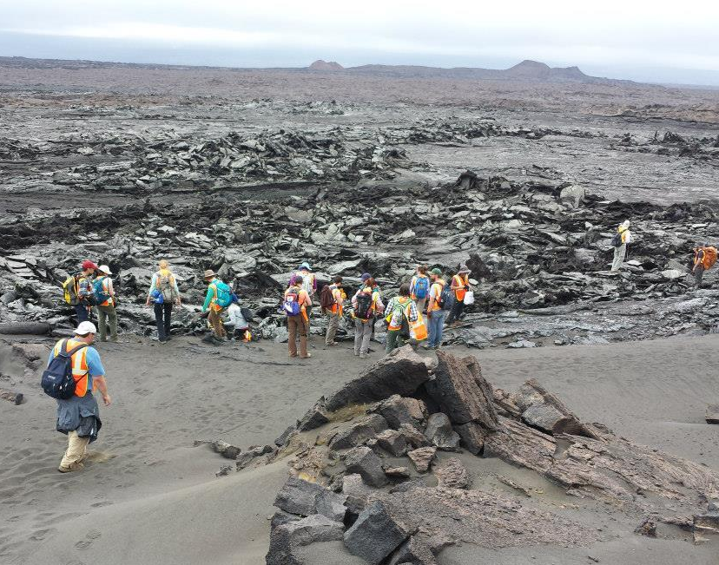
University of Arizona Classes
4-5 classes/semester
~1800 students/year
LASC 195A
Water and Life on Mars
PTYS 170B1
The Universe and Humanity:
Origin and Destiny
PTYS 206
The Golden Age of Planetary Exploration
PTYS 214
Astrobiology: A Planetary Perspective
PTYS 554
Evolution of Planetary Surfaces
PTYS 594
Planetary Geology Field Studies

Slide 22
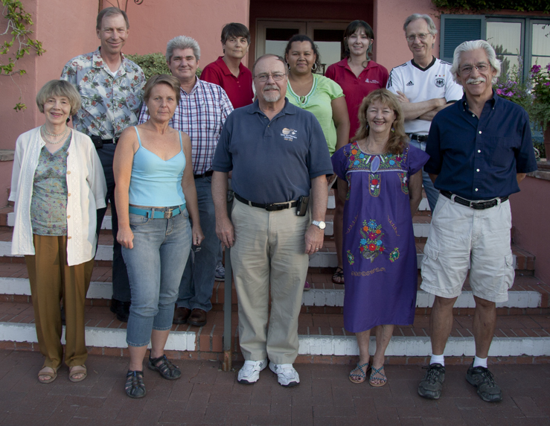
Partnering with Local Collaborators
HiRISE
UA College of Science
Arizona Space Grant
Biosphere 2
Center for Creative Photography
Flandrau Science Center
Pima Air and Space Museum
Tucson Festival of Books
Girl Scouts
Kuiper Circle Community Outreach Committee
22

Slide 23
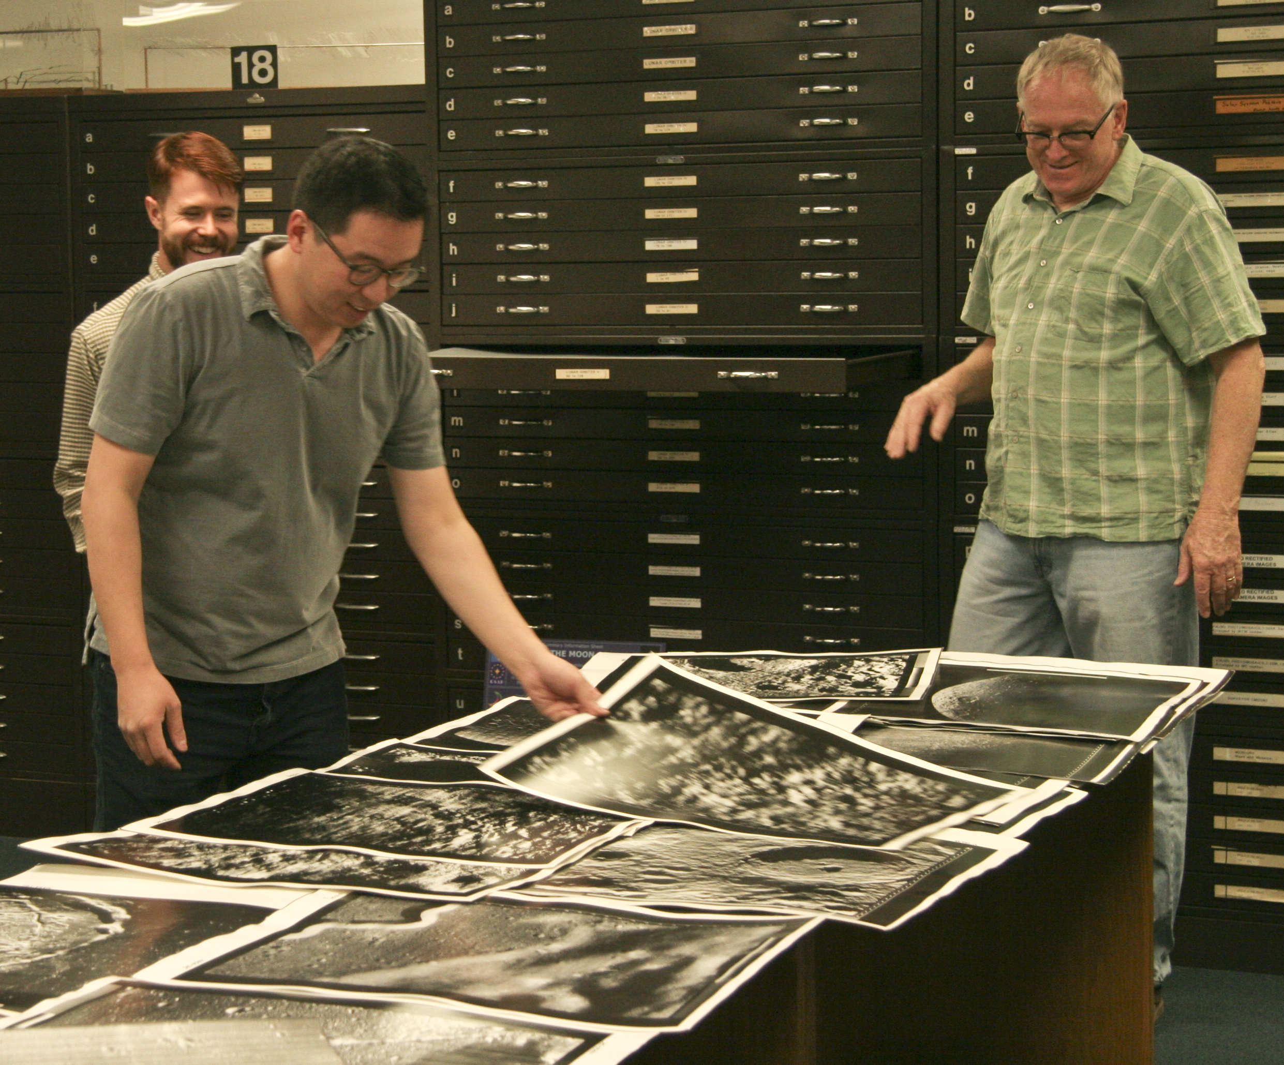
Working with various organizations to produce media and exhibits
Notes:
Jason Davis Desert Moon
Center for Creative Photography, Jan-May Exhibit 2015

Slide 24
Archiving
Research
Education & Public Outreach
The Space Imagery Center @ LPL

Slide 25
EXTRAS
(need to fill in more of these)

Slide 26
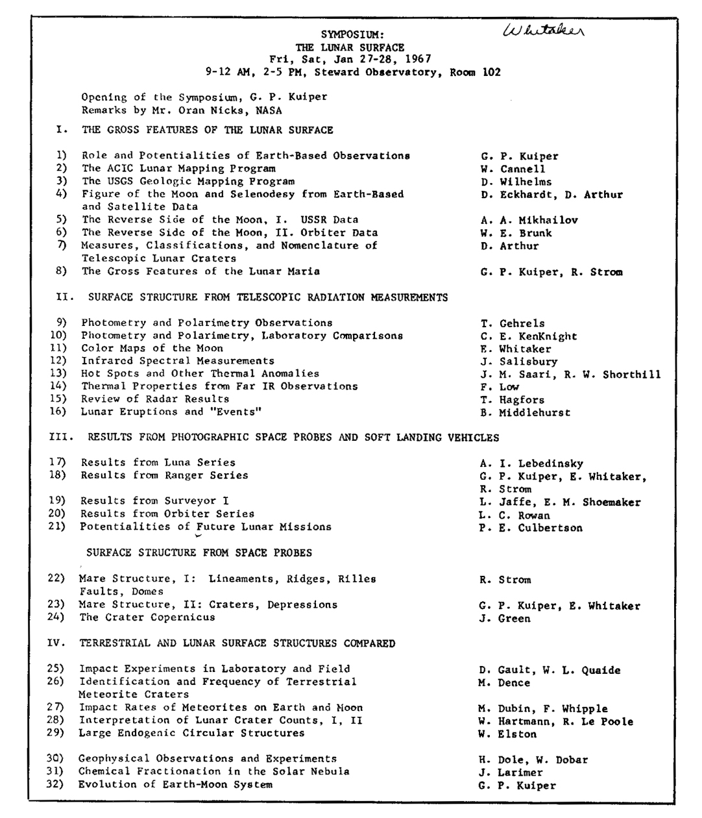
Audio files
Put audio recordings
online
27 lectures from Symposium
Kuiper talks:
Origin of the Moon and Planets
Lunar Surface
Kuiper Memorial Service
Dr. Kuiper
Lunar surface
Feb. 15, 1973
Notes:
Not all the talks were given at the Symposium

Slide 27
Banks et al., Crater Population and Resurfacing of the Martian North Polar Layered Deposits, J. Geophys. Res., 115, E08006, 2010.
Becerra et al., Transient Bright "Halos" on the South Polar Residual Cap of Mars: Implications for Mass-Balance, Icarus, In Press, 2014.
Burleigh et al., Small Impacts Trigger Dust Landslides on Mars, LPSC, 2009.
Diniega et al., Seasonality of Present-day Martian Dune-Gully Activity, Geology, 38(11), 1047-1050, 2010.
Sharma and Byrne, Comparison of Titan's north polar lakes with terrestrial analogs, Geophys. Res. lett., 38, L24203, 2011.
Sharma and Byrne, Constraints on Titan's topography through fractal analysis of shorelines, Icarus, 209(2), 723-737, 2010.
Turner et al. (2012), Near-UV and optical observations of the transiting exoplanet TrES-3b, Month. Note. Royal Astron. Soc., 48.

