Slide 1
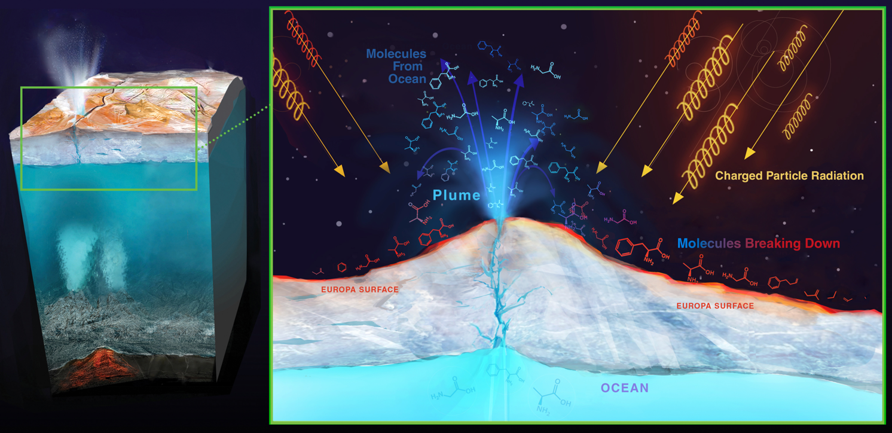
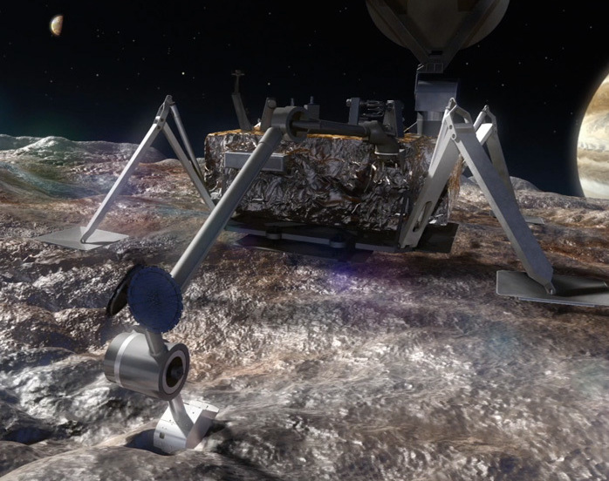
Cold Lightweight Imagers For Europa (C-LIFE)
Shane Byrne – University of Arizona (shane@LPL.arizona.edu)
Christian d'Aubigny, Bashar Rizk, Linda Powers, Michael Ward, Alyssa Baller, Steve Meyer, Elizabeth Turtle, Alfred McEwen
Due to observed plumes, the Europan surface is a means to investigate its ocean…
…but the Europan Surface is a hostile location
Our Camera Design Overcomes Five Major Challenges
Radiation
Planetary Protection
Low Ambient Temperature
Low Available Energy
Very Low Downlink

Slide 2
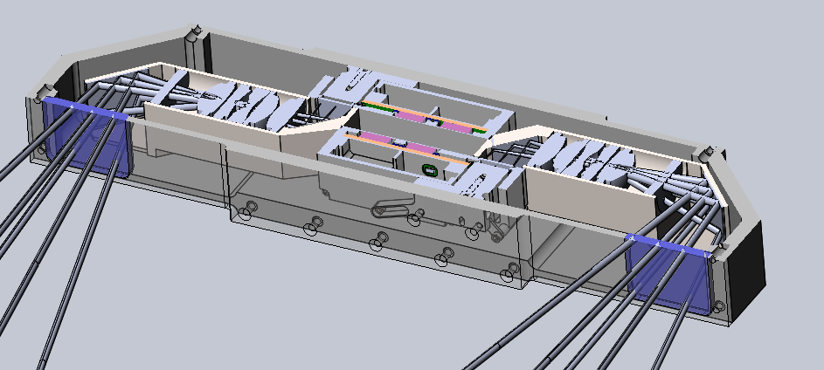
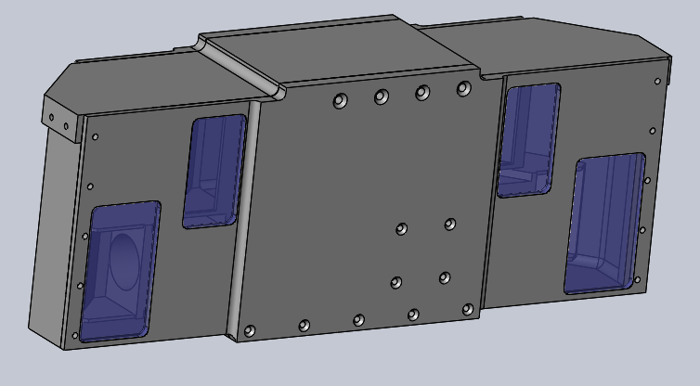
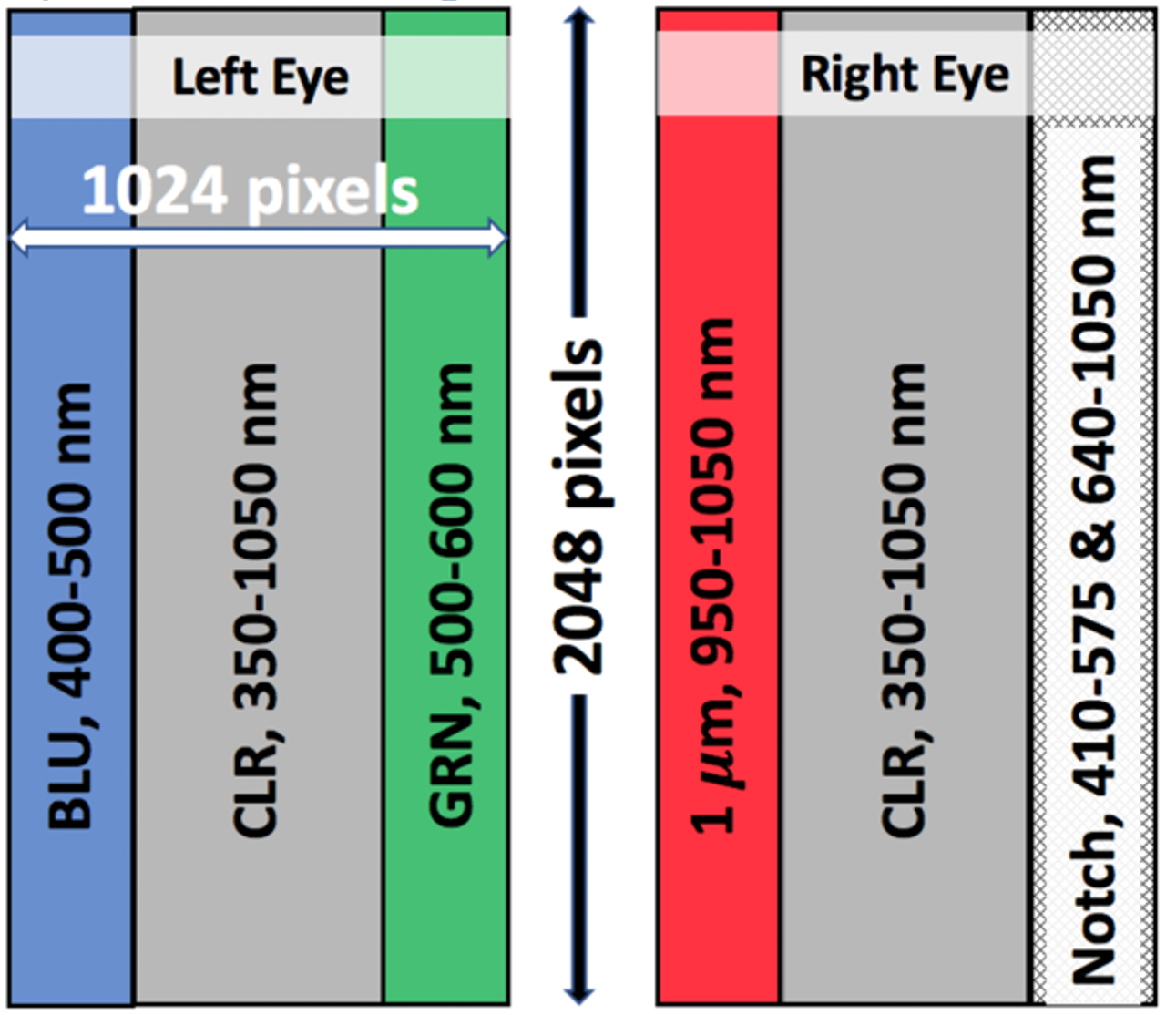
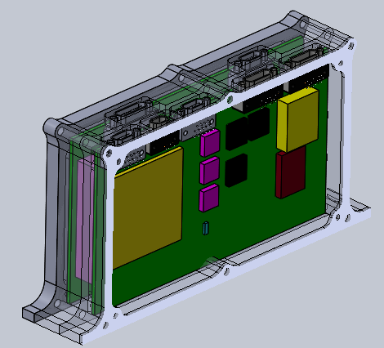
Radiation & Planetary Protection:
Dual-periscope design
maximizes self-shielding
Parts survive required thermal sterilization and radiation doses
Detector Readout Modules
LED periscopes
Rad-hard Lens stack
Detector periscopes,
20cm apart
Low Temperatures & Energy:
No moving parts or deployable covers with progressive focus and strip filters Cryogenic storage and no survival heating between observing sessions
Fluorescence excited by three separate LEDs and detected by one notch filter
Color filters match the camera on Europa Clipper
Stereo in Pan
Low Downlink:
Multi-image median filtering and wavelet compression. More-advanced tools in future work.
Redundant Electronics

Slide 3
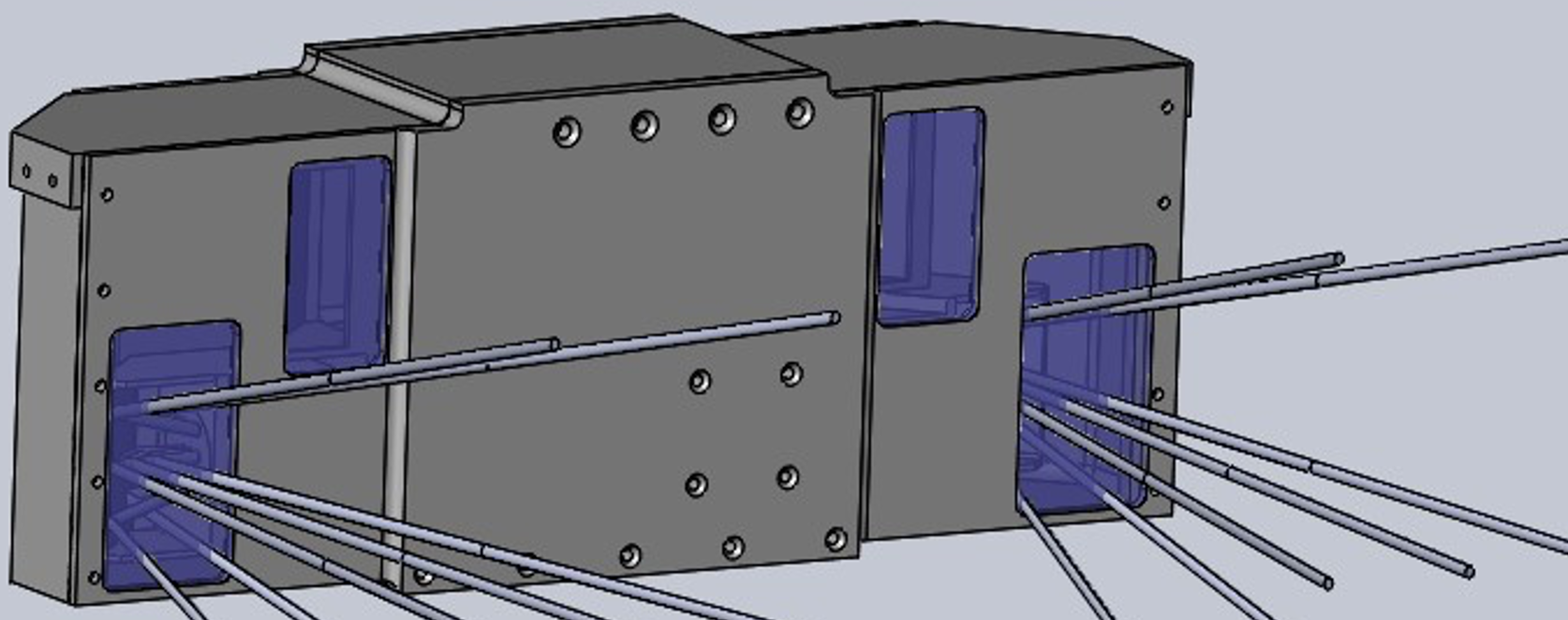
Cold Lightweight Imagers For Europa (C-LIFE)
Shane Byrne – University of Arizona (shane@LPL.arizona.edu)
Christian d'Aubigny, Bashar Rizk, Linda Powers, Michael Ward, Alyssa Baller, Steve Meyer, Elizabeth Turtle, Alfred McEwen
C-LIFE has high impact on mission success and Europan science.
Color stereo panorama
Fluorescence of organic materials in three bands
Plume detection through forward scattered light near east/west horizon
Change detection at excavation site and through tidal effects
Autonomous operation, higher-level product generation and smart algorithms to prioritize downlink

