Slide 1
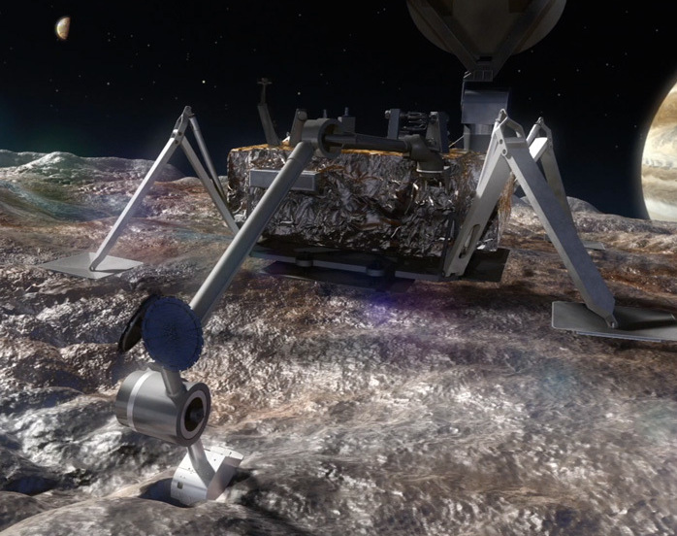
Cold Lightweight Imagers For Europa (C-LIFE)
Shane Byrne – University of Arizona
Christian d'Aubigny, Bashar Rizk, Linda Powers, Michael Ward, Alyssa Baller, Steve Meyer, Elizabeth Turtle, Alfred McEwen

Slide 2
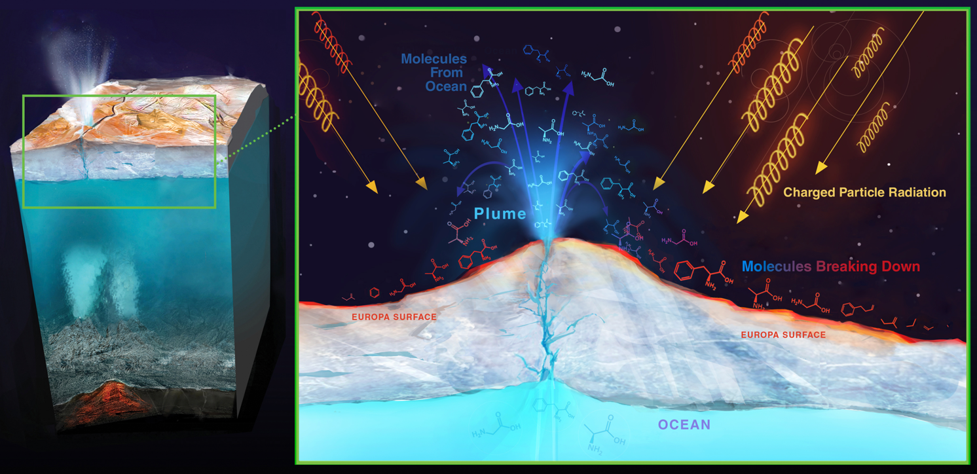
Cold Lightweight Imagers For Europa (C-LIFE)
Shane Byrne – shane@LPL.arizona.edu
Due to observed plumes, the Europan surface is a means to investigate the ocean

Slide 3
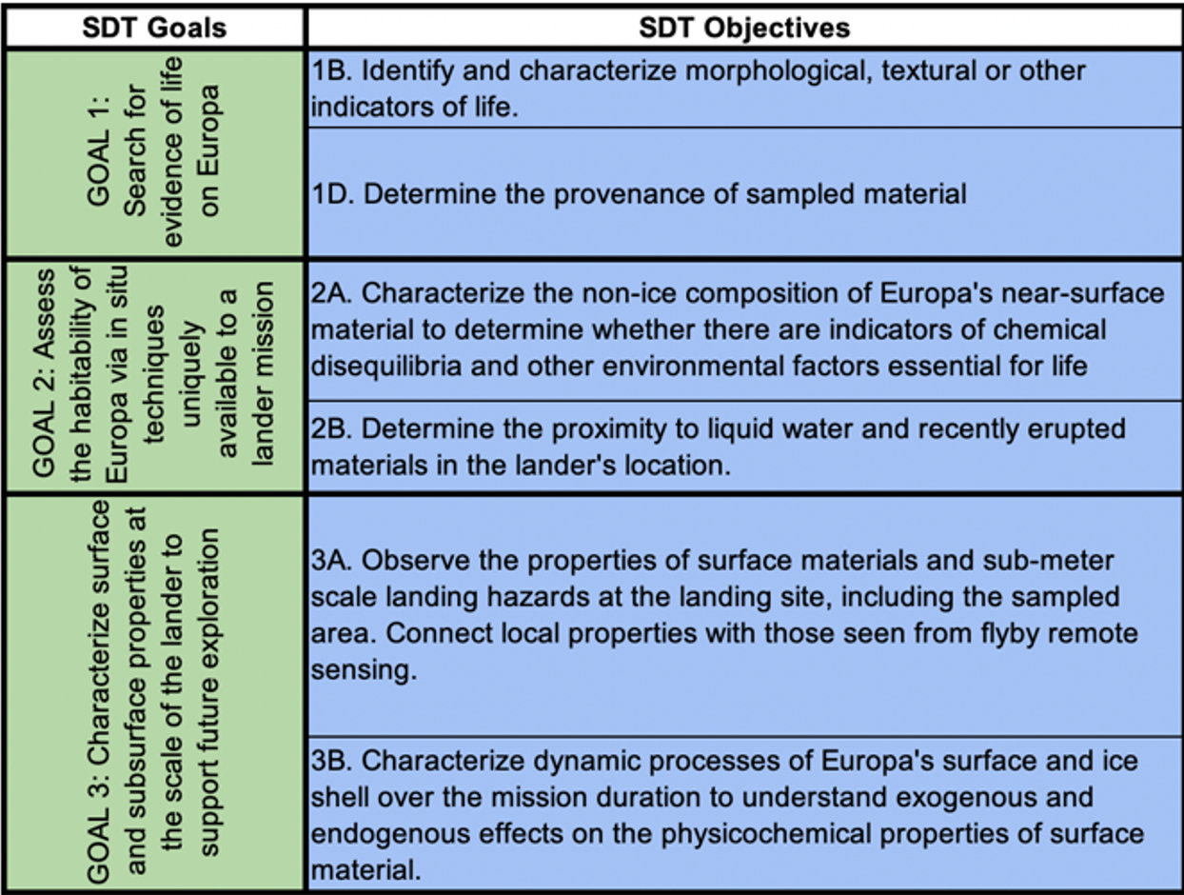
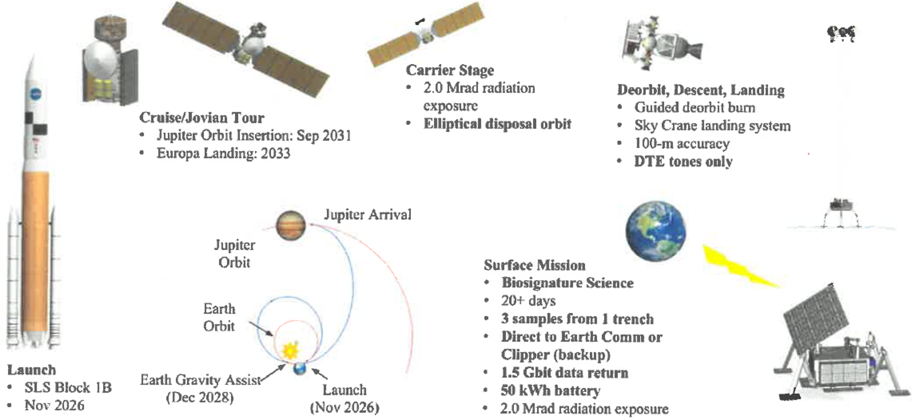
Cold Lightweight Imagers For Europa (C-LIFE)
Shane Byrne – shane@LPL.arizona.edu
The Europa Lander
Focused on astrobiology
One of the most hostile environments in the solar system
An SDT defined three science goals, with many Objectives
Objectives Relevant to the Camera Instrument

Slide 4
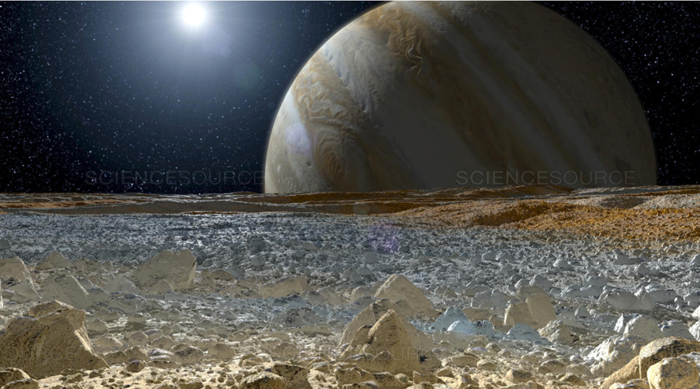
Cold Lightweight Imagers For Europa (C-LIFE)
Shane Byrne – shane@LPL.arizona.edu
The C-LIFE Camera is developed at U. Arizona under awards from NASA’s COLDTech and ICEE-2 programs
Industry Partners
SRI International
Ball Aerospace
Space Dynamics Lab
Main Challenges
Radiation (mostly electrons)
Temperature (surface of Europa close to 100 K)
Planetary Protection (Camera Head must survive a 6-log reduction in bioburden)
Low available energy (a battery powered mission)
Very low downlink (600 Mbits for all science data)

Slide 5
Cold Lightweight Imagers For Europa (C-LIFE)
Shane Byrne – shane@LPL.arizona.edu
C-LIFE ‘Traditional’ Science Plans
Europan day 1: Full color stereo panorama (needed early for sample site selection)
Europan day 2: Night-time fluorescence investigations and plume searches close to 6AM and 6PM (highest phase angles).
Europan day 3: Full color stereo of lander workspace assuming sampling activities have already occurred.
Europan day 4 & 5: Continued imaging for change detection of excavated material and from tidal responses.
…but 600 Mbit is a non-traditional constraint
Significant automation and onboard data processing will be necessary and something we’ll focus on in the upcoming year

Slide 6
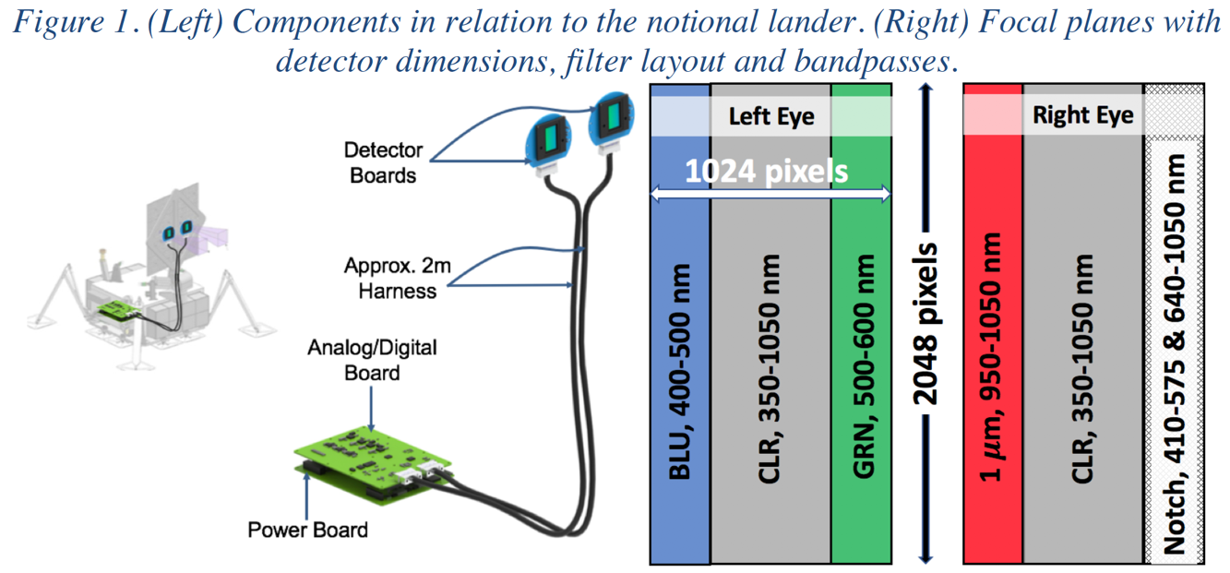
Cold Lightweight Imagers For Europa (C-LIFE)
Shane Byrne – shane@LPL.arizona.edu
C-LIFE architecture
Stereo Color Imager
Pan/Tilt from the HGA
No Moving Parts
No deployable lens covers
No Survival Heating
LEDs support nighttime and shadow imaging
Fluorescence investigation to find organics
A camera head with minimal electronics
Vault electronics with data processing and automation capabilities
Color filters match the camera on Europa Clipper
Stereo in Pan
Fluorescence excited by three separate LEDs, but detected by one filter
Progressive focus from infinity at the top of the detector to lander sample port at bottom

Slide 7
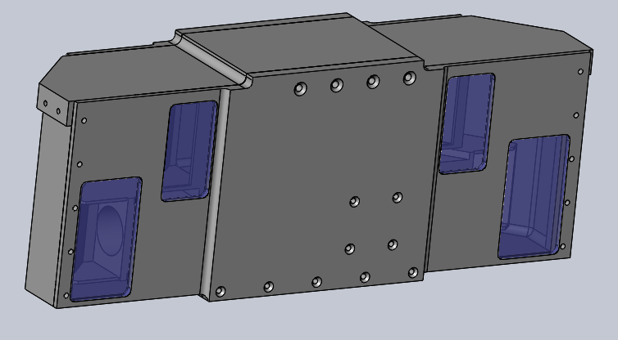
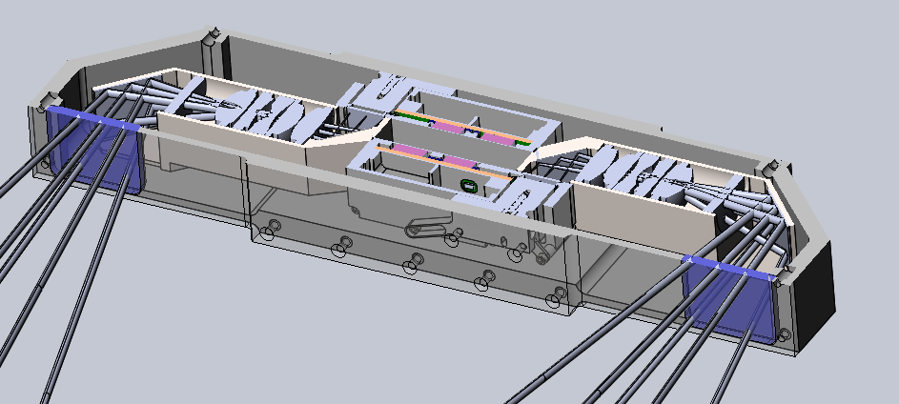
Cold Lightweight Imagers For Europa (C-LIFE)
Shane Byrne – shane@LPL.arizona.edu
LED periscopes
C-LIFE Camera head
24.5 x 9.5 x 6 cm, slim design
Dual periscope design shields detectors and LEDs from open space and provide maximum self-shielding
Two Detector Readout Modules from SRI utilize their MkxNk detector (1x2k)
Detector periscopes,
20cm apart
Detector Readout Modules
Rad-hard Lens stack

Slide 8
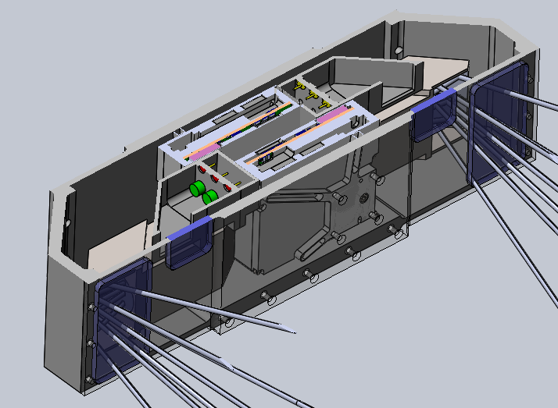
Cold Lightweight Imagers For Europa (C-LIFE)
Shane Byrne – shane@LPL.arizona.edu
Detector Readout Module
LED periscopes

Slide 9
Cold Lightweight Imagers For Europa (C-LIFE)
Shane Byrne – shane@LPL.arizona.edu
C-LIFE is mission critical and so must be highly redundant.
Redundant Vault Electronics
Both Eyes
Cross-strapped

Slide 10
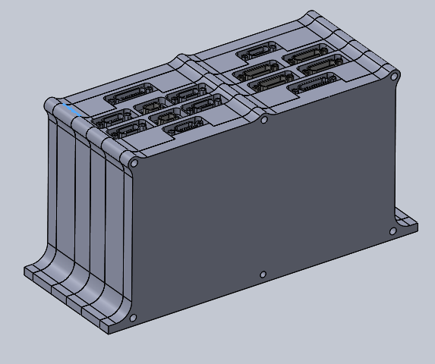
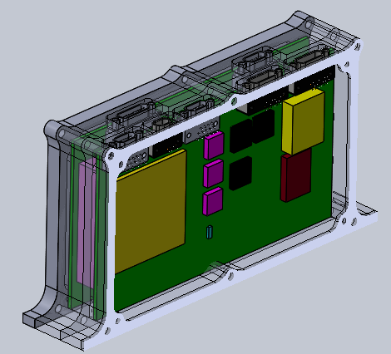
Cold Lightweight Imagers For Europa (C-LIFE)
Shane Byrne – shane@LPL.arizona.edu
Vault Electronics are designed for low data return and high radiation.
Multi-image median filters
Sub-setting and thumbnailing of images
Wavelet compression
Future Investigations
On board mosaic building
On board stereo DTM generation
Autonomous designation of most-typical and most-unusual terrain in surroundings

Slide 11
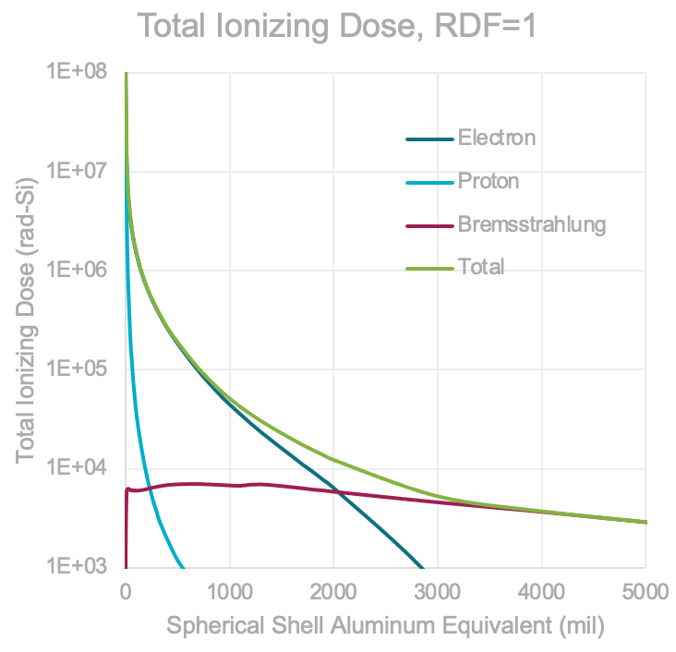
Cold Lightweight Imagers For Europa (C-LIFE)
Shane Byrne – shane@LPL.arizona.edu
Main challenges: Radiation
NOVICE modeling performed by Ball Aerospace
With our design, most parts tolerate the environment with an RDF of 2
A few parts need more analysis – radiation test plan developed
Main challenges: Temperature
ConOPs envisioning warming the Camera Head electronics only for a short operations period each Europan day.
Cryogenic storage (no survival heating when not in use)
UA and SDL testing program has established that all parts survive cryogenic storage for 10s of hours with no loss of performance

Slide 12
Cold Lightweight Imagers For Europa (C-LIFE)
Shane Byrne – shane@LPL.arizona.edu
Main challenges: Planetary Protection
6-log bioburden reduction required for the camera head, 4-log for the vault
All parts have been verified to survive the bakeout times and temperatures required
Main challenges: Low available energy
Mitigated with ConOPs and components that require no survival heating
Detailed energy budget (and allowance from project) still TBD
Main challenges: Low Downlink Capacity
600 Mbit for all science data in the mission (no instrument breakdown available)
With a traditional campaign C-LIFE could take up to 2/3 of this.
Smarter ways to select what to download will be investigated over the next year

Slide 13
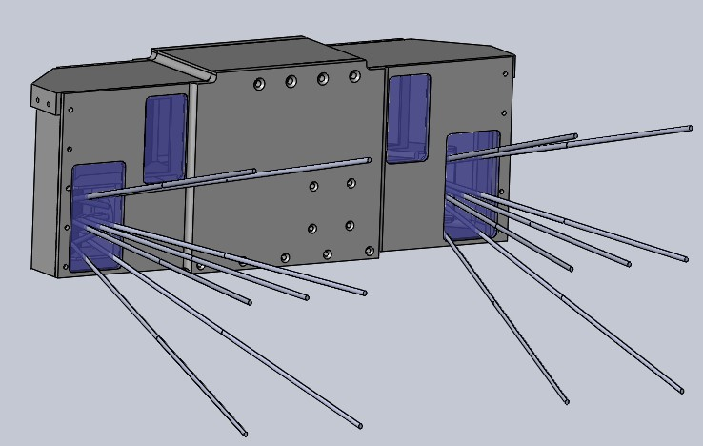
Cold Lightweight Imagers For Europa (C-LIFE)
Shane Byrne – shane@LPL.arizona.edu
C-LIFE is suitable for the surface of airless Ocean Worlds with little modification
Work continues on improving autonomy and fluorescence detection
Summary
Stereo color imaging with dual-periscope design
LEDs for imaging within shadows or at night
Strobing LEDs to excite fluorescence in organic material
No moving parts with progressive focus & strip filters
Highly radiation tolerant
No survival heating in nominal operations
Adopts the most stringent Planetary Protection protocols
Data filtering and compression accommodates low data rates and radiation-noise removal

