Slide 1
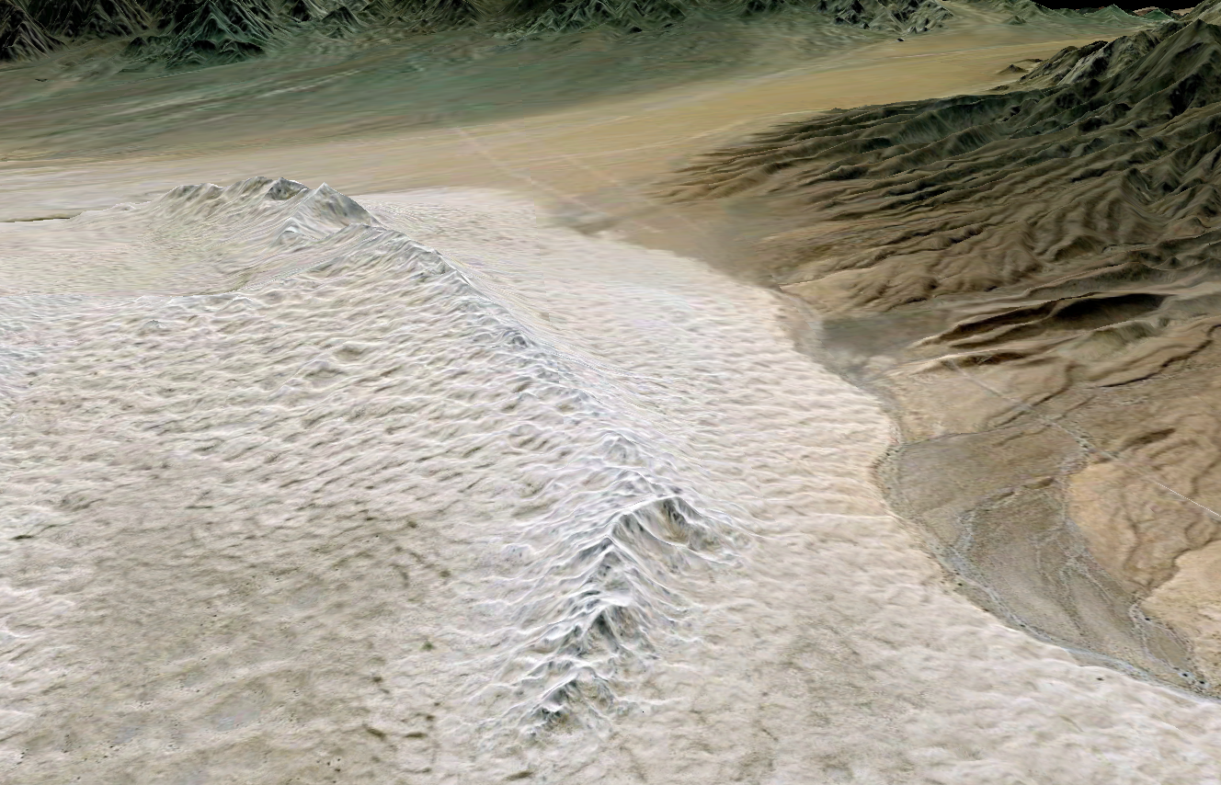
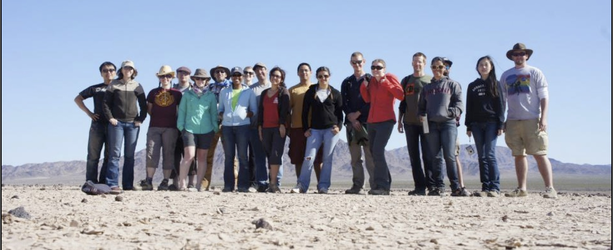
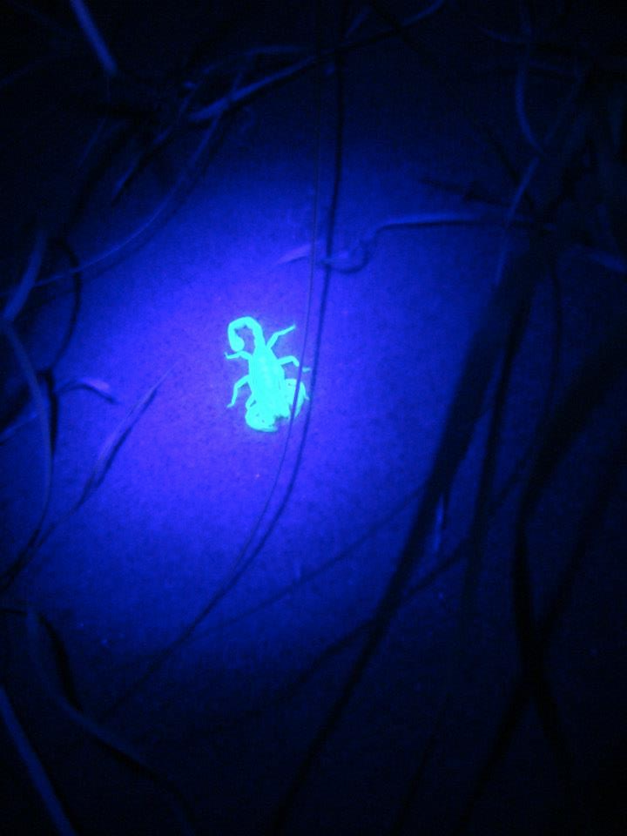
Ptys 594 – Spring 2013
Mojave Remote Sensing Postmortem

Slide 2
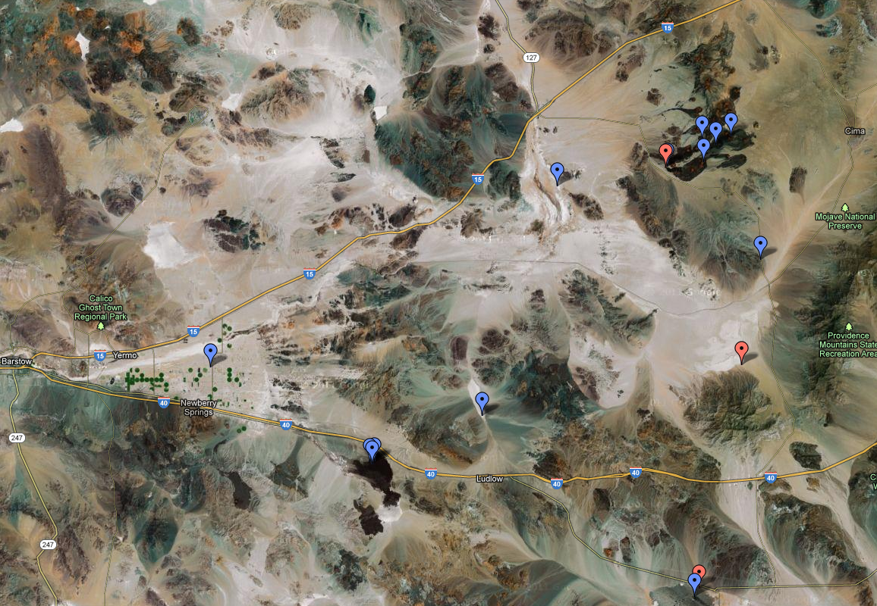

Slide 4
Itinerary
Thur: Kelso Dunes
Camp at Kelso
Friday: Kelbaker Road Outcrop
Soda Lake
Cima cone
Cima lava tube
Camp at Cima
Saturday: Mojave agricultural fields
Pisgah Flows
Pisgah lava tube
Amboy crater with areal support
Camp at Amboy
Sunday: Broadwell lake

Slide 5
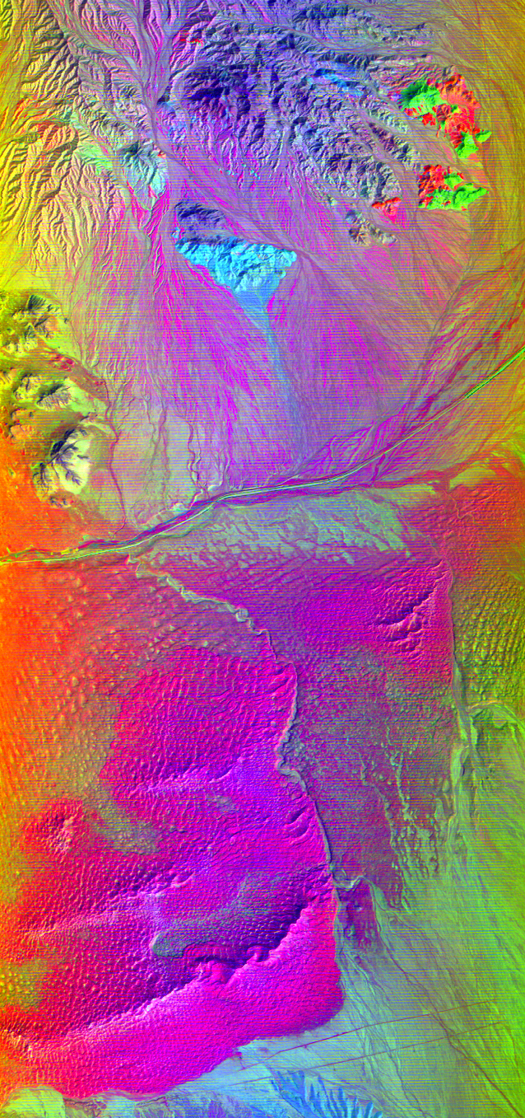
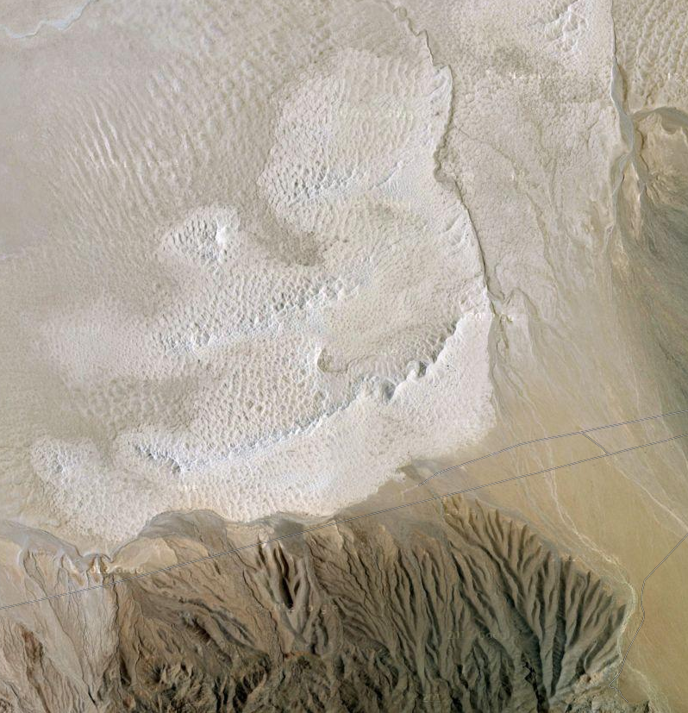
Kelso Dunes
Uniform surface composition

Slide 6
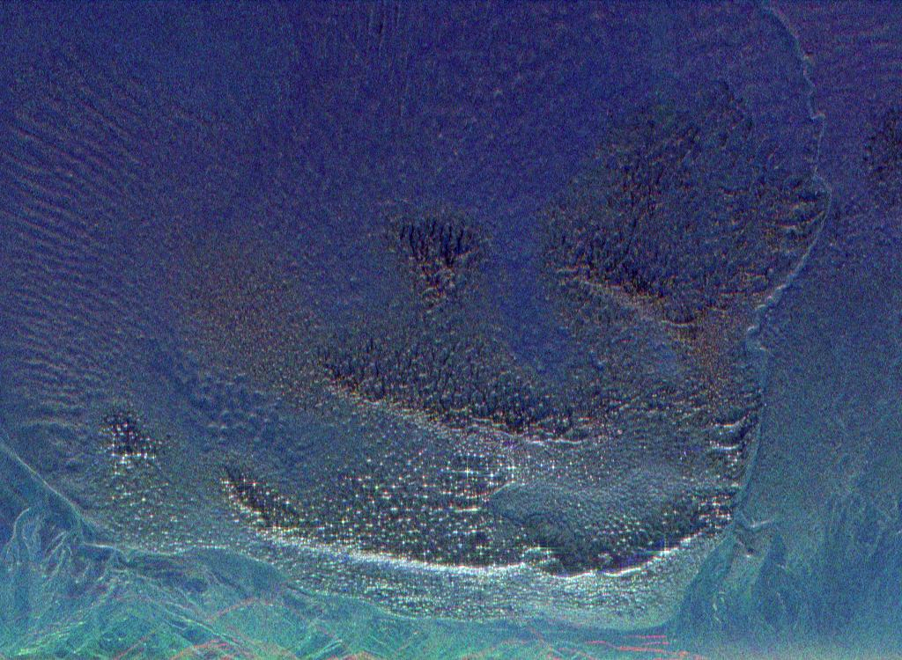
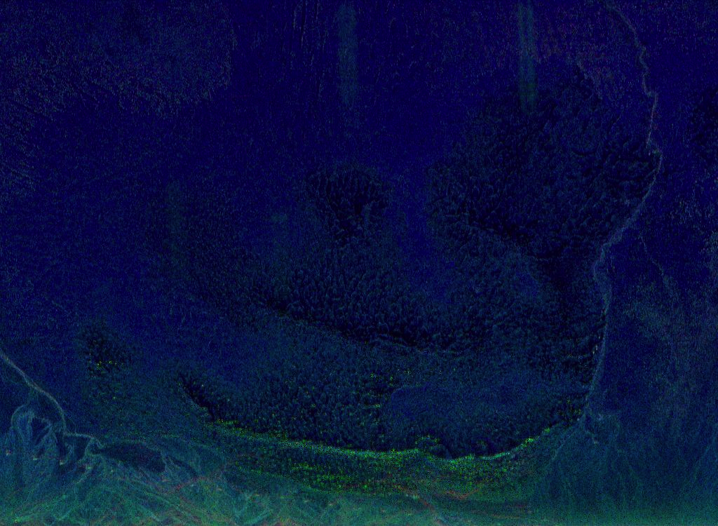
Kelso Dunes
Old AIRSAR RADAR response
HH
P (80cm)
L (25 cm)
C (5cm)
HV

Slide 7
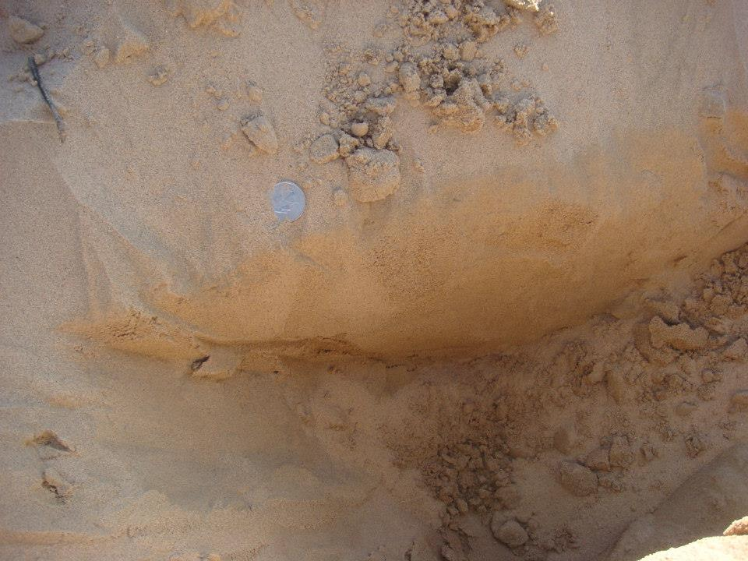
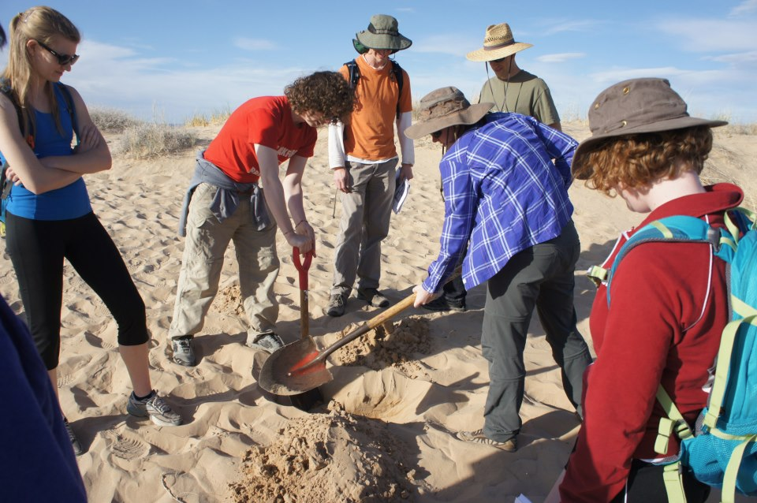

Slide 8
~17cm
~11.5cm deep

Slide 9
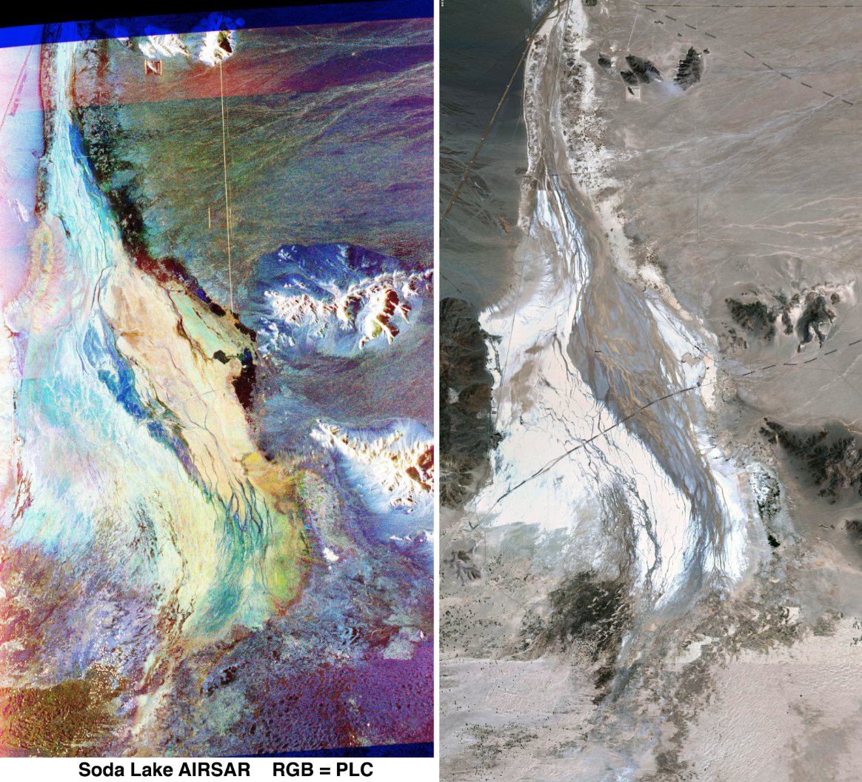

Slide 10
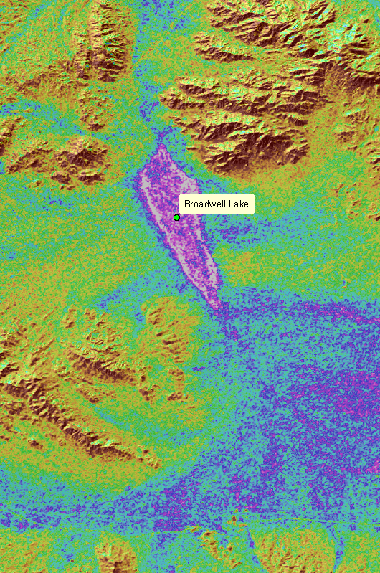
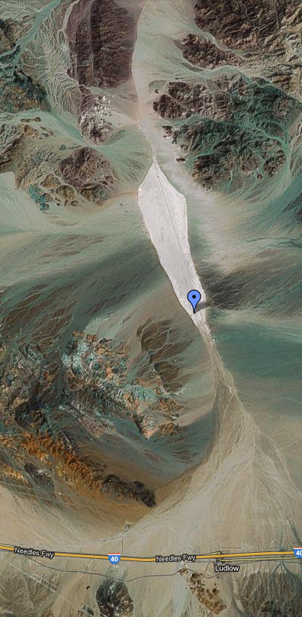

Slide 11
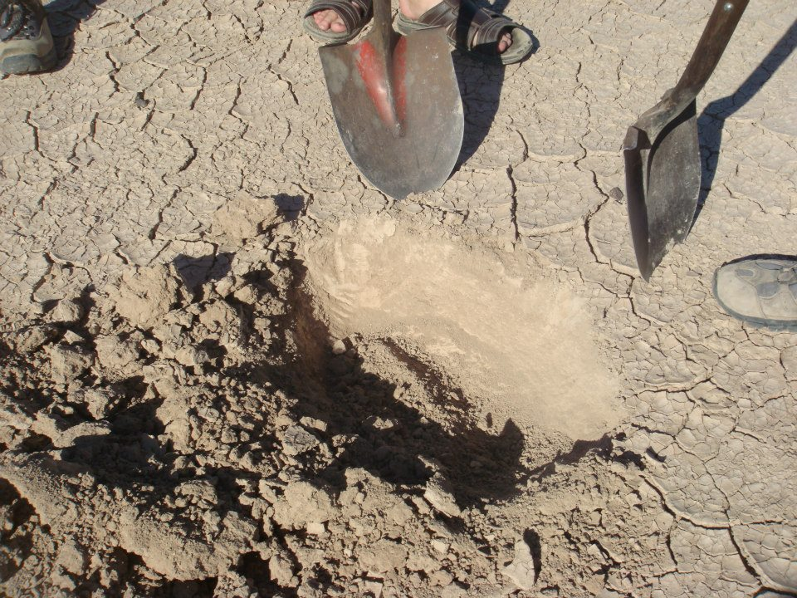
Dry all the way down at Broadwell Playa

Slide 12
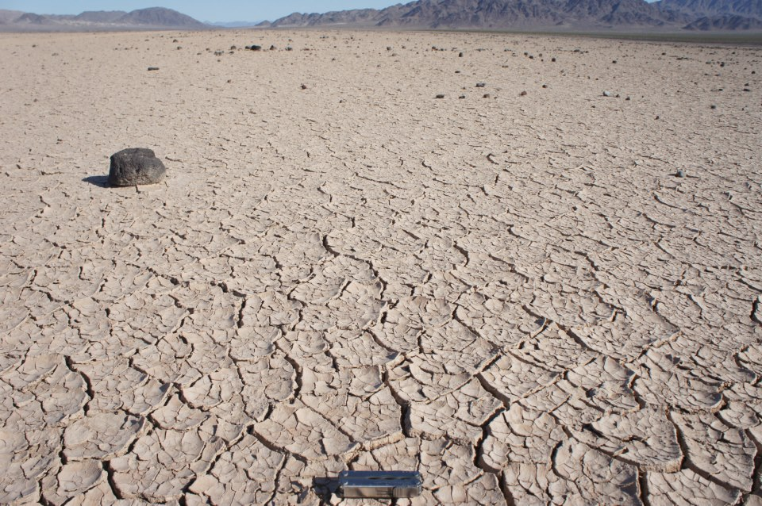
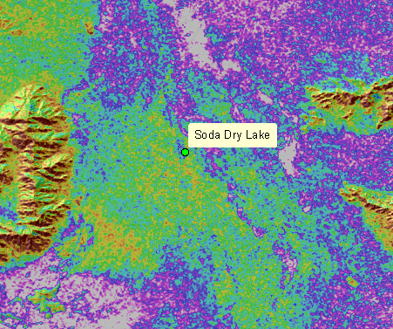
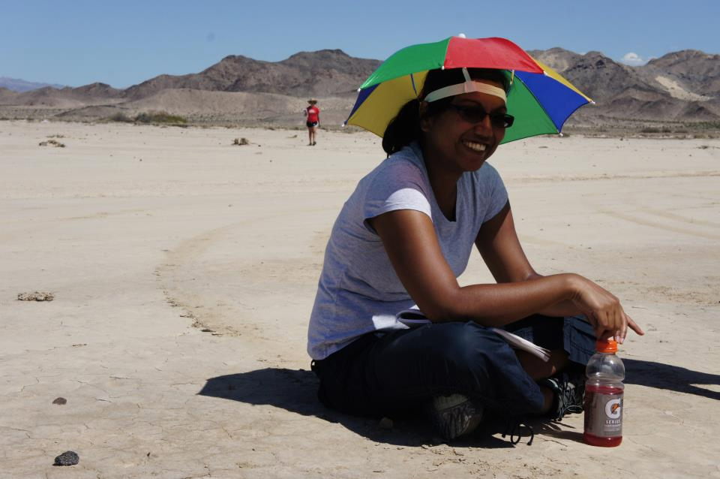

Slide 13
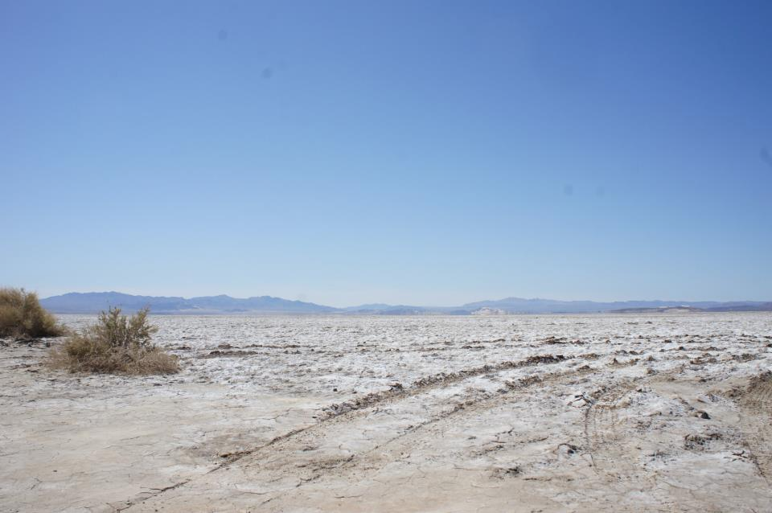
Contact between RADAR bright and dark areas – Soda lake

Slide 14
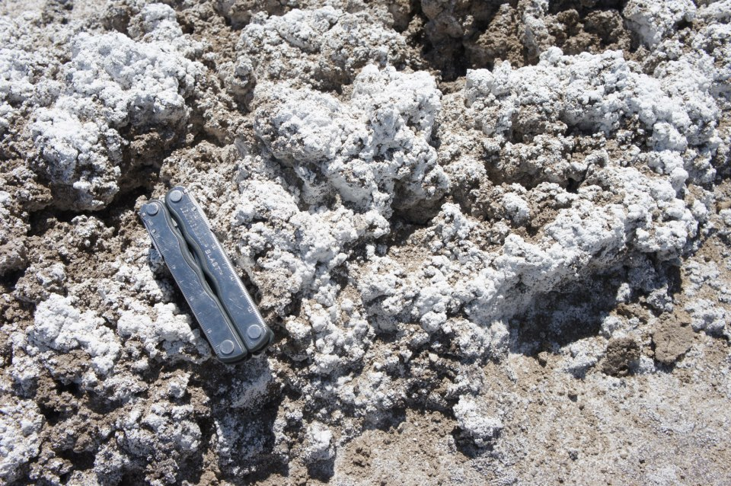

Slide 15
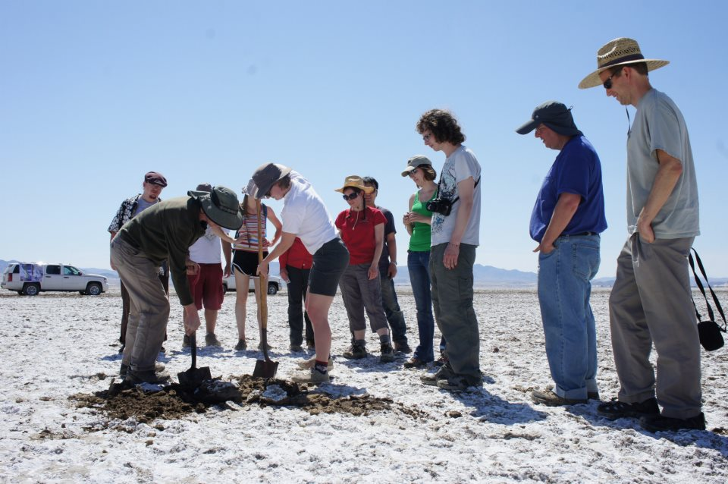

Slide 16
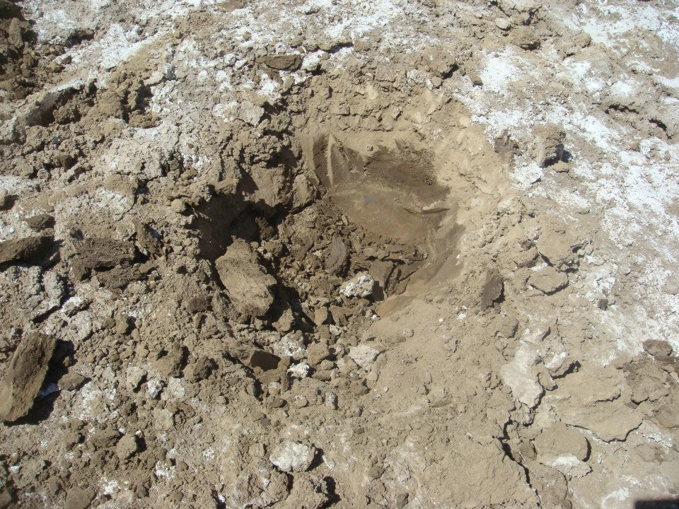
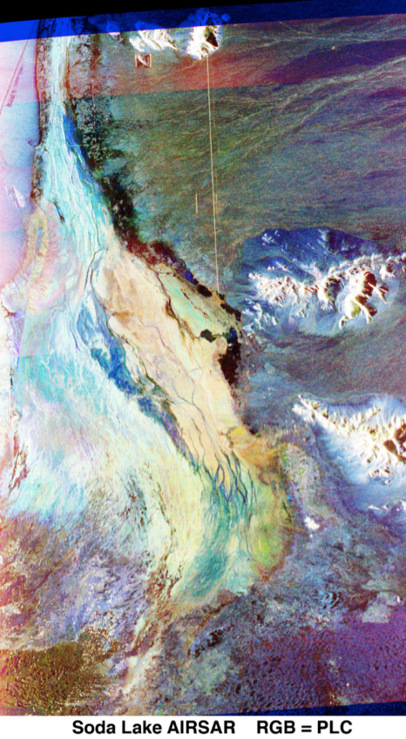

Slide 17
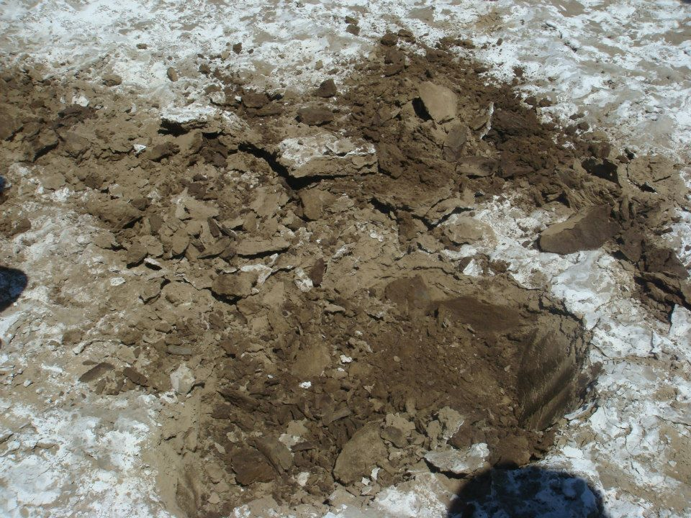

Slide 18
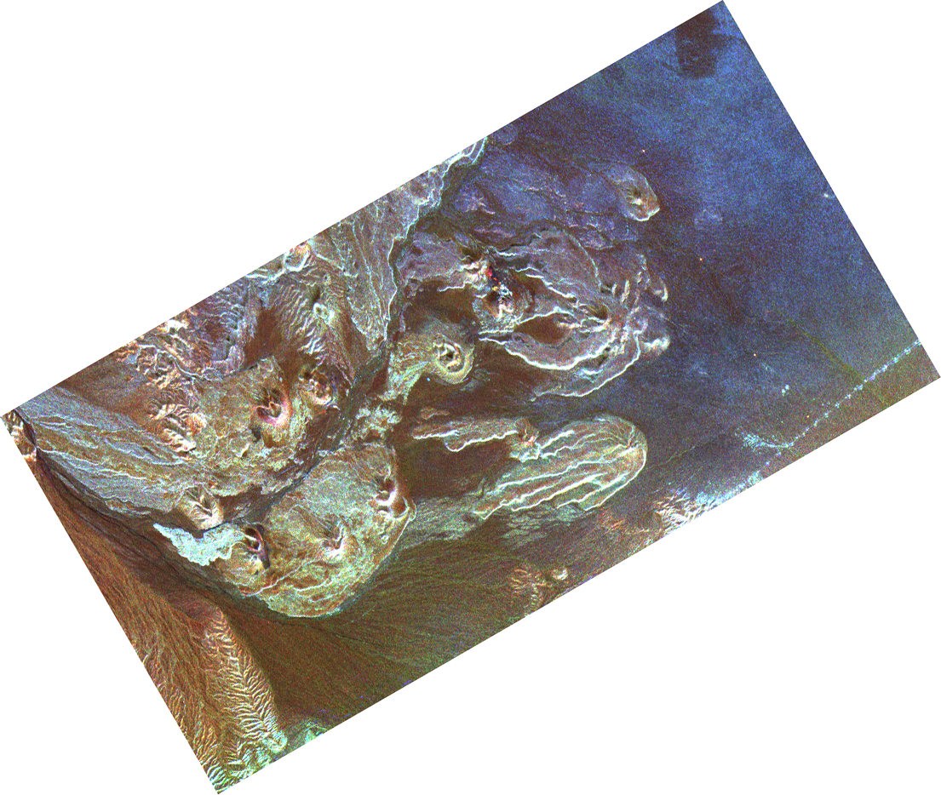
P
L
C

Slide 19
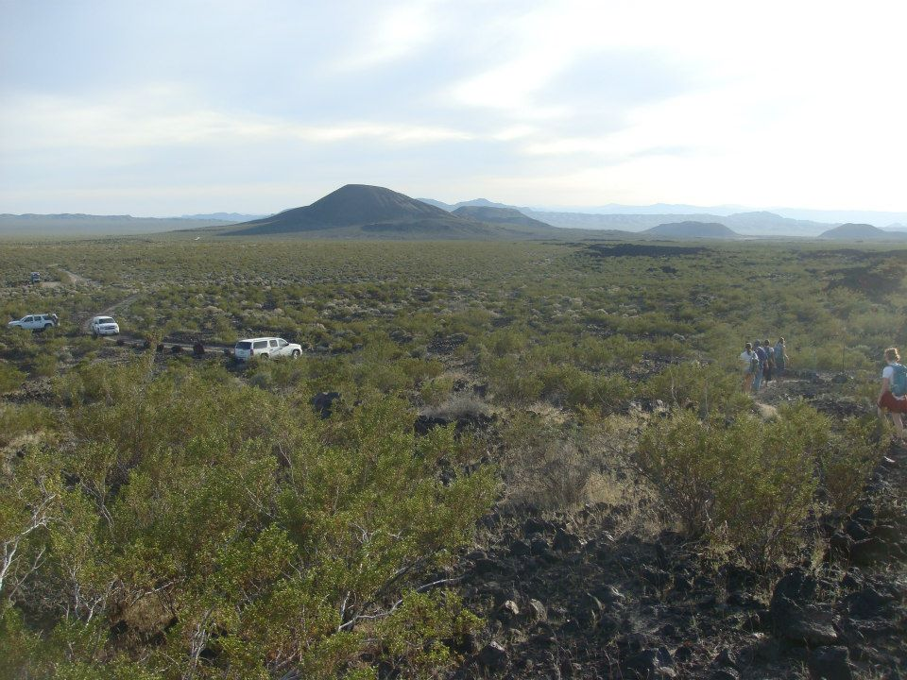
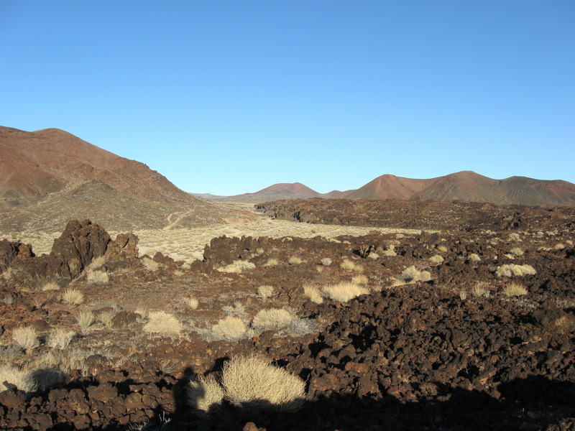
P
L
C

Slide 20
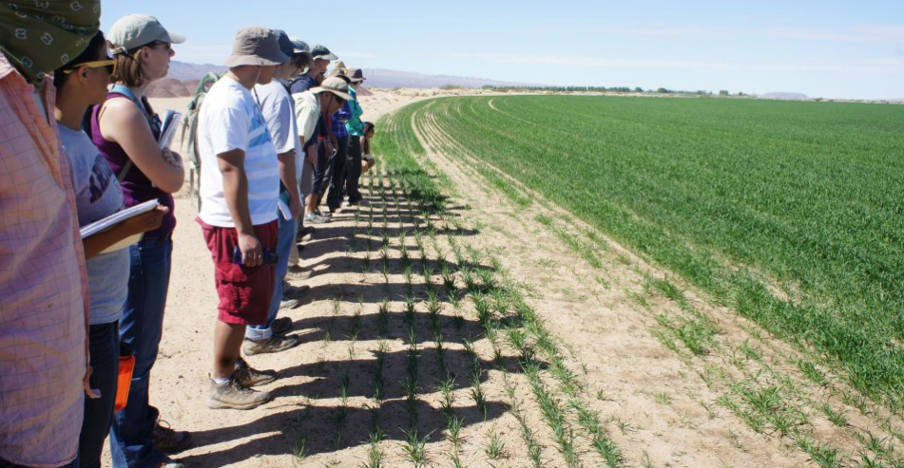
Pathological Topography at the Mojave Agricultural Fields UAVSAR L-band RGB = HH-HV-VV
Affects on both brightness and polarization

Slide 21
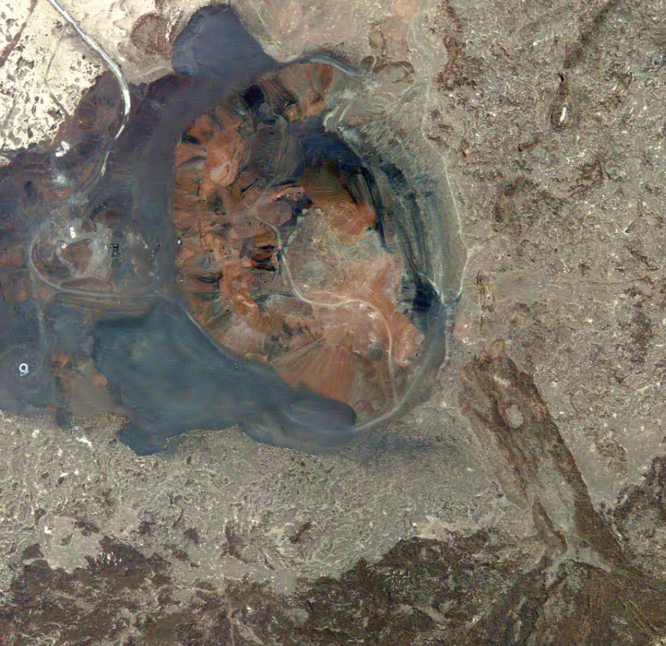
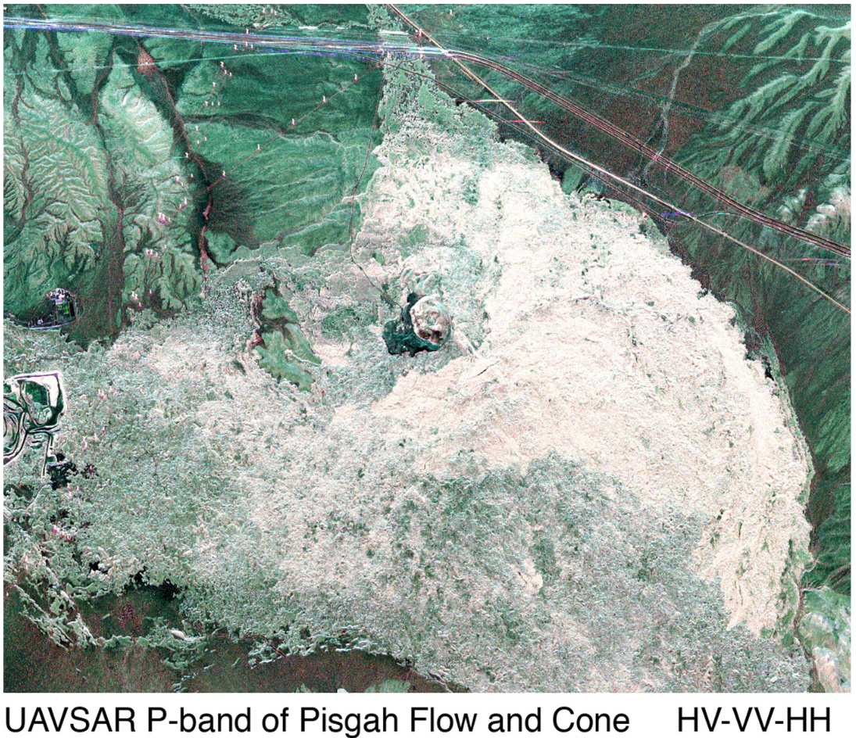
L

Slide 22
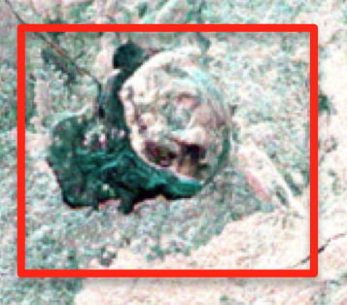
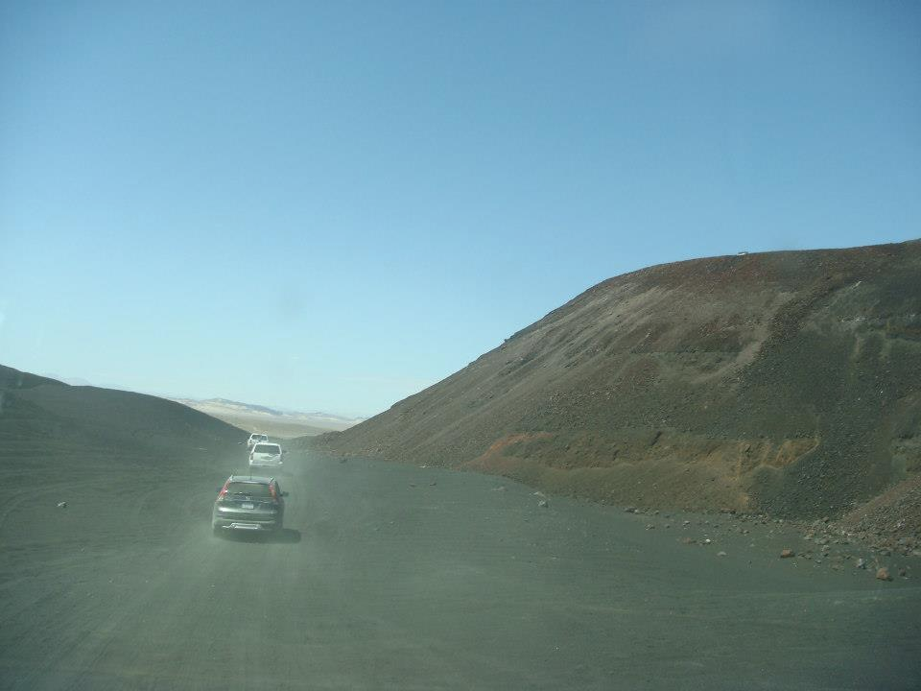
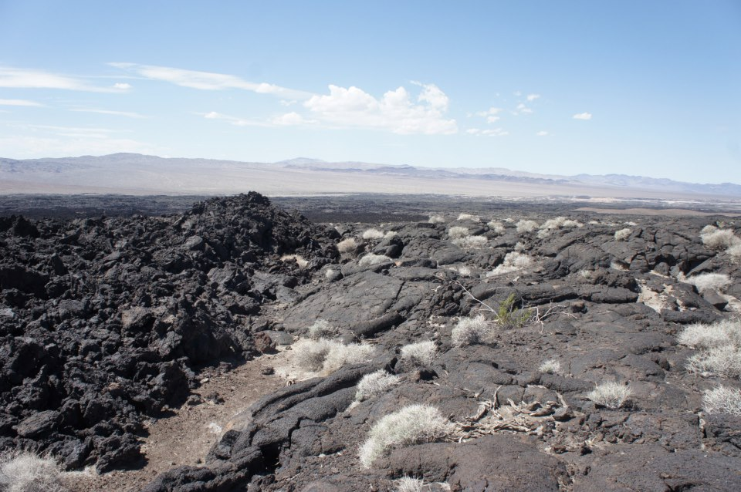

Slide 23
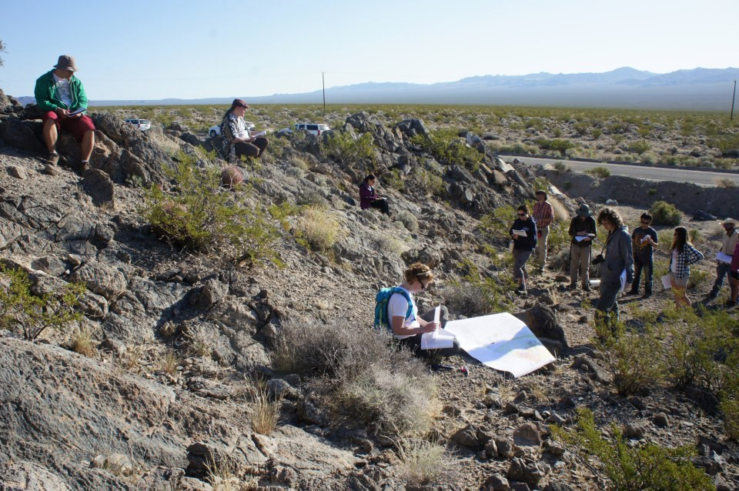
Kelbaker Road Outcrop
Variable surface composition

Slide 24
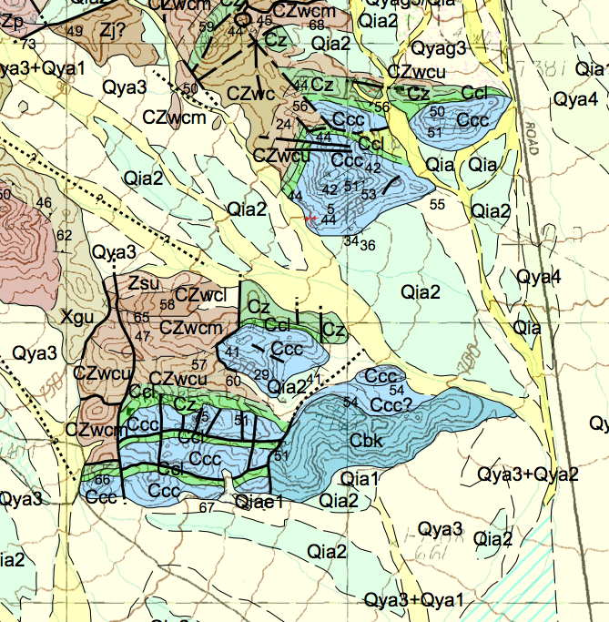
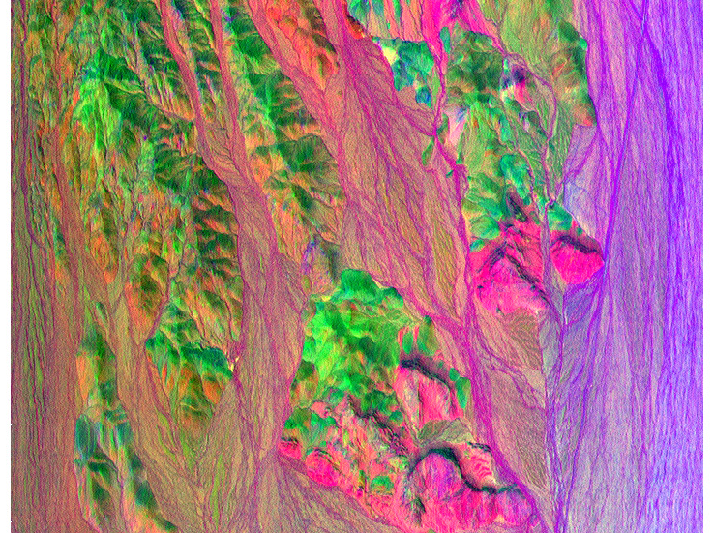
Bedford (2003)
(not a sand worm)
Decorrelation stretch of MASTER bands 9.1, 2.4, 0.5 microns

Slide 25
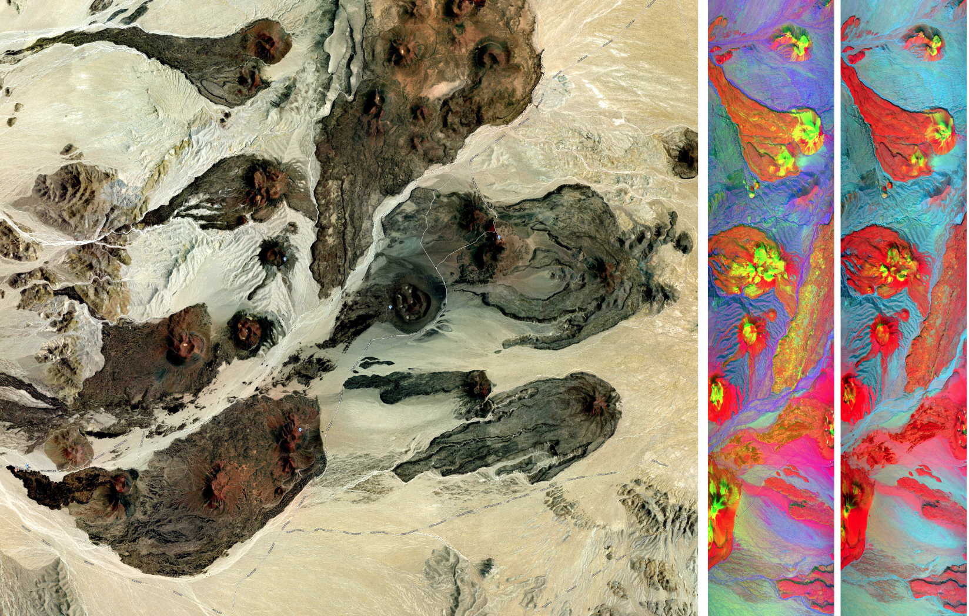

Slide 26
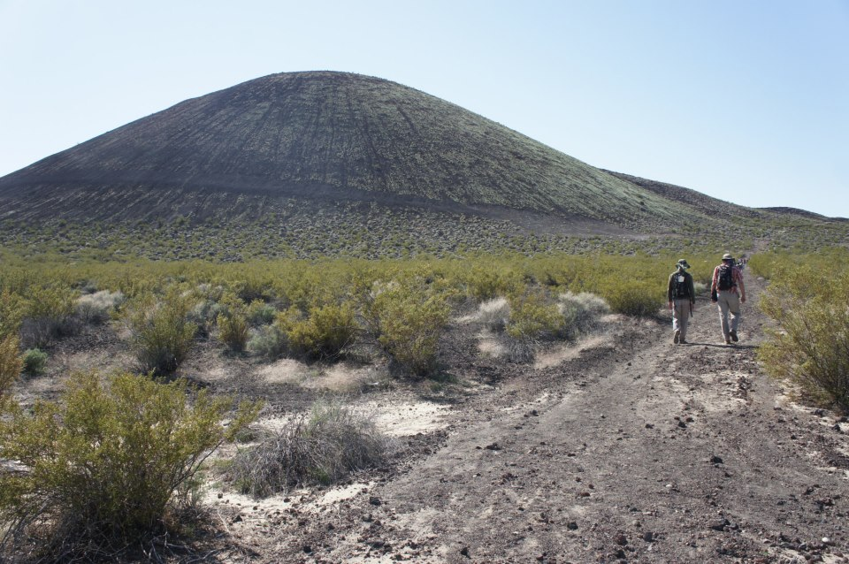
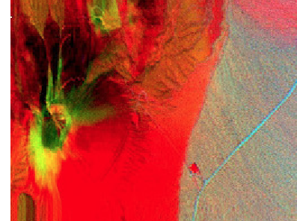
Doesn’t look so bad…

Slide 27
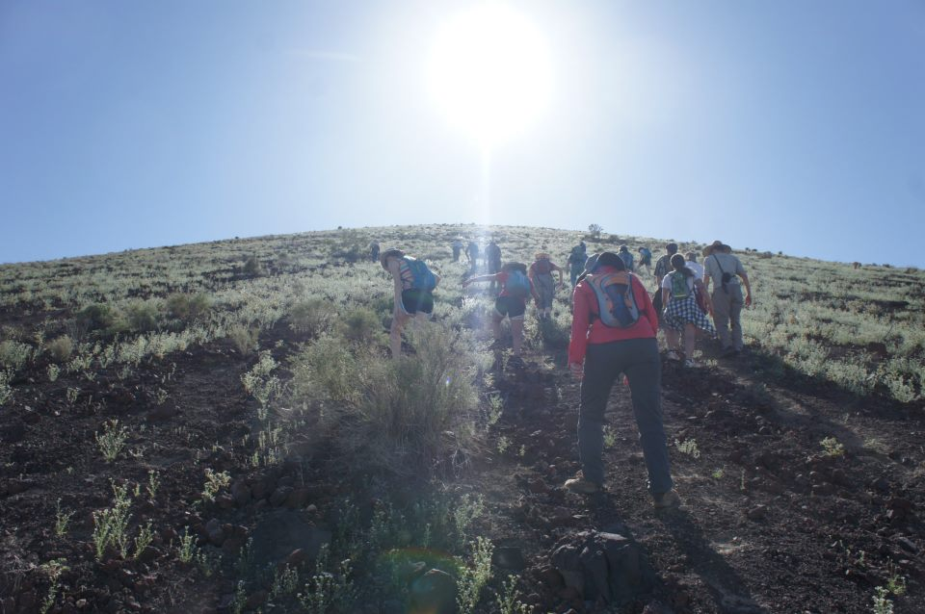
Ok, admittedly it did turn out to be pretty steep…

Slide 28
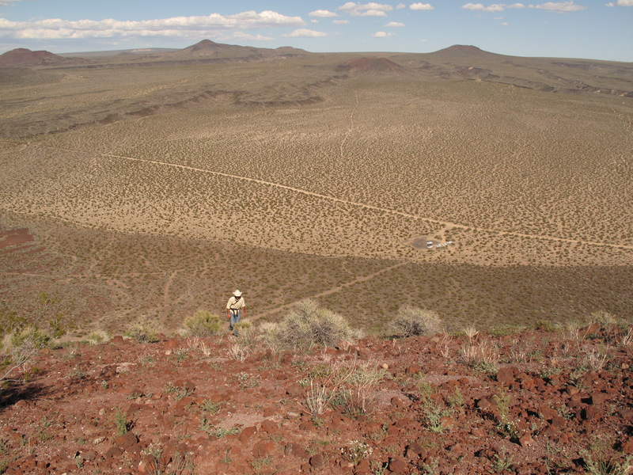
And high…
But look! Weathered cinders….

Slide 29
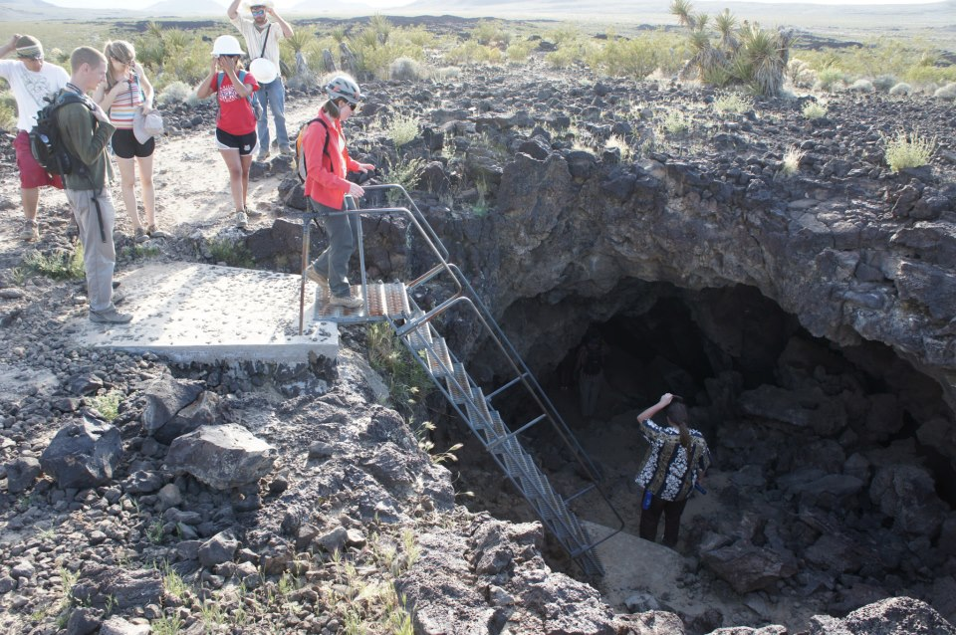
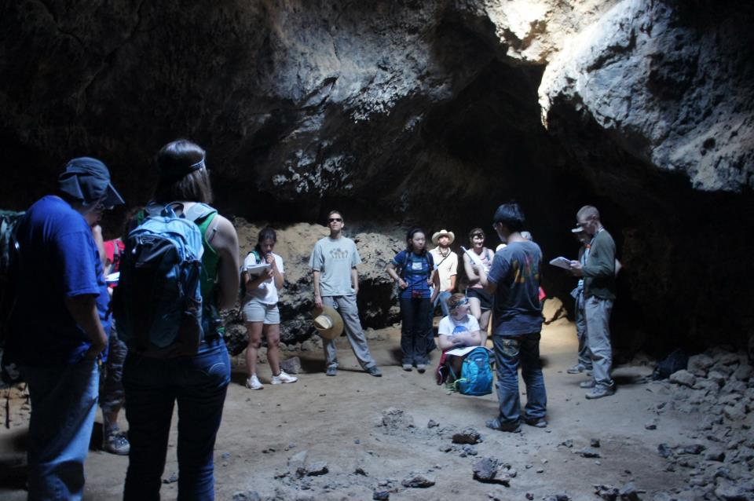

Slide 30
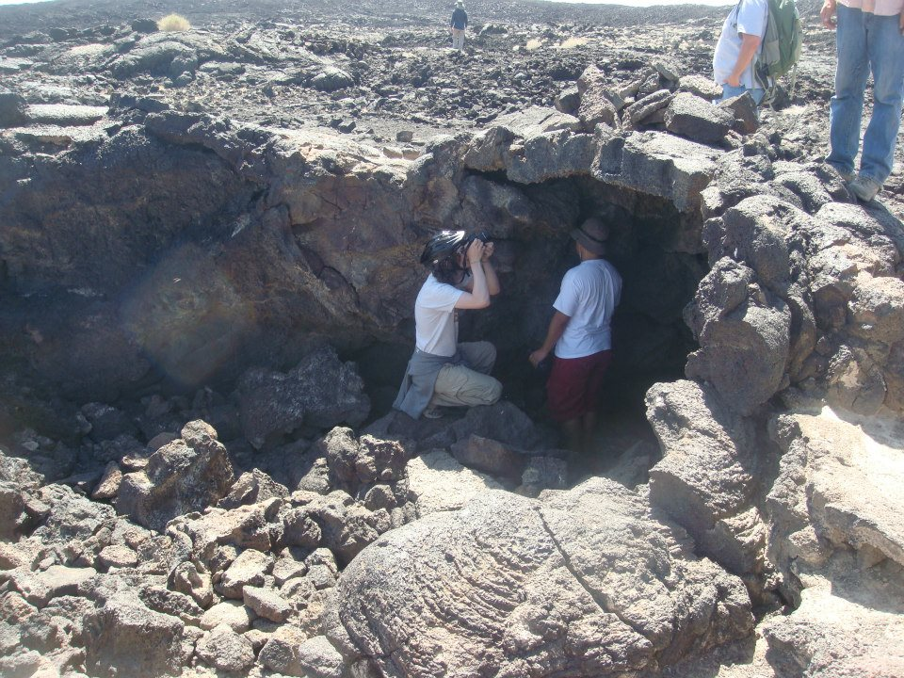
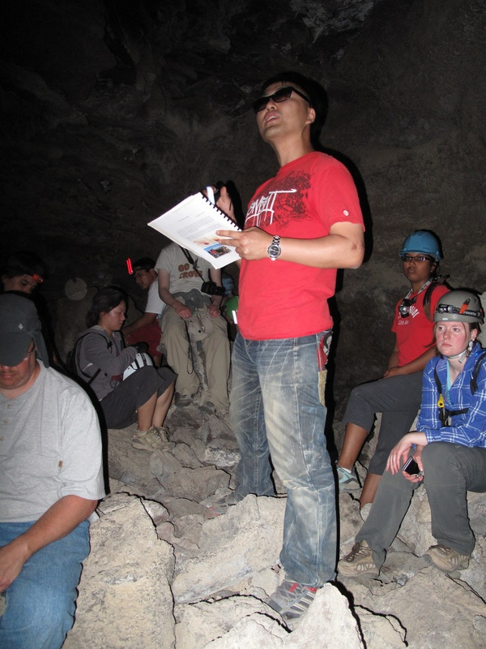
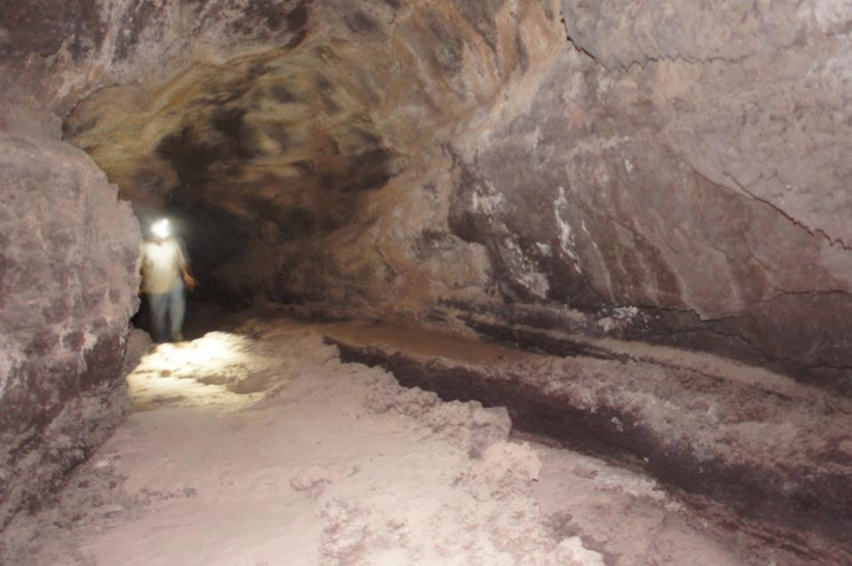

Slide 31
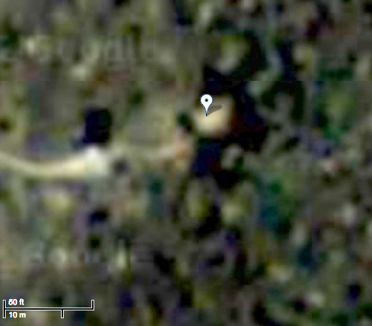
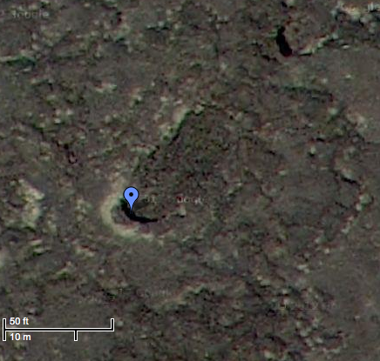
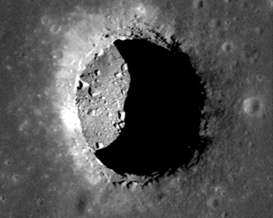
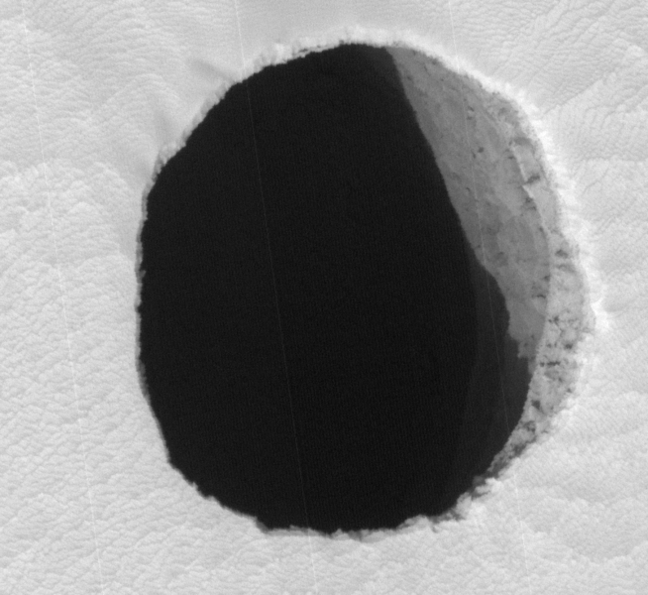
Pisgah
Cima
Moon
Mars

Slide 32
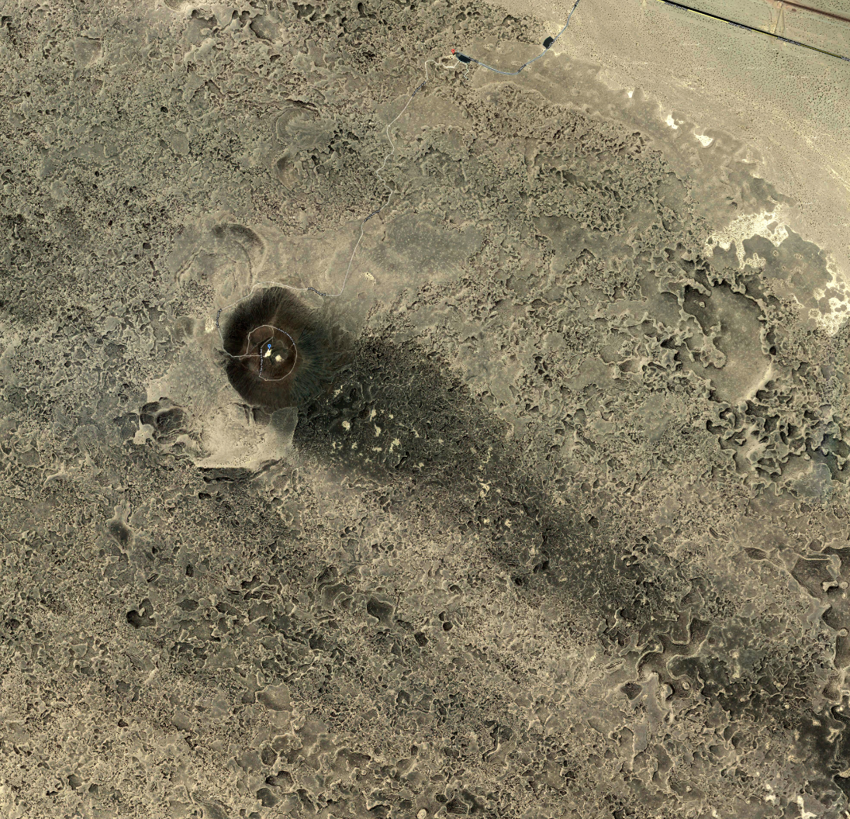

Slide 33
X-band total power
C-band total power

Slide 35
Us getting lost….

Slide 36
Corey finds the streak….

Slide 37
Final positions…

Slide 38
Not bad!

Slide 42
Everyone loves Amboy

Slide 43
How about Fall 2013?
Funds for a ‘big’ trip have appeared
Donations by Kelly Kolb, Jani Radebaugh, and a large donation from an anonymous donor.
If we throw all our spacegrant money for the year ($5K) and have 20 people enroll then we could coble together $25K (with a very small trip the following semester).
Hawaii
Glacier/Waterton
Iceland (probably not financially doable)
Alaska (probably not financially doable – Colin estimated ~$35K in 2005)
Timing?
Need a conventional option for next semester too
------------------------------------------------------------------
Northern New Mexico
Incl. with K/T boundary stops?
Southern Utah
Overlap with HiRISE?
Many sites west of Canyonlands
Stratigraphic bedform themed trip (mostly southern New Mexico + White Sands)

Slide 44
Classes 8/26 - 12/19
HiRISE knocks out 8/9 and 8/16
Thanksgiving & AGU knock out 11/29, 12/6 and 12/13
Options Leaving Friday:
8/23
8/30 Labor Day Weekend
9/6
9/13
9/20
9/27
10/4 DPS
10/11 DPS
10/18
10/25
11/1 I might be out of town
11/8
11/15
11/22
Surfaces fieldtrip goes somewhere here too…
Too Warm for southern UT?
Too Cold for northern NM?

