Slide 1
Polar caps, ice and the history of climate change on Mars
Shane Byrne (shane@lpl.arizona.edu)

Slide 2
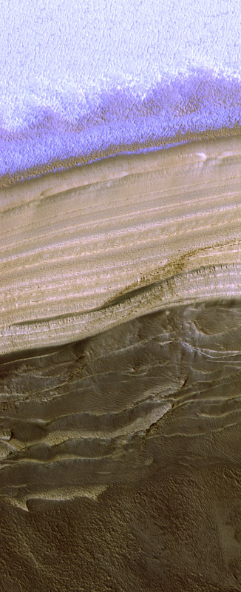
Three things to talk about
  Seasonal frost
  Residual Ice Caps
  Polar layered deposits
PSP_001378_2640

Slide 3
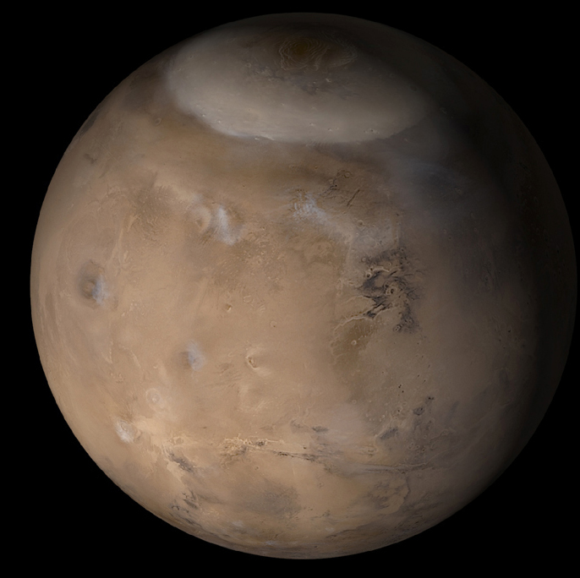
Seasonal frost on Mars
  Major feature of martian seasons
  Exotic CO₂ ice processes
  Seasonal timescale of 686 days
Residual ice caps
  Interacting with current climate
  Affected by global dust storms
  10⁰ to 10² years
Polar layered deposits
  Record of changing climate
  Linked to orbital variations
  10⁵ to 10⁷ years
Older Polar deposits
MOC wide angle, msss.com

Slide 4
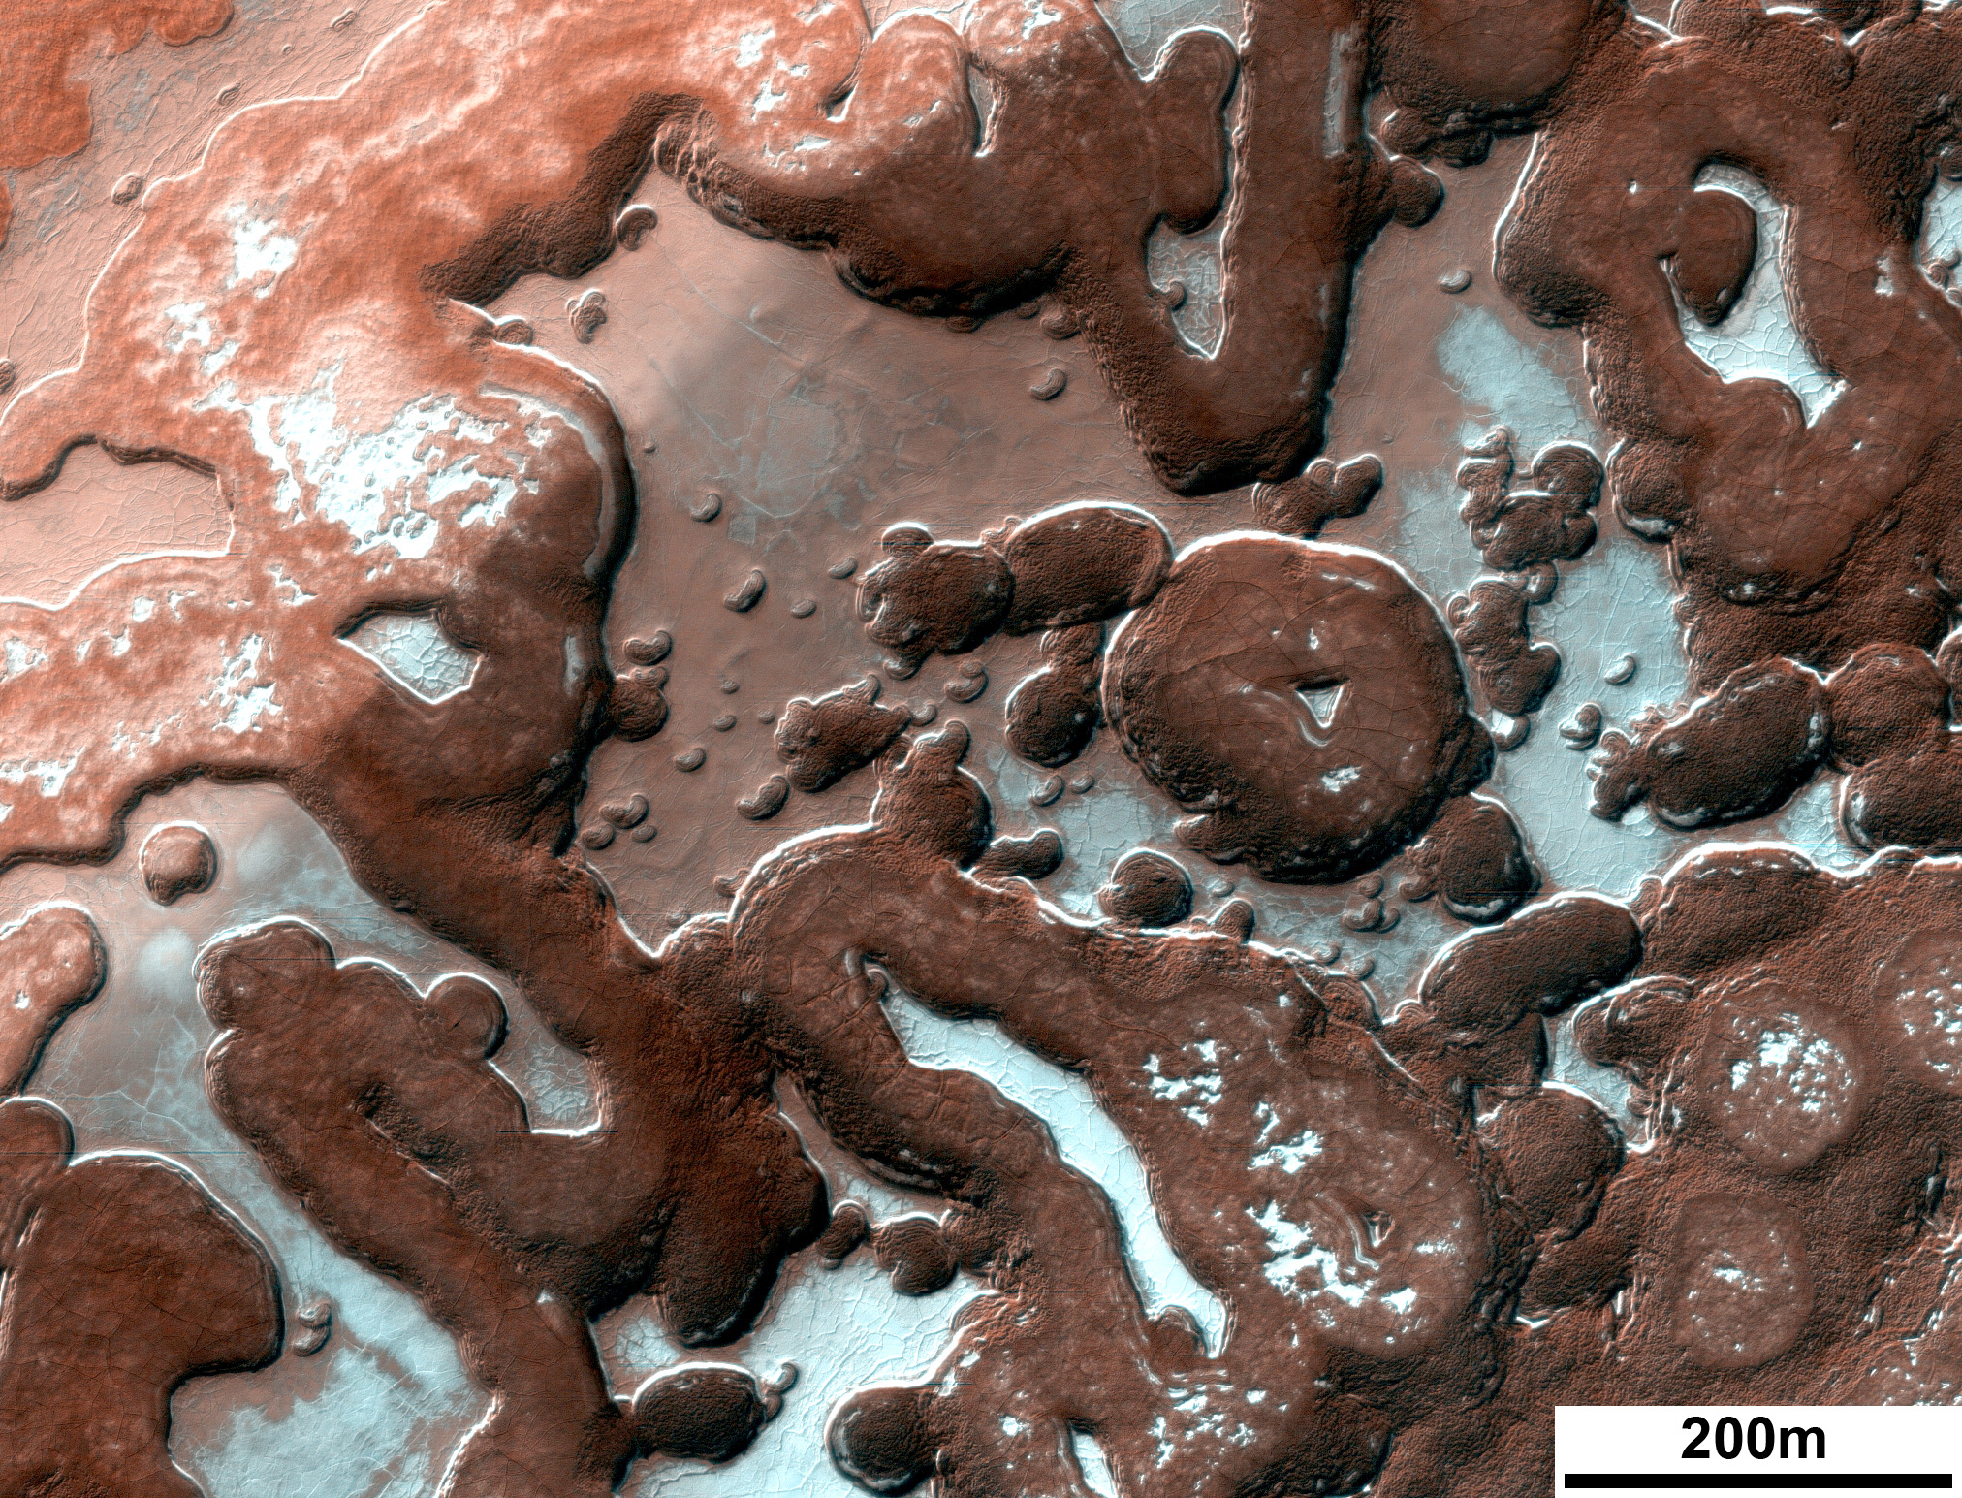
Seasonal frost on Mars
  Major feature of martian seasons
  Exotic CO₂ ice processes
  Seasonal timescale of 686 days
Residual ice caps
  Interacting with current climate
  Affected by global dust storms
  10⁰ to 10² years
Polar layered deposits
  Record of changing climate
  Linked to orbital variations
  10⁵ to 10⁷ years
Older Polar deposits
PSP_006270_0955

Slide 5
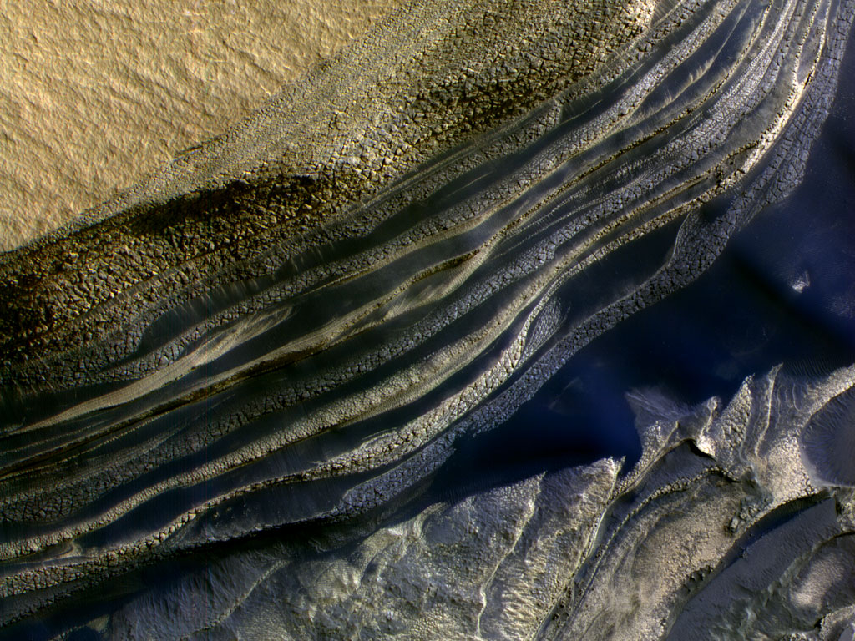
Seasonal frost on Mars
  Major feature of martian seasons
  Exotic CO₂ ice processes
  Seasonal timescale of 686 days
Residual ice caps
  Interacting with current climate
  Affected by global dust storms
  10⁰ to 10² years
Polar layered deposits
  Record of changing climate
  Linked to orbital variations
  10⁵ to 10⁷ years
Older Polar deposits
PSP_001334_2645

Slide 6
Climate on Mars: Much simpler than the Earth
  No oceans
  No Vegetation or People
  Not much volcanism
  Not much cloud cover
Just sunlight
  Sunlight at the pole depends on Mars’ orbit
Obliquity
  Earth ~ 23 degrees
  Mars today ~ 25 degrees
Eccentricity
  Earth ~ 0 (circular)
  Mars today ~ 0.1 (ellipse)

Slide 7
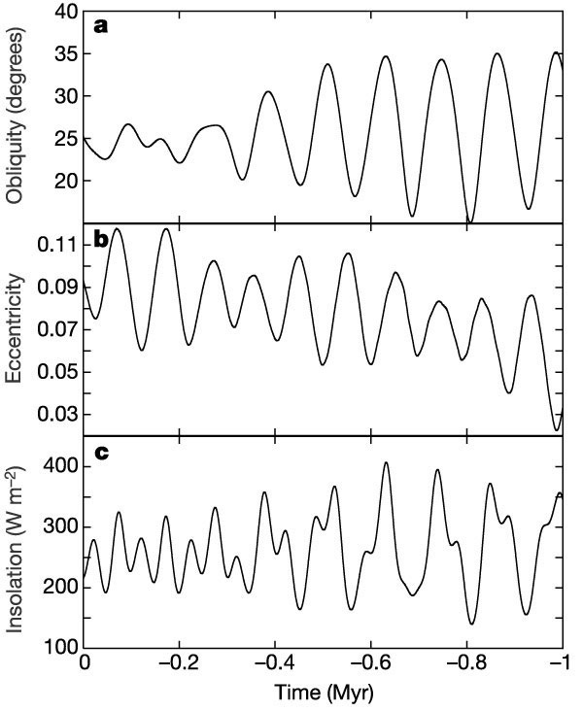
Laskar et al., 2003

Slide 8
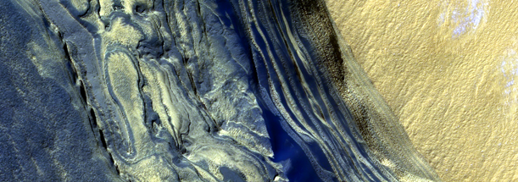
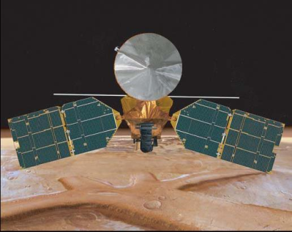
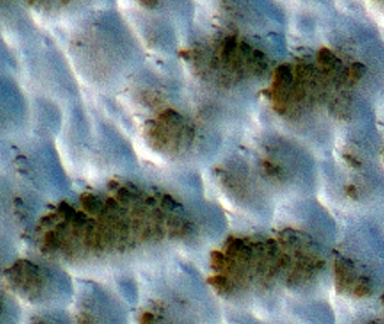
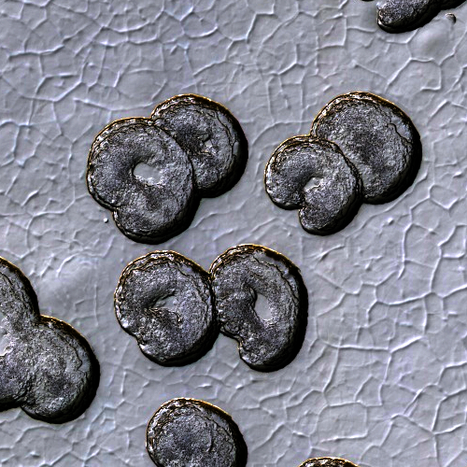
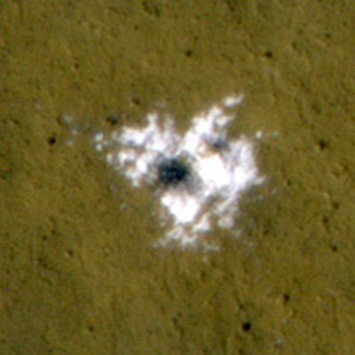
Climatic Record
Spacecraft Record
YEARS
10⁸
10⁷
10⁶
10⁵
10⁴
10³
10²
10¹
10⁰
Recent climatic variations
Interannual variability of the current climate

Slide 9
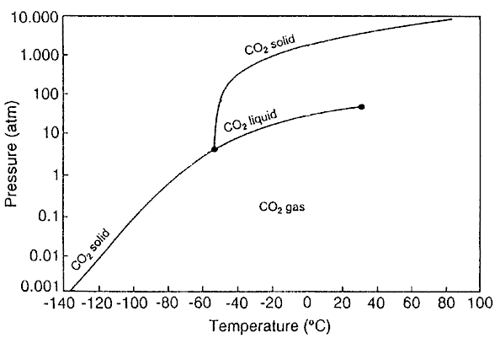
Seasonal Ice Caps
Mars has a similar obliquity (25°) to the Earth.
  Ensures seasons with periods of permanent polar darkness and daylight.
Mars has a low pressure CO₂ atmosphere.
  Permits seasonal icecaps of CO₂ ice to form
  Leighton and Murray (1966)

Slide 10
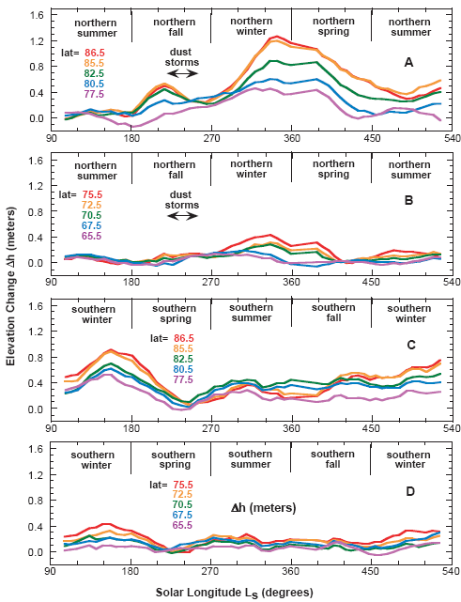
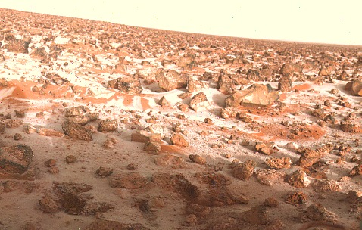
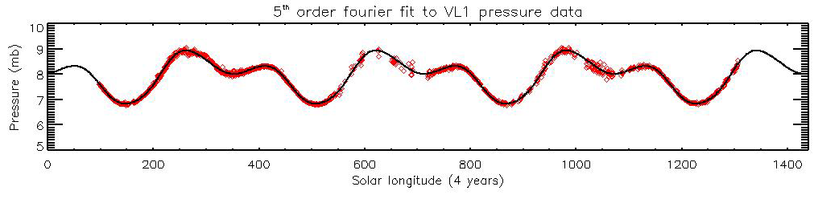
Extend from the pole to the mid-latitudes
About 1m thick
Smith et al.,
2001

Slide 11
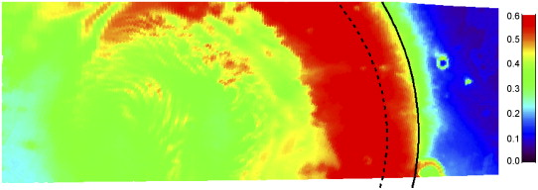
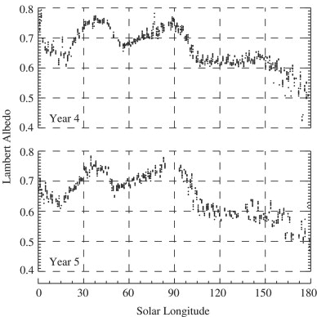
CO₂ not the only volatile in play….
Wagstaff et al., 2008
Annulus of water frost tracks the edge of the retreating cap
Repeatable each year
Byrne et al., 2008

Slide 12
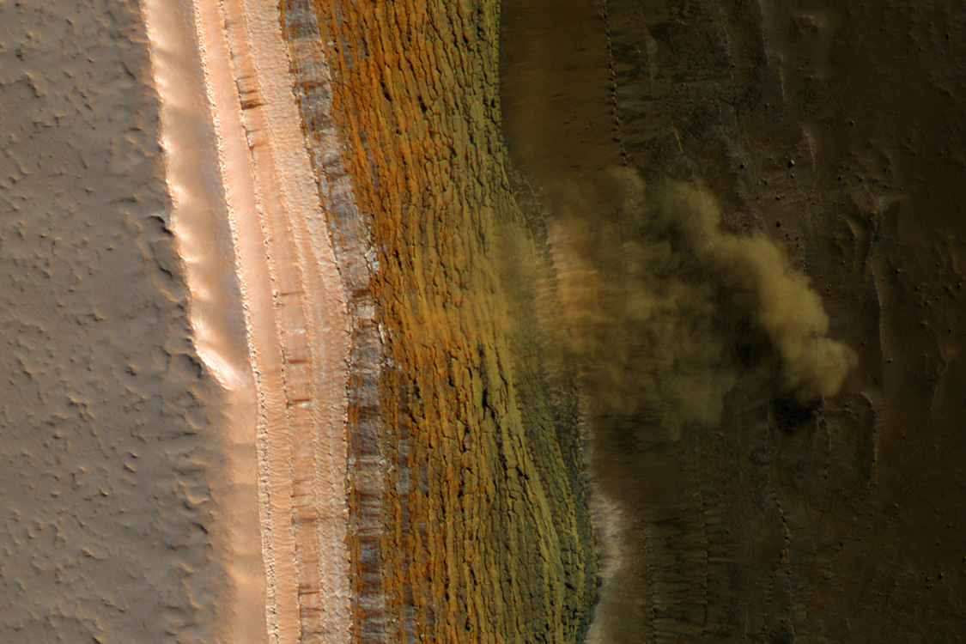

Slide 13
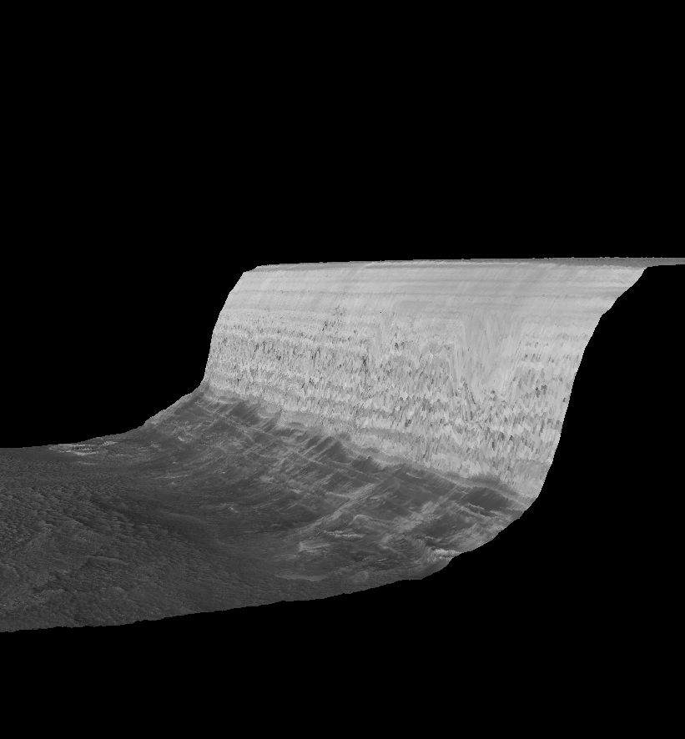
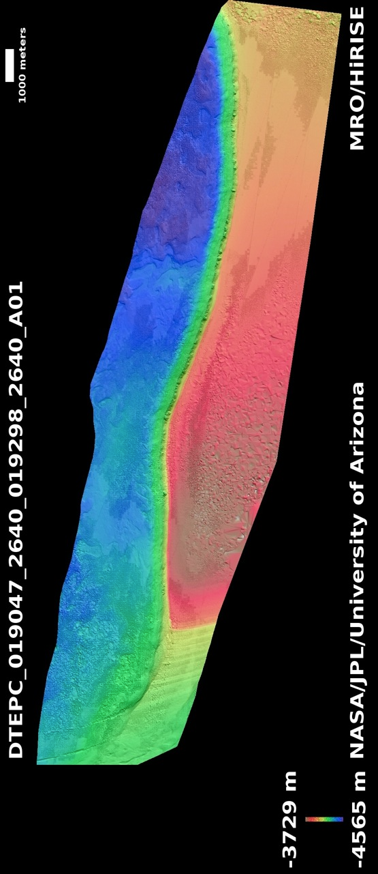
No Vertical Exaggeration (!)

Slide 14
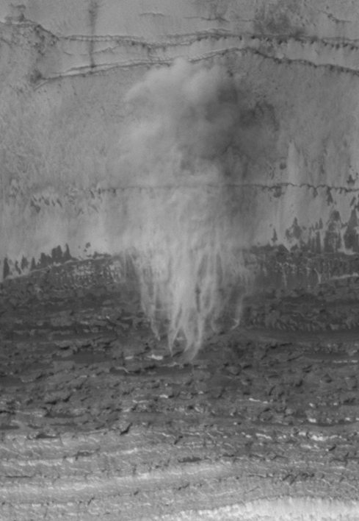
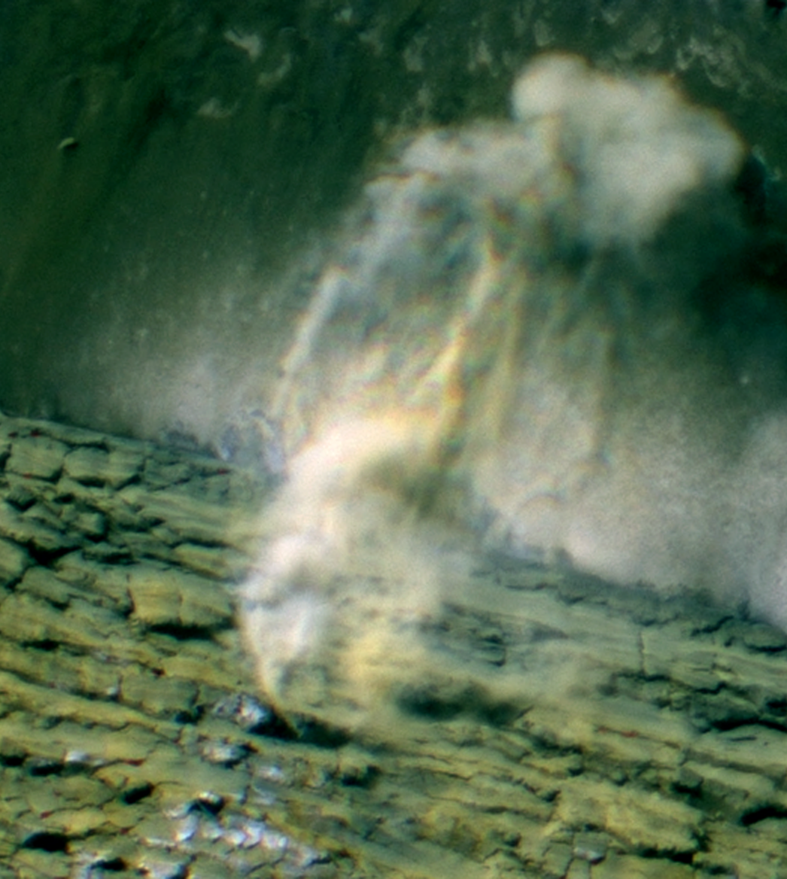
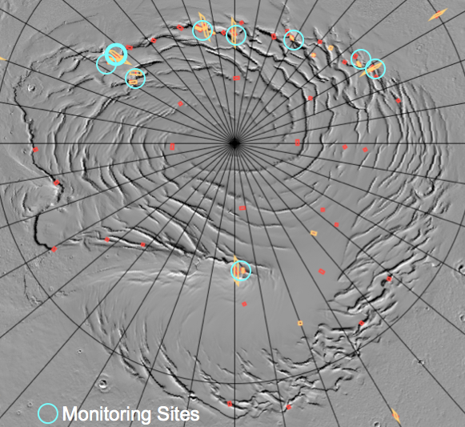
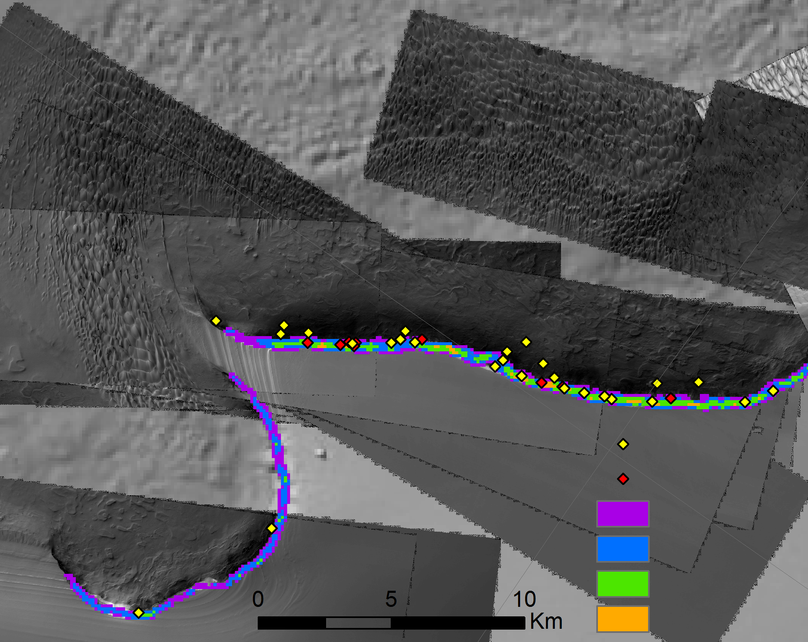
MY 30 Av
MY 29 Av
Slope 30 - 40
Slope 40 - 50
Slope 50 - 60
Slope 60 - 80

Slide 15
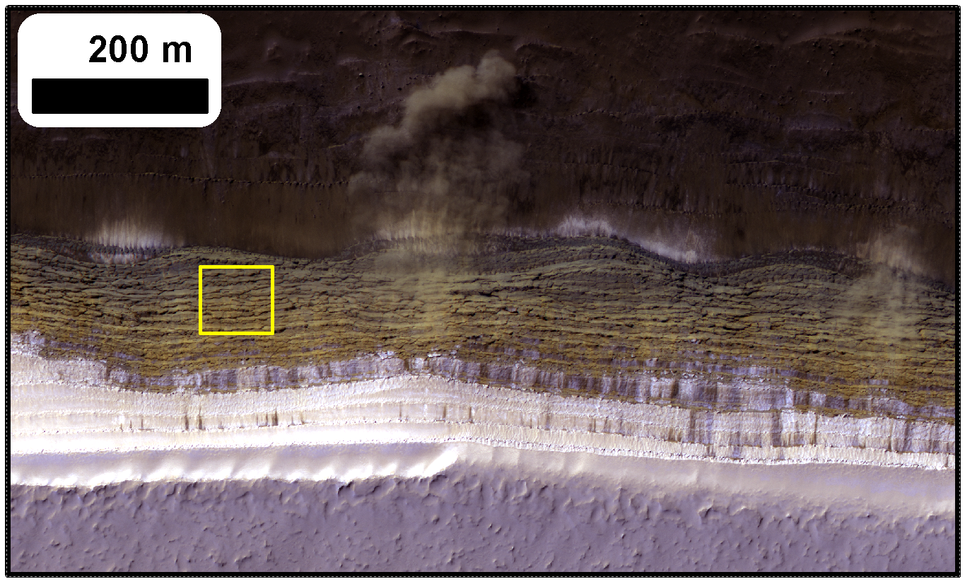
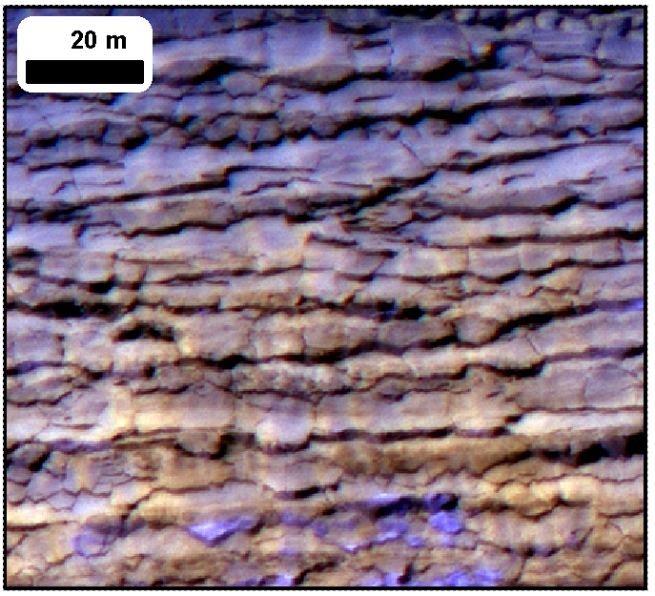
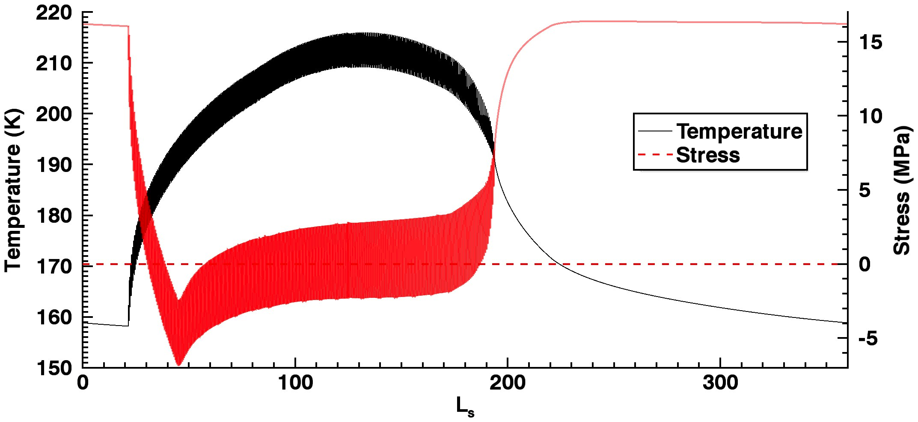
Thermal stresses are being modeled to explain unusual scarp texture
45 degree SW slope

Slide 16
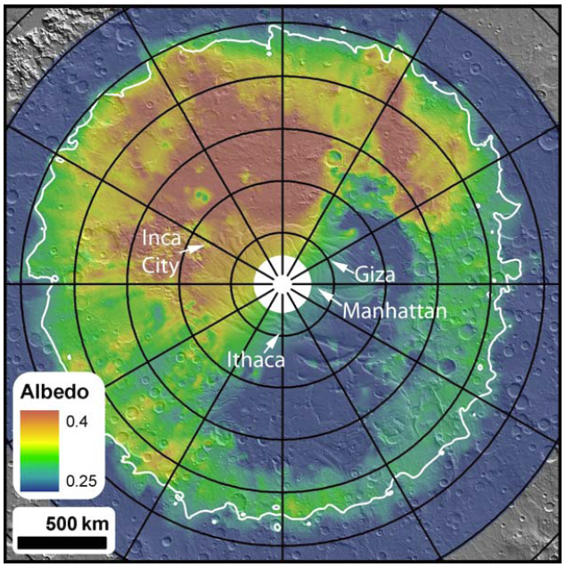
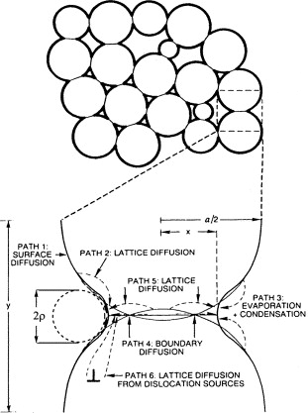
Cryptic behavior…
  Low albedo region inside the CO₂ cap
  Spectral indicators of large grain size
  Large areas anneal into a transparent slab in 100’s of days
Eluszkiewicz et al., 2005

Slide 17
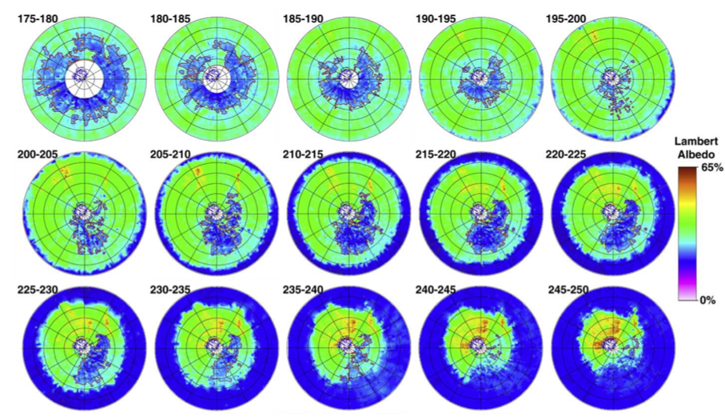
Piqueux et al. 2002

Slide 18
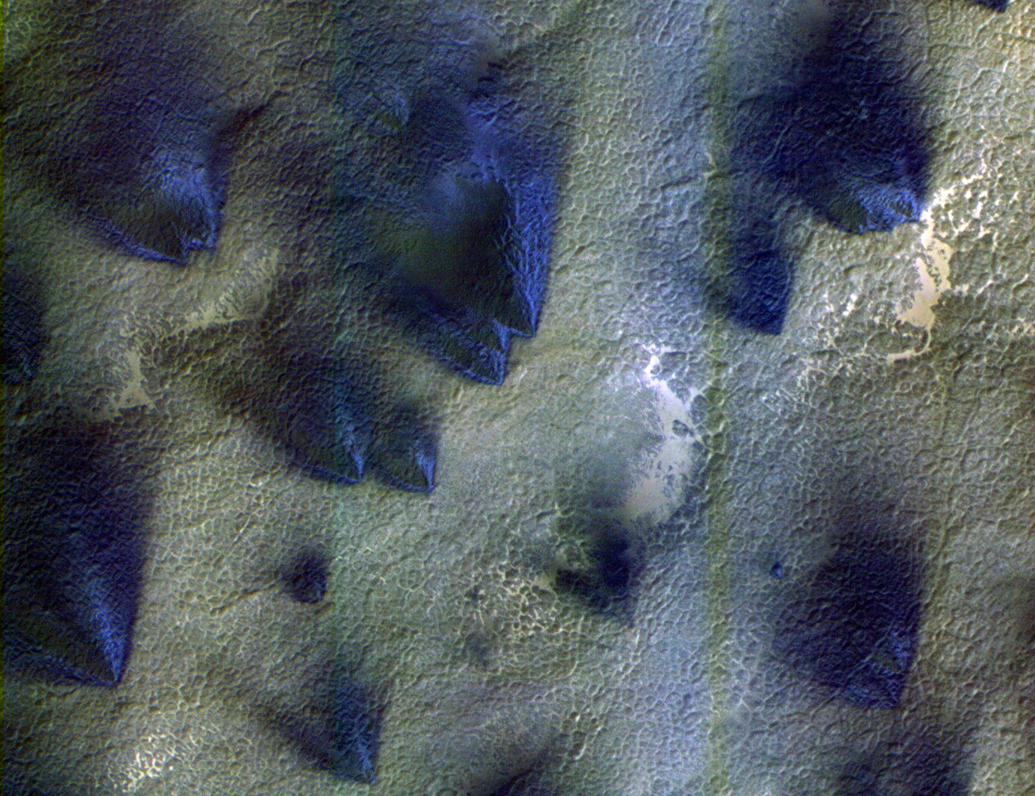
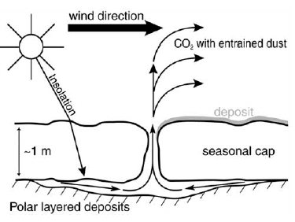
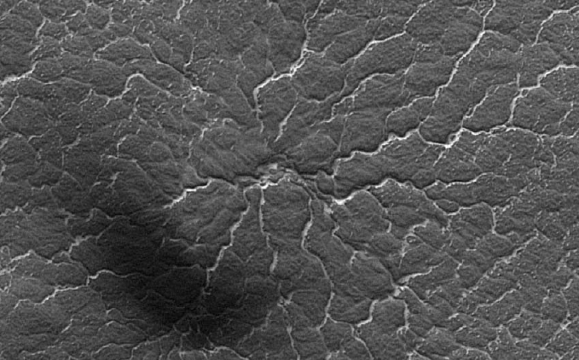
Behavior of a transparent slab of CO₂ ice
PSP_002675_0945
Multiple fan (wind) directions
Scouring of channels to produce ‘spiders’
PSP_002533_0935

Slide 19
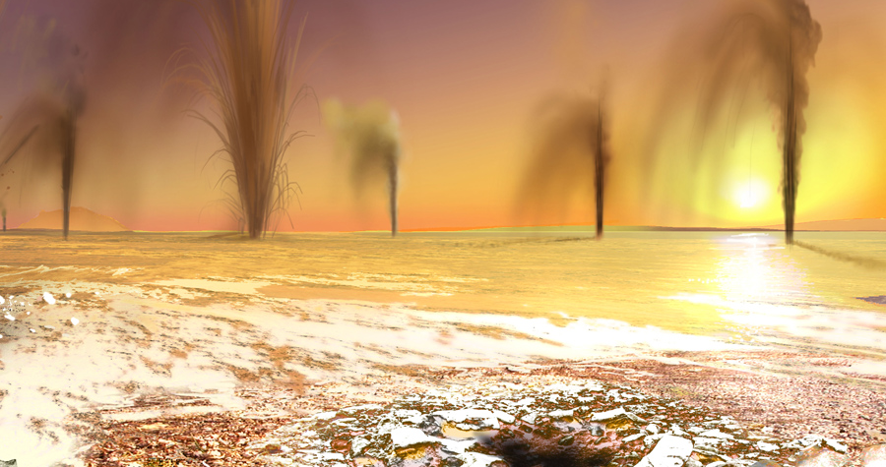
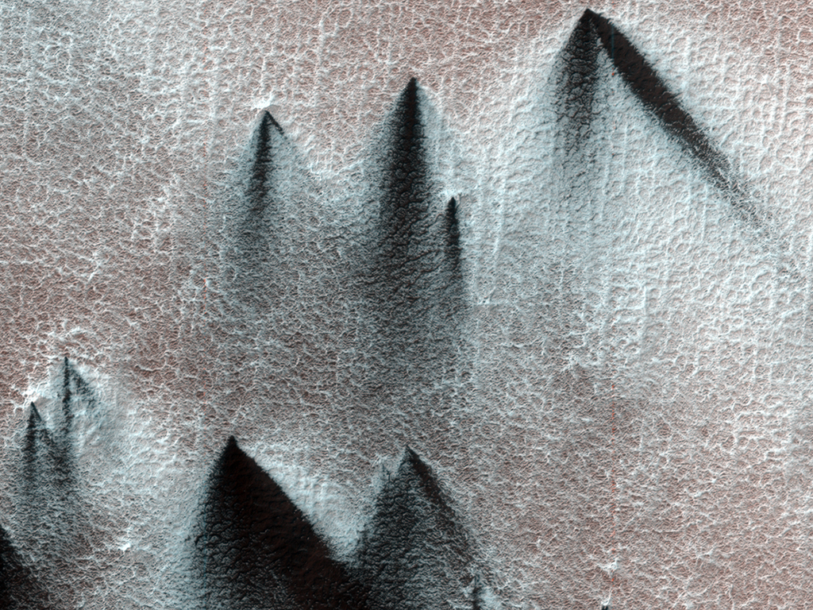

Slide 20
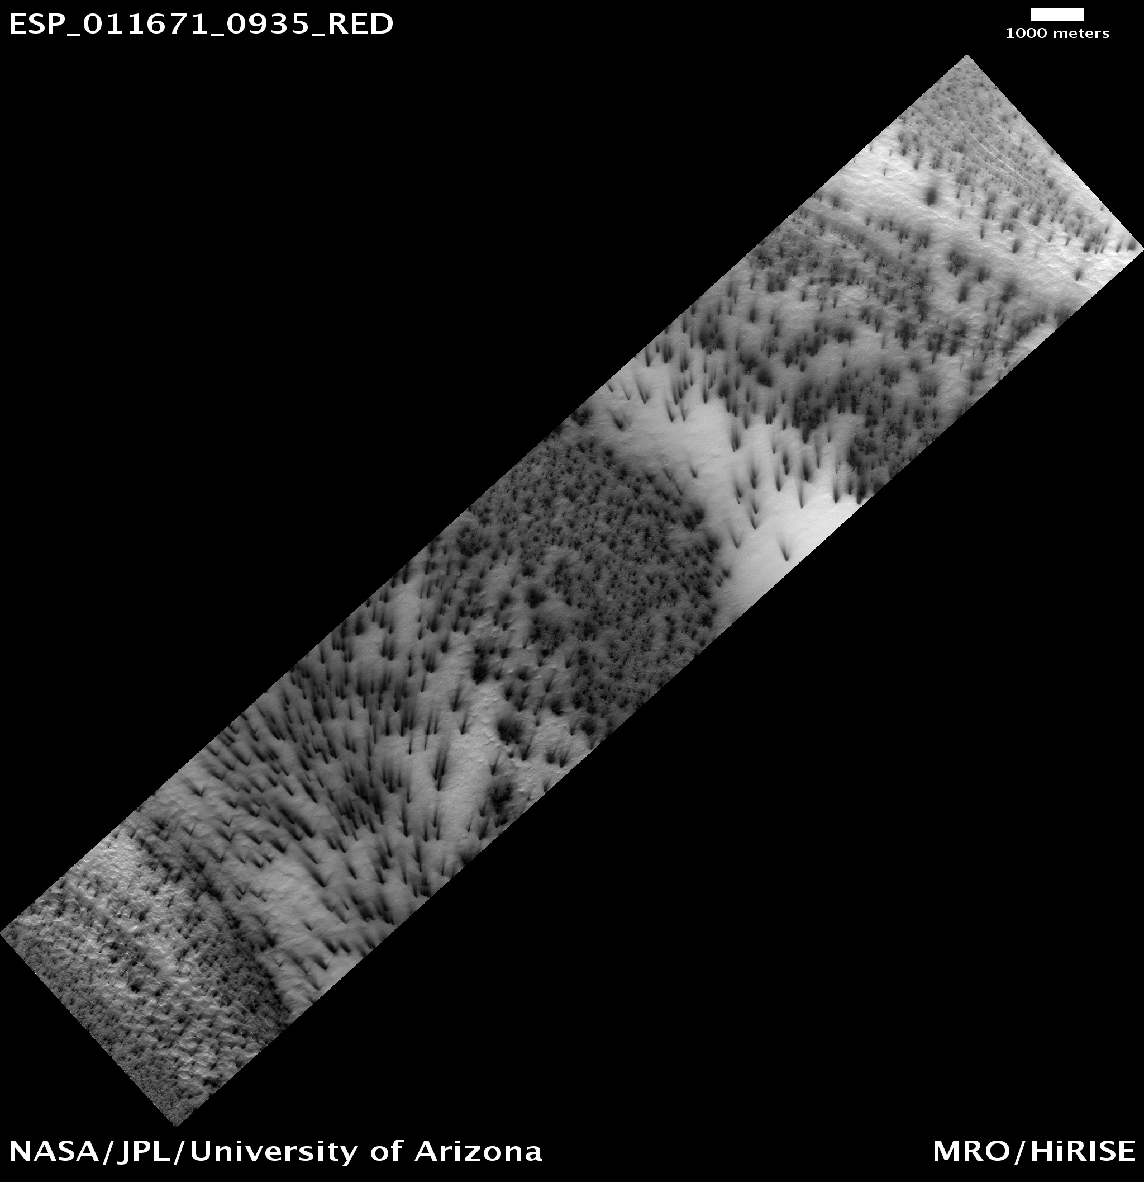

Slide 21
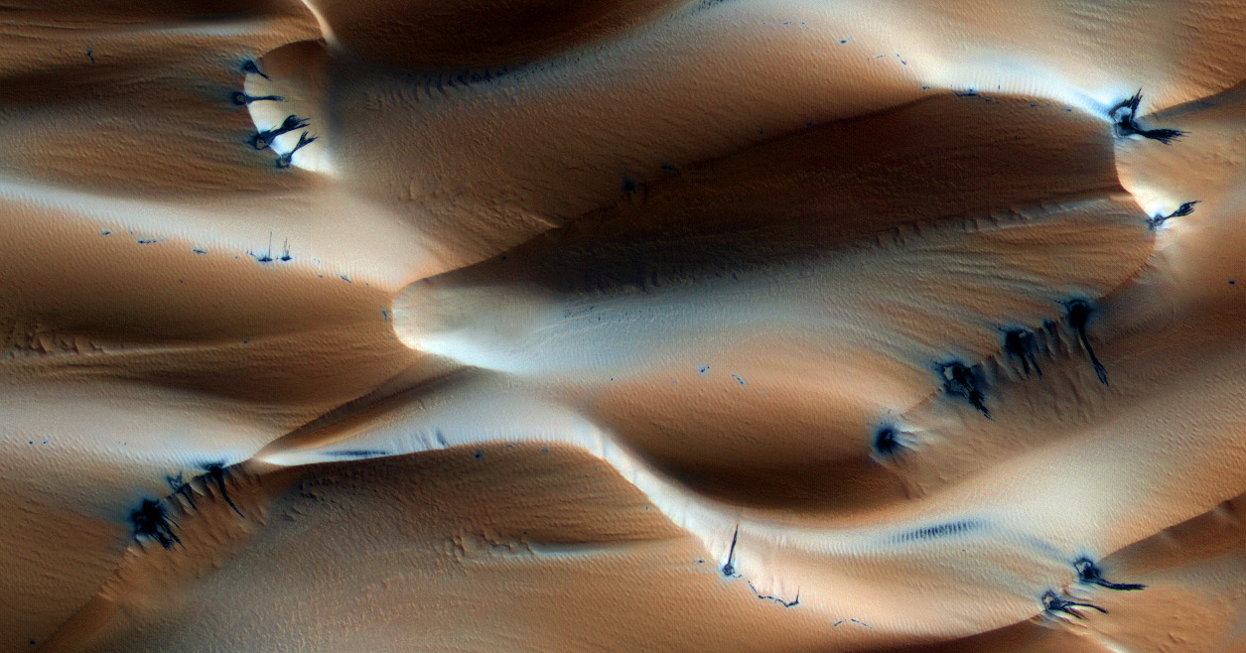
Transparent ice in the northern cap ???
PSP_007193_2640

Slide 22
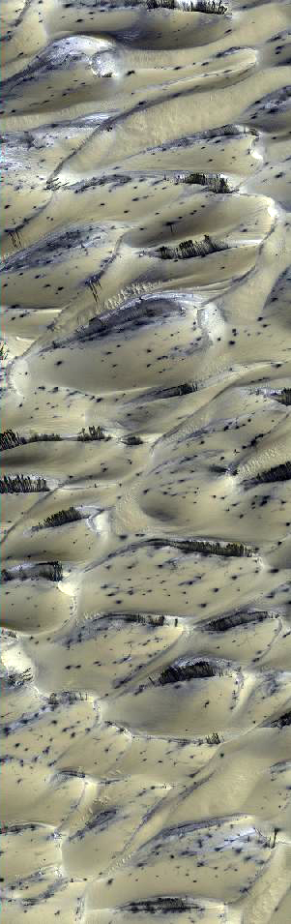
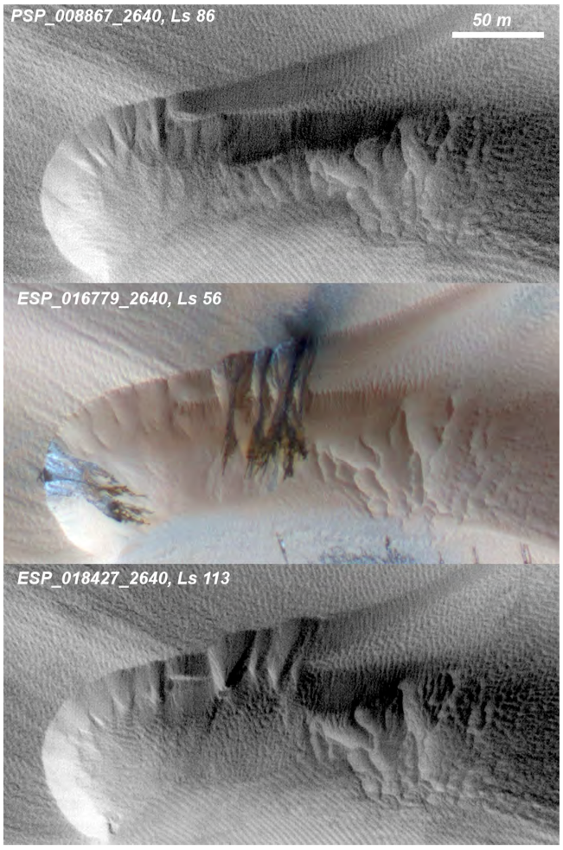
Dunes with seasonal CO₂ venting on Mars
Hansen et al., 2011

Slide 23
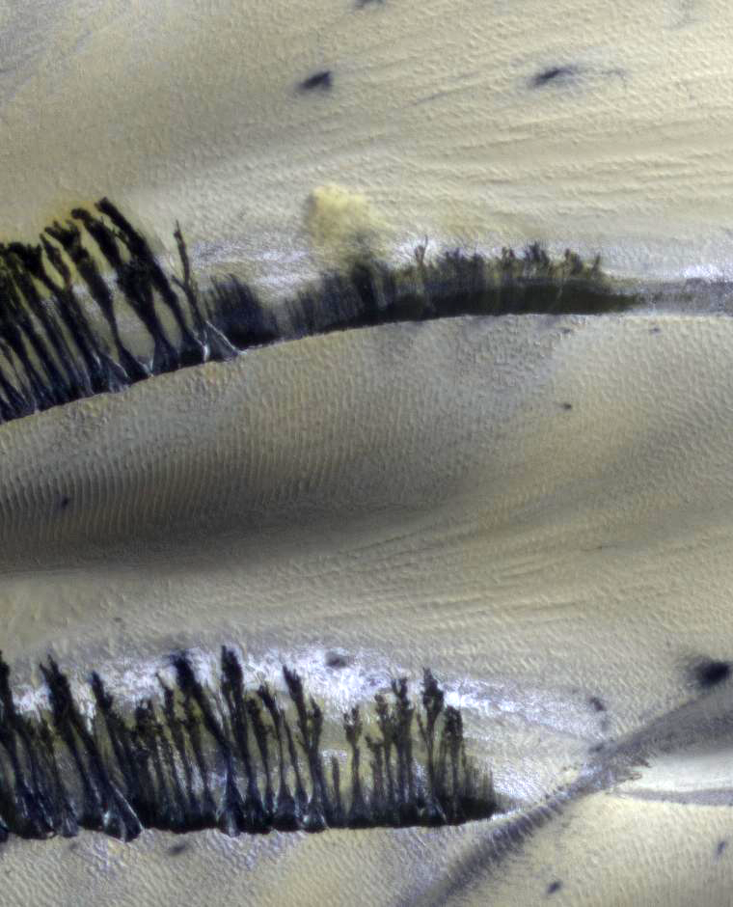

Slide 24
Classic barchan spring sequence
Lat / Lon: 75.8N / 94E

Slide 25
Cracks on crest become source of sandfalls
Landscape restoration
“Buzzel” Lat / Lon: 84N / 233E

Slide 26
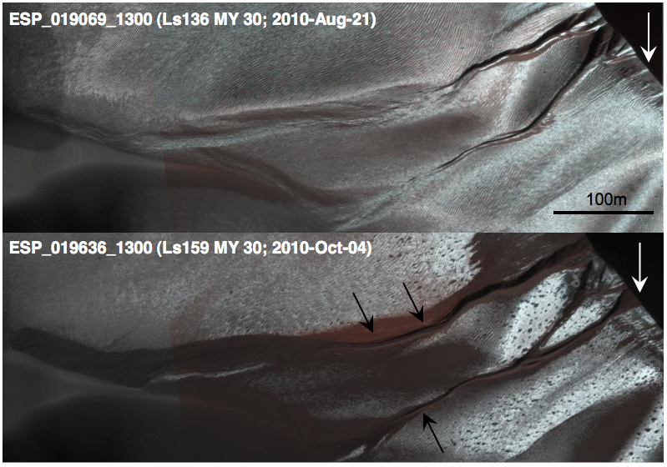
Avalanching frost carves gullies in dunes every winter
Dune migration erases gullies
Diniega et al., 2010

Slide 27
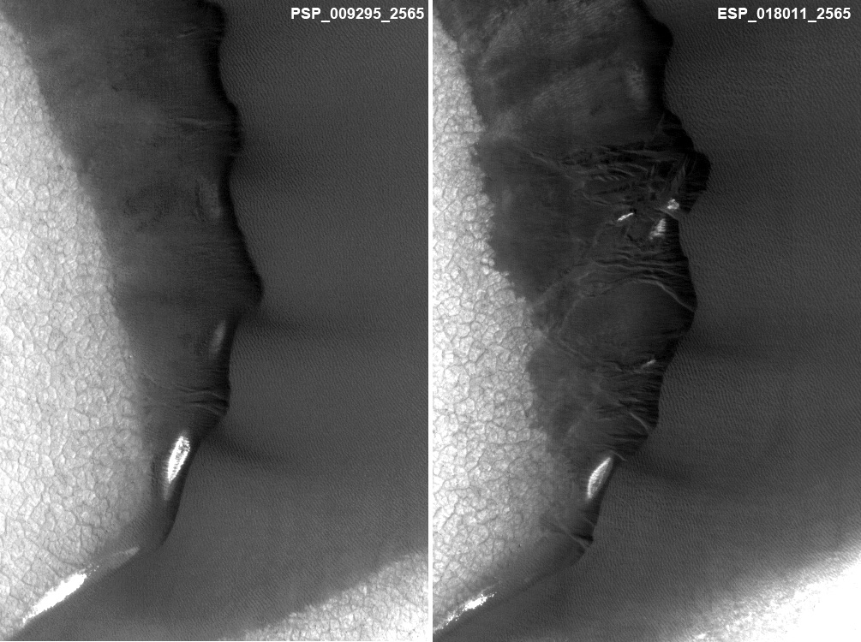
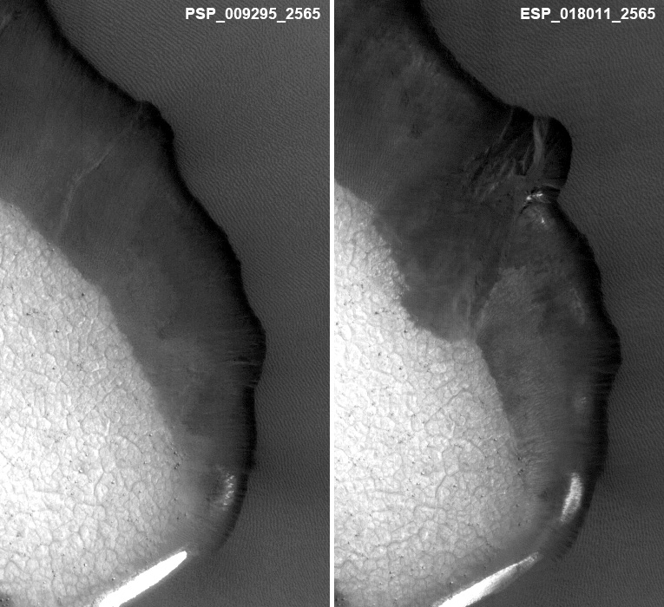
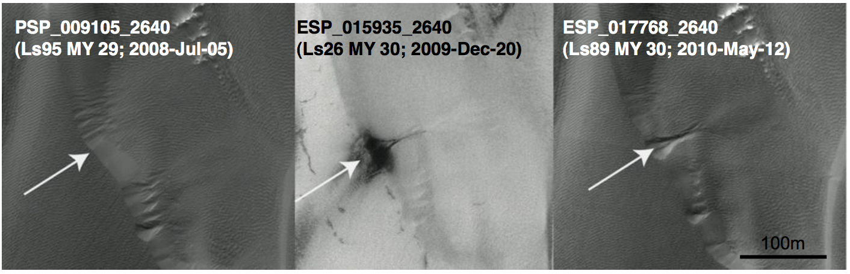

Slide 28
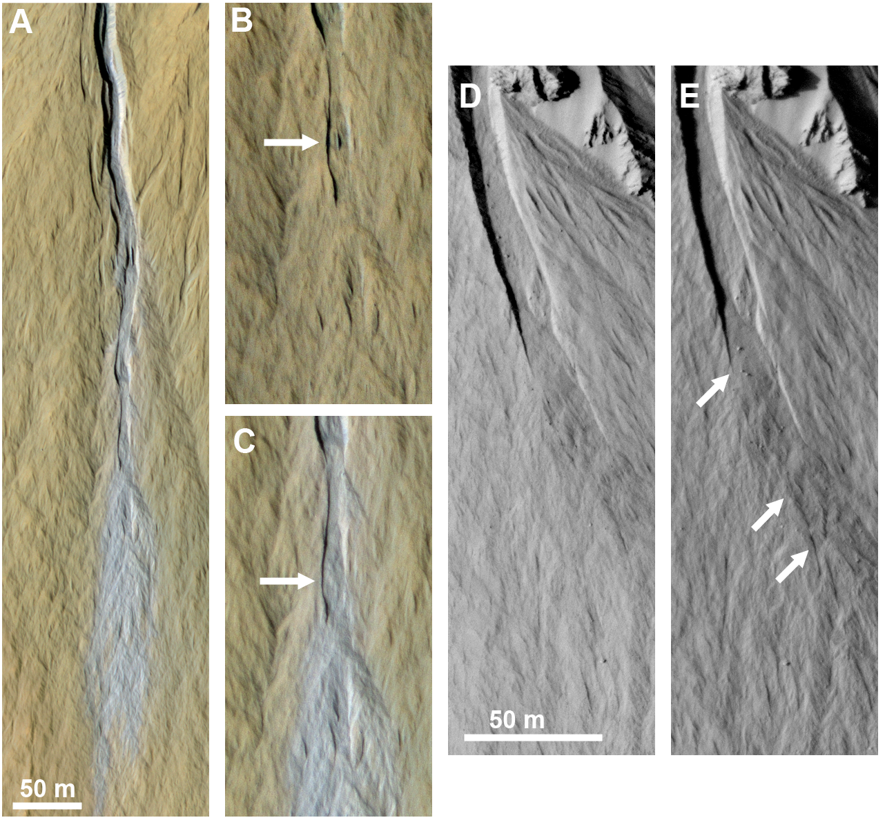
Dundas et al., 2010

Slide 29
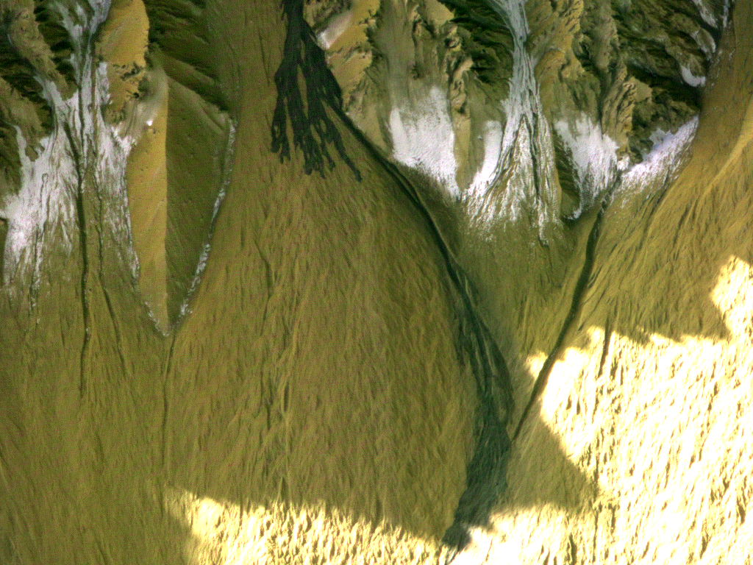
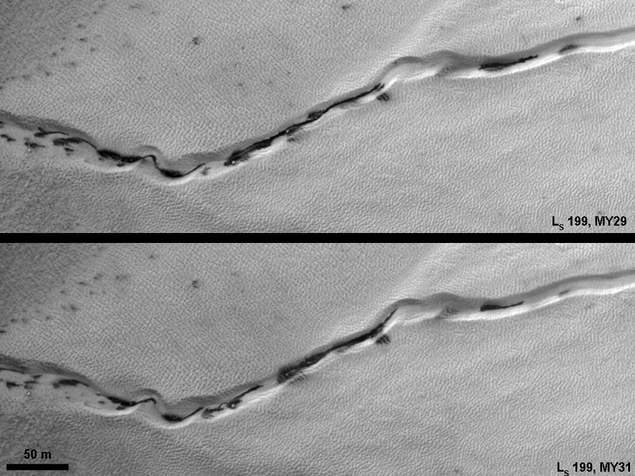
Frost and Gully Activity
Mass movements in gullies occur when CO₂ frost is present, or during defrosting.
Defrosting spots and flows often concentrate in gullies.
Frost activity is largely repeatable from year to year, but major mass movements are stochastic.
Current activity may be a major component of gully formation
Gasa crater: new deposit between L_{S} 128-141.

Slide 30
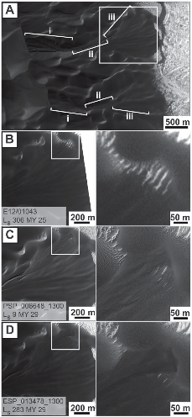
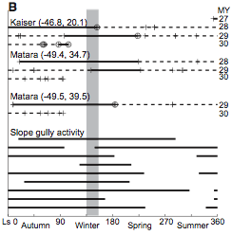
Gully activity only occurs in the winter….
  Probably frost avalanches
&
Diniega et al., 2010
Dundas et al. 2010

Slide 31
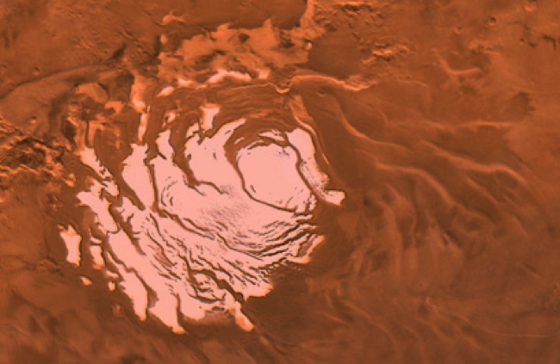
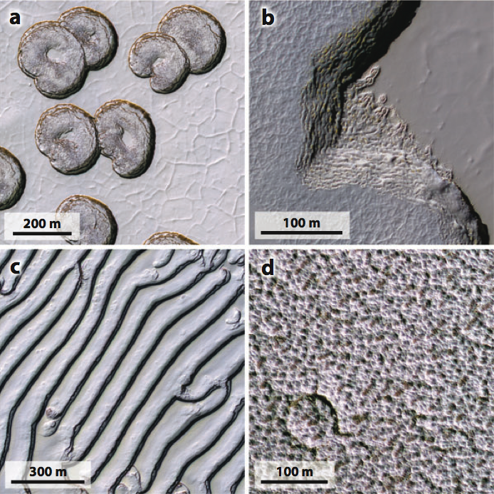
Martian Residual CO₂ cap
The residual ice-caps partially cover the layered deposits.
  Very thin
  Southern residual ice is CO₂
Interacting with current climate
  Exchanging volatiles on annual timescales
  Climate record of decades to centuries

Slide 32

Thomas et al., 2005
Swiss-cheese pits expand by meters per year.

Slide 33



Cusps have strong south-pointing tendencies.
Expansion driven by non-symmetric insolation
  Undercutting causes mass-wasting of uppermost layer
  Initially circular pits (solid) also become asymmetric over time (dashed)

Slide 34





South polar residual cap
  2-10 meters of CO₂
  Underlain by water ice
160 K
150 K

Slide 35




Reincarnation of the Residual Cap
Surface roughness increases with time – pits form
Remnants of old cap determine where new pits will form.
Different generations of ice cap overlap
Minimum thickness is always zero
  Swiss-cheese depressions are always present

Slide 36


Slide 37


South polar Halos
Observed only during one particular Mars year (MY 28)
Also the year of a perihelion duststorm
MY 25 had equinox duststorm – no halo effect
Notes:
(this and following 2 slides: 1min)

Slide 38
Seasonal frost on Mars
  Major feature of martian seasons
  Exotic CO₂ ice processes
  Seasonal timescale of 686 days
  Avalanche connection to martian gullies
Residual ice caps
  Interacting with current climate
  Affected by global dust storms
  10⁰ to 10² years (south), 10⁴ years (north)
  Exchanging with mid-latitude ground-ice
Polar layered deposits
  Record of changing climate, linked to orbital variations
  10⁵ to 10⁷ years
  Large ice movement to equator and mid-latitudes over long timescales

Slide 39
Climatic Record
Spacecraft Record
YEARS
10⁸
10⁷
10⁶
10⁵
10⁴
10³
10²
10¹
10⁰
Recent climatic variations
Interannual variability of the current climate

