Slide 1
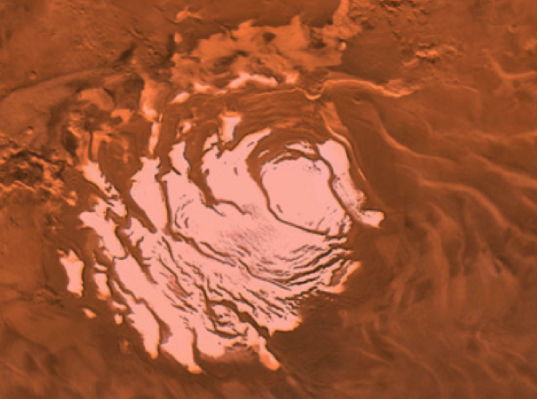
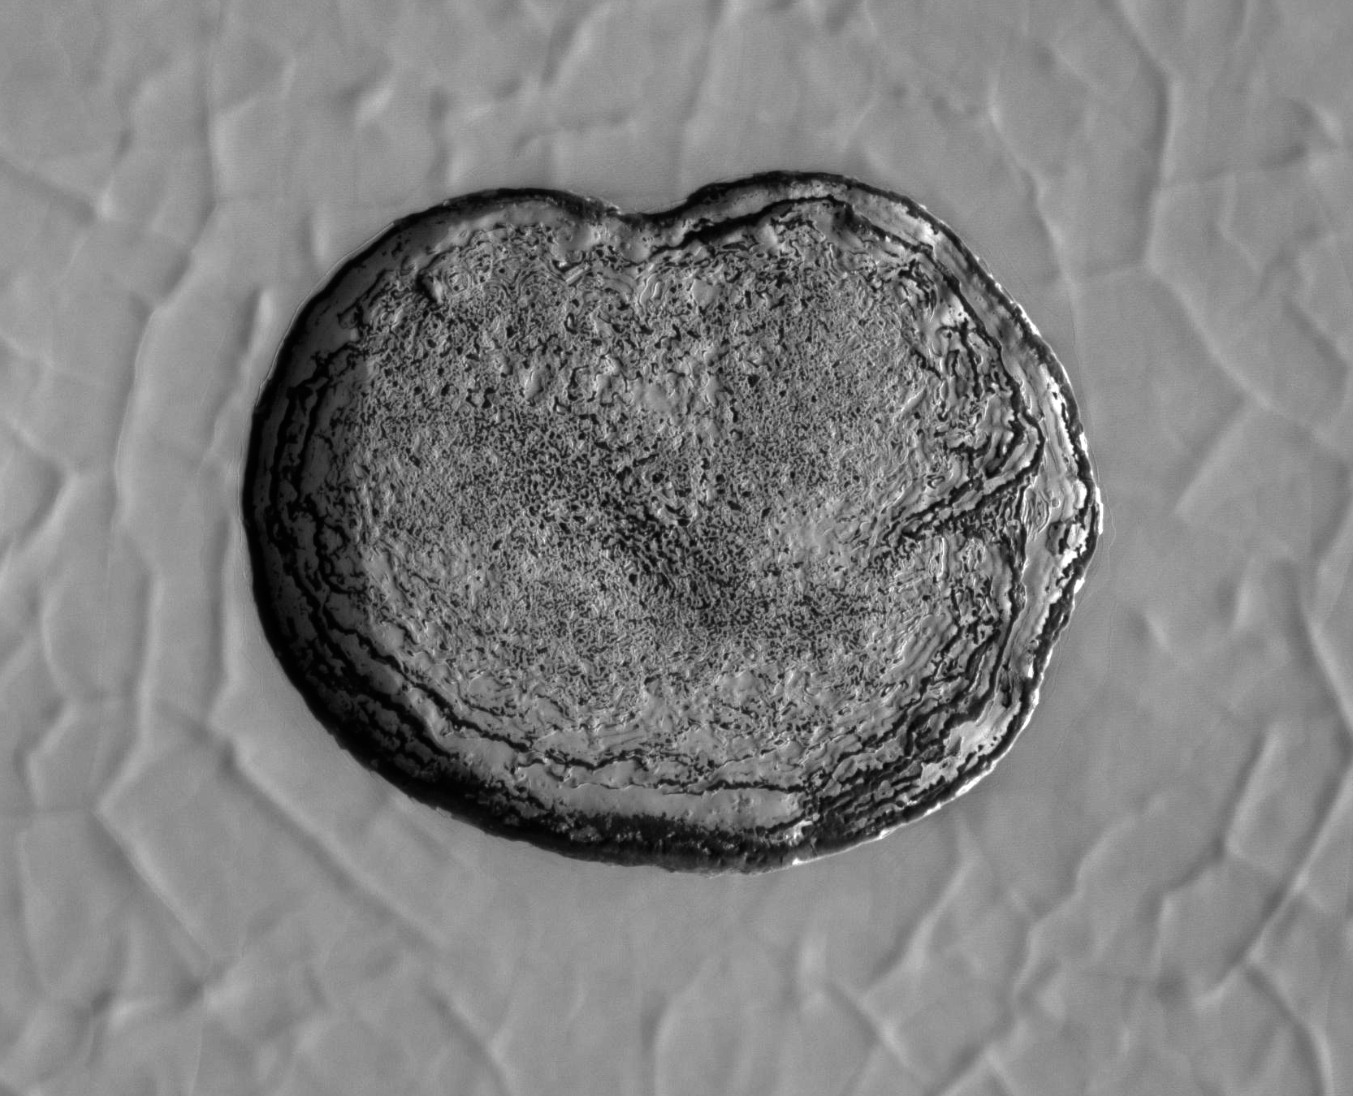
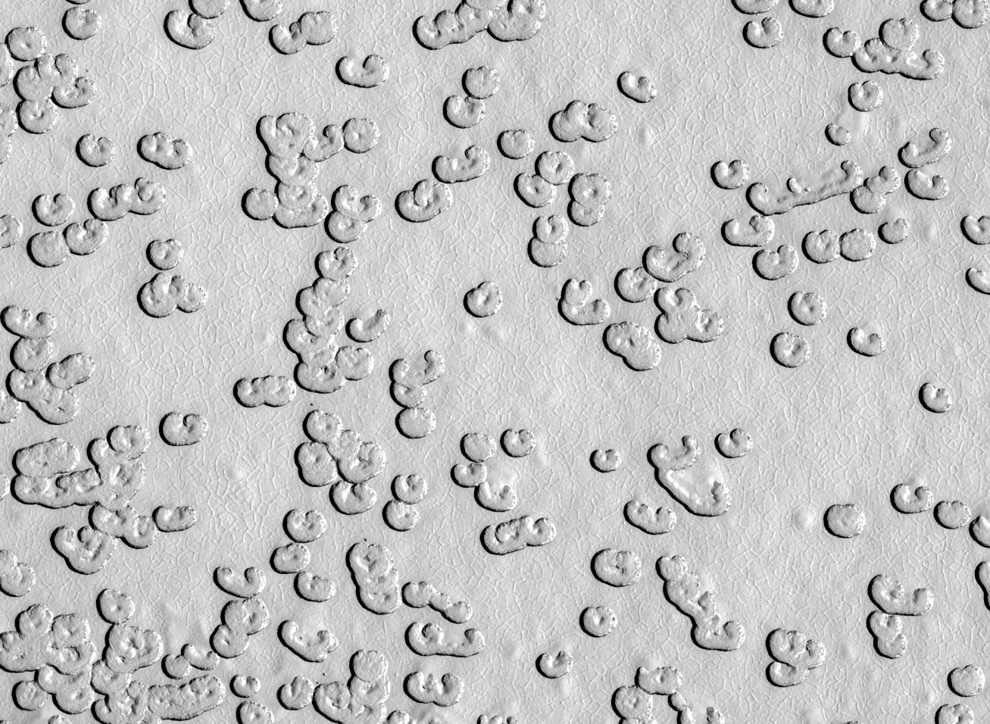
Change in the CO₂ Residual Cap
South polar residual cap is a few-meter-thick slab of CO₂ ice
Pits expand at m/yr (Malin et al. 2001, Thomas et al. 2005; 2009) indicate CO₂ being returned to the atmosphere
Climate change?
G11_022329_0931_XN_86S006W

Slide 2
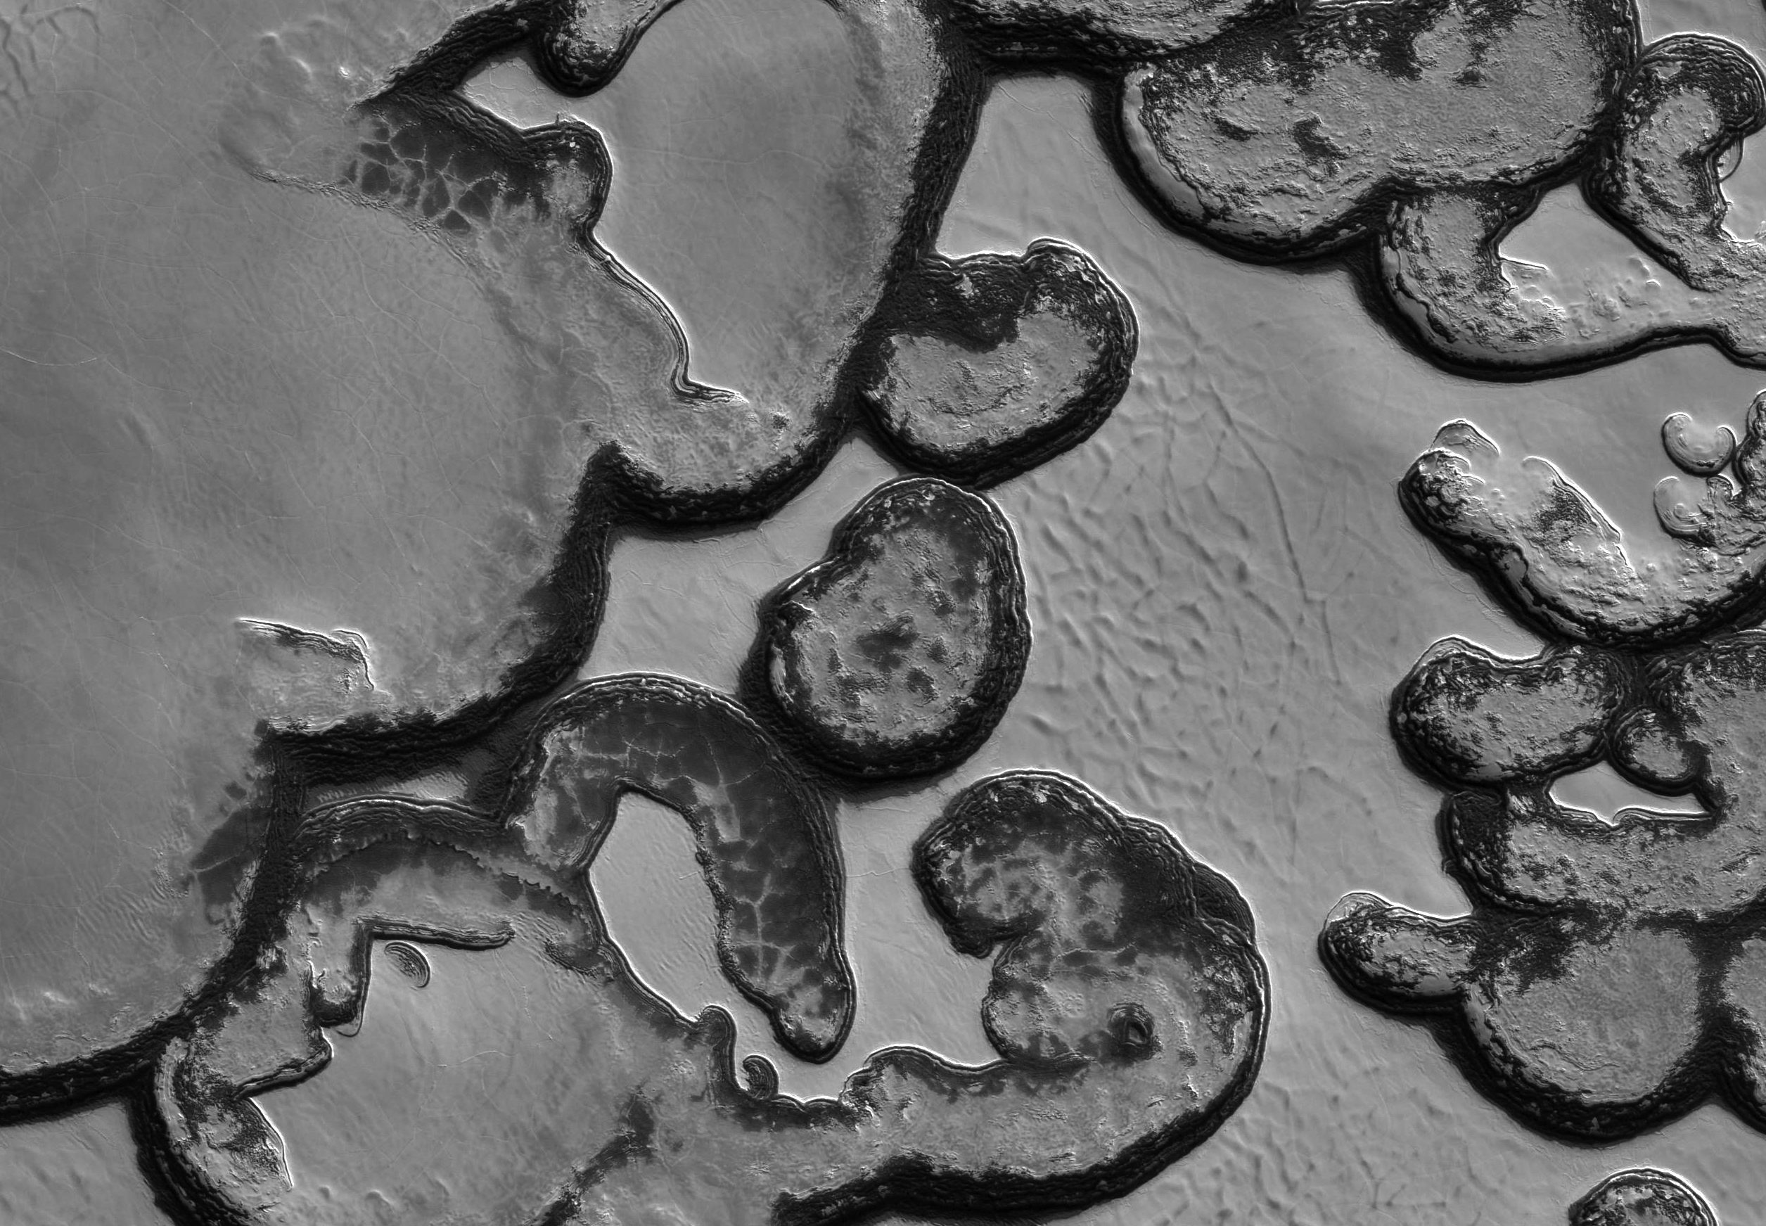
Widespread retreat of scarp walls and removal of remnant mesas

Slide 3
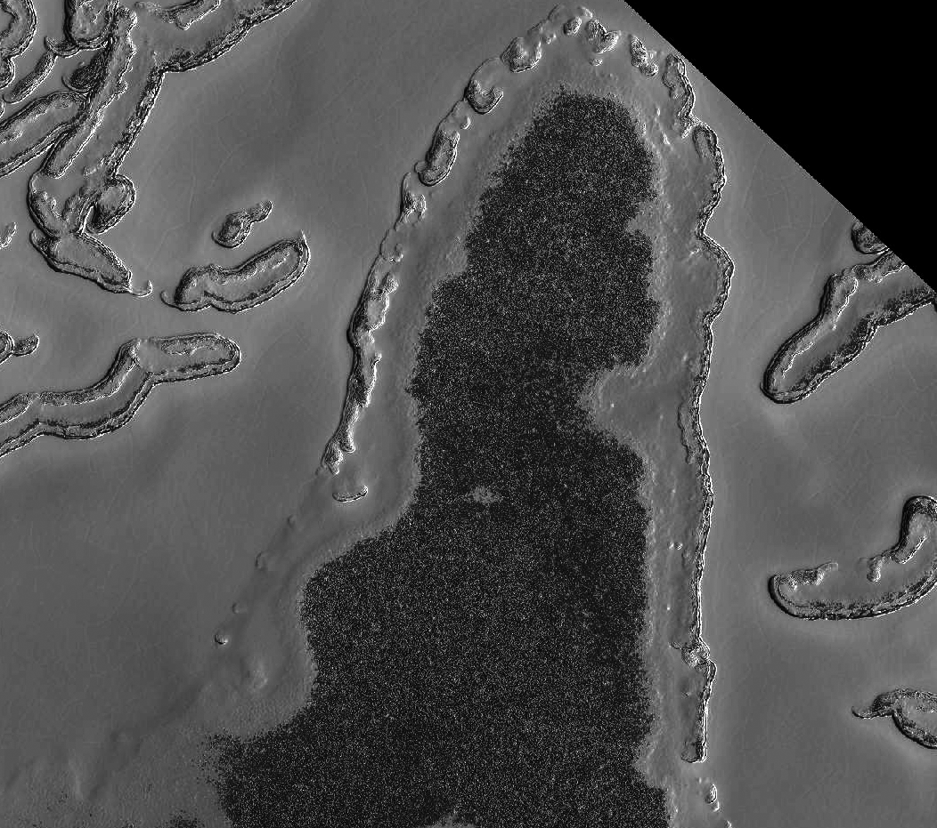
Residual Cap refrosting MY 28-31

Slide 4
Residual Cap refrosting MY 28-31

