Slide 1
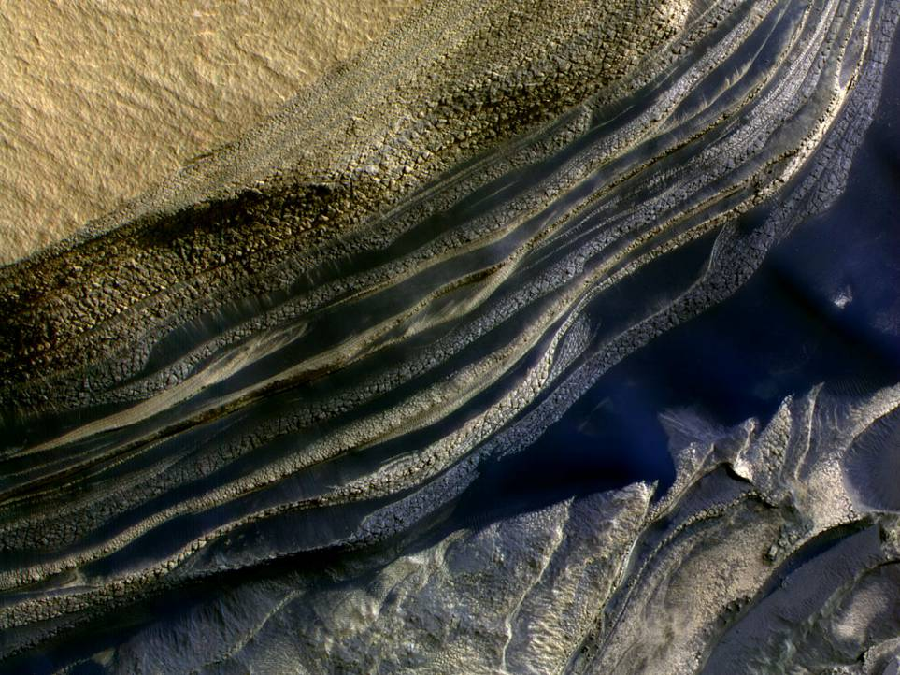
HiRISE Polar Geology
Status and Plans September 2012
Shane Byrne & Ken Herkenhoff
Material also from Sarah³ Pat² & Candy¹

Slide 2
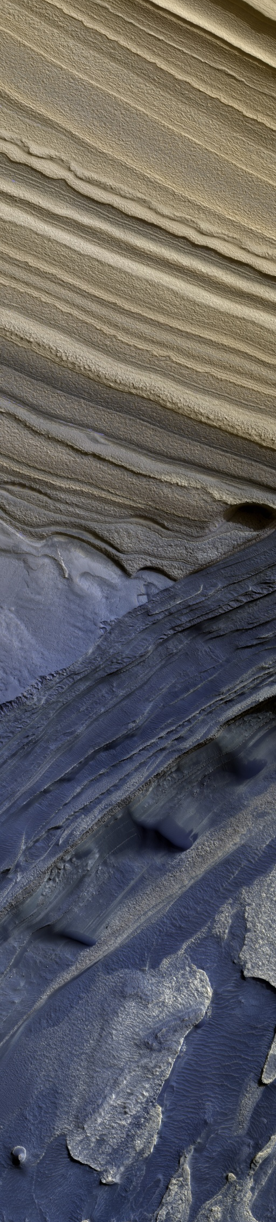
Current status of the Polar Geology Theme
Ongoing Projects
Plans for the upcoming Southern Summer

Slide 3
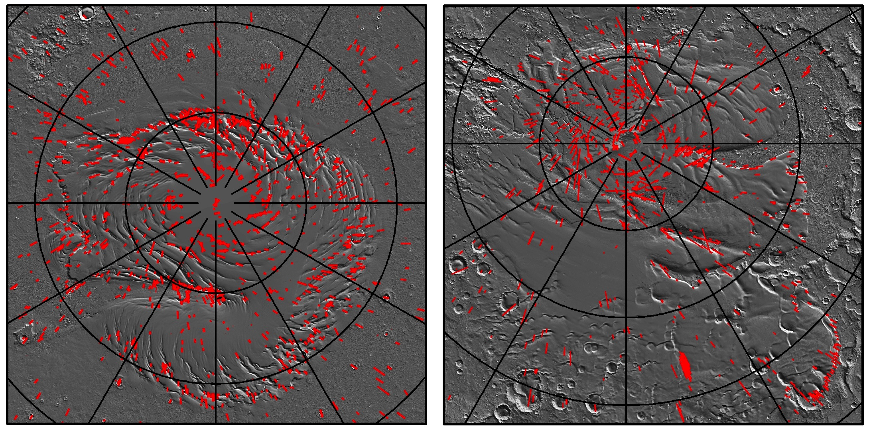
Coverage up to orbit 28607
North
South

Slide 4
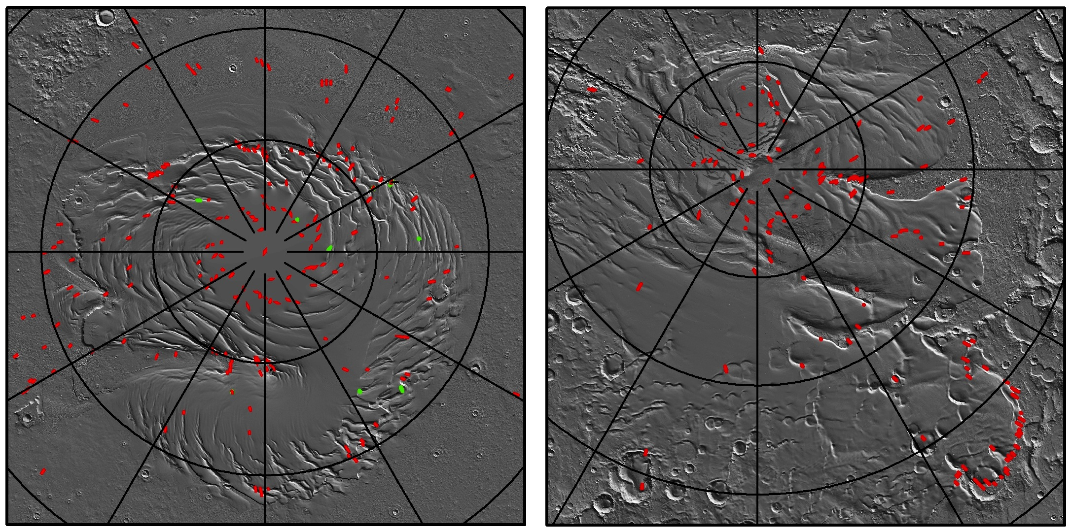
Stereo Coverage up to orbit 28607
North
South

Slide 5
Polar Geology by the numbers
 | North 3.5 summers | South 3 summers | Total
Acquired | 268 | 52 | 320
Released | 701 | 515 | 1216
Suggested-10 | 0 | 3 | 3
Suggested-09 | 3 | 20 | 23
Suggested-08 | 6 | 28 | 34
Suggested-07 | 7 | 26 | 33
Suggested-06 | 14 | 31 | 45
Complete Stereo | 189 | 127 | 316
Incomplete Pairs | 5 | 21 | 26

Slide 6
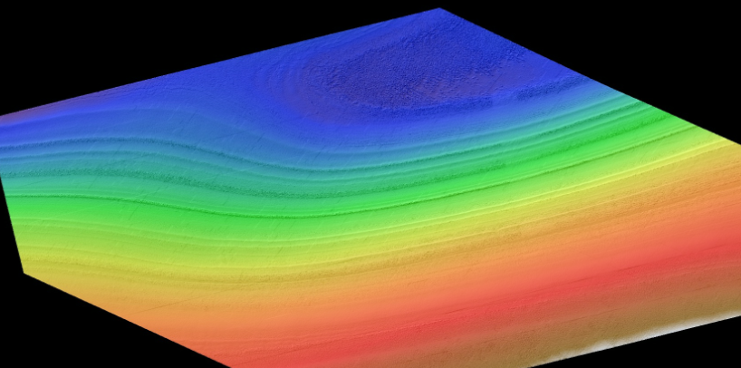
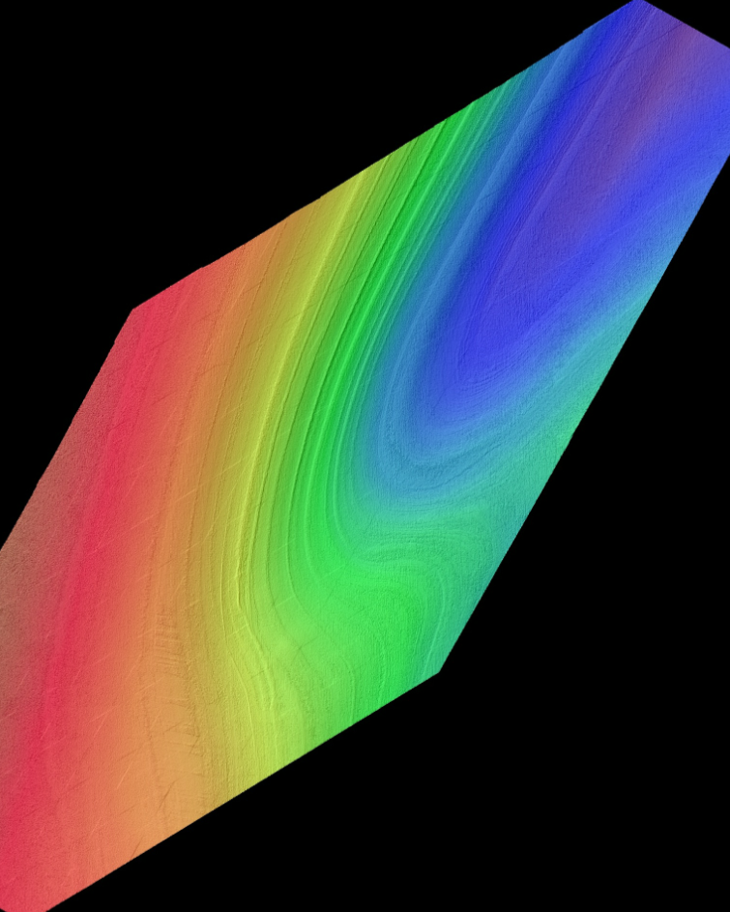
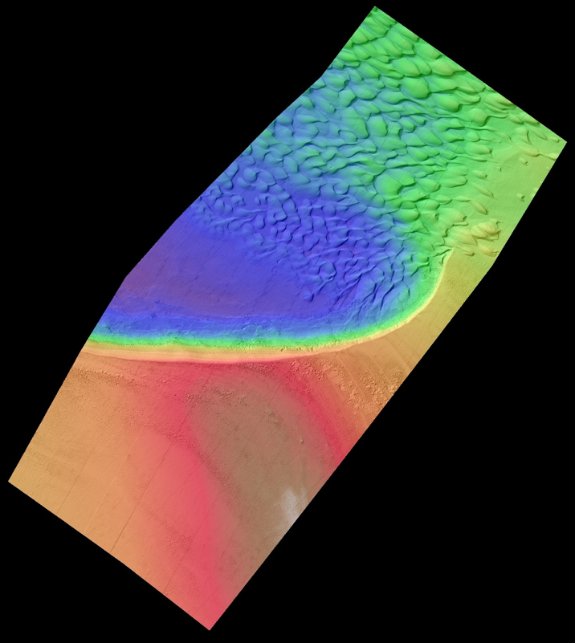
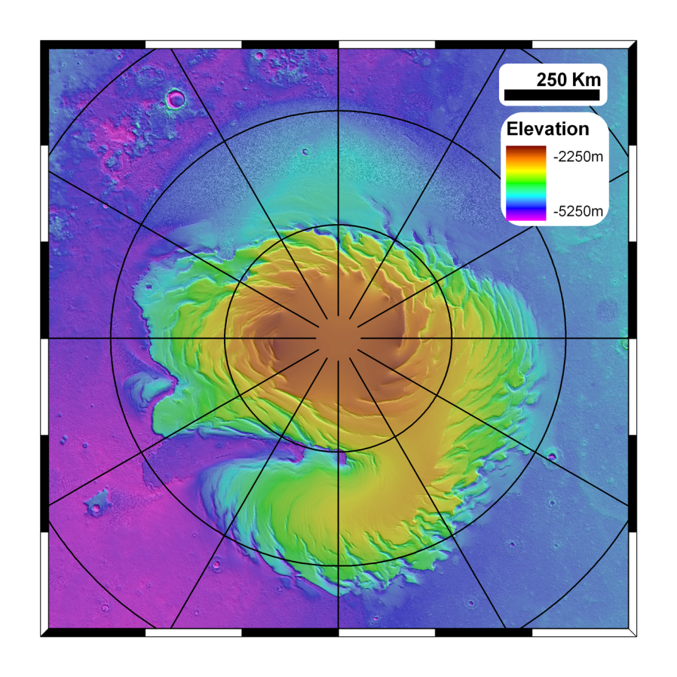
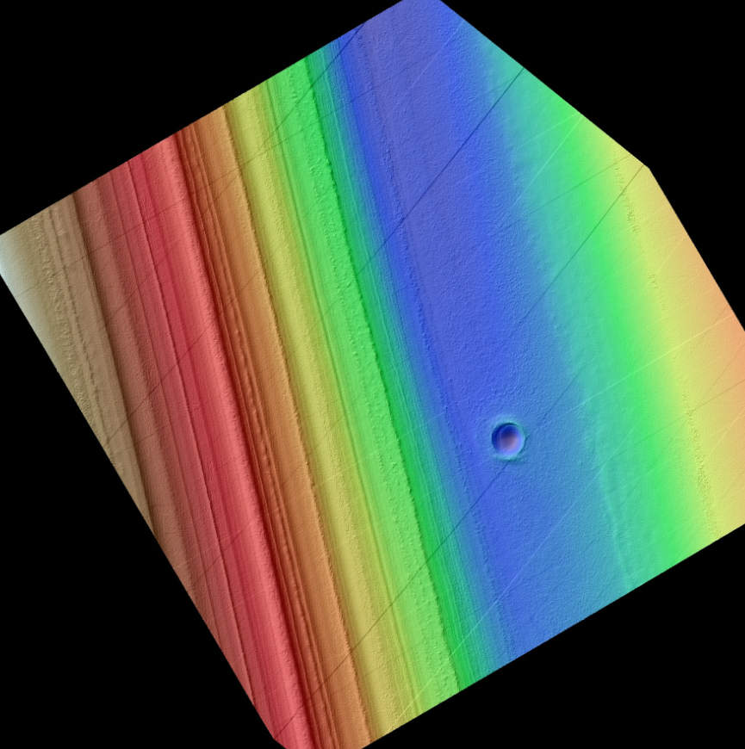
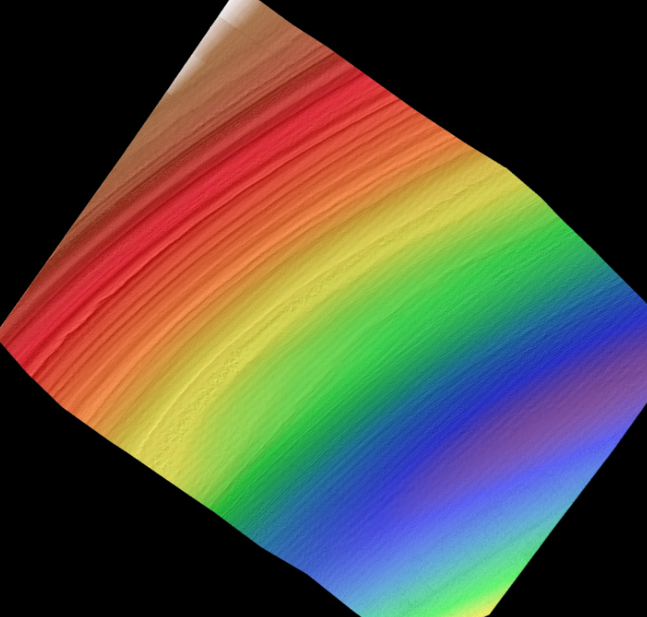
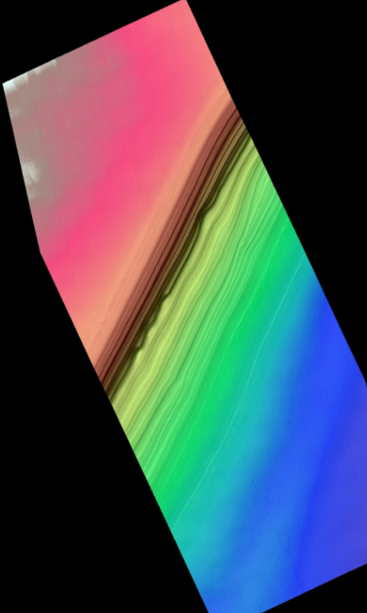

Slide 7
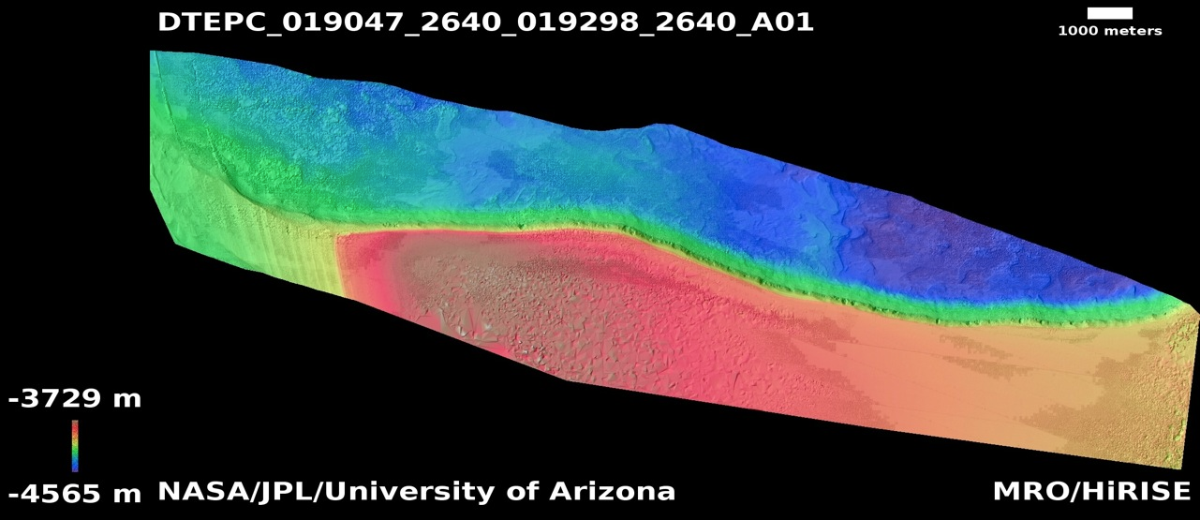
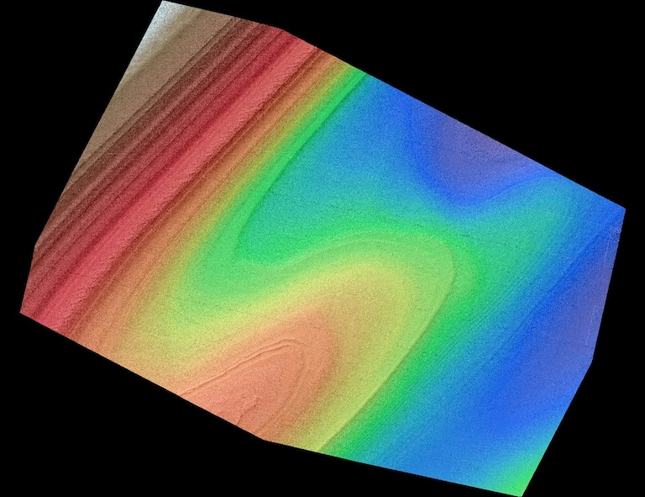
Recent NPLD DTMs

Slide 8
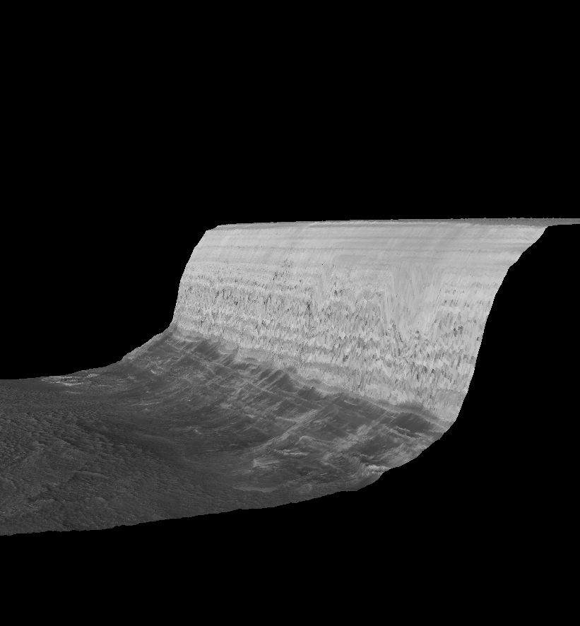
Problems on these super-steep scarps
  Discuss retargeting these at lunch with specially chosen geometries

Slide 9
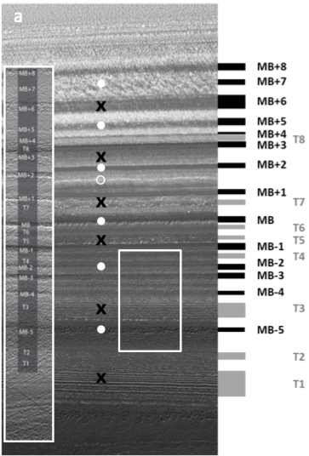
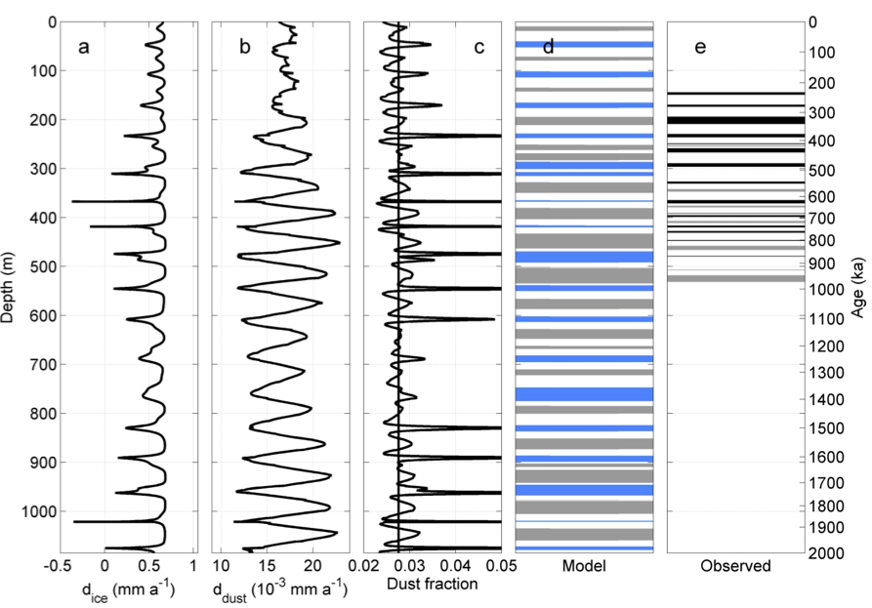
Hvidberg et al. – in press at Icarus
  Modeling stratigraphic mapping from HiRISE stereo

Slide 10
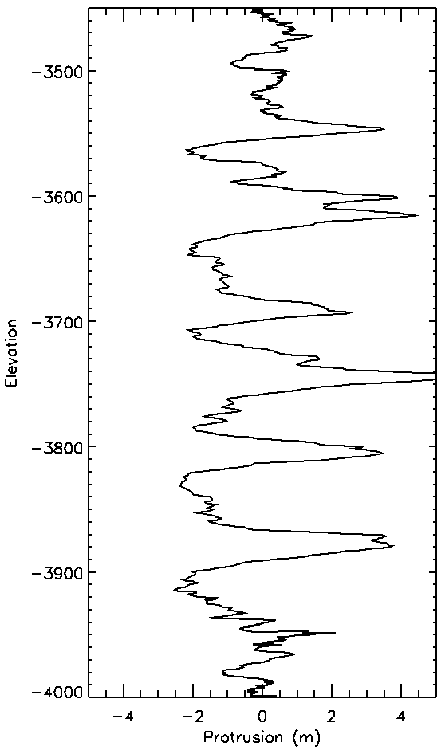
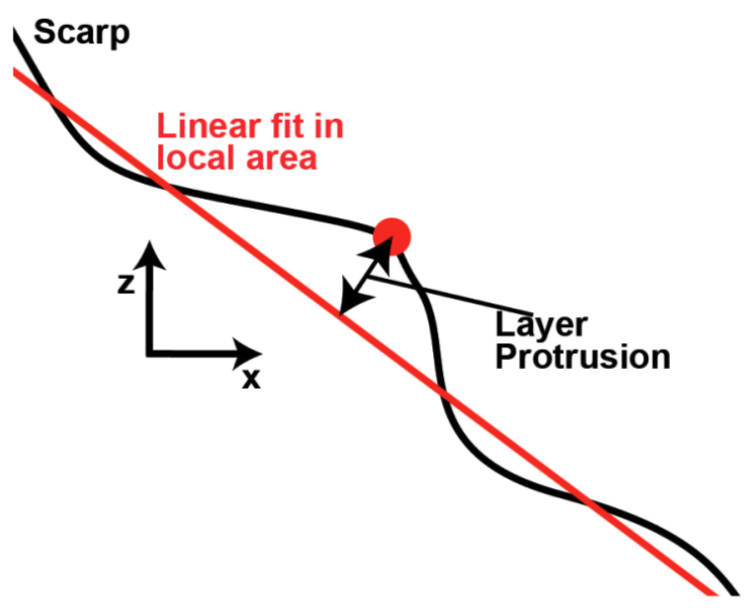
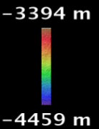
Window 100m

Slide 11
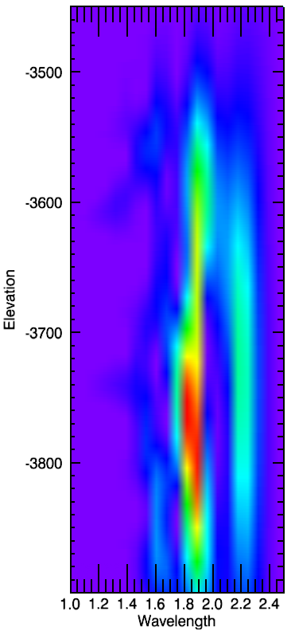
Window 100m
80m
60m
20m
40m

Slide 12
Combine models and layer protrusion studies

Slide 13
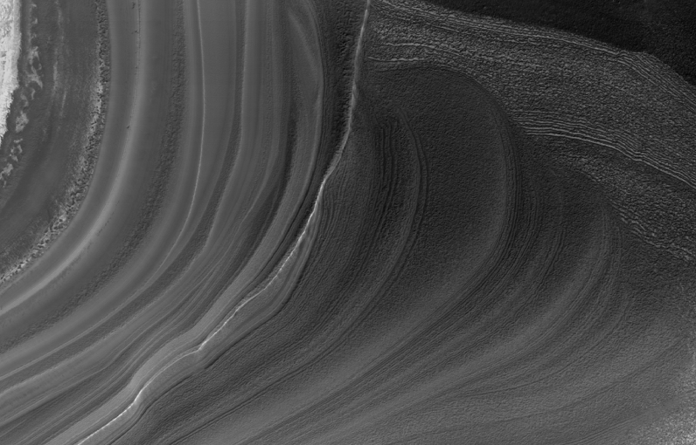
But, unconformities are everywhere…

Slide 14
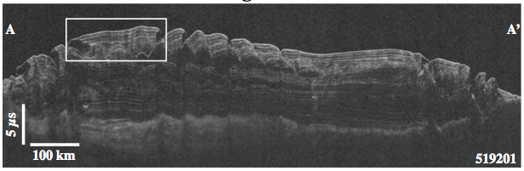
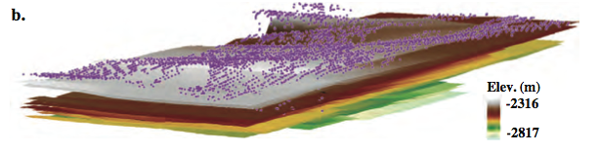
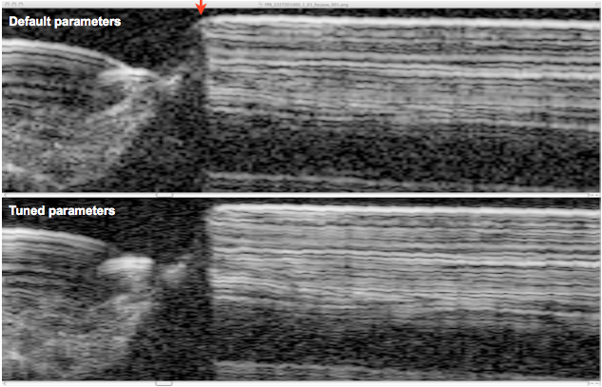
Collaboration with the SHARAD team
New SHARAD processing (from Than Putzig) will help compare thinner reflectors to HiRISE layers
Christian et al., In Prep.

Slide 15
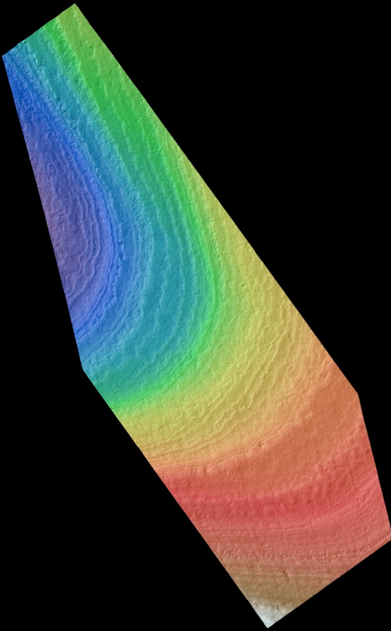
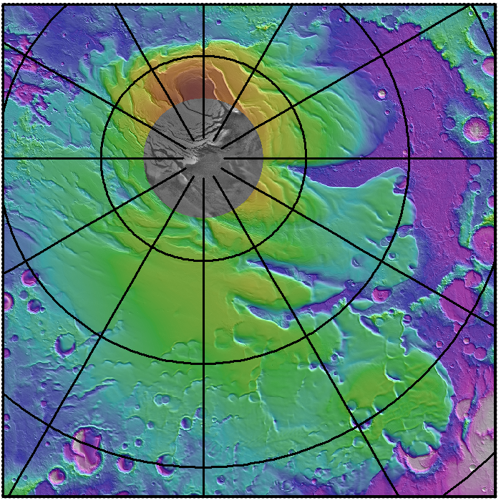
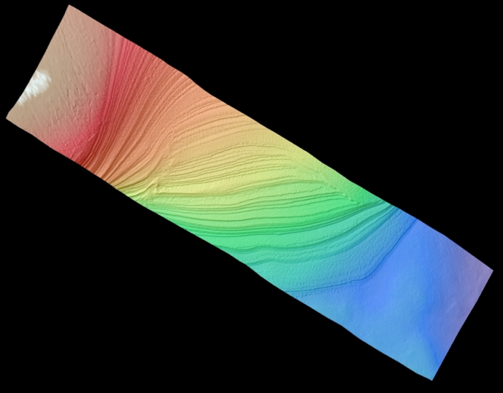
First SPLD stratigraphy DTMs just produced!!

Slide 16
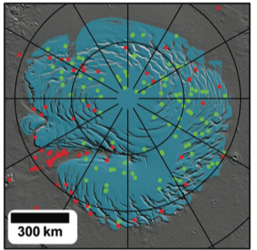
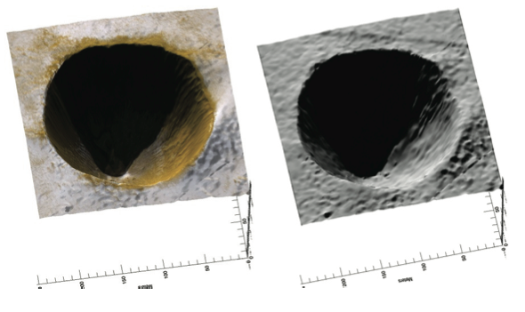
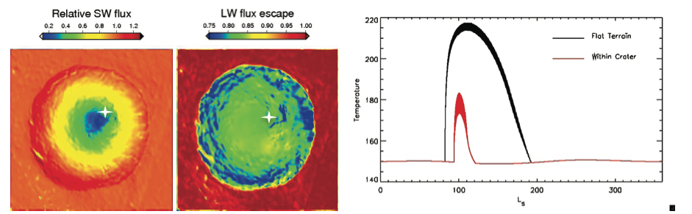
Banks et al. crater population shows north polar crater infill rates at ~1cm per martian year (over the last 20 Kyr)
Needs an update using Ingrid’s new work.
High-res DTMs can be used to relate this to polar accumulation
Many followup images acquired this year
  Look for changes in slumping lag material
  Data not yet analyzed :<

Slide 17
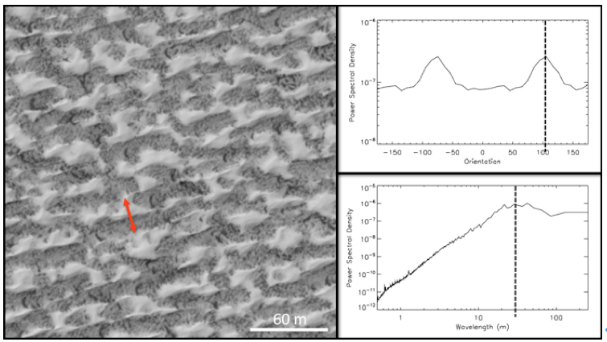
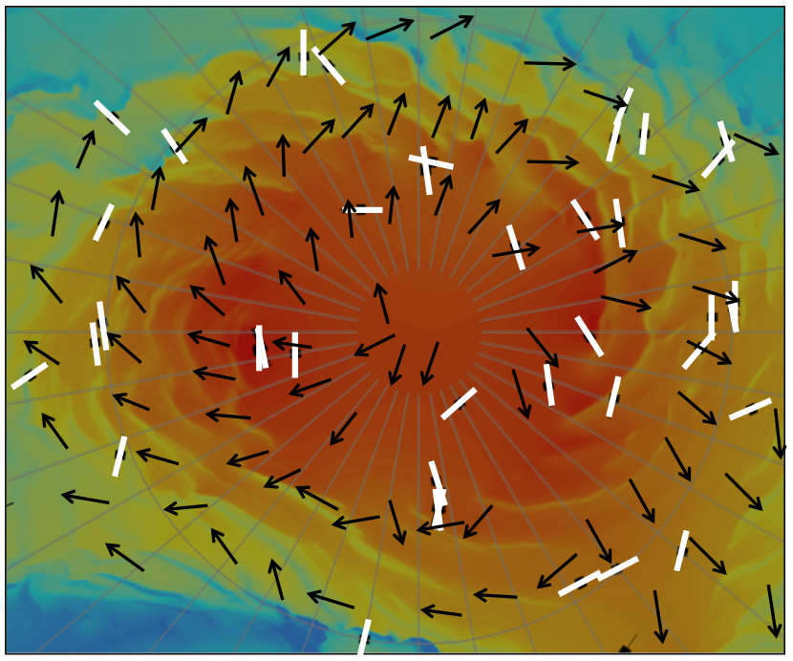
Residual cap studies
Residual cap textures have some correlation with wind direction
Next steps:
Photoclinometry to characterize residual cap relief
Collaboration with SHARAD to look at surface reflected power as a proxy for roughness

Slide 18
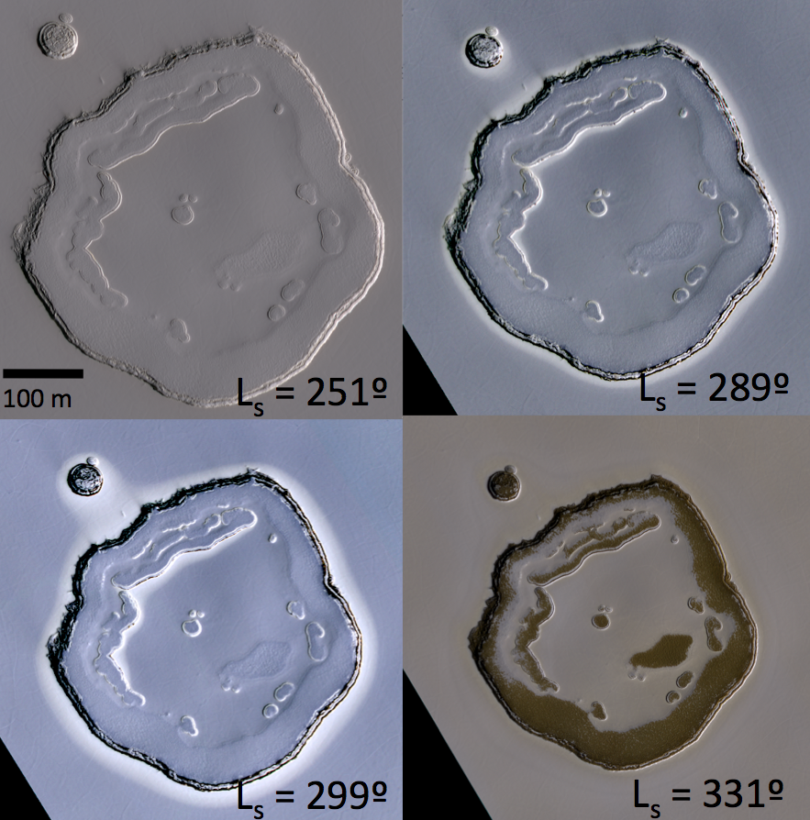
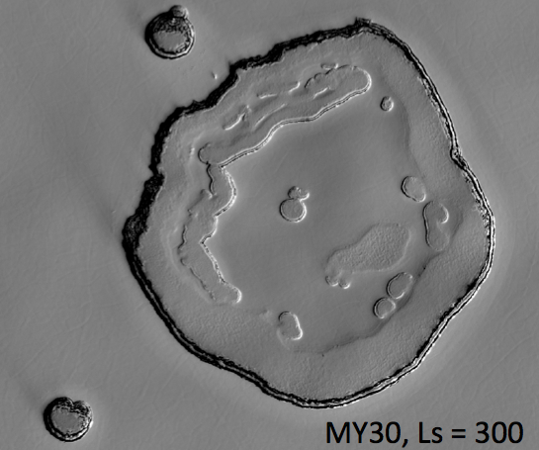
South polar interannual differences – Swiss-cheese pit halos
  Widespread occurrence in MY 28
  Not in HiRISE images for MY 29 and 30
  Not in MOC images for MY 24-27 (questionable SNR)
Colorless albedo enhancements – driven by grain-size differences
Possible if most Mars years have net accumulation – but occasional years have neutral or net loss of ice
Pat and I have extensive help from Adrian Brown on incorporating CRISM data

Slide 19
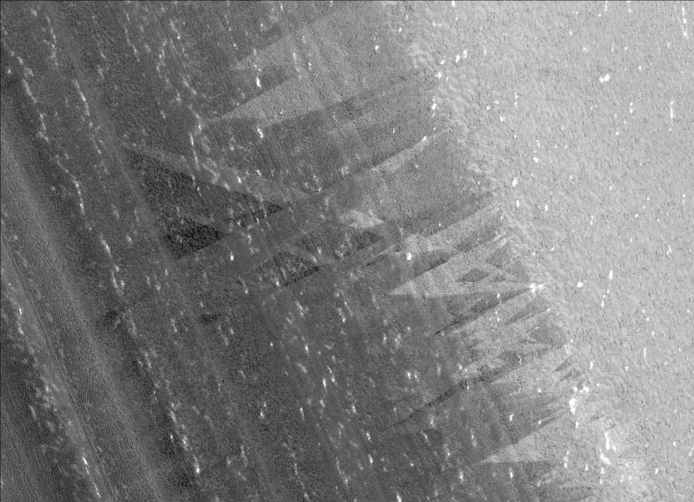

North Polar Summer Streaks
PSP_009273_2610
80.8°N, 330.6°E
L_{s} = 100.6
Absent in MY 31 ?!
N
Sun
Downslope
200 m
Notes:
Streaks oriented down and across slope, so not just gravity-driven. No streaks evident in spring images. Monitoring indicates frost mobilized in early summer.

Slide 20
Some Polar Geology Papers By Us And Others Since The Last Team Meeting
Hvidberg, C.S., K.E. Fishbaugh, M. Winstrup, A. Svensson, S. Byrne and K. Herkenhoff (2012), Reading the climate record of the Martian polar layered deposits, Icarus, In Press.
Beyer, R.A., K.M. Stack, J.L. Griffes, R.E. Milliken, K.E. Herkenhoff, S. Byrne, J.W. Holt and J.P. Grotzinger (2012), An Atlas of Mars Sedimentary Rocks as seen by HIRISE, Society for Sedimentary Geology Special Publication, 102, 49-96.
Conway, S. J., N. Hovius, T. Barnie, J. Besserer, S. Le Mouelic, R. Orosei, and N. A. Read (2012), Climate-driven deposition of water ice and the formation of mounds in craters in Mars' north polar region, Icarus, 220, 174-193.
Fastook, J. L., J. W. Head, D. R. Marchant, F. Forget, and J.-B. Madeleine (2012), Early Mars climate near the Noachian-Hesperian boundary: Independent evidence for cold conditions from basal melting of the south polar ice sheet (Dorsa Argentea Formation) and implications for valley network formation, Icarus, 219, 25-40.
Guallini, L., F. Brozzetti, and L. Marinangeli (2012), Large-scale deformational systems in the South Polar Layered Deposits (Promethei Lingula, Mars): "Soft-sediment" and Deep-Seated Gravitational Slope Deformations Mechanisms, Icarus, 220, 821-843.
Limaye, A. B. S., O. Aharonson, and J. T. Perron (2012), Detailed stratigraphy and bed thickness of the Mars north and south polar layered deposits, J. Geophys. Res., 117, 6009.

Slide 21
Polar Geology Plans
Northern summer is almost at an end
  Later summer imaging of outliers like Louth crater
Plans for the 4th southern spring & summer
  Seasonal processes initially dominate
Residual cap monitoring
  Swiss-cheese expansion
  Frost halo checks
SPLD cratering needs a thorough investigation
  Last published crater stats were from counts done with MOLA! In 2002!
  Geologic mapping shows two distinct surface units on the SPLD
  HiRISE followups on known targets, searches of CTX data to get more craters
SPLD stereo data very unevenly distributed – fix this

