Slide 1


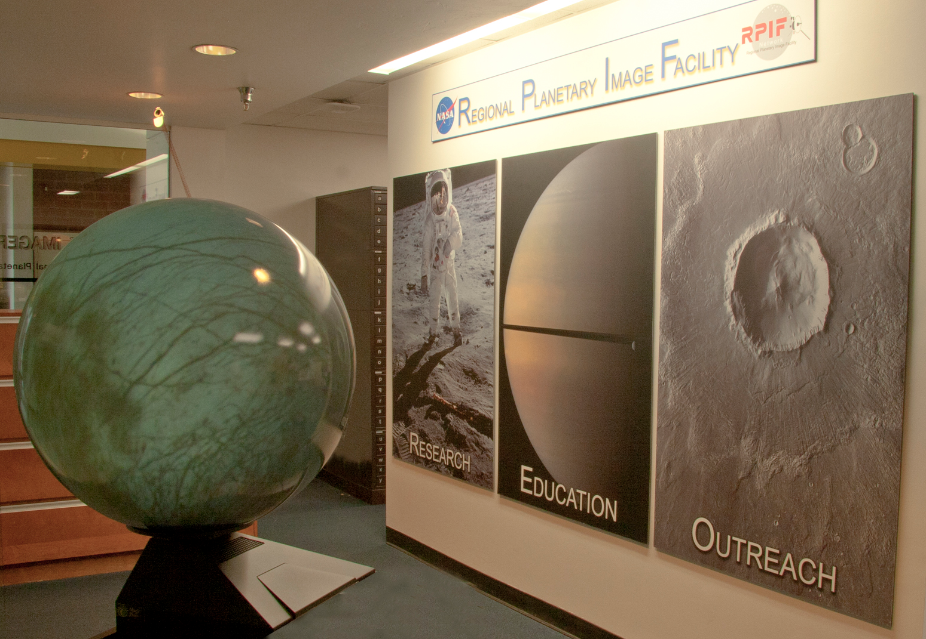
RPIF Review 2016
Space Imagery Center
University of Arizona
Director:
Shane Byrne
Data Manager:
Maria Schuchardt

Slide 2

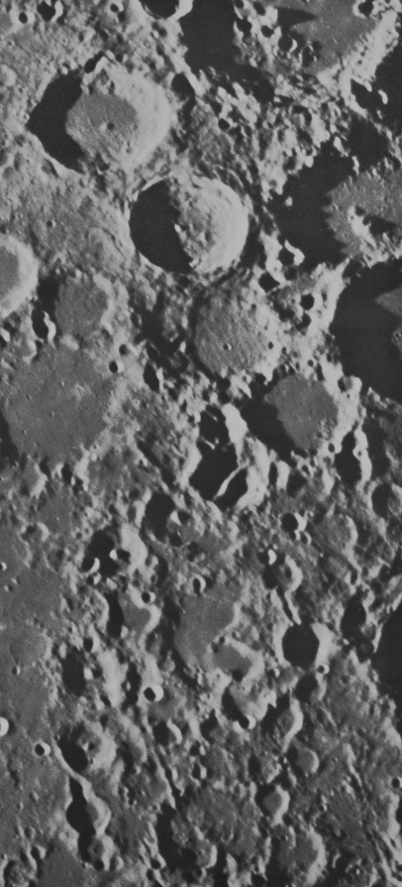
Outline
The Space Imagery Center
History
Current Facilities
Current People
Unique Attributes
Funding
Our Activities
Archiving
Enabling Research
Public Engagement
Current Budget
The future
Planned Activities
Funding

Slide 3
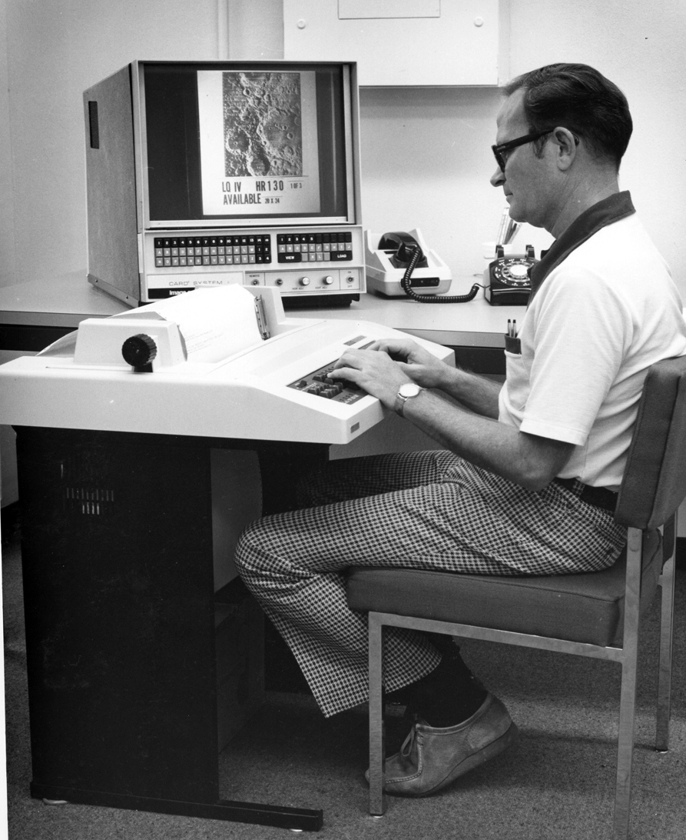
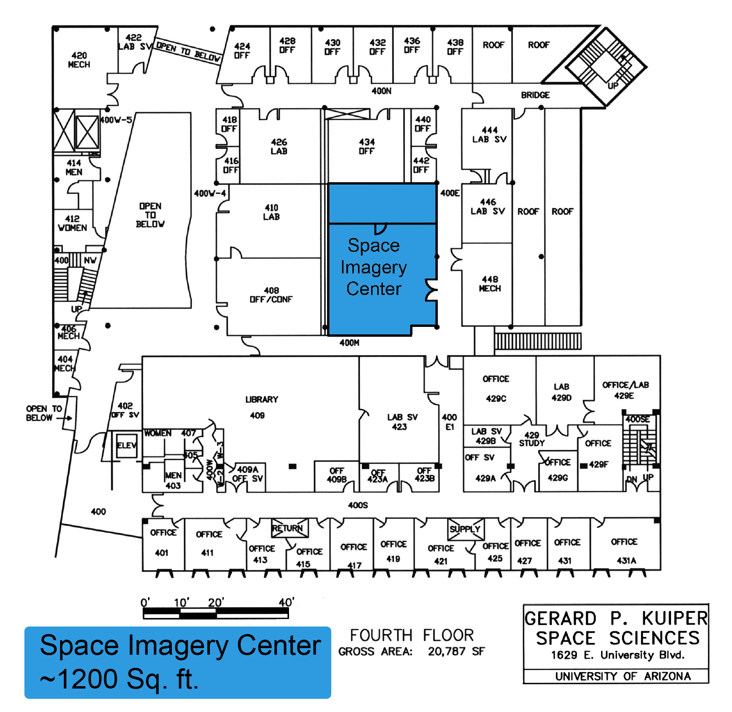
History
Established in 1977
Steve Dwornik, Robert Strom, and the University of Arizona administration
Memorandum of Understanding (MOU)
In short, UA provides the data manager’s salary and NASA pays the running costs
Historically supported by the PG&G program.
Current award ended in 2015 – two augmentations awarded so far
Directors
Bob Strom 1977-1999
David Kring 2000-2006
Shane Byrne 2007-present
Centrally located with significant space in the main departmental building

Slide 4
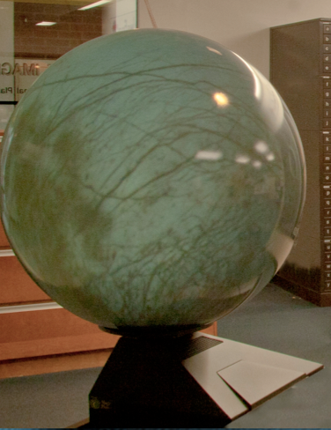
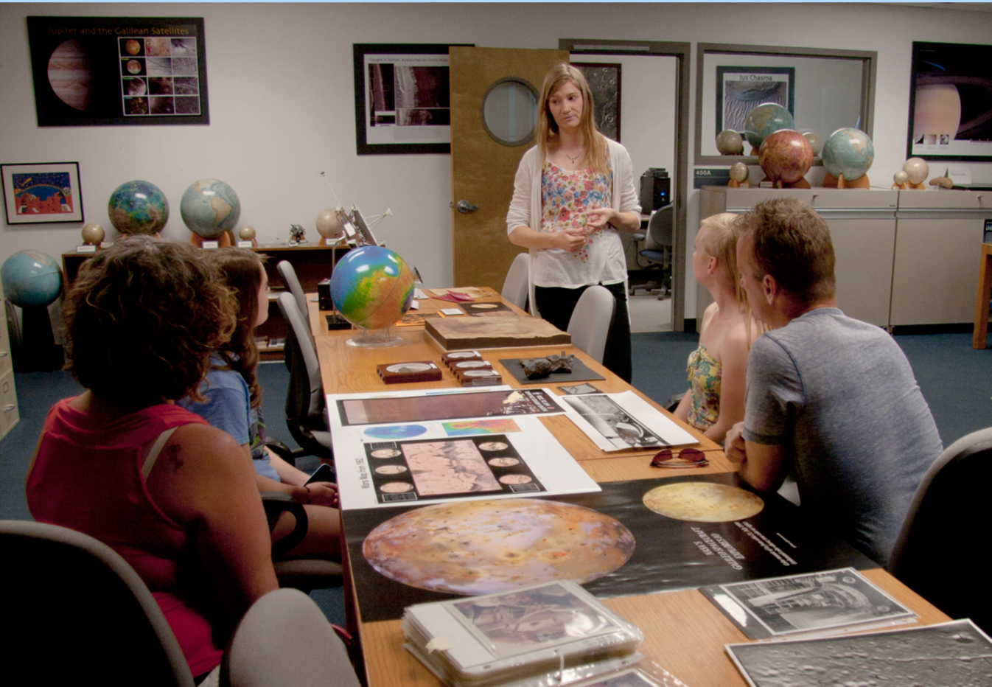
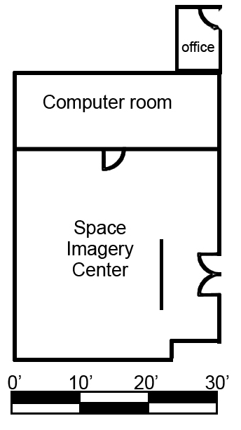
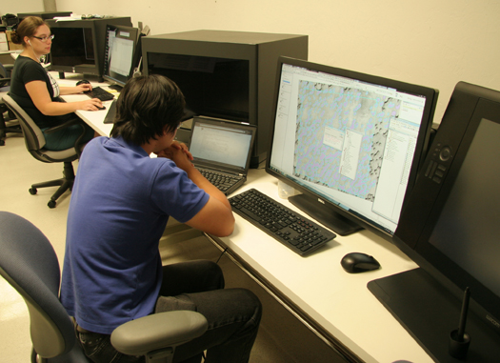
Physical Description, Main Room
Total footage: 2140 sq. ft.
Main room, 900 sq. ft.
Computer (Mac)
Small format scanner
Film scanner
Lunar Orbiter, Apollo,
Magellan, Prints
Atlases (Kuiper’s
Photographic Lunar Atlas)
Computer room, 300 sq. ft.
3 Work Stations
  3D stereo monitors
Additional Computer (Mac)
  Image processing & GIS
Large format Scanner
USGS geologic Maps
Telescope
Meteorite cases

Slide 5
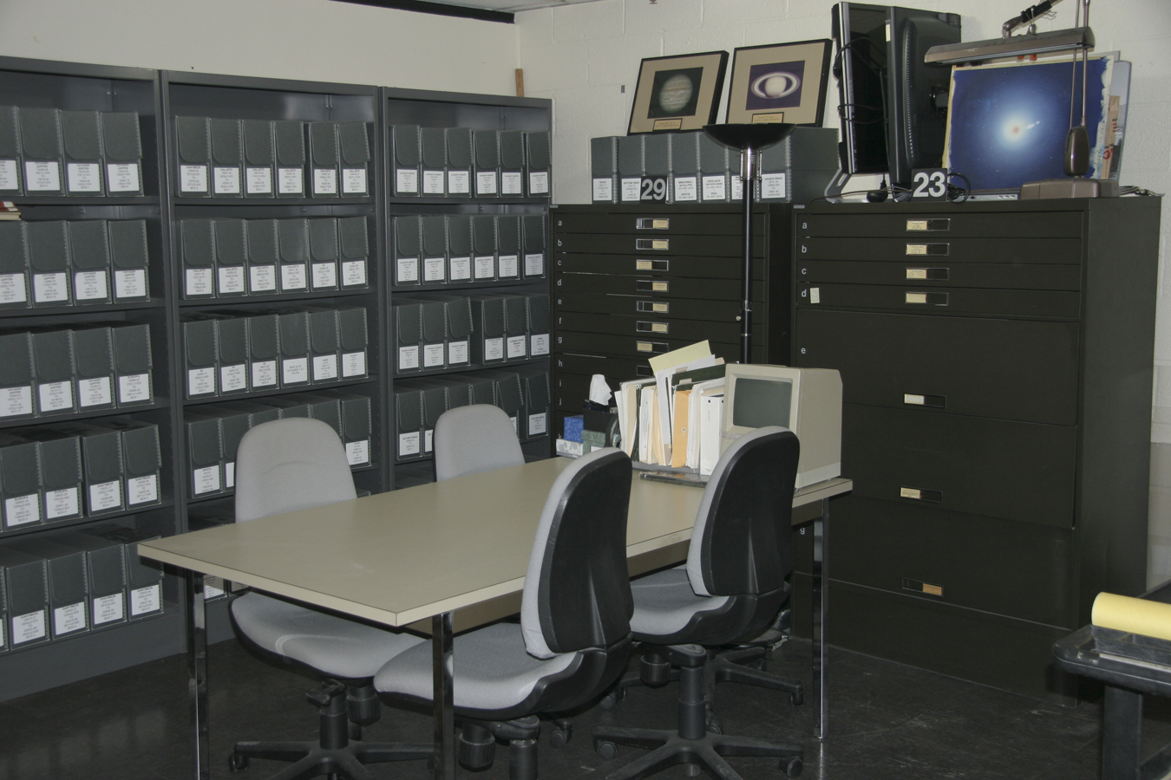
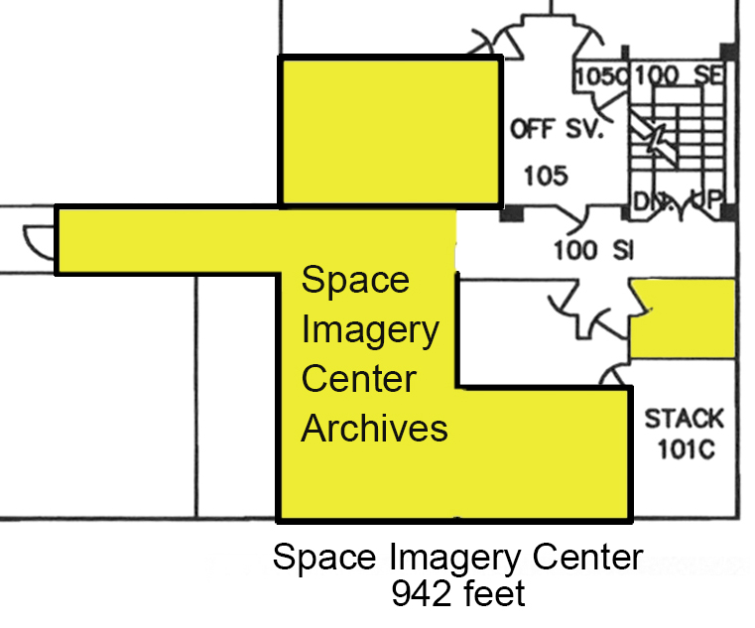
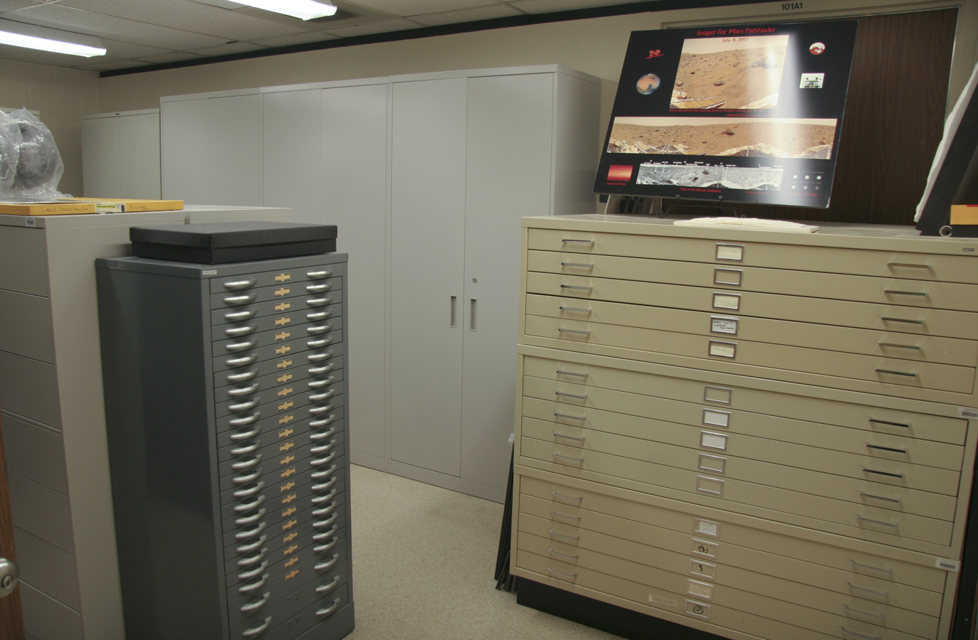
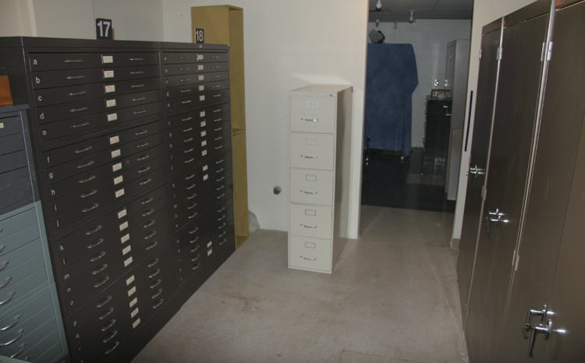
Auxiliary Space
Working room for use of older images in the collection
Rectified Lunar Atlas Globe
Wright Globe
Earth based images

Slide 6
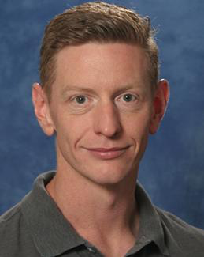
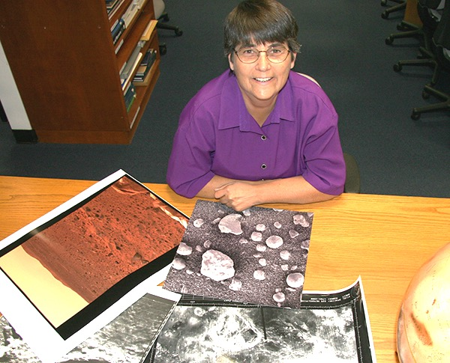
Organization: Personnel
Shane Byrne, director of the Space Imagery Center, is an Associate Professor at the University of Arizona’s Lunar and Planetary Laboratory, whose research interests in surface processes.
Maria Schuchardt, the Data Manger, is responsible for the day to day operation of the center, organizing outreach events.
An undergraduate assistant, helps with event organization, manning the facility, web design etc…
Notes:
I can help them locate websites that have images and maps
The NASA Regional Planetary Image Facility, an international system of planetary image libraries, was established in 1977. These facilities maintain photographic and digital data as well as mission documentation and cartographic data.
Each facility's general holding contains images and maps of planets and their satellites taken by solar system exploration spacecraft.
These planetary image facilities are open to the public. The facilities are primarily reference centers for browsing, studying, and selecting lunar and planetary photographic and cartographic materials. Experienced staff can assist scientists, educators, students, media, and the public in ordering materials for their own use. For appointment information and operation hours, contact your nearest facility.
Over the years and the computer age our focus has been shifting to/ adding outreach activities… and name tags ☺

Slide 7
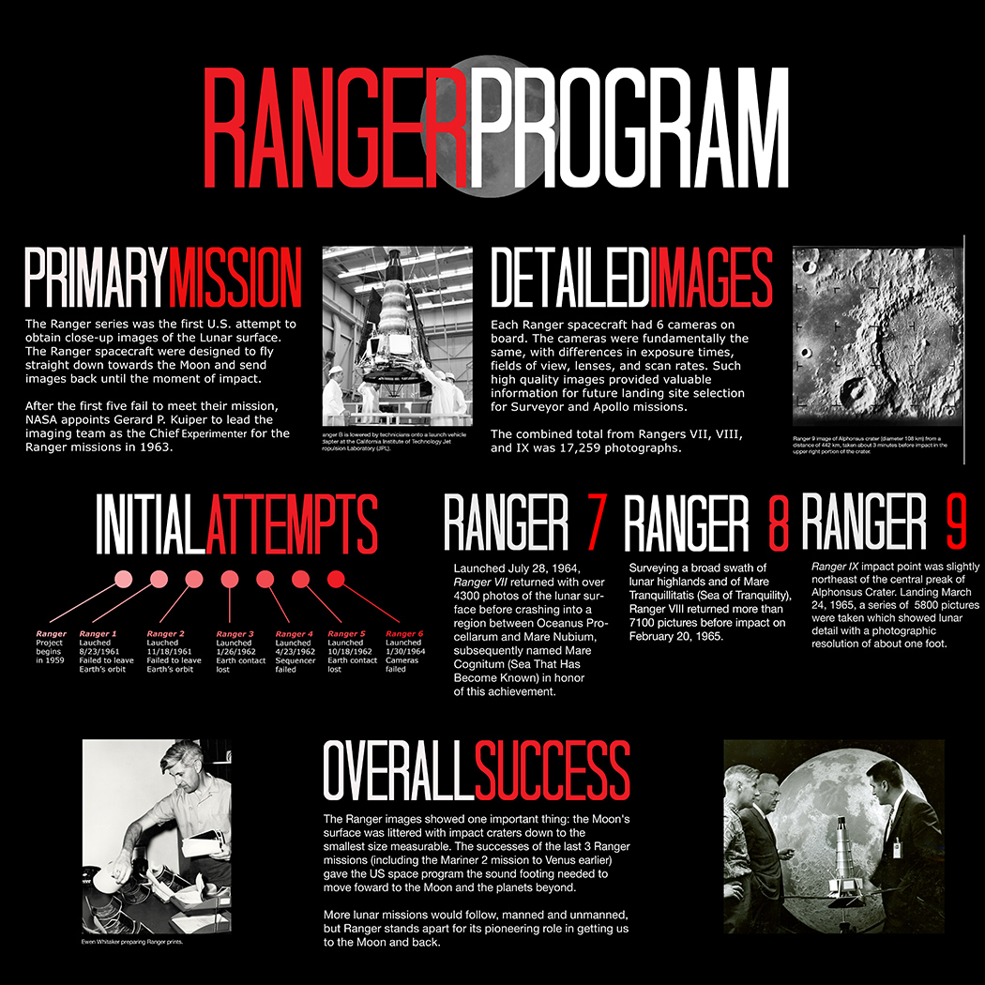

Student assistants: Posters

Slide 8
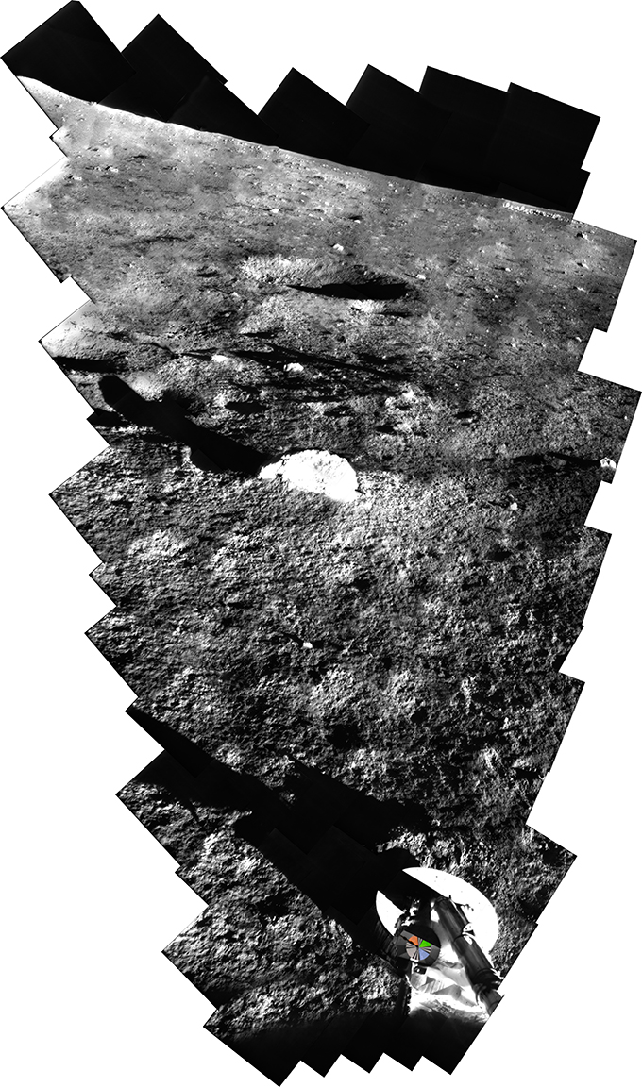
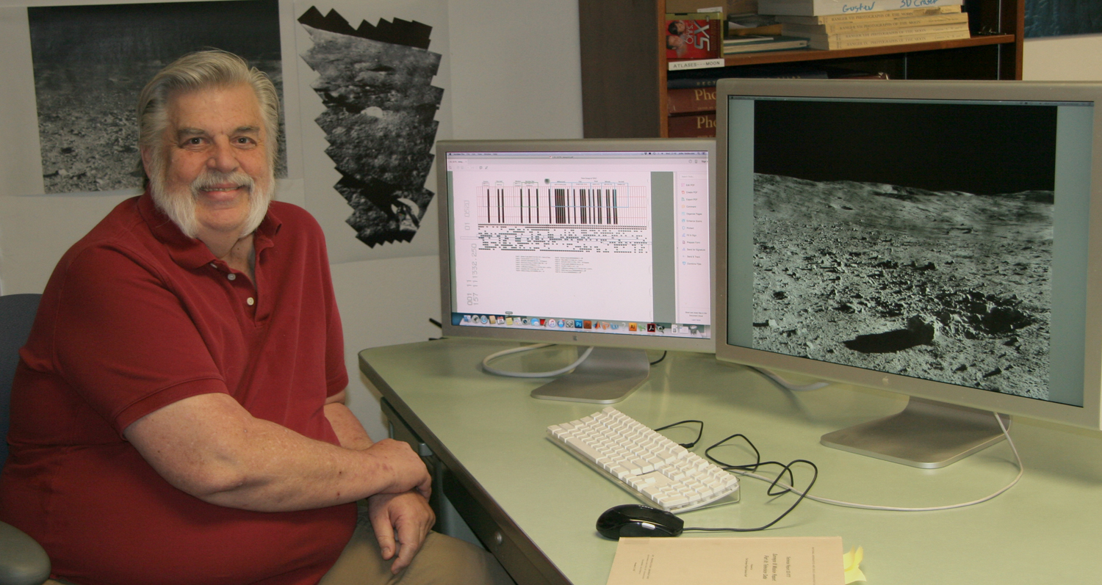
Organization: Personnel
John Anderson, media technician, is a temporary employee whose task is to scan, process, and prepare Surveyor images for the Planetary Data System (PDS).
Was paid by separate grant for early part,
Some SIC and private funds
New composite from Surveyor 1
Notes:
Management Plan
1. A description of the project’s organization;
When funding is available, a student is hired to provide assistance with archiving, designing graphics and organizing large events and producing a yearly product.
Yes
2. A description of the roles played by each member of the organization;
Dr. Byrne, provides the direction of the lab
Maria Schuchardt provides the daily running of the center, organizing the archive, provides tours of the facilities, as well as off-site lectures on planetary science topics.
John Anderson is a temporary employee whose task is to scan, process, and prepare Surveyor images for the Planetary Data System (PDS). The decoding of the BCD for the mission has proven to be challenging, and Leon Palfox, a research member of LPL has provided many hours, at no cost to the SIC grant to design a program to interpret the data from the 90,000 images.

Slide 9
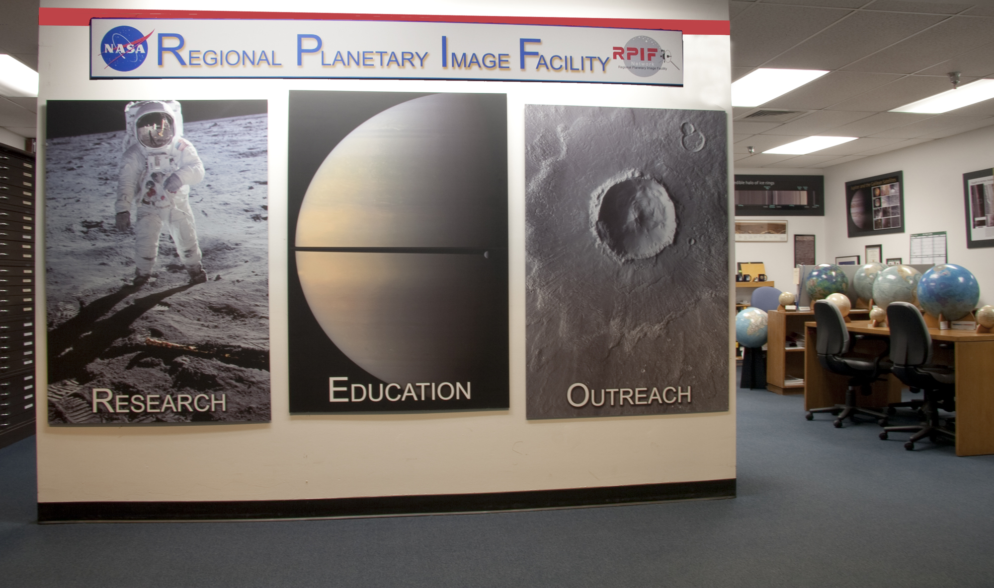
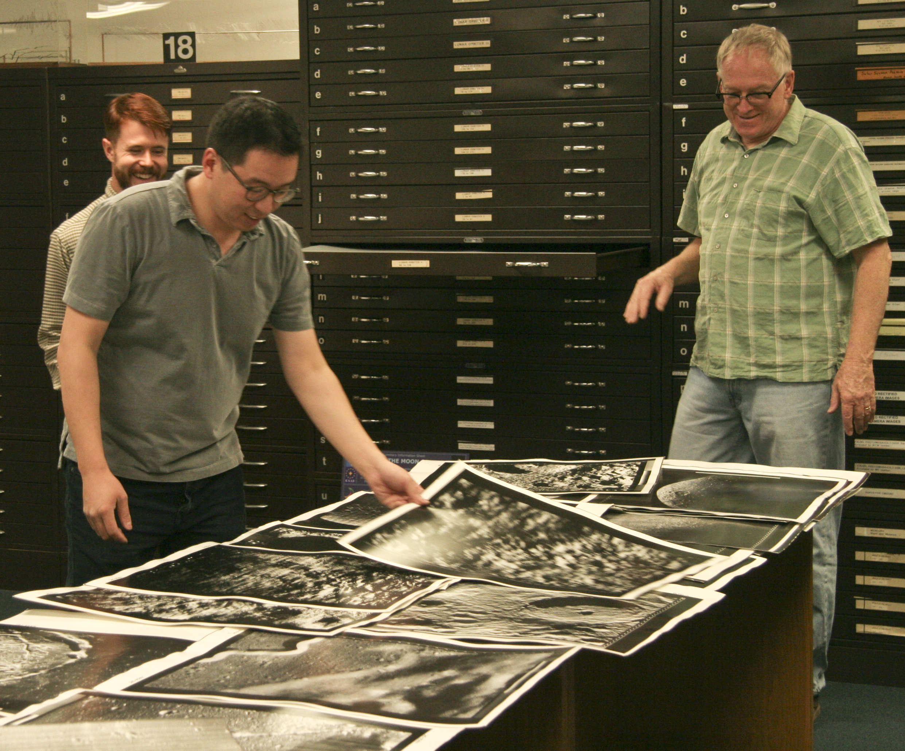
Collection
Collection
Large Physical Collection
  Prints/Negatives/CDS from (~400,000) Lunar Orbiter, Surveyor, Ranger, Apollo, Gemini, Mariner 6 - 10, Pioneer 10 & 11, Voyager, Viking, Pathfinder, Mars Global Surveyor, Magellan
  Maps: >1,900, not including duplicates
  Much gray literature and historical books and artifacts
  Historical lunar atlases
  Historical items such as globes, analog image map-projection equipment
  Outreach material incl. posters, meteorite kits, telescope etc…

Slide 10
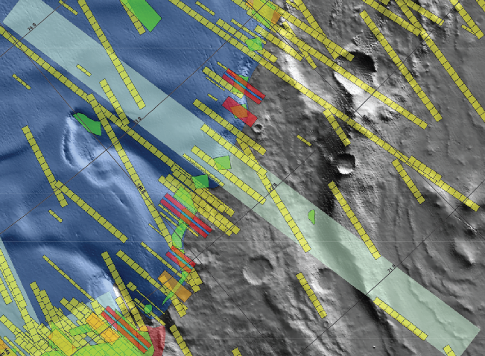
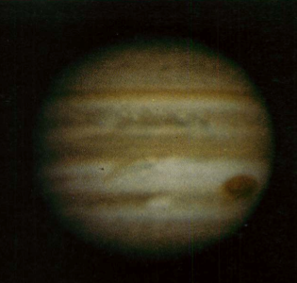
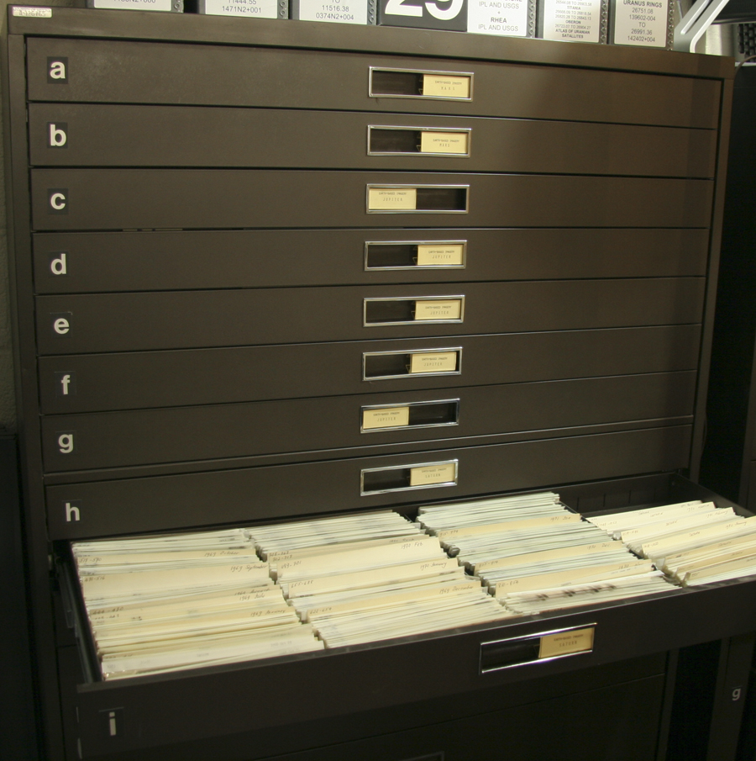
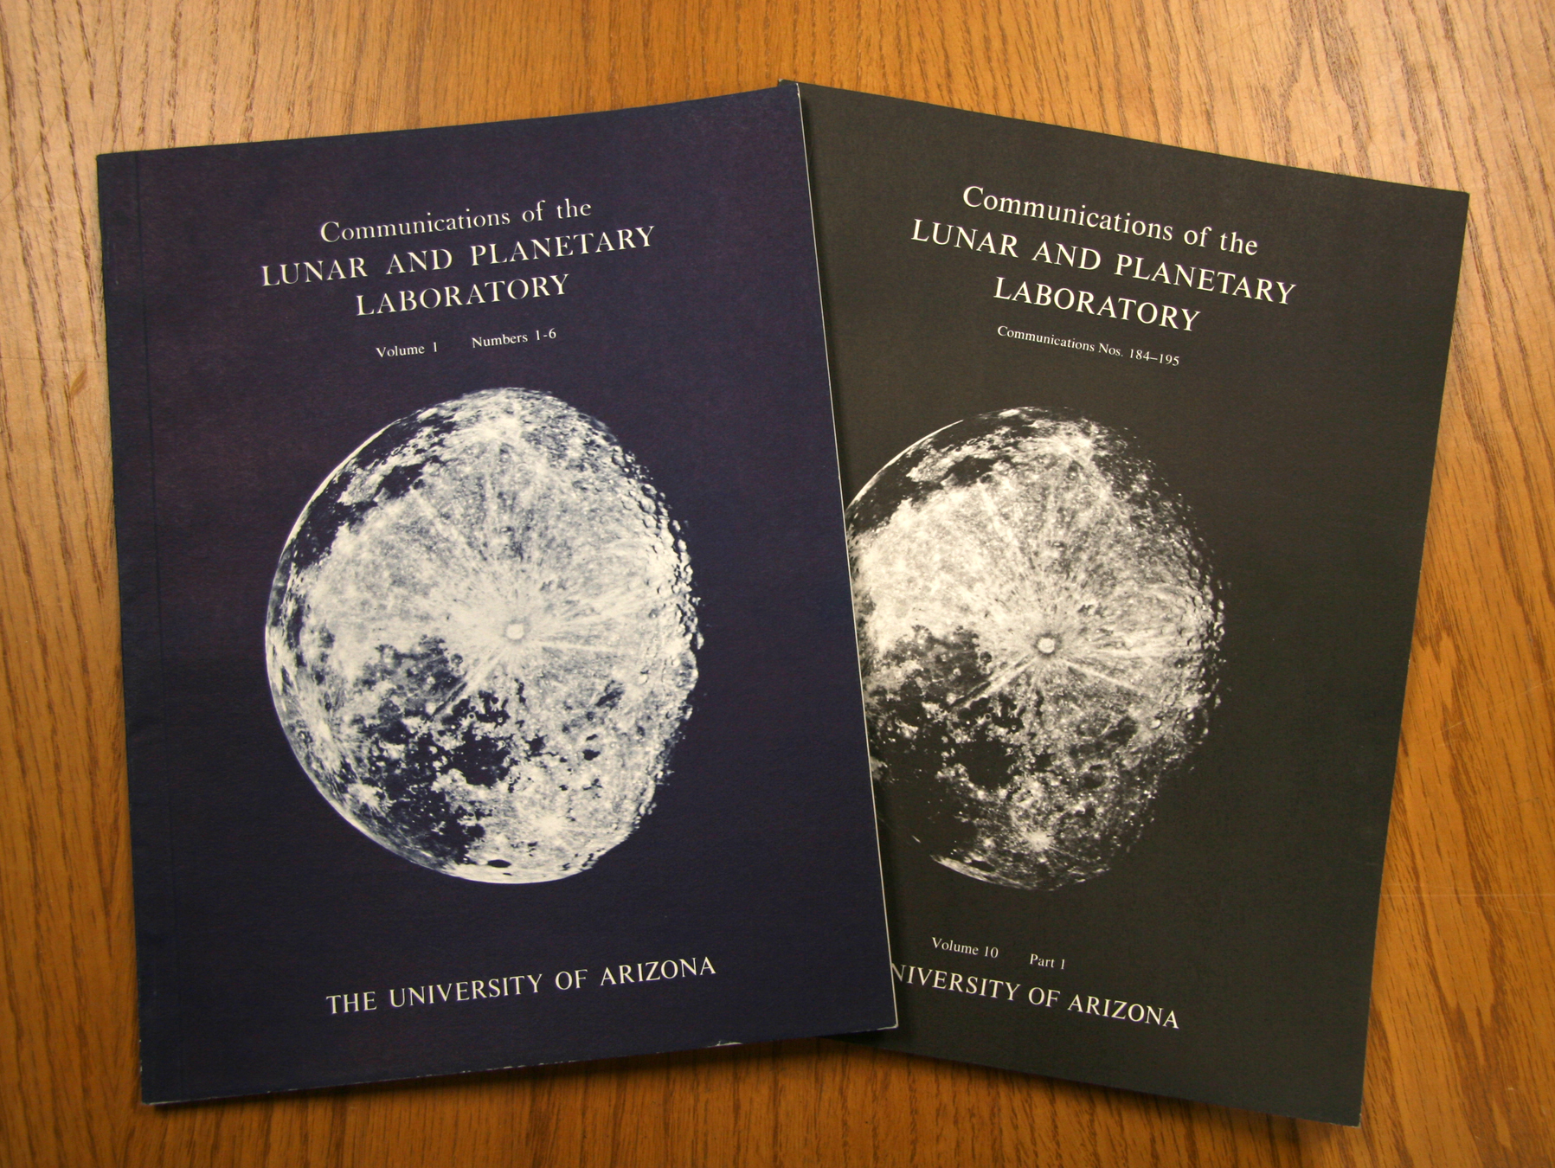
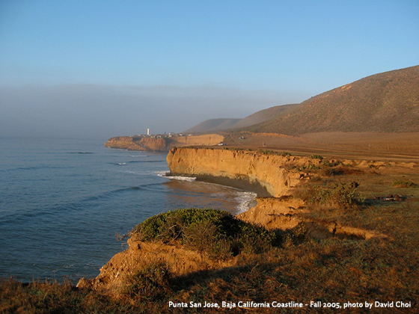
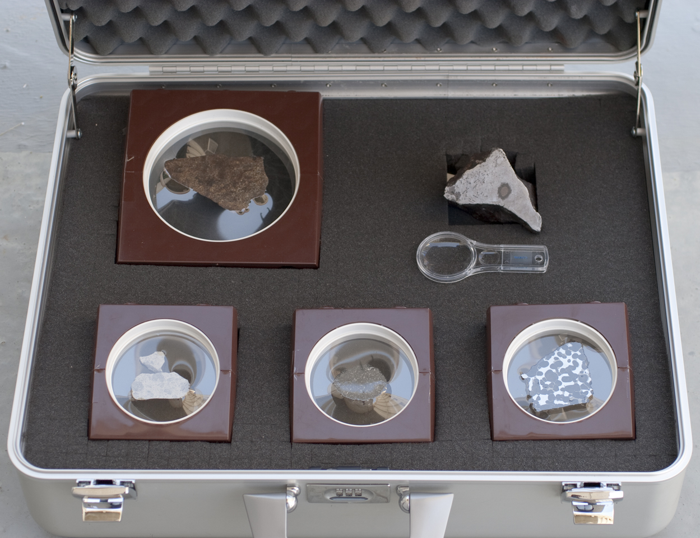
Unique Attributes
Socet set stereogrammetry & GIS facilities
Earth based images of planets
Comm. LPL Journals
Meteorite kits for educators
Planetary analogue geology field guides
Historical audio recordings from 1960

Slide 11
Funding
UA provides
The director’s time – estimated at 1month/year, about $41k/year incl. ERE & IDC
The data managers salary - $114k/year incl. ERE & IDC
Liberian that has cataloged our collection – difficult to quantify $?
IT support (including our web presence) – difficult to quantify $?
i.e. at least $155k / year, but realistically much more
NASA provides
Average of $38.5k/year in running costs (~$105 per day)
Alternates between $37k and $40k every other year
Private donations have totaled $15K in the past year, but have been negligible before that and those donations were earmarked for the Surveyor scanning project
Cost leverage for NASA is at least a factor of 5 !
i.e. these funds go a long way

Slide 12
Usage
Number of hours facility was available: 2000/year
Number individuals using facility: 500/year
Most contact with the public are through organized events (a few thousand per year)
Number from under-represented groups: ~50% (under-served schools and minorities)
We don’t conduct research, but rather support it.
Estimate % of time RPIF staff (figures for data manager/Director)
1. Supports research 10% / 60%
2. Archiving 20% / 20%
3. Public Engagement 70% / 20%
Fraction of users from US institutions: 88%, international groups from Norway, Wales visit every year, ~60 people.

Slide 13
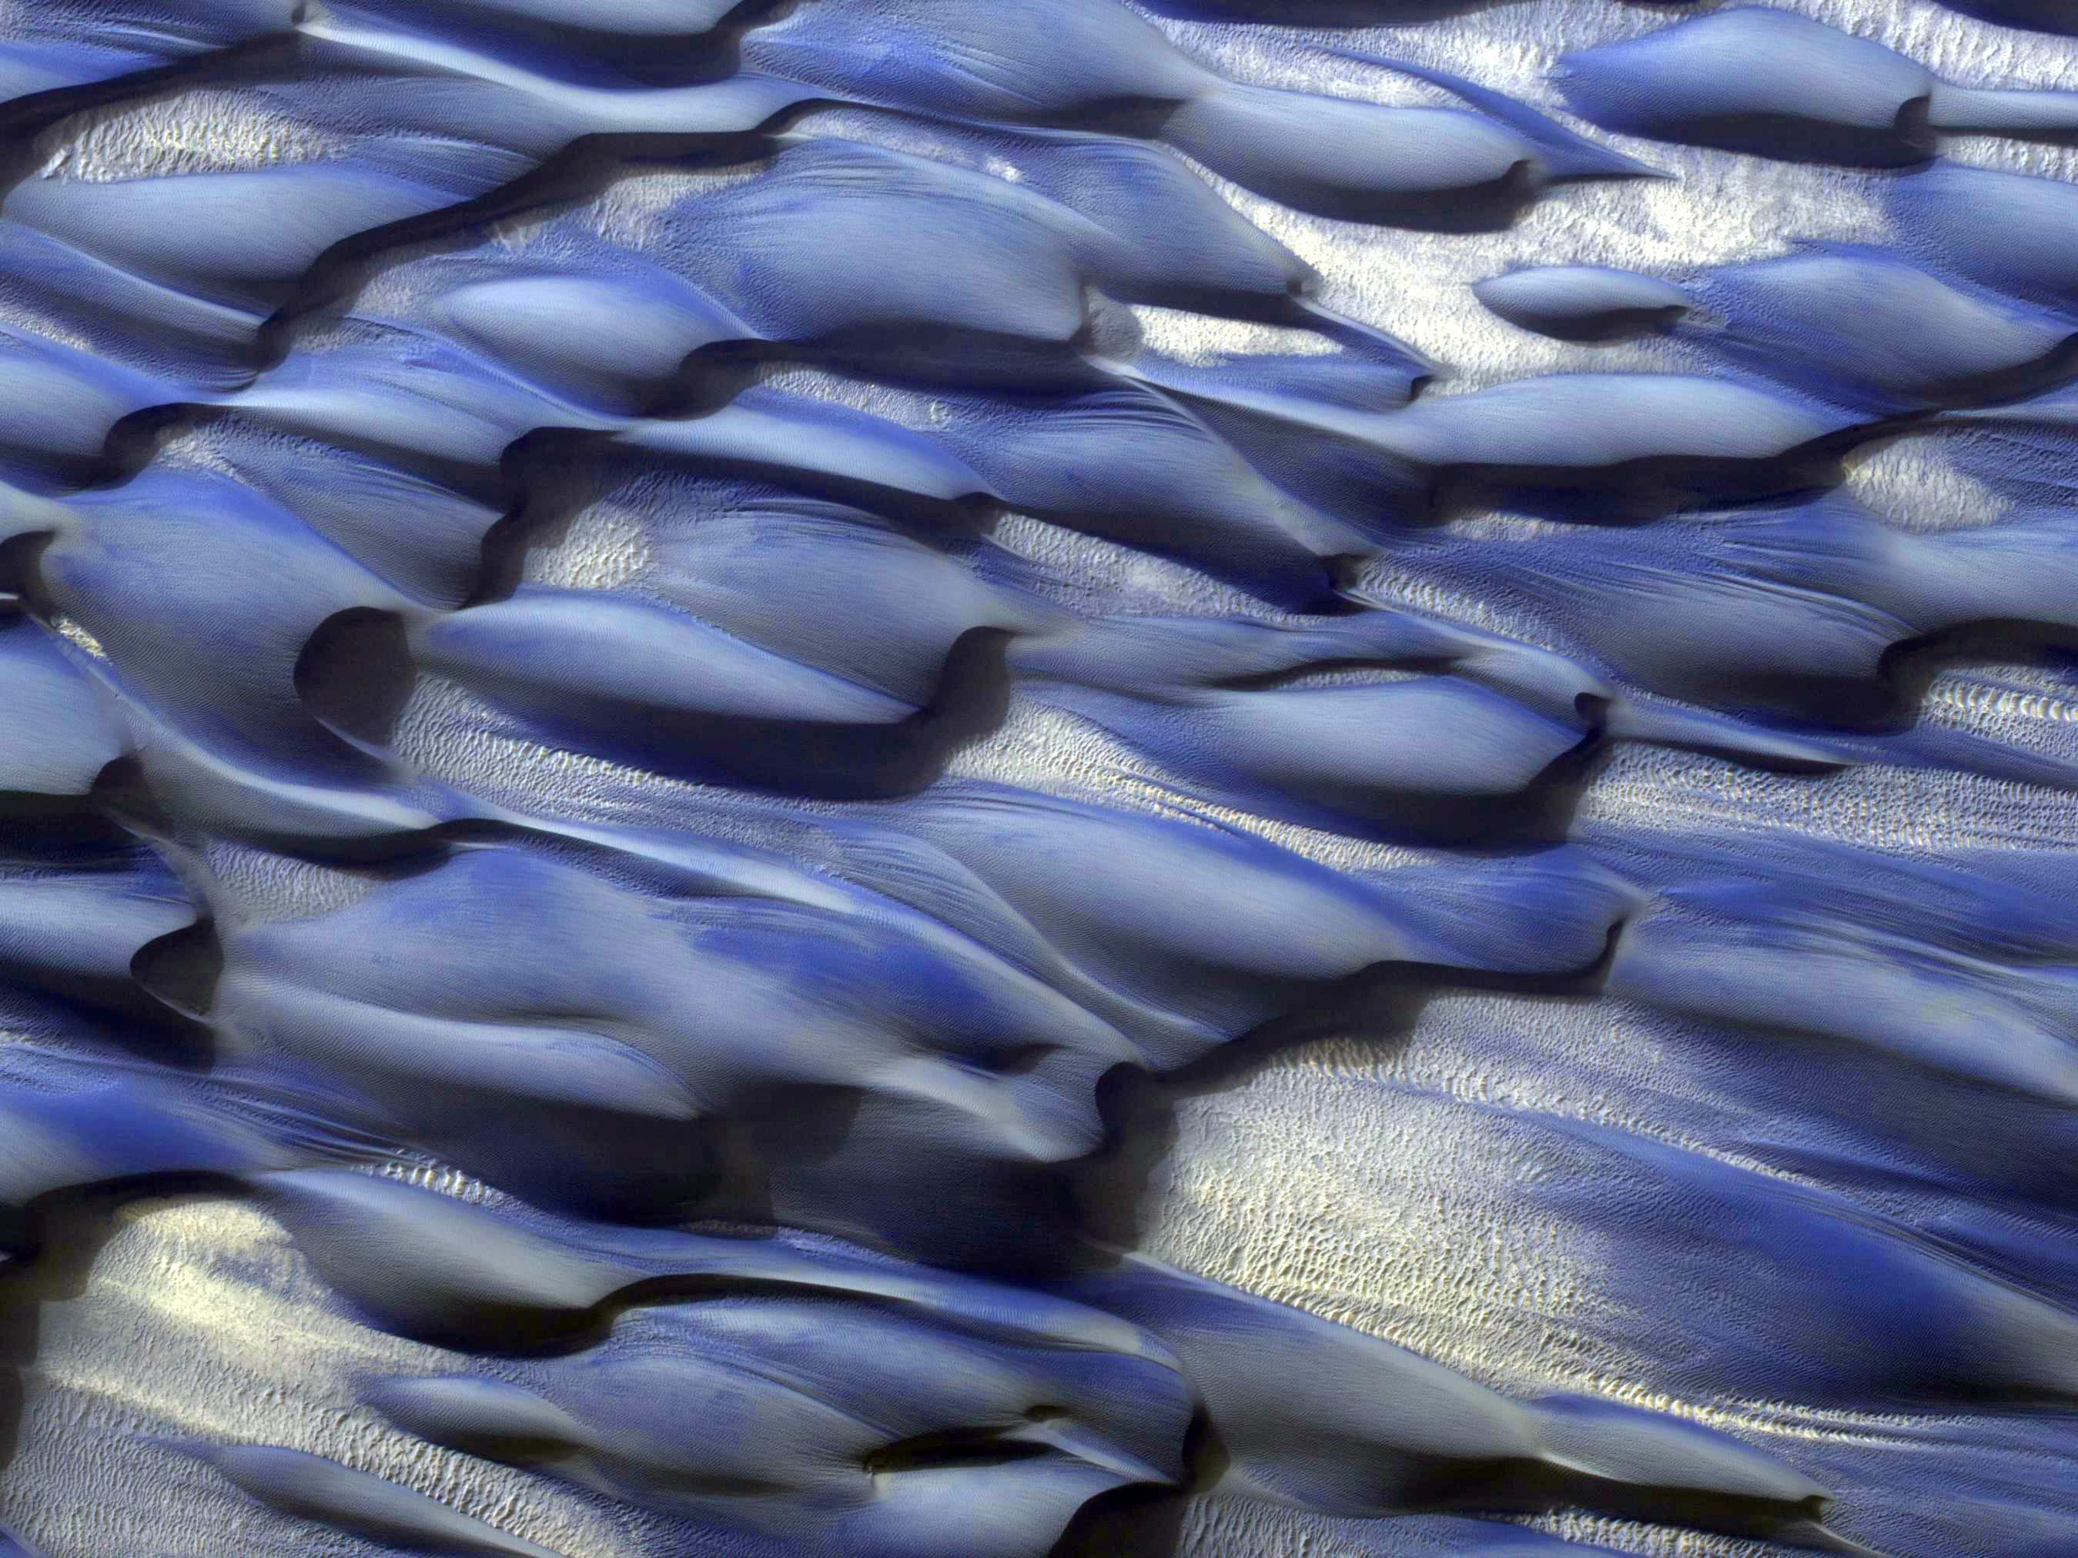
Archiving
Research
Education & Public Outreach

Slide 14
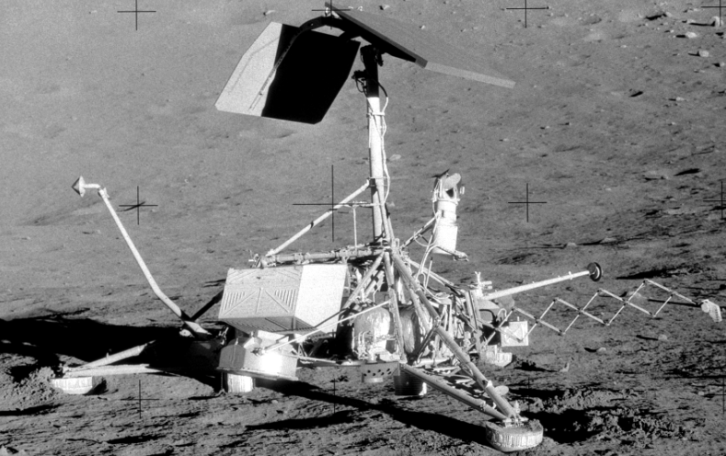
Within a remarkable 20 months (May 1966 to January 1968) NASA’s Surveyor Program successfully landed no less than five spacecraft (Surveyor 1,3,5,6,7) on the surface of the Moon.
90,000 images of the surface (incl. the otherwise unvisited lunar highlands were returned to Earth)
Images were archived on 70mm film rolls (the digital data were disposed of) at the NSSDC and later some RPIFs (JPL, USGS & UA).
With help from the NSSDC and additional funding from the LASER program – we’re archiving these data at the PDS.

Slide 15
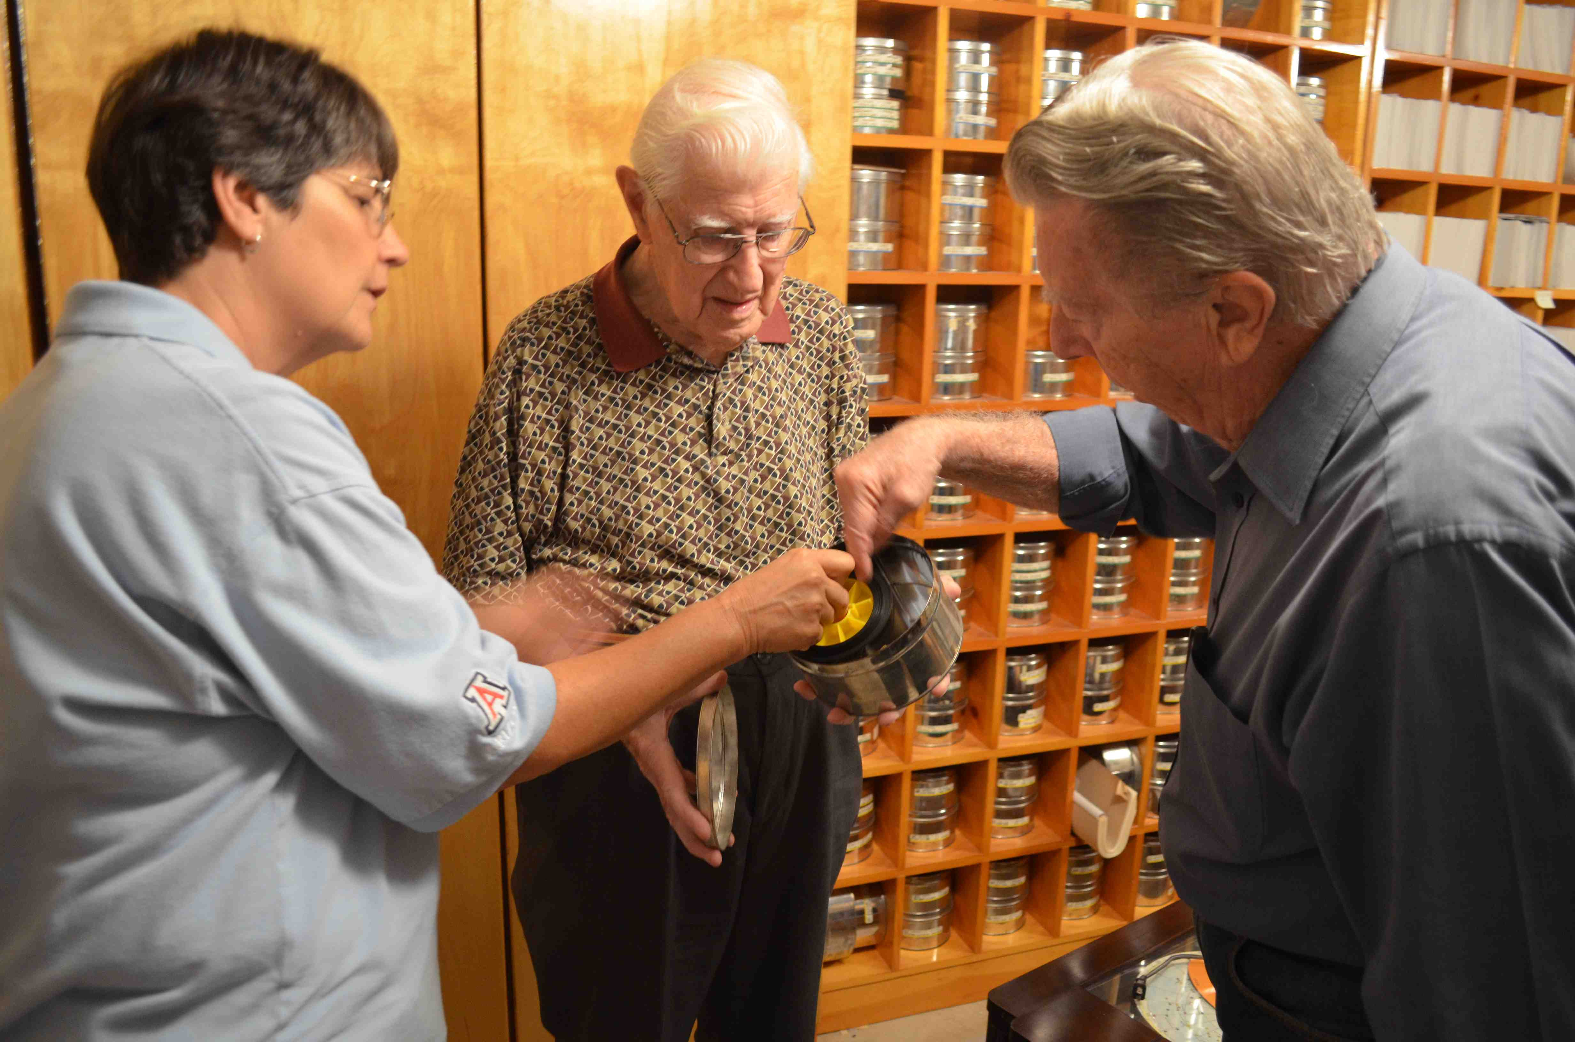
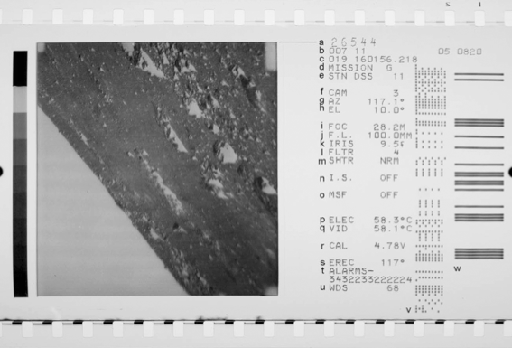
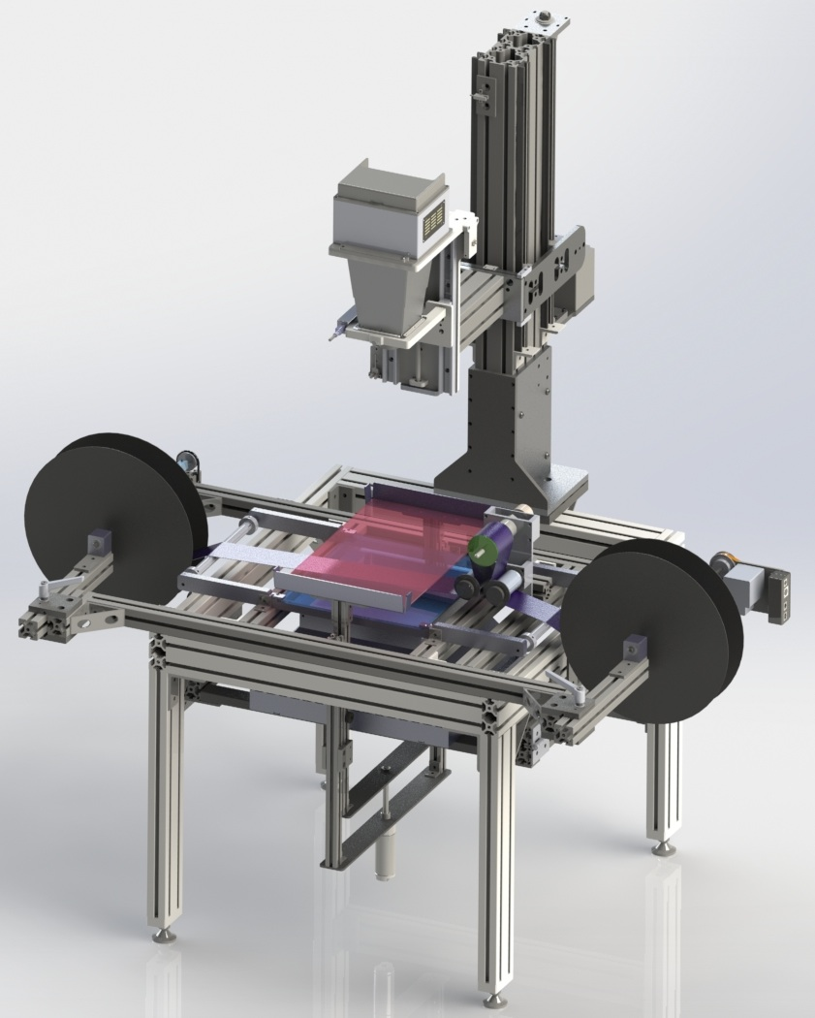
Our collection was on continuous rolls allowing us to scan the whole thing by renting specialized equipment

Slide 16
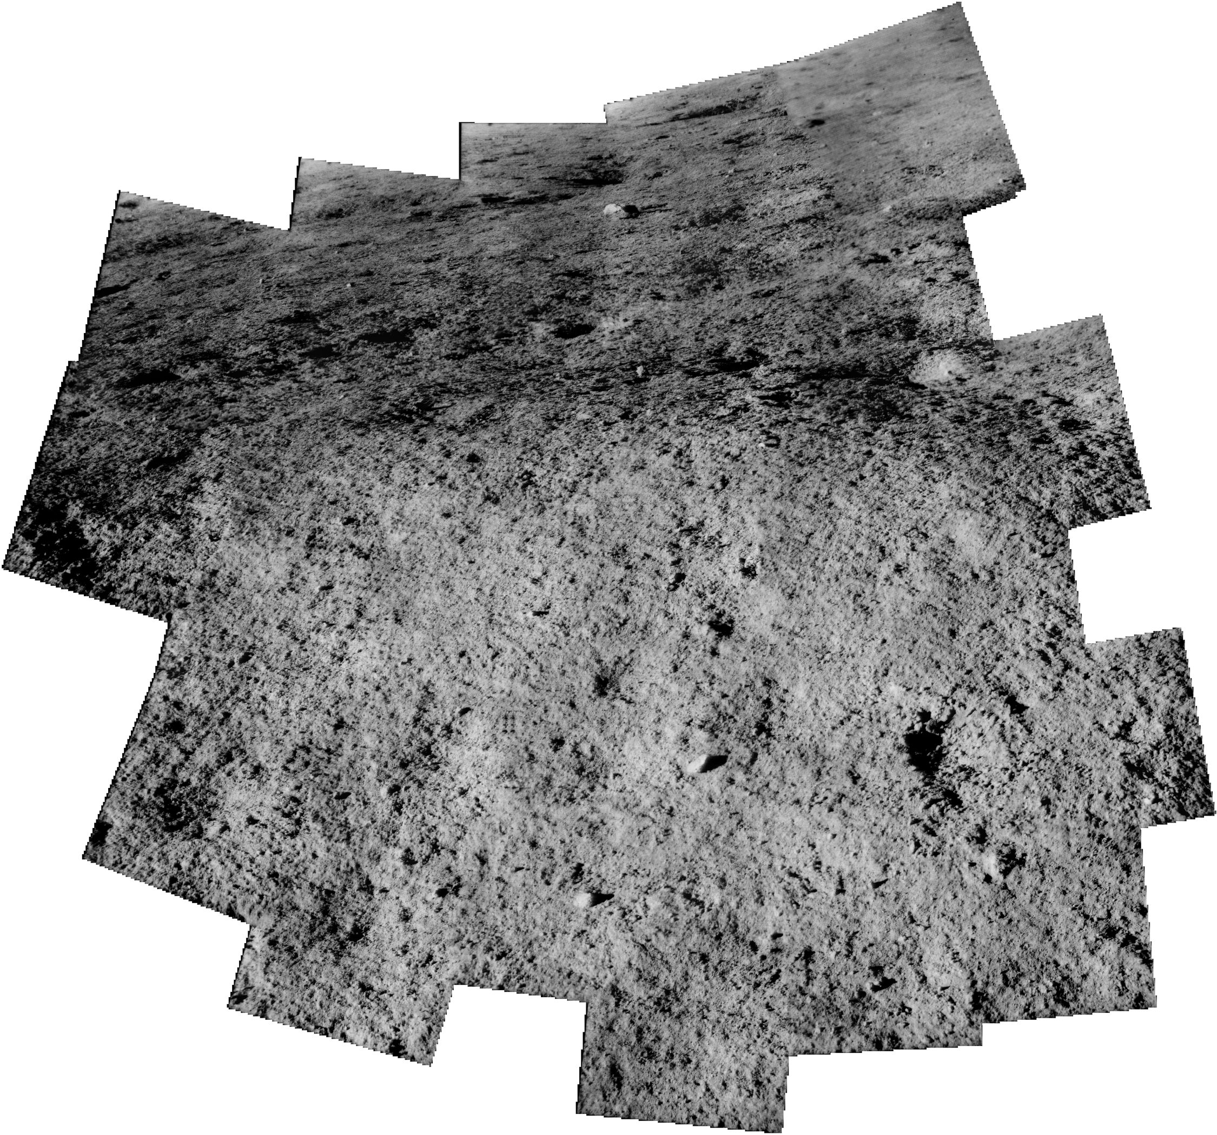
The images themselves are now rescued and can be manipulated digitally…

Slide 17
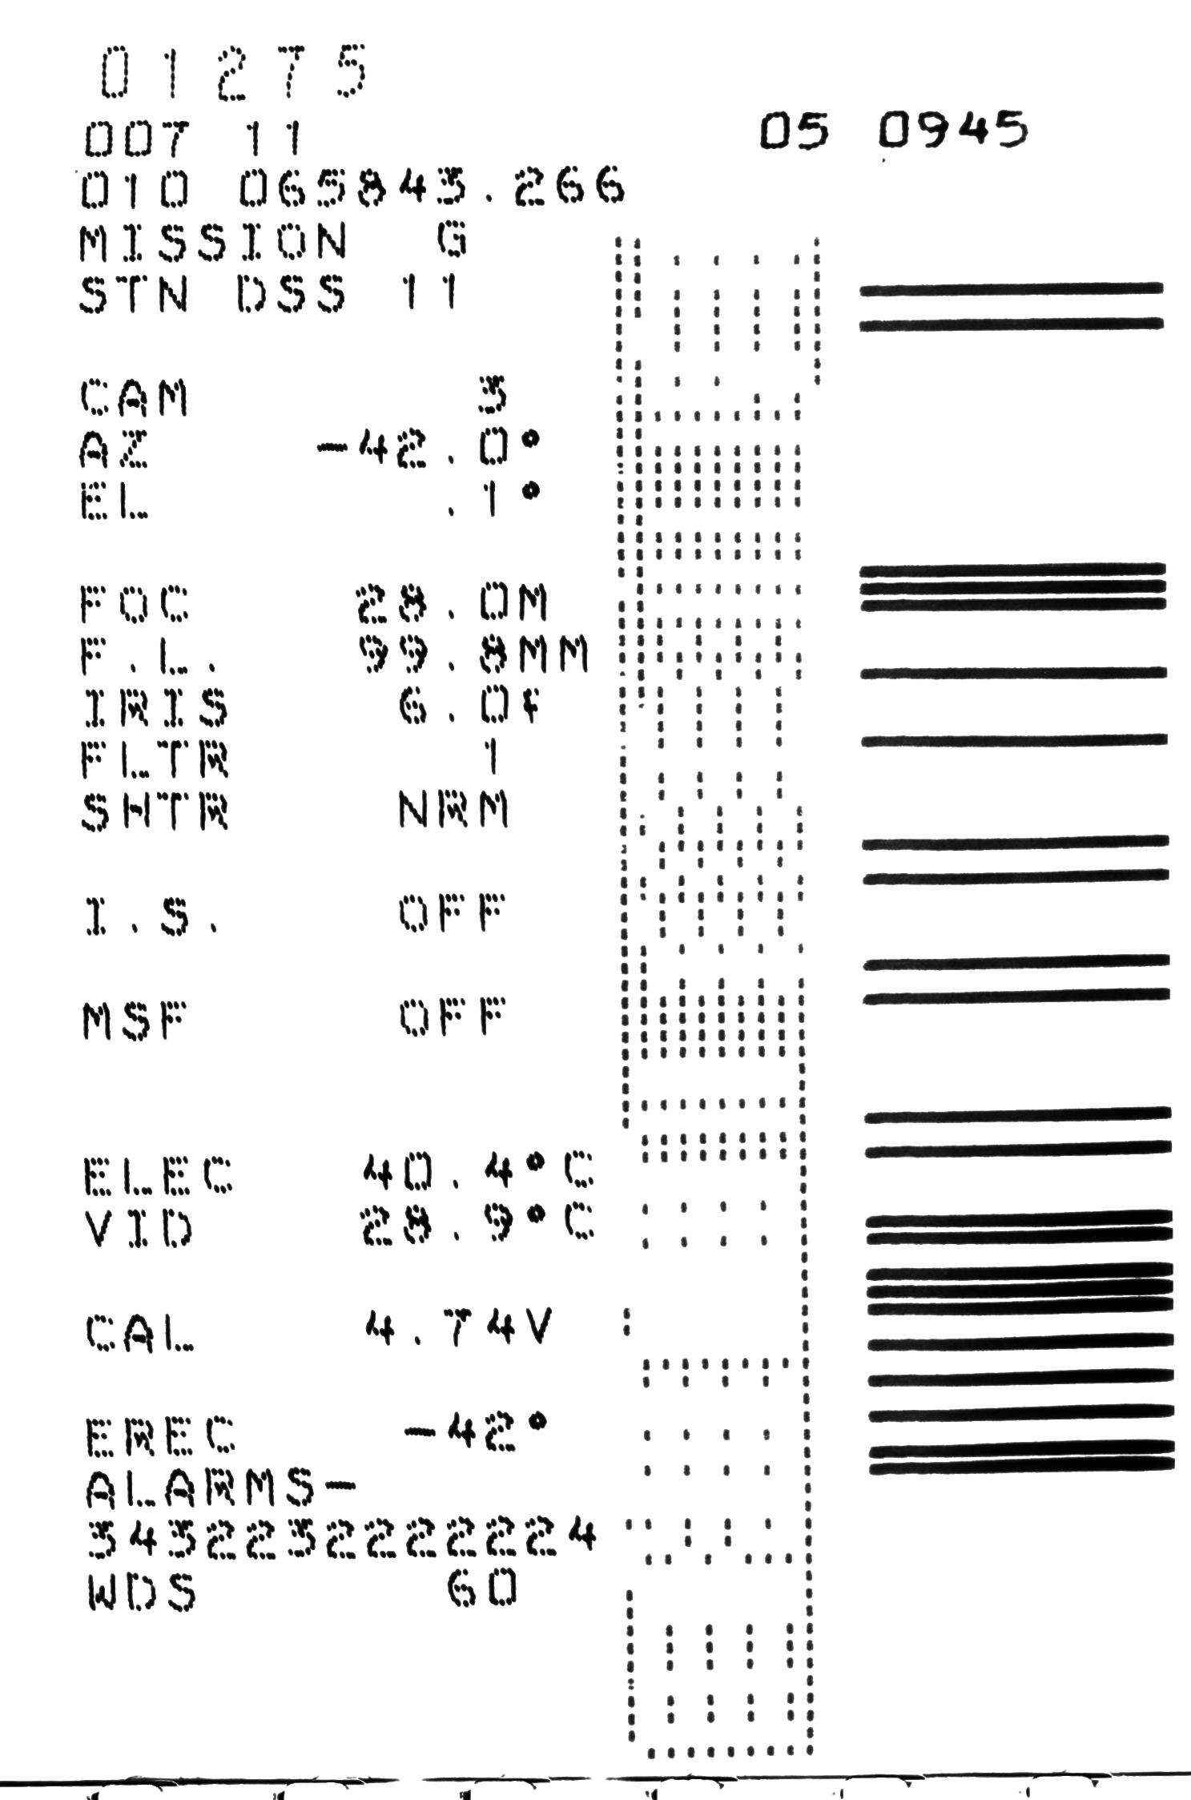
The decoding of the metadata in BCD for the mission has proven to be challenging
A lot of historical research on old technical memorandums and interviews with retired engineers allowed us to figure this out
Leon Palfox, a research member of LPL, has provided many hours, at no cost to the SIC grant, to design a program to interpret the data from the 90,000 images.
Notes:
Management Plan
1. A description of the project’s organization;
When funding is available, a student is hired to provide assistance with archiving, designing graphics and organizing large events and producing a yearly product.
Yes
2. A description of the roles played by each member of the organization;
Dr. Byrne, provides the direction of the lab
Maria Schuchardt provides the daily running of the center, organizing the archive, provides tours of the facilities, as well as off-site lectures on planetary science topics.
John Anderson is a temporary employee whose task is to scan, process, and prepare Surveyor images for the Planetary Data System (PDS). The decoding of the BCD for the mission has proven to be challenging, and Leon Palfox, a research member of LPL has provided many hours, at no cost to the SIC grant to design a program to interpret the data from the 90,000 images.

Slide 18
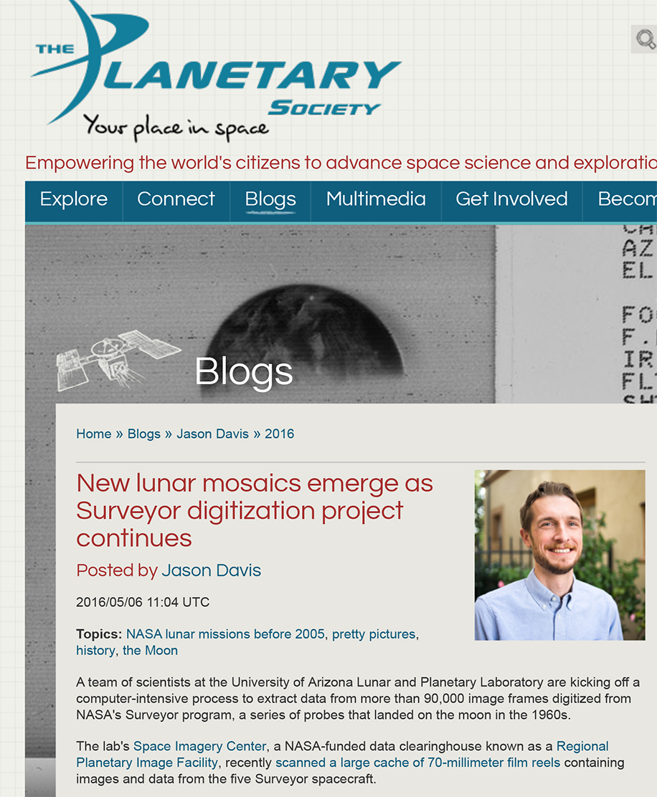
Data are now being assembled into PDS format
We’ll likely archive this PDS volume within the next 12 months
Media interest is high and the 50th anniversary of the Surveyor landings is upon us
Many ancillary products such as controlled mosaics and DTMs of one site are planned

Slide 19
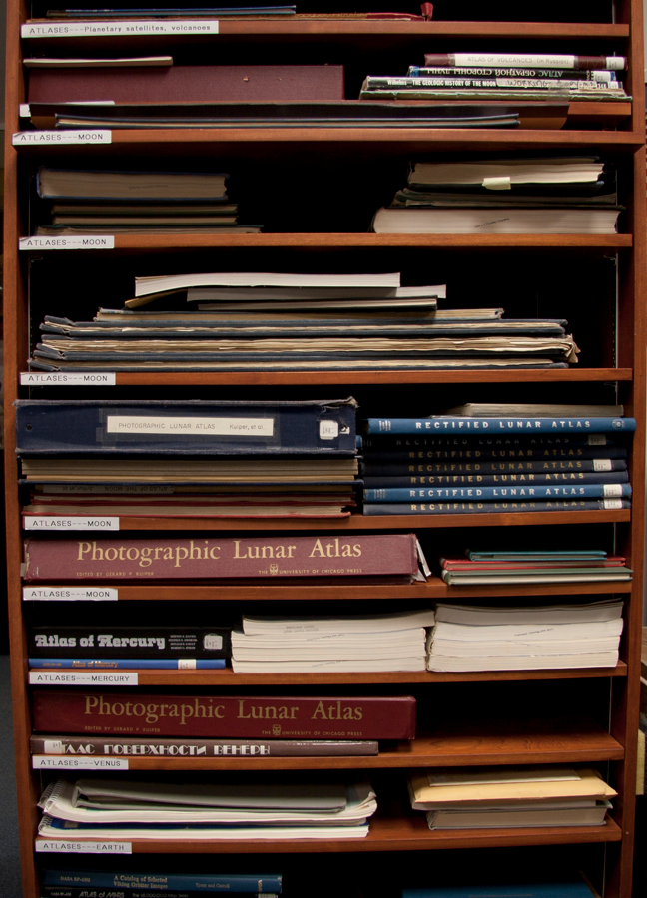
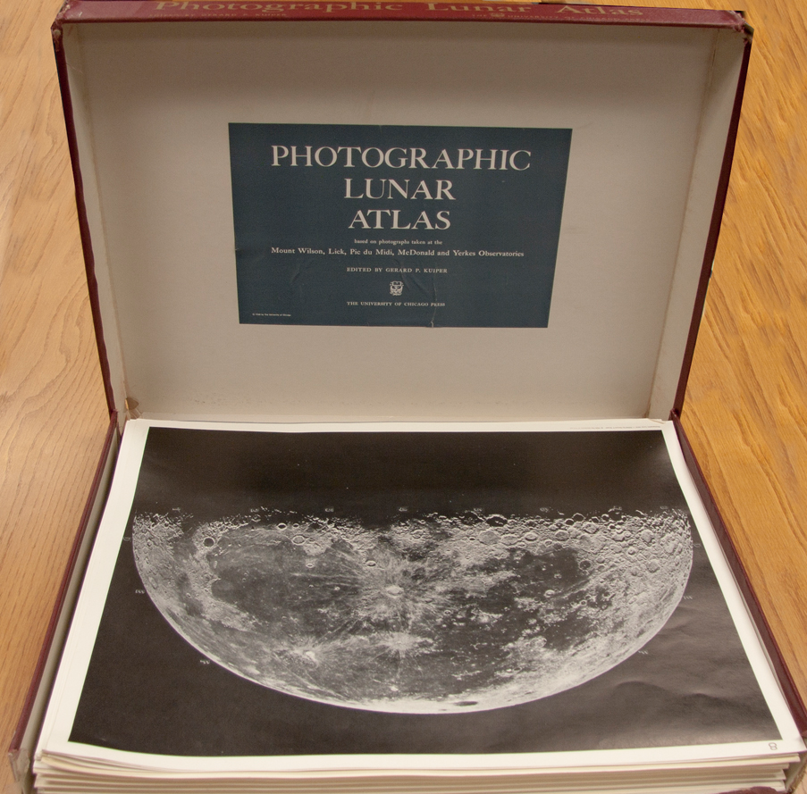
Scanning of maps and atlases

Slide 20
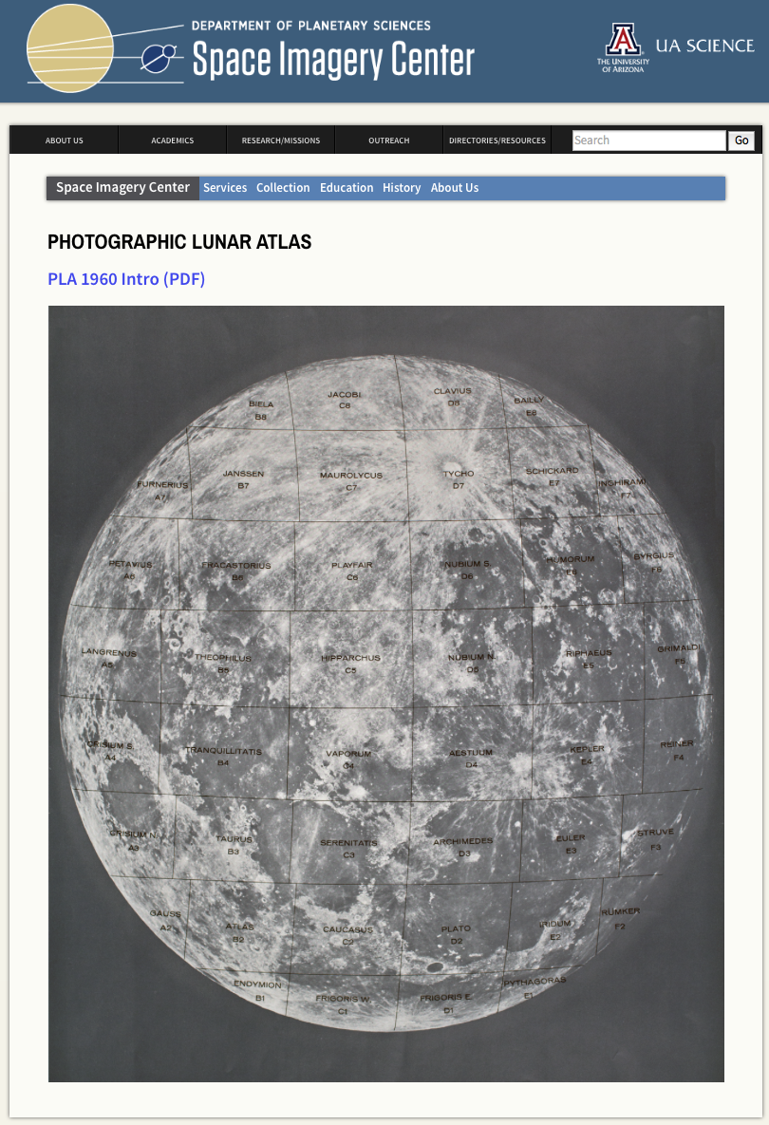
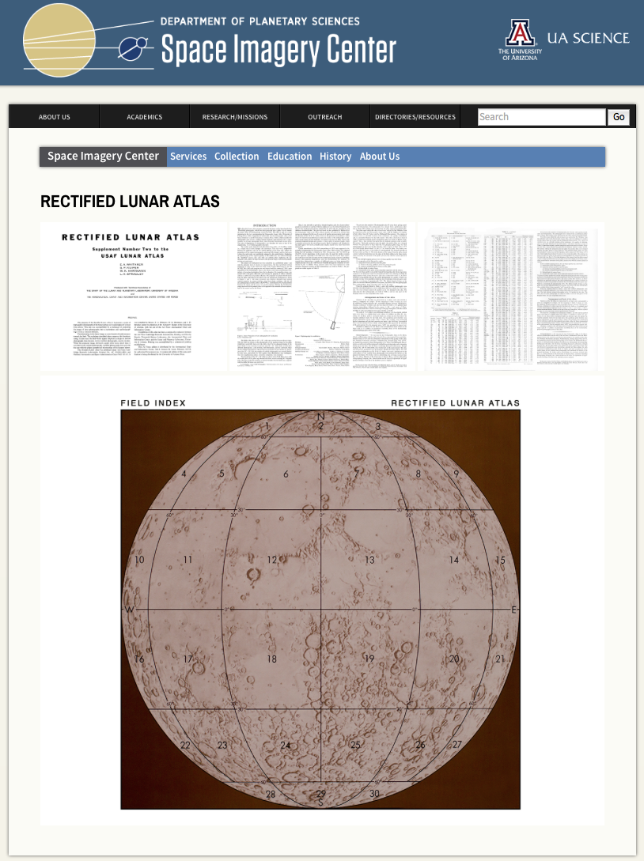

Slide 21
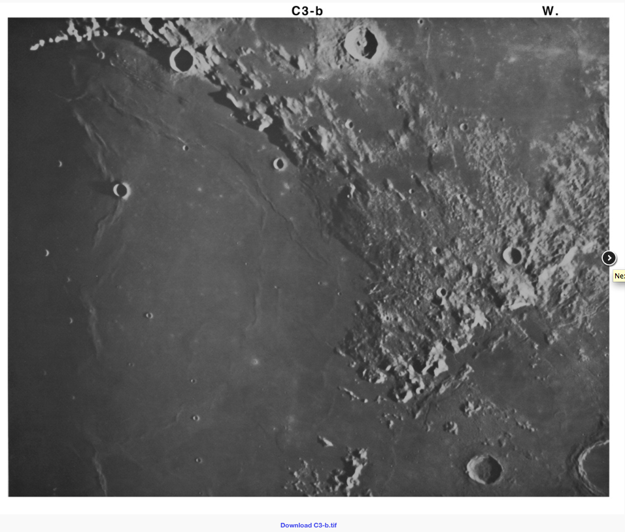
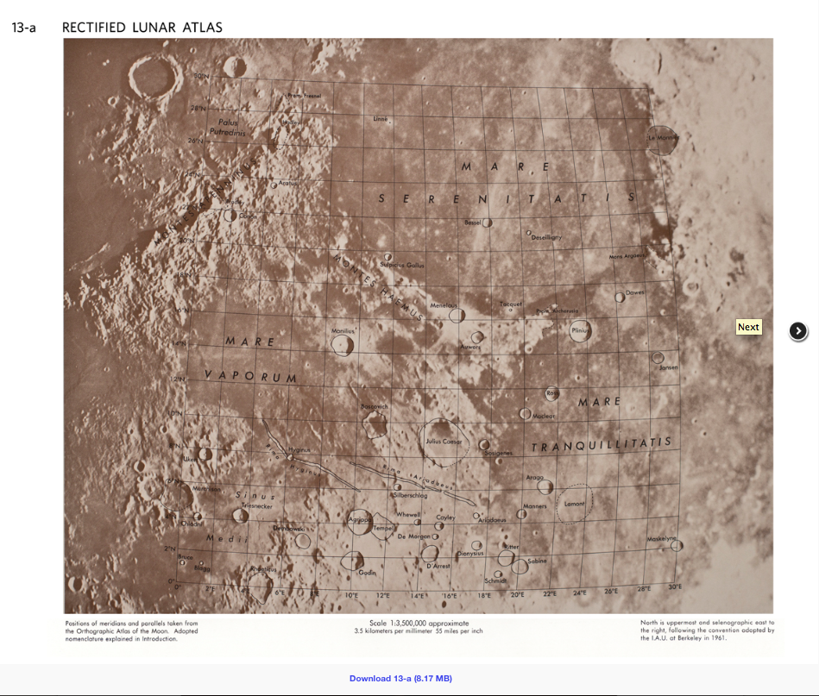

Slide 22
Communications of the Lunar and Planetary Laboratory
  Peer-reviewed journal that ran from 1962-1973
  PDFs of all papers online
  Metadata searchable on NASA ADS, with links to PDFs
20 years of geologic fieldtrip guides scanned and made available online
  LPL’s Planetary Analogue Fieldtrip class
  Covers a few hundred geologic stops
  Widely distributed throughout the south-west

Slide 23
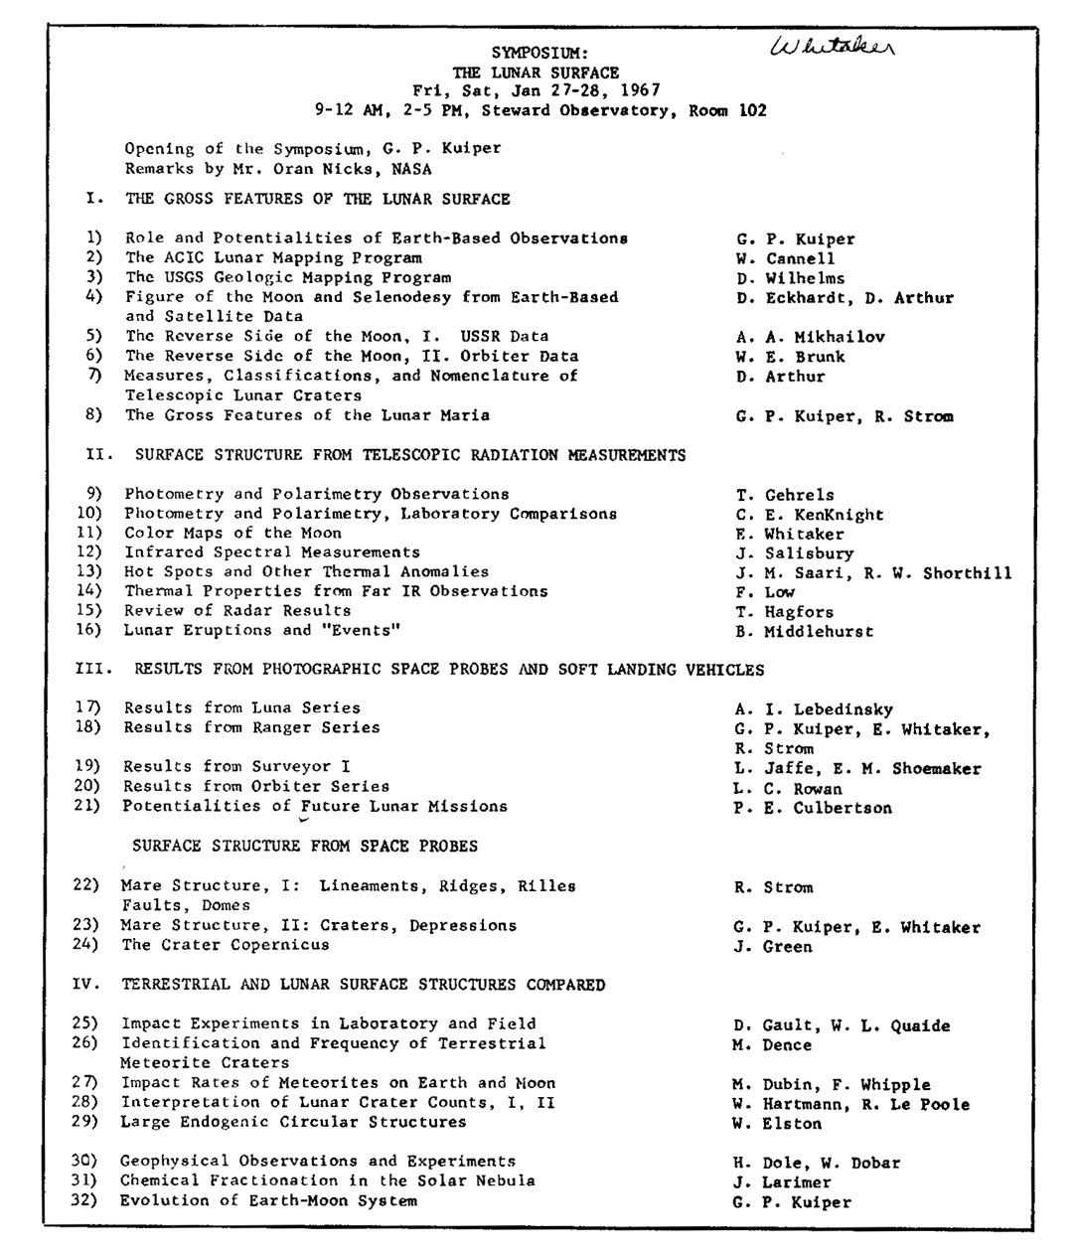
Past audio recordings
now online
27 lectures from Symposium
Kuiper talks:
Origin of the Moon and Planets
Lunar Surface
Kuiper Memorial Service
Notes:
Not all the talks were given at the Symposium

Slide 24
Archiving
Research
Education & Public Outreach

Slide 25
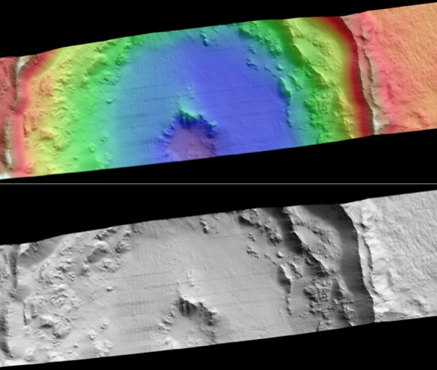

Current work:
Assembly of a three-station stereogrammetry lab
Our industry partner BAE Systems have provided an academic license worth multiple $100K
RPIF money leveraged with the Lunar and Planetary Lab and another faculty member allowed us to acquire three stations with specialized polarizing displays
Currently in high use by faculty, postdocs, graduate students and Spacegrant undergrads

Slide 26
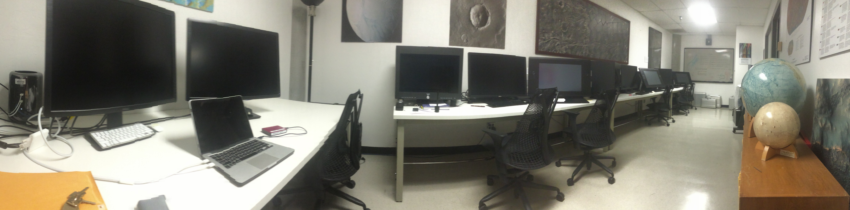
BAE systems has agreed to give us five Socet Set licenses for only $2500/year with no initial purchase fee. Thus we saved $242.5K in the first year and $60.6K each year thereafter.
Missions and other institutions (like the USGS) can’t get this rate because they’re not educational institutions
We combined some startup money from Prof.s Byrne and Hamilton, a departmental investment and $21K of RPIF money to acquire >$70k worth of equipment.
Value of this lab over 5 years is about ~$600k – cost to NASA was only $21k

Slide 27
Assistance with data preparation
  Especially GIS data
Accessible hardware running GIS software
  A useful service while ArcGIS licenses were expensive
Target selection for ongoing instruments/missions
  HiRISE
  Messenger

Slide 28
Archiving
Research
Education & Public Outreach

Slide 29
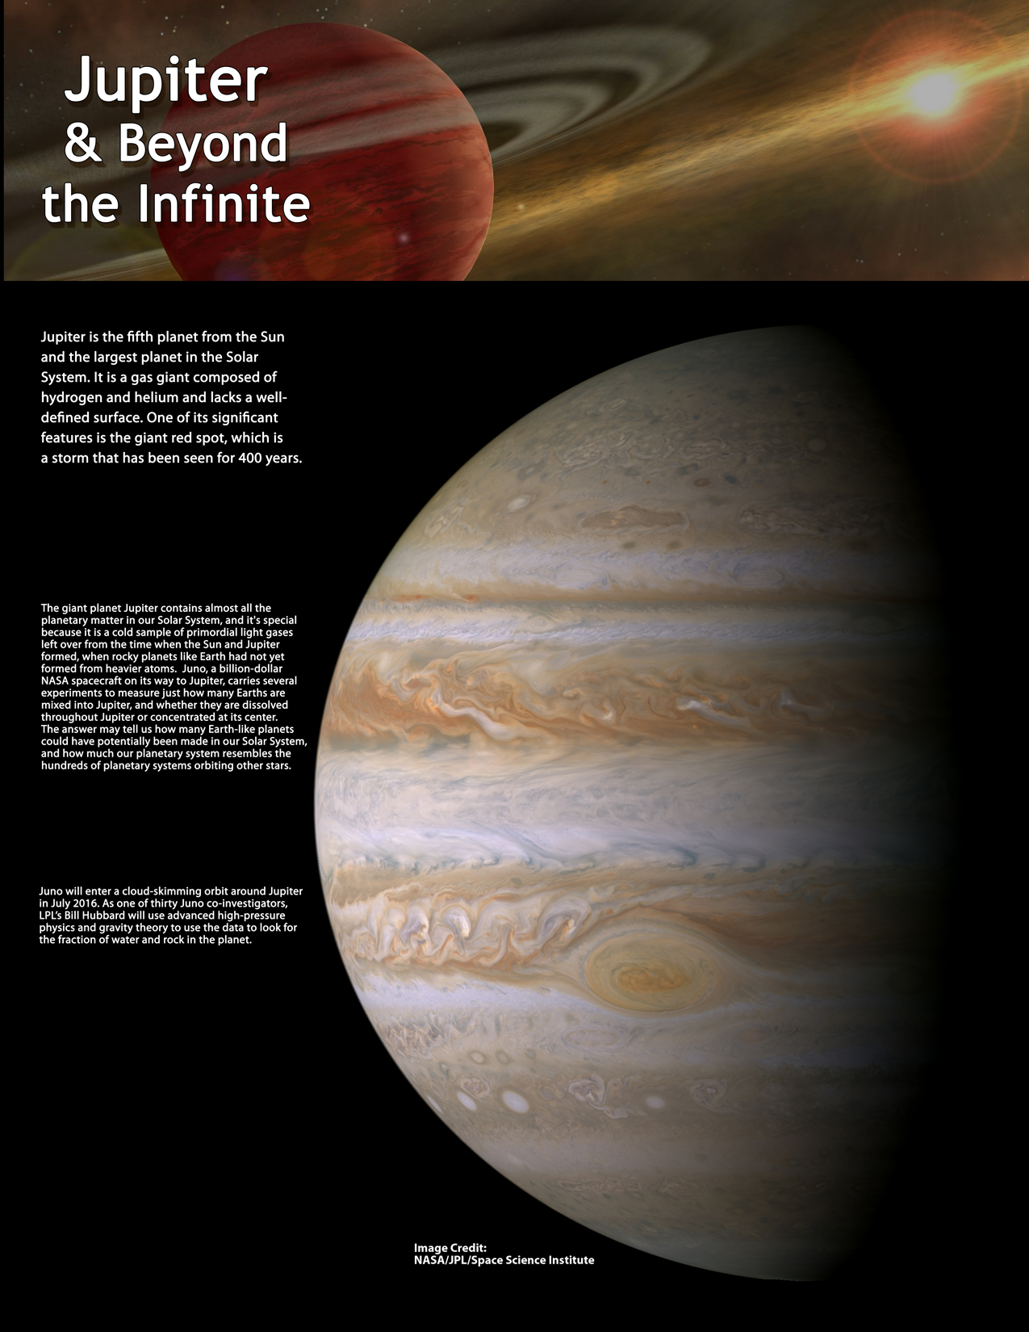
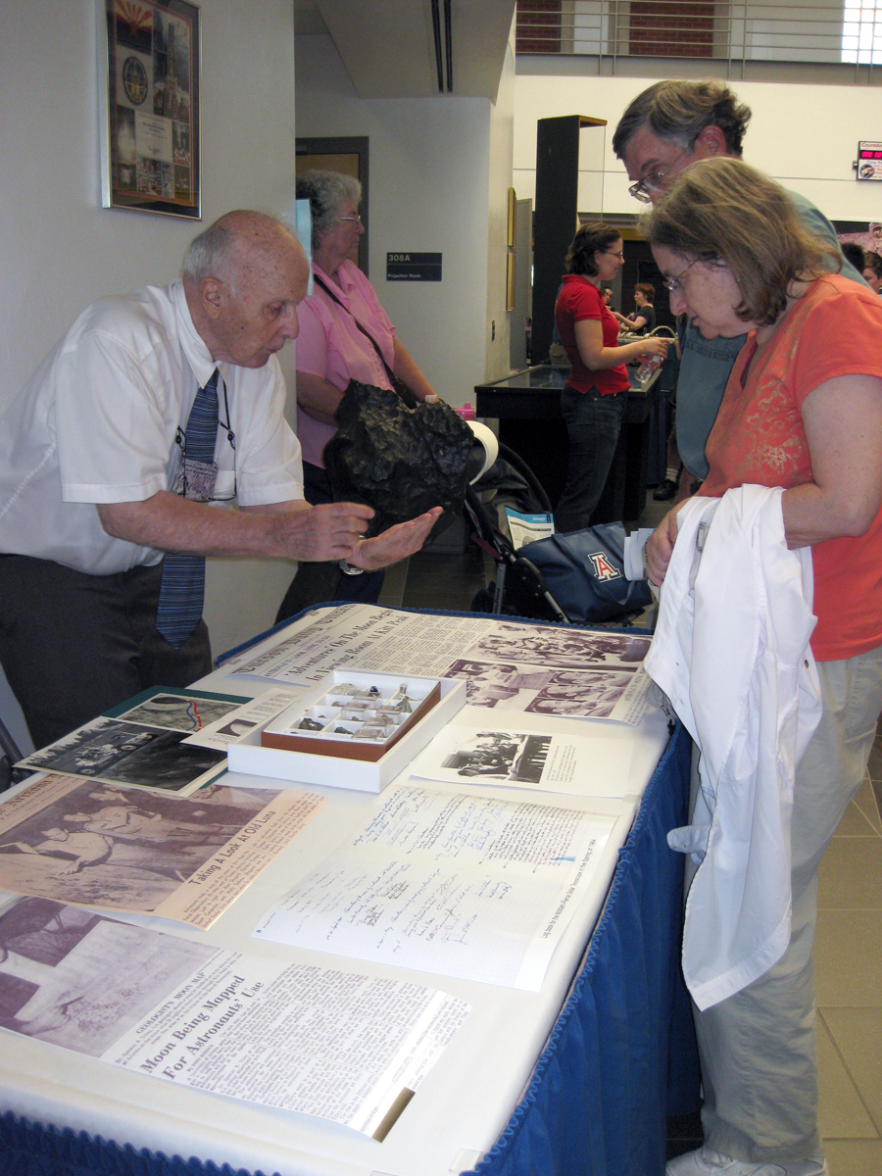
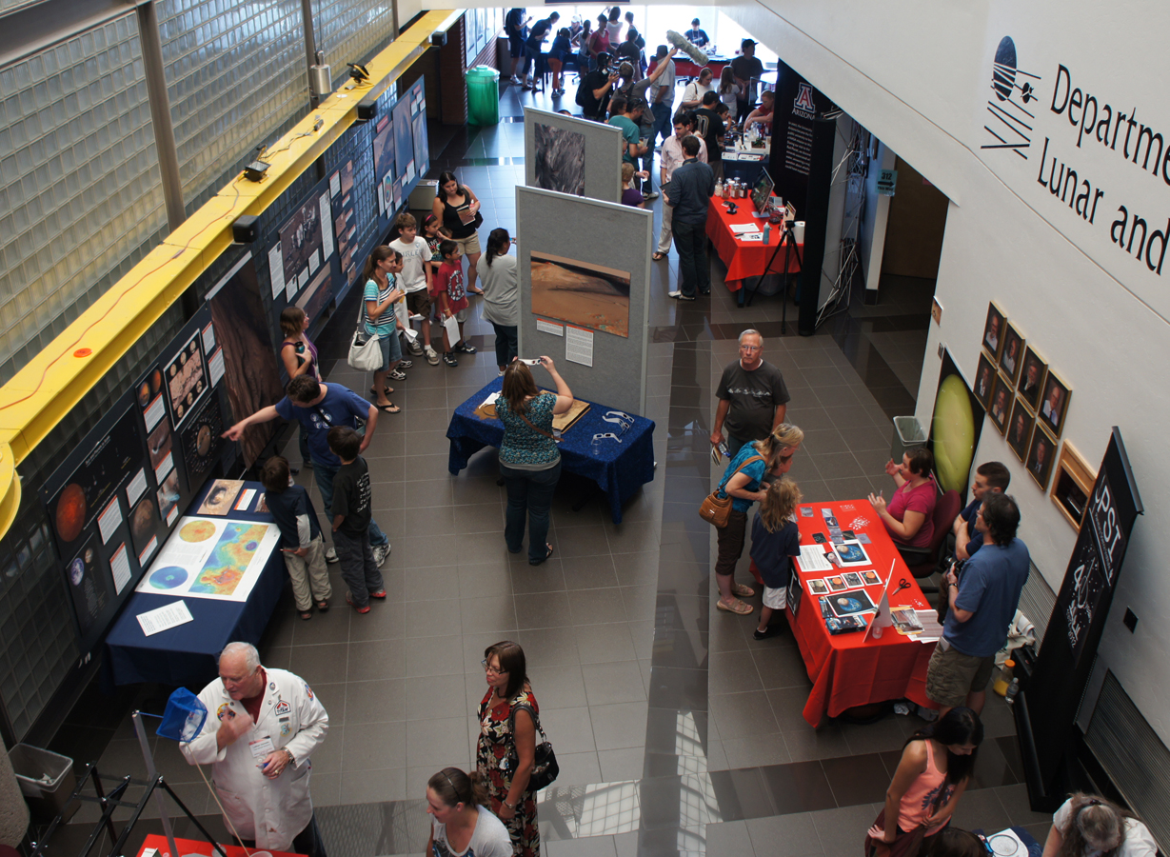
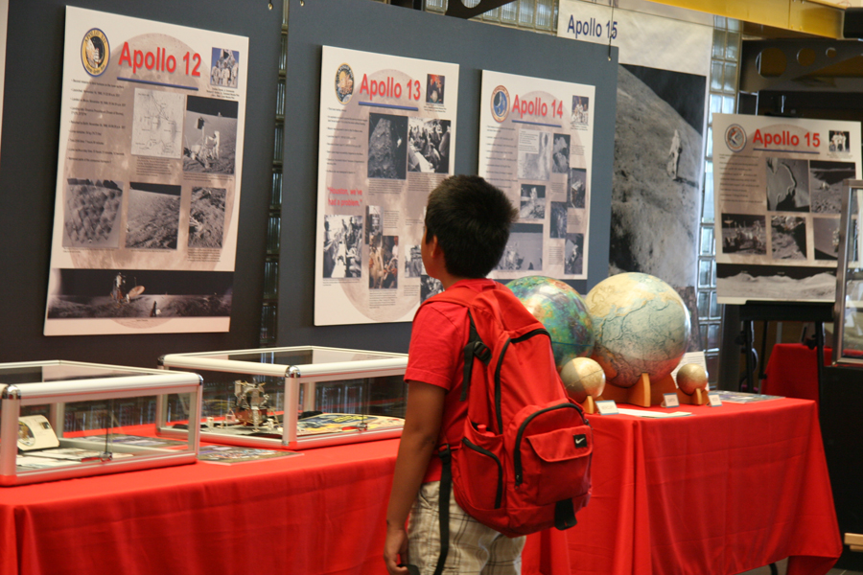
Summer Open Houses
  Our main annual event: Attracts 100s of people per year
2007, May 5th: “Cinco de Mars” - Phoenix Mission exhibit. 450 Participants.
2008, May 25th: Phoenix Mission Landing Event. 1500 Participants.
2009, July 18th: 40th Anniversary of Apollo 11’s moon landing. 500 Participants.
2010, Jan. 30th: Arizona Meteorites. 330 Participants.
2011, April 12th: 50th Anniversary of Yuri Gagarin’s flight. 150 Participants.
2012, July, 28th: Curiosity Mission and Landing. 693 Participants.
2013, July 20th: Jupiter and Beyond the Infinite, 773 Participants.
2014, July 20th: Everything Lunar, 531 Participants
2015, July 18th: Small bodies of the Solar System 400 Participants

Slide 30
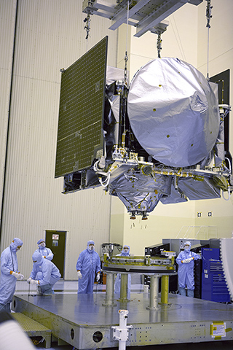
This year Summer Science Saturday, will be held on Saturday, August 27, from 10:00 am to 4:00 pm.
The theme of this year’s event is the UA/LPL OSIRIS-REx mission, the first NASA mission to capture an asteroid sample and return it to Earth.
The spacecraft will launch twelve days later on September 8 (weather permitting).

Slide 31
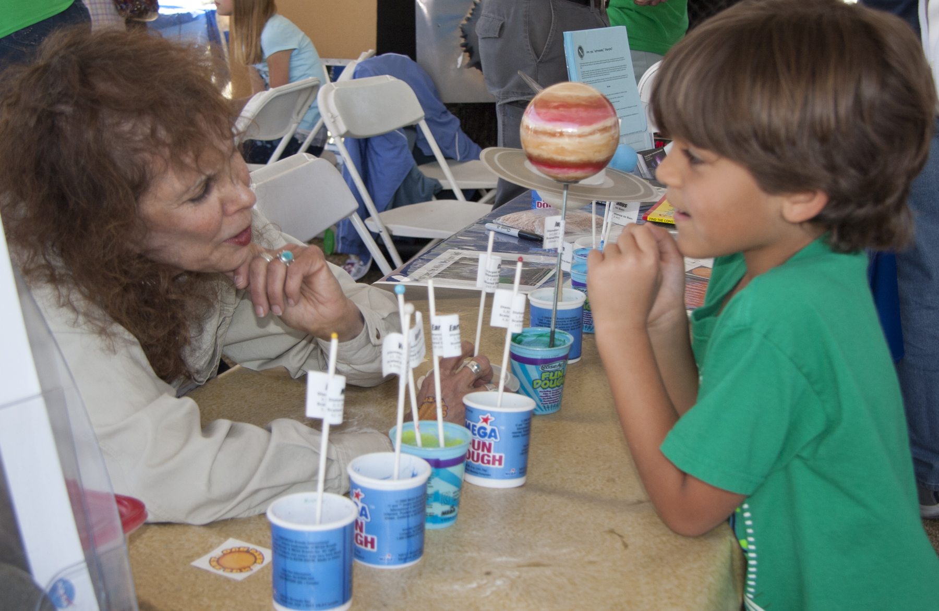
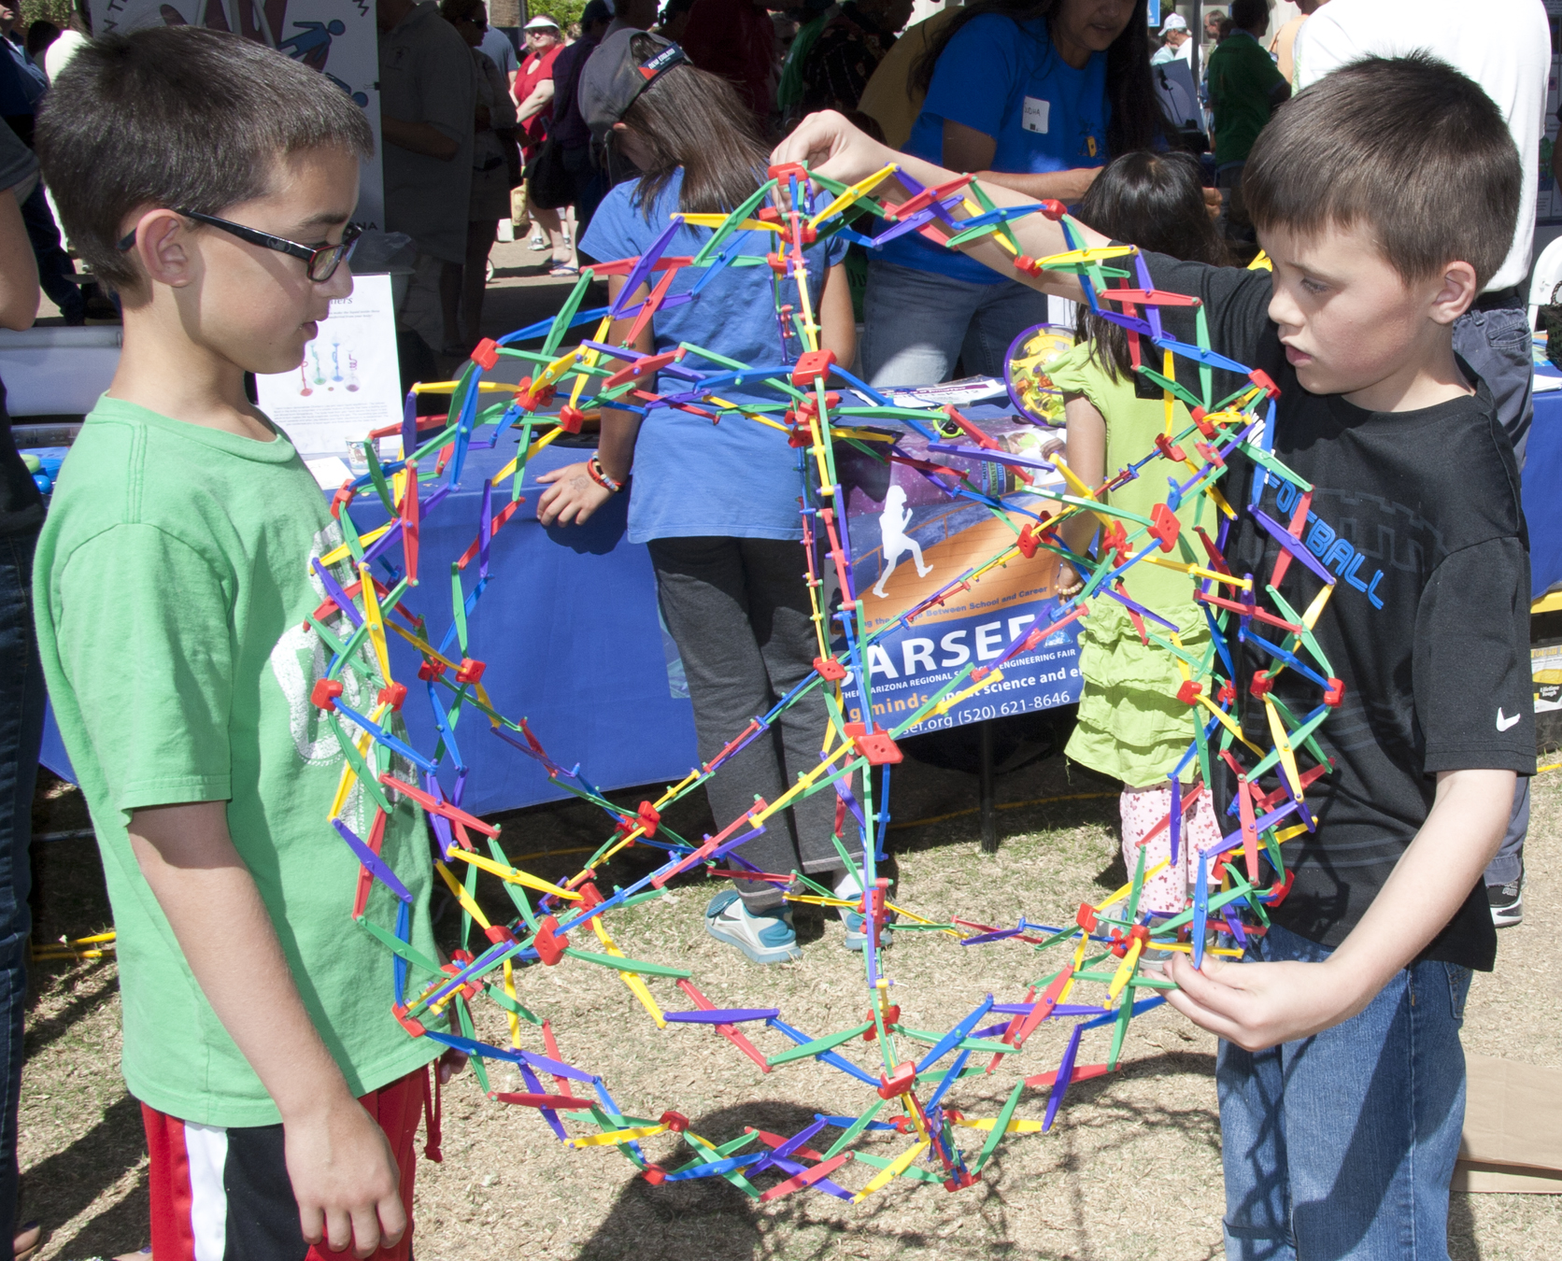
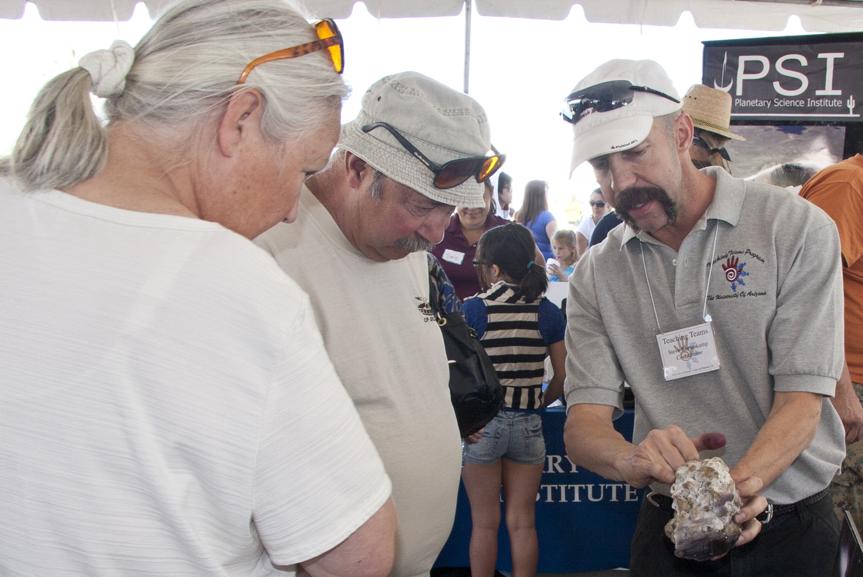

Tucson Festival of Books
Tucson Festival of Books, Science City, ~ 1,200 interactions each year for us over 2 days
Notes:
Attendence:
Beshore: 100
Swindle:
Russell:

Slide 32




Fall Evening Lecture Series
The lecture series was started in the fall of 2009
Older lectures on another site
Pluto, Up-close and Personal
Volcanism on Earth & Mars
Mars Active and Icy
Available on iTunes https://itunes.apple.com/us/itunes-u/lunar-planetary-laboratory/id1056791227
32
Notes:
Attendence:
Beshore: 100
Swindle:
Russell:

Slide 33




SIC Tours, Schools, Events
Events in the community reached 8,853 students 2013-2015
Public visits to SIC: 465

Slide 34


Teacher Workshops
SIC has collaborated with other organizations in Tucson to create workshops for teachers.
This is a valuable offering, especially to elementary teachers who have little (or no) astronomy knowledge.
We can also provide the continuing education credits that they need
Notes:
We have had 3 teacher workshops in the past 5 years. There have been eight participants to 25. There has been no cost to the teachers, but in the future we may charge a minimal fee, $10 to encourage the teachers to show up. SIC collaborates with other groups in town to organize and implement the workshops.

Slide 35
Teaching
Classes
4 to 5 classes per semester
~1800 students this year
LASC 195A
Water and Life on Mars
PTYS 170B1
The Universe and Humanity:
Origin and Destiny
PTYS 206
The Golden Age of Planetary Exploration
PTYS 214
Astrobiology: A Planetary Perspective
PTYS 554
Evolution of Planetary Surfaces
The meteorite kits and a set of globes are used for astrobiology and general education classes at the university, as well as being taken to school groups and community events.

Slide 36




Teaching PTYS 594 Field Trips
Scanned field guide archive proving very useful outside UA too
https://www.lpl.arizona.edu/sic/collection/fieldtrips

Slide 37




Center for Creative Photography
Early 2015, 107 days on exhibit, 6,542 visitors.
Notes:
Now I’m on the organizing committee for Science City

Slide 38


Flandrau Planetarium
When the show was over at the Center for Creative photography, the Science Center hung the moon images.
The planetarium had 35,000 guests from May 2015 through April 2016.
Notes:
Now I’m on the organizing committee for Science City

Slide 39


Use of Archives in Film
Provided images and videos for Jason Davis, Space Grant intern and journalism student, to produced a 35-minute documentary telling the story of Gerard Kuiper and the Lunar & Planetary Laboratory’s involvement with early lunar research and the Apollo missions.
Filmmaker Jason Davis (left) poses with Captain Mark Kelly, a former astronaut who narrated the film.
Notes:
Jason Davis Desert Moon
Center for Creative Photography, Jan-May Exhibit 2015

Slide 40
Use of Archives in Print
Space Imagery Center provided images and use of facilities for Melissa L. Sevigny to write Under Desert, Skies.

Slide 41





Collaborations
UA College of Science
Arizona Space Grant
Flandrau Science Center
Pima Air and Space Museum
Girl Scouts
Kuiper Circle Community Outreach Committee

Slide 42
Budget and the Future

Slide 43
Funding
UA provides
The director’s time – estimated at 1month/year, about $41k/year incl. ERE & IDC
The data managers salary - $114k/year incl. ERE & IDC
Liberian that has cataloged our collection – difficult to quantify $?
IT support (including our web presence) – difficult to quantify $?
i.e. at least $155k / year, but realistically much more
NASA provides
Average of $38.5k/year in running costs (~$105 per day)
Alternates between $37k and $40k every other year
Private donations have totaled $15K in the past year, but have been negligible before that and those donations were earmarked for the Surveyor scanning project
Cost leverage for NASA is at least a factor of 5 !
i.e. these funds go a long way

Slide 44
NASA Cost

Slide 45
The Future
Continue public engagement efforts
Evening lecture series
Open house
K-12 school visits and tours
K-12 teacher workshops
Public presentations
Work with existing and new partners
New Equipment to aid Public Engagement
3D flat screen TV for visiting school group to see the DTMs we produce in-house
3D printer for DTM visualization (especially for sight-impaired kids)
Additional initiatives in archiving and research

Slide 46


The Future - Archiving
Scanning Maps and Atlases
  Large format scanner (48”)
  That do not duplicate existing online content
Surveyor digital archive
  Digital data from scanning
  Gray literature
  Surveyor related publications
  Regenerate landing site mosaics
Telescopic images
  A huge undertaking – 10s of
  thousands of frames
Audio Archive
  Initial digitization of early LPL symposia complete
  Plans to archive interviews with Planetary Scientists involved with early missions
Continue to conserve and digitize…
  Gray literature, ~10⁵ hard copy prints from early lunar and planetary missions, ~2000 USGS geologic maps, etc…

Slide 47

The Future – Research
Community requested DTMs
  Currently this capacity rests mostly with spacecraft teams
  We plan to solicit DTM requests online from the Planetary Science community
  We plan to purchase another two workstations and hire undergraduates to do the processing (we’ve cloned the procedures developed by the HiRISE team)
  A PDART proposal to leverage RPIF infrastructure will be resubmitted

Slide 48
The Future - Research
GIS data bundles
Space Imagery Center has assisted many researchers with digital data analysis through use of GIS.
Such investments of work have typically not been preserved (except as publications)
We will Sample GIS project files can ship with the data
Mars
N. Pole
MOLA
Moon
S. Pole
HiRISE
12 TB disk
Titan
Hellas
GRS
Etc…
Etc…
Etc…

Slide 49
The Future - Funding
We wish to preserve our current collection, research assistance and public engagement activities
In addition, we want to expand in the ways detailed on the last slides
The value to NASA has been at least 5 times what it commits in funding
However, $105 per day is not enough to fund a NASA facility that is this active
We squeeze a lot out of these dollars, but not in a sustainable way
Future funding proposals will be closer to $100k / year, which will still provide value that’s 2-3 times what NASA invests.

Slide 50
Questions
Space Imagery Center
University of Arizona
Director:
Shane Byrne
Data Manager:
Maria Schuchardt

Slide 51
Extras

Slide 52


Architecture
Canaan Skye Martin
The project is a look into Adaptive Architecture and the hidden possibilities of extreme environments with a focus on lunar habitation through passive system integration and construction by means of on-site materials.
Notes:
The project is a look into Adaptive Architecture and the hidden
possibilities of extreme environments with a focus on lunar habitation
through passive system integration and construction by means of
on-site materials.
Thanks again for your help! You've been amazing!

