Slide 1
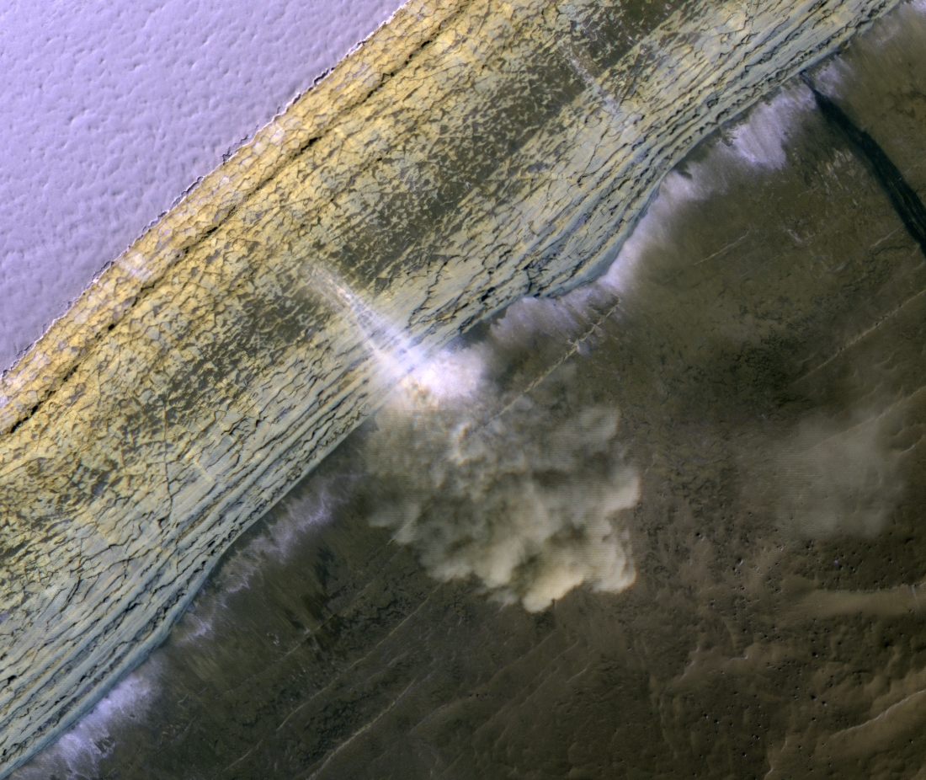
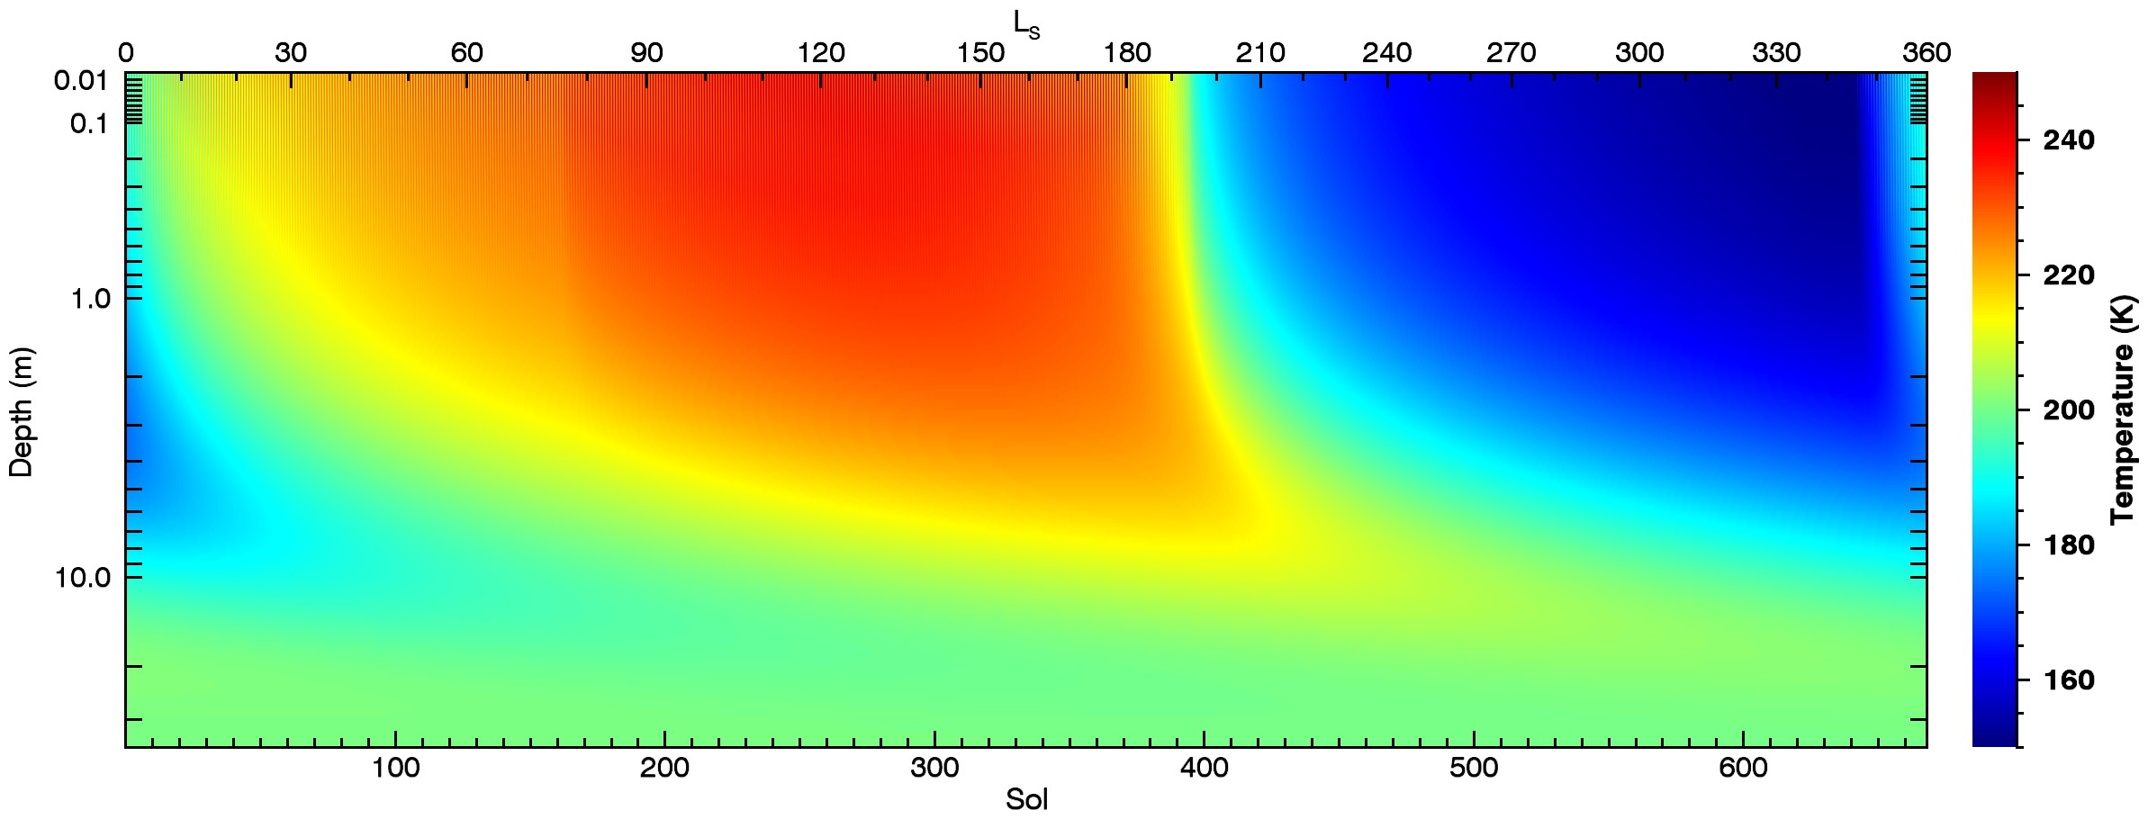
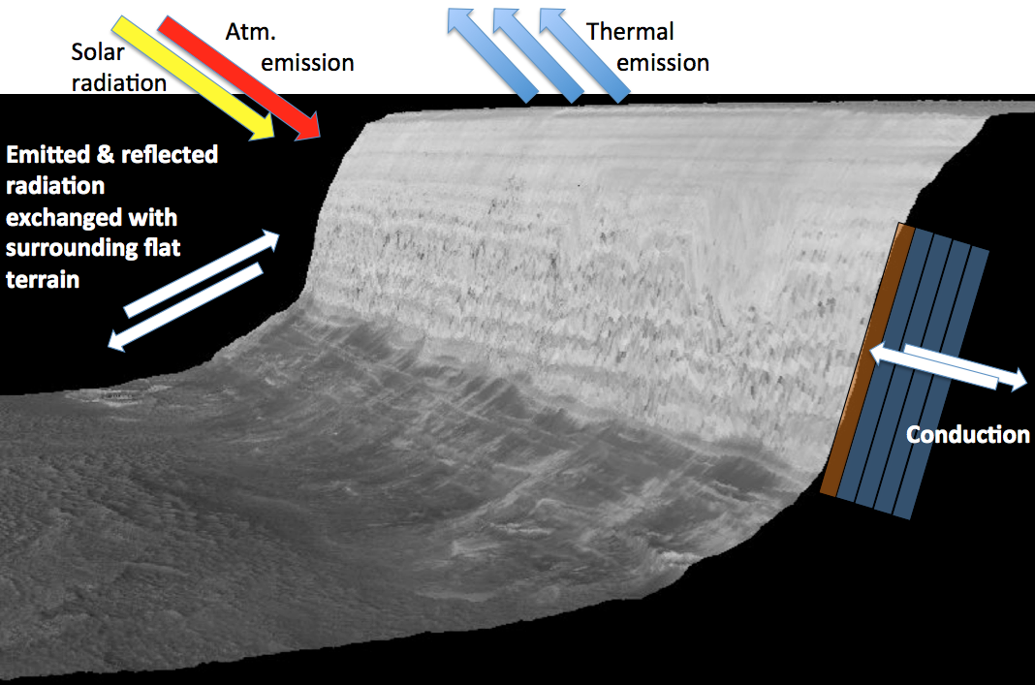
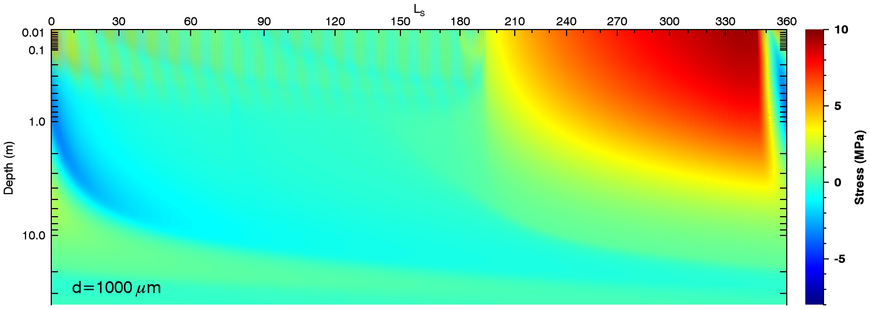
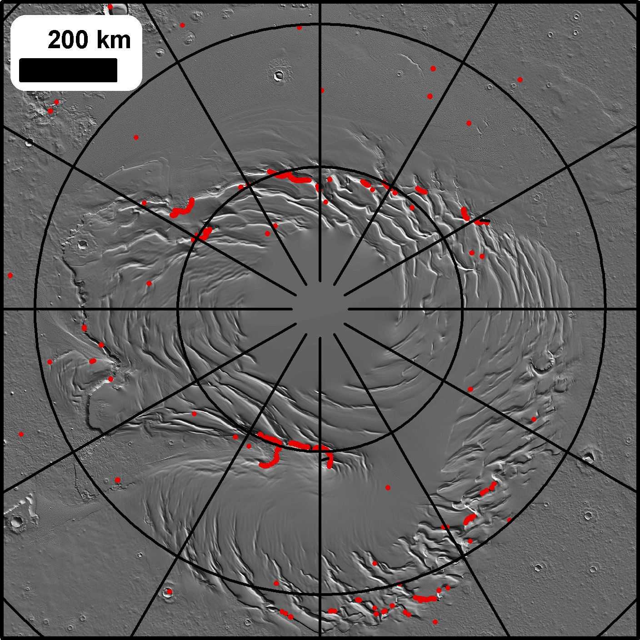
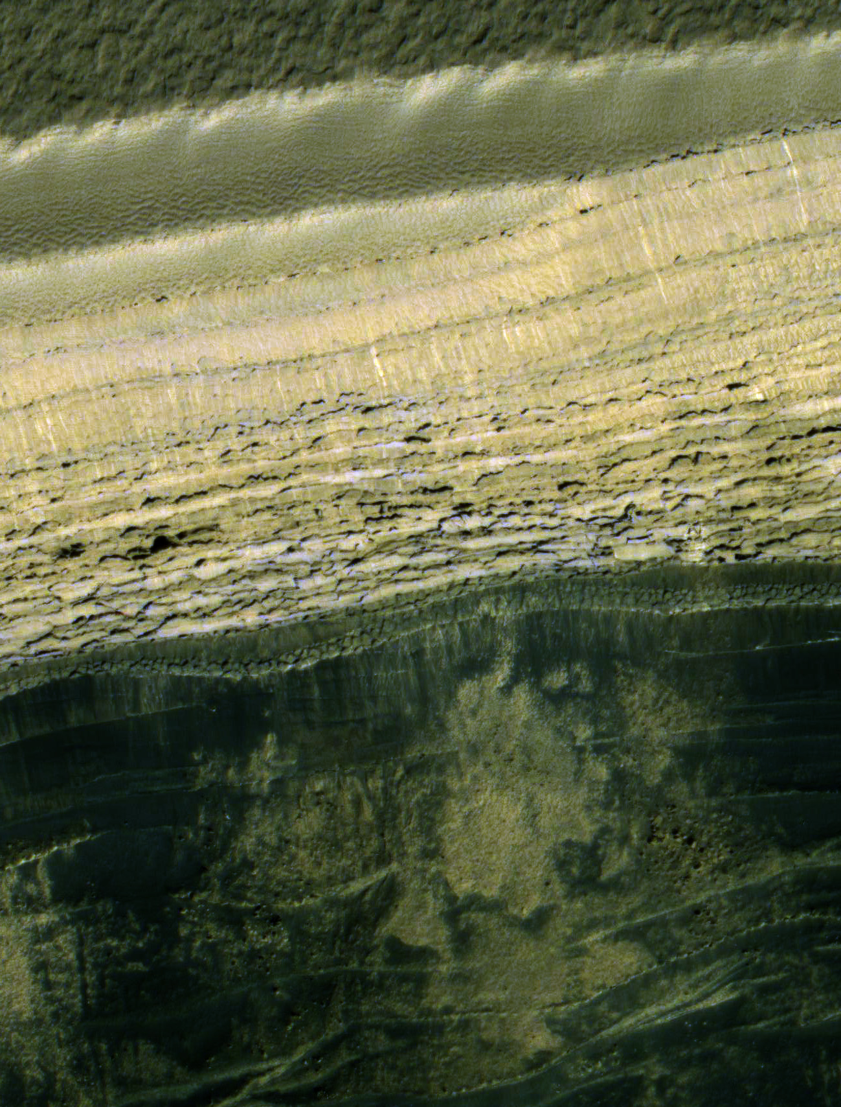
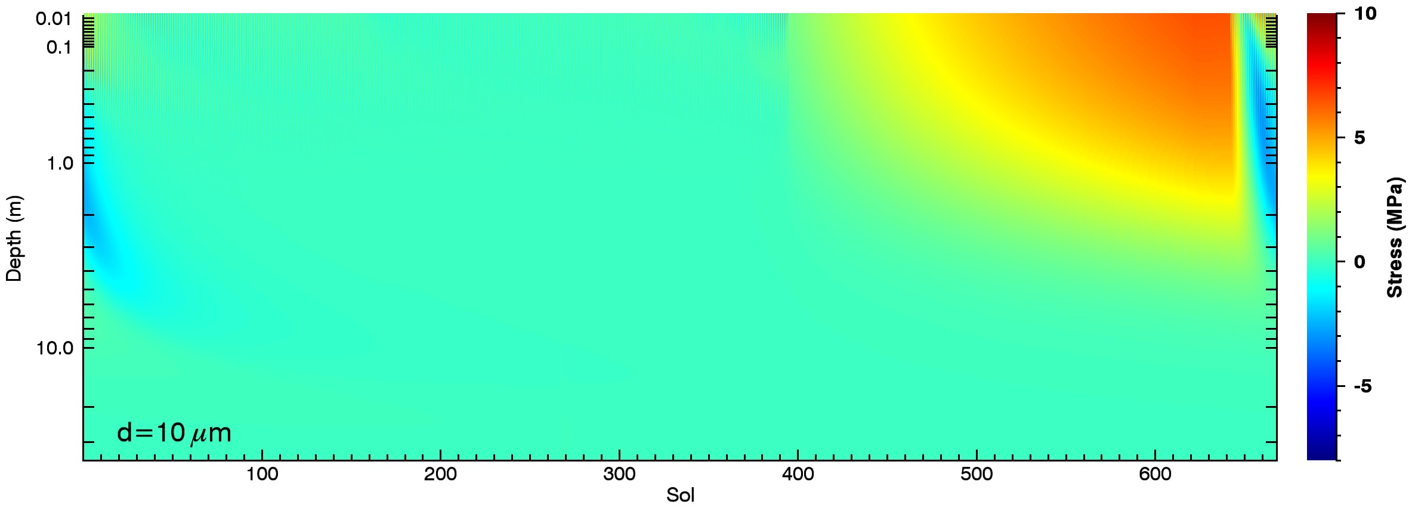
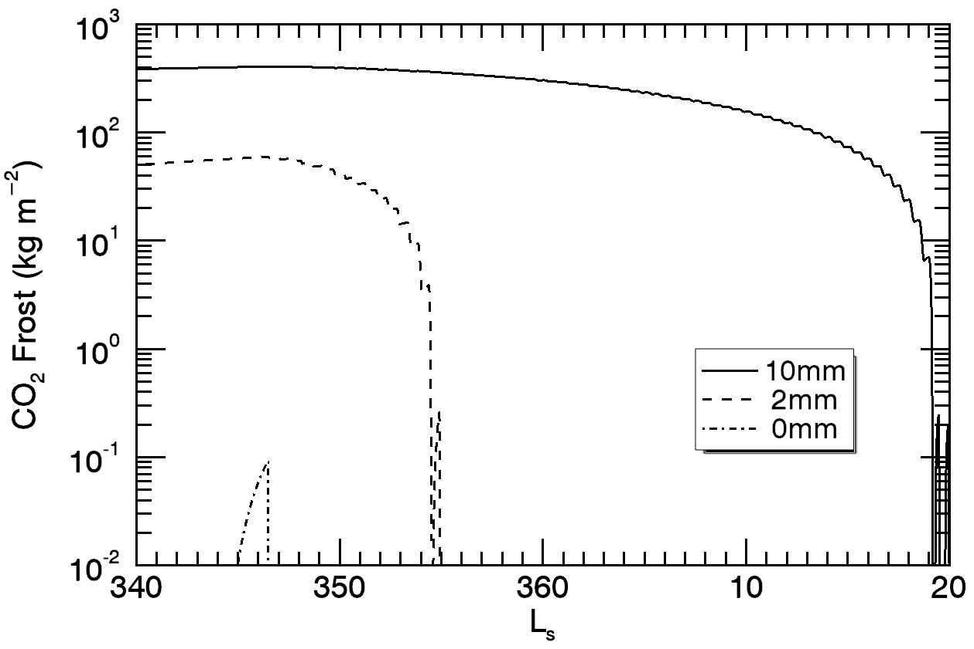
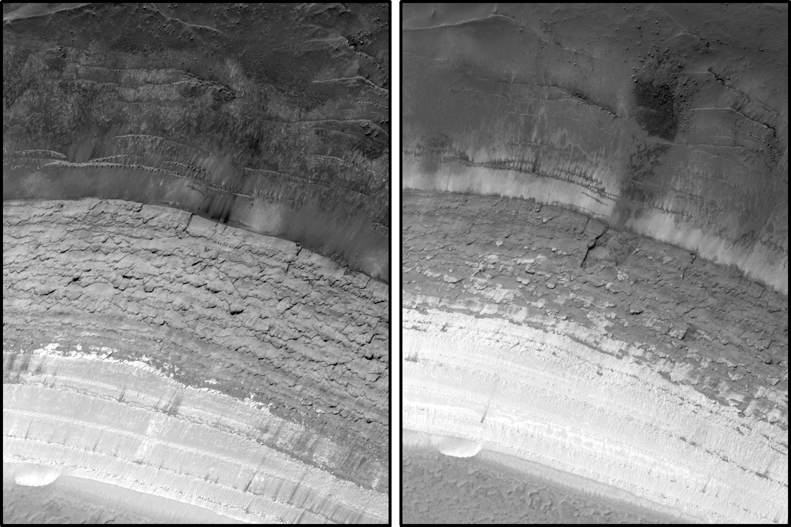
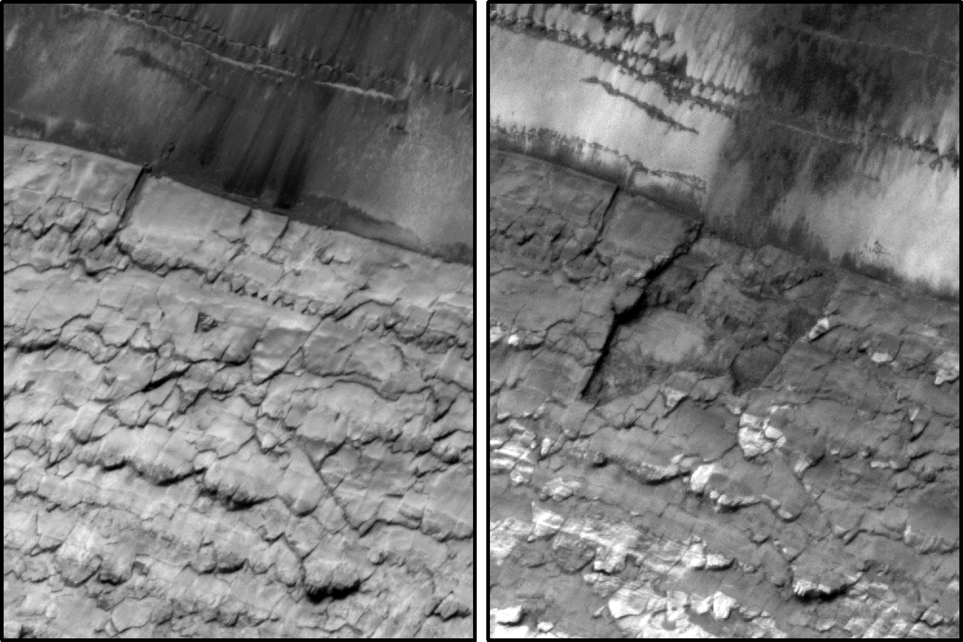
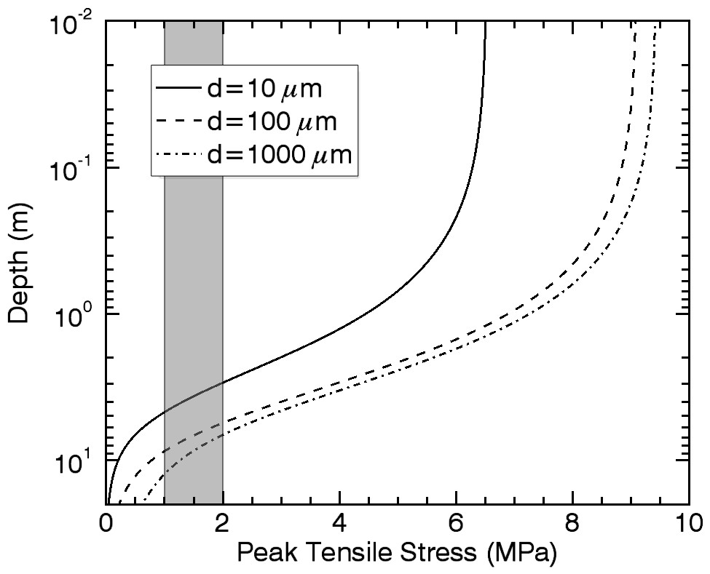
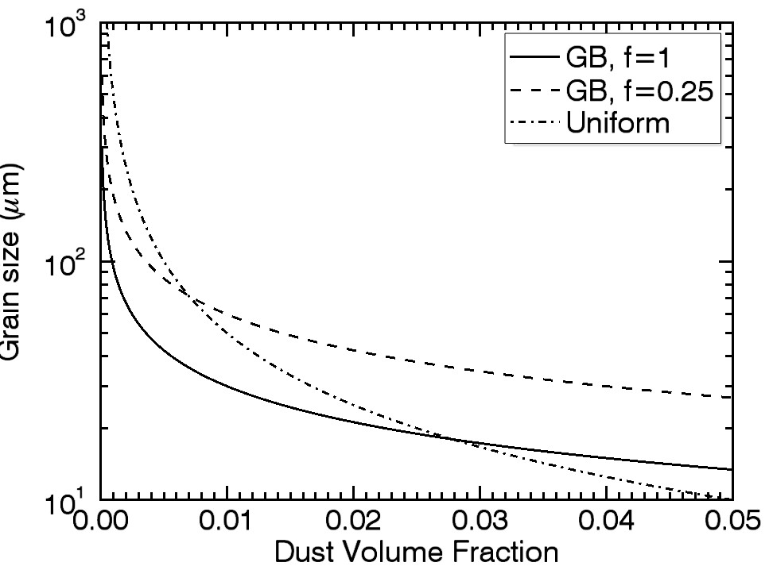
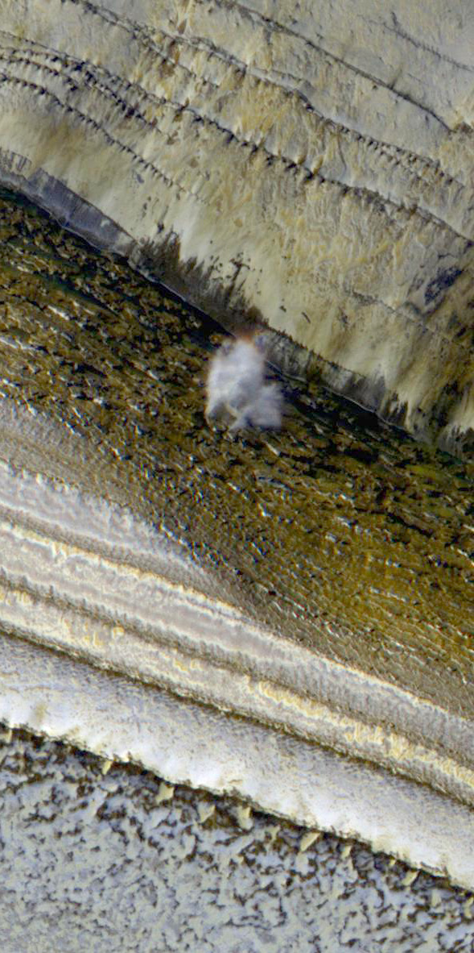
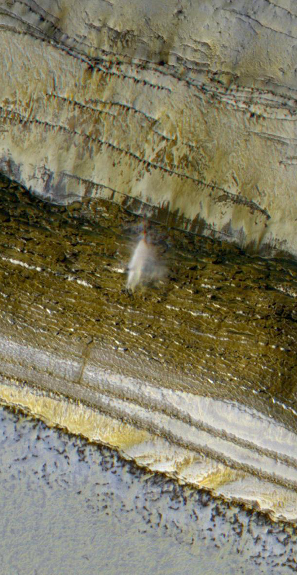
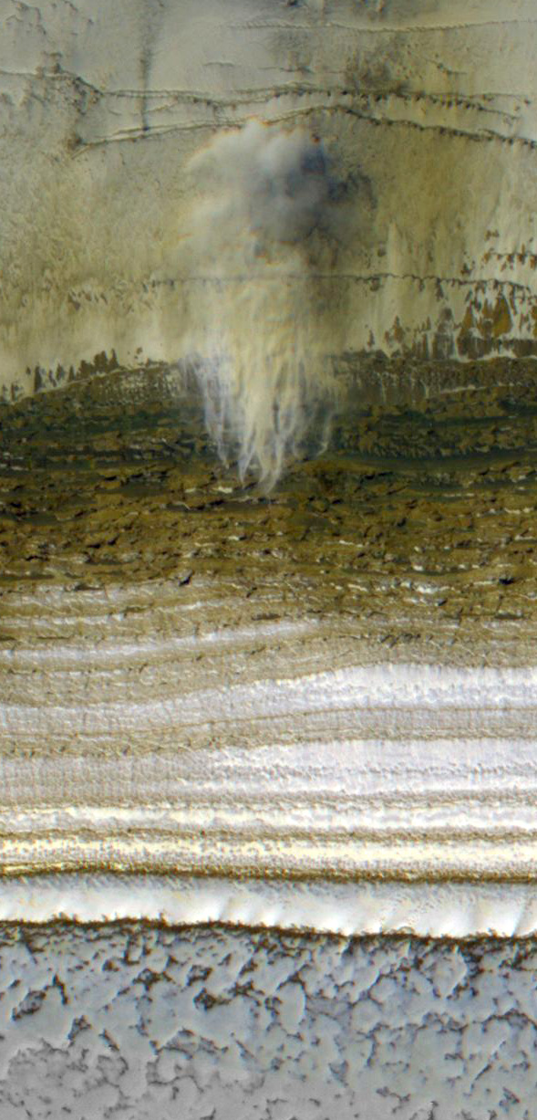
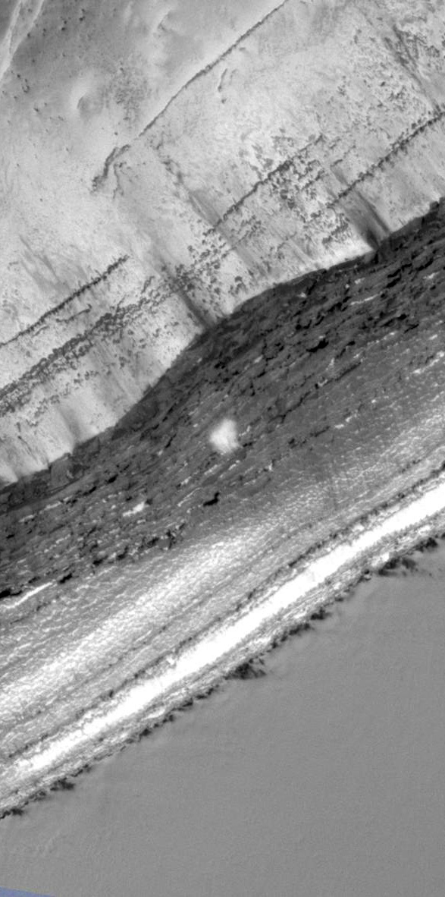
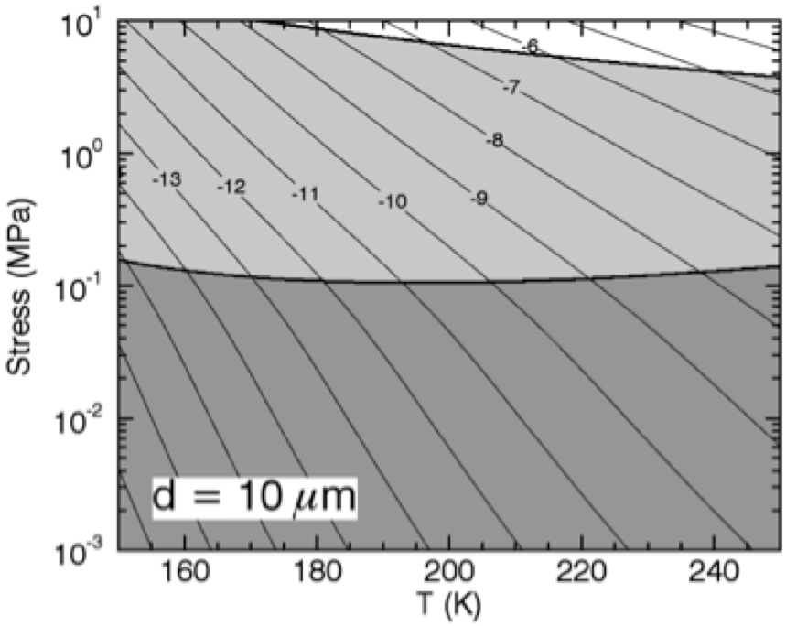
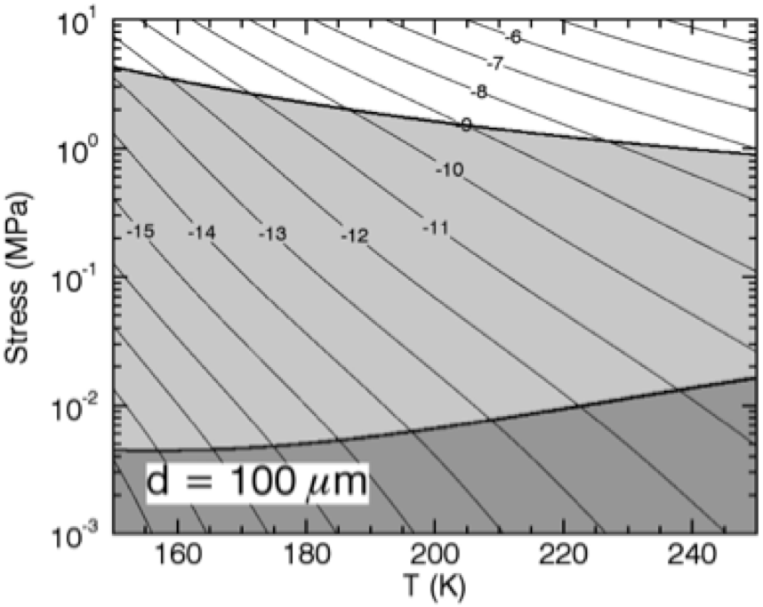
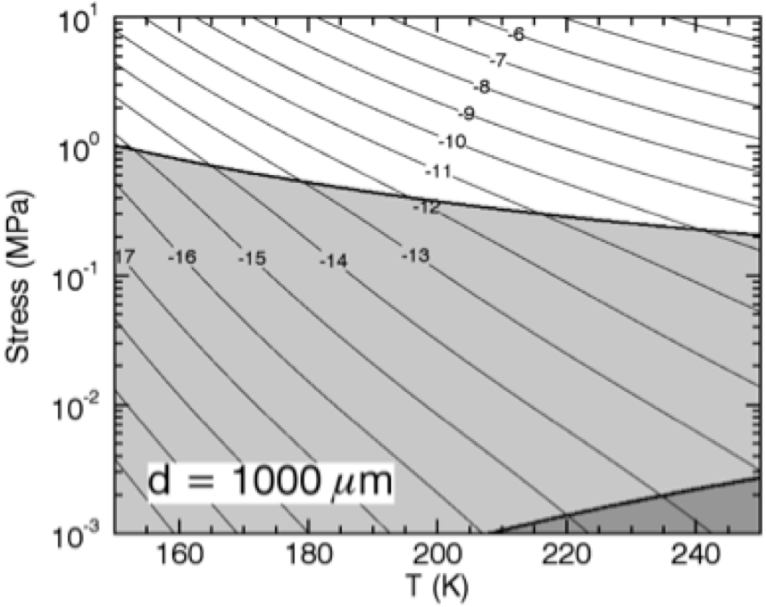
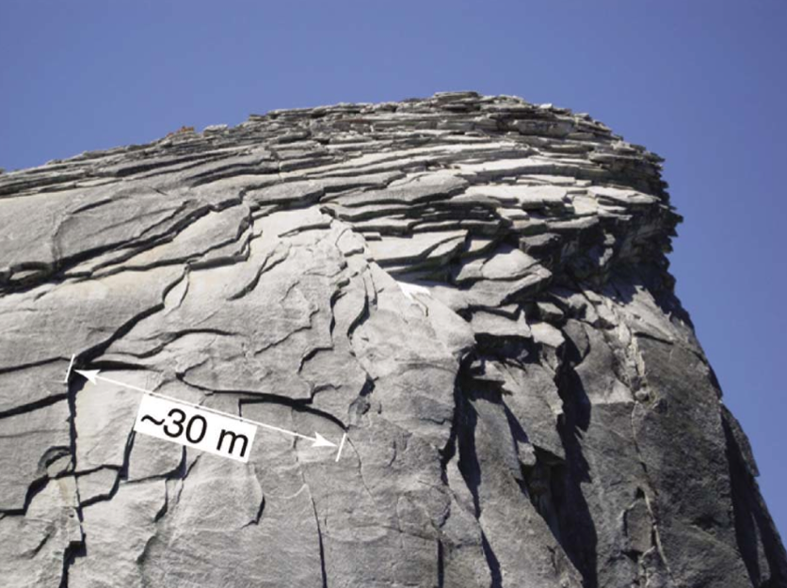
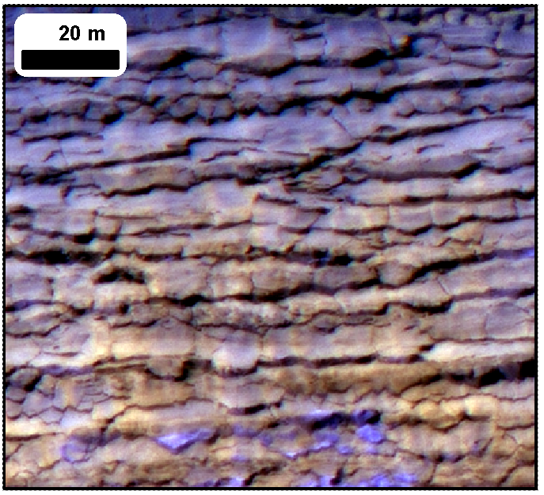
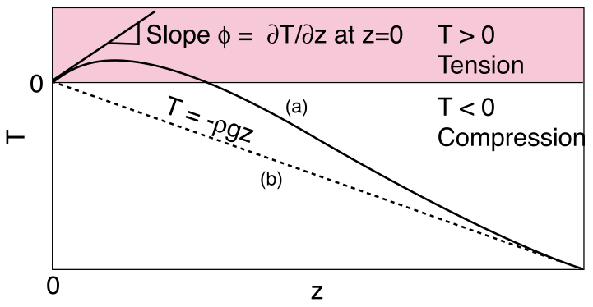
Icy Polar Cliffs: Stressed Out and Falling to Pieces
S. Byrne, P.S. Russell, A.V. Pathare, P. Becerra, J.L. Molaro, S.S. Mattson, M.T. Mellon and the HiRISE Team
30 second summary…
Blockfalls and pervasive cracking are common on steep (70°) north polar cliffs
Models show thermoelastic stresses from wintertime cooling can easily produce the cracks
Exfoliation of slab-like fragments can be explained with compressive thermoelastic stresses and surface curvature
Model
We model temperatures on these inclined scarps with a semi-implicit subsurface thermal conduction model.
Surrounding flat surfaces are modeled separately to calculate reflected and emitted radiation from them to the scarp.
Dust cover thickness
is a critical parameter
Results
Temperature results for a SW-facing 70° slope as a function of depth and season
Resultant stresses for 1 and 0.01 mm grains
Stresses at the surface (below) easily exceed the tensile strength of water ice (1-2 Mpa)
How about surface-parallel joints & slab exfoliation? Compression (in early spring especially) and scarp curvature can lead to surface-normal tension below the surface (Martel, GRL, 2011). Falling fragments may trigger the avalanches.
Observations
See Russell et al. poster nearby
ESP_032616_2640 shows the scarp defrosted at L_{s} 350 and puts a constraint of 0-2mm on any dust.
Locations and appearance of steep (>35°) slopes
Calculation of stress follows the method of Mellon (JGR, 1997). Thermal expansion/contraction causes scarp-parallel compression/tension.
No stresses
perpendicular to
the scarp.
High roll images toward the scarp are the best way to look for changes.
Slab-like fragments (this one was 70m across) are exfoliated.
Debris at the base of these scarps is common.
Images are ESP_016292_2640 & ESP_024639_2640
where
Viscous strain rate (Goldsby & Kohlsedt, JGR, 2001) is grain size dependent.
Peak tensile stress exceeds ice strength down to several meters, although some model assumptions start to break down. So surface-perpendicular cracks are easy to form.
We use Zenner pinning (Durand et al., JGR, 2006) to estimate grain sizes from SHARAD dust abundances.
Deformation maps under relevant conditions show that dislocation creep (white) dominates at high T and stresses, grain-size sensitive creep (light-gray, basal slip and grain-boundary sliding) dominates for small grains. Diffusion (dark gray) dominates at low stresses.
Avalanches are also common in the early spring – sometimes (above) there are up to four simultaneous avalanches occurring in a single image.
This model has been previously applied to terrestrial granitic domes

