Slide 1
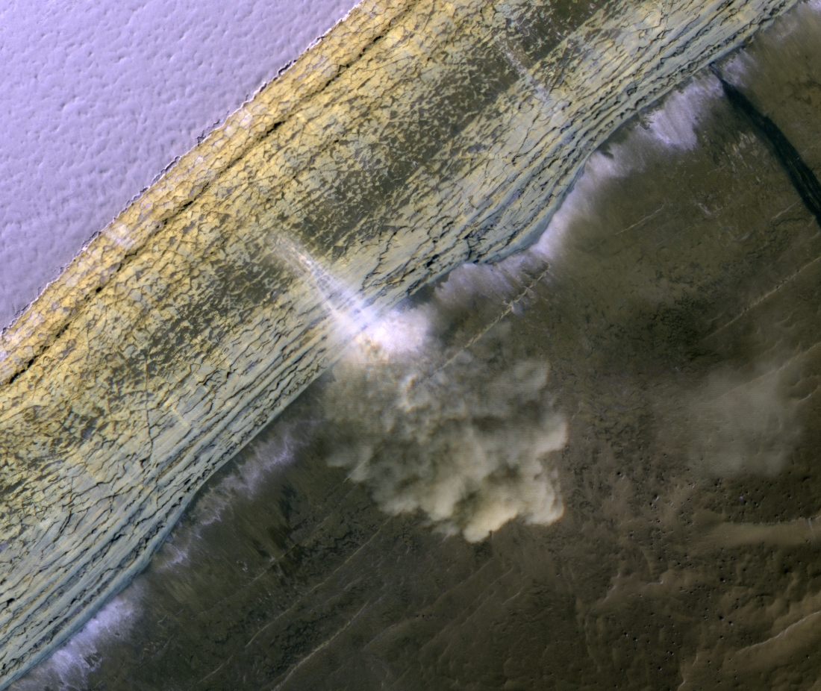
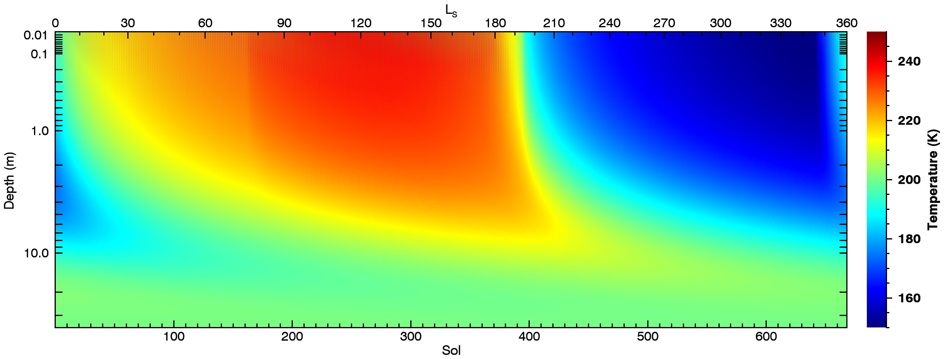
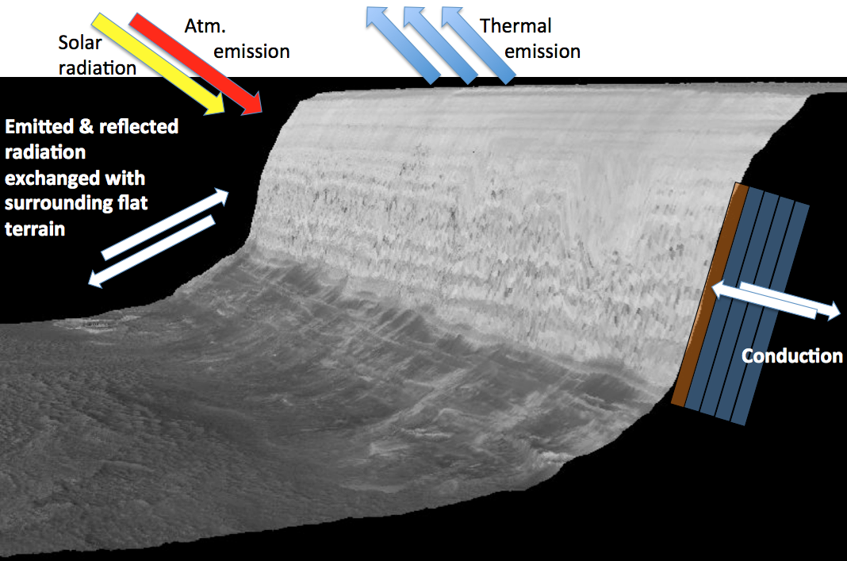
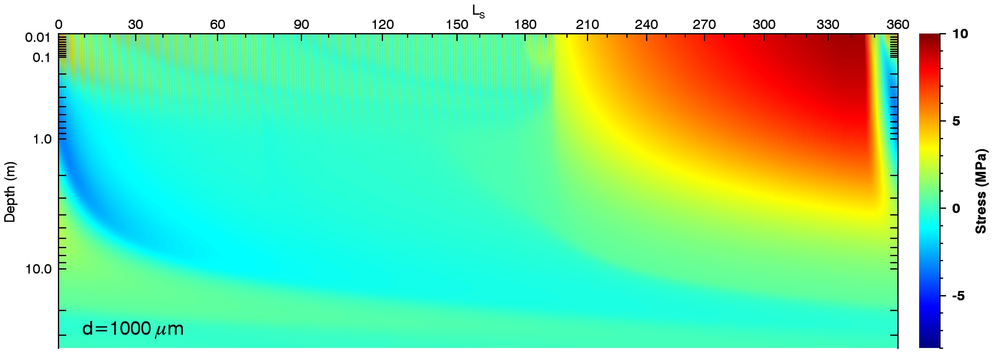
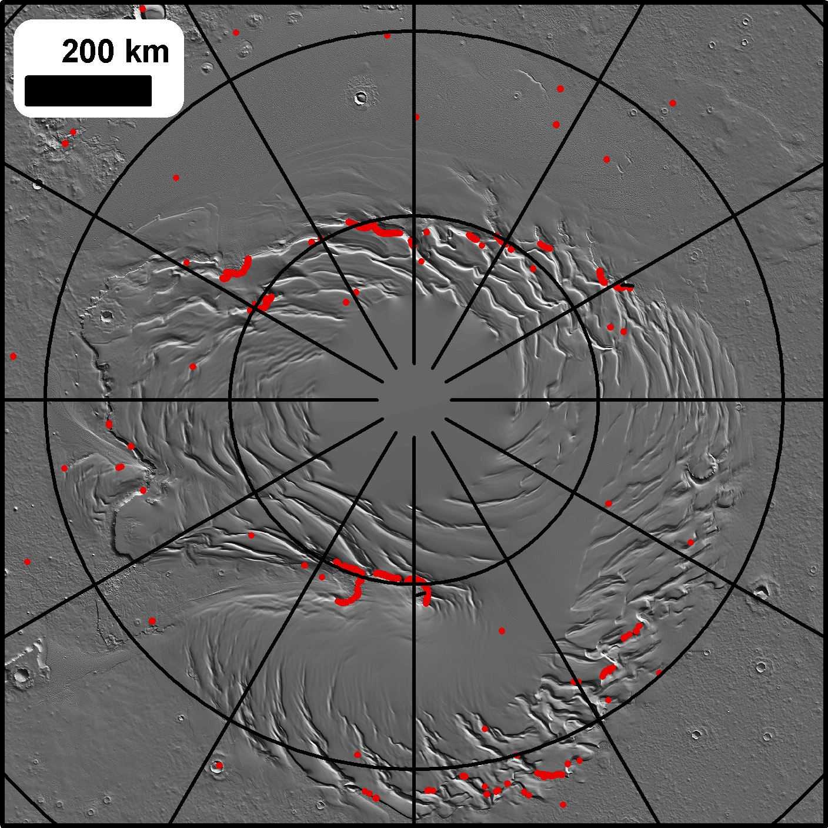
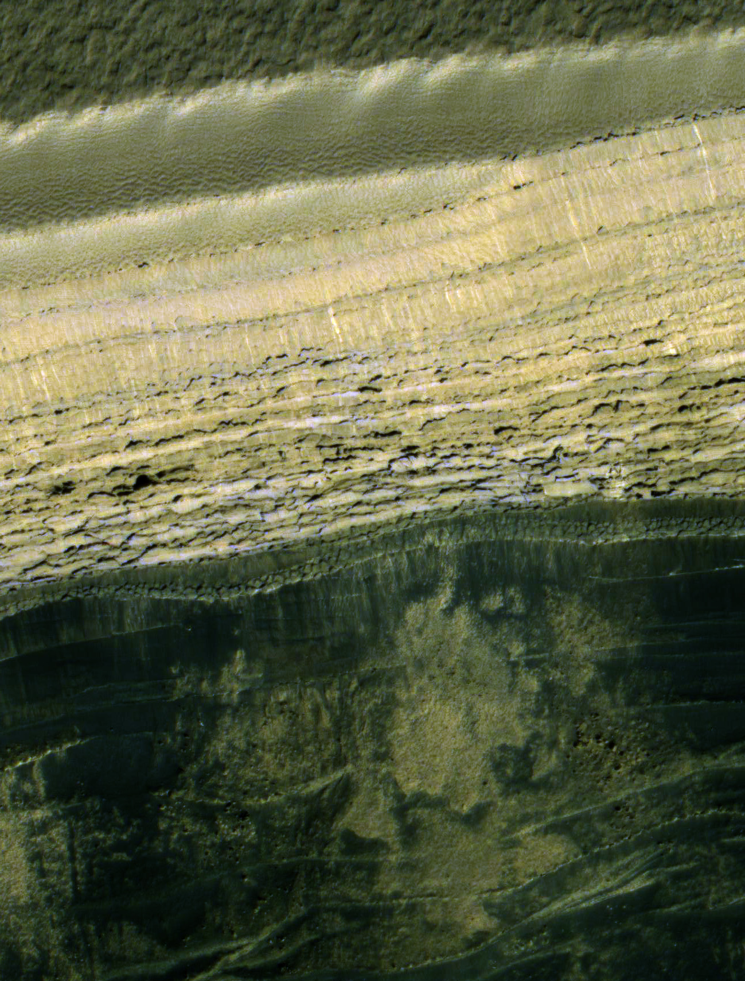
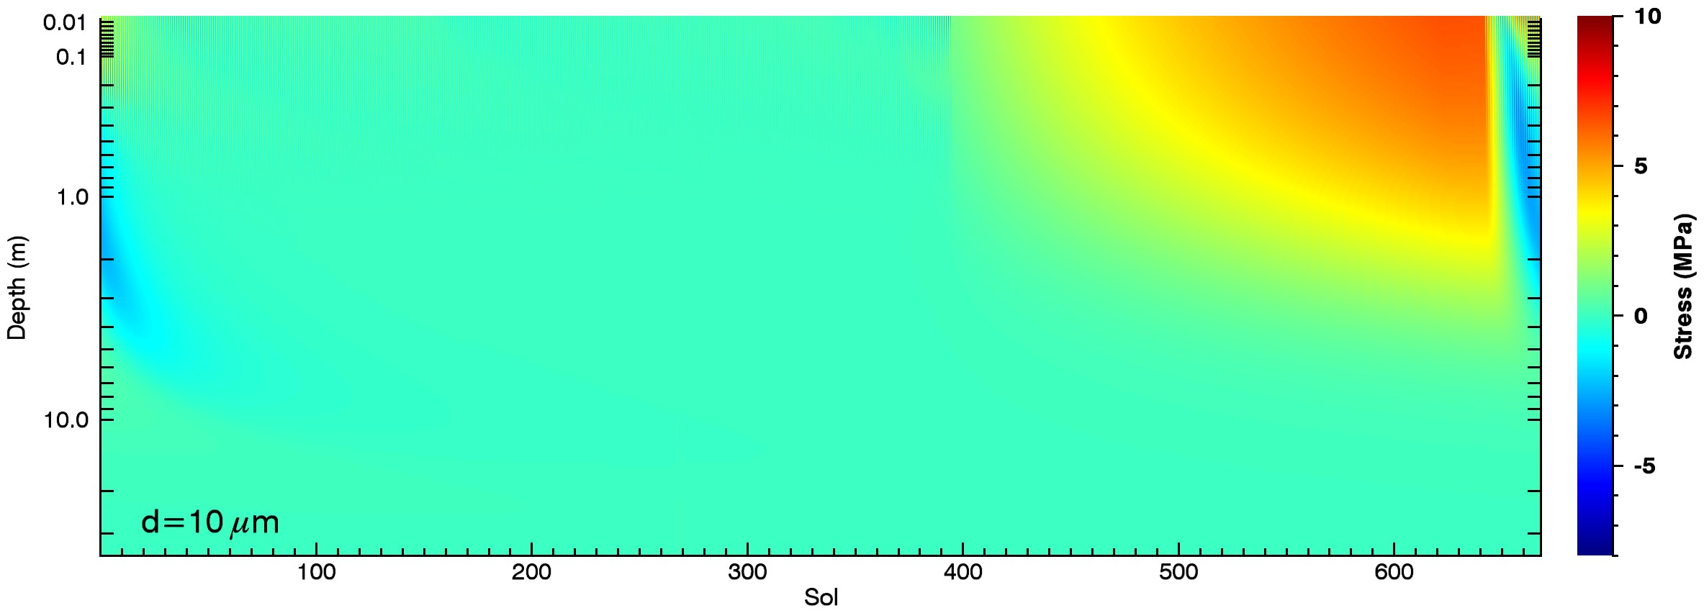
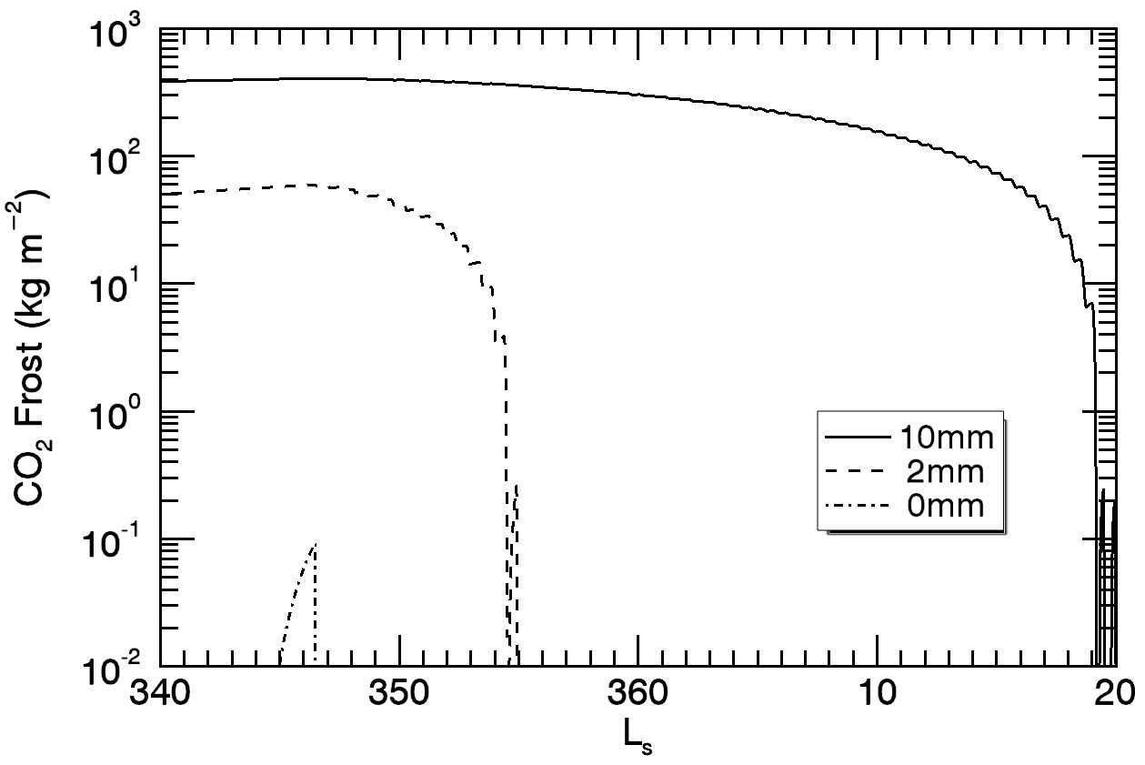
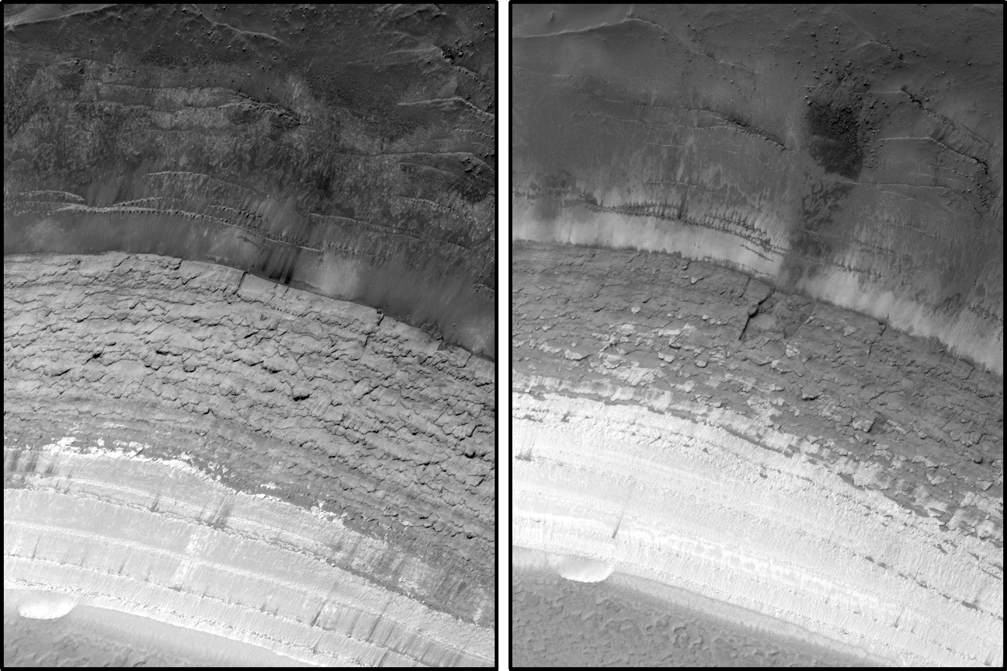
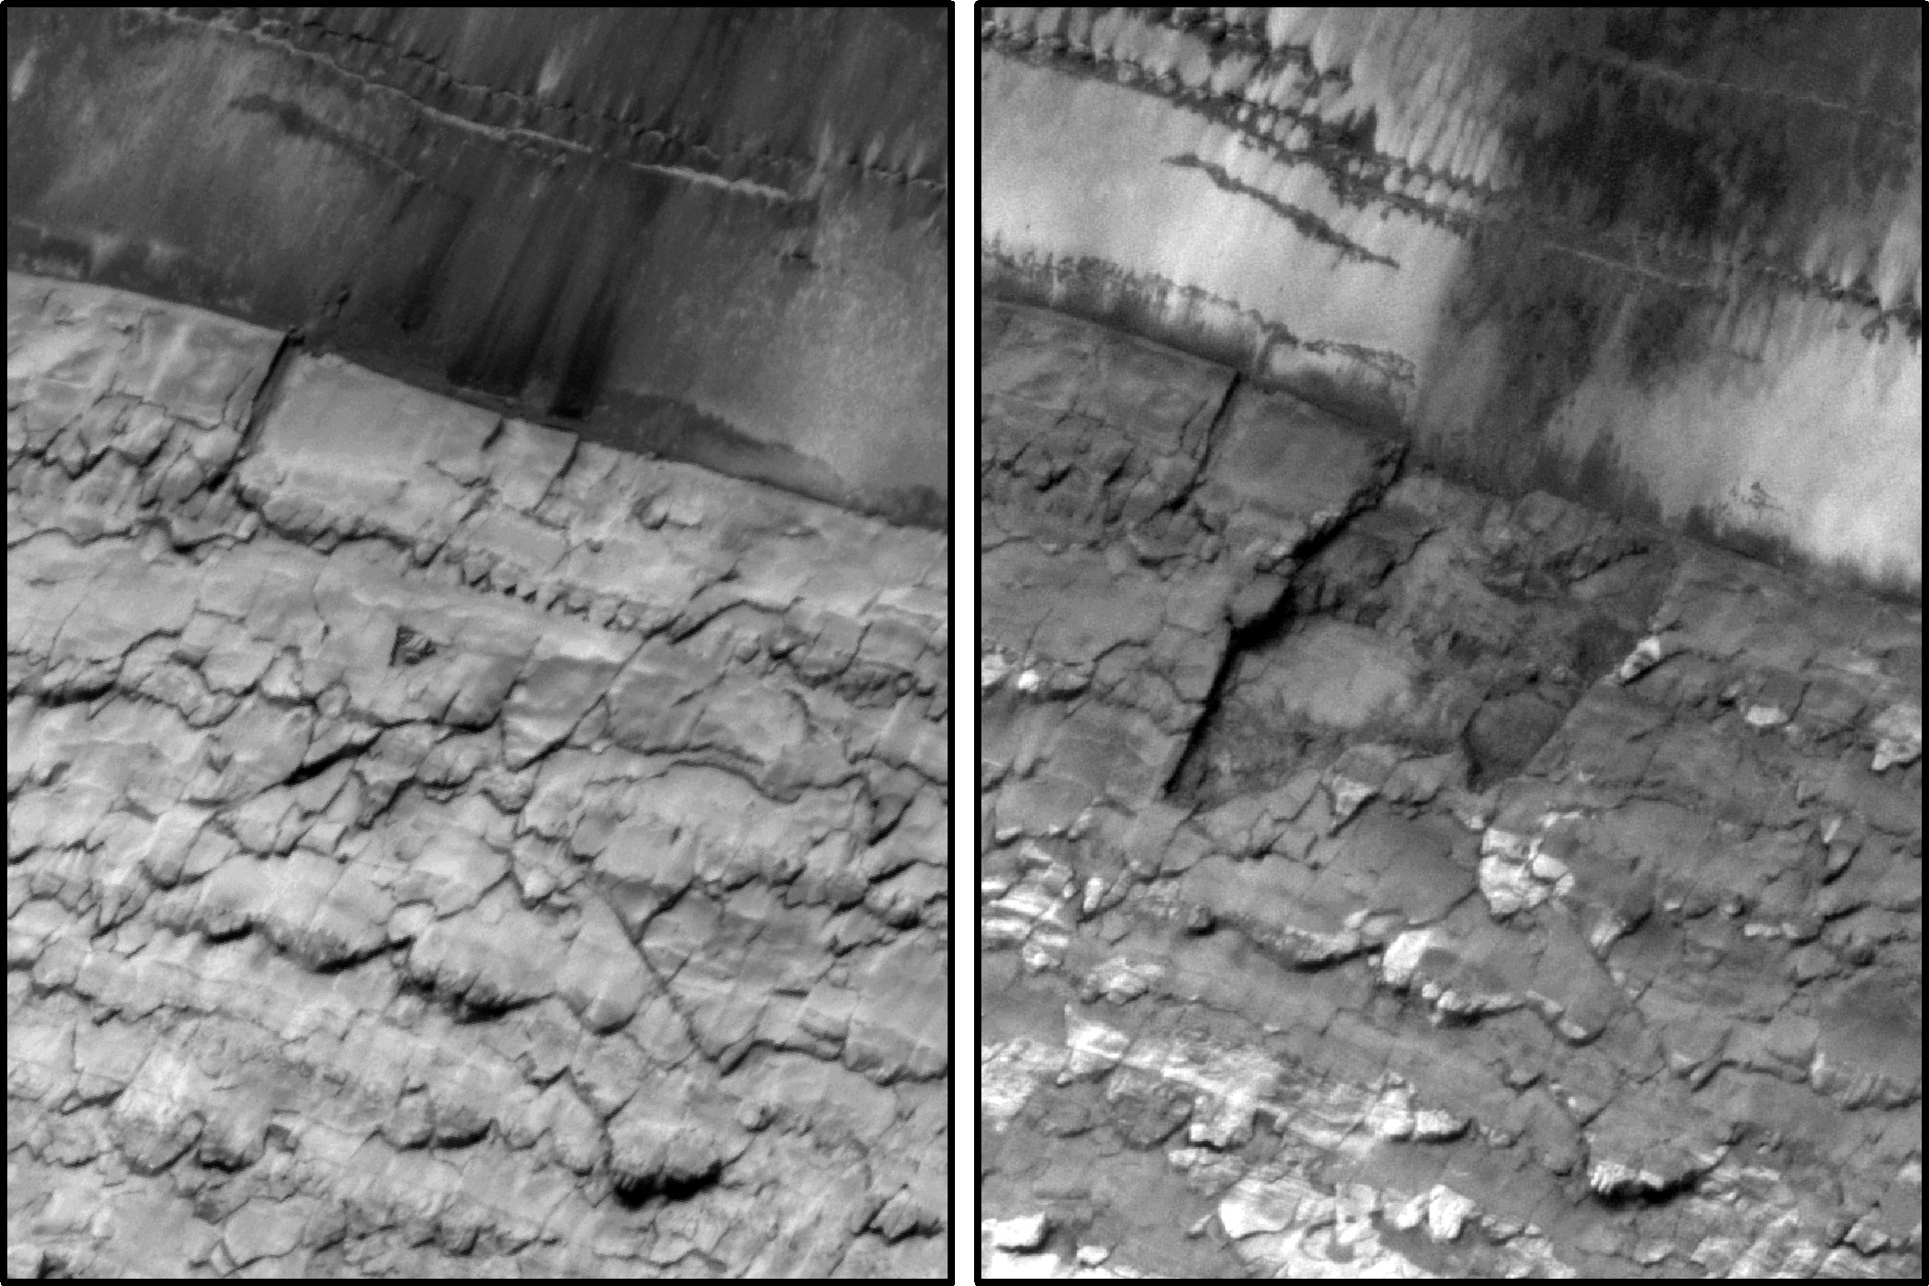
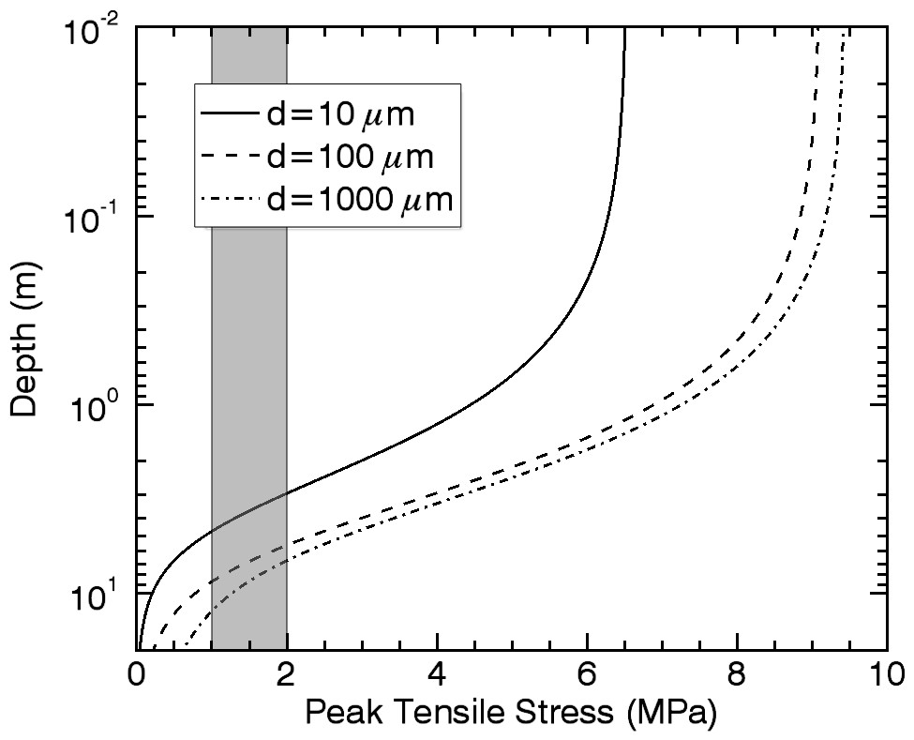
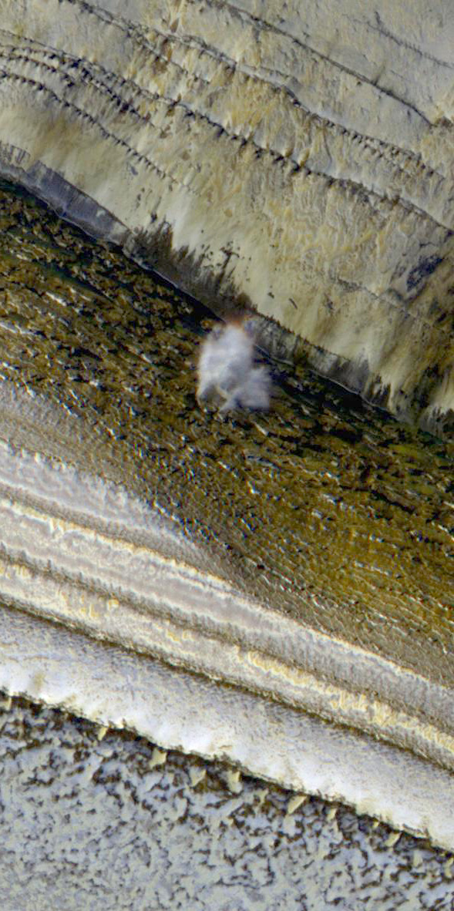
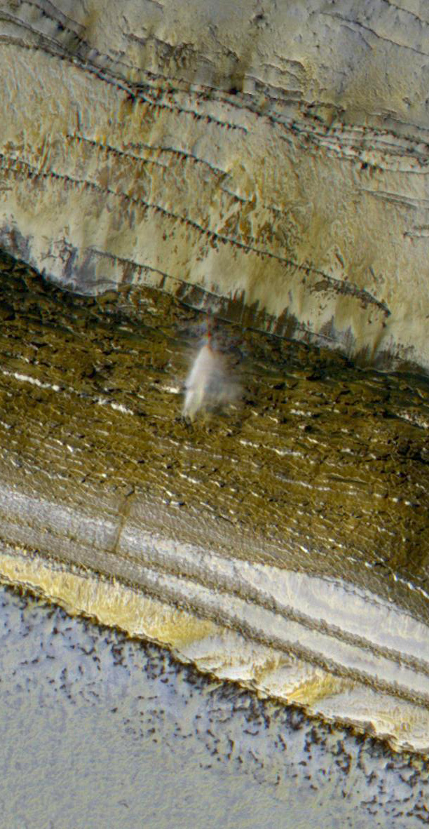
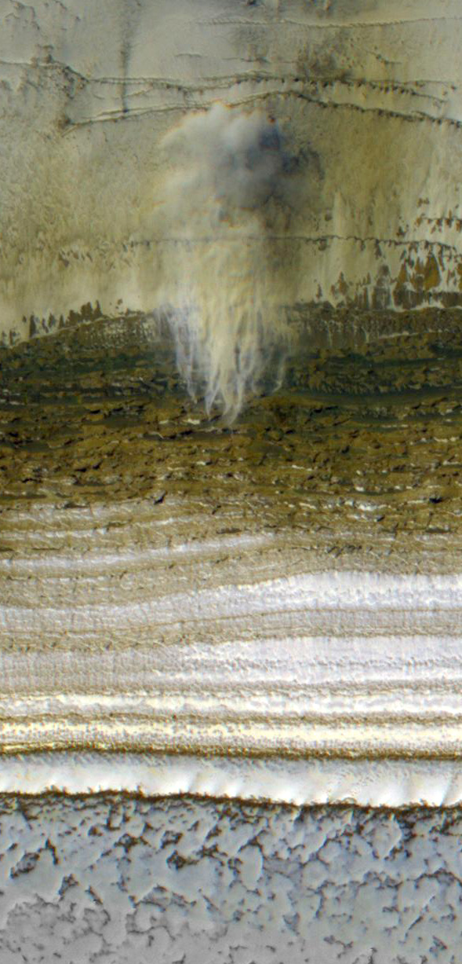
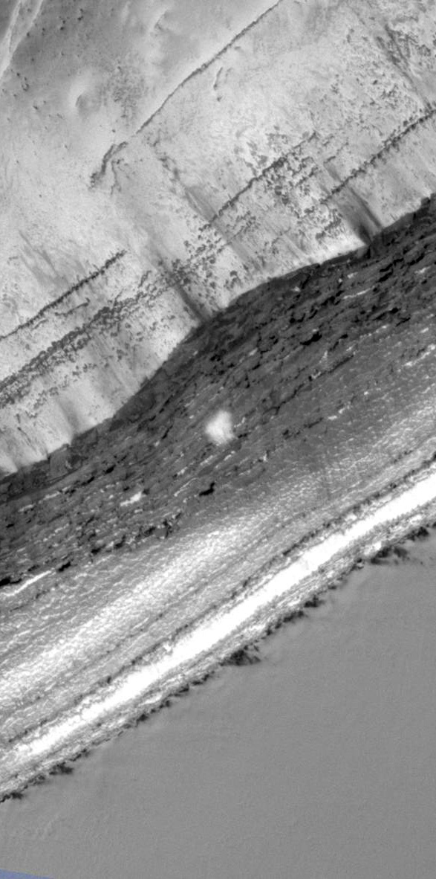
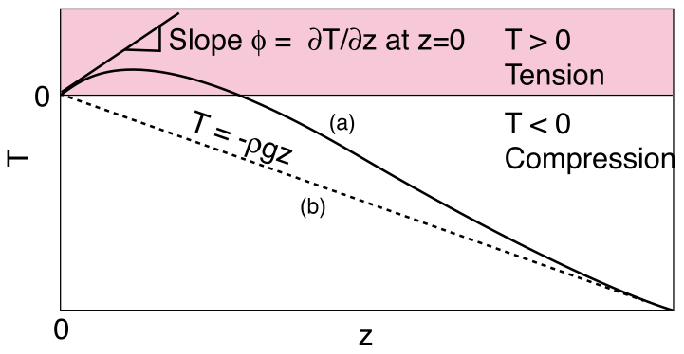
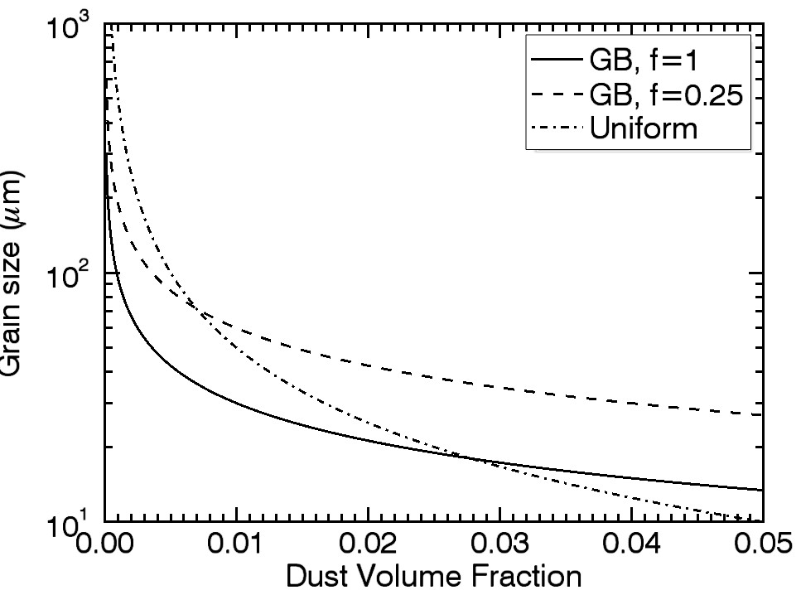
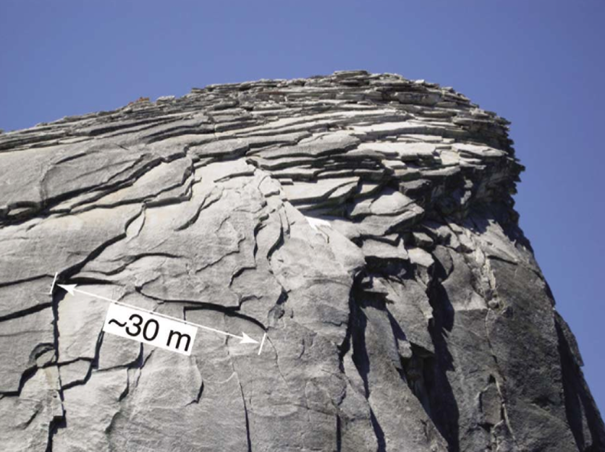
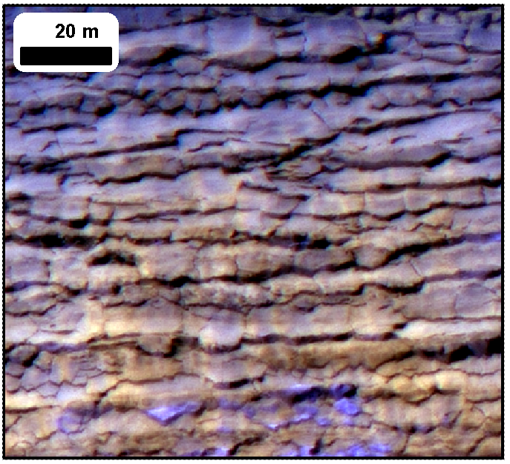
Icy Polar Cliffs: Stressed Out and Falling to Pieces
S. Byrne, P.S. Russell, A.V. Pathare, P. Becerra, J.L. Molaro, S.S. Mattson, M.T. Mellon and the HiRISE Team
30 second summary…
Blockfalls and pervasive cracking are common on steep (70°) north polar cliffs
Models show thermoelastic stresses from wintertime cooling can easily produce the cracks
Exfoliation of slab-like fragments can be explained with compressive stresses and surface curvature
Model
We model temperatures on these inclined scarps with a semi-implicit subsurface thermal conduction model.
Surrounding flat surfaces are modeled separately to calculate reflected and emitted radiation from them to the scarp.
Dust cover thickness
is a critical parameter
Results
Temperature results for a SW-facing 70° slope as a function of depth and season
Resultant stresses for 1 and 0.01 mm grains
Observations
See Russell et al. poster nearby
Locations and appearance of steep (>35°) slopes
ESP_032616_2640 shows the scarp defrosted at L_{s} 350 and puts a constraint of 0-2mm on any dust.
Stresses at the surface (below) easily exceed the tensile strength of water ice (1-2 Mpa)
High roll images toward the scarp are the best way to look for changes.
Slab-like fragments (this one was 70m across) are exfoliated.
Debris at the base of these scarps is common.
Images are ESP_016292_2640 & ESP_024639_2640
Calculation of stress follows the method of Mellon (JGR, 1997). Thermal expansion/contraction causes scarp-parallel compression/tension.
No stresses perpendicular to the scarp.
where
Peak tensile stress exceeds ice strength down to several meters. So surface-normal cracks are easy to form. How about surface-parallel joints & slab exfoliation?
Viscous strain rate (Goldsby & Kohlsedt, JGR, 2001) is grain size dependent.
We use Zenner pinning (Durand et al., JGR, 2006) to estimate grain sizes from SHARAD dust abundances.
Compression and scarp curvature can lead to surface-normal tension below the surface (Martel, GRL, 2011). Falling fragments may trigger the avalanches.
Avalanches are also common in the early spring – sometimes (above) there are up to four simultaneous avalanches occur in a single image.

