Slide 1
Mars Geology – Ice
Shane Byrne (shane@lpl.arizona.edu)

Slide 2
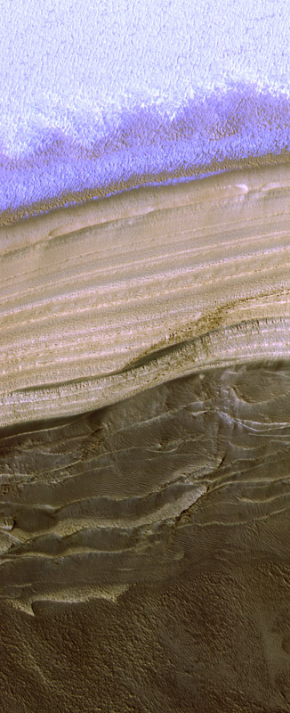
Three things to consider
  Seasonal frost
  Residual Ice Caps
  Polar layered deposits and mid-latitude ground ice
PSP_001378_2640

Slide 3
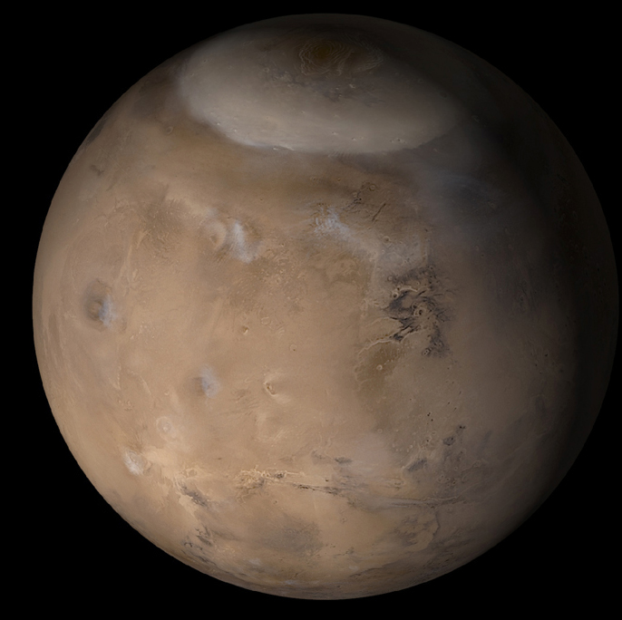
Seasonal frost on Mars
  Major feature of martian seasons
  Exotic CO₂ ice processes
  Seasonal timescale of 686 days
Residual ice caps
  Interacting with current climate
  Affected by global dust storms
  10⁰ to 10² years (South)
  10³ to 10⁴ years (North)
Polar layered deposits
  Record of changing climate
  Linked to orbital variations
  10⁵ to 10⁷ years
Older Polar deposits
MOC wide angle, msss.com

Slide 4
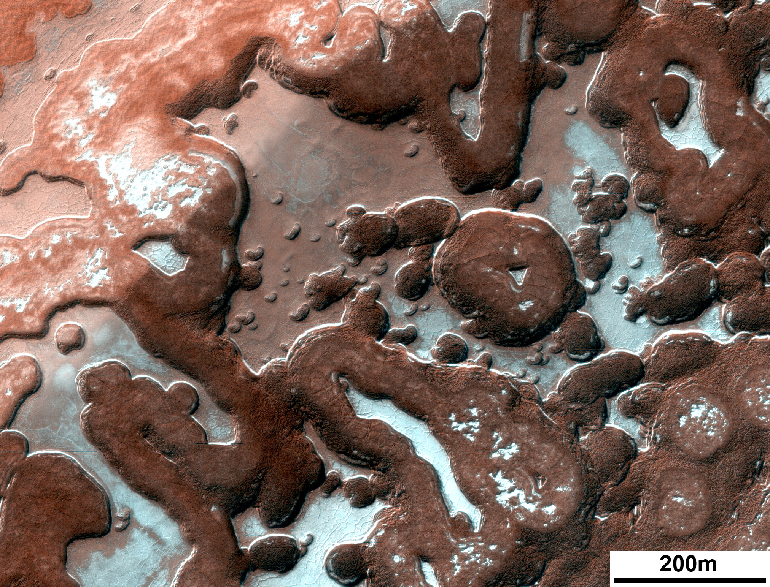
Seasonal frost on Mars
  Major feature of martian seasons
  Exotic CO₂ ice processes
  Seasonal timescale of 686 days
Residual ice caps
  Interacting with current climate
  Affected by global dust storms
  10⁰ to 10² years
Polar layered deposits
  Record of changing climate
  Linked to orbital variations
  10⁵ to 10⁷ years
Older Polar deposits
PSP_006270_0955

Slide 5
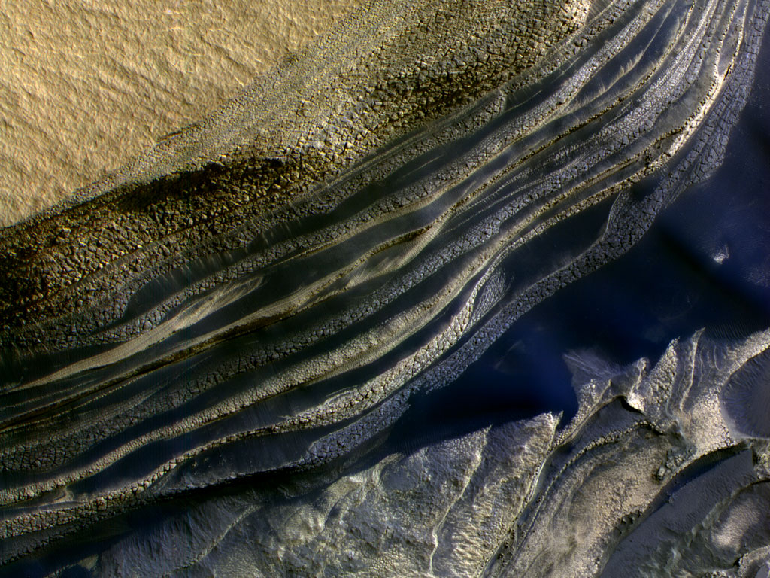
Seasonal frost on Mars
  Major feature of martian seasons
  Exotic CO₂ ice processes
  Seasonal timescale of 686 days
Residual ice caps
  Interacting with current climate
  Affected by global dust storms
  10⁰ to 10² years
Polar layered deposits
  Record of changing climate
  Linked to orbital variations
  10⁵ to 10⁷ years
Older Polar deposits
PSP_001334_2645

Slide 6
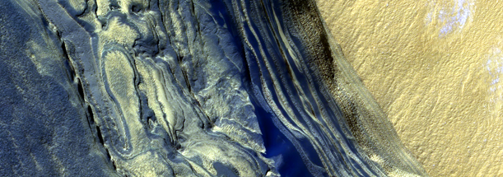
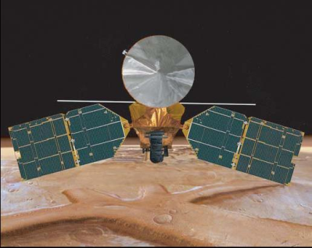
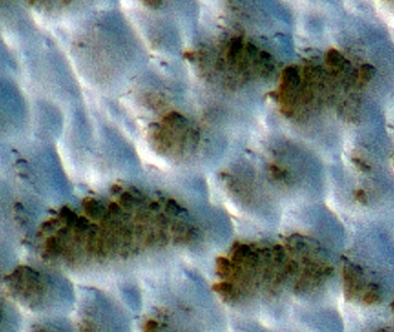
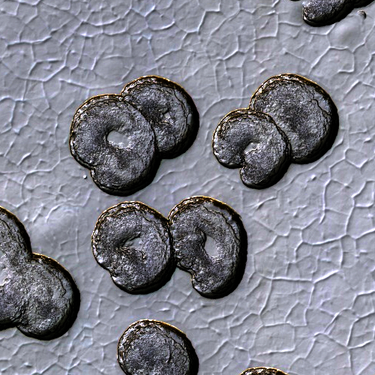
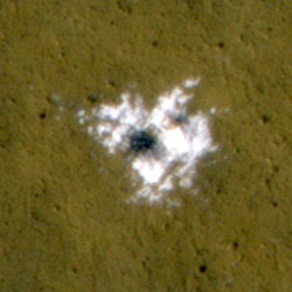
Climatic Record
Spacecraft Record
YEARS
10⁸
10⁷
10⁶
10⁵
10⁴
10³
10²
10¹
10⁰
Recent climatic variations
Interannual variability of the current climate

Slide 7
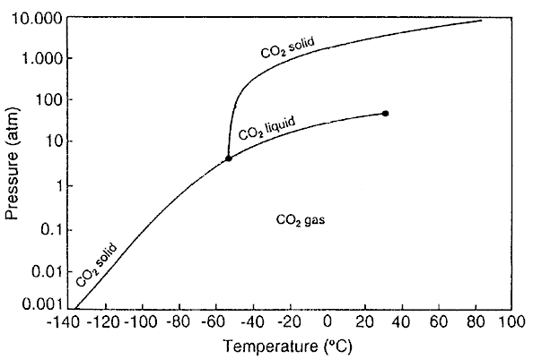
Seasonal Ice Caps
Mars has a similar obliquity (25°) to the Earth.
  Ensures seasons with periods of permanent polar darkness and daylight.
Mars has a low pressure CO₂ atmosphere.
  Permits seasonal icecaps of CO₂ ice to form
  Leighton and Murray (1966)

Slide 8
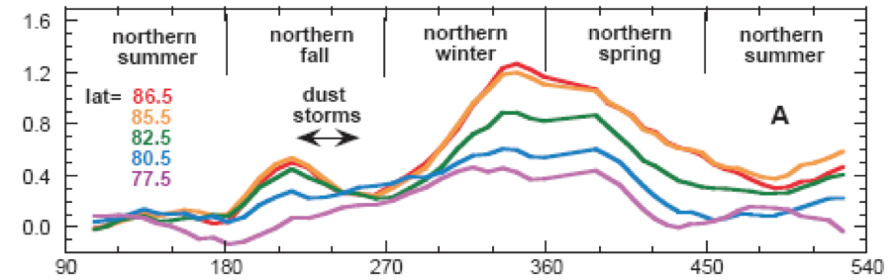
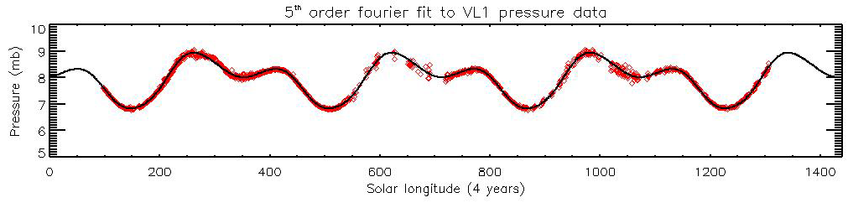
About 25% of the atmosphere condenses out as frost so the global atmospheric pressure fluctuates
Frost caps extend from the pole to the mid-latitudes and are ~1m thick
Smith et al., 2001

Slide 9


Slide 10
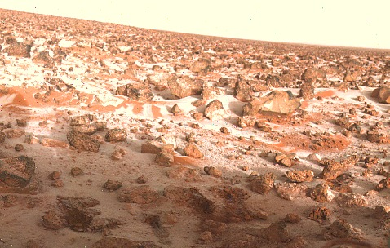
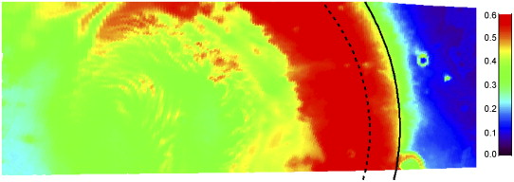
CO₂ not the only volatile in play….
Trace amounts of water frost are also present
Annulus of water frost tracks the edge of the retreating cap
Also repeatable each year
Water frost at the Viking Lander 2 site
Wagstaff et al., 2008

Slide 11
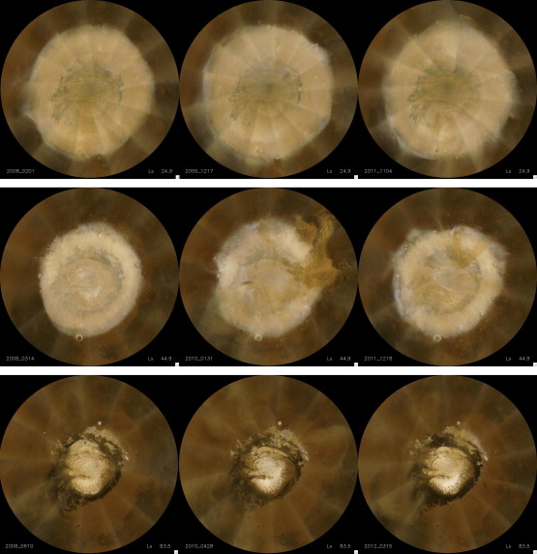
Seasonal caps run pretty much like clockwork each year
Residual caps are left at the north and south pole in the summer – more on them later
MY 29
MY 30
MY 31
L_{s} 25
L_{s} 45
L_{s} 84
Calvin et al. 2014

Slide 12
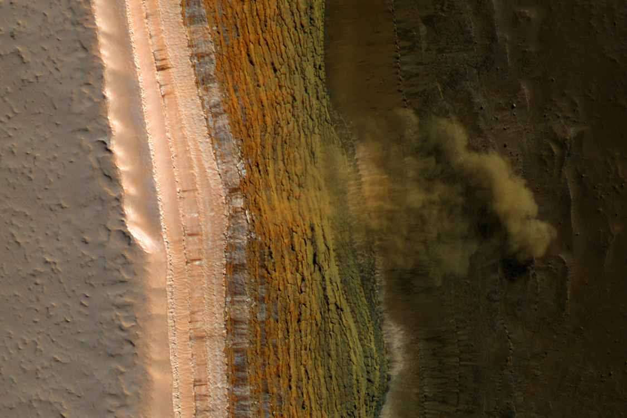

Slide 13
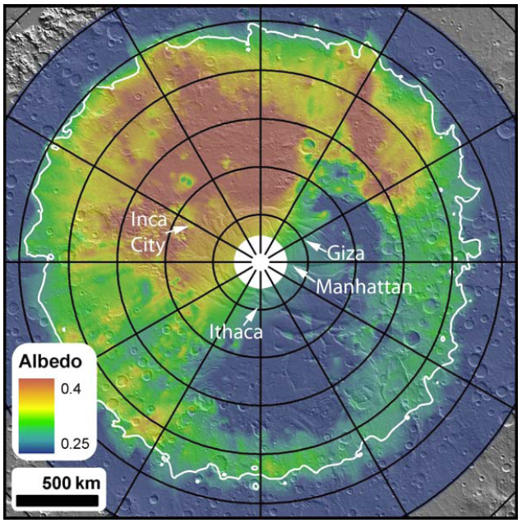
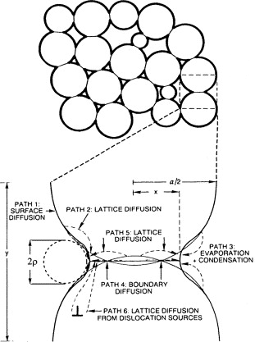
Cryptic behavior…
  Low albedo region inside the CO₂ cap
  Spectral indicators of large grain size
  Large areas anneal into a transparent slab in 100’s of days
Eluszkiewicz et al., 2005

Slide 14
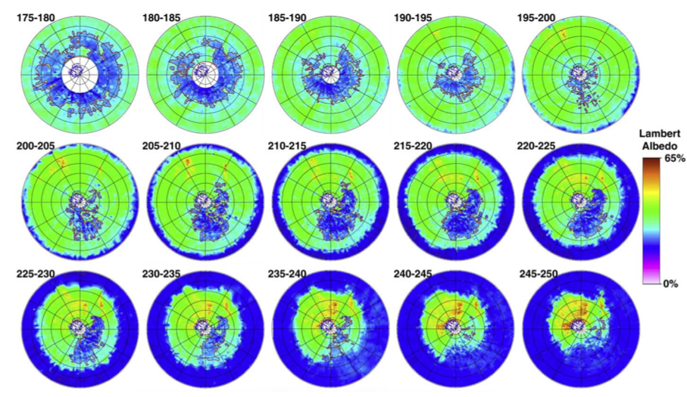
Piqueux et al. 2002

Slide 15
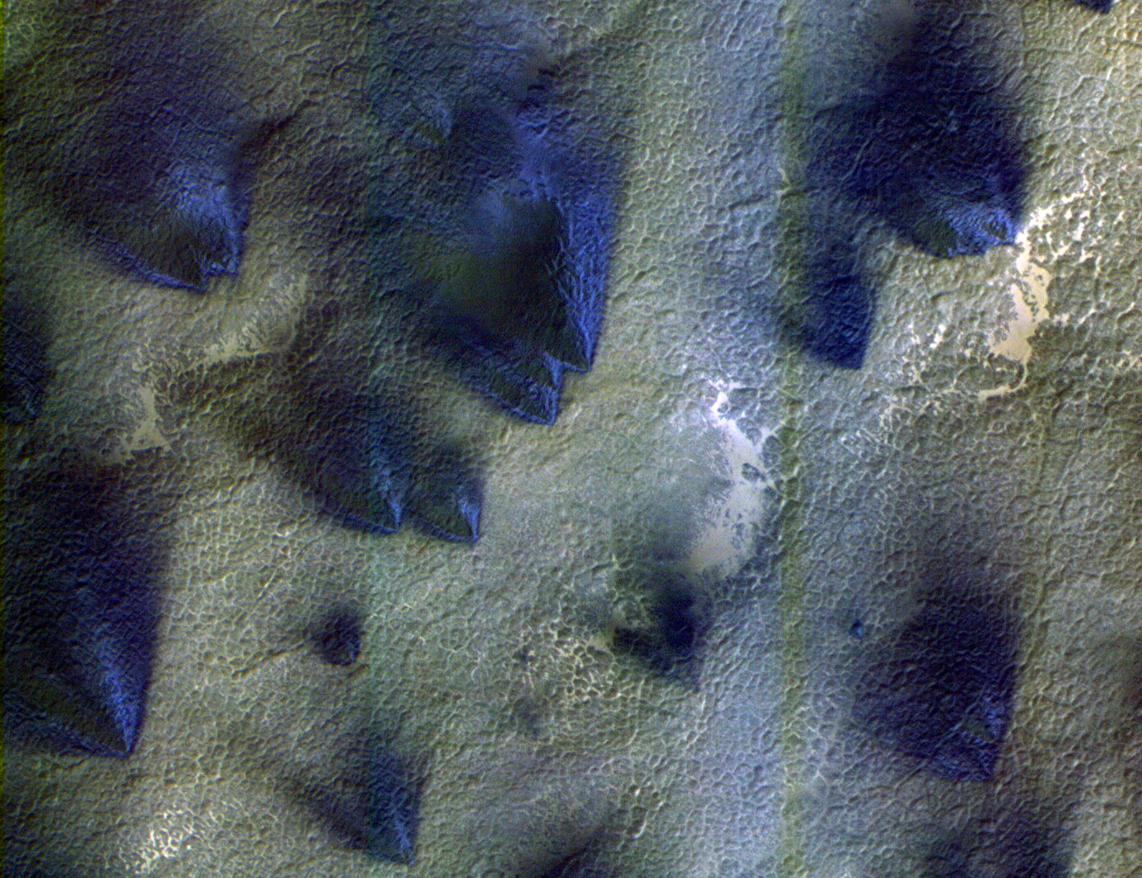
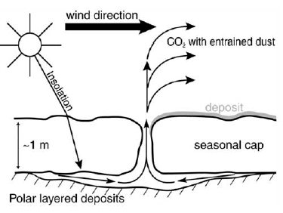
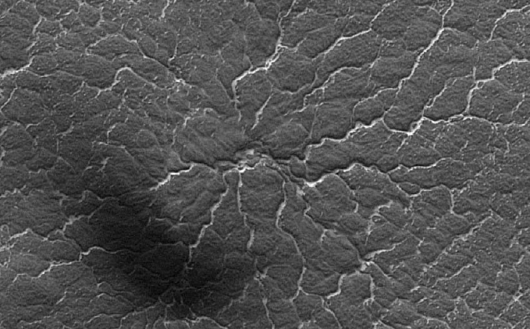
Behavior of a transparent slab of CO₂ ice
PSP_002675_0945
Multiple fan (wind) directions
Scouring of channels to produce ‘spiders’
PSP_002533_0935

Slide 16
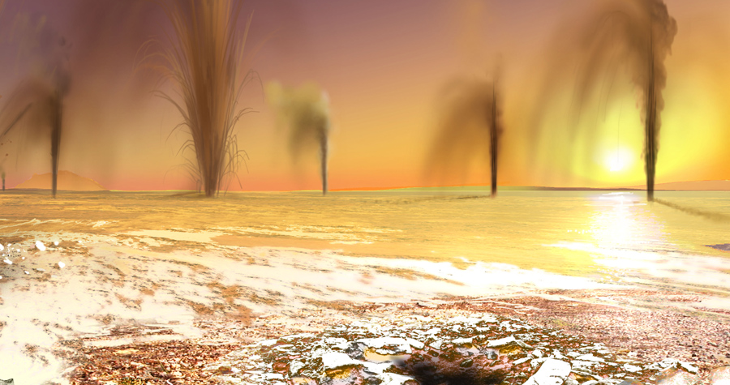
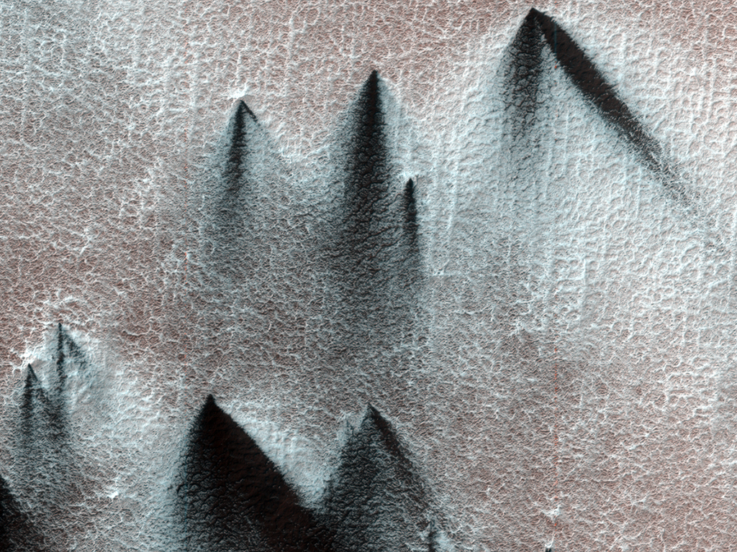

Slide 17
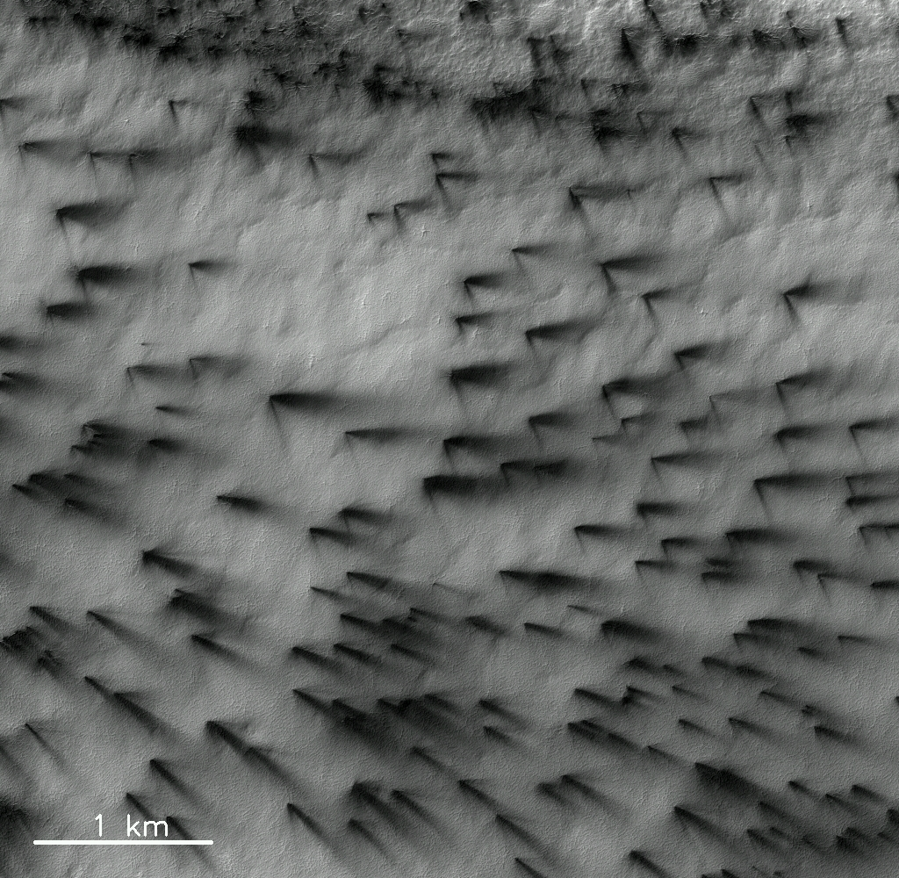

Slide 18
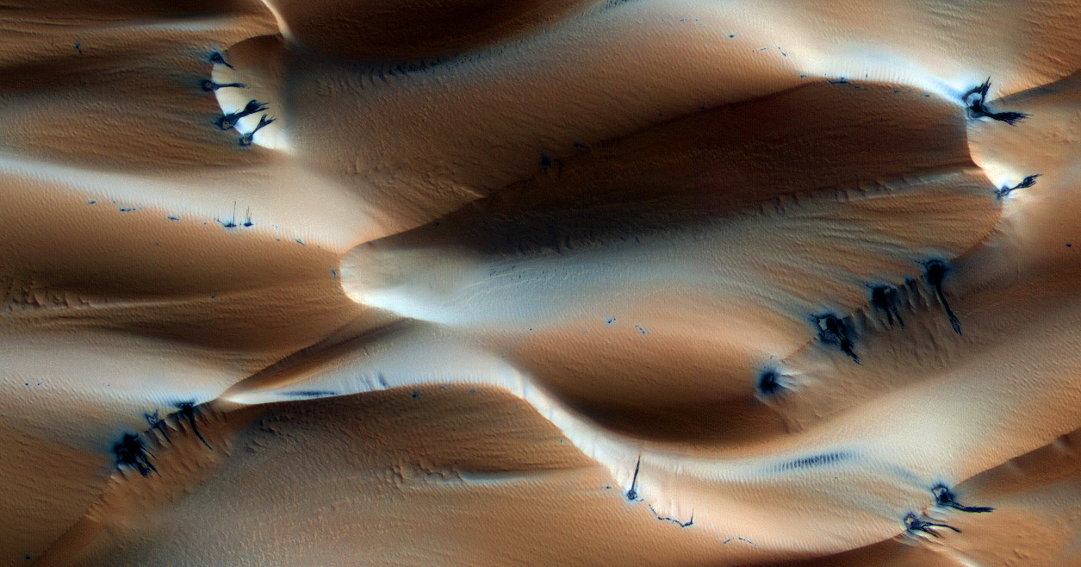
Transparent ice in the northern cap ???
PSP_007193_2640

Slide 19
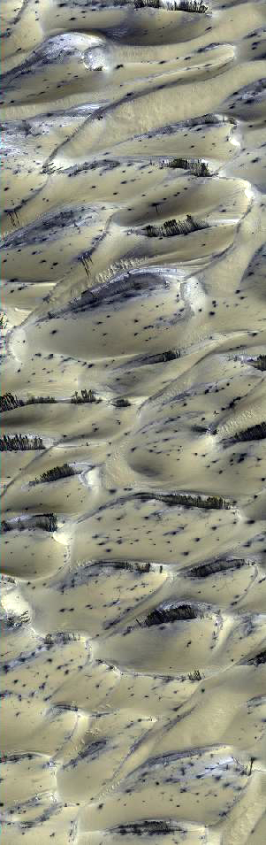
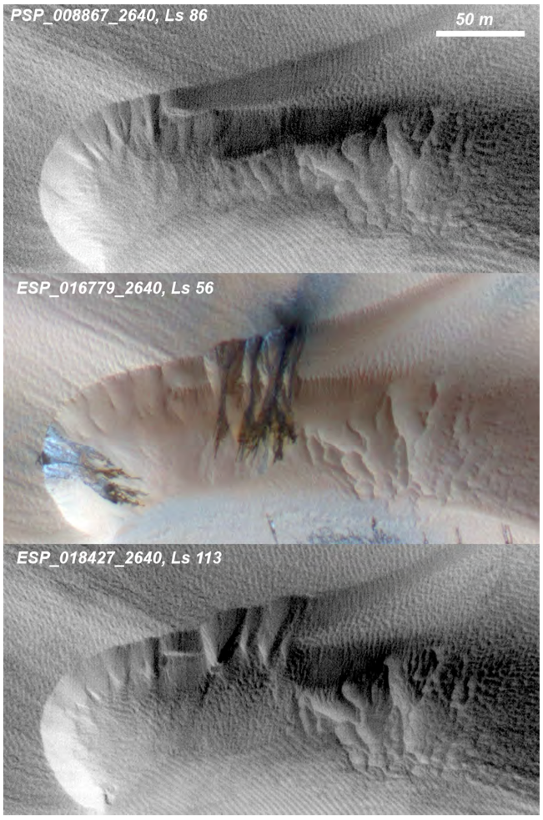
Dunes with seasonal CO₂ venting on Mars
Hansen et al., 2011

Slide 20
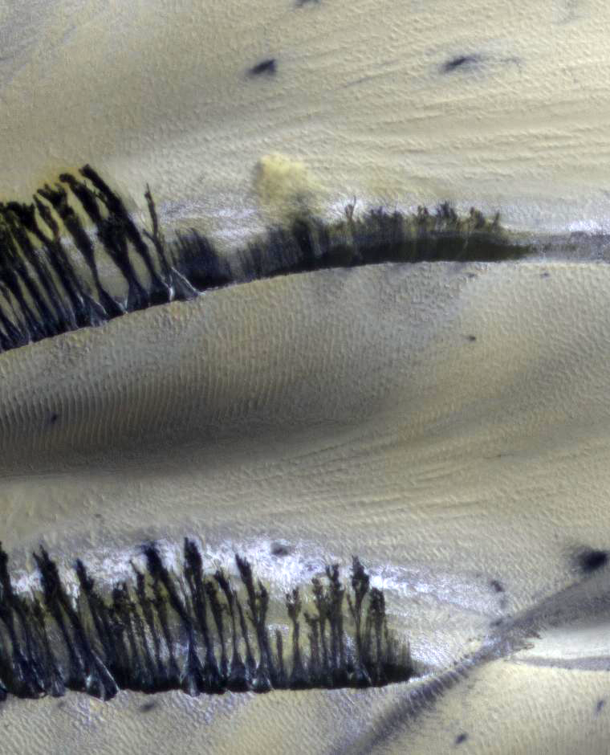

Slide 21
Classic barchan spring sequence
Lat / Lon: 75.8N / 94E

Slide 22
Cracks on crest become source of sandfalls
Landscape restoration
“Buzzel” Lat / Lon: 84N / 233E

Slide 23
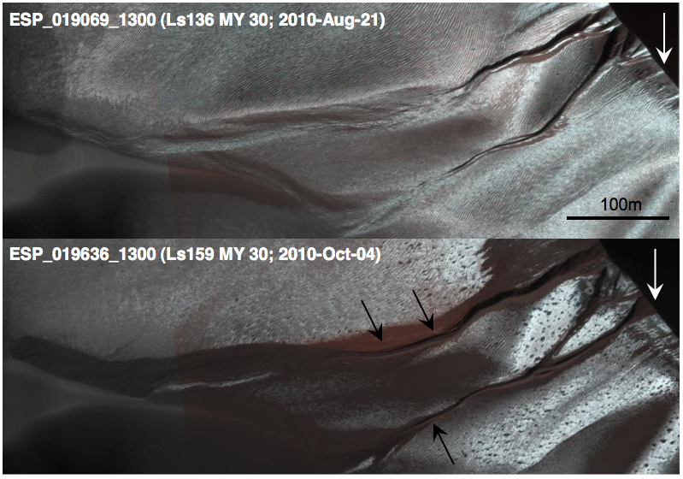
Avalanching frost carves gullies in dunes every winter
Dune migration erases gullies
Diniega et al., 2010

Slide 24
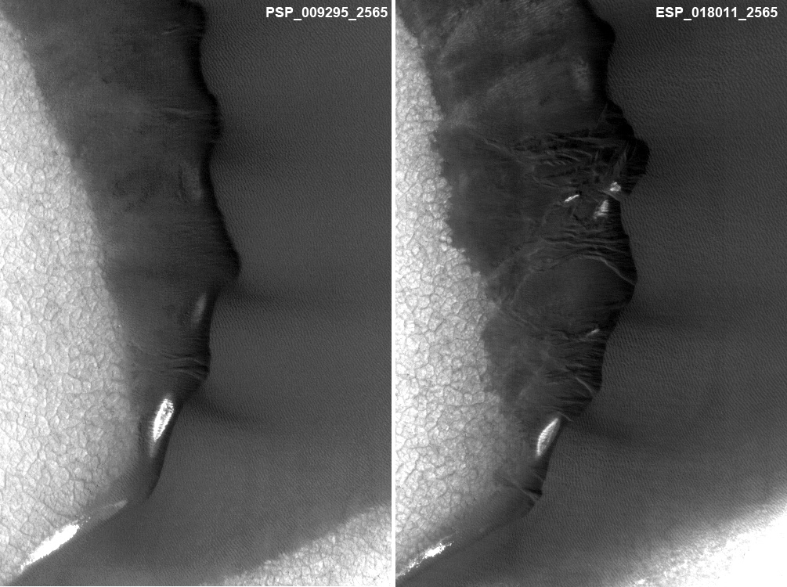
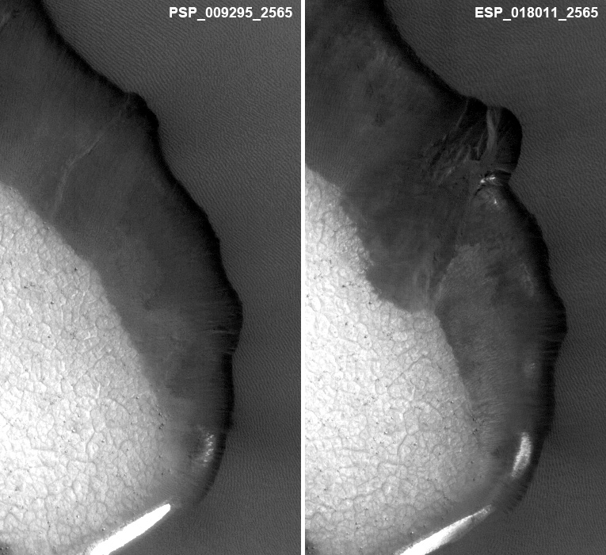
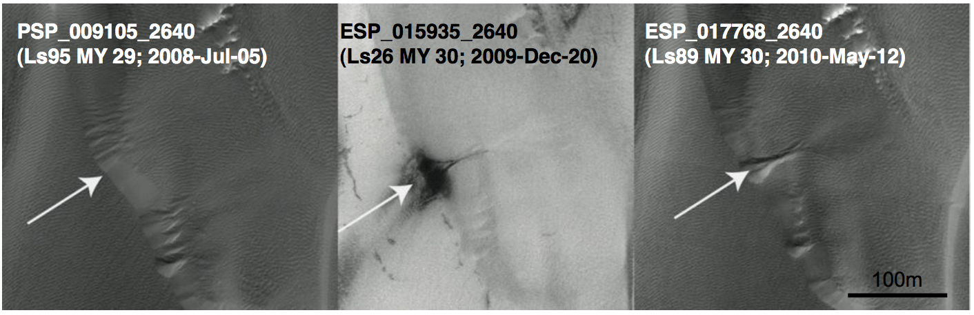

Slide 25
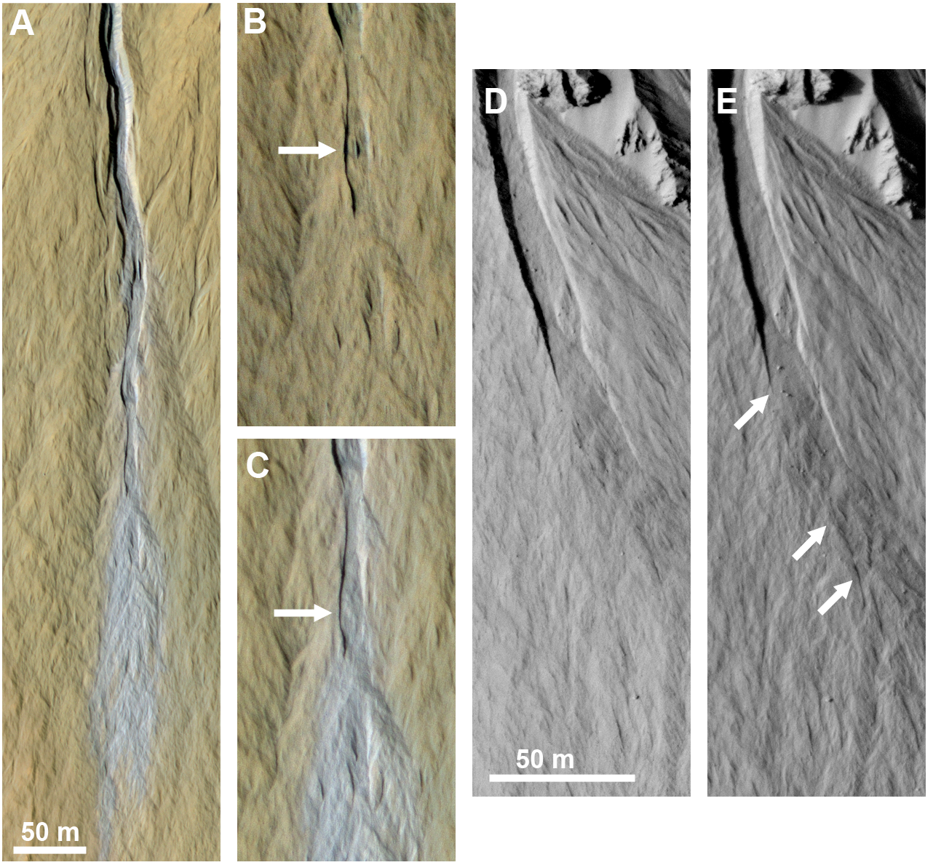
Dundas et al., 2010

Slide 26
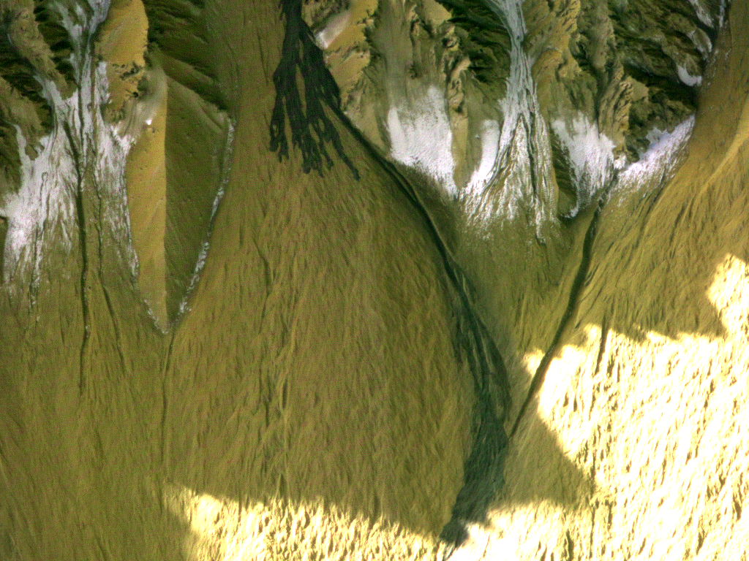
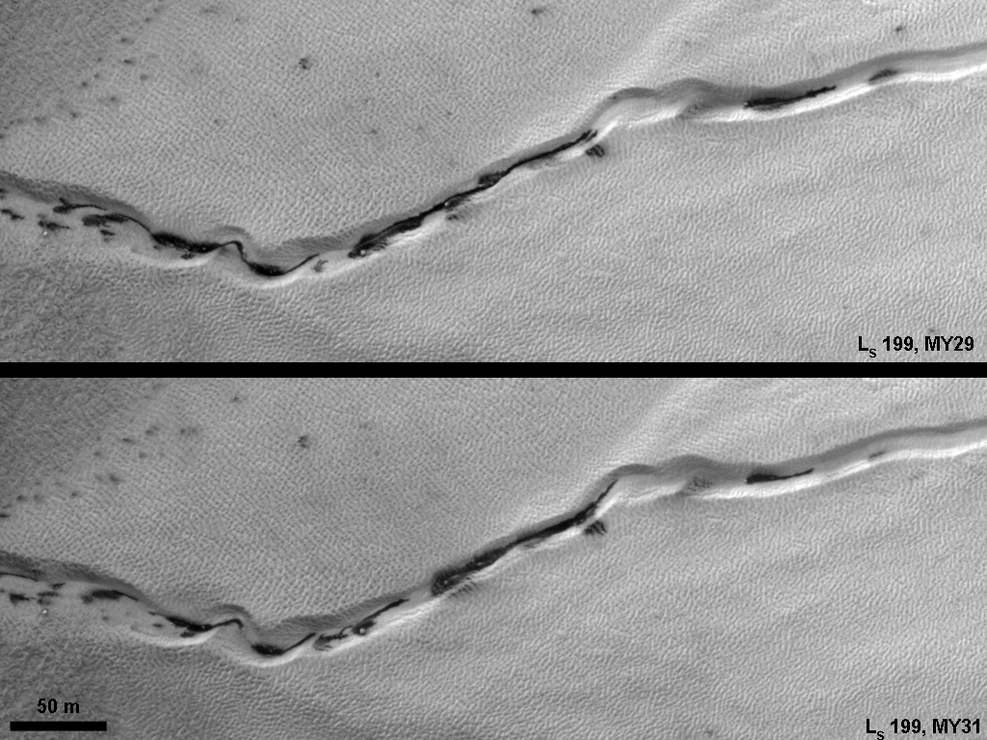
Frost and Gully Activity
Mass movements in gullies occur when CO₂ frost is present, or during defrosting.
Defrosting spots and flows often concentrate in gullies.
Frost activity is largely repeatable from year to year, but major mass movements are stochastic.
Current activity may be a major component of gully formation
Gasa crater: new deposit between L_{S} 128-141.

Slide 28
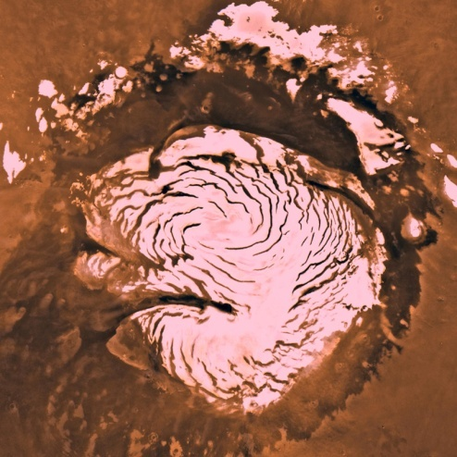
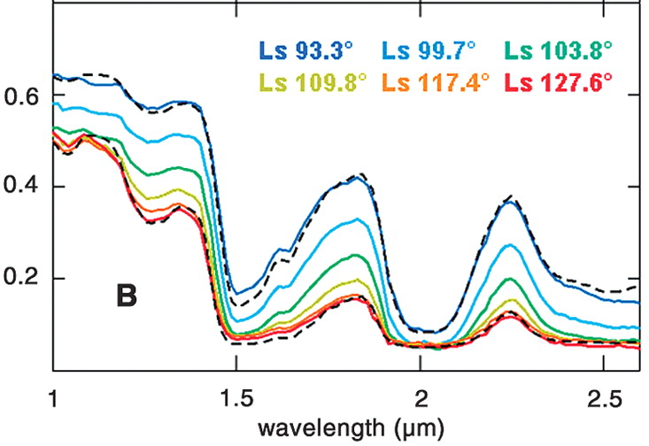
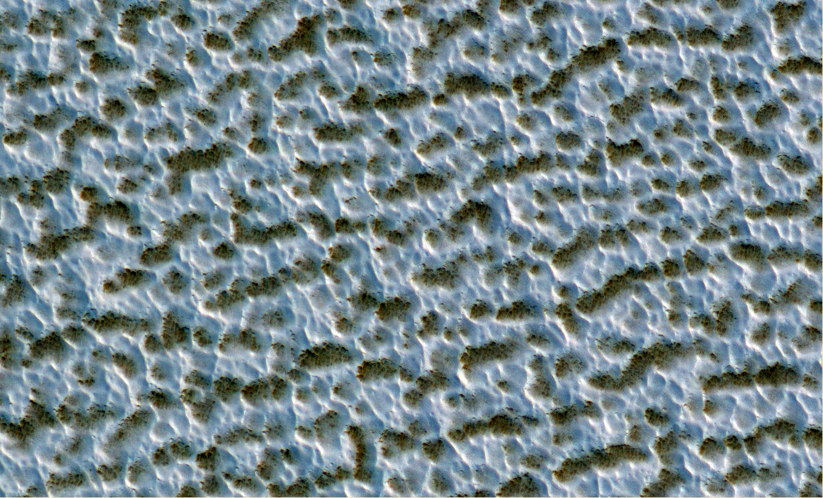
Residual ice caps
North polar residual ice cap is made of dust-free large-grained water ice
Langevin et al., 2005

Slide 29
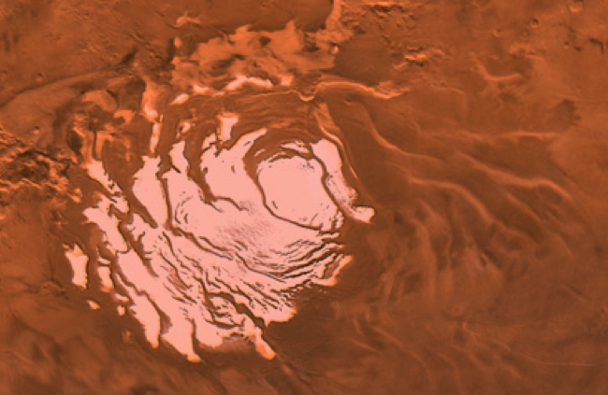
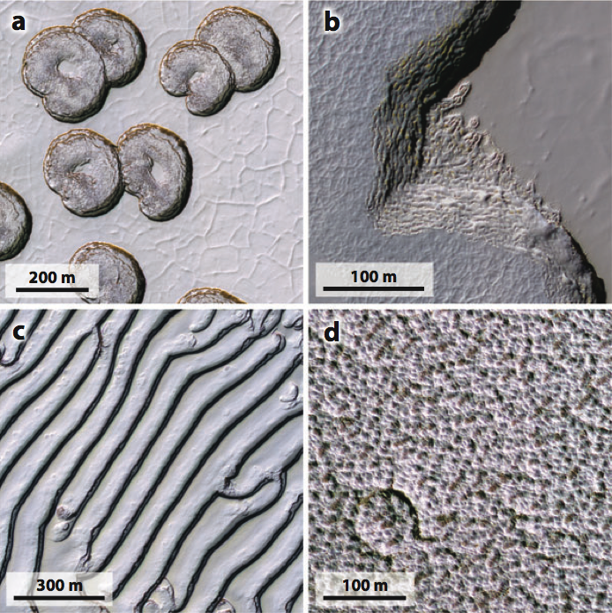
Martian Residual CO₂ cap
The residual ice-caps partially cover the layered deposits.
  Very thin
  Southern residual ice is CO₂
Interacting with current climate
  Exchanging volatiles on annual timescales
  Climate record of decades to centuries

Slide 30
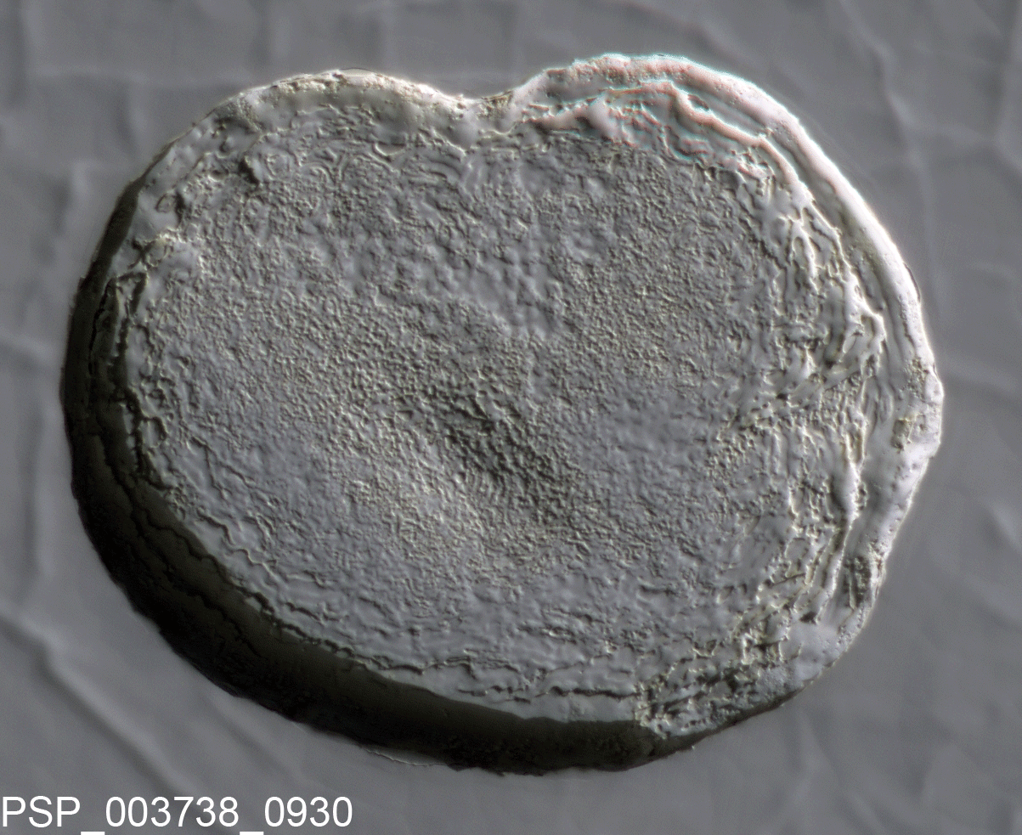
Thomas et al., 2005
Swiss-cheese pits expand by meters per year.

Slide 31
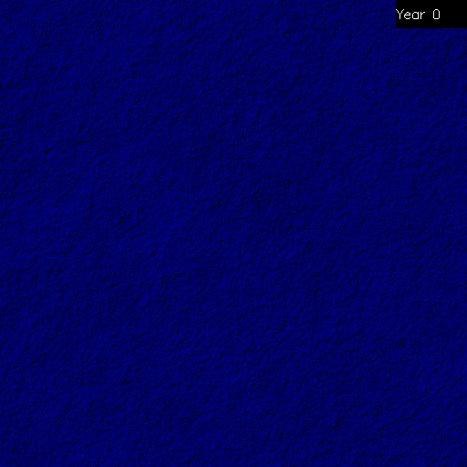

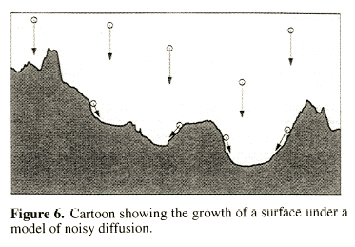
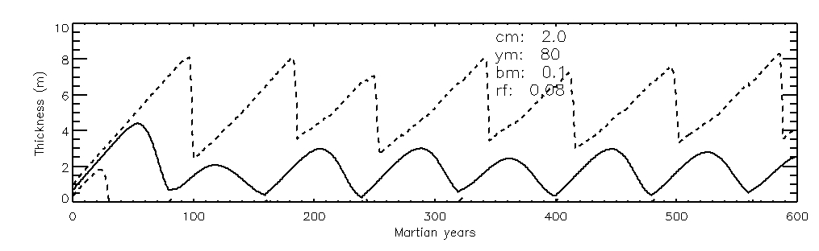
Reincarnation of the Residual Cap
Surface roughness increases with time – pits form
Remnants of old cap determine where new pits will form.
Different generations of ice cap overlap
Minimum thickness is always zero
  Swiss-cheese depressions are always present

Slide 32
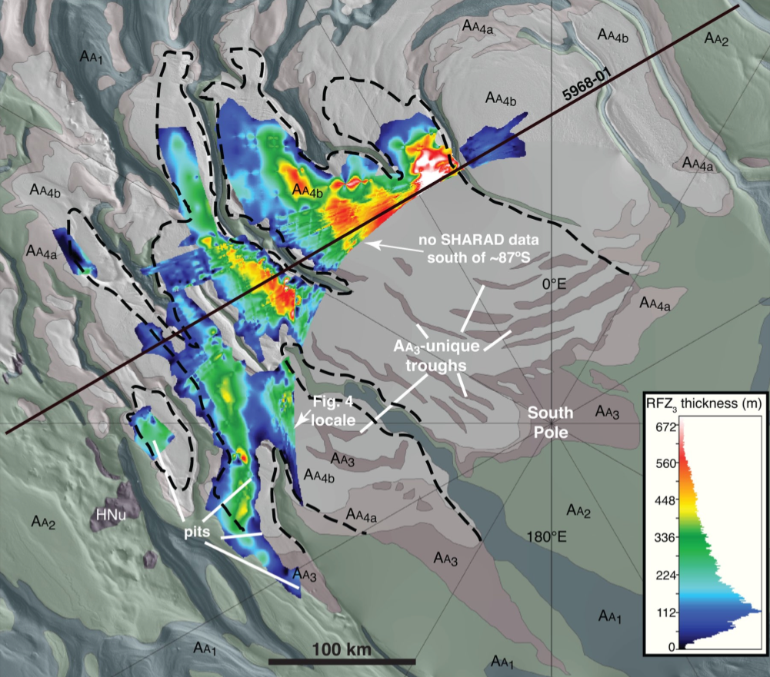
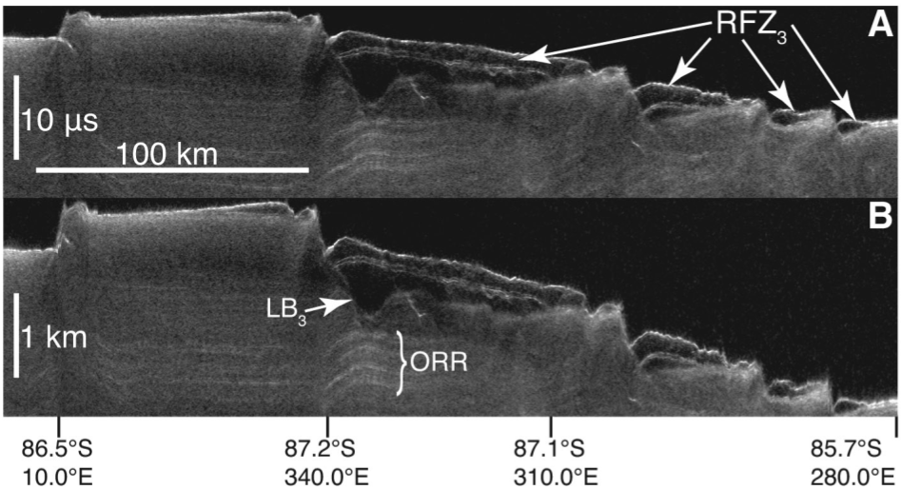
More CO₂ ice buried below some H₂O ice
  Accessible to the atmosphere in high obliquity periods
  Could double atmospheric pressure
Current residual cap stabilizes this larger deposit
CO₂ ice, a few meters thick
10-10²yr timescales
H₂O ice, a few meters thick
10⁴ yr timescales
Buried CO₂ ice
Up to 100s meters thick
10⁵ yr timescales
Polar Layered Deposits
H₂O ice
Up to 4km thick
10⁶-10⁷ yr timescales
Phillips et al., 2011

Slide 33
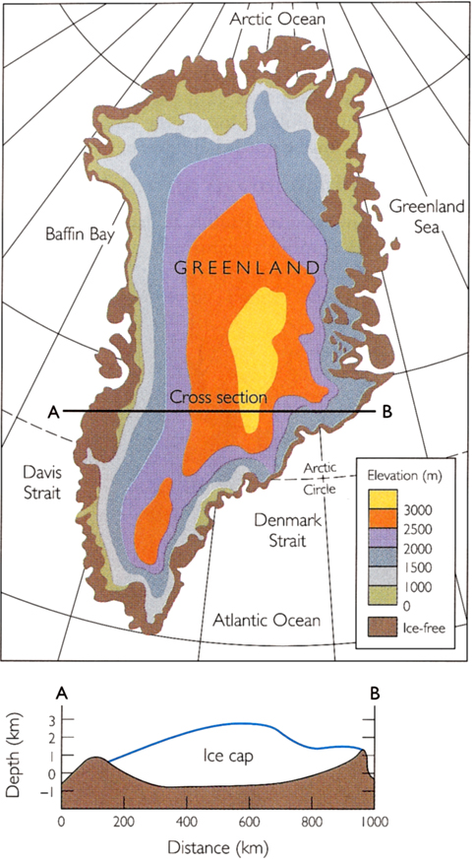
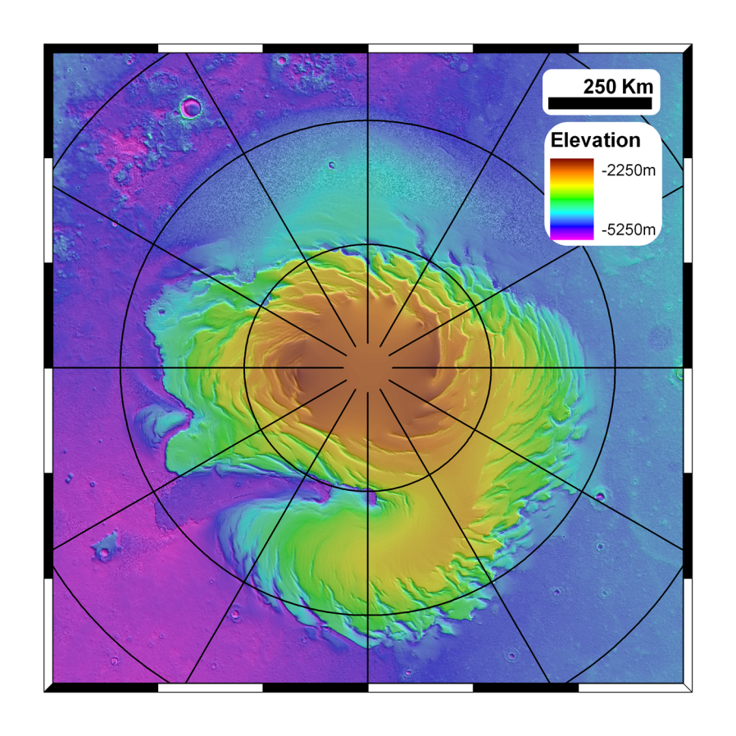
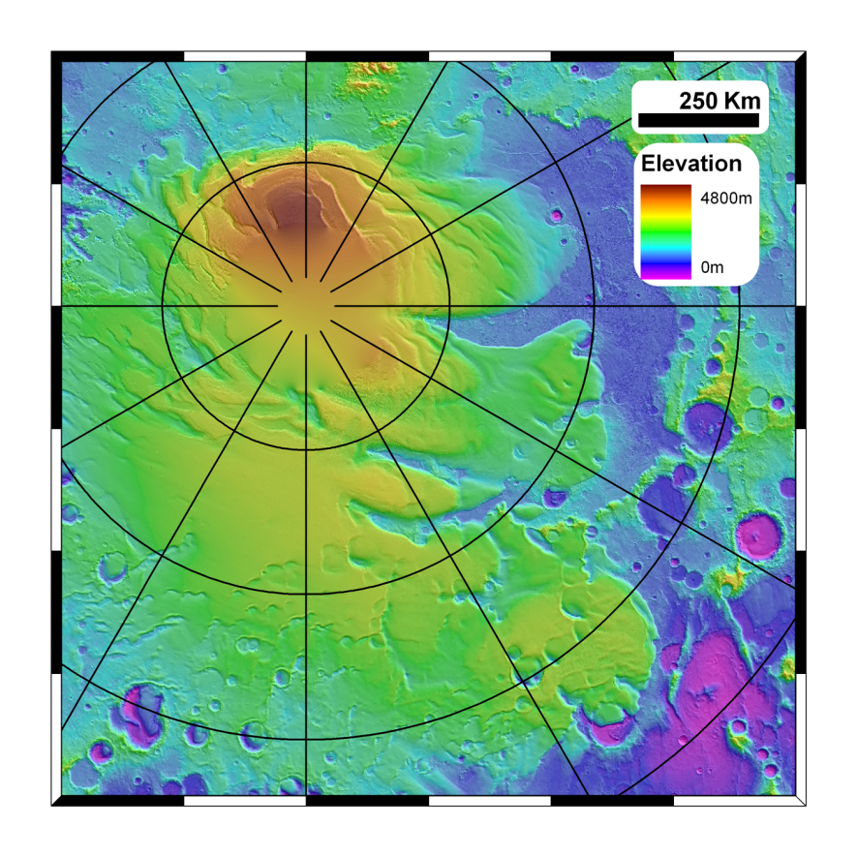


6 million km³
Mars North pole
Mars South pole
1.1 million km³
1.2 million km³

Slide 34


Layers similar to those in ice-cores on the Earth
Climate record of a few million years

Slide 35

Radar layers look like they should correspond to the layers we see in images
  This link has proven hard to nail down precisely though

Slide 37
Obliquity
  Earth ~ 23 degrees
  Mars today ~ 25 degrees
Eccentricity
  Earth ~ 0 (circular)
  Mars today ~ 0.1 (ellipse)

Slide 38

Laskar et al., 2003

Slide 39


Even larger variations before that
  Factor of 3 variation in solar power
Factor of 3 in solar power on the Earth
Laskar et al., 2003

Slide 40

Martian “Ice Ages”
During high obliquities
  Ice is more stable in the mid-latitudes
  Water ice sublimates from polar ice caps
  Reaccumulates in the mid-latitudes
During low obliquities
  Ice is more stable at the poles
  So water moves back…
High-obliquity
Low-obliquity

Slide 41
Jump to higher obliquity ~5 million years ago
It’s thought that the polar layered deposits could not survive that
This simple picture is probably naïve and conflicts with basic info like the cratering record of the south polar layered deposits (which shows the surface age to be 10s of Myr)

Slide 42
Climatic Record
Spacecraft Record
YEARS
10⁸
10⁷
10⁶
10⁵
10⁴
10³
10²
10¹
10⁰
Recent climatic variations
Interannual variability of the current climate

