Slide 1
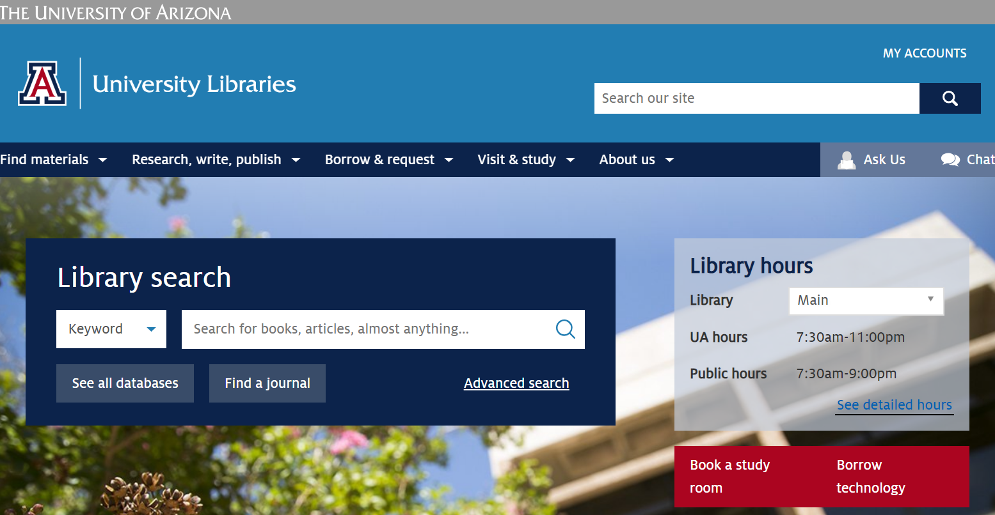
University of Arizona Libraries
Jim Martin, Associate Librarian
Research & Learning, Library Liaison for the College of Science
Notes:
Main open 24 hours Sunday 9am through Friday 1am; (Sat hours are) 9am-1am;
SEL closes at 11pm Sun-Thurs; closes at 6pm Friday and Saturday

Slide 2

Free Resources & Services
Notes:
Interlibrary Loan or Request a purchase for items we don’t have

Slide 3
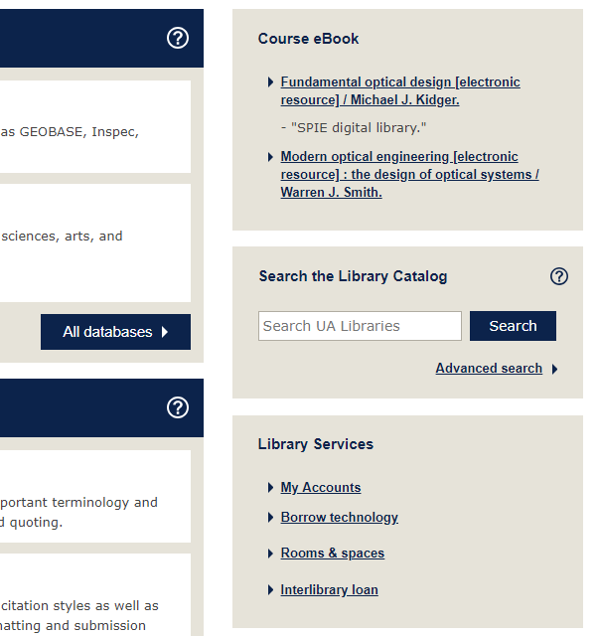
Access ebooks Assigned for your Courses
Each semester, The UA Libraries work with the UA Bookstore and review all “Required Course Materials” submitted by instructors
Wherever possible, the Library will purchase them as ebooks and then link them to the course
Notes:
Check your course web pages! The library works with the UA Bookstore to review and purchase ebook editions as many “Required Course Materials” as we can, and then we link them to the Course home page in D2L

Slide 4
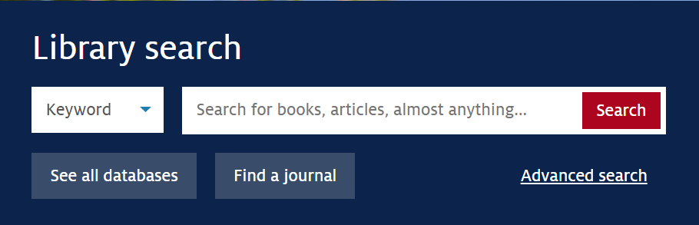
Use Library search
All in One searching
Combines Library print and online holdings with other databases
Use your NetID to sign in to your Library account
  Interlibrary Loan
  Room reservations
  Items checked out

Slide 5


Borrow Print Materials
For Graduate Students
  21 Day Loan Period
  AUTOMATIC RENEWALS unless the item is on hold
  Item you need is checked out? We can borrow the item for you from another library
Express Retrieval
  For items on the shelf, use the REQUEST option and we’ll retrieve the item for you and place it on the HOLD shelf
Notes:
Will autorenew up to 6 Years

Slide 6

Interlibrary Loan
Items you can request:
  Books
  Articles
  Book Chapters
  Standards
  Theses & Dissertations
Available in :
  5-10 days
  2-3 days
  2-3 days
  2-3 days
  7-10 days
Notes:
Many databases allow you to request from the journal article record, or fill out manually

Slide 7
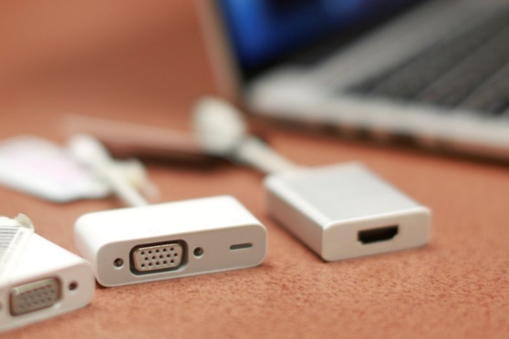

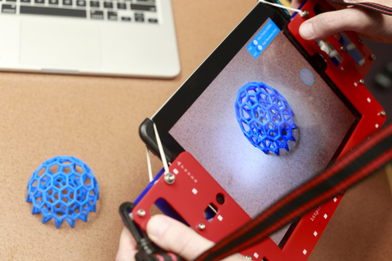
Borrow Technology
The Library’s website will tell you how many are available at any given time
Laptops & Tablets
Cords & Chargers
Digital Cameras & Projectors
Audio Equipment
3D Scanners
Scientific Calculators
Notes:
Main Library technology lending has temporarily moved to Weaver Science-Engineering Library, Room 200S

Slide 8
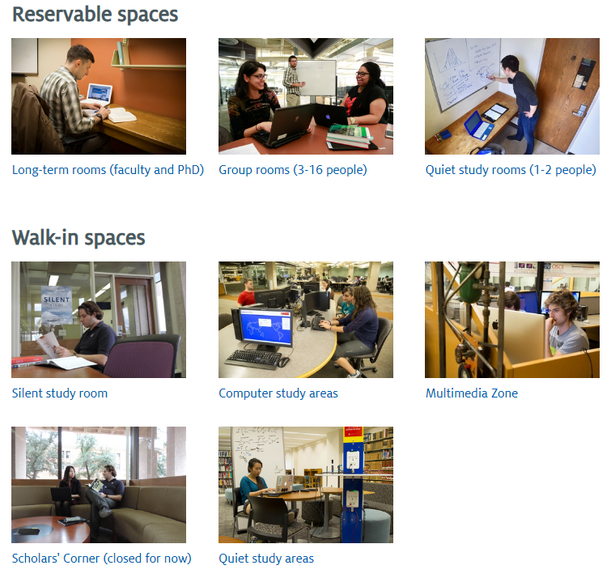
Reservable Rooms & Spaces
Notes:
For individual or group use; Long term study rooms (double occupancy; semester); Comp Exam Rooms (one month); When comps completed, can reserve Dissertation writers’ room (one semester; shared room);

Slide 9
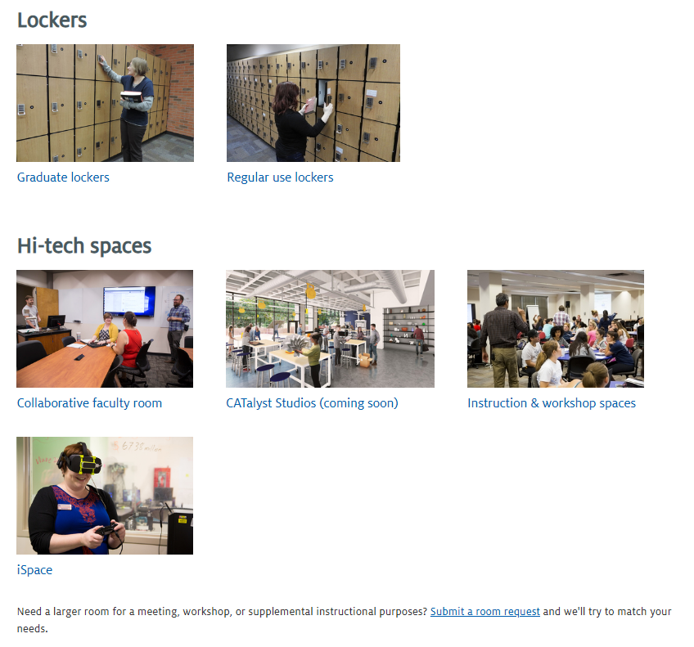
Rooms & Spaces

Slide 10

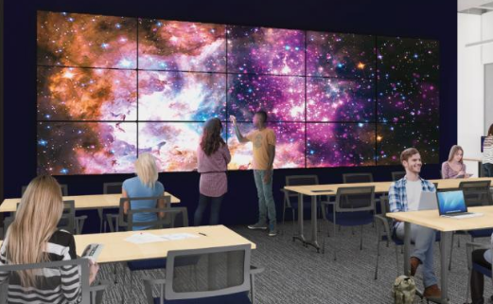
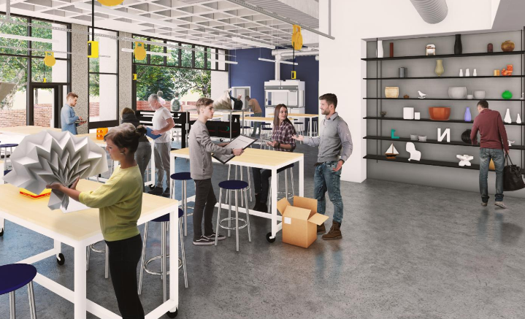
Student Success District
The Main Library, the Albert B. Weaver Science-Engineering Library, Bear Down Gym, and a new four-story building into an interconnected facility
Library renovations are slated to be done by mid 2020, including a Data Studio & a Maker Studio

Slide 11
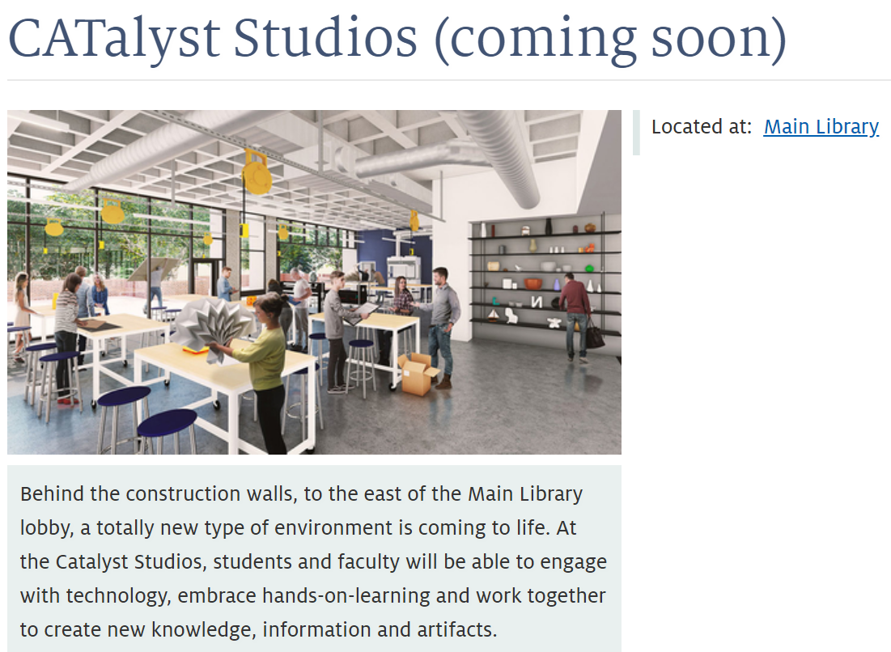
.
Notes:
Data Studio
Learn computational research skills, share your dynamic data visualizations, connect with communities across campus.
Large-scale, high-resolution data visualization wall
Learning communities to support your research in data science and digital scholarship
Seminar-style learning environment
The Terry Seligman VR/AR Studio
Put on a headset, grab your controllers, and discover virtual spaces and environments. Our state-of-the-art equipment includes:
HTC Vive
Oculus Rift
Oculus Go
Google Daydream
Maker Studio
Prototype, play, make art and share your skills in our spacious, beautiful maker studio.
Laser cutters
CNC router
Sewing machines
Vinyl cutter
DIY computing
Screenprinting
Letterpress

Slide 12




Attend an Event!

Slide 13
Attend a Workshop listed under Events & Exhibits or follow us on social media
Researcher IDs
Journal/Article impact factors
Measuring Your Research Impact
Open Access & Copyright
Data Management Planning
EndNote X9
Managing Research Projects with
the Open Science Framework

Slide 14
Visit our “For graduate students” page
http://new.library.arizona.edu/grads

Slide 15

