Slide 1
Global Warming How Serious Is It?
Robert G. Strom, Professor Emeritus
Department of Planetary Sciences and Lunar and Planetary Laboratory
University of Arizona
Tucson, Arizona

Slide 2
List of Presentations
Part 1 --- Summary of Global Warming
Part 2 --- The Denial Syndrome and Its Dangers
Part 3 --- Climate Change Basics and Past Climates
Part 4 --- Temperature Rise
Part 5 --- Human Cause of Global Warming
Part 6 --- Melting Ice and Rising Sea Level
Part 7 --- Ocean Acidification, Weather and Melting Permafrost
Part 8 --- Future Consequences
Part 9 --- Requirements to Mitigate the Problem

Slide 3
Part 1
Summary of Global Warming

Slide 4
Global Warming Made Simple
Robert Strom
With Temperature Diagrams by David Roberts

Slide 5
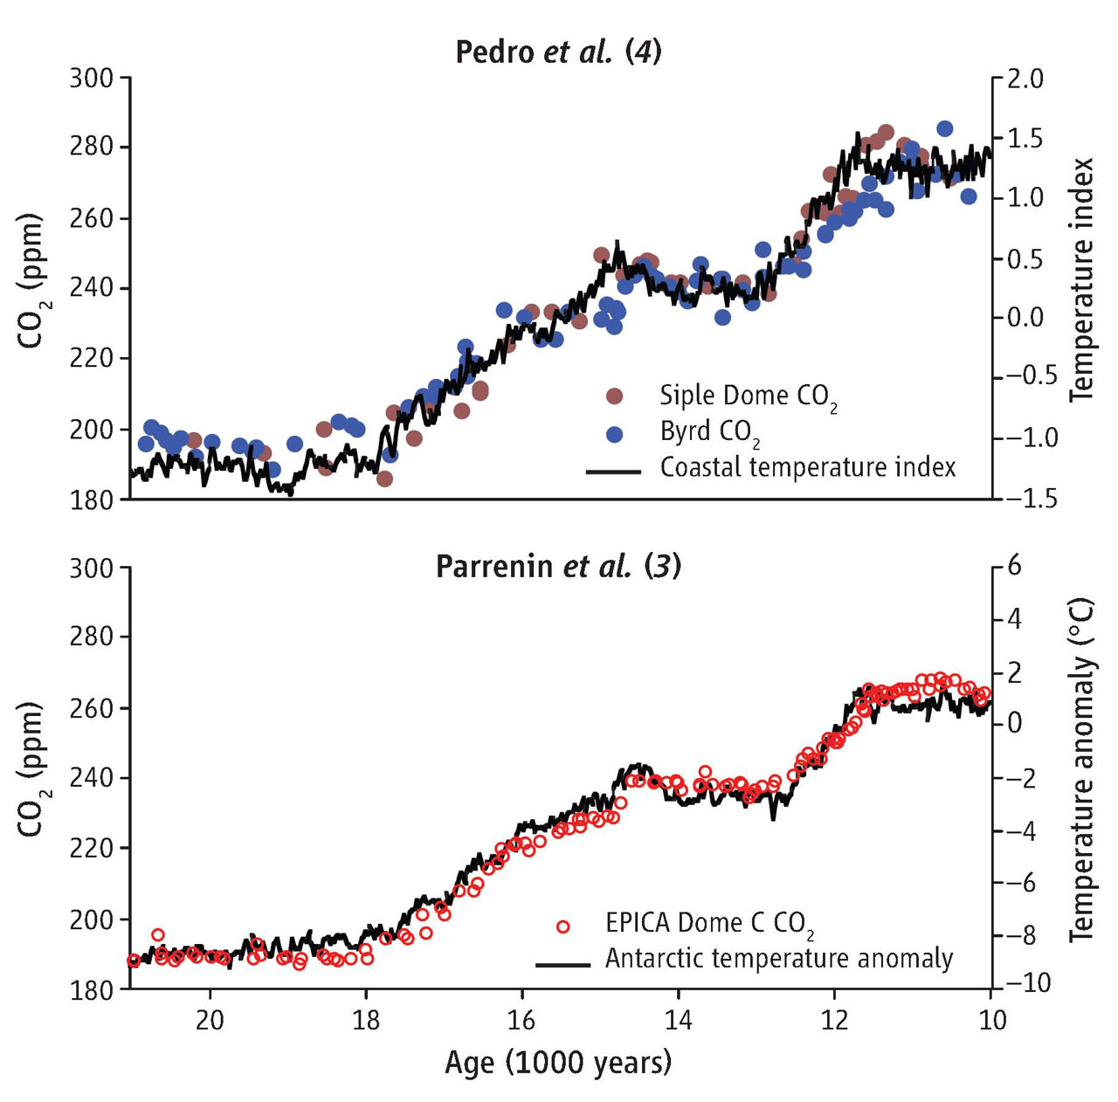
There is a Strong Correlation Between Atmospheric CO₂ and Temperature
Carbon dioxide concentrations and averages of temperature proxy records for last deglaciation, as compiled by Parrenin et al.
Notes:
These are two different studies of the atmospheric CO2 and Antarctic temperature anomaly or coastal temperature index from 10 to 21 thousand years ago. There is almost a perfect correlation between CO2 abundance and temperature. This indicates that there is a strong relationship between CO2 abundance and temperature.

Slide 6
The Past 280 ppm CO₂
For the last 10,000 years Earth’s climate has been relatively stable (±0.5° C).
All civilization has taken place during this stable period.

Slide 7
Today 396 ppm CO₂
Our global average temperature has risen 0.8° C since pre-industrial times.
The effects of global warming are already beginning.

Slide 8
Dangerous Level 430 ppm CO₂
Very serious consequences will occur for humans, the economy, and political stability.
It is almost certain that we will reach this temperature no later than the end of the century and probably sooner.

Slide 9
Hell on Earth 670 ppm CO₂
By ~2100:
1. Highest temperature in 40 million years.
2. Sea level rise >1 m.
3. Drought over 40% of inhabited land.
4. Mass Starvation
5. Death of about half the world population.
6. Mass extinction ( >50% species extinct).
7. Economic and political chaos.
8. Probably the end of civilization as we know it today.

Slide 10
Where we are Headed ~1000 ppm CO₂
At our current rate of greenhouse gas emissions we will reach ~6° C soon after the end of the century (last reached 50 million years ago).
That will certainly be the end of civilization if not humanity.

Slide 11
Conclusions
Our present course Leads to certain Catastrophe.
To stabilize the temperature below the Catastrophic level, global emissions must peak within 3 years and decline rapidly every year thereafter.

Slide 12
Reliability of Global Warming Parameters
Global warming
Rise in greenhouse gases
Primary Cause of global warming
Long term consequences of global warming
Solution to the problem
Prospects of implementing a solution
Firmly Established (100%)
Firmly Established (100%)
Firmly Established (>95%)
Many known, but other consequences probable
Well understood
Extremely uncertain and getting worse

Slide 13
The World’s Science Societies Support the Science Findings on Global Warming
National Academies of Science in 33 countries and 67 science organizations from various countries (total = 100) support the findings on global warming and its human cause. Five of the 100 are listed below.
U.S. National Academy of Sciences
American Geophysical Union
American Meteorology Society
American Association for the Advancement of Science
British Royal Society
This global support is unprecedented.
Go to “Climate Change Lines of Evidence” on YouTube for National Research Council
of the National Academy of Sciences 25 min. slide show on evidence for climate change.

Slide 14
Key Scientific Findings
Global Warming is unequivocal and primarily human-induced.
Climate changes are underway and are projected to grow.
Widespread climate-related impacts caused by global warming are occurring now and will increase. (In 2011 the world experienced the most extreme weather events since record keeping began in the 1800s. In the U.S. alone, the cost was $52 billion)
Climate change will stress water resources in some places.
Crop and livestock production will be increasingly challenged.
Coastal areas are at increasing risk from sea-level rise and storm surge.
Risks to human health will increase.
Climate change will interact with many social and environmental stresses to produce adverse effects.
Thresholds will be crossed, leading to large changes in climate and ecosystems. (This may be starting to happen)
Future climate change and its impacts depend on choices made TODAY.
Notes:
These are the key findings of the Intergovernmental Panel on Climate Change (IPCC) and other governmental committees.

