Slide 1
Part 2
The Denial Syndrome and Its Dangers

Slide 2
The Denial Syndrome
The Denial Syndrome is when people or organizations refuse to accept a principle that has been proven by overwhelming evidence.
Sometimes this is due to self-interest, ignorance, or political and religious beliefs.
In other cases they apparently do not want to face reality because of deep-seated biases or irrational fear.

Slide 3
The Denial Syndrome Used on Some Well Understood Subjects
Global Warming
Ozone Depletion
Apollo Moon Landings
Plate Tectonics
Evolution
Spherical Earth
Copernican Theory (Earth orbits Sun, etc.)
The Holocaust
The Adverse Effects of Smoking, etc, etc.

Slide 4
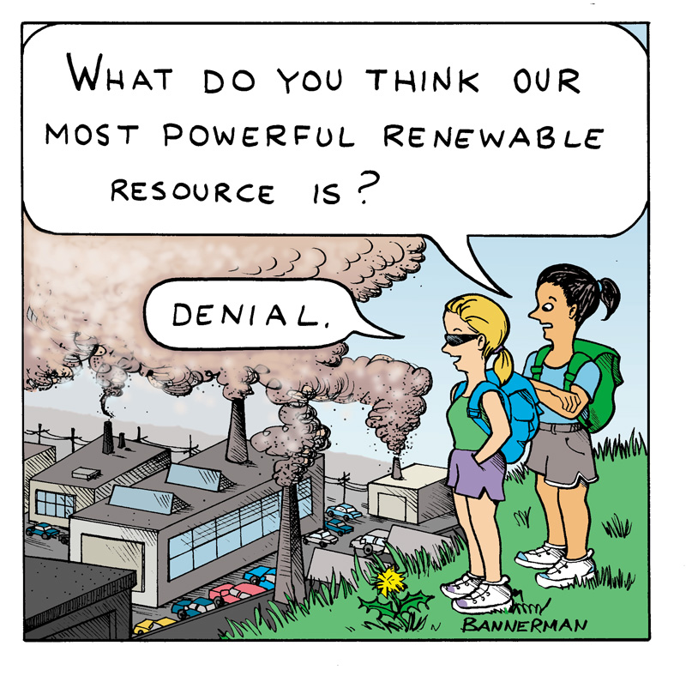
Of Course!

Slide 5
Some Statements on Global Warming by Several Newly Elected Congressmen
"With the possible exception of Tiger Woods, nothing has had a worse year than global warming. We have discovered that a good portion of the science used to justify "climate change" was a hoax perpetrated by leftist ideologues with an agenda.” —Todd Young, new congressperson from Indiana
"I absolutely do not believe that the science of man-caused climate change is proven. Not by any stretch of the imagination. I think it’s far more likely that it’s just sunspot activity or something just in the geologic eons of time where we have changes in the climate." —Ron Johnson, new senator Wisconsin
"I think we ought to take a look at whatever the group is that measures all this, the IPCC, they don't even believe the crap." —Steve Pearce, new congressperson from New Mexico
"There isn't any real science to say we are altering the climate path of the earth." —Roy Blunt, new senator from Missouri
"It's a bigger issue, we need to watch 'em. Not only because it may or may not be true, but they're making up their facts to fit their conclusions. They've already caught 'em doing this." —Rand Paul, new senator from Kentucky

Slide 6
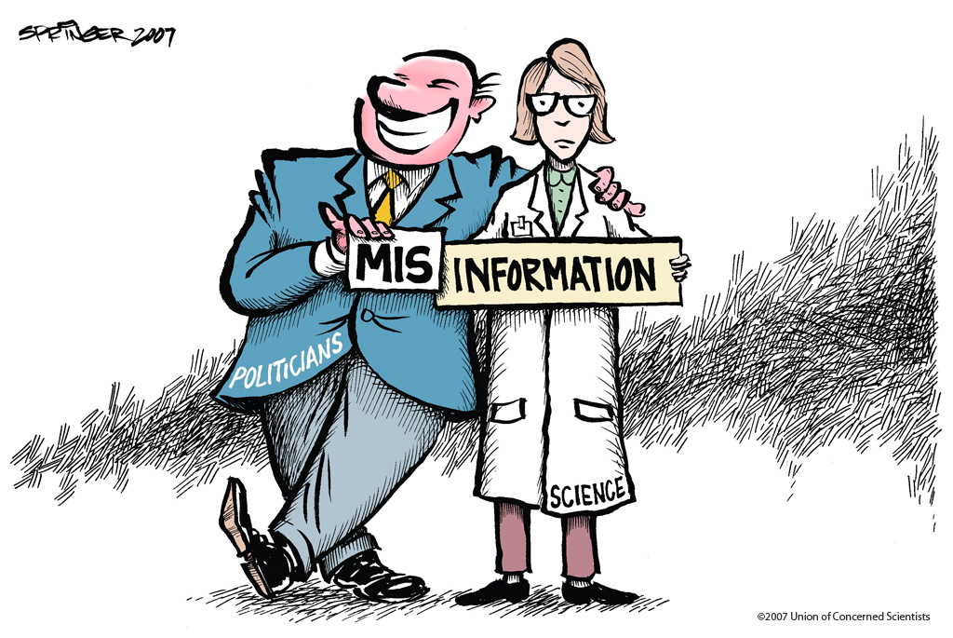
How True!

Slide 7
Congress has consistently blocked action on climate change
During the 2011 Congress, the House voted 21 times to block actions that address climate change.
This includes blocking the no-cost establishment of a National Climate Service within the National Oceanic and Atmospheric Administration (NOAA). This climate science source would have put all climate information into one accessible location.

Slide 8
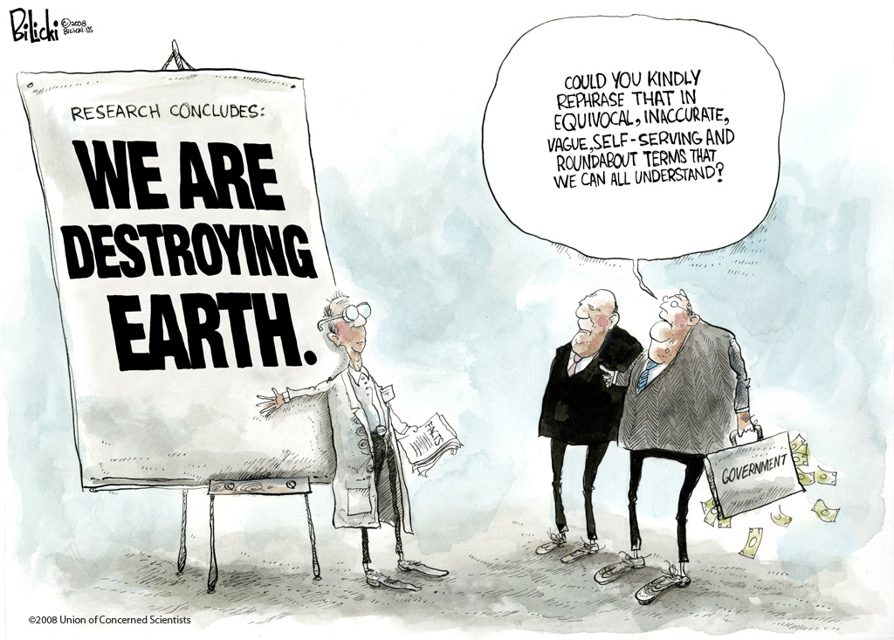
Here We Go Again!

Slide 9
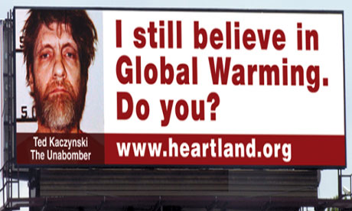
Chicago Billboard Paid for by the Ultraconservative Heartland Institute
Appeared on the Heartland website “the most prominent advocates of global warming aren’t scientists. They are murderers, tyrants, and madmen.”

Slide 10
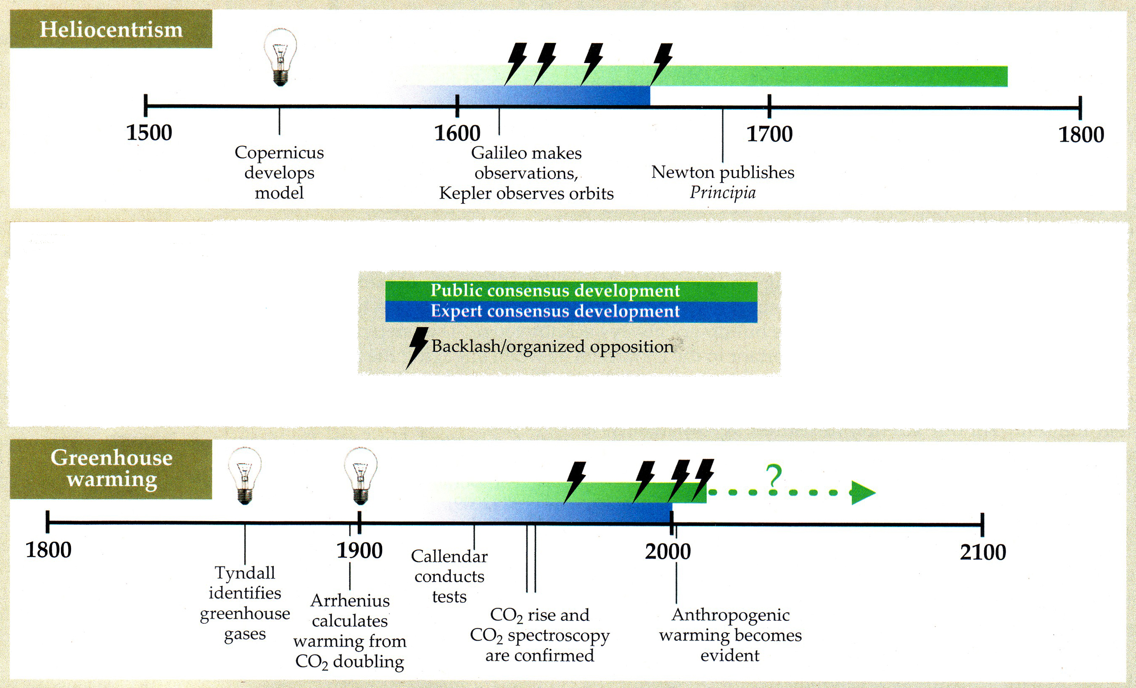
Apparently Our Mental Processes Have Not Changed in 400 years
Notes:
Modified from Physics Today, page 39, October 2011 issue.

Slide 11
Deterrents to Solving the Problem
(AIDS)
Apathy
Ignorance
Denial
Stupidity

Slide 12
In the U.S., the Denial Syndrome, Misinformation, Disinformation, and Science Illiteracy have Led to a Disregard of the Dangers of Global Warming and the Urgency of Mitigating the Problem.

