Slide 1
Part 3
Climate Change Basics
and
Past Climates

Slide 2
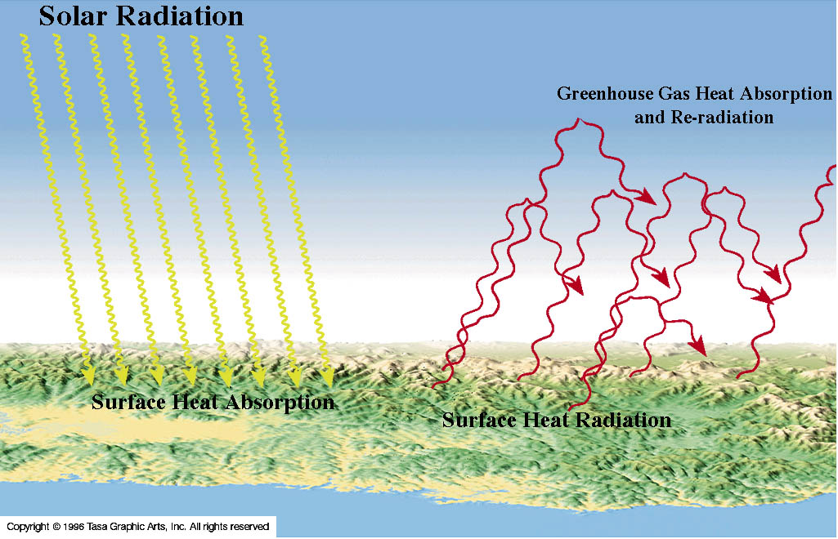
The Greenhouse Effect
Notes:
In the greenhouse effect, solar radiation is absorbed by the Earth’s surface resulting in surface warming (yellow wavy lines). Much of this absorbed energy is eventually re-radiated at longer infrared wavelengths as heat (red wavy lines). A portion of this heat is absorbed by greenhouse gases and re-radiated back to the Earth’s surface. This re-radiated energy further warms the surface. The more greenhouse gases that are present, the more heat is absorbed and re-radiated, and the hotter it gets.

Slide 3
Earth’s Atmospheric Composition, Temperatures and Pressure
Composition | Percent
Nitrogen (N₂) | 78
Oxygen (O₂) | 21
Argon (Ar) | 0.93
Carbon Dioxide (CO₂) | 0.039
Water Vapor (H₂O) | Variable 0-4
Sea level Surface Pressure (Bars) | 1
Surface Temperature Extremes (°C) | 60 to −130 (Global Mean = 14.8)
Notes:
The relatively small amount of CO₂ in the atmosphere has been used as an argument against CO₂ as the cause of global warming. See next slide.

Slide 4
Atmospheric Abundance of CO₂ and Global Temperatures
CO₂ Percent | Average Global Temperature (°C) | Event
0.018 | 9 (48°F) | Last Ice Age Minimum
0.028 | 14 (57°F) | Interglacial Period (Holocene)
0.039 | 14.8 (58.6°F) | Today (Anthropocene = Human Era)
0.043 | 16 (61°F) | Critical for Humans and Other Species
0.065 | 18 (64°F) | Catastrophic for Humans and Other Species
~0.12 | 25 (77°F) | Hot House Maximum
96.5 | 480 (896°F) | Venus Surface
Notes:
Relatively small changes in the atmospheric CO₂ content can cause significant changes in the global average temperature and major disruptions of the environment. The Anthropocene is a the new epoch of human influence on major environmental changes.

Slide 5
Global Average Temperature (°C) Relative to Pre-industrial
[1885-1920 Average]
-5 | Depth of the last Ice Age (~20 thousand years ago) CO₂ = 180 ppm
0 | Pre-industrial (CO₂ = 280 ppm)
0.8 | The Present (Frequency of extreme floods, draughts, and temperatures are beginning) CO₂ = 396 ppm
2 | Dangerous (serious drop in food production, serious water shortages, significant sea level rise (>1 m [3 ft]), political unrest, major drop in world economy, major animal extinctions and millions of human deaths) [~15 million years ago] CO₂ = 430 ppm
4 | Catastrophic (Probably the end of civilization as we know it) [~45 million years ago] CO₂ = 670 ppm
6 | 55 and 252million years ago (two of the hottest periods in geologic history) 252 million years ago was greatest mass extinction CO₂ ≅ 1000 ppm

Slide 6
Warming of the Human Body and the Earth (°C) | Human Body Condition | Global Warming Condition (see previous slide)
0 | Normal Feelings | Pre-Industrial “normal”
0.8 | Discomfort | Present (increased frequency of extreme weather events)
2.0 | Pyrexia (very ill) | Critical (very Dangerous)
4.0 | Hyperthemia (near death) | Catastrophic (end of civilization as we know it)
6.0 | Death | Possibly the end of humanity
Notes:
Comparison of the effects of the rise in temperature of the human body and the same rise in the global average temperature of the Earth. It has been normalized so that the normal temperature of the human body and the “normal” pre-industrial temperature of the Earth is 0° C.

Slide 7
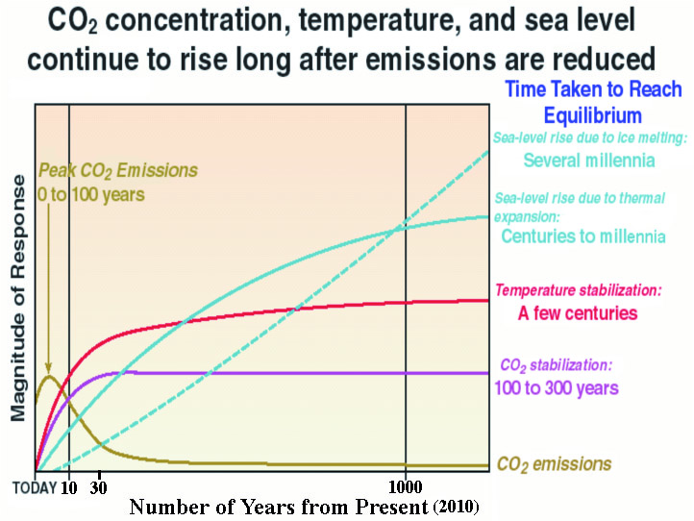
Notes:
This diagrammatic representation shows the period of time before part of the climate system reaches equilibrium long after CO₂ emissions are reduced. This delay is due to the inertia of the climate system, primarily the oceans. Even if we reduce today’s greenhouse gas emissions to zero, we will still have a 0.6° to 1° C rise in average global temperature, and sea level rise will continue into the foreseeable future . In other words, “We have already shot ourselves in the foot”. We now need to keep from shooting ourselves in the head. From UN IPCC Report, 2001.

Slide 8
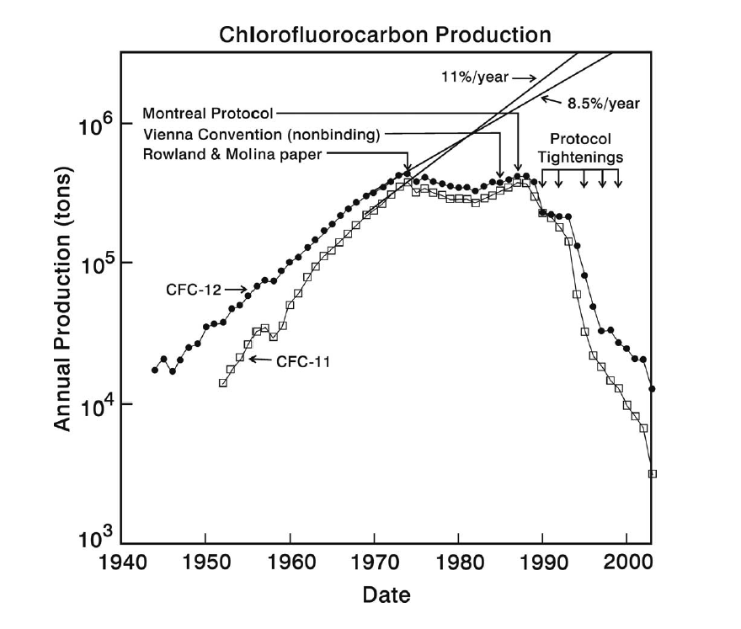
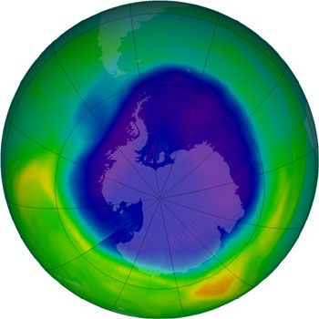
The Ozone Hole: Inertia in Action
CFCs have decreased dramatically during the past 20 years.
The ozone hole in 2011 was still large because of the long lifetime of CFCs in the stratosphere.
It will take about 70 years for the ozone hole to disappear.
2011
Notes:
This is an example of the inertia of a climate system; in this case the response of the ozone layer. Although the CFC’s that cause a depletion of the ozone layer have declined dramatically since about 1988, the ozone hole is still at its maximum primarily because of the long lifetime of CFC’s in the stratosphere.

Slide 9
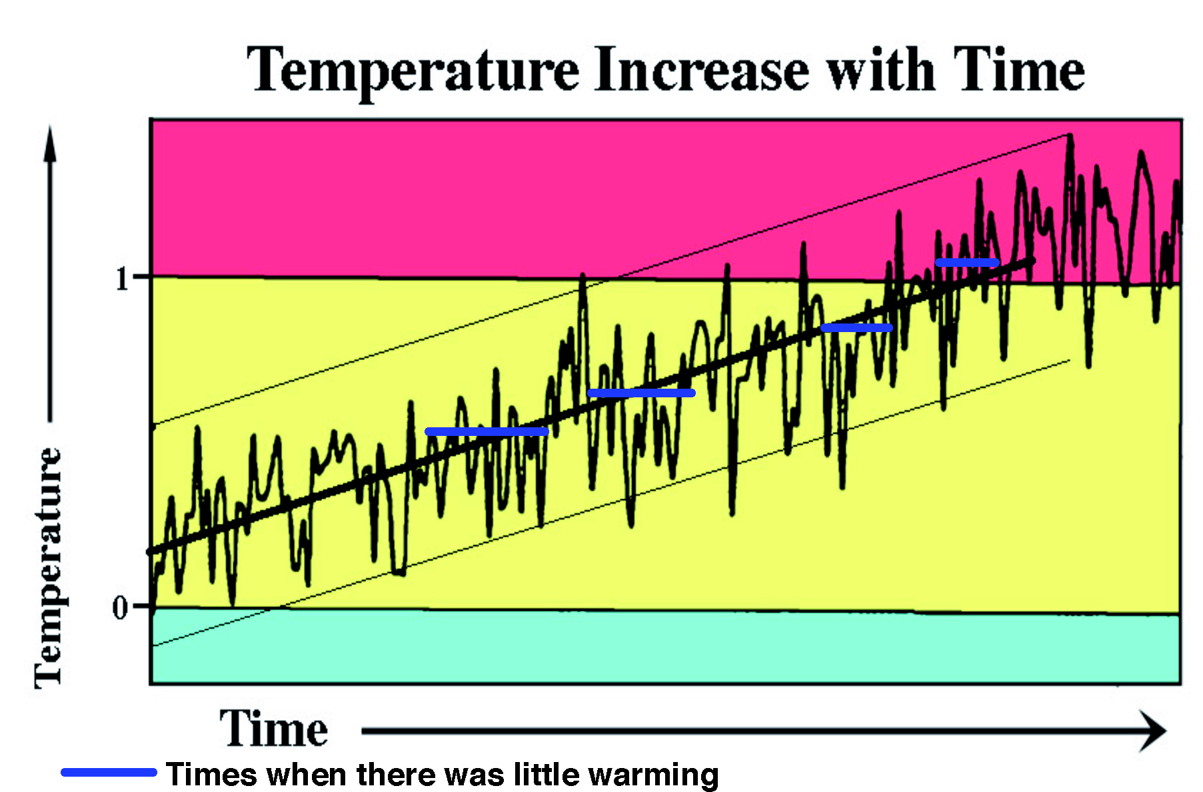
Diagram of Natural Variations of Climate during Warming
Notes:
This diagrammatic representation shows the natural variations in climate. The thick line is approximately the average increase in temperature over time, while the two fainter lines show the approximate range in temperatures with time.
Climate has natural occurring fluctuations that result in a saw-tooth temperature curve. Our present increase in global temperature is not uniform. For a variety of reasons, some years will be cooler or hotter than others. Some of these reasons include large volcanic eruptions, variations in solar irradiance, or the presence of El Nino and La Nina events, among other natural phenomena. Although the overall trend is for increased temperatures, there are some years that are warmer or cooler than adjacent years. For example, 1998 and 2005 were the hottest years on record since world temperature recordings began in 1880, but the years in between have been slightly cooler (2002 and 2003 were the second and third warmest years, respectively). The temperature trend, however, has been consistently upward.

Slide 10
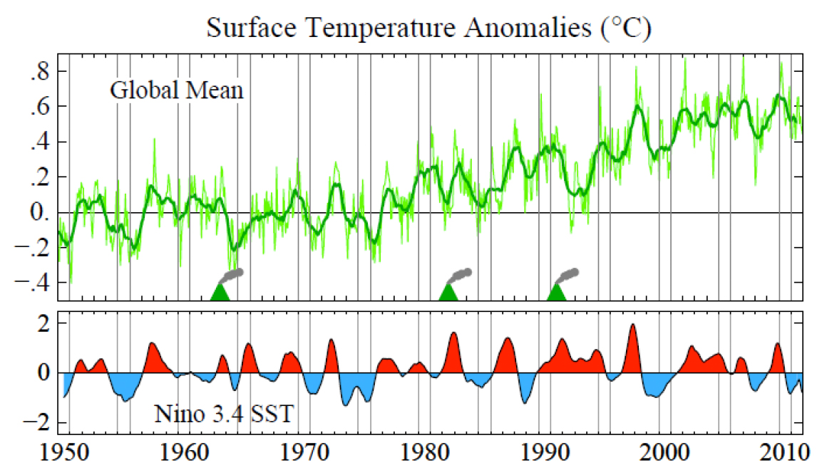
El Niños (red), La Niñas (blue) and Large Volcanic Eruptions Cause Short-term Climate Variations
Notes:
El Niños are conditions where the tropical Pacific Ocean temperatures are warmer than normal, and this leads to warmer atmospheric conditions. La Niñas are conditions were the tropical Pacific Ocean temperatures are cooler than normal, leading to cooler atmospheric conditions. The stylized volcanoes represent major volcanic eruptions that cooled the atmosphere. The last one is Pinatubo that was the largest eruption since the turn of the century and cooled the atmosphere for several years during an El Nino. From Hansen, et al., Global Temperature in 2011, Tends and Prospects, Jan. 18, 2012.

Slide 11
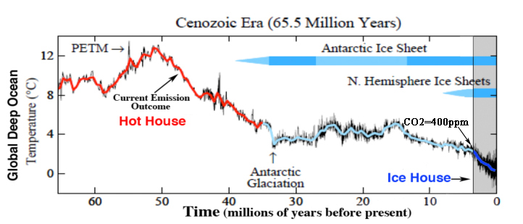
Paleoclimate in the Cenozoic Era
PETM = Paleocene-Eocene Thermal Maximum
Hot House = No Ice on Earth
Ice House = Both Ice Sheets Present plus Glacial and Interglacial Periods
All Human Evolution Occurred in an Ice House
Notes:
The climate changes that have occurred in the past 65 million years indicate that our current rate of climate change is catastrophic for humans and other species. We are drastically changing the planetary environment on a very short timescale relative to geological time. This graph shows the global deep ocean temperature over the past 65 million years derived from ocean sediment cores. The global average atmospheric temperature was, of course, much warmer. During the Holocene in the “Ice House” it was 14 degrees C, and at the top of the “Hot House” it was about 25 degrees C. About 3.5 million years ago in the Pliocene the atmospheric CO2 content was about the same as today (~400 ppm). The last time the CO2 content was this high there were no humans on Earth and sea level was about 5 m higher than today. If the current CO2 emission rate continues we will eventually reach the temperature indicated by the arrow showing the “Current Emission Outcome”.

Slide 12
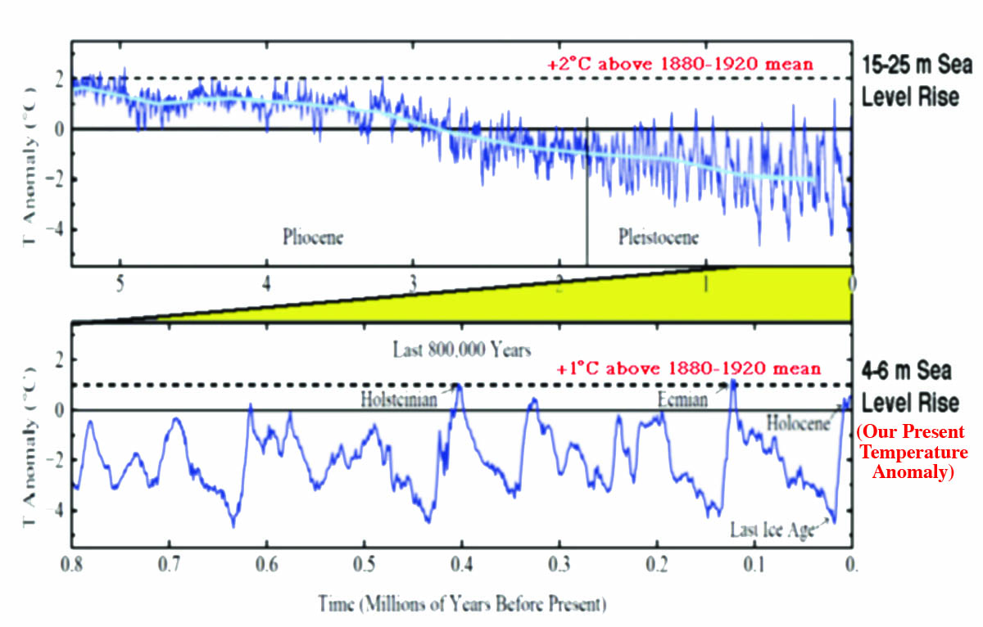
Temperature Anomaly Relative to the 1880-1920 Mean and Sea Level Rise
Notes:
Modified from Hansen et al., Scientific Case for Avoiding Dangerous Climate Change to Protect Young People and Nature, 2011.

Slide 13
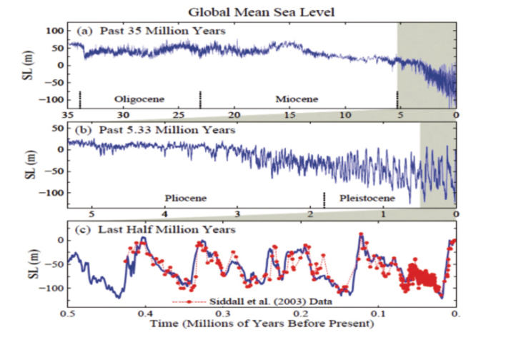
Sea Level during the past 35 million years

Slide 14
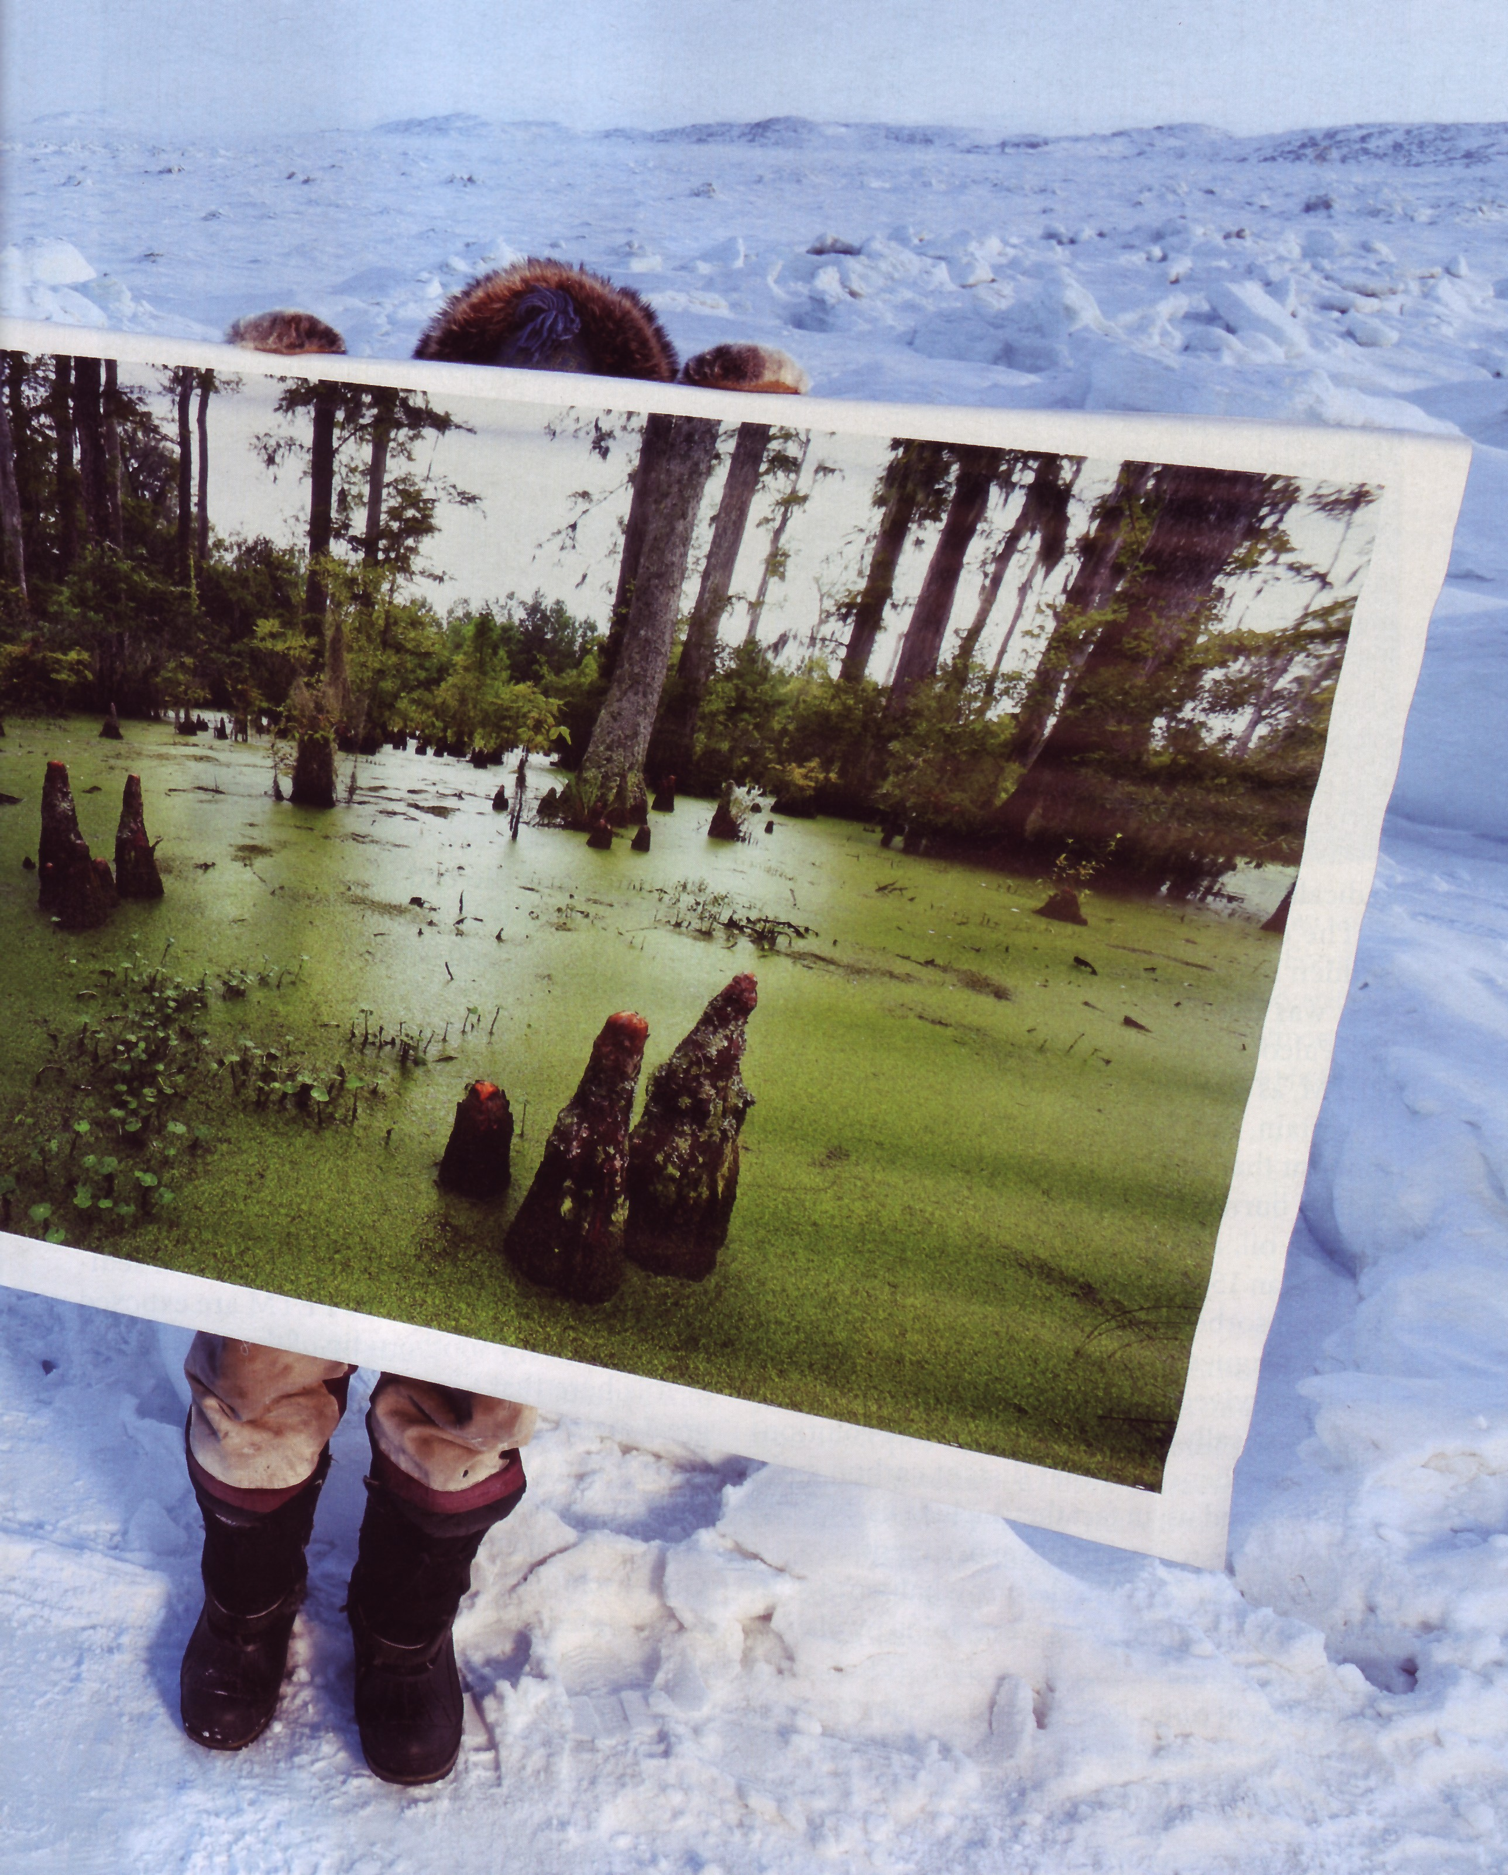
The Arctic in the Paleocene-Eocene Thermal Maximum (PETM)
Average Annual Arctic Temp. = 20° C (68° F)
Arctic Ocean Surface Temp. = 22° C (72°F); same as the present Hawaiian ocean surface
An Eskimo holds a picture of what the Arctic might have looked like during the PETM.
Notes:
From the National Geographic Magazine

Slide 15
New Arctic Pliocene Data
Northeast arctic Russia 3.4-3.6 million years ago had summer temperatures ~8° C warmer than today (3° C).
At that time the atmospheric CO₂ content was about the same as today (~400 ppm).
The climate sensitivity is considerably greater than previously estimated.

Slide 16
Summary: Cenozoic Era
The average rate of change in CO₂ was ~100 ppm/million years or 0.0001 ppm/year
The human rate today is 2 ppm/year (20,000 times faster than the natural rate)
The “abrupt” PETM temperature rise took ~25,000 years with a duration of ~50,000 years
The current rise in temperature is about 100 times faster than in the PETM
Humans overwhelm “slow” geologic changes
We are producing “A Different Planet”

Slide 17
The Permian/Triassic Mass Extinction (70-96% of Species Extinct) Was Caused by a Climate Change 252 million Years Ago
The greatest mass extinction in geologic history was caused by a global warming event resulting from massive flood volcanism lasting ~2 million years, releasing huge amounts of CO_{2’} and methane from the continental shelves.
The global warming started slowly in an “Ice House” similar to today’s and ended in a “Hot House” 9° C (16° F) hotter than today.
We are currently headed in that direction but much more rapidly; maybe less than 200 years.

