Slide 1
Part 4
Temperature Rise

Slide 2
Global Average Temperature Change for the Past 11,300 Years (Holocene) (Science, 8 March 2013: Vol. 339 no. 6124, pp. 1198-1201)
Notes:
Temperature change over past 11,300 years (in blue, via Science, 2013) plus projected warming this century on humanity’s current emissions path (in red, via recent literature). A stable climate enabled the development of modern civilization, global agriculture, and a world that could sustain a vast population. Now, the most comprehensive “Reconstruction of Regional and Global Temperature for the Past 11,300 Years” ever done reveals just how stable the climate has been — and just how destabilizing manmade carbon pollution has been and will continue to be unless we dramatically reverse emissions trends. The temperature is changing 50 times faster than it did during the time modern civilization and agriculture developed, a time when humans figured out where the climate conditions — and rivers and sea levels — were most suited for living and farming. We are headed for 7 to 11°F warming this century on our current emissions path — increasing the rate of change 5-fold yet again. Science 8 March 2013: Vol. 339 no. 6124 pp. 1198-1201 DOI: 10.1126/science.1228026

Slide 3
Temperature Anomaly (1880-2012) Baseline: 1951-1980
Aerosols
Aerosols
(tiny particles)
Aerosols
Aerosols
Aerosols
Aerosols
Notes:
Land-Ocean Temperature anomaly for 1880-2010. The blue bars are the uncertainty limits at the 95% probability. The relatively flat area between 1951 and about 1980 is because aerosols were dominating the temperature regime. The volcano symbols indicate major volcanic eruptions that lowered the temperature. The El Nino (orange) and La Nina (blue) in the bottom chart indicate heating (orange) and cooling (blue) of the atmosphere by El Nino’s and La Nina’s. The relatively flat area during the last 10 years is due to a combination of La Nina’s and increased aerosol emissions from China. Courtesy of NASA Goddard Institute of Space Studies.

Slide 4
Temperature Anomaly (1880-2011) Baseline: 1951-1980

Slide 6
Systematic Decadal Shift to Higher Temperatures Relative to 1951-1980
Notes:
Frequency of occurrence of local June-July-August temperature anomalies (relative to 1951-1980 mean) for Northern Hemisphere land in units of local standard deviation (horizontal axis). Temperature anomalies in 1951-1980 match closely the normal distribution (green curve), which is used to define cold (blue), typical (white) and hot (red) seasons, each with probability 33.3%.

Slide 7
Temperature Anomalies from 1884 to 2011
Baseline = 1951-1980
Notes:
This movie is from the NASA Goddard Institute for Space Studies (GISS) and shows the increase in global temperature from 1884 to 2011. The baseline value is the mean global average temperature between 1951 and 1980 when the temperature was about the same due to aerosols (See slide 21). In this movie the white and blue areas are anomalies at or below the 1951-1980 baseline and yellow to red areas are anomalies above that baseline (See temperature bar). Global warming actually started about 1920 (See slide 21).

Slide 8
Arctic Air Temperature Anomalies from Proxies (blue) and Observations (red)
Notes:
Blue line: estimates of Arctic air temperatures over the last 2,000 years based on proxy records from lake sediments, ice cores and tree rings. The green line shows the best fit long-term cooling trend for the period ending 1900. The red line shows the recent warming based on actual observations. (Courtesy Science, modified by the University Corporation for Atmospheric Research).

Slide 9
Record High Temperatures in the U.S. are Increasing and Record Lows are Decreasing
Notes:
Spurred by a warming climate, daily record high temperatures occurred twice as often as record lows over the last decade across the continental United States, new research shows. The ratio of record highs to lows is likely to increase dramatically in coming decades if emissions of greenhouse gases continue to climb.

Slide 11
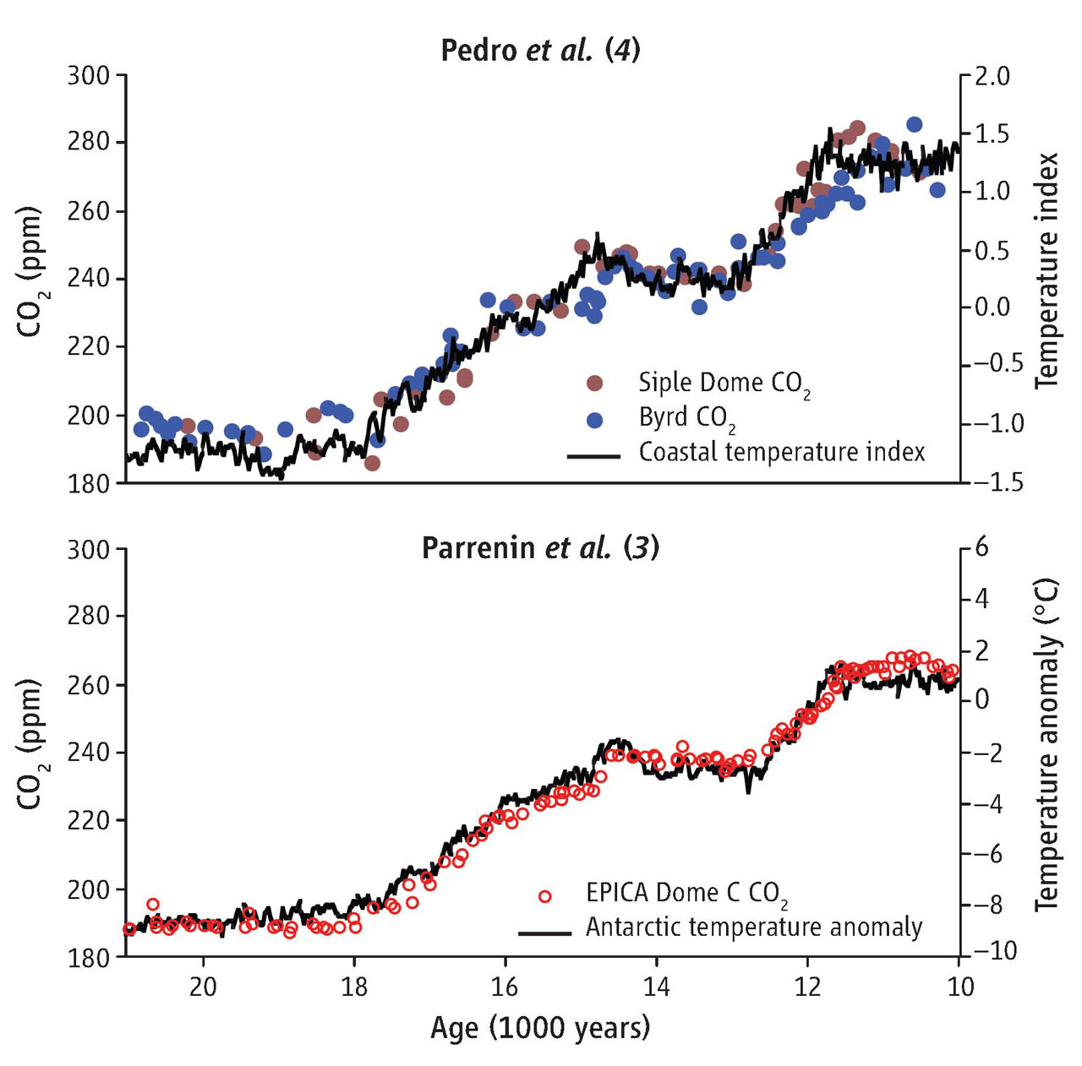
Lead and lag.Carbon dioxide concentrations and averages of temperature proxy records for last deglaciation, as compiled by Parrenin et al.
Published by AAAS
E J Brook, Science, 2013;339:1042-1043
Notes:
Lead and lag.Carbon dioxide concentrations and averages of temperature proxy records for last deglaciation, as compiled by Parrenin et al. (3) and Pedro et al. (4). Pedro et al. used existing CO₂ and temperature proxy data from coastal Antarctic cores and the temperature anomaly is presented in standard deviation units (the number of standard deviations from the mean of the record) to illustrate the average timing of temperature change. Parrenin et al.'s record is the average temperature anomaly for all the records they combine (in °C), relative to modern conditions. Using largely independent methods and data, both studies indicate a very tight coupling between regional Antarctic temperatures and CO₂.

Slide 12
Notes:
Analysis of air bubbles trapped in an Antarctic ice core extending back 800,000 years documents the Earth’s changing CO₂ concentration. Over this long period natural factors (Milankovitch cycles) have caused the atmospheric CO₂ concentration to vary within a range of about 170 to 280 ppm. Temperature related data make clear that these variations have played a central role in determining the global climate. As a result of human activities, the present CO₂ concentration of about 396 ppm is about 35% above its highest level over at least the last 800,000 years. In the absence of strong control measures, emissions projected for this century would result in the CO₂ concentration increasing to a level that is roughly 2 to 3 times the highest level occurring over the glacial-interglacial era that spans the last 800,000 years or more.

Slide 13
Notes:
The rapid rise in atmospheric CO₂ from direct systematic measurements begun on the Island of Hawaii in 1958. The rise is shown in this graph of the mean annual CO₂ abundance, and is called the Keeling Curve. The “Safe Upper Limit” is the CO₂ abundance level where the ice sheets do not disappear entirely. At this limit all of the Greenland ice sheet and most of the Antarctic ice sheet will eventually melt in several thousand years. Emissions of other more powerful greenhouse gases (halocarbons, methane, etc) have pushed the equivalent concentration of CO2 in the atmosphere to about 478 ppm.

Slide 14
Atmospheric CO² and Global Warming
Stabilization CO² Concentration: Best Estimate (ppm) | Lower End (ppm) | Upper End (ppm) | Equilibrium Global Average Warming (°C)
280 | ---- | ---- | 0
340 | 320 | 380 | 1
430 | 370 | 540 | 2
540 | 440 | 760 | 3
670 | 530 | 1060 | 4
840 | 620 | 1490 | 5
Notes:
From: Climate Stabilization Targets: Emissions, Concentrations, and Impacts over Decades to Millennia, National Academy of Science, 2010

Slide 15
Notes:
At our present CO₂ level we will eventually reach about 1.8° C.

Slide 16
Earth’s Heat Gain During the Past 50 years (10²¹ Joules*)
Oceans (0-2 km depth) = 245 (91%)
Continents = 10.4 (4%)
Earth’s Ice = 8.1 (3%)
Atmosphere = 6.6 (2%)
*A joule is a unit of heat energy
Notes:
All of Earth’s systems show a heat gain. Most of that gain has been in the oceans and the least has been in the atmosphere. These heat gains show that global warming is indeed global in scope. The large amount of warming of the oceans will result in continued global warming even if we stopped all emissions today.

Slide 17
Ocean Heat Content Compared to Total Land, Atmosphere and Ice Heat Content.
Notes:
In the year 2000 the Land+Ice+Atmosphere was ~13% and the Ocean (0-2 km depth) was ~87%. Ten years later (2010) the Land+Ice+Atmosphere was 9% and the Ocean (0-2 km depth) was 91%. This is the main reason that the global average temperature has been about the same during the past 10 years.

Slide 18
What Global Average Temperatures Become Critical and Catastrophic for Humans?
The current best estimate is 2° C (3.6° F) above pre-industrial levels is critical. About 4° C (7° F) is catastrophic. The Earth is now 0.8° C (1.4° F) above pre-industrial levels.
When the CO₂ abundance reaches ~430 ppm the temperature anomaly will eventually reach 2° C. At ~670 ppm it will eventually reach a ~4° C.
The current abundance (2013) is 396 ppm and rising at a rate of 2 ppm/year, and this rate is increasing. At the present abundance the temperature will eventually reach 1.8° C.
Even at today’s abundance the temperature anomaly could reach the critical level by the end of the century. (Armour and Roe, GRL, 38, 2011; Arora, et al., GRL, 38, 2011)
Notes:
The greenhouse gas levels and temperatures constituting dangerous interference with the climate system are difficult to predict. It depends not only on the intensity of the climate changes but also on the human response to them. When food and water become scarce in certain parts of the world the response could be drastic such as widespread war making the situation even worse, particularly if atomic weapons were involved. In this slide the current best estimates are given, but they could be underestimated because it is almost impossible to predict the human response to catastrophic environmental changes. The uncertainty makes it even more urgent to begin major reductions in greenhouse gases NOW. The consequences that are currently occurring are due to only a 0.8 degree C temperature rise above the pre-industrial average.
The finding that we will reach the critical temperature by the end of the century no matter what we due it from the following papers: Armour and Roe, Climate commitment in an uncertain world, GRL, 38, L01707, 2011; and Arora, et al., Carbon emission limits required to satisfy future representative pathways of greenhouse gases, GRL, 38, L05805, 2011.

Slide 19
Probable Temperature Increases for “Low, Moderate and High CO₂ Growth” (numerical data 2011)
Increase in Global Average Temperatures
2° C (3.6° F)
Critical
3° C (5.4° F)
5.5° C (10° F)
Catastrophic
Notes:
The diagrams on the right show the projected increase in temperature from 2020-2029 to 2090-2099 for low, moderate and high CO₂ emissions. On the left is the expected global average temperatures for each case. We are presently on the high CO₂ growth rate. Graphic from the IPCC 2007 report, and numbers from Arora et al. GRL 38, L05805, 2011.

Slide 20
WHAT IS CRITICAL AND WHAT IS CATASTROPHIC?
CRITICAL --- serious drop in food production, serious water shortages, significant sea level rise (~1 m [3 ft]), political unrest, major drop in world economy, major animal extinctions and millions of human deaths. Third-world countries, e.g. Africa, are affected most, including large human migrations.
CATASTROPHIC --- mass extinction event (>50% species extinction), major sea level rise, mass starvation, political and economic chaos, ~50% human deaths (>3 billion people). Probably the end of civilization as we know it today.
Notes:
These consequences are generalized estimates based on a variety of studies. Some scientists consider the possibilities are so dire that very few humans survive. For example, the eminent and highly respected scientist James Lovelock who is responsible for the Gaia Hypothesis says that global warming is irreversible -- and that more than 6 billion people will perish by the end of the century. Most other scientists feel that we can prevent very serious disruptions, but only if we act now with very large reductions in greenhouse emissions and probably CO₂ extraction from the atmosphere.

