Slide 1
Part 5
Humans are the Primary Cause of Global Warming

Slide 2
Some Reasons We Know Humans are the Main Cause
There is a good correlation between the rise in human-caused emissions of greenhouse gases, the rise in atmospheric greenhouse gases, and the rise in temperature. The rate of increase in each is unprecedented.
There is a good correlation between the growth in the human population and the rise in greenhouse gases and temperature.
Computer simulations indicate that only human-caused emissions of greenhouse gases can cause the observed rise in temperature of the atmosphere and other Earth systems (Oceans, Continents and Ice).
No other natural causes can account for the present rapid rise in temperature and CO₂. The present rate of CO₂ increase is about 20,000 faster than natural rates.
Carbon isotopes due to burning fossil fuels are the main constituent of the increased CO₂ concentration (falling ¹³C to ¹²C ratio).
Notes:
The above are only some the reasons we know that humans are the primary cause of global warming. There about 6 other indications that we are responsible.

Slide 3
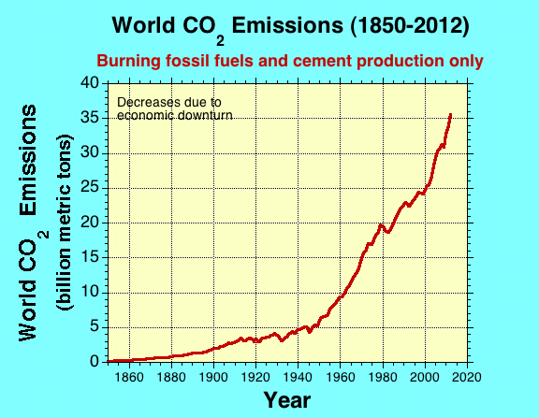
Notes:
Carbon emissions are 'too high' to curb climate change
By Mark Kinver Environment reporter, BBC News The concentration of CO2 is continue to rise, despite global efforts to curb future increases
Continue reading the main story Related Stories
Greenhouse gases hit record high
CO2 'drove end to last ice age'
Antarctic may host methane stores
It is increasingly unlikely that global warming will be kept below an increase of 2C (3.6F) above pre-industrial levels, a study suggests.
Data show that global CO2 emissions in 2012 hit 35.6bn tonnes, a 2.6% increase from 2011 and 58% above 1990 levels.
The researchers say that emissions are the largest contributor to future climate change and a strong indicator of potential future warming.
The findings have been published in the journal Nature Climate Change.
Meanwhile, the data has been published in the journal Earth System Science Data Discussions. The amount for 2012 is a best estimate.

Slide 4
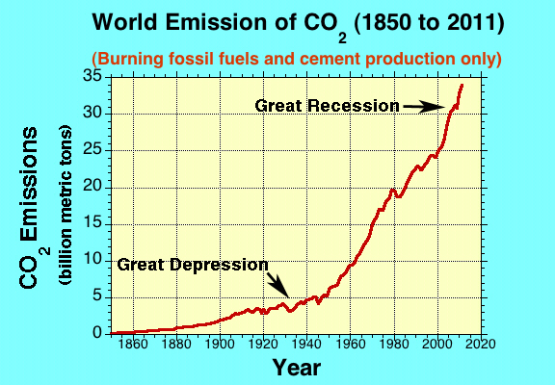

Slide 5
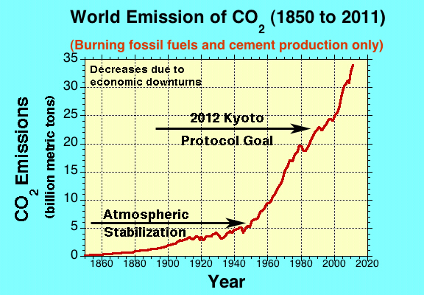

Slide 6
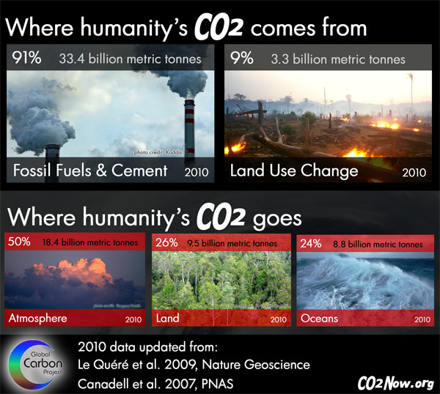

Slide 7
Annual Growth Rate of CO₂ Emissions
1990s | 1.3 %
2000 - 2008 | 3.3 %
2009 | -1.4 %
2010 | 4.9 %
Notes:
This table shows the percentage increase or decrease in the annual growth rate of CO₂ emissions from 1990 to 2010.

Slide 8
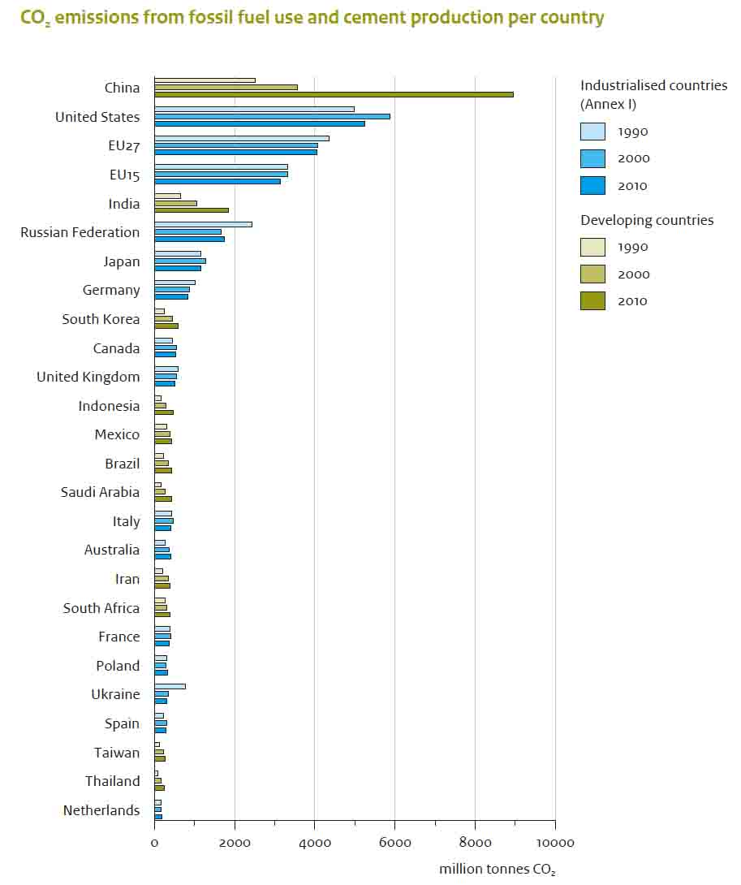
Country CO₂ Emissions for 1990, 2000 and 2010
Notes:
Source: Long-term Trend in Global CO₂ Emissions. 2011 Report, PBL Netherlands Environmental Assessment Agency, The Hague, European Union, 2011. All the developing countries show increases in CO₂ emissions for 2010. This is particularly true for China and India. That is the cause of the large growth rate in CO₂ emissions for 2010 shown in the previous slide.

Slide 9
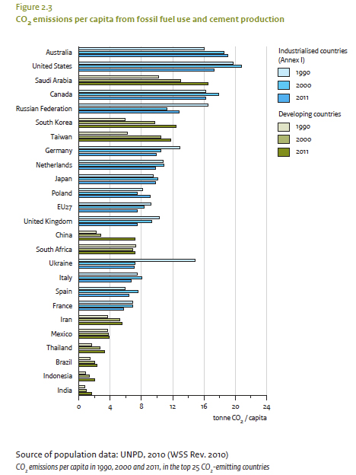
Per Capita CO₂ Emissions for 1990, 2000, and 2011

Slide 10
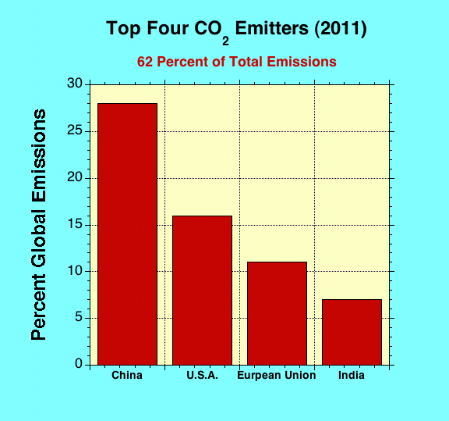
Notes:
This bar chart shows the percentage CO₂ emissions of the top 4 countries.

Slide 11
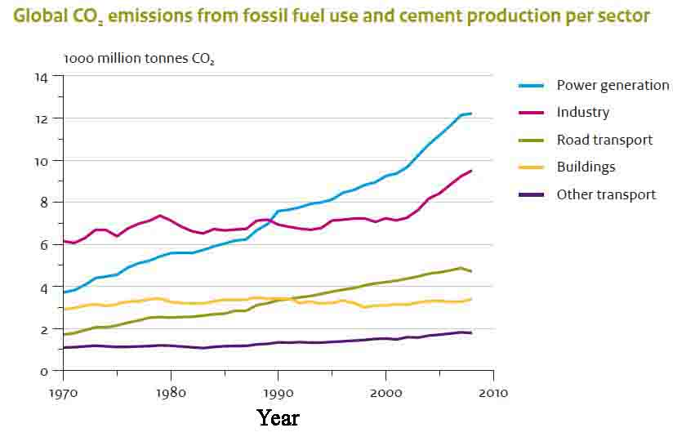
Notes:
Source: Long-term Trend in Global CO2 Emissions. 2011 Report, PBL Netherlands Environmental Assessment Agency, The Hague, European Union, 2011.

Slide 12
Coal: The Worst CO₂ Emitter
One mid-sized coal-fired power plant (500-megawatts) emits about 3.5 million tons of CO₂ annually.
This is equivalent to 625,000 additional cars on the road traveling 12,000 miles per year.
In the U.S. utility companies have proposed building 185 new coal-fired power plants (10 in operation, 32 under construction, and 90 in early development).
China is building, on average, 2 coal-fired power plants each week.

Slide 13
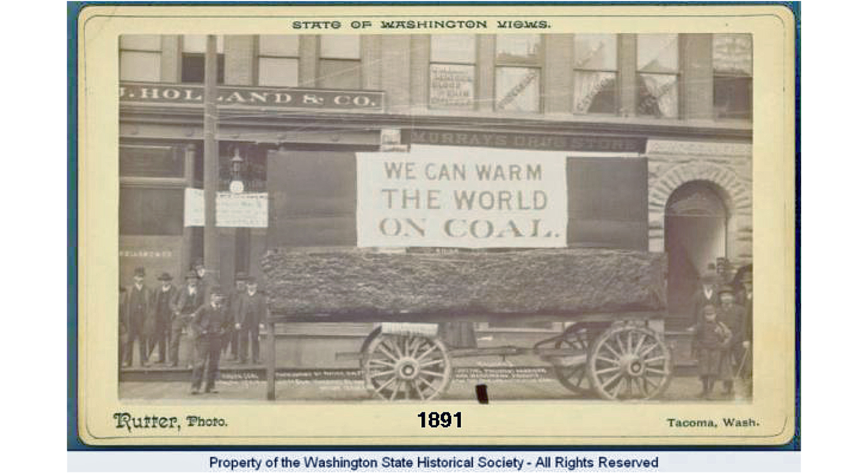
How Right They Were!
Notes:
Full description: “A rectangular piece of coal in a wagon is on display in the middle of Pacific Avenue in Tacoma before the arrival of President Harrison in May, 1891. A sign behind the wagon reads, “We Can Warm the World on Coal”. A group of men stand on either side of the wagon in front of S.J. Holland’s and Murray’s Drug Store.”

Slide 14
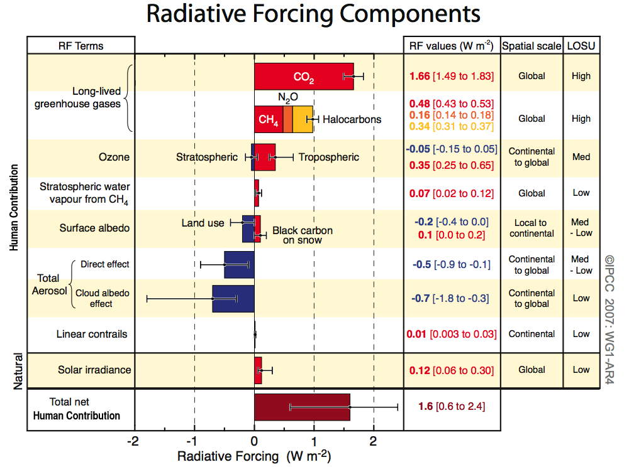
Intensity of Climate Drivers (2006)
Notes:
Radiative forcing is the quantity used to measure the amount of climate change. It is expressed in terms of watts per square meter (Wm⁻²). A positive value heats the Earth, and a negative value cools the Earth. Radiative forcings (climate drivers) due to various causes are shown in this diagram (the numbers are in watts per square meter). The red forcings (right) heat the Earth, and the blue forcings (left) cool the Earth. Greenhouse gases are mainly responsible for the current warming and far outweigh the others. However, the human-caused aerosols have produced a significant cooling which has kept the temperature from reaching even higher levels than today. Those aerosols now appear to be decreasing. (UN IPCC 4th Assessment, 2007)

Slide 15
Radiative Forcing from Various Causes
(Black Carbon is not included and the sunlight-reflecting potential of Aerosols may be overestimated¹)
Notes:
Estimated climate forcings, with uncertainties that vary from small for well-mixed greenhouse gases to large for unmeasured tropsopheric aerosols. Forcings through 2003 (vertical line) are the same as used by Hansen et al. (2007), except the tropospheric aerosol forcing after 1990 is approximated as -0.5 times the GHG forcing. Aerosol forcing includes all aerosol effects, including indirect effects on clouds and snow albedo. GHGs include O₃ and stratospheric H2O, in addition to well-mixed GHGs.
¹ Geophysical Research Letters, doi:10,1029/2012GL053469,2012.

Slide 16
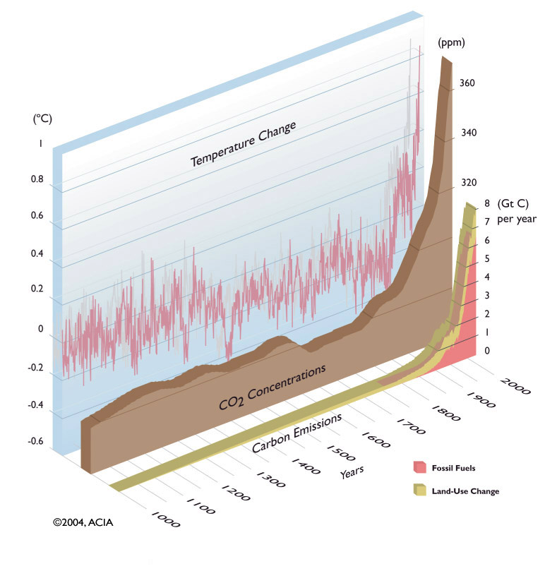
Temperature, CO₂ Concentrations and Human- Caused Carbon Emissions
Notes:
This graph shows the relationship between the temperature change, the change in atmospheric carbon dioxide concentration, and the change in human-caused carbon emissions. All three increase sharply at the same time indicating human-caused greenhouse gas emissions is the main cause of global warming. From Arctic Climate Impact Assessment, Impact of the Warming Arctic: Artic Climate Impact Assessment, 2005)

Slide 17
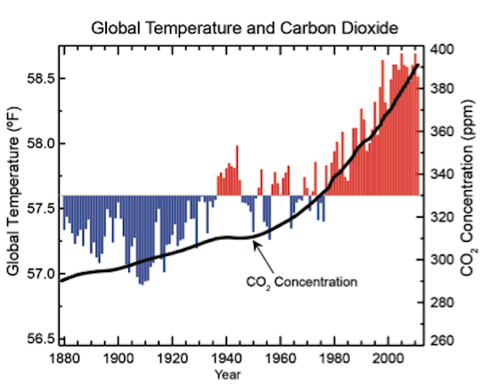
Notes:
Global annual average temperature (as measured over both land and oceans; scale on left) has increased by more than 1.4°F (0.8°C) since 1880. Red bars show temperatures above the long-term average, and blue bars indicate temperatures below the long-term average. The black line shows atmospheric carbon dioxide (CO2 concentration in parts per million (ppm); scale on right. While there is a clear long-term global warming trend, some years do not show a temperature increase relative to the previous year, and some years show greater changes than others. These year-to-year fluctuations in temperature are due to natural processes, such as the effects of El Niños, La Niñas, and the eruption of 12 large volcanoes. Figure source: NOAA NCDC. Temperature data from NOAA NCDC 2012; CO2 data from NOAA ESRL 2012.

Slide 18
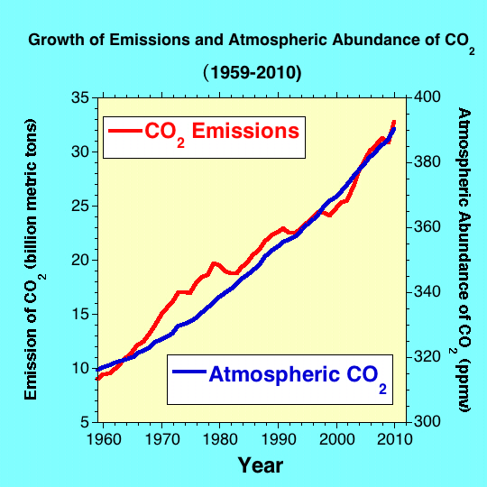
Notes:
This graph shows the human-caused CO₂ emissions and the atmospheric concentration of CO₂ from 1959 to 2010. The increase in emissions and atmospheric concentration is very similar, indicating a causal relationship.

Slide 19
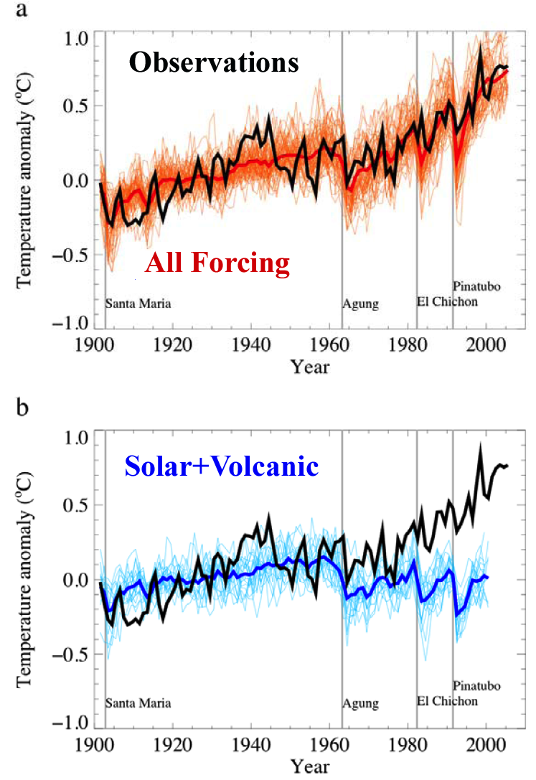
Only Human-caused Greenhouse Gas Emissions Can Account for Global Warming
The black line is the observed temperature rise.
The orange area is computer simulations of all emissions, including human.
The blue area is computer simulations of only natural emissions and the increase in solar activity.
Notes:
This is a comparison of computer simulations of global average temperature anomalies and the observed temperatures (black line) from 1900 to the 2005. The upper graph shows all forcings (red) including human-caused greenhouse gases, and the lower graph is only natural forcing by solar irradiance and volcanism (blue). They show that only human-caused greenhouse gases can account for the observed warming. The named vertical lines are major volcanic eruptions that lower the temperature. These computer simulations are additional evidence that humans are the primary cause of global warming. From the UN IPCC 4th assessment 2007.

Slide 20
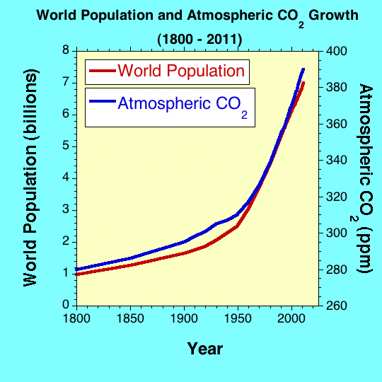
Notes:
This graph show the population growth and increase in atmospheric CO₂ from 1800 to 2011. There is an excellent correlation between the population and CO₂ curves indicating that the rate of increase in atmospheric CO₂ and the rate of population growth are the same. This is further evidence that humans are the cause of the rise in atmospheric CO₂.

Slide 21
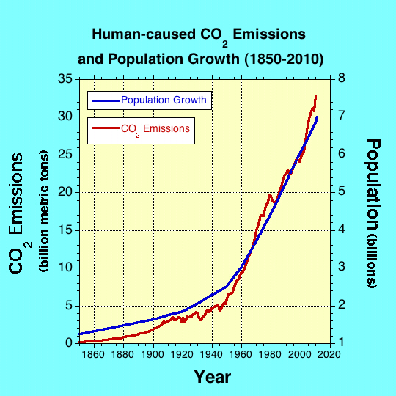
Notes:
This graph shows the population growth and the increase in human-caused CO₂ emissions from 1850 to 2010. The good correlation indicates that the rate of increase of human-caused CO₂ emissions and population growth are very similar.

