Slide 1
Part 6
Melting Ice and Rising Sea Level

Slide 2
Some Current General Consequences of Global Warming
More Severe Heat Waves of Greater Duration
Sea-level Rise and Ocean Acidification (Oceans are acidifying 10 times faster today than 55 million years ago when a mass extinction of marine species occurred - PETM)
Glaciers, Ice Sheet and Permafrost Melting
Spreading Disease
Plant and Animal Range Shifts Plus Extinctions
Coral Reef Degradation
More Severe and Frequent Weather Events (2011 was the worst)
More Severe and Frequent Flooding (2011 was the worst)
More Severe Droughts and Fires (2011 was the worst)
Notes:
Because of the large absorption of CO₂ , the oceans are producing large quantities of carbonic acid. The oceans are, therefore, becoming acidic. If CO₂ emissions are not drastically reduced now, the acidity of the oceans will violate EPA Quality Criteria (1976) by mid century or sooner (Geophys. Res. Letters, Sept. 25, 2007). This will significantly risk marine biota and adversely impact the food webs and key biogeochemical processes.

Slide 3
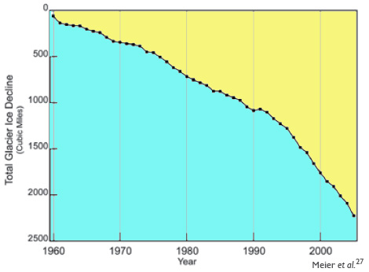
Cumulative Decrease in Global Glacier Ice

Slide 4
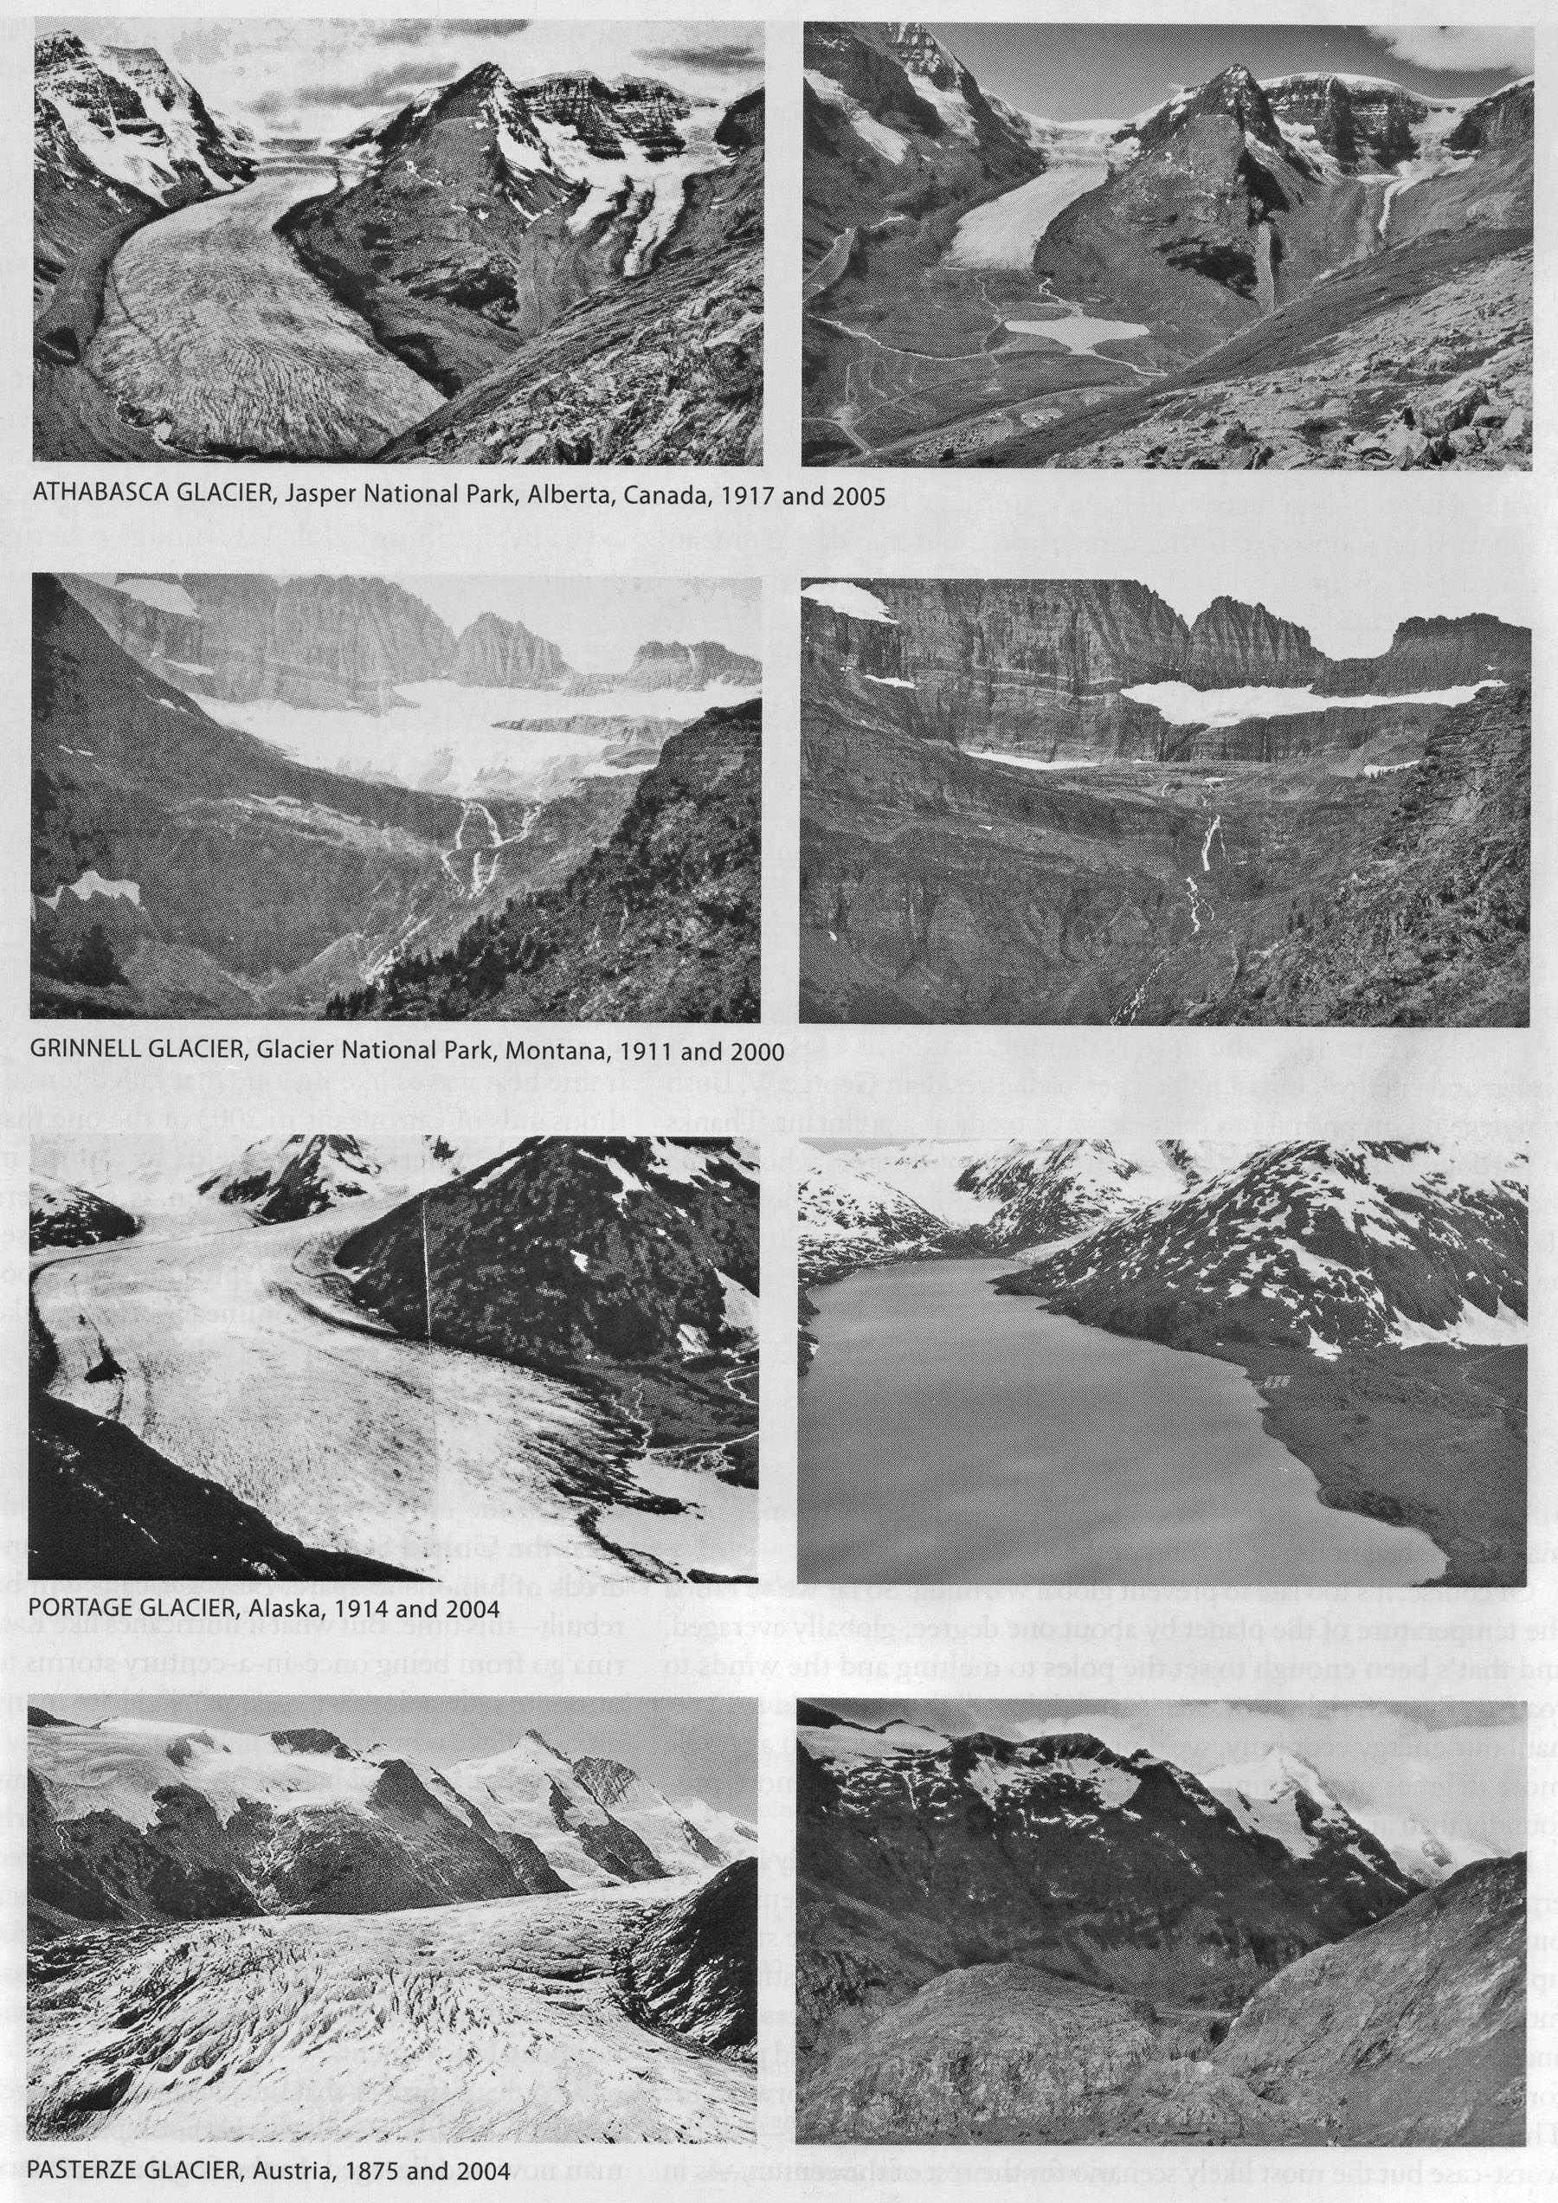
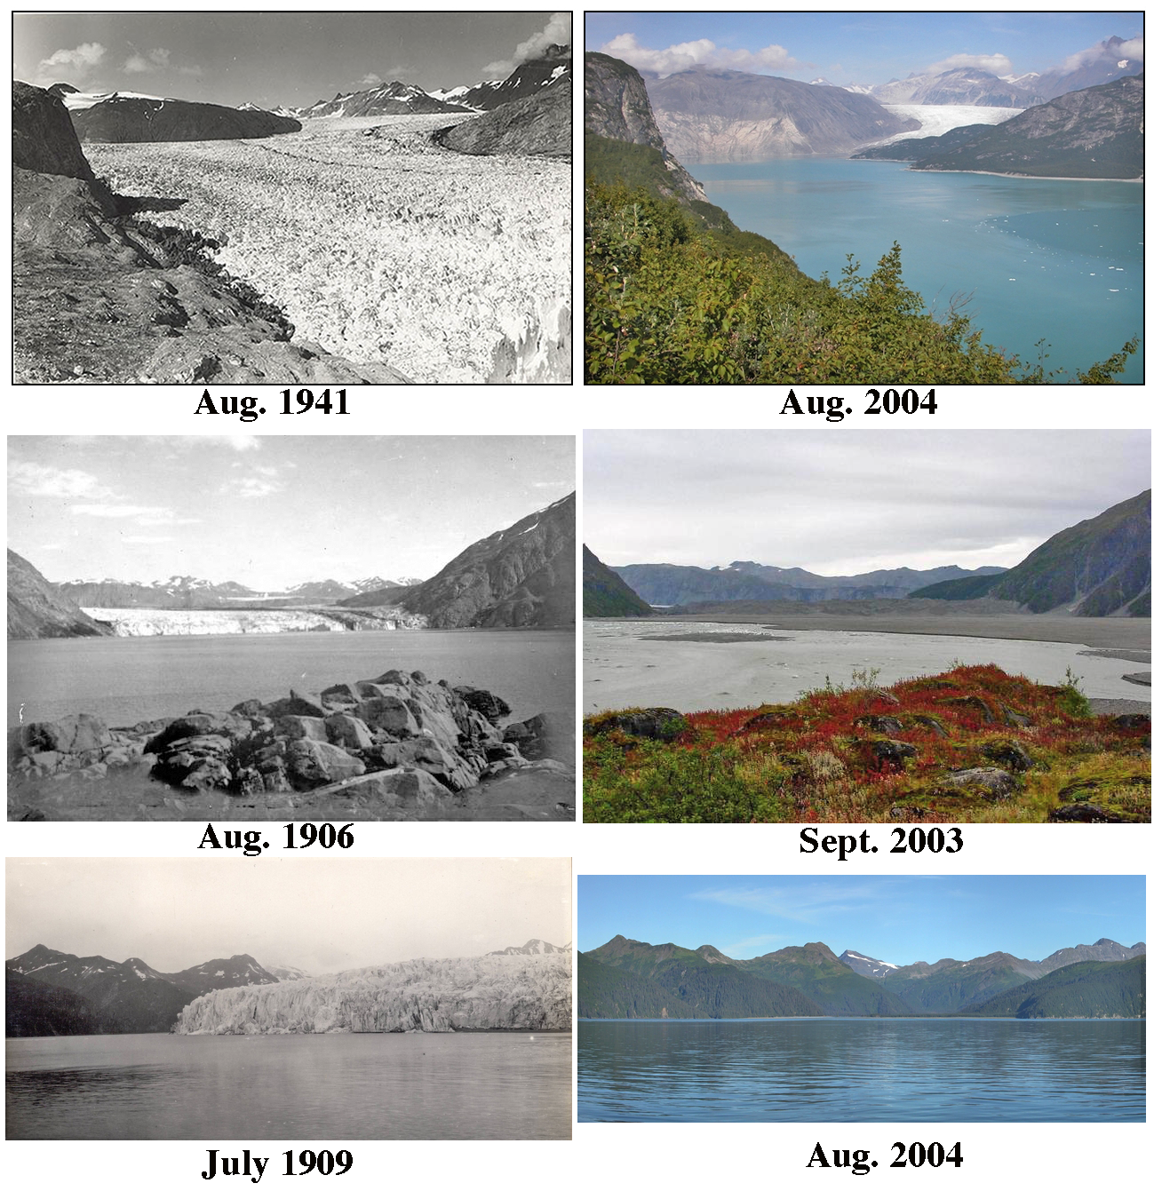
Melting Glaciers
Notes:
The comparisons on the left are various glaciers around the world. The comparisons on the right are for three Alaskan glaciers. Notice the vegetation differences in the top two Alaskan comparisons due to climate change. The rate at which some of the world's glaciers are melting has more than doubled, data from the United Nations Environment Programme has shown. Average glacial shrinkage has risen from 30 centimeters per year between 1980 and 1999, to 1.5 meters in 2006. Some of the biggest losses have occurred in the Alps and Pyrenees mountain ranges in Europe.
Experts have called for "immediate action" to reverse the trend, which is seen as a key climate change indicator. Estimates for 2006 indicate shrinkage of 1.4 meters of 'water equivalent' compared to half a meter in 2005.
Achim Steiner, Under-Secretary General of the UN and executive director of its environment programme (UNEP), said: "Millions if not billions of people depend directly or indirectly on these natural water storage facilities for drinking water, agriculture, industry and power generation during key parts of the year.
"There are many canaries emerging in the climate change coal mine. The glaciers are perhaps among those making the most noise and it is absolutely essential that everyone sits up and takes notice.
Litmus test
He said that action was already being taken and pointed out that the elements of a green economy were emerging from the more the money invested in renewable energies.
Mr Steiner went on: "The litmus test will come in late 2009 at the climate convention meeting in Copenhagen.
"Here governments must agree on a decisive new emissions reduction and adaptation-focused regime. Otherwise, and like the glaciers, our room for manoeuvre and the opportunity to act may simply melt away."
Dr Ian Willis, of the Scott Polar Research Institute, said: "It is not too late to stop the shrinkage of these ice sheets but we need to take action immediately."
The findings were compiled by the World Glacier Monitoring Service which is supported by UNEP. Thickening and thinning is calculated in terms of 'water equivalent'.
Glaciers across nine mountain ranges were analysed. Dr. Wilfried Haeberli, director of the service, said: "The latest figures are part of what appears to be an accelerating trend with no apparent end in sight.
"This continues the trend in accelerated ice loss during the past two and a half decades and brings the total loss since 1980 to more than 10.5 metres of water equivalent."
During 1980-1999, average loss rates had been 0.3 metres per year. Since the turn of the millennium, this rate had increased to about half a metre per year.
The record annual loss during these two decades - 0.7 metres in 1998 - has now been exceeded by three out of the past six year (2003, 2004 and 2006).
On average, one metre water equivalent corresponds to 1.1 metres in ice thickness. That suggests a further shrinking in 2006 of 1.5 actual metres and since 1980 a total reduction in thickness of ice of just over 11.5 metres or almost 38 feet.
In its entirety, the research includes figures from around 100 glaciers, with data showing significant shrinkage taking place in European countries including Austria, Norway, Sweden, Italy, Spain and Switzerland.
Norway's Breidalblikkbrea glacier thinned by almost 3.1 metres in one of the largest reductions.

Slide 5
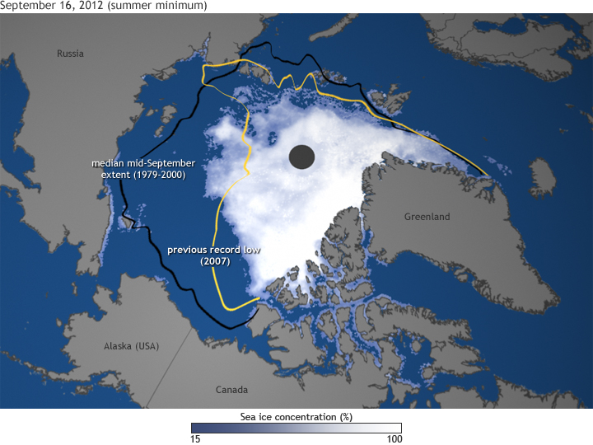
Greatest decline of Arctic Summer Sea Ice
(Sept. 16, 2012)
Notes:
On August 26, 2012, Arctic sea ice extent shrank to 1.58 million square miles (4.1 million square kilometers), an area about half the size of the Lower 48 United States. That ice was melting was not news; after all, the Arctic ice pack undergoes an annual cycle of winter expansion and summer melting. The “news” was that the extent had broken the previous record low, set in summer 2007, and there were still several more weeks to go in the melt season.
By the time the summer melt season came to an end in mid-September, the ice extent had shrunk down to just 1.3 million square miles (3.41 square kilometers), setting a new record low that was 18 percent smaller than the previous record and nearly 50 percent smaller than the long-term (1979-2000) average. This map shows ice concentration on September 16, along with the extent of the previous record low (yellow line) and the mid-September median extent (black line).
It can be hard to imagine how radical a transformation the loss of so much ice is. Most of us live in a world where snow and ice are transient things, momentarily hiding the “real” landscape. In the Arctic, ice is the real landscape, and for it to have shrunk to half its historic summer extent is as much a transformation of the environment as if half the forests of New England had been replaced by Saguaro cactus.
The transformation from icy to ice-free has ecological consequences and physical ones. The loss of sea ice directly affects polar bears, seals, walruses, and many birds, for which the sea ice is a raft, a place to haul out, rest, feed, and give birth. The “where, when, and what kind” of blooms of phytoplankton—the foundation of the marine food web—is changing, and those changes cascade through fish populations.
The most profound physical impact ice loss is that the loss becomes a sort of “self-fulfilling prophecy.” Less ice turns Arctic latitudes from a bright white solar reflector into a dark expanse of open water: a black t-shirt on a summer day. The more ice that melts, the more sunlight the ocean absorbs. The more sunlight the ocean absorbs, the warmer it gets, and the more ice melts.
That self-reinforcing feedback loop is the heart of the process that scientists refer to as “Arctic amplification” of global warming, and it explains why temperatures have risen faster in the Arctic than they have at temperate latitudes.

Slide 6
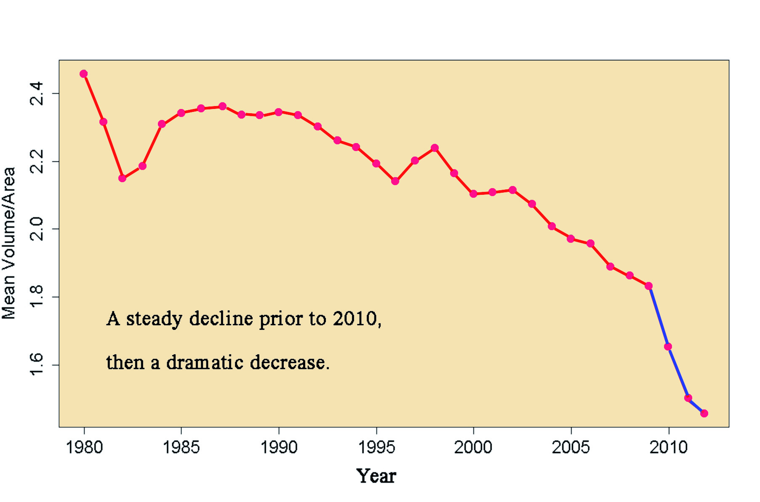
Ratio of Mean Volume to Area of Arctic Summer Sea Ice
Notes:
This graph shows a dramatic increase in the loss of the Arctic summer sea ice. There has been a steady decline in the ratio of mean volume to area until 2010. At that time the rate of decrease has increased significantly.

Slide 7
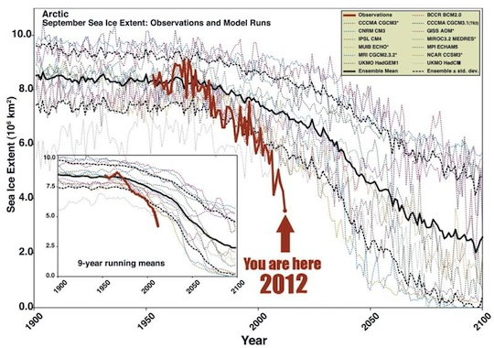
Computer Models Seriously Underestimated the Decline in Summer Sea Ice

Slide 8
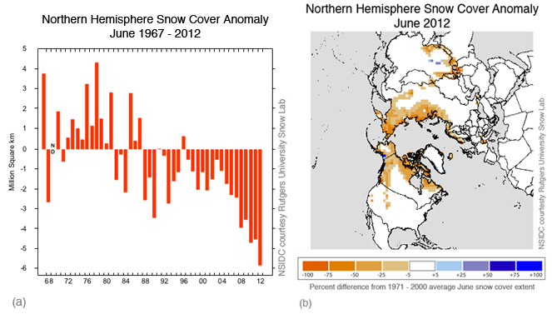
Decline in Arctic Snow Cover 1967-2012

Slide 9
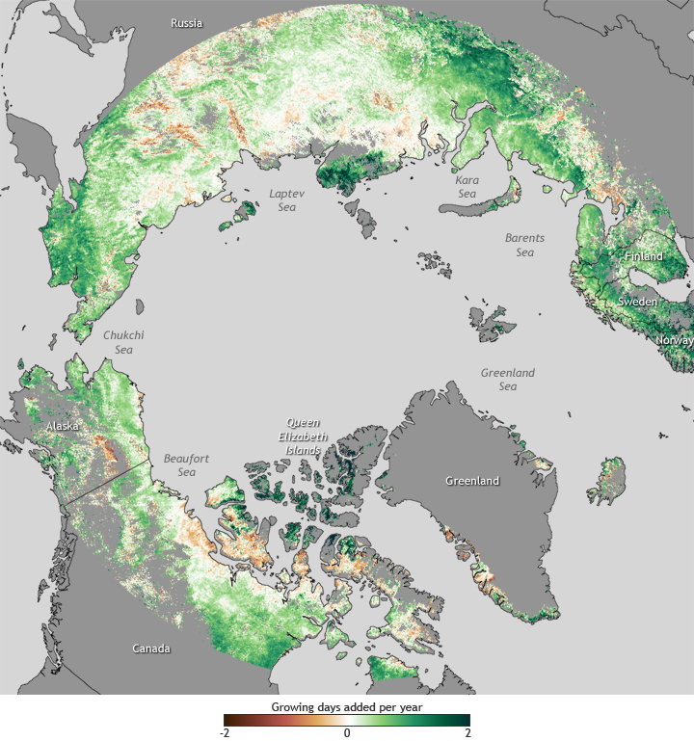
Increased Growing Season
Notes:
Few real-world signs of climate change are easier to read than changes in the growing season of familiar vegetation. From lilacs—which are flowering earlier—to allergy-causing ragweed—which is producing pollen longer into the fall, vegetation is reacting to Earth’s rising surface temperature.
The map above shows changes in the length of the growing season in high northern latitudes based on satellite observations of vegetation “greenness” between 1982-2008. Green colors indicate places where the growing season increased by up to 2 days per year, while brown colors show places where the growing season became shorter by up to 2 days per year.
Greens dominate the map, indicating that most of the high-latitudes are experiencing longer growing seasons now than they did more than two and half decades ago. In a few places, growing seasons appear to have expanded by up to almost 3 weeks. However, in some places, the growing season has become shorter.
Why are some places are bucking the overall trend toward longer growing seasons? Numerous local factors could be at play, including changes in the timing or amount of precipitation or the drying out of soil due to higher temperatures.

Slide 10
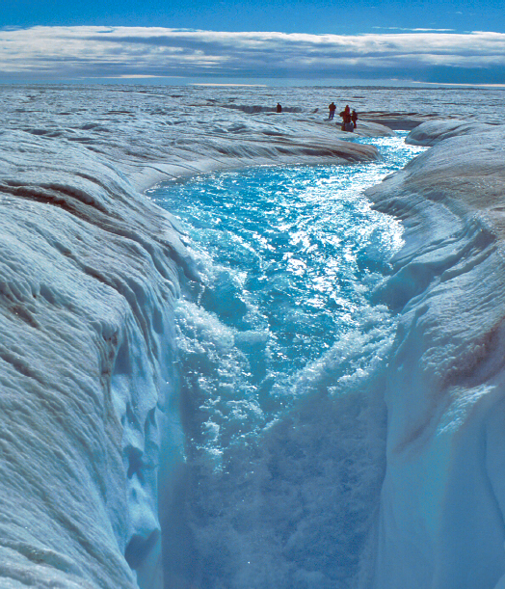
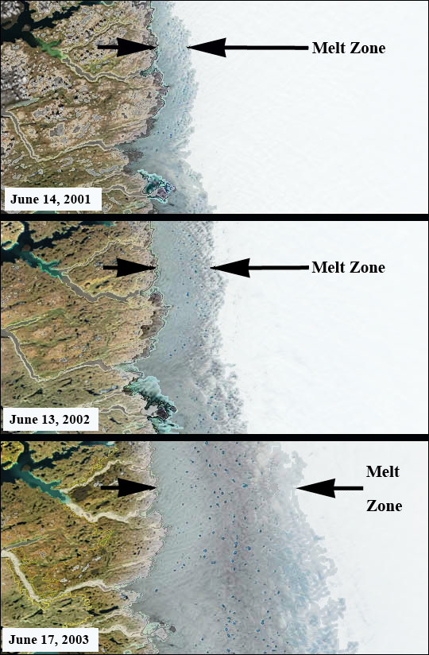
Greenland Ice Sheet Melting
Notes:
(Left) Meltwater on Greenland’s ice sheet is pouring down a hole in the ice (a moulin) to eventually reach the base of the ice sheet causing it to move more rapidly to the ocean. Source; Roger Braithwaite, University of Manchester (UK). (Right) These satellite images show the increasing extent of melting on one part of the Greenland ice sheet between 2001 and 2003. Each frame is about 150 km across. Modified from Jacques Descloitres, MODIS Land Rapid Response Team, NASA Goddard Space Flight Center, Greenbelt, MD.

Slide 11
Arctic Changed Dramatically in the Last 5 Years (2007-2011)
A NASA satellite found that 430 billion tons of ice melted in Greenland from 2010 to 2011, and melting is accelerating. Since 2000, Greenland’s largest glaciers decreased by 1375 km².
The past 5 years have had the 5 lowest summer sea ice levels on record. For two consecutive years all 3 major passages through the arctic have been open in the summer.
This year’s temperature is 1.4° C higher than what was normal since 1980.
Also Himalayan glaciers in Nepal and Bhutan (10) have shrunk 22% in the last 30 years.

Slide 12
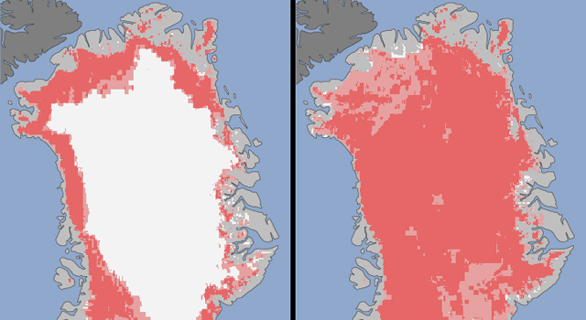
Between July 8 (left) and July 12, 2012 (right) about 97% of the surface of the Greenland ice sheet had thawed
Notes:
Extent of surface melt over Greenland’s ice sheet on July 8, 2012 (left) and July 12, 2012 (right). Measurements from three satellites showed that on July 8, about 40 percent of the ice sheet had undergone thawing at or near the surface. In just a few days, the melting had dramatically accelerated and an estimated 97 percent of the ice sheet surface had thawed by July 12. Via NASA/JPL.

Slide 13
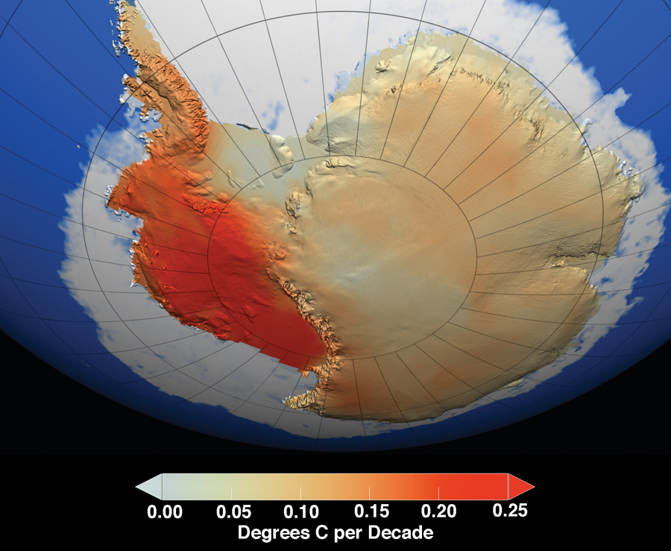
Antarctic Temperature Trend for Last 50 Years
Notes:
This map shows the temperature trend of the Antarctic over the last 50 years (1957-2006).

Slide 14
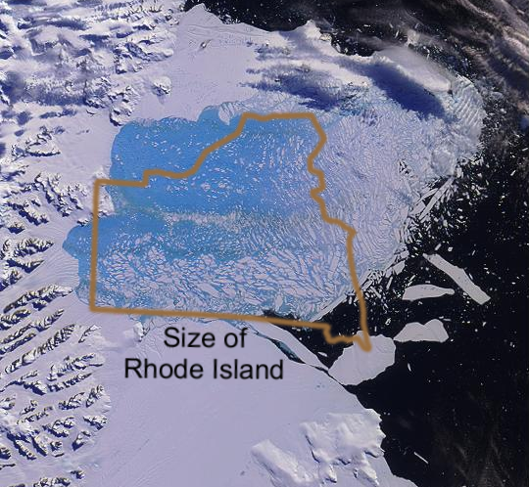
Larson B Ice Shelf Collapse 2002
Notes:
The collapse of the Antarctic ice shelves on the Antarctic Peninsula is becoming more frequent. Although this does not cause a rise in sea level, it does allow the glaciers on the land area to advance rapidly into the sea which does cause a rise in the sea level.

Slide 15
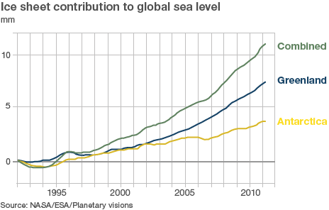

Slide 16
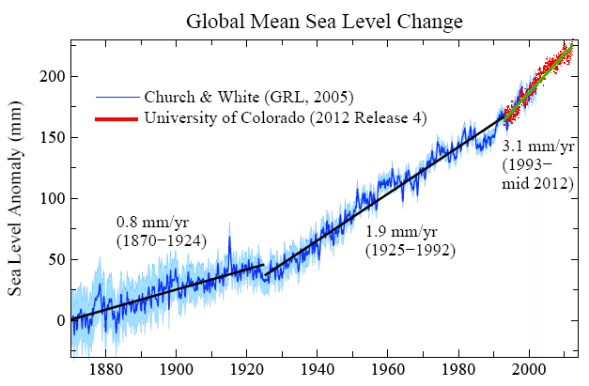
Notes:
The rate of sea level increase is growing.

Slide 17
Southeastern Seaboard After a 1 and 6 m (3 and 20 ft) Sea Level Rise
Notes:
This diagram shows the area in the eastern part of the U.S. inundated by a rise in sea level of 1 and 6 meters. Courtesy of the Dept. of Environmental Science, Univ. of Arizona.

Slide 18
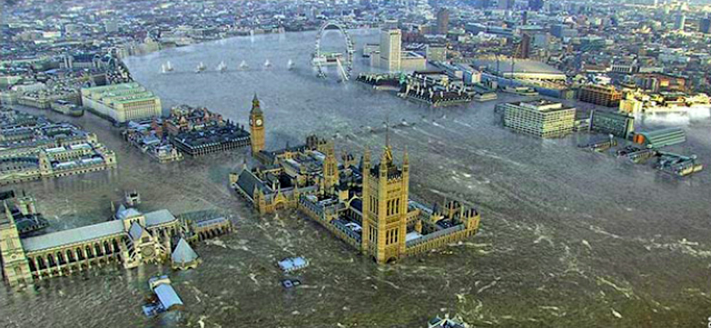
London Underwater from a 6 m (20 ft) Rise in Sea Level
Notes:
This is a computer simulation shows the effect of a 6 meter rise of sea level on the city of London, England. The Houses of Parliament and Big Ben are shown in the middle foreground.

Slide 19
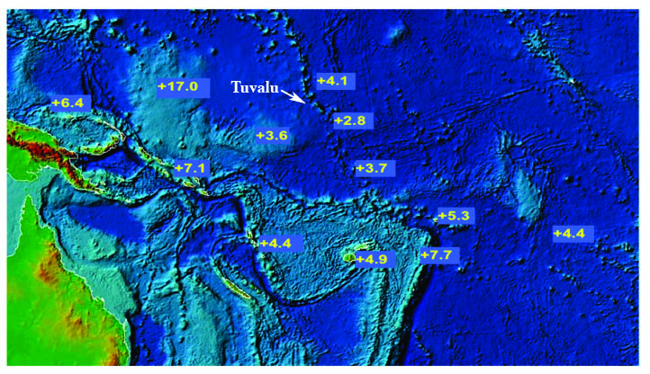
Annual Sea Level Rise (mm/yr) in the Tuvalu Area as of June 2012
Notes:
Sea level rise in mm/yr from island measurements by sea level meters.

Slide 20
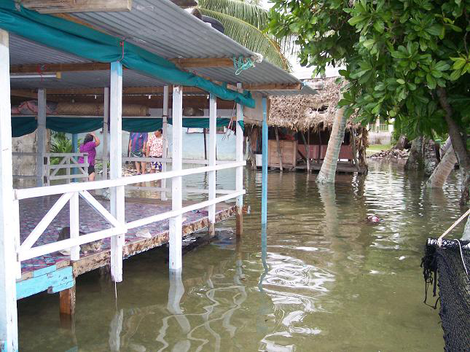
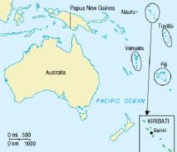
“High Tide” in the Tuvalu Islands
Notes:
Houses flooded by 2006 high tides exacerbated by rising sea levels in Funafuti, Tuvalu Islands.The island nation is now being evacuated because it is becoming unlivable due to the rising sea level caused by global warming. Tuvalu now has to import food because sea level rise has contaminated the ground water with salt that no longer will support local crops of taro and other vegetables. About 75 people are being relocated to New Zealand each year. Photo courtesy of Monise Laafai, TuvaluIslands.com.

Slide 21
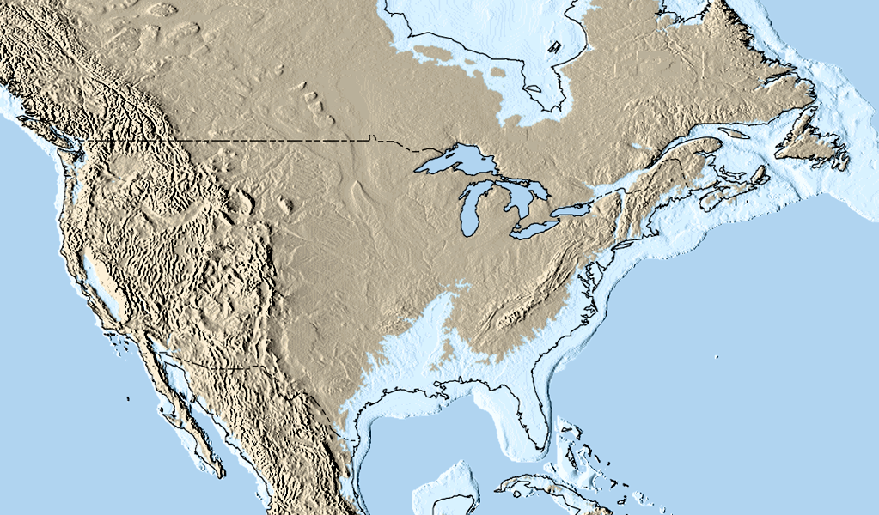
Sea Level in North America if all Ice on Earth Melted (~70 m or 230 ft rise)
Notes:
This map shows the changes in sea levels for the United States region during the last ice age (line between light blue and darker blue), the present interglacial period (present shore line in black), and if all ice on Earth were to melt (line between light blue and brown). Courtesy Tasa Graphic Arts, Inc.

