Slide 1
Part 8
Future Consequences of Global Warming

Slide 2
Notes:
This graph shows the projected atmospheric CO₂ abundance from 2007 to 2030 (dark blue). This projection is based on the growth rates between 1990 and. 2007. The historical data is from the Mauna Loa Observatory, Hawaii. The projected growth rate depends on projected emissions shown on a previous slide, the contribution from positive feedbacks, and the actions to cut greenhouse gas emissions by the world community. Currently this projection is probably underestimated. The projection suggests that by 2030 the CO₂ abundance (~454 ppm) will be within the critical level, and that the average global temperature anomaly will eventually reach 2° C (currently it is 0.6° C). However, we have already crossed the level where long-term (100’s of years) danger (the critical temperature) will occur unless we extract CO₂ from the atmosphere. We have also crossed the level where harmful effects are occurring (see previous slides), and these will only get worse as we approach the critical level in about 2025 or sooner. This is the reason that we must start today to drastically reduce our greenhouse gas emissions.

Slide 3
United Nations Framework Convention on Climate Change (UNFCCC)
Highlights of the Durban, South Africa Meeting in Dec. 2011
The Kyoto Protocol will be extended 5 years (Canada refused)
A new legally binding agreement for the reduction of CO₂ emissions will be formulated by 2015.
The signatories to that agreement will begin reducing their emissions starting in 2020.
Notes:
These are the main highlights of the 2011 meeting in Durban, South Africa.

Slide 4
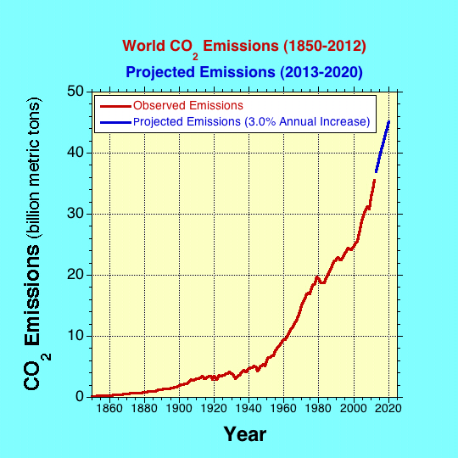
Projected Emissions by 2020

Slide 5
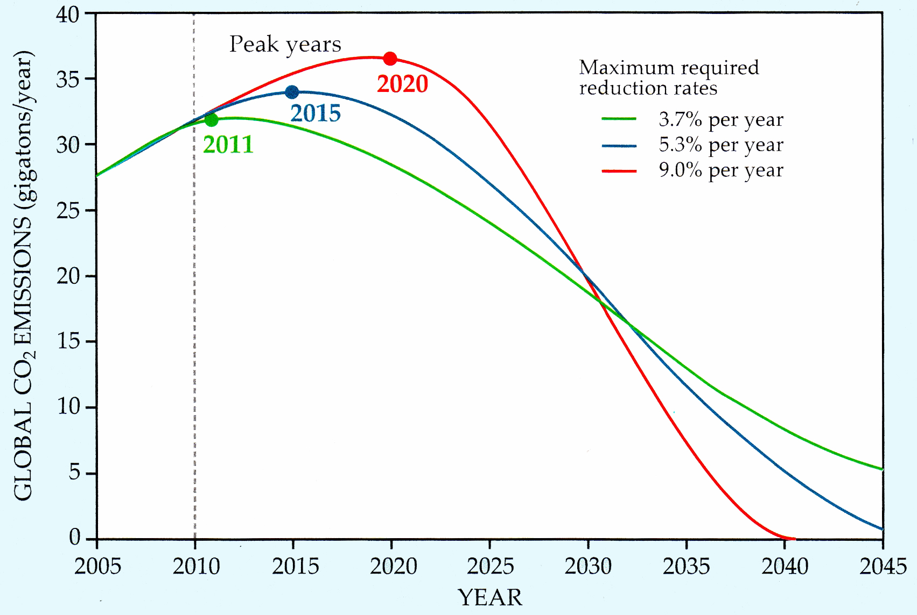
CO₂ Emission Reduction to Limit the Rise in Global Average Temperature to the Critical 2° C (3.6° F)—2009 analysis
UNFCCC Goal
Notes:
Three scenarios, each of which would limit the total global emission of CO₂ from fossil fuel burning and industrial processes to 750 Gt over the period 2010-50. If emissions remain negligible after 2050, that limit yields an estimated 67% probability of capping global warming at 2 degrees C above pre-industrial temperatures. As indicated by the color-keyed table, the later the year of peak emission, the higher would have to be the maximum rate of annual reduction, which would begin in the early 2030s. (Adapted from the German Advisory Council on Global Change factsheet 2/2009)

Slide 6
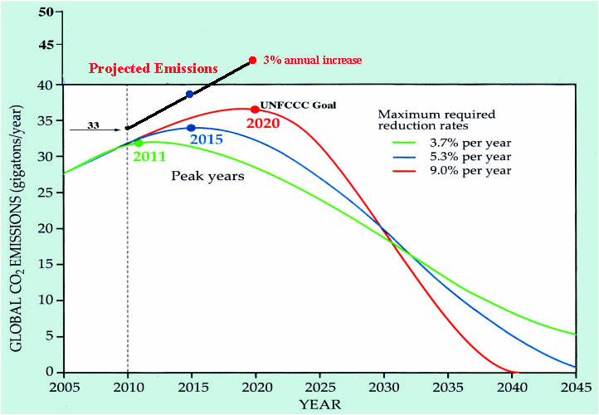
Projected Emissions to 2020 if the Average Annual Increase is 3%
Notes:
If the present increase in world CO₂ emissions continues to increase at about an annual rate of 3% then the emissions will be at 43 billion metric tons in 2020 when the UNFCCC recommends the world start reducing CO₂ emissions. At this point it will be almost impossible to keep the temperature from reaching the critical level of 2° C, and VERY DIFFICULT to keep below the catastrophic level of 4° C.

Slide 7
Can We Avoid Dangerous Global Warming?
(2° C above pre-industrial)
It depends on (1) the year global greenhouse gases peak, (2) the rate at which they subsequently decline, and (3) the possibility of negative emissions (carbon sequestration) later.
Only if emissions peak in 2014 and then decline at 3.5% per year with massive sequestration later in the century can we prevent a dangerous level at 1.8° C increase above pre-industrial levels.
Without sequestration, peak emissions must occur in 2016 and decline by 3.5% per year to limit temperature rise to the dangerous level of 2.0° C above pre-industrial levels.
This would require a level of immediate, global, coordinated action never seen in human history.
It is highly unlikely that we will stay below the dangerous level.
It is more likely we will experience global warming at or near the catastrophic level.
Notes:
From the U.K. Met Office, the Walker Institute, the Tyndall Centre, and the Grantham Institute: “Development of Emissions Pathways Meeting a Range of Long-term Temperature Targets”

Slide 8
Possible Political and Societal Consequences
Three Climate Change Scenarios:
Expected (1.3° C Increase)
Severe (2.6° C Increase)
Catastrophic (5.6° C Increase)
Reference: The Age of Consequences: The Foreign Policy and National Security Implications of Global Climate Change, Center for Strategic and International Studies, Washington, DC , November 2007.
Notes:
Reference: The Age of Consequences: The Foreign Policy and National Security Implications of Global Climate Change, Center for Strategic and International Studies, Washington, DC , November 2007.

Slide 9
Scenario 1 (Expected)
Global Temperature Anomaly = 1.3° C
Sea level rise of about 0.23 meter
This temperature anomaly is certain because of the inertia of the system.
The time for this condition is probably about the year 2030.

Slide 10
Environmental Stresses
Water Scarcity for ~1.7 billion people
Tropical Infectious Diseases Spread North
Frequent Flooding for over 3 million people
About 30 million people subject to starvation

Slide 11
Political and Societal Stresses
Conflicts over resources
About 25 million people displaced from coastal areas
Immigrations from countries with widespread disease causes political unrest
Dissatisfaction with governments may radicalize internal politics
Social services become burden to governments
Large decrease in world GDP

Slide 12
Scenario 2 (Severe)
Global Temperature Anomaly = 2.6° C
Sea level rise of >0.5 meter
This scenario looks more and more probable.
The time for this condition may be about 2060-2100.

Slide 13
Environmental Stresses
Sea level rise of ~0.5 meter
Water scarcity affects over 2 billion people
About 50 million people displaced from coastal areas
Up to 15 million people face severe flooding
Significant increase in diseases including malnutrition and infectious diseases
Major changes in marine ecosystems due to ocean acidification

Slide 14
Political and Societal Stresses
Wealthier nations provoke poorer highly stressed nations to abandon democracy and increase aggressive behavior to neighbors
Global fish stocks crash causing conflicts among nations for food.
Many nations may privatize water resources causing internal upheavals
Globalization will probably end and rapid economic decline will occur.
Alliance systems and multinational institutions may end.
Private corporations may become more important than governments

Slide 15
Scenario 3 (Catastrophic)
Global Temperature Anomaly = 5.6° C
Sea level rise = >4 m
This condition may occur about the end of the century

Slide 16
Environmental Stresses
About 170 million people displaced because of sea level rise
Water scarcity affects about 3.5 billion people (half today’s population)
Collapse of the marine ecosystem
Mass starvation due to crop failures and fish depletion
Large increase in deaths due to high temperatures, spread of diseases and malnutrition
Mass extinction of over 50% of existing species

Slide 17
Political and Societal Stresses
Massive migration to the north (U.S., Canada, Russia and Europe) leads to chaos in these regions
Rage at governments, rise in religious radicalism, and hostility and violence toward immigrants leads to political chaos
Economic collapse is a distinct possibility
Nuclear war is also a possibility
Probably the end of civilization as we know it

