Slide 1
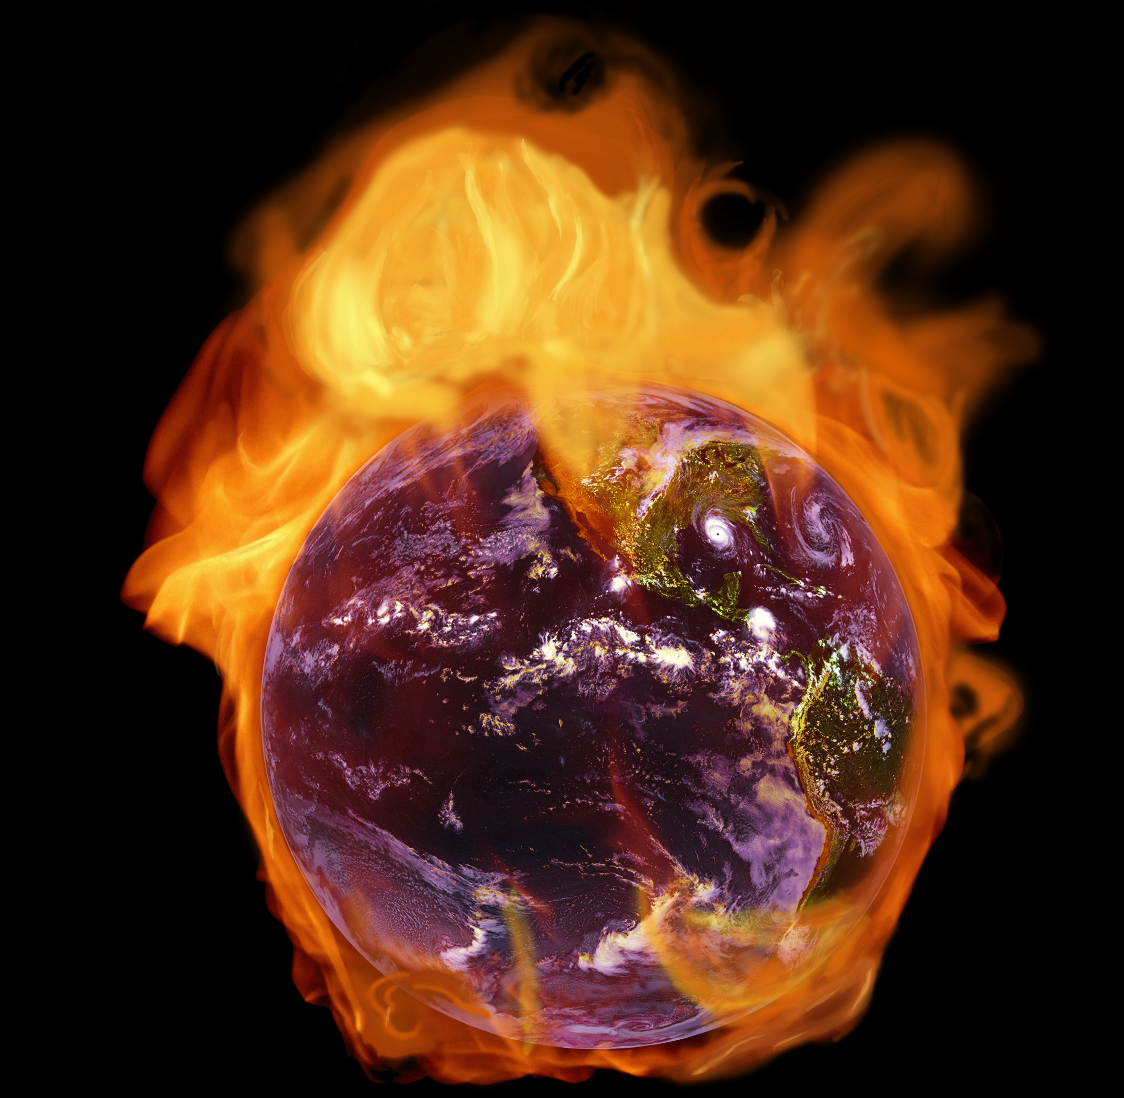
Global Warming
How Serious Is It?
Robert G. Strom, Professor Emeritus
Department of Planetary Sciences and Lunar and Planetary Laboratory
University of Arizona
Tucson, Arizona

Slide 2
List of Detailed Presentations for Downloading
Part 1 --- Summary of Global Warming
Part 2 --- The Denial Syndrome and Its Dangers
Part 3 --- Climate Change Basics and Past Climates
Part 4 --- Temperature Rise
Part 5 --- Human Cause of Global Warming
Part 6 --- Melting Ice and Rising Sea Level
Part 7 --- Ocean Acidification, Weather and Melting Permafrost
Part 8 --- Future Consequences
Part 9 --- Requirements to Mitigate the Problem

Slide 3
Reliability of Global Warming Parameters
Global warming
Rise in greenhouse gases
Primary Cause of global warming
Long term consequences of global warming
Solution to the problem
Prospects of implementing a solution
Firmly Established (100%)
Firmly Established (100%)
Firmly Established (>95%)
Many known, but other consequences probable
Well understood
Extremely uncertain and getting worse

Slide 4
The World’s Science Societies Support the Science Findings on Global Warming
National Academies of Science in 33 countries and 67 science organizations from various countries (total = 100) support the findings on global warming and its human cause. Five of the 100 are listed below.
U.S. National Academy of Sciences
American Geophysical Union
American Meteorology Society
American Association for the Advancement of Science
British Royal Society
This global support is unprecedented.
Go to “Climate Change Lines of Evidence” on YouTube for National Research Council
of the National Academy of Sciences 25 min. slide show on evidence for climate change.

Slide 5
Key Scientific Findings
Global Warming is unequivocal and primarily human-induced.
Climate changes are underway and are projected to grow.
Widespread climate-related impacts caused by global warming are occurring now and will increase. (In 2011 the world experienced the most extreme weather events since record keeping began in the 1800s. In the U.S. alone, the cost was $52 billion)
Climate change will stress water resources in some places.
Crop and livestock production will be increasingly challenged.
Coastal areas are at increasing risk from sea-level rise and storm surge.
Risks to human health will increase.
Climate change will interact with many social and environmental stresses to produce adverse effects.
Thresholds will be crossed, leading to large changes in climate and ecosystems. (This may be starting to happen)
Future climate change and its impacts depend on choices made TODAY.
Notes:
These are the key findings of the Intergovernmental Panel on Climate Change (IPCC) and other governmental committees.

Slide 6
In the U.S., the Denial Syndrome, Misinformation, Disinformation, and Science Illiteracy have Lead to a Disregard of the Dangers of Global Warming and the Urgency of Mitigating the Problem.
Notes:
Gallop poll 2011

Slide 7
Atmospheric Abundance of CO₂ and Global Temperatures
CO₂ Percent | Average Global Temperature (°C) | Event
0.018 | 9 (48°F) | Last Ice Age Minimum
0.028 | 14 (57°F) | Interglacial Period (Holocene)
0.039 | 14.8 (58.6°F) | Today (Anthropocene = Human Era)
0.043 | 16 (61°F) | Critical for Humans and Other Species
0.065 | 18 (64°F) | Catastrophic for Humans and Other Species
~0.12 | 25 (77°F) | Hot House Maximum
96.5 | 480 (896°F) | Venus Surface
Notes:
Relatively small changes in the atmospheric CO₂ content can cause significant changes in the global average temperature and major disruptions of the environment. The Anthropocene is a the new epoch of human influence on major environmental changes.

Slide 8
Warming of the Human Body and the Earth (°C) | Human Body Condition | Global Warming Condition (see previous slide)
0 | Normal Feelings | Pre-Industrial “normal”
0.8 | Discomfort | Present (increased frequency of extreme weather events)
2.0 | Pyrexia (very ill) | Critical (very Dangerous)
4.0 | Hyperthemia (near death) | Catastrophic (end of civilization as we know it)
6.0 | Death | Possibly the end of humanity
Notes:
Comparison of the effects of the rise in temperature of the human body and the same rise in the global average temperature of the Earth. It has been normalized so that the normal temperature of the human body and the “normal” pre-industrial temperature of the Earth is 0° C.

Slide 9
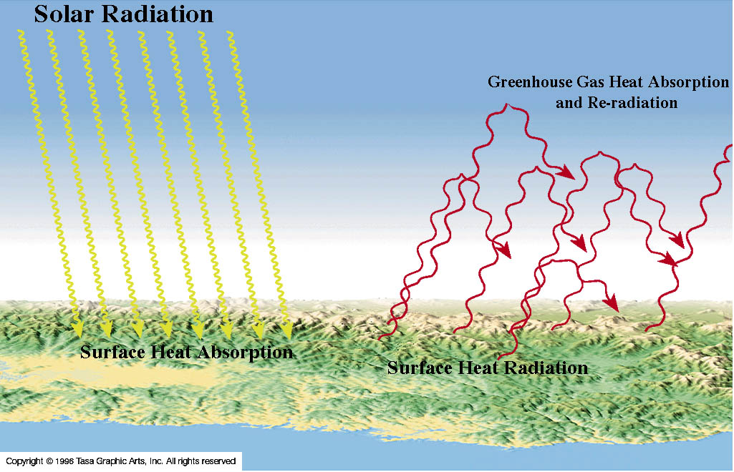
The Greenhouse Effect
Notes:
In the greenhouse effect, solar radiation is absorbed by the Earth’s surface resulting in surface warming (yellow wavy lines). Much of this absorbed energy is eventually re-radiated at longer infrared wavelengths as heat (red wavy lines). A portion of this heat is absorbed by greenhouse gases and re-radiated back to the Earth’s surface. This re-radiated energy further warms the surface. The more greenhouse gases that are present, the more heat is absorbed and re-radiated, and the hotter it gets.

Slide 10
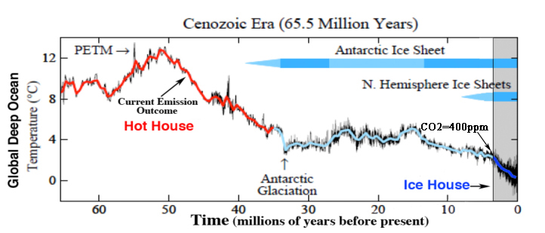
Paleoclimate in the Cenozoic Era
PETM = Paleocene-Eocene Thermal Maximum
Hot House = No Ice on Earth
Ice House = Both Ice Sheets Present plus Glacial and Interglacial Periods
All Human Evolution Occurred in an Ice House
Notes:
The climate changes that have occurred in the past 65 million years indicate that our current rate of climate change is catastrophic for humans and other species. We are drastically changing the planetary environment on a very short timescale relative to geological time. This graph shows the global deep ocean temperature over the past 65 million years derived from ocean sediment cores. The global average atmospheric temperature was, of course, much warmer. During the Holocene in the “Ice House” it was 14 degrees C, and at the top of the “Hot House” it was about 25 degrees C. About 3.5 million years ago in the Pliocene the atmospheric CO2 content was about the same as today (~400 ppm). The last time the CO2 content was this high there were no humans on Earth and sea level was about 5 m higher than today. If the current CO2 emission rate continues we will eventually reach the temperature indicated by the arrow showing the “Current Emission Outcome”.

Slide 11
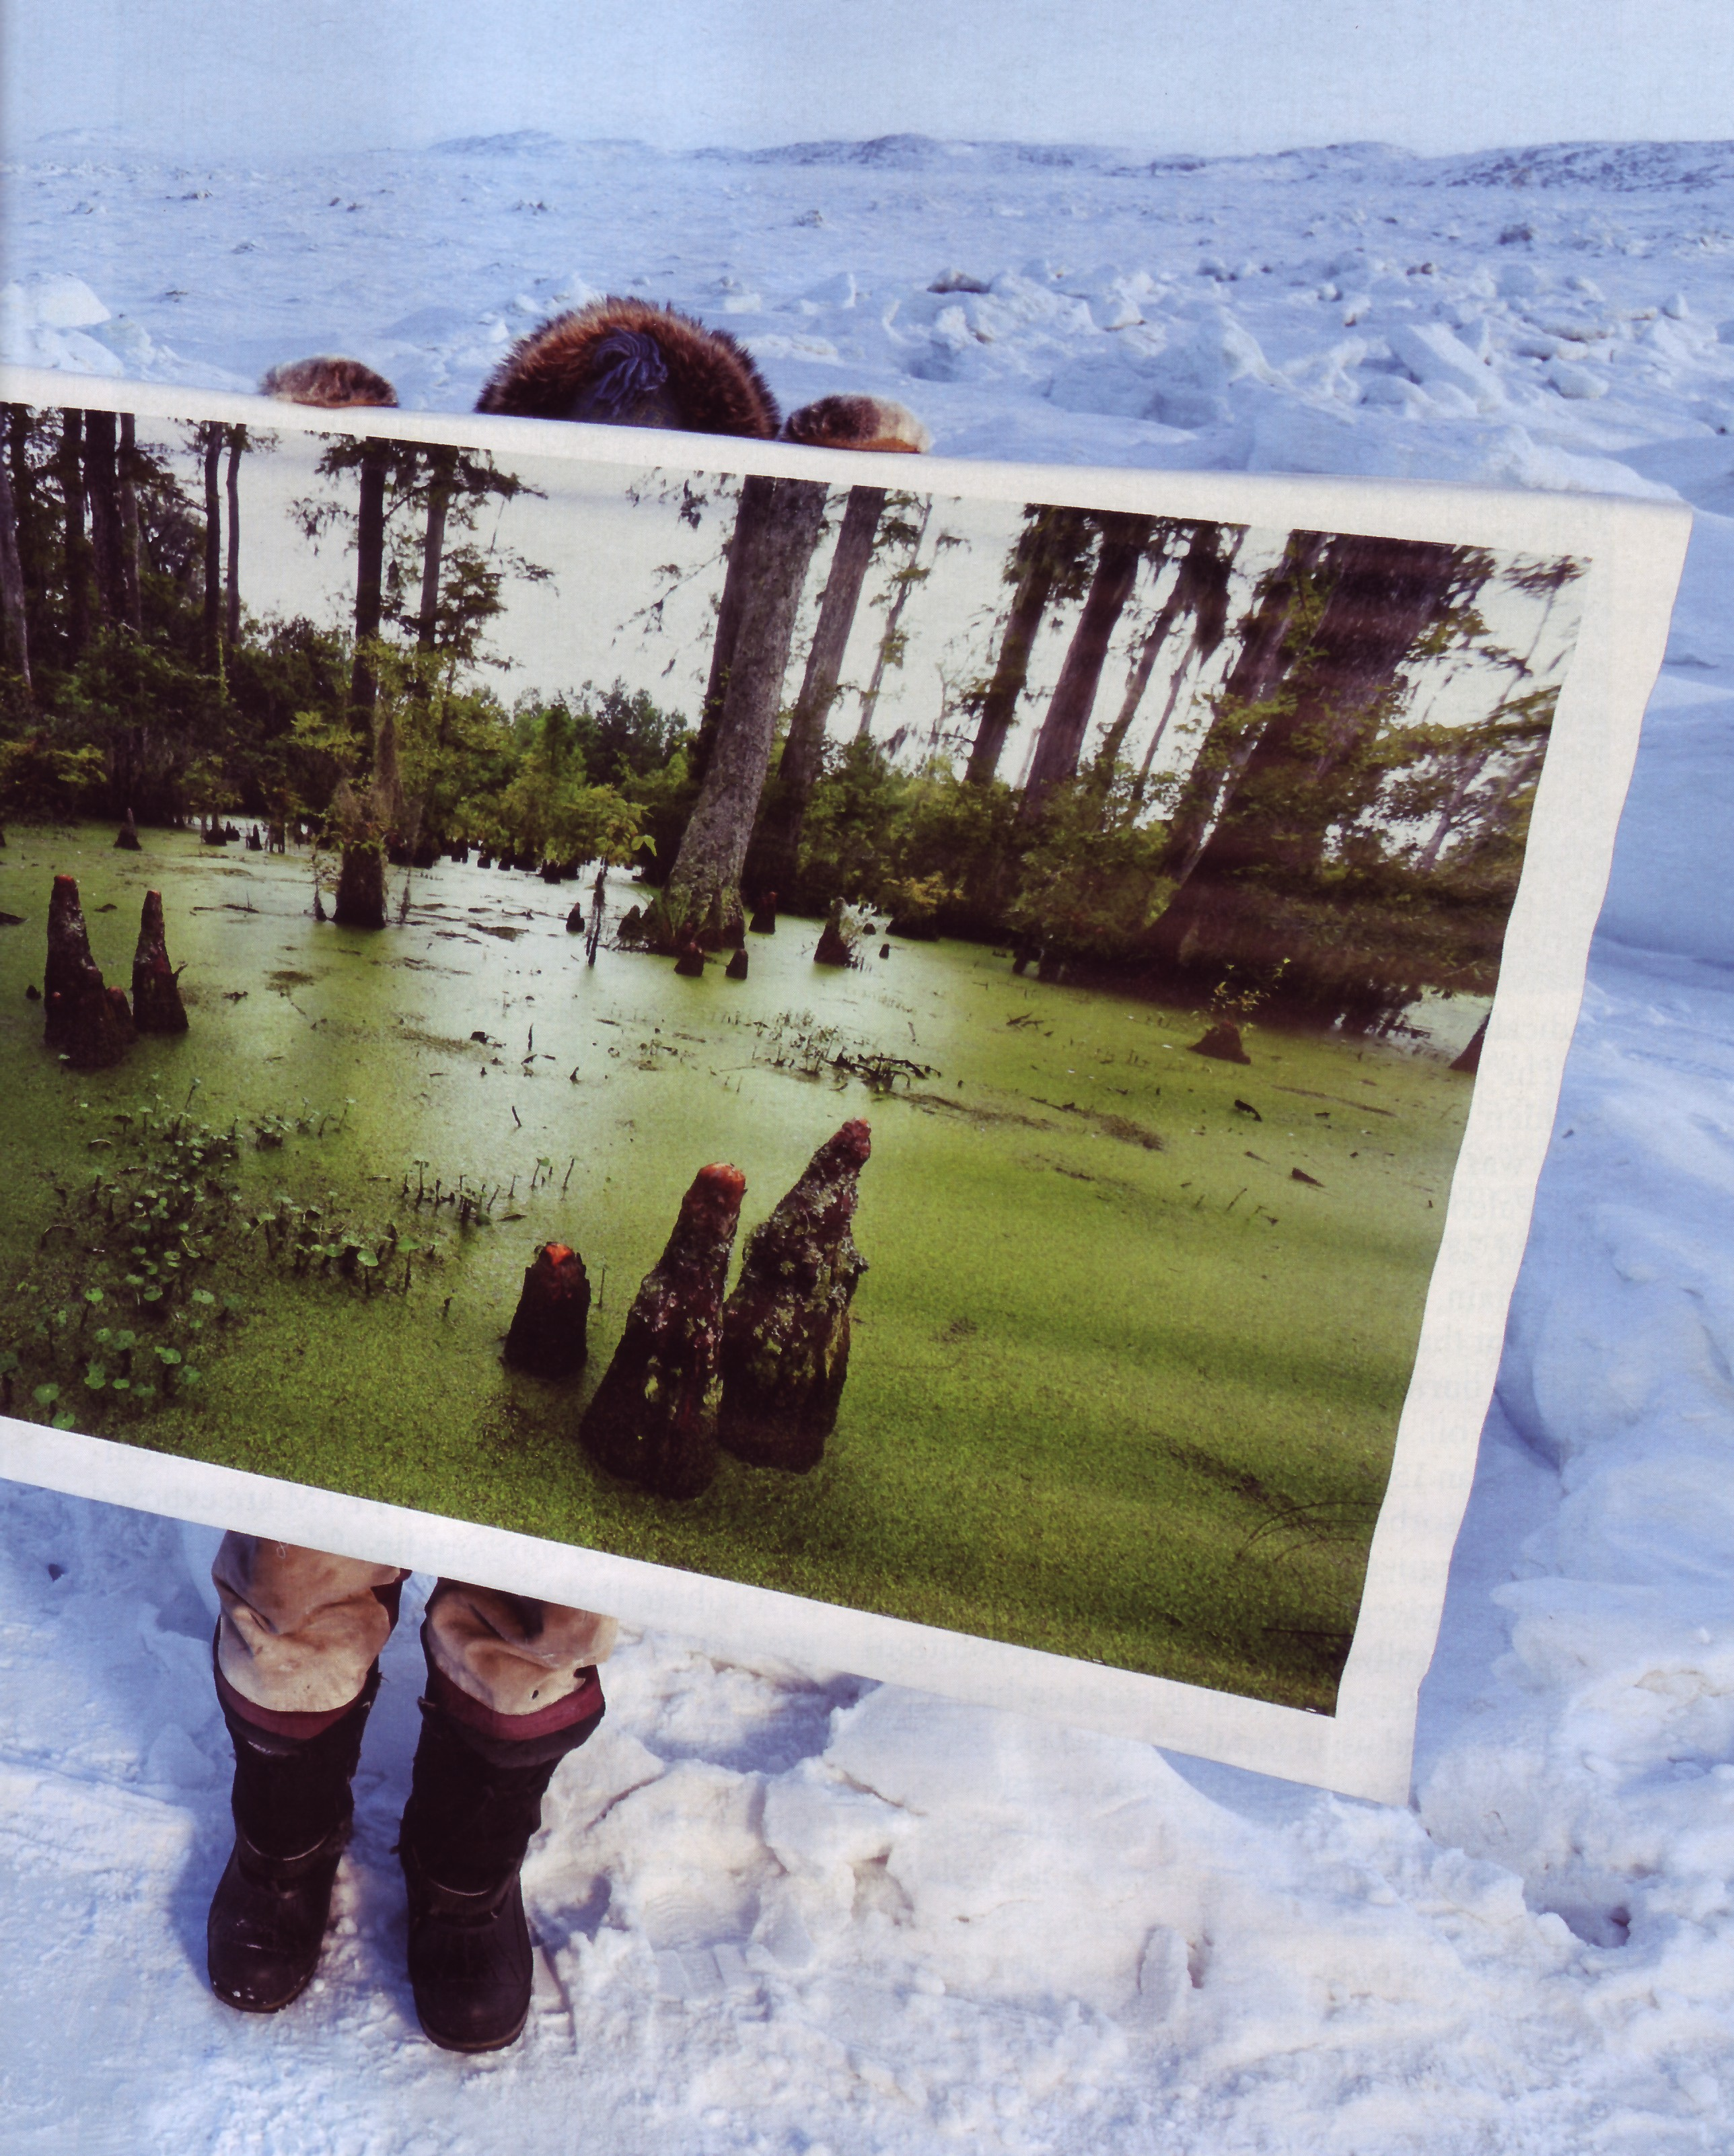
The Arctic in the Paleocene-Eocene Thermal Maximum (PETM)
Average Annual Arctic Temp. = 20° C (68° F)
Arctic Ocean Surface Temp. = 22° C (72°F)
An Eskimo holds a picture of what the Arctic looked like during the PETM.
Notes:
From the National Geographic Magazine

Slide 12
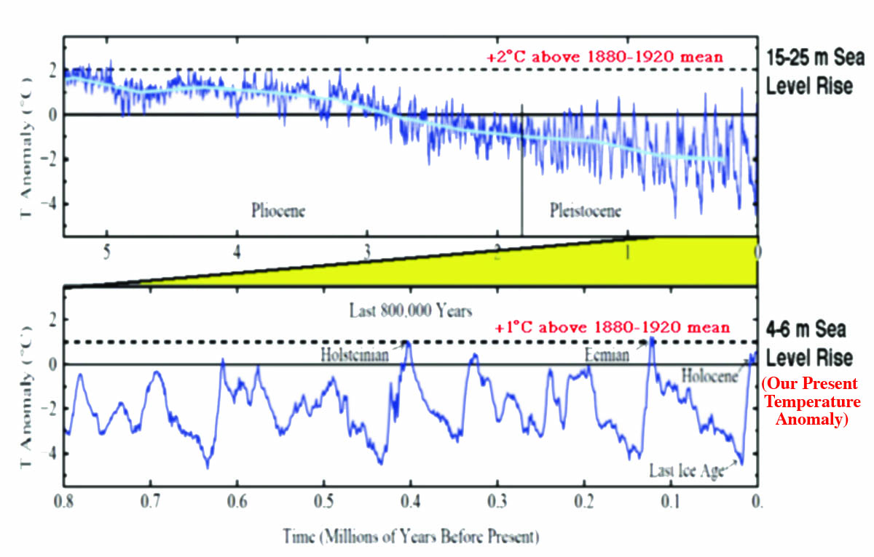
Temperature Anomaly Relative to the 1880-1920 Mean and Sea Level Rise
Notes:
Modified from Hansen et al., Scientific Case for Avoiding Dangerous Climate Change to Protect Young People and Nature, 2011. We are currently at 0.8 degrees C above the 1880-1920 mean. It seems we are headed for a 4-6 m rise in sea level in the not too distant future. At the dangerous level of 2 degrees C we may eventually see a 15-25 m sea level rise.

Slide 13
Summary: Cenozoic Era
The average rate of change in CO₂ was ~100 ppm/million years or 0.0001 ppm/year
The human rate today is 2 ppm/year (20,000 times faster than the natural rate)
The “abrupt” PETM temperature rise took ~25,000 years with a duration of ~50,000 years
The current rise in temperature is about 100 times faster than in the PETM
Humans overwhelm “slow” geologic changes
We are producing “A Different Planet”

Slide 14
Temperature Anomaly (1880-2012)
Baseline: 1951-1980
Aerosols
Aerosols
(tiny particles)
Aerosols
Aerosols
Aerosols
Aerosols
Notes:
Land-Ocean Temperature anomaly for 1880-2010. The blue bars are the uncertainty limits at the 95% probability. The relatively flat area between 1951 and about 1980 is because aerosols were dominating the temperature regime. The volcano symbols indicate major volcanic eruptions that lowered the temperature. The El Nino (orange) and La Nina (blue) in the bottom chart indicate heating (orange) and cooling (blue) of the atmosphere by El Nino’s and La Nina’s. The relatively flat area during the last 10 years is due primarily to the higher rate of increased warming of the oceans (see slide 18), and also to a combination of La Nina’s and increased aerosol emissions from China. Courtesy of NASA Goddard Institute of Space Studies.

Slide 15
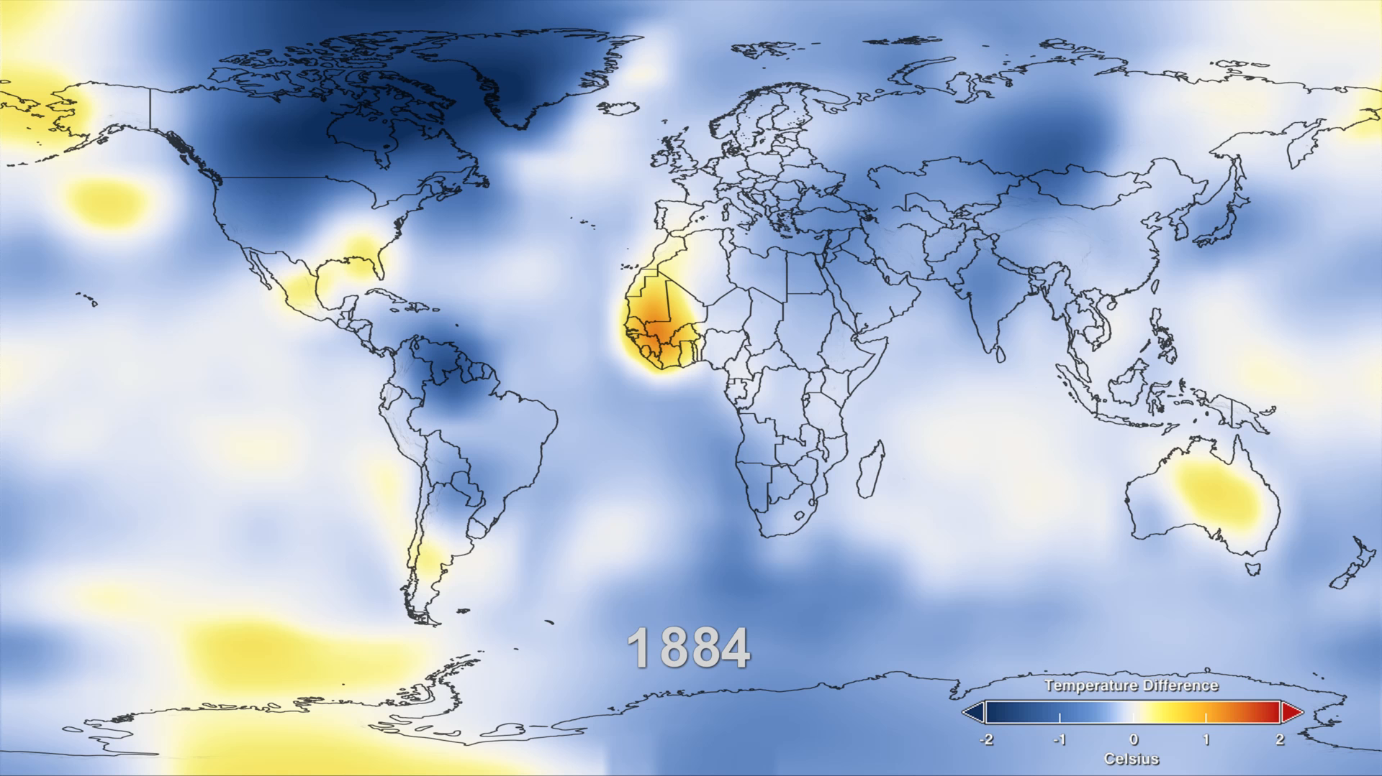
Temperature Anomalies from 1884 to 2011
Baseline = 1951-1980
Notes:
This movie is from the NASA Goddard Institute for Space Studies (GISS) and shows the increase in global temperature from 1884 to 2011. The baseline value is the mean global average temperature between 1951 and 1980 when the temperature was about the same due to aerosols (See slide 21). In this movie the white and blue areas are anomalies at or below the 1951-1980 baseline and yellow to red areas are anomalies above that baseline (See temperature bar). Global warming actually started about 1920 (See slide 21).

Slide 16
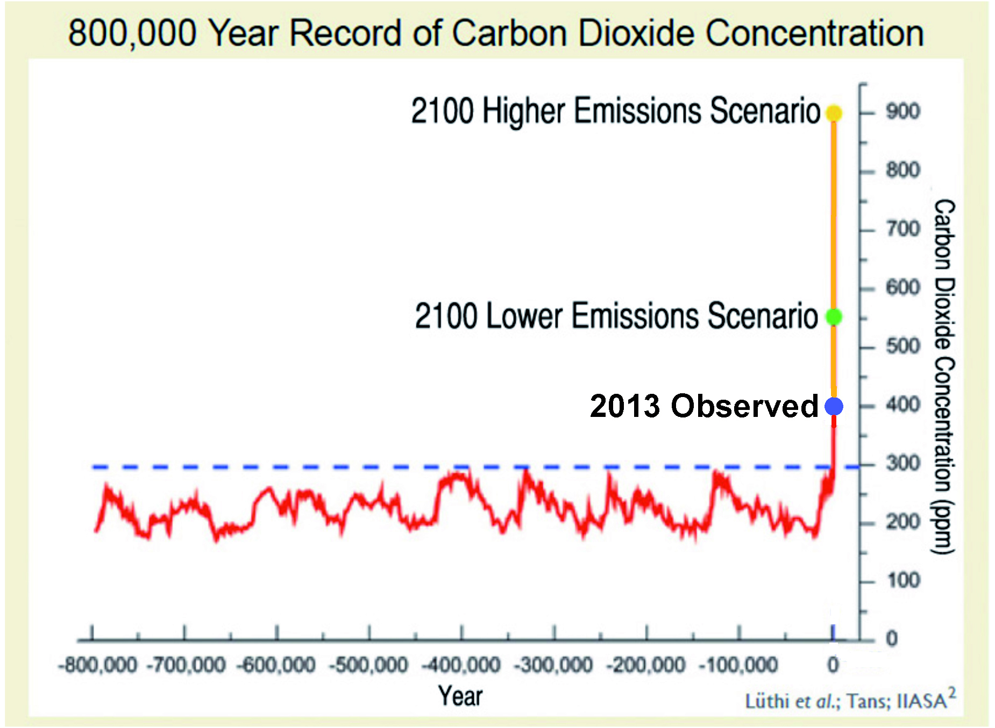
Notes:
Analysis of air bubbles trapped in an Antarctic ice core extending back 800,000 years documents the Earth’s changing CO₂ concentration. Over this long period natural factors (Milankovitch cycles) have caused the atmospheric CO₂ concentration to vary within a range of about 170 to 280 ppm. Temperature related data make clear that these variations have played a central role in determining the global climate. As a result of human activities, the present CO₂ concentration of about 396 ppm is about 35% above its highest level over at least the last 800,000 years. In the absence of strong control measures, emissions projected for this century would result in the CO₂ concentration increasing to a level that is roughly 2 to 3 times the highest level occurring over the glacial-interglacial era that spans the last 800,000 years or more.

Slide 17
Earth’s Heat Gain During the Past 50 years (10²¹ Joules*)
Oceans (0-2 km depth) = 245 (91%)
Continents = 10.4 (4%)
Earth’s Ice = 8.1 (3%)
Atmosphere = 6.6 (2%)
*A joule is a unit of heat energy
Notes:
All of Earth’s systems show a heat gain. Most of that gain has been in the oceans and the least has been in the atmosphere. These heat gains show that global warming is indeed global in scope. The large amount of warming of the oceans will result in continued global warming even if we stopped all emissions today.

Slide 18
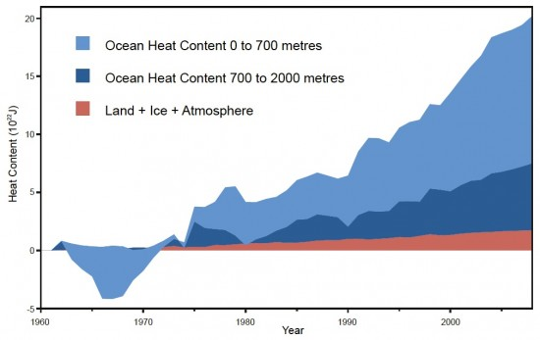
Ocean Heat Content Compared to Total Land, Atmosphere and Ice Heat Content.
Notes:
In the year 2000 the Land+Ice+Atmosphere was ~13% and the Ocean (0-2 km depth) was ~87%. Ten years later (2010) the Land+Ice+Atmosphere was 9% and the Ocean (0-2 km depth) was 91%. This is the main reason that the global average temperature has been about the same during the past 10 years.

Slide 19
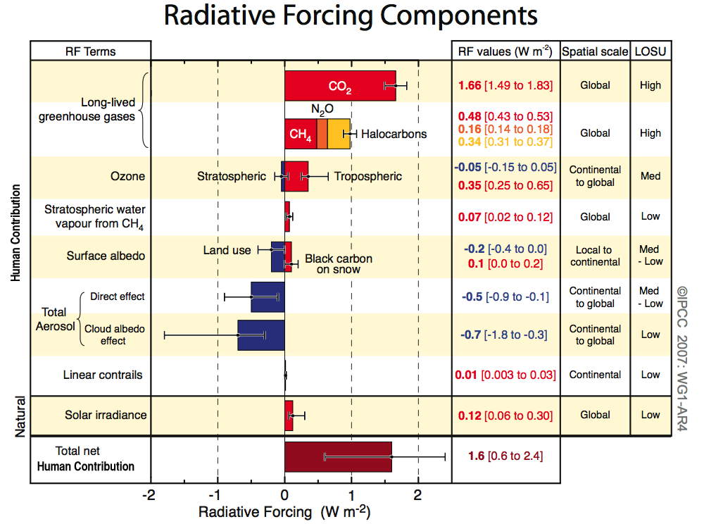
Intensity of Climate Drivers (2006)
Notes:
Radiative forcing is the quantity used to measure the amount of climate change. It is expressed in terms of watts per square meter (Wm⁻²). A positive value heats the Earth, and a negative value cools the Earth. Radiative forcings (climate drivers) due to various causes are shown in this diagram (the numbers are in watts per square meter). The red forcings (right) heat the Earth, and the blue forcings (left) cool the Earth. Greenhouse gases are mainly responsible for the current warming and far outweigh the others. However, the human-caused aerosols have produced a significant cooling which has kept the temperature from reaching even higher levels than today. Those aerosols now appear to be decreasing. (UN IPCC 4th Assessment, 2007)

Slide 20
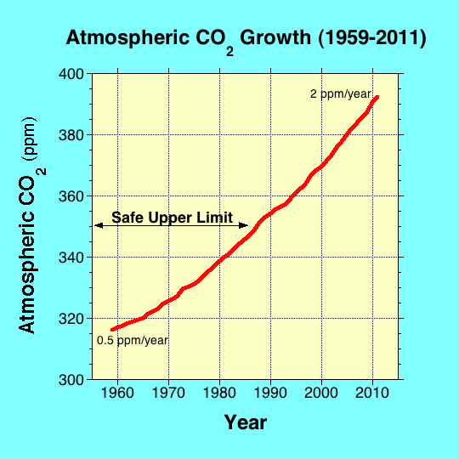
Notes:
The rapid rise in atmospheric CO₂ from direct systematic measurements begun on the Island of Hawaii in 1958. The rise is shown in this graph of the mean annual CO₂ abundance, and is called the Keeling Curve. The “Safe Upper Limit” is the CO2 abundance level where the ice sheets do not disappear entirely. At this limit all of the Greenland ice sheet an most of the Antarctic ice sheet will melt eventually (several thousand years). Emissions of other more powerful greenhouse gases (halocarbons, methane, etc) have pushed the equivalent concentration of CO2 in the atmosphere to about 478 ppm.

Slide 21
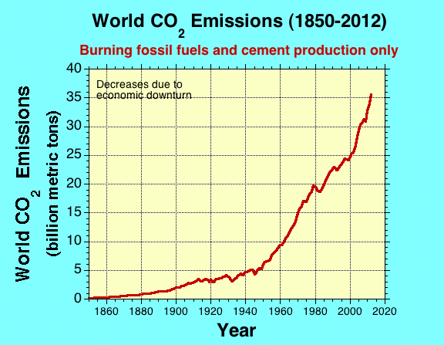
Notes:
Carbon emissions are 'too high' to curb climate change
By Mark Kinver Environment reporter, BBC News The concentration of CO2 continues to rise, despite global efforts to curb future increases
Continue reading the main story Related Stories
Greenhouse gases hit record high
CO2 'drove end to last ice age'
Antarctic may host methane stores
It is increasingly unlikely that global warming will be kept below an increase of 2C (3.6F) above pre-industrial levels, a study suggests.
Data show that global CO2 emissions in 2012 hit 35.6bn tonnes, a 2.6% increase from 2011 and 58% above 1990 levels.
The researchers say that emissions are the largest contributor to future climate change and a strong indicator of potential future warming.
The findings have been published in the journal Nature Climate Change.
Meanwhile, the data has been published in the journal Earth System Science Data Discussions.

Slide 22
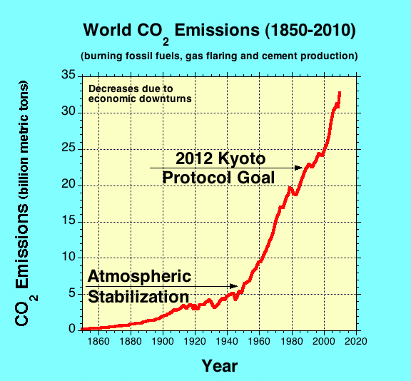
Notes:
The Kyoto Protocol was a failure. In order to stabilize the atmospheric CO2 atmospheric abundance at the 2010 level we must decrease the emissions to the level shown.

Slide 23
Some Reasons We Know Humans are the Main Cause
There is a good correlation between the rise in human-caused emissions of greenhouse gases, the rise in atmospheric greenhouse gases, and the rise in temperature. The rates of increase in each is unprecedented.
There is a good correlation between the growth in the human population and the rise in greenhouse gases and temperature.
Computer simulations indicate that only human-caused emissions of greenhouse gases can cause the observed rise in temperature of the atmosphere and other Earth systems (Oceans, Continents and Ice).
No other natural causes can account for the present rapid rise in temperature and CO₂. The present rate of CO₂ increase is about 20,000 faster than natural rates.
Carbon isotopes due to burning fossil fuels are the main constituent of the increased CO₂ concentration (falling ¹³C to ¹²C ratio).
Notes:
The above are only some the reasons we know that humans are the primary cause of global warming. There about 6 other indications that we are responsible.

Slide 24
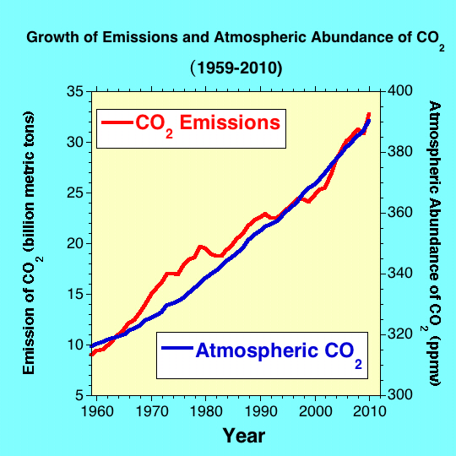
Notes:
This graph shows the human-caused CO₂ emissions and the atmospheric concentration of CO₂ from 1959 to 2010. The increase in emissions and atmospheric concentration is very similar, indicating a causal relationship.

Slide 25
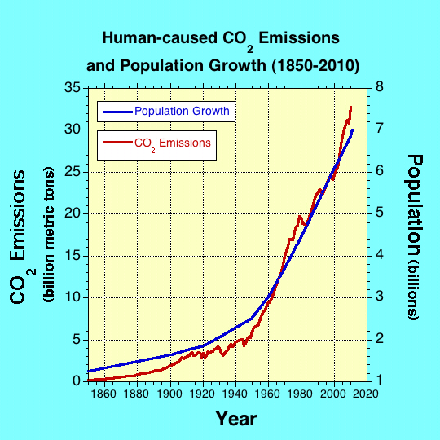
Notes:
This graph shows the population growth and the increase in human-caused CO₂ emissions from 1850 to 2010. The good correlation indicates that the rate of increase of human-caused CO₂ emissions and population growth are very similar.

Slide 26
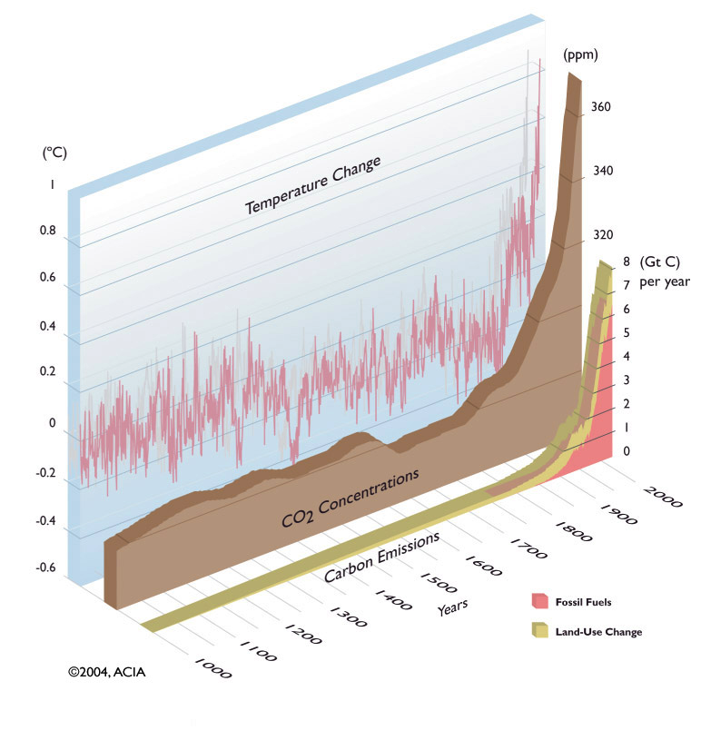
Temperature, CO₂ Concentrations and Human- Caused Carbon Emissions
Notes:
This graph shows the relationship between the temperature change, the change in atmospheric carbon dioxide concentration, and the change in human-caused carbon emissions. All three increase sharply at the same time indicating human-caused greenhouse gas emissions is the main cause of global warming. From Arctic Climate Impact Assessment, Impact of the Warming Arctic: Artic Climate Impact Assessment, 2005)

Slide 27
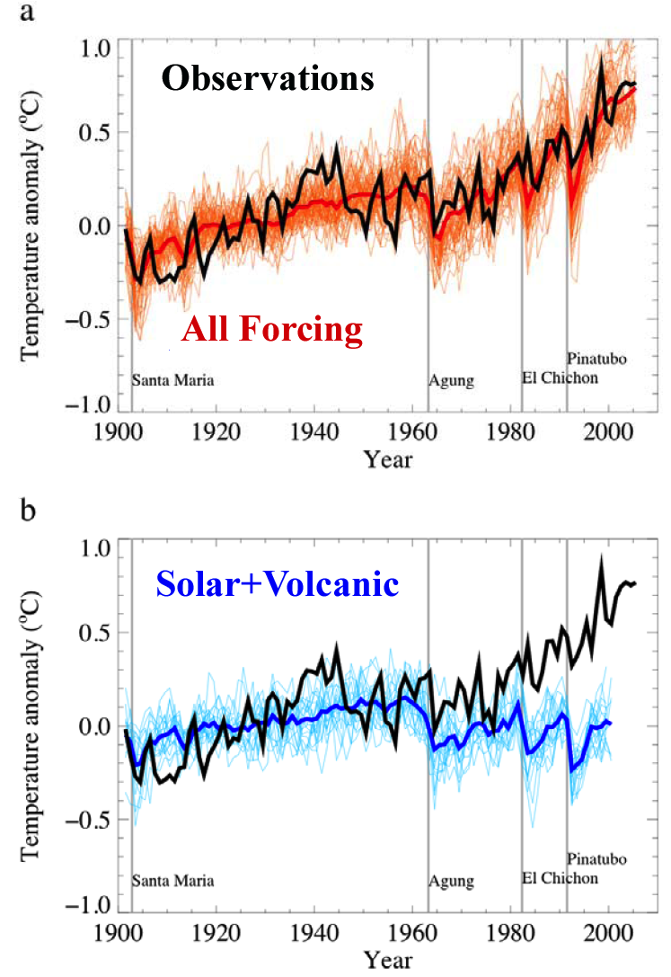
Only Human-caused Greenhouse Gas Emissions Can Account for Global Warming
The black line is the observed temperature rise.
The red area is computer simulations of all emissions, including human.
The blue area is computer simulations of only natural emissions and the increase in solar activity.
Notes:
This is a comparison of computer simulations of global average temperature anomalies and the observed temperatures (black line) from 1900 to the 2005. The upper graph shows all forcings (red) including human-caused greenhouse gases, and the lower graph is only natural forcing by solar irradiance and volcanism (blue). They show that only human-caused greenhouse gases can account for the observed warming. The named vertical lines are major volcanic eruptions that lower the temperature. These computer simulations are additional evidence that humans are the primary cause of global warming. From the UN IPCC 4th assessment 2007.

Slide 28
What Global Average Temperatures Become Critical and Catastrophic for Humans?
The current best estimate is 2° C (3.6° F) above pre-industrial levels is critical. About 4° C (9° F) is catastrophic. The Earth is now 0.8° C (1.4° F) above pre-industrial levels.
When the CO₂ abundance reaches ~430 ppm the temperature anomaly will eventually exceed 2° C. At ~650 ppm it will eventually reach a minimum of 4° C.
The current abundance (2012) is 396 ppm and rising at a rate of 2 ppm/year, and this rate is increasing.
Even at today’s abundance the temperature anomaly may reach the critical level by the end of the century. (Armour and Roe, GRL, 38, 2011; Arora, et al., GRL, 38, 2011)
Notes:
The greenhouse gas levels and temperatures constituting dangerous interference with the climate system are difficult to predict. It depends not only on the intensity of the climate changes but also on the human response to them. When food and water become scarce in certain parts of the world the response could be drastic such as widespread war making the situation even worse, particularly if atomic weapons were involved. In this slide the current best estimates are given, but they could be overestimated or underestimated because it is almost impossible to predict the human response to catastrophic environmental changes. The uncertainty makes it even more urgent to begin major reductions in greenhouse gases now. The consequences that are currently occurring are due to only a 0.6 degree C temperature rise above the pre-industrial average.
The finding that we will reach the critical temperature by the end of the century no matter what we due it from the following papers: Armour and Roe, Climate commitment in an uncertain world, GRL, 38, L01707, 2011; and Arora, et al., Carbon emission limits required to satisfy future representative pathways of greenhouse gases, GRL, 38, L05805, 2011.

Slide 29
WHAT IS CRITICAL AND WHAT IS CATASTROPHIC?
CRITICAL --- serious drop in food production, serious water shortages, significant sea level rise (~1 m [3 ft]), political unrest, major drop in world economy, major animal extinctions and millions of human deaths. Third-world countries, e.g. Africa, are affected most, including large human migrations.
CATASTROPHIC --- mass extinction event (>50% species extinction), major sea level rise, mass starvation, political and economic chaos, ~50% human deaths (>3 billion people). Probably the end of civilization as we know it today.
Notes:
These consequences are obviously generalized estimates based on a variety of studies. Some scientists consider the possibilities are so dire that very few humans survive. For example, the eminent and highly respected scientist James Lovelock who is responsible for the Gaia Hypothesis says that global warming is irreversible -- and that more than 6 billion people will perish by the end of the century. Most other scientists feel that we can prevent very serious disruptions, but only if we act now with very large reduction in greenhouse emissions.

Slide 30
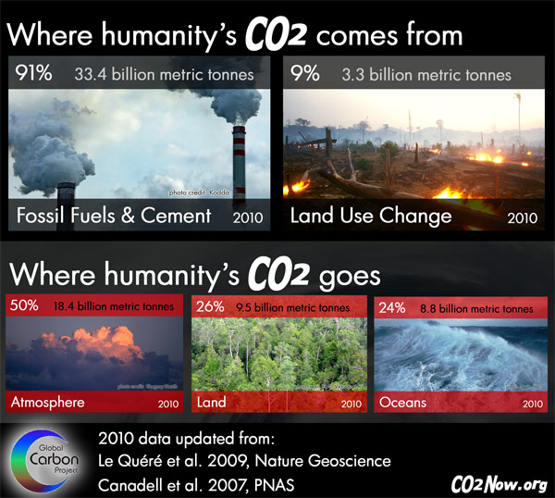
Notes:
This diagram shows the source and destination of the the CO2 emitted by humans. Half of the CO2 accumulates in the atmosphere and the rest goes to the land and oceans.

Slide 31
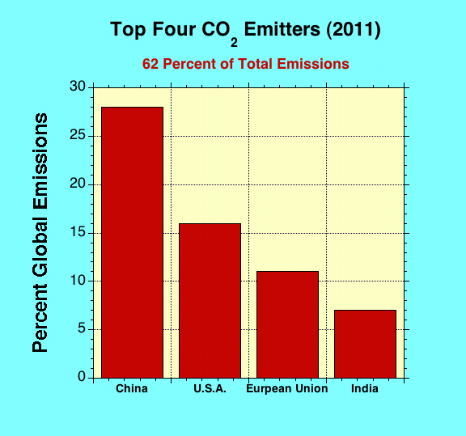
Notes:
This bar chart shows the percentage CO₂ emissions of the top 4 countries.

Slide 32
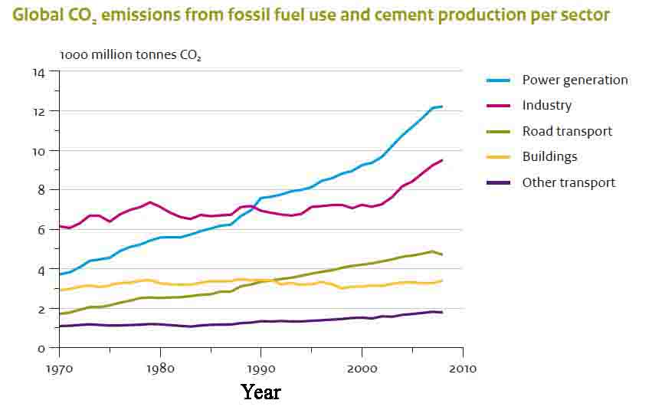
Notes:
Source: Long-term Trend in Global CO2 Emissions. 2011 Report, PBL Netherlands Environmental Assessment Agency, The Hague, European Union, 2011.

Slide 33
Some Current General Consequences of Global Warming
More Severe Heat Waves of Greater Duration
Sea-level Rise and Ocean Acidification (Oceans are acidifying 10 times faster today than 55 million years ago when a mass extinction of marine species occurred - PETM)
Glaciers, Ice Sheet and Permafrost Melting
Spreading Disease
Plant and Animal Range Shifts Plus Extinctions
Coral Reef Degradation
More Severe and Frequent Weather Events (2011 was the worst)
More Severe and Frequent Flooding (2011 was the worst)
More Severe Droughts and Fires (2011 was the worst)
Notes:
Because of the large absorption of CO₂ , the oceans are producing large quantities of carbonic acid. The oceans are, therefore, becoming acidic. If CO₂ emissions are not drastically reduced now, the acidity of the oceans will violate EPA Quality Criteria (1976) by mid century or sooner (Geophys. Res. Letters, Sept. 25, 2007). This will significantly risk marine biota and adversely impact the food webs and key biogeochemical processes.

Slide 34
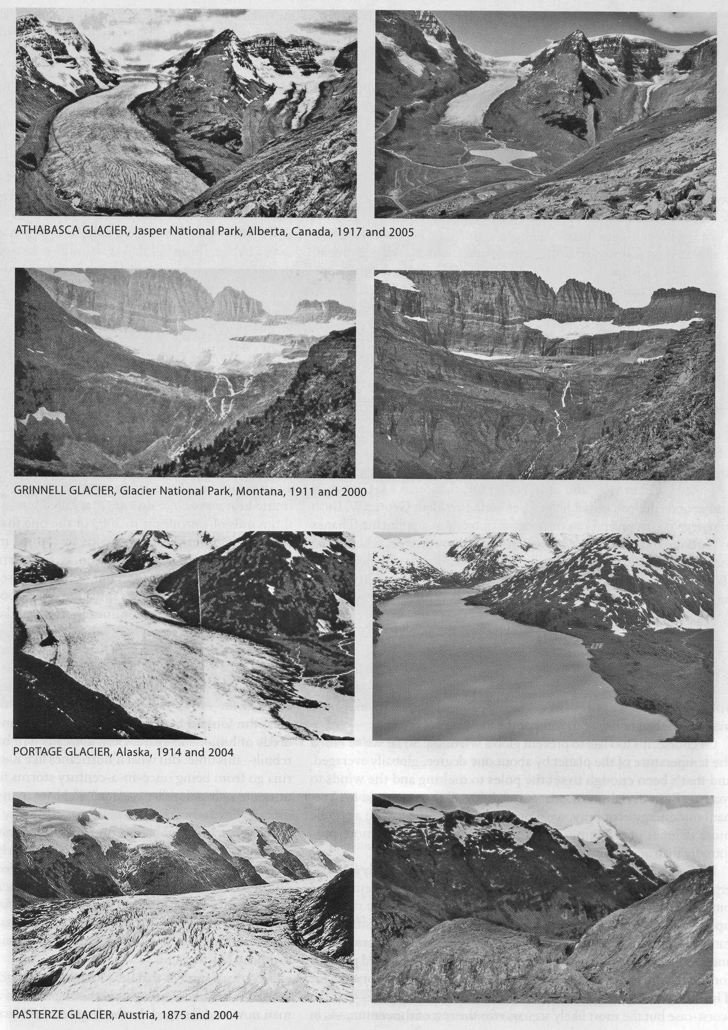
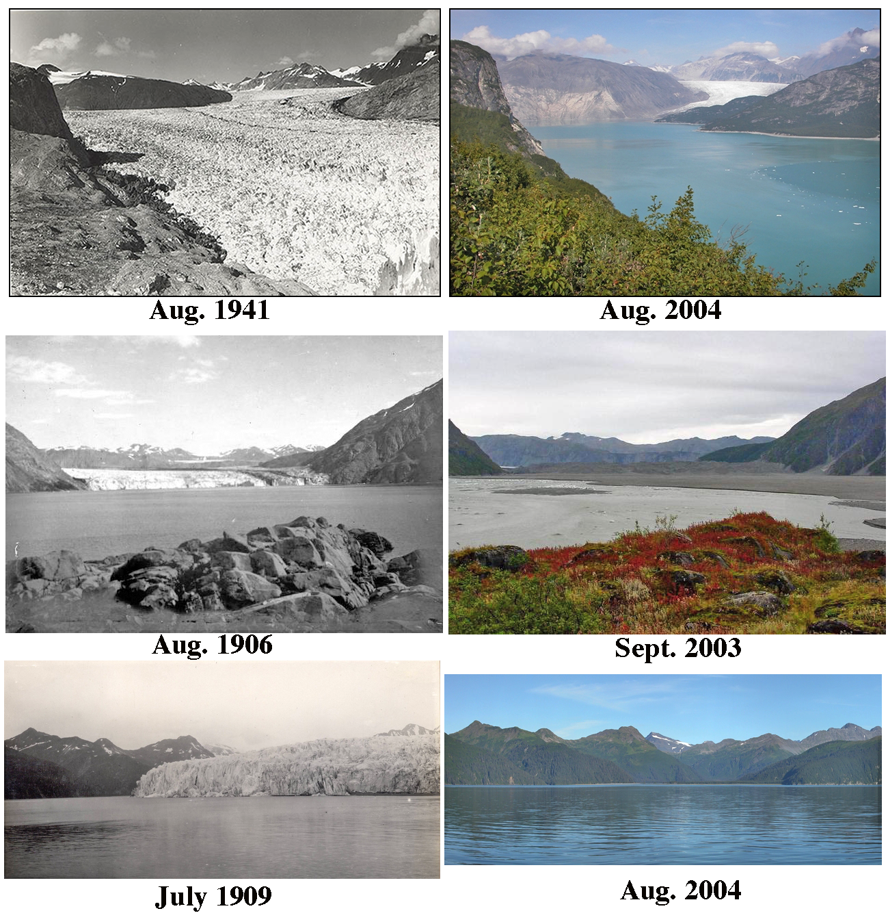
Melting Glaciers
Notes:
The comparisons on the left are various glaciers around the world. The comparisons on the right are for three Alaskan glaciers. Notice the vegetation differences in the top two Alaskan comparisons due to climate change. The rate at which some of the world's glaciers are melting has more than doubled, data from the United Nations Environment Programme has shown. Average glacial shrinkage has risen from 30 centimeters per year between 1980 and 1999, to 1.5 meters in 2006. Some of the biggest losses have occurred in the Alps and Pyrenees mountain ranges in Europe.
Experts have called for "immediate action" to reverse the trend, which is seen as a key climate change indicator. Estimates for 2006 indicate shrinkage of 1.4 meters of 'water equivalent' compared to half a meter in 2005.
Achim Steiner, Under-Secretary General of the UN and executive director of its environment programme (UNEP), said: "Millions if not billions of people depend directly or indirectly on these natural water storage facilities for drinking water, agriculture, industry and power generation during key parts of the year.
"There are many canaries emerging in the climate change coal mine. The glaciers are perhaps among those making the most noise and it is absolutely essential that everyone sits up and takes notice.
Litmus test
He said that action was already being taken and pointed out that the elements of a green economy were emerging from the more the money invested in renewable energies.
Mr Steiner went on: "The litmus test will come in late 2009 at the climate convention meeting in Copenhagen.
"Here governments must agree on a decisive new emissions reduction and adaptation-focused regime. Otherwise, and like the glaciers, our room for manoeuvre and the opportunity to act may simply melt away."
Dr Ian Willis, of the Scott Polar Research Institute, said: "It is not too late to stop the shrinkage of these ice sheets but we need to take action immediately."
The findings were compiled by the World Glacier Monitoring Service which is supported by UNEP. Thickening and thinning is calculated in terms of 'water equivalent'.
Glaciers across nine mountain ranges were analysed. Dr. Wilfried Haeberli, director of the service, said: "The latest figures are part of what appears to be an accelerating trend with no apparent end in sight.
"This continues the trend in accelerated ice loss during the past two and a half decades and brings the total loss since 1980 to more than 10.5 metres of water equivalent."
During 1980-1999, average loss rates had been 0.3 metres per year. Since the turn of the millennium, this rate had increased to about half a metre per year.
The record annual loss during these two decades - 0.7 metres in 1998 - has now been exceeded by three out of the past six year (2003, 2004 and 2006).
On average, one metre water equivalent corresponds to 1.1 metres in ice thickness. That suggests a further shrinking in 2006 of 1.5 actual metres and since 1980 a total reduction in thickness of ice of just over 11.5 metres or almost 38 feet.
In its entirety, the research includes figures from around 100 glaciers, with data showing significant shrinkage taking place in European countries including Austria, Norway, Sweden, Italy, Spain and Switzerland.
Norway's Breidalblikkbrea glacier thinned by almost 3.1 metres in one of the largest reductions.

Slide 35
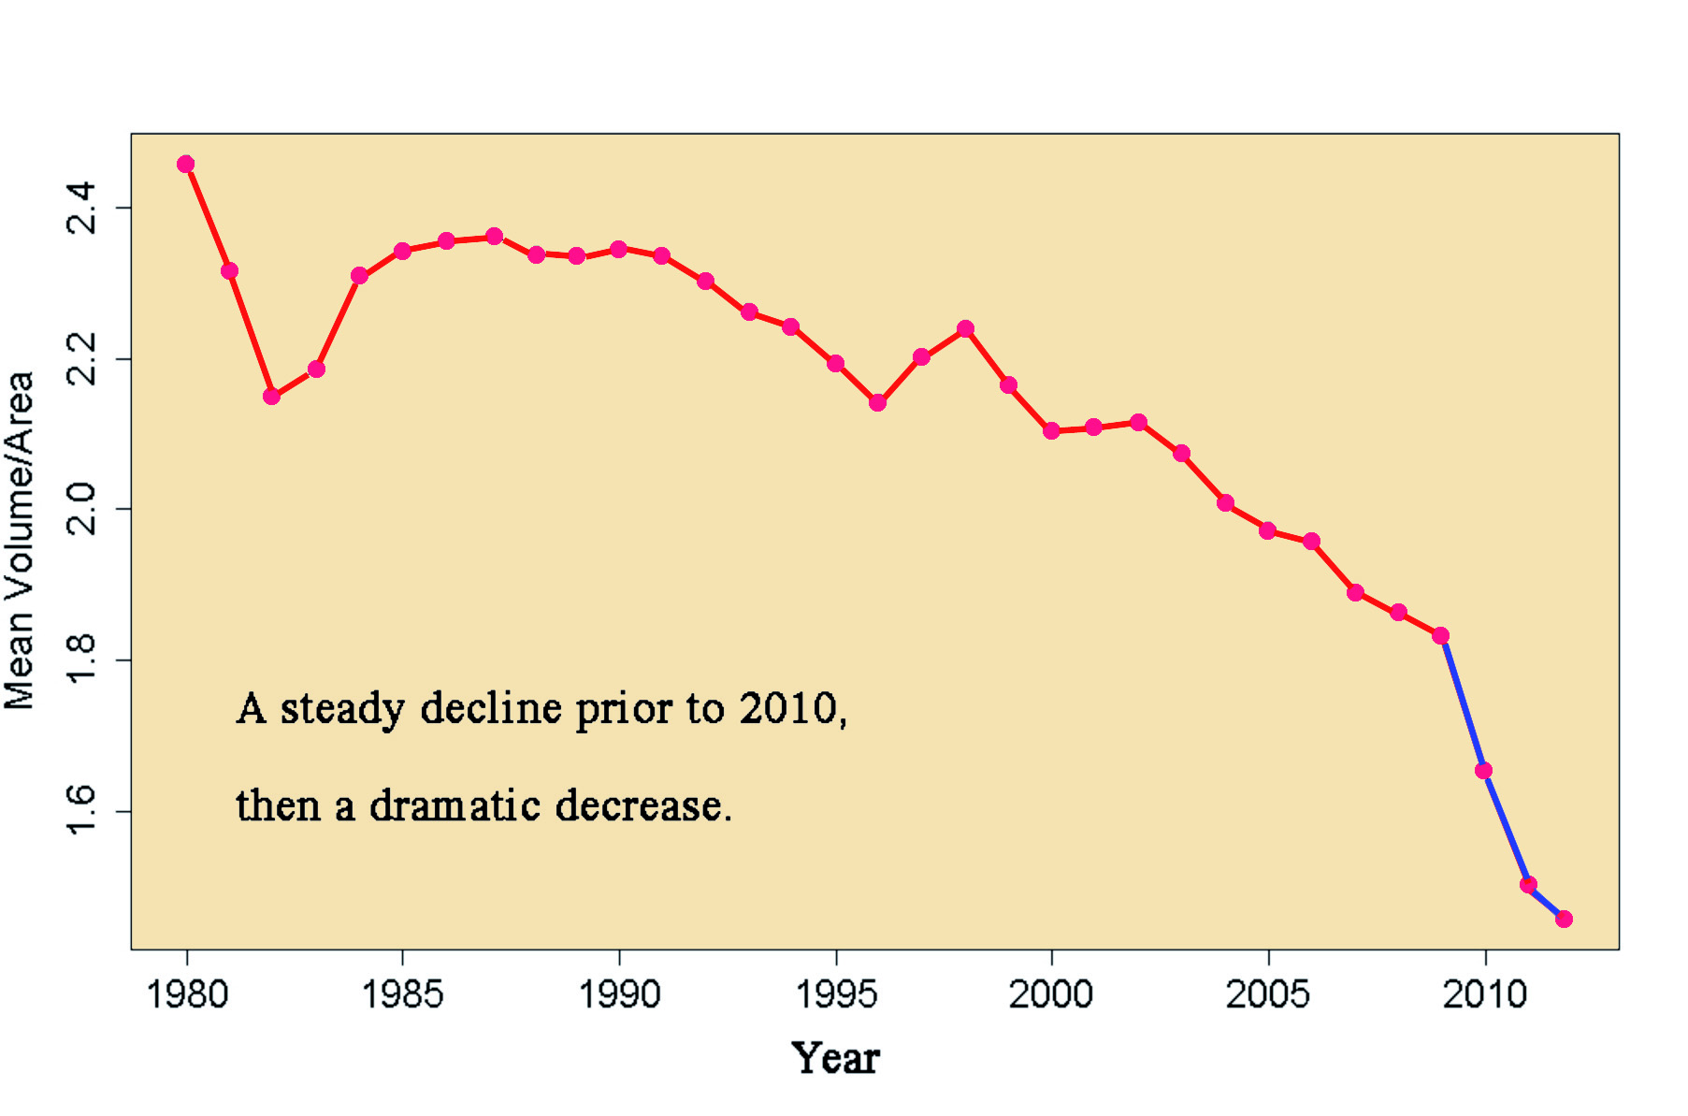
Ratio of Mean Volume to Area of Arctic Summer Sea Ice
Notes:
This graph shows a dramatic increase in the loss of the Arctic summer sea ice. There has been a steady decline in the ratio of mean volume to area until 2010. At that time the rate of decrease has increased significantly.

Slide 36
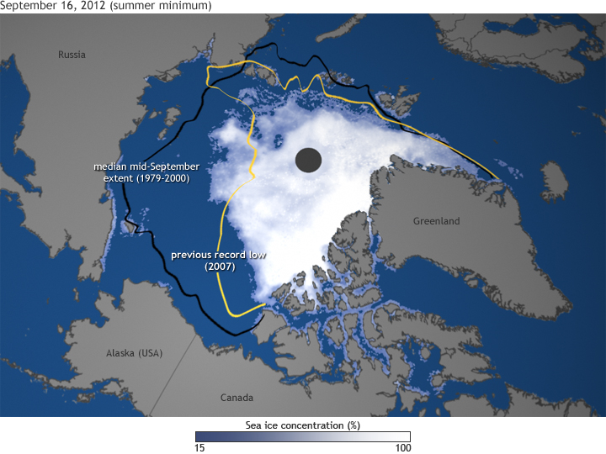
Greatest decline of Arctic Summer Sea Ice
(Sept. 16, 2012)
Notes:
On August 26, 2012, Arctic sea ice extent shrank to 1.58 million square miles (4.1 million square kilometers), an area about half the size of the Lower 48 United States. That ice was melting was not news; after all, the Arctic ice pack undergoes an annual cycle of winter expansion and summer melting. The “news” was that the extent had broken the previous record low, set in summer 2007, and there were still several more weeks to go in the melt season.
By the time the summer melt season came to an end in mid-September, the ice extent had shrunk down to just 1.3 million square miles (3.41 square kilometers), setting a new record low that was 18 percent smaller than the previous record and nearly 50 percent smaller than the long-term (1979-2000) average. This map shows ice concentration on September 16, along with the extent of the previous record low (yellow line) and the mid-September median extent (black line).
It can be hard to imagine how radical a transformation the loss of so much ice is. Most of us live in a world where snow and ice are transient things, momentarily hiding the “real” landscape. In the Arctic, ice is the real landscape, and for it to have shrunk to half its historic summer extent is as much a transformation of the environment as if half the forests of New England had been replaced by Saguaro cactus.
The transformation from icy to ice-free has ecological consequences and physical ones. The loss of sea ice directly affects polar bears, seals, walruses, and many birds, for which the sea ice is a raft, a place to haul out, rest, feed, and give birth. The “where, when, and what kind” of blooms of phytoplankton—the foundation of the marine food web—is changing, and those changes cascade through fish populations.
The most profound physical impact ice loss is that the loss becomes a sort of “self-fulfilling prophecy.” Less ice turns Arctic latitudes from a bright white solar reflector into a dark expanse of open water: a black t-shirt on a summer day. The more ice that melts, the more sunlight the ocean absorbs. The more sunlight the ocean absorbs, the warmer it gets, and the more ice melts.
That self-reinforcing feedback loop is the heart of the process that scientists refer to as “Arctic amplification” of global warming, and it explains why temperatures have risen faster in the Arctic than they have at temperate latitudes.

Slide 37
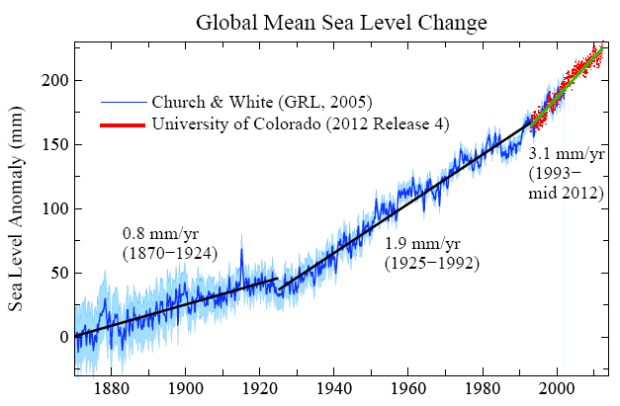
Notes:
The rate of sea level increase is growing.

Slide 38
Southeastern Seaboard After a 1 and 6 m (3 and 20 ft) Sea Level Rise
Notes:
This diagram shows the area in the eastern part of the U.S. inundated by a rise in sea level of 1 and 6 meters. Courtesy of the Dept. of Environmental Science, Univ. of Arizona.

Slide 39
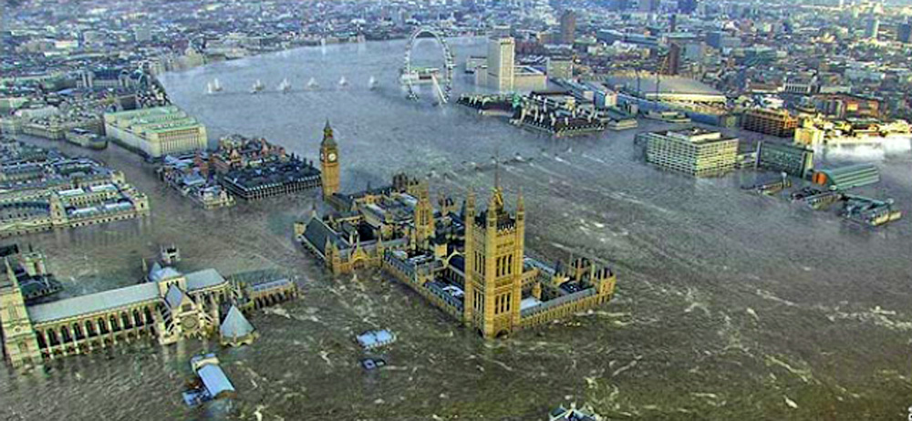
London Underwater from a 6 m (20 ft) Rise in Sea Level
Notes:
This is a computer simulation shows the effect of a 6 meter rise of sea level on the city of London, England. The Houses of Parliament and Big Ben are shown in the middle foreground.

Slide 40
Ocean Acidification
Currently, the ocean absorbs about eight billion tons of CO₂ annually that would otherwise stay in the atmosphere.
The additional absorbed CO₂ from the increase in atmospheric CO₂ is reacting with the water (H₂O) to produce carbonic acid.
The oceans are becoming more acidic which destroys chlorophyll and organism’s shells (coral, plankton, etc.) disrupting the food chain.
Since the industrial revolution, the acidity of ocean surface waters has increased by 30 percent. This change is greater and happening about 100 times faster than for previous acidification events during the past millions of years.
This has serious consequences for humans and other species who depend on the oceanic food chain for their existence.

Slide 41
Heat is Energy
The hotter the atmosphere, the more energetic it becomes.
Therefore, weather events are stronger and more frequent.

Slide 42
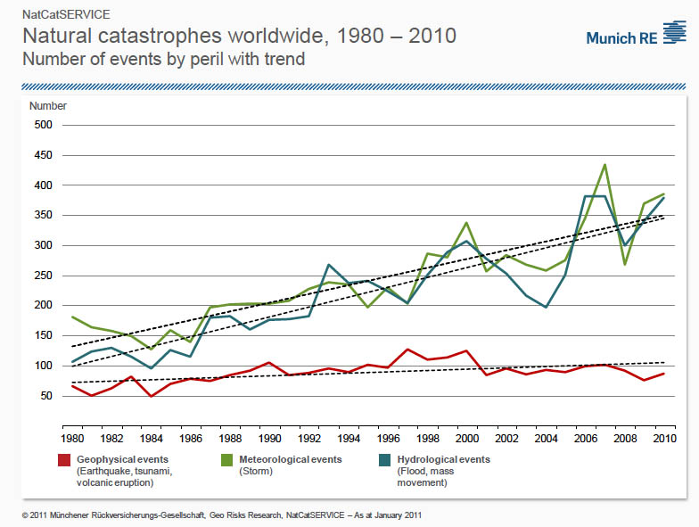
Worldwide Natural Disasters, 1980-2010
Notes:
This graph was produced Munich RE, the largest re-insurer in the world. They are very concerned about global warming the price they will have to pay for the damage it causes.

Slide 43
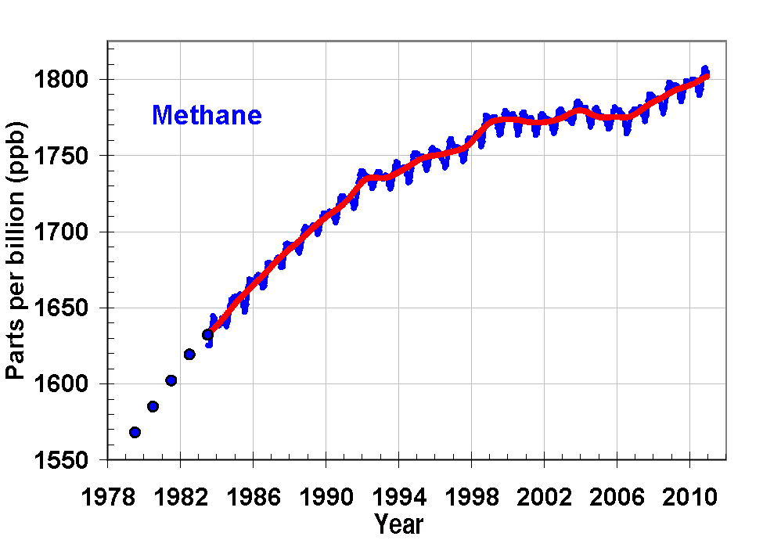
Methane Increasing After 8 Years of Stability
From 1999 to 2006 (8 years) the methane abundance has been relatively stable due to industrial changes in Russia, changes in the methods of rice farming, and methane capture from landfill sites.
In 2007 the world methane abundance began to increase.
Based on carbon isotope analyses the methane is of biogenic origin.
The source is probably the release from melting permafrost, but the Arctic continental slope methane hydrates may eventually contribute. [More research needed]
We may eventually reach a tipping point primarily caused by CO₂ and enter a non-linear climate response.
Notes:
This graph shows the methane atmospheric abundance from 1979 through 2011. Beginning in 2007 the methane began to increase after 8 years of stability. Data from NOAA for the Baring Head Station.

Slide 44
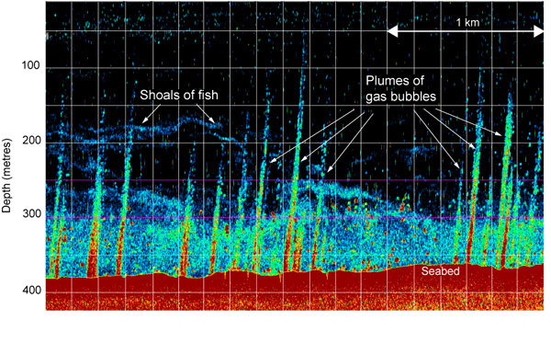
Example of Methane Release from Arctic Continental Shelf.
Most of the Methane is NOT Reaching the Atmosphere, yet.
Notes:
(a) Location of survey west of Svalbard. (b) Positions of plumes acoustically imaged with the EK60 sonar, depicted by “pins”, superimposed on perspective view of the bathymetry of part of the area of plume occurrence. Bathymetry is from EM120 multibeam survey of cruise JR211 gridded at 20-meter resolution, combined with high-resolution survey data from the Norwegian Hydrographic Service for the shallower-than-200 meter part of the map. (c) Part of the record from an EK60 acoustic survey from JR211, showing examples of observed plumes. Amplitude of the acoustic response is given by the color of the “bubbles”. All plumes show a deflection towards the north caused by the West Svalbard Current. The seabed, at about 240 meters depth, is shown by the strong (red) response. From; Westbrook, et al., Escape of methane gas from the seabed along the West Spitsbergen continental margin, Geophys. Res. Letters, Vol. 36, L15608, 2009.

Slide 45
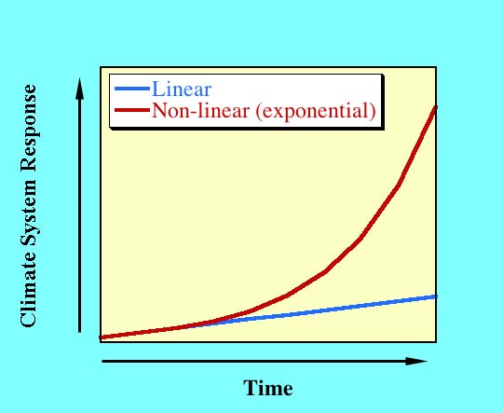
Positive Feedbacks Can Lead to a Non-linear Climate Response
Notes:
A non-linear response of the climate system from positive feedbacks would probably be catastrophic. In the graph, the “Climate System Response” could consist of a combination of a rise in temperature, an increased frequency and duration of extreme weather events, increased ice sheet collapse and rise in sea level, etc. Today we could be near or at the beginning of a non-linear change.

Slide 46
United Nations Framework Convention on Climate Change (UNFCCC)
Highlights of the Durban, South Africa Meeting in Dec. 2011
The Kyoto Protocol will be extended 5 years (Canada refused)
A new legally binding agreement for the reduction of CO₂ emissions will be formulated by 2015.
The signatories to that agreement will begin reducing their emissions starting in 2020.
Notes:
These are the main highlights of the 2011 meeting in Durban, South Africa.

Slide 47
Notes:
This graph shows the projected atmospheric CO₂ abundance from 2007 to 2030 (dark blue). This projection is based on the growth rates between 1990 and 2007. The historical data is from the Mauna Loa Observatory, Hawaii. The projected growth rate depends on projected emissions shown on a previous slide, the contribution from positive feedbacks, and the actions to cut greenhouse gas emissions by the world community. Currently this projection is probably underestimated. The projection suggests that by 2030 the CO₂ abundance (~454 ppm) will be within the critical level, and that the average global temperature anomaly will eventually reach 2° C (currently it is 0.8° C). However, we have already crossed the level where long-term (100’s of years) danger (the critical temperature) will occur unless we extract CO₂ from the atmosphere. We have also crossed the level where harmful effects are occurring (see previous slides), and these will only get worse as we approach the critical level in about 2025 or sooner. This is the reason that we must start today to drastically reduce our greenhouse gas emissions.

Slide 48
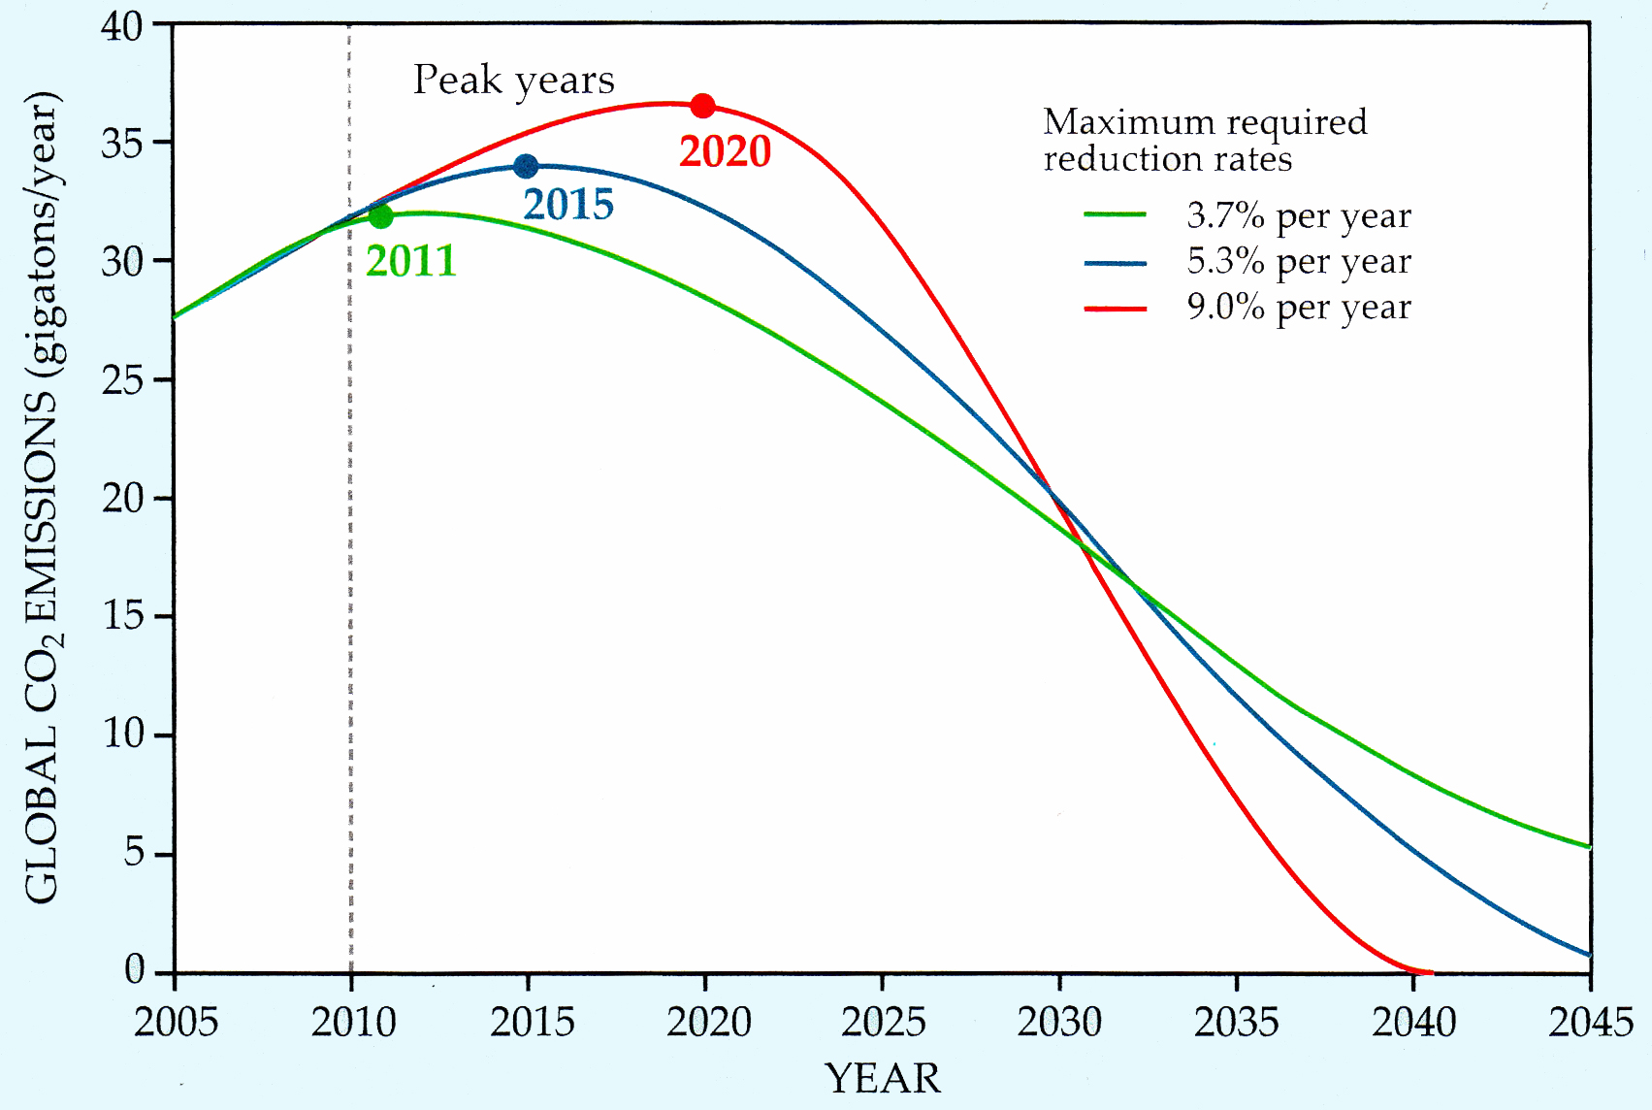
CO₂ Emission Reduction to Limit the Rise in Global Average Temperature to the Critical 2° C (3.6° F)—2009 analysis
UNFCCC Goal
Notes:
Three scenarios, each of which would limit the total global emission of CO₂ from fossil fuel burning and industrial processes to 750 Gt over the period 2010-50. If emissions remain negligible after 2050, that limit yields an estimated 67% probability of capping global warming at 2 degrees C above pre-industrial temperatures. As indicated by the color-keyed table, the later the year of peak emission, the higher would have to be the maximum rate of annual reduction, which would begin in the early 2030s. (Adapted from the German Advisory Council on Global Change factsheet 2/2009)

Slide 49
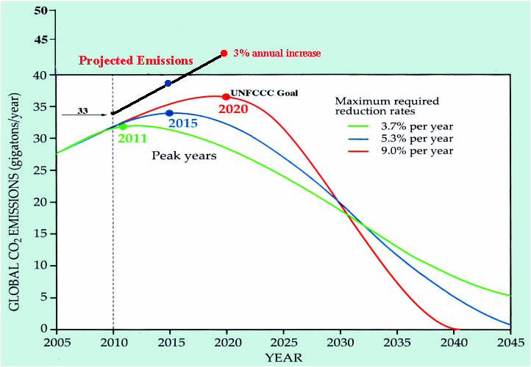
Projected Emissions to 2020 if the Average Annual Increase is 3%
Notes:
If the present increase in world CO₂ emissions continues to increase at about an annual rate of 3% then the emissions will be at 43 billion metric tons in 2020 when the UNFCCC recommends the world start reducing CO₂ emissions. At this point it will be almost impossible to keep the temperature from reaching the DANGEROUS level of 2° C, and VERY DIFFICULT to keep below the catastrophic level of 4° C.

Slide 50
Can We Avoid Dangerous Global Warming?
(2° C above pre-industrial)
It depends on (1) the year global greenhouse gases peak, (2) the rate at which they subsequently decline, and (3) the possibility of negative emissions (carbon sequestration) later.
Only if emissions peak in 2014 and then decline at 3.5% per year with massive sequestration later in the century can we prevent a dangerous level at 1.8° C increase above pre-industrial levels.
Without sequestration, peak emissions must occur in 2016 and decline by 3.5% per year to limit temperature rise to the dangerous level of 2.0° C above pre-industrial levels.
This would require a level of immediate, global, coordinated action never seen in human history.
It is highly unlikely that we will stay below the dangerous level.
It is more likely we will experience global warming at or near the catastrophic level.
Notes:
From the U.K. Met Office, the Walker Institute, the Tyndall Centre, and the Grantham Institute: “Development of Emissions Pathways Meeting a Range of Long-term Temperature Targets”

Slide 51
We Must Make the World Governments Aware of the Seriousness of our Problem
The 100 Nation Science Academies and Science Societies must issue a non-technical report on global warming understandable to non-science politicians. (A technical report is also required)
In the report they must DEMAND that primarily developed countries reduce greenhouse gas emissions to prevent a global catastrophe.
Failure to do this will doom future generations to a horrible future or possibly no future at all.

Slide 52
A Permanent Long-term Fix
Decrease World CO₂ emissions 90 to 95%
AND
Artificially Extract CO₂ from the atmosphere to lower its abundance from 400 ppm to 350 ppm
“Following cessation of emissions, (NATURAL) removal of atmospheric carbon dioxide decreases radiative forcing, but is largely compensated by slower loss of heat to the ocean, so that atmospheric temperatures do not drop significantly for at least 1,000 years.”
Notes:
Quote from---Solomon, et al., Irreversible climate change due to carbon dioxide emissions, Proc. National Academy of Science, 106, no. 6, 1704-1709, Feb. 10, 2009.

Slide 53
Global Warming:
How Serious Is It?
The most serious problem facing humanity since civilization began 11,000 years ago.
It could be the end of civilization if we do not act now. “Now” is NOT 2020 as proposed by the Dec. 2011 Durban, S. Africa Climate Conference.

