Slide 1
Formation of the Moon
By Brad Shaver

Slide 2
Previous Models
Fission
Capture
Binary Accretion

Slide 3
Fission Model
Idea was Earth spinning at high rate.
Tossed material off surface.
Problem is that the moon should be orbiting at earth’s equator!

Slide 4
Capture Model
Moon formed in different location
Captured by earth
However, moon and earth have same composition!

Slide 5
Binary Accretion Model
Moon formed from remains of earth
Similar to planets forming from remains of stars
Problem is moon doesn’t have much metallic iron!

Slide 6
Along comes Apollo
Lunar samples show same makeup as earth
Density of moon is roughly equal to earth’s mantle
Have very little volatile elements
Formed in high temperature
Oxygen isotopes similar to earth
So…
The moon must be from earth!

Slide 7
Kona meeting
1984 meeting in Hawaii
Discussed other ideas for origin of moon
Impact model became popular
Explained high angular momentum
Protoplanets helped form this idea
-collided with each other in early solar system

Slide 8
Impact Model
Basic Idea
Collision with earth
Caused material to be thrown off
Reaccreted to form moon

Slide 9
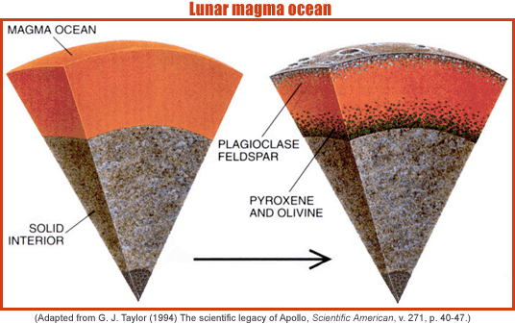
Impact Model continued
Accretion caused magma oceans
Lunar samples showed evidence for this
Hot enough to get rid of volatile elements

Slide 10
Moons Interior
Crust
60-150km, mostly anorthite
Regolith 3-5m in maria, 10-20m in highlands
Mantle
around 100km, makes up most of moons interior
Core
Might be partially molten
The cause of the offset center of mass may be due to the crust being uneven

Slide 11
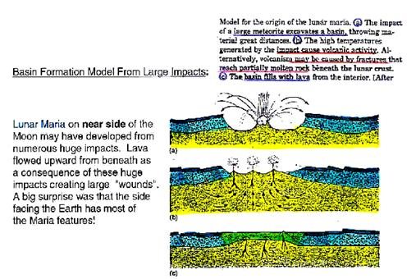
After cooling
Maria began to form from impacts
Lunar samples suggest came from mantle
Usually 1-2 km thick and low viscosity

Slide 12
Volcanism
Volcanoes also contributed to maria
Dome and cone
Viscosity low
Large concentration of cones in Marius hills complex

Slide 13
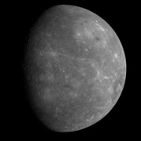
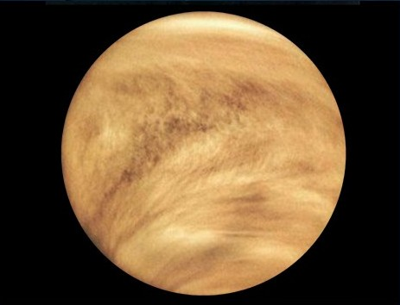
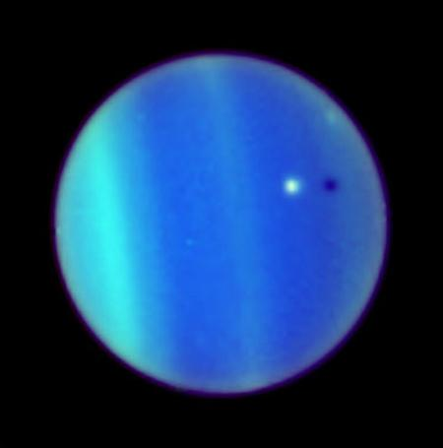
Impact model for other bodies?
Yes
Mercury is mostly core (60%)
Density is equal to iron density
Venus and Uranus rotation

Slide 14
References
"Moon." Wikipedia, The Free Encyclopedia. 11 Nov 2008, 15:56 UTC. 13 Nov 2008 <http://en.wikipedia.org/w/index.php?title=Moon&oldid=251118218>.
Spudis, Paul D. "Moon." World Book Online Reference Center. 2004. World Book, Inc. (http://www.worldbookonline.com/wb/Article?id=ar370060.)

