Slide 1
Aeolian Processes

Slide 2
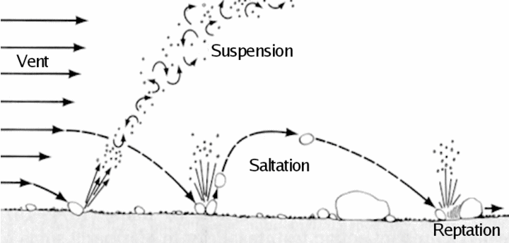
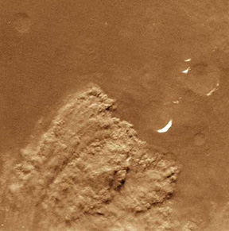
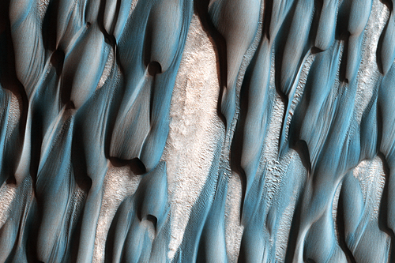
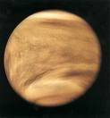
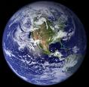
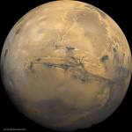
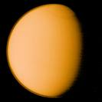
Suspension and saltation
On which planets?
Venus
Earth
Mars
Titan

Slide 3
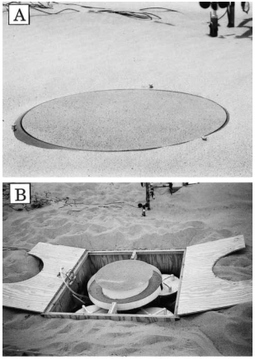
In a planetary boundary layer
Drag of wind on surface produces a shear stress
Measured with drag plates
We define a ‘shear velocity’ u*
Just another way to quantify the shear stress
For a Newtonian fluid (like air):
In a thin laminar sub-layer η is constant and a property of the fluid (and temperature)
Above this layer, turbulence dominates, η is a property of the flow (an Eddy viscosity) and varies with height and u
Empirically – law of the wall… (κ is Von Karman’s constant ~ 0.41)

Slide 4
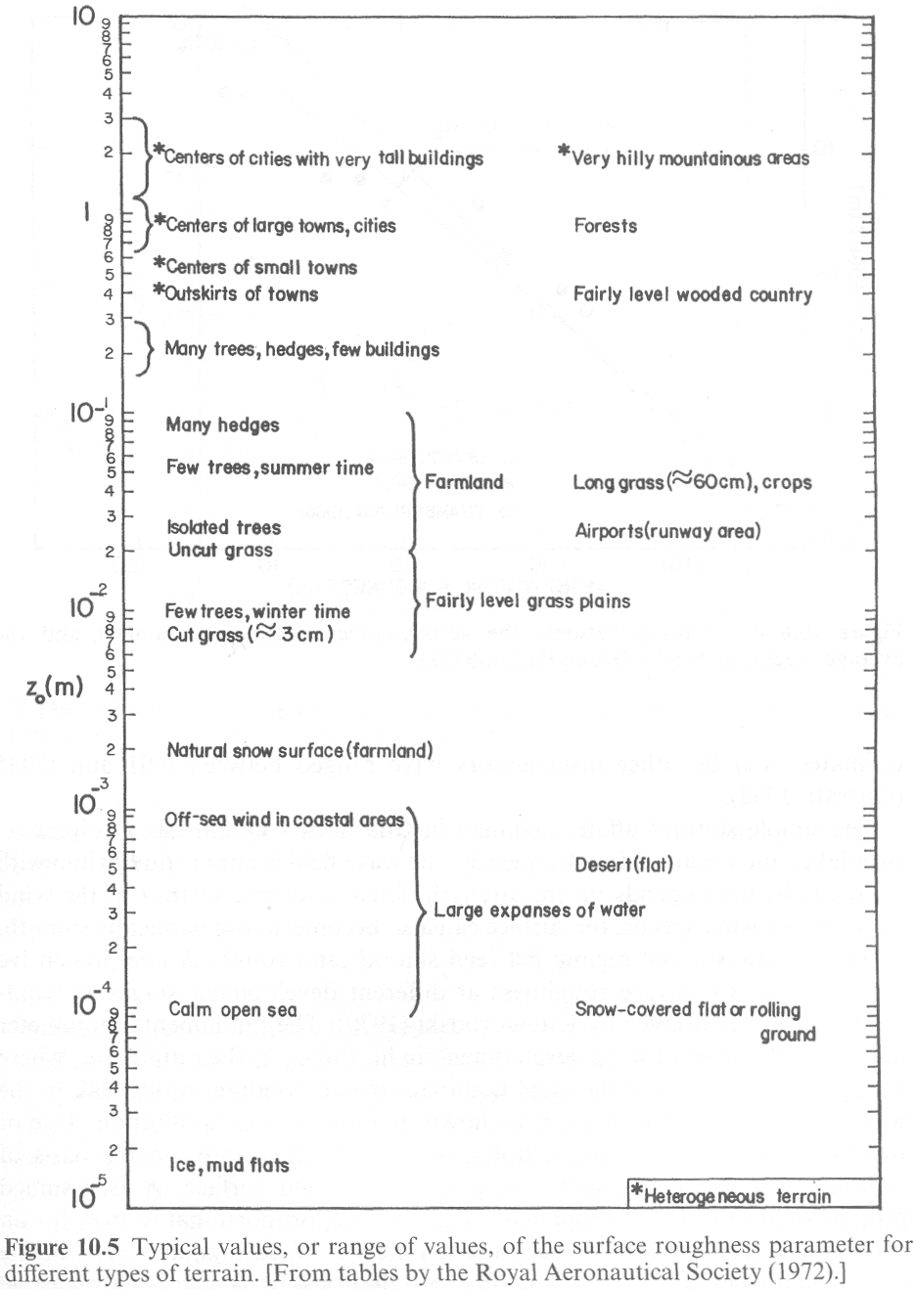
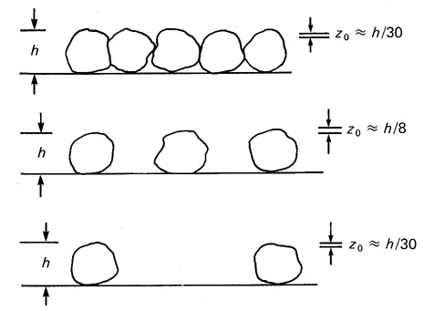
Z₀ is the equivalent roughness height
1/30th of the grain size for quiescent situations
Otherwise it’s empirically determined from several wind measurements at different heights
Medium
sand
Greeley, 1985

Slide 5
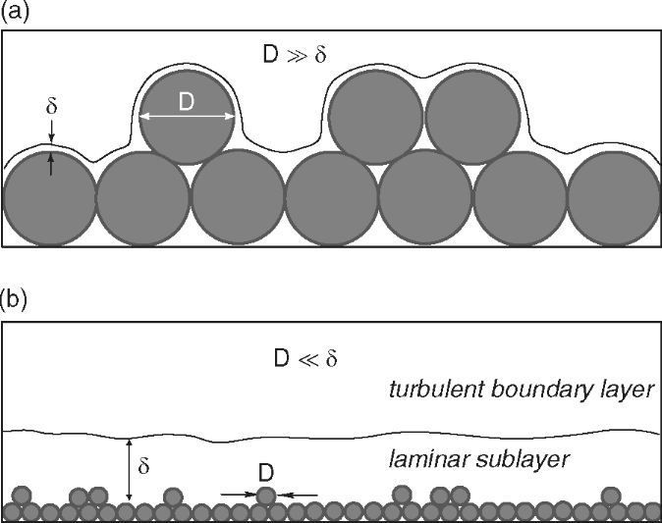
Two regimes
Balance shear stresses with weight – buoyancy of particles
At the threshold velocity, some component of drag force balances the particle weight
A is ~0.1 for particles in turbulent air
Big grains stick up into turbulent flow
Transition at: z/z_{o} ~ 5 – 10
Neither approach works well in the transition zone
Little grains hide in the laminar flow
Anderson and Anderson 2010
or
A² often called θ

Slide 6
Define the frictional Reynolds number
A varies with this value
where n >>>1
Recall:
A
Turbulent zone:
~3.5
Re*
Laminar zone:
Small particles in laminar zone
Large particles in turbulent zone
Easiest particles to move depends on
Atm. viscosity
Atm. density
Particle weight (density and gravity)
Buoyancy effects minor (until we get to the fluvial processes lectures)
u_{T}
?
d

Slide 7
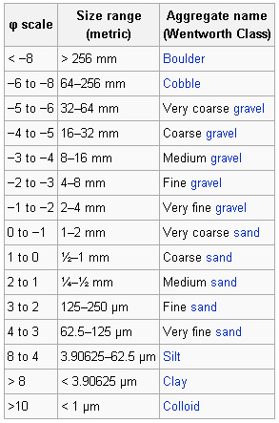
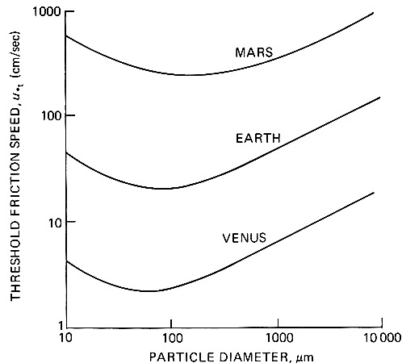
Saltation threshold increases with particle size
Particles classified by Udden-Wentworth scale
Easiest particles to move are sand-sized
Dust
Sand-sized
Gravel
0.1 mm
1mm
1cm
Greeley, 1985

Slide 8
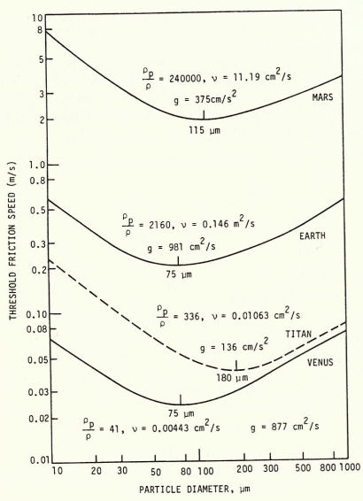
Easy to move, but not easy to suspend
Particles are launched off the surface, but re-impact a short time later – saltation!
Impact angles much shallower than launch angles
Impacting grains can dislodge new particles (reptation)
Impacting grains can push larger particles (creep)
Greeley, 1985

Slide 9
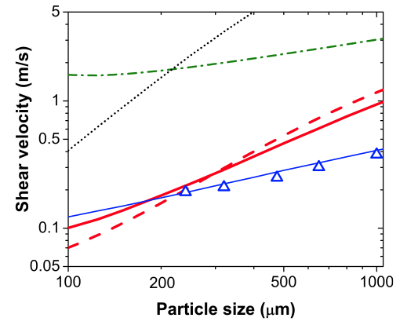
Impact vs fluid threshold
It’s easier to keep saltation going than start it
Impact threshold is ~0.8 times the fluid threshold for Earth
…but ~0.1 times the fluid threshold for Mars
This is what makes martian saltation possible
Kok, 2010
Kansas State University

Slide 10
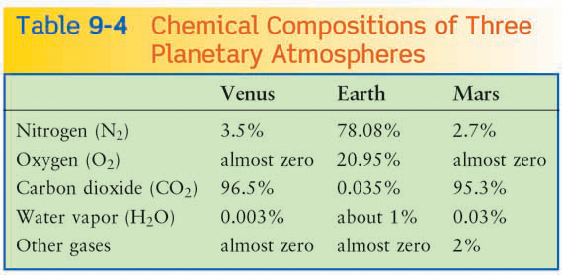
Titan
95%
Zero
Zero
Zero
5% methane
Dune Potential (All else being equal)
Venus
Titan
Earth
Mars
Density Kg m⁻³ | 71.92 | 1.27 | 0.027 | 5.3
Gravity (m s⁻²) | 8.9 | 9.8 | 3.7 | 1.35
Dune material | Basalt | Quartz | Basalt | Organics (lower density)

Slide 11
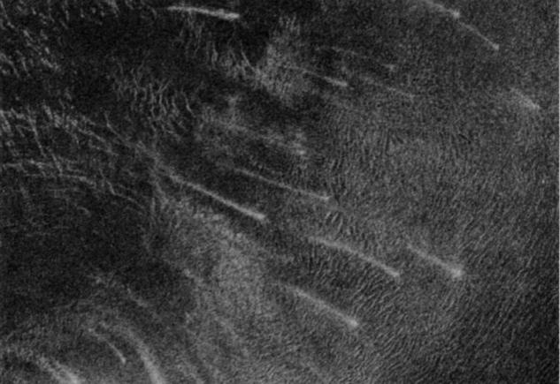
As usual – all else is not equal
Venus has very few dunes (two fields known)
Lack of weathering into small particles
Detectability of dunes ?
Low surface winds
Mars has extensive dunefields
Very high wind speeds
Lots of active weathering breaking up rocks
Dune Potential (All else being equal)
Venus
Titan
Earth
Mars
Fortuna-Meshkenet field
Weitz et al. 1994

Slide 12
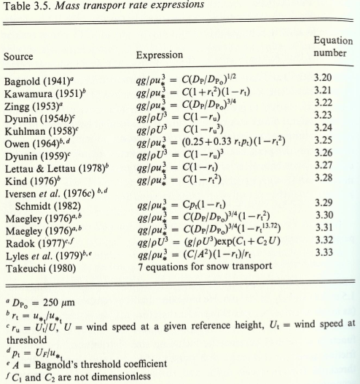
Sand flux per unit length is proportional to shear velocity cubed
There are many variations fit to empirical data
Most sand is moved by the most energetic winds
Greeley, 1985

Slide 13
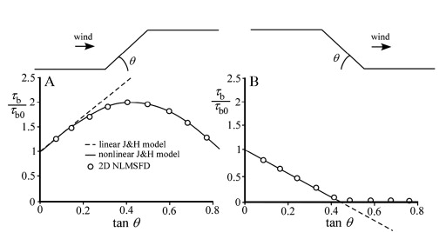
Low hills of sand feel asymmetric shear stress
Turbulent shear stress at many wavelengths combined linearly
Jackson and Hunt 1975
Doesn’t work so well when slopes > 10-15°
Shear stress drops to zero when slopes exceed ~ 25°
Pelletier 2009

Slide 14
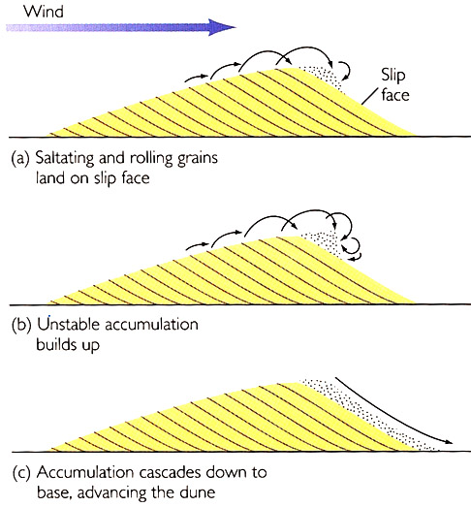
Flat
Neutral mass balance
Stoss
Slope
Negative mass balance
Lee
Slope
Positive mass balance
Formation of a dune…
Asymmetric shear stress causes lee-slope of all low hills to steepen
Lee slopes steepen past 25°
Air flow separates from lee-slope surface
Sand falls onto the upper lee-slope and is not removed causing steepening
Lee slope approaches angle of repose
Slope controlled by gain avalanches
Dune advances

Slide 15
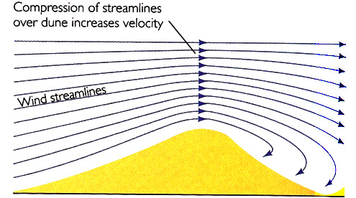
Dune velocity
Mass in 1m wide slice: ½ b h ρ_{dune}
Time to advance 1 dune length: b / v
Mass flux (q) mass/time:
Bigger dunes move slower for a given sand flux
Dunefields with similar sized dunes are stable
Dune height is self-limiting due to streamline compression
h
b

Slide 16
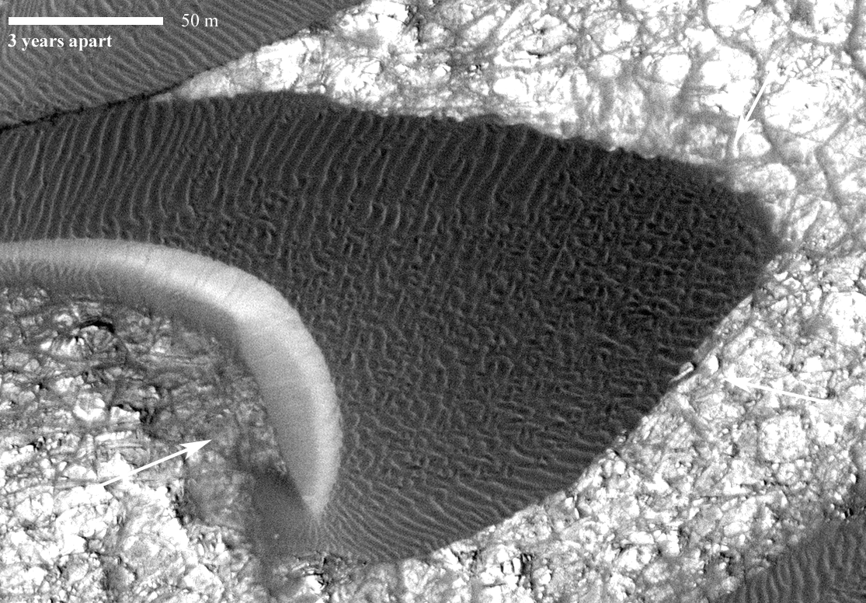
Bridges et al. 2012

Slide 17
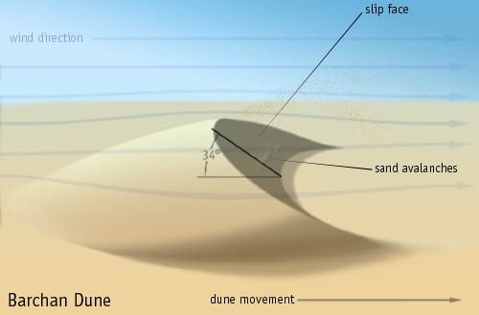
Dunes
Upwind: Stoss side
Downwind: Lee side
Highest point: crest
Slipface start: Brink
Horn
Stoss
Lee
Horn

Slide 18
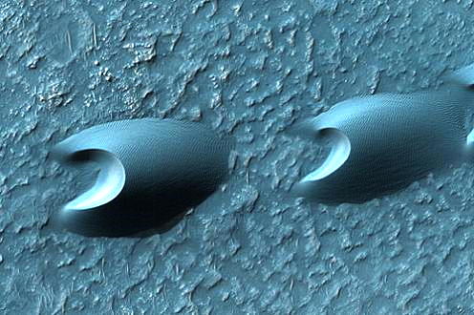
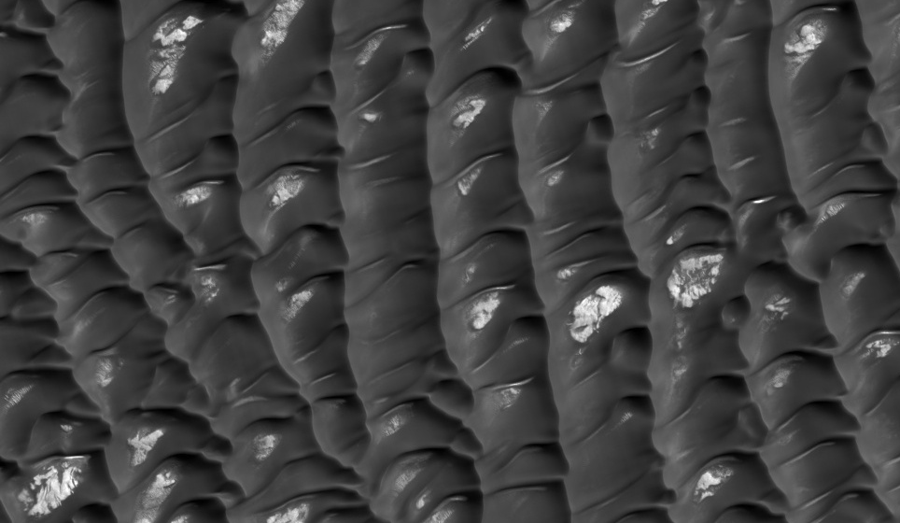
Unidirectional winds
Dune shape depends on sand supply
Barchan Barchanoid ridges Transverse
Increasing sand supply

Slide 19
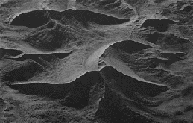
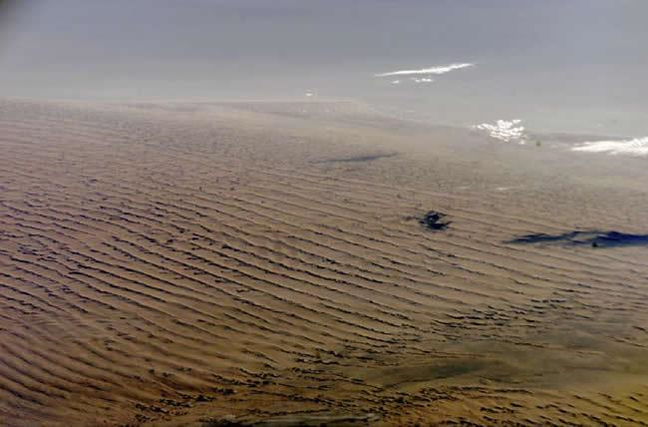
When wind directions vary
Linear dunes – a little variation
Star dunes – a lot of variation
Star Linear/Longitudinal

Slide 20
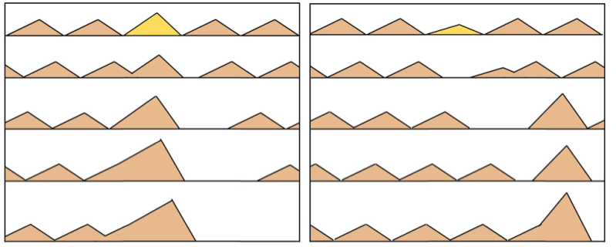
Dune interactions and dunefields
For fast dune collisions…
A perturbation to a dune size leads to runaway growth

Slide 21
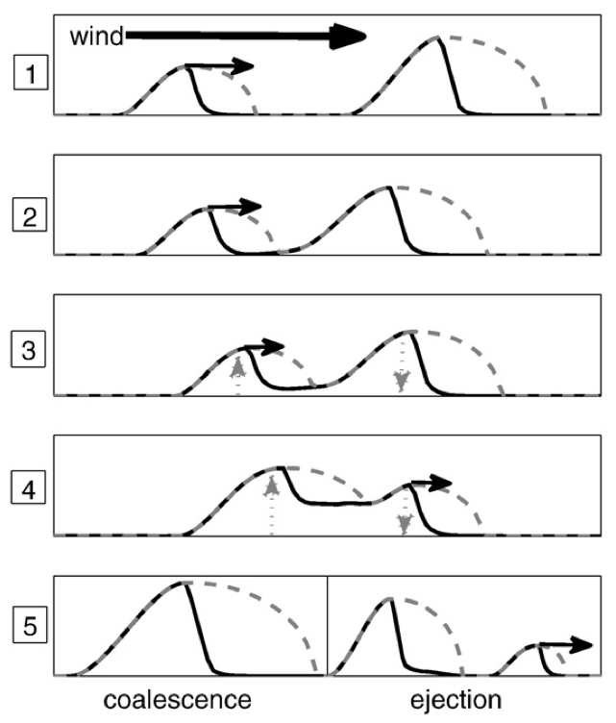
Slow collisions
Dunes have a separation bubble
(zone of zero shear stress)
Smaller dune can approach slowly
Starts to ‘steal’ sand from the larger dune
Dune-size ratio close to 1
Interaction is slow
Upwind dune steals sand until size ratio is reversed
Downwind dune is now faster and escapes
Dune-size ratio far from 1
Interaction is fast
Dunes merge
Diniega et al. 2010

Slide 22
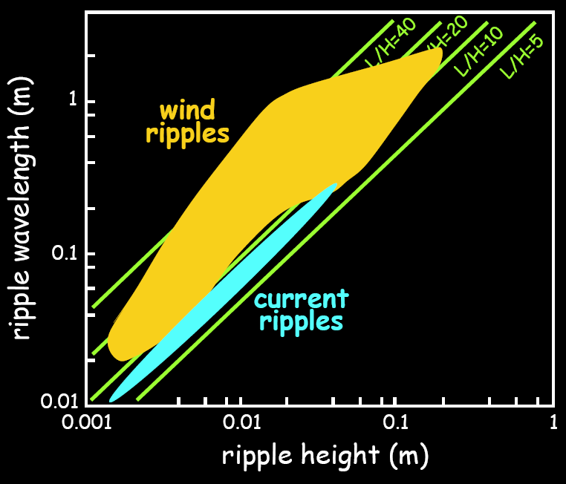
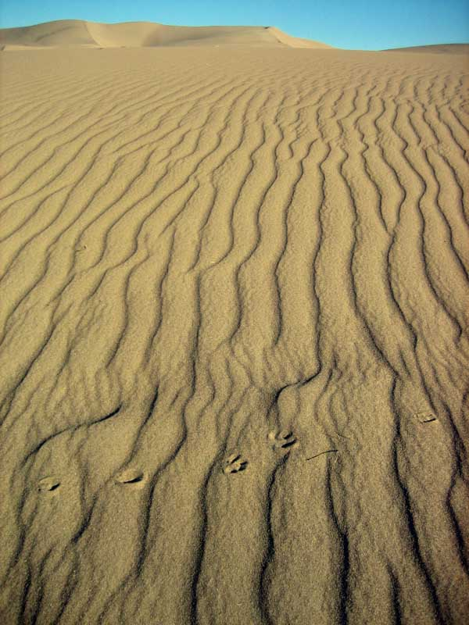
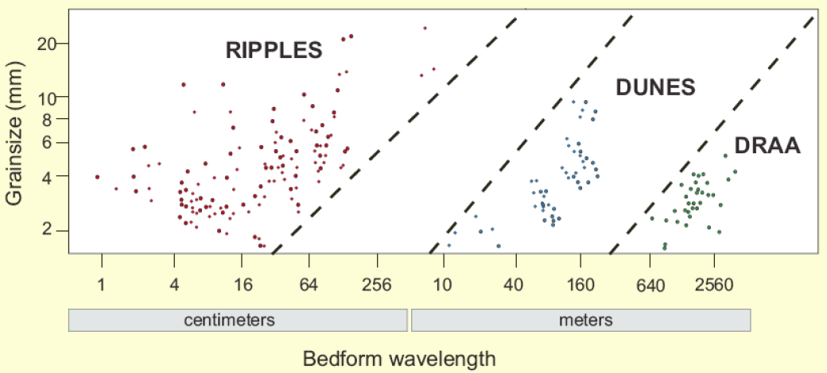
Ripples
Form perpendicular to wind direction
Much more dynamic than dunes
Asymmetric, 8-10 vs 20-30 degree slopes
Separation bubbles, but not slip faces
Wavelengths 0.5cm to 25m (mega-ripples)
Typical wavelengths 7-14cm, heights 0.5-1cm
Ripple index: L / Height, typically ~18
Wavelength related to grain-size
(but also wind speed…)

Slide 23
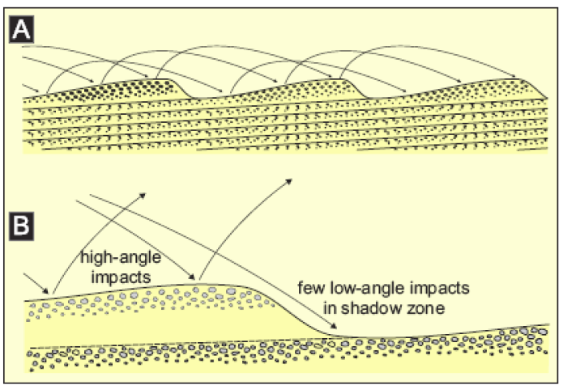
Bagnold again…
Saltation path length ~ wavelength
High angle impacts erode material from Stoss side
Low angle impacts deposit material in shadow zone
Coarse-grained material tends to get concentrated on the crests

Slide 24
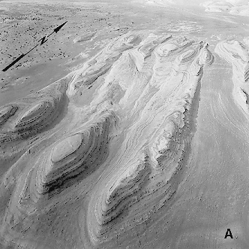
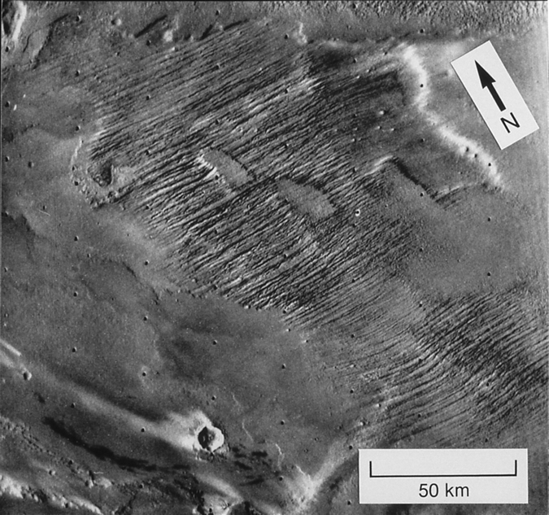
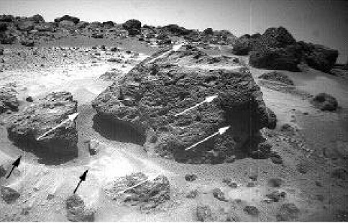
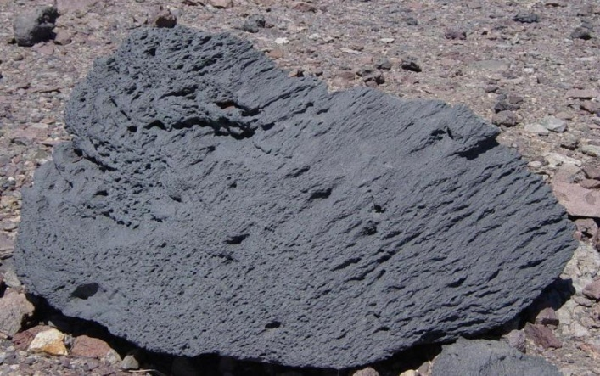
Aeolian Erosion
Yardangs
Wind blown particles abrades surface
Erosion leaves elongated mounds as remnants
Requires strong, virtually unidirectional, wind.
Eroded material must be consolidated
Recentwind action
Older wind action
Ventifacts
Elongated erosional marks on rocks
Usually works on originally circular vesicles
Used as paleo-wind direction indicators e.g. pathfinder landing site

Slide 25
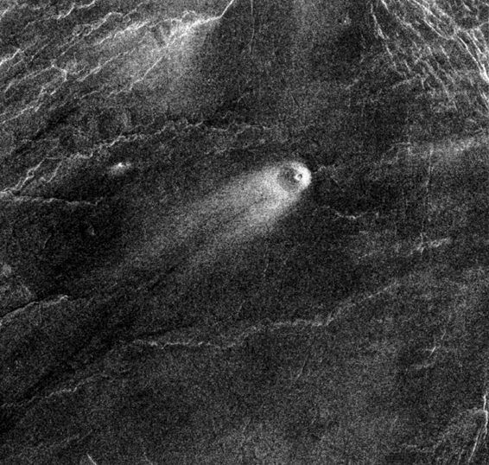
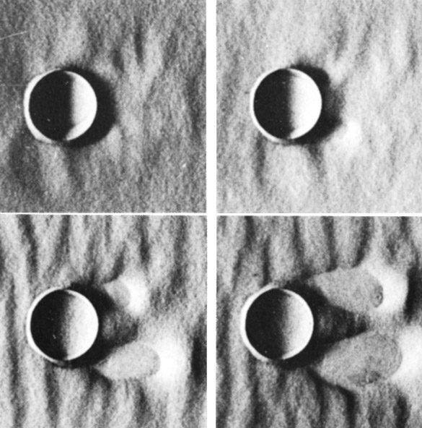
Crater Streaks
Topographic obstacles cause turbulence
Can strip away bright dust
Separation eddy can also form in lee of obstacle
Causes deposition
Venus
Mars
Wind Tunnel

Slide 26
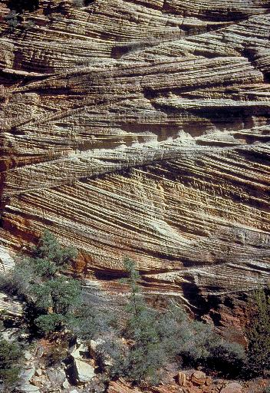
Cross-Bedding
Dunes can be lithified in place, preserving their internal stratigraphy

Slide 27
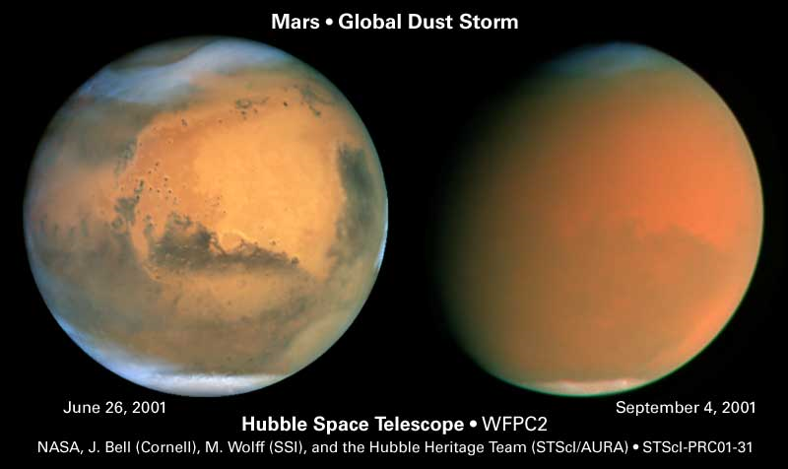
Suspension?

Slide 28
Suspension
All particles eventually settle out of a quiescent atmosphere
Reynolds number quantifies whether an atmosphere is quiescent
Re > 10s means turbulent flow (viscosity doesn’t damp eddies)
High velocity flows are more turbulent
Low viscosity fluids are more turbulent
Consider laminar flow around a falling sphere
Drag from sphere affects air within a cylinder ~2d wide
Downward force from weight – buoyancy
Upward force from viscous drag
Stress ~ viscosity x strain rate
Area affected is curved wall of cylinder
…and ignoring some numerical factors
Equating the two gives the terminal velocity
Stokes’ law
3d
d
d
v

Slide 29
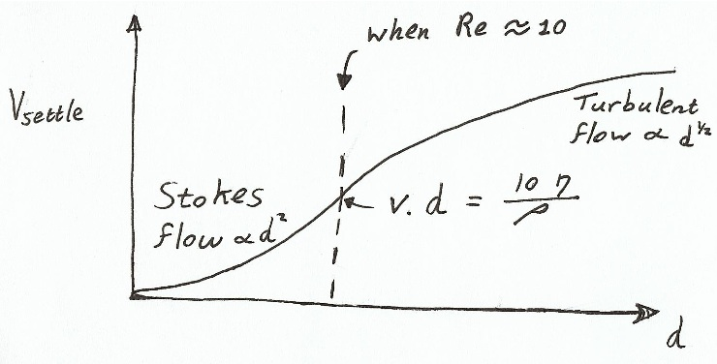
Turbulent flow
As before downward force from weight – buoyancy
Falling particle is opposed by ram pressure
Equating these to find the settling velocity – not very sensitive to particle size
Low pressure
d
High pressure
v

Slide 30
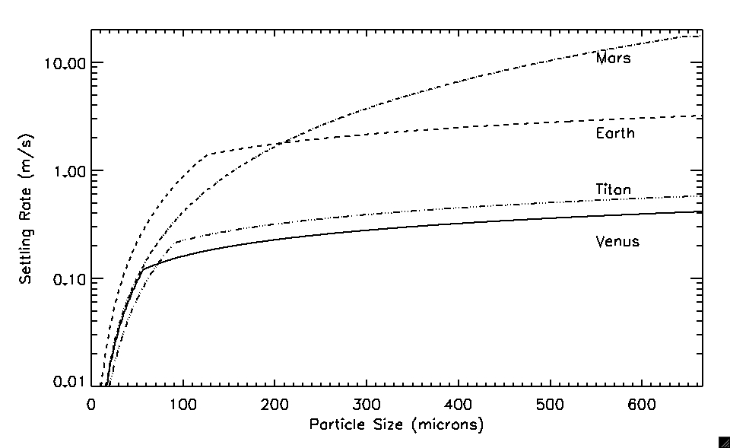
Turbulent eddies have speeds ~0.2 the mean windspeed
For suspension:
For dust sized particles: Mars, Venus and Titan are effective at suspending particles
…but Venus (and Titan?) probably doesn’t have high near-surface winds

Slide 31
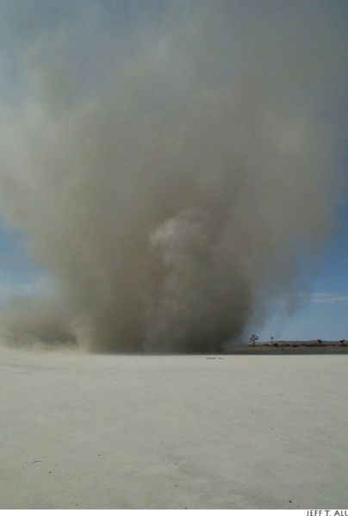
Dust Devils
Plume of hot air rises
Penetrates cooler atmospheric layer
gets stretched out vertically
Conservation of angular momentum starts column spinning
More hot air gets sucked in at the base to keep it self-sustaining

Slide 32
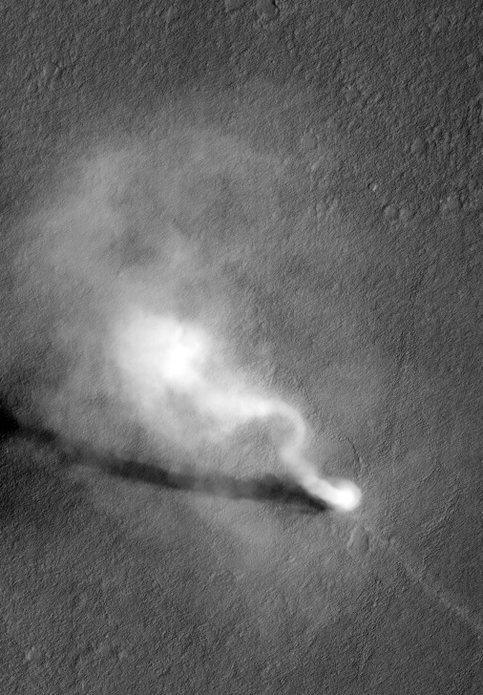
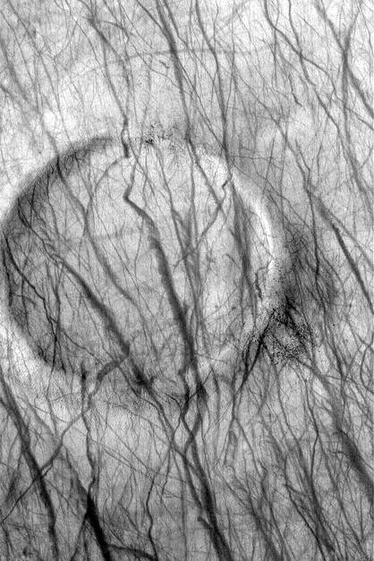
Common in certain areas on Mars
Older streaks fade with time - redeposition of dust
Dust-devil shadows indicate heights of one to several km

