Slide 1
Fluvial Processes

Slide 2
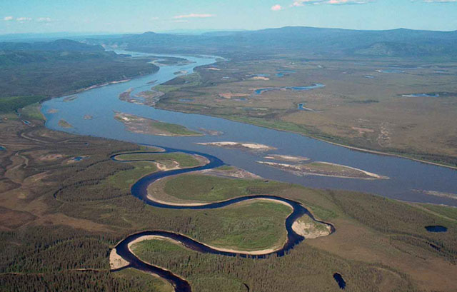
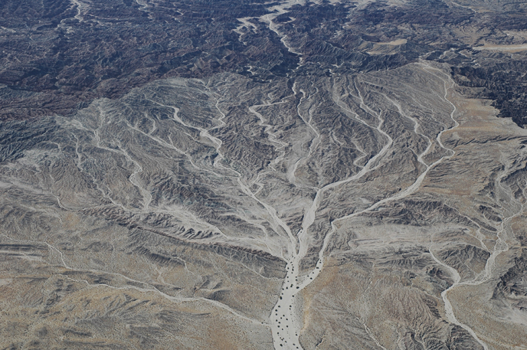
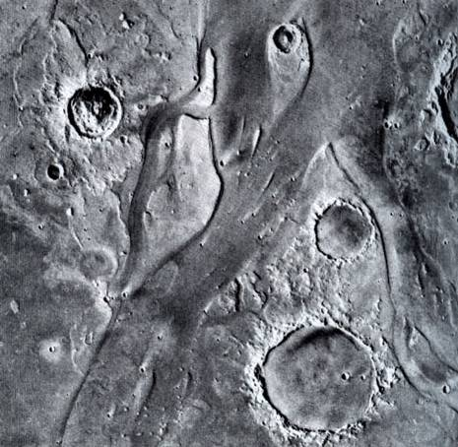
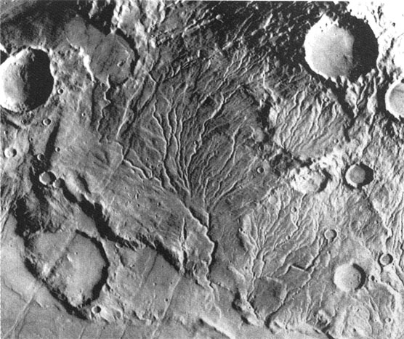
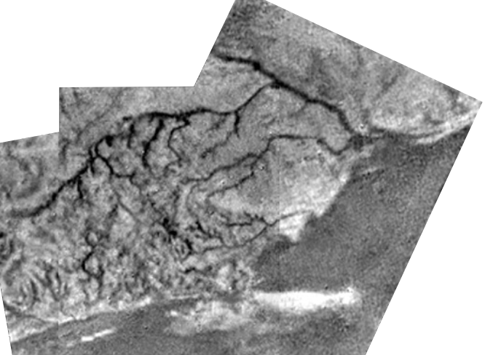
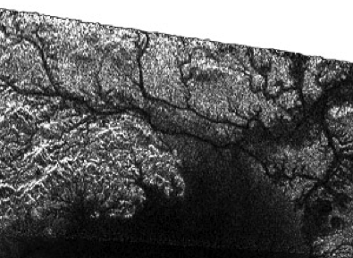
Earth
Liquid = water
Sediment = mostly quartz
Mars
Liquid = water
Sediment = mostly basalt
Titan
Liquid = Methane (mostly)
Sediment = organic stuff
and H₂O ice

Slide 3
Lower gravity
Slower flow
…but easier to transport sediment
Fluid viscosity and density
Affects particle buoyancy and settling velocity
Water can carry bigger particles in suspension

Slide 4
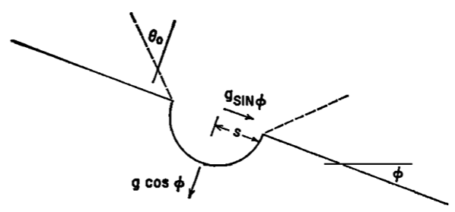
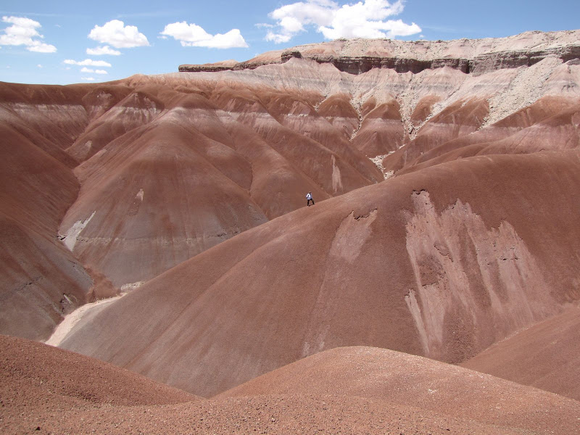
Growth of Drainage Features
Fluvial erosion starts with rainfall
Rainsplash is similar to micrometeorite bombardment
‘Ejecta’ is preferentially transported downslope
Diffusive smoothing where dominant
Channel formation suppressed
Downhill

Slide 5
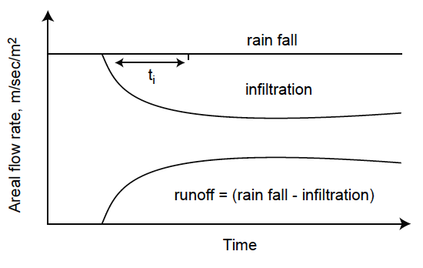
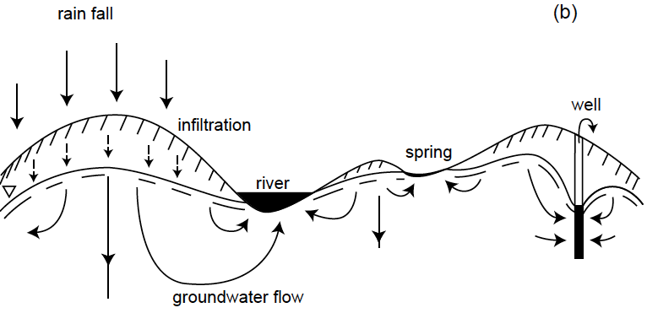
Fluid mostly infiltrates surface
Infiltration rate fast at first until near-surface pores are filled, constant rate thereafter set by permeability
Fluid that doesn’t infiltrate the subsurface can run off
Causes erosion
Surface with high infiltration rates are
very resistant to erosion
Melosh 2011

Slide 6
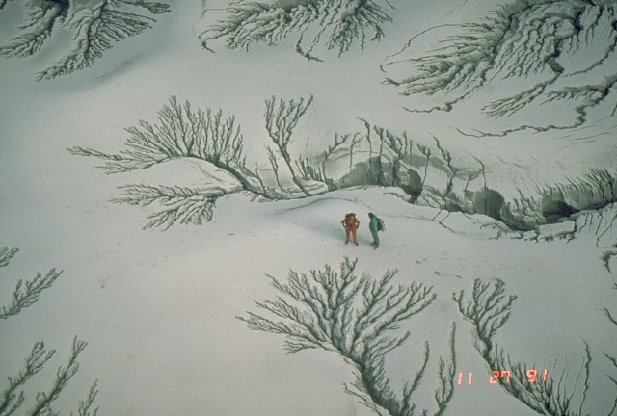
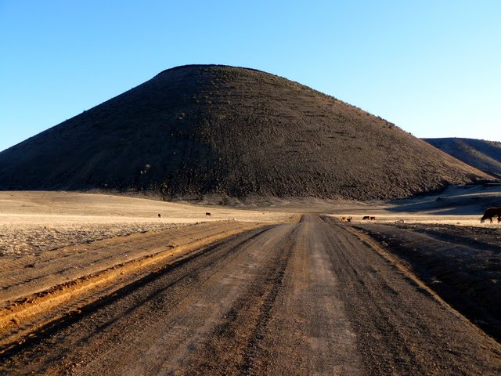
Permeability effects on erosion
Low permeability ash 5 months after eruption
High permeability cinders 50 Kyr after eruption

Slide 7
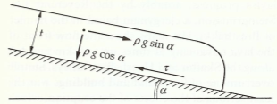
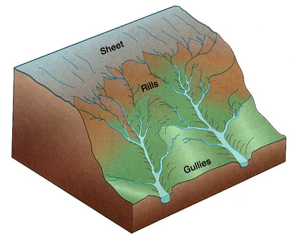
Flow thickness increases with distance from the divide
Shear stress depends on flow thickness
Transport of debris is a threshold process
No channelization where flow is thin
Rainsplash smoothing suppresses rille formation
At some point transition from sheet flow to rille formation

Slide 8
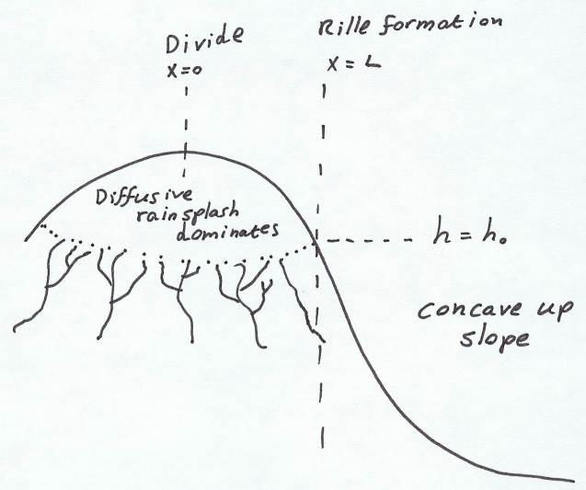
If surface is eroded until stress falls below the threshold…
x is distance from drainage divide
Solving this gives a logarithmic profile
Result is a characteristic terrestrial hillshape
z = z_{o}

Slide 9
Rilles combine to form networks
E.g. Pinatubo ash deposit
Low permeability, high runoff
A wet environment
5 months after the eruption

Slide 10
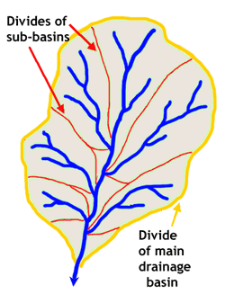
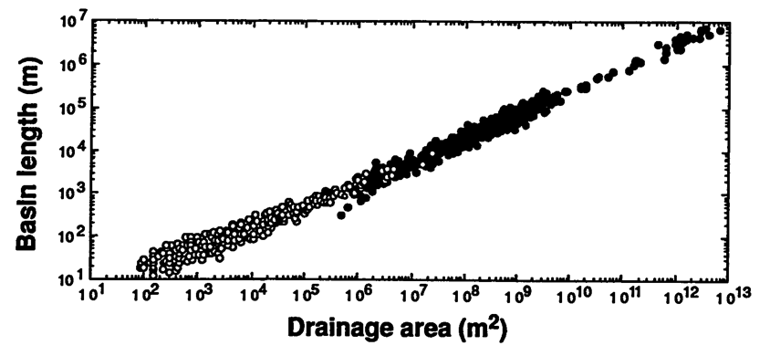
Drainage basins
Range from a few m across to continental in scale
Bounded by divides
Area, length relation
Montgomery and Dietrich 1992

Slide 11
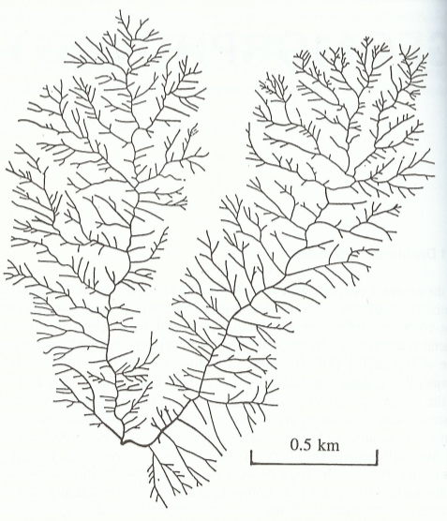
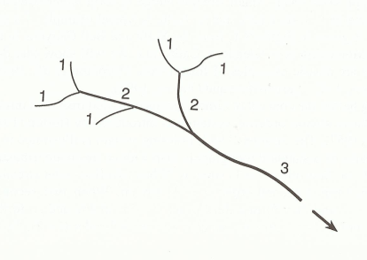
Networks characterized by Strahler number
Stream order
1 – initial rilles
2 – combining 2 order 1 streams
3 – combining 2 order 2 streams etc…
Combining streams of different order gives a stream with the higher order – side branches
Some rivers can by up to 10th order (Mississippi)
The nearby Gila river is 8th order
e.g. fifth order network
Turcotte 1997

Slide 12
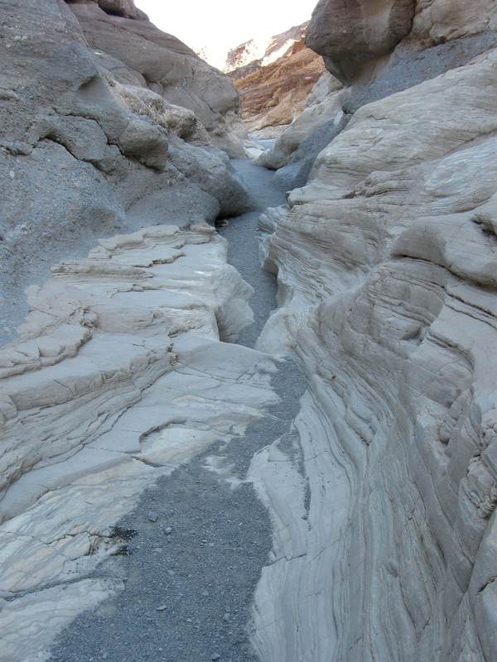
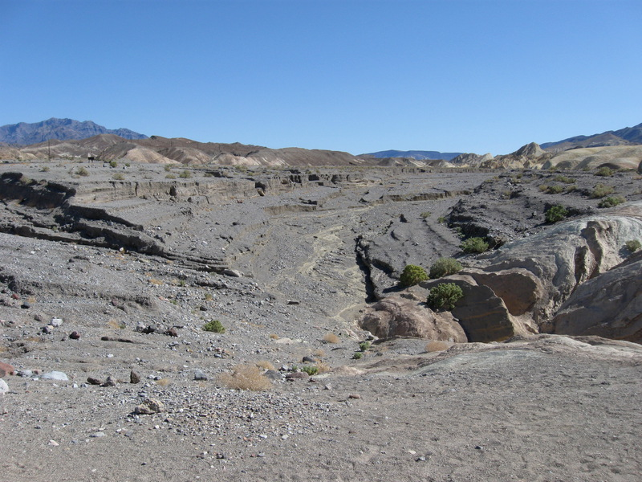
Two types of channel
Bedrock channel – detachment limited
Alluvial channel – transport limited

Slide 13
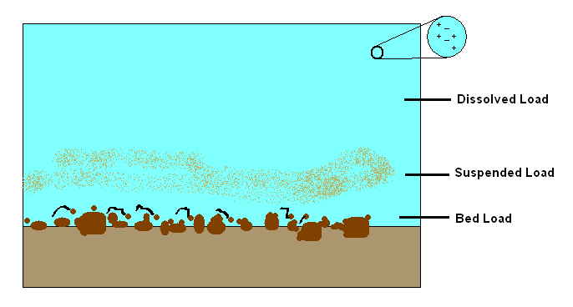
Sediment Transport
Moving material
Bedload – saltating and rolling material
Suspended load
Washload
Very fine particles (essentially part of the fluid)
Washload

Slide 14
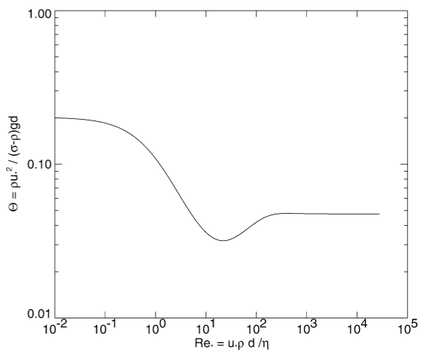
Transport threshold - The Shields curve
Define the shear velocity
Define the boundary Reynolds number
Motion when threshold shear stress is within some factor of the adjusted weight
This factor is the Shields criterion
Function of Rayleigh number
Empirically determined
Burr et al. 2006

Slide 15
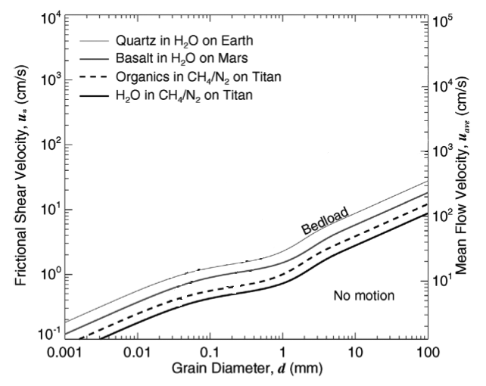
All Re* and θ_{t} values along that line can be converted to u* and d
U* is proportional to u_{ave} (constant depends on bed roughness)
Yields different threshold curves for different material parameters and gravity
Frictional velocities on Earth, Titan and Mars differ by only a factor of ~3
Burr et al. 2006

Slide 16
Sediment flux
Similar to aeolian transport
With a threshold
Dimensionless flux approximated by:
where Β depends on transport stage (T_{s}):
i.e. how far above the threshold you are
θ_{t} is in the range 0.04-0.06 for most flows
Re-dimentionalize q_{*s}
q_{s} is sediment flux per meter of stream width
Burr et al. 2006

Slide 17
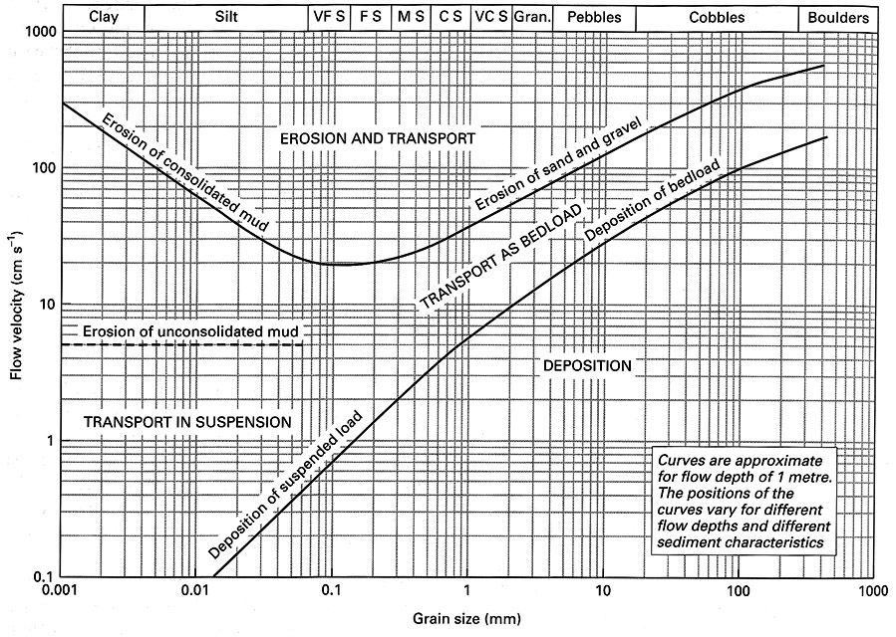
Hjulstrom diagram often used instead
Uses dimensional velocity instead of shear velocity
Curves are different for every depth
Not as flexible as the Shields curve – not easily transferred to other planets

Slide 18
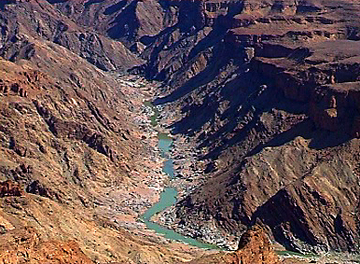
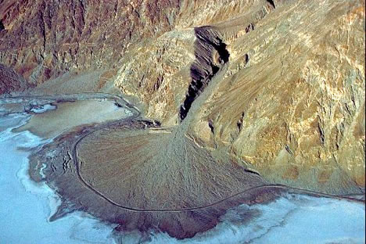
Stream power is a measure of how much sediment a river can carry
P_{s}/w is the unit stream power
or
Reduction in unit stream power can switch erosion to deposition
Increase in w
Decrease in Q

Slide 19
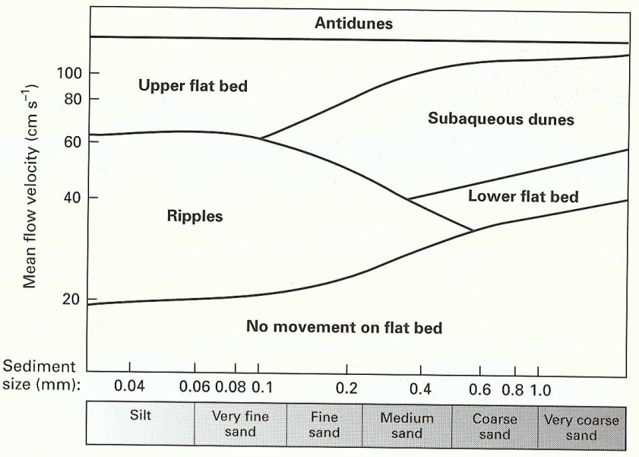
Turbulent flow entraining particles is complex
Adding a deformable bed is even more complex
Antidunes
High-velocity shallow flows
Shallow water wavespeed
Froude number
When Fr approaches 1
Surface wave setup λ~2πh that propagates upstream
Wave causes varying shear stress that causes variable bed erosion
Upstream propagating bedforms oversteepen and break

Slide 20
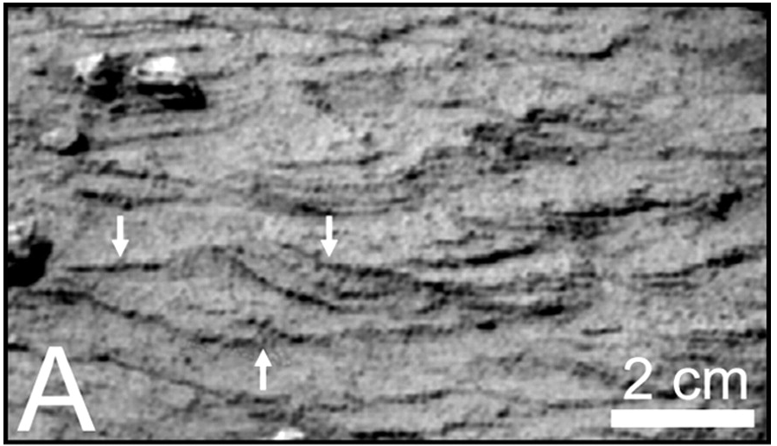
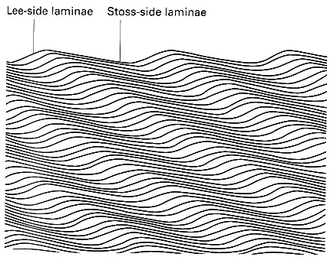
MER discoveries of festoon cross-bedding indicates beds deposited by flowing water
Estimated flow speeds of ~0.5 m/s
Grotzinger et al. 2006

Slide 21
Bedrock Erosion
Proceeds by:
Abrasion from suspended sediment
Plucking
Cavitation
Bedrock abrasion on Titan
Roughly as easy to do as on Earth
Various properties of the two bodies and materials involved cancel
Abrasion of water ice is easier
Lower kinetic energy on Titan
Big question is how much run-off there is and the nature of the debris
Bedrock stream erosion on Mars
Harder than Earth – lower kinetic energy
Equally hard rocks

Slide 22
Flow velocities and discharges
Open channel flow described by the manning equation:
R_{h} is the hydraulic radius
Flow-cross-section / Wet-perimeter
i.e. for a rectangular trough
When w>>h then R_{h} ~ h
S is the dimensionless gradient (m/m)
n is the Manning coefficient of roughness
Varies from:
~0.02 – smooth beds and straight plans
to
~0.08 – rough beds and sinuous plans
n is determined empirically
Empirically ‘discovered’ in 19th century by averaging a bunch of pre-existing flow laws
Problem is that ‘n’ has dimensions – can’t be generalized to other planets
Chezy’s law has the same problem:
w
h

Slide 23
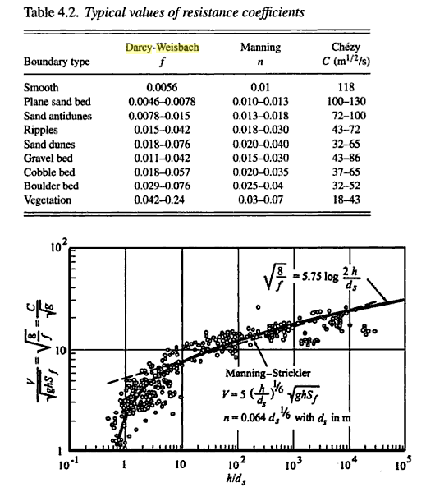
Darcy-Weisbach law
Balance shear stress with friction
Downhill force per unit length
Friction with walls in terms of mean velocity:
i.e.
Flow velocity is:
Discharge is:
When w >> h then
Empirical relations that relate f_{c} to
Grain-size of bed material
Hydraulic radius (usually flow depth)
w
h
Compare to eolian flow, law of the wall
Julien et al. 2006

Slide 24
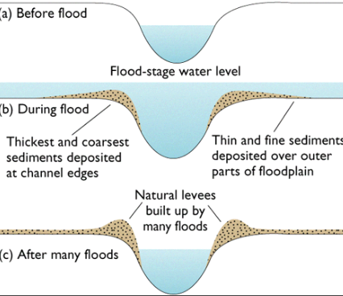
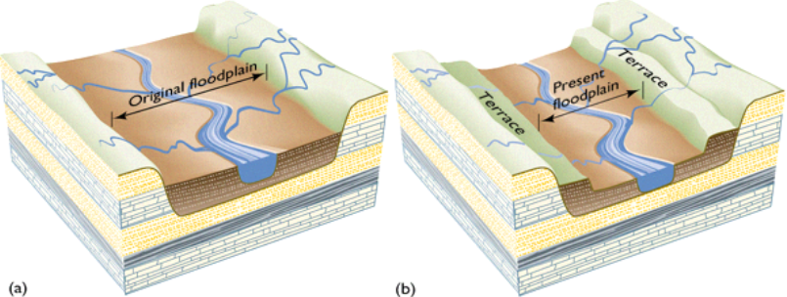
Mature rivers slow down and deposit material
Levees and floodplains
Terraced floodplains
Tectonic change in landscape height
Decreases in sediment load
Increasing discharge

Slide 25
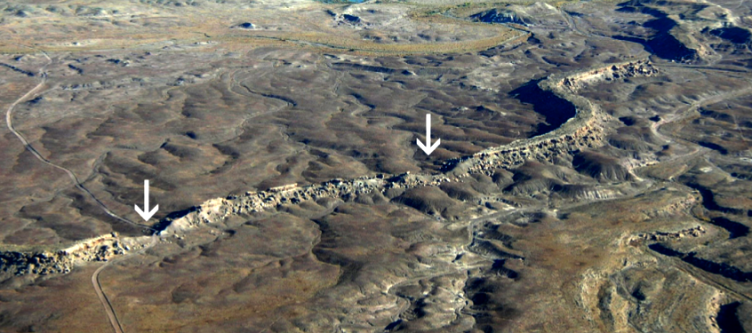
Inverted relief
Channels contain coarser grained material than floodplains
Coarser material is more resistant to erosion and remains as a ridge
Burr et al. 2009

Slide 26
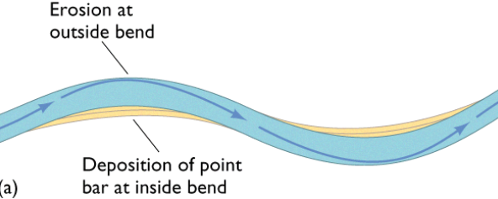
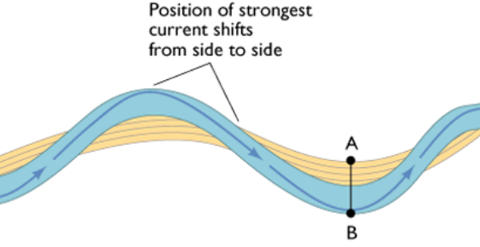
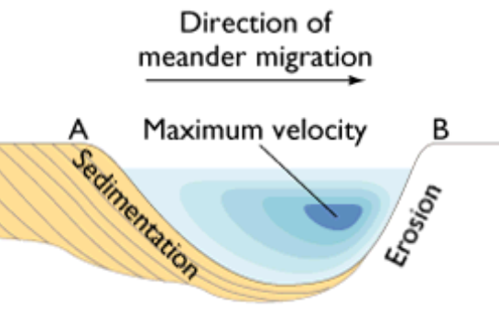
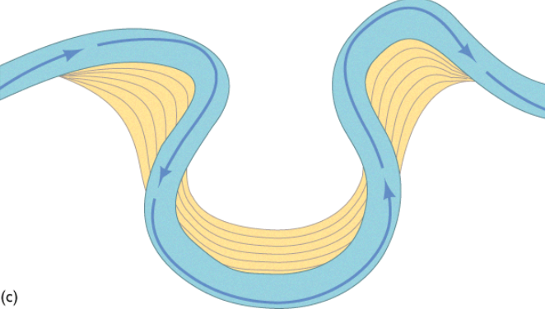
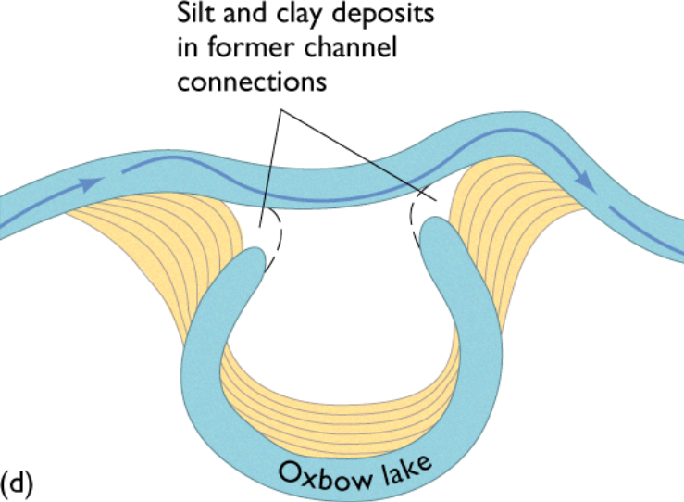
Meanders
Water channel migrates by erosion of one bank and deposition on the other
Faster water on the outside bank
Scroll-bars from sedimentation on inner bank
Friction with wall leads to helical flow
Fastest velocity not on outer edge
Press and Siever 1998

Slide 27
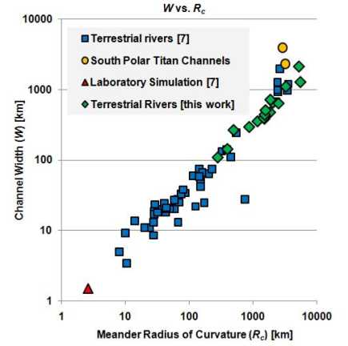
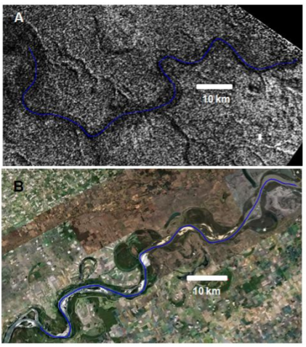
Meander wavelength and radius of curvature
Width of river related to meander radius of curvature
Titan
Earth
Malaska et al. 2011

Slide 28
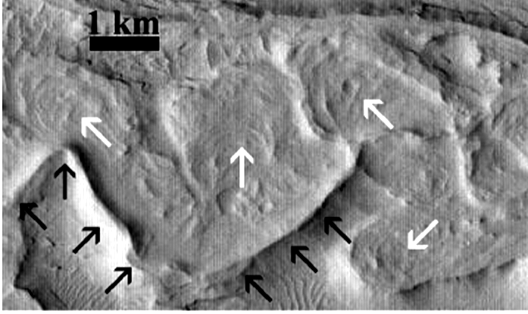
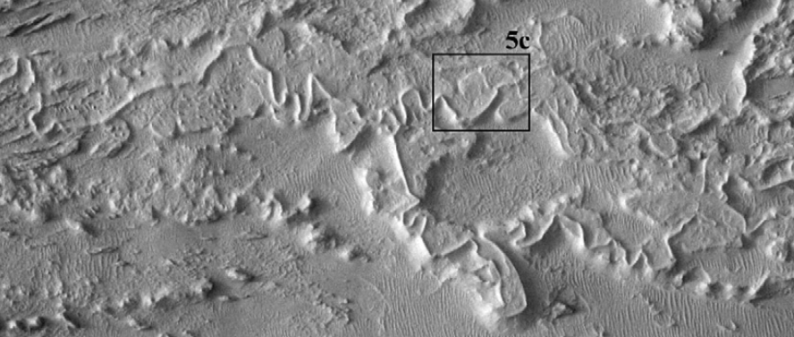
Martian meanders
Including scroll bars
Burr et al. 2009

Slide 29
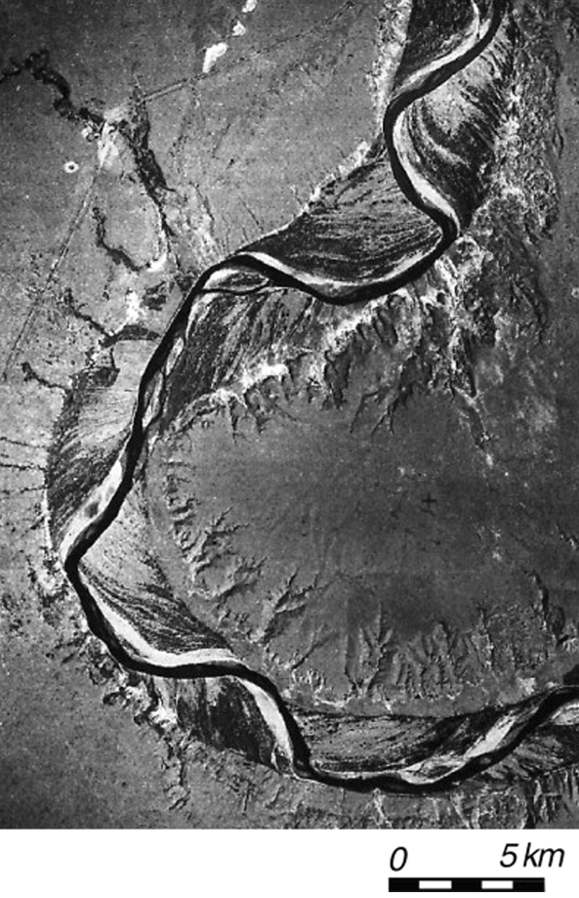
Underfit rivers have two meander wavelengths superposed
Shorter one is present-day
Likely due to change in river discharge (width) with climate
Posamentier 2001

Slide 30
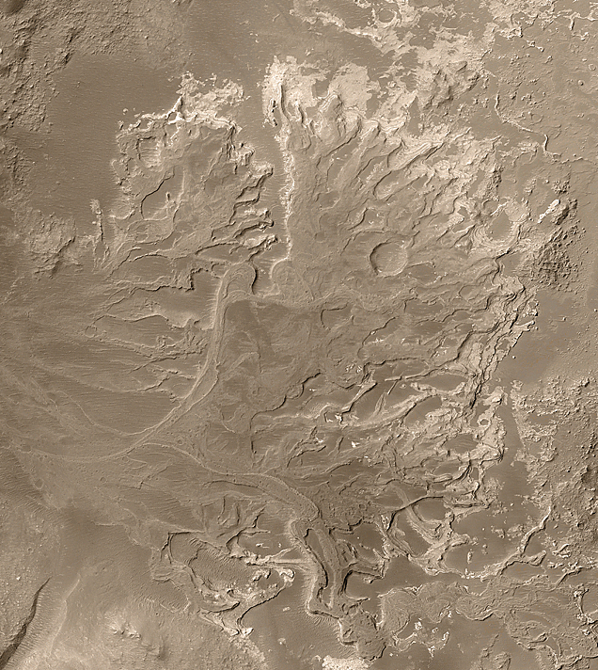
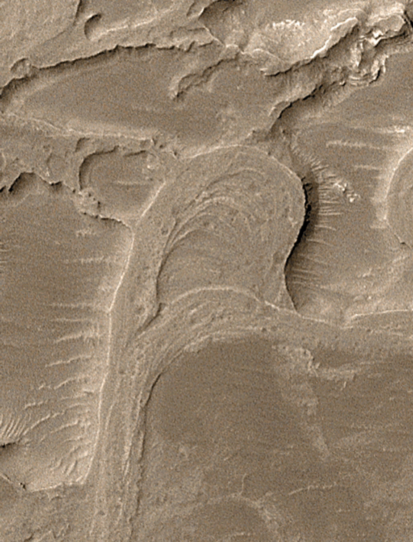
Meander with Scrollbars
msss.com

Slide 31
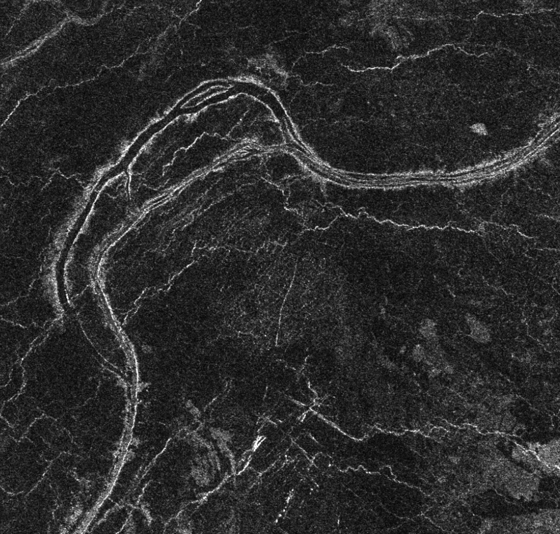
Meanders of lava channels on Venus ?
Melosh 2011

