Slide 1
Glacial and Periglacial Processes

Slide 2
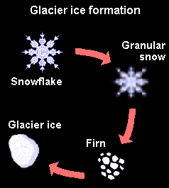
Ice Grain Growth
On the Earth the snow to ice conversion timescale is of order years
On Mars water ice is vapor deposited
Very little porosity
Modeling suggests grain-growth over 1000’s of years
Very dependant on thermal history
Micron sized grains
mm sized grains
Langevin et al., 2005

Slide 3
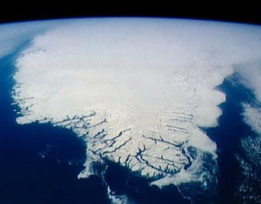
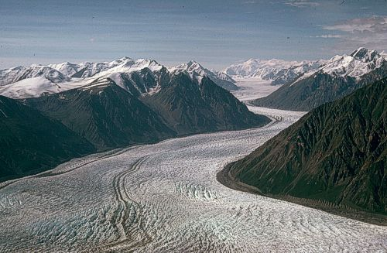
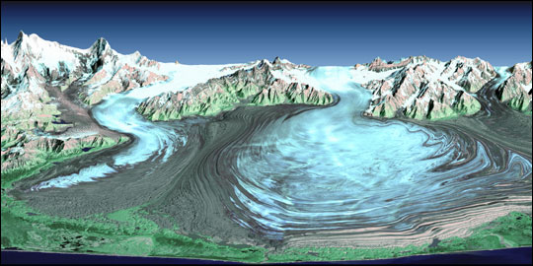
Three (more like 2.5) main types of glacial ice to consider
Ice sheets
>50,000 km²
Valley glaciers
Piedmont glaciers
Small valley-fed ice sheets

Slide 4
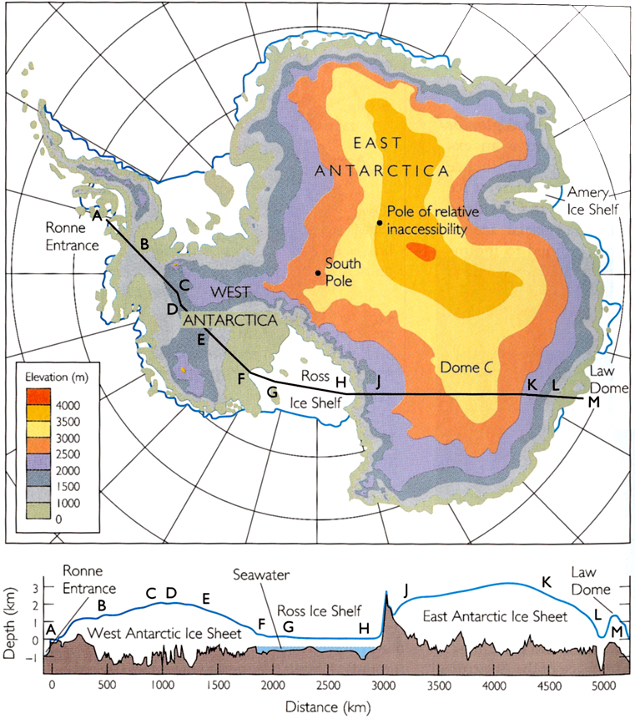
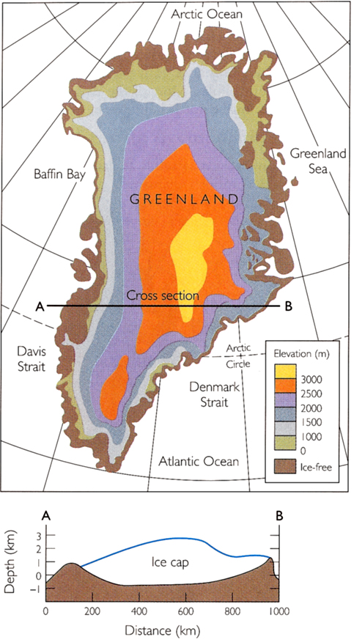
Big ice sheets of the inner solar system – Earth
30 million km³
6 million km³

Slide 5
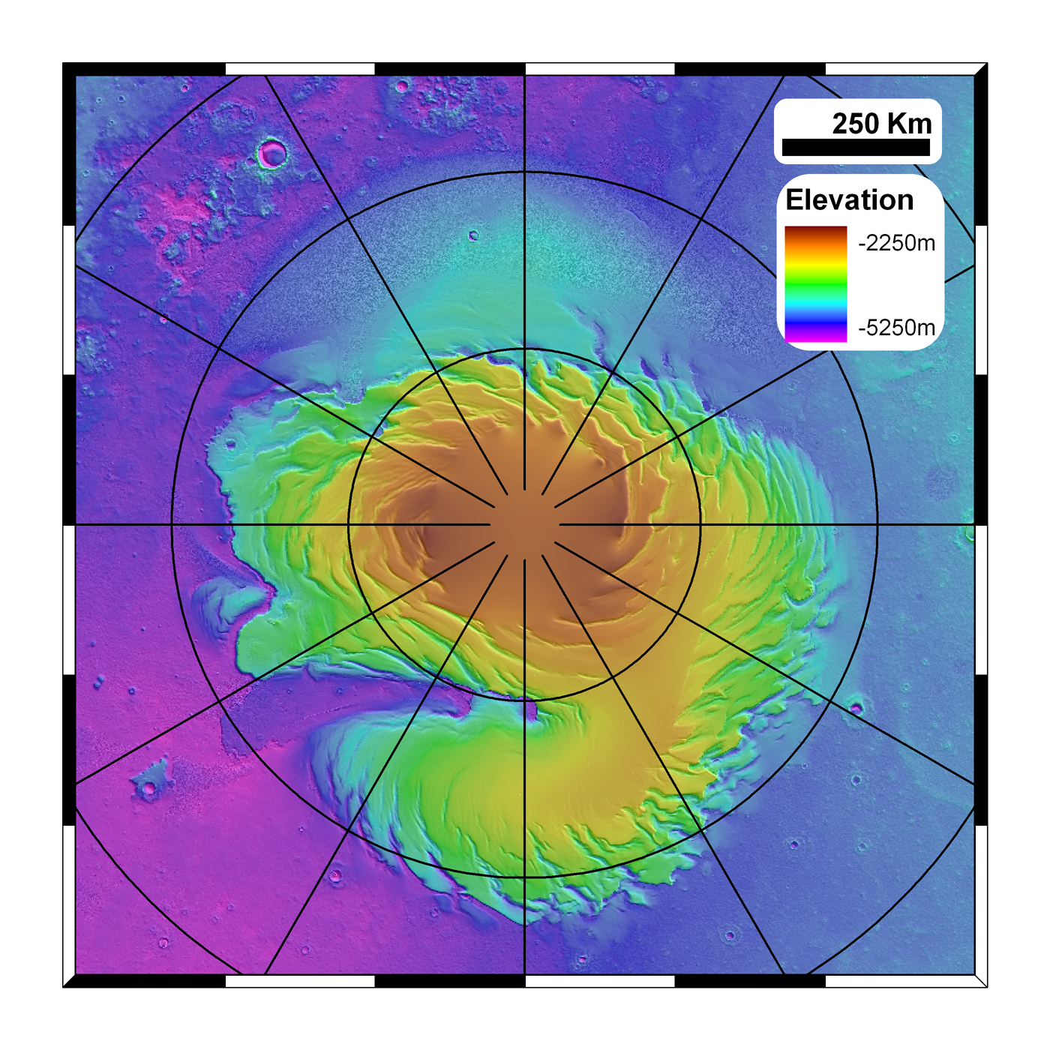
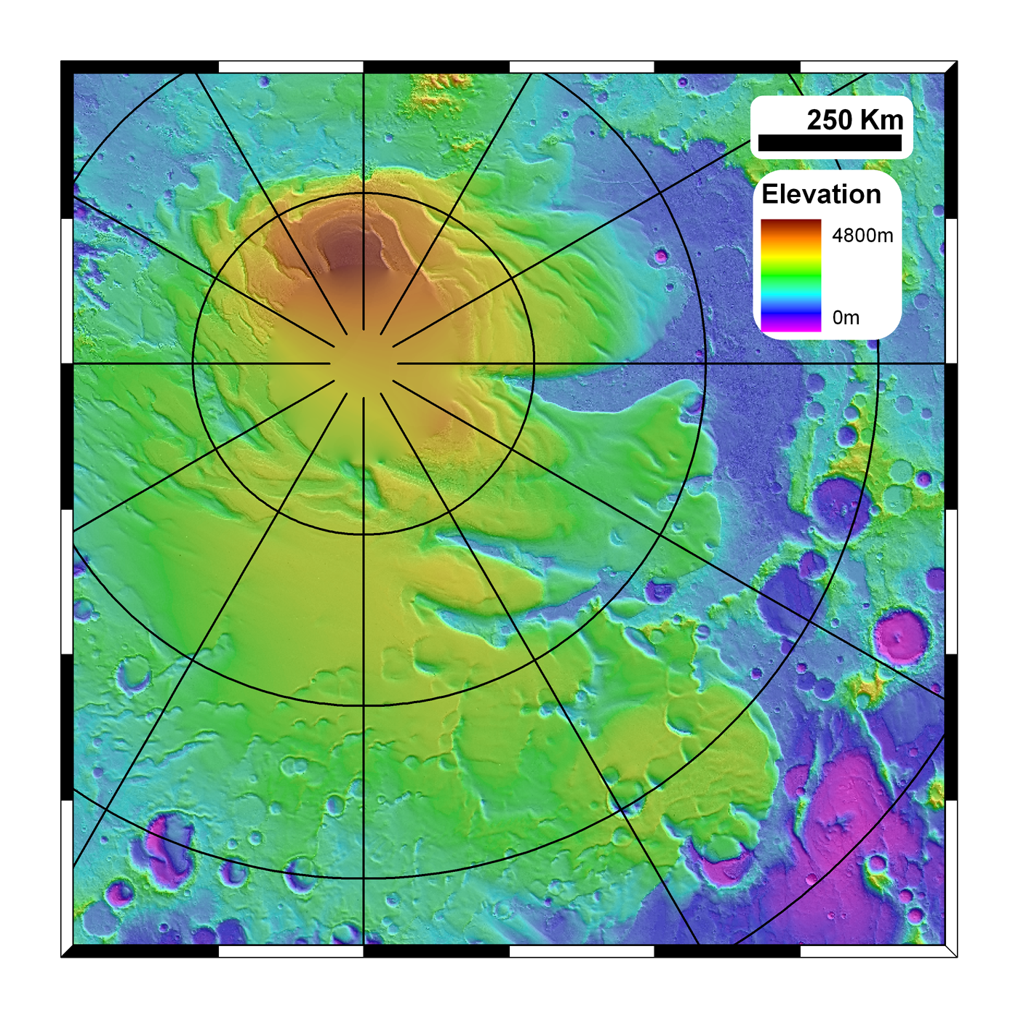
Big ice sheets of the inner solar system – Mars
About 20% of the size of the Greenland ice-sheet
1.1 million km³
1.2 million km³

Slide 6
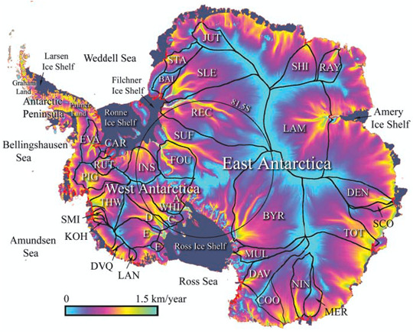
Like fluvial systems, ice flows have drainage divides

Slide 7
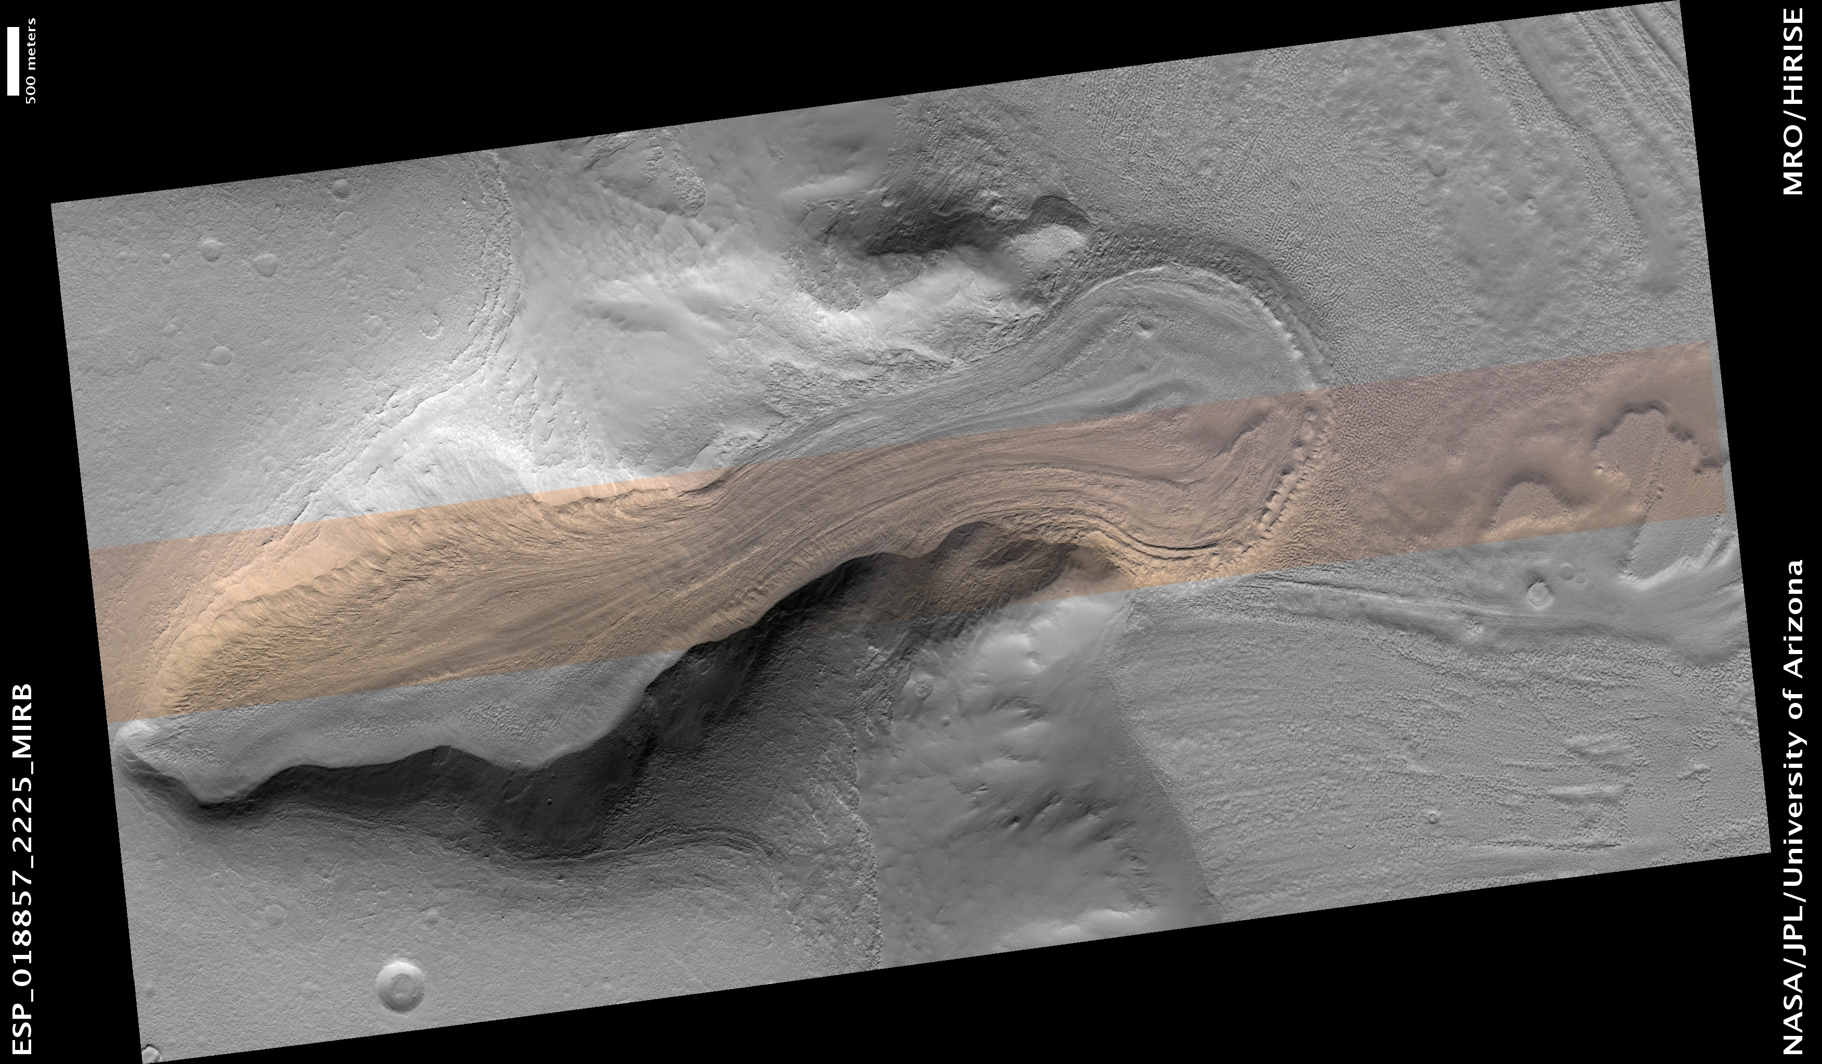

Slide 8
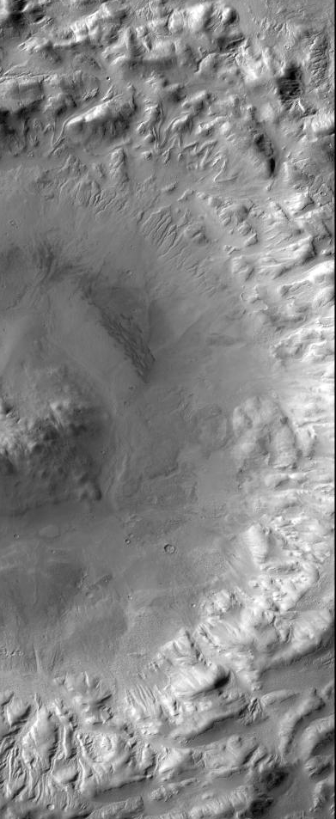
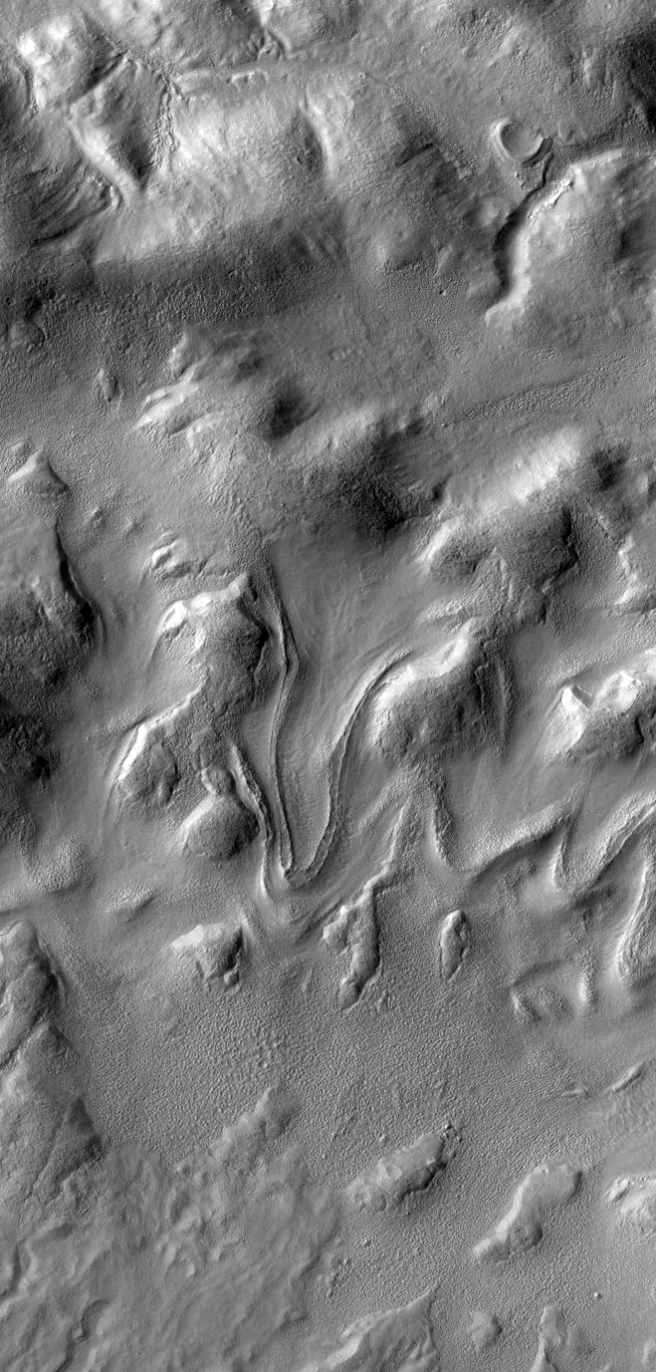

Slide 9
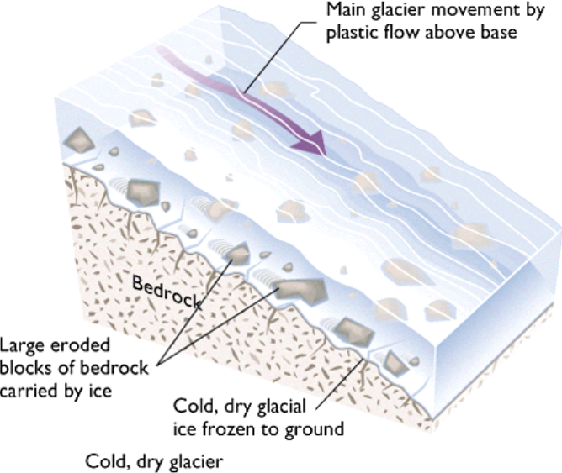
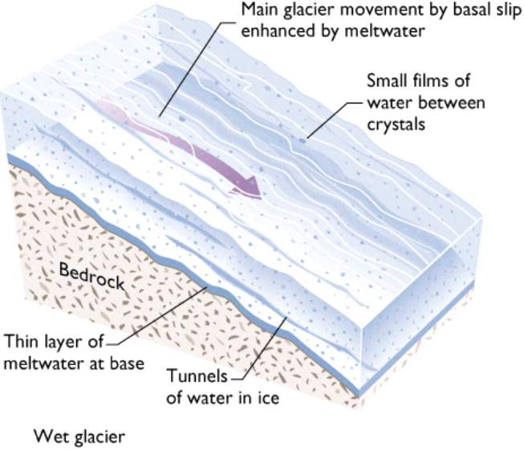
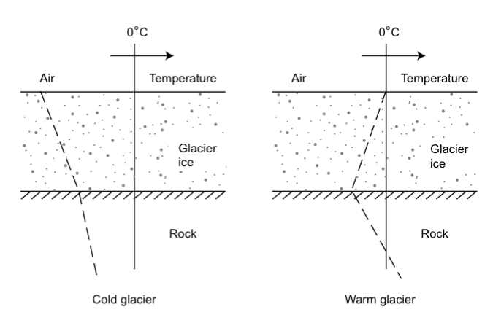
Glaciers are also divided into warm and cold-based
Cold-based glaciers
Below the freezing point everywhere
Heat conducted upwards
Frozen to base (no slip)
Moves only by internal deformation
Warm-based glaciers
At the melting point everywhere
Heat conducted towards the base from both directions
Liquid water layer forms at the bottom
Moves by internal deformation and basal sliding (~ 50:50)
Press and Siever
Melosh 2011

Slide 10
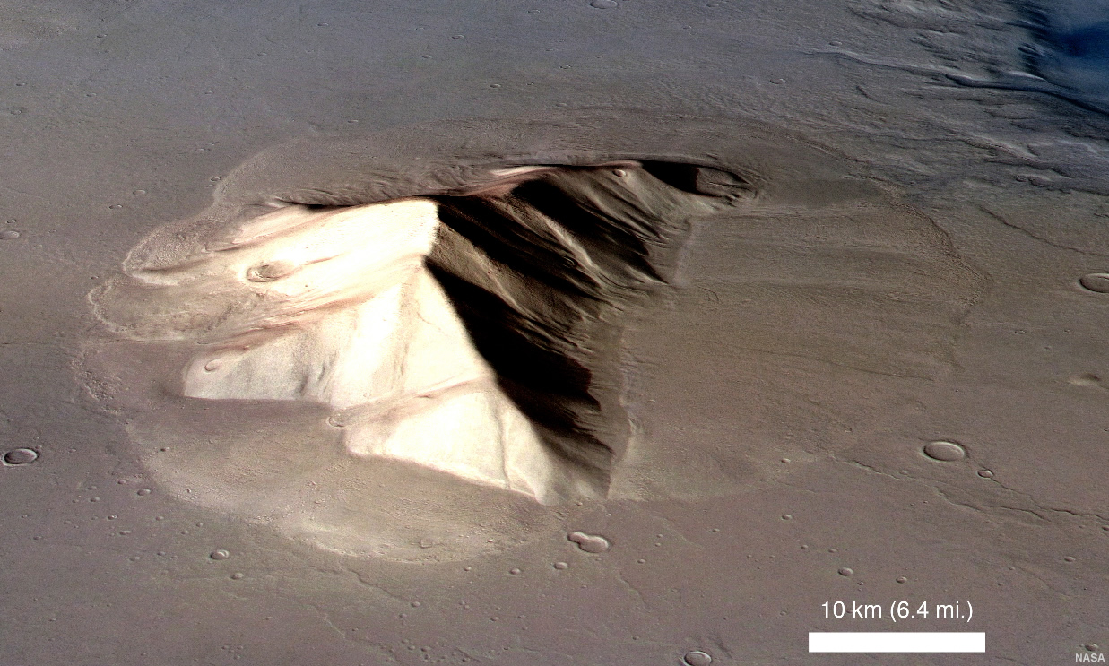
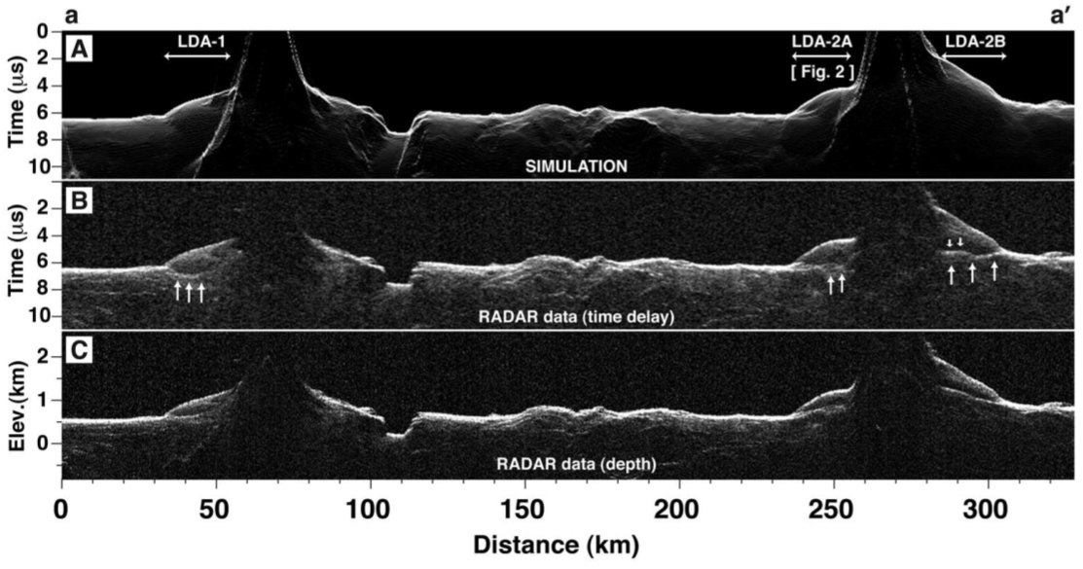
Lobate ‘debris’ aprons
Now known to be almost pure ice
Holt et al., 2008

Slide 11
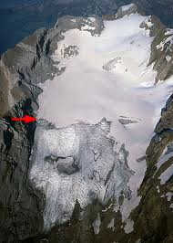
Most terrestrial glaciers and ice sheets have an equilibrium line
Caused by increased snowfall at higher elevations
Martian glaciers won’t have this
More likely to have uniform accumulation
(or none at all)
Accumulation pattern leads to vertical velocities for particles
Burial above the snowline – particle moves deeper
Sublimation/melting below the snowline – particle moves shallower
Upturned layers considered diagnostic of flow

Slide 12
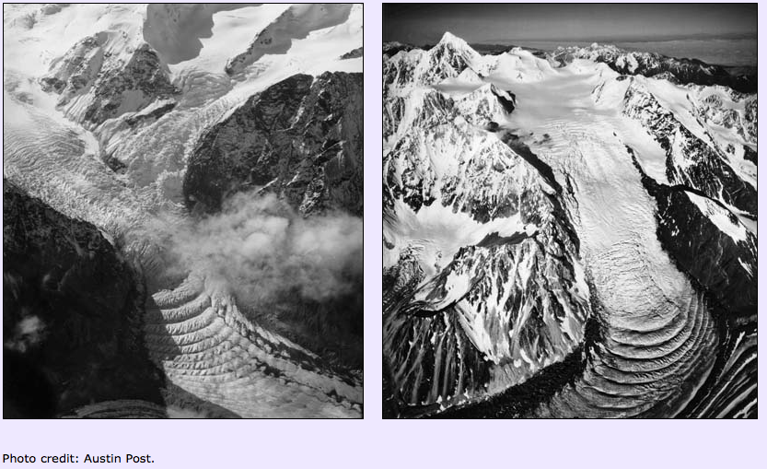
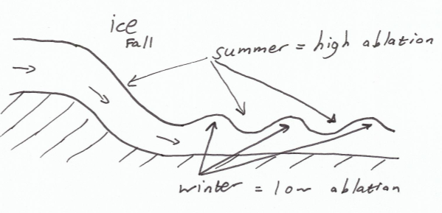
Ogives are regular swales that develop in the wake of ice falls
Annual summer/winter cycle in ablation on steep ice fall
Wavelength / year = velocity

Slide 13
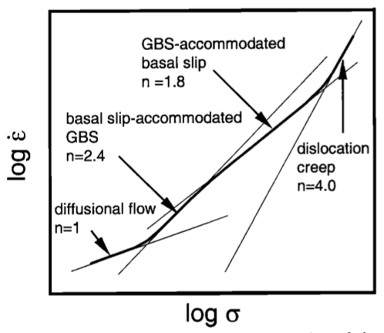
Crystalline substances near their melting points don’t behave elastically
Flow in response to applied stress
Glen’s flow law
Glen found n ~3, but reality is more complex
The prefactor ‘A’ depends on
Temperature (T)
Pressure (P)
Grain size (d) to some power (p)
Activation energy and volume (E* and V*)
And stuff we don’t understand yet (A_{o})…
E.g. crystal orientation, enhancement factors etc…
Different physical mechanisms apply under
different stresses
n, p and E* vary between mechanisms

Slide 14
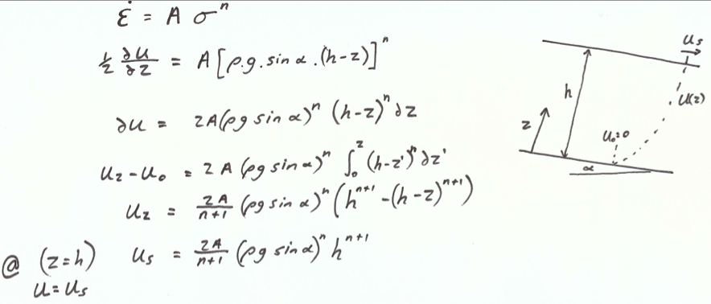
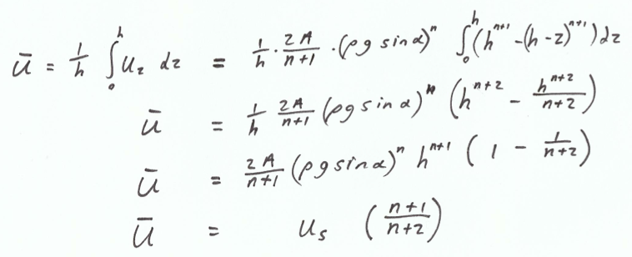
Surface velocity of flowing ice sheet
Mean velocity

Slide 15
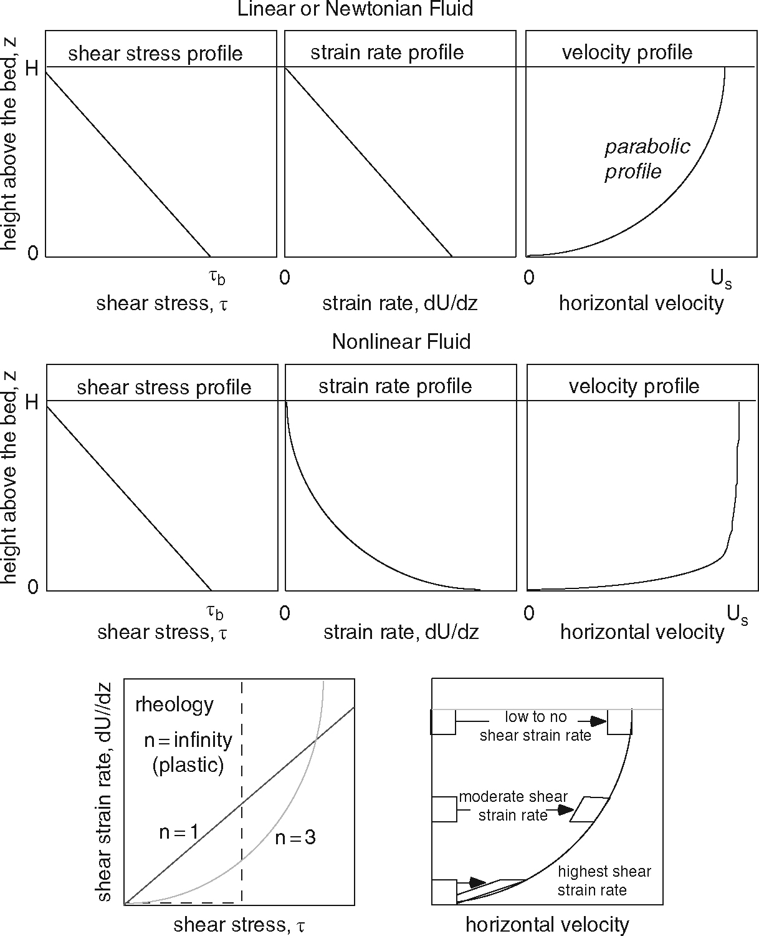
Perfectly plastic
A single ‘yield’ stress decides whether there’s motion
i.e. movement or no movement
Works when n is large
This is close to ice behavior
Yield stress ~ 0.1 Mpa

Slide 16
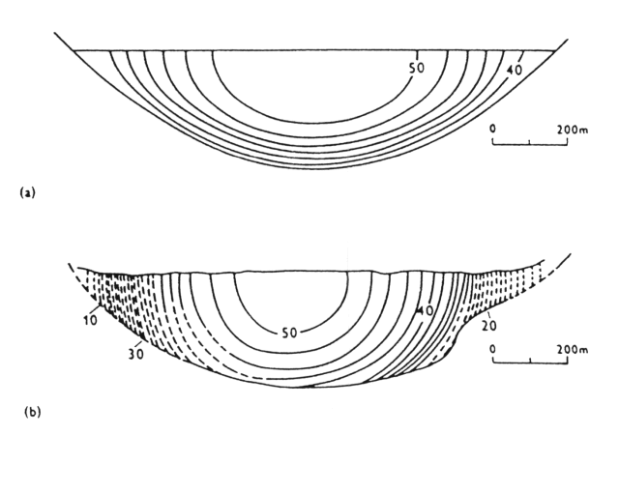
Flow in a valley glacier
Friction with walls as well as floor
Velocity is a maximum on the surface at the center line
Calculation
Observations of Athabasca glacier

Slide 17
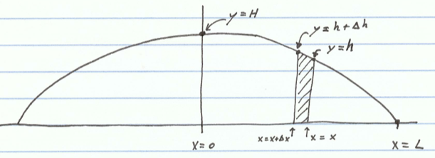
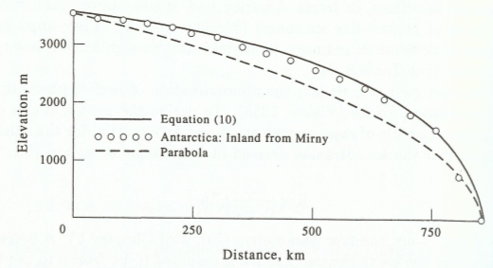
Perfectly plastic behavior predicts ice cap shapes… kind of
Shape set by a yield stress works the same way a lava flow front (Bingham rheology)
When non-plastic behavior is taken into account and a uniform accumulation rate is used
Same as above when n becomes infinite
…but using this you can figure out what n is.

Slide 18
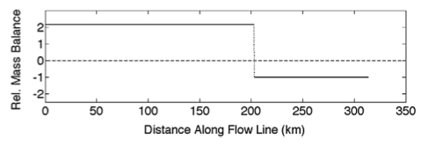
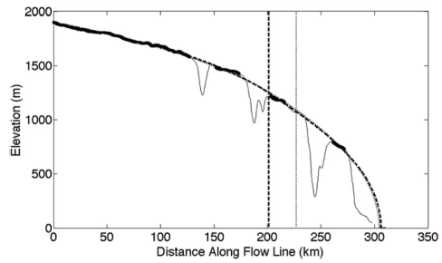
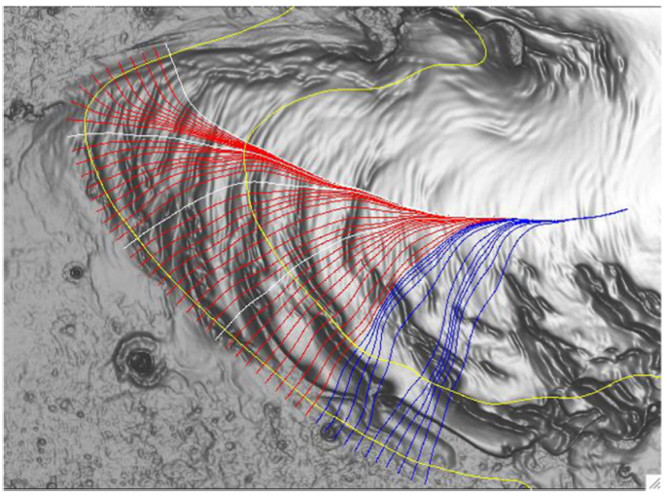
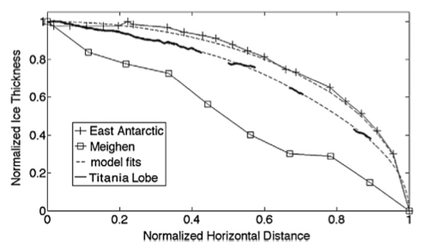
Martian ice cap approaches the same behavior
Shape appears consistent with flowing ice with an equilibrium line
Fits indicate n= 3-4
Ice flow thought unlikely for other reasons though
Winebrenner et al. 2008

Slide 19
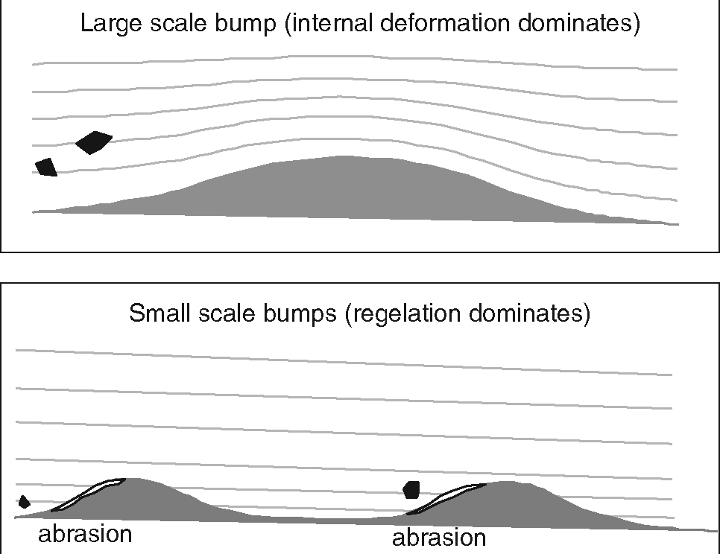
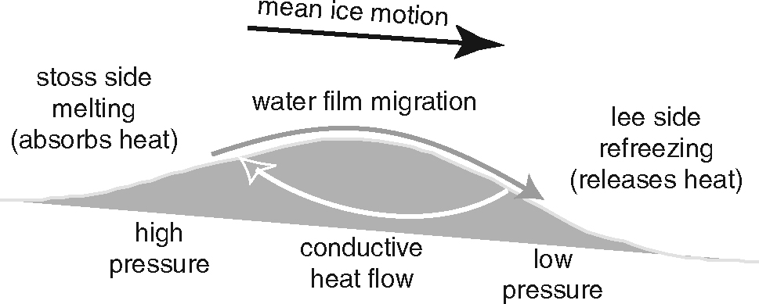
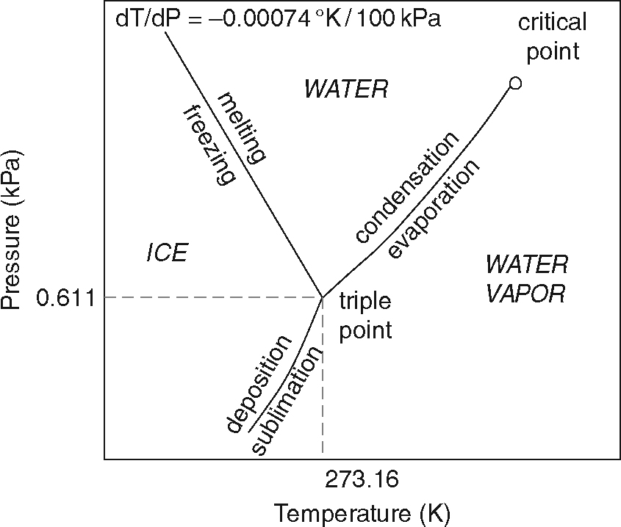
Ice diverts around large obstacles
Regelation
Pressure induced melting
Flow around small obstacles
Heat conduction to melting front limits the size of obstacle this works for
Obstacles ~1m across are the hardest to circumvent – sets basal friction

Slide 20
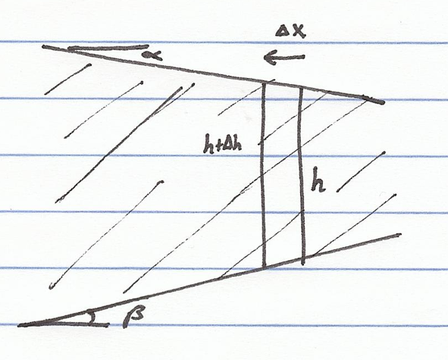
Ice flows with the surface slope… even if that means going uphill
i.e. only the surface slope matters

Slide 21
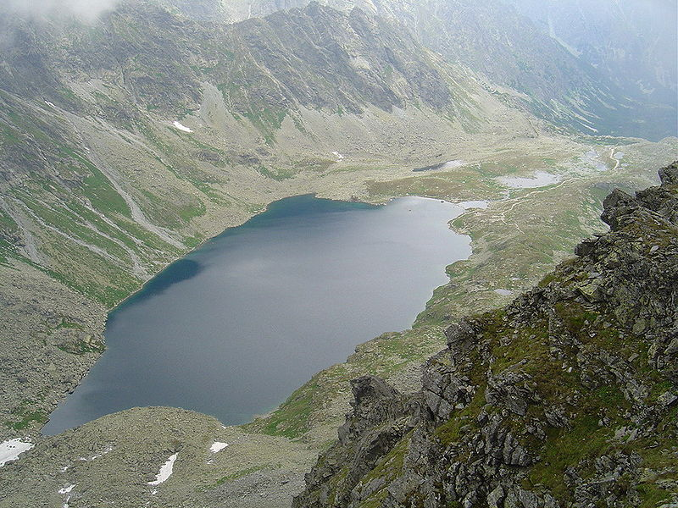
Previous uphill glacial flow can be seen as lakes in glacially carved valleys
Such lakes are called tarns

Slide 22
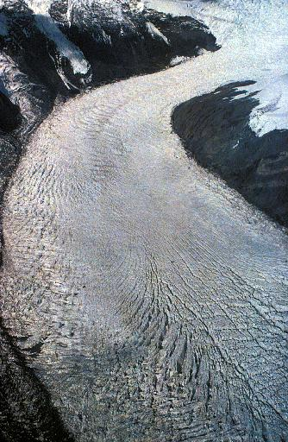
Velocity differences across the surface of the glacier produce crevasses
Shear stress produced by the walls
Equivalent to extensional and compressional stresses orientated 45° to that
Tension produces crevasse at an angle to the valley walls pointing upstream
Crevasses later get rotated by differential flow
Maximum depths of ~25m
Flow from left to right

Slide 23
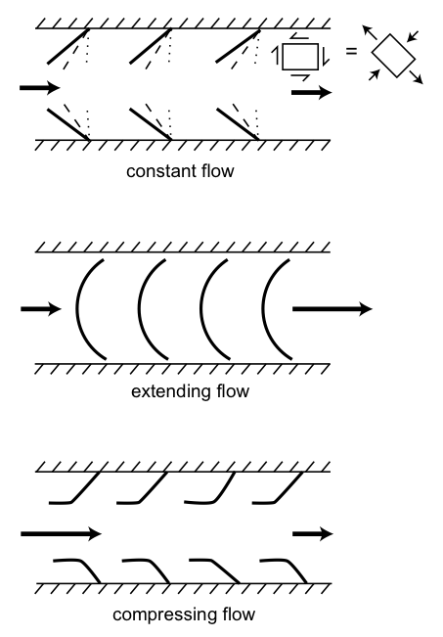
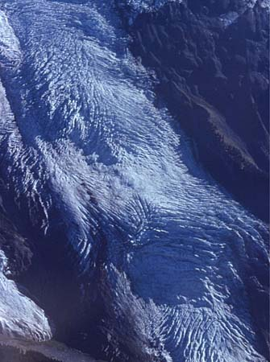
A: steady flow
B: Accelerating flow
C: Decelerating flow
Melosh 2011

Slide 24
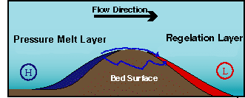
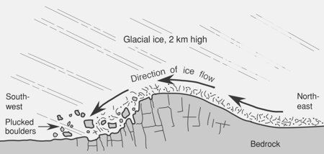
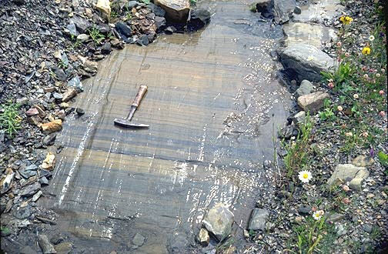
Plucking and polishing – glaciers on rock
Freezing during regelation can incorporate loose debris
Pressure difference between upstream and downstream sides of the obstacle results it it being ‘plucked’ out of the bed
Debris can ‘polish’ rocks smooth

Slide 25
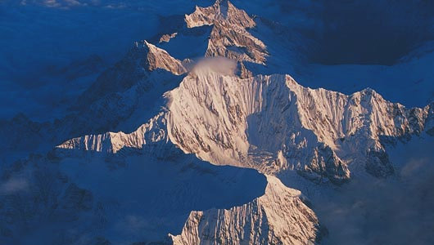
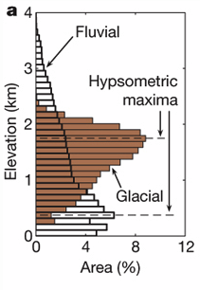
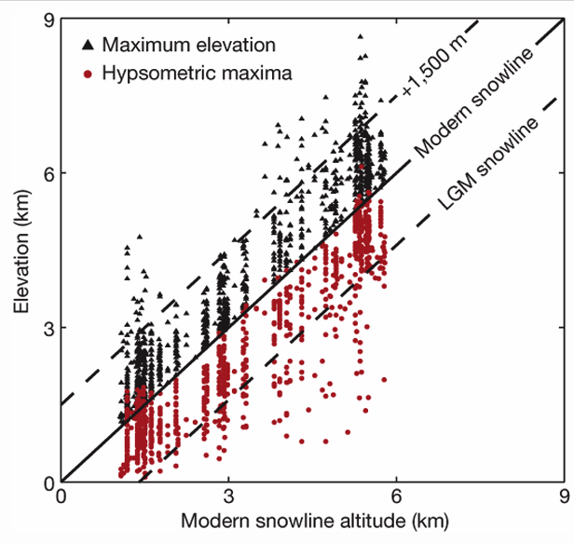
Glacial control of Topography
The glacial buzzsaw
Earth’s high-altitude topography controlled by glaciers
High-latitude mountains are smaller
Mountain peak elevation correlate with snowline elevation
Egholm et al. 2009

Slide 26
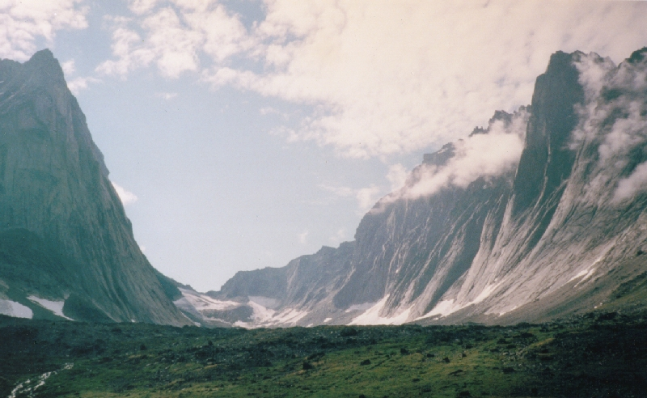
Fluvial V-shaped valleys get eroded into glacial U-shaped valleys
Hanging tributaries
Flat floors
Steep walls

Slide 27
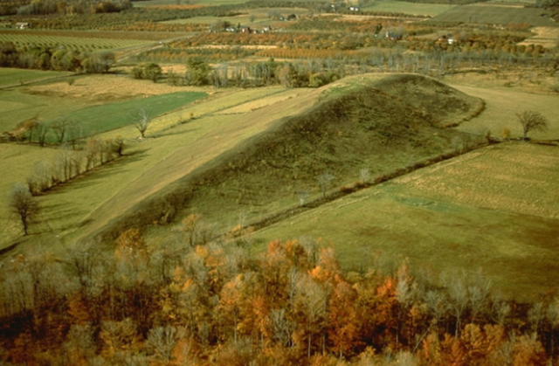
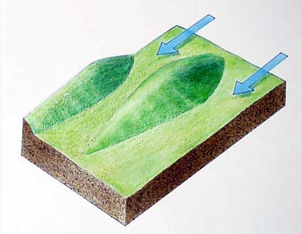
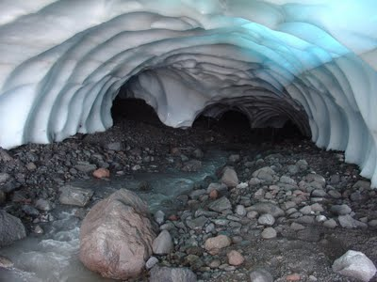
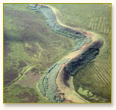
Glaciers on Soft sediment
Sediment deforms and interacts with sub-glacial water and glacial flow in a complex way
Drumlins are a common byproduct
Sub-glacial water travels in tunnels that adjust in size to just contain the flow
Pressure / melting-temperature feedback
Basal topography not too important as these are pressurized conduits
Deposition in these tunnels leaves ridges that persist after the glacier disappears
Known as eskers

Slide 28
Esker-like ridges exit the south polar ice sheet of Mars
100s of km long
…but 100m high and ~1km wide
Much bigger than terrestrial examples
Head and Pratt 2001

Slide 29
Glacial Till
Poorly sorted debris carried by glacier
Fine grained component – glacial flour

Slide 30
Glacial deposition
Terminal moraines where glaciers dump debris
Ice always moves forward even when glacier is in retreat
Non-ice debris accumulates
Kettles mark the location of former ice outliers
Glacial outwash plains composed of glacial till

Slide 31
Ground ice processes
Permafrost covers a large portion of the Earth
Ground ice on Mars theorized to exist for some time
Regolith provides the thermal insulation
Sharp latitude cutoff
Stable ice distribution changes with climate
Diffusive contact with the atmosphere

Slide 32
Ground ice on Mars theorized to exist for some time
Regolith provides the thermal insulation
Stable ice distribution changes with climate
Diffusive contact with the atmosphere
Water vapor
Surface
Mellon et al., 2004

Slide 33
A stable depth (ice temperature) exists where
Chamberlain and Boynton, 2007

Slide 34
Many models – same behavior
Shallow high-latitude ice
Ice-free equatorial region
Very sharp boundary
Boundary position very sensitive
Thermophysical properties
Independently determined
Global average water vapor
Today’s value is 10-14 pr μm
Chamberlain and Boynton, 2007

Slide 35
Thickness of the icy regolith
Perhaps up to 10s of meters
38 meters in this case
Limited by geothermal gradient (deposition limit not stability limit)

Slide 36
Active layer can be pressurized when frozen from the top down (beginning of winter)
Outbursts freeze as icings
Melosh 2011

Slide 37
Wet Periglacial Processes
An active layer
Annual melting and refreezing of the upper surface
0.1 to a few meters thick
Permafrost is very impermeable – active layer becomes water-logged in summer months
Leads to mass movements on slopes – Gelifluction/Solifluction

Slide 38
Similar slope movements on Mars – melting not expected in current climate
Fretted terrain
Concentric crater fill
Lineated Valley Fill
Levy et al. 2010

Slide 39
Dry Periglacial Processes
Polygons form from thermal cycling of buried ice

Slide 40
Warmer ice – some viscous flow
Mellon et al. 2008
Mellon, 1997
Model as a viscoelastic solid
Short-term elastic behavior
Long-term viscous behavior
Heating → expansion → compression
Some stress relieved by viscous creep
Cooling → shrinkage → extension
Less stress relieved viscously at lower T
Tensile stress causes cracking
Stresses highest in polygon center

Slide 41
Repeated thermal cycling
Cracks propagate
Propagation stops when it hits another crack
Cracks fill with debris (or ice)
Compression cause ridges along cracks
Zone of weakness for next year
Cracks get widened progressively
Sublimation
Sand wedge
Ice wedge
Marchant and Head 2007

Slide 42
Frost Heave and Premelting
Gibbs Thompson effect
Freezing point depressed by surface curvature
Liquid stays mobile around grain boundaries
Taber, 1930
Rempel, 2007

Slide 43
Modeled for pure water on the Earth
A slow process on Mars?
Film thickness on the order of monolayers (0.35 nm)
Mid-latitude ice on Mars (~200k) would have about 2 molecular layers of water
Effects of perchlorates and other salts not included
Kereszturi et al., 2009

Slide 44
Thin films exist around impurities
Films freeze on cold side
Particle pushed along thermal gradient towards warmer temperatures
Gravity irrelevant
Impurities eventually expelled from ice
Ground ice can self-purify itself
Miller and Black, 2003

Slide 45
Pingos on Mars??
Water in the near subsurface freezes
Frost heave produces growing ice lens – causes uplift
Water confined by either artesian pressure or trapped in lake sediments
Dundas et al., 2007

Slide 46
The Phoenix lander discovered very pure buried water ice

Slide 47
Pure ground ice on Mars is exposed by small impact craters
Frost heave likely
Buried snow unlikely

Slide 48
Thermokarst
Scalloped terrain on Mars
Lefort et al. 2009

Slide 49
Removal of ground ice causes collapse and slope feedback
Leads to asymmetric shape
Dundas et al. 2011

