Slide 1
History of Mars

Slide 2
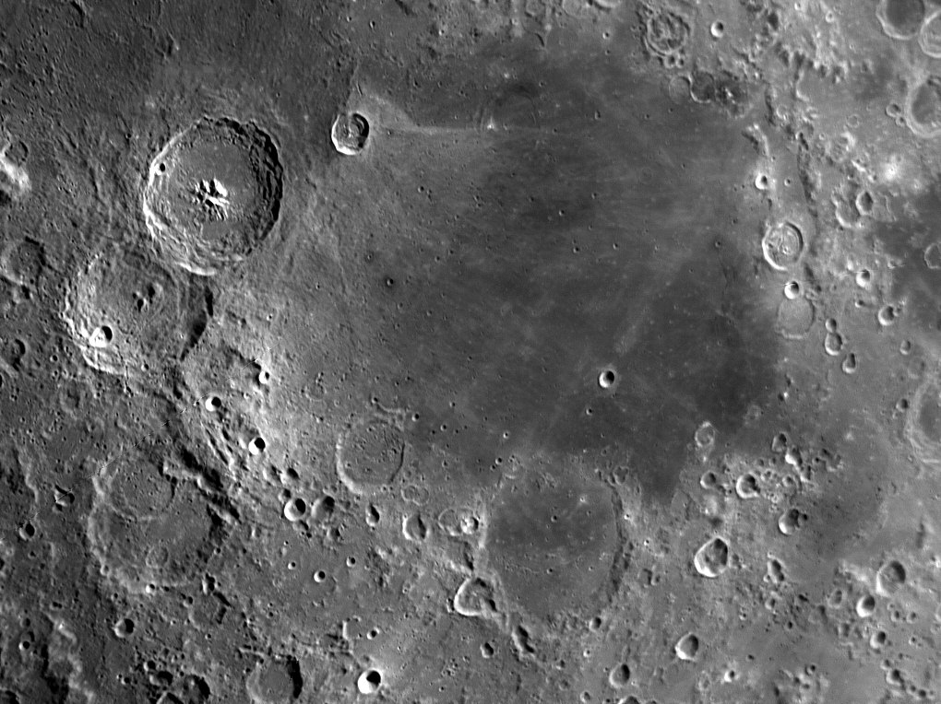
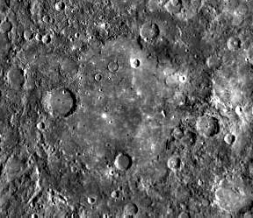
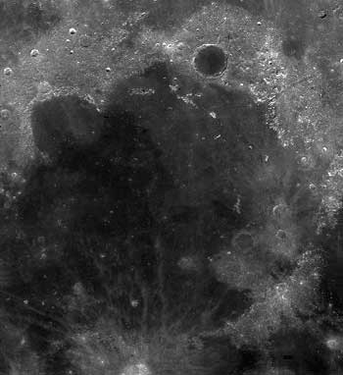
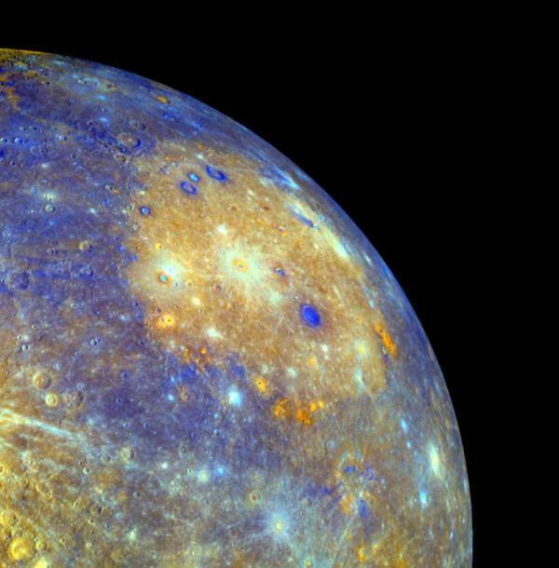
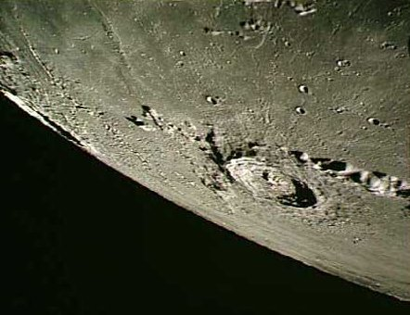
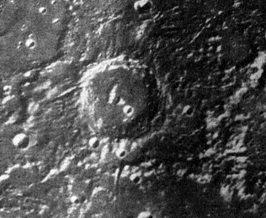
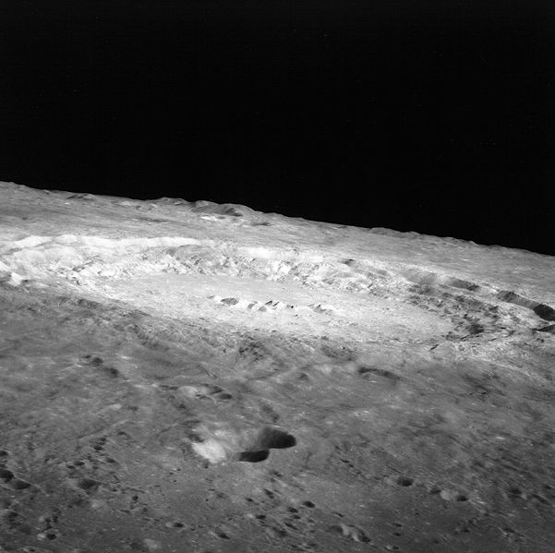
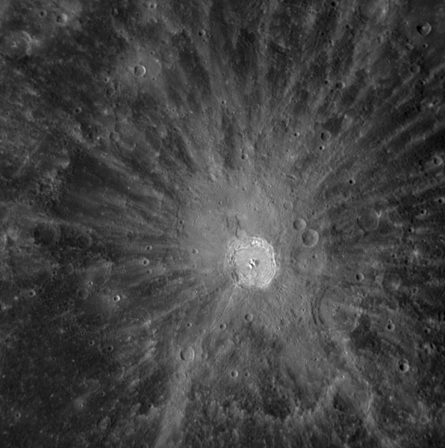
For the Moon and Mercury – large basins/craters define stratigraphic boundaries
Moon
(Real ages known)
Mercury
Pre-Nectarian
4.5 – 3.92 Ga
Pre-Tolstojan
4.5 -
Nectarian
3.92 – 3.85 Ga
Tolstojan
Imbrian
3.85 – 3.15 Ga
Calorian
Eratosthenian
3.15 – 1.0 Ga
Mansurian
Copernican
1.0 – 0 Ga
Kuiperian

Slide 3
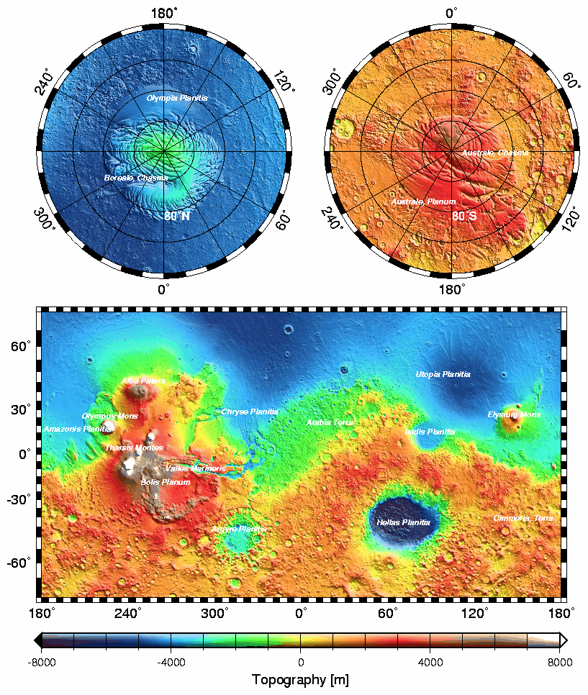
The Moon/Mercury is a set of overlapping ejecta blanket with some volcanic flows
Mars is a great deal more complex
  Craters
  Volcanics
  Extensive tectonics
  Fluvial reworking
  Aeolian reworking
  Periglacial processes
  Large ice sheets

Slide 4
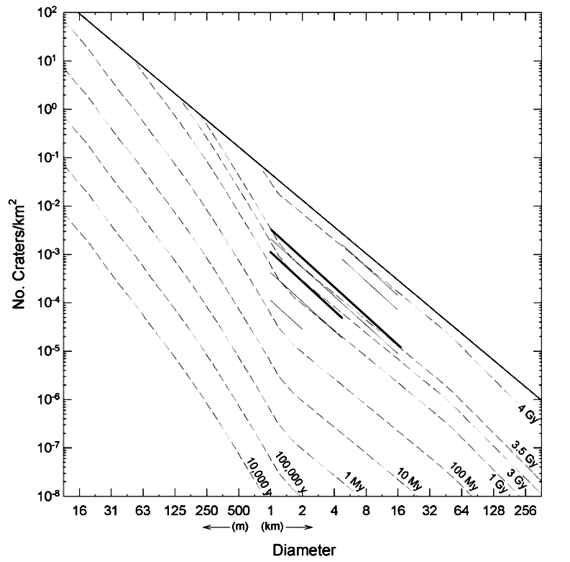
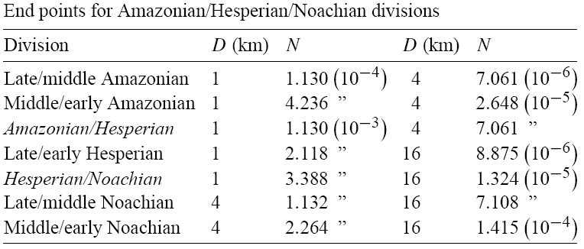
Three martian eons
  Noachian 4.1 Ga – 3.9 Ga
  Hesperian 3.9 Ga – 3.1 Ga
  Amazonian 3.1 Ga onward
  Divided into early/middle/late eras
Defined by crater counts – not events
  Crater count divisions chosen so that Hellas occurs at the beginning of the Noachian
Hartmann, 2005

Slide 5
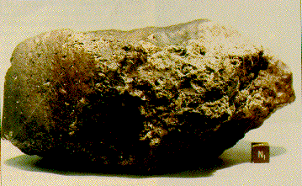
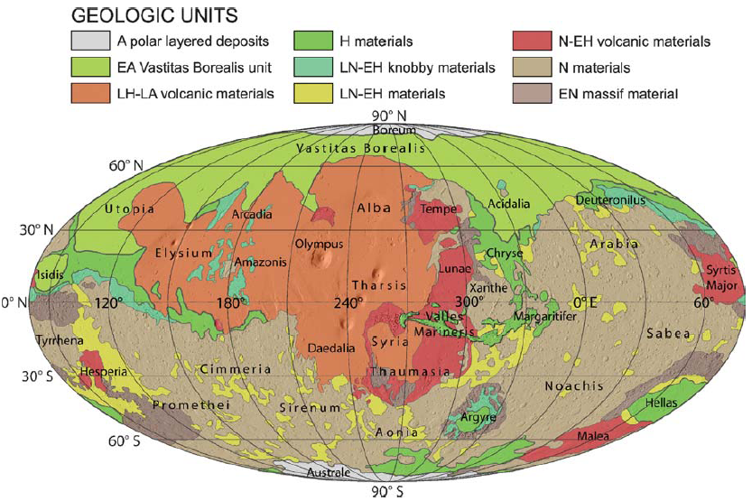
Mars in the only planet to preserve both very ancient and modern terrain
Hf/W constrains on differentiation timing
  Mars differentiates ~10Myr
    Mars basaltic crust < 40Myr
Crystallization age of ALH84001
  4.1 Ga – a very old rock (Lapen et al. 2010)
  Revised downward from 4.5Ga
Nimmo and Tanaka, 2005

Slide 6
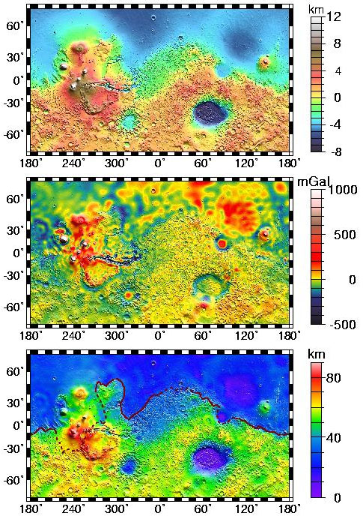
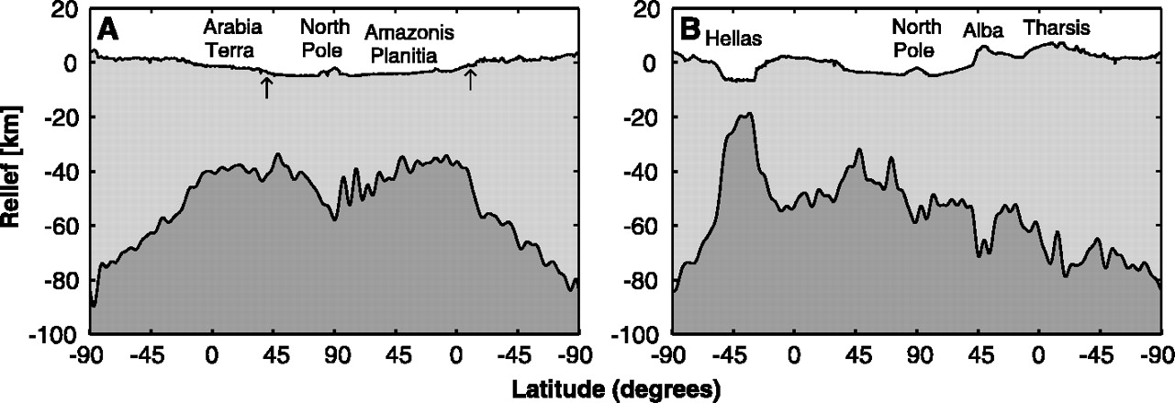
Crustal Dichotomy
Northern and southern hemispheres of Mars are very distinct:
  North
    Low elevation
    Few Craters – Young
    Smooth terrain
    Thin Crust
    No Magnetized rock
  South
    High elevation
    Heavily cratered – Old
    Rough terrain
    Thick crust
    Magnetized rock
Dichotomy boundary mostly follows a great circle, but is interrupted by Tharsis
No gravity signal associated with the dichotomy boundary - compensated
Theories on how to form a dichotomy:
  Giant impact (Earth/Moon idea)
  Several large basins
  Degree 1 convection cell
  Early plate tectonics
Zuber et al., 2000

Slide 7
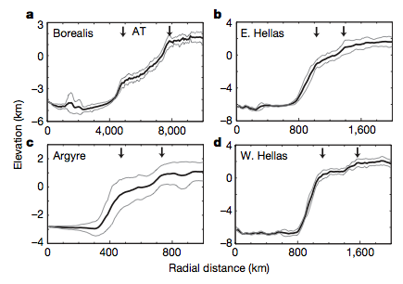
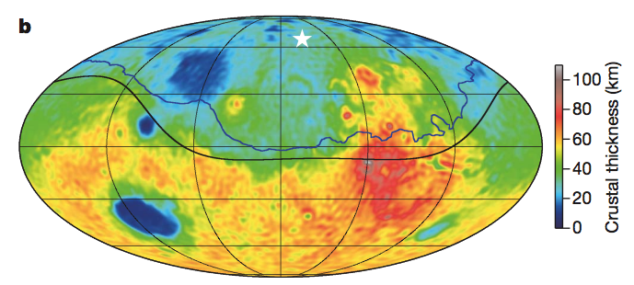
Borealis basin
  208E, 67N
  4250-5300 km in radius
Shares slope break with at ~1.5 basin radii with other basins
Largest impact structure in the solar system
Andrews-Hanna et al., 2008

Slide 8
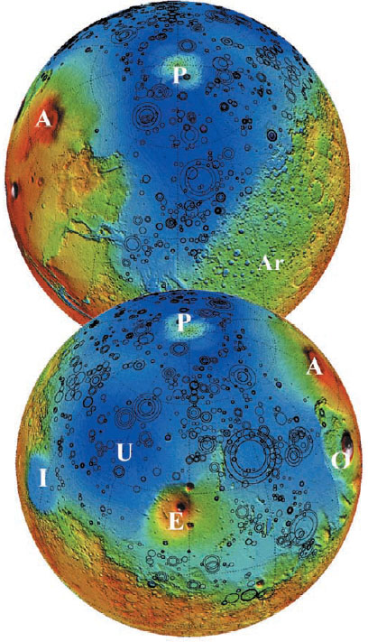
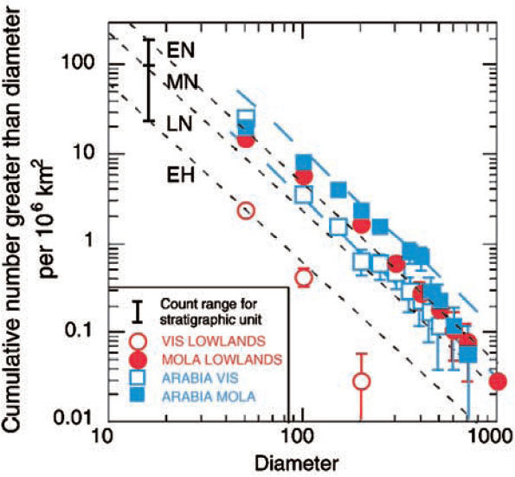
Despite all this the difference is only skin deep
Buried impact basins in the northern hemisphere have been mapped
Before this burial the northern and southern hemispheres were indistinguishable in age
  Rules out Earth-style plate tectonics
Northern hemisphere is a thinly covered version of the southern hemisphere
  Mantled by 1-2 km of material (sediments and volcanic flows)
Frey et al., 200?

Slide 9
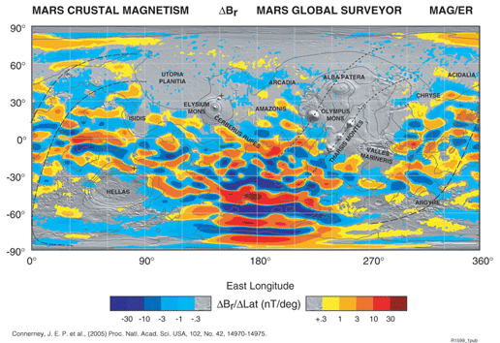
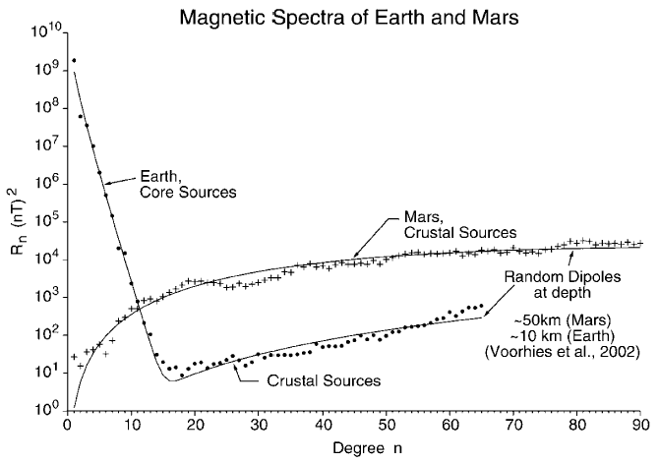
Magnetic Fields
Mars currently has no dipole field
Areas of magnetized crust have been discovered – dipole existed once
  Vigorous core convection driven by ⁴⁰K decay?
  Crust sources much stronger than Earths
Connerney et al., 2004
Hood et al., 2003
Lack of magnetic field over Hellas and Argyre basins attributed to shock demagnetization
  Lack of remagnetization indicates dynamo had shut down
  Hellas = beginning of the Noachian
Absence of remnant fields in the northern hemisphere is a puzzle
  Removed by hydrothermal circulation?

Slide 10
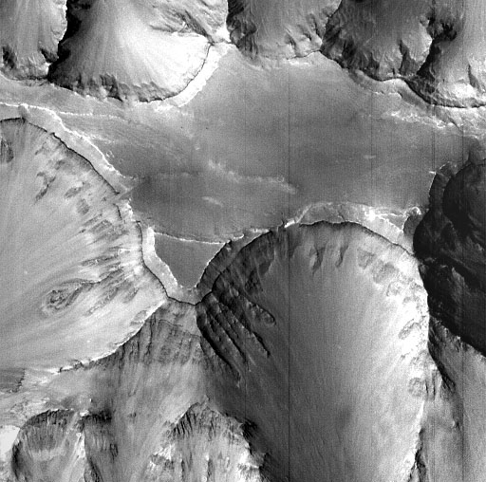
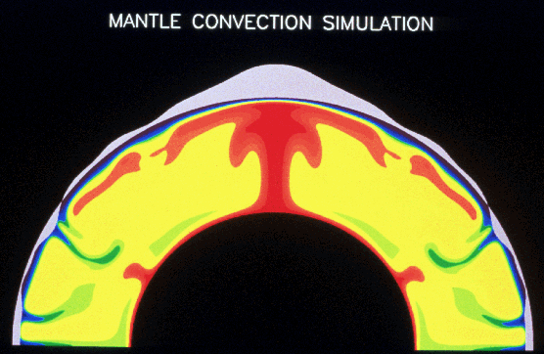
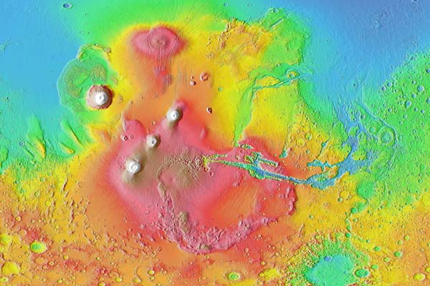
Tharsis
Tharsis begins forming
  Initial mantle formation led to unstable density structure
    Remains active throughout Martian history
    Long-lived mantle plumes hard to understand
    Volcanism may have outgassed a substantial early atmosphere
    Location on dichotomy boundary is a puzzle
    Flows as recent as a few 10 Myr
  Volcanic rock sequences 8km thick can be seen in the walls of Valles Marineris
  Pole-to-pole slope and Tharsis bulge control the planet’s shape
  Mass of Tharsis likely caused some polar wander

Slide 11
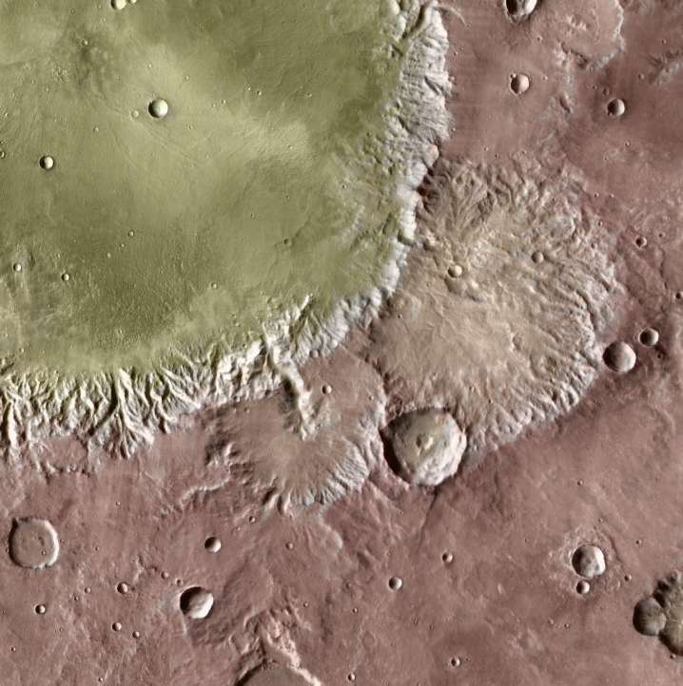
Noachian terrains have show extensive fluvial dissection
40E, 10S
20km

Slide 12
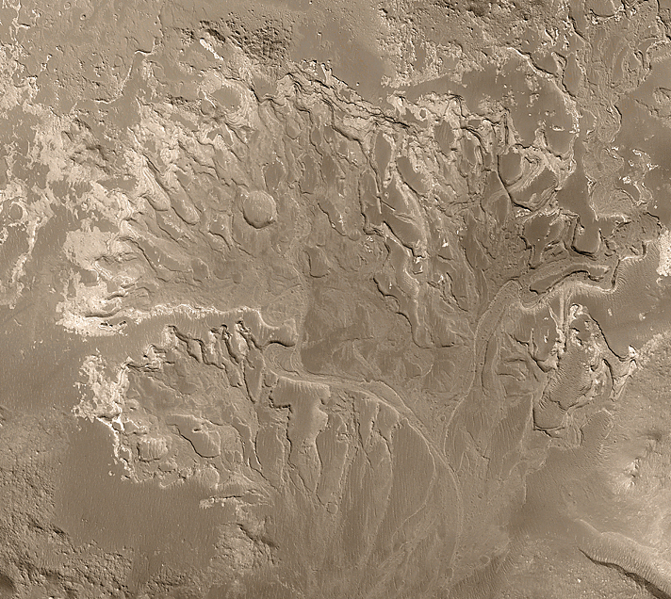
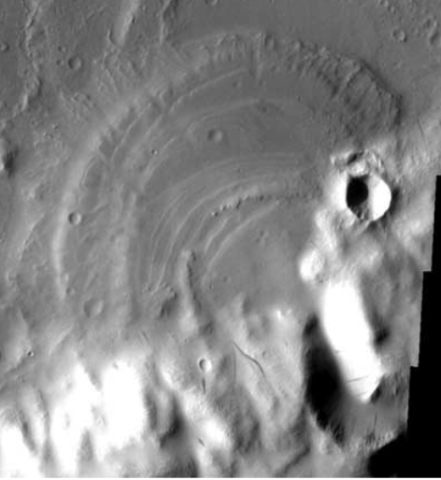
MSSS
Fans and deltas
  Show pervasive fluvial activity during the Noachian
Irwin et al. 2005

Slide 13
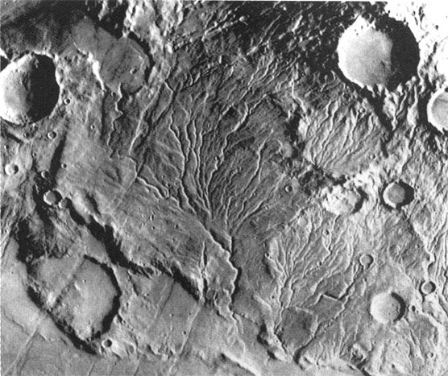
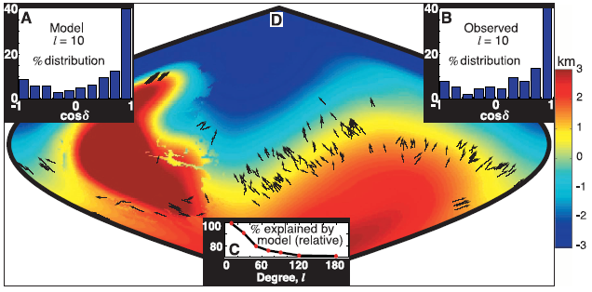
Valley Networks
Valleys with dendritic patterns
  Erosion by groundwater sapping not precipitation?
  Or not… some cases look like surface runnoff?
Valley orientations indicate they formed after the bulk of Tharsis was in place.
Formation of Tharsis rise therefore occurred very early
Phillips et al., 2001

Slide 14
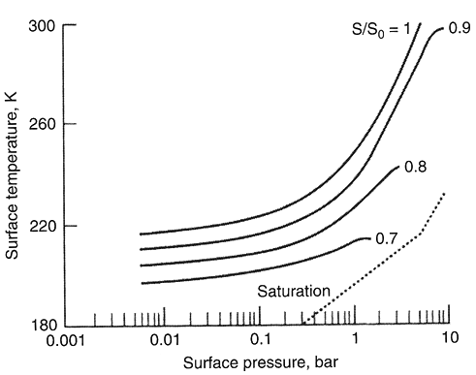
Noachian climate
Problem to get warm Noachian temperatures
  Faint young sun – surface temp. 190-200 K
  Large greenhouse effect required
  CO₂ and H₂O is an option
    But you need very big atmospheres (a few bars)
    May be able to reduce this with clouds
  Reducing species
    NH₃, CH₄ etc… are very effective but rare
  Carbonates?
    Big CO₂ atmospheres producing lots of liquid water…
    Quickly forms carbonic acid and combines with Ca in rocks
    Locks up C in carbonates (CaCO₃) – no plate recycling on Mars
    People have spent a long long time looking for these carbonates
Haberle, 1998

Slide 15
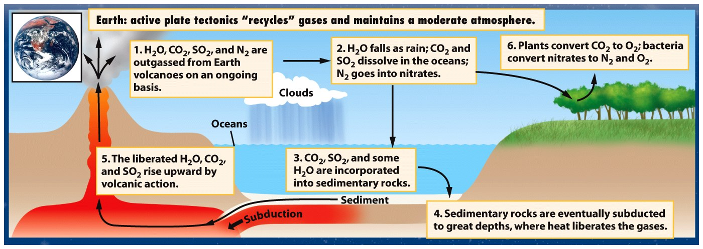
Earth
Rocks recycled by plate tectonics
Rock cycle
Mars, Earth
CO₂ and water goes into rocks
Earth, Venus, Mars
All start with CO₂ and water in their atmosphere
Mars
No plate tectonics–CO₂ stuck in rocks
Runaway icehouse
Venus
Water not stable as liquid
Venus
CO₂ stays in atmosphere
Runaway greenhouse

Slide 16
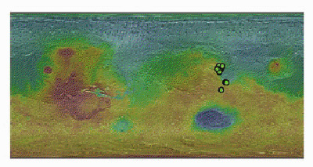
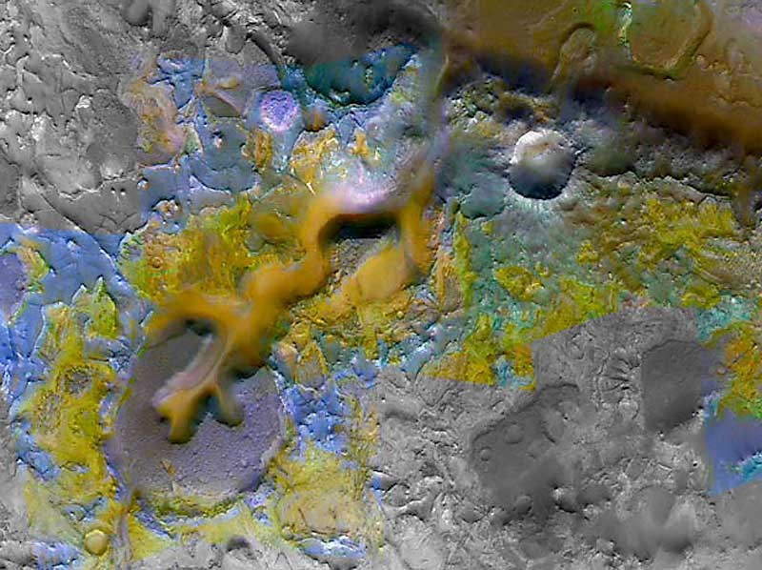
There’s just one problem
  We can’t find these CO₂ bearing rocks (carbonates)
  Some recent progress on this…
  Spectral evidence of carbonates discovered in Nili Fossae
    Ehlmann et al. - 2009

Slide 17
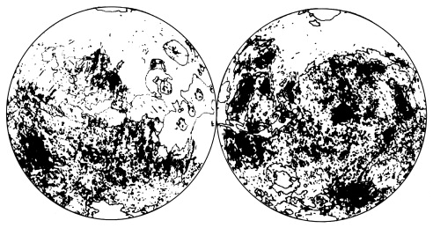
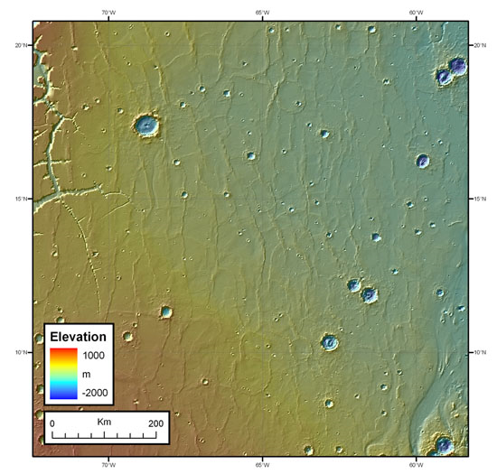
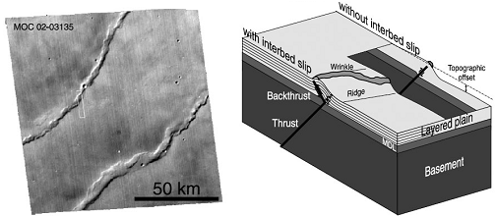
Hesperian Volcanism
Extensive plains volcanism
  with subsequent wrinkle ridges
Northern plains resurfaced
  ~1km of fresh basalt
  Noachian impact crater population covered up
Large amount of SO₂ released
  Combines with water to form acids
  Shift from phyllosilicate to sulfate deposits
Montési and Zuber, 2003

Slide 18
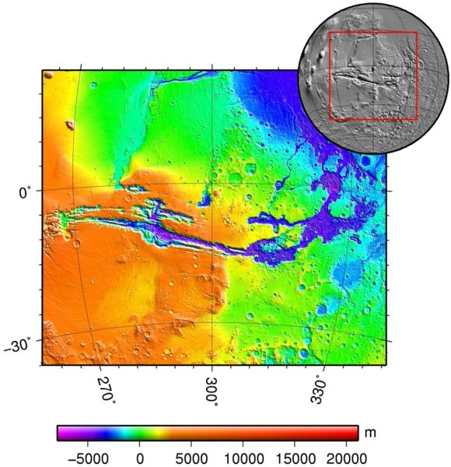
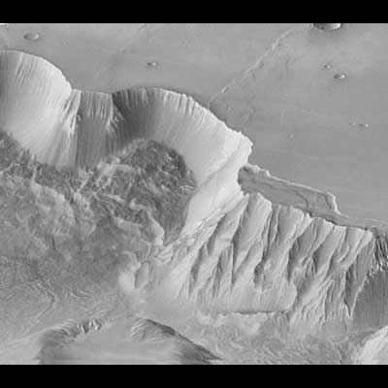
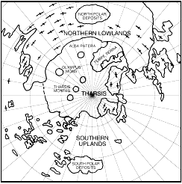
Hesperian Tectonics
Growth of Tharsis causes circumferential extension
Annulus of extensional features
  1000’s km in extent
Opening of Valles Marineris
  Radial to Tharsis
  Extension stresses begin rift
  Unclear why most extension is in one place
    Another mantle plume under Valles Marineris?
  Canyon subsequently widened by landslides
  Later filled with layered deposits
    Probably from paleo-lakes

Slide 19
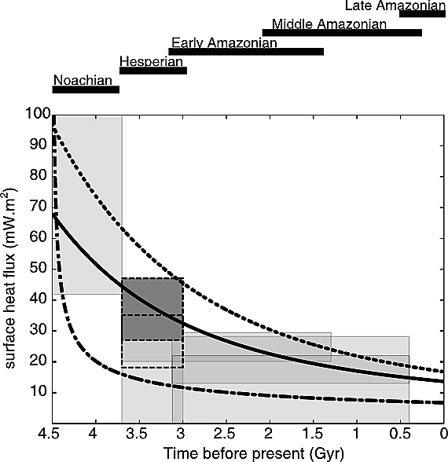
The Hesperian: A Changing Planet
Early greenhouse atmosphere quickly removed
  Warm-wet transition to cold-dry
Planetary heat flow declines
  Lithospheric thickening deduced from brittle to ductile transition
  Volcanism tailing off
Montési and Zuber, 2003

Slide 20
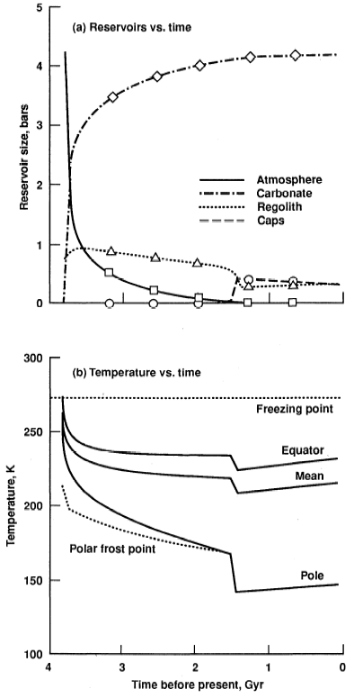
The Hesperian: A Changing Planet
Early greenhouse atmosphere quickly removed
  Warm-wet transition to cold-dry
Haberle, 1998
Lots of fluvial erosion
Not much fluvial erosion

Slide 21
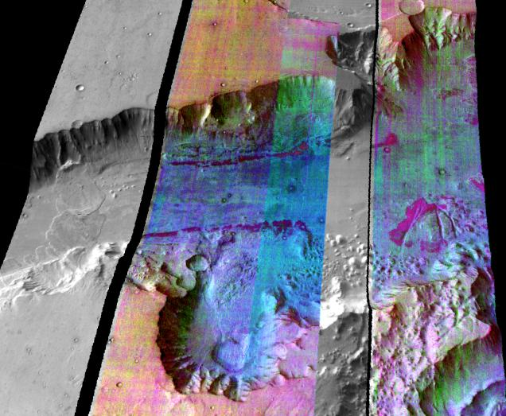
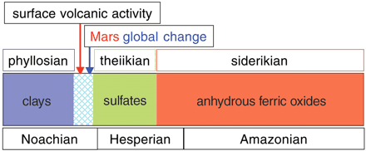
Evidence for change
Hesperian lava plains are undissected
  Noachian terrains are highly dissected by valley networks
Gusev crater basalts are not weathered at all (spirit rover)
  But the Columbia Hills rocks (older) are
OMEGA mineralogical results
  Clay formation ceases
  Transition to acidic environment to from sulfates
    Also requires evaporation
  Young terrains show no aqueous alteration
Presence of olivine on the surface
Bibring et al., 2006
Christensen et al., 2003

Slide 22
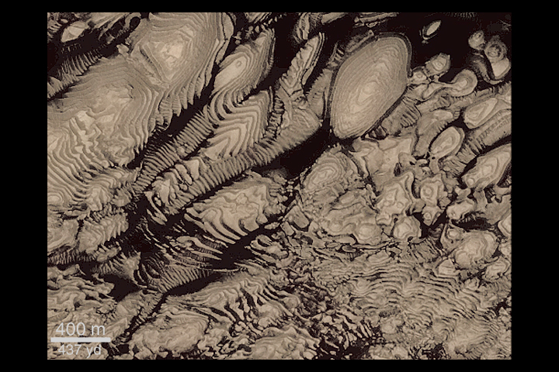
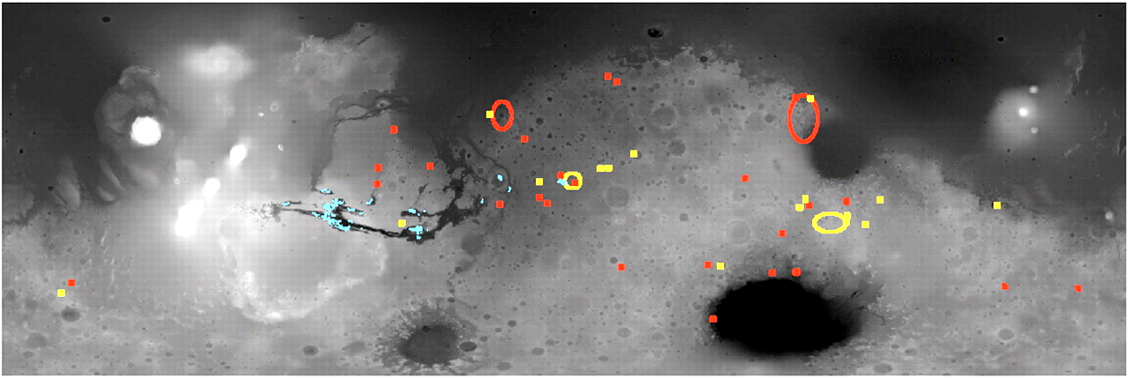
Water at the Noachian-Hesperian Boundary
Valley networks indicate surface water in the Noachian
Inevitable to have this water pool into craters and low areas
Ancient sedimentary rock layers found in craters
  Indicate active past
  Possible paleo-lake environments
  OMEGA indicates light toned layered deposits are sulfate rich in composition
    Implies evaporites
Bibring et al., 2006

Slide 23
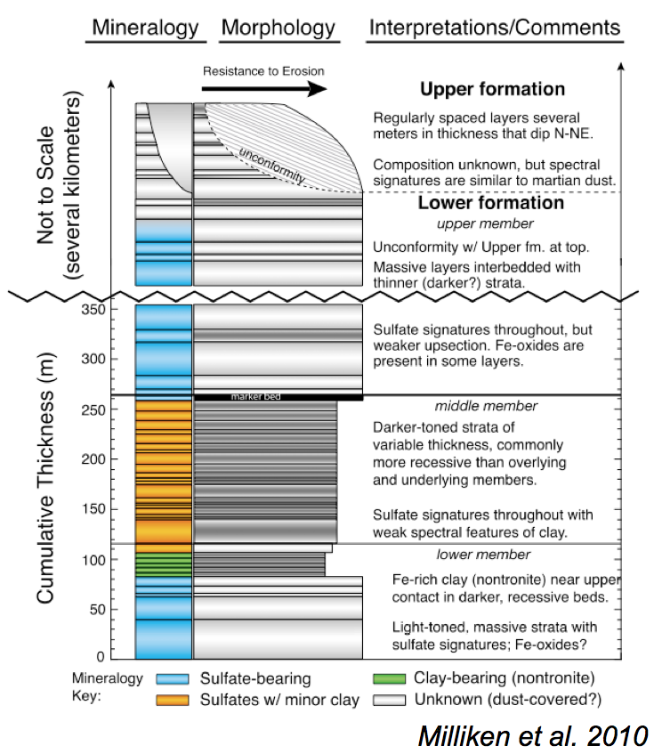
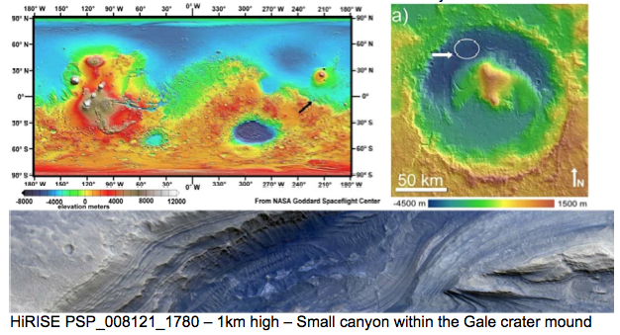
Gale crater is Noachian aged and ~150km in diameter.
It contains a layered mound of sedimentary material 5.2km high
  That’s higher than the crater rim in places
  i.e. the entire crater was entombed in sedimentary rock and later exhumed

Slide 24
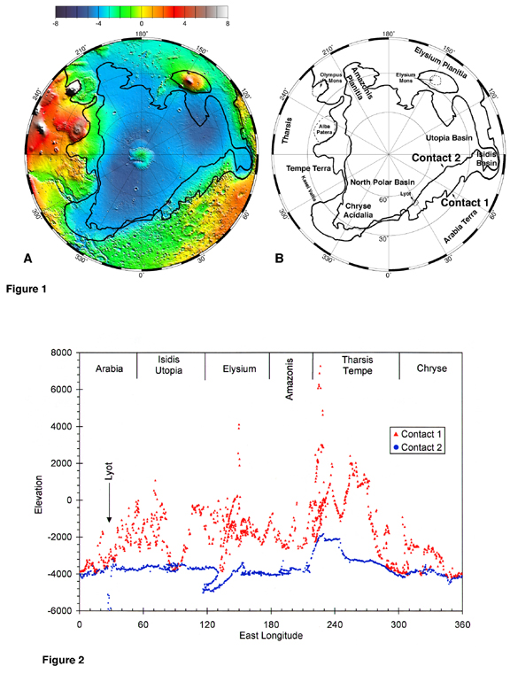
Ocean?
Original ‘shorelines’ mapped by Tim Parker from Viking data in late 1980’s
One of the contacts he identified is close to an equipotental surface
Makes sense since all surface water will drain into the low-lying northern hemisphere
Still a lot of disagreement on whether to believe this
  No obvious shoreline features in high resolution imagery
  …but…
  Ocean may have been ice-covered
  Subsequent volcanic constructs have altered the shoreline elevation
Head et al., 1999

Slide 25
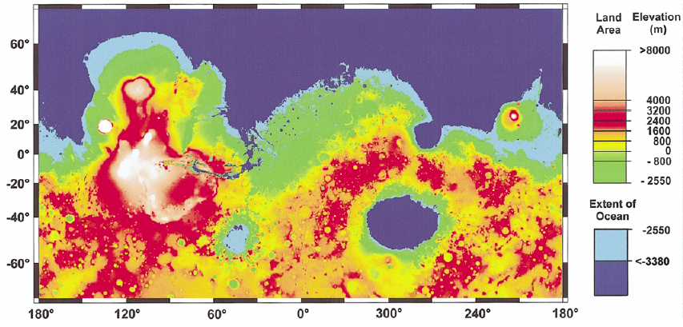
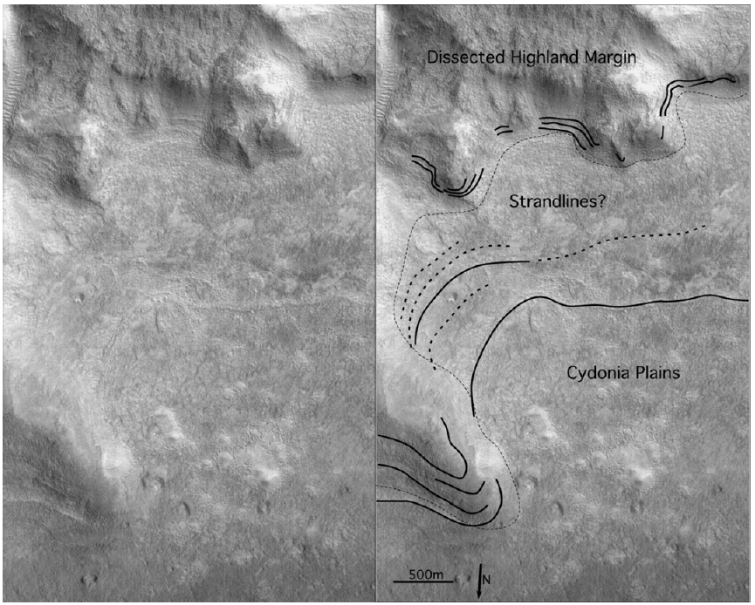
“Shoreline” erosional features are subtle
Recent search for depositional features turned up nothing (Ghatan and Zimbelman, 2006)
  Effects of ice cover?
Clifford and Parker, 2001

Slide 26




Cryosphere
Mega-regolith ensures crust is porous to great depth
Clifford and Parker, 2001
Mars starts freezing water in pore space
  Declining heat flux
  Environmental change
Early ocean freezes over

Slide 27




What happens next?
  No ice covered ocean in the northern lowlands today
Clifford and Parker, 2001

Slide 28

Subterranean water table is higher than ocean surface
Outflow occurs if cryosphere fails
Cryosphere continues to thicken over time
  Failure become less and less likely
  Possibly no liquid water left beneath the cryosphere today
  Deep aquifer model for gully formation relies on expanding cryosphere pressurizing groundwater
Important shift for Mars
Clifford and Parker, 2001
Pervasive fluvial activity transitions to isolated outburst events

Slide 29



Outflow Channels
Huge flood carved channels
Contains streamlined Islands
Similar to channeled scablands in Washington
Likely that a large underground reservoir emptied catastrophically
  Source region collapses to chaos terrain
  Flood empties into northern lowlands

Slide 30



Terrestrial analogue
  End of the last ice-age
  Glacial lake Missoula- Ice-dam breaks
Channeled scablands, Washington
Outflow channel, Mars

Slide 31


Amazonian Volcanism and glaciation
Hesperian
  Plains volcanism
  Paterae
Amazonian dominated by shield volcanism
  Construction of big Tharsis shields e.g. Olympus Mons
Extreme elevation have led to glaciations during the amazonian
Head et al., 2005

Slide 32

Volcanism continues up to the present day: Surge of activity 100 & 200 Myr ago.
Neukum et al., 2004

Slide 33



Amazonian Polar Layered Deposits
Domes of layered material ~3Km thick and ~1000km across are found at each pole.
  Mixtures of water-ice and dust.
  Similar in size to Greenland ice sheet
Layers are thought to record variations in climate due to orbital changes
  Climatic record of millions (maybe 10’s of millions) years long.
North South
Laskar et al., 2003

Slide 34


Water vapor
Ground ice processes
Permafrost covers a large portion of the Earth
Ground ice on Mars theorized to exist for some time
  Regolith provides the thermal insulation
  Sharp latitude cutoff
  Stable ice distribution changes with climate
  Diffusive contact with the atmosphere
Surface

Slide 35



Ground-Ice driven features dominate on Mars today
Levy et al. 2010

Slide 36


Many models – same behavior
  Shallow high-latitude ice
  Ice-free equatorial region
  Very sharp boundary
Boundary position very sensitive
  Thermophysical properties
    Independently determined
  Global average water vapor
    Today’s value is 10-14 pr μm
  Advances and retreat of ground ice correspond to waning and waxing of polar layered deposits.
Chamberlain and Boynton, 2007

Slide 37



The Phoenix lander discovered very pure buried water ice

Slide 38




Pure ground ice on Mars is exposed by small impact craters
  Frost heave likely
  Buried snow unlikely

Slide 39
Pre-Noachian
4.5 – 4.1 Ga
Planetary accretion
  Core differentiation <13 Myr (¹⁸²W – ¹⁸²Hf isotopes)
  Central magnetic field – (driven by ⁴⁰K decay?)
  Crustal asymmetry forms
Mars is heavily cratered
Magnetic field switches off
Formation of Hellas and Argyre
Construction of Tharsis
  Outgassing of large greenhouse atmosphere
Warm(?) & Wet Period
  Valley networks and ocean(?) form
  Phyllosilicate weathering products
Volcanic plains laid down
  Northern hemisphere mantled
  SO₂ released – causes switch to sulfate weathering?
Extensive tectonism
  Wrinkle ridges
  Opening of Valles Marineris
Removal of greenhouse atmosphere
  Thickening cryosphere
  First polar ice caps
  Dry environment – anhydrous ferric oxides
Outburst flooding
Giant Shield Volcanoes form
Modern day polar deposits and mid-latitudes exchange ice
Noachian
4.1 – 3.9 Ga
Hesperian
3.9 – 3.1 Ga
Amazonian
3.1 – 0 Ga

