Slide 1
Aeolian Processes

Slide 2
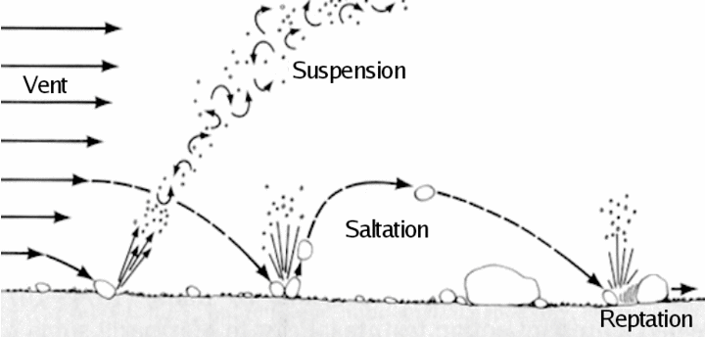
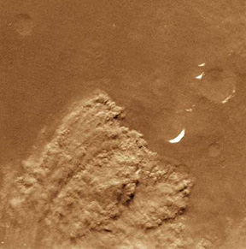
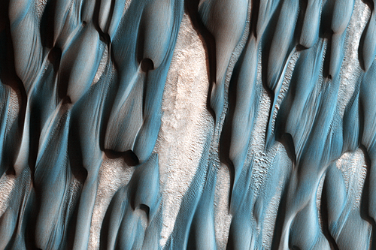
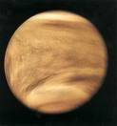
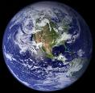
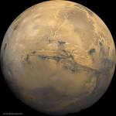
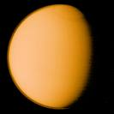
Suspension and saltation
On which planets?
Venus
Earth
Mars
Titan

Slide 3
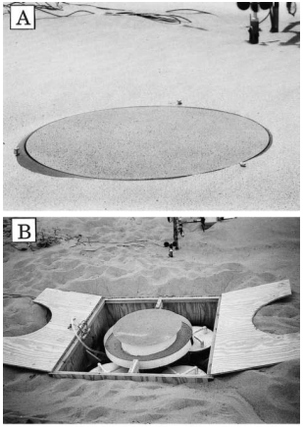
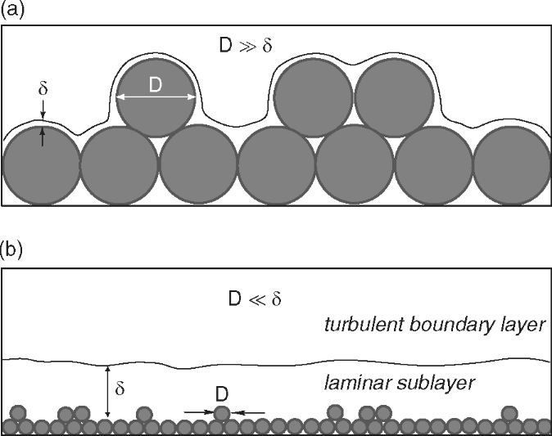
In a planetary boundary layer
Drag of wind on surface produces a shear stress
Measured with drag plates or velocity as a function of height
We define a ‘shear velocity’ u*
Just another way to quantify the shear stress
Above a thin viscous layer, turbulence dominates, η is a property of the flow (an Eddy viscosity) and varies with height and u
Empirically – law of the wall… (κ is Von Karman’s constant ~ 0.41)
Big grains stick up into turbulent flow
Lots of vertical air motion
Little grains hide in the laminar flow
No vertical air motion
Anderson and Anderson 2010

Slide 4
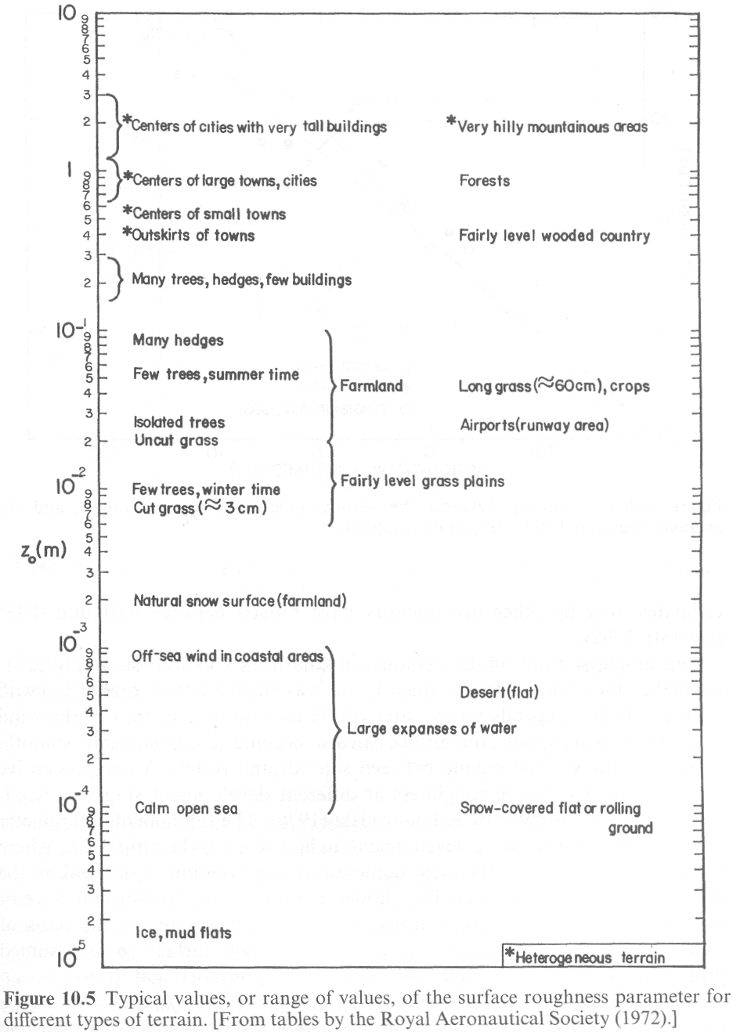
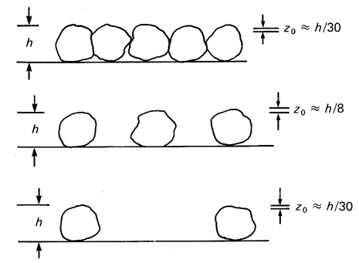
Z₀ is the equivalent roughness height
1/30th of the grain size for quiescent situations
Otherwise it’s empirically determined from several wind measurements at different heights
Medium
sand
Greeley, 1985

Slide 5
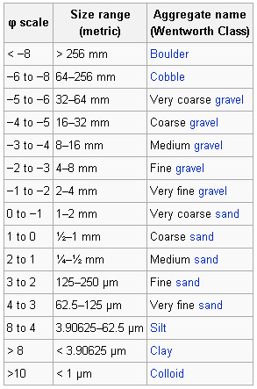
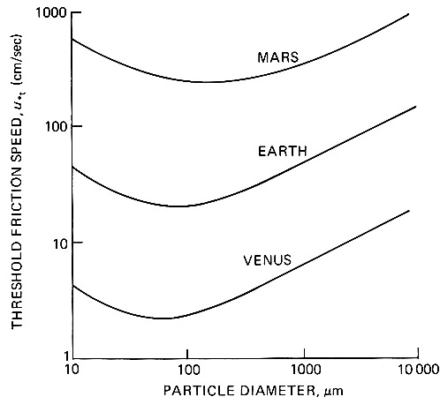
Saltation threshold increases with particle size
Particles classified by Udden-Wentworth scale
Easiest particles to move are sand-sized
Dust
Sand-sized
Gravel
0.1 mm
1mm
1cm
Greeley, 1985

Slide 6
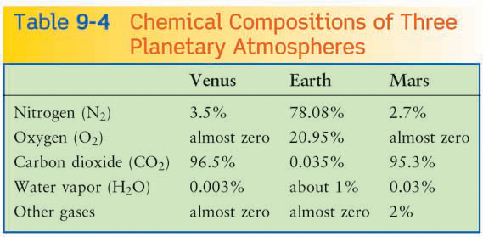
Titan
95%
Zero
Zero
Zero
5% methane
Dune Potential (All else being equal)
Venus
Titan
Earth
Mars
Density Kg m⁻³ | 71.92 | 1.27 | 0.027 | 5.3
Gravity (m s⁻²) | 8.9 | 9.8 | 3.7 | 1.35
Dune material | Basalt | Quartz | Basalt | Organics (lower density)

Slide 7
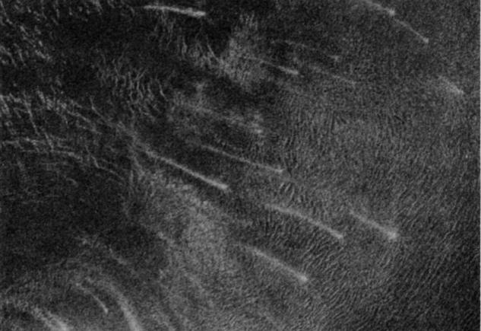
As usual – all else is not equal
Venus has very few dunes (two fields known)
Lack of weathering into small particles
Detectability of dunes ?
Low surface winds
Mars has extensive dunefields
Very high wind speeds
Lots of active weathering breaking up rocks
Dune Potential (All else being equal)
Venus
Titan
Earth
Mars
Fortuna-Meshkenet field
Weitz et al. 1994

Slide 8
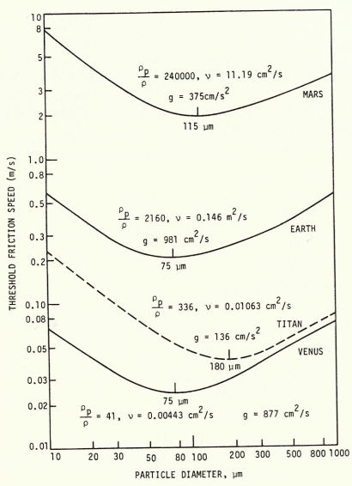
Easy to move, but not easy to suspend
Particles are launched off the surface, but re-impact a short time later – saltation!
Impact angles much shallower than launch angles
Impacting grains can dislodge new particles (reptation)
Impacting grains can push larger particles (creep)
Saltation on Mars should be really hard but the impact threshold is a lot lower than the fluid threshold.
Greeley, 1985

Slide 9
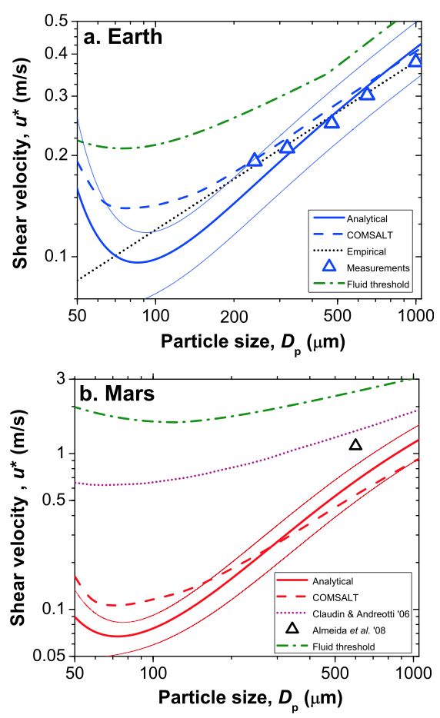
Impact vs fluid threshold
It’s easier to keep saltation going than start it
Impact threshold is ~0.8 times the fluid threshold for Earth
…but ~0.1 times the fluid threshold for Mars
This is what makes martian saltation possible
Kansas State University
Kok, 2010

Slide 10
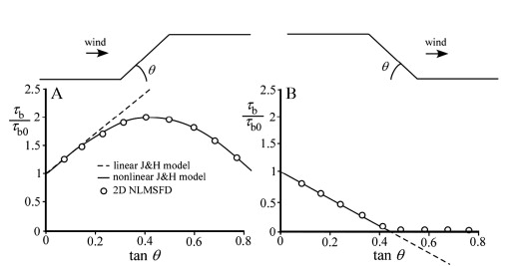
Low hills of sand feel asymmetric shear stress
Turbulent shear stress at many wavelengths combined linearly
Jackson and Hunt 1975
Doesn’t work so well when slopes > 10-15°
Shear stress drops to zero when slopes exceed ~ 25°
Pelletier 2009

Slide 11
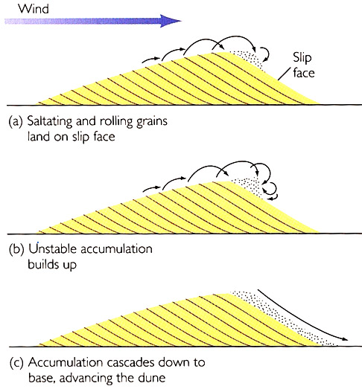
Flat
Neutral mass balance
Stoss
Slope
Negative mass balance
Lee
Slope
Positive mass balance
Formation of a dune…
Asymmetric shear stress causes lee-slope of all low hills to steepen
Lee slopes steepen past 25°
Air flow separates from lee-slope surface
Sand falls onto the upper lee-slope and is not removed causing steepening
Lee slope approaches angle of repose
Slope controlled by gain avalanches
Dune advances

Slide 12
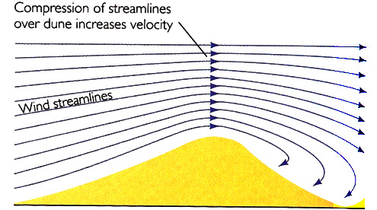
Dune velocity
Mass in 1m wide slice: ½ b h ρ_{dune}
Time to advance 1 dune length: b / v
Mass flux (q) mass/time:
Bigger dunes move slower for a given sand flux
Dunefields with similar sized dunes are stable
Dune height is self-limiting due to streamline compression
h
b

Slide 13
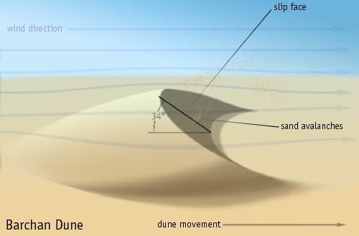
Dunes
Upwind: Stoss side
Downwind: Lee side
Highest point: crest
Slipface start: Brink
Horn
Stoss
Lee
Horn

Slide 14
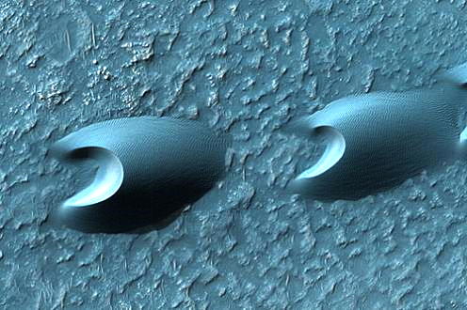
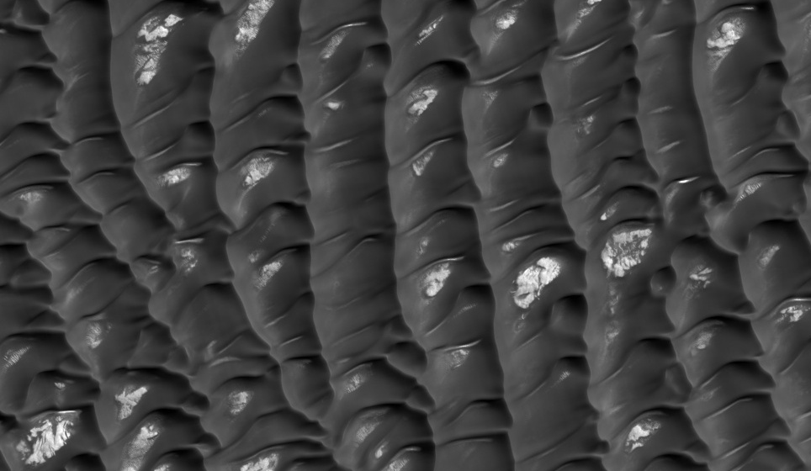
Unidirectional winds
Dune shape depends on sand supply
Barchan Barchanoid ridges Transverse
Increasing sand supply

Slide 15
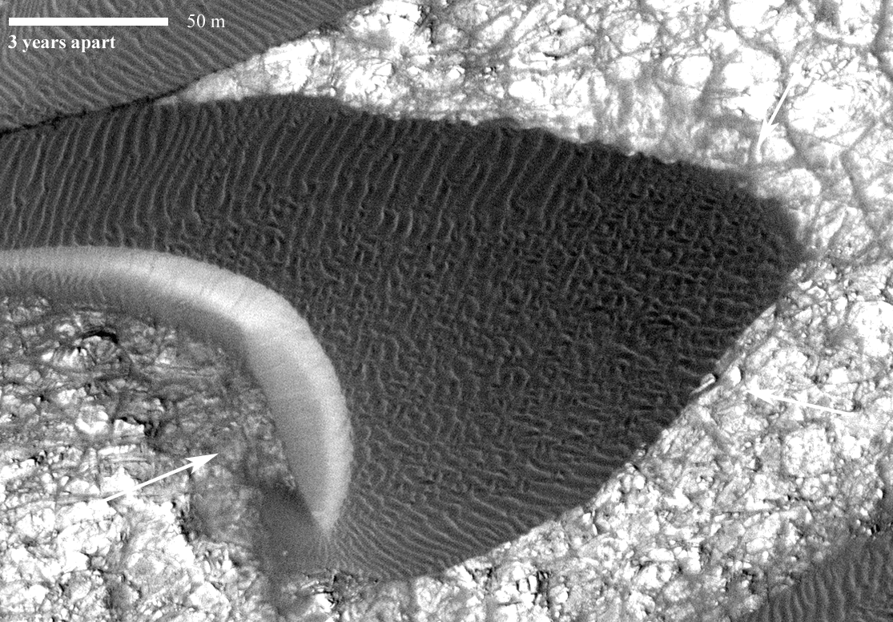
Bridges et al. 2012

Slide 16
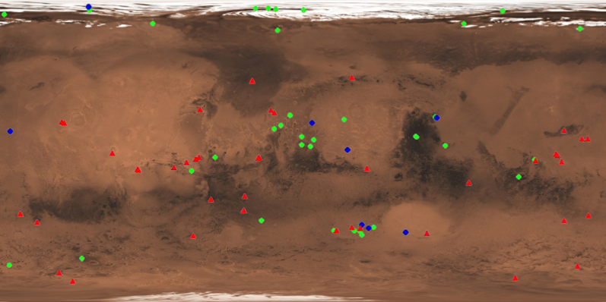
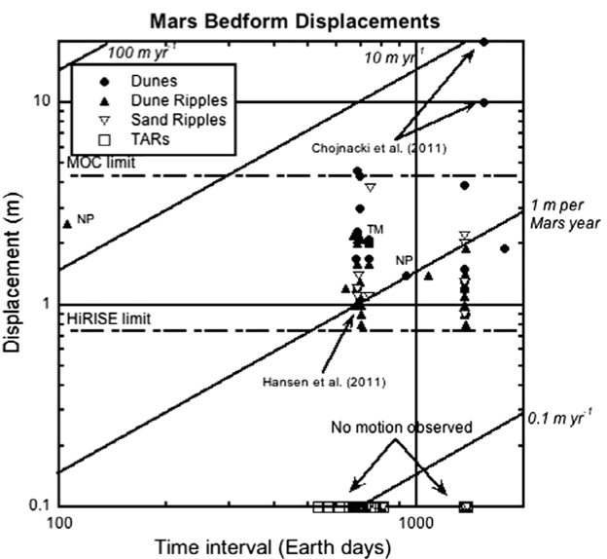
We’ve moved beyond change detection to rate measurements.
More time allows the slower/less-frequent motion to be quantified.
Thousands of (admittedly limited) meteorological stations - for free
Bridges et al. 2013
Bridges et al. 2012

Slide 17
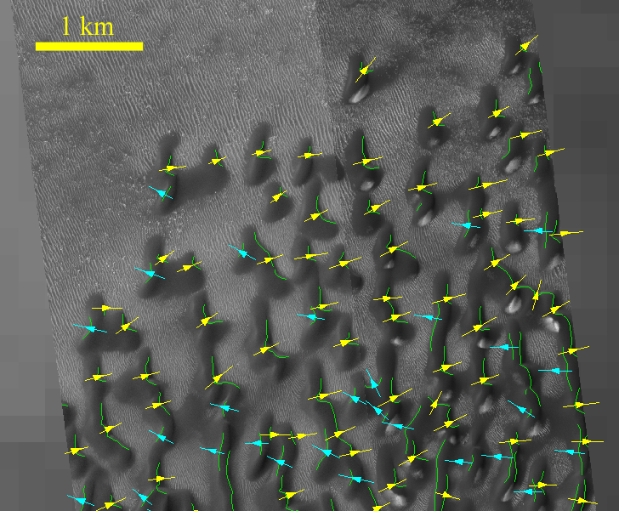
Barchan dunes provide valuable wind direction measurements

Slide 18
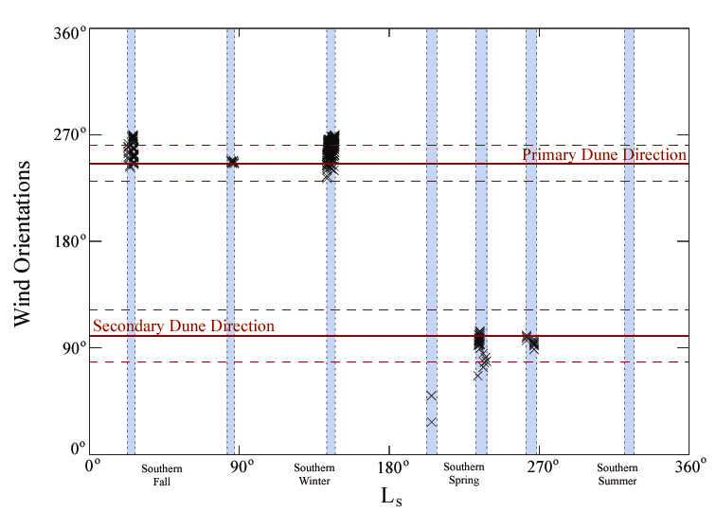
Late Southern Fall (L_{s} = 86˚, 2 PM)
Surface geology can be tied to atmospheric modeling
Indicates the dunes formed under current wind directions
Fenton et al.
Late Southern spring (L_{s} = 286˚, 4 PM)
Late Southern spring (L_{s} = 286˚, 4 PM)

Slide 19
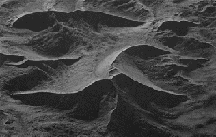
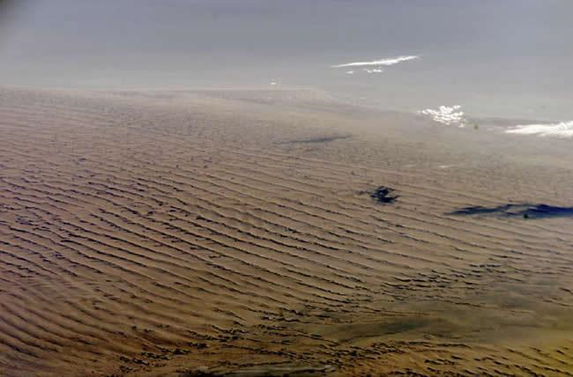
When wind directions vary
Linear dunes – a little variation
Star dunes – a lot of variation
Star Linear/Longitudinal

Slide 20
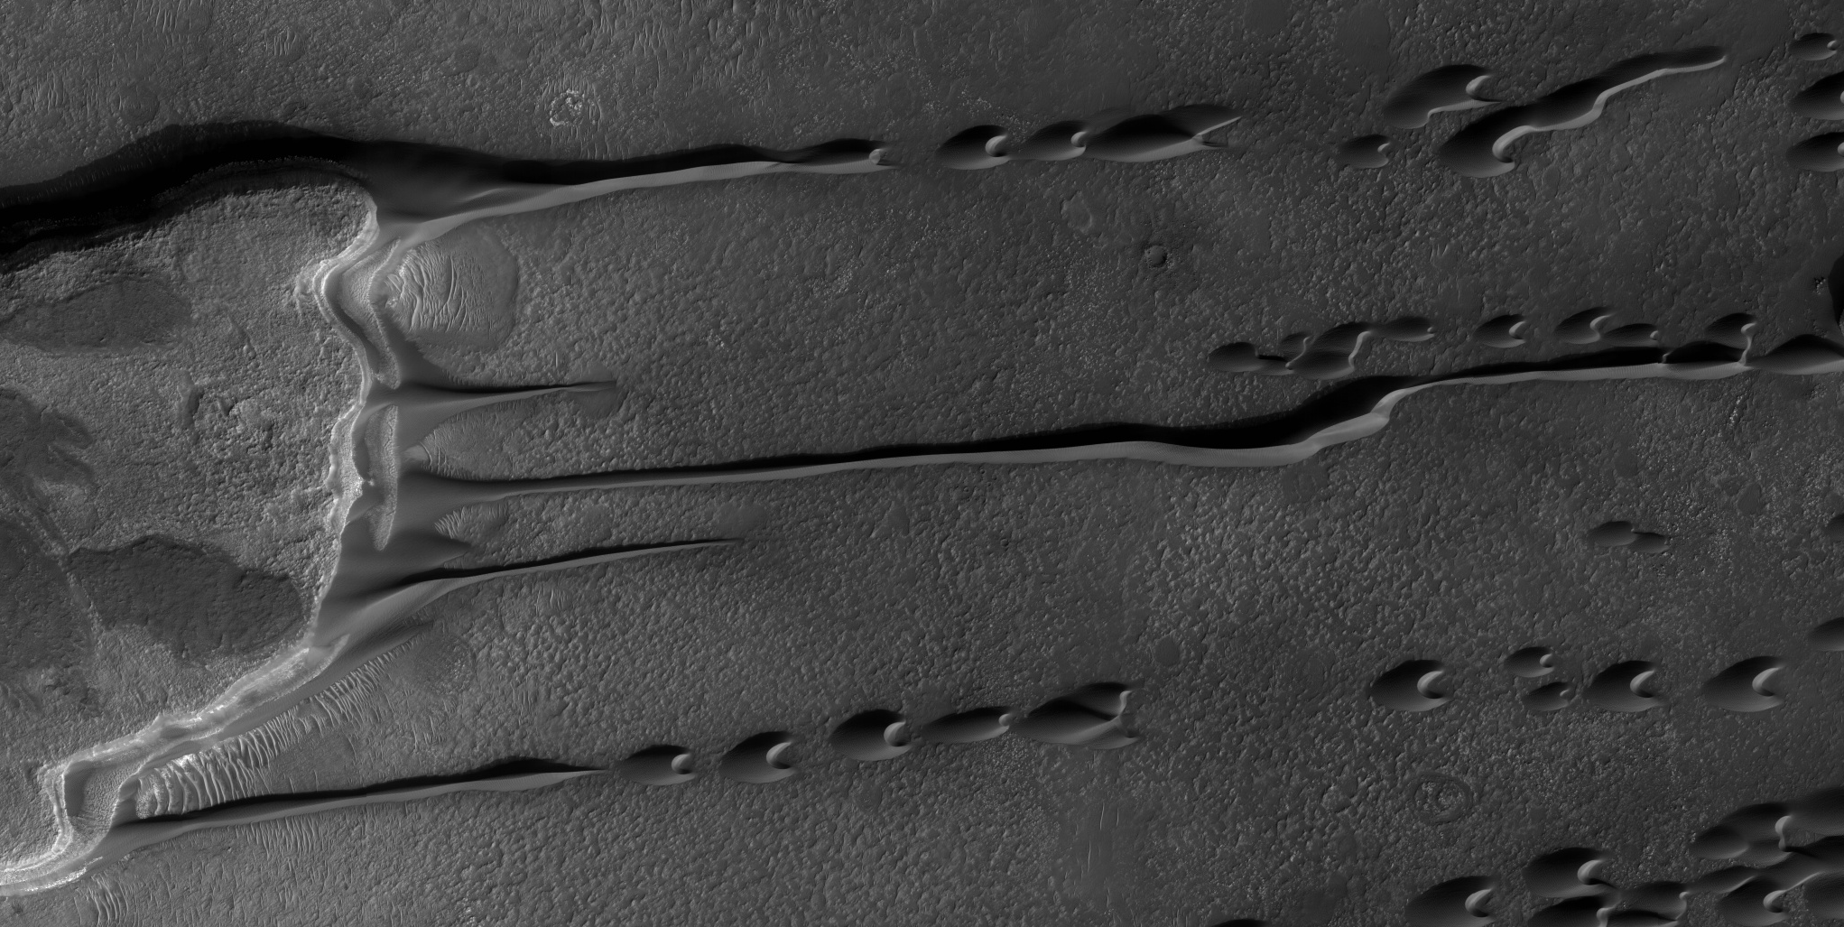
What’s going on here (PSP_007676_1385)?

Slide 21
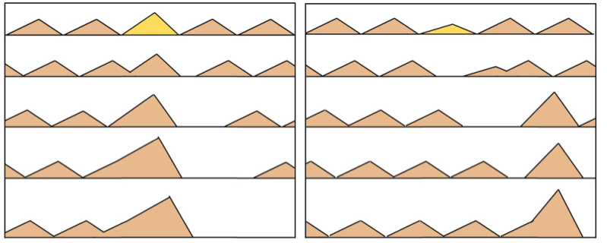
Dune interactions and dunefields
For fast dune collisions…
A perturbation to a dune size leads to runaway growth

Slide 22
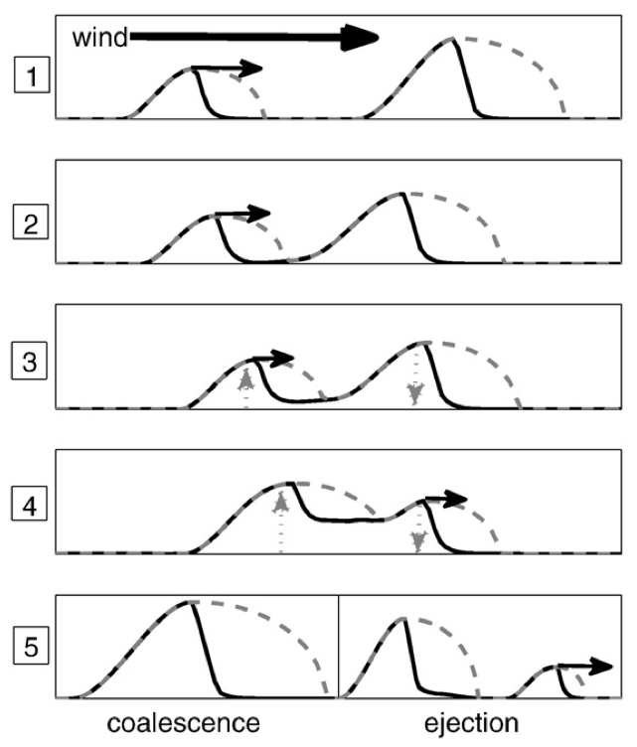
Slow collisions
Dunes have a separation bubble
(zone of zero shear stress)
Smaller dune can approach slowly
Starts to ‘steal’ sand from the larger dune
Dune-size ratio close to 1
Interaction is slow
Upwind dune steals sand until size ratio is reversed
Downwind dune is now faster and escapes
Dune-size ratio far from 1
Interaction is fast
Dunes merge
Diniega et al. 2010

Slide 23
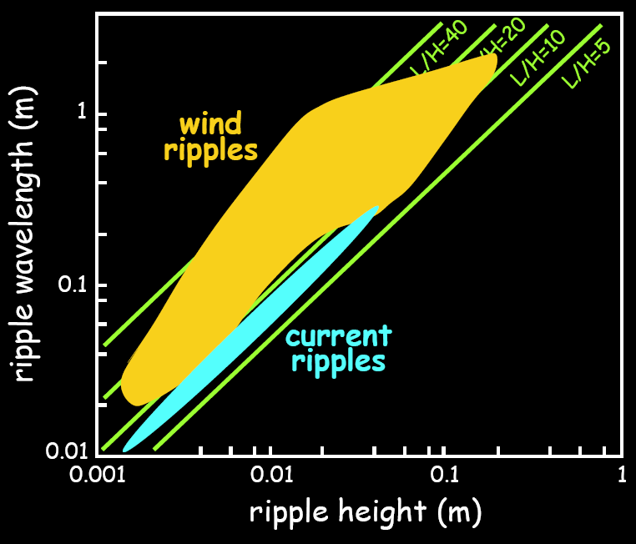
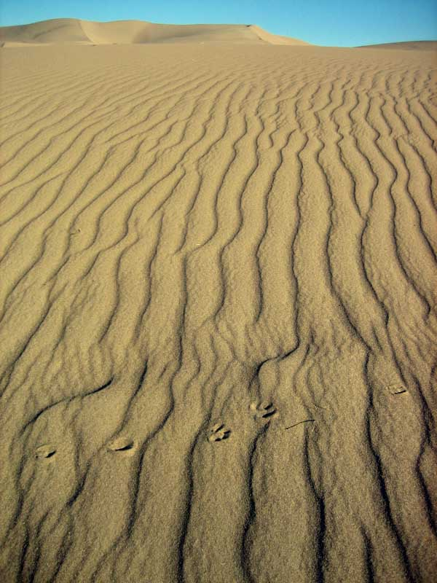
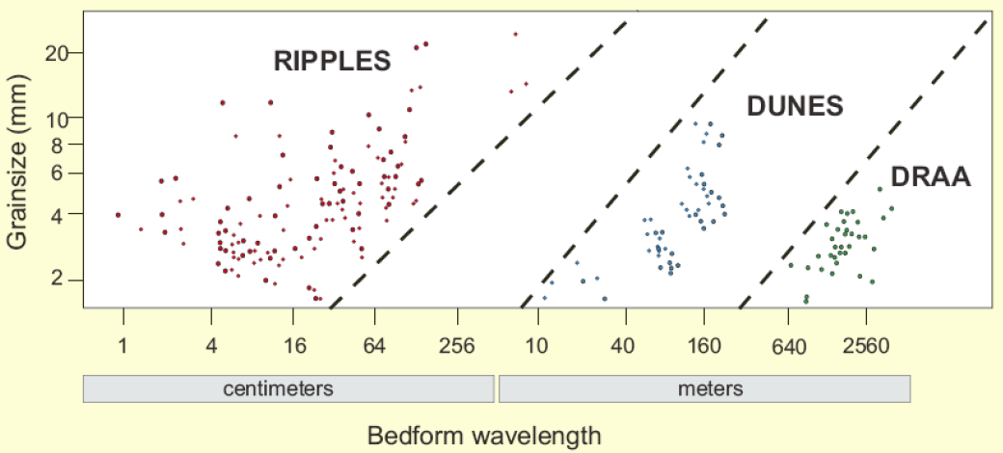
Ripples
Form perpendicular to wind direction
Much more dynamic than dunes
Asymmetric, 8-10 vs 20-30 degree slopes
Separation bubbles, but not slip faces
Wavelengths 0.5cm to 25m (mega-ripples)
Typical wavelengths 7-14cm, heights 0.5-1cm
Ripple index: L / Height, typically ~18
Wavelength related to grain-size
(but also wind speed…)

Slide 24
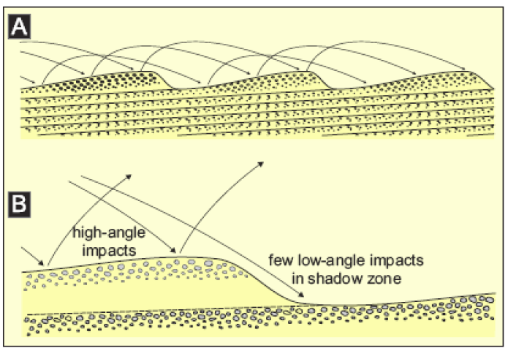
Bagnold again…
Saltation path length ~ wavelength
High angle impacts erode material from Stoss side
Low angle impacts deposit material in shadow zone
Coarse-grained material tends to get concentrated on the crests

Slide 25
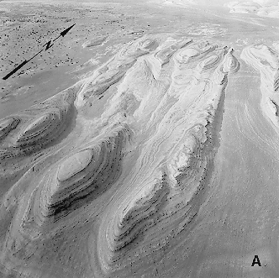
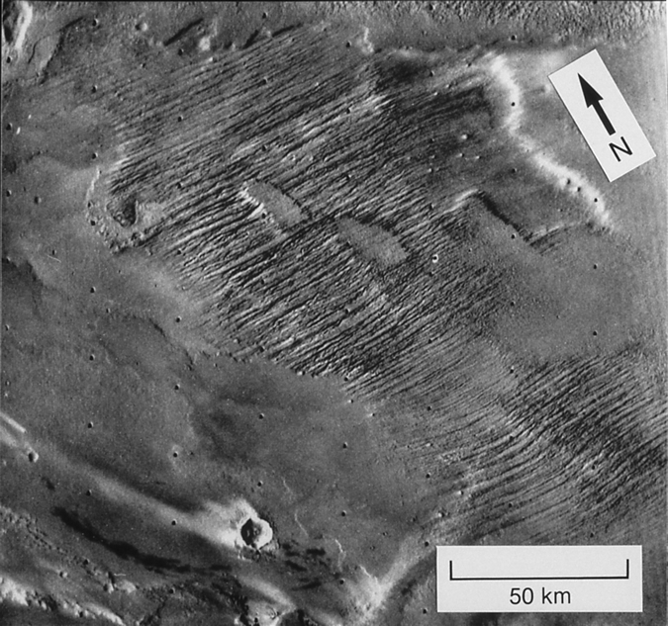
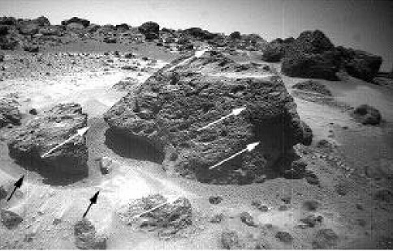
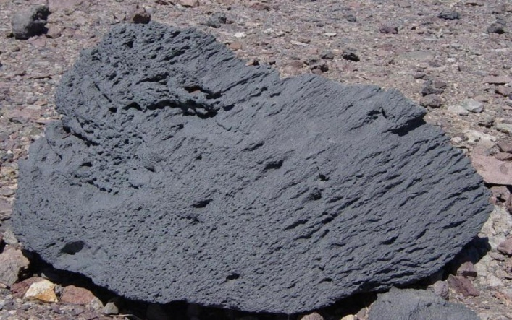
Aeolian Erosion
Yardangs
Wind blown particles abrades surface
Erosion leaves elongated mounds as remnants
Requires strong, virtually unidirectional, wind.
Eroded material must be consolidated
Recentwind action
Older wind action
Ventifacts
Elongated erosional marks on rocks
Usually works on originally circular vesicles
Used as paleo-wind direction indicators e.g. pathfinder landing site

Slide 26
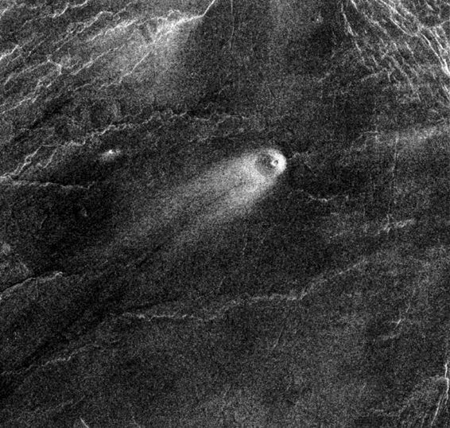
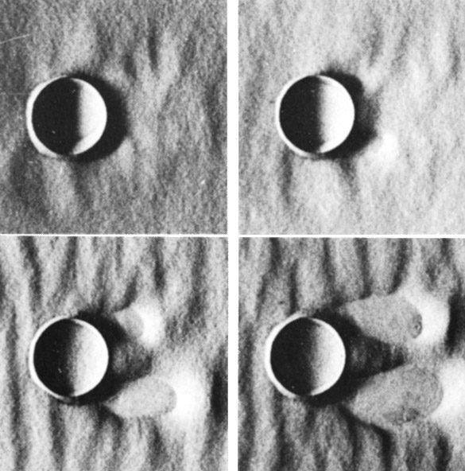
Crater Streaks
Topographic obstacles cause turbulence
Can strip away bright dust
Separation eddy can also form in lee of obstacle
Causes deposition
Venus
Mars
Wind Tunnel

Slide 27
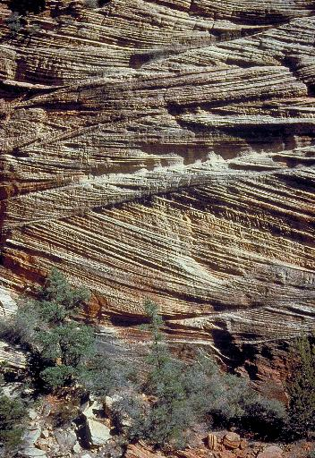
Cross-Bedding
Dunes can be lithified in place, preserving their internal stratigraphy

Slide 28
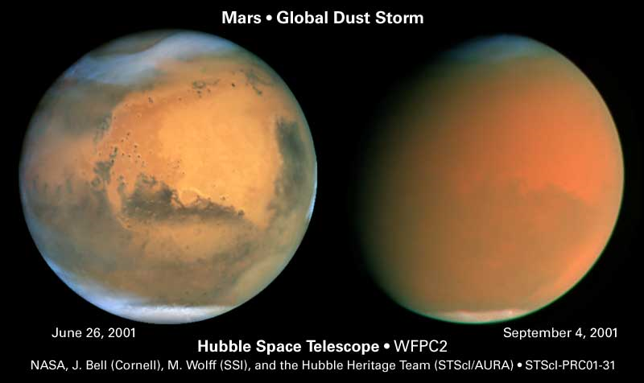
Suspension?

Slide 29
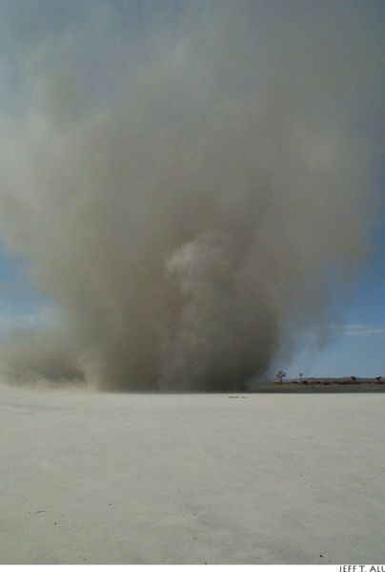
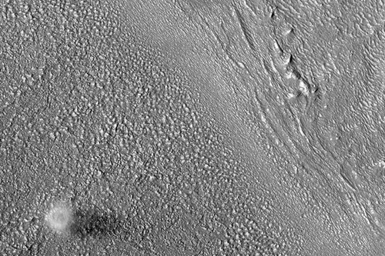
Dust Devils
Plume of hot air rises
Penetrates cooler atmospheric layer
gets stretched out vertically
Conservation of angular momentum starts column spinning
More hot air gets sucked in at the base to keep it self-sustaining

Slide 30
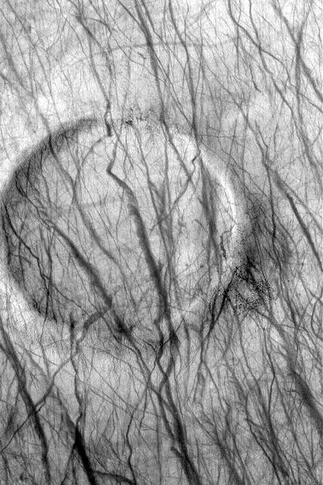
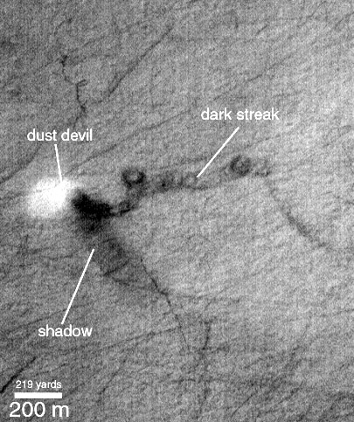
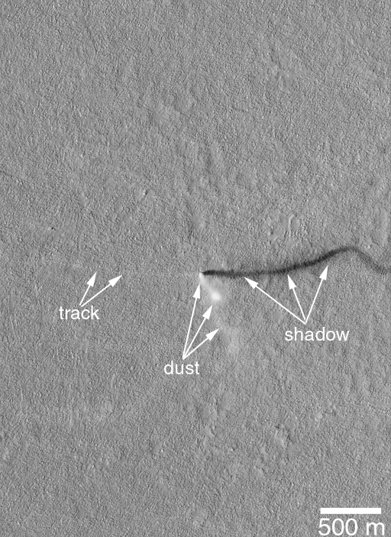
Common in certain areas on Mars
Older streaks fade with time- redeposition of dust
Dust-devil shadows indicate heights of one to several km

Slide 31
Common in certain areas on Mars
Older streaks fade with time - redeposition of dust
Dust-devil shadows indicate heights of one to several km

Slide 32
Climate affects wind
Wind affects climate through shifting albedo (temperature) patterns
Geissler et al. 2013
+332 days
+1012 days
+1829 days
Daubar et al. 2012

Slide 33
Long-term Dust Changes
Dust storms occur frequently on Mars
Cause the albedo patterns to evolve in shape and size

Slide 34
Martian albedo patterns have changed in the past few decades
Mostly caused by thin layers of dust being transported around the surface
Changes the daytime temperature patterns
Night-time temperatures unaffected – i.e. a very thin layer
Climate change on Mars?
Fenton et al., 2007

