Slide 1
Mars Geology – Ice
Shane Byrne (shane@lpl.arizona.edu)

Slide 2
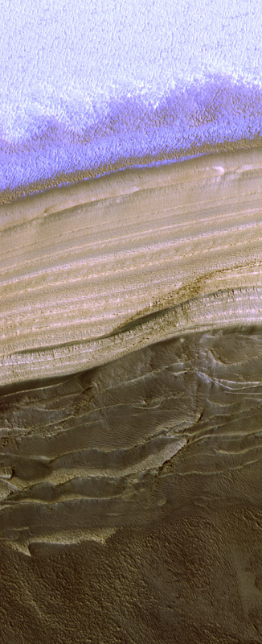
Three things to consider
  Seasonal frost – covered earlier
  Residual Ice Caps
  Polar layered deposits and mid-latitude ground ice
PSP_001378_2640

Slide 3
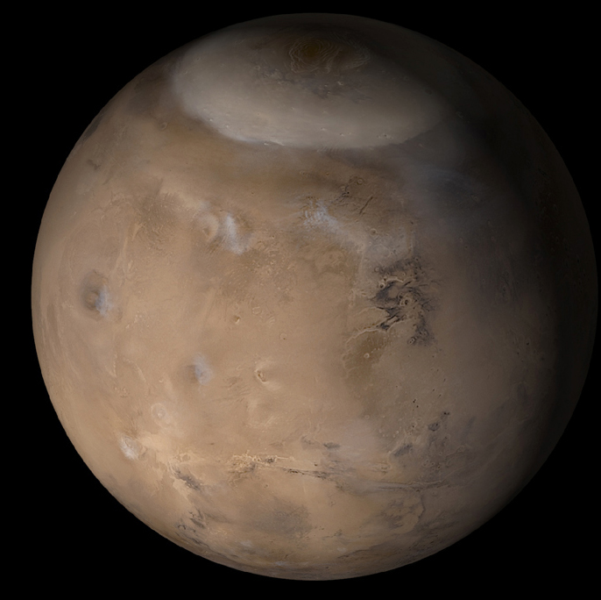
Seasonal frost on Mars
  Major feature of martian seasons
  Exotic CO₂ ice processes
  Seasonal timescale of 686 days
Residual ice caps
  Interacting with current climate
  Affected by global dust storms
  10⁰ to 10² years (South)
  10³ to 10⁴ years (North)
Polar layered deposits
  Record of changing climate
  Linked to orbital variations
  10⁵ to 10⁷ years
Older Polar deposits
MOC wide angle, msss.com

Slide 4
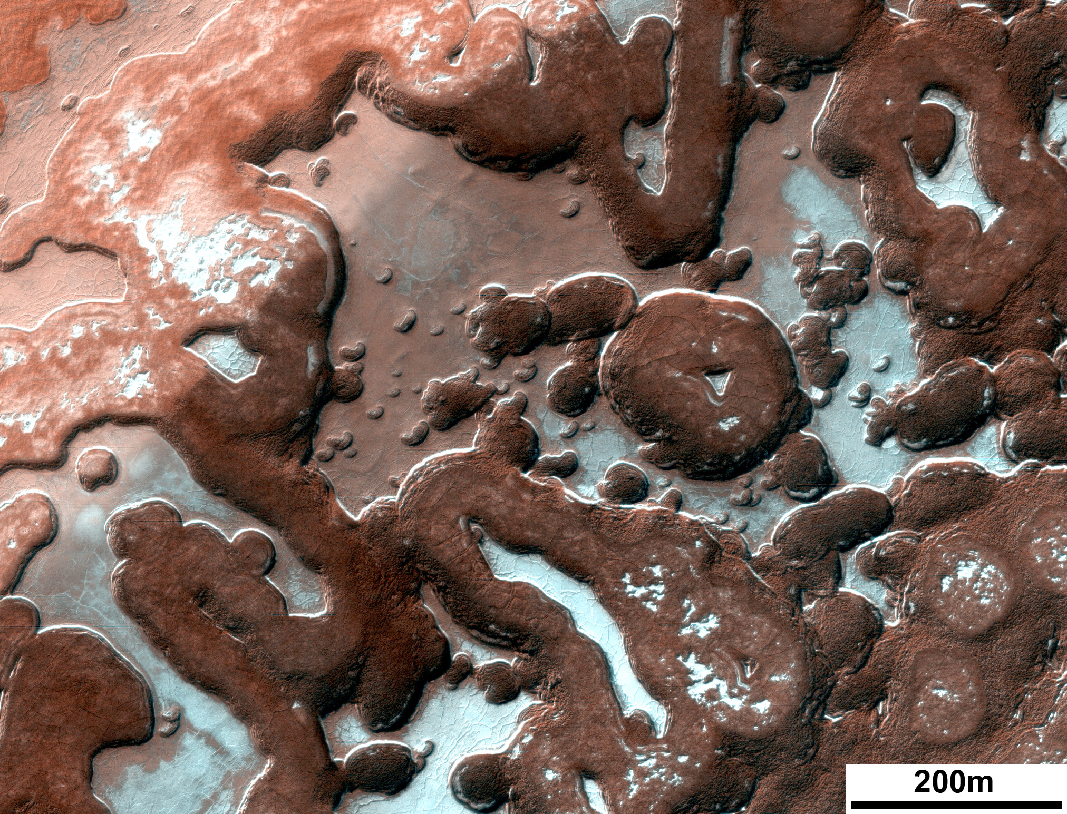
Seasonal frost on Mars
  Major feature of martian seasons
  Exotic CO₂ ice processes
  Seasonal timescale of 686 days
Residual ice caps
  Interacting with current climate
  Affected by global dust storms
  10⁰ to 10² years
Polar layered deposits
  Record of changing climate
  Linked to orbital variations
  10⁵ to 10⁷ years
Older Polar deposits
PSP_006270_0955

Slide 5
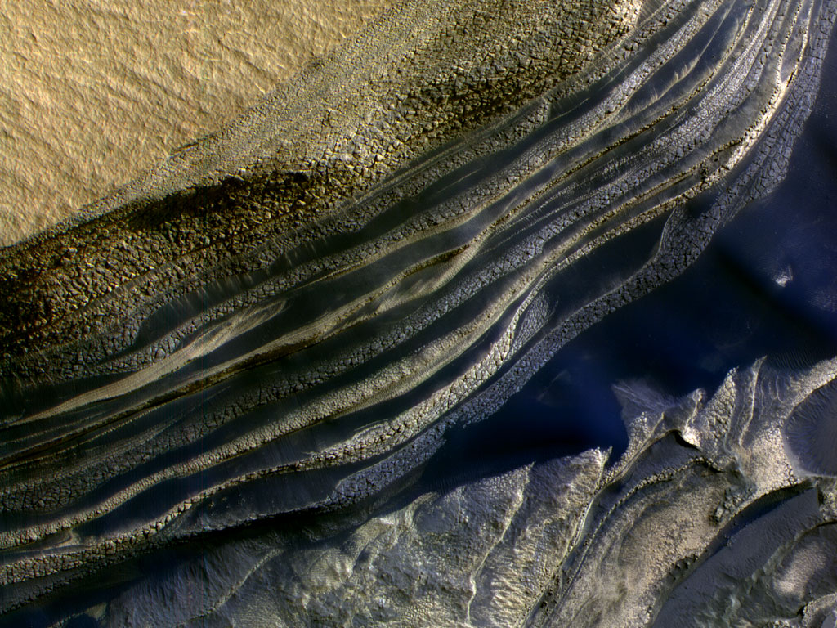
Seasonal frost on Mars
  Major feature of martian seasons
  Exotic CO₂ ice processes
  Seasonal timescale of 686 days
Residual ice caps
  Interacting with current climate
  Affected by global dust storms
  10⁰ to 10² years
Polar layered deposits
  Record of changing climate
  Linked to orbital variations
  10⁵ to 10⁷ years
Older Polar deposits
PSP_001334_2645

Slide 6
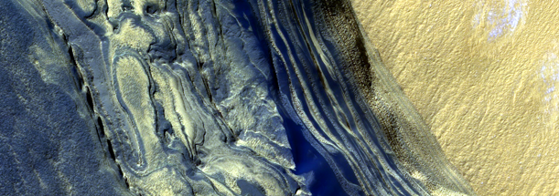
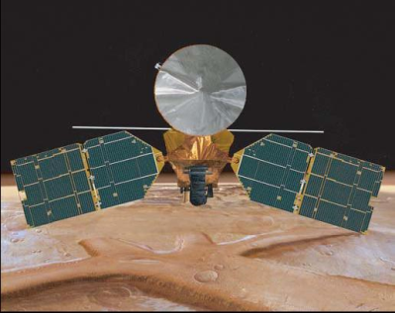
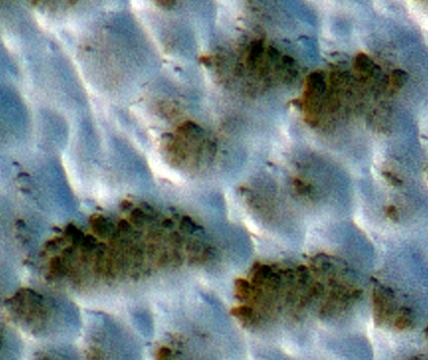
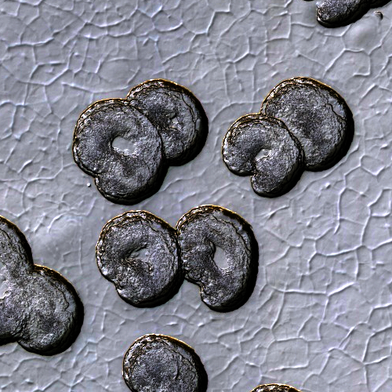
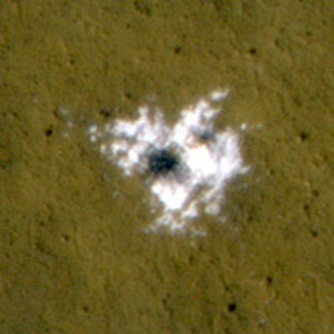
Climatic Record
Spacecraft Record
YEARS
10⁸
10⁷
10⁶
10⁵
10⁴
10³
10²
10¹
10⁰
Recent climatic variations
Interannual variability of the current climate

Slide 7
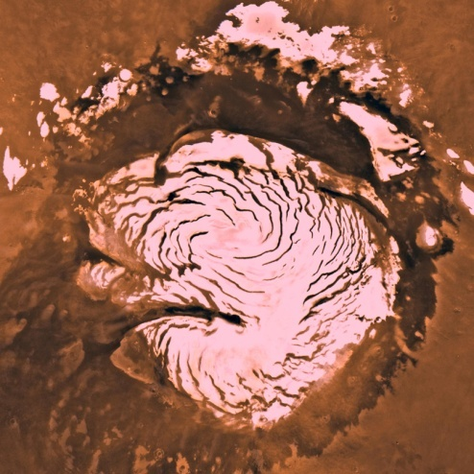
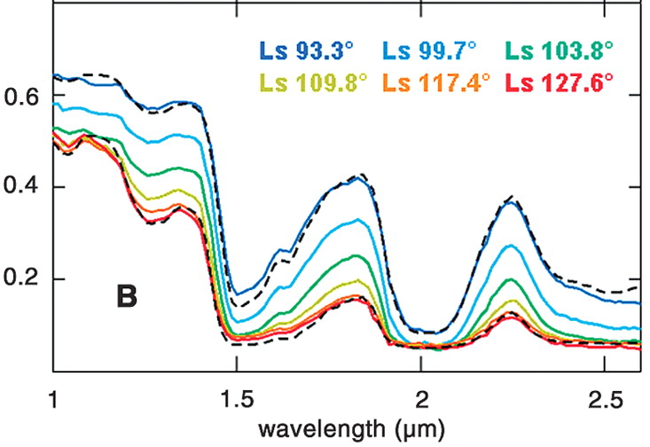
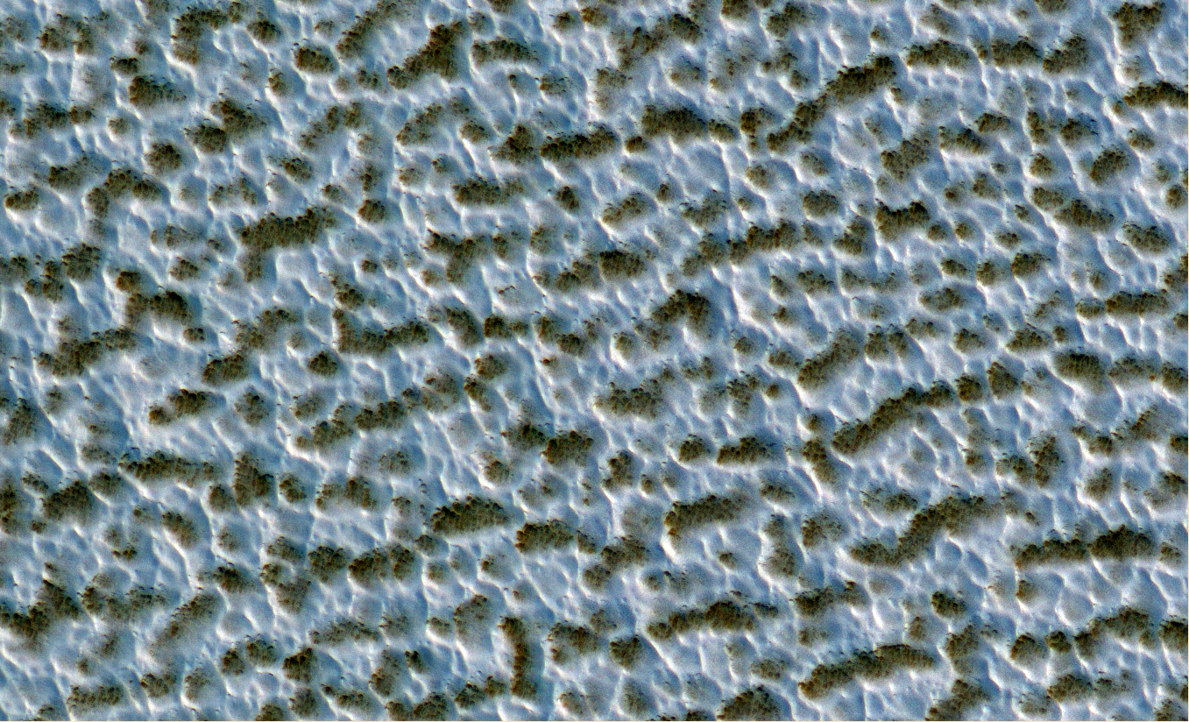
Residual ice caps
North polar residual ice cap is made of dust-free large-grained water ice
Langevin et al., 2005

Slide 8
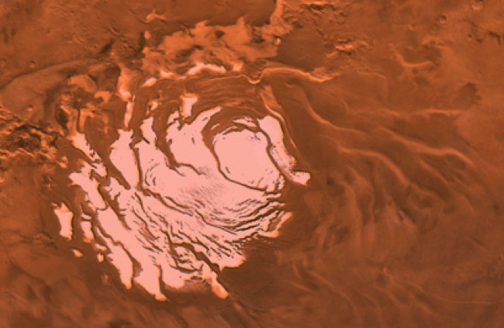
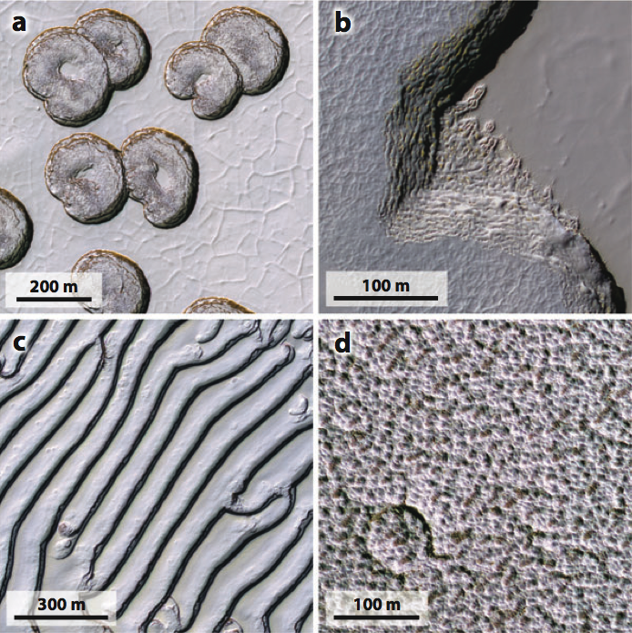
Martian Residual CO₂ cap
The residual ice-caps partially cover the layered deposits.
  Very thin
  Southern residual ice is CO₂
Interacting with current climate
  Exchanging volatiles on annual timescales
  Climate record of decades to centuries

Slide 9
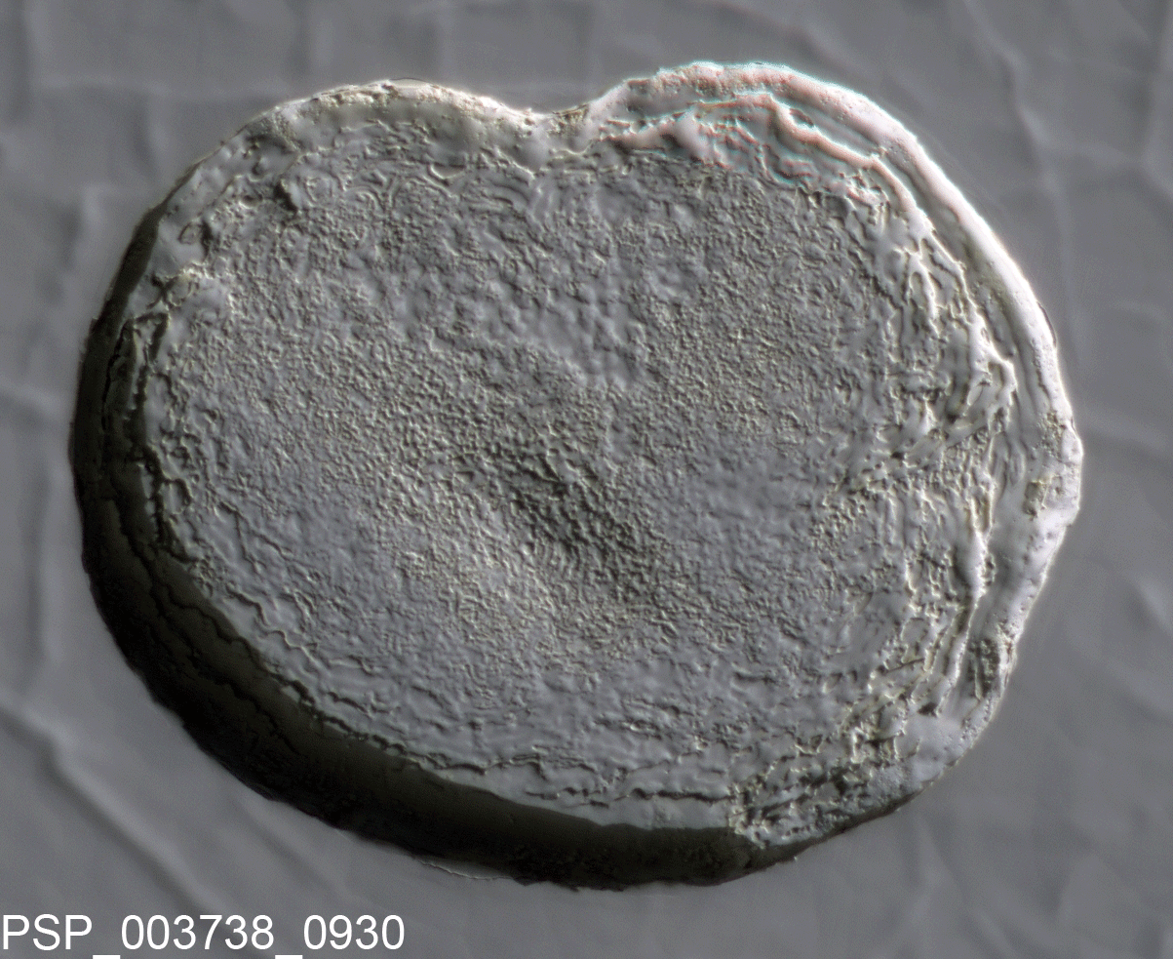
Thomas et al., 2005
Swiss-cheese pits expand by meters per year.

Slide 10
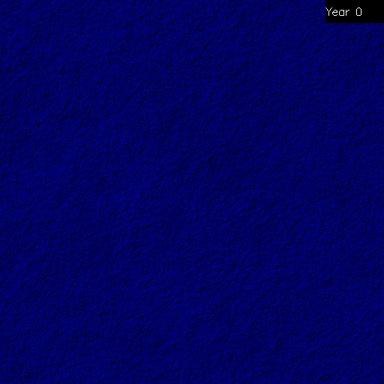

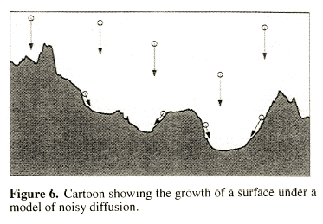
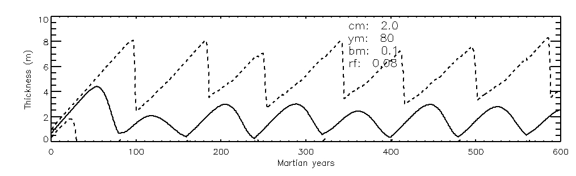
Reincarnation of the Residual Cap
Surface roughness increases with time – pits form
Remnants of old cap determine where new pits will form.
Different generations of ice cap overlap
Minimum thickness is always zero
  Swiss-cheese depressions are always present

Slide 11
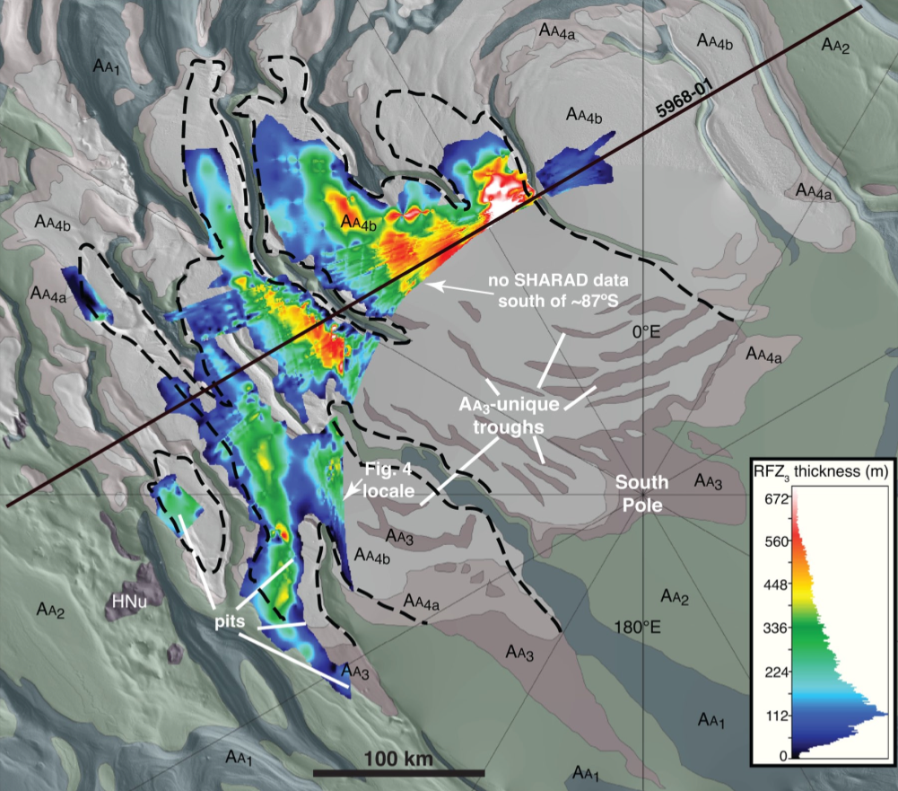
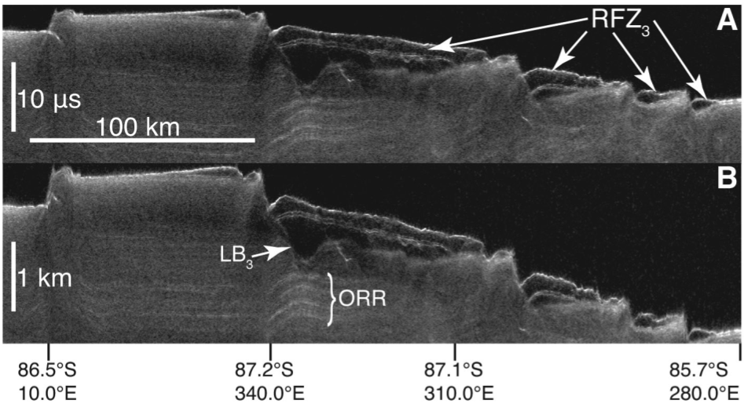
More CO₂ ice buried below some H₂O ice
  Accessible to the atmosphere in high obliquity periods
  Could double atmospheric pressure
Current residual cap stabilizes this larger deposit
CO₂ ice, a few meters thick
10-10²yr timescales
H₂O ice, a few meters thick
10⁴ yr timescales
Buried CO₂ ice
Up to 100s meters thick
10⁵ yr timescales
Polar Layered Deposits
H₂O ice
Up to 4km thick
10⁶-10⁷ yr timescales
Phillips et al., 2011

Slide 12
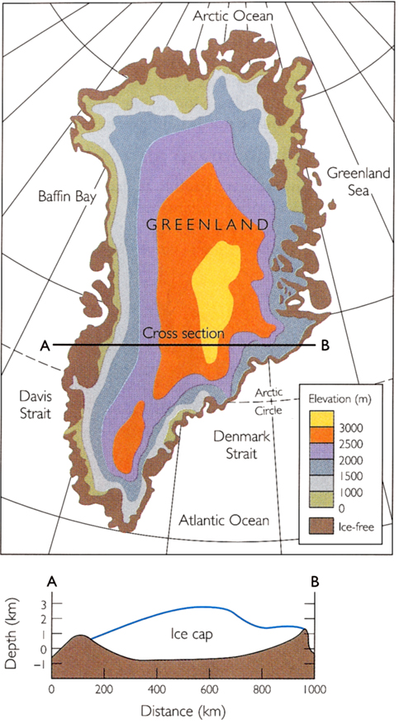
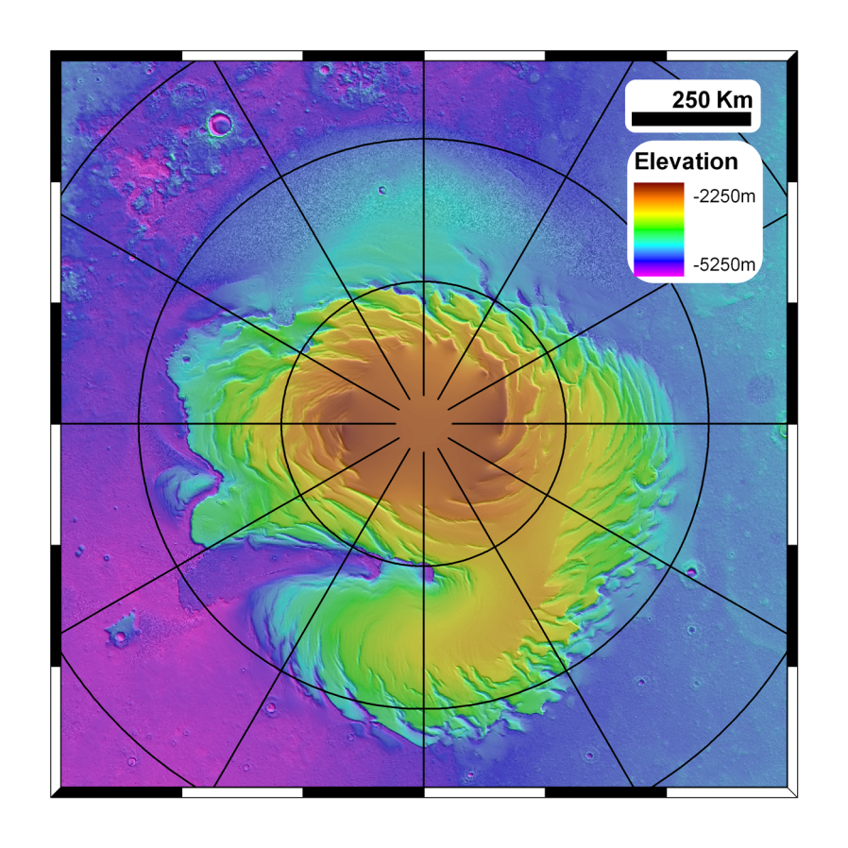
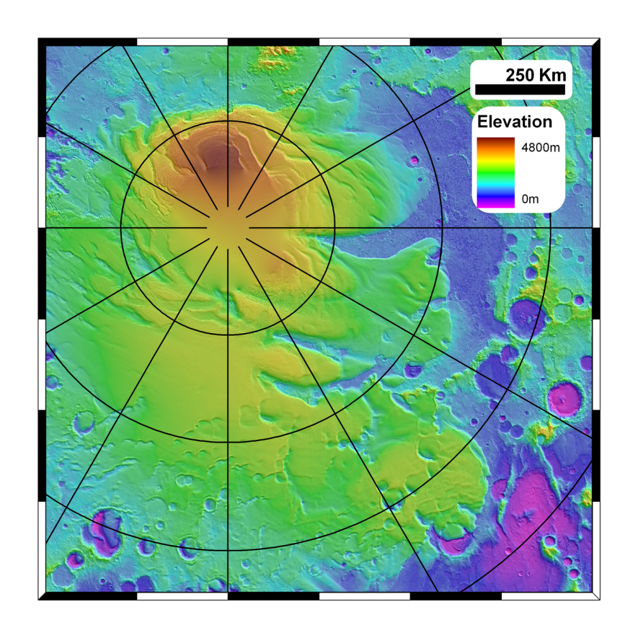
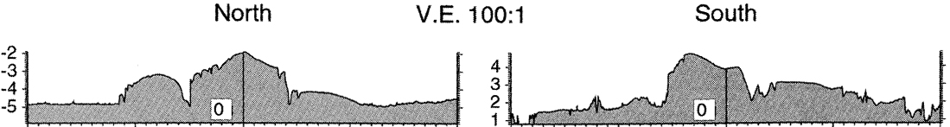
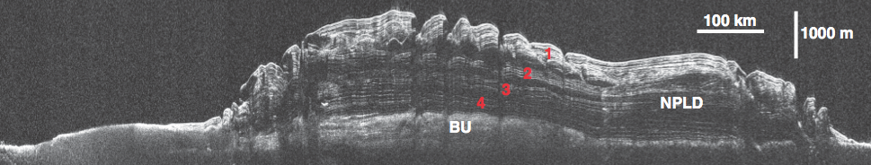
6 million km³
Mars North pole
Mars South pole
1.1 million km³
1.2 million km³

Slide 13
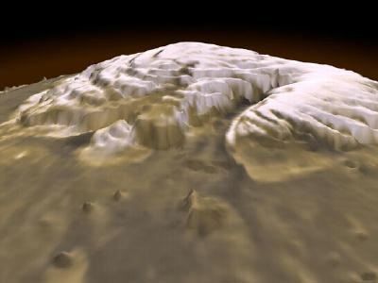
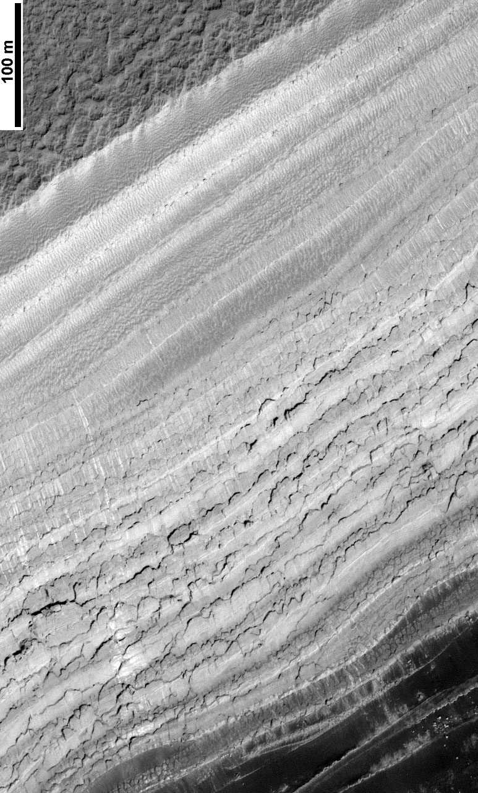
Layers similar to those in ice-cores on the Earth
Climate record of a few million years

Slide 14
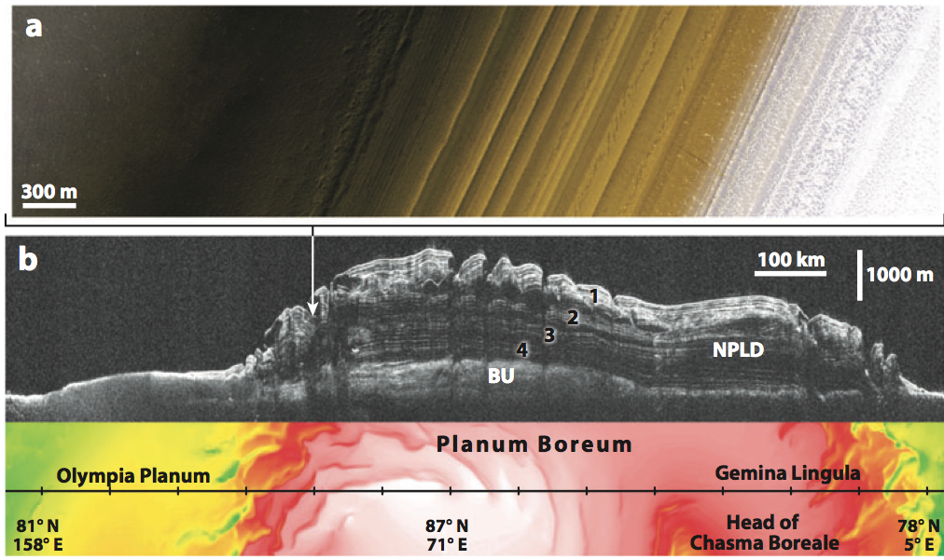
Radar layers look like they should correspond to the layers we see in images
  This link has proven hard to nail down precisely though

Slide 16
Obliquity
  Earth ~ 23 degrees
  Mars today ~ 25 degrees
Eccentricity
  Earth ~ 0 (circular)
  Mars today ~ 0.1 (ellipse)

Slide 17
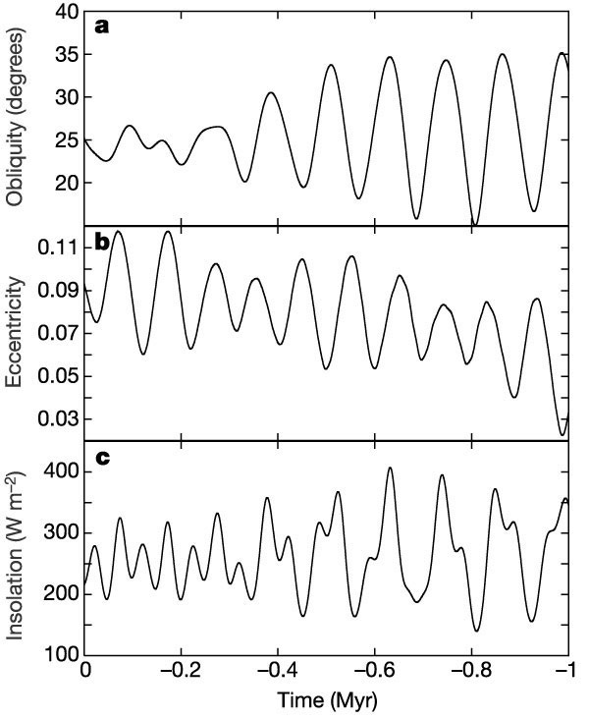
Laskar et al., 2003

Slide 18
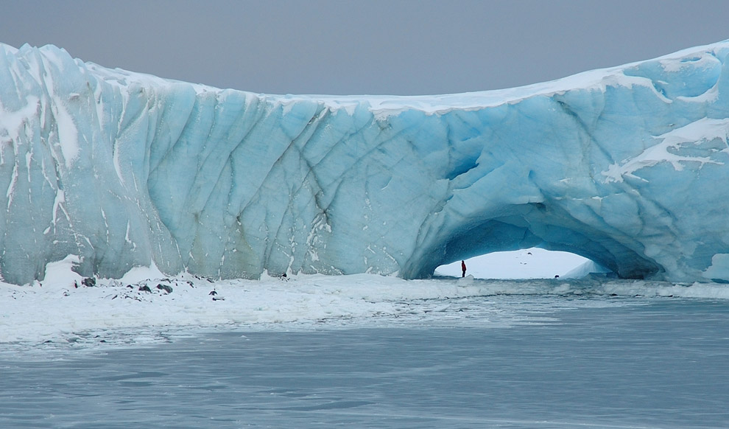
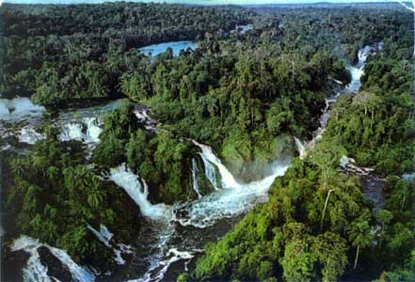
Even larger variations before that
  Factor of 3 variation in solar power
Factor of 3 in solar power on the Earth
Laskar et al., 2003

Slide 19
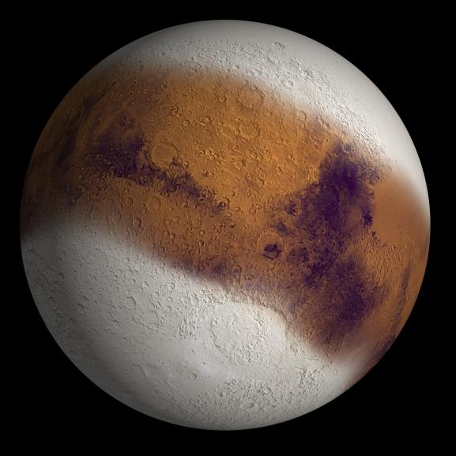
Martian “Ice Ages”
During high obliquities
  Ice is more stable in the mid-latitudes
  Water ice sublimates from polar ice caps
  Reaccumulates in the mid-latitudes
During low obliquities
  Ice is more stable at the poles
  So water moves back…
High-obliquity
Low-obliquity

Slide 20
Jump to higher obliquity ~5 million years ago
It’s thought that the polar layered deposits could not survive that
This simple picture is probably naïve and conflicts with basic info like the cratering record of the south polar layered deposits (which shows the surface age to be 10s of Myr)

Slide 21
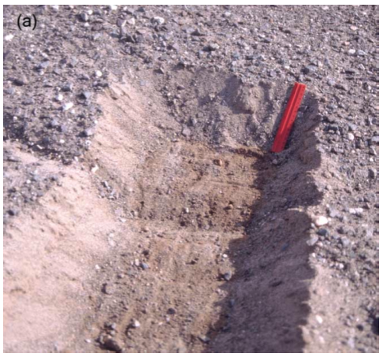
Ground ice on Mars theorized to exist for some time
  Regolith provides the thermal insulation
  Stable ice distribution changes with climate
  Diffusive contact with the atmosphere
Water vapor
Surface
Inches to a few feet down

Slide 22
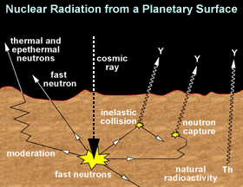
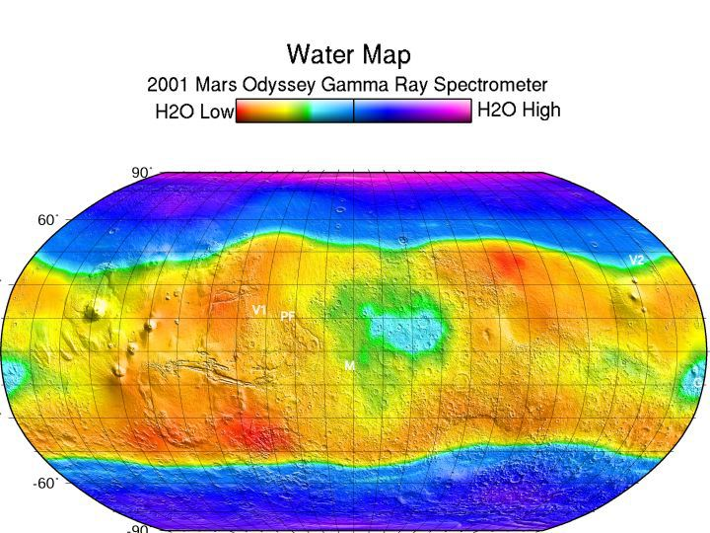
Gamma Ray spectrometer on Mars Odyssey spacecraft has detected hydrogen (from H₂O) in near surface
  At pretty low resolution

Slide 23
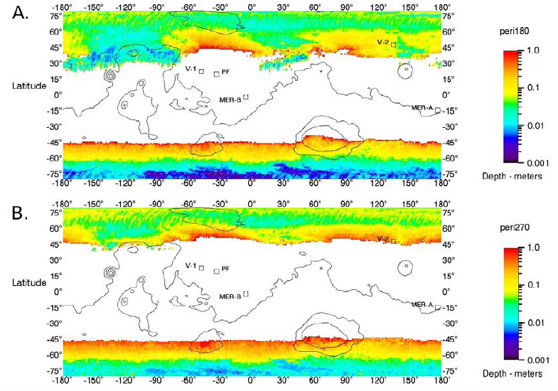
Abrupt edge to ice table
Edge of ground-ice extent is VERY sensitive to climate
10,000 years in the past
Chamberlain and Boynton, 2007
3,000 years in the future

Slide 24
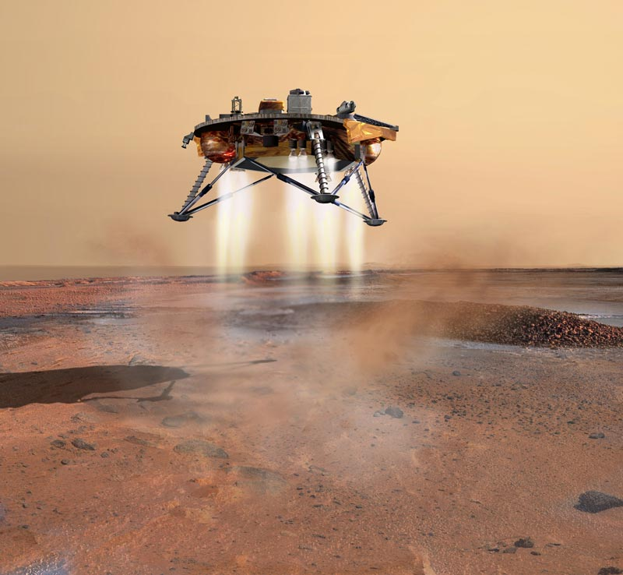
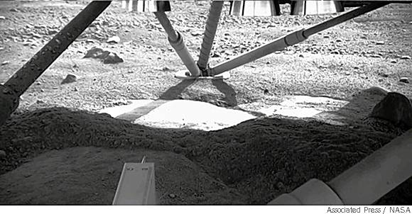
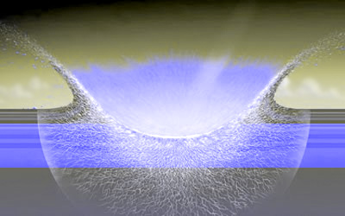
We can dig for the ice…
Another option?
  Small impacts continuously probe the subsurface
  If only we could find them….

Slide 25
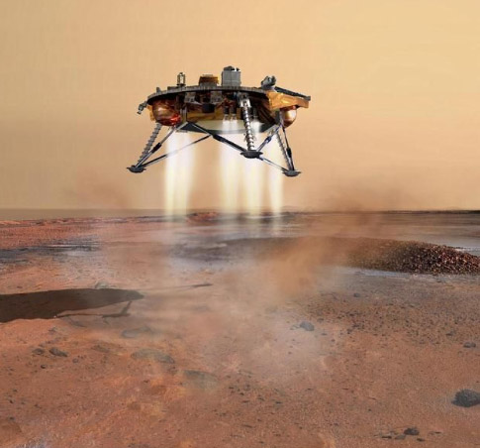
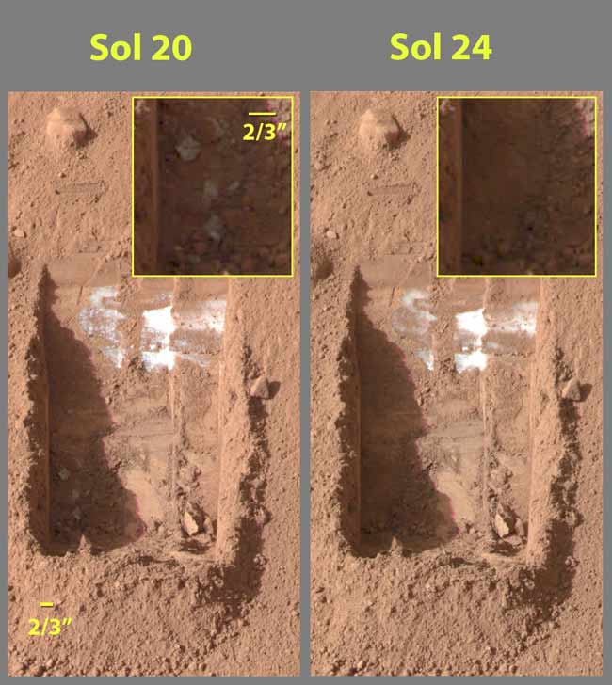
The Phoenix lander discovered very pure buried water ice

Slide 26
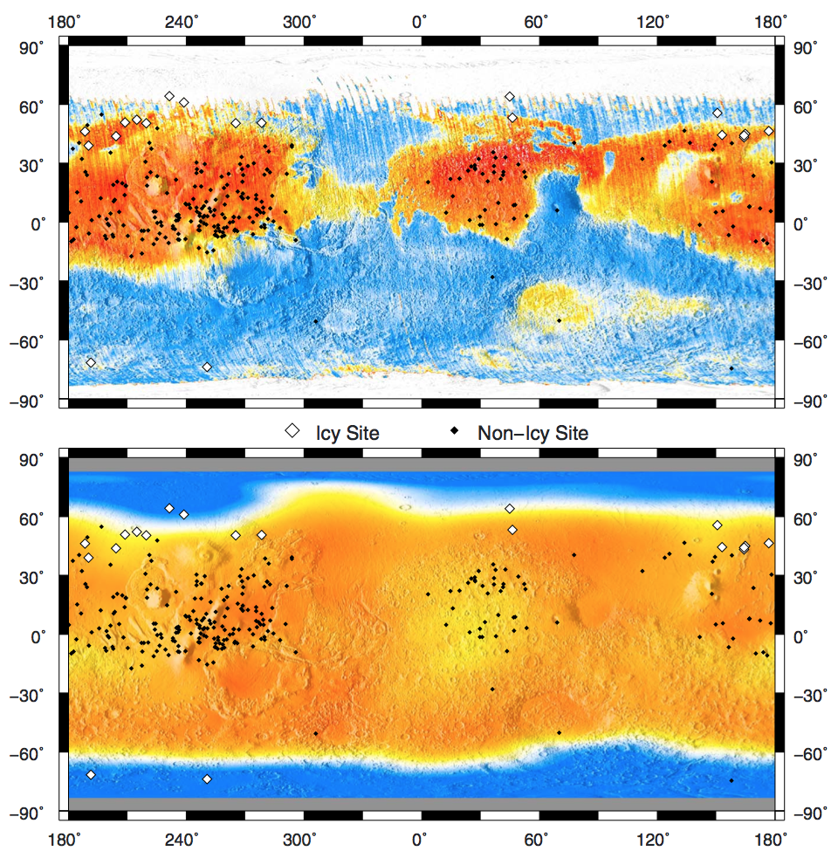
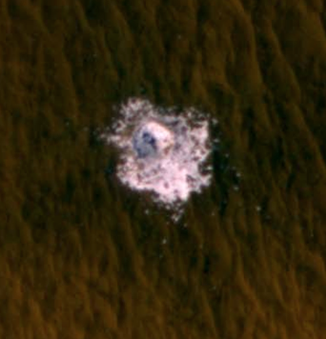
New impacts expose ice in unexpected locations

Slide 27
Problem?
Expected
Observed

Slide 28
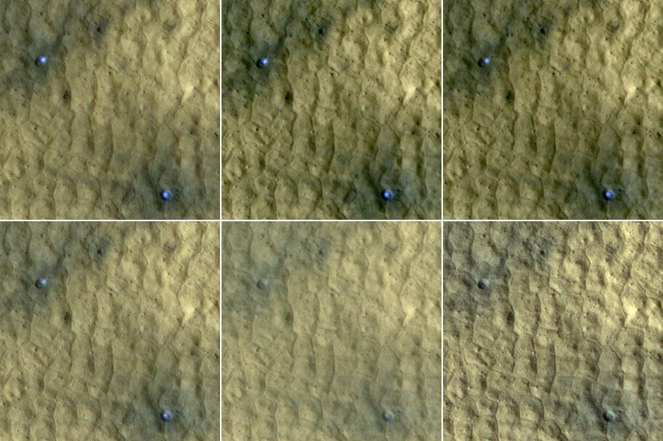
Bright material fades during the martian summer at site 1 over 104 days
  Two craters: diameters 4m, depths 0.5m, 46.3° N 176.9° E

Slide 29
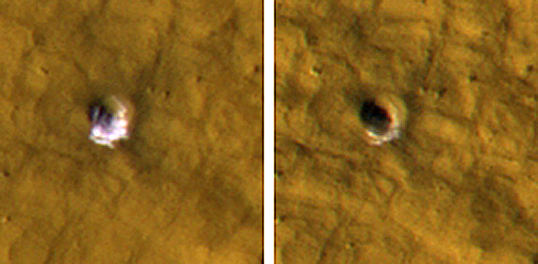
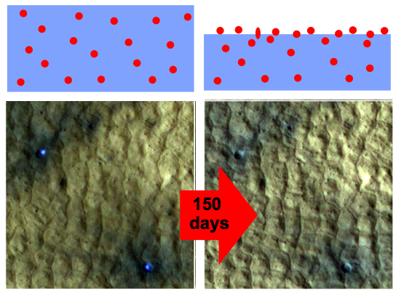
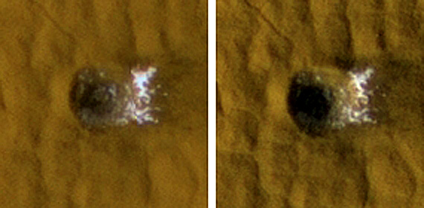
88 days
104 days
50 days
35m
75m
Nominal sublimation gives ~1.7 mm by Ls 180
Optically thick lag in HiRISE BG (0.55 microns) of ~17 microns
  17 microns of dust in 1.7mm of ice is very clean: 1% by volume

Slide 30
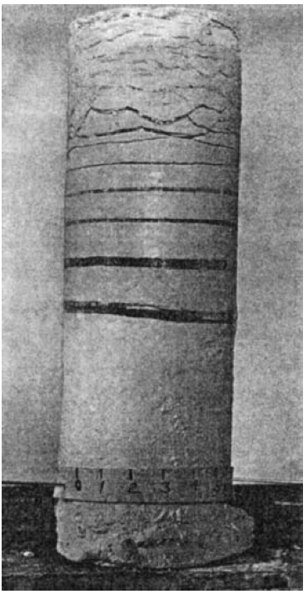
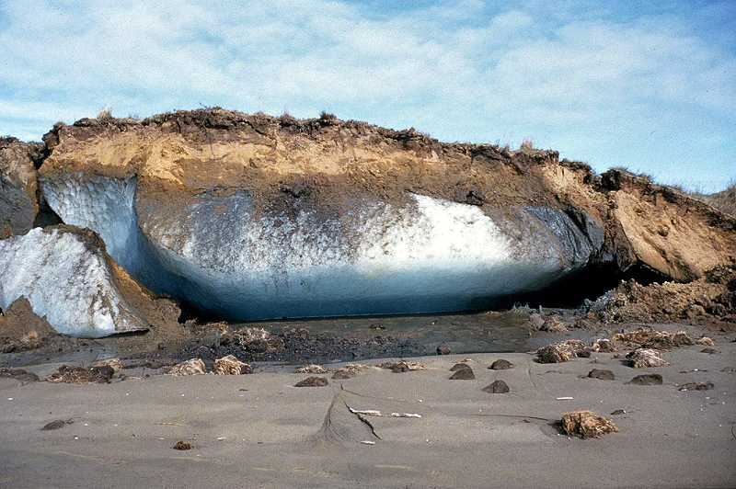
Options for producing buried ice?
  Buried snow from a past climate – but how did it stick around until today?
  Thermal cycling of pore ice – uncertain effectiveness
  Frost Heave
    Requires thin films of liquid water
    Common on the Earth
    Thought to be only able to produce thin ice lenses at shallow depths (Sizemore et al. 2014)
Taber, 1930

Slide 31
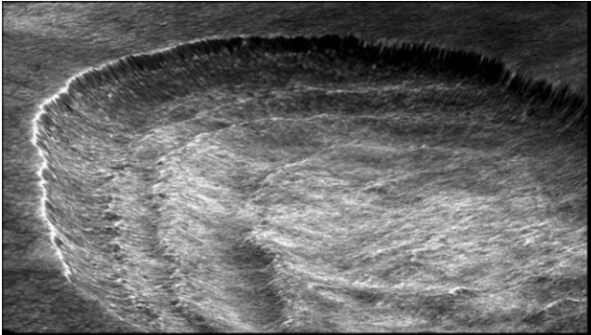

Thermokarst
Scalloped terrain on Mars
Expanded secondary craters
Lefort et al. 2009
Viola et al. 2015

Slide 32


Removal of ground ice causes collapse and slope feedback
  Leads to asymmetric shape
Dundas et al. 2011

Slide 33


Thickness of the icy regolith
  Perhaps up to 10s of meters
    38 meters in this case
  Limited by geothermal gradient (deposition limit not stability limit)

Slide 34

Lobate aprons in the mid-latitudes are also almost pure ice

Slide 35


Lobate aprons are transparent to radar waves
  Holt et al. 2008

Slide 36


Icy slope movements on Mars – melting not expected in current climate
  Fretted terrain
  Concentric crater fill
  Lineated Valley Fill
Levy et al. 2010

Slide 37

Surface texture sometimes called brain terrain

Slide 38





Slide 39



Slide 40



Dissected mantle distribution
h
Viscous flow features distribution
Milliken et al., 2003
Gullies
Lobate ‘debris’ apron distribution
Hauber et al., 2008

Slide 41
Ice moves back and forth between the poles and mid-latitudes as climate changes
The polar layered deposits record these climate variations from orbital changes over at least millions of years
Residual ice caps provide a link between the current climate and the climate record in the polar layered deposits
Mid-latitude ice depths and extent is set by diffusive exchange of water vapor in the atmosphere
Yet, everywhere we look it’s in the form of buried pure ice and not pore-filling ice
  Some combination of old snowfall preservation and modern frost heave may explain this
Glacial and periglacial processes dominate today between the mid-latitudes and the poles.

