Slide 1
Mars Data and where to find them

Slide 2
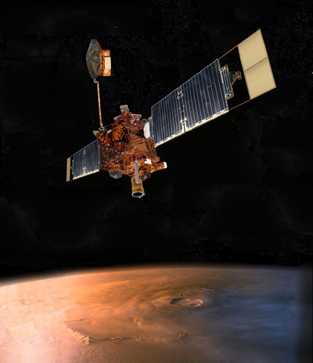
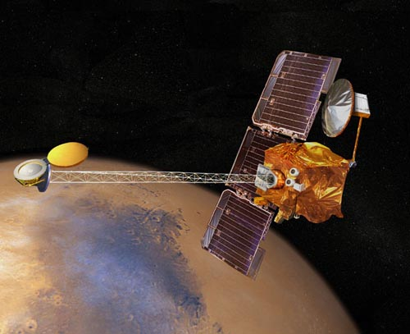
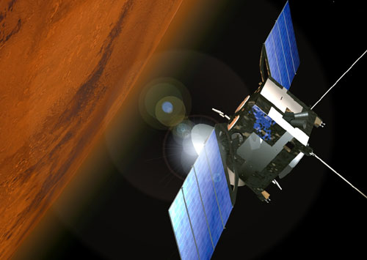
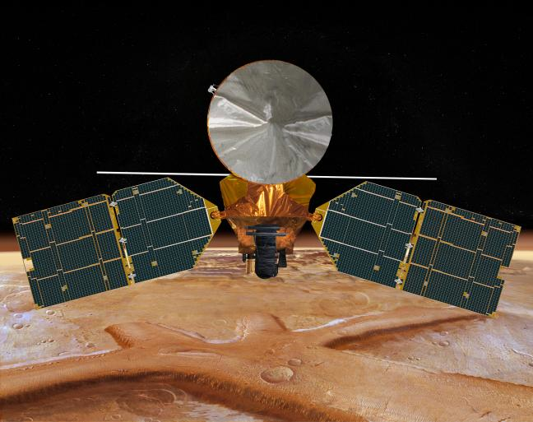
Types of instruments to talk about
Gamma and Neutron Spectrometers
Thermal cameras
Spectrometers
Hyperspectal imagers
RADAR
Mars Global Surveyor (MGS)
Mars Odyssey (ODY)
Mars Express (MEX)
Mars Reconnaissance Orbiter (MRO)

Slide 3
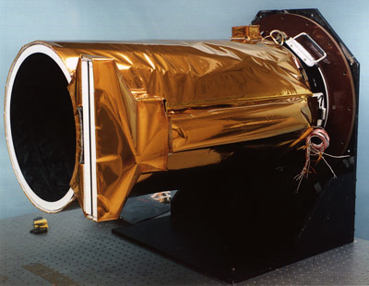
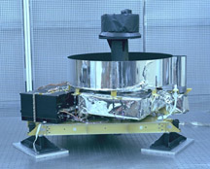
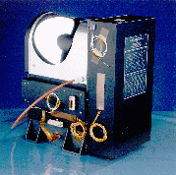
Mars Global Surveyor
At Mars 1998-2006
Unexpectedly had to fly backwards in its orbit
Broken solar panel delayed mission start, but it revolutionized Mars Science
Mars Orbiter Camera (MOC)
Broadband visible imager, up to 1.4 m/pixel
Image widths 3km with variable length
Mars Orbiter Laser Altimeter
1 micron pulsed laser at 10 Hz, footprint size ~180m
Global topography accurate to the nearest meter
Also measured surface reflectance, roughness and cloud heights
Thermal Emission Spectrometer
Broadband thermal and visible bolometers – albedo and temperature measurements
Thermal Spectra 6-50 microns – multiple applications
3x6 km resolution
Magnetometer
Particles and fields measurements
Wasn’t expected to yield any surface info, but the broken solar panel turned out to be useful after all…

Slide 4
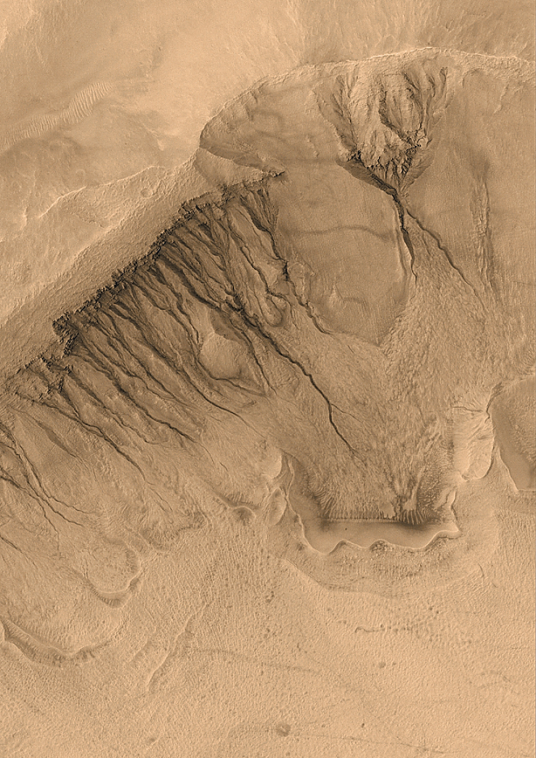
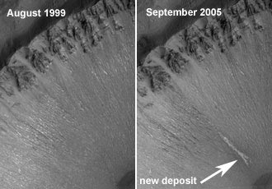
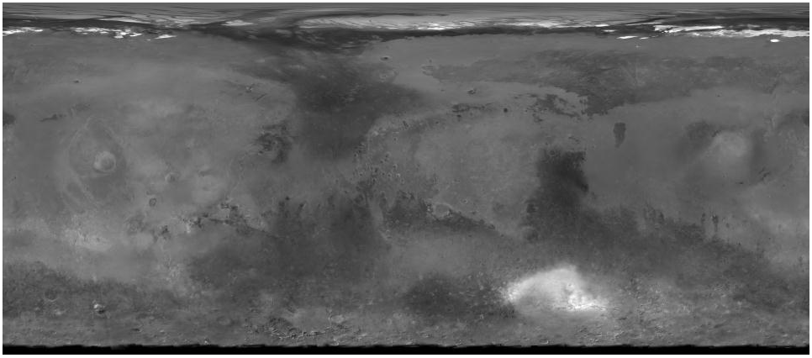
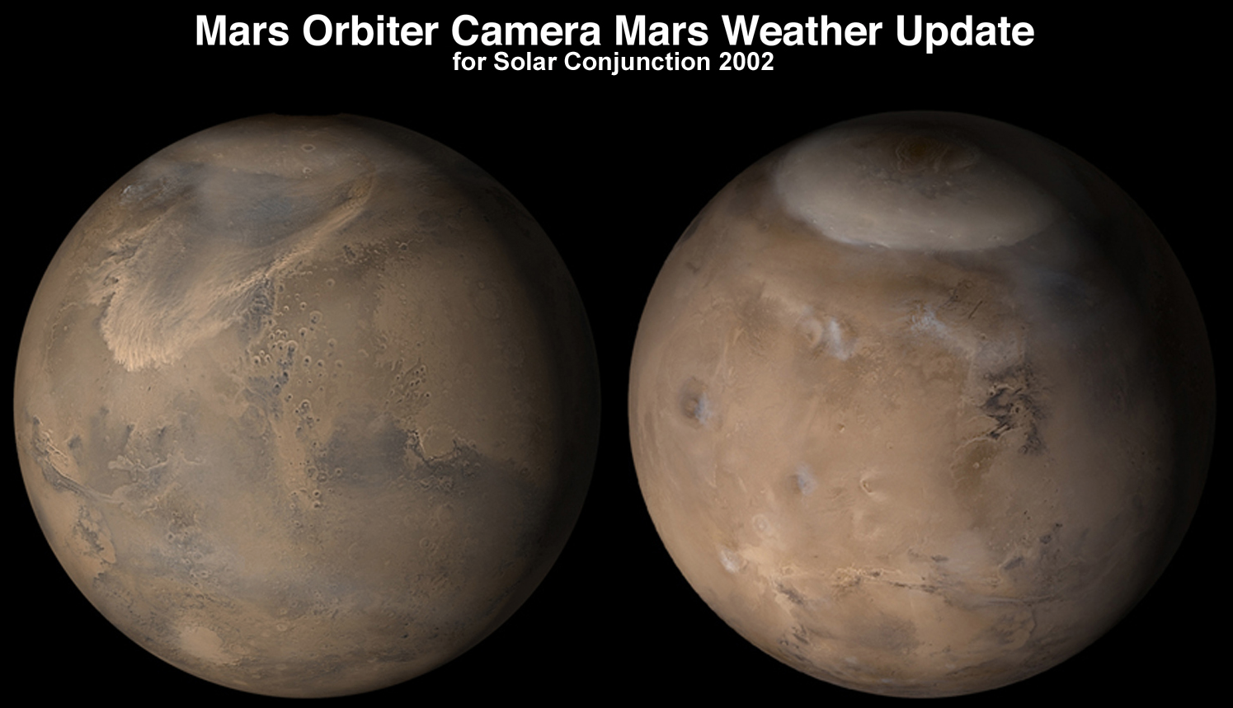
MOC
Malin Space Science Systems
Data can be found on the PDS as well as www.msss.com
Narrow angle camera
Gullies and their activity
Polar layers & frost changes
New impacts
Sedimentary layers
Landing site safety
Wide angle camera
MOC global Atlas
Daily global weather maps

Slide 5
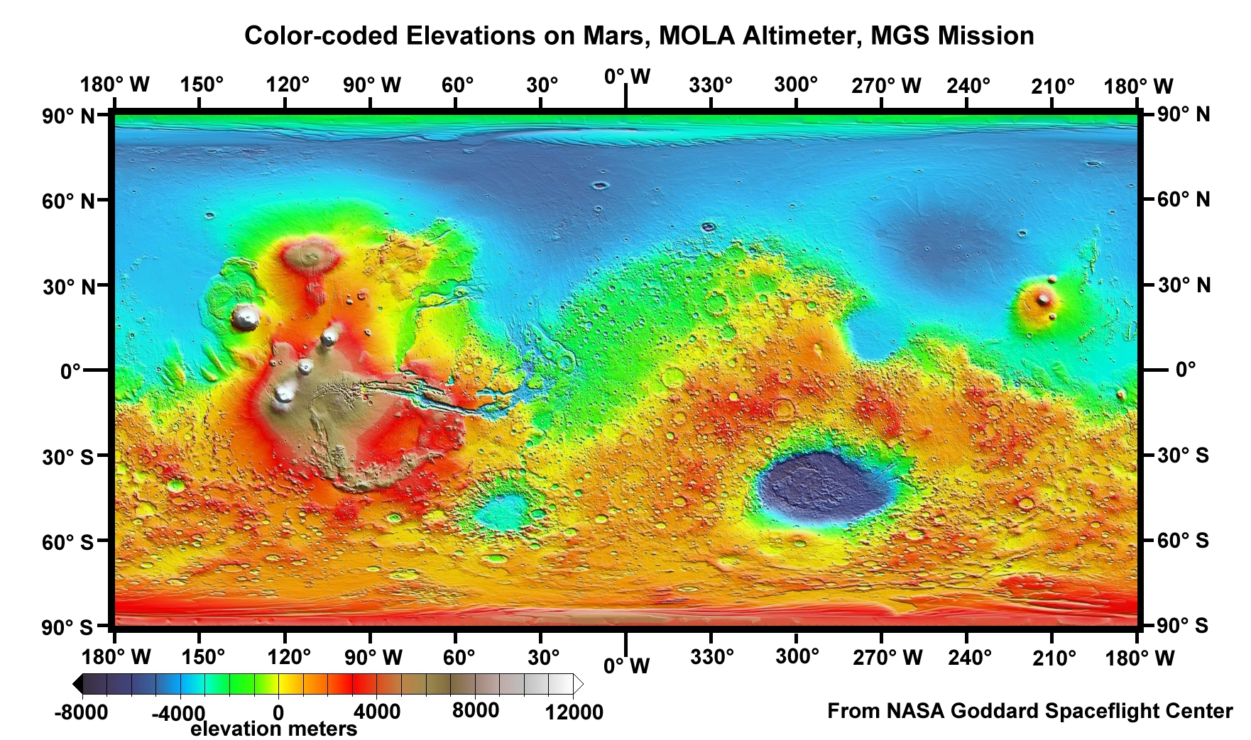
MOLA
Global topography
Some gaps at equator (up to a few kilometers), but complete polar coverage
Track cross-over correction makes the dataset globally self-consistent
This is the key dataset that everything else is georeferenced to

Slide 6
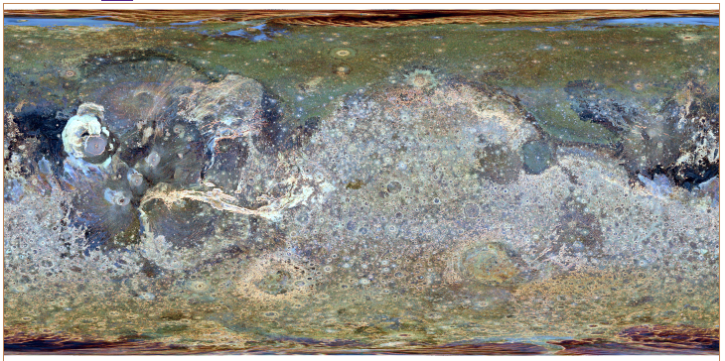
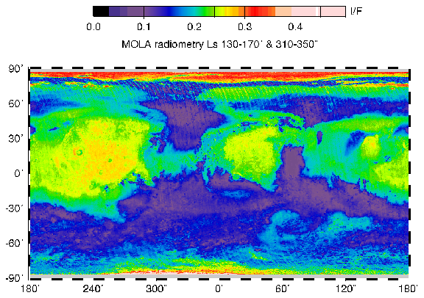
Kreslavsky & Head vertical roughness. Red, green and blue composite from roughness at 0.6 km, 2.4 km, and 9.2 km baselines.
Reflectance measurements from the active reflection
Later MOLA made passive measurements of reflected sunlight

Slide 7
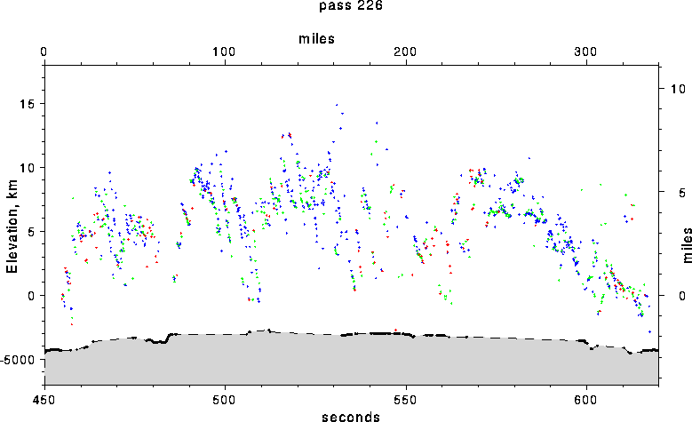
MOLA can detect clouds on both the day and night sides

Slide 8
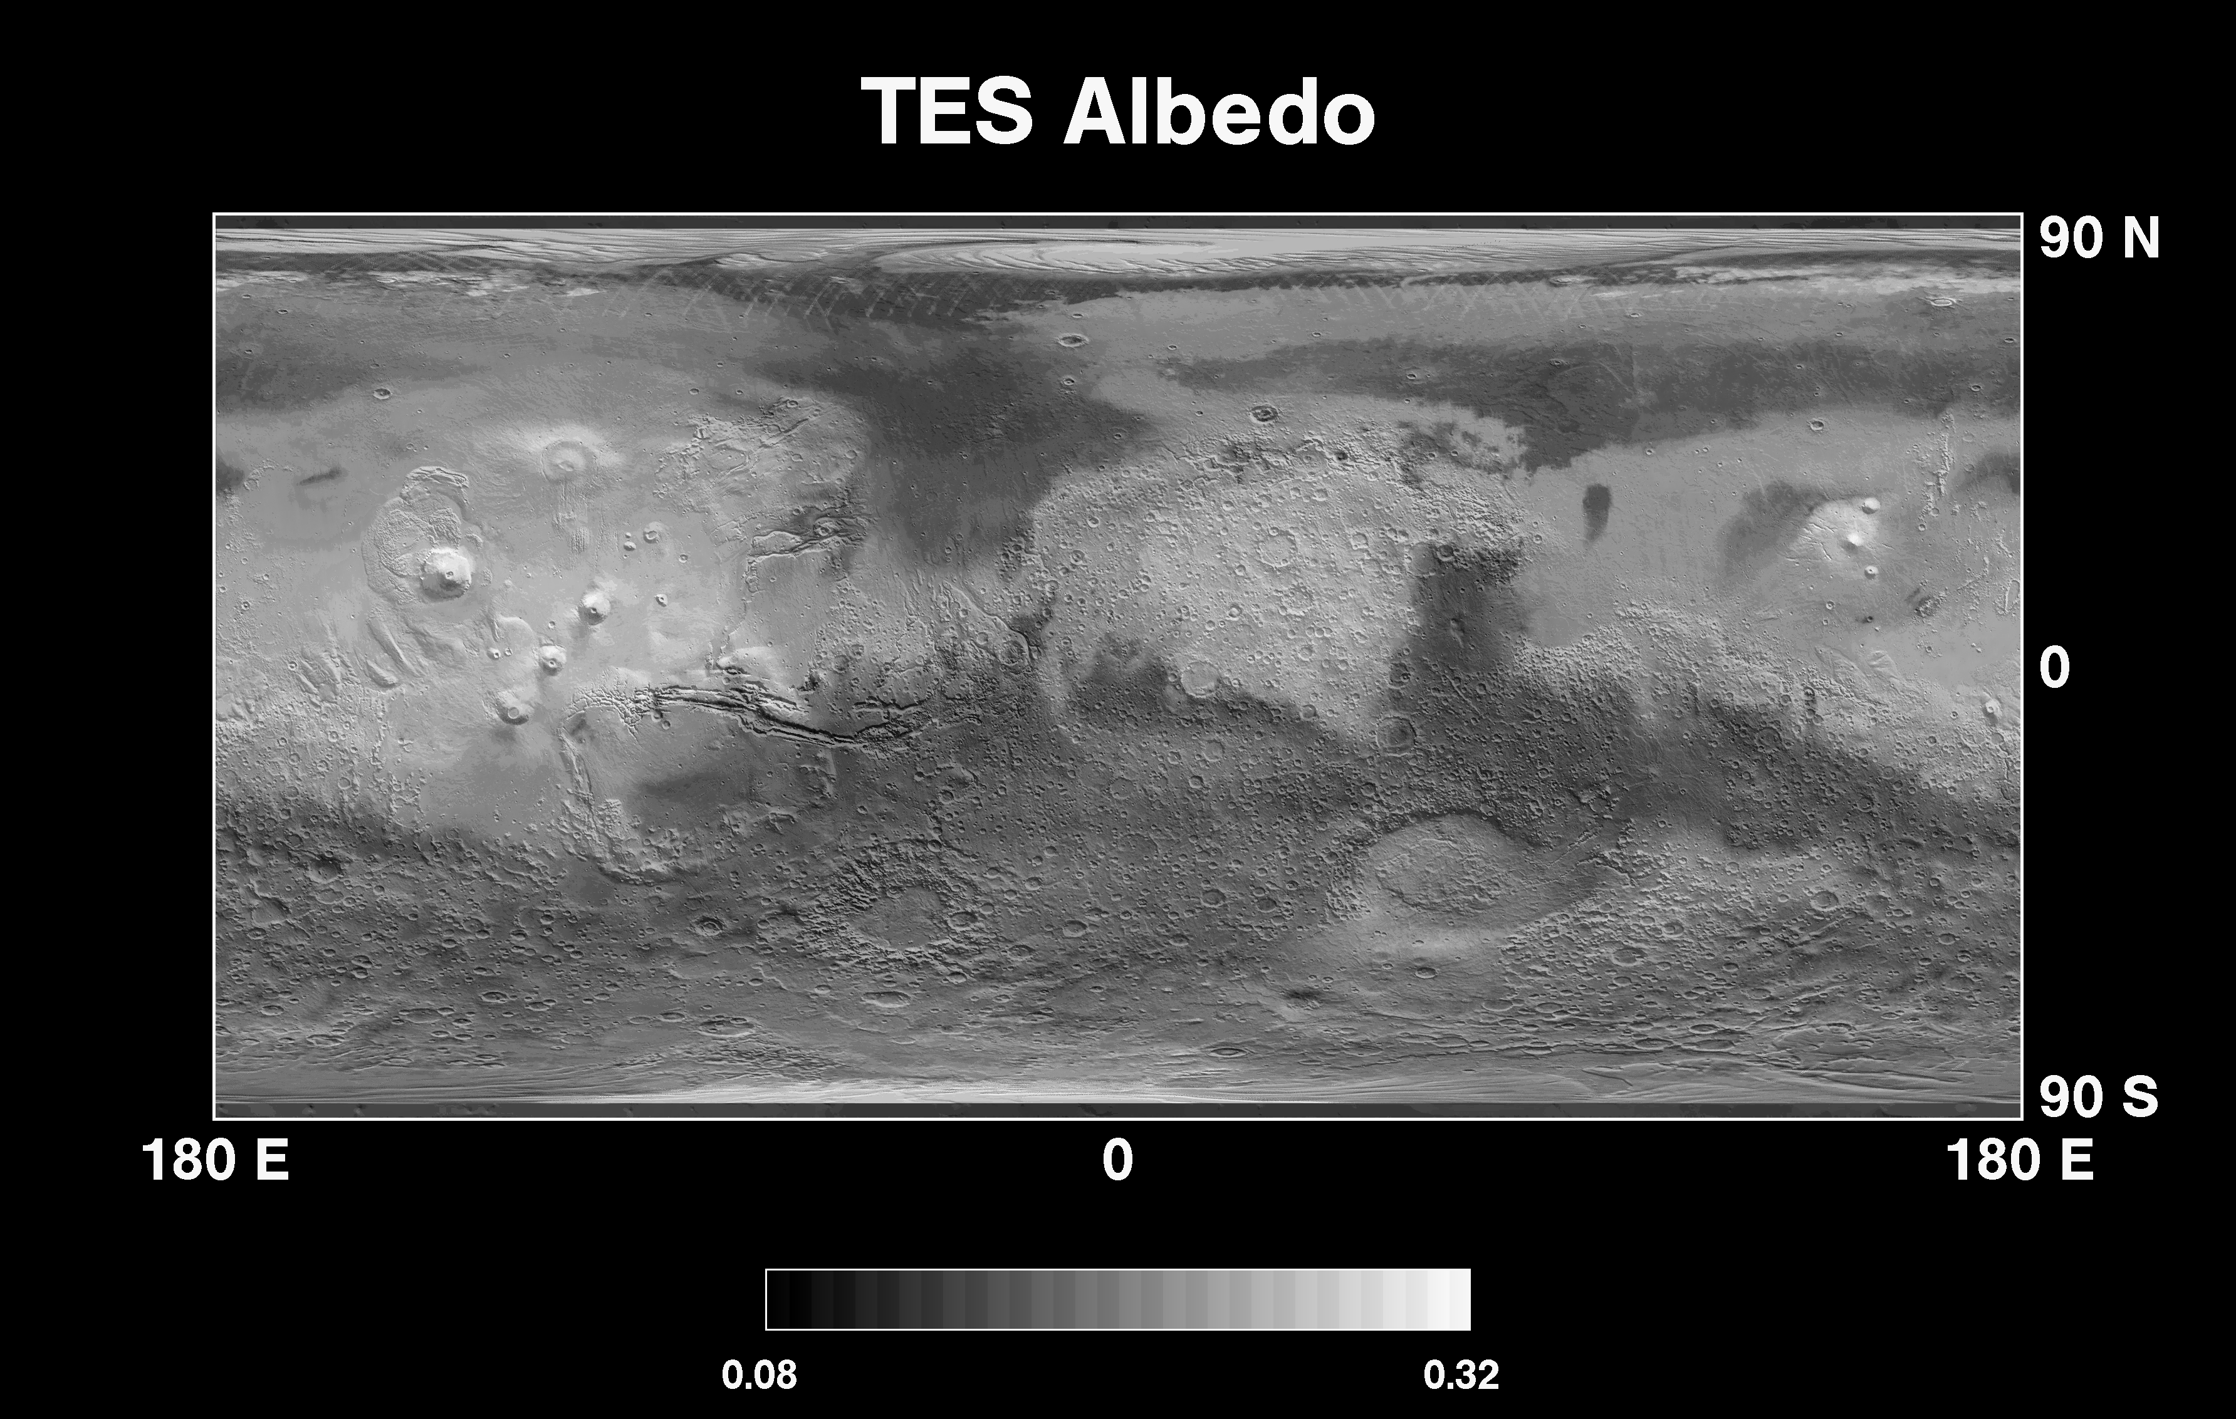
TES
Bolometers yield albedo and temperature maps
Modeling the temperatures yields thermal inertia data

Slide 9
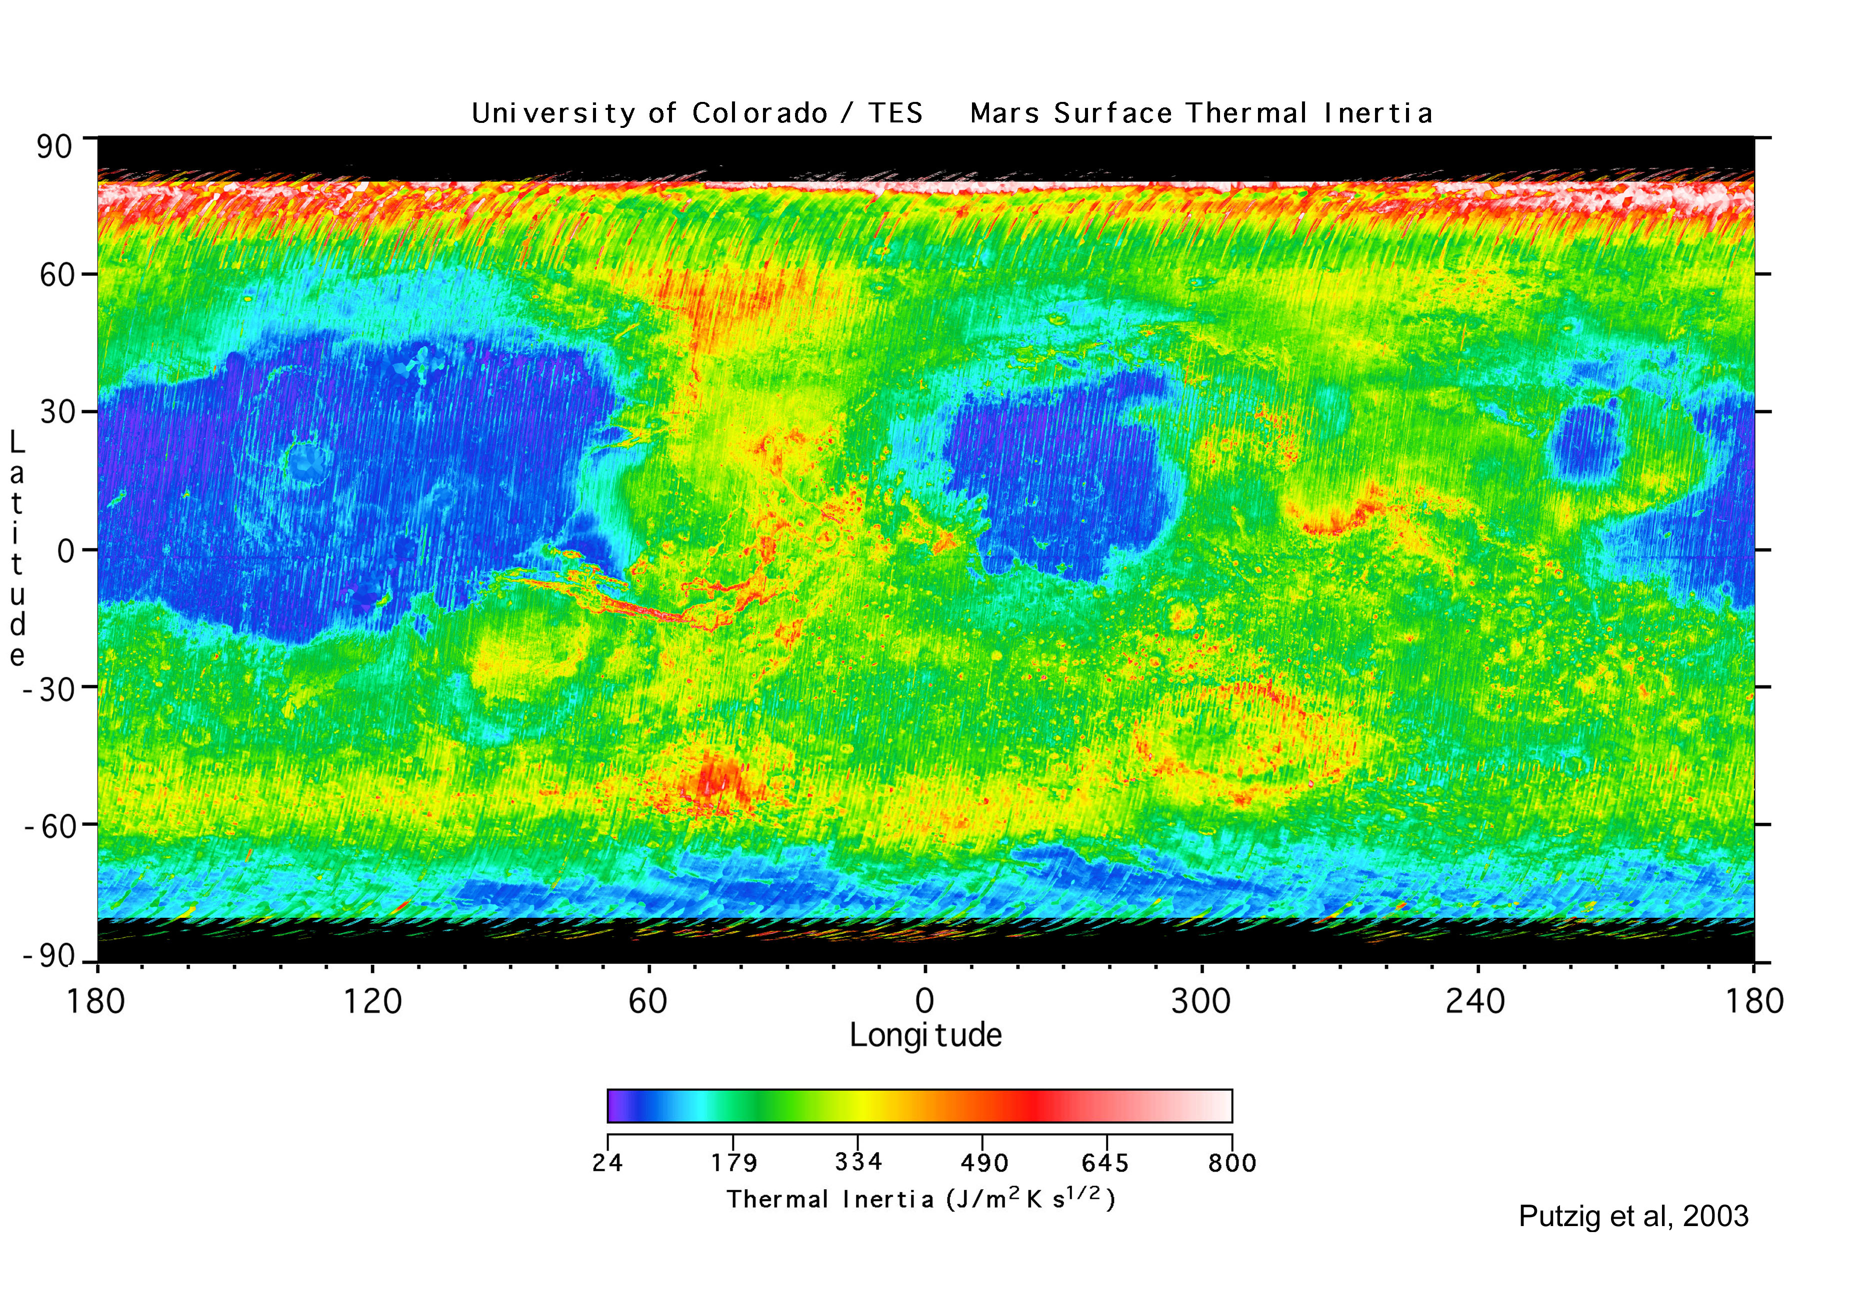
TES
Bolometers yield albedo and temperature maps
Modeling the temperatures yields thermal inertia data

Slide 10
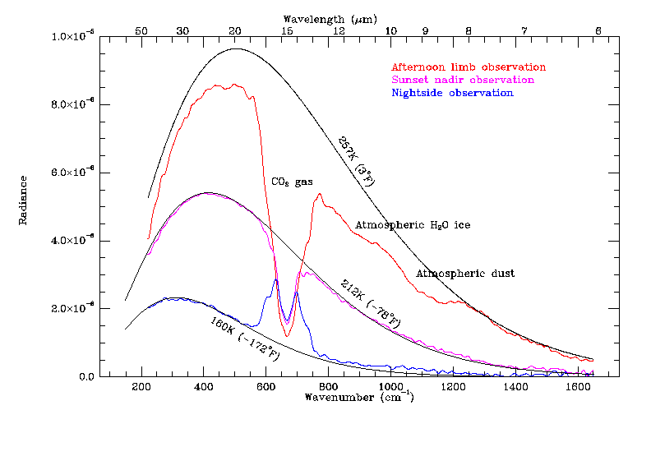
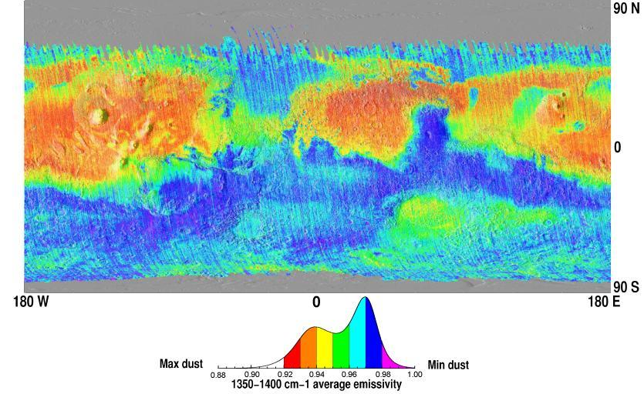
TES spectra can be used for mineralogy of the surface and studies of the atmosphere
e.g. dust abundance map from Ruff and Christensen (JGR, 2002)

Slide 11
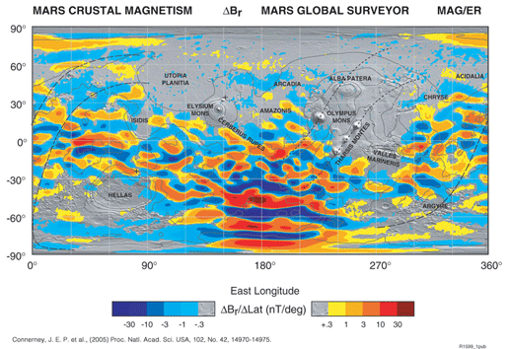
Areas of magnetized crust discovered by the MGS magnetometer
Mars currently has no dipole field, but a dipole field existed once
Crustal magnetization much stronger than on Earth
This discovery was an accident enabled by the broken solar panel
Lack of magnetic field over Hellas and Argyre basins attributed to shock demagnetization
Absence of remnant fields in the northern hemisphere is a puzzle – perhaps due to hydrothermal circulation

Slide 12
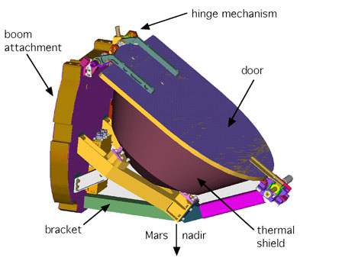
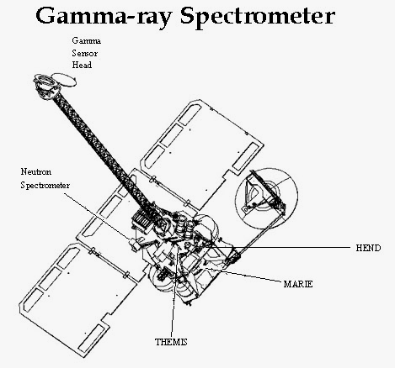
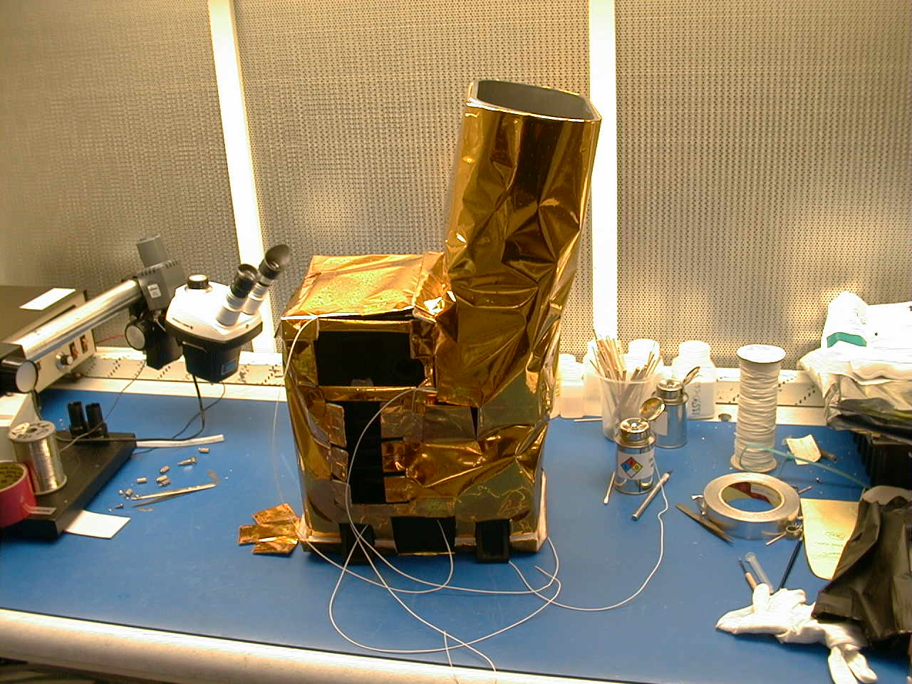
Mars Odyssey
At Mars 2001-present
Gamma Ray Spectrometer
Three instruments in one
Detects gamma rays, neutrons & high-energy neutrons
600km resolution
Slow accumulation of counting statistics over the mission
THEMIS
Visible camera, 18m/pixel with five color bands
IR camera, 100 m/pixel with 9 independent bands

Slide 13
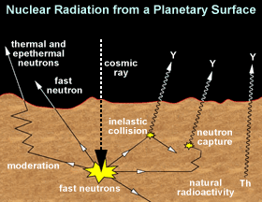
GRS – yields elemental and hydrogen (water) maps and

Slide 14
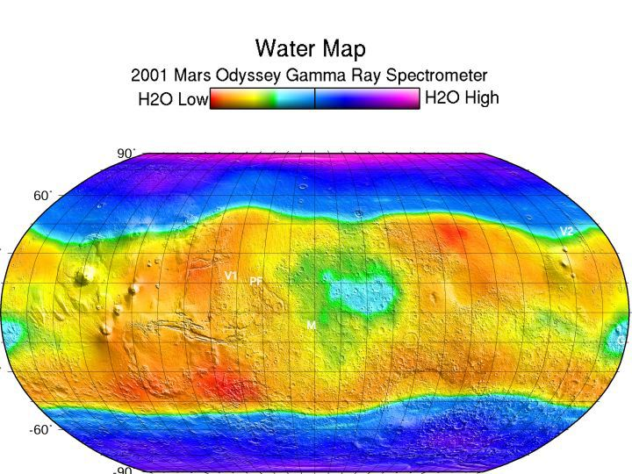
Gamma Ray spectrometer on Mars Odyssey spacecraft has detected hydrogen (from H₂O) in near surface

Slide 15
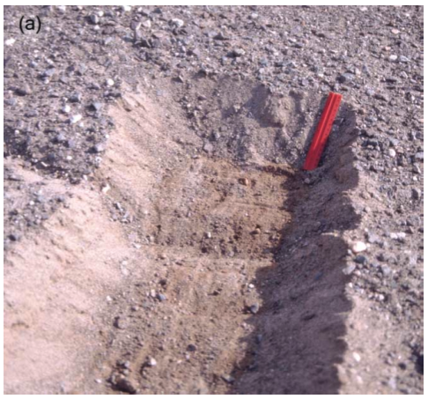
Ground ice on Mars theorized to exist for some time
Regolith provides the thermal insulation
Stable ice distribution changes with climate
Diffusive contact with the atmosphere
Water vapor
Surface
Up to a few feet down

Slide 16
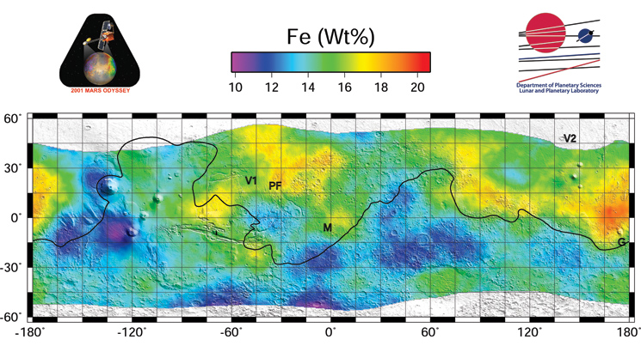
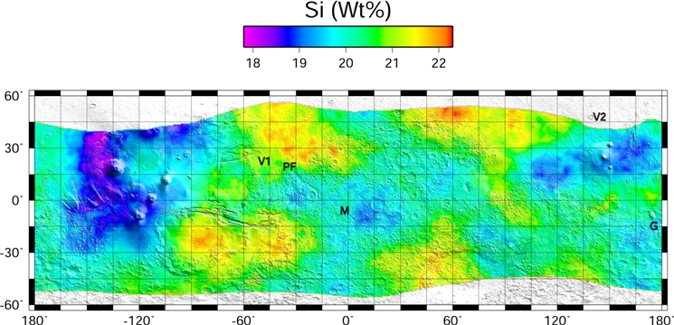
Gamma rays provide elemental maps

Slide 17
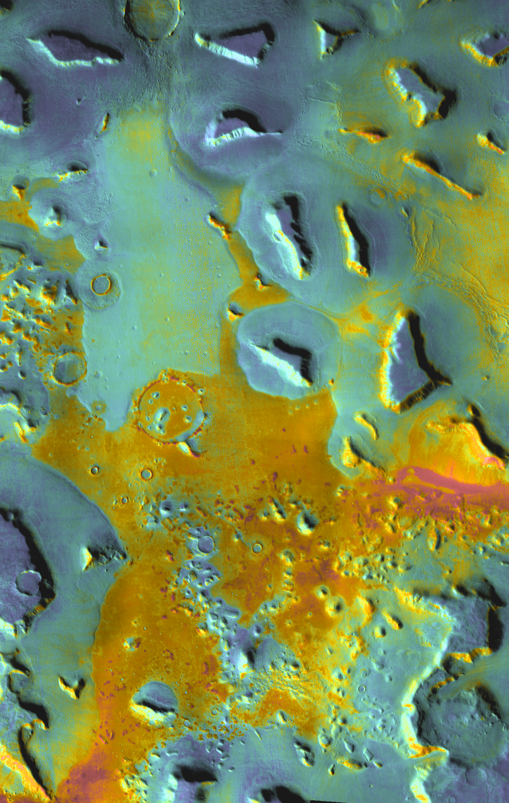
THEMIS
Band combinations yield composition info
Daytime IR global map at 100m/pixel is used for HiRISE targeting now
Nighttime IR map is less complete, but can be used to derive thermal inertias
THEMIS doesn’t have the temperature accuracy that TES did (especially at low temperatures), but it’s much higher resolution

Slide 18
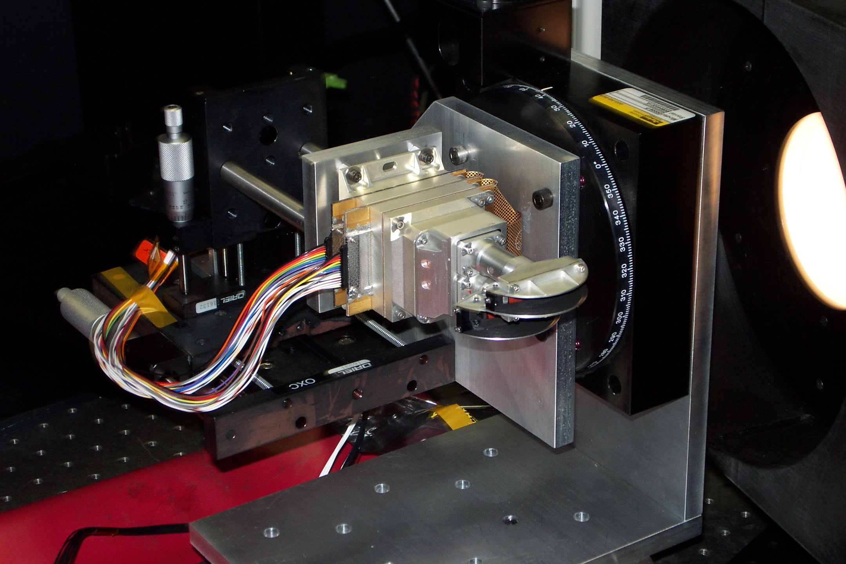
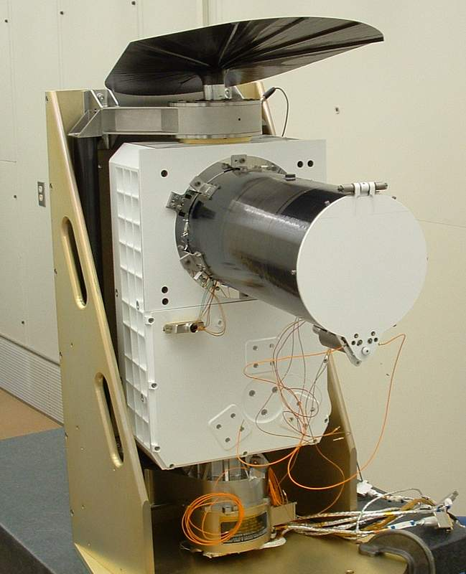
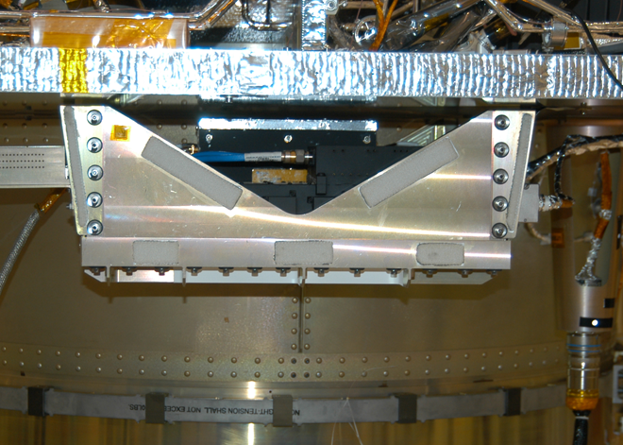
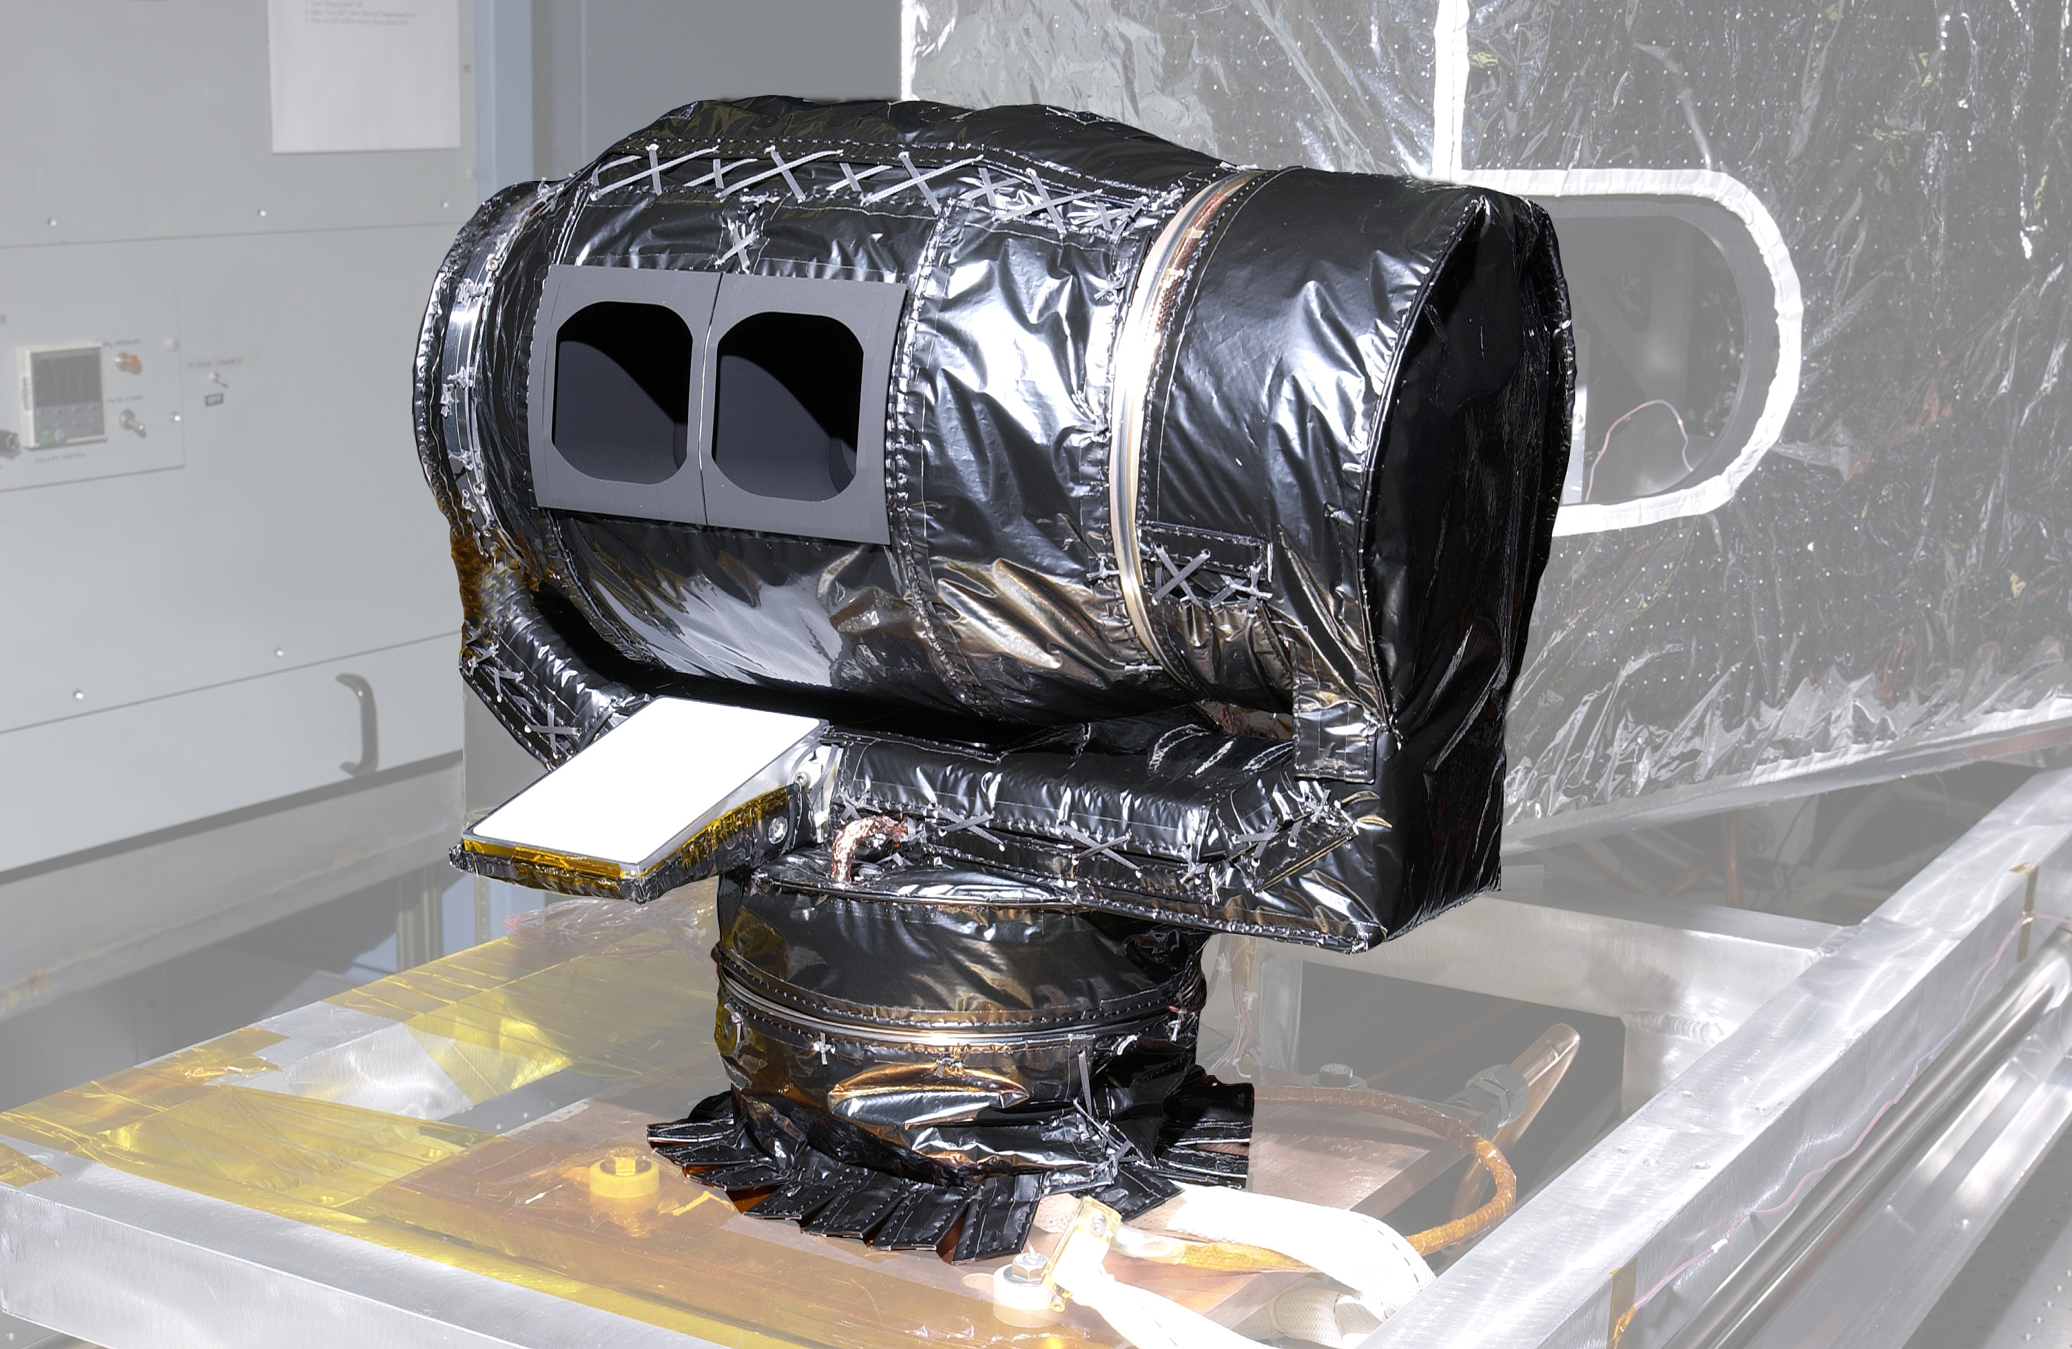
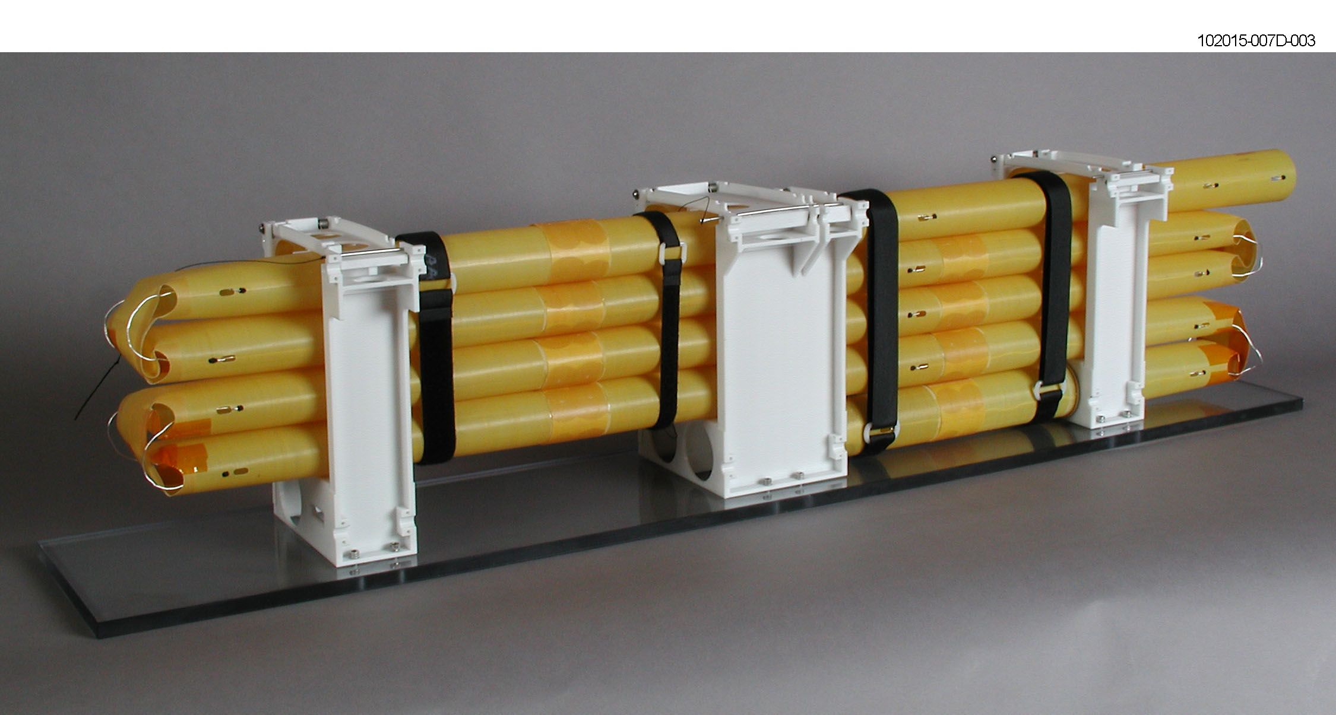
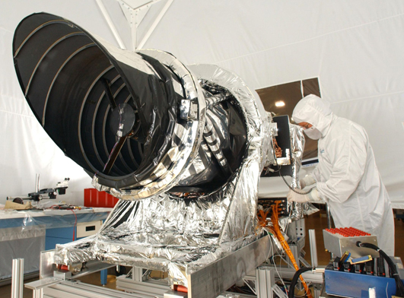
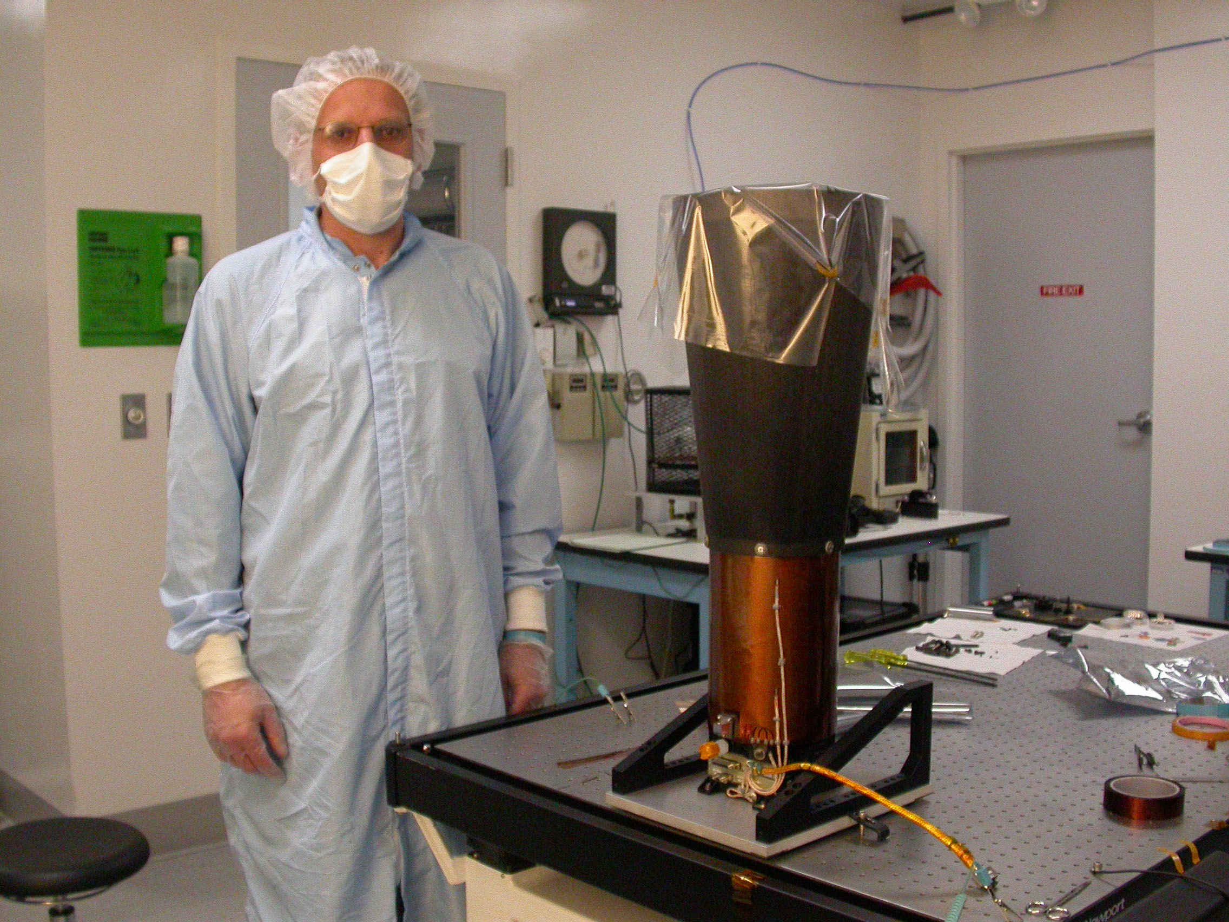
MRO Science Instruments
CRISM
MARCI
SHARAD
MCS
HiRISE
CTX

Slide 24
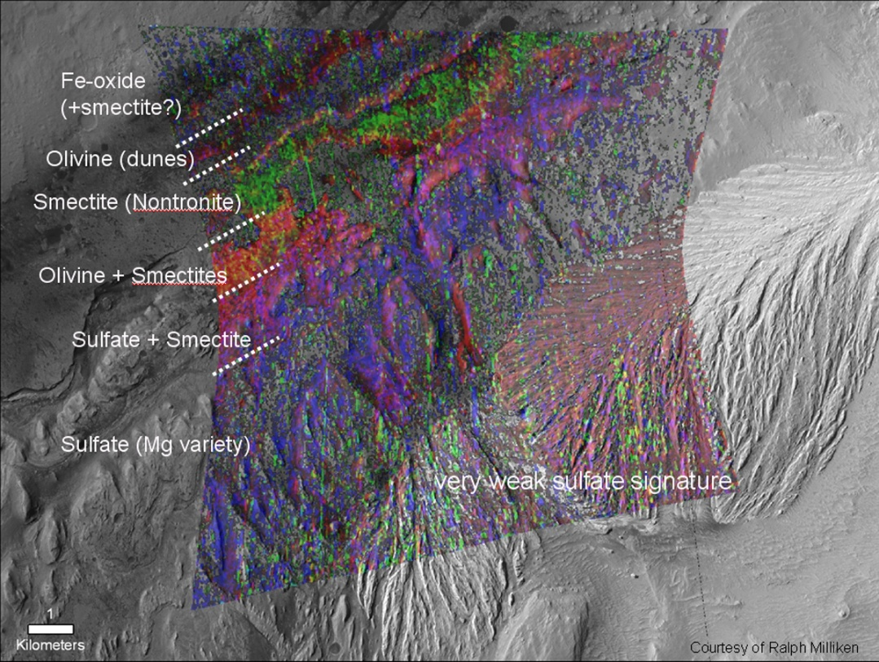
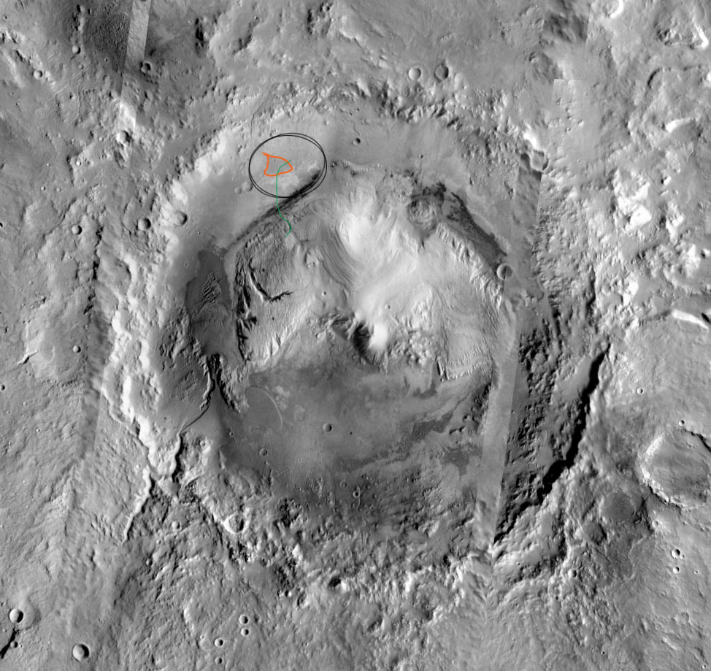
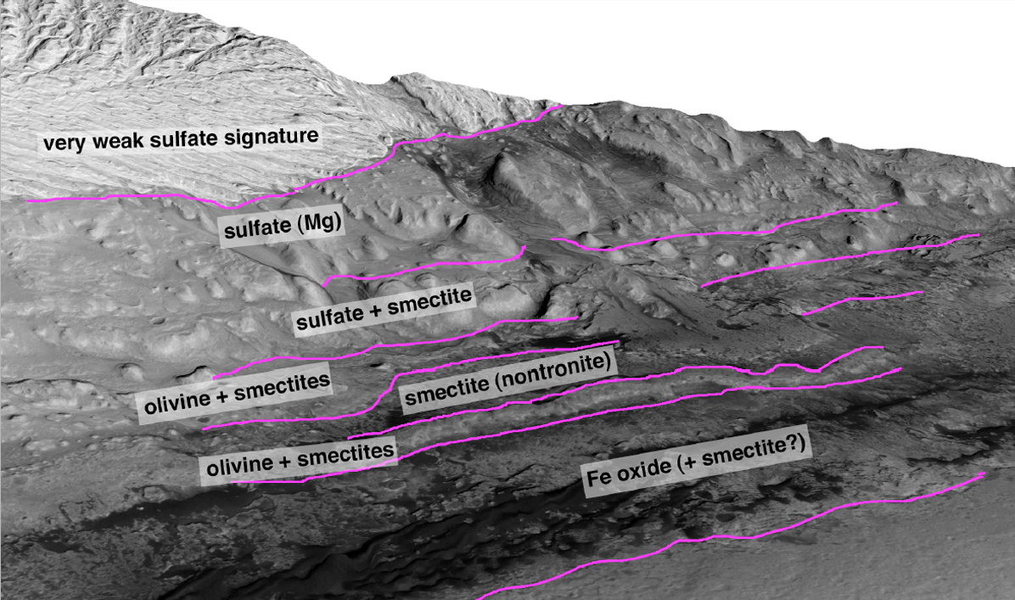
CRISM FRT 58A3 Draped on CTX
From Ralph Milliken
Minerals in Gale Crater

Slide 30
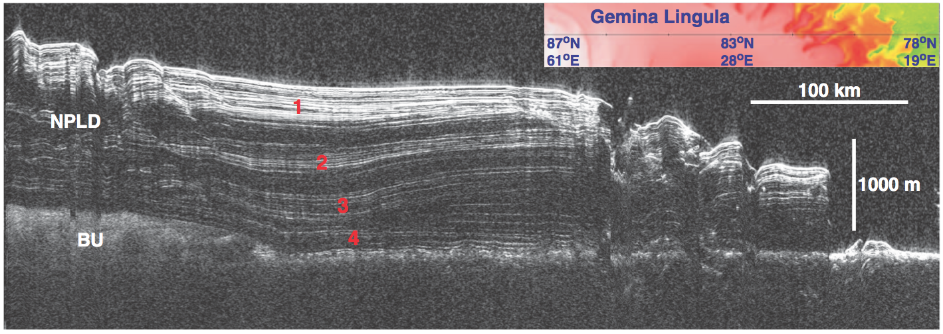
Polar layered deposits work very well with RADAR

Slide 31
ice
Water
ε’ ~80!

Slide 32
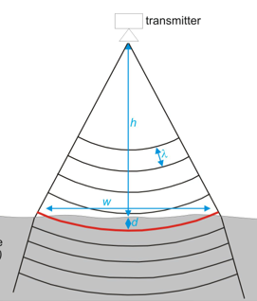
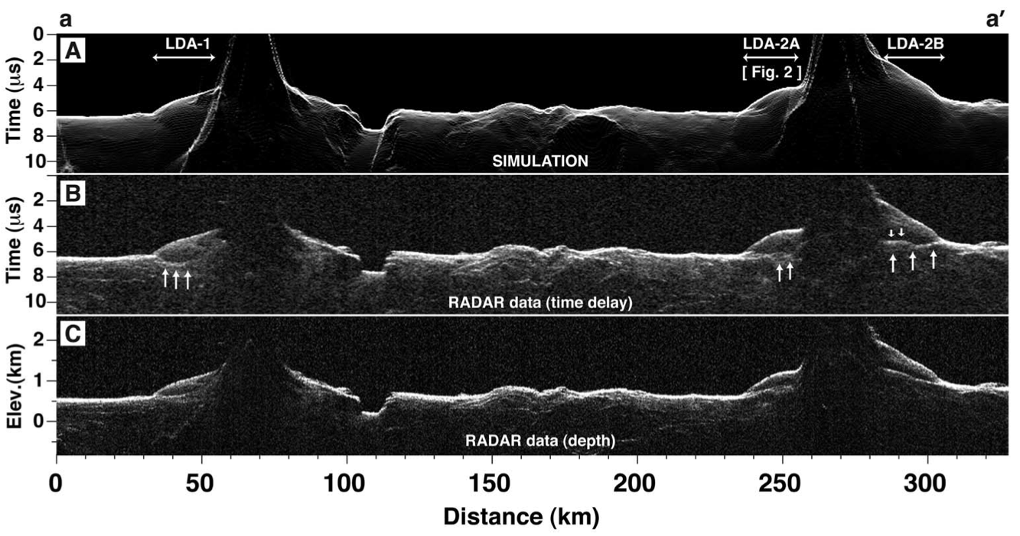
Converting time to depth and looking for surface clutter
Off nadir surface returns can be detected at the same time as nadir surface returns
Deep layers in a low permittivity material (e.g. ice) can be detected at the same time as shallow layers in a high permittivity material (e.g. rock)

Slide 33
Where do we find all this stuff? (I)
The Planetary Data System (PDS) officially archives all planetary science data
http://pds.jpl.nasa.gov
It’s divided into several nodes: Atmospheres, Imaging, Geosciences etc…
PDS formatted data is self-describing and so will last forever, but is not user friendly
Where do we find all this stuff? (II)
An image search tool that includes most imaging datasets can be found at
http://viewer.mars.asu.edu/
Maps of image footprints can be browsed at
http://themis.asu.edu/maps
Global dataset of Mars can be accessed at
http://www.mars.asu.edu/data/

