Slide 1
Mars Climate, Seasons and Orbit

Slide 2
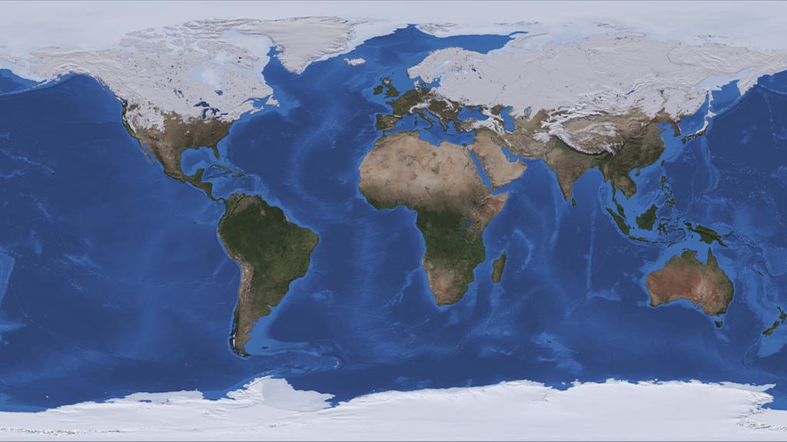
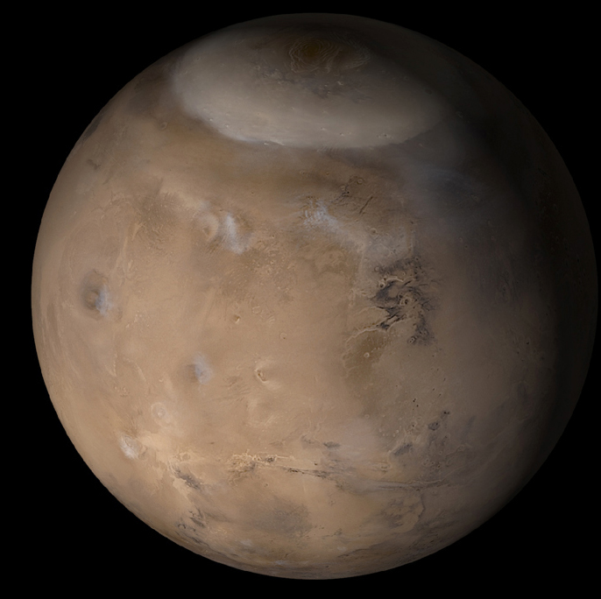
Mars seasons have similarities to the Earth
  The martian year is 1.9 Earth Years
  The martian obliquity is 25 degrees (vs. 23.5 for the Earth)
  Poles with periods of permanent darkness and daylight
  Mars has seasonal ice caps that come and go
  Mars has seasonal cloud activity
…but also differences
  The Mars-Sun distance varies seasonally and this also controls temperatures
  The seasonal ice is dominated by CO₂ not H₂O
  Seasonal ices mostly condense and ablate directly of the surface – snowfall is only important in a few places
  Earth has important oceanic interactions that Mars lacks
  Seasonal dust storms have a major effect on Mars

Slide 3
Obliquity
  Tilt of the planet compared to its orbital plane
  Earth ~ 23.5 degrees
  Mars today ~ 25 degrees
Northern Summer
Southern Summer
High Obliquity
Low Obliquity

Slide 4
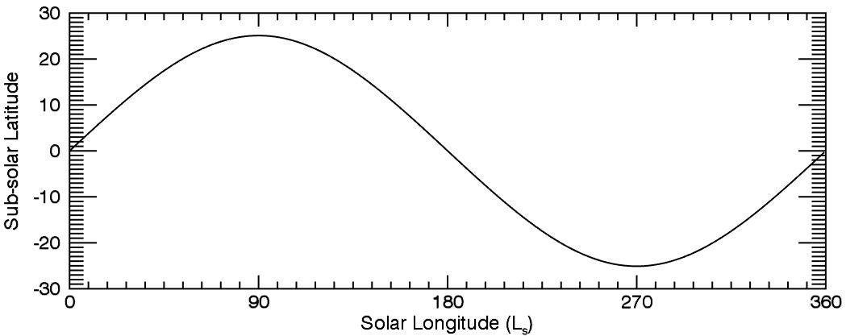
Solar longitude is denoted by Ls
  Measures seasons on Mars
South
Fall
Winter
Spring
Summer
North
Spring
Summer
Fall
Winter

Slide 5
The orbit of Mars
  Semi-major axis (a) is 1.52 AU
  Average solar flux is less than half that of the Earth (43%)
  Eccentricity (e) is 0.1 (slightly elliptical – Earth is 0, circular)
  Solar distance varies from 1.37 to 1.67 AU
  So solar flux varies from 53% to 36% of the Earth’s
How does this compare to the seasons?
  Perihelion – closest approach to the sun is at L_{s} 252
  Aphelion – furthest from the sun is at L_{s} 72
  Perihelion is near southern summer solstice
  Southern summers are hotter and shorter
  Northern summers are cooler and longer
  Each pole receives the same total sunlight though

Slide 6
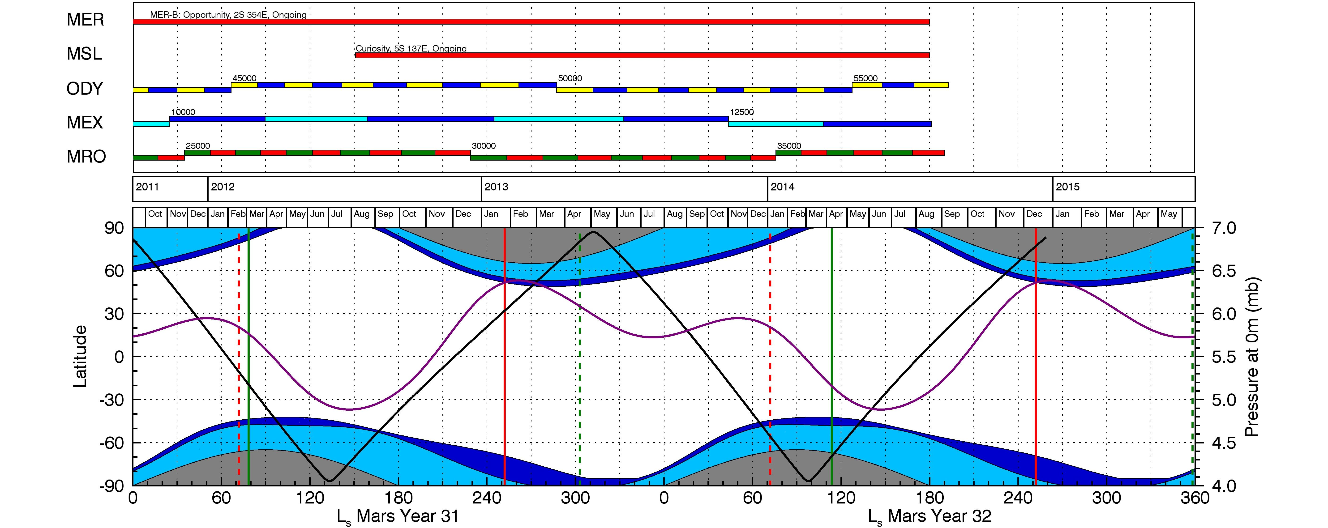
Perihelion
Mars year numbering?
Totally arbitrary – MY1 is in 1955
Aphelion
Opposition (as seen from Earth)
Conjunction (as seen from Earth)
Polar Night

Slide 7
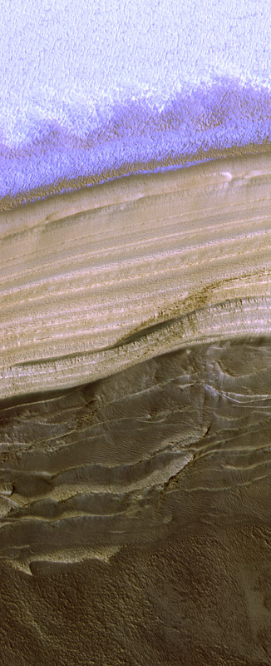
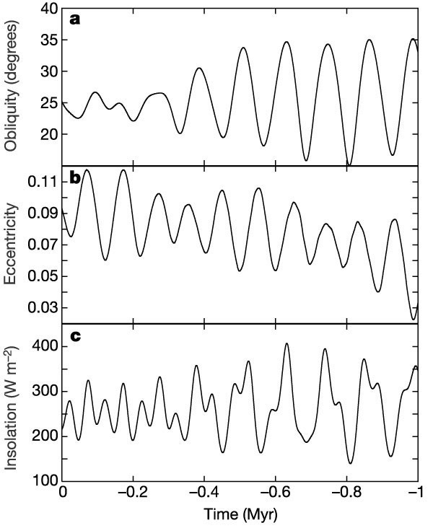
Laskar et al., 2003

Slide 8
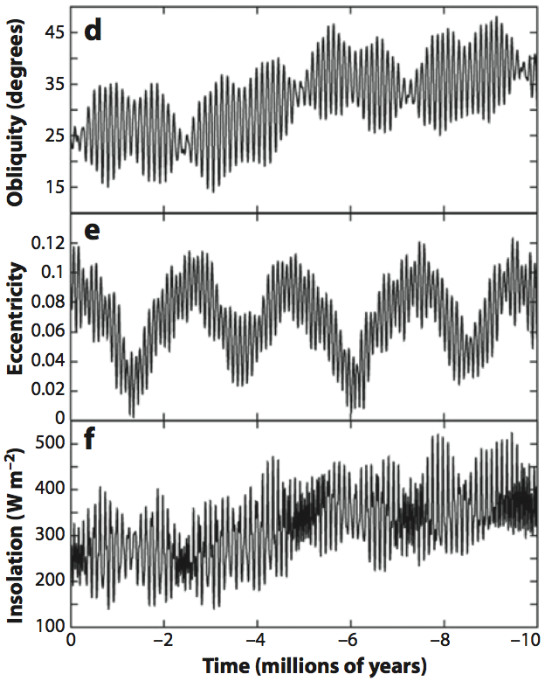
Laskar et al., 2003

Slide 9
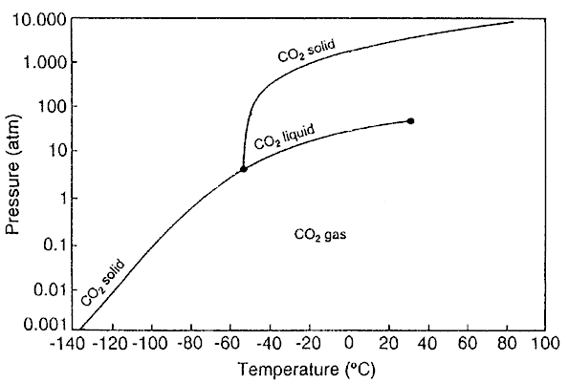
Seasonal Ice Caps
Mars has a similar obliquity (25°) to the Earth.
  Ensures seasons with periods of permanent polar darkness and daylight.
Mars has a low pressure CO₂ atmosphere.
  Permits seasonal icecaps of CO₂ ice to form
  Leighton and Murray (1966)

Slide 10
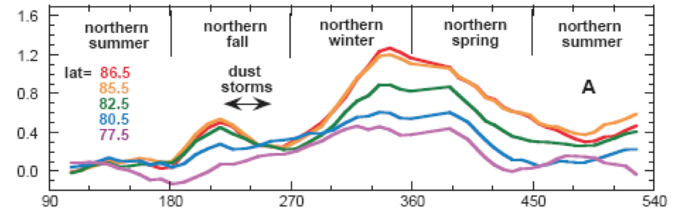
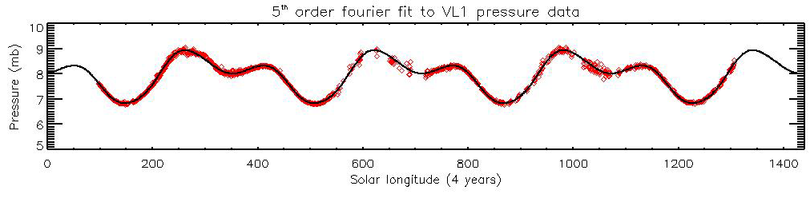
About 25% of the atmosphere condenses out as frost so the global atmospheric pressure fluctuates
Frost caps extend from the pole to the mid-latitudes and are ~1m thick
Smith et al., 2001

Slide 11


Slide 12
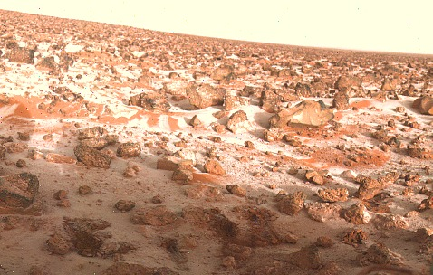
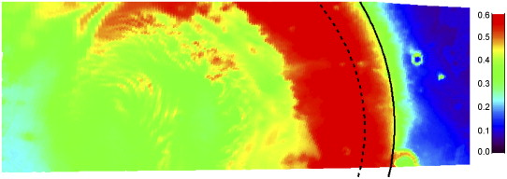
CO₂ not the only volatile in play….
Trace amounts of water frost are also present
Annulus of water frost tracks the edge of the retreating cap
Also repeatable each year
Water frost at the Viking Lander 2 site
Wagstaff et al., 2008

Slide 13
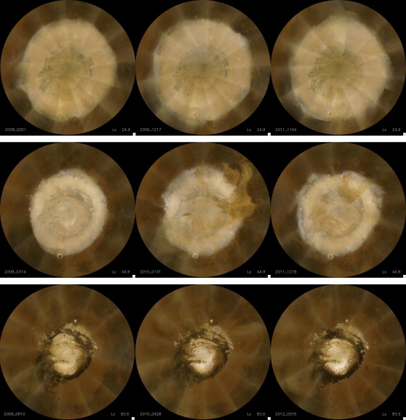
Seasonal caps run pretty much like clockwork each year
Residual caps are left at the north and south pole in the summer – more on them later
MY 29
MY 30
MY 31
L_{s} 25
L_{s} 45
L_{s} 84
Calvin et al. 2014

Slide 14
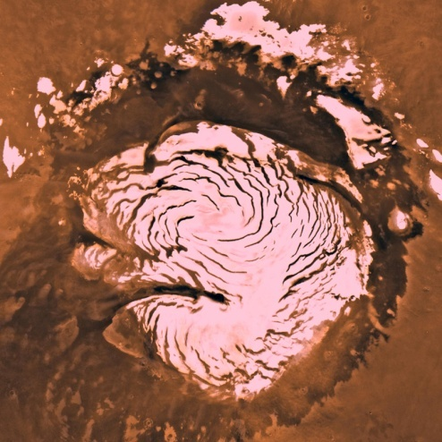
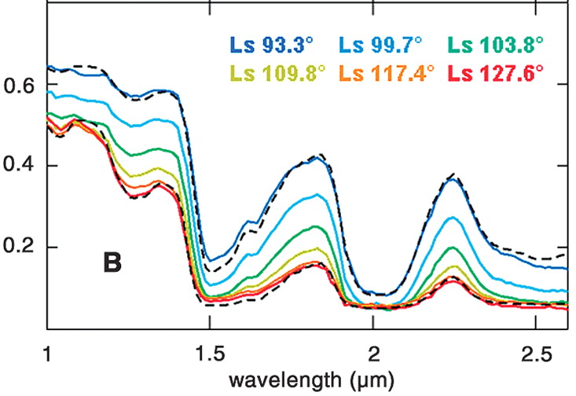
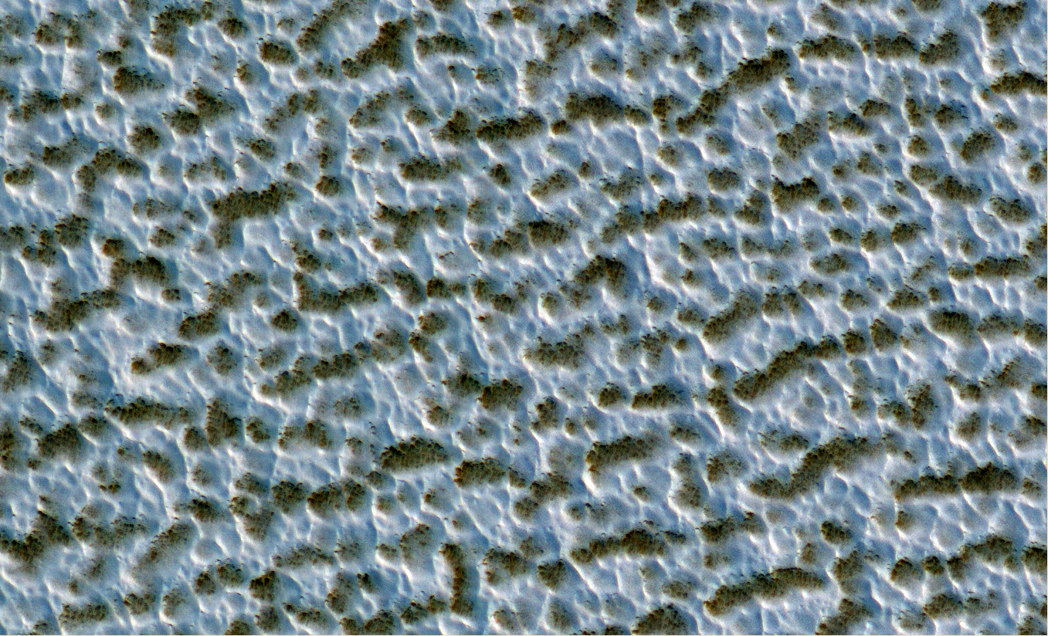
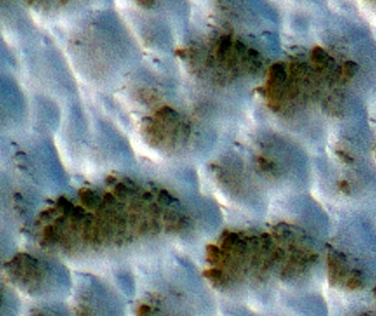
Residual ice caps
North polar residual ice cap is made of dust-free large-grained water ice
Langevin et al., 2005

Slide 15
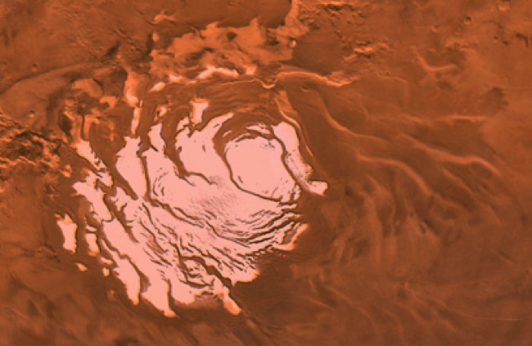
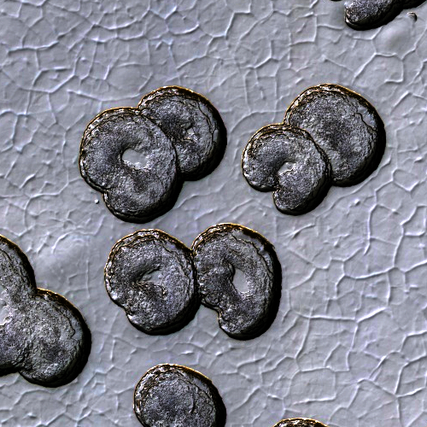
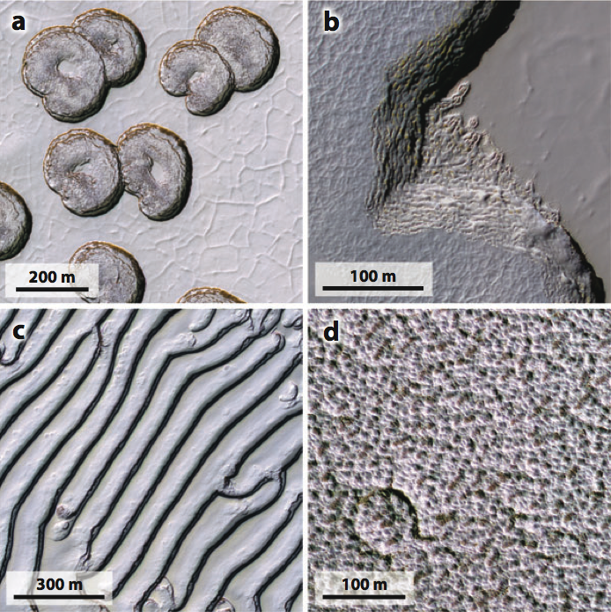
Martian South Polar Residual CO₂ cap
Interacting with current climate
  Exchanging volatiles on annual timescales
  Climate record of decades to centuries

Slide 16
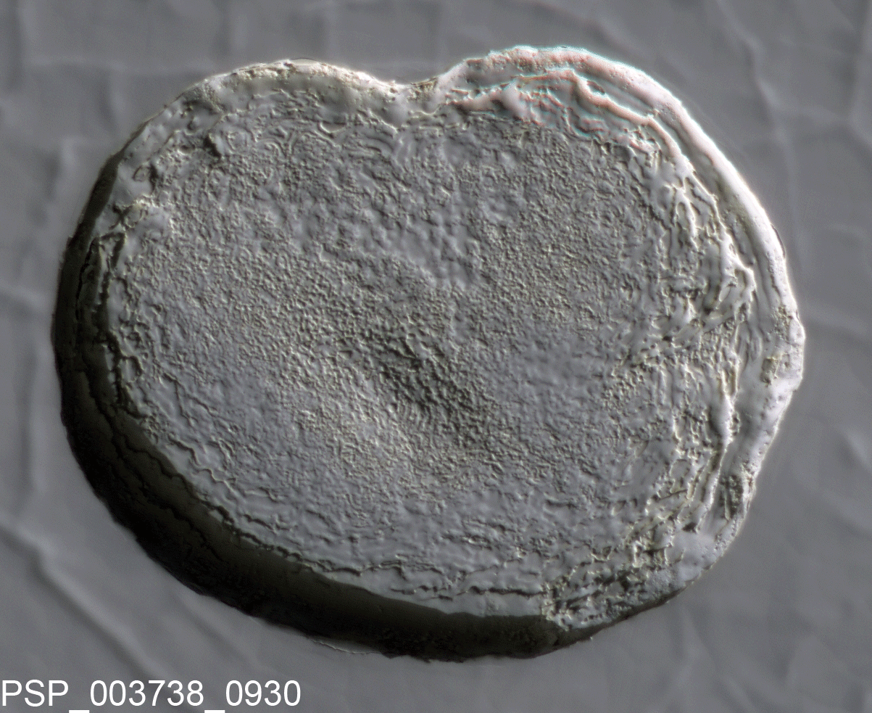
Thomas et al., 2005
Swiss-cheese pits expand by meters per year.

Slide 17
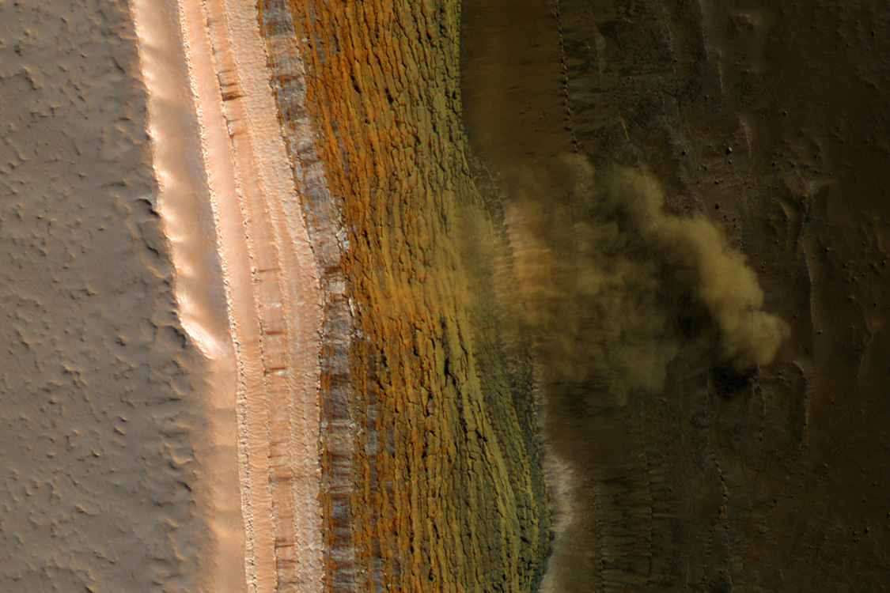

Slide 18
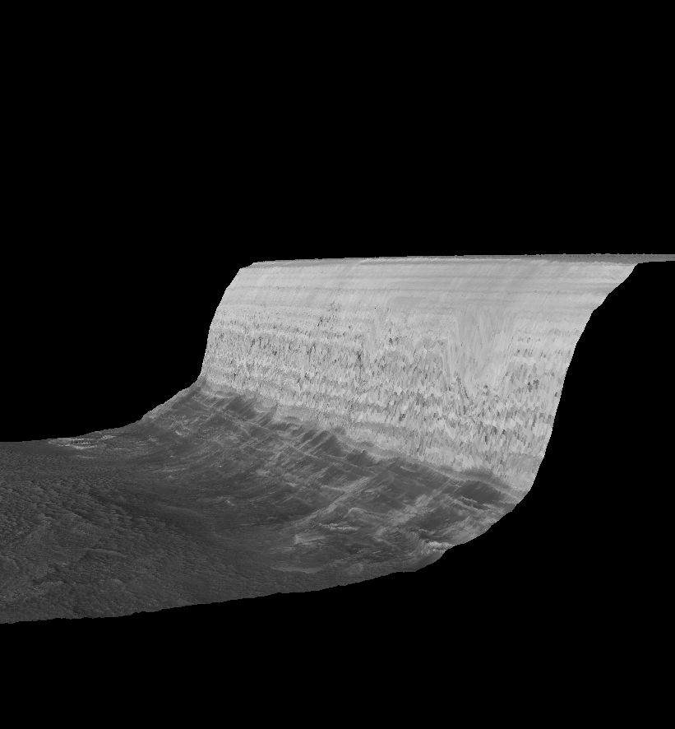
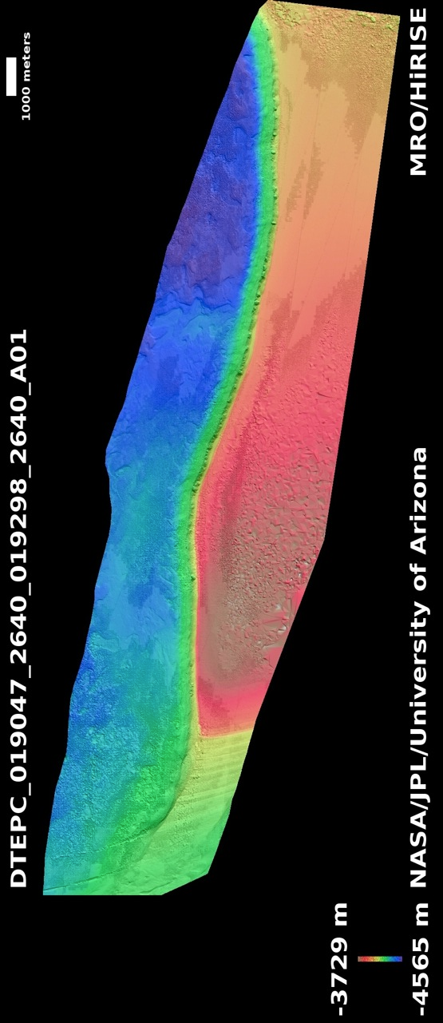
No Vertical Exaggeration (!)

Slide 19
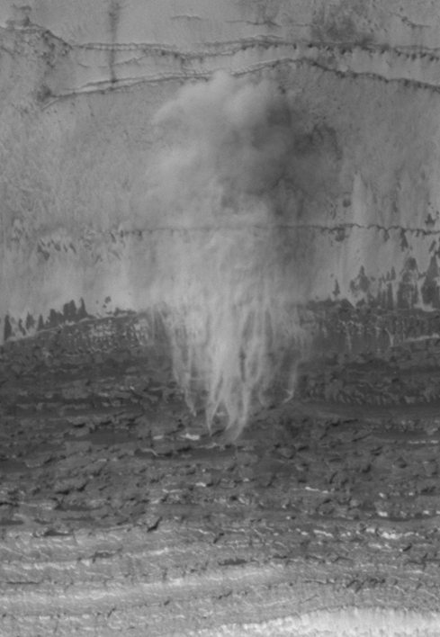
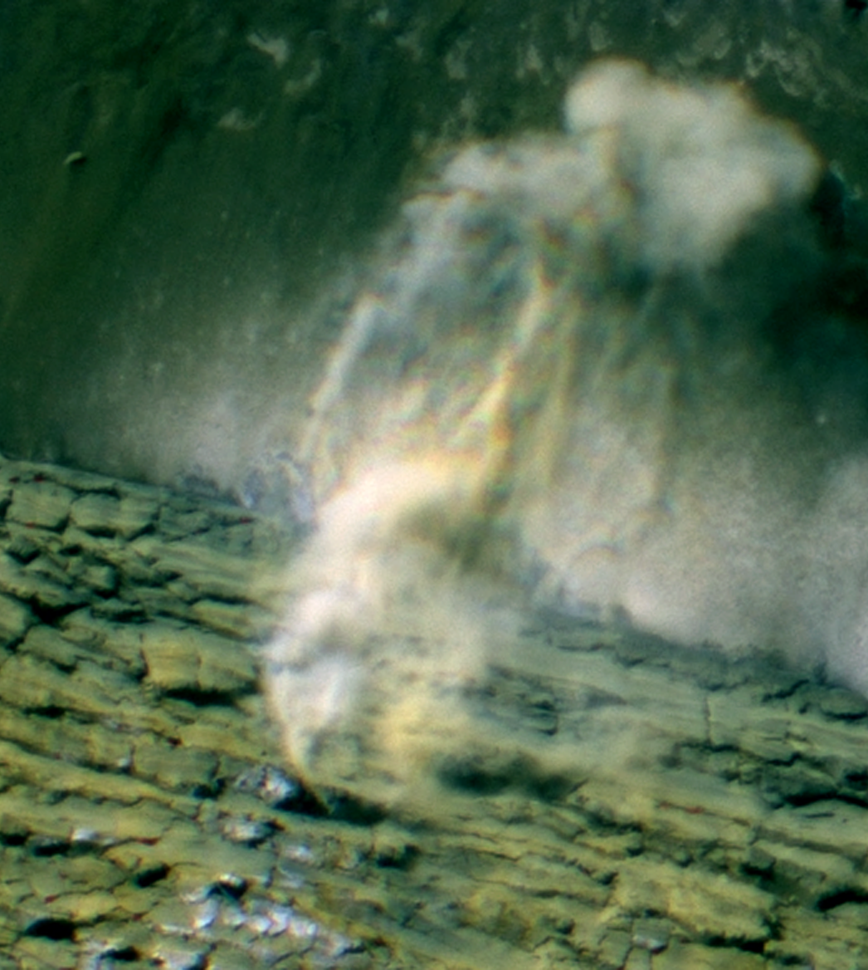
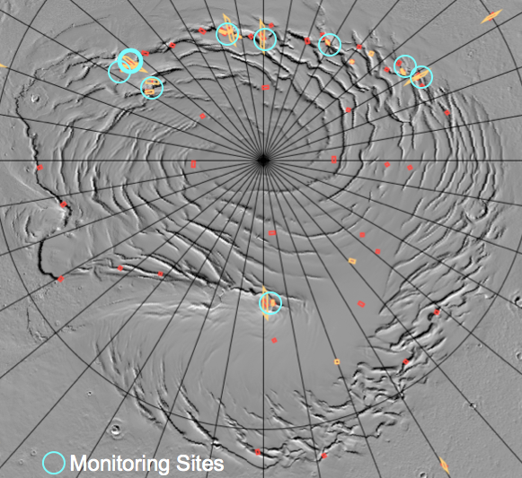
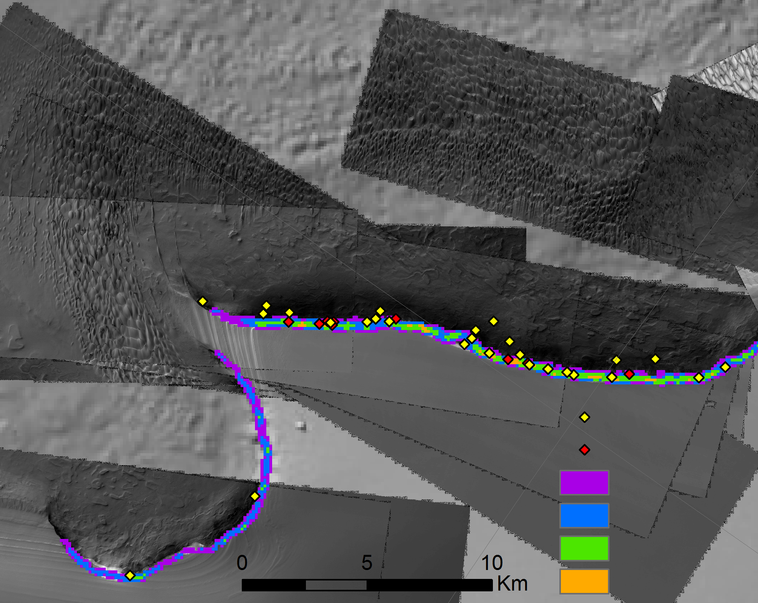
MY 30 Av
MY 29 Av
Slope 30 - 40
Slope 40 - 50
Slope 50 - 60
Slope 60 - 80

Slide 20
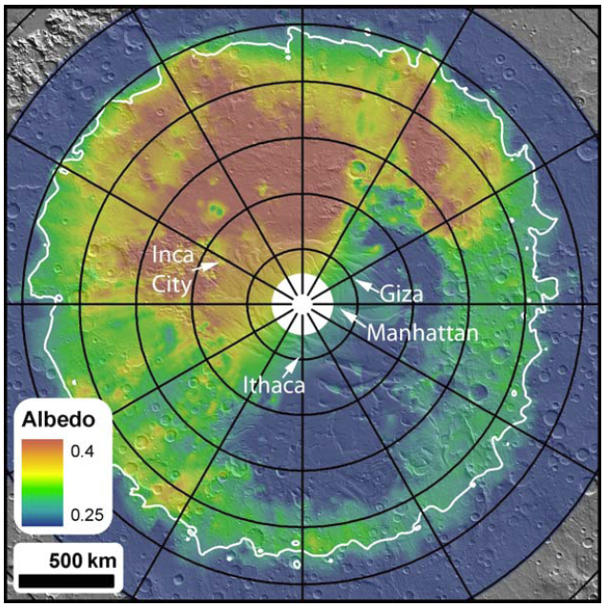
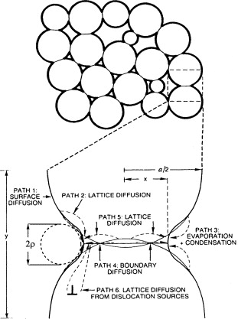
Cryptic behavior…
  Low albedo region inside the CO₂ cap
  Spectral indicators of large grain size
  Large areas anneal into a transparent slab in 100’s of days
Eluszkiewicz et al., 2005

Slide 21
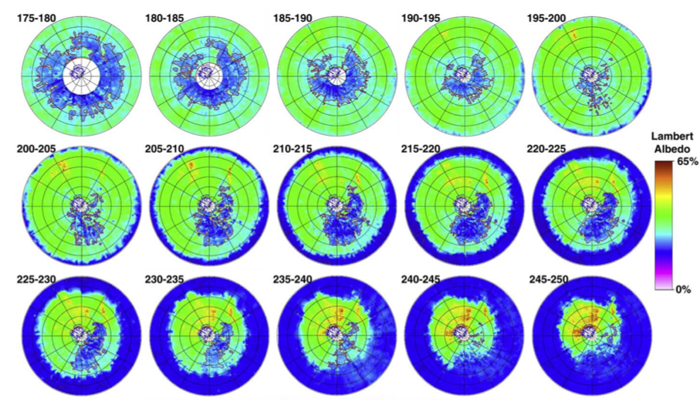
Piqueux et al. 2002

Slide 22
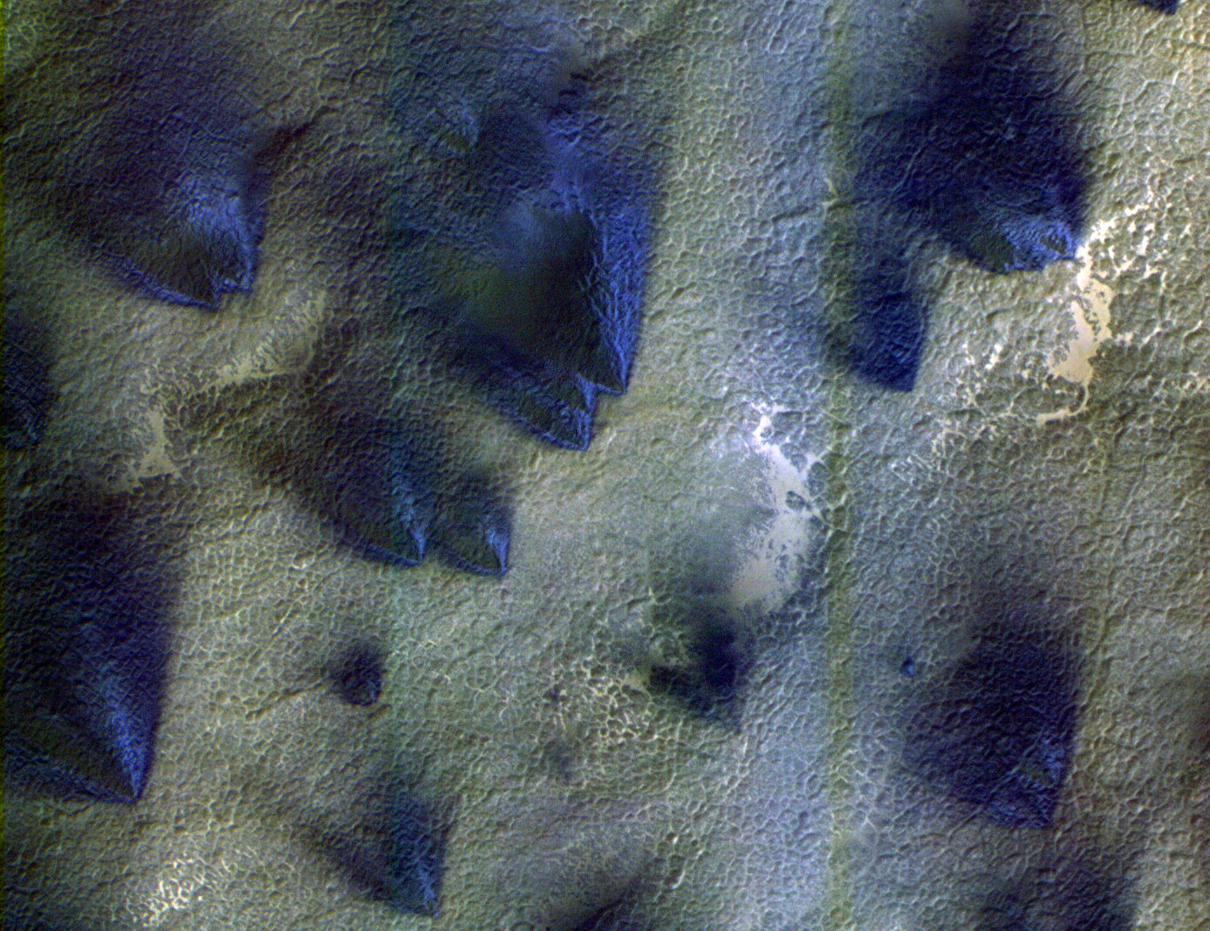
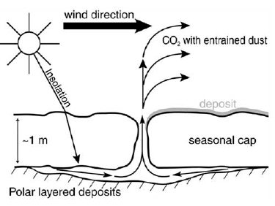
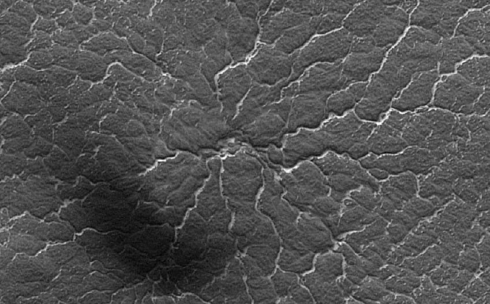
Behavior of a transparent slab of CO₂ ice
PSP_002675_0945
Multiple fan (wind) directions
Scouring of channels to produce ‘spiders’
PSP_002533_0935

Slide 23
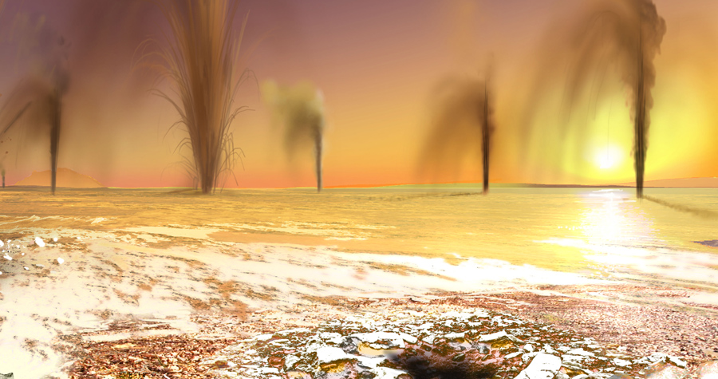
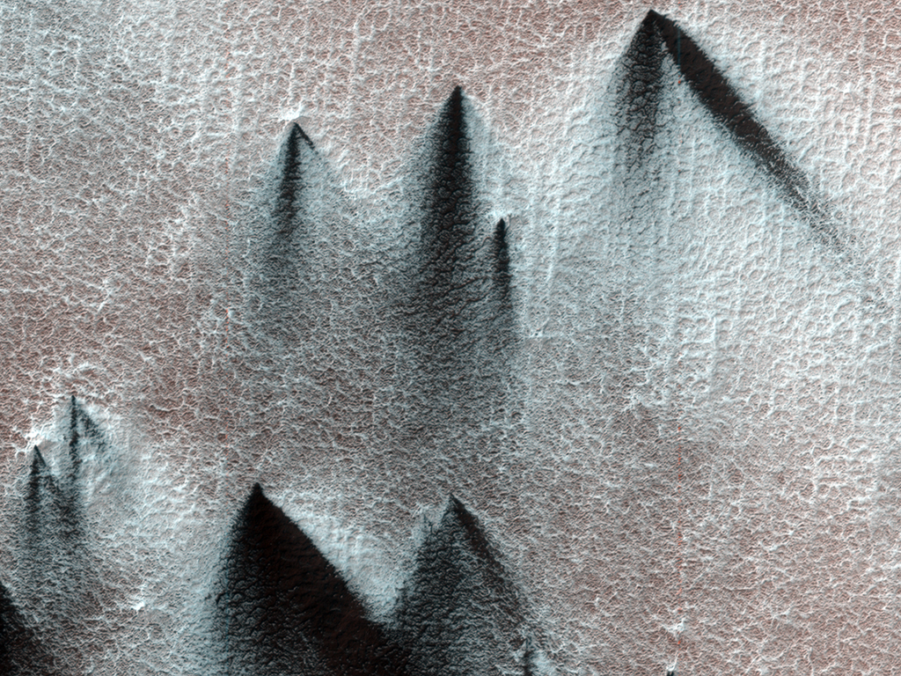

Slide 24
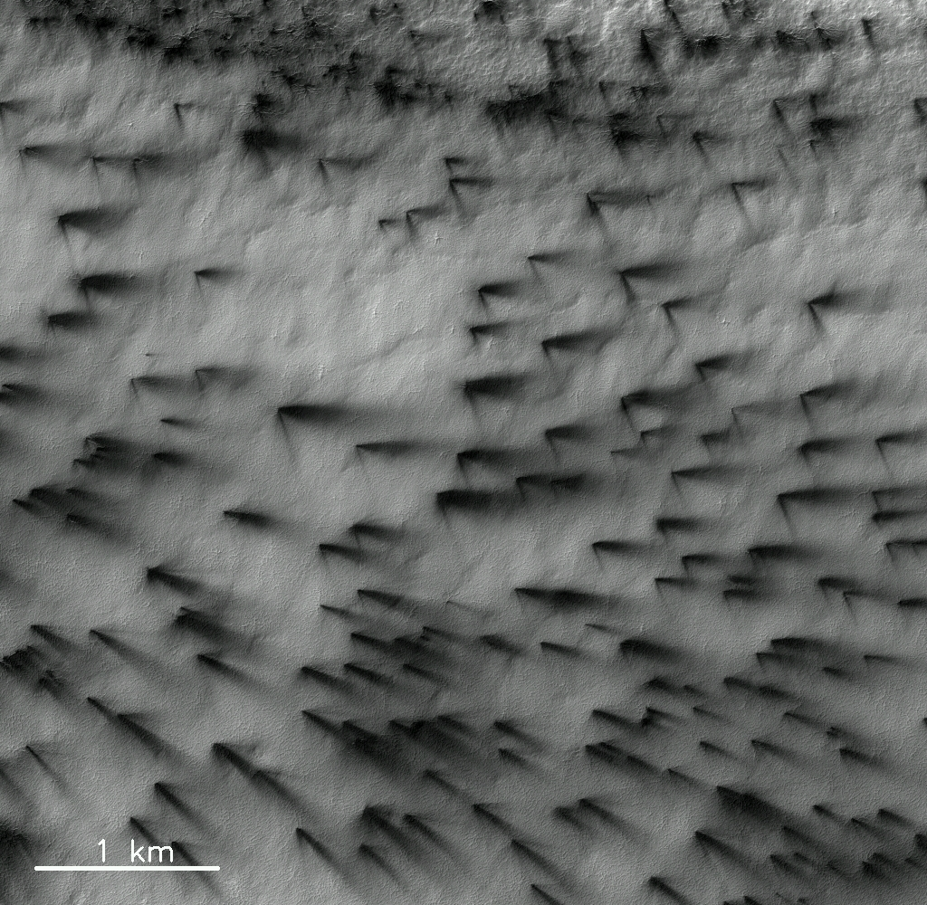

Slide 25
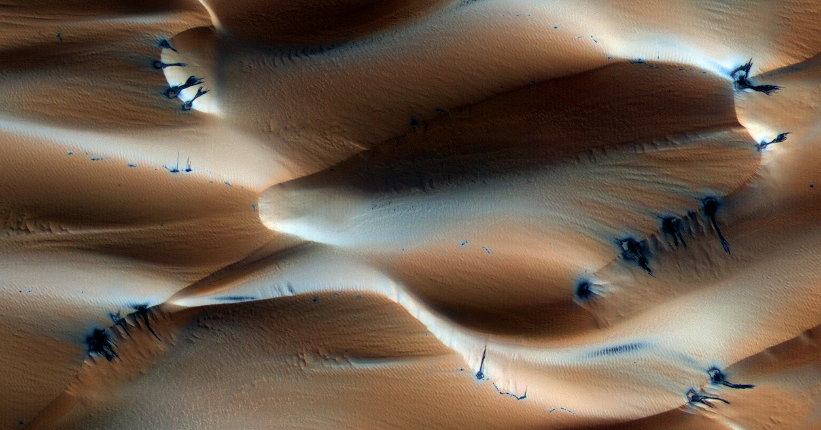
Transparent ice in the northern cap ???
PSP_007193_2640

Slide 26
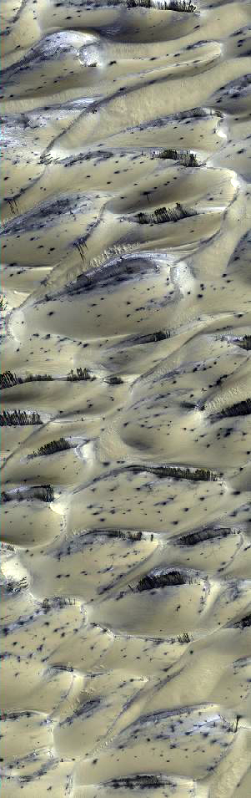
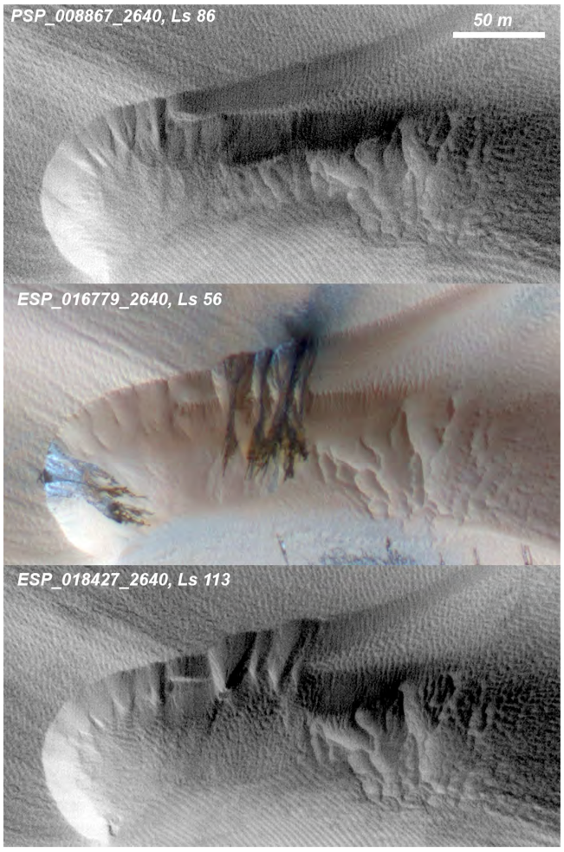
Dunes with seasonal CO₂ venting on Mars
Hansen et al., 2011

Slide 27
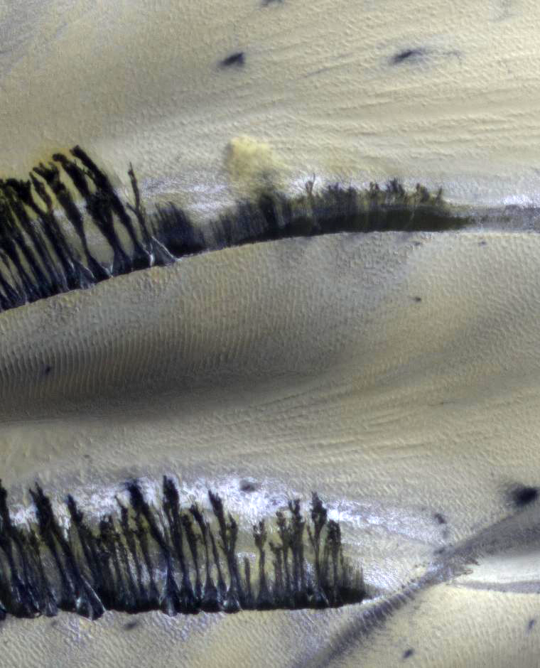

Slide 28
Classic barchan spring sequence
Lat / Lon: 75.8N / 94E

Slide 29
Cracks on crest become source of sandfalls
Landscape restoration
“Buzzel” Lat / Lon: 84N / 233E

Slide 30
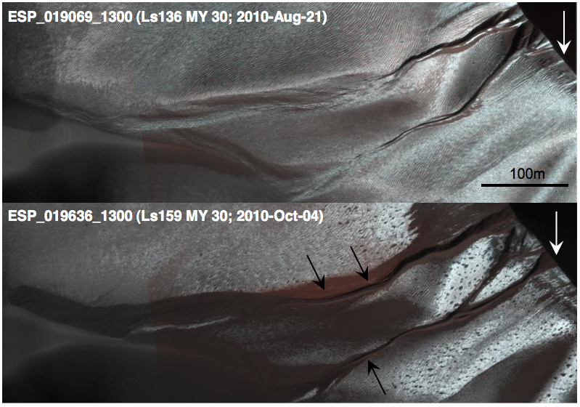
Avalanching frost carves gullies in dunes every winter
Dune migration erases gullies
Diniega et al., 2010

Slide 31
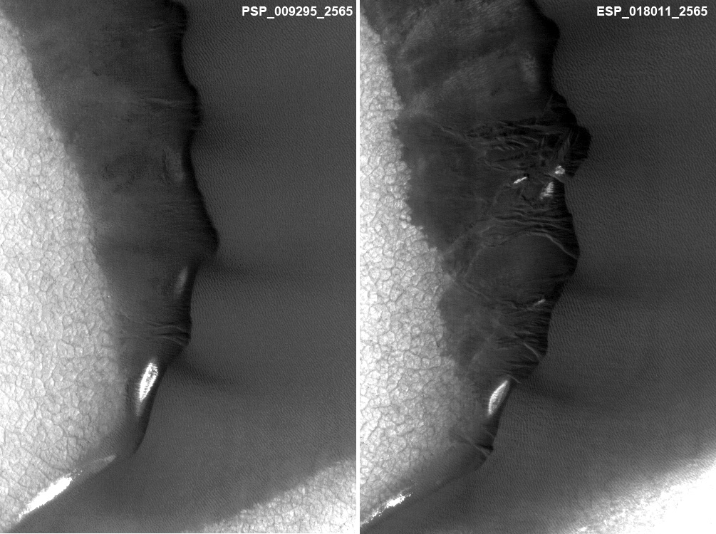
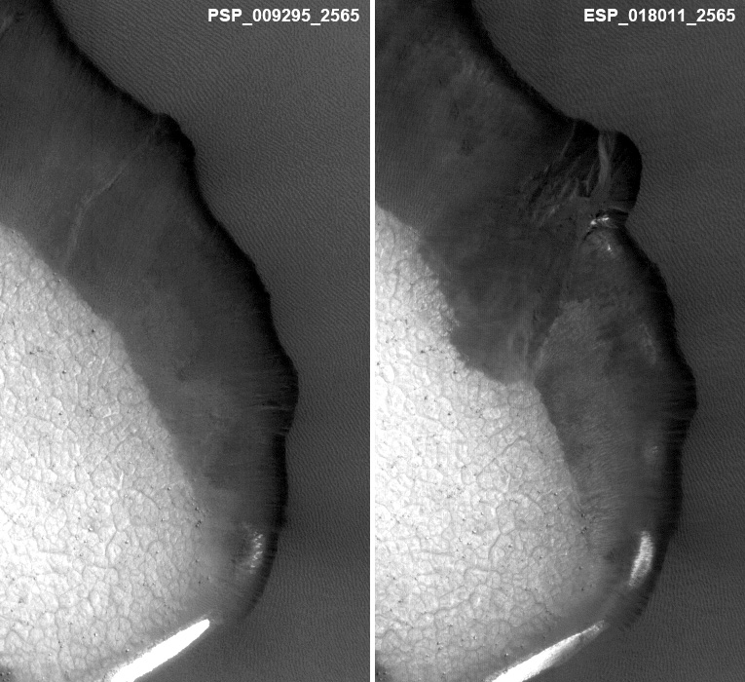
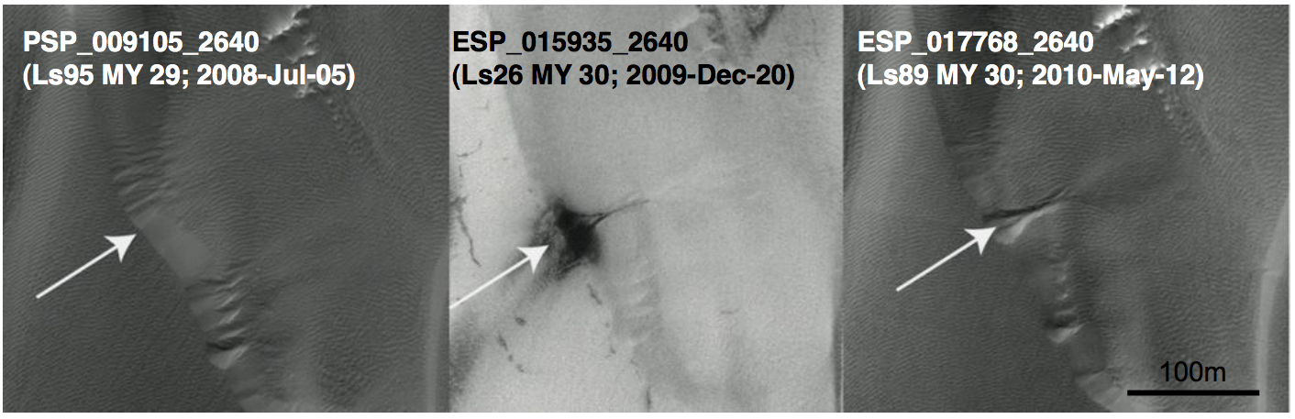

Slide 32
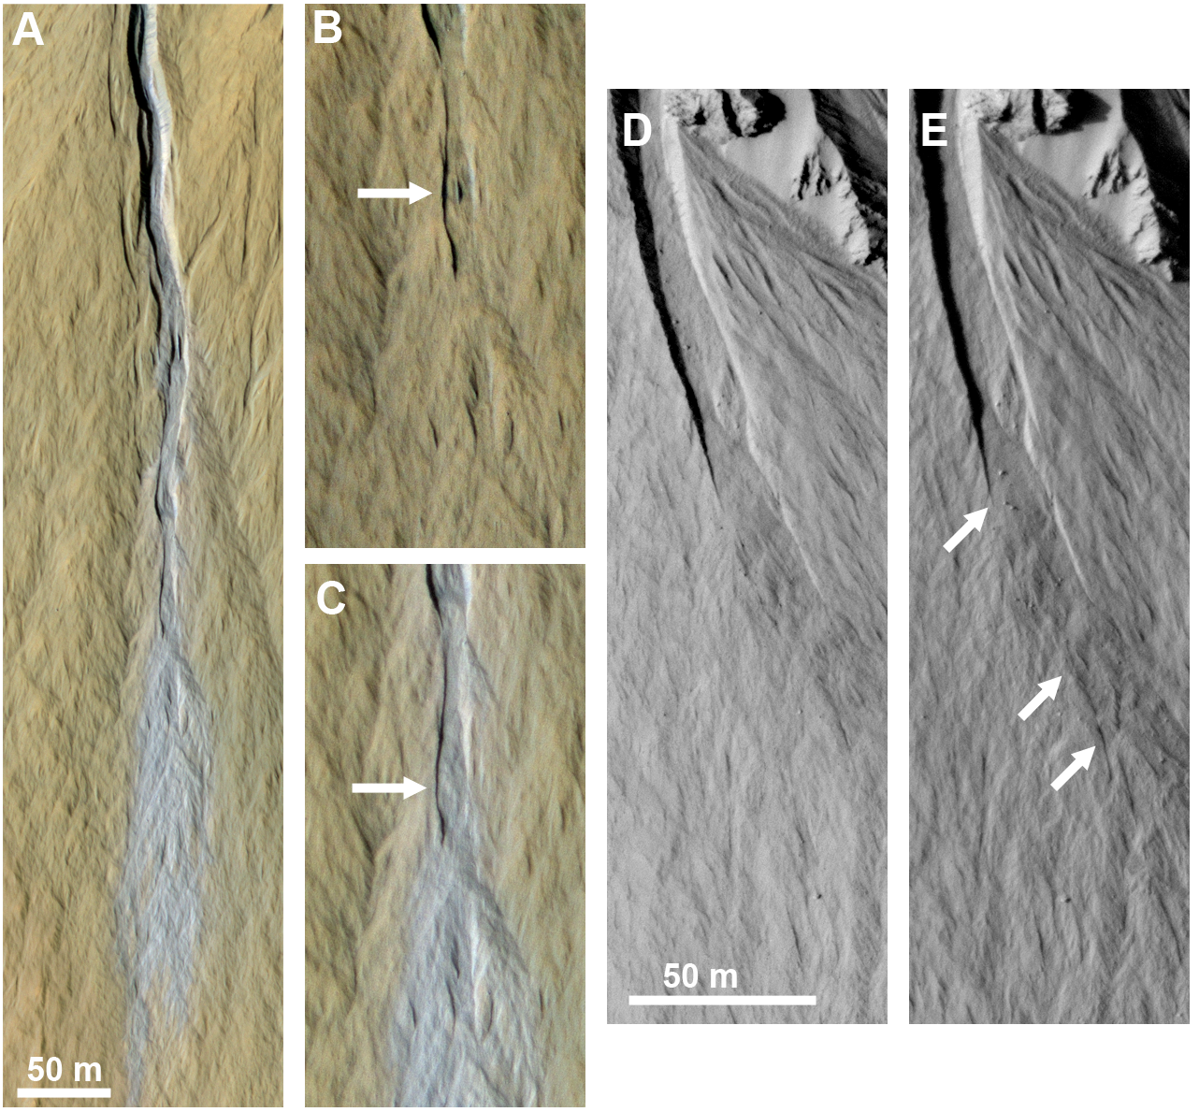
Dundas et al., 2010

Slide 33
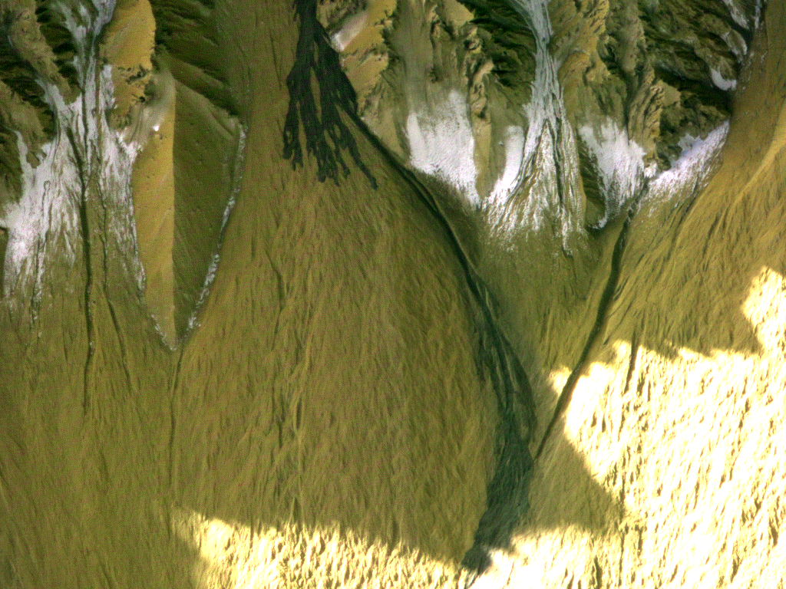
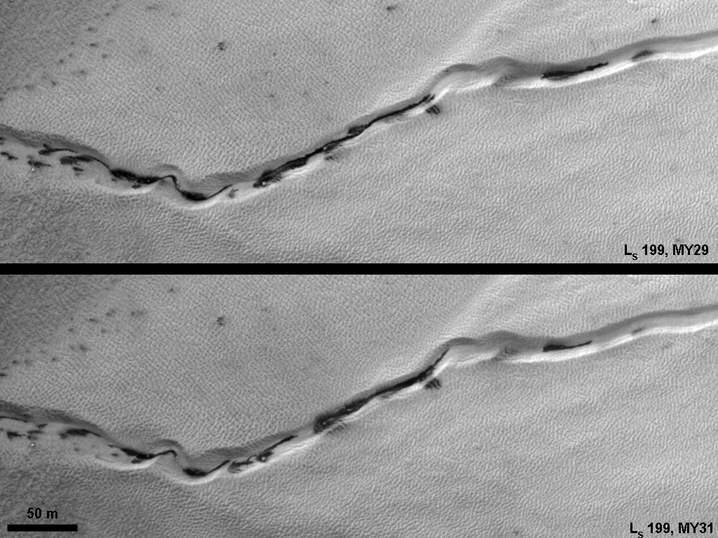
Frost and Gully Activity
Mass movements in gullies occur when CO₂ frost is present, or during defrosting.
Defrosting spots and flows often concentrate in gullies.
Frost activity is largely repeatable from year to year, but major mass movements are stochastic.
Current activity may be a major component of gully formation
Gasa crater: new deposit between L_{S} 128-141.

Slide 34
How about dust storms?
  Cap edge dust storms are common – probably driven by large temperature gradients
MY 29
MY 30
MY 31
L_{s} 25
L_{s} 45
L_{s} 84
Calvin et al. 2014

Slide 35
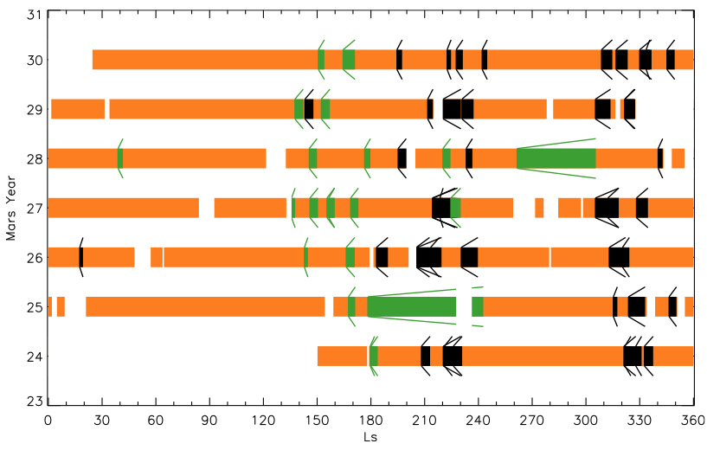
Other dust storms are mostly initiated in the southern Spring and Summer
Wand and Richardson 2013

Slide 36
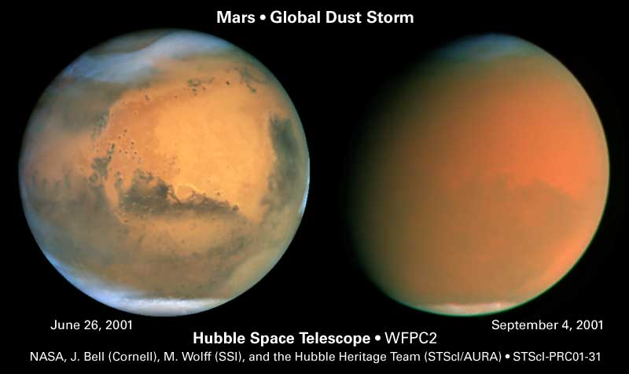
Dust storms can go global roughly every three martian years – MY 25 and MY 28

Slide 37

Dust storms can go global roughly every three martian years – MY 25 and MY 28

Slide 38
Recap
Mars has seasons much like the Earth
We measure season in degrees of solar longitude (L_{s})
Mars year designations are arbitrary, we’re currently in MY32
  MY 33 starts in June 2015
There are some big differences from the Earth
  Orbital eccentricity plays a big role
  Dust storms have important effects and are occasionally global
The main seasonal ice is CO₂
  Leads to transparent ice slabs and some exotic phenomena that we don’t have on the Earth
  CO2 frost/ice is likely the driver of activity in martian gullies today and not liquid water

