Slide 1
Mars Surface Materials

Slide 2
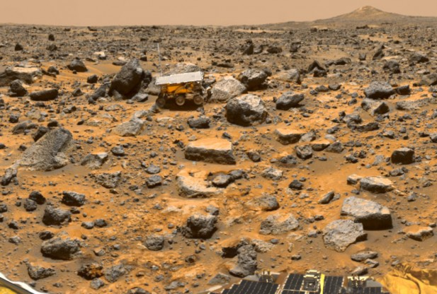
Mars surface materials are similar to the parts of the Earth
The main crustal rocks are volcanic basalt

Slide 3
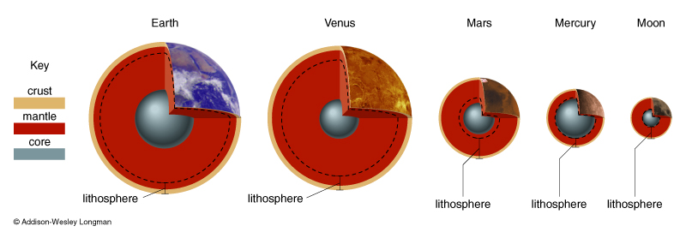
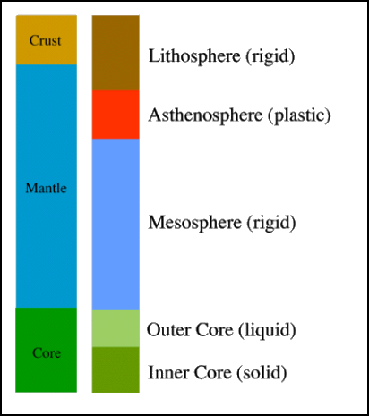
Overview of a rocky planet
Starts as homogeneous mix of rock & iron
Molten state allows differentiation
Iron core cools and solidifies (not yet complete for the Earth)
Millions
of years
Billions
of years
~12,800 km

Slide 4
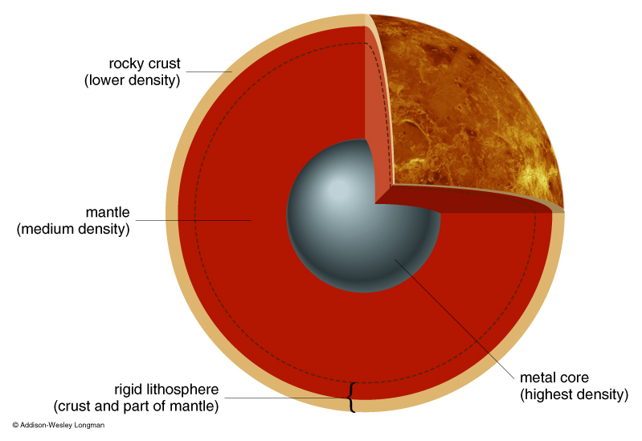
Compositional vs. mechanical terms
Crust, mantle, core are compositionally different
Earth has two types of crust
Lithosphere, Asthenosphere, Mesosphere, Outer Core and Inner Core are mechanically different
Earth’s lithosphere is divided into plates…

Slide 5
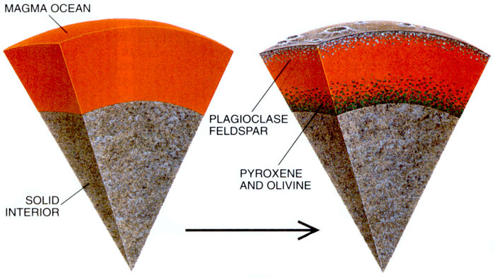
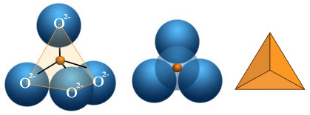
Giant Impacts make Magma Oceans
Lunar magma ocean was probably at least a few hundred km thick
Apollo 11 returned highland fragments, first suggestion of Magma ocean
Idea since extended to other terrestrial planets
A melt has a bulk chemical composition, but no crystals
Minerals are mechanically separable crystals with a distinct composition
Terrestrial planets are dominated by silicon-oxygen based minerals – silicates
Silicate rocks are built from SiO₄ tetrahedra

Slide 6
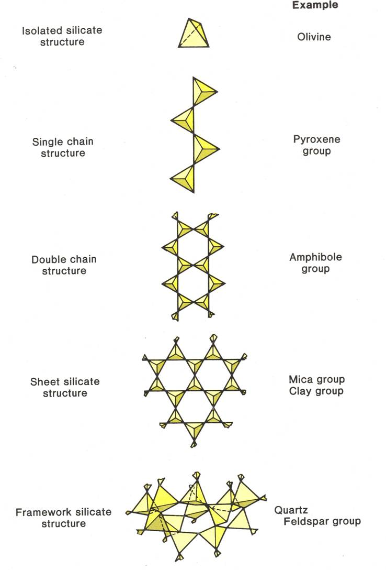
Depending on how Oxygen is shared
Olivine
Isolated tetrahedra joined by cations (Mg, Fe)
(Mg,Fe)₂SiO₄ (forsterite, fayalite)
Pyroxene
Chains of tetrahedra sharing 2 Oxygen atoms
(Mg, Fe) SiO₃ (orthopyroxenes)
(Ca, Mg, Fe) SiO₃ (clinopyroxenes)
Feldspars
Framework where all 4 oxygen atoms are shared

Slide 7
Earth/Venus/Mars
Olivine and pyroxene rain out of a magma ocean leaving a crust that’s more enriched in feldspar minerals
This remaining composition is called Basaltic
Basalt is a broad term (to be expounded upon in the volcanism lectures!)
Variations in water content
Variations in alkali metal content
Variations in silica content
These are initial crusts that will be heavily modified by:
Stripping by Giant Impacts
Plate Tectonics
Volcanism
Millions
of years

Slide 8
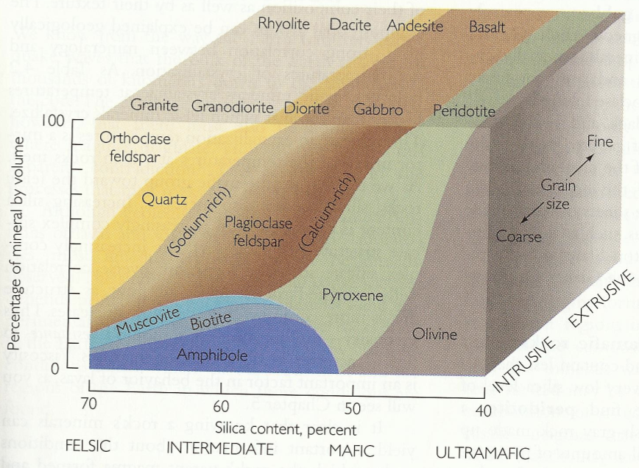
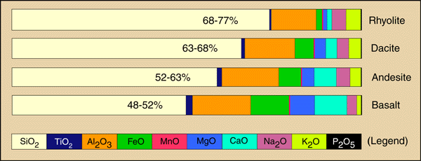
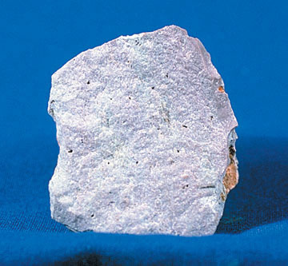
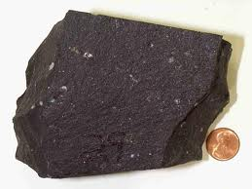
Ultrabasic
Primative
Basic
Acidic
Evolved
Fe poor
Light
Less-dense
Fe rich
Dark
Dense

Slide 9
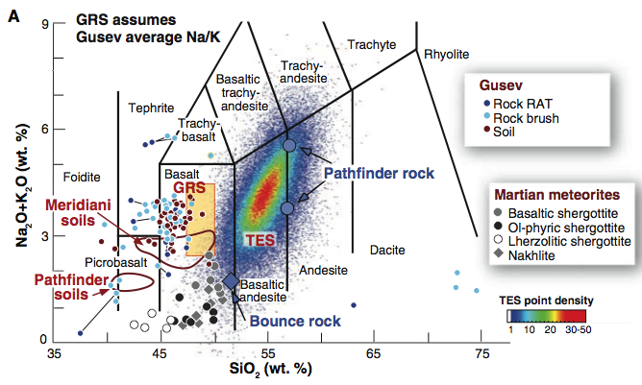
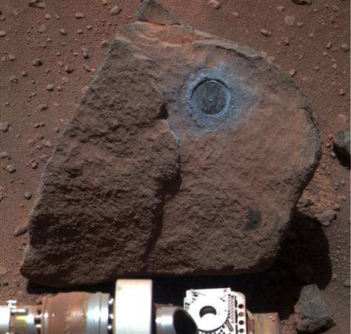
Martian in-situ and orbital measurements
Crust dominated by basalt
With a thin weathered coating
McSween et al., 2009

Slide 10
Mars: Crustal Dichotomy
Northern and southern hemispheres of Mars are very distinct:
North
Low elevation
Few Craters – Young
Smooth terrain
Thin Crust
No Magnetized rock
South
High elevation
Heavily cratered – Old
Rough terrain
Thick crust
Magnetized rock
Dichotomy boundary mostly follows a great circle, but is interrupted by Tharsis
No gravity signal associated with the dichotomy boundary - compensated
Theories on how to form a dichotomy:
Giant impact
Several large basins
Degree 1 convection cell
Early plate tectonics
Zuber et al., 2000

Slide 11
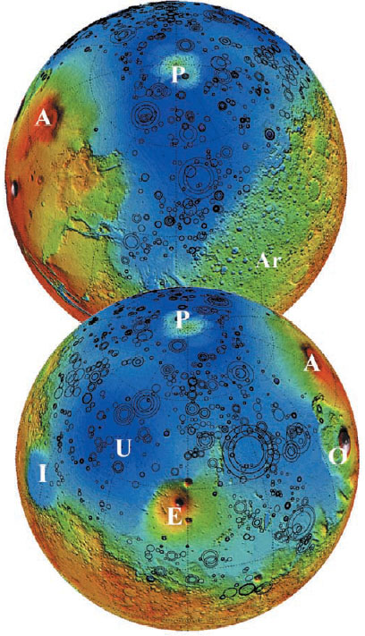
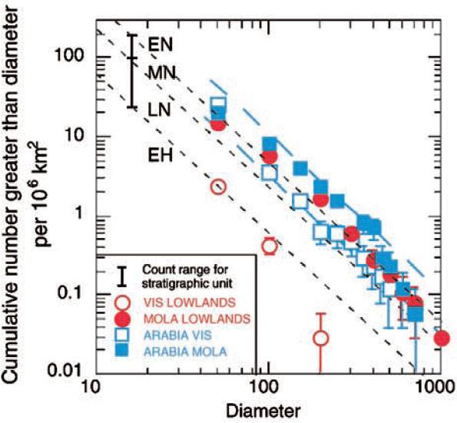
Despite all this the difference is only skin deep
Buried impact basins in the northern hemisphere have been mapped
Before this burial the northern and southern hemispheres were indistinguishable in age
Rules out Earth-style plate tectonics
Northern hemisphere is a thinly covered version of the southern hemisphere
Mantled by 1-2 km of material (sediments and volcanic flows)
Frey et al., 200?

Slide 12
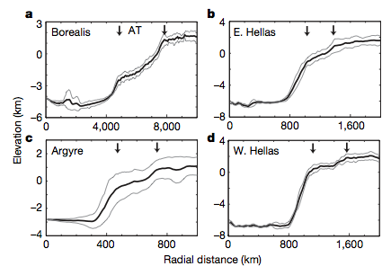
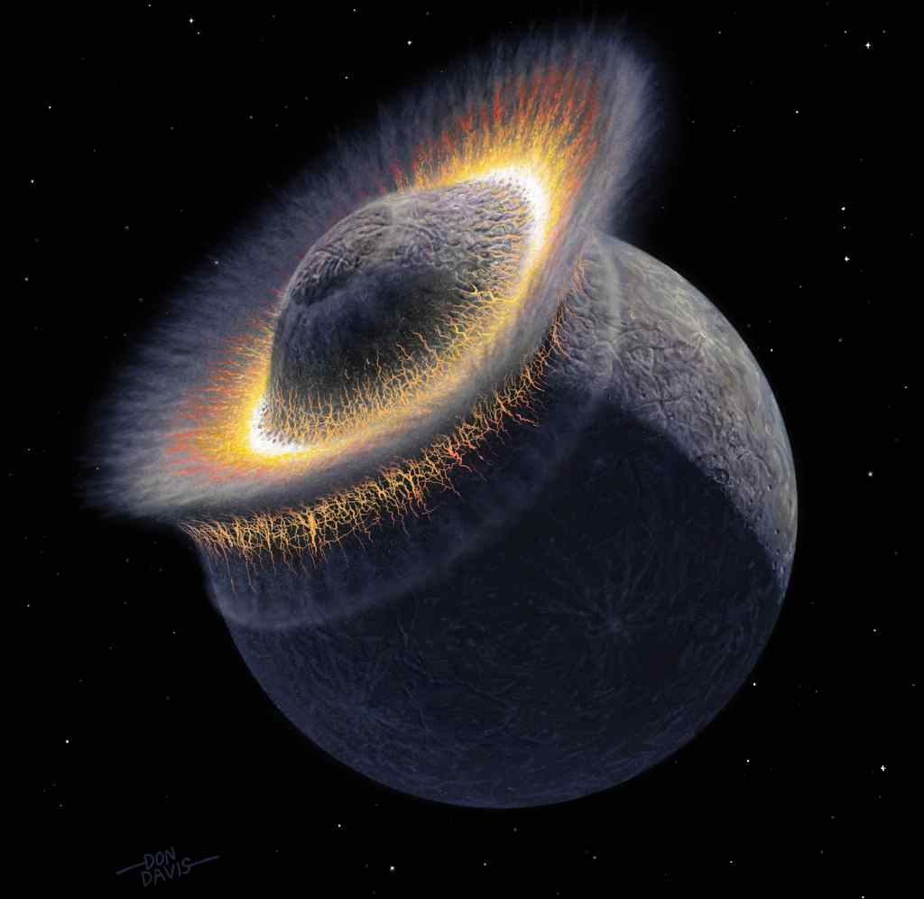
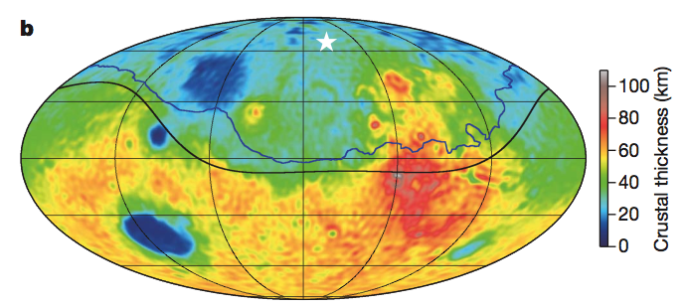
Borealis basin
208E, 67N
4250-5300 km in radius
Shares slope break with at ~1.5 basin radii with other basins
Largest impact structure in the solar system
Andrews-Hanna et al., 2008

Slide 13
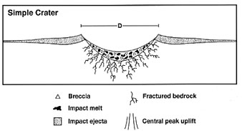
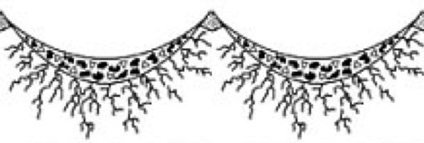
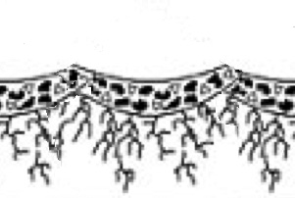
Crust of airless bodies suffers many impacts
Repeated impacts create a layer of pulverized rock
Old craters get filled in by ejecta blankets of new ones
Regolith grows when crater breccia lenses coalesce
Assume breccia (regolith) thickness of D/4
Maximum thickness of regolith is D_{eq}/4 , but not in all locations
Smaller craters are more numerous and have interlocking breccia lenses < D_{eq}/4
Growth of Regolith
Shoemaker et al., 1969

Slide 14
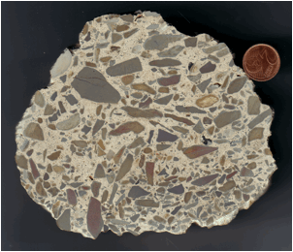
Impact breccia
Unsorted angular fragments

Slide 15
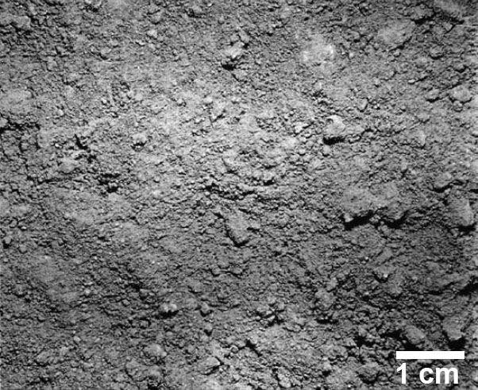
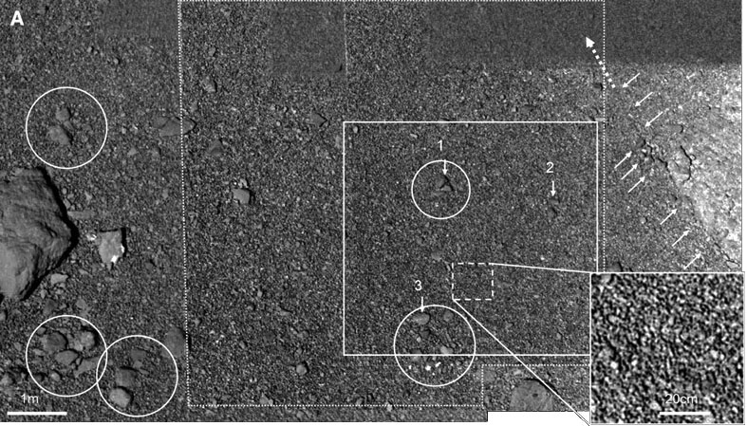
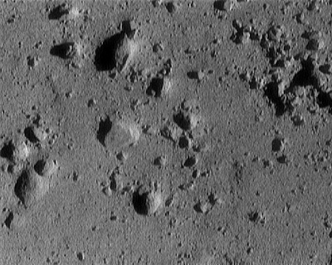
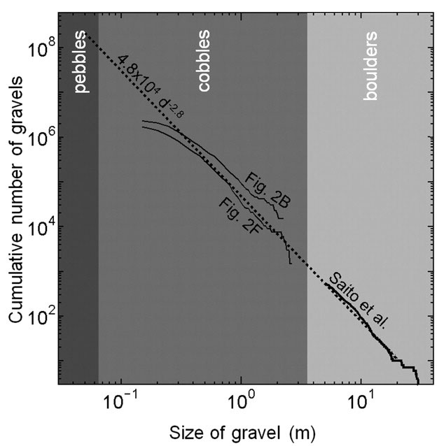
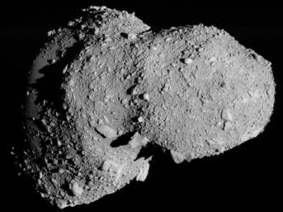
All rocky airless bodies covered with regolith (‘rock blanket’)
Moon - Helfenstein and Shepard 1999
Itokawa – Miyamoto et al. 2007
Miyamoto et al. 2007
Eros – NEAR spacecraft (12m across)

Slide 16
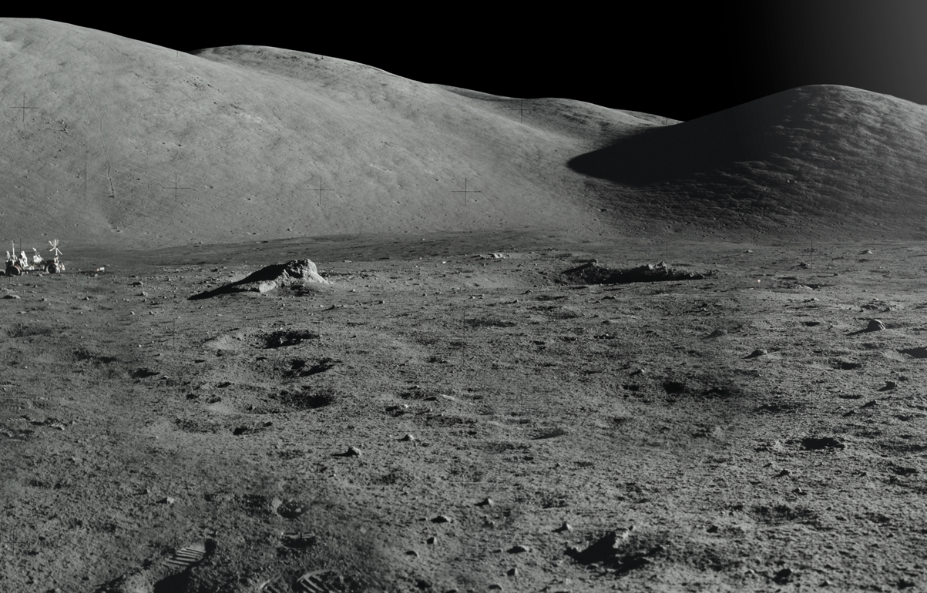
This is where the story ends (more or less) for the Moon/Mercury/asteroids

Slide 17
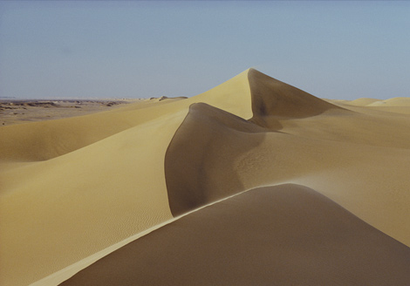
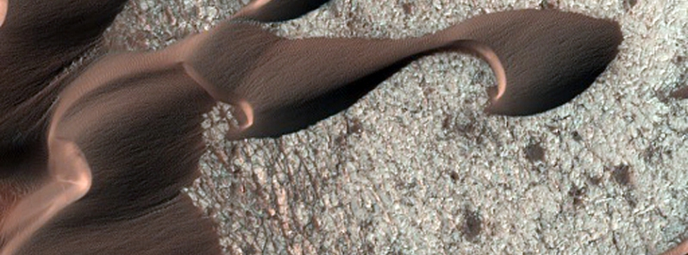
Earth
Breakup of rocks into sand sized particles is common on Earth and Mars, but the composition of these particles are very different
Earth is mostly quartz because it survives a lot longer than anything else
Mars is mostly chips of basalt, because that’s what dominates the local environment
Rare places on the Earth also have basaltic sand e.g. Hawaii and Iceland
Mars

Slide 18
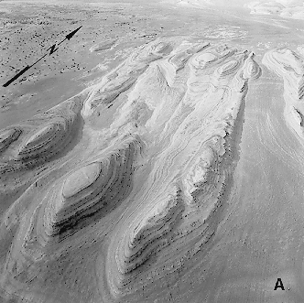
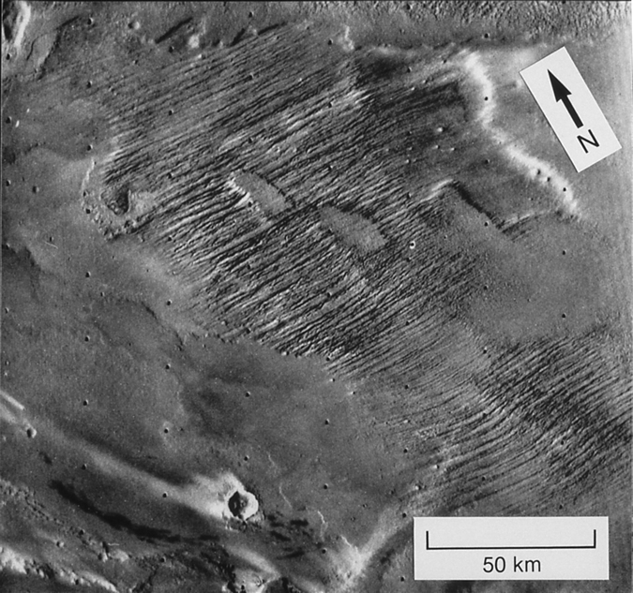
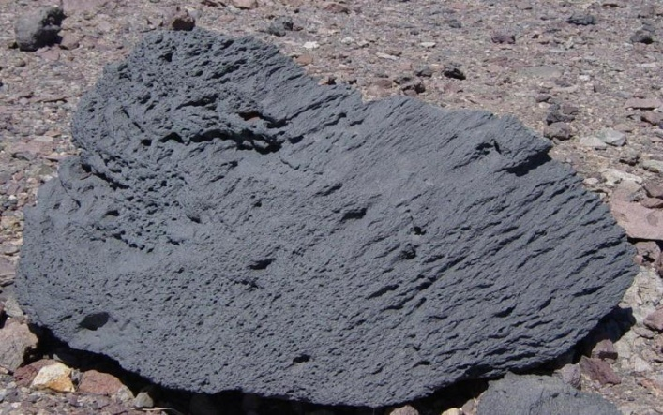
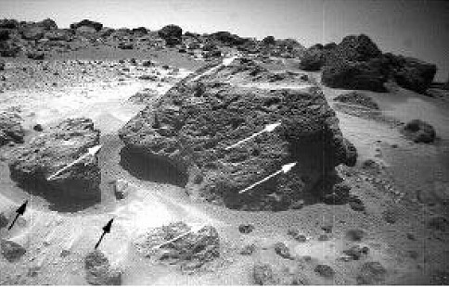
Aeolian Erosion
Yardangs
Wind blown particles abrades surface
Erosion leaves elongated mounds as remnants
Requires strong, virtually unidirectional, wind.
Eroded material must be consolidated
Recentwind action
Older wind action
Ventifacts
Elongated erosional marks on rocks
Usually works on originally circular vesicles
Used as paleo-wind direction indicators e.g. pathfinder landing site

Slide 19
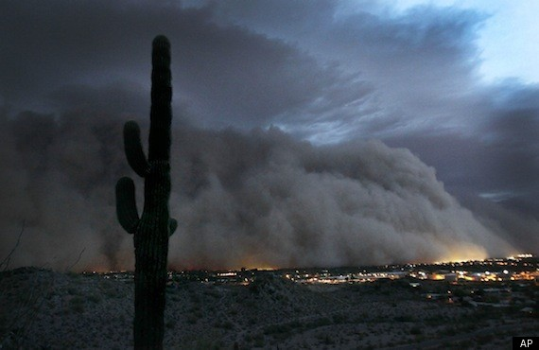
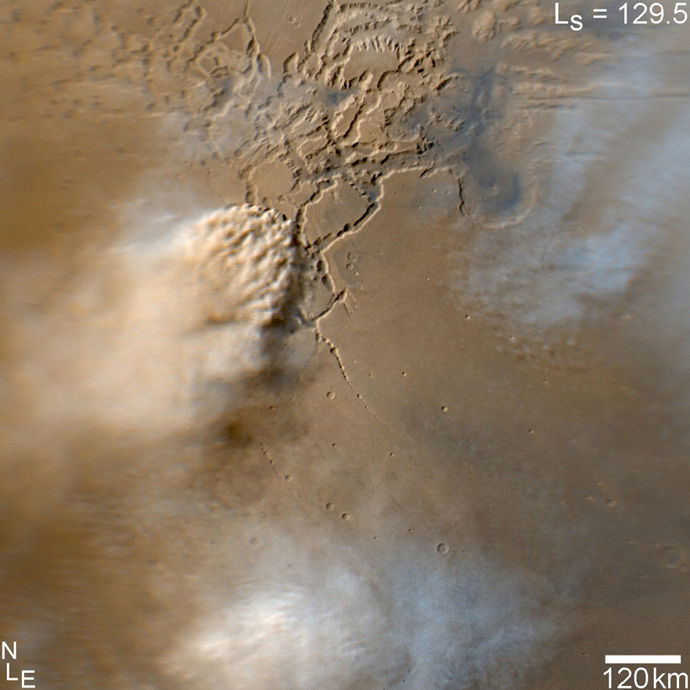
Dust is common on both Mars and Earth – but not so mobile on the Earth
Earth (Phoenix, AZ)
Mars (Noctis Labyrinthus)

Slide 20
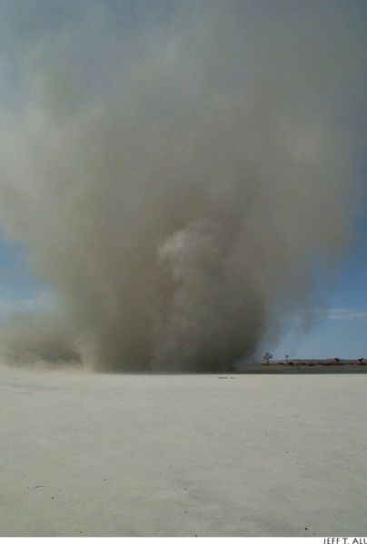
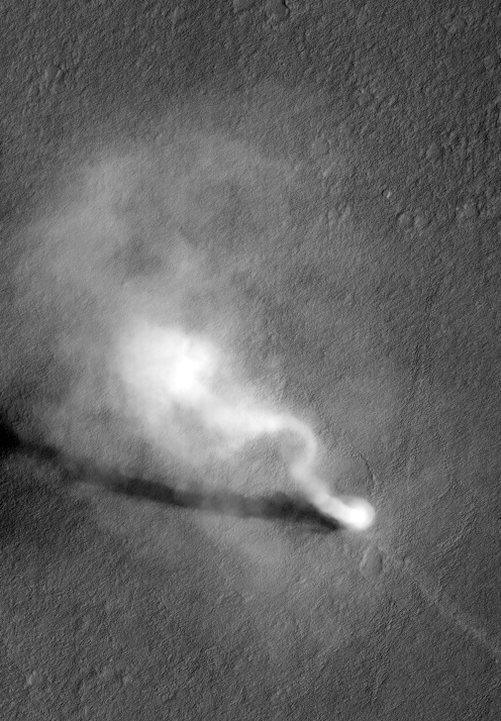
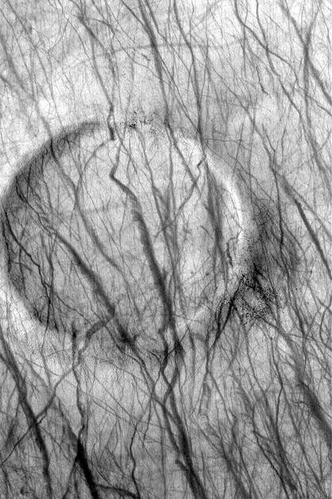
Common in certain areas on Mars
Older streaks fade with time - redeposition of dust
Dust-devil shadows indicate heights of one to several km
Earth (Eloy)
Mars
Mars
Mars, Gusev Crater

Slide 21
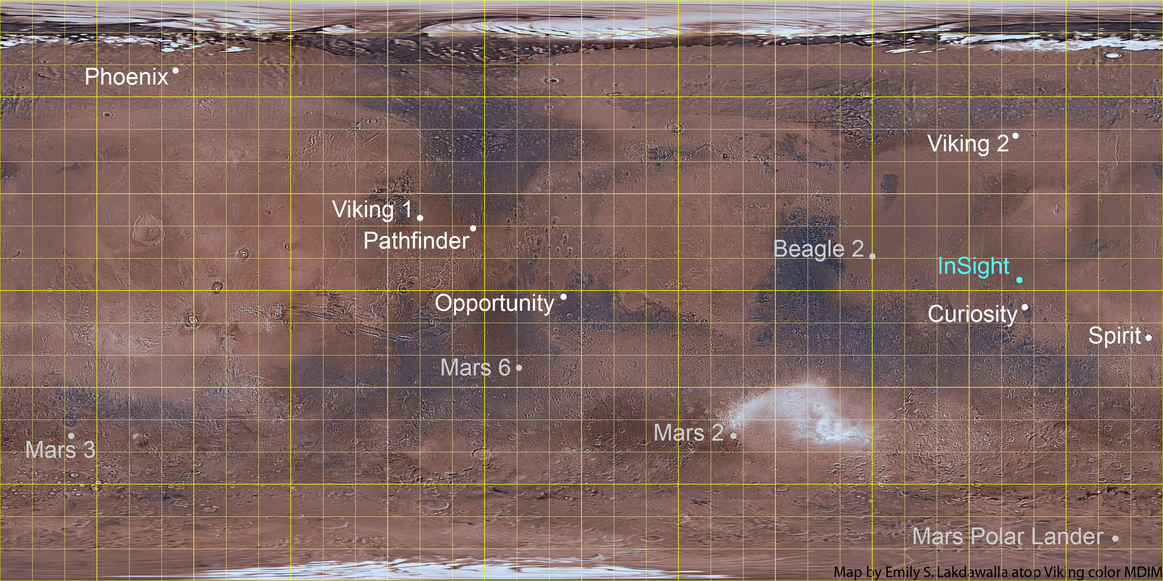

Slide 23
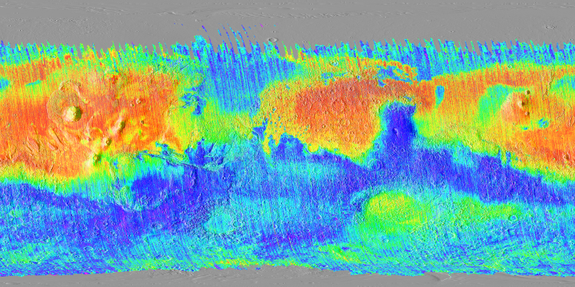
Mars has very large dusty areas
Landed missions always avoid these areas
Bright and pretty featureless in HiRISE images
Dust index map from Ruff and Christensen

Slide 24
Mars has very large dusty areas
Landed missions always avoid these areas
Dusty areas are bright and pretty featureless in HiRISE images
Dust index map from Ruff and Christensen

Slide 25
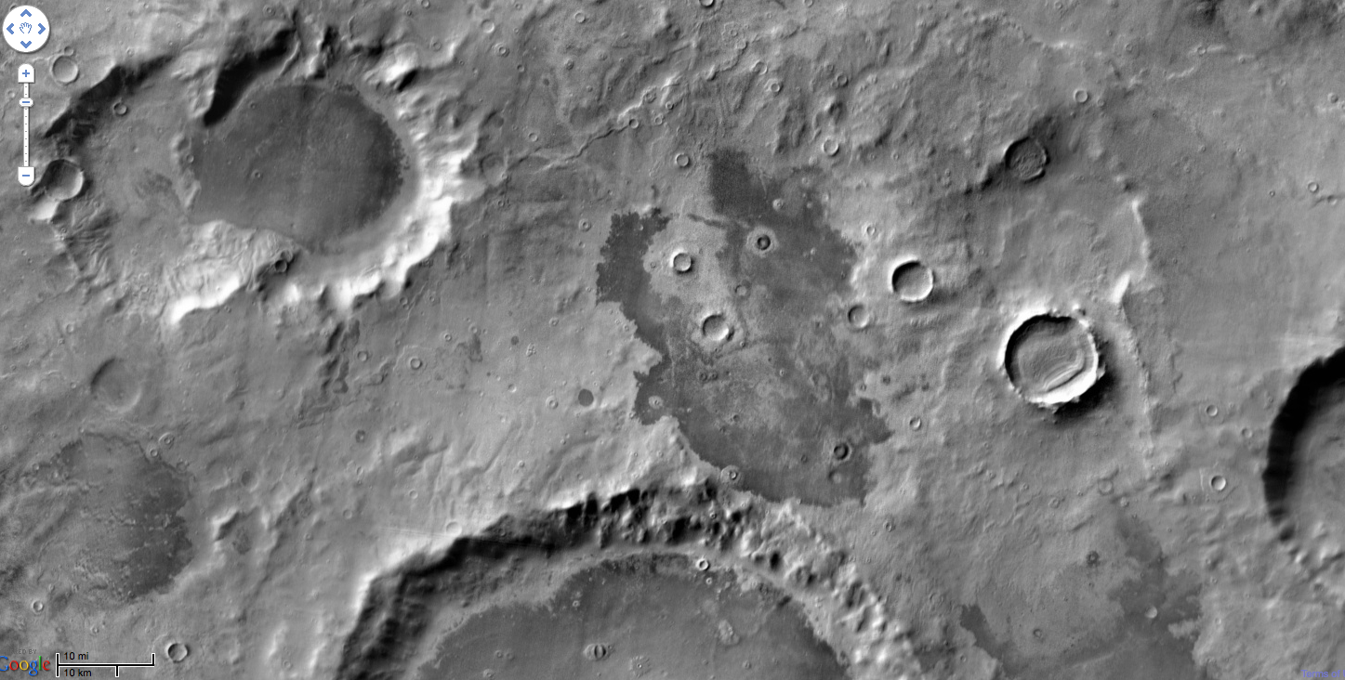
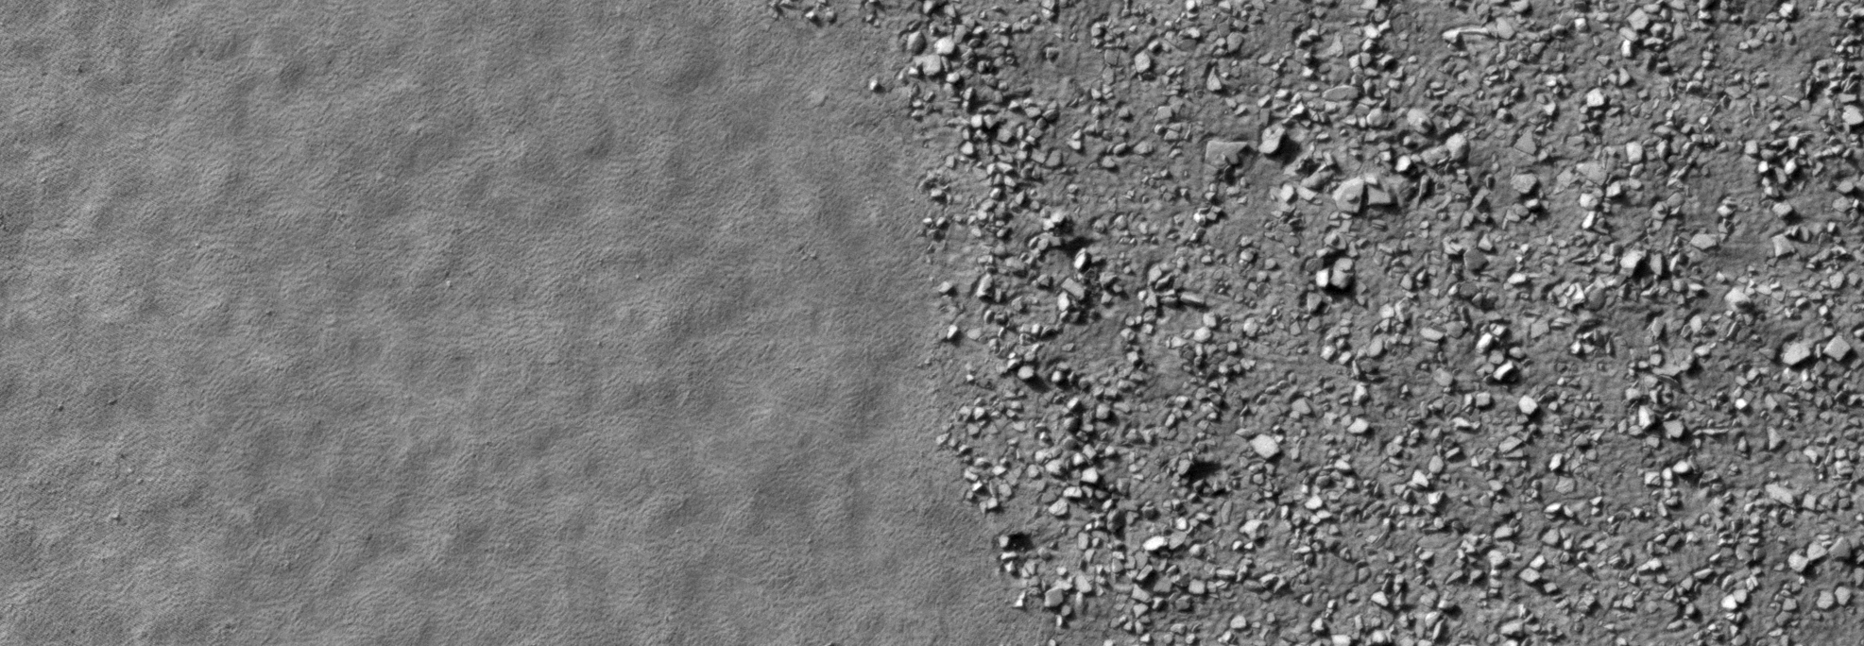
Thermal inertia is used as a predictor of rock abundance for landing site selection.
Themis Daytime IR
darker=cooler=higher TI
ESP_024117_1185

Slide 26
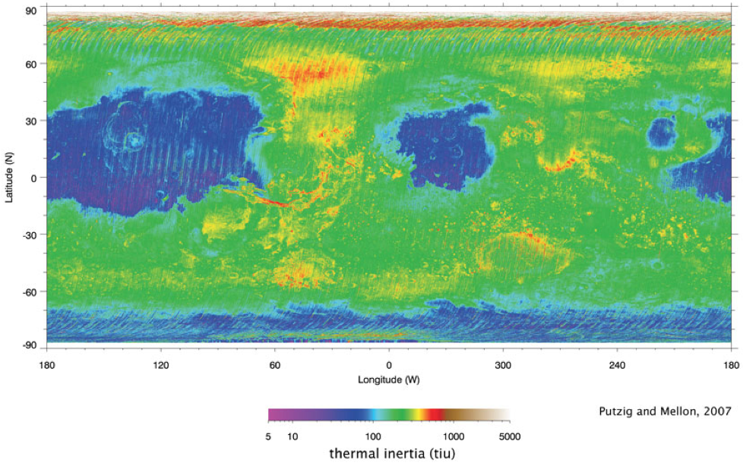
Mike Mellon, U. Colorado

Slide 27
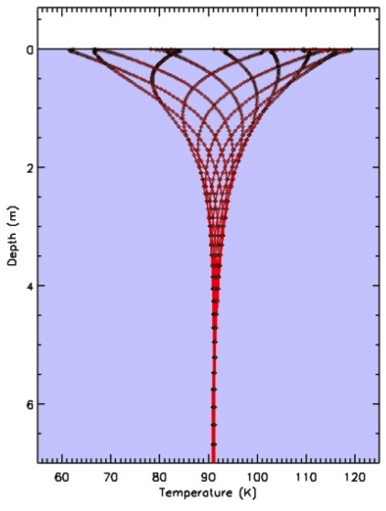
Temperature waves propagate into the subsurface each day
The depth they reach depends on the material thermal inertia
Thermal inertia
k is thermal conductivity
ρ.c is density times heat capacity
(ρ.c)^{0.5} = 900-1400 (factor of ~1.5)
The thermal ‘skin depth’ is
τ is the timescale e.g. 1 day
d ranges from meters to millimeters because of differences in k
d
Day
Night
ROCK
ROCK

Slide 28
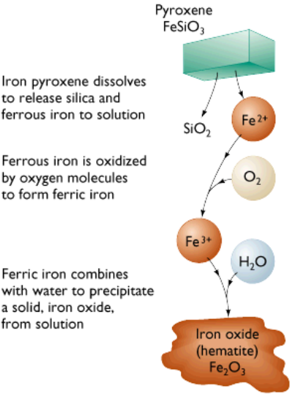
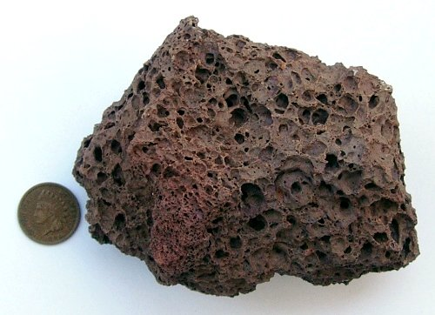
Chemical Alteration
Chemical weathering
Reaction with water (maybe acidified) and/or oxygen
Pyroxenes (weathering of basalt)
Oxidation of iron
Fe – metallic iron
Fe²⁺ – Ferrous iron (water soluble)
Fe³⁺ – Ferric iron (water insoluble)
3FeSiO₃ + O₂ ➔ 2Fe₂O₃ + 4SiO₂
Pyroxene ultimately breaks down into Hematite and Silica
Weathered basalt looks reddish on Earth/Mars

Slide 29
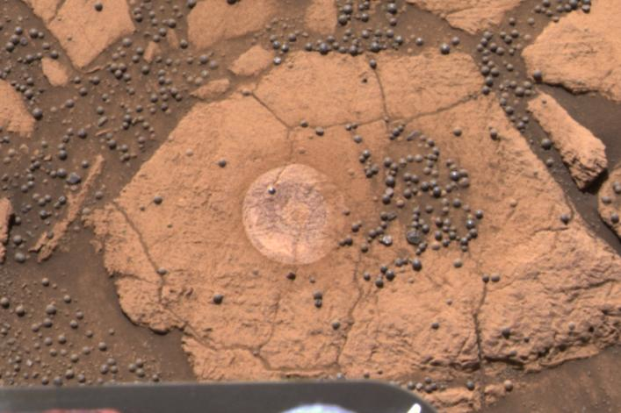
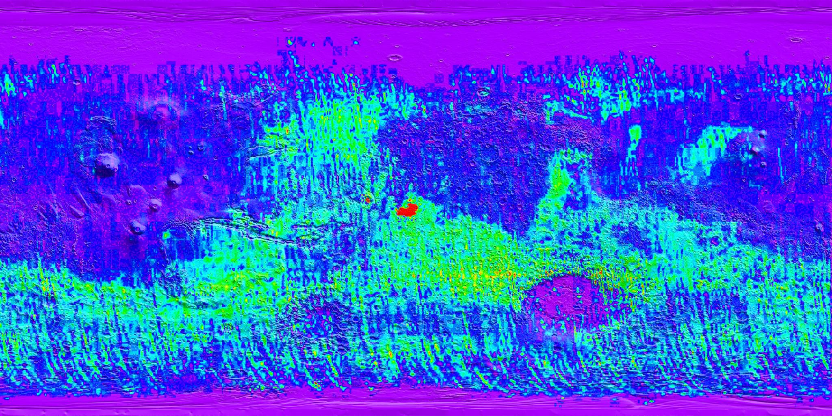
Hematite in large quantities is relatively rare on Mars – but not at the opportunity landing site
Discovery by Mars Global Surveyor influenced the course of the Mars Exploration rover missions

Slide 30
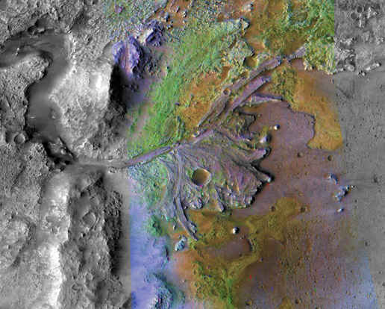
Feldspars
Potassium feldspar converted to Kaolinite, a clay mineral
2KAlSi₃O₈ + 2H₂CO₃ + H₂O ➔ Al₂Si₂O₅(OH)₄ + 4SiO₂ + 2K⁺ + 2HCO₃⁻
Another important way in which granite is broken down
Ion mobility Ca > Na > Mg > K > Si > Fe > Al
Aluminum can get progressively concentrated when weathering rates are very high
Clay minerals (green) are being discovered on Mars in an increasing number of locations
Clays appear only in the oldest materials on the planet and require water to from.
Indicates that wet conditions

Slide 31
What do ancient martian rocks tell us?
Clay minerals formed in wet conditions and they’re common in ancient rocks
Wray et al., 2008
Ehlmann et al., 2009
Noachian crustal hydrothermal clays
Noachian layered clays
Ehlmann et al., 2008
Osterloo et al., 2008
Noachian delta/fan clay-bearing sediments
Noachian "glowing terrain" rich in chloride salts

Slide 32
A big change for Mars
(Bibring et al., 2006)
4.5 billon yrs ago
present
MARS
EARTH
Hadean
Archaean
Proterozoic
Phan.
4.6 Gyr
3.85 Gyr
2.5
Gyr
543 Myr
present day
oldest rocks
oldest fossil life

Slide 33
Gale crater

Slide 35
Water ice in the Regolith
Gamma Ray spectrometer on Mars Odyssey spacecraft has detected hydrogen (from H₂O) in near surface

Slide 36
Ground ice on Mars theorized to exist for some time
Regolith provides the thermal insulation
Stable ice distribution changes with climate
Diffusive contact with the atmosphere
Water vapor
Surface
Up to a few feet down

Slide 37
The Phoenix lander discovered pore-filling ice and pure buried water ice

Slide 38
New craters expose this ice of wide areas – but it’s not pore filling…
How did pure ice come to be underground?
50m

Slide 39
Recap
Mars has the same rocks and minerals that the Earth does
Early differentiation resulted in a basaltic crust
i.e. the whole crust is very similar to Hawaiian lava flows
A giant impact probably rearranged enough material to create a hemispheric difference in crustal thickness
Smaller impacts pounded the crust into a regolith of angular rock fragments
Other processes also contribute to breaking rocks up into sand and dust
Dusty areas on Mars are common and have distinct thermal behavior
Thermal inertia can be used to infer rock abundances and regolith grain sizes
Chemical alteration produced a suite of other minerals, including:
Hematite at the opportunity landing site
Clays in the oldest terrains that have seen seen liquid water activity
Ice is another major constituent at mid- and high-latitudes
Pore-filling ice in the regolith is easy to explain
Pure sheets of buried ice also exist, but are currently still a puzzle

