Slide 1
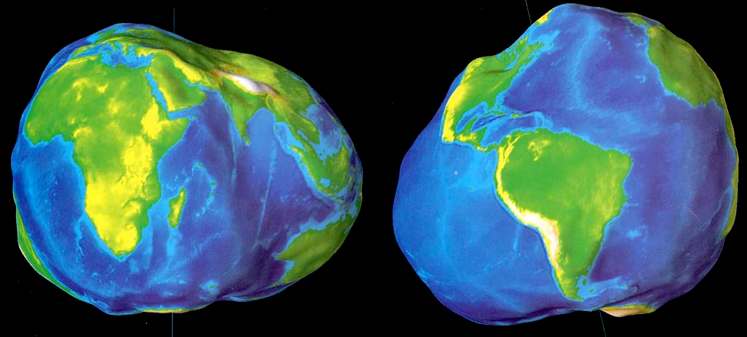
Gravity and Topography II

Slide 2
Gravity and Topography I
Shapes of planets, rotation and oblateness
Center of mass/figure offsets, fossil figures etc…
Hypsometry and geoids
Gravity and Topography II
Crustal isostacy vs. flexure vs. dynamic support
Gravity anomalies
Mapping crustal thickness
Topographic statistics on planetary surfaces

Slide 3
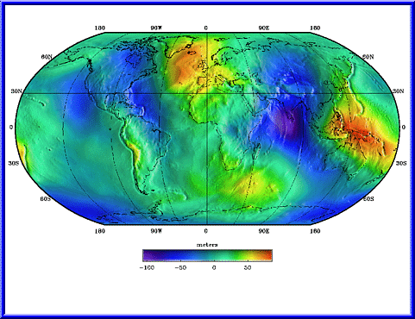
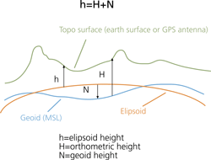
Geoid Recap
Real planets are lumpy, irregular, objects
Deviations of the equipotential surface from the ellipsoid make up the geoid
Gravity is the gradient of this potential perpendicular to its surface
Expressed in meters – range on Earth from ~ -100 to +100 meters
Earth’s geoid is the equipotential surface corresponding to mean sea level
This is the definition of a flat surface – but it has high and low points
A reference ellipsoid is fit to the geoid (for most planets it’s a sphere)
Topography is measured relative to the geoid

Slide 4
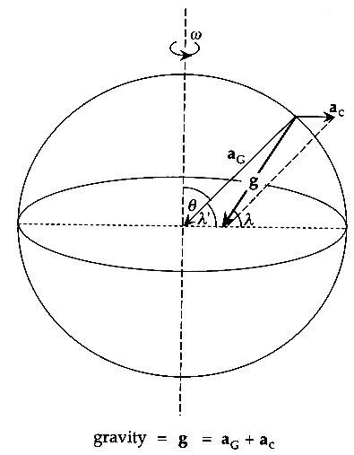
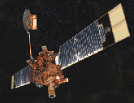
Measuring Gravity with Spacecraft
Gravity measured in Gals
1 gal = 1 cm s⁻²
Earth’s gravity ranges from 976 (polar) to 983 (equatorial) gal
Sum of centrifugal and gravitational accelerations give expected gravity
Gravity anomalies (deviations from expect gravity) are measured in mgal
Gravitational anomalies
Only really addressable with orbiters
Surface resolution roughly similar to altitude
Anomalies cause along-track acceleration and deceleration
Changes in velocity cause doppler shift in tracking signal
Convert Earth line-of-sight velocity changes to change in g
Downward continue to surface to get surface anomaly
What about the far side of the Moon?

Slide 5
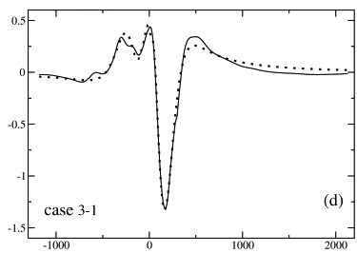
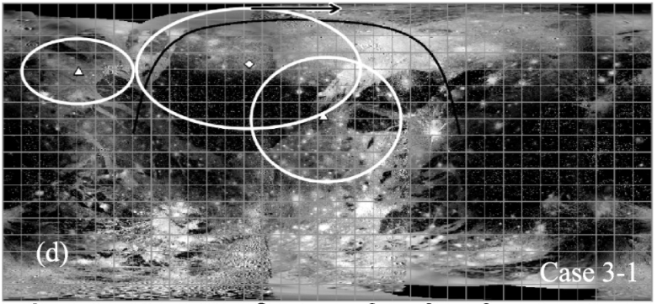
Flybys of Ganymede revealed gravity anomalies
Explainable with distributed mass excesses/deficits
Deficits in bright terrain, excess in dark terrain
Non-unique solutions show the value of an orbiter!
Palguta et al., 2009

Slide 6
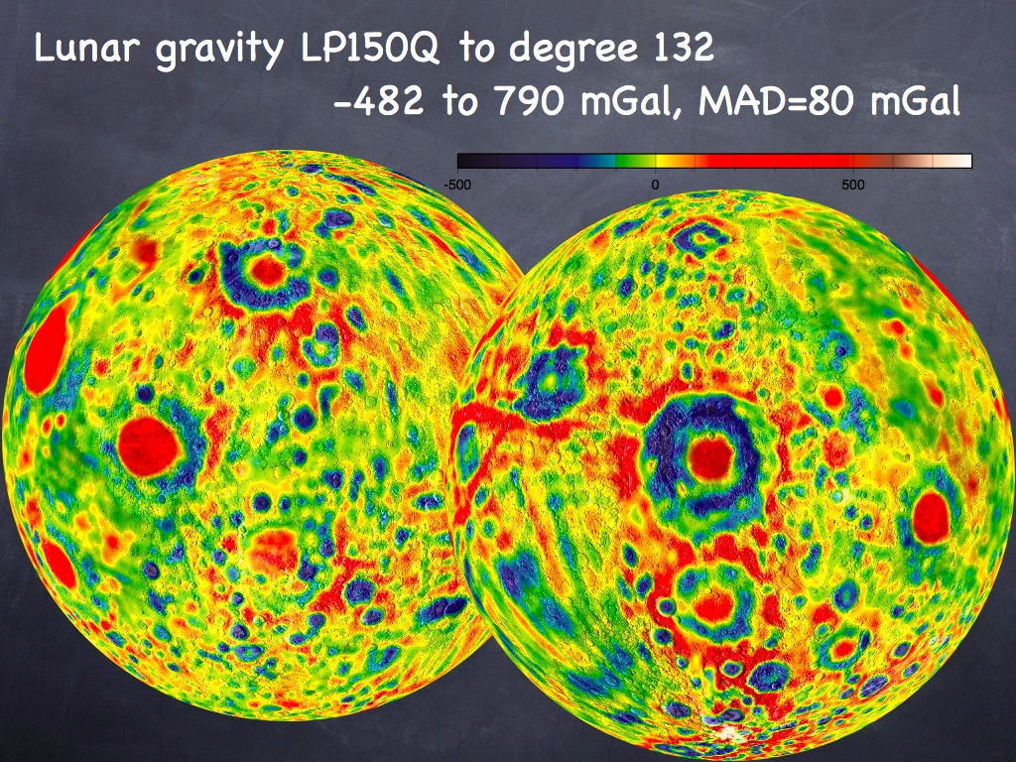
Corrections to Observations
Before we can start interpreting gravity anomalies we need to make sure we’re comparing apples to apples…
Free-Air correction
Assume there’s nothing but vacuum between observer and reference ellipsoid
Just a distance correction

Slide 7
Bouguer correction
Assume there’s a constant density plate between observer and reference ellipsoid
Remove the gravitation attraction due to the mass of the plate
If you do a Bouguer correction you must follow up with a free-air correction
Ref.
Ellipsoid
Ref.
Ellipsoid
Bouguer
Free-Air

Slide 8
Terrain correction
Not commonly done except in very mountainous regions
Divide terrain into radial sectors
Use DEM to find h at distance r₁ to r₂
Eötvös correction
Vertical component of the coriolis force (for moving observers)
Tidal correction
Effects of Moons/Sun on local planetary shapes
Other corrections
Local-geology specific effects of density anomalies e.g. magma chambers etc...

Slide 9
Start with g_{obs} at P and Q
Do terrain correction first
If needed
g_{obs} – Δg_{T}
Then remove bouguer plate
g_{obs} – Δg_{T} – Δg_{B}
Then do free-air correction
g_{obs} – Δg_{T} – Δg_{B} – Δg_{FA}
The remove expected g_{o}
g_{obs} – Δg_{T} – Δg_{B} – Δg_{FA} – g_{o}
This is the gravity anomaly
Often, for spacecraft data, only the free-air correction is made
Now we can compare gravity values from place to place

Slide 10
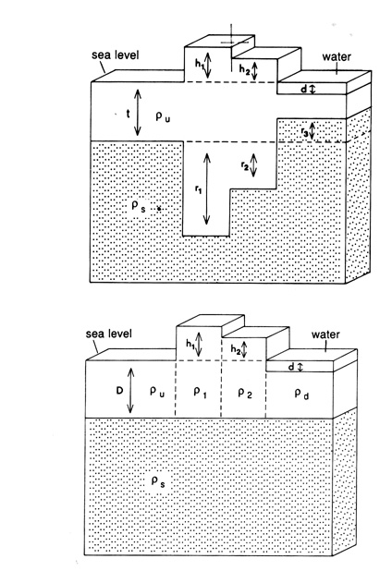
Effects of Compensation
Simple view of mountains
Supported by lithospheric strength
Large positive free-air anomaly
Bouguer correction should get rid of this
Anomalies due to mountains are much weaker than expected though
Due to compensation
Airy Isostasy
Compensation achieved by mountains having roots that displace denser mantle material
gH₁ ρ_{u} = gr₁ (ρ_{s} – ρ_{u})
Pratt Isostasy
Compensation achieved by density variations in the lithosphere
gD ρ_{u} = gh₁ ρ₁ = gh₂ ρ₂ etc..
Vening Meinesz
Flexural Model that displaces mantle material
Combines flexure with Airy isostasy

Slide 11
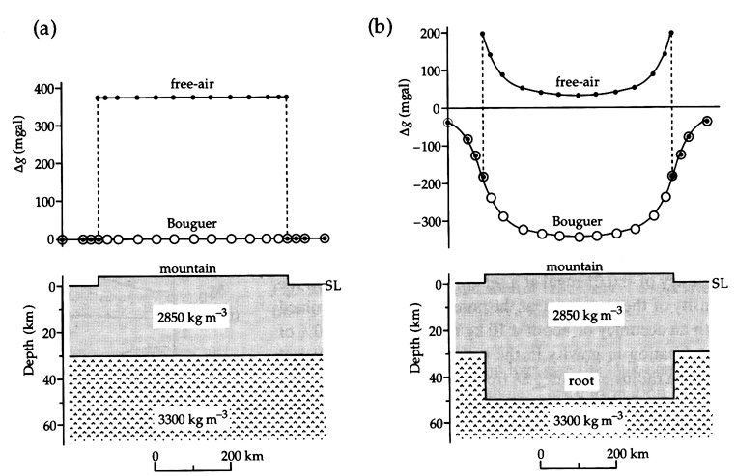
Uncompensated
Compensated
Strong positive free-air anomaly
Weak positive free-air anomaly
Zero or weak negative Bouguer anomaly
Strong negative Bouguer anomaly

Slide 12
+ve free air
0 free air
-ve free-air
0 Bouguer
+ve Bouguer
-ve Bouguer
+ve Bouguer
0 Bouguer
-ve Bouguer

Slide 13
Interpretation of Anomalies
Two ways to interpret Bouguer anomalies
Mass excesses/deficits in the near surface
Constant density crust that varies in thickness
Play off density contrast with mantle against the mean crustal thickness

Slide 14
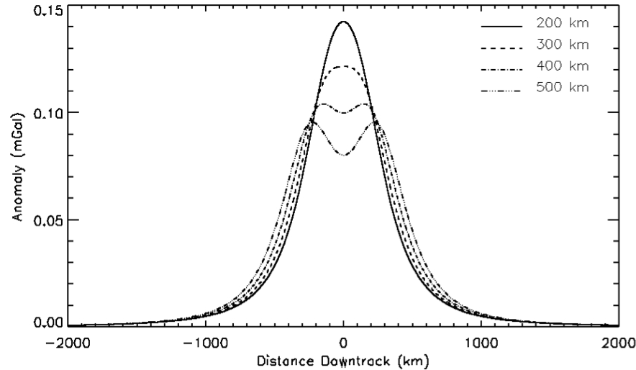
Hard to separate nearby gravity anomalies
e.g. two over-dense (by 300 kg m⁻³) spheres 10km across and 20km deep as seen by a spacecraft 300km above the surface…
Spacecraft altitude is roughly the resolution of the gravity dataset
Anomaly separation

Slide 15
Assume crustal density is constant
Bouguer anomalies depend on
Density difference between crust and mantle
Moho topography
Negative anomalies mean thicker crust
Positive anomalies mean thinner crust
Choose a mean crustal thickness and a crust/mantle density difference
-ve Bouguer
+ve Bouguer

Slide 16
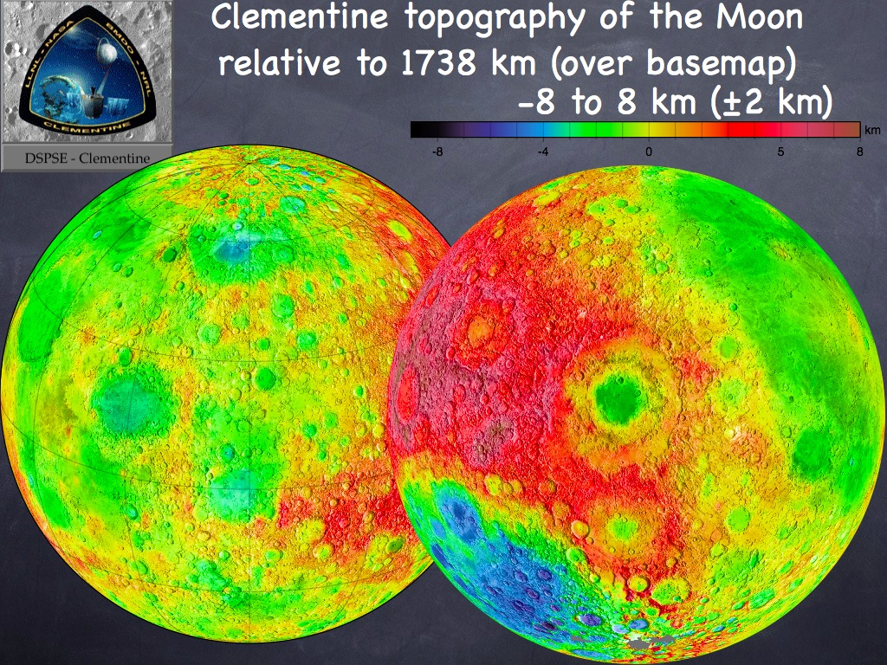
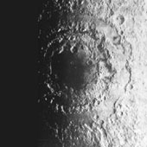
Lunar gravity
Craters <200km diameter
Negative Bouguer anomalies
Mass deficit due to excavated bowl and low density of fall-back rubble
Mountains
Positive free-air anomalies
Support by a rigid lithosphere
Mascons
First extra-terrestrial gravity discovery
Very strong positive anomalies
Uplift of denser mantle material beneath large impact basins
Later flooding with basalt
Bulls eye pattern – multiring basins
Only the center ring was
flooded with mare lavas
Flexure
South pole Aitken Basin
Appears fully
compensated
Older
Free-Air

Slide 17
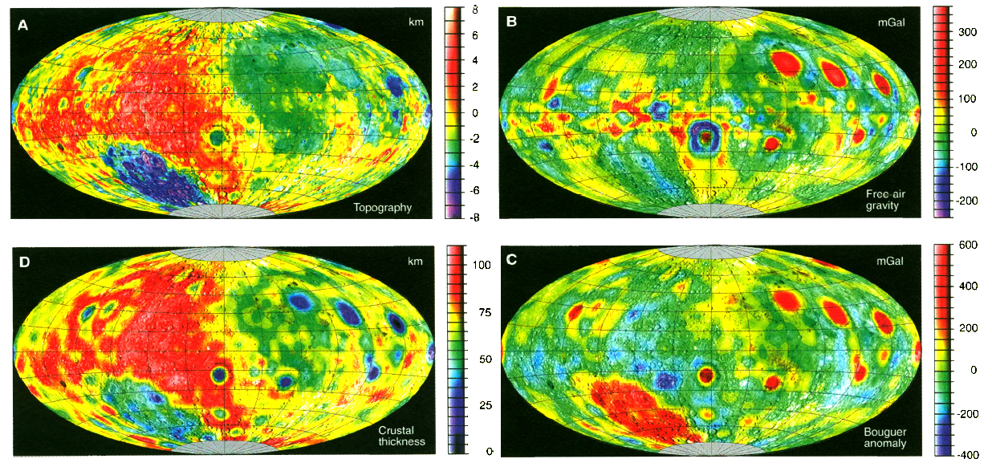
Crustal thickness maps show lunar crustal dichotomy
Zuber et al., 1994

Slide 18
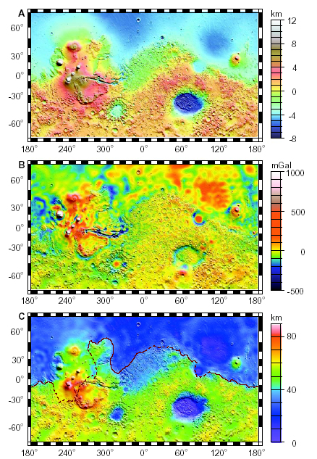
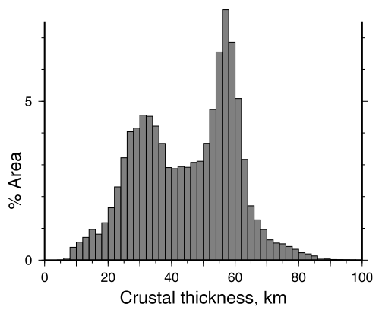
Zuber et al., 2000
Mars Gravity
Tharsis
Large free-air anomaly indicates it is uncompensated
But it’s too big and old to last like this
Flexurally supported?
Crustal thickness
Assume Bouguer anomalies caused by thickness variations in a constant density crust
Need to choose a mean crustal thickness
Isidis basin sets a lower limit
Free Air

Slide 19
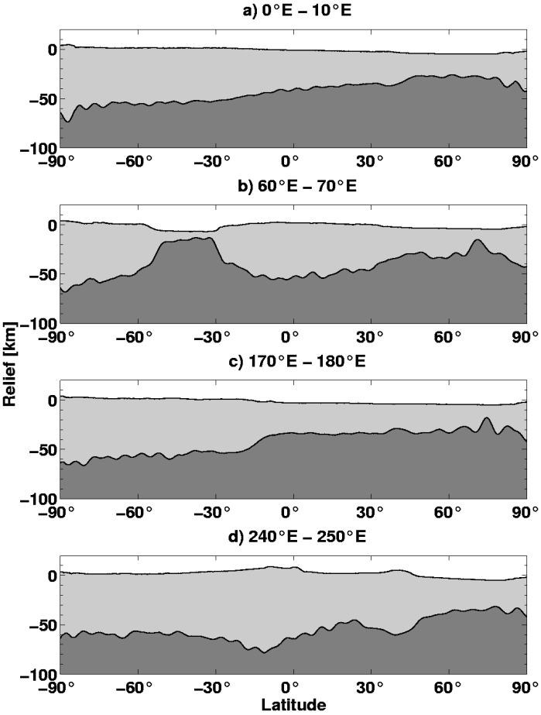
Crustal thickness of different areas
But many features are uncompensated….
So Bouguer anomaly doesn’t translate directly into crustal thickness
Zuber et al., 2000

Slide 20
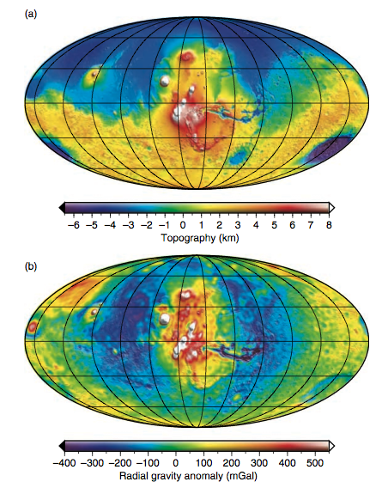
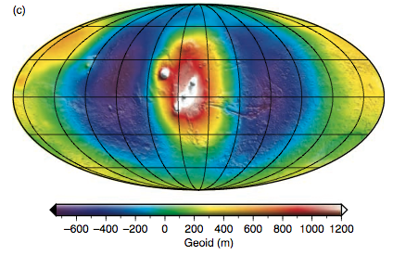
Tharsis
Site of large +ve free-air anomaly
Surrounded by –ve anomaly ‘moat’
Indicates at least some support by flexure of the lithosphere (~Vening Meinesz)
+ve free-air
-ve free-air
0 free-air
Wieczorek, 2007

Slide 21
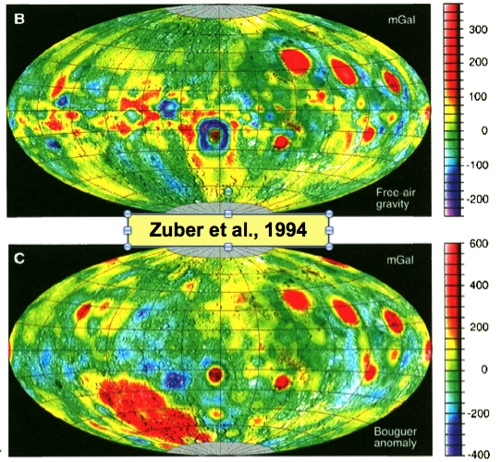
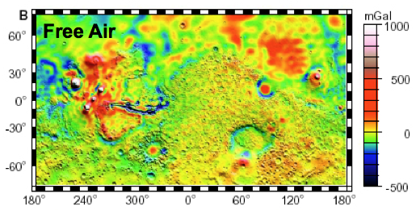
A common occurrence with large impact basins
Lunar mascons (near-side basins holding the mare basalts)
Utopia and Isidis basins on Mars
Initially isostatic
+ve Bouguer
0 free-air
Sediment/lava fill basin
Now flexurally supported
+ve Bouguer
+ve free-air

Slide 22
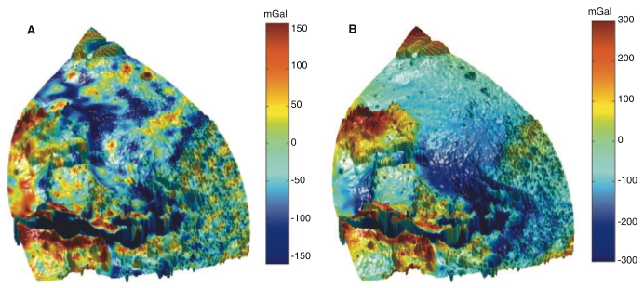
Crustal density is not always uniform
Smaller scale anomalies reveal buried flood channels
-ve free-air anomalies indicate fill with less dense material
Actual free-air anomaly
Predicted free-air anomaly
Zuber et al., 2000

Slide 23
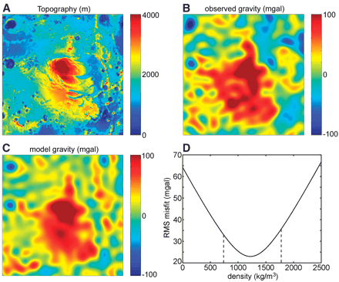
South polar layered deposits of Mars
Large inner solar system ice sheet containing some dust…
Gravity data indicate density of 1220 kg m⁻³
Water-ice with 15% dust
Zuber et al., 2007

Slide 24
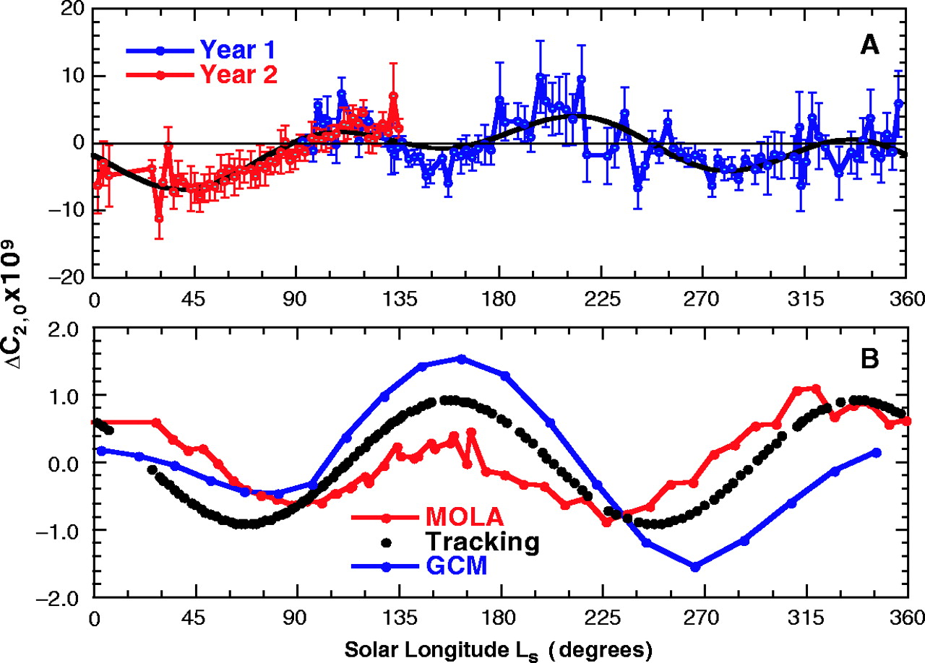
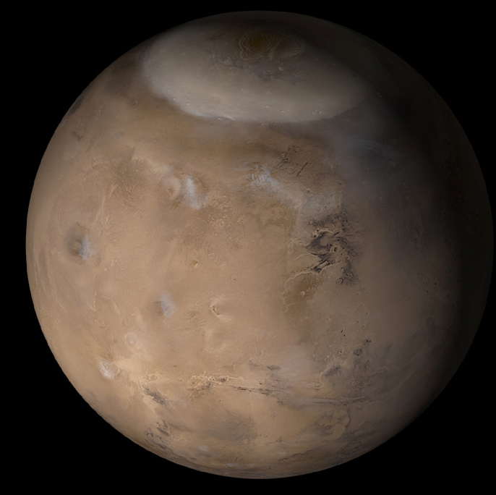
Time variable gravity
Martian seasonal cap incorporate about 25% of the atmosphere
About ~7x10¹⁵ Kg
Causes periodic flattening of the gravity field
Smith and Zuber, 2005

Slide 25
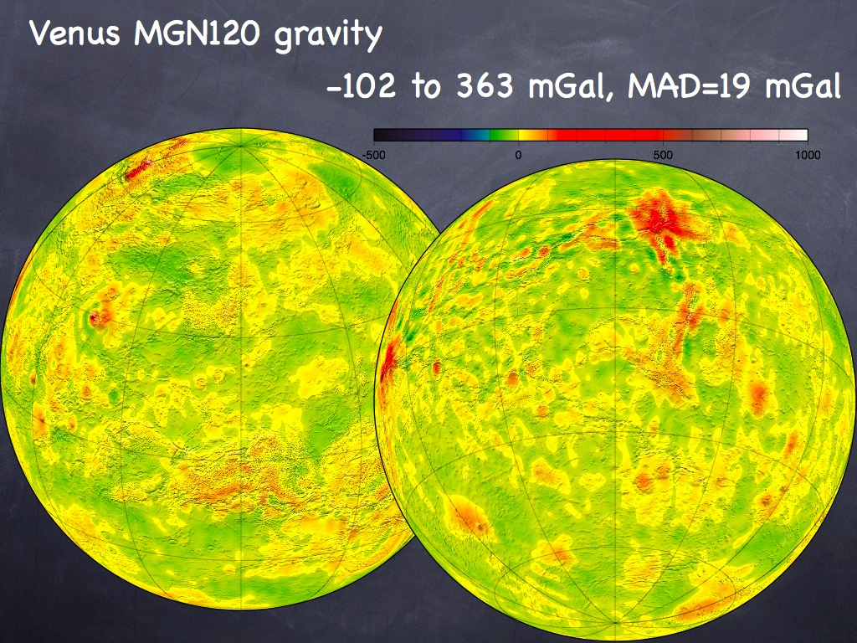
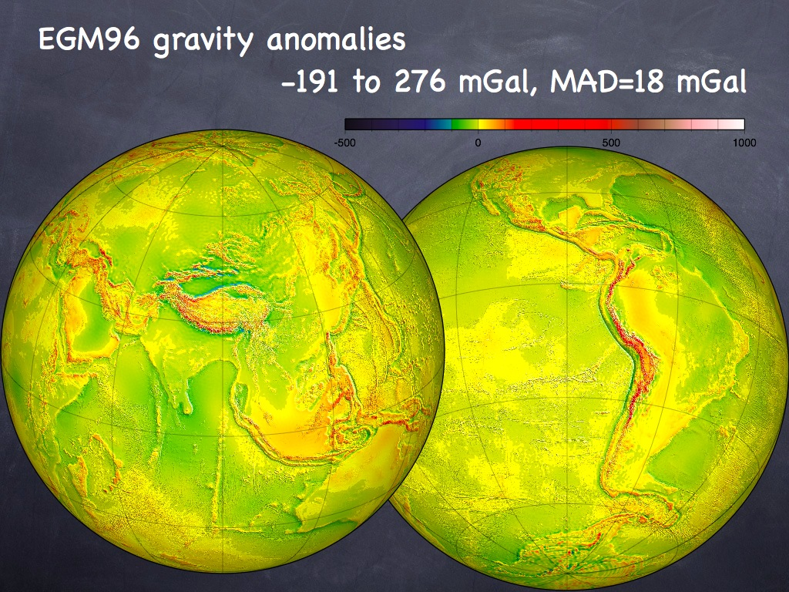
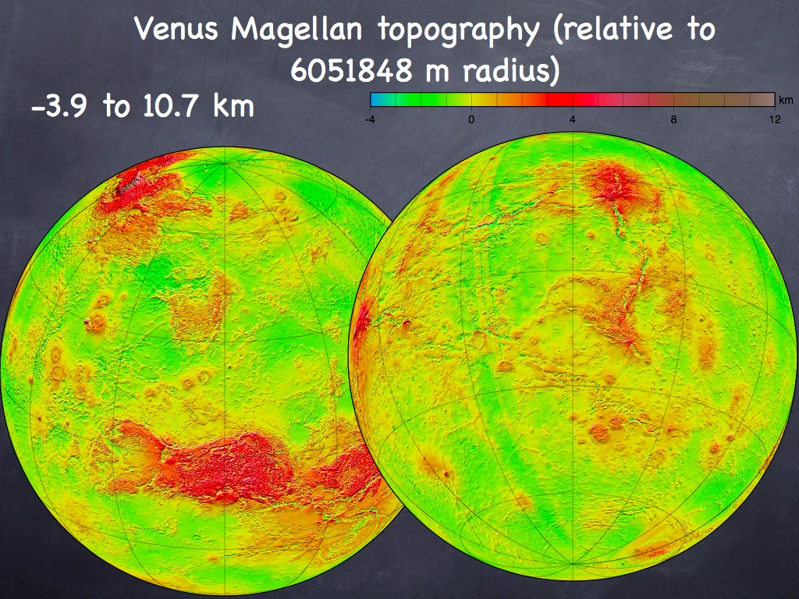
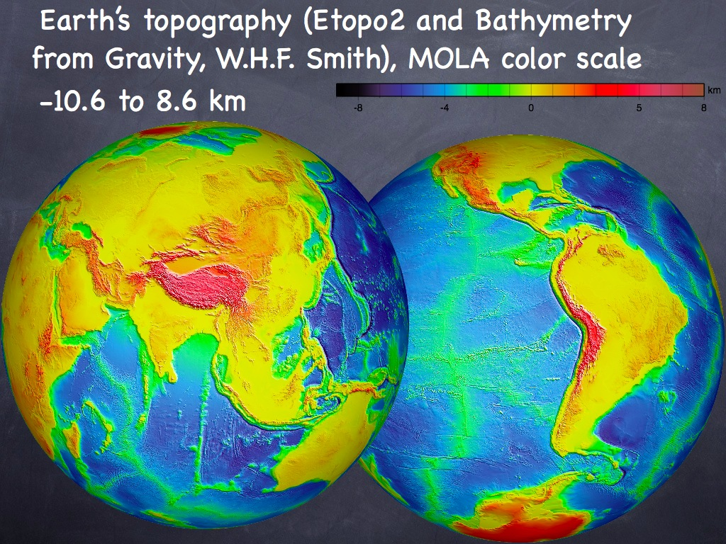
Large planets: Slower cooling, thinner lithospheres
Small free-air anomalies
Topography supported isostatically or dynamically

Slide 26
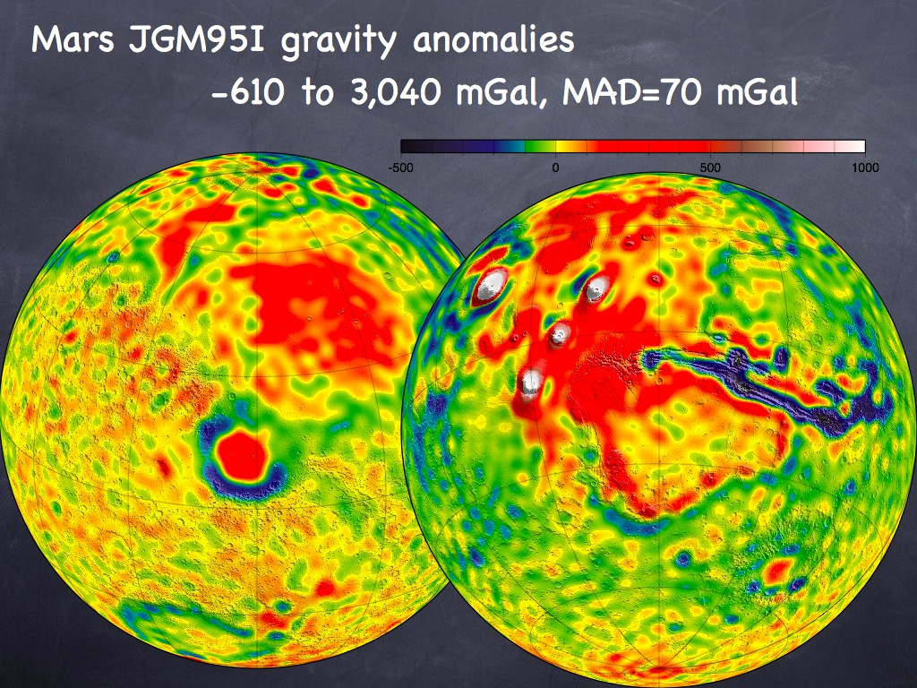
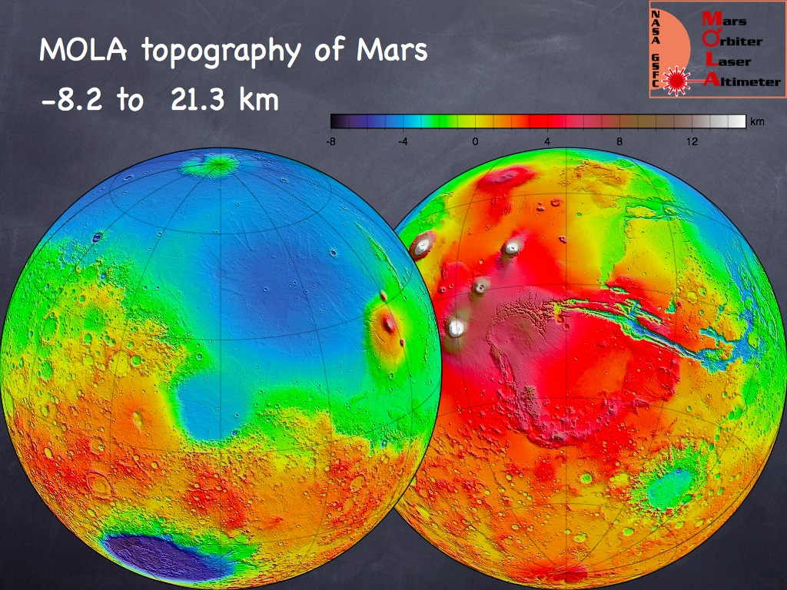
Small planets: Faster cooling, thicker lithospheres
Large free-air anomalies
Topography supported by flexure of thick lithosphere

Slide 27
Time for this?
Small scale topography characterized statistically
‘Roughness’ is very scale dependant

Slide 28
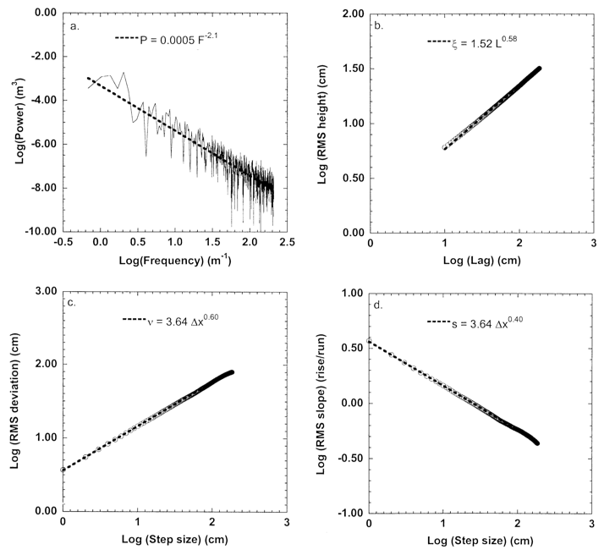
Commonly used 1D measures of roughness
RMS height vs profile length
Fourier power spectrum
RMS deviation vs. lag
RMS slope
vs. lag

Slide 29
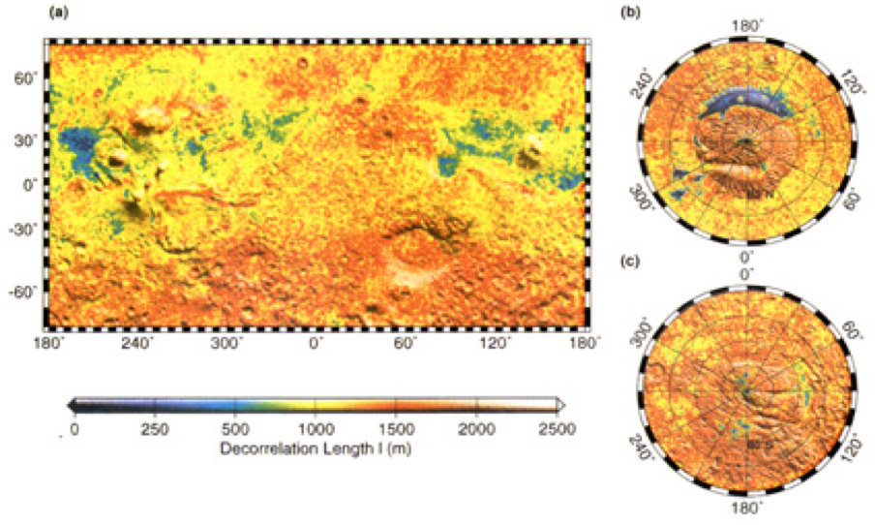
Commonly used 1D measures of roughness
Decorrelation length, l
Where the autocovarience falls to half the its initial value the topography is ‘decorrelated’
where
Aharonson et al., 2001

Slide 30
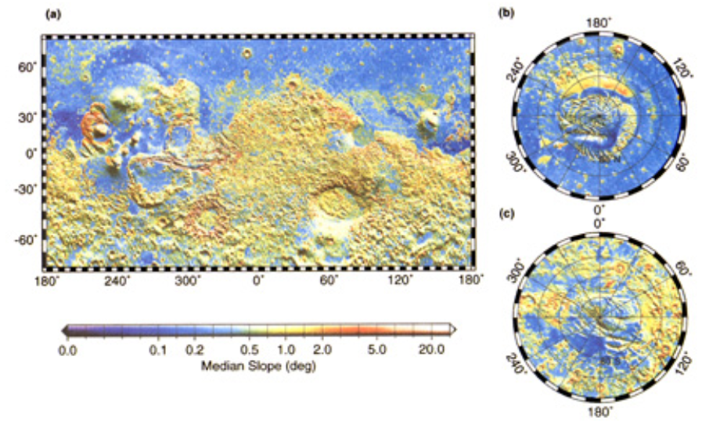
Commonly used 2D measures of roughness
Median slope within a local area
Aharonson et al., 2001

Slide 31
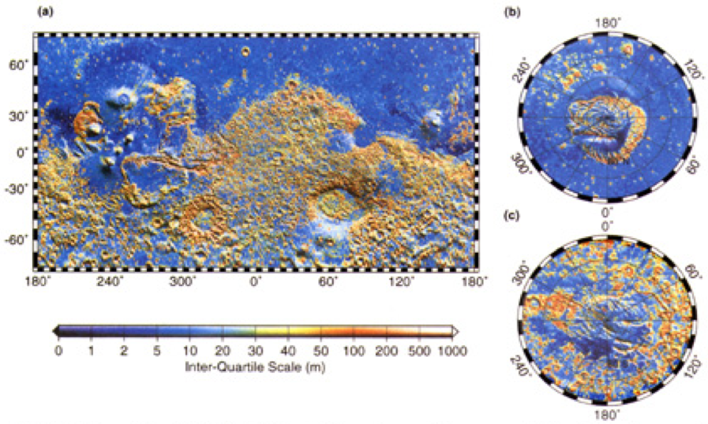
Commonly used 2D measures of roughness
Interquartile scale of elevations
The range of elevations that contains half the measurements
Aharonson et al., 2001

Slide 32
Spectral descriptions
Fourier power spectra

